Slide 1
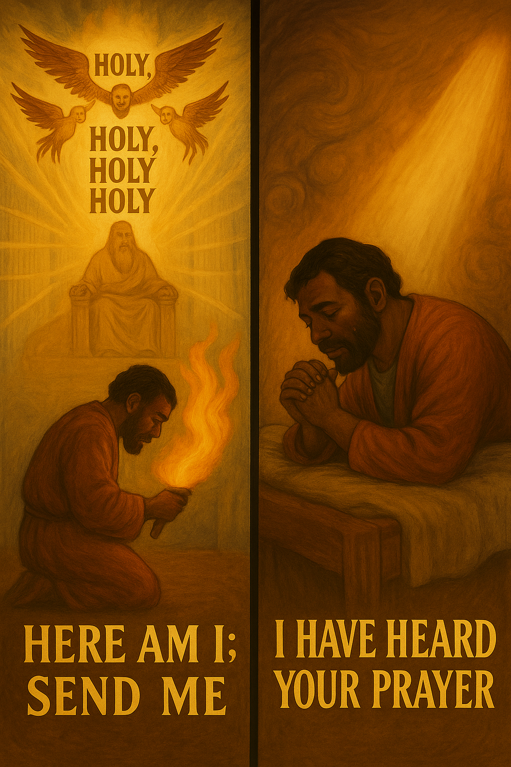
ISAIAH’S CALL
AND MINISTRY
Then I heard the voice of the Lord saying,“ Whom shall I send? And who will go for us?” And I said, “Here am I. Send me!”
—Isaiah 6:8 NIV
Week of September 07
Notes:
This lesson introduces Isaiah’s call and Hezekiah’s prayer. Both reveal how God calls and transforms people to serve Him.

Slide 2
Prayer
Heavenly Father, help us be attentive to how You have called us to go into the world and represent You. Give us the courage to speak of You to a world that desperately needs to know You and Your message of salvation. In Jesus’ name, we pray, Amen.
Notes:
Prayer
Heavenly Father, help us be attentive to how You have called us to go into the world and represent You. Give us the courage to speak of You to a world that desperately needs to know You and Your message of salvation. In Jesus’ name, we pray, Amen.
Thought to Remember
Respond to God’s call!

Slide 3

    Agenda
    Review
    Introduction
    Lesson Context
    Overview
        A Holy Calling - Isaiah 6:1–8 NIV
        From Sickness to Victory - Isaiah 38:1–5 NIV
    Conclusion
    Question & Answers
ISAIAH’S CALL AND MINISTRY
Then I heard the voice of the Lord saying,“ Whom shall I send? And who will go for us?” And I said, “Here am I. Send me!”
—Isaiah 6:8 NIV
3
Notes:
A Holy Calling - Isaiah 6:1–8 NIV
From Sickness to Victory - Isaiah 38:1–5 NIV
Introduces the role of prophets, who are God’s messengers during a time when many have neglected their role as God’s holy people
Isaiah and Hezekiah surrender and allow the holy God to bring transformation.
Here is an analysis, summary, and commentary on Isaiah 6:1–8 and Isaiah 38:1–5, with each statement limited to 100 words:
---
Isaiah 6:1–8 – Isaiah’s Call
Summary:
Isaiah’s vision of the Lord enthroned reveals God’s holiness and glory. Overcome by his sin, Isaiah confesses unworthiness. A seraph touches his lips with a live coal, symbolizing forgiveness and cleansing. God asks, “Whom shall I send?” and Isaiah responds, “Here am I; send me.”
Commentary:
This passage shows that true service begins with a vision of God’s holiness, a recognition of personal sin, and God’s cleansing grace. Isaiah’s response models obedience—once forgiven, he is ready for mission. God equips His messengers not because of worthiness but because of His purifying work.
---
Isaiah 38:1–5 – Hezekiah’s Prayer
Summary:
King Hezekiah falls gravely ill, and Isaiah declares he will die. Hezekiah prays earnestly, recalling his faithfulness, and weeps before the Lord. God hears, sending Isaiah back with a message of mercy: fifteen more years of life will be granted, and Hezekiah’s prayer has been answered.
Commentary:
This account shows God’s responsiveness to humble, heartfelt prayer. Hezekiah’s tears and trust move God to extend his life. While God is sovereign, He chooses to act in response to prayer, teaching believers to seek Him in crisis. Faithful prayer can alter circumstances and strengthen spiritual dependence on God.
><><><><>><><><><><><><><><><><><><><><><>><><><
Lessons from Isaiah 6:1–8 (Isaiah’s Call)
1. God’s Holiness Revealed – A true encounter with God reveals His majesty and emphasizes His absolute holiness, reminding us of our unworthiness without His cleansing.
2. Confession Precedes Cleansing – Isaiah’s admission of sin opened the way for God’s purification. Confession leads to forgiveness and readiness for service.
3. God Provides Purification – The coal touching Isaiah’s lips symbolizes God’s grace that removes sin and equips us for His work.
4. Divine Calling Requires Willingness – God seeks willing servants; Isaiah’s “Here am I, send me” reflects immediate obedience.
5. Mission Follows Transformation – Only after Isaiah was cleansed did God commission him, showing that ministry flows from God’s transformation.
---
Lessons from Isaiah 38:1–5 (Hezekiah’s Prayer)
1. Life is Fragile – Hezekiah’s illness reminds us of human frailty and the certainty of death apart from God’s mercy.
2. Prayer Changes Circumstances – Hezekiah’s sincere prayer moved God to extend his life, teaching that earnest petitions matter to God.
3. God Hears and Sees – The Lord acknowledged Hezekiah’s tears and faithfulness, showing that God responds personally to His people.
4. Faith in Crisis Matters – Turning to God in distress demonstrates reliance on Him rather than human strength or resources.
5. God’s Mercy Extends Life and Hope – The fifteen extra years symbolize God’s power to restore and grant new opportunities for service and faithfulness.

Slide 4

It’s Your Call (and His)
At age 11, I first sensed God calling me to vocational ministry. During a revival meeting, an evangelist approached me and said, “Young man, I’m setting you aside for the ministry. ” At that time, the encounter did not impact me, but I reconsidered the evangelist’s words years later.
Throughout my teenage years, I continued to sense that call to ministry. Trusted friends repeatedly encouraged me. People in my congregation confirmed the call and encouraged me to begin training for ministry. Backed by the encouragement and confirmation from my congregation, I enrolled in a Bible college to follow the Lord’s call.
There seem to be two types of calls from God. The first type is what we might designate as a “general” call. These are the thoughts, actions, and attitudes that God expects of every believer. The expectations of this call are found in the pages of Scripture.
The second type is what we might designate as a “specific” call: a sensed call of God to a particular or specialized ministry. There is disagreement regarding whether every believer receives this kind of call. Today’s lesson examines the details of a call unmistakably from God.
ISAIAH’S CALL AND MINISTRY
Notes:
Main Idea
God calls every believer to live faithfully in obedience to His Word, and at times He places a specific calling on individuals for particular ministries. Both general and specific calls are part of His divine purpose.
Three Key Points
General Call for All Believers – Every Christian is called to live by Scripture, demonstrating faith, obedience, and godly character in everyday life.
Specific Call to Ministry – God sometimes sets individuals apart for unique roles, such as preaching, teaching, or leadership, confirmed by His Spirit and affirmed by others.
Affirmation of Calling – God often uses the church community, mentors, and life circumstances to confirm His call, preparing individuals for faithful service.
Summary
God’s call comes in two forms: the general call for all believers to live by His Word, and the specific call to specialized service. Both are divine invitations to obedience and faithfulness. Personal experiences, spiritual conviction, and encouragement from others help confirm the reality of God’s call. The lesson emphasizes that answering God’s call, whether general or specific, requires humility, readiness, and trust in His direction.

Slide 5
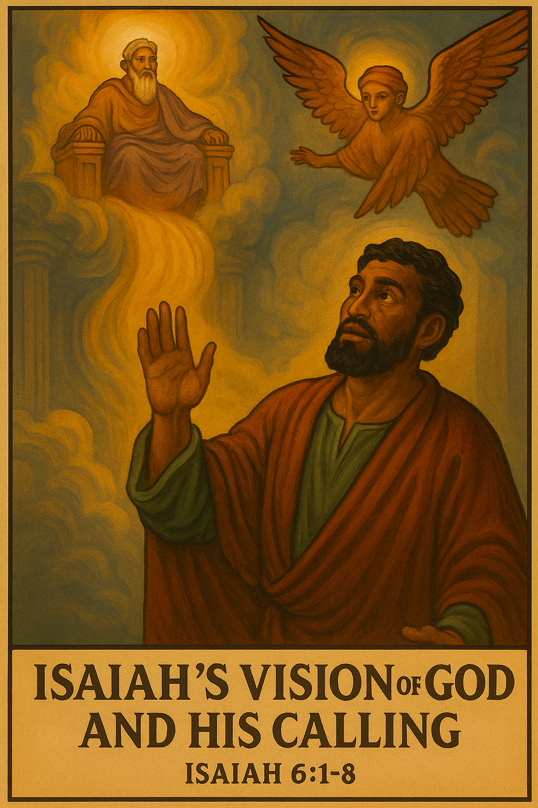
Lesson Context
ISAIAH’S CALL AND MINISTRY
Isaiah was a prophet of God whose ministry spanned more than sixty years, serving during the reigns of four kings in Judah. Quoted often in the New Testament, Isaiah’s mission was to call God’s people away from idolatry and injustice and back to true worship of the living God. His ministry began nearly two centuries after Israel divided into the northern and southern kingdoms, with his focus on Judah. Unlike most prophets, Isaiah’s call is recorded later in chapter six, after the opening chapters reveal Judah’s corruption, arrogance, and moral decay. It was in this context of rebellion that God called Isaiah to proclaim His judgment and offer a summons to repentance.
5
Notes:
Isaiah, a prophet quoted about sixty times in the New Testament, ministered for over sixty years during the reign of four Judean kings. His calling came in Isaiah 6, after the book’s opening chapters establish Judah’s spiritual decline. Following Israel’s division into northern and southern kingdoms, Isaiah’s focus was on Judah, a nation marked by idolatry, injustice, and false security in prosperity and power. God described His people as a vineyard producing bad fruit, redefining good and evil. In this setting of rebellion, Isaiah was called to declare God’s judgment and urge repentance and true worship.
Lesson Context
The New Testament quotes Isaiah about sixty times. Isaiah was a husband and father and—most importantly—a prophet of God, called to warn Judah of God’s coming judgment for wrongdoing. A prophet speaks for God and interprets God’s messages. In certain cases, prophets receive dreams and visions. Isaiah 1:1 gives a summary of Isaiah’s prophetic ministry: he serves more than sixty years under four kings of Judah. He calls the people to forsake idolatry and wickedness, to return to worship of the living God.
Lesson Context (STD)
Isaiah began his prophetic ministry about 200 years after the nation of Israel divided. In 931 BC, the united monarchy of Israel split into two parts: Israel (the northern kingdom) and Judah (the southern kingdom). Isaiah’s ministry focused on the southern kingdom of Judah, as reflected by the Judean kings listed in Isaiah 1:1.
Surprisingly, the Lord’s call on Isaiah doesn’t occur until Isaiah 6. This is at variance from the usual pattern of recording a prophet’s call at or very near a book’s beginning (examples: Jeremiah 1:4–19; Ezekiel 1:1–3:15). Perhaps the writer wanted to establish the context of the call, which the first five chapters of Isaiah accomplish.
The people of Judah had become a “sinful nation,” being openly rebellious against the Lord (Isaiah 1:1–5). A sense of self-sufficiency accompanied a facade of economic prosperity, military security, and religious arrogance (2:7–8). The Lord depicts His people as a vineyard that produced unacceptable fruit (5:1–7). In their doing of injustice, they had redefined the terms good and evil (5:20).
Such was the era that Isaiah found himself in when his call came about.

Slide 6
Key Points
Seraphim
God created all things, earthly and heavenly. Seraphim described in this text (seraphim is plural; seraph is singular) have a name associated with “burning” or “serpents. ” These creatures of heaven are mentioned nowhere else in the Bible, and they are unlike other heavenly servants (compare cherubim in Isa. 37:16). A general view is that they are six-winged serpentine creatures with faces and hands like humans (a hand mentioned in v. 6). They have three pairs of wings—perhaps mimicking the threefold cry: “Holy, holy, holy. ” Two sets of wings are used only to cover themselves, in reverent submission to the Lord of heaven.
ISAIAH’S CALL AND MINISTRY
Holy, Holy, Holy
Threefold repetition of holy gives it the highest degree of emphasis in Hebrew. Holiness is one of God’s essential attributes. It is part of God’s inherent nature, the most important thing that His servants emphasize in this scene (even more central than God’s might and power).
6
Notes:
In Isaiah’s vision, he saw heavenly beings called seraphim, a name meaning “burning ones.” These unique creatures appear only in Isaiah 6 and are different from the more familiar cherubim. Each had six wings—two to cover their faces, two to cover their feet, and two for flying—showing deep reverence before God’s holiness. Their role was to worship God continually, crying out, “Holy, holy, holy ,” and to serve Him as messengers. The seraphim remind us of God’s glory and the reverence all creation owes Him.
In Isaiah’s vision, the seraphim cry out, “Holy, holy, holy,” a phrase repeated three times to show the greatest possible emphasis in Hebrew. This repetition highlights holiness as God’s core attribute—separating Him completely from sin and creation. More than His power or might, God’s holiness defines who He is and how He is to be worshiped. For Isaiah, and for us, this vision teaches that encountering God always begins with recognizing His perfect holiness.

Slide 7
Key Points
King Uzziah
Uzziah played a major role in the direction of the southern kingdom of Judah. At the age of sixteen, Uzziah was declared king by the people. His reign began in 792 BC, alongside his father as a co-regent. His days as king were marked by times of great material prosperity and military campaigns. Uzziah claimed victories over the Philistines, toppling major cities.
Uzziah was a brilliant military strategist, using recaptured cities to protect Judah’s interests. He went to war against the Philistines and broke down the walls of Gath, Jabneh, and Ashdod. He rebuilt towns near Ashdod and elsewhere among the Philistines (see 2 Chron. 26:6). Although he was stricken with leprosy at the end of his life, Uzziah is said to have done what was right (2 Kings 15:3). That is why his death was such a blow to the nation.
ISAIAH’S CALL AND MINISTRY
7
Notes:
King Uzziah became king of Judah at just sixteen years old and ruled during a time of great prosperity and military strength. He was a skilled strategist who defeated the Philistines, tore down their city walls, and rebuilt towns to secure Judah’s borders. Under his leadership, the nation flourished, enjoying stability and protection. Sadly, later in life he was struck with leprosy, yet Scripture still remembers him as a king who mostly did what was right in God’s eyes. His death brought uncertainty to Judah, making Isaiah’s vision of God’s eternal throne even more powerful.

Slide 8
Key Points
Prophecy Versus Magic
Communication with the divine realm (in antiquity, called divination) is an important profession for members of a royal court. Ancient methods of consulting the gods included reading the heavens, casting lots, interpreting dreams, or reading various signs. Isaiah’s message here is exceptional for two reasons. First, Isaiah initially gives bad news instead of telling the king what he wants to hear. Other ancient diviners would tend to flatter their lord, but Isaiah speaks the truth. Second, Isaiah apparently does not use any elaborate method of divination. He simply shares what God has told him.
ISAIAH’S CALL AND MINISTRY
8
Notes:
In Isaiah’s time, many kings relied on diviners who used signs, dreams, or rituals to predict the future, often telling rulers only what they wanted to hear. Isaiah stood apart because he spoke truth from God, even when the message was difficult or unwelcome. Unlike fortune-tellers who relied on tricks or rituals, Isaiah needed no special methods—he simply delivered God’s word faithfully. This shows us the difference between human attempts to control the future and God’s true revelation. For believers, it reminds us to value truth from God over flattering or easy messages.
A Psalm of Thanksgiving
Main Idea
Hezekiah’s psalm shows how God can turn sorrow into thanksgiving. After facing death, he praises God for restoring his life, but it also warns that gratitude must lead to faithful living and teaching the next generation.
Summary
In this passage, Hezekiah writes a song after God healed him from a deadly sickness. At first, he laments the sadness of dying young, feeling deep anguish. But once God restores his health, his tone changes to joy and thanksgiving. He acknowledges that only the living can praise God and pass on His truth. Sadly, history shows Hezekiah failed to pass this faith to his son Manasseh, who became one of Judah’s most wicked kings.
Analysis & Commentary
Hezekiah’s psalm teaches that God listens when His people cry out in distress. His healing became a testimony of God’s mercy and power. Yet the passage also carries a warning: gratitude to God should not fade after the blessing arrives. Hezekiah praised God with words but did not guide his son into faithfulness, which had lasting consequences for Judah. For young believers today, the lesson is clear—our gratitude to God should shape both our lives and the way we influence others, especially those who look up to us.
Turn to God in Hard Times
Hezekiah cried out to God when he was facing death, and God heard him. We should remember to pray honestly when life feels overwhelming—God cares about our struggles and answers according to His will.
Show Gratitude Through Actions
Hezekiah praised God after his healing, but later failed to live out gratitude by guiding his son. True thankfulness is more than words—it’s living faithfully and making choices that honor God.
Pass Faith to Others
Only the living can share God’s truth. Teens can make an impact by sharing faith with friends, siblings, and others, ensuring God’s goodness is remembered by the next generation.

Slide 9
Key Points
A Psalm of Thanksgiving
Beyond the scope of the printed Scripture for today’s reading, Isaiah 38:9–20 contains a psalm or song-poem that expresses Hezekiah’s gratitude for the favor and the physical healing he has experienced. The structure of this psalm can be compared to others, like Psalm 30. At the beginning, Hezekiah expresses a complaint: “in the prime of [his] life,” he is about to die, which makes him feel “anguish of [his] soul” (vv. 10–15).
But in v. 16, the psalm switches from lament to joy, as Hezekiah experiences gratitude for a restoration of physical health. He notes in verses 18–19 that only the living can extol God’s faithfulness and pass this knowledge on to children. But tragically, Hezekiah utterly fails to sufficiently instruct his son to be faithful to God. Hezekiah’s son, Manasseh, would be considered among the most heinous and wicked of Judah’s kings.
ISAIAH’S CALL AND MINISTRY
9
Notes:
A Psalm of Thanksgiving
Hezekiah’s psalm shows how God can turn sorrow into thanksgiving. After facing death, he praises God for restoring his life, but it also warns that gratitude must lead to faithful living and teaching the next generation.
Summary
In this passage, Hezekiah writes a song after God healed him from a deadly sickness. At first, he laments the sadness of dying young, feeling deep anguish. But once God restores his health, his tone changes to joy and thanksgiving. He acknowledges that only the living can praise God and pass on His truth. Sadly, history shows Hezekiah failed to pass this faith to his son Manasseh, who became one of Judah’s most wicked kings.
Analysis & Commentary
Hezekiah’s psalm teaches that God listens when His people cry out in distress. His healing became a testimony of God’s mercy and power. Yet the passage also carries a warning: gratitude to God should not fade after the blessing arrives. Hezekiah praised God with words but did not guide his son into faithfulness, which had lasting consequences for Judah. For young believers today, the lesson is clear—our gratitude to God should shape both our lives and the way we influence others, especially those who look up to us.
Turn to God in Hard Times
Hezekiah cried out to God when he was facing death, and God heard him. We should remember to pray honestly when life feels overwhelming—God cares about our struggles and answers according to His will.
Show Gratitude Through Actions
Hezekiah praised God after his healing, but later failed to live out gratitude by guiding his son. True thankfulness is more than words—it’s living faithfully and making choices that honor God.
Pass Faith to Others
Only the living can share God’s truth. Teens can make an impact by sharing faith with friends, siblings, and others, ensuring God’s goodness is remembered by the next generation.

Slide 10

A Holy Calling - Isaiah 6:1–8 NIV
ISAIAH’S CALL AND MINISTRY
1 In the year that King Uzziah died, I saw the Lord, high and exalted, seated on a throne; and the train of his robe filled the temple.
2 Above him were seraphim, each with six wings: With two wings they covered their faces, with two they covered their feet, and with two they were flying.
3 And they were calling to one another: “Holy, holy, holy is the Lord Almighty; the whole earth is full of his glory. ”
4 At the sound of their voices the doorposts and thresholds shook and the temple was filled with smoke.
5 “Woe to me!” I cried. “I am ruined! For I am a man of unclean lips, and I live among a people of unclean lips, and my eyes have seen the King, the Lord Almighty. ”
6 Then one of the seraphim flew to me with a live coal in his hand, which he had taken with tongs from the altar.
7 With it he touched my mouth and said, “See, this has touched your lips; your guilt is taken away and your sin atoned for. ”
8 Then I heard the voice of the Lord saying, “Whom shall I send? And who will go for us?” And I said, “Here am I. Send me!”
The death of King Uzziah meant the end of a stable era for Judah.
Isaiah experiences a vision of God’s heavenly temple, the holy space filled by God’s undiluted presence.
Isaiah fears that his sin, his “unclean lips” make him unworthy, but a heavenly creature touches his lips to cleanse them.
Isaiah answers God’s call; he will be God’s messenger.
10
Notes:
A Holy Calling - Isaiah 6:1–8 NIV
When King Uzziah died, Judah faced uncertainty and instability. Yet in that moment of national crisis, Isaiah received a vision reminding him that God still ruled from His heavenly throne. The vision revealed God’s holiness, majesty, and power through vivid sights and sounds—the Lord exalted, His robe filling the temple, angelic beings declaring His holiness, and the temple shaking with His glory. While earthly kings come and go, God remains sovereign, reminding His people to trust Him above all.
Main Idea
Earthly leaders may fail or pass away, but God is eternally sovereign, holy, and in control of every situation.
Three Key Points
Uzziah’s death brought uncertainty, but God’s throne remained secure.
Isaiah’s vision revealed God’s unmatched holiness and glory.
The scene showed God’s power over both heaven and earth, despite human weakness.
Summary
The death of King Uzziah marked the end of stability for Judah, but Isaiah’s vision of God’s throne showed that ultimate security rests in the Lord. The vision emphasized God’s holiness, majesty, and control over all things, assuring Isaiah that God’s purposes endure even when earthly powers fail.
Three Practical Life Lessons
Trust God’s sovereignty when life feels uncertain—He is always on the throne.
Remember God’s holiness and approach Him with reverence in worship and daily living.
Anchor your hope in God, not human leaders, because only He remains unshaken.
><><><><><><><><><><><><><><><
=---------------------------------------------------------------------
The text begins with a date, the death of Uzziah, whose reign as king of Judah ends in tragedy and illness (see 2 Chron. 26:16–21). During his fifty-two years as ruler, Uzziah “did what was right in the eyes of the Lord” (2 Kings 15:3), and his passing means uncertainty for the nation facing threats abroad. But the heavenly temple of God opens to reveal a vision to Isaiah: God is in control. He is “high and exalted,” and nothing escapes His attention (Isa. 6:1). Isaiah beholds the almighty God sitting enthroned in the heavenly temple, with all kinds of sights and sounds around Him. Isaiah sees the Lord’s flowing robe filling the sacred space (v. 1); he sees servants of God with unusual shapes (v. 2); and he hears these angelic creatures extolling God’s holiness and glory (v. 3). Just the sound of their voices causes an earthquake, while smoke—representing God’s glory—fills the temple (v. 4).

Slide 11
From Sickness to Victory - Isaiah 38:1–5 NIV
ISAIAH’S CALL AND MINISTRY
1 In those days Hezekiah became ill and was at the point of death. The prophet Isaiah son of Amoz went to him and said, “This is what the Lord says: Put your house in order, because you are going to die; you will not recover. ”
2 Hezekiah turned his face to the wall and prayed to the Lord,
3 “Remember, Lord, how I have walked before you faithfully and with wholehearted devotion and have done what is good in your eyes. ” And Hezekiah wept bitterly.
4 Then the word of the Lord came to Isaiah:
5 “Go and tell Hezekiah, ‘This is what the Lord, the God of your father David, says: I have heard your prayer and seen your tears; I will add fifteen years to your life. ’”
Isaiah is now well into his ministry as God’s prophet, decades later than his call described in Isaiah 6.
The king at the time, Hezekiah, has become ill. He is also facing the crisis of attacking Assyrian armies.
Isaiah’s message from God is not positive: Hezekiah should prepare to die.
But after a sincere prayer of petition, Hezekiah receives fifteen more years of life and the strength to lead his people through crisis.
11
Notes:
Three Key Points
Pride Brings Trouble – Hezekiah’s illness was connected to pride, reminding us that sin has consequences even for faithful leaders.
Prayer Invites God’s Intervention – Hezekiah’s tearful, sincere prayer called on God’s covenant faithfulness, and God responded with compassion.
God’s Mercy Brings Life and Deliverance – God extended Hezekiah’s life by fifteen years and delivered Judah from the Assyrians, showing His power to restore both individuals and nations.
Three practical life lessons
Pride Leads to Trouble
Just like Hezekiah, when we let pride creep in, it can weaken us spiritually and even bring hardship. Teens can learn to stay humble by giving God the credit for their talents, successes, and opportunities.
Prayer Makes a Difference
Hezekiah’s tearful prayer changed his situation. This shows that honest prayer—whether in words or tears—matters to God. Teens can trust that God hears their cries, even when problems seem impossible.
God Brings Hope in Hard Times
God added years to Hezekiah’s life and saved his nation. This reminds teens that God’s mercy can bring new chances and victories. Even when life feels hopeless, God has the power to restore.
><><><><><><><><><><><><><><><
Isaiah 38:1–5 NIV
><><><><><><><><><><><><><><><
Main Idea
Hezekiah’s story shows the power of humble, heartfelt prayer—God hears His people, extends mercy, and acts on their behalf even in desperate times.
Summary
During Assyria’s threat, King Hezekiah became gravely ill and received a death message from Isaiah. Instead of resisting, he turned to God in broken prayer, asking God to remember his devotion. God responded with mercy, granting him fifteen more years and rescuing Jerusalem from its enemies. This passage highlights God’s faithfulness to those who seek Him sincerely and demonstrates that prayer can change the outcome of life’s darkest moments.
From Sickness to Victory - Isaiah 38:1–5 NIV
=---------------------------------------------------------------------
Since Isaiah is willing to carry messages for God, he can be asked to share either good or ill tidings. In this case, the context several decades later is the middle of a war. The powerful nation of Assyria is trying to capture all the territory of Judah. At this crucial juncture, the king, Hezekiah, has become deathly ill (v. 1). According to the parallel text of 2 Chronicles 32:25, it is the sin of pride that brought trouble upon him.
Isaiah comes to the king with a message from God: do not expect recovery. Hezekiah does not question whether this is from God; and the king responds with a tearful prayer that asks God, “Remember” (v. 3). It might seem like an odd request to God, but this word often refers to God’s covenant faithfulness (see Gen. 8:1; Deut. 9:27; Lev. 26:45).
Hezekiah’s prayer is asking God to look with favor upon his rule, since Hezekiah has “walked faithfully and with wholehearted devotion” (Isa. 38:3). He had broken down the places of idolatrous worship and followed God’s commands, unlike many kings before him (2 Kings 18:4–5). By facing the wall in prayer, Hezekiah shows that his request can only be answered by God.
God relents from the initial plan and message and adds fifteen years to the life of Hezekiah (see Isa. 38:5). At the same time that God extends the life of Hezekiah, God also orchestrates a miraculous rescue for Judah and city of Jerusalem (Isa. 38:6). The Assyrians would soon be forced to withdraw, thanks in part to the prayers and courageous leadership of Hezekiah.

Slide 12
Apply the Message
Seek God’s calling in each area of life.
ISAIAH’S CALL AND MINISTRY
From the two examples in the lesson, this devotion and conclusion shows that a “calling” from God might mean reckoning with our own uncertainties. We might not feel like the perfect candidates to be God’s messengers.
A True Calling
As Christians, we’re drawn toward a calling from God. We desire for our responsibilities at home, church, and even our jobs to hold heavenly weight. But sometimes the places we serve don’t feel fulfilling—so we think, “Perhaps this is not my calling. ” Or, a job is dull and monotonous, so It can‘t my calling. Isaiah’s example shows that God has something different to say about the roles we play. Turning our attention to God and surrendering our lives can point us toward a calling, no matter the context.
In the first example, Isaiah sees heaven opened, and all his earthly concerns put into perspective by the awesome vision of God’s throne. Isaiah’s sinfulness is a problem, but God heals him and empowers him to speak. In the second example, King Hezekiah is powerless to save himself. He needs God’s intervention to preserve his life and save the nation. Both men—Isaiah, then Hezekiah—fulfill their vocation or “calling” by first demonstrating a willingness to turn to God.
Repentance, which means turning or changing our thinking, is central to finding our spiritual callings. It is the process of submitting to God’s transformation. We must relinquish control of the narrative (whether finding the perfect job, marriage partner, or context to serve) and submit to God’s leading. Ironically, it is often when we feel unprepared and powerless—when we lay our lives before God and confess our bent and broken ways—that we discover a new sense of mission. God always shapes our hopes and dreams into something more glorious than we would imagine for ourselves.
Notes:
Restated Analysis
Many Christians struggle to recognize God’s calling when life feels routine, unimportant, or overwhelming. Yet Isaiah and Hezekiah show that true calling begins not in our strength but in surrender to God. Isaiah was cleansed and sent after confessing his sin. Hezekiah received healing and strength only after turning to God in weakness. Both discovered their purpose through repentance and trust, not self-reliance. Calling is less about position and more about submission—allowing God to shape our lives into something greater than we imagine.
Main Idea
God’s true calling is revealed when we surrender to Him, allowing repentance and transformation to prepare us for service in any context.
Three Key Points
Calling is not limited to special roles—even ordinary work can carry eternal significance when surrendered to God.
Repentance leads to transformation—Isaiah and Hezekiah show that admitting weakness opens the door for God’s power.
God reshapes our hopes—when we feel powerless, God creates a mission greater than we could design ourselves.
Summary
A true calling is not about finding the “perfect role” but about surrendering to God’s will. Isaiah’s cleansing and Hezekiah’s healing both show that God equips those who turn to Him. Repentance and submission bring clarity, transforming ordinary moments into opportunities to serve God’s greater purpose.
Three Practical Life Lessons
Don’t underestimate small roles—school, work, or chores can be part of God’s call when done faithfully.
Admit your weakness to God—He works through honesty and humility, not self-sufficiency.
Trust God with your future—when life feels uncertain, He can shape your path into something better than you planned.

Slide 13
Apply the Message
Seek God’s calling in each area of life.
ISAIAH’S CALL AND MINISTRY
From the two examples in the lesson, this devotion and conclusion shows that a “calling” from God might mean reckoning with our own uncertainties. We might not feel like the perfect candidates to be God’s messengers.
A True Calling
1 What are the sorts of responsibilities in our lives that we might surrender to God?
2 Do you think turning to God is a one-time act or a repeated practice in Christian faith? Why?
3 Does repentance make a larger impact on us individually or on others?
Notes:
1 What are the sorts of responsibilities in our lives that we might surrender to God?
Most people have responsibilities that change depending on context. The same person can be a daughter, a wife, a mother, and an employee. Among other things, we need God to help us to balance the need to please others, the desire for novelty, or the desire to receive recognition.
2 Do you think turning to God is a one-time act or a repeated practice in Christian faith? Why?
For many, the initial decision to follow Christ is a turning point and a memorable event. But on a day-to-day basis, the Christian life is full of new opportunities to turn to God, to be restored after a pattern of sin or to grow closer in relationship with the heavenly Father. Perhaps we find that we thought that we surrendered everything, but we hadn’t yet brought everything under Christ’s lordship.
3 Does repentance make a larger impact on us individually or on others?
Repentance certainly impacts the individual. Like Isaiah— whose lips were touched by the hot coal—we have the opportunity to approach God’s holy throne, even when we feel unworthy. And a person whom God transforms is also ready to make an impact upon others, to go and share the Word of God without inhibition or hypocrisy.

Slide 14
Conclusion
Here Am I. Send Me!
Not everyone will experience the same call to vocational ministry as I described at the outset. However, God calls everyone to serve Him. Regardless of where God calls us to serve, we should answer with our version of “Here am I; send me!”
When we respond humbly and willingly, God will use us to represent Him to others. Some of us may serve God through vocational ministry. Others will serve Him via their witness through their “9-to-5” jobs, relationships with family and friends, financial support of mission work, etc. When we follow God’s call, regardless of where it takes us, we are in a place of service to Him.
ISAIAH’S CALL AND MINISTRY
14
Notes:
• Every believer is called
• Service takes many forms
• God values willingness more than position
Answering God’s call is about obedience, not role. Like Isaiah, we should say: Here am I; send me. God will use us in His way.

Slide 15
Live It Out: Ask God to make us effective messengers.
As you consider the lesson for today, when each of the two characters submitted themselves to God’s plan and purposes, ask God to show you any way that you might surrender to the calling He has for you.
ISAIAH’S CALL AND MINISTRY
  God’s call is not limited to pastors, missionaries, or prophets—He calls every believer to serve. The question is not whether you are called, but how you will respond. Like Isaiah, may we have the courage to say, “Here am I; send me,” trusting that God can use us in our families, schools, jobs, and communities.
  When we offer ourselves willingly, we become vessels for His glory and His message to the world.
  Every believer is called to serve God, and the right response is readiness and obedience: “Here am I; send me.”
Notes:
Three Key Points
Not all are called to ministry roles, but all are called to service.
Service takes many forms—work, relationships, generosity, and witness.
God values willingness over position—He can use anyone who humbly says yes.
Three Practical Life Lessons
Say yes to God daily—small acts of faithfulness matter just as much as big ones.
Serve where you are—school, work, family, or friendships can all be mission fields.
Be willing, not perfect—God equips those who are available, not just those who feel qualified.
God does not call every believer into full-time ministry, but He does call every Christian to serve Him. Isaiah’s example teaches us that the right response to God’s call is humble availability—“Here am I; send me.” Service may look different for each person: preaching, teaching, working a job with integrity, raising a family in faith, or supporting missions. What matters most is our willingness to be used wherever God places us.
Main Idea
Summary
Answering God’s call is less about the specific role and more about the heart of obedience. Whether in church ministry, daily work, or personal relationships, God can use each believer to represent Him. When we respond like Isaiah, God multiplies our impact for His kingdom.

Slide 16
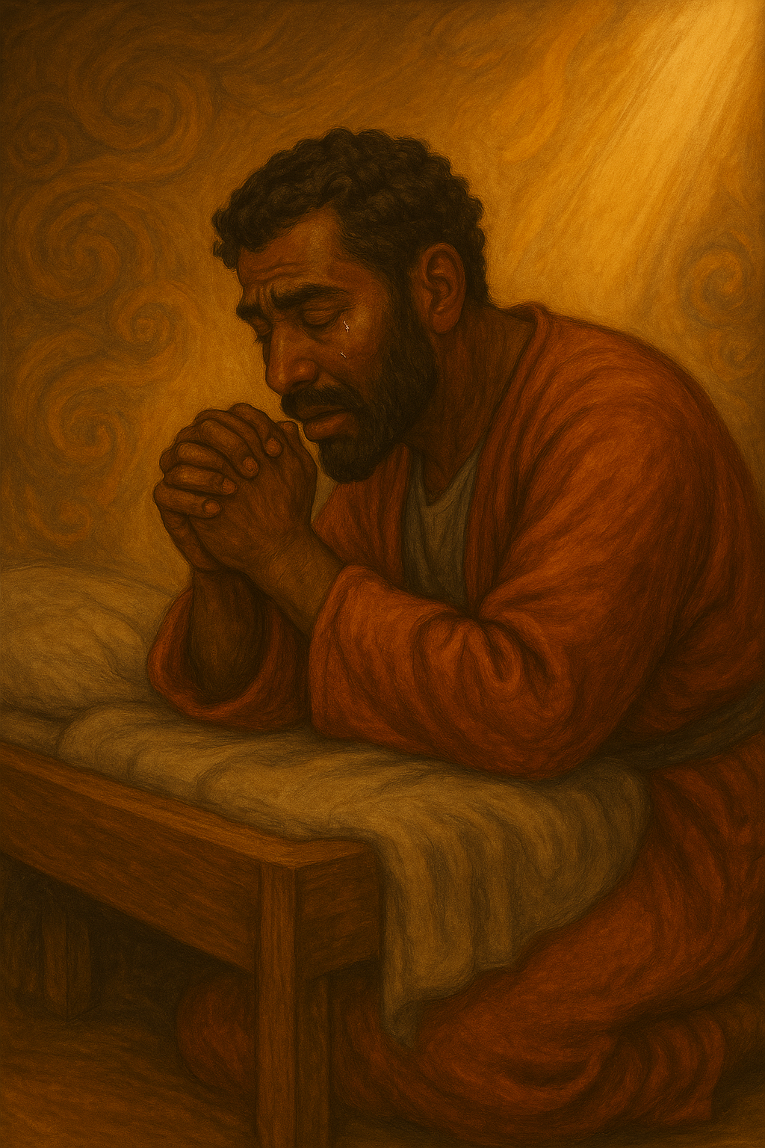



  The Lord bless thee, and keep thee:
  The Lord make his face shine upon thee, and be gracious unto thee:
  The Lord lift up his countenance upon thee and give thee peace.
  - Numbers 6:24-26,
Material adapted by Stanford W. Bowman Jr. from Echoes® Adult and Bible-in-Life® Adult Fall 2025 quarter with permission, © David C Cook, https://davidccook.org. May not be further reproduced. All rights reserved.

Slide 17
ISAIAH’S CALL AND MINISTRY
A Holy Calling - Isaiah 6:1–8 NIV
1 When have you been a messenger for someone else? What was that like?
2 What does it feel like to deliver either good or bad news?
3 Have you ever felt that God was inviting you to join a “messenger service”? What might that entail?
QUESTION & ANSWER
Those who carry messages for others are asked to represent the sender. It means conveying tone as well as content. When we carry messages of God, we represent the Father in heaven.
Most of us will enjoy carrying good news: the birth of a new baby, the receipt of a promotion, the speedy recovery of a friend. But we might dislike carrying foul news or critical reports. Many people don’t want to be associated with this kind of message.
Paul says that we act as messengers because “Christ’s love compels us,” not to build ourselves up or appear proud (2 Cor. 5:14). As His messengers, God gives us new insight in order to see people as He sees them, to speak the truth in love.
Notes:
A Holy Calling - Isaiah 6:1–8 NIV
1 When have you been a messenger for someone else? What was that like?
Those who carry messages for others are asked to represent the sender. It means conveying tone as well as content. When we carry messages of God, we represent the Father in heaven.
2 What does it feel like to deliver either good or bad news?
Most of us will enjoy carrying good news: the birth of a new baby, the receipt of a promotion, the speedy recovery of a friend. But we might dislike carrying foul news or critical reports. Many people don’t want to be associated with this kind of message.
3 Have you ever felt that God was inviting you to join a “messenger service”? What might that entail?
Paul says that we act as messengers because “Christ’s love compels us,” not to build ourselves up or appear proud (2 Cor. 5:14). As His messengers, God gives us new insight in order to see people as He sees them, to speak the truth in love.

Slide 18
ISAIAH’S CALL AND MINISTRY
From Sickness to Victory - Isaiah 38:1–5 NIV
1 How does Hezekiah respond to news that his sickness would lead to death?
2 Why might Hezekiah choose to pray with his face to the wall?
3 Why would God give Isaiah the first message, only to relent and give Hezekiah fifteen more years of life?
QUESTION & ANSWER
Hezekiah turns to the Lord. He humbles himself and relies upon God’s faithfulness. He uses the language of God’s covenant faithfulness to prompt God to “remember” his obedience.
Hezekiah is a king in the line of David. Like most kings, he struggles with pride. God uses this sickness to capture Hezekiah’s attention and turn his heart back. Facing a wall is an image of his powerlessness for a king who usually faces obedient servants.
One valid answer is that we don’t know for sure. Isaiah’s job is to communicate precisely what God requires. But we do know the effect of telling Hezekiah that he would soon die: he calls upon the Lord and humbles himself in the face of an impossible obstacle. Hezekiah would need that kind of reliance upon God to lead the nation.
Notes:
From Sickness to Victory - Isaiah 38:1–5 NIV
1 How does Hezekiah respond to news that his sickness would lead to death?
Hezekiah turns to the Lord. He humbles himself and relies upon God’s faithfulness. He uses the language of God’s covenant faithfulness to prompt God to “remember” his obedience.
2 Why might Hezekiah choose to pray with his face to the wall?
Hezekiah is a king in the line of David. Like most kings, he struggles with pride. God uses this sickness to capture Hezekiah’s attention and turn his heart back. Facing a wall is an image of his powerlessness for a king who usually faces obedient servants.
3 Why would God give Isaiah the first message, only to relent and give Hezekiah fifteen more years of life?
One valid answer is that we don’t know for sure. Isaiah’s job is to communicate precisely what God requires. But we do know the effect of telling Hezekiah that he would soon die: he calls upon the Lord and humbles himself in the face of an impossible obstacle. Hezekiah would need that kind of reliance upon God to lead the nation.

Slide 19
Closing Prayer
Father,
    We do not feel fit for Your service. We are flawed and self-righteous. Even when You call us to act as Your messengers, our first thought is about ourselves and what we lack.
    Help us to grow in courage, so that we can share about Your salvation with free hearts. We pray in Christ’s name. Amen.
Notes:
Encourage students to pray for courage to represent Christ. Challenge them to live faithfully, trusting God’s call in school, family, and future.
Prayer: Lord, make us effective messengers.
Challenge: Respond to God’s call in every part of life.

Slide 20
  The Lord bless thee, and keep thee:
  The Lord make his face shine upon thee, and be gracious unto thee:
  The Lord lift up his countenance upon thee and give thee peace.
  - Numbers 6:24-26,
Material adapted by Stanford W. Bowman Jr. from Echoes® Adult and Bible-in-Life® Adult Fall 2025 quarter with permission, © David C Cook, https://davidccook.org. May not be further reproduced. All rights reserved.

