Slide 1
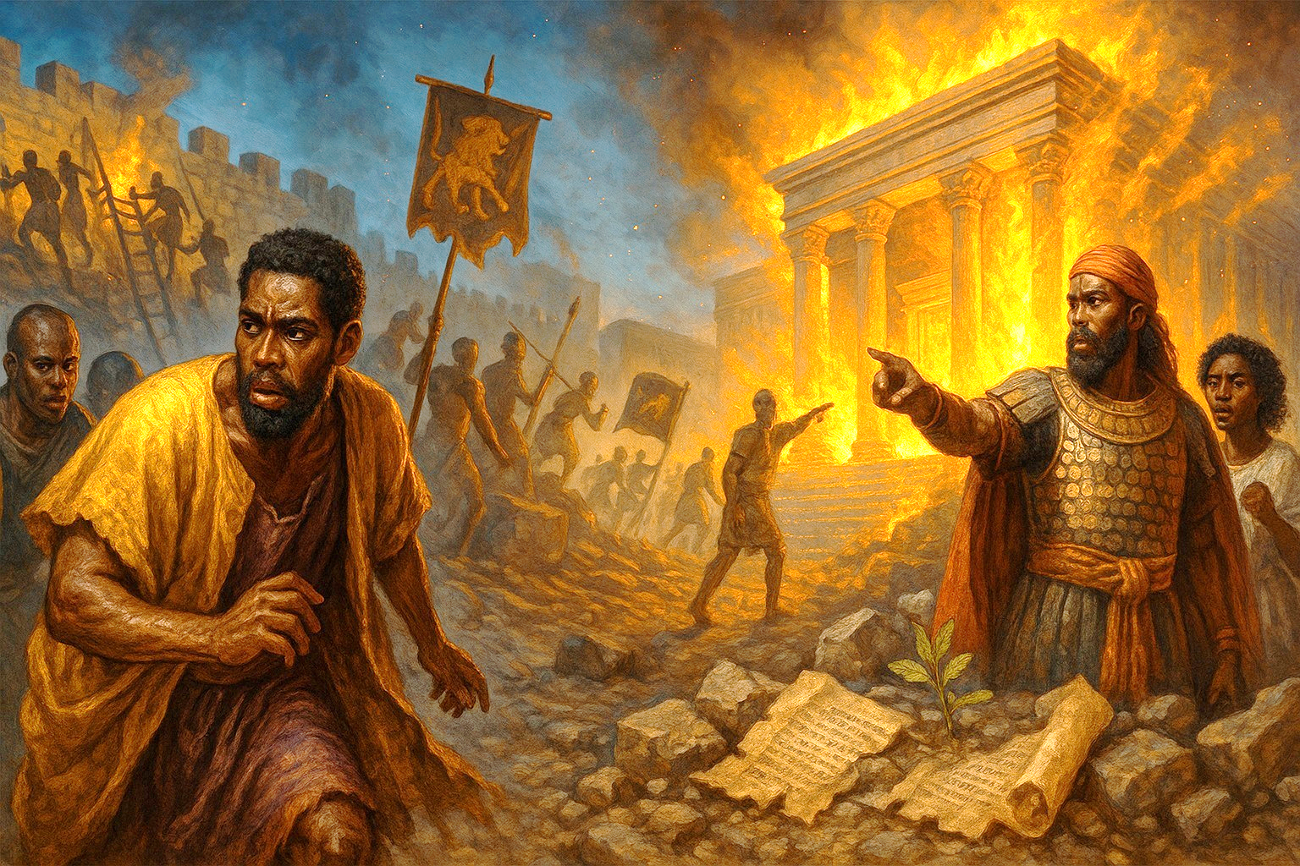

Slide 2
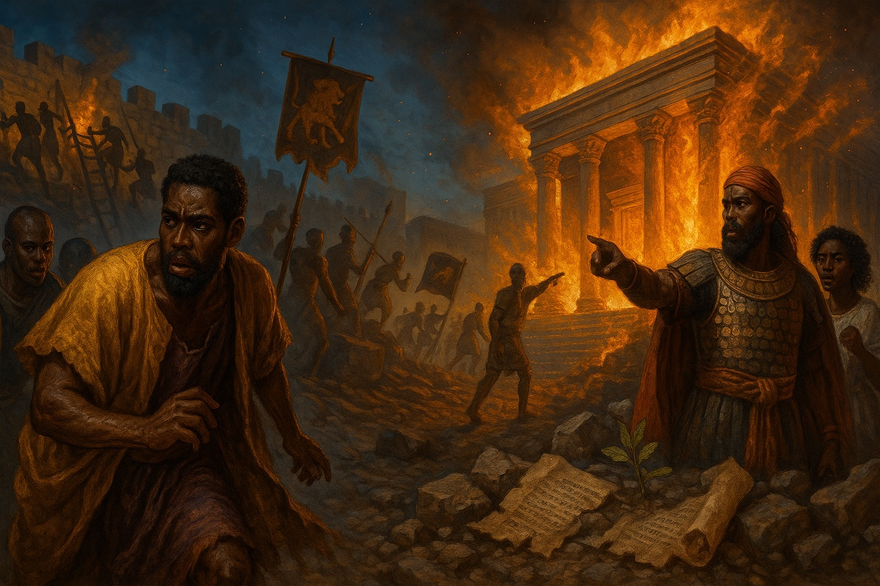
JERUSALEM’S FALL
For through the anger of the Lord it came to pass in Jerusalem and Judah, until he had cast them out from his presence, that Zedekiah rebelled against the king of Babylon.
—2 Kings 24:20 KJV
Week of September 21

Slide 3
Prayer
God of justice, we acknowledge You are right in all Your ways. Your righteousness shows us our wickedness, and so we come to You in repentance. Empower us to seek, learn, and apply lessons from Bible history. In the name of Jesus we pray. Amen.
    Thought to Remember
    God means what He says!
Notes:
Prayer
God of justice, we acknowledge You are right in all Your ways. Your righteousness shows us our wickedness, and so we come to You in repentance. Empower us to seek, learn, and apply lessons from Bible history. In the name of Jesus we pray. Amen.
Thought to Remember
God means what He says!

Slide 4
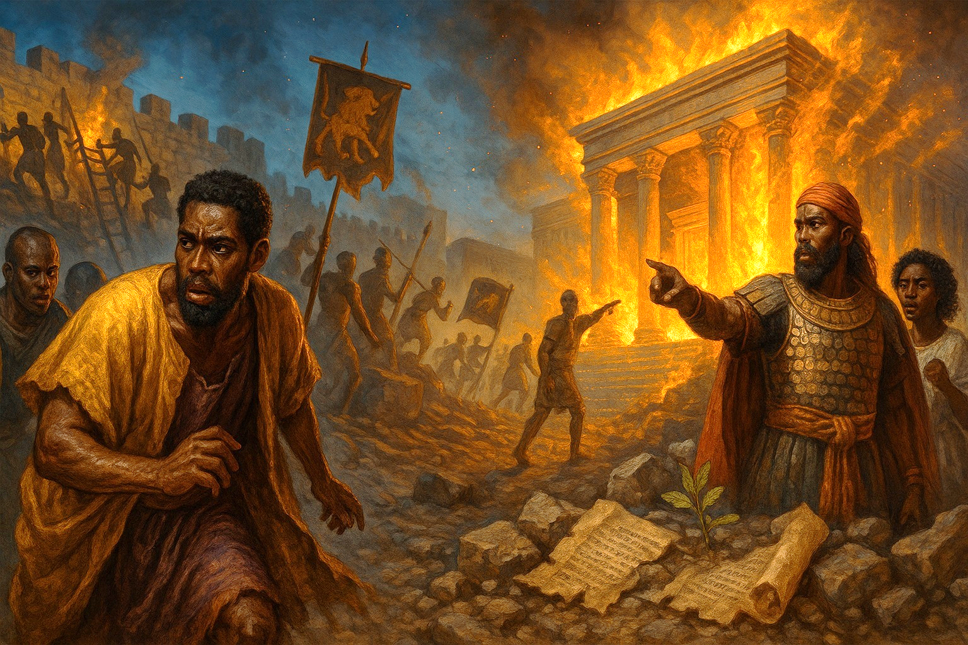
Agenda
4
For through the anger of the Lord it came to pass in Jerusalem and Judah, until he had cast them out from his presence, that Zedekiah rebelled against the king of Babylon.
—2 Kings 24:20 KJV
    Review
    Introduction
    Lesson Context
    Overview
    No Escape - 2 Kings 24:18–25:2 KJV
    The Fall of Jerusalem - 2 Kings 25:3–9 KJV
    Conclusion
    Question & Answers
JERUSALEM’S FALL
Notes:
No Escape - 2 Kings 24:18–25:2 KJV
The Fall of Jerusalem - 2 Kings 25:3–9 KJV
========================================
Analysis
Zedekiah, age 21, reigned 11 years and “did that which was evil in the sight of the LORD,” repeating Jehoiakim’s sins (KJV, 24:18–19). Against the prophetic word through Jeremiah, he rebelled against Babylon; the siege began in his ninth year and lasted ~18 months (25:1–3). Famine broke the city; the wall was breached; Zedekiah fled, was captured near Jericho, judged at Riblah, saw his sons slain, and was blinded and taken to Babylon (25:4–7). Nebuzaradan then burned the temple, palace, and great houses—signaling the end of Judah’s monarchy and temple worship (25:8–9). These events are framed not merely as geopolitics but as covenant judgment—“because of the LORD’s anger… he thrust them from his presence” (24:20, AMP). The lesson resources highlight Zedekiah’s refusal to heed Jeremiah and the Lord’s use of Nebuchadnezzar as an instrument (“my servant”), without endorsing Babylon’s cruelty.
Summary
Judah’s last king spurned God’s word, trusted human alliances, and rebelled against Babylon. God handed Jerusalem over: siege, starvation, a shattered wall, a humiliated king, and at last the torching of the temple and city. Theologically, this is the covenant curse realized and the presence withdrawn—yet within judgment God preserves a future beyond exile (cf. Jer 29:10).
Commentary (Pastoral-Theological)
1. The sin behind the fall. The text insists the calamity came “through the anger of the LORD” (24:20). Zedekiah’s political missteps only expose a deeper spiritual revolt—decades formed by Manasseh’s idolatry and bloodshed that Josiah’s renewal could not finally undo.
2. God’s sovereignty in judgment. Scripture calls Nebuchadnezzar “my servant” (Jer 25:9; 27:6), meaning God can use pagan power to chasten His people without approving its pride. Judgment is not God’s abdication but His governance toward holiness.
3. Presence withdrawn, hope preserved. Burning the “house of the LORD” dramatized the departure of protection; yet exile would not be God’s last word. He promised a return “after seventy years”—discipline unto restoration, not annihilation (Jer 29).
Christologically, the collapse of David’s throne intensifies the longing for a sinless, faithful King. The gospel answers: “The Lord God will give Him the throne of His father David” (Luke 1:32). In Jesus, the true Temple and better King, God restores His people (Col 1:13–14).
Three Key Points
1. Final unraveling: Zedekiah’s rebellion triggers Jerusalem’s sieging, breach, and the monarchy’s end (586 B.C.).
2. Instrumental sovereignty: God uses Nebuchadnezzar as His agent of judgment, without endorsing Babylon’s evil.
3. Temple burned, presence withdrawn: Nebuzaradan burns the temple and city—judgment made visible.
Three Life Lessons
1. Heed God’s Word over human strategy. Choosing alliances and optics over obedience invites ruin (Jer 27:12–15; Ezek 17:15). God’s counsel—even when humbling—saves.
2. Leadership answers to God. Zedekiah’s unbelief imperiled a nation. Leaders must submit to Scripture, steward authority, and protect the flock.
3. Judgment aims at restoration. Exile disciplines; it does not erase the promise. In Christ, the faithful King, God brings us back to Himself (Luke 1:32; Col 1:13–14).
KJV note: “It came to pass… that he had cast them out from his presence” (24:20) underscores theology, not fate.
AMP nuance: God “thrust them from His presence” captures the relational breach that the cross of Christ ultimately heals.
Analysis
Zedekiah, placed on Judah’s throne by Nebuchadnezzar at age 21, “did that which was evil in the sight of the LORD” (24:19, KJV). Rejecting Jeremiah’s counsel to submit to Babylon, he rebelled (24:20). Babylon responded with an 18-month siege beginning in Zedekiah’s ninth year (25:1–3). Famine shattered morale; the city wall was breached; the royal guard fled by night, but Zedekiah was captured near Jericho and taken to Riblah. There he witnessed the execution of his sons, was blinded, chained, and deported (25:4–7). Shortly after, Nebuzaradan arrived and burned the house of the LORD, the king’s palace, and “every great man’s house,” signaling the collapse of Judah’s political and cultic life (25:8–9). The narrator frames this as covenant judgment: persistent disobedience culminates in loss of land, king, and temple—exactly what Deuteronomy warned.
Summary
Judah’s last king persists in evil and defies God’s word. Babylon besieges Jerusalem, starvation sets in, the defense collapses, the king is humiliated and removed, and the temple and city are burned. The fall of Jerusalem is not random geopolitics but the outworking of God’s just judgment on sustained rebellion.
Main Message
When God’s word is spurned, no throne, wall, or temple can save. Covenant defiance invites covenant consequences; false securities crumble before the holiness of God.
Four Key Points
1. Moral cause: Zedekiah’s evil and unbelief—especially rejecting prophetic counsel—stand behind the political disaster (24:19–20).
2. Siege and famine: Babylon’s long siege starves the city, exposing the fragility of Judah’s defenses without God (25:1–3).
3. Royal humiliation: Zedekiah’s flight, capture, and blinding mark the effective end of Davidic rule in Jerusalem (25:4–7).
4. Temple destroyed: Nebuzaradan burns the LORD’s house and the city’s great structures—visible proof that judgment has fallen (25:8–9).
Three Life Lessons
1. Heed God’s word over optics and alliances. Strategies that ignore Scripture may look bold but lead to ruin (cf. Jer 27).
2. Leadership is accountable to God. A leader’s unbelief harms many; integrity and teachability protect communities under pressure.
3. Reject false security. Sacred spaces, traditions, and past victories cannot substitute for present repentance and obedience; only humble submission to the Lord sustains us when pressure comes.

Slide 5
Foreseen Disaster
JERUSALEM’S FALL
Most of our unwelcome experiences are unforeseen. An accident, a negative medical diagnosis, a conflict with a loved one—if we could foresee such events, we would likely take steps to avoid them.
Some things, however, we can reasonably foresee or predict. Failure to fix a leak in the roof will result in more and more damage. A poor diet will lead to a variety of illnesses. “I should have known better” is what we say when a foreseeable disaster befalls us. We experience the pain of regret and shame, thinking of what we could have done to avoid it. We may try to shift the blame. But our experiences in that regard are nothing new to the human condition, as today’s lesson makes clear.
Notes:
Main Message
Some disasters are not surprises. When God’s clear warnings are ignored, collapse is not accidental but inevitable. Judah’s fall under Zedekiah was a foreseen disaster—repeatedly warned by God’s word—and the flames that consumed the temple simply revealed a fire that unbelief had already lit (2 Kings 24:19–20; 25:8–9; cf. 2 Chr 36:15–16 “till there was no remedy,” KJV).
Analysis
- Unheeded counsel: Zedekiah “did evil” and rejected the prophetic path of humble submission (Jer 27). Spiritual leaks were visible: idolatry, injustice, and stubborn hearts.
- Predictable trajectory: Rebellion invited a siege, famine, breach, capture, and blinding (25:1–7). What looked like geopolitics was covenant consequence (24:20).
- Symbolic finale: The burning of the temple and palaces (25:8–9) signaled that false securities (place, tradition, alliances) cannot protect a people who refuse repentance.
- Mercy behind judgment: Exile was severe, yet aimed at restoration; God would later “visit” His people and return them (Jer 29:10–14), keeping the Davidic hope alive until Christ.
Summary
Judah’s last chapter is a case study in preventable ruin. God sent warnings; leaders dismissed them; consequences followed. The lesson is not merely historical grief but present wisdom: heed God’s voice early, or sorrow will teach it later.
Four Key Points
1. Warnings were abundant—prophets, conscience, and covenant law sounded the alarm (2 Chr 36:15–16).
2. Sin dulls foresight—“evil in the sight of the LORD” (24:19) blinded judgment more surely than Babylon blinded Zedekiah.
3. False refuges fail—temple slogans and political gambits could not shield from divine discipline (25:8–9).
4. Judgment serves redemption—God’s discipline preserves a future beyond the ruins (Jer 29; Luke 1:32).
Three Life Lessons
1. Fix the leak when it’s small. Early obedience prevents compounded damage. When Scripture exposes a crack—repent, reconcile, rebuild boundaries now (Prov 28:13).
2. Trust God’s word over appearances. The impressive “roof”—titles, buildings, networks—cannot compensate for a rotting beam of unbelief (Matt 7:24–27).
3. Let consequences become course-corrections. If you’re already in a “siege,” don’t double down; humble yourself, seek wise counsel, and take the first faithful step back (James 4:6–8).
Teaching/Devotional Helps
- Hook: “Unforeseen vs. foreseen” disasters—roof leak, diet, relationships—then pivot: Judah’s fall was foreseen.
- Text: 2 Kings 24:18–25:9 (KJV/AMP).
- Aim: Move hearers from regretful hindsight (“I should have known”) to obedient foresight (“I will act now”).
- Response: Identify one “leak” (habit, relationship, stewardship), confess it, and schedule a concrete repair this week—call, apology, budget change, accountability check-in.
“Because of the anger of the LORD… he cast them out from his presence” (2 Kings 24:20, KJV). God’s holiness makes ignored warnings deadly; His mercy makes heeded warnings lifesaving.

Slide 6
Lesson Context
JERUSALEM’S FALL
Beginning with King David, a king from David’s line had ruled in Judah for more than four centuries. But by the time of the last king, Zedekiah, Jerusalem was well within the grip of Babylonian power. In fact, King Nebuchadnezzar of Babylon selected Zedekiah to be a puppet king of Judah after the previous king was taken captive to Babylon. But Zedekiah inflamed the anger of Babylon by turning to rebellion again.
Today’s text takes us to the time frame of 597–586 BC. Many centuries had passed since Moses warned the Israelites of the consequences of breaking God’s covenant (Deuteronomy 29:9– 28; 30:15–18). The prophets reminded Israel and Judah of the coming judgment (2 Kings 24:2). The exile of the northern kingdom of Israel in 722 BC had proven the prophets’ warnings true (17:3–23). Now Judah too would face God’s judgment.
The blame for the tragedy in today’s text is most directly traced to the nation’s line of leadership. Were we to draw a “good and evil” timeline of Judah’s 20 rulers since the beginning of the divided monarchy in the tenth century BC (1 Kings 12), we would see startling swings from evil to good and back again to evil. Today’s lesson introduces us to the last in that line of 20 kings, a man named Zedekiah.
Zedekiah’s father, Josiah, was the last godly king of Judah (2 Kings 22:1–23:28). Josiah had four sons, Zedekiah being the third of those (1 Chronicles 3:15). Zedekiah might never have been king were it not for the untimely death of his father in battle (2 Kings 23:29–30; 2 Chronicles 35:20–24; compare Jeremiah 46:2).
Following Josiah’s death, his ungodly son Jeho ahaz (also known as Shallum, 1 Chronicles 3:15; Jeremiah 22:11–12) ruled briefly before being deported to Egypt by Pharaoh (2 Kings 23:30–33). Concurrently, Pharaoh installed Eliakim—another son of Josiah—as king, changing his name to Jehoiakim (23:34). When Jehoiakim died 11 years later, he was succeeded by his son Jehoiachin (24:1–6).
By that time the Babylonians were on the march, overtaking Jerusalem a scant three months after Jehoiachin’s ascent to the throne. The Babylonians installed one of his relatives, Mattaniah, in his place as king (2 Kings 24:8–17), renaming him Zedekiah. The first three verses of our lesson’s text are worded almost identically to that of Jeremiah 52:1–3 and are very similar to 2 Chronicles 36:11–13.
Notes:
For over four centuries a son of David sat on Judah’s throne. By Zedekiah’s day, however, Judah lived under Babylon’s shadow. After deporting King Jehoiachin (597 BC), Nebuchadnezzar installed Mattaniah—renamed Zedekiah—as a vassal. Instead of heeding the prophets (especially Jeremiah), Zedekiah chose rebellion, provoking Babylon’s siege and the final destruction of Jerusalem (586 BC).
This moment was not sudden. Moses had warned that covenant infidelity would end in exile (Deut 29–30). Prophets repeatedly sounded the alarm (2 Kings 24:2). The northern kingdom had already fallen in 722 BC (2 Kings 17). Judah’s royal line since the split (1 Kings 12) swung between reform and relapse. Josiah, Zedekiah’s father, was the last godly king; his untimely death (2 Kings 23) was followed by the brief rule of Jehoahaz (deposed by Egypt), the long, corrupt reign of Jehoiakim (installed by Egypt, later dominated by Babylon), and the three-month reign of Jehoiachin (deported to Babylon). Zedekiah—the third son of Josiah—was the last monarch of Judah (2 Kings 24–25; 2 Chron 36; Jer 52).
Main Message
Some disasters are foreseen. When God’s clear word is ignored, collapse is not an accident but the predictable outcome of covenant defiance. Judah’s fall under Zedekiah is judgment long warned, now fulfilled; yet even in judgment God preserves a future beyond the ruins.
Analysis of 2 Kings 24:18–25:9 (KJV/AMP)
- Zedekiah’s character: He “did that which was evil in the sight of the LORD” (24:19). Moral failure—not merely political miscalculation—drives the narrative (24:20).
- Defiance vs. submission: Jeremiah counseled submission to Babylon as God’s discipline; Zedekiah’s rebellion rejected that word, ensuring siege and famine (25:1–3).
- Royal humiliation: The flight, capture near Jericho, execution of his sons before him, and his blinding (25:4–7) signal the end of the Davidic throne in Jerusalem—for now.
- Temple burned: Nebuzaradan burns the LORD’s house, the palace, and great houses (25:8–9). The visible end of city and sanctuary dramatizes the relational breach: God’s presence withdrawn because of hard-hearted disobedience.
Four Key Points to Emphasize
1. Covenant cause: The theological engine is 24:20—God “cast them out from his presence.” Politics expresses spiritual reality.
2. Prophetic clarity: Judah was not uninformed; Moses and the prophets foretold these consequences. Warnings spurned become woes fulfilled.
3. Instrumental sovereignty: Babylon is God’s rod of discipline—used by Him, though not excused by Him.
4. Finality of the fire: The temple’s destruction exposes false security; sacred places cannot protect unrepentant hearts.
Three Life Lessons
1. Heed warnings early. Fix the “leak” when it’s small—repent quickly, reconcile promptly, recalibrate habits before they harden (Prov 28:13).
2. Leadership answers to God. A leader’s unbelief imperils many. Seek Scripture-shaped counsel; humility protects the people you serve.
3. Trade optics for obedience. Alliances, slogans, and appearances cannot save; only yielded hearts and faithful steps under God’s word endure the siege.
KJV/AMP thread: God’s anger “because of” covenant breach (24:20), the siege and famine (25:1–3), the king’s capture and blinding (25:4–7), and the burning of the house of the LORD (25:8–9) together proclaim a foreseen disaster—and prepare the longing for the faithful King and true Temple fulfilled in Christ.

Slide 7
Key Points
JERUSALEM’S FALL
God’s Servant, Nebuchadnezzar
When God’s word of judgment came to Judah through Jeremiah, Nebuchadnezzar—king of Babylon—is identified as God’s servant (Jer. 25:9; 27:6; 43:10). Under Nebuchadnezzar, Babylon was going to destroy Judah and the surrounding nations, who would then serve Babylon for seventy years (Jer. 25:9–11). There’s no reason to think that Nebuchadnezzar thought of himself as doing what God wants. Nebuchadnezzar was God’s servant in the sense that he was God’s chosen agent. This does not mean that God approved of Nebuchadnezzar’s cruelty and pride, for God would also punish the king of Babylon and his nation “for their guilt” (Jer. 25:12).
When God works through world events, including the rise and fall of nations, He is not endorsing evil methods. He is showing that His plan can be accomplished, no matter the schemes or intentions of the humans in charge.
Notes:
Analysis
- Agent, not exemplar: Scripture calls Nebuchadnezzar “my servant” because God appoints him to carry out judgment on Judah (Jer 25:9; 27:6; 43:10). “Servant” here means instrument of providence, not moral approval.
- Judgment with a term: Judah and neighboring nations would serve Babylon for “seventy years”—divine discipline with a set boundary (Jer 25:11).
- Two-edged sovereignty: The same God who uses Babylon also promises to judge Babylon “for their guilt” (Jer 25:12). Human empires are tools in God’s hand and targets of His justice.
- Historical outworking: In 2 Kings 24:18–25:9 God’s decree becomes history—Zedekiah rebels, Jerusalem is besieged, the king is captured and blinded, and the temple is burned. Judah’s collapse fulfills the word spoken through the prophets.
Summary
Nebuchadnezzar is God’s chosen instrument to bring covenant judgment on Judah. His conquest of Jerusalem in Zedekiah’s day is neither accident nor endorsement of Babylon’s cruelty; it is God’s holy governance. Yet the same sovereignty that disciplines Judah sets the duration of exile and later calls Babylon to account.
Commentary
Kings frames Jerusalem’s fall theologically: “for through the anger of the LORD… he cast them out from his presence” (2 Kgs 24:20, KJV/AMP). Jeremiah explains the means: God hands Judah to Nebuchadnezzar, “my servant.” That title clarifies providence: the Lord can steer even pagan power to accomplish His purposes while in no way sharing its pride or violence. This keeps us from two errors—fatalism (history is blind) and cynicism (might makes right). History is supervised by a holy God, and might is answerable to Him.
Zedekiah’s refusal to submit to the word of the Lord turned Babylon’s rise into Judah’s ruin. The burned temple (2 Kgs 25:9) signals that ritual without repentance cannot shield a people from divine discipline. Yet Jeremiah’s seventy-year horizon guards hope: discipline is measured, mercy is planned, and the Judge of all the earth will also judge Babylon. In the larger canon, the collapse of David’s throne intensifies longing for the faithful Son of David whose kingdom cannot be burned and in whom God’s presence returns to dwell with His people.
Four Key Points
1. Nebuchadnezzar = appointed instrument, not approved model (Jer 25:9; 27:6; 43:10).
2. Exile is timed by God—“seventy years” defines discipline, not despair (Jer 25:11).
3. God judges the judge—Babylon’s pride meets divine justice (Jer 25:12).
4. 2 Kings 24–25 shows fulfillment—rebellion, siege, temple fire: prophecy becomes history.
Three Life Lessons
1. Heed God’s word even when it humbles you. Submission to hard providences is safer than resistance to clear revelation.
2. Reject false security. Sacred places and past victories cannot protect unrepentant hearts; obedience does.
3. Trust God’s governance and timing. He can use imperfect agents for holy ends and still right every wrong in His appointed time.

Slide 8
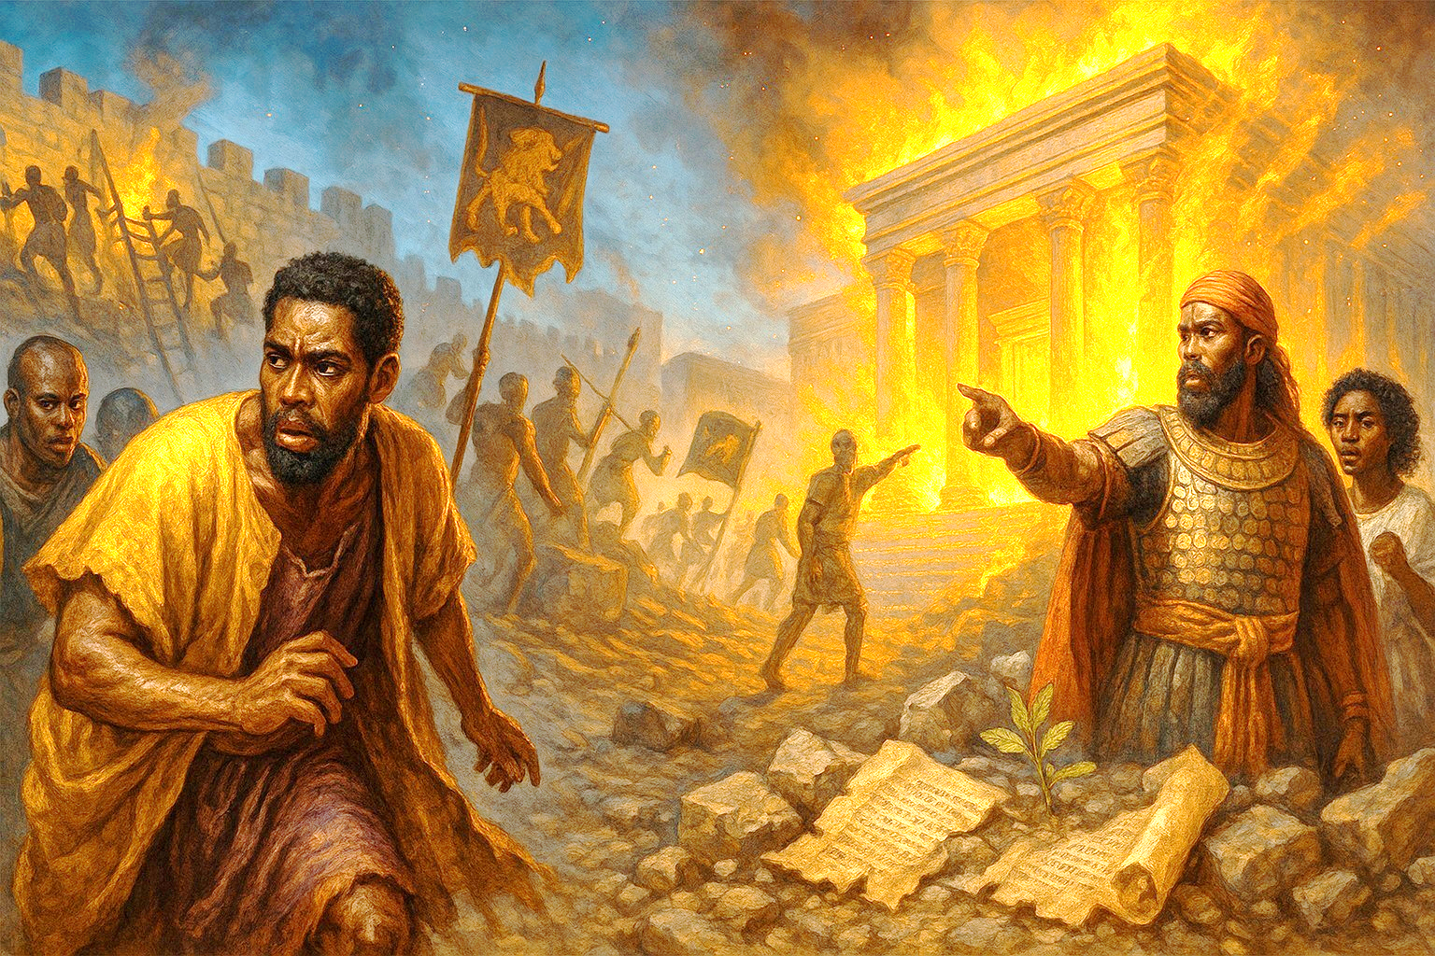
Key Points
JERUSALEM’S FALL
The Way of Manasseh
Second Kings presents a stark contrast between the reigns of Manasseh and Josiah. Manasseh adopted the detestable practices of other nations. He rebuilt the high places used for idolatry and erected altars to false gods. All this leads the people into terrible sin. He even builds altars for idols in God’s temple, sacrificed his son, and filled Jerusalem with innocent blood (2 Kings 21:1–16). Josiah, on the other hand, turns to God, renews the covenant and roots out idolatry in the land. He desecrates the high places, breaks down the altars, and removes idolatrous practices from the temple (2 Kings 23:1–28). This alone did not quench God’s anger (2 King 23:26). Manasseh had gone so far, and the four kings who succeed Josiah all take up the ways of Manasseh, doing evil in the sight of the God (2 Kings 23:31–24:20).
Help from Egypt?
A hallmark of Judah’s unfaithfulness was its association with surrounding nations. The kings pursued these alliances because of their lack of trust in God. Part of Zedekiah’s sin was his attempt to build an anti-Babylonian coalition of allies, even though God warns him not to rebel against Babylon (Jer. 27:12–15). Zedekiah sends envoys to Egypt, hoping to receive horses and a large army to help him stand against Babylon (Ezek. 17:15). During the Babylonian siege on Jerusalem, Pharoah’s army really did march into the area (Jer. 37:5). This results in a brief pause to the siege. However, this only gives a short window of safety. God sends word to Zedekiah: “Pharaoh’s army, which has marched out to support you, will go back to its own land, to Egypt. Then the Babylonians will return and attack this city; they will capture it and burn it down” (Jer. 37:7–8). Zedekiah’s scheming for allies was not going to prevent God’s judgment from arriving.
Notes:
Analysis
Manasseh’s reign (2 Kings 21:1–16) normalized covenant revolt. He rebuilt high places, installed Baal worship, practiced sorcery, placed idolatrous altars inside the temple, sacrificed his son, and “filled Jerusalem from one end to another” with innocent blood. This was not mere private sin; it was state policy that catechized a nation into rebellion. Josiah later reversed practices (2 Kings 23:1–28), renewing covenant and purging idols, yet Scripture insists “the LORD turned not from the fierceness of his great wrath… because of all the provocations that Manasseh had provoked” (23:26; cf. 24:3–4, KJV). After Josiah, his successors (Jehoahaz, Jehoiakim, Jehoiachin, Zedekiah) “did evil,” reverting to Manasseh’s path (23:31–24:20). Thus, when we arrive at 2 Kings 24:18–25:9, Zedekiah’s rebellion and Jerusalem’s fall are the ripened fruit of Manasseh’s legacy: siege, famine, breached walls, royal humiliation, and the burning of the temple—covenant curses realized.
Summary
Manasseh’s institutionalized idolatry and bloodshed saturated Judah so deeply that even Josiah’s exemplary reforms could not erase accumulated guilt. Post-Josiah kings returned to evil, and under Zedekiah the nation met the consequences God had long warned: Babylon’s siege, the king’s capture, and the temple’s destruction. The “way of Manasseh” explains why judgment became unavoidable.
Commentary (KJV/AMP thread)
The narrator grounds catastrophe in theology, not luck. Manasseh’s sins defiled the land (cf. Num 35:33), perverted worship, and trained consciences. Josiah’s reforms prove that godly leadership matters, but they also expose the limits of top-down change when hearts remain unchanged. Hence the chilling verdict: judgment comes “for the sins of Manasseh” (2 Kings 24:3–4). This does not deny personal responsibility of later kings; rather, it names the intergenerational momentum of evil—habits become norms, norms harden into structures, and structures resist reform. By Zedekiah’s day, trusting Egypt and defying Jeremiah’s word only accelerated what Deuteronomy foretold. The temple’s fire (25:8–9) dramatizes the relational breach (“He thrust them from His presence,” 24:20, AMP). Yet exile is not God’s last word; the same Scriptures hold out promised restoration (Jer 29:10) and a future Son of David whose reign and temple cannot be burned (Luke 1:32; John 2:19–21).
Four Key Points
2482. Manasseh’s legacy is decisive: His idolatry and bloodshed become the stated cause behind God’s unrelenting anger (2 Kings 23:26–27; 24:3–4).
2483. Josiah’s reform was real but insufficient: Practices changed; the nation’s heart did not, so wrath remained (2 Kings 23:25–27).
2484. Post-Josiah relapse: Jehoahaz, Jehoiakim, Jehoiachin, and Zedekiah return to evil, re-entrenching Manasseh’s path (2 Kings 23:31–24:20).
2485. Judgment consummated: Under Zedekiah, covenant curses mature—siege, exile, and the temple burned (2 Kings 24:18–25:9).
Three Life Lessons
3064. Private idolatries become public futures. What leaders tolerate in worship and ethics soon becomes culture. Guard the heart; reform the household; steward the platform.
3065. Reform must reach the roots. Policies, programs, and even zealous purges cannot replace repentance, catechesis, and Spirit-wrought renewal. Seek heart change, not just rule change (Prov 4:23).
3066. Do not presume on past revivals. Yesterday’s obedience cannot mortgage today’s unbelief. Keep short accounts with God—repent early, practice justice, and heed His word while it is day.
===========================================================
Help from Egypt? — Zedekiah’s Misplaced Trust
(2 Kings 24:18–25:9; Jer 27:12–15; 37:5–8; Ezek 17:15; cf. Deut 17:16; Isa 30:1–3; 31:1; Ps 20:7)
Analysis
- God’s hard but holy instruction: Through Jeremiah, the Lord commanded Judah to “bring your necks under the yoke of the king of Babylon” as His appointed discipline (Jer 27:12–15). Submission here was obedience to God, not capitulation to fate.
- Zedekiah’s counter-strategy: Rather than repent and submit, Zedekiah sought an anti-Babylonian coalition, sending envoys to Egypt for “horses and much people” (Ezek 17:15). This violated the royal ethic (Deut 17:16) and the prophetic warning against leaning on Egypt (Isa 30:1–3; 31:1).
- A seductive reprieve: Pharaoh’s army briefly lifted the siege (Jer 37:5), tempting Judah to read circumstances as vindication. God immediately clarified: Egypt will “return to its own land,” Babylon will come back and “burn this city” (Jer 37:7–8).
- Inevitable outcome: With God’s word spurned, events flowed to their ordained end: siege, breach, Zedekiah’s capture and blinding, and the burning of the temple and city (2 Kings 25:1–9). The alliance did not delay judgment; it deepened Judah’s guilt (cf. 2 Chron 36:13; Ezek 17:18–21).
Summary
Zedekiah tried to outmaneuver God’s discipline by courting Egypt. Scripture interprets that diplomacy as unbelief. The short pause in Babylon’s siege only exposed Judah’s refusal to trust the Lord. Because God’s word—not geopolitics—governs history, Jerusalem fell, the temple burned, and exile began.
Commentary (KJV/AMP)
The prophets distinguish strategy from obedience. God’s command to submit to Babylon was not passivity; it was repentance in action. By seeking Egyptian horses, Zedekiah reenacted Israel’s oldest reflex—trusting what looks strong (chariots, treaties, optics) rather than the God who speaks (Ps 20:7). Ezekiel frames the move as oath-breaking against both Nebuchadnezzar and the Lord whose name sealed that oath (Ezek 17:18–19). Jeremiah exposes the illusion of “help”: Egypt’s shadow cannot shelter covenant breakers. The brief relief when the Chaldeans withdrew was a providential test; the word of the Lord, not a headline, tells the truth. When Nebuzaradan torched the “house of the LORD,” Judah learned that sacred places cannot protect unrepentant people. Yet even here grace glimmers: the same God who sent them out promised a measured exile and future return (Jer 29:10). The path forward is not cleverer coalitions but contrite hearts under God’s hand.
Four Key Points
1. Divine directive: Submission to Babylon was God’s revealed will for that hour (Jer 27:12–15).
2. Egyptian alliance = unbelief: Seeking horses and armies from Egypt violated covenant ethics and prophetic warning (Ezek 17:15; Deut 17:16; Isa 31:1).
3. Temporary relief ≠ divine approval: Pharaoh’s advance paused the siege, but God decreed Babylon’s return and Jerusalem’s burning (Jer 37:5–8).
4. Judgment consummated: With God’s word rejected, Jerusalem fell and the temple burned (2 Kings 25:1–9).
Three Life Lessons
1. Don’t baptize rebellion as strategy. If God has spoken, the only wise course is obedience—however humbling. Brilliant plans cannot rescue disobedience.
2. Beware the “short-window reprieve.” A brief easing of pressure may test whether we’ll double down on self-reliance or return to the Lord. Let Scripture, not circumstances, set your compass.
3. Keep your covenants before God. Integrity in vows (personal, marital, vocational, ecclesial) is spiritual worship. Breaking oaths invites discipline; humble fidelity invites God’s keeping.

Slide 9
The Temple’s Destruction
JERUSALEM’S FALL
The first temple, which was constructed during the reign of King Solomon, was central to Judah’s life and worship. Their identity as God’s people was tethered to the temple, since it symbolized God’s presence with them, along with His blessing and protection. Scripture refers to the temple as the “house of God” and the “house of the Lord” (1 Chron. 22:2; Eccl. 5:1; Jer. 26:2; Ezek. 8:16). At the temple’s dedication, Solomon acknowledges that God cannot be contained by any building (1 Kings 8:27), but it still serves as a tangible reminder that God is with them, working for their good. When the temple is burned after the Babylonian siege, its destruction would be incredibly jarring for the people, demonstrating the withdrawal of God’s presence and protection. God “thrust them from his presence” because of their idolatry and sin (2 Kings 24:20). But God promises to come to them again, after their exile to Babylon (Jer. 29:10).
Notes:
Analysis
Solomon’s temple anchored Judah’s worship and identity—the “house of the LORD,” a tangible sign of God’s nearness and favor (1 Chr 22:2; Eccl 5:1; Jer 26:2). Yet Solomon had confessed that the Most High cannot be contained by a house (1 Ki 8:27). When Judah persisted in idolatry and injustice, the symbol could not protect the people from the God it symbolized. Under Nebuzaradan, Babylon burned the temple, palace, and great houses (2 Ki 25:8–9). The narrator interprets this theologically: “because of the anger of the LORD… he cast them out from his presence” (KJV), “thrust them from His presence” (AMP) (2 Ki 24:20). Ezekiel pictures the same reality as the departing glory (Ezek 10–11). Yet the fire was not the finale: the Lord promised to “visit” His people after seventy years and restore them (Jer 29:10).
Summary
The temple’s destruction is covenant judgment made visible. God withdrew protective presence from a people who clung to sacred space while rejecting His word. The loss shattered false security yet preserved hope: exile would end, because God’s mercy outlasts His wrath.
Commentary
- Sign vs. Substance. The temple was a sign of God’s dwelling, not a talisman to shield disobedience. When hearts bow to idols, “the house of the LORD” becomes a slogan rather than a sanctuary (cf. Jer 7). The blaze of 2 Kings 25 unmasks this presumption.
- Presence and Purity. God’s presence is morally charged. Idols in the courts (Ezek 8) and blood in the streets (2 Ki 21) made continued indwelling a contradiction. Withdrawal was not divine weakness but holy consistency.
- Judgment unto Hope. The same word that decreed judgment set its term. Seventy years (Jer 29:10) means discipline with a horizon. The ruins point forward to a purified people, a rebuilt house, and ultimately to Christ—the true Temple (John 2:19–21) in whom God dwells with us.
- From Place to Person. The fall intensifies longing for the faithful Son of David. In Jesus, God’s presence is not confined to stone but given to His people by the Spirit (John 14:16–18; 1 Cor 3:16).
Four Key Points
1. Theological cause: The temple burned because Judah broke covenant; God “cast them out from his presence” (2 Ki 24:20).
2. Limits of sacred space: A holy building cannot cover an unholy people (1 Ki 8:27; Jer 7).
3. Public sign of a prior breach: The fire revealed a relationship already ruptured (Ezek 10–11).
4. Timed mercy: Exile was severe but measured; restoration was promised (Jer 29:10).
Three Life Lessons
1. Don’t confuse symbols with surrender. Church buildings, programs, and traditions are good gifts, not substitutes for repentance and obedience.
2. Guard worship’s integrity. What we permit in God’s courts—beliefs, practices, ethics—either welcomes His presence or grieves it. Purity matters because God is near.
3. Hope after loss. Even when our “temples” fall—ministries, plans, reputations—God’s promises stand. Seek Him in humility; He restores on His timetable and by His Son.

Slide 10

No Escape - 2 Kings 24:18–25:2 KJV
10
JERUSALEM’S FALL
18 Zedekiah was twenty and one years old when he began to reign, and he reigned eleven years in Jerusalem. And his mother’s name was Hamutal, the daughter of Jeremiah of Libnah.
19 And he did that which was evil in the sight of the Lord, according to all that Jehoiakim had done.
20 For through the anger of the Lord it came to pass in Jerusalem and Judah, until he had cast them out from his presence, that Zedekiah rebelled against the king of Babylon.
2 KINGS 25:1–2
1 And it came to pass in the ninth year of his reign, in the tenth month, in the tenth day of the month, that Nebuchadnezzar king of Babylon came, he, and all his host, against Jerusalem, and pitched against it; and they built forts against it round about.
2 And the city was besieged unto the eleventh year of king Zedekiah.
Zedekiah is the last in a line of several kings, all who do not follow God.
Zedekiah was made king when Babylon defeated and deported the last king, his nephew. Against the message of God, Zedekiah rebels against Babylon again.
Babylon returns to make an example of this rebellion. The army lays siege to the city.
Notes:
No Escape - 2 Kings 24:18–25:2 KJV
Kings 24:18–20
><><><><><><><><><><><><><>>
2 Kings 24:18–25:2 NIV
18 Zedekiah was twenty-one years old when he became king, and he reigned in Jerusalem eleven years. His mother’s name was Hamutal daughter of Jeremiah; she was from Libnah. 19 He did evil in the eyes of the Lord, just as Jehoiakim had done. 20 It was because of the Lord’s anger that all this happened to Jerusalem and Judah, and in the end he thrust them from his presence. Now Zedekiah rebelled against the king of Babylon. 1 So in the ninth year of Zedekiah’s reign, on the tenth day of the tenth month, Nebuchadnezzar king of Babylon marched against Jerusalem with his whole army. He encamped outside the city and built siege works all around it. 2 The city was kept under siege until the eleventh year of King Zedekiah.
><><><><><><><><><><><><><>>
No Escape
Zedekiah became king in place of his nephew, who had ruled only three months. Zedekiah’s mother, Hamutal, was also the mother of the former king of Judah who was taken captive by Pharaoh Necho. Hamutal herself was the daughter of Jeremiah of Libnah (2 Kings 24:18), not to be confused with Jeremiah the prophet. Zedekiah did evil in the sight of God “just as Jehoiakim had done” (2 Kings 24:19). Jehoiakim went as far as burning a scroll from Jeremiah the prophet (Jer. 36:22–26). He unwisely rebelled against Nebuchadnezzar of Babylon (2 Kings 24:1).
Zedekiah—the same king who permitted Jeremiah’s attempted murder in last week’s lesson—paid no attention to the word of the Lord spoken through Jeremiah (Jer. 37:2). Zedekiah learned nothing from his brother’s failed rebellion, and he rebels against the king of Babylon again (2 Kings 24:20). Instead of seeking God’s protection, he forms an anti-Babylonian alliance with Edom, Moab, Ammon, Tyre, and Sidon (Jer. 27:3).
But God warns Zedekiah against such rebellion: “Bow your neck under the yoke of the king of Babylon; serve him and his people, and you will live” (Jer. 27:12). The Lord warns of famine, plague, banishment, and peril for not submitting to this rule; going as far as to refer to Nebuchadnezzar as “my servant” (Jer. 27:6, 13–15). Thus, Zedekiah’s rebellion amounts to additional disobedience to God and disregard for His message. What happens next is a result of God’s anger: God shall look at Jerusalem and Judah and shall “thrust them from his presence” (2 Kings 24:20). As king, Zedekiah has done evil in the sight of God and rejected all hope of restoration. The people of Judah have become habitually unfaithful, following the behaviors of other nations and defiling the temple (see 2 Chron. 36:14).
As expected, the king of Babylon does not take kindly to another rebellion from Judah and from a king sworn to him. Nebuchadnezzar marches back to Jerusalem and lays siege to the city in the ninth year of Zedekiah’s reign (2 Kings 25:1). Nebuchadnezzar brings his “whole army” with him this time, showing how desperate the situation has become. The Babylonians surround Jerusalem and build siege works to attack the city. These would include ramps and walllike structures, so that soldiers could eventually climb over the walls and breach the defenses. At this time, some residents apparently go over to the Babylonians, meaning that people are able to leave but not to reenter (Jer. 38:19; 39:9). The siege lasts until the eleventh year of Zedekiah’s reign (2 Kings 25:2), because the Babylonians are patient and intent to finish the job.
Analysis
- Lineage and legacy: Zedekiah (son of Josiah; mother Hamutal of Libnah, not Jeremiah the prophet) comes to the throne after his nephew Jehoiachin’s three-month reign (2 Kgs 24:8–18). Like Jehoiakim, he “did evil in the sight of the LORD” (24:19).
- Spurning the word: Though Jeremiah spoke plainly (Jer 27:12–15; 37:2), Zedekiah repeated the earlier rebellion, permitting plots against Jeremiah (Jer 38) and refusing God’s directive to submit to Babylon (2 Kgs 24:20; 2 Chr 36:13).
- Misplaced alliances: He chased an anti-Babylonian bloc (Edom, Moab, Ammon, Tyre, Sidon; Jer 27:3) and courted Egypt (Ezek 17:15). A brief Egyptian feint paused the siege (Jer 37:5), but God said Babylon would return and burn the city (Jer 37:7–8).
- Siege and inevitability: In Zedekiah’s ninth year, Nebuchadnezzar came “with all his army,” built siege works, and settled in for a patient chokehold (2 Kgs 25:1–2). Some defected to the Babylonians (Jer 38:19; 39:9). Famine deepened, the wall was eventually breached, and the flight-capture-blinding of Zedekiah followed, with the temple and city burned (2 Kgs 25:3–9).
- Theology of the fall: Kings states the cause: “through the anger of the LORD… he thrust them from his presence” (24:20 KJV/AMP). Nebuchadnezzar is “my servant” (Jer 25:9; 27:6)—God’s instrument, not God’s ideal. Judgment would be severe yet time-bounded (Jer 25:11; 29:10).
Summary
Zedekiah learned nothing from history or prophecy. He rejected God’s word, broke oaths, and trusted alliances. Babylon’s siege tightened, famine grew, the wall broke, and escape proved impossible. Jerusalem’s fall was not a surprise of fate but a certainty of covenant judgment—yet even this discipline carried a horizon of promised restoration.
Commentary (Pastoral–Theological)
“No escape” is not merely tactical; it is spiritual. When God prescribes a humbling obedience (“bring your necks under the yoke,” Jer 27:12), resistance masquerading as strategy hastens ruin. Zedekiah’s coalition politics, oath-breaking (Ezek 17:18–19), and contempt for the prophetic word turned a hard providence into a hopeless one. The siege exposes the emptiness of false refuges—Egypt’s cavalry, city walls, even the temple—when hearts are unrepentant. Yet sovereignty cuts two ways: the Lord who wields Babylon also limits Babylon and promises return after exile. Kings therefore invites contrition, not cynicism—bow to God’s word early, and the “no escape” becomes a doorway to mercy.
Four Key Points
1. Prophetic clarity rejected: Zedekiah “hearkened not” to Jeremiah; disobedience—not bad luck—drives the narrative (Jer 37:2; 2 Kgs 24:19–20).
2. Alliance ≠ salvation: The Egypt option gave a brief reprieve, not rescue (Ezek 17:15; Jer 37:5–8).
3. Siege as certainty: Patient, total pressure—siege works, famine, defections—made collapse inevitable (2 Kgs 25:1–3; Jer 38:19).
4. Judgment with a horizon: God’s presence withdrawn (24:20) leads to temple fire (25:8–9), yet exile is timed for restoration (Jer 29:10).
Three Life Lessons
1. Obey the hard word. When Scripture and conscience are clear, humble submission is safer than clever resistance.
2. Keep your covenants. Oath-breaking invites discipline; integrity under pressure invites God’s keeping (Ezek 17:18–19).
3. Don’t mistake reprieves for approval. Temporary relief is a test; let God’s word—not changing circumstances—set your course.

Slide 11
The Fall of Jerusalem - 2 Kings 25:3–9 KJV
11
JERUSALEM’S FALL
3 And on the ninth day of the fourth month the famine prevailed in the city, and there was no bread for the people of the land.
4 And the city was broken up, and all the men of war fled by night by the way of the gate between two walls, which is by the king’s garden: (now the Chaldees were against the city round about:) and the king went the way toward the plain.
5 And the army of the Chaldees pursued after the king, and overtook him in the plains of Jericho: and all his army were scattered from him.
6 So they took the king, and brought him up to the king of Babylon to Riblah; and they gave judgment upon him.
7 And they slew the sons of Zedekiah before his eyes, and put out the eyes of Zedekiah, and bound him with fetters of brass, and carried him to Babylon.
8 And in the fifth month, on the seventh day of the month, which is the nineteenth year of king Nebuchadnezzar king of Babylon, came Nebuzaradan, captain of the guard, a servant of the king of Babylon, unto Jerusalem:
9 And he burnt the house of the Lord, and the king’s house, and all the houses of Jerusalem, and every great man’s house burnt he with fire.
The walls are breached, and the city of Jerusalem falls to the Babylonians.
Zedekiah flees, but he does not escape.
Nebuchadnezzar has Zedekiah’s entire family killed and takes him in chains to Babylon.
The city, all its buildings, and the temple of God are destroyed in a fire.
Notes:
><><><><><><><><><><><><><>>
2 Kings 25:3–9 NIV
3 By the ninth day of the fourth month the famine in the city had become so severe that there was no food for the people to eat. 4 Then the city wall was broken through, and the whole army fled at night through the gate between the two walls near the king’s garden, though the Babylonians were surrounding the city. They fled toward the Arabah, 5 but the Babylonian army pursued the king and overtook him in the plains of Jericho. All his soldiers were separated from him and scattered, 6 and he was captured. He was taken to the king of Babylon at Riblah, where sentence was pronounced on him. 7 They killed the sons of Zedekiah before his eyes. Then they put out his eyes, bound him with bronze shackles and took him to Babylon. 8 On the seventh day of the fifth month, in the nineteenth year of Nebuchadnezzar king of Babylon, Nebuzaradan commander of the imperial guard, an official of the king of Babylon, came to Jerusalem. 9 He set fire to the temple of the Lord, the royal palace and all the houses of Jerusalem. Every important building he burned down.
><><><><><><><><><><><><><>>
The Fall of Jerusalem
The Babylonian siege of Jerusalem lasted for approximately eighteen months. 2 Kings 25:3 reveals the devastating result: “There was no food for the people to eat. ” They were cut off from help.
The city wall is broken in approximately 586 BC, prompting Judah’s army to flee (2 Kings 25:4). Probably the northern wall was breached, since Judah’s army flees through a gate by the king’s garden. This indicates a southeastern escape, perhaps by way of the Fountain Gate described in Nehemiah 3:15. Those who flee head toward “the Arabah,” traveling along the road between Jerusalem and Jericho. The Babylonians who surround Jerusalem prepare a pursuit.
The dishonored King Zedekiah is overtaken by the Babylonians near the city of Jericho (2 Kings 25:5–6). Zedekiah and his family are captured, Judah’s army scattered. Zedekiah is taken to Nebuchadnezzar in Riblah, some three hundred miles from Jerusalem in modern-day Syria (2 Kings. 25:6). This is the Babylonian military headquarters in the region. Zedekiah receives a brutal sentence for his rebellion. Babylon wants to make an example, in case others might would contemplate treachery. His sons are slain before his eyes. It becomes the last thing he sees, for immediately he is blinded, bound, and taken as a prisoner to Babylon (2 Kings 25:7). This puts an end to Zedekiah’s rule and extinguishes the possibility of any heir. Zedekiah eventually dies alone in prison (Jer. 52:11).
In 2 Kings 25:8, dates start being counted by the years of Nebuchadnezzar’s rule, instead of Zedekiah’s (compare 2 Kings 25:1, 3). There is no longer a king in Judah. About a month after the siege, Nebuzaradan, a high ranking Babylonian official and commander of Babylon’s army, lays waste to the city. He burns the temple, the palace, the houses, and every important building (2 Kings 25:9). The temple, which symbolizes God’s presence with His people, is gone. With the temple utterly destroyed, what can that mean for the people of God now sent into exile?
Analysis
- Eighteen-month chokehold: The siege starves Jerusalem—“there was no food for the people” (25:3). Famine reveals that Judah is cut off from both help and hope because God’s word has been spurned (24:20).
- Breach and flight: In 586 BC the wall is broken (25:4). The royal guard and Zedekiah flee by night through the king’s garden toward the Arabah—an escape route commonly associated with the Fountain Gate area (cf. Neh 3:15). Babylon’s encirclement becomes pursuit.
- Capture and sentence: Zedekiah is overtaken near Jericho, brought to Riblah—the Babylonian field HQ—where his sons are slain before him; then he is blinded, bound, and deported (25:5–7; cf. Jer 52:11). Royal sight, line, and city are all extinguished.
- Temple fire and civic ruin: A month later Nebuzaradan arrives and burns the house of the LORD, the palace, and “every great house” (25:8–9). Kings now dates by Nebuchadnezzar’s years, not Judah’s—there is no king in Zion. The visible sign of God’s presence is gone, dramatizing that He has “thrust them from His presence” (24:20, AMP).
Summary
Jerusalem’s fall is the predictable end of long-ignored warnings. Famine, breach, flight, capture, blinding, deportation, and finally the burning of temple and city—each step declares that covenant defiance has reached its consequence. Yet the same God who withdraws protection has promised restoration after exile.
Commentary (KJV/AMP)
The narrative is more than military history; it is covenant theology in motion. Hunger (25:3) is Deuteronomy’s curse embodied; the breached wall (25:4) reveals that sin has already breached the covenant; the king’s capture (25:5–7) exposes the collapse of Davidic leadership under unbelief; the temple’s destruction (25:9) unmasks the lie that sacred space can shield disobedient hearts. Still, judgment is measured, not manic. God had named the instrument (Nebuchadnezzar), the cause (Manasseh’s sins and ongoing rebellion), and the horizon (return after the appointed years). The ruins therefore call not for cynicism but for repentance and hope in the greater Son of David, the true Temple in whom God dwells with His people.
Four Key Points
1. Starvation as verdict: “No food” (25:3) signals covenant curse, not mere bad luck.
2. End of the dynasty: Zedekiah’s blinding and the death of his sons (25:7) end the visible Davidic line in Jerusalem—for the moment.
3. Presence withdrawn: The temple’s burning (25:8–9) is the public sign of 24:20—God cast them out from His presence.
4. New calendar, new reality: Dating by Nebuchadnezzar (25:8) underscores that Judah’s throne and structures have fallen under foreign yoke by God’s decree.
Three Life Lessons
1. Heed God’s hard word early. Delayed obedience turns discipline into devastation; repentance at the first warning averts famine of both bread and soul.
2. Don’t trust symbols over surrender. Walls, titles, and even temples cannot protect an unrepentant heart; obedience is the only refuge.
3. Hope beyond the ashes. God’s discipline is purposeful and bounded. Seek Him in humility; He restores on His timetable and by His promised King.

Slide 12
CONCLUSION:
The Right and Wrong Kind of Leaders
12
It seems like everyone is looking for a savior— something or someone to make the world right. To lift up a neighborhood. To rescue the country. To drive back the darkness that fills the news. Longing for a better world is part of the human experience. But how do we get there? One of the ways people try is by attaching their hopes to human leaders: business executives, public figures, politicians. They all get put on a pedestal from time to time, assigned savior status by their most ardent supporters. But human leaders often disappoint. The business executive commits fraud. The public figure cheats on his wife. The politician breaks her campaign promises. And the headlines are still full of darkness. To make matters worse, people tend to reflect the character of whoever they’re following. After all, leaders lead, even if they’re heading in the wrong direction. The people of Judah followed kings like Zedekiah into detestable idolatry, which led to ruin. Today, businesspeople adopt the shady practices of their bosses, if it means advancement. Fans take up the values of their favorite cultural icon, if it means fitting in. And constituents follow the example of politicians who demean their dissenters. Sometimes, Christians stop loving their enemies. Surely that command can’t apply during an election season, can it?
When all that clamoring doesn’t result in a better world, what then? When Jerusalem lies in ruins, what follows? What we need is a better king—a leader who is always trustworthy, always faithful, and always keeps His promises. A leader like that isn’t found on a ballot or list of influencers, but in the pages of Scripture. Jesus is that leader. He’s the rightful king who can make the world new. He’s the one whose message and example is worth following, because it leads us to the kingdom of God. Will we follow Jesus, or attach hope to someone else? Who will you choose today?
JERUSALEM’S FALL
Notes:
The Right and Wrong Kind of Leaders — A Biblical Reflection (anchored in 2 Kings 24:18–25:9)
Main Message
Human leaders make real differences—but none can bear messianic weight. Judah’s fall under Zedekiah proves that when a people mirror a corrupt leader, ruin follows. Scripture redirects our hope from flawed thrones to the faithful Son of David. Jesus alone is the King whose character, cross, and kingdom can renew a people. “Put not your trust in princes” (Ps 146:3, KJV); follow the King who never fails (Heb 13:8).
Analysis
- Moral imitation is inevitable. “Leaders lead—even if in the wrong direction.” Zedekiah’s unbelief trained Judah in unbelief (2 Kgs 24:19–20). Communities absorb a leader’s loves and lies.
- Messianic politics disappoint. Idolatrous hope in executives, celebrities, or candidates produces compromise and cynicism (Jer 17:5). Judah attached hope to Zedekiah—and to Egypt—and reaped ashes (Jer 37:5–8; 2 Kgs 25:8–9).
- Scripture gives a better King. The prophets promise a righteous Branch, a shepherd-king who executes justice and saves (Jer 23:5–6; Ezek 34). The Gospels identify Him as Jesus, the crucified and risen Son of David (Luke 1:32–33; John 18:36).
- Kingdom ethics are not seasonal. “Love your enemies” is not suspended during campaigns (Matt 5:44). Allegiance to Christ governs speech, conduct, and conscience year-round (Phil 3:20; Col 3:17).
Summary
Our hunger for rescue often overinflates human leaders into saviors. Judah tried that with Zedekiah and found devastation. The Bible answers our longing with a different King—Jesus—whose rule cleanses hearts, reforms communities, and will one day renew the world. Hope in Him; evaluate every other leader by His standard.
Commentary (KJV/AMP)
Zedekiah “did that which was evil” (2 Kgs 24:19), and the nation reflected it. The siege and the temple’s fire expose the lie that charisma or coalition can substitute for covenant fidelity. By contrast, Jesus’ leadership is cruciform: He serves, tells truth, keeps promises, and gives His life “a ransom for many” (Mark 10:42–45). His Spirit forms a counter-culture of enemy-love, integrity, and hope (Gal 5:22–23). Christians should pray for earthly leaders (1 Tim 2:1–2), honor rightful authority (Rom 13:1–7), hold them accountable to justice (Mic 6:8), but reserve worship and ultimate trust for Christ alone.
Four Key Points
2415. Leaders shape people. Character cascades; Zedekiah’s unbelief multiplied unbelief.
2416. Misplaced savior-hopes corrupt. Idolize a leader and you will excuse their sins—and learn them.
2417. Scripture warns against trust in princes. Realism without despair: respect rulers, don’t deify them (Ps 146:3).
2418. Jesus is the better King. His truth, mercy, and power actually heal people and societies—now in part, fully at His return.
Three Life Lessons
2886. Choose character over charisma. In church, work, and civic life, prize truthfulness, humility, and faithfulness to God’s word above talent and hype.
2887. Imitate Christ, not the crowd. Let the Sermon on the Mount and the fruit of the Spirit set your tone—especially toward opponents.
2888. Anchor hope in Christ and act responsibly. Pray, vote, serve, and hold leaders accountable—but fix your ultimate confidence on the King who never breaks His promises.
Discussion Questions and Answers

Slide 13
CONCLUSION:
The Right and Wrong Kind of Leaders
13
1 What are examples of would-be saviors to whom people attach their hopes?
2 What happens when people follow the wrong kind of leader?
3 What happens to those who follow Jesus, above all else?
JERUSALEM’S FALL
Notes:
1 What are examples of would-be saviors to whom people attach their hopes?
The writer mentions business leaders, public figures, and politicians; but we can probably add to that list from our own experience. Even the wrong kind of church leader can become a harmful influence and someone who is acting out of selfish ambition.
2 What happens when people follow the wrong kind of leader?
Bad leaders lead to ruinous outcomes. That is an inescapable lesson from today’s text. The kings of Judah could have led the nation into repentance. Instead, they pursued their own ideas of safety and power, and they encouraged the nation to join in idolatry and unjust practices.
3 What happens to those who follow Jesus, above all else?
Jesus commands His followers to love their enemies, and as He was crucified He asked for forgiveness from His persecutors (Matt. 5:43–48; Luke 23:34). Following a king like Jesus leads people into a completely different understanding of power. Those who follow Him are transformed into His likeness, so that they can honor the Father in heaven.

Slide 14
Live It Out: Make Jesus your king.
14
JERUSALEM’S FALL
It may seem easy to list reasons to herald Jesus as king, but it is harder to live in light of these truths. We can pray for human leaders, even if we know that they are probably going to disappoint us. Christ will never disappoint us or lead us into ruin.
  Following King Jesus
    For every weakness that we spot in human leaders, there is an example of someone who has exhibited perfect leadership. When we face unavoidable situations and see the harms of human leaders, we can pray for God’s kingdom to come soon.
Notes:
Live It Out

Slide 15
Conclusion
15
CLOSING PRAYER
JERUSALEM’S FALL
Father,
  Jesus,
  All around us we hear the call of would-be leaders who are intent to make themselves the story. They all pale in comparison to You, for Your leadership was never about Your position. Even when we are confused by this world, help us to look to You as a king worth serving. May your kingdom come. Amen.

Slide 16
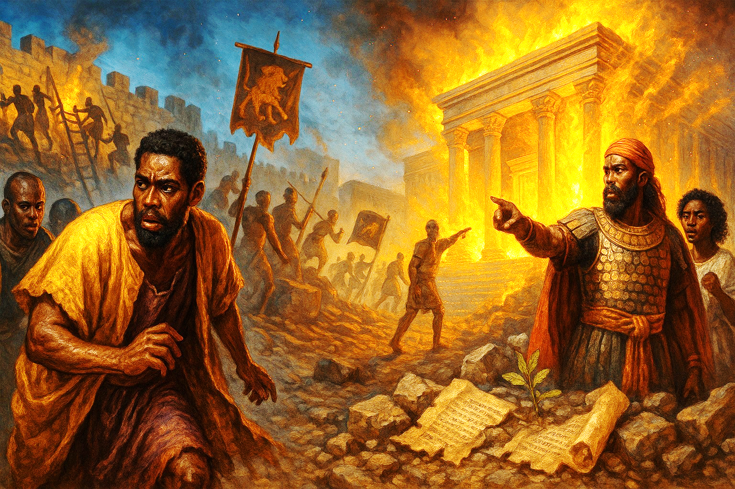



  The Lord bless thee, and keep thee:
  The Lord make his face shine upon thee, and be gracious unto thee:
  The Lord lift up his countenance upon thee and give thee peace.
  - Numbers 6:24-26,
Material adapted by Stanford W. Bowman Jr. from Echoes® Adult and Bible-in-Life® Adult Fall 2025 quarter with permission, © David C Cook, https://davidccook.org. May not be further reproduced. All rights reserved.

Slide 17
QUESTION & ANSWER
No Escape
17
JERUSALEM’S FALL
1 How does Zedekiah do evil the eyes of God?
2 Why was disaster coming to Jerusalem and Judah?
3 How would the situation have been different, had leaders obeyed God?
Zedekiah does not accept the word of God spoken through Jeremiah the prophet. Instead, Zedekiah imprisoned the Lord’s prophet and was complicit in an attempt to kill Jeremiah. Zedekiah also rebelled against Babylon, when God had warned him to submit to the yoke of the king of Babylon.
On one level, this was a natural consequence angering a powerful king. But the theological reason for this punishment was God’s anger. Jerusalem’s siege and destruction were entirely predictable outcomes, for anyone who had been listening to what was spoken by Jeremiah.
Zedekiah should have listened to the word spoken through Jeremiah rather than persecuting him. He should have listened to God by submitting to the yoke of Babylon rule and God’s righteous judgment. He should have trusted God, who was telling Zedekiah that even Babylon’s king was under His authority. If Zedekiah had obeyed, numerous lives would be saved and the city would probably not have been destroyed.
Notes:
1 How does Zedekiah do evil the eyes of God?
Zedekiah does not accept the word of God spoken through Jeremiah the prophet. Instead, Zedekiah imprisoned the Lord’s prophet and was complicit in an attempt to kill Jeremiah. Zedekiah also rebelled against Babylon, when God had warned him to submit to the yoke of the king of Babylon.
2 Why was disaster coming to Jerusalem and Judah?
On one level, this was a natural consequence angering a powerful king. But the theological reason for this punishment was God’s anger. Jerusalem’s siege and destruction were entirely predictable outcomes, for anyone who had been listening to what was spoken by Jeremiah.
3 How would the situation have been different, had leaders obeyed God?
Zedekiah should have listened to the word spoken through Jeremiah rather than persecuting him. He should have listened to God by submitting to the yoke of Babylon rule and God’s righteous judgment. He should have trusted God, who was telling Zedekiah that even Babylon’s king was under His authority. If Zedekiah had obeyed, numerous lives would be saved and the city would probably not have been destroyed.

Slide 18
QUESTION & ANSWER
The Fall of Jerusalem
18
JERUSALEM’S FALL
1 What did the brutal sentence carried out against Zedekiah mean for the kingdom of Judah?
2 Why is destruction of the temple especially jarring?
Judah has fallen. There is no longer any king on the throne of Judah, and all Zedekiah’s children are dead. Jerusalem is now extremely weak and subject to the whims of a foreign oppressor. It is not clear that there will ever again be a nation of Judah or a Davidic king on the throne.
The temple symbolizes God’s presence with His people. Their life and worship centers around what happens in the temple. It is—at least it was—the foundation of their sense of identity as God’s people. Thus its destruction signals a major change. They are now a people cut off and thrust away from God’s presence and protection.
Notes:
1 What did the brutal sentence carried out against Zedekiah mean for the kingdom of Judah?
Judah has fallen. There is no longer any king on the throne of Judah, and all Zedekiah’s children are dead. Jerusalem is now extremely weak and subject to the whims of a foreign oppressor. It is not clear that there will ever again be a nation of Judah or a Davidic king on the throne.
2 Why is destruction of the temple especially jarring?
The temple symbolizes God’s presence with His people. Their life and worship centers around what happens in the temple. It is—at least it was—the foundation of their sense of identity as God’s people. Thus its destruction signals a major change. They are now a people cut off and thrust away from God’s presence and protection.

Slide 19
  The Lord bless thee, and keep thee:
  The Lord make his face shine upon thee, and be gracious unto thee:
  The Lord lift up his countenance upon thee and give thee peace.
  - Numbers 6:24-26,
Material adapted by Stanford W. Bowman Jr. from Echoes® Adult and Bible-in-Life® Adult Fall 2025 quarter with permission, © David C Cook, https://davidccook.org. May not be further reproduced. All rights reserved.

