Slide 1
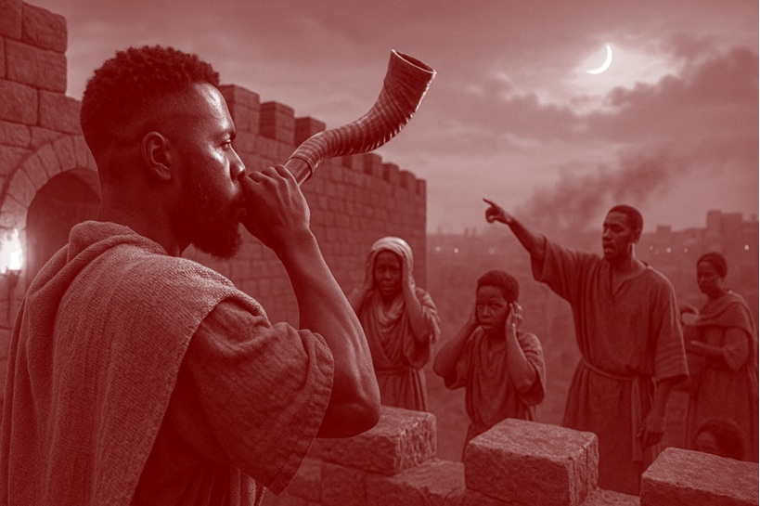
Ezekiel’s Responsibility
“Son of man, I have made you a watchman for the people of Israel; so hear the word I speak and give them warning from me. ”
—Ezekiel 33:7 NIV
Week of November 23
Notes:
Ezekiel’s Responsibility
November 23

Slide 2
Prayer
O God our Father, who does not desire any­one to be lost in sin or crushed by despair, speak good news into our broken world so that we may make wrongs right and restore relationships to a state of health. Keep us from the path of eter­nal death. Grant us strength as we continue on the way of the One who is “the way, the truth, and the life,” Your Son, Jesus. It is in His name we pray. Amen.
Thought to Remember
Speak and act as a watchman!
Notes:
Prayer
O God our Father, who does not desire any­one to be lost in sin or crushed by despair, speak good news into our broken world so that we may make wrongs right and restore relationships to a state of health. Keep us from the path of eter­nal death. Grant us strength as we continue on the way of the One who is “the way, the truth, and the life,” Your Son, Jesus. It is in His name we pray. Amen.
Thought to Remember
Speak and act as a watchman!

Slide 3
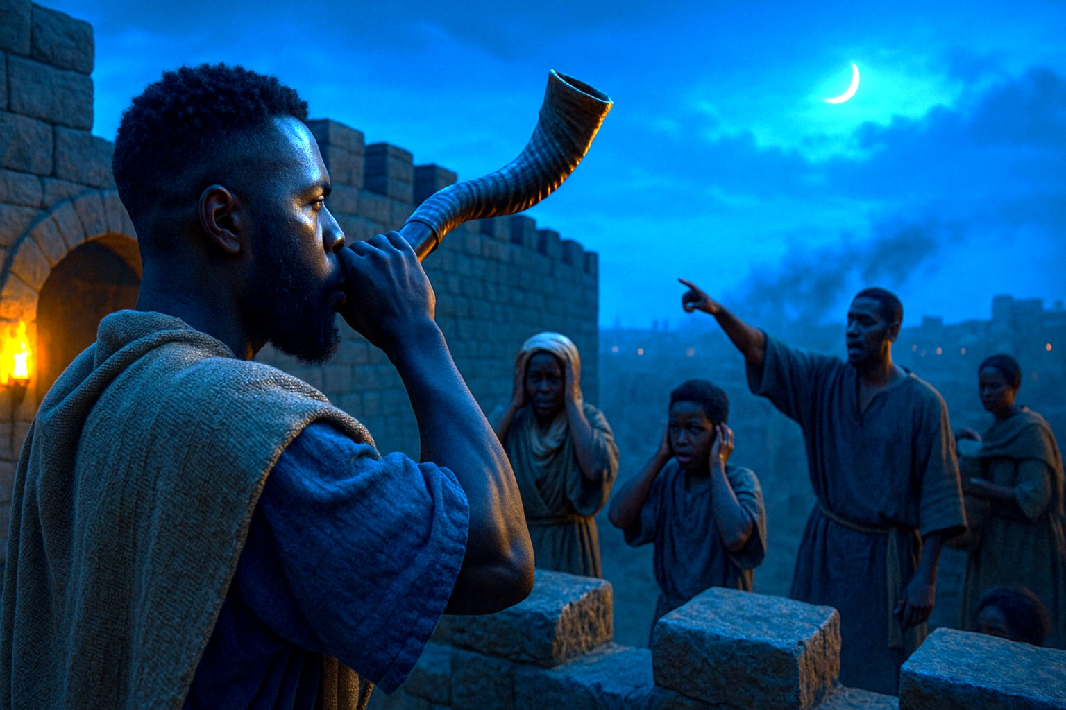
Agenda
“Son of man, I have made you a watchman for the people of Israel; so hear the word I speak and give them warning from me. ”
—Ezekiel 33:7 NIV
EZEKIEL’S SIGN
    Review
    Introduction
    Lesson Context
    Overview
      A Watchman for Israel - Ezekiel 33:7–11 KJV
      Evaluating Behavior - Ezekiel 33:12-16
    Conclusion
    Question & Answers
3
Notes:
A Watchman for Israel - Ezekiel 33:7–11 KJV
Evaluating Behavior - Ezekiel 33:12-16
====--------------------------------------
Summary
Ezekiel is appointed Israel’s “watchman” to relay God’s warnings; silence makes him accountable for the wicked’s blood, but faithful warning clears him (vv.7–9). God answers the exiles’ despair—He takes no pleasure in the death of the wicked and urges, “Turn… and live” (vv.10–11). Past righteousness cannot offset present sin; if the wicked repent, practice justice, make restitution, and walk in life-giving statutes, they will live, and former sins will not be remembered (vv.12–16a).
Analysis
God’s justice is present-tense and personal: He weighs today’s posture, not yesterday’s résumé. Past righteousness cannot shield current rebellion; true repentance bears public fruit—restitution, just dealings, and new obedience (vv.12–16a). This corrects exile blame-shifting and defends God’s fairness while holding open a door of hope (vv.10–11). The “watchman” paradigm also binds God’s messenger: withholding the word shares in harm; giving it discharges the charge (vv.7–9).
Commentary
Read in a Baptist frame, the call to “turn and live” foreshadows the new covenant: the law exposes our need, and God provides grace in Christ; no one is righteous by curve-grading, and preaching becomes a holy compulsion. Therefore the church serves as watchmen—warning from Scripture, inviting repentance, and pursuing repair that matches confession: return what was taken, and walk in the statutes that give life.
Summary
Ezekiel 33:7–16a recommissions the prophet as Israel’s “watchman” in exile. He must hear God’s word and warn the people: failure to speak makes him complicit; faithfulness to warn clears him, even if hearers refuse to repent . God reveals His heart: He takes no pleasure in the death of the wicked but desires their turning and life . The passage affirms divine fairness: past righteousness cannot cancel present sin, yet genuine repentance—proved by just deeds and restitution—brings life and full forgiveness .
Commentary
From a Baptist vantage, the text marries personal responsibility with evangelical proclamation. The covenant principle is searching: “trusting” in one’s former righteousness is fatal; only ongoing obedience matters (KJV, vv.12–13) . Yet the gospel contour already glows: God’s justice is matched by mercy—He invites turning, not perishing . In the new-covenant frame, this watchman ministry expands as believers preach Christ; we are “compelled to preach,” warning and wooing with the good news, not grading ourselves on a curve . Repentance bears fruit in restitution and renewed justice—public acts that verify inward change .
Analysis
Structure.• vv.7–9: Commission and accountability—Ezekiel must deliver God’s warnings; silence shares guilt, speech discharges duty .• vv.10–11: God’s pastoral appeal—He answers despair (“How then can we live?”) with His oath-bound desire for life, not death .• vv.12–16a: The adjudication principle—no “banked” righteousness; repentance cancels remembered sins and is evidenced in concrete justice like returning collateral and stolen goods .
Theological emphasis. God is impeccably fair: He judges current posture, not sentimental history, while throwing open a living path for the penitent . The passage anticipates the gospel pattern later clarified: life is given to those who turn in faith and then walk in God’s life-giving decrees .
3 Key Points
1. Ezekiel is a divinely appointed watchman; warning is his burden and accountability .
2. God prefers repentance to retribution; He desires that the wicked turn and live .
3. Present obedience or present rebellion—not past record—determines outcome; true repentance includes restitution and justice .
3 Life Lessons
Refuse silence. Love warns. When God gives you a word, speak it with humility and courage; silence can share in another’s harm .
Repent practically. Turning to God means making wrongs right—return what was taken, embrace just practices, and walk in His life-giving ways .
Don’t live on yesterday’s righteousness. Keep short accounts with God; He weighs today’s heart and steps, not yesterday’s resume .

Slide 4
Learning about Hot Stoves
EZEKIEL’S SIGN
Philosophies regarding learning styles go in and out of fashion. Categorizing people as visual learners, auditory learners, or kinesthetic (physical activity) learners has its adherents. Categorizing learning theories as cognitive, behaviorist, con­structivist, humanist, and connective holds sway in some quarters. The list goes on and on.
Let’s try a simpler approach by proposing that there are two general ways to learn things: by wis­dom and by experience. Wisdom is when you learn from the mistakes of others; experience is when you learn from your own mistakes. Parents read­ily see these two learning styles in their children. The mother warns that the stove is hot. One child heeds the warning and doesn’t touch it (wisdom); the other child puts his hand on the stove anyway, only to withdraw it quickly in pain (experience).
We’ve all heard the old saying, “Experience is the best teacher. ” But we easily see the fallacy of this axiom when the alternative is to be taught by wisdom. In today’s lesson, the residents of Judah now in Babylonian exile continue to learn the hard way (by experience) the consequences of disobey­ing God; they are also reminded of the alternative.
Notes:
Main Idea
Don’t chase labels or fads. People learn best when instruction blends multiple modalities with clear goals, purposeful practice, and fast feedback—what the “hot stove” metaphor captures: immediate consequences shape understanding and behavior.
Analysis
“Learning styles” categories are popular, but tailoring only to a preferred style rarely improves outcomes. Strong learning designs mix words, visuals, and hands-on practice, while managing cognitive load. Behaviorism explains why quick, specific feedback (“hot stove”) powerfully directs behavior; constructivism reminds us learners build meaning through active tasks; cognitive theory stresses memory strategies (retrieval, spacing); humanist and connectivist lenses add motivation, relevance, and social networks. The wise move is integrative: design safe, low-stakes “hot stove” moments that give rapid feedback without real harm, then reinforce with reflection and spaced practice.
Three Key Points
1. Labels (visual/auditory/kinesthetic) shouldn’t drive instruction; evidence favors varied, well-structured learning experiences.
2. Immediate, specific feedback accelerates learning—consequences teach faster than explanations alone.
3. Blending theories (cognitive, behaviorist, constructivist, humanist, connectivist) yields sturdier results than any single framework.
Three Life Lessons
• Don’t box yourself in—stretch beyond your “favorite” way to learn.
• Seek fast feedback; small, quick corrections beat big, late ones.
• Make meaning, not just motions—ask why, connect ideas, and practice deliberately.
Summary
“Learning about Hot Stoves” warns against overreliance on learning-style labels and theory silos. Real learning thrives on multimodal input, active practice, and rapid feedback that safely mirrors real-world consequences. Integrating insights from multiple learning theories—while prioritizing timely correction and reflective practice—produces deeper, more durable understanding.on.
Let’s try a simpler approach
by proposing that there are two general ways to learn things: by wis­dom and
by experience. Wisdom is when you learn from the mistakes of others;
experience is when you learn from your own mistakes. Parents read­ily see these
two learning styles in their children. The mother warns that the stove is hot. One
child heeds the warning and doesn’t touch it (wisdom); the other child puts his
hand on the stove anyway, only to withdraw it quickly in pain (experience).
We’ve all heard the old
saying, “Experience is the best teacher. ” But we easily see the fallacy of
this axiom when the alternative is to be taught by wisdom. In today’s lesson,
the residents of Judah now in Babylonian exile continue to learn the hard way
(by experience) the consequences of disobey­ing God; they are also reminded of
the alternative.

Slide 5
Lesson Context
The chapter of Ezekiel 33 condenses and explains aspects of the message found several chapters earlier in Ezekiel 18 (also mentioned in Lesson 8 of this quarter). An issue that is relevant to those living in exile and those remaining back in Judah is, Who is responsible for this mess? In many ways, God gives similar messages to each group, showing that He notices righteous living and will be merciful to individuals who uphold His commands.
References to “the twelfth year” of the Bab­ylonian exile bracket today’s lesson text of Eze­kiel 33:7–16a (see Ezekiel 32:1, 17; 33:21). That exile happened in three stages, with deportations taking place in the years 605, 597, and 586 BC (2 Kings 24:1–25:21). “The twelfth year” dates from 597 BC (Ezekiel 1:2). Thus our lesson today takes us into the year of the fall of Jerusalem, in 586 BC. The residents of Judah who had been in exile already for 12 years and longer were about to experience another wave of their countrymen join­ing them in captivity.
Regarding literary context, the text for today’s lesson is part of the larger unit of Ezekiel 33:1– 20. This unit examines and illustrates Ezekiel’s role as a prophet, the messages he is to convey, what mindset to expect from his audience, and how to respond to wrong thinking. Ezekiel 33:1– 20 is something of a condensed version of Ezekiel 18, in which the prophet corrects an exaggerated view of group responsibility that sees its members as children suffering for the sins of their parents.
EZEKIEL, THE BOOK
The book of Ezekiel is commonly and most simply outlined in terms of three sections:
    I. Judgment on the covenant people (chapters 1–24)
    II. Judgment on foreign nations (chapters 25–32)
    III. New hope for God’s people (chapters 33–48)
EZEKIEL’S SIGN
5
Notes:
Summary: Ezekiel 33 grounds Judah’s catastrophe in current moral agency and extends hope: heed the watchman, repent, and live.
Main idea: In crisis, God reasserts personal responsibility and offers a path back through repentance.
Analysis: Ezekiel 33 (set around the fall of Jerusalem, 586 BC) revisits themes from chapter 18. Exile came in three waves (605, 597, 586 BC). The unit (33:1–20) defines Ezekiel’s watchman role, confronts fatalism and blame-shifting, and clarifies God’s fairness: each person is accountable for present choices; repentance brings life, ongoing rebellion brings death.
Three key points:
Historical frame: tri-deportations culminating in Jerusalem’s fall.
Literary frame: a condensed reprise of Ezekiel 18.
Theological frame: individual accountability with open mercy.
Three life lessons:
Own your choices today.
Reject victimhood narratives that excuse sin.
Keep turning—God delights to forgive.

Slide 6
Key Points
EZEKIEL’S SIGN
The Lives of Exiles—
The prophet Ezekiel is among the first of a smaller group of exiles in Babylon. This initial deportation occurs in 597 BC, fueled by Jehoiakim’s refusal to pay tribute to Babylon. As a result, Nebuchadnezzar invades and deports roughly seven thousand soldiers, officials, and artisans to the kingdom of Babylon. As is custom, exiles in Babylon are allowed to keep some of their customs. But Jewish exiles would certainly not be able to offer sacrifices or worship at the temple in Jerusalem (which wouldn’t stand for long anyway).
Exiles like Daniel and his friends are given roles in the king’s court, where they experience levels of prosperity while living in a foreign land. Life in Babylon was about serving King Nebuchadnezzar and building his kingdom. The Babylonians allow the exiles to marry, start families, and even travel, within limits. Exiles like Ezekiel could buy, sell, and build homes (see Jer. 29:4–7).
Notes:
Summary: Exile limited temple access but not covenant faithfulness; God called His people to settle, serve, and stay distinct.
Main idea: God’s people can remain faithful and fruitful under foreign rule, even without temple sacrifice.
Analysis: The first deportation (597 BC) removed ~7,000 leaders and artisans to Babylon. Exiles kept many customs, married, worked, traded, and built homes, yet temple worship ceased. Jeremiah 29:4–7 reframed exile as a season to seek the city’s welfare without surrendering covenant identity. Prosperity and displacement coexisted, testing loyalty to Yahweh over imperial culture.
Three key points:
1. Deportation was strategic: remove Judah’s leadership/artisans.
2. Life continued—homes, families, commerce—within limits.
3. Worship rhythms were disrupted; identity had to be interior and communal.
Three life lessons:
• Thrive where God plants you.
• Hold identity tighter than location.
• Work for your city’s good without worshiping it.

Slide 7
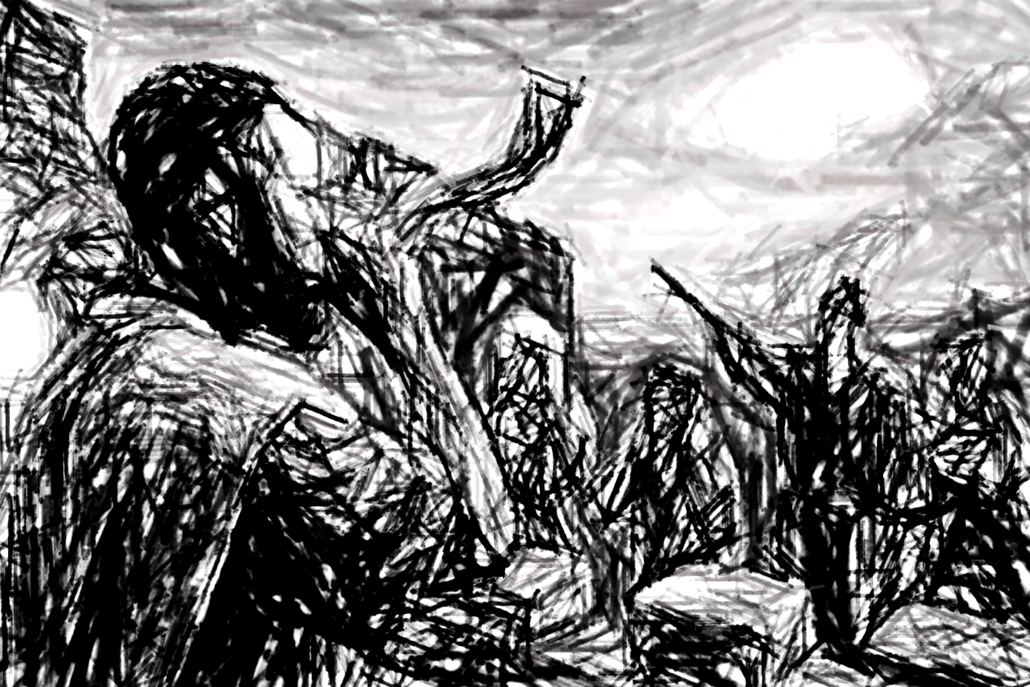
Key Points
EZEKIEL’S SIGN
Sound the Trumpet!—
In ancient Israel, the trumpet or shophar was a hollowed-out animal horn. Shophar is a transliteration of the Hebrew word for ram’s horn. The shophar served various purposes in Israel’s religious and military life and is mentioned more than any other instrument in the Bible. As an instrument, it would probably produce only three tones. The shophar sounded during wartime conflict, a warning that catastrophe is ahead. That prepares us to understand when God compares Ezekiel, the watchman, to a person sounding the trumpet (outside of this printed text, Ezek. 33:3). Part of the watchman’s role is to sound the alarm and to blow the shophar when danger comes near.
This warning sound has two functions. First, it strikes fear into the hearts of the attacking enemy, showing that strong wills are at the ready. Second, the warning blast rallies people to the collective defense. In Ezekiel’s case, the trumpet is a call to repent and turn back to God. He warns of the danger that he sees.
Notes:
Summary: Like a battle horn, Ezekiel’s preaching sounds a timely, public call to turn back to God.
Main idea: Divine warnings are mercy in motion—alarms meant to awaken repentance.
Analysis: The shophar (ram’s horn) signaled war and crisis with stark, simple tones. Its blast both unsettled enemies and rallied defenders. God casts Ezekiel as the watchman whose “trumpet” is proclamation: name the danger, summon repentance, and ready the people for God’s judgment and mercy. Ignoring the horn brings harm; heeding it brings life.
Three key points:
Shophar = alarm for imminent danger.
Warning both deters foes and mobilizes allies.
Ezekiel’s message functions as the horn: repent now.
Three life lessons:
Treat warnings as gifts.
Answer alarms with action, not apathy.
Be a faithful “horn”—lovingly alert others.

Slide 8
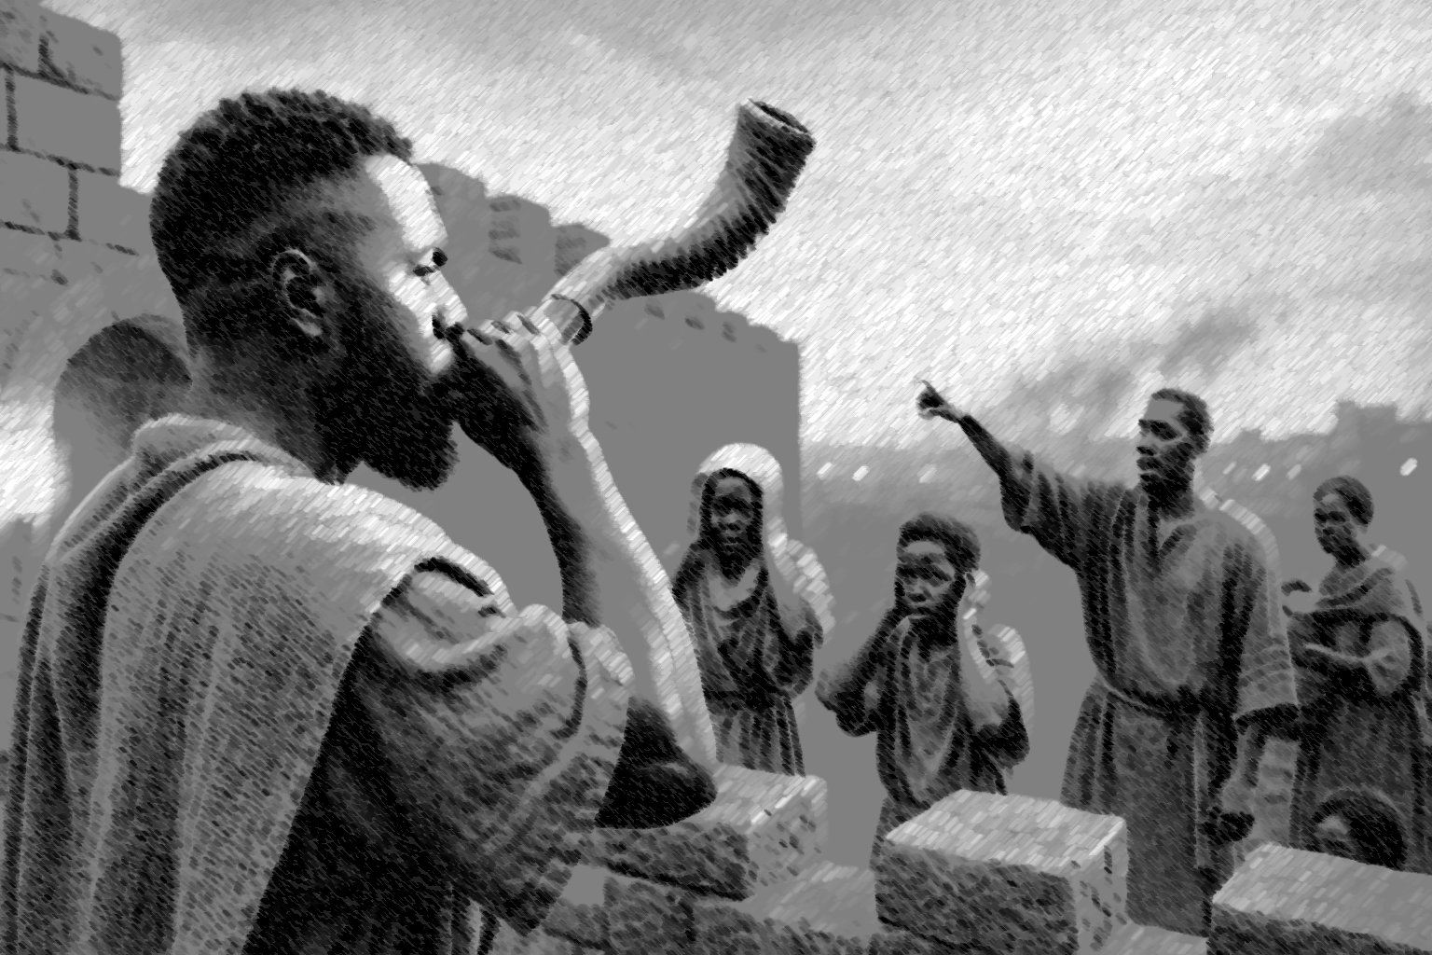
Key Points
EZEKIEL’S SIGN
A Prophet in Exile
Ezekiel plays a significant role in the last days of Judah, even though he spends all of his prophetic ministry in exile. God uses Ezekiel’s life to illustrate His love and correction of Israel. God even uses the sudden death of his wife to illustrate the sorrow that was coming to the remnant of Judah in exile (Lesson 11). We do not know how Ezekiel’s life ends, but for more that two decades, he is faithful in proclaiming the message of repentance. For all we know, he never physically returns to the land of Judah; Ezekiel is a prophet in exile. As a prophet called by God, it is no wonder God prompts dramatic symbolism during Ezekiel’s ministry (for instance, Ezek. 5:1–17). The people of Judah do not receive Ezekiel’s prophetic ministry with warm feelings. They do not wish to hear his message that Jerusalem shall fall.
Notes:
Summary: Ezekiel’s long obedience in exile shows God’s relentless pursuit of His people through embodied, often unwelcome truth.
Main idea: Faithfulness is measured by obedience, not popularity or geography.
Analysis: Ezekiel ministered entirely from exile, using dramatic sign-acts to embody God’s message. Even the death of his wife became a living parable of Jerusalem’s ruin. For decades he preached repentance to a resistant audience. He may never have returned to Judah; his calling proved that God’s word is not bound by borders or public approval.
Three key points:
Entire ministry occurred outside Judah.
Sign-acts made truth visible amid hard hearts.
Decades of perseverance despite rejection.
Three life lessons:
Obey when it costs you.
God can use personal pain redemptively.
Measure ministry by faithfulness, not applause.

Slide 9
Key Points
  Pledge for a Loan
  Verse 15 mentions “[giving] back” something taken “in pledge for a loan,” which is a concept that has a modern analogue: collateral. By tradition in antiquity, a person might obtain a loan by handing over something of great value (for instance, an item of clothing). But if a person became unable to repay, the one who made the loan might feel justified to keep a treasured pledge. In some cases, this might literally be the shirt off another person’s back! God describes this as something “stolen. ” We do not understand the entire context, but this appears to reinforce the demand that God’s people offer mercy and compassion, even in their business dealings.
EZEKIEL’S SIGN
9
Notes:
Summary: Justice in lending—returning pledges and restoring losses—is a non-negotiable mark of turning to God.Main idea: Real repentance reforms economic life—mercy governs money.
Analysis: Collateral (a pledged item) secured ancient loans. Torah required compassion—returning a poor person’s cloak, refusing predatory gain. Ezekiel’s mention of “giving back the pledge” and restoring what was taken links righteousness to restitution. God calls retaining life-essentials “theft”; His people must reflect His mercy in contracts, collateral, and collections.
Three key points:
Collateral protected lenders but invited abuse.
God demands mercy over legal advantage.
Restitution is concrete proof of repentance.
Three life lessons:
Put people before profit.
Make wrongs right, not just “sorry.”
Let business practices preach your faith.

Slide 10
A Watchman for Israel - Ezekiel 33:7–11 KJV
7 “Son of man, I have made you a watchman for the people of Israel; so hear the word I speak and give them warning from me.
8 When I say to the wicked, ‘You wicked person, you will surely die,’ and you do not speak out to dissuade them from their ways, that wicked person will die for[a] their sin, and I will hold you accountable for their blood.
9 But if you do warn the wicked person to turn from their ways and they do not do so, they will die for their sin, though you yourself will be saved.
10 “Son of man, say to the Israelites, ‘This is what you are saying: “Our offenses and sins weigh us down, and we are wasting away because of[b] them. How then can we live?”’
11 Say to them, ‘As surely as I live, declares the Sovereign Lord, I take no pleasure in the death of the wicked, but rather that they turn from their ways and live. Turn! Turn from your evil ways! Why will you die, people of Israel?’
Ezekiel has a specific mission, to be the watchman who communicates a warning for the people of God living in exile.
A watchman looks for danger and rouses people from their slumber. Ezekiel sees catastrophe ahead for those who continue in wicked ways.
As a watchman, Ezekiel is also accountable. If he fails at his job, he will be partly responsible.
God invites repentance from all people. God does not enjoy the death of the wicked
EZEKIEL’S SIGN
10
Notes:
Summary
Ezekiel’s trumpet-call frames God’s justice and mercy: sin is a real threat, the warning is real grace, and life is promised to all who turn to the Lord.
Main idea
Divine warnings are mercy; the watchman’s task is to call sinners to turn and live.
Analysis
Ezekiel, “son of man,” is set as watchman to a hard-hearted people (Ezek 33:7–9). Like a sentry sounding the shophar, he must announce approaching judgment. If he keeps silent, he shares guilt; if he warns and they ignore, their blood is on themselves. God’s heart stands open: He takes no pleasure in the death of the wicked but urges repentance (33:10–11). The office binds the messenger to speak and the hearers to respond.
Three key points
1. The watchman’s duty is proclamation, not persuasion by force.
2. Silence is complicity; faithful warning clears the messenger.
3. God’s desire is reconciliation—“turn… and live.”
Three life lessons
Treat warnings as grace, not grievance.
Speak truth in love; withholding help harms.
Repentance is urgent and hopeful—God delights to forgive.
><><><><><><><><><><><><><><
A Watchman for Israel
Warn the people. This is the call for the prophet Ezekiel. He is a prophet to a people in exile, where he receives this important mission from the Lord. He shall proclaim God’s message to those who habitually disobey God’s commands. Even in life under Babylon’s rule, God’s people need a messenger.
This humble “son of man” (which means the same as human being) is called a watchman in this text (also in Ezek. 3:16–17). It underscores his role as a herald of warnings from the Lord. In the ancient Near East, every major town has a watchman stationed at the city gate, someone responsible for the safety and protection of the people. If any kind of danger is advancing upon the city, a watchman can spot the signals from far away. He can sound the alarm to bar the gates and to protect everyone from an attack to come.
But God uses the symbol of a watchman to refer to the people’s need for repentance. Because sin is like an attacking army, the prophet can watch for signs that God’s people are heading into catastrophe. As their watchman, Ezekiel is tasked with warning the wicked against continuing to do what is wrong. If he fails in his role—metaphorically, if he falls asleep instead of watching carefully— the lives and safety of others would be upon him (Ezek. 33:8). God would still punish the wicked, but it would be Ezekiel’s failure too. Conversely, if Ezekiel warns Israel to turn away from sin, but the people refuse, they will die in their sin while Ezekiel’s own life is spared (Ezek. 33:9). Ezekiel would be blameless if he has done the job of giving the warning.
The exiles in Babylon might think of themselves as blameless. They see consequences for sin everywhere, but they do not connect the dots to their own behavior. They say, “How . . . can we live?” (v. 10). Through Ezekiel, God expresses a desire for reconciliation. God does not even enjoy punishing the wicked (v. 11). Rather, God wants the people to turn and to avoid death as a consequence.
A Watchman for Israel

Slide 11
Evaluating Behavior - Ezekiel 33:12-16
12 “Therefore, son of man, say to your people, ‘If someone who is righteous disobeys, that person’s former righteousness will count for nothing. And if someone who is wicked repents, that person’s former wickedness will not bring condemnation. The righteous person who sins will not be allowed to live even though they were formerly righteous. ’
13 If I tell a righteous person that they will surely live, but then they trust in their righteousness and do evil, none of the righteous things that person has done will be remembered; they will die for the evil they have done.
14 And if I say to a wicked person, ‘You will surely die,’ but they then turn away from their sin and do what is just and right—
15 if they give back what they took in pledge for a loan, return what they have stolen, follow the decrees that give life, and do no evil—that person will surely live; they will not die.
16 None of the sins that person has committed will be remembered against them. They have done what is just and right; they will surely live.
God has words of instruction to prepare people to repent and turn to Him.
For those who have been righteous in the past but who take up a new streak of wicked behavior, God will deal with them as a wicked person (punished with death).
For those who have been wicked in the past and who turn to God with sincere repentance, God will deal with them as a righteous person (rewarded with more life).
In each case, these statements defend God’s fairness.
In all times and places, people can turn to God to receive mercy.
EZEKIEL’S SIGN
11
Notes:
Summary
Ezekiel teaches that God’s justice is profoundly fair and refreshingly hopeful. Past righteousness cannot cover present sin, but past wickedness does not doom a repentant person. When we turn, make restitution, and walk in God’s ways, He grants life; when we presume on our history and persist in sin, we face death.
Main idea
God judges us by our present posture, not our past record; genuine repentance—proved by restitution and renewed obedience—leads to life, while presumption on former righteousness leads to death.
Analysis
Ezekiel contrasts two trajectories. The once-righteous who turns to sin will not be shielded by prior obedience; God “forgets” former merits because current rebellion defines reality. Conversely, the once-wicked who repents—returning what was taken, practicing justice, and walking in God’s statutes—“shall surely live.” This settles the fairness question: exile isn’t fate or bias; it is moral cause and effect. God takes no pleasure in punishing; He invites a turn that is ethical, concrete, and ongoing.
Three key points
1. Present obedience or present rebellion—not yesterday’s résumé—determines God’s verdict.
2. Repentance is measurable: restitution, justice, and sustained obedience.
3. God’s fairness dismantles both fatalism (“we can’t change”) and presumption (“we’ve done enough”).
Three life lessons
• Keep short accounts with God; yesterday’s faithfulness can’t excuse today’s sin.
• Make wrongs right—return, repay, restore—as part of repentance.
• Don’t blame circumstances; choose the turn that leads to life today.
><><><><><><><><><><><><><><
Evaluating Behavior
If God does not enjoy punishing “the wicked,” how does God feel about people who flip from one way of living to another? That is the question addressed in this section. In the first case, say a person has been righteous before God for their entire life, but that same person starts a new sinful pattern. As Ezekiel communicates, their formerly righteous behavior does not outweigh their sin. As he says, “The righteous person who sins will not be allowed to live” (v. 12). No person is above the fray and immune to being judged harshly for sin. Otherwise, a person could reason, “I’ve done enough. ” Rather, God will deliberately “forget” any former righteousness, if a person walks into a new path of sin (v. 13).
Alternatively, say a person has been wicked in the past, but this person repents. Ezekiel uses a specific example: If someone returns ill-gotten goods (something stolen or accepted in a manipulative trade), and if that same person has truly reformed their ways so as to follow God’s decrees into the future, “that person will surely live; they will not die” (v. 15).
These statements all reveal a defense of God’s fairness. The exiles might try to blame God or the Babylonians for their plight. They believe God’s judgment is harsh and that they have no room to repent. However, the message to them is to be compassionate and merciful. All they need to do, regardless of past behavior, is to return to the faithful service of God.
Those who consider themselves righteous cannot rest on past behavior, or worse, turn to sin (Ezek. 33:13). No matter how righteous they believe themselves to be, the Lord calls them to follow His commands, to repay any debts, and to practice justice. Instead of death, in this new reality of exile, God continues to offer life.

Slide 12
Apply the Message:
We can be messengers of God’s forgiveness.
Grading on a Curve?
I remember a class that I took in high school. The teacher had designed the course to stretch his students. For quizzes and tests, the topics were so challenging that most classmates and I worried we had gotten less than half of them right. We soon learned that the same teacher graded on a generous curve. “The highest score on this test was seventy-four percent,” he would say, “so anything above sixty-four is an A. ”
I fear that many of us treat God’s kingdom and God’s righteousness the same way. We might think to ourselves, I’m doing so much, how could I possibly be facing consequences? We forget that the righteous requirement of God is, as expressed by Jesus, “Be perfect, therefore, as your heavenly Father is perfect” (Matt. 5:48). It might not feel fair to be accountable for it all, but we are.
But in the new covenant context, God has given His Word, and more than that, God has given faithful men and women who teach and proclaim the gospel of Jesus. Like Ezekiel, who held the role of watchman, the apostle Paul says, “I am compelled to preach. Woe to me if I do not preach the gospel!” (1 Cor. 9:16). When the heat is on, when all eyes are watching, and at great peril to themselves, godly men and women remain “on the wall” to declare the truth of the good news. They warn of the consequences of unfaithfulness, and they proclaim God’s offer of life.
EZEKIEL’S SIGN
12
Notes:
Grading on a Curve?
Main idea
God doesn’t “grade on a curve.” His standard is His own holiness (“Be ye therefore perfect,” KJV, Matt 5:48). Our hope isn’t comparative goodness but Christ’s righteousness received by faith and obeyed in daily repentance. Warnings and gospel proclamation are mercies that call us to life.
Analysis
Comparing ourselves to others breeds presumption: “I’m better than most, so consequences shouldn’t apply.” Scripture levels that illusion. God measures us by His holy character, not by class averages. Thus the watchman ministry persists: like Ezekiel—and Paul who is “compelled to preach” (1 Cor 9:16)—we warn of sin’s wages and announce Christ’s saving grace. The new covenant doesn’t relax the standard; it provides a Savior and the Spirit to form Christ in us.
Three key points
1. God’s standard is perfection, not relative performance.
2. Grace doesn’t lower the bar; Christ fulfills it and shares His righteousness with believers.
3. Watchmen proclaim both warning and welcome: turn from sin, trust Christ, walk in obedience.
Three life lessons
• Stop grading yourself against others; stand before God with humility and truth.
• Flee presumption; keep short accounts through repentance, faith, and restitution where needed.
• Receive gospel courage to speak: loving warnings are part of loving people.
Summary
“Grading on a curve” comforts the proud but cannot save the guilty. God’s unbending holiness exposes our need; the gospel answers it in Christ. Therefore, heed the watchman’s call, abandon comparison, and embrace a life of repentant faith and Spirit-enabled obedience.

Slide 13
Apply the Message:
We can be messengers of God’s forgiveness.
EZEKIEL’S SIGN
Grading on a Curve?
1 In your experience, where and when has God used a “watchman” (male or female) to warn against danger ahead?
2 How have you ever tried to grade yourself on a curve?
3 How has the role of messenger changed in a new covenant context, when we have the gospel of Jesus to share?
13
Notes:
1 In your experience, where and when has God used a “watchman” (male or female) to warn against danger ahead?
In our workplace, our church denomination, or our family lives, God can send messengers to warn that past behavior does not predict future success. Looking around the Christian world, many churches and denominations have suffered when they tolerated unfaithfulness.
2 How have you ever tried to grade yourself on a curve?
In the end, it is not an evaluation of our behavior that counts before the king. God isn’t like a rigorous teacher who is willing to grade on a curve. God offers Himself, in the person of Jesus, and God accepts those who place their faith in Him. God offers life, and “the righteous will live by faith” (Rom. 1:17; Gal. 3:11; compare Hab. 2:4).
3 How has the role of messenger changed in a new covenant context, when we have the gospel of Jesus to share?
Ezekiel’s message was about life and death in exile, especially in the physical sense. But in the new covenant context, the life that God offers is eternal life, which is the salvation that comes by faith in the Son of God.

Slide 14
Conclusion
EZEKIEL’S SIGN
Living as a Watchman
As members of the new covenant, today we continue to ponder the connection between sin and suffering for those living under the old cov­enant (compare Job 21:19; Luke 13:1–5; John 9:2). Righteous people do indeed suffer because of realities beyond their control. But today’s les­son says that the path of the righteous is the one to travel nonetheless. Walking the path of the wicked results in destruction. Considering God’s charge to Ezekiel to be a watchman, how might we live out a watchman role?
At the outset, it is important to understand that Ezekiel received his call to serve as a prophetic watchman by direct revelation from God. Ezekiel filled this role at a particular time in history, to a particular group of people, in ways that were rele­vant to his time, place, and audience. We are not prophets in the same sense that Ezekiel was. Those who claim today to be commissioned by God to be prophets in the sense of being able to foretell the future may well be proven wrong (Deuteron­omy 18:22; Hebrews 1:1–2).
Even so, there are opportunities for us to speak a watchman’s words of warning and wisdom to those around us. God doesn’t desire that anyone should perish (2 Peter 3:9). He punishes disobedi­ence justly, but He is also gracious, merciful, and patient. He invites sinners to repent and turn from their wicked ways to find life in His Son. We have this good news to proclaim!
Moreover, it is not up to us whether people heed our words. Like Ezekiel, our responsibil­ity is to tell the story of the good news of the gospel (Matthew 28:19–20). Whether that good news is accepted or rejected is not within our control. However, our own faithfulness in pro­claiming it is.
14
Notes:
Summary
New-covenant watchmen don’t predict the future; they witness to Jesus. In a world where suffering isn’t a simple scoreboard, believers still must sound clear warnings, offer the gospel, and disciple the willing. Our task is proclamation and presence; God’s task is conviction and conversion.
Main idea
God doesn’t call new-covenant believers to foretell the future like Ezekiel, but to embody his watchman spirit: warn in love, witness to Christ, and walk faithfully—leaving outcomes to God.
Analysis
Scripture rejects a simple “sin = suffering” formula (Job 21; Luke 13; John 9). Still, two paths remain: righteousness leads to life; wickedness to ruin. Ezekiel’s watchman office was historically unique (Deut 18:22; Heb 1:1–2), yet its ethic endures: God is just, patient, and unwilling that any should perish (2 Pet 3:9). Our charge is proclamation and discipleship (Matt 28:19–20). Faithfulness means timely warning, gospel invitation, and endurance—trusting God with whether hearers accept or refuse.
Three key points
The “watchman” pattern guides believers: warn, invite, and disciple with Scripture and grace.
Responsibility = faithfulness to speak; results belong to God.
God’s character—just, merciful, patient—grounds urgent warnings and hopeful appeal.
Three life lessons
Speak truth in love: silence can harm, but harshness can harden—aim for both courage and kindness.
Keep going when ignored; obedience is success even when outcomes disappoint.
Hold out hope: God delays judgment to open a door for repentance.

Slide 15
One Bible, One Story
EZEKIEL’S SIGN
Overcoming Sin, How?
You may notice that Ezekiel’s words present the problem of sin without a clear message of how sin shall be overcome. He talks in broad categories of how people respond to God in the context of exile (“a righteous person” versus “a wicked person”). Yet, we know that no one is “righteous” in the sense of being entirely without sin (Rom. 3:23). In God’s sovereign plan, the failures of people always set the stage for a greater victory to be accomplished by God. Israel’s corporate failure to keep the covenant sets up the giving of a new covenant through Christ (see Matt. 26:28). And individual patterns of sin set the stage for God to heal and to redeem us by Christ’s victory over sin and death. Paul says, “The law was our guardian until Christ came that we might be justified by faith” (Gal. 3:24).
15
Notes:
Summary
Ezekiel names the disease—sin—and insists on immediate turning to God. The New Testament supplies the cure: the law exposes, Christ atones, and faith justifies. Thus the watchman’s warning becomes a gospel invitation—leave self-reliance, trust Jesus’ finished work, and walk in the new-covenant life God freely gives.
Main idea
Ezekiel diagnoses the problem—personal sin and present-tense accountability—but leaves the cure implicit. The new covenant reveals the remedy: Christ’s atoning blood and justifying grace provide the righteousness the law demanded but could not supply (Rom 3:23; Matt 26:28; Gal 3:24).
Analysis
Ezekiel’s “righteous” vs “wicked” categories expose our need by evaluating today’s obedience, not yesterday’s résumé. Yet since “all have sinned,” no one can survive on performance. In God’s design, the law functions as a guardian/tutor, driving sinners to Christ, who secures forgiveness, imputes righteousness, and by the Spirit enables the life God requires—what Ezekiel anticipates and the new covenant delivers.
Three key points
Ezekiel clarifies sin’s seriousness and personal responsibility but withholds the final cure.
Human righteousness collapses under universal sin; the law convicts rather than saves (Rom 3:23; Gal 3:24).
Christ inaugurates the new covenant—full forgiveness and a new standing with God (Matt 26:28).
Three life lessons
Don’t trust comparative goodness; flee to Christ’s righteousness.
Let conviction lead to conversion: repent, believe, and begin Spirit-empowered obedience.
Turn failures into altars—bring past wrongs to the cross and make concrete restitution where possible.

Slide 16
Live It Out: Share a message of warning and salvation.
EZEKIEL’S SIGN
  Ezekiel is held responsible for communicating the message that God entrusts to him, a message of sorrow. God has entrusted us with a message that is good news, not lamentations. How much more responsible shall God hold each of us to communicate the good news of Christ’s redemption? Encourage your group to respond to the prompt in “Bringing a Message of God’s Salvation” by identifying a specific circle of influence that God entrusts to them.
Bringing a Message of God’s Salvation
God calls Ezekiel to serve as a watchman in a particular time and place. But God expects all people to speak the truth in love and to seek the good of others. With the Word of God and the person of Jesus before us as examples, each of us has a circle of influence where we can share the good news of God’s salvation.
16
Notes:
Live It Out -
Main Idea
God has entrusted every believer with a “watchman” stewardship: warn in love and announce Christ’s salvation within the circles where He has placed us (Ezek 33; Eph 4:15; 2 Pet 3:9; Matt 28:19–20).
Analysis
Ezekiel’s office was unique, yet its ethic continues: silence in the face of soul-danger is unloving; truthful, hopeful speech is obedience. The gospel gives both warning (judgment is real) and invitation (Christ saves fully). God measures our faithfulness to speak, not our ability to secure results. Our most credible platform is our God-given sphere—family, neighbors, coworkers, and friends—where consistent character, prayer, and clear words converge (Rom 1:16; Col 4:5–6).
Three Key Points
1. Stewardship: We are accountable to share the message God entrusted to us.
2. Content: Hold warning and good news together—truth in love, grace with clarity.
3. Context: Start in your real circles of influence and live a credible witness.
Three Life Lessons
• Silence can be complicity; loving people means lovingly warning.
• Proximity multiplies fruit—serve and speak where you already have trust.
• Faithfulness is success; outcomes belong to God.
Summary
New-covenant “watchmen” don’t predict the future; they proclaim Jesus. Speak plainly, live transparently, pray persistently, and trust God to work.
---
Put It Into Practice (quick plan)
Name your circle: one person each in family, work/school, neighborhood, online.
Pray daily: ask for openings and soft hearts (AMP: Col 4:3).
Prepare two sentences: a gentle warning about sin’s end (KJV: Rom 6:23) and a hopeful invitation to Christ (KJV: John 3:16).
- Act this week: serve tangibly, share briefly, invite a next step (coffee, church, Scripture reading).

Slide 17
Closing prayer
We are imperfect and reluctant messengers, just like Your prophets of old. Help us to exercise influence in the places that You send us. Give us the right words to share the gospel— perhaps even to share words of warning. Help us to stay awake and watchful, not only for danger, but to glimpse the glory of Your kingdom, which we know is coming. In the name of Christ, our king, we pray.
Amen.

Slide 18



  The Lord bless thee, and keep thee:
  The Lord make his face shine upon thee, and be gracious unto thee:
  The Lord lift up his countenance upon thee and give thee peace.
  - Numbers 6:24-26,
Material adapted by Stanford W. Bowman Jr. from Echoes® Adult and Bible-in-Life® Adult Fall 2025 quarter with permission, © David C Cook, https://davidccook.org. May not be further reproduced. All rights reserved.

Slide 19
QUESTION & ANSWER
A Watchman for Israel
EZEKIEL’S SIGN
1 What is the role of a watchman?
2 What would Ezekiel warn people against?
3 How does God feel about punishing and killing “the wicked”?
A watchman is someone who is stationed to protect a city or a group of people. He has to look far away to try to spot danger that is looming on the horizon. For instance, a watchman would spot the fires of an approaching army and would warn the people to take safety within the city walls.
Ezekiel is warning the people against a different kind of enemy: their own sin. In exile, they were not being attacked by an army, but they were tending to disassociate the consequences of sin from their own ongoing behaviors.
Perhaps surprisingly, God does not enjoy the death of the wicked. Even though God is entirely just and fair, the death of wicked people does not please God, their creator. Second Peter 3:9 agrees: “[God] is patient with you, not wanting anyone to perish, but everyone to come to repentance. ”
Notes:
1 What is the role of a watchman?
A watchman is someone who is stationed to protect a city or a group of people. He has to look far away to try to spot danger that is looming on the horizon. For instance, a watchman would spot the fires of an approaching army and would warn the people to take safety within the city walls.
2 What would Ezekiel warn people against?
Ezekiel is warning the people against a different kind of enemy: their own sin. In exile, they were not being attacked by an army, but they were tending to disassociate the consequences of sin from their own ongoing behaviors.
3 How does God feel about punishing and killing “the wicked”?
Perhaps surprisingly, God does not enjoy the death of the wicked. Even though God is entirely just and fair, the death of wicked people does not please God, their creator. Second Peter 3:9 agrees: “[God] is patient with you, not wanting anyone to perish, but everyone to come to repentance. ”

Slide 20
QUESTION & ANSWER
Evaluating Behavior
EZEKIEL’S SIGN
1 Why is it important for the exiles to take responsibility for their own actions?
2 How is the message of repentance a message that offers hope?
3 What kinds of behaviors might people be tempted to trust as evidence of past righteousness?
For those who received a corporate consequence for wrongdoing (resulting in many deaths), it would be easy to regard exile as someone else’s fault. Through Ezekiel, God dispenses with this thinking. No matter a person’s past behavior, to continue to live, God requires adherence to His righteous requirements.
God promises to set aside all past wickedness. God is willing to receive the repentance of those who had been perpetuating evil. If a person reforms and turns to what is right, God will allow that person to live. God does not make one person responsible for the actions of everyone else.
Many sorts of behaviors could be counted as righteous, in the minds of an ancient or modern audience. For instance, a business owner might claim to have dealt with fairness, paid every tax required, and taken care of employees. But that provides no assurance that future accountability will never come, should that same person do what is wrong.
Notes:
1 Why is it important for the exiles to take responsibility for their own actions?
For those who received a corporate consequence for wrongdoing (resulting in many deaths), it would be easy to regard exile as someone else’s fault. Through Ezekiel, God dispenses with this thinking. No matter a person’s past behavior, to continue to live, God requires adherence to His righteous requirements.
2 How is the message of repentance a message that offers hope?
God promises to set aside all past wickedness. God is willing to receive the repentance of those who had been perpetuating evil. If a person reforms and turns to what is right, God will allow that person to live. God does not make one person responsible for the actions of everyone else.
3 What kinds of behaviors might people be tempted to trust as evidence of past righteousness?
Many sorts of behaviors could be counted as righteous, in the minds of an ancient or modern audience. For instance, a business owner might claim to have dealt with fairness, paid every tax required, and taken care of employees. But that provides no assurance that future accountability will never come, should that same person do what is wrong.

Slide 21
  The Lord bless thee, and keep thee:
  The Lord make his face shine upon thee, and be gracious unto thee:
  The Lord lift up his countenance upon thee and give thee peace.
  - Numbers 6:24-26,
Material adapted by Stanford W. Bowman Jr. from Echoes® Adult and Bible-in-Life® Adult Fall 2025 quarter with permission, © David C Cook, https://davidccook.org. May not be further reproduced. All rights reserved.

