Slide 1
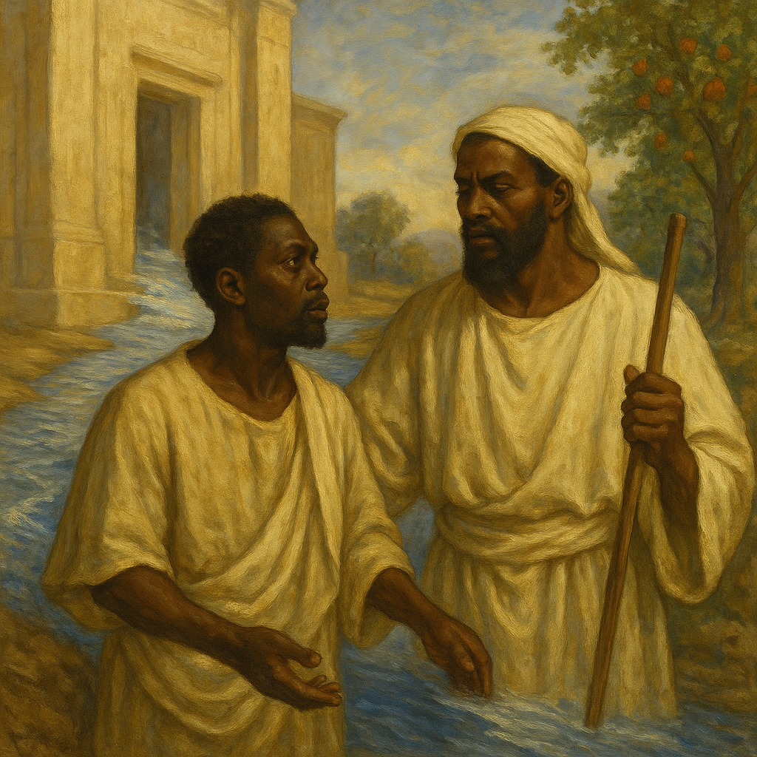
EZEKIEL’S VISION
And by the river upon the bank thereof, on this side and on that side, shall grow all trees for meat, whose leaf shall not fade, neither shall the fruit thereof be consumed: it shall bring forth new fruit according to his months, because their waters they issued out of the sanctuary: and the fruit thereof shall be for meat, and the leaf thereof for medicine.
—Ezekiel 47:12 KJV
Week of November 30
Notes:
EZEKIEL’S VISION
November 30

Slide 2
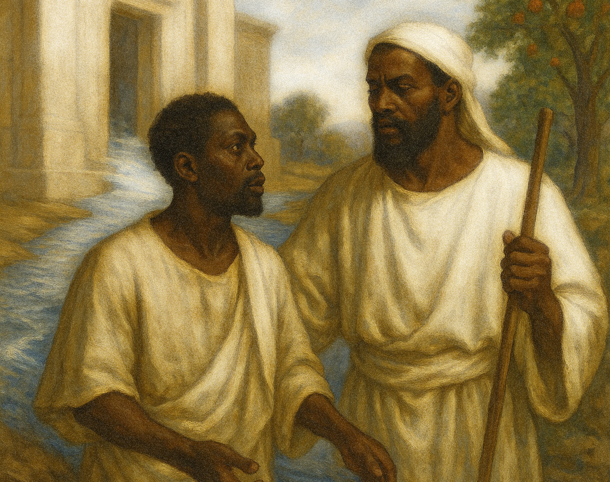
Prayer
O God, we see a world both broken and beautiful. Help us to see Your new world, not only in time and space but also in human souls deeply connected to You, our Creator. Help us find ways to live in that world dawning because of Your Son. Amen.
  Thought to Remember
  If God is for us, no one can stand against us!
Notes:
Prayer
O God, we see a world both broken and beautiful. Help us to see Your new world, not only in time and space but also in human souls deeply connected to You, our Creator. Help us find ways to live in that world dawning because of Your Son. Amen.
Thought to Remember
Our current situation isn’t permanent.

Slide 3
LESSON OUTLINE
EZEKIEL’S VISION
  LESSON FOCUS: God’s redemptive plan is firm and unshakable.
  LESSON SCRIPTURE: Ezekiel 47:1–9, 12
  LIVE IT OUT: : Be like a vessel that overflows with God’s life.
  Review
  Introduction
  Lesson Context
  Overview
  Conclusion
  Question & Answers
A Deepening Stream - Ezekiel 47:1–5 KJV
A Healing River - Ezekiel 47:6–9, 12 KJV
Notes:
A Deepening Stream - Ezekiel 47:1–5 KJV
A Healing River - Ezekiel 47:6–9, 12 KJV
Summaries
Ezekiel sees a tiny trickle of water flowing from the temple—God’s own presence—on the south side of the altar, moving east toward the desert and the Dead Sea. Guided by a radiant figure, he walks along the stream as it deepens from ankle-deep to a mighty, uncrossable river. Wherever this river flows, it heals what was dead: even the salty Dead Sea is made fresh and filled with swarming life. On its banks grow endless fruit trees whose unfailing fruit feeds and whose unfading leaves bring continual healing to all.
Commentary
Ezekiel’s temple river shows that all true renewal flows from God’s abiding presence, assuring exiles He has not abandoned them. As the water deepens from a trickle to an uncrossable river, it pictures ever-growing grace and the Spirit drawing believers into deeper surrender and life. When the river reaches the desert and Dead Sea, dead places are healed, proving no situation is beyond God’s restoring power. Those rooted in this river become “trees of righteousness,” bearing continual fruit and bringing healing to a broken world.

Slide 4
EZEKIEL’S VISION
INTRODUCTION
Mirage or Hope?
  A character in a movie is alone in a hot and arid place. He is parched with thirst and nearing heat exhaustion from the blazing sun. Suddenly, he sees a glimmering pool near a tree. Water and shade! The character experiences a surge of hope. But hopes are dashed when he eventually realizes that he has been fooled by a shimmering illusion. What seemed to support life turned out to be only a mirage4
  The presence of water is a sign of life. This inescapable fact invites powerful comparisons and imagery in the Bible (examples: Jeremiah 2:13; John 7:37–39). Today’s lesson offers one of the most powerful of those.
Notes:
Main Idea
The illustration contrasts the emptiness of a mirage with the Bible’s picture of real, life-giving water, preparing us to see that only God, revealed in Christ, offers true and lasting hope instead of illusion.
The story pictures a lone traveler in a burning desert, dying of thirst. When he sees a shining pool by a tree, hope explodes in his heart—only for him to discover it is a mirage. The scene shows how cruel false hopes can be: what promised life had no water at all. Using this image, the lesson turns to Scripture, where water symbolizes genuine spiritual life, pointing us to God’s “living water” as our only sure hope.
Three Key Points
1. In a desert, water and shade mean survival, so a thirsty traveler will desperately hope when he thinks he sees them.
2. A mirage cruelly raises expectations and then disappoints, revealing that what looked life-giving was actually empty.
3. Scripture uses water as a rich symbol for true spiritual life, contrasting God’s living water with false, deceptive sources (Jeremiah 2:13; John 7:37–39).
Three Life Lessons
1. Not everything that looks life-giving really is; we must test hopes against God’s truth, not our feelings.
2. Chasing illusions—whether sinful desires, idols, or self-made plans—can leave us more exhausted and hopeless than before.
3. Only the “living water” that Jesus gives can truly satisfy the soul and sustain us when life feels like a desert.

Slide 5
Waters of Babylon
Wherever Ezekiel looked, if he walked the streets of Babylon, he’d likely see water. Other exiles in Babylon would immediately recognize a connection to water and waterways. The city of Babylon was encompassed and traversed by the Euphrates River, running through its center. Canals flowed in the suburbs, too, and Ezekiel lived on one of them, the River Chebar. Some suggest, therefore, that Ezekiel’s vision draws imagery from these waters. Since the prophet’s messages of judgment are concluded, he proclaims restoration and redemption in the aftermath. Water in the Bible can also be associated with salvific blessing: “With joy you will draw water from the wells of salvation” (Isa. 12:3).
Deepening Waters as Sanctification
The ever-deepening stream of Ezekiel’s vision could even be applied to the sanctifying-process aspect of salvation: an ongoing, continually deeper purifying of our lives in Christ. If justification is a point-in-time declaration of God’s forgiveness, then sanctification is the gradual outworking of that position in Christ, as God is able to make us into the people He has declared us to be (see Rom. 8:28– 30; 1 Thess. 5:23).
EZEKIEL’S VISION
LESSON CONTEXT
Notes:
Waters of Babylon
Ezekiel’s vision uses the familiar rivers of Babylon to show that, after judgment, God will send life-giving, saving waters of restoration to His people.
Babylon, where Ezekiel lived in exile, was full of rivers and canals, especially the Euphrates and the Chebar. Exiles constantly saw water, so Ezekiel’s vision of life-giving waters would resonate deeply. Now that his judgments are finished, the prophet announces hope and renewal. In Scripture, water often symbolizes God’s saving work; Isaiah 12:3 pictures believers joyfully drawing water from salvation’s wells. Ezekiel’s watery imagery thus promises real, restorative blessing from God.
=================================
Deepening Waters as Sanctification
Ezekiel’s deepening waters symbolize the lifelong sanctifying work of God, who moves believers from shallow beginnings into a rich, ever-deeper experience of Christlike holiness.
The vision of a river that grows from a trickle to a mighty stream offers a vivid picture of sanctification. Justification happens at conversion, when God declares us forgiven and righteous in Christ. Sanctification is the gradual unfolding of that reality, as the Spirit uses life’s circumstances to conform us to Jesus. Like stepping farther into Ezekiel’s river, believers are called to enter more deeply into God’s cleansing, transforming work until they fully reflect the holiness He has already pronounced over them.
=================================
Analysis
The paragraph links Ezekiel’s river vision to his real setting in watery Babylon. Surrounded by the Euphrates and canals, exiles would feel the force of water imagery. After messages of judgment, Ezekiel now uses water to picture restoration, tying it to the wider biblical theme of water as salvation and blessing (Isaiah 12:3).
Three Key Points
Babylon was a river city: the Euphrates ran through it, with canals all around, including the Chebar where Ezekiel lived.
Ezekiel’s audience, familiar with these waterways, would quickly connect his vision of water to their daily surroundings.
After judgment oracles, Ezekiel now uses water imagery to proclaim restoration and God’s saving blessings.
Three Life Lessons
God often speaks to us using images from our everyday environment so His message feels close and understandable.
Seasons of judgment and loss are not God’s final word; He also promises restoration and fresh streams of hope.
Like water in a desert, God’s salvation is not a luxury but a necessity; we must “draw water from the wells of salvation” with joy.
=================================
Deepening Waters as Sanctification
Analysis
This paragraph connects Ezekiel’s ever-deepening river with the believer’s sanctification. Justification is a once-for-all legal declaration that we are forgiven in Christ. Sanctification is the lifelong process by which God practically shapes our character to match that declaration. As the water in Ezekiel 47 moves from shallow to “waters to swim in,” so the Spirit leads believers into deeper purity, obedience, and Christlikeness (Rom. 8:28–30; 1 Thess. 5:23).
Three Key Points
1. Ezekiel’s deepening river pictures the progressive nature of Christian growth and holiness.
2. Justification is instantaneous; sanctification is ongoing, working out what God has already declared true in Christ.
3. God Himself is the active agent, gradually forming us into the people He has called, justified, and destined to glorify.
Three Life Lessons
1. Do not settle for “ankle-deep” Christianity; God invites us into ever-deeper surrender and obedience.
2. Sanctification takes time; be patient with God’s process in your life and in others.
3. Every trial, correction, and blessing can be part of God’s shaping work, moving us closer to Christ’s likeness.
=================================

Slide 6
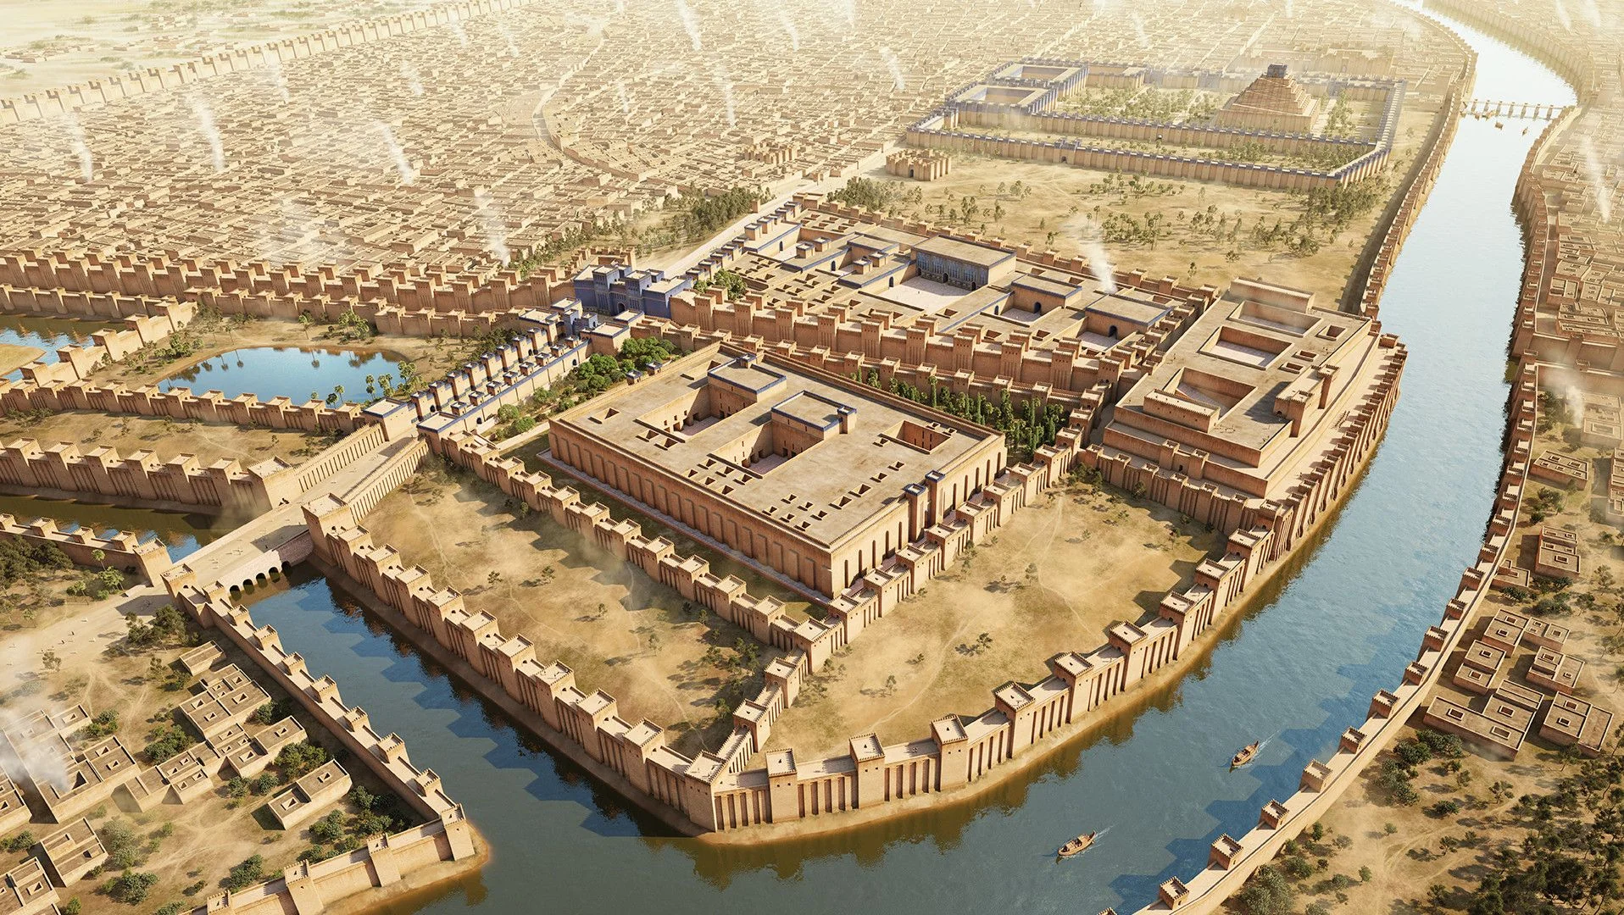
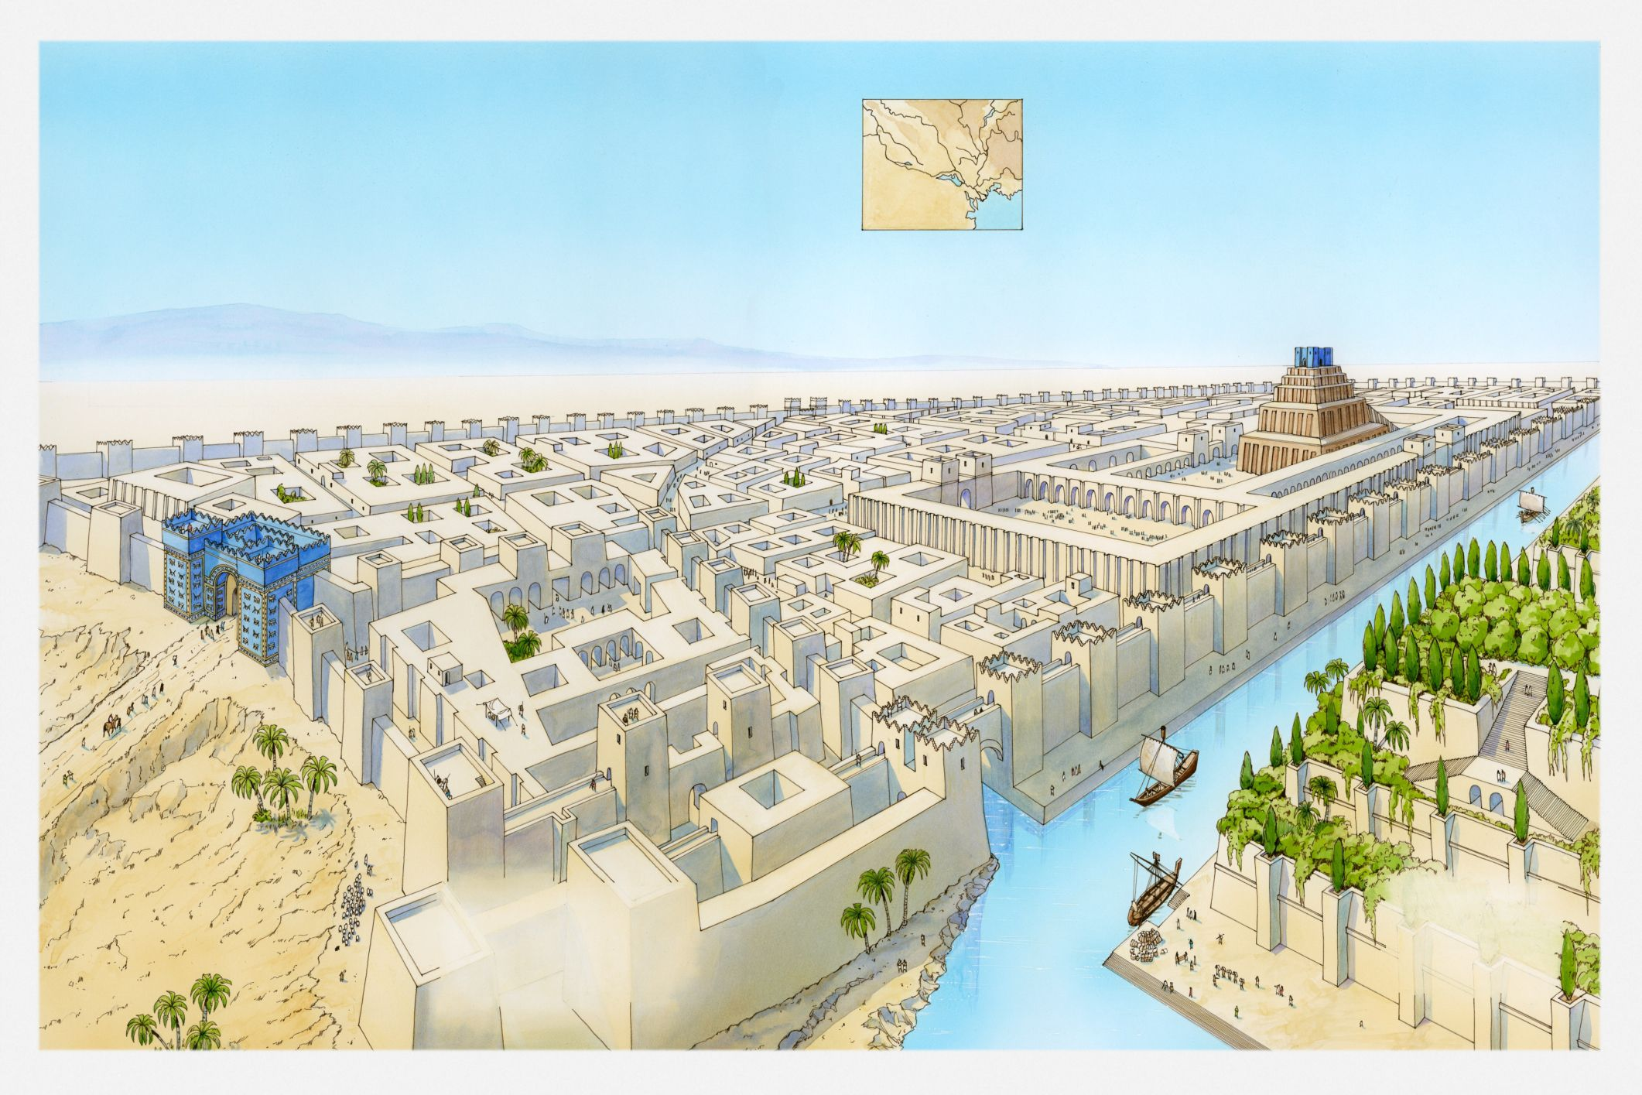
EZEKIEL’S VISION
INTRODUCTION
Ancient Babylon was a sprawling, monumental city characterized by massive walls, a network of canals, and grand structures like the Ishtar Gate and the Etemenanki ziggurat. During its peak under Nebuchadnezzar II, the city was elaborately decorated, particularly with glazed blue bricks on its Processional Way and major gates. It was divided by the Euphrates River and featured palaces, temples, paved roads, and public buildings.

Slide 7
LESSON CONTEXT
EZEKIEL’S VISION
Images Common to Ezekiel and Revelation
Have you noticed any connections to Revelation in Ezekiel? In Revelation, John draws heavily from this text: “On each side of the river stood the tree of life, bearing twelve crops of fruit, yielding its fruit every month. And the leaves of the tree are for the healing of the nations” (Rev. 22:2). Both visioners see life-giving trees, monthly fruit, and healing leaves. These finite images reveal the infinite goodness of God’s “kingdom come. ”
If we move to application, we find an abundance of ideas that Christians have proposed. For example, here is what eighteenth-century Bible commentator Matthew Henry advises: “Christians are supposed to be these trees. . . trees of righteousness, the planting of the Lord (Isa. 61:3), set by the rivers of water, the waters of the sanctuary (Ps. 1:3), grafted into Christ the tree of life, and by virtue of their union with Him made trees of life too, rooted in Him (Col. 2:7). ”
A Difference between Ezekiel and Revelation
For all that Ezekiel and John of Patmos say in common, Revelation 21:22 gives a separate image of the future state of God’s restored city: “I did not see a temple. ” As John develops this idea, he explains, “The Lord God Almighty and the Lamb are its temple. ” Each of these prophetic visions, from Ezekiel to Revelation, are expressing that God shall dwell with His people. But in the surprising twist that John includes, the physical temple itself is no longer required, because God’s presence is so immediate and so available that the purpose of the temple has been fulfilled in the person of Jesus.
Notes:
Images Common to Ezekiel and Revelation
Ezekiel and John share a unified vision of God’s final kingdom, where the river of life and the tree of life symbolize believers, rooted in Christ, continually bearing fruit and healing for the nations.
Ezekiel and Revelation are joined by a shared picture: a river of life, trees on both sides, never-ending fruit, and leaves that heal. These images point to the overflowing goodness of God’s coming kingdom. Matthew Henry presses the image onto believers: in Christ we become “trees of righteousness,” planted by God, rooted in the tree of life, and constantly nourished by His living waters so we can bear fruit and bring healing to the world.
=================================
A Difference between Ezekiel and Revelation
Ezekiel and Revelation both promise God’s dwelling with His people, but Revelation shows the climax: no more temple building, because God and the Lamb themselves are the living temple among us.
Ezekiel pictures a renewed temple at the heart of God’s restored city. John, in Revelation 21:22, goes further: in the final state he sees no temple, because “the Lord God Almighty and the Lamb are the temple.” Both prophets proclaim that God will live with His people. John’s surprise twist shows that the old temple’s role is complete. Its true meaning is fulfilled in Jesus Christ, whose immediate presence replaces every earthly symbol and structure.
=================================
Analysis
The paragraph shows how John’s vision in Revelation 22 echoes Ezekiel’s river and trees: same river, tree of life, monthly fruit, and healing leaves. These images point beyond themselves to God’s coming kingdom, where His presence brings full life and wholeness. Matthew Henry then applies the picture to believers, who—united to Christ—become “trees of righteousness,” planted by the waters of God’s grace and bearing fruit and healing for others.
Three Key Points
1. Revelation 22 deliberately mirrors Ezekiel’s vision: one river, the tree of life, constant fruit, and leaves that heal the nations.
2. Both prophets use concrete pictures of trees and water to hint at the infinite goodness and completeness of God’s future kingdom.
3. Matthew Henry sees Christians as those trees—rooted in Christ, nourished by the waters of the sanctuary, and made “trees of life” for others.
Three Life Lessons
1. Our hope is not vague; God gives repeated, consistent images of a future where His life heals every nation and wound.
2. If we are united to Christ, we are not decorative trees; we are meant to bear constant fruit that feeds and blesses others.
3. Staying “planted by the rivers of water” means remaining rooted in Christ and His Word so our leaves—our words and actions—bring healing, not harm.
=================================
A Difference between Ezekiel and Revelation
Analysis
This paragraph notes that Ezekiel sees a restored temple, while John in Revelation sees a city with no temple. Both agree on the big truth: God will live with His people. John adds a Christ-centered twist—God’s presence is so direct in the New Jerusalem that a building is no longer needed. The Lord God Almighty and the Lamb are the temple. The structure was always a pointer; in the end, the Person (Jesus) is the reality.
Three Key Points
1. Ezekiel and John both describe God dwelling with His people in a renewed city.
2. Revelation 21:22 says there is no physical temple in the New Jerusalem.
3. God Himself and the Lamb (Jesus) are the temple, showing the temple’s purpose is fulfilled in Christ’s presence.
Three Life Lessons Learned
1. Religious buildings and systems are important, but they are not the final goal—God Himself is.
2. Our worship should center on Christ’s presence, not just on places, traditions, or routines.
3. One day, we will enjoy God’s immediate, unhindered presence; that hope should shape how we live and worship now.

Slide 8
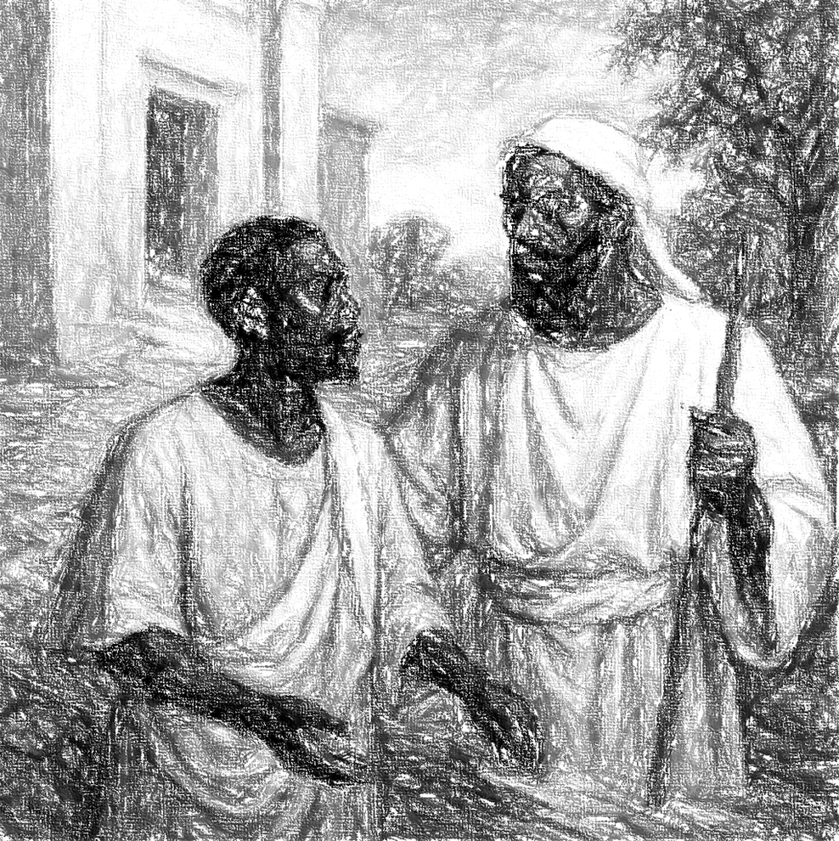
Ezekiel 40–48 is from around 572 BC, fourteen years after the fall of Jerusalem. Ezekiel and his people are still in the land of exile and doomed to remain there for at least thirty years longer. Psalm 137:1 sets the mood: “By the rivers of Babylon we sat and wept when we remembered Zion. ” But by an amazing journey-vision, the prophet returns to Judah to see a restored temple of a coming messianic age.
Most of the contextual information in the previous lessons from Ezekiel still applies and need not be repeated here. What’s changed about the context is a shift from addressing the Judahites’s then-present situation in Babylon to a vision of the future. All of Ezekiel 40–48, about 20 percent of the entire book, relates this vision. Understanding the meaning and significance of the vision is crucial to appreciate this great book fully. The imagery of the “water of life” river and its surroundings has parallels elsewhere in the Bible. Revelation 22, in particular, offers several points for fruitful comparison.
LESSON CONTEXT
The vision is meant to encourage God’s people. The exile had decimated their homeland. Their capital had been razed. Their temple was destroyed. The exiles now lived in a strange land under a foreign power. While the prophets had predicted a return (Jeremiah 29:10–14), many feared they would never see Judah again. Ezekiel’s visions offer these exiles reason to hope. The visions concern a new city and a transformed homeland. The glory of this new Jerusalem and Judah will be greater than what was lost.
The vision opens in Ezekiel 40:1 with a record of the date. By comparison with various texts and calendars, that date would likely be around 573 BC. As the reader moves through the text from 40:1, Ezekiel is seen to receive details concerning a restored city and temple. These prophetic images include particulars regarding the officials to serve in the new temple, allotment of land, and instructions regarding offering procedures for Passover and other special days. Then we arrive at chapter 47.
EZEKIEL’S VISION
Notes:
Ezekiel 40–48 shifts from present exile to future hope, revealing a detailed vision of a restored temple, city, land, and life-giving river meant to assure God’s devastated people that His presence will return and His future glory will surpass their past.
Around 573–572 BC, Ezekiel and Judah’s exiles remain in Babylon, mourning their ruined homeland and destroyed temple. Into that sorrow, God carries Ezekiel in a vision back to Judah to see a new, glorious temple and a transformed land. Chapters 40–48, a major portion of the book, describe this future city, its leaders, worship, land allotments, and especially the river of life in chapter 47. The vision’s purpose is pastoral: to encourage broken exiles that God’s restoration—and His presence—are still sure.
Analysis
These paragraphs set Ezekiel 47 inside the larger vision of chapters 40–48. Historically, Ezekiel is still in Babylon, years after Jerusalem’s fall, with decades of exile still ahead. Emotionally, the people feel Psalm 137’s grief. Into that despair, God grants a detailed, future-oriented vision of a new temple, city, land, and the “water of life” river. The focus shifts from present judgment to promised restoration, with strong links to Revelation’s final hope.
Three Key Points
1. Historical setting – Ezekiel 40–48 is dated around 573–572 BC, long after Jerusalem’s destruction; the people remain in exile, grieving what was lost.
2. Shift to future vision – About 20% of the book (chaps. 40–48) is one sustained vision of a restored temple, city, land, and worship order, culminating in the river of life in chapter 47.
3. Purpose of encouragement – The vision assures exiles that God will restore them; the new Jerusalem and Judah will surpass the former glory, echoing later images in Revelation 22.
Three Life Lessons Learned
1. God does not leave His people with judgment as the final word; He also gives visions of future grace to sustain them in present pain.
2. Even when our “Jerusalem” lies in ruins, God can promise a restoration greater than what we lost, in ways we cannot yet imagine.
3. Detailed promises of God’s presence and worship—rather than vague optimism—are what anchor faith during long seasons of waiting and exile.

Slide 9
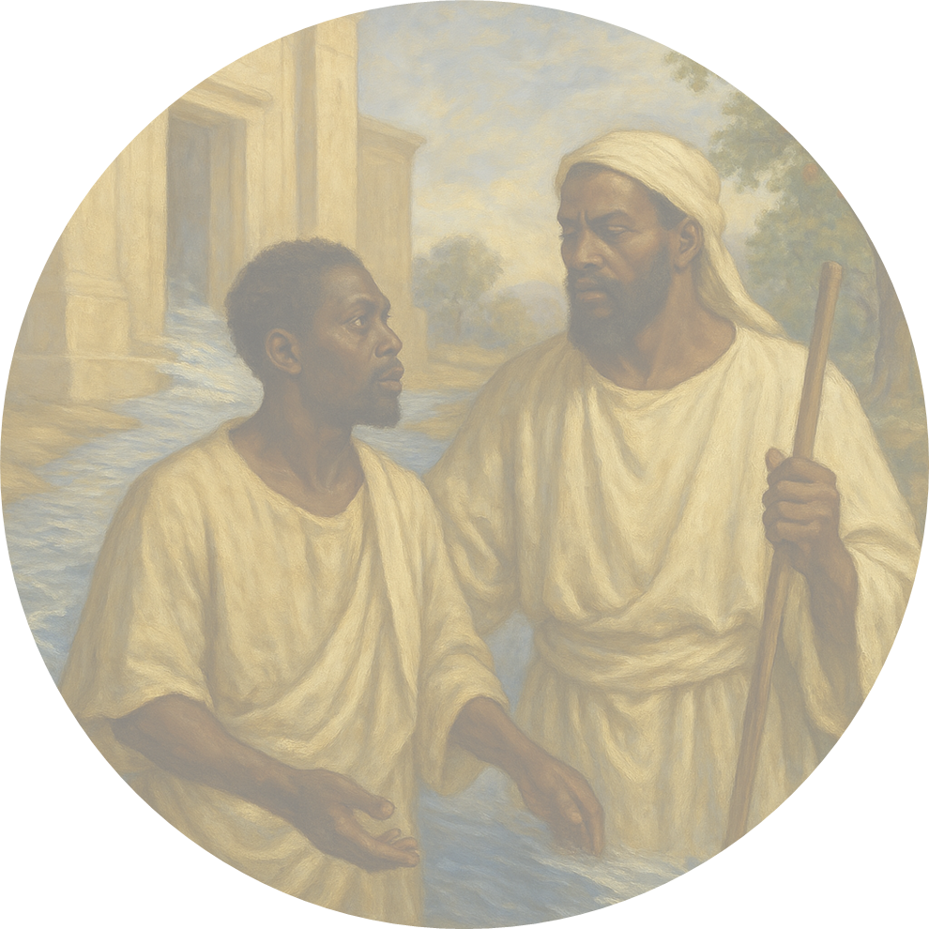
LESSON OVERVIEW
EZEKIEL’S VISION
A Deepening Stream - Ezekiel 47:1–5 KJV
1 Afterward he brought me again unto the door of the house; and, behold, waters issued out from under the threshold of the house eastward: for the forefront of the house stood toward the east, and the waters came down from under from the right side of the house, at the south side of the altar.
2 Then brought he me out of the way of the gate northward, and led me about the way without unto the utter gate by the way that looketh eastward; and, behold, there ran out waters on the right side.
3 And when the man that had the line in his hand went forth eastward, he measured a thousand cubits, and he brought me through the waters; the waters were to the ankles.
4 Again he measured a thousand, and brought me through the waters; the waters were to the knees. Again he measured a thousand, and brought me through; the waters were to the loins.
5 Afterward he measured a thousand; and it was a river that I could not pass over: for the waters were risen, waters to swim in, a river that could not be passed over.
  Many years after the fall of Jerusalem, the exiles to Babylon have settled into a lifestyle without the temple and its role in the worship of God.
  Ezekiel is shown a vision where he is transported to Judah, and he sees a restored city of God on the hilltop of Mount Zion.
  God’s presence, which departed from the first temple, shall be permanently restored to dwell with His people.
  Ezekiel sees a stream of water flowing out from God’s presence, and he watches as the waterway is measured.
  As the water goes out from God’s presence, it grows in depth, eventually getting so deep that no person can cross the river.
  God’s plan to dwell with His people is firm and unchanged, despite all the tragedies of the past.
Notes:
Ezekiel’s vision of a deepening river flowing from the restored temple shows that God’s returning presence in the midst of His people will bring ever-expanding, unstoppable life and hope to a people shattered by exile.
In the midst of Babylonian exile, Ezekiel is carried in vision to a high mountain to see a new Jerusalem and temple, guided by a shining, angelic figure. God’s glory has returned, and the east gate is shut in permanent presence. From beneath the temple threshold, water trickles out, passing south of the altar and flowing toward the Dead Sea, deepening with each measured distance. This miraculous river reverses earlier visions of departure, proclaiming that God will once again dwell with His people and send life-giving blessing into the most desolate places.
Analysis
This section explains Ezekiel 47 within the larger temple vision of chapters 40–48. An angelic guide shows Ezekiel a new, elevated Jerusalem where God’s glory has permanently returned. From this temple, a small trickle of water becomes a deep river flowing toward the Dead Sea. The deepening stream symbolizes God’s restored, life-giving presence reversing earlier visions of His departure and offering hope to exiles longing for the temple and God’s nearness again.
Three Key Points
1. Heavenly Guide and New City - Ezekiel is led by a radiant, bronze-like figure to a high mountain, where he sees a restored Jerusalem and temple on Mount Zion. The guide commands him to report everything he sees, showing this vision is both revelation and commission.
2. God’s Presence Permanently Returned - The eastern gate is shut because the Lord has entered and will not leave again. This contrasts with earlier chapters where God’s glory departed. Now, God’s dwelling in the midst of His people is secure, forming the foundation for the river that flows from His presence.
3. A Miraculously Deepening River - Water begins as a trickle from under the temple threshold, south of the altar, then deepens with each thousand cubits until it becomes a river too deep to cross. Flowing toward the Dead Sea, it pictures God’s life and power moving outward into the most barren places.
Three Life Lessons Learned
1. God Brings Hope into Exile - Even when we feel far from home and everything familiar is ruined, God can grant visions of restoration that steady our faith and keep us from despair.
2. God’s Presence Is the Source of Life - The river does not begin in human effort or politics but in the sanctuary. True renewal—personal or communal—always flows from God’s presence, not from our schemes.
3. God’s Work Often Starts Small, Then Grows - The stream begins as a trickle yet becomes a mighty river. Likewise, God’s work in us and in the church may start quietly, but He can deepen it far beyond what we can manage or predict.
<><><><><><><><><><><><><><><><><
Ezekiel 47:1–5 NIV
1 The man brought me back to the entrance to the temple, and I saw water coming out from under the threshold of the temple toward the east (for the temple faced east). The water was coming down from under the south side of the temple, south of the altar.
2 He then brought me out through the north gate and led me around the outside to the outer gate facing east, and the water was trickling from the south side.
3 As the man went eastward with a measuring line in his hand, he measured off a thousand cubits and then led me through water that was ankle- deep.
4 He measured off another thousand cubits and led me through water that was knee-deep. He measured off another thousand and led me through water that was up to the waist.
5 He measured off another thousand, but now it was a river that I could not cross, because the water had risen and was deep enough to swim in—a river that no one could cross.
<><><><><><><><><><><><><><><><><
A Deepening Stream
This chapter continues a description of a vision that is shown to Ezekiel, beginning in 40:1. Ezekiel sees a rather mysterious man— his “appearance was like bronze” (Ezek. 40:3)—who leads Ezekiel to a mountaintop to observe a restored city of Jerusalem. The spokesman (probably an angel of God) says to Ezekiel, “Tell . . . everything you see” (Ezek. 40:4). Even in the midst of exile and disappointment, God shows a hopeful message. Ezekiel sees a city set on a hill—Mount Zion—where God has linked heaven and earth and placed His presence in a new temple. Ezekiel learns that the eastern gate to the sanctuary is locked forever, since God shall never leave (Ezek. 44:1–3).
The God of heaven will dwell in the midst of His people; and in chapter 47, the prophet sees trickling water coming from under the southern threshold of this temple’s entry. The water is coming from the presence of God (Ezek. 47:12). The altar of sacrifice would stand in the outdoor court, so the waters dribble down “south of the altar,” flowing southeastward toward the Dead Sea (v. 8).
The man leads Ezekiel on a tour, all while measuring the length of the stream a thousand cubits at a time. A cubit is a measurement from the elbow to the tip of the longest fingers, about one and a half feet. Thus, four successive measurements total about six thousand feet. The stream grows deeper and deeper with each thousand cubits of its flow (vv. 2–5).
The image of miraculously deepening water, flowing from God’s presence, shall be applied in many ways by later Christians (a symbol for baptism, the Holy Spirit, growth of the church). But the historical context is Judah’s present situation in exile, where God’s people are desperate to restore a temple to the center of Israel’s spiritual life. This imagery reverses the vision of Ezekiel 8–11, where the prophet witnesses a heavenly chariot carrying away the glory of Yahweh (see 9:3; 10:4; 11:22–24). Now, in this vision of a renewed temple, God’s life-giving presence is restored and secure.

Slide 10
LESSON OVERVIEW
EZEKIEL’S VISION
A Healing River - Ezekiel 47:6–9, 12 KJV
6 And he said unto me, Son of man, hast thou seen this? Then he brought me, and caused me to return to the brink of the river.
7 Now when I had returned, behold, at the bank of the river were very many trees on the one side and on the other.
8 Then said he unto me, These waters issue out toward the east country, and go down into the desert, and go into the sea: which being brought forth into the sea, the waters shall be healed.
9 And it shall come to pass, that every thing that liveth, which moveth, whithersoever the rivers shall come, shall live: and there shall be a very great multitude of fish, because these waters shall come thither: for they shall be healed; and every thing shall live whither the river cometh.
12 And by the river upon the bank thereof, on this side and on that side, shall grow all trees for meat, whose leaf shall not fade, neither shall the fruit thereof be consumed: it shall bring forth new fruit according to his months, because their waters they issued out of the sanctuary: and the fruit thereof shall be for meat, and the leaf thereof for medicine.
  The water that flows from God’s presence is life-giving, making creation look like a restored garden of Eden.
  The water reaches the salty Dead Sea, where it turns the salty water into fresh water so that living creatures can multiply.
  The river has fruit trees along its bank, and these trees behave unlike any other natural tree.
  They grow fruit year-round, and their leaves are useful as healing medicines.
  People who would dwell in this land will have all that they need: creation shall be renewed by its Creator.
Notes:
Ezekiel’s healing river shows that when God’s life flows from His presence, it renews even the deadest places, turning curse into abundance and pointing to a fully restored creation.
Ezekiel watches the river from God’s temple reach the Dead Sea and miraculously make it fresh, filled with fish and life. Fruit trees grow along the banks, never losing their leaves, never failing to bear fruit, providing food and medicine without decay. This vision anticipates the whole creation being freed from bondage, like Paul describes in Romans 8. God’s plan leads His people—and His world—back to a better Eden, where His glory and grace bring unending nourishment and healing.
Analysis
This section shows Ezekiel’s river not just as personal blessing but as creation-wide healing. The most lifeless place the exiles knew—the Dead Sea—becomes fresh and full of creatures. Supernatural trees give nonstop fruit and medicine. Normal patterns of decay are reversed. Ezekiel’s vision links back to Eden and forward to Paul’s hope in Romans 8: creation freed from corruption. God’s presence doesn’t only forgive sinners; it renews land, water, bodies, and communities until the whole earth becomes a restored garden of God.
Three Key Points
1. Dead Sea Transformed - The river from God’s temple flows into the Dead Sea and turns its salty, deadly waters fresh. Swarms of living creatures and abundant fish appear, echoing the fifth day of creation. The most hopeless environment becomes a picture of overflowing life.
2. Ever-Fruitful, Healing Trees - Fruit trees line the river’s banks. Their leaves never wither and their fruit never fails. Month after month they bear. Their fruit is food; their leaves are medicine. Even what is normally discarded (leaves) becomes a channel of God’s healing.
3. Creation-Wide Renewal - This vision pulls together Eden, Ezekiel’s future temple, and Paul’s Romans 8 hope. Creation, now groaning under frustration and decay, will one day be liberated. God’s redemptive plan moves history toward a restored earth where His glory washes away curse, sickness, and death.
Three Life Lessons Learned
1. No Place Is Beyond God’s Healing - If God can turn the Dead Sea fresh, He can redeem the most damaged lives, families, churches, and communities we know.
2. God’s People Are Meant to Nourish and Heal - Like these trees, we are to be rooted in God’s presence, bearing steady fruit and offering “leaves” of encouragement, mercy, and justice that heal others.
3. Our Hope Is Bodily and Earthly, Not Just Spiritual - Christian hope includes a renewed creation. We should care for bodies, land, and justice now as a preview of the coming restored earth.
<><><><><><><><><><><><><><><><><
Ezekiel 47:6–9, 12 NIV
6 He asked me, “Son of man, do you see this?” Then he led me back to the bank of the river.
7 When I arrived there, I saw a great number of trees on each side of the river.
8 He said to me, “This water flows toward the eastern region and goes down into the Arabah, where it enters the Dead Sea. When it empties into the sea, the salty water there becomes fresh.
9 Swarms of living creatures will live wherever the river flows. There will be large numbers of fish, because this water flows there and makes the salt water fresh; so where the river flows everything will live.
12 Fruit trees of all kinds will grow on both banks of the river. Their leaves will not wither, nor will their fruit fail. Every month they will bear fruit, because the water from the sanctuary flows to them. Their fruit will serve for food and their leaves for healing. ”
<><><><><><><><><><><><><><><><><
A Healing River
Ezekiel now comes to the bank of the river and marvels at its life-giving qualities. When the waters flow into the salty Dead Sea, the sea itself becomes sweet and fresh: “swarms of living creatures” populate this freshened water and abundance prevails (vv. 8–9). This activity recalls the creation of sea creatures on the fifth day of creation (Gen. 1:20–23).
Many fruit trees grow on the river’s bank, and they have supernatural qualities: leaves never wither, fruit never decays, and the cycle of ripening fruit is continuous (Ezek. 47:12).
Anyone who has visited the Dead Sea can attest to its briny bite. Though people love to wade and float effortlessly in its waters, nurses stand on shore to tend to those who get water in their eyes. Today, anyone who is temporarily blinded by the Dead Sea needs an extensive eye wash! Yet, according to the prophet, such waters have turned sweet and healing. The healing work of God flows unceasingly, ready to wash the whole creation in God’s glory.
If the fruit of the trees “will serve for food,” then the leaves of the trees will serve a medicinal purpose (v. 12). There is nourishment and healing for all. And never decay! Leaves normally fall from trees and wither on the ground, but in this new creation, the discarded leaves are purposeful and life-giving.
This vision—and those of all the biblical prophets—glimpses an earth restored, an entire creation renewed. The apostle Paul may have thought of this vision when he writes, “For the creation was subjected to frustration . . . in hope that the creation itself will be liberated from its bondage to decay and brought into the freedom and glory of the children of God” (Rom. 8:20–21).
Thus, in a sense, the whole redemptive plan of God brings His people back to the garden. Eden, as it should have been, is a restored earth, where the memory of human weakness and doubt is overcome by God’s saving work.

Slide 11
Apply the Message:God’s presence breathes life into the world.
Waters of Healing, For and From God’s People
The New Testament often picks up the imagery of flowing water as a way of expressing a fundamental truth about Christian faith: abundant life streams from the presence of God. For instance, in John 7:38–39, Jesus connects this flowing water with the life-giving power of the Holy Spirit. Later in John 19:33–34, the blood of Jesus flows together with water from Jesus’ side when He is pierced by a soldier’s spear. When Jesus allows Himself to be poured out, the mercy and power of God’s Spirit flows freely into the world.
We know from 1 Corinthians 16:9 that the bodies of God’s people are “temples of the Holy Spirit. ” Through His grace and forgiveness, God sanctifies those in Christ as His dwelling place. And yet, if we truly wish to be like Christ, we cannot simply rest on our laurels and keep the gift to ourselves. Like Jesus, we must allow ourselves to be given for others, so that the love of God’s Spirit might flow freely into the lives of those around us. This is how the world is changed: by God’s holy people offering themselves in love, for the sake of the world. It is this openness that allows us to become temples, the sources of an ever-flowing river of God’s mercy.
But that can feel costly! It can require us to give up our time and energy, to let go of trying to control the situation, and to trust Him to meet us on the way. Jesus shows us that, to be a channel of His peace, means entrusting ourselves to God. When we do, we find that our lives (miraculously) remain filled to the brim, overwhelmed with the life-giving grace of the Holy Spirit. Let us become these temples of God’s presence, so that the life of God can abide in us and so that others can be nourished and restored.
EZEKIEL’S VISION
Notes:
Because Christ poured Himself out and gave us His Spirit, we—God’s Spirit-filled temples—are called to become healing rivers, allowing God’s mercy to flow through our surrendered lives to a thirsty world.
The New Testament takes Ezekiel’s river imagery and centers it in Jesus. He promises living water—the Holy Spirit—to all who believe, and from His pierced side blood and water flow, signifying life and cleansing for the world. Believers are now temples of the Holy Spirit, sanctified for God’s presence. But this gift is not for comfort alone. We are called, like Christ, to be poured out in love so that God’s mercy flows through us. Though costly, such surrender leads to lives continually refilled and overflowing with His healing grace.
Analysis
This section links Ezekiel’s healing river to the New Testament’s “living water” imagery. The river of life becomes a picture of the Holy Spirit flowing from Christ’s sacrifice and through believers, who are now God’s temples. The point isn’t only that we receive the Spirit’s life, but that we are to become channels of it—poured out in sacrificial love. As we yield time, control, and comfort, God keeps refilling us, so that others taste His mercy, healing, and restoration through us.
Three Key Points
1. Jesus identifies “living water” with the Holy Spirit flowing from Himself to believers (John 7:38–39; 19:33–34).
2. Believers’ bodies are temples of the Holy Ghost, sanctified as God’s dwelling (1 Corinthians 6:19).
3. God intends His people not just to receive grace but to be poured out so His mercy can reach the world.
Three Life Lessons
1. True spirituality is not hoarding blessings but letting God’s love flow through us in service and sacrifice.
2. Being a channel of living water is costly—time, energy, control—but Jesus shows that poured-out lives are never empty.
3. When we entrust ourselves to God in obedience, He keeps us “filled to the brim” with the Spirit’s grace as we bless others.

Slide 12
Apply the Message:God’s presence breathes life into the world.
Waters of Healing, For and From God’s People
1 Why is water such an important metaphor in Scripture?
2 What are ways that you have experienced God’s restoration?
3 Is there anyone in your life who might benefit from your initiation of kindness toward them?
EZEKIEL’S VISION
Notes:
1 Why is water such an important metaphor in Scripture?
Water tends to be used to symbolize God’s life-giving abundance. From a physical sense, humans cannot live without water. It sustains and it keeps us from withering away. Likewise, water can be used to symbolize spiritual heath and wellness.
2 What are ways that you have experienced God’s restoration?
This is an open-ended question for each of us to name times that we may have felt “parched” and needed the restorative, sweet waters that God provides. Perhaps we were in a hopeless situation, without a community of Christian brothers and sisters, or in a situation that no human could fix.
3 Is there anyone in your life who might benefit from your initiation of kindness toward them?
This is another open-ended question to prompt us to think outside ourselves. Like the water in the vision of Ezekiel, which only grows deeper as it flows out from God’s temple, we can be vessels of God’s sustaining life for one another. When we offer God’s mercy and love to others, it does not drain us dry. We might not see the ends of God’s restoration, but we do not have to be afraid of offering ourselves.

Slide 13
CONCLUSION:
EZEKIEL’S VISION
Hope for Abundant Life
The most significant word picture in today’s passage is that of water. The Old Testament uses water imagery to convey the message that God’s “water of life” is never stagnant but always available, active, and life-giving (Psalms 1:3; 36:8; 84:5–6; Isaiah 12:3; 41:18; 43:19; 66:12; Jeremiah 31:9). Jesus used the imagery of water on various occasions to depict the abundant life He came to bring. When He attended the Feast of Tabernacles in Jerusalem, He declared, “If any man thirst, let him come unto me, and drink. He that believeth on me, as the scripture hath said, out of his belly shall flow rivers of living water” (John 7:37–38; compare 4:10, 14).
Jesus was not quoting a single, particular Old Testament passage, but the general message derived from several passages, including our text for today. Interestingly, the climax of the Feast of Tabernacles featured the pouring out of water as part of the symbolism. It was in such a setting— perhaps during the pouring-out ceremony itself —that Jesus made His promise of living water.
One observer noted that the water-pouring ceremony at this feast in Jesus’ day was interpreted in various Jewish traditions as a symbolic anticipation of the outpouring of the Spirit in fulfillment of various Scriptures, including Ezekiel 47:1–9. The Gospel of John says that Jesus used “living water” to refer to the Spirit (John 7:39). This means that we can now enjoy the benefits of the spiritual refreshment from the Holy Spirit.
13
Notes:
The Bible’s water imagery finds its fulfillment in Jesus, who at the Feast of Tabernacles promises the Holy Spirit as “living water,” so believers can experience and share God’s abundant, ever-flowing life.
Scripture often pictures God’s saving presence as life-giving water—never stagnant, always renewing. Jesus steps into this imagery during the Feast of Tabernacles, when water is poured out in the temple, and invites the thirsty to come to Him and drink. He promises that those who believe will have “rivers of living water” flowing from within. John clarifies this refers to the Holy Spirit, through whom we now enjoy continual spiritual refreshment and power.
Analysis
This section ties Ezekiel’s river to a wider biblical theme: God’s “water of life” is active, abundant, and available. OT passages show the Lord as the source of refreshing streams; Jesus steps into that imagery at the Feast of Tabernacles, offering Himself as the giver of “living water”—the Holy Spirit (John 7:37–39). The point: in Christ, what Ezekiel saw in vision becomes spiritually present reality for believers today.
Three Key Points
1. Unified Bible theme – From Psalms and Isaiah to Jeremiah and Ezekiel, water pictures God’s never-stagnant, life-giving presence.
2. Jesus fulfills the image – At the Feast of Tabernacles’ water-pouring ceremony, Jesus promises “rivers of living water” to all who believe, drawing on many OT texts at once.
3. Living water = the Spirit – John explains that Jesus is promising the Holy Spirit, the One who now brings God’s refreshing, renewing life to His people.
Three Life Lessons
1. Spiritual dryness is not our destiny; in Christ, God offers continual refreshment by the Holy Spirit, not occasional splashes.
2. We must come and drink—actively trust and receive from Jesus—instead of trying to satisfy our thirst with lesser “waters.”
3. Those who believe are not just cups to be filled but channels: the Spirit’s rivers are meant to flow out of us to bless others.

Slide 14
Live It Out: Be like a vessel that overflows with God’s life.
EZEKIEL’S VISION
No matter what we do, no matter whether we involve ourselves in God’s plan at all, God’s future is coming. God is in control and able to redeem creation from the effects of sin. God invites us to be agents of the new creation, to be vessels of His overflowing presence in our lives. The invitation under “Water to Begin Anew” is to conduct a prayer practice while drinking a glass of water each morning. Invite your group of students to keep a prayer journal to record what God uses this practice to do.
Water to Begin Anew
A nearly universal human need is to begin each day with a drink. In the week ahead, you are invited to begin each morning by drinking a glass of water. At the same time, you will pray for God to make you a vessel of His life-giving presence. Ask the following questions of God, and keep notes of any divine encounters prompted by God.
14
Notes:
Because God’s renewing future is sure, believers should intentionally live as overflowing vessels of His life, using simple daily practices to stay open to His presence and work.
This section reminds us that God’s future restoration is guaranteed by His power, not ours. Yet He graciously invites us to participate as agents of new creation, vessels of His overflowing life. A suggested practice, “Water to Begin Anew,” links a universal daily act—drinking water—with a focused prayer: “Lord, make me a vessel of Your life-giving presence.” By pairing this with a prayer journal, believers can track how God uses this simple rhythm to shape them and bless others.
Three Key Points
1. God’s redemptive future is certain and not dependent on human cooperation; He remains sovereign and able to renew creation.
2. Believers are invited to be “agents of new creation,” vessels through whom God’s overflowing, life-giving presence touches others.
3. The “Water to Begin Anew” practice uses a simple daily drink of water as a trigger for prayer, openness to the Spirit, and journaling God’s work.
Three Life Lessons Learned
1. My role is not to “make” God’s kingdom come, but to cooperate with what He is already doing, available as His instrument.
2. Small, repeated spiritual habits (like praying over a glass of water) can open deep channels for God’s presence in ordinary life.
3. Keeping a prayer journal helps me notice and remember “divine encounters,” strengthening faith that God is active in and through me.

Slide 15
Prayer
God,
We are Your people, desiring to be filled each day with Your presence. Even as we drink the water that sustains our physical life, we ask You to sustain us with living water that springs up within us. Help us to live in light of Your new creation as we await the future that is secure in Your hands. We ask You to renew us in Jesus’ holy name. Amen.
Notes:
God, as I begin my day aware of Your presence and sustaining life, who shall you send me to fill today? Who do you need me to encourage? Who do you need me to restore?
God,
We are Your people, desiring to be filled each day with Your presence. Even as we drink the water that sustains our physical life, we ask You to sustain us with living water that springs up within us. Help us to live in light of Your new creation as we await the future that is secure in Your hands. We ask You to renew us in Jesus’ holy name. Amen.

Slide 16



  End
    The Lord bless thee, and keep thee:
    The Lord make his face shine upon thee, and be gracious unto thee:
    The Lord lift up his countenance upon thee and give thee peace.
    - Numbers 6:24-26,
Material adapted by Stanford W. Bowman Jr. from Echoes® Adult and Bible-in-Life® Adult Fall 2025 quarter with permission, © David C Cook, https://davidccook.org. May not be further reproduced. All rights reserved.

Slide 17
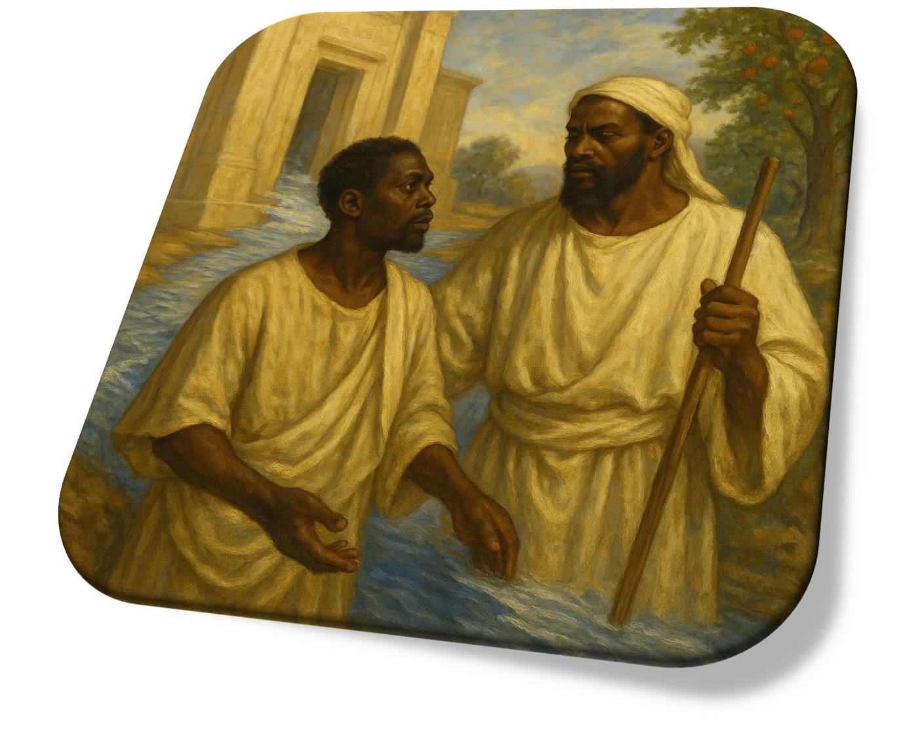
EZEKIEL’S VISION
QUESTION & ANSWER
A Deepening Stream
1 What would coming to the temple mean for Ezekiel?
2 From where is all this water coming?
3 Why might Ezekiel point out that “no one could cross” the river?
For one thing, it meant coming to the place of God’s presence. In Old Testament times, God would manifest His presence in particular places that link heaven and earth. In the original temple, the Lord’s presence resides within the most Holy Place , atop the cover of the ark of the covenant. It apparently has a cloud-like glow (Lev. 16:2). Witnessing God’s presence and God’s temple restored would be especially encouraging to those living in exile.
The water is coming from the presence of God in the sanctuary of the temple (see 47:12). God’s presence shall never depart again. And these are sanctified waters! The river’s destination is the Dead Sea, east of Jerusalem.
This question evokes our curiosity and might prompt good discussion. Ezekiel is reporting what he sees, but he does not explain each and every detail. Perhaps it is an indication that humans cannot comprehend the grandeur of God’s holy presence. We do not grasp or control what God’s life-giving power is doing.
17
Notes:
1 What would coming to the temple mean for Ezekiel?
For one thing, it meant coming to the place of God’s presence. In Old Testament times, God would manifest His presence in particular places that link heaven and earth. In the original temple, the Lord’s presence resides within the most Holy Place , atop the cover of the ark of the covenant. It apparently has a cloud-like glow (Lev. 16:2). Witnessing God’s presence and God’s temple restored would be especially encouraging to those living in exile.
2 From where is all this water coming?
The water is coming from the presence of God in the sanctuary of the temple (see 47:12). God’s presence shall never depart again. And these are sanctified waters! The river’s destination is the Dead Sea, east of Jerusalem.
3 Why might Ezekiel point out that “no one could cross” the river?
This question evokes our curiosity and might prompt good discussion. Ezekiel is reporting what he sees, but he does not explain each and every detail. Perhaps it is an indication that humans cannot comprehend the grandeur of God’s holy presence. We do not grasp or control what God’s life-giving power is doing.

Slide 18
EZEKIEL’S VISION
QUESTION & ANSWER
A Healing River
1 What are the effects of the river’s water?
2 What might this reveal about God’s attitude toward the earth’s environment?
3 What does a captive people, like Ezekiel’s generation, need from a deepening, healing river?
The waters bring life to what was formerly dead. This is the healing, enlivening, saving work of God in beautiful imagery: saltwater turning fresh, flora and fauna springing forth. We might point to times when we have seen water come to a dry place, with similar effects, perhaps turning a brown countryside green.
God loves everything He has created. The earth and the garden of Eden are created as a place for fellowship between Creator and His creatures, especially those made in His image. Creation has been warped, weakened, abused, and sickened by sin and death. But the Creator will restore all things to their proper order. Our own attitude should look to honor God’s creation, to preserve and conserve as best we can.
The message would bring comfort. Ezekiel gives a vision of something better and more glorious than the historical topography of the land of promise. God can bring a future where sin and death are reversed, when what has gone so wrong can be made right again.
18
Notes:
1 What are the effects of the river’s water?
The waters bring life to what was formerly dead. This is the healing, enlivening, saving work of God in beautiful imagery: saltwater turning fresh, flora and fauna springing forth. We might point to times when we have seen water come to a dry place, with similar effects, perhaps turning a brown countryside green.
2 What might this reveal about God’s attitude toward the earth’s environment?
God loves everything He has created. The earth and the garden of Eden are created as a place for fellowship between Creator and His creatures, especially those made in His image. Creation has been warped, weakened, abused, and sickened by sin and death. But the Creator will restore all things to their proper order. Our own attitude should look to honor God’s creation, to preserve and conserve as best we can.
3 What does a captive people, like Ezekiel’s generation, need from a deepening, healing river?
The message would bring comfort. Ezekiel gives a vision of something better and more glorious than the historical topography of the land of promise. God can bring a future where sin and death are reversed, when what has gone so wrong can be made right again.

Slide 19
  End
    The Lord bless thee, and keep thee:
    The Lord make his face shine upon thee, and be gracious unto thee:
    The Lord lift up his countenance upon thee and give thee peace.
    - Numbers 6:24-26,
Material adapted by Stanford W. Bowman Jr. from Echoes® Adult and Bible-in-Life® Adult Fall 2025 quarter with permission, © David C Cook, https://davidccook.org. May not be further reproduced. All rights reserved.

