Slide 1

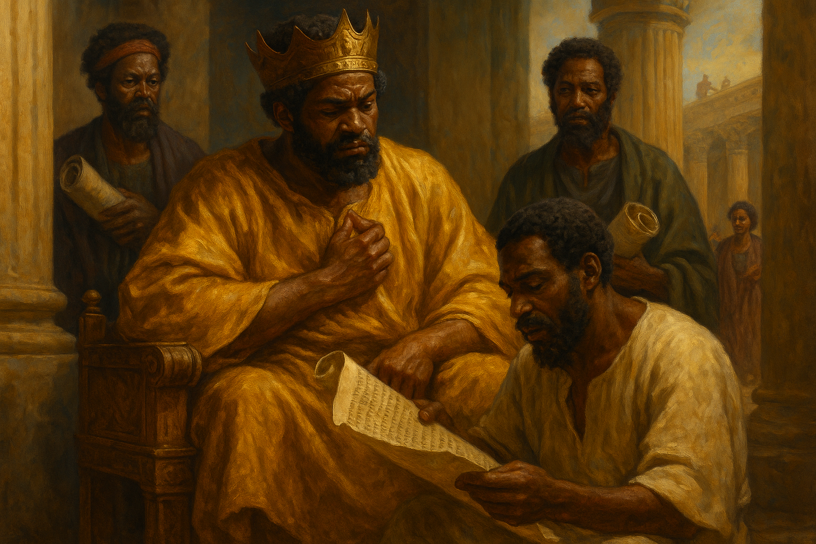
Hilkiahs Discovery
So there was great joy in Jerusalem: for since the time of Solomon the son of David king of Israel there was not the like in Jerusalem.
—2 Chronicles 30:26 KJV
Week of September 21

Slide 2
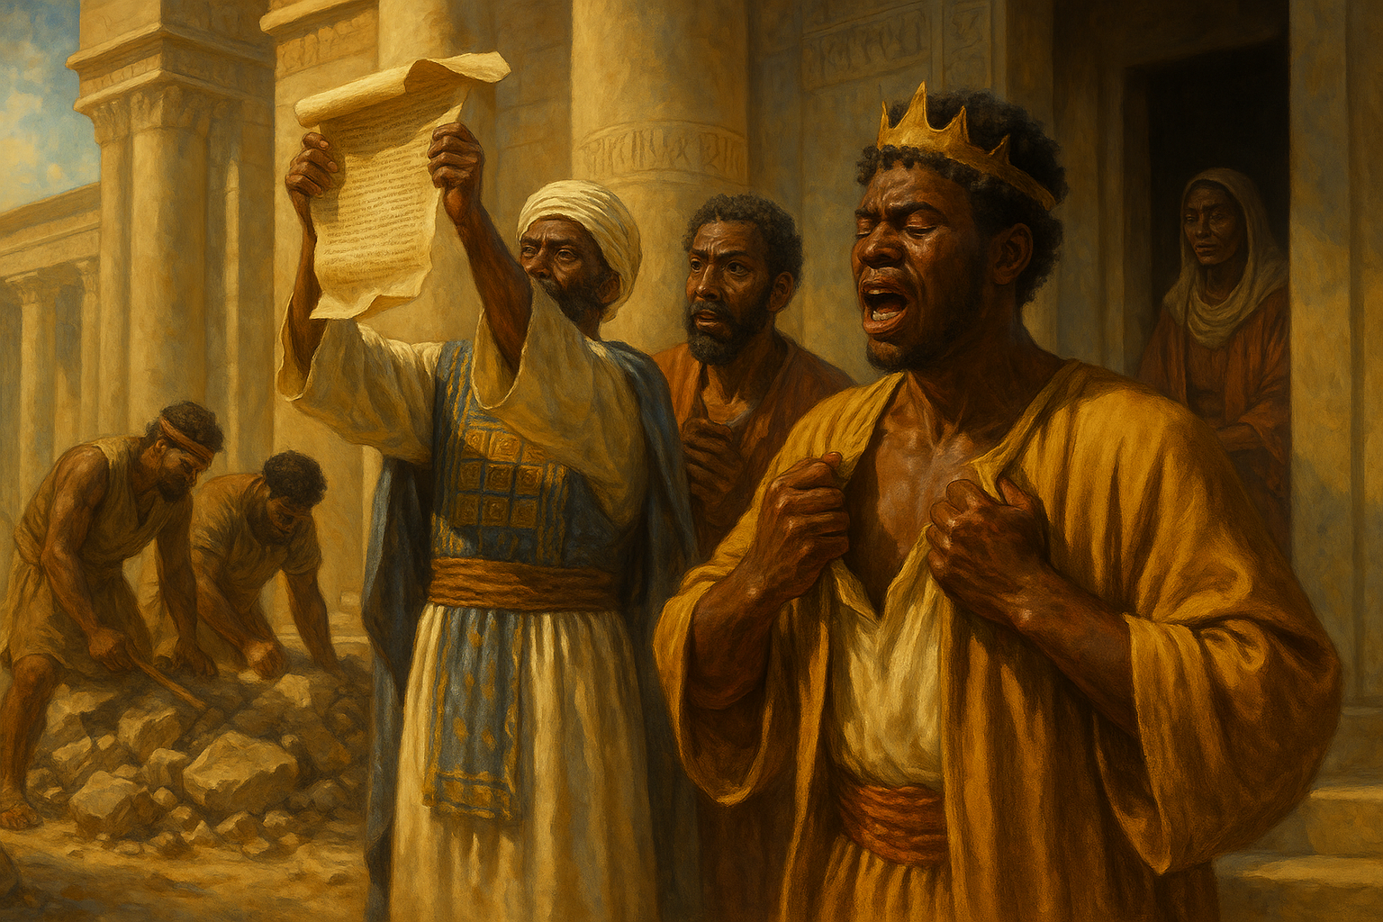
Prayer
Lord God, we seek You night and day as we listen to Your voice and meditate on Your Word. Give us soft hearts so we might obey Your Word and submit to Your guidance for our lives. In Jesus’ name we pray. Amen.
Thought to Remember
Be a Josiah, not a Jehoiakim.
Notes:
Prayer
Lord God, we seek You night and day as we listen to Your voice and meditate on Your Word. Give us soft hearts so we might obey Your Word and submit to Your guidance for our lives. In Jesus’ name we pray. Amen.
Thought to Remember
Be a Josiah, not a Jehoiakim.

Slide 3
Agenda
3
So there was great joy in Jerusalem: for since the time of Solomon the son of David king of Israel there was not the like in Jerusalem.
—2 Chronicles 30:26 KJV
Review
Introduction
Lesson Context
Overview
God’s Word Discovered. - 2 Chronicles 34:15–18 KJV
Josiah’s Repentance - 2 Chronicles 34:19–22, 26–27 KJV
Conclusion
Question & Answers
Hilkiahs Discovery
Notes:
God’s Word Discovered. - 2 Chronicles 34:15–18 KJV
Josiah’s Repentance - 2 Chronicles 34:19–22, 26–27 KJV
><><><><><><><><><><><><><><><><><><>><><><
Lesson Context
Josiah’s reign as king is from 640 to 609 BC; the latter half overlaps with Jeremiah’s ministry. By this point the northern tribes of Israel are gone, and the Neo-Assyrian empire is weakened and soon to fall to Babylon.
Summary — In 2 Chronicles 34:15–27 the temple restoration yields a long-hidden “Book of the Law.” Shaphan reads it to King Josiah; the king rends his garments, mourns Judah’s covenant failure, and sends officials to consult the prophet Huldah. Huldah declares impending judgment because of persistent idolatry, but promises mercy to Josiah personally because of his humble, contrite heart.
Analysis — Text and context The “book” most likely contains Deuteronomy (laws, covenant curses, public-reading commands). Its disappearance signals institutional neglect; its discovery functions as a catalyst for national reform and a reminder that Scripture read publicly can reorient a people’s identity and policy.
Analysis — Josiah’s response Tearing garments is authentic royal repentance: visible grief, humility, and corporate identification with national sin. Josiah’s immediate action—seeking God through trusted officials—models pastoral leadership that submits first to Scripture, not to political convenience.
Analysis — Huldah’s prophecy Huldah’s message balances justice and mercy: the covenant’s curses remain justly due because of prolonged disobedience, yet God hears genuine repentance and grants mitigation for the faithful king. This highlights corporate responsibility alongside individual accountability.
Theological commentary God’s Word functions as both law and mirror: it reveals covenant obligations and convicts the heart. The passage teaches that Scripture’s discovery (or rediscovery) does not erase consequences, but a tender, humbled heart moves God to hear and to show temporal mercy.
Practical application Prioritize Scripture’s public and private reading, submit leaders to its authority, and cultivate a posture of humility when conviction comes. Let this episode encourage regular engagement with God’s Word so it shapes decisions, reforms institutions, and prompts swift repentance when we stray.

Slide 4
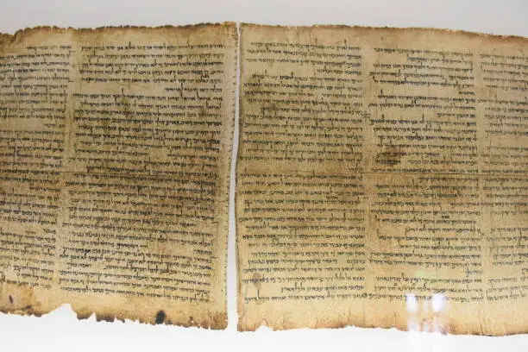
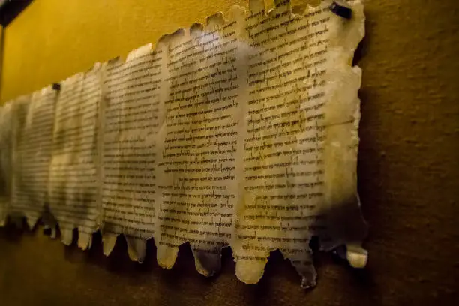
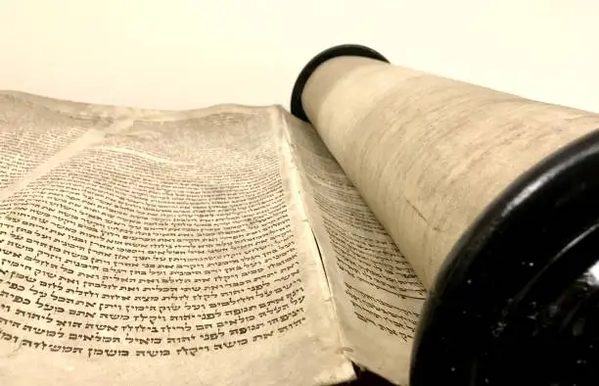
The Dead Sea Scrolls
Hilkiahs Discovery
The world of archeology was turned upside down in 1947 after shepherds made a startling discovery in a cave near the Dead Sea: seven ancient scrolls encased in jars. Over the next 10 years, hundreds more scrolls were found in the surrounding area, most dating from the third century BC to the first century AD. The collection, called the Dead Sea Scrolls, became one of the most significant archeological finds of the twentieth century.
These scrolls shed significant light on life during the time between the testaments, the practices and beliefs of the people who lived in that region, and the reliability of the Old Testament texts. These scrolls had been “lost” for centuries, waiting to be discovered. Since their unearthing, our knowledge of the time period that Jesus walked on earth has significantly expanded.
Today’s lesson details an account of a significant archeological discovery made in the temple complex in the seventh century BC. The response of Judah’s king to this finding would have significant ramifications for him and the kingdom.
Notes:
Main idea
The Dead Sea Scrolls are a large collection of Second-Temple Jewish manuscripts discovered between 1947–1956 near the Dead Sea; they provide the oldest extant Hebrew copies of many biblical books, reshaping our understanding of Jewish life, scriptural transmission, and the religious landscape around the time of Jesus.
The Dead Sea Scrolls
Encyclopedia Britannica
Brief analysis
The scrolls—written mainly in Hebrew with some Aramaic and Greek—include biblical books, sectarian rules, liturgy, and apocrypha, dating roughly from the 3rd century BCE through the 1st century CE; they came from caves near Qumran and related Judaean Desert sites.
Their discovery overturned assumptions about textual instability: comparison of Dead Sea biblical manuscripts with later Masoretic texts shows remarkable fidelity across a millennium, strengthening confidence in the transmission of Old Testament writings.
Encyclopedia Britannica
Technological advances (high-resolution imaging, digital libraries) now make thousands of fragments accessible for study and preservation, accelerating transcription, dating, and multi-disciplinary research.
The Dead Sea Scrolls
Three key points
Origin & scope — Over 900 texts and many fragments were recovered from multiple caves near Qumran between 1947 and the mid-1950s; they reflect diverse genres and communities.
Live Science
Textual impact — The scrolls include some of the oldest manuscripts of biblical books, pushing Hebrew manuscript evidence back by more than a thousand years and demonstrating substantial textual continuity.
Encyclopedia Britannica
Cultural insight — Beyond biblical texts, the corpus reveals sectarian theology, calendar systems, liturgical practice, and messianic expectations that illuminate Jewish belief varieties in the Second Temple period.
Wikipedia
Three life lessons learned
Rediscovery matters — Lost or neglected documents can reorient faith and scholarship; like Josiah’s rediscovered “book of the law,” the scrolls call readers back to Scripture and sober reflection. (See 2 Chr. 34 for the earlier biblical parallel.)
Preserve and share — Investing in preservation and open access (digital imaging and libraries) multiplies the scrolls’ value for theology, history, and public education.
The Dead Sea Scrolls
Humble certainty — The scrolls invite humility: they confirm careful transmission of Scripture while reminding us that manuscripts also reflect diverse practices and theological tensions requiring thoughtful interpretation.
Encyclopedia Britannica
Significant details from the provided URLs
Israel Museum (Shrine of the Book) highlights the original discovery, the early caves, and how key scrolls came into modern museums; it frames the find as a turning point for archaeological and textual studies.
imj.org.il
The Leon Levy Dead Sea Scrolls Digital Library (deadseascrolls.org.il) uses advanced imaging to preserve and publish thousands of fragments, enabling global scholarly access and ongoing re-assessment of readings and datings.
The Dead Sea Scrolls
Summary
The Dead Sea Scrolls are a transformational archaeological and textual corpus from the Second Temple era, discovered in Judaean Desert caves and now digitally preserved for worldwide study. They supply the oldest Hebrew witnesses to many biblical books, reveal the rich religious life of the period, and bolster confidence in the Old Testament’s textual transmission while also showing the diversity of Jewish belief before and around the time of Christ.

Slide 5
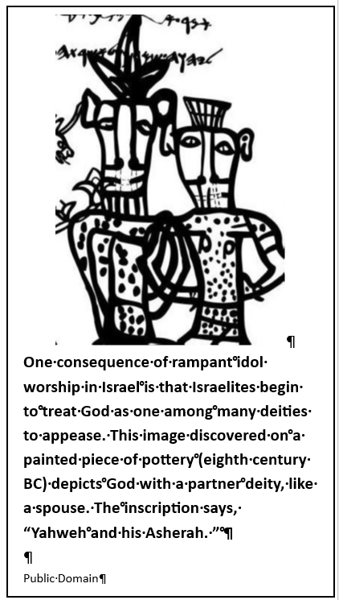
Key Points
Hilkiahs Discovery
ZEPHANIAH’S INFLUENCE ON JOSIAH
The book of Zephaniah gives warnings to the people of Judah who are breaking God’s covenant. Zephaniah prophesies during the reign of Josiah, so Josiah may be undertaking reforms because of these warnings. The people believe that God won’t do anything to them—good or bad—so they have no need to worry (Zeph. 1:12). Zephaniah tells the people, “Seek righteousness, seek humility; perhaps you will be sheltered on the day of the Lord’s anger” (Zeph. 2:3). This is exactly what Josiah does, and the Lord honors this, allowing Josiah to die in an era of relative peace.
Notes:
ZEPHANIAH’S INFLUENCE ON JOSIAH
Main idea
Zephaniah’s prophetic warnings—calling Judah to humility and righteousness—provide a theological and moral backdrop that helps explain Josiah’s zeal for reform; the prophet’s message and the king’s response fit together: God warns, the people repent, and mercy follows.
Analysis
Zephaniah preaches during Josiah’s reign, urging people to “seek righteousness, seek humility” (Zephaniah 2:3) because the nation has grown complacent (1:12). His voice confronts the false security of a people who assume God will do nothing to discipline them. Josiah’s reforms—private seeking, public purges, temple restoration—answer the very summons Zephaniah gives. The text implies prophetic warning and royal obedience can intersect to produce national blessing and relative peace.
Three key points
Zephaniah confronts complacency with urgent calls to repentance (e.g., Zeph. 1:12; 2:3).
The prophet’s ethic—seek righteousness and humility—becomes the posture of Josiah and fuels reform.
Prophetic proclamation can prepare a people’s heart so leaders can implement lasting change.
Three life lessons learned
Don’t assume spiritual immunity—God disciplines a complacent people.
Humility and the intentional seeking of righteousness are practical responses to prophetic conviction.
When prophets and leaders align around Scripture, corporate renewal becomes possible.
Summary
Zephaniah’s message warns Judah of God’s coming judgment but offers a way of shelter: humility and righteous seeking. Josiah’s reforms read as a practical answer to that summons. The prophet’s call and the king’s obedience together show how God often uses prophetic admonition to awaken leaders and catalyze national repentance.
==============================================
A SCROLL IN THE FOUNDATION
Main idea
Finding the “Book of the Law” in the temple’s foundation signals how central the law once was to Israel’s covenant life—and how far leadership had drifted when that same book lay hidden and neglected.
Analysis
Ancient builders often deposited foundation documents as dedication tokens; a copy of the law in the temple foundation would have testified to the covenantal center of worship in Solomon’s day. That a copy was recovered while repairing the temple reveals institutional neglect: the law had once been foundational literally and spiritually, but later kings allowed it to be lost to common view. The physical recovery becomes a symbolic reclaiming of covenant priority.
Three key points
Foundation deposits were ancient markers of dedication—finding the law there is a sign of original priority.
The book’s concealment shows institutional and spiritual decline under later kings.
The discovery during repairs turned physical restoration into spiritual renewal.
Three life lessons learned
Guard what is foundational—records and Scripture must be preserved and honored.
Physical restoration (buildings, institutions) often prompts spiritual reorientation.
Recoveries from the past can call a community back to the priorities its founders intended.
Summary
The law found in the temple foundation is both archaeological practice and theological symbol: it proves the law’s original centrality and exposes later neglect. Recovering that scroll forced Judah to recover its covenant identity and helped launch Josiah’s reforms.

Slide 6
Key Points
Hilkiahs Discovery
A SCROLL IN THE FOUNDATION
Discovering a forgotten or lost document during renovation efforts is consistent with ancient Near Eastern temple construction. Archaeologists have discovered that a building’s foundation provided an opportunity to deposit special inscriptions or documents. Perhaps in the days of the temple’s construction under Solomon, this “Book of the Law” was widely known and available. But finding a copy of it in the temple’s foundation shows how central it used to be for the covenant relationship, a relationship that had been neglected by Judah’s leaders.
Notes:
ZEPHANIAH’S INFLUENCE ON JOSIAH
Main idea
Zephaniah’s prophetic warnings—calling Judah to humility and righteousness—provide a theological and moral backdrop that helps explain Josiah’s zeal for reform; the prophet’s message and the king’s response fit together: God warns, the people repent, and mercy follows.
Analysis
Zephaniah preaches during Josiah’s reign, urging people to “seek righteousness, seek humility” (Zephaniah 2:3) because the nation has grown complacent (1:12). His voice confronts the false security of a people who assume God will do nothing to discipline them. Josiah’s reforms—private seeking, public purges, temple restoration—answer the very summons Zephaniah gives. The text implies prophetic warning and royal obedience can intersect to produce national blessing and relative peace.
Three key points
Zephaniah confronts complacency with urgent calls to repentance (e.g., Zeph. 1:12; 2:3).
The prophet’s ethic—seek righteousness and humility—becomes the posture of Josiah and fuels reform.
Prophetic proclamation can prepare a people’s heart so leaders can implement lasting change.
Three life lessons learned
Don’t assume spiritual immunity—God disciplines a complacent people.
Humility and the intentional seeking of righteousness are practical responses to prophetic conviction.
When prophets and leaders align around Scripture, corporate renewal becomes possible.
Summary
Zephaniah’s message warns Judah of God’s coming judgment but offers a way of shelter: humility and righteous seeking. Josiah’s reforms read as a practical answer to that summons. The prophet’s call and the king’s obedience together show how God often uses prophetic admonition to awaken leaders and catalyze national repentance.
==============================================
A SCROLL IN THE FOUNDATION
Main idea
Finding the “Book of the Law” in the temple’s foundation signals how central the law once was to Israel’s covenant life—and how far leadership had drifted when that same book lay hidden and neglected.
Analysis
Ancient builders often deposited foundation documents as dedication tokens; a copy of the law in the temple foundation would have testified to the covenantal center of worship in Solomon’s day. That a copy was recovered while repairing the temple reveals institutional neglect: the law had once been foundational literally and spiritually, but later kings allowed it to be lost to common view. The physical recovery becomes a symbolic reclaiming of covenant priority.
Three key points
Foundation deposits were ancient markers of dedication—finding the law there is a sign of original priority.
The book’s concealment shows institutional and spiritual decline under later kings.
The discovery during repairs turned physical restoration into spiritual renewal.
Three life lessons learned
Guard what is foundational—records and Scripture must be preserved and honored.
Physical restoration (buildings, institutions) often prompts spiritual reorientation.
Recoveries from the past can call a community back to the priorities its founders intended.
Summary
The law found in the temple foundation is both archaeological practice and theological symbol: it proves the law’s original centrality and exposes later neglect. Recovering that scroll forced Judah to recover its covenant identity and helped launch Josiah’s reforms.

Slide 7
Key Points
Hilkiahs Discovery
A PROPHETESS
Josiah’s staff seek out Huldah, who is a prophet and the wife of Shallum. Nothing else is known of Huldah, but she is noteworthy among a patriarchal culture, for she is sought out as someone who hears directly from the Lord. A few other female prophets are named in Scripture: Miriam, sister of Moses (Ex. 15:20); Deborah, who leads Israel during the time of the judges (Judg. 4:4); and Noadiah, a prophet who hinders Nehemiah (Neh. 6:14). The prophet Joel tells of a day when God’s Spirit will fall on men and women, who shall prophesy (Joel 2:28). Peter recognizes this prophecy as fulfilled at Pentecost (Acts 2:17–18).
THE CURSE OF EXILE
From Huldah, Josiah learns that curses written in the book of the law will come to pass (2 Chron. 34:24). This refers to the covenant blessings and curses from Deuteronomy 28. There, Moses reminds the people that they will be cursed if they disobey, blessed if they obey. The words include the following: “The Lord will drive you . . . to a nation unknown to you or your ancestors. . . . You will become a thing of horror, a byword and an object of ridicule among all the peoples” (Deut. 28:36–37). These curses mean the loss of their homes, the loss of the temple, and dishonor before other nations.
Notes:
A PROPHETESS
Main idea
Huldah’s role as a prophetess (sought by Josiah’s officials) shows God’s sovereign choice of spokespersons—male or female—and highlights the place of prophetic confirmation alongside Scripture in discerning God’s will.
Analysis
Huldah, wife of Shallum, is consulted to interpret the newly discovered book; her verdict carries authority. In a patriarchal society her prominence is notable but not unprecedented (Miriam, Deborah). The prophetic gift in Scripture sometimes appears in women; Joel’s promise of prophetic outpouring on both sexes (Joel 2:28) and Peter’s application at Pentecost (Acts 2:17–18) confirm that God speaks through women. Huldah’s message blends judgment and mercy and functions as divine confirmation to the king’s course.
Three key points
Huldah is a legitimate, authoritative prophet whose word confirms the Scripture’s implications.
Female prophets appear in Scripture and are part of God’s normal pattern of calling.
Prophetic confirmation can complement Scripture’s convicting power when action is needed.
Three life lessons learned
Don’t dismiss God’s messengers because of their gender; God equips whom He wills.
Seek wise, Spirit-led counsel when Scripture convicts—confirmation aids wise action.
God’s communication may come through unexpected persons; be attentive and humble.
Summary
Huldah’s decisive role demonstrates that God calls both men and women to speak His word. Her message validates the law’s demand and gives Josiah the prophetic confirmation he needs to press forward with reform, combining Scripture’s authority and prophetic guidance.
============================================
THE CURSE OF EXILE
Main idea
Huldah warns that the covenant curses of Deuteronomy 28—exile, loss, and disgrace—are just and will be realized because of Judah’s prolonged disobedience; the revelation explains both the severity of coming judgment and the stakes of covenant unfaithfulness.
Analysis
The “curses” Huldah cites draw explicitly on Deuteronomy’s covenant framework: blessings for obedience, curses for disobedience (Deut. 28). These include loss of land, temple desecration, and exile—catastrophic outcomes that would mark Judah’s future. Huldah’s word is unvarnished: God’s standards have consequences. Yet the narrative also shows nuance—because of Josiah’s humility God delays or mitigates certain personal penalties for the king even while the nation bears corporate judgment.
Three key points
The covenant in Deuteronomy frames Israel’s fate—obedience brings blessing; disobedience brings curses.
Huldah affirms that the covenant’s curses (including exile) remain effective and real.
Judgment is corporate and consequential, but God’s response to personal repentance can spare individuals.
Three life lessons learned
Covenantal promises are serious: sin carries consequences that are neither arbitrary nor avoidable by convenience.
Repentance cannot always reverse all consequences, but it can alter God’s relational response toward the repentant.
Spiritual reform must be earnest and comprehensive; partial or cosmetic changes do not avert covenant penalties.
Summary
Huldah’s declaration connects the discovered law to Deuteronomy’s curses: because of long disobedience Judah faces exile and dishonor. The warning underscores the gravity of covenant breach while also illustrating that genuine humility (as shown by Josiah) can draw God’s mercy even amid deserved judgment.

Slide 8
Context
This lesson continues exploring the kings and prophets of the kingdom of Judah. As such, the context of lesson 2 also applies to this lesson.
Hilkiahs Discovery
Following the reign of Hezekiah in Judah (715–685 BC), the Jerusalem temple fell into disrepair and neglect. Much of this occurred during the reign of Judah’s longest-reigning king, Manasseh (696–642 BC). His reign was marked by sin and evil. He reestablished idolatrous practices (2 Kings 21:3), shed innocent blood (21:16; 24:4), and “did that which was evil in the sight of the Lord” (21:2). His sinful acts culminated in his desecration of the Jerusalem temple (21:7), the same temple that Hezekiah had purified (see lesson 2). Scripture lists Manasseh’s sinful actions as a reason Judah faced disaster, destruction, and exile (21:10–15).
Manasseh was succeeded as king by his son, Amon. He was also an evil king: he worshiped idols and “humbled not himself before the Lord” (2 Chronicles 33:22–23). Two years into his reign, he was assassinated. His eight-year-old son, Josiah, replaced him on the throne of Judah (34:1).
Josiah’s reign (640–609 BC) differed from those of his father and grandfather. At age 16, he began to “seek after” God (2 Chronicles 34:3a). Four years later, he made efforts to cleanse both Judah and Jerusalem of idolatry (34:3b–7). Then, at age 26, in the eighteenth year of his reign, he took steps to repair the temple in Jerusalem (34:8). This act was significant because previous kings had allowed the temple complex to fall into ruin (34:11). In the years preceding the project, little faithful worship had occurred in the temple, except during a brief season (33:14–17). The temple’s restoration was the climactic reform of Josiah’s reign. Yet, it yielded an unexpected finding, as today’s lesson will show.
The parallel account of 2 Chronicles 34:15–22, 26–27 (today’s lesson) can be found in 2 Kings 22:8–14, 18–19.
Notes:
Main idea
After years of temple neglect under Manasseh and Amon, young King Josiah leads a decisive return to covenant faithfulness: he seeks God, removes idolatry, restores the temple, and sets the stage for a rediscovery of Scripture that will fuel national reform (2 Chronicles 34; see parallel in 2 Kings 22).
Analysis
This passage sits at a turning point in Judah’s story. Manasseh’s long, idolatrous reign left the temple and nation spiritually ruined; Amon continued that path and was assassinated. Josiah, enthroned as a child, matures into a godly reformer. His spiritual growth is staged: seeking God at 16, cleansing the land at 20, and undertaking major temple repairs at 26 (the 18th year of his reign). The temple project is more than construction; it recovers sacred space and yields an unexpected textual discovery—the “book of the law”—which will convict the nation and catalyze revival. This episode underscores how leadership, Scripture, and worship-places interact in covenant renewal.
Three key points
1. Roots of ruin: Manasseh’s idolatry and temple desecration produced moral and institutional decay that made revival necessary (see 2 Kings 21; 2 Chr. 33).
2. Stages of reform: Josiah’s reform is gradual and spiritual—personal seeking, public cleansing, and institutional restoration—showing that true reform often builds in phases.
3. Scripture as catalyst: Repairing the temple led to the rediscovery of God’s law; public access to Scripture became the spark for national repentance and policy change (parallel: 2 Kings 22:8–20).
Three life lessons learned
1. Leadership matters: A single leader’s heart—humble, Scripture-centered—can redirect a nation’s course; spiritual renewal often begins at the top.
2. Restoration requires work: Physical rebuilding (temple repair) and spiritual renewal (removing idols, reading the law) go hand in hand; both are necessary for lasting change.
3. Never underestimate rediscovery: When Scripture is recovered or given fresh authority, it exposes sin, convicts the heart, and compels repentance—Scripture’s presence reforms institutions and people.
Summary
After Hezekiah’s reforms the temple later fell into neglect under Manasseh and Amon, whose idolatry and violence brought Judah to moral ruin and set the stage for judgment. Josiah, who becomes king as a child, begins a spiritual trajectory—seeking God at 16, purging idolatry at 20, and repairing the temple at 26 (18th year). The restoration yields the critical discovery of the Law, a turning point that will confront the people with covenant obligations and enable sweeping reform. The passage teaches that God uses seasons of patient leadership, careful restoration, and faithful attention to Scripture to revive a backslidden people.

Slide 9

God’s Word Discovered. - 2 Chronicles 34:15–18 KJV
9
Hilkiahs Discovery
15 And Hilkiah answered and said to Shaphan the scribe, I have found the book of the law in the house of the Lord. And Hilkiah delivered the book to Shaphan.
16 And Shaphan carried the book to the king, and brought the king word back again, saying, All that was committed to thy servants, they do it.
17 And they have gathered together the money that was found in the house of the Lord, and have delivered it into the hand of the overseers, and to the hand of the workmen.
18 Then Shaphan the scribe told the king, saying, Hilkiah the priest hath given me a book. And Shaphan read it before the king.
Josiah becomes king because his father is assassinated, but he seeks to follow God by eliminating idolatry and renovating the temple.
During renovation, workers discover a scroll called “the Book of the Law,” and no one appears to know what it is.
Josiah receives a report and hears this document read for the first time.
Notes:
.
><><><><><><><><><><><><><
Generations after Hezekiah, a new king is on a righteous campaign to restore Judah’s worship of the one, true God. Josiah does what is right in God’s eyes (2 Chron. 34:2–3). Josiah becomes king at only eight years old, and when he is sixteen, he begins to seek God. At twenty, he begins ridding Judah of the influence of foreign gods. This is all the more impressive because Josiah’s grandfather, Manasseh, did extraordinary evil in the sight of God, to the point that God says that Judah shall be delivered into exile (2 Kings 21:10–15). King Amon, Josiah’s father, continued this heinous evil and refused to humble himself before the Lord. Then, Josiah becomes king at a young age because Amon’s officials conspire to assassinate him. On the heels of these terrible tragedies, Josiah heeds the messages of the prophets and turns his heart toward the Lord God of Israel.
Josiah has the idols, alters, and Asherah poles taken down and the bones of false priests burned (2 Chron. 34:4–7). He seeks to repair God’s temple in Jerusalem, which has been neglected and filled with false worship once more. With money collected from Judah and the remnant of Israel, workers are paid to repair and restore the temple (2 Chron. 34:9–11).
It is during this restoration that Hilkiah the priest finds a scroll, the “Book of the Law,” neglected somewhere in the temple. It is possible that the book had been stored near the walls or foundation of the temple, which is how it had become lost. Most historians agree that the “book” here contains part or all of Deuteronomy, since Josiah’s later reforms match what is written in Deuteronomy (which is Moses’ final sermon to God’s people entering Canaan).
Shaphan, the temple secretary, takes the scroll to King Josiah and reports that work is proceeding as expected (v. 16). The money for the temple is being used for its restoration (v. 17). Apparently in the mind of Shaphan, the discovery of a scroll is trivial, almost an afterthought. He reports about it last and calls it simply “a book” (v. 18). Until Shaphan reads the text before the king, no one recognizes the significance of this discovery.
Main idea
God raises a young, godly king—Josiah—whose patient, staged devotion (seeking God, purging idolatry, repairing the temple) turns outward neglect into spiritual renewal; the physical restoration uncovers a lost copy of God’s law that becomes the spark for nationwide reform.
Analysis
Generations of neglect under Manasseh and Amon left the temple and nation spiritually ruined. Josiah’s faith matures in stages: he begins seeking God at 16, removes idols at 20, and in his 18th year (about age 26) finances and oversees temple repairs. The found scroll—likely a Deuteronomic text—was literally hidden in the fabric of the building, symbolizing how far the covenant had been set aside. Shaphan’s casual report shows how numb officials had become; only when the law is read aloud before the king does its authority penetrate the court and conscience.
Three key points
1. Staged growth matters: Josiah’s reforms are progressive—personal seeking, communal cleansing, then institutional repair—showing real revival builds over time.
2. Scripture’s centrality: The rediscovered “book of the law” (likely Deuteronomy) supplies the content and authority for the reforms Josiah implements.
3. Physical and spiritual restoration are linked: repairing the temple led directly to spiritual awakening; fixing structures can expose buried truth.
Three life lessons learned
1. Don’t despise small discoveries—what seems trivial (a scroll) can become God’s instrument for sweeping change.
2. Leaders must model spiritual formation—personal devotion precedes public reform; the heart of a leader sets the tone for a people.
3. Rebuilding requires both money and moral courage—funds restore walls, but Scripture restores worship and direction.
Summary
Josiah becomes king as a child in a nation scarred by his grandfather Manasseh’s idolatry and his father Amon’s wickedness. As he matures, Josiah seeks God, removes idols, and launches a temple restoration funded by the people of Judah and remnants of Israel. During repairs Hilkiah discovers a neglected “book of the law” hidden in the temple—probably Deuteronomy. Shaphan reports it casually, but when the text is read to Josiah its power becomes evident. The discovery ties together personal piety, public reform, and institutional recovery: Scripture, once rediscovered and honored, becomes the decisive catalyst for national repentance and renewal.

Slide 10
Josiah’s Repentance - 2 Chronicles 34:19–22, 26–27 KJV
10
Hilkiahs Discovery
19 And it came to pass, when the king had heard the words of the law, that he rent his clothes.
20 And the king commanded Hilkiah, and Ahikam the son of Shaphan, and Abdon the son of Micah, and Shaphan the scribe, and Asaiah a servant of the king’s, saying,
21 Go, inquire of the Lord for me, and for them that are left in Israel and in Judah, concerning the words of the book that is found: for great is the wrath of the Lord that is poured out upon us, because our fathers have not kept the word of the Lord, to do after all that is written in this book.
22 And Hilkiah, and they that the king had appointed, went to Huldah the prophetess, the wife of Shallum the son of Tikvath, the son of Hasrah, keeper of the wardrobe; (now she dwelt in Jerusalem in the college:) and they spake to her to that effect.
26 And as for the king of Judah, who sent you to inquire of the Lord, so shall ye say unto him, Thus saith the Lord God of Israel concerning the words which thou hast heard;
27 Because thine heart was tender, and thou didst humble thyself before God, when thou heardest his words against this place, and against the inhabitants thereof, and humbledst thyself before me, and didst rend thy clothes, and weep before me; I have even heard thee also, saith the Lord.
Josiah responds with regret and grief; he learns that his people have fallen short of God’s ways.
The stipulations of this “Book of the Law” are probably drawn from Deuteronomy, which concludes with a series of curses that will come to those who have not kept the covenant.
Josiah inquires of God what to do; he sends word to a female prophet named Huldah.
God notes the sincere repentance of Josiah, and God does not send Judah into exile during Josiah’s lifetime.
Notes:
><><><><><><><><><><><><><
Josiah hears the message of this scroll for the first time and responds with repentance. Tearing of robes signifies grief: he is cut to the core by the recognition that he and the people of Judah have not kept their side of the covenant.
The book of Deuteronomy lays out God’s requirements for Israel, stipulations that a nation devoted to God must observe. They are to worship Him alone, reminding each generation that God is unlike any other (Deut. 6:4–9). They shall care for the foreigner, the widow, and the orphan (Deut. 10:18–19). They shall behave with justice in all their dealings, remembering that God was their merciful rescuer (Deut. 16:18–20). Imagine hearing some of these ideas from Moses’ sermon for the first time!
The same document outlines blessings and curses, a way of success and a path to abject failure. Moses says, “I set before you today life and prosperity, death and destruction” (Deut. 30:15). But Josiah hears these words as a king whose nation has failed at nearly every turn. He attributes the division of the people and the destruction of the northern kingdom of Israel to this failure: “Great is the Lord’s anger that is poured out on us because those who have gone before us have not kept the word of the Lord” (2 Chron. 34:21).
Josiah sends his staff to inquire with a prophet, to see what God has to say about their disobedience. They go to Huldah, a woman living in Jerusalem (2 Chron. 34:21). What they hear in response is extraordinary (v. 27). God is indeed angry with Judah, among other things, for the sins of Josiah’s father and grandfather. But because Josiah humbles himself before God’s Word and repents with sincere grief at Judah’s sin, God listens. God doesn’t remove the consequences or paper over the breach in the covenant relationship, but the Lord hears Josiah’s appeal, and that is enough.
Main idea
When Josiah hears the words of the rediscovered Law (likely Deuteronomy) he is cut to the heart, publicly repents, and seeks God’s guidance; his humility moves God to hear him—even though covenantal consequences predicted in the Law remain real. (See 2 Chron. 34:15–27; Deut. 30:15.)
Analysis
The tearing of robes is a vivid, culturally intelligible sign: the king expresses public grief, identification with national guilt, and submissive mourning before God. The Law Josiah hears is not abstract theology but a covenant handbook: it calls Israel to exclusive worship (Deut. 6), to justice and care for the vulnerable (Deut. 10, 16), and it sets before the people blessings for obedience and curses for disobedience (Deut. 28; cf. Deut. 30:15). Josiah’s immediate reaction—sending envoys to consult a prophet (Huldah)—models a measured, godly response: read Scripture, feel its weight, seek divine wisdom, and act in humble obedience. Huldah’s reply makes the hard truth plain: corporate judgment fits the covenant breach, yet God hears a contrite leader and grants personal mercy. The passage dramatizes how Scripture functions as law, mirror, and catalyst—revealing sin, provoking repentance, and shaping national destiny without magically removing consequences.
Three key points
1. Scripture convicts and exposes — Hearing God’s law publicly can pierce conscience and reveal institutional failure (2 Chron. 34:19–21).
2. Repentance is public and costly — Josiah’s tearing of his garments shows that genuine repentance is visible, costly, and identified with the people.
3. Mercy and justice coexist — The covenant promises both judgment for corporate disobedience and mercy for humble, repentant hearts (Huldah’s message; cf. Deut. 28–30).
Three life lessons learned
1. Don’t treat Scripture casually. A casual “book” can carry divine authority; reading God’s Word before the community demands a reverent, responsive posture.
2. Leadership begins with humility. Leaders who confess and identify with their people’s sin position the community to receive restoration and mercy.
3. Repentance alters relationship, not always outcomes. Genuine repentance reopens the door to God’s compassion, but it does not automatically erase the natural or covenantal consequences of long-term disobedience.
Summary
Josiah’s discovery and listening moment show Scripture’s power to pierce the conscience and redirect a nation. The Law he hears lays out God’s expectations—exclusive worship, justice for the vulnerable, and the stark choice between life and death (Deut. 30:15). Josiah responds with visible grief (tearing his robes), seeks prophetic counsel through Huldah, and learns a sobering truth: the covenant curses are deserved because of prolonged sin, yet God hears the contrite king and shows personal mercy. The episode teaches that Scripture functions as an unforgiving mirror and a merciful guide; it convicts, summons repentance, and shapes both judgment and restoration.

Slide 11
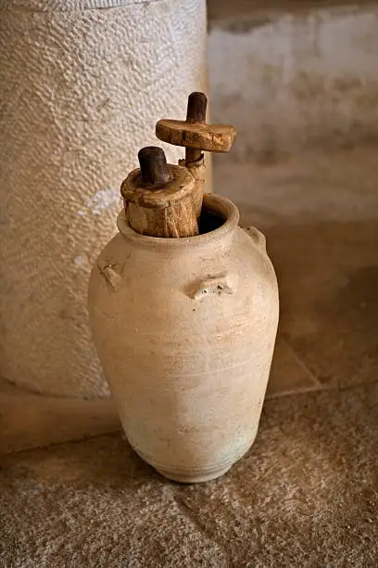
Apply the Message:
Scripture should not be overlooked or ignored.
11
This devotion contemplates the authority and utility of Scripture. While Scripture is more than an “instruction manual,” it is the first place that God’s people should go to find wisdom and guidance when facing difficult decisions.
Hilkiahs Discovery
GIVING ORDER TO CHAOS
When my daughter was young, she loved the idea of playing with LEGO bricks. For her birthday, she asked for an elaborate set, complete with a house, pets, and minifigures whose skin tone and curly hair looked just like hers. But when it came to actual assembly, her exuberance turned to frustration. She would ignore the instructions and get right to work, haphazardly stacking bricks in hopes the house would look exactly like it did on the box.
Her younger brother took a different approach. After digging through the box for the instruction manual, he laid it open to the first page. Step by step, brick by brick, he followed the manual with precision. Before long, the pile of bricks became a charming cottage.
When Hilkiah discovered the scroll and brought it to the king, the people of Judah had been living without this Scripture to guide them. Their lives looked more like my daughter’s disorganized pile of bricks, rather than the darling house the designers intended. But under Josiah’s leadership, they opened Scripture and let it guide their reformation.
Sometimes I can be more like my daughter— and the people of Judah—than I’d like to admit. I look first to the world around me—whether social media posts, viral videos, or even good books—when deciding how to assemble the pieces of my life. But as difficulties come and stresses mount, the structure collapses; and I don’t look or sound like Jesus.
What if I took the better approach? What if I started looking to Scripture first when making decisions? What if I allowed God’s Word to direct the pieces of my life: my schedule, attitudes, and words? I think the result would be what the designer had in mind.
Notes:
Main idea
Scripture is the essential guide that brings order to life’s chaos; when we consult God’s Word first—rather than cultural noise or our own impulse—we build a steady, well-designed life like a completed LEGO house rather than a messy pile of bricks.
Analysis
The author uses a simple home anecdote (LEGO assembly) to show two approaches: impulse versus following instructions. Hilkiah’s discovery of the scroll is the biblical analogue—the law returns and provides the pattern Judah had abandoned. The piece argues that Scripture is more than an instruction manual, yet it functions exactly like one when we face choices: it orders priorities, corrects misguided builds, and shows how to care for others. The temptation to rely on social media or pop wisdom leads to collapse; conversely, intentional Scripture-first living yields the shape God designed.
Three key points
1. Scripture-first practice: Make the Bible the primary resource for wisdom and decision-making, not a last resort.
2. Formative process: Regular use of Scripture disciplines habits, schedules, attitudes, and speech so life resembles the designer’s plan.
3. Restoration by guidance: Returning to God’s Word brings structure and spiritual repair—what renovation (like Hilkiah’s) began for Judah can begin in us.
Three life lessons learned
1. Don’t improvise important builds: Impulsive choices often produce fragile results; follow God’s revealed pattern instead.
2. Habits matter: Small, consistent acts—reading, pausing, applying—are how Scripture reshapes daily life.
3. Replace noise with the norm: When cultural currents conflict with Scripture, choose the Word as your first framing lens.
Summary / Practical application
The devotion urges Christians to stop treating Scripture as optional background noise and to make it the first place they consult. Using the LEGO story, the writer contrasts chaotic, self-directed attempts with careful obedience to the designer’s plan. Hilkiah’s finding of the scroll shows how recovering the Word restored Judah; the same recovery can reorder our schedules, words, and priorities. Practically: (1) pause before big decisions and read a relevant passage, (2) create a daily Scripture habit (even while doing chores), and (3) let the Bible test what you see on social media. Doing these will turn scattered pieces into a faithful, sturdy life that reflects God’s design.
Discussion Questions and Answers
1 Where do you go for ideas and wisdom when making decisions? Has any source ever led you in the wrong direction?
If we are honest, when it comes to making difficult decisions, many of us probably are like the writer of this devotion, who cites the power of social media and cultural influencers. But many Christians have had the experience of trying to make sense of difficult things, only to realize that God is the only one with adequate instructions and wisdom. As the author and source of all that is good, God can be trusted not to lead us down the wrong direction, and the careful study of Scripture orients us to God’s perspective.
2 When have you seen God’s mercy come into a difficult situation, perhaps a circumstance where forgiveness seemed impossible?
Many responses to this question will raise difficult issues: divorce, hurtful words, disregard for another. This lesson does not give a prescription for solving every harm, but it does amaze us by the patience of God. Even when generations of kings had done everything possible to ruin a relationship with God, He does not close the book.

Slide 12
Apply the Message:
Scripture should not be overlooked or ignored.
12
This devotion contemplates the authority and utility of Scripture. While Scripture is more than an “instruction manual,” it is the first place that God’s people should go to find wisdom and guidance when facing difficult decisions.
Hilkiahs Discovery
GIVING ORDER TO CHAOS
1 Where do you go for ideas and wisdom when making decisions? Has any source ever led you in the wrong direction?
2 When have you seen God’s mercy come into a difficult situation, perhaps a circumstance where forgiveness seemed impossible?
Notes:
Discussion Questions and Answers
1 Where do you go for ideas and wisdom when making decisions? Has any source ever led you in the wrong direction?
If we are honest, when it comes to making difficult decisions, many of us probably are like the writer of this devotion, who cites the power of social media and cultural influencers. But many Christians have had the experience of trying to make sense of difficult things, only to realize that God is the only one with adequate instructions and wisdom. As the author and source of all that is good, God can be trusted not to lead us down the wrong direction, and the careful study of Scripture orients us to God’s perspective.
2 When have you seen God’s mercy come into a difficult situation, perhaps a circumstance where forgiveness seemed impossible?
Many responses to this question will raise difficult issues: divorce, hurtful words, disregard for another. This lesson does not give a prescription for solving every harm, but it does amaze us by the patience of God. Even when generations of kings had done everything possible to ruin a relationship with God, He does not close the book.

Slide 13
Live It Out: Commit to regular reading of Scripture and look for surprises.
13
Hilkiahs Discovery
A PRACTICE OF SCRIPTURAL STUDY
As you may already know, a plan of Scriptural study is printed at the bottom of this page of each lesson. These readings are designed to prepare your heart to receive from God. And like the people of Josiah’s day, you might find that you “discover” a message that was long forgotten or a truth of Scripture that you had previously neglected. God speaks to us through the study of Scripture!
Notes:
Seven Practical Lessons from Our Discussion — with Action Steps
1. MAKE SCRIPTURE YOUR FIRST STOP
When decisions press in, read God’s Word first rather than scrolling social media. Scripture orders life like an instruction manual and reveals God’s priorities (2 Chr. 34; Deut.). Action: Before big choices this week, read one short passage (e.g., Deut. 6 or 30) and write one sentence about how it should shape your decision.
2. PRACTICE REGULAR, AUDIBLE SCRIPTURE READING
Hearing Scripture aloud (as Josiah did) breaks numbness and lets the Word penetrate the heart. Listening daily helps you notice themes you miss in silent reading. Action: Start a 20–30 minute daily habit of listening to an audio Bible or reading aloud one chapter with a prayer to apply it.
3. RESPOND TO CONVICTION WITH HUMILITY AND VISIBLE REPENTANCE
Josiah tore his garments — an outward sign of inward regret. True change begins when leaders and ordinary believers confess and act. Action: When Scripture convicts you, name one specific change, confess it to God (and someone you trust), and set a 7-day accountability check.
4. RECOVER AND PRESERVE WHAT’S FOUNDATIONAL
What was once central (the law in the temple) had been neglected. Protect church practices, family devotions, and key documents that shape faith. Action: Inventory spiritual practices in your household or church; restore one neglected pattern (family devotions, public Scripture reading, prayer meeting).
5. SEEK WISE, SPIRIT-LED COUNSEL
Josiah consulted Huldah. Scripture plus godly counsel protects against impulsive or misinformed action. Action: Before implementing major changes, ask two mature Christians to pray and give feedback on your plan.
6. BUILD PATIENCE INTO SPIRITUAL FORMATION
God often prepares leaders by waiting — long seasons grow character (Abraham, Moses, Joseph, David). Do not despise delays; use them for growth. Action: Make a 3-month plan to develop one spiritual habit (study, fasting, mentoring), and note weekly progress in a simple journal.
7. CENTER HOPE ON CHRIST, NOT MERELY REFORM
Human reform (even Josiah’s) cannot erase all consequences—Christ alone fulfills the covenant and bears the curse for believers (John 1:14; Gal. 3:13). Our obedience follows, not secures, our standing in Him. Action: Each morning this week, read a short gospel passage (John 1 or Romans 5) and write one way Christ’s work frees you to obey without fear.

Slide 14
Conclusion
14
CLOSING PRAYER
Hilkiahs Discovery
Father,
We thank You for giving us Your Word and all of the wisdom that it contains. We confess that we have found ways to neglect or ignore Scripture, even today. Bring us back to the awe and wonder that we should feel when we read and make us people who are filled with Your words. We pray in the name of Jesus, the living Word. Amen.

Slide 15
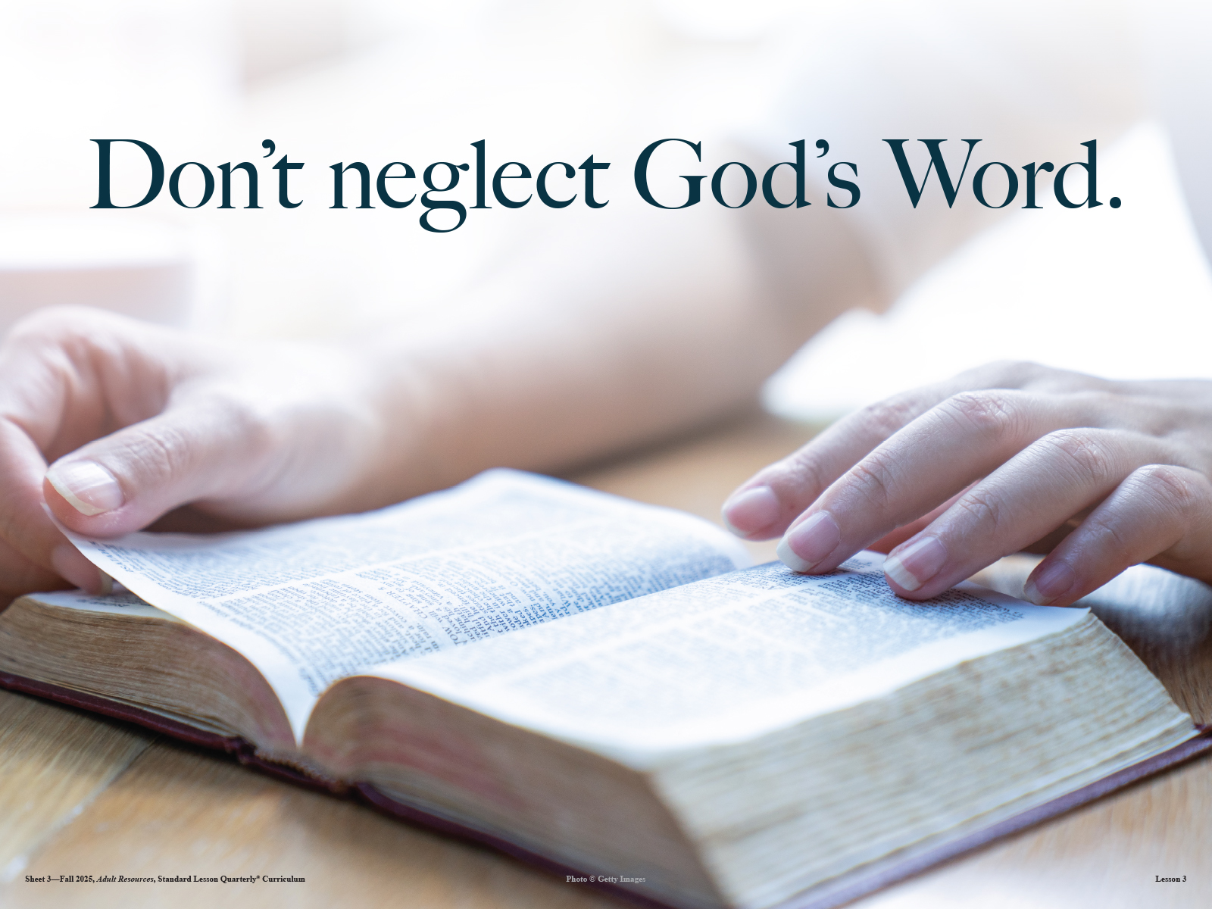



The Lord bless thee, and keep thee:
The Lord make his face shine upon thee, and be gracious unto thee:
The Lord lift up his countenance upon thee and give thee peace.
- Numbers 6:24-26,
Material adapted by Stanford W. Bowman Jr. from Echoes® Adult and Bible-in-Life® Adult Fall 2025 quarter with permission, © David C Cook, https://davidccook.org. May not be further reproduced. All rights reserved.

Slide 16
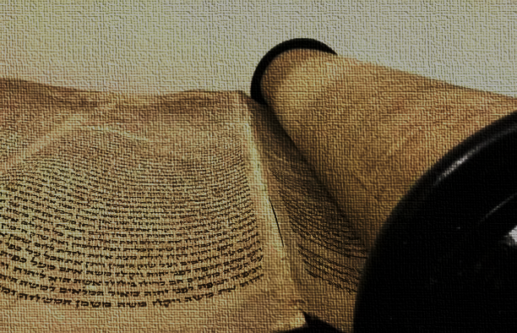
QUESTION & ANSWER
God’s Word Discovered
16
Hilkiahs Discovery
1 Why do you think Josiah serves the Lord, when his father and grandfather had not?
2 What prompts the rediscovery of an important message from God?
3 Do you see any ways that we repeat the pattern of treating God’s Word as trivial?
We don’t know for certain what prompts Josiah to return to the worship of God. It shows that, despite all the idolatry that had come into Israel, there was still some knowledge of the right course of action, as a result of the ministry of God’s prophets. For instance, Zephaniah was active during Josiah’s reign (Zeph. 1:1).
Josiah is already on the path toward reformation. He is already seeking to follow God’s ways by rebuilding the temple in disrepair. In the process of renovating the temple, the priests and secretaries locate a document that has fallen into obscurity. It could have been placed there in the days of Solomon, when the temple was first constructed.
There are many ways that we can treat the Word of God as insignificant. One way is to fail to read and be familiar with Scripture. Or perhaps we treat the Bible as an artifact rather than a living text, as something God said in the past, but words which have no relevance to our lives today.
Notes:
God’s Word Discovered.
1 Why do you think Josiah serves the Lord, when his father and grandfather had not?
We don’t know for certain what prompts Josiah to return to the worship of God. It shows that, despite all the idolatry that had come into Israel, there was still some knowledge of the right course of action, as a result of the ministry of God’s prophets. For instance, Zephaniah was active during Josiah’s reign (Zeph. 1:1).
2 What prompts the rediscovery of an important message from God?
Josiah is already on the path toward reformation. He is already seeking to follow God’s ways by rebuilding the temple in disrepair. In the process of renovating the temple, the priests and secretaries locate a document that has fallen into obscurity. It could have been placed there in the days of Solomon, when the temple was first constructed.
3 Do you see any ways that we repeat the pattern of treating God’s Word as trivial?
There are many ways that we can treat the Word of God as insignificant. One way is to fail to read and be familiar with Scripture. Or perhaps we treat the Bible as an artifact rather than a living text, as something God said in the past, but words which have no relevance to our lives today.

Slide 17
QUESTION & ANSWER
Josiah’s Repentance
17
Hilkiahs Discovery
1 What does Josiah’s response to hearing God’s Word demonstrate?
2 Why was God angry with the people of Judah?
3 What does this statement mean: “I have heard you, declares the Lord” (v. 27)?
Josiah is earnest in his desire to repent for the sins of his ancestors. He repents, not just for having done what was wrong, but for the ignorance that the people have shown to God’s covenant stipulations. If they are to stay in possession of the land and have success in all they do, they must keep the covenant.
The sins of Judah and its kings were heinous because they should have known better. God had given them a message that they should have followed, but they had instead chased after pagan gods and treated the poor of their land with contempt. In 2 Kings 21:16, Manasseh had filled the entire land with “innocent blood” (meaning people who had died or been killed unjustly).
God doesn’t say, “That’s alright. Let’s forget it ever happened. ” God treats the violation of the covenant as serious, and He will still send the nation of Judah into exile. But God listens to the prayer of Josiah, and He restrains this consequence, for a time. Even when Judah is in exile, God will continue to speak to them through prophets and will bring them back one day.
Notes:
1 What does Josiah’s response to hearing God’s Word demonstrate?
Josiah is earnest in his desire to repent for the sins of his ancestors. He repents, not just for having done what was wrong, but for the ignorance that the people have shown to God’s covenant stipulations. If they are to stay in possession of the land and have success in all they do, they must keep the covenant.
2 Why was God angry with the people of Judah?
The sins of Judah and its kings were heinous because they should have known better. God had given them a message that they should have followed, but they had instead chased after pagan gods and treated the poor of their land with contempt. In 2 Kings 21:16, Manasseh had filled the entire land with “innocent blood” (meaning people who had died or been killed unjustly).
3 What does this statement mean: “I have heard you, declares the Lord” (v. 27)?
God doesn’t say, “That’s alright. Let’s forget it ever happened. ” God treats the violation of the covenant as serious, and He will still send the nation of Judah into exile. But God listens to the prayer of Josiah, and He restrains this consequence, for a time. Even when Judah is in exile, God will continue to speak to them through prophets and will bring them back one day.

Slide 18
The Lord bless thee, and keep thee:
The Lord make his face shine upon thee, and be gracious unto thee:
The Lord lift up his countenance upon thee and give thee peace.
- Numbers 6:24-26,
Material adapted by Stanford W. Bowman Jr. from Echoes® Adult and Bible-in-Life® Adult Fall 2025 quarter with permission, © David C Cook, https://davidccook.org. May not be further reproduced. All rights reserved.

