Slide 1
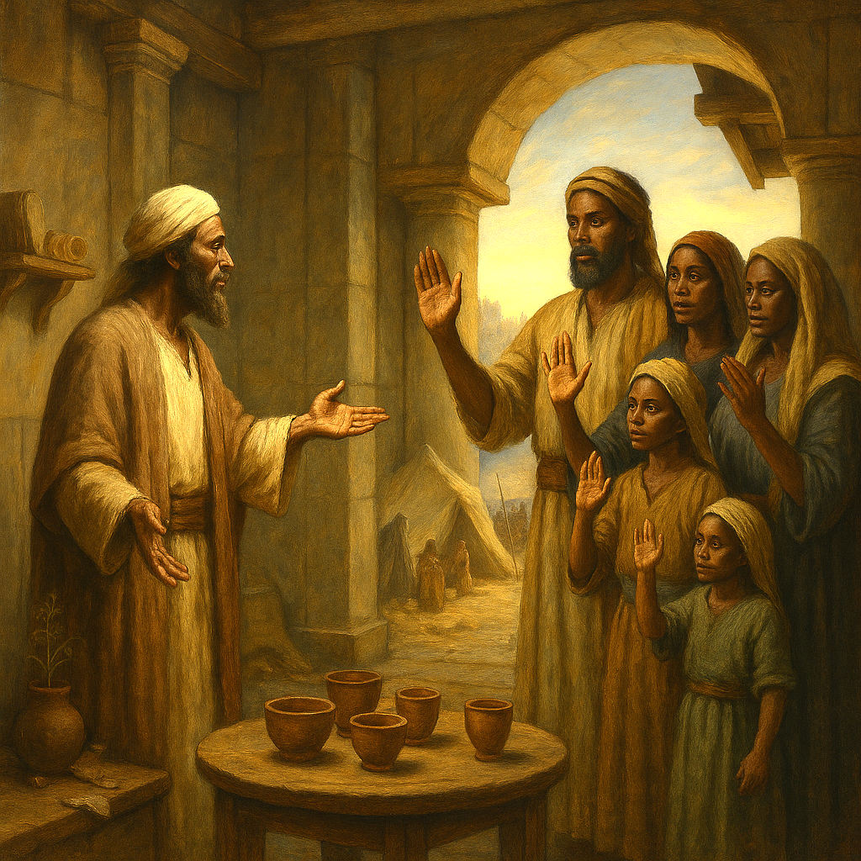
A FAMILY’S EXAMPLE
To this day they do not drink wine, because they obey their forefather’s command.
—Jeremiah 35:14b NIV
Week October 19
Notes:
A FAMILY’S EXAMPLE
October 19
God highlights that Judah ignores His voice, yet the Rechabites honor a human ancestor’s command. The irony rebukes Judah: if human tradition can shape life for generations, how much more should God’s word command obedience.

Slide 2
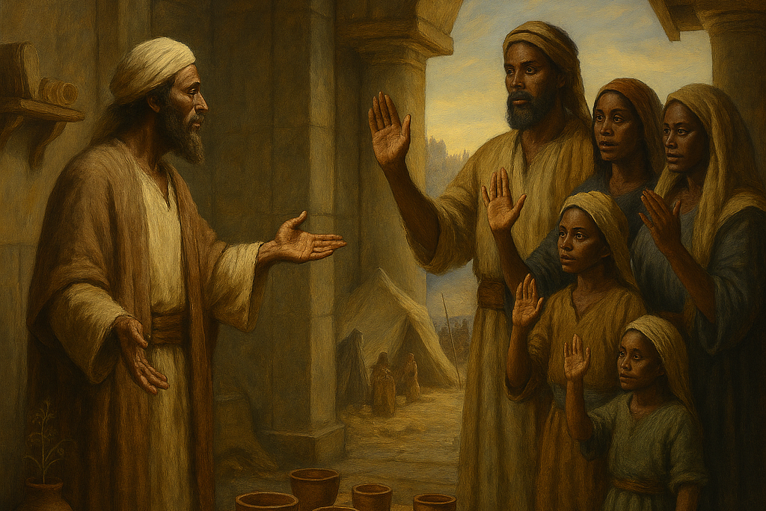
Prayer
Father, grant us the courage to examine our traditions and the wisdom to know which to keep, which to modify, and which to abandon. May our traditions always be a way of serving You as You would have us. Use us to encourage the formation of families and communities who honor You. In Jesus’ name. Amen.
Thought to Remember
Use traditions to foster faithfulness to God
Notes:
Prayer
Father, grant us the courage to examine our traditions and the wisdom to know which to keep, which to modify, and which to abandon. May our traditions always be a way of serving You as You would have us. Use us to encourage the formation of families and communities who honor You. In Jesus’ name. Amen.
Thought to Remember
Use traditions to foster faithfulness to God

Slide 3

LESSON OUTLINE
A FAMILY’S EXAMPLE
Lesson Scripture: Jeremiah 35:5–11
Lesson Focus: Be faithful to God’s ways, even more than human traditions.
Review
Introduction
Lesson Context
Overview
The Rekabite Vows-Jeremiah 35:5–7 NIV
Radical Obedience-Jeremiah 35:8–11 NIV
Bible Application
Conclusion
Question & Answers
Notes:
The Rekabite Vows-Jeremiah 35:5–7 KJV
Radical Obedience-Jeremiah 35:8–11
Summary—Scene Setup (vv.5–6)
Jeremiah sets bowls of wine before the Rechabites and invites them to drink. They refuse, citing the command of their forefather Jonadab son of Rechab: “You shall drink no wine.” The test reveals a community whose identity is grounded in ancestral obedience.
Summary—Lifestyle Command (vv.6–7)
Jonadab’s rule extended beyond abstaining from wine: do not build houses, sow seed, or plant vineyards; live in tents. This nomadic simplicity was meant to guard them from compromise, luxury, and the idolatrous patterns tied to settled, agrarian life.
Summary—Long Obedience (v.8)
The Rechabites testify that they have faithfully kept Jonadab’s charge “unto this day.” Their generational consistency contrasts starkly with Judah’s chronic refusal to heed God’s prophets and covenant.
Summary—Specific Practices (vv.9–10)
They enumerate their compliance: no houses, vineyards, fields, or seed; they dwell in tents and “obey and do” all Jonadab commanded. Their submission is holistic—belief expressed in social structure, economics, and daily habits.
Summary—Exceptional Relocation (v.11)
They only entered Jerusalem because of Babylonian and Aramean threat. Even this move is practical, not a surrender of principle. Their convictions remained intact under pressure.
Commentary—Human Tradition vs. Divine Command
God highlights that Judah ignores His voice, yet the Rechabites honor a human ancestor’s command. The irony rebukes Judah: if human tradition can shape life for generations, how much more should God’s word command obedience.
Commentary—Simplicity as Spiritual Strategy
Jonadab’s rule is not asceticism for its own sake; it’s a hedge against assimilation. Simplicity protected the Rechabites from idolatrous economies and desires. Spiritual disciplines often require structural choices, not merely private intentions.
Commentary—Embodied Obedience
Their faithfulness is visible: housing, agriculture, and diet align with conviction. Scripture commends obedience that reforms routines, budgets, and ambitions—“doers,” not hearers only.
Commentary—Witness Under Pressure
Crisis tested, but did not cancel, their obedience. True piety proves resilient when safety, convenience, or culture press for compromise. The Rechabites model steadfastness amid geopolitical turmoil.
Commentary—Application to Judah (and Us)
God uses the Rechabites as a living sermon to expose Judah’s hard heart. The call is clear: repent, revere God’s word, and build patterns that make obedience likely—household rules, communal accountability, and disciplined simplicity that keeps hearts undivided.

Slide 4
LESSON INTRODUCTION
A FAMILY’S EXAMPLE
Traditions for Stability
In the musical Fiddler on the Roof, viewers are oriented by the first and well-known song, “Tradition. ” The main character, Tevya, acts as a guide throughout the song, telling how traditions help his Jewish community maintain its sense of balance and cohesiveness. After describing one of the traditions he and his fellow Jews follow, Tevya raises a question: “How did this tradition get started? I’ll tell you. I don’t know. ” Then he adds emphatically, “But it’s a tradition. And because of our traditions, every one of us knows who he is and what God expects him to do. ” Later Tevya declares that, without the traditions guiding him and his fellow Jews, “our lives would be as shaky as a fiddler on the roof. ”
That’s an interesting philosophy, and it can be very appealing with regard to family unity. But a given tradition’s ultimate value is validated only insofar as it aligns with God’s Word (Matthew 15:1–7; compare Luke 14:26). Today’s Scripture text from the book of Jeremiah invites us to explore this connection.
Notes:
Main Idea
Traditions can steady families and communities, but their true value is proven only when they submit to—and serve—the authority of God’s Word. When tradition aligns with Scripture (Jer 35), it forms faithful habits; when it competes with Scripture (Matt 15:1–7), it must be corrected so loyalty to Christ remains supreme (Luke 14:26).
Analysis
“Tradition” (à la Tevye) offers identity and cohesion, yet unexamined customs can drift from God’s intent. Jesus rebuked traditions that nullified God’s commands, showing Scripture is the plumb line. Jeremiah 35 commends the Rechabites’ disciplined pattern as a living sermon: their ancestral rule fostered obedience, not idolatry. Thus, the question is not “Do we have traditions?” but “Do our traditions direct us to covenant faithfulness?” Wise believers test customs by Scripture, fruit, and mission: Do they form holiness, love, and witness—or merely preserve comfort?
Three Key Points
Scripture Over Custom: God’s Word—not heritage—has final authority for faith and practice.
Formative Power of Habits: Tradition can embed obedience into daily rhythms, stabilizing life in turbulent times.
Discernment Required: Keep traditions that promote holiness and love; revise or release those that hinder obedience or mission.
Three Life Lessons
Audit Your Traditions: List family/church “we’ve always done it” practices; keep those that clearly align with biblical commands and gospel witness.
Form Holy Rhythms: Establish Scripture-anchored habits (prayer times, Sabbath practices, generosity patterns) that train the heart toward Christ.
Choose Christ First: When custom and Christ conflict, graciously honor people but obey Jesus without compromise.
Summary
Traditions give stability and identity, but they are only as good as their alignment with God’s Word. Jesus warns against customs that override Scripture, while Jeremiah 35 showcases a tradition that safeguards obedience. Believers should examine, refine, and practice traditions that deepen holiness and witness, submitting every cherished pattern to the lordship of Christ.

Slide 5
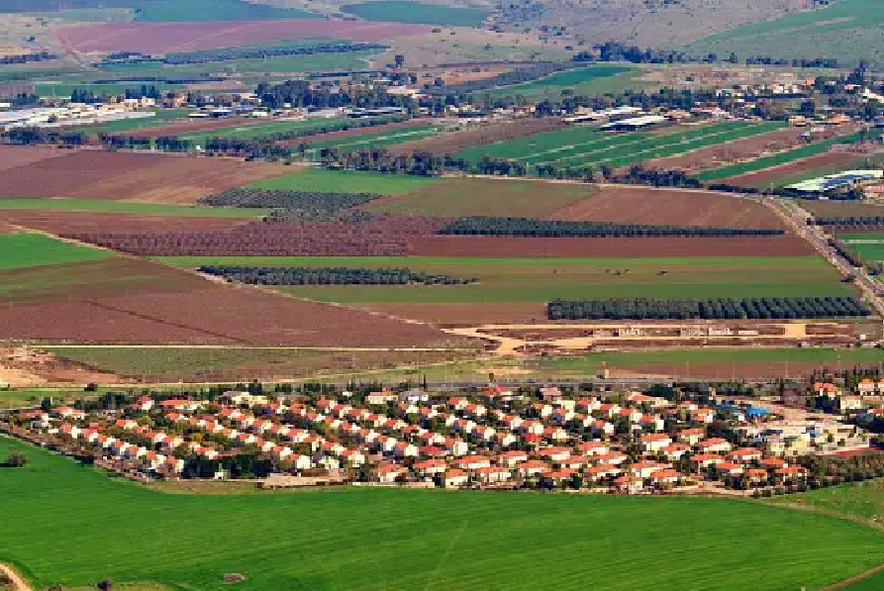
LESSON INTRODUCTION
A FAMILY’S EXAMPLE
Who Are the Rekabites?
The ancestry of the Rekabites dates back to the Kenites, a nomadic tribe that included Moses’ father-in-law, Jethro. According to 1 Chronicles 2:55, a Kenite named Hammath preceded Jehonadab as a “father of the Rekabites. ” Once the Israelites came into the promised land, the Kenites settled “among the inhabitants of the Desert of Judah in the Negev near Arad” (Judg. 1:16), which is near the border of modern-day Jordan.
The Rekabites appear to have retained their nomadic lifestyle. Over the following centuries, they moved throughout the land of inheritance. They were probably in the northern kingdom of Israel at the time they had taken their original vows and may have migrated south toward Judah after the fall of Israel in 722 BC.
Notes:
Who were the Rechabites?
A clan within the Kenites, a non-Israelite, Yahweh-fearing group linked to Jethro (Moses’ father-in-law). See Judg 1:16; 1 Chr 2:55 (“the Kenites…from Hemath/Hamath, the father of the house of Rechab”).
Named for Rechab; their prominent leader was Jehonadab (Jonadab) son of Rechab, who partnered with Jehu in purging Baal worship (2 Kgs 10:15–28).
Where did they live?
Initially alongside Judah in the Negev near Arad (Judg 1:16).
As nomads, they moved throughout Israel’s land. Many likely lived in the north when Jonadab’s rules were first embraced and later shifted south toward Judah after Israel’s fall in 722 BC.
What set them apart?
They kept ancestral commands from Jonadab: no wine, no permanent houses, no fields or vineyards; live in tents (Jer 35:6–10).
This simplicity guarded them from idolatrous patterns tied to settled luxury and preserved a pilgrim identity.
Why do they matter biblically?
In Jeremiah 35, God uses the Rechabites as a living sermon: they obey a human ancestor faithfully, while Judah ignores God’s voice. Their steadfastness under pressure (entering Jerusalem only due to Babylonian/Aramean threat, Jer 35:11) exposes Judah’s disobedience.
God commends them with a promise of enduring lineage (Jer 35:18–19).
Theological takeaways
1. Obedience forms identity: Shared rules shape a people for faithfulness across generations.
2. Simplicity can be protective: Deliberate limits help resist cultural idols.
3. Scripture over custom: Their example is praised because it aligns with God’s purposes; any tradition that contradicts God’s Word must yield (cf. Matt 15:1–9).

Slide 6

LESSON CONTEXT
A FAMILY’S EXAMPLE
Jehonadab
Jehonadab lived in the ninth century BC, during the reign of King Jehu of Israel. Second Kings 10:15–31 tells that Jehonadab meets with Jehu (about 842 BC), and agrees to help Jehu eliminate the house of King Ahab and the Baal worship established by Ahab’s house. Verses 23–28 describe how Jehu and Jehonadab brought all Baal’s servants into the temple of Baal; after making sure “that no one who serves the Lord is here with you—only servants of Baal” (v. 23), Jehu sends his guards and officers in to kill Baal’s servants, then has them destroy the temple of Baal itself.
At their first meeting, Jehu recruits Jehonadab because of their mutual “zeal for the Lord” (v. 16). That same zeal remains evident in Jehonadab’s followers more than two hundred years later. The Rekabites’ reputation precedes them by the time they meet Jeremiah in the temple.
During the temperance movements of the early twentieth century, the Rekabites’ refusal to drink wine was cited as an example for all believers to follow. Then and now, it is important to recognize and honor their faithfulness without missing the bigger point of obedience to God in all things. The Rekabites’ nomadic lifestyle prohibited them from planting vineyards, and avoiding wine was only one part of their vows.
Still, the Bible prohibits drunkenness and has many examples of its harms (Gen. 9:20–25; 19:30–38; Lev. 10:1–2, 8; Gal. 5:21; Eph. 5:18). Yet Jesus’ first miracle was turning water into wine at the wedding at Cana (John 2:1–11). Thus the apostle Paul’s advice probably sums it up best: “whether you eat or drink . . . do it all for the glory of God” (1 Cor. 10:31).
Notes:
Main Idea
Jehonadab’s God-centered zeal birthed a disciplined rule for his clan; their centuries-long obedience (Jer 35) becomes God’s sermon against Judah’s disobedience. Temperance is commendable, but the larger call is comprehensive obedience that glorifies God in all things (1 Cor 10:31).
Analysis
In 2 Kings 10:15–28, Jehu enlists Jehonadab because both burn with “zeal for the LORD.” Together they purge Baal’s cult. Jehonadab then bequeaths a family rule—no wine, no houses, no fields; live as tent-dwelling pilgrims (Jer 35:6–10). Two centuries later, the Rechabites’ fidelity contrasts Judah’s covenant breach. Scripture prohibits drunkenness (Gen 9; Eph 5:18; Gal 5:21) yet recognizes wine’s legitimate use (John 2:1–11; Ps 104:15). Thus Christian liberty is stewarded under love and God’s glory (Rom 14; 1 Cor 10:31). The point is not mere abstinence, but structured obedience that resists idolatry and aligns habits with holiness.
Three Key Points
1. Zeal with Structure: Jehonadab’s zeal matured into rules that formed a faithful community over generations (Jer 35:8–10).
2. Living Parable: God uses the Rechabites to expose Judah—human tradition obeyed; divine command ignored (Jer 35:13–16).
3. Liberty Under Lordship: Scripture forbids drunkenness while permitting wise, situational use of wine; love and God’s glory govern practice (Eph 5:18; John 2; 1 Cor 10:31).
Three Life Lessons
1. Build Guardrails: Establish family/church rhythms that make obedience easier and compromise harder (daily prayer, Sabbath habits, generosity).
2. Form Communities of Conviction: Shared rules—freely embraced—can preserve holiness amid cultural pressure.
3. Practice Charitable Temperance: Whether you abstain or partake, do so to edify others and honor Christ (Rom 14:19–23).
Summary
Jehonadab exemplifies zeal translated into durable discipline. His descendants’ steadfastness functions as God’s rebuke to Judah and a model for us: craft holy habits, value community rules that protect fidelity, and exercise Christian liberty so that “whether…eat, or drink…do all to the glory of God.”

Slide 7
LESSON CONTEXT
A FAMILY’S EXAMPLE
Nebuchadnezzar’s Raids of Judah—
Another immediate effect of Nebuchadnezzar’s initial raids was that, in submitting to Babylon, Jehoiakim had sent “some of the Israelites from the royal family and the nobility” to Babylon—including the prophet Daniel and his friends (Dan. 1:3, 6–7).
At the likely time of this passage (605–604 BC), King Nebuchadnezzar of Babylon had already begun raiding the regions around Judah, including Syria, Lebanon, and Israel, thus driving the Rekabites from the lands they had previously settled. Second Kings 24:1 also informs us that Nebuchadnezzar had begun raiding the outer regions of the southern kingdom of Judah, and eventually besieged Jerusalem itself: “Jehoiakim became his vassal for three years. But then he turned against Nebuchadnezzar and rebelled [in 601 BC]. ” Jehoiakim would join forces with the Egyptians and would eventually be removed by Nebuchadnezzar in 598 BC, carried off to Babylon.
Notes:
Main Idea
Babylon’s first waves (605–604 BC) destabilized Judah and displaced groups like the Rechabites into Jerusalem (Jer 35:11). These raids fulfilled prophetic warnings, exposed Judah’s false securities, and set the stage for successive deportations (Dan 1:1–7; 2 Kgs 24), showing God’s sovereignty in judgment and mercy.
Analysis
After Carchemish (605 BC), Nebuchadnezzar secured the Levant, pressuring Judah. Jehoiakim submitted, then rebelled (c. 601 BC), inviting punitive campaigns. The “first deportation” (traditionally 605/604) carried select nobles—including Daniel—into Babylonian training (Dan 1:3–7). Jehoiakim’s regime collapsed 598/597; Jehoiachin and more captives went to Babylon (2 Kgs 24:10–17). Amid these shocks, the Rechabites sought refuge in Jerusalem (Jer 35:11). Their steadfast obedience contrasts Judah’s covenant breach: geopolitical crisis did not erase their vows. God uses empire as an instrument of discipline, calling His people from presumption to repentant fidelity.
Three Key Points
1. Historical Setting of Jer 35: Early Babylonian raids explain why the Rechabites were in Jerusalem, preserving vows under duress.
2. Judah’s Political Miscalculation: Jehoiakim’s revolt exposed Judah to judgment and escalated deportations (leadership, artisans, youth).
3. God’s Sovereign Discipline: Empires rise as rods in God’s hand; prophecy, not policy, is the ultimate interpreter of events.
Three Life Lessons
1. Faithfulness Under Pressure: Crisis reveals what rules us; anchor habits in God’s Word so convictions endure displacement.
2. Don’t Confuse Expediency with Wisdom: Short-term political maneuvers (Jehoiakim’s pivot) can sow long-term ruin; seek counsel from Scripture.
3. Read Providence Theologically: Headlines confirm God’s warnings; respond with repentance, prayer, and practical obedience.
Summary
Nebuchadnezzar’s early campaigns (605–604 BC) tightened Babylon’s grip, triggered deportations (beginning with Daniel and nobles), and pushed the Rechabites into Jerusalem. Judah’s rebellion magnified judgment, while the Rechabites’ obedience stood as a living rebuke. History in Jeremiah 35 is theology in motion: God disciplines to restore, calling His people to repentant, resilient faith.

Slide 8
LESSON CONTEXT
A FAMILY’S EXAMPLE
Jeremiah 35 takes place during the reign of King Jehoiakim, most likely around 605 BC, before Jeremiah is barred from entering the temple (Jer. 36:5). He has spent several years calling the people to turn back to God, often by unorthodox means: hiding and ruining a new garment (Jer. 13:1–11), smashing a clay jar as an example of God’s destructive power (Jer. 19:10–11), even wearing a yoke (Jer. 27:2; 28:10– 11). Here Jeremiah uses a peculiar example—in fact, a peculiar people—to get his message across.
Today’s lesson is the third in a series of five from the book of Jeremiah. The overall context is the same as those: Jeremiah’s 40-year prophetic ministry was to warn the people of Judah of God’s judgment to come at the hands of the Babylonians. This was to happen because of the Judeans’ sinfulness and rebellion against the Lord.
Our Scripture text for today’s lesson records events that took place “in the days of Jehoiakim the son of Josiah king of Judah,” which is the period 609–598 BC (Jeremiah 35:1). To understand the significance of this time frame, we should view it against the larger backdrop of three chronological pressure points of Babylonian dominance in Palestine. Those three are the years 605, 597, and 586 BC; they are the years the Judeans were carried into exile in successive stages (2 Kings 24:1, 12; 25:1–21). The reference in Jeremiah 35:11 to a family’s relocation to Jerusalem due to Babylonian incursion indicates that the invasion of 605 BC is in view.
Those were indeed turbulent times. In an earthly sense, there were power struggles between the world powers of Assyria and Babylon. Nineveh, the capital of Assyria, fell in 612 BC. Babylon’s victory at the epic Battle of Carchemish in 605 BC (Jeremiah 46:2) meant the passing of one oppressor only to be replaced by a new one. Is it any wonder that Jeremiah felt inadequate for his task (1:6)?
The incident in today’s text occurred at roughly the halfway point in Jeremiah’s 40-year efforts to convince God’s people to repent of their wrongdoing and return to the Lord. These efforts included use of some rather striking visual aids as teaching tools, all commanded by God: a soiled linen “girdle” or sash (Jeremiah 13:1–11), a visit to a potter’s house (18:1–11), and the wearing of a makeshift yoke to symbolize submission to Babylon (27:1–7). Today’s Scripture text records yet another visual aid by which Jeremiah tried to appeal to an increasingly wayward people.
A footnote: Jeremiah 35:3 mentions “Jaazaniah the son of Jeremiah,” but he is a different Jeremiah than the prophet (compare Jeremiah 1:1 with 35:3).
Notes:
Main Idea
Jeremiah 35 uses the Rechabites as a living parable during Jehoiakim’s turbulent reign: in a world shaking under Babylon, steadfast obedience to God’s word—not cultural habit or political maneuver—anchors God’s people.
Analysis
Midway through Jeremiah’s 40-year ministry (c. 605 BC), Judah faced Babylon’s rise after Carchemish. Jeremiah, already known for striking object-lessons (linen sash, smashed jar, yoke), stages another: the Rechabites’ fidelity to their ancestor’s rule. Their integrity under pressure exposes Judah’s refusal to heed the Lord. The setting—successive Babylonian incursions (605, 597, 586 BC)—clarifies why the Rechabites had entered Jerusalem and heightens the moral contrast: crisis did not loosen their convictions, while Judah’s prosperity had already eroded hers. The episode rebukes empty religiosity and calls for embodied repentance.
Three Key Points
Historical Pressure: Babylon’s dominance (605–586 BC) frames Jeremiah’s sign-acts, showing judgment is imminent, not hypothetical.
Living Sermon: The Rechabites’ practiced obedience becomes God’s object-lesson against Judah’s selective hearing.
Prophetic Method: God-authorized visuals translate doctrine into decision, pressing Judah to repent before exile deepens.
Three Life Lessons
1. Form Conviction into Habit: Build rhythms that hold when life trembles—Scripture, prayer, gathered worship, generosity.
2. Test Traditions by Scripture: Keep practices that foster holiness; discard those that nullify God’s commands.
3. Read Crisis Theologically: Political shifts are not ultimate; ask what faithfulness looks like now, and obey promptly.
Summary
Under Jehoiakim, with Babylon advancing, Jeremiah leverages the Rechabites as a concrete contrast: they obey a human ancestor; Judah ignores the living God. Situated between 605 and 586 BC and amid Jeremiah’s other sign-acts, the account insists that true security is covenant obedience. The call remains: convert beliefs into habits that endure pressure, align tradition with Scripture, and meet shaking times with immediate, practical repentance.

Slide 9
LESSON OVERVIEW
A FAMILY’S EXAMPLE
The Rekabite Vows-Jeremiah 35:5–7 NIV
5 Then I set bowls full of wine and some cups before the Rekabites and said to them, “Drink some wine. ”
6 But they replied, “We do not drink wine, because our forefather Jehonadab[a] son of Rekab gave us this command: ‘Neither you nor your descendants must ever drink wine.
7 Also you must never build houses, sow seed or plant vineyards; you must never have any of these things, but must always live in tents. Then you will live a long time in the land where you are nomads. ’
Jeremiah has invited a family called the Rekabites to join him in a room of the temple.
Once there, Jeremiah places bowls of wine before them and invites them to drink.
Instead, the Rekabites explain that this would violate their family’s traditions, which prohibit living in houses, farming crops, and drinking wine.
They have kept these traditions in the hope that they shall remain in the land.
Notes:
><><><><><><><><><><><><><><><
The Rekabite Vows
The setting is the middle of Jeremiah’s prophetic ministry. At least some of the worst outcomes have already begun. But there is yet time to save lives and to make the people understand that turning to God’s mercy is their only hope. The faithless king of Judah, Jehoiakim, has not led the people into sincere repentance. Judah has been forced to submit to the invading powers of Babylon (1 Kings 24:1). Amidst all the coming and going from the city of Jerusalem, God sends Jeremiah to one family: the Rekabites, descendants of their ancestor, Rekab. God has a planned demonstration in mind.
Jeremiah brings the clan into the temple and arranges a test. He sets bowls of wine before the family and tells them to drink (Jer. 35:5). But there is something to know about the Rekabites: unlike most other families of this time, they have certain unique traditions. They do not drink wine, do not farm, and they live in tents (vv. 6–7).
Through his actions, Jeremiah is tempting this group to violate longheld family traditions. Before them is a prophet of God who has invited them to enter the temple and has made an offer of wine (presumably, before observers). But Jeremiah anticipates their response. Jeremiah (more importantly, God) already knows what the Rekabites will do.
The family comes at Jeremiah’s invitation, but they flatly decline to drink any wine set before them. They explain their traditions, perhaps thinking this might be a simple misunderstanding: “Our forefather Jehonadab, son of Rekab gave us this command: ‘Neither you nor your descendants must ever drink wine’” (v. 6). The family members have probably kept this vow for more than two centuries, and they are not about to violate it now.
We may wonder why the Rekabites have this tradition in the first place. Unfortunately, the rest of Scripture is mostly silent about them; Jeremiah 35 is the only chapter that describes their history. More than likely, the reason their ancestor had forbidden the drinking of wine or the cultivation of crops was to free his descendants from being settled in one territory. The Rekabites are probably a clan of permanent nomads, expected to live like nomads, and a love for wine would make that lifestyle impossible.
Jehonadab—the ancestor who came up with these traditions— promised his family that, if they keep these traditions, they will “live a long time in the land where [they] are nomads” (v. 7). This promise closely resembles the wording of Israel’s covenant: “Observe therefore all the commands I [God] am giving you . . . so that you may live long in the land” (Deut. 11:8–9). And here is the crux of Jeremiah’s demonstration. Before the observers, Jeremiah highlights a family who upholds their traditions to ensure a righteous outcome.
Main Idea
God uses the Rechabites’ centuries-long fidelity to their ancestor’s rule as a living sermon: when even human tradition can shape obedient lives, Judah’s refusal to heed the Lord is inexcusable. The path to safety in turbulent times is not political maneuver but embodied obedience.
Analysis
Mid-ministry, amid Babylon’s pressure and Jehoiakim’s faithlessness, Jeremiah stages a temple test (Jer 35:5–7). The Rechabites politely refuse wine, explaining vows from Jehonadab: no wine, no farming, no permanent houses—live as nomads. Their rule likely guarded them from assimilation and idolatry bound to settled luxury. Jehonadab’s promise of “long life in the land” echoes covenant language (cf. Deut 11:8–9). God contrasts this family’s consistent obedience with Judah’s selective hearing. The point is not teetotalism per se, but ordered lives that make faithfulness likely.
Three Key Points
1. Obedience Under Scrutiny: In the temple, before witnesses, the Rechabites keep their vows, proving integrity where it’s hardest—publicly and under prophetic invitation.
2. Tradition as Formation: Their customs are a discipleship structure—limits that protect holiness and identity in a hostile culture.
3. Prophetic Contrast: God holds up their human rule-keeping to expose Judah’s neglect of divine command; fidelity is possible even in crisis.
Three Life Lessons
1. Build Holy Guardrails: Establish family/church rhythms—clear yeses and noes—that channel desire toward God and away from idols.
2. Let Habits Carry Convictions: Don’t rely on intentions alone; craft practices (time, budget, community rules) that embody obedience.
3. Honor God Above Custom: Keep traditions that aid holiness; revise or release any that compete with God’s Word.
Summary
Jeremiah’s wine-test shows a clan whose inherited rule produced resilient obedience. Their steadfastness under Babylonian pressure rebukes Judah’s disobedience and calls God’s people to shape life—habits, limits, and communal expectations—so that faithfulness becomes our default. The Rechabites remind the church that ordered lives, aligned with Scripture, are God’s means to preserve His people in shaking times.

Slide 10
LESSON OVERVIEW
A FAMILY’S EXAMPLE
Radical Obedience-Jeremiah 35:8–11 NIV
8 We have obeyed everything our forefather Jehonadab son of Rekab commanded us. Neither we nor our wives nor our sons and daughters have ever drunk wine
9 or built houses to live in or had vineyards, fields or crops.
10 We have lived in tents and have fully obeyed everything our forefather Jehonadab commanded us.
11 But when Nebuchadnezzar king of Babylon invaded this land, we said, ‘Come, we must go to Jerusalem to escape the Babylonian[a] and Aramean armies. ’ So we have remained in Jerusalem. ”
The Rekabites continue to explain that they have come to the city of Jerusalem to seek refuge from the wars and conflicts in the land.
They have not violated their traditions in any way.
This demonstration of faithfulness stands in stark contrast to the rest of Judah, who has not obeyed the covenant with God.
Notes:
><><><><><><><><><><><><><><><
Radical Obedience
The Rekabites and their leader, Jaazaniah, continue to explain these vows and their refusal to drink wine. After their forefather forbid them to drink wine, build houses, or farm, they “obeyed everything [he] commanded” (v. 8). Because they all followed these commands to live as nomads, they “have lived in tents and have fully obeyed” (v. 10). Their long-standing zeal toward keeping ancestral traditions overcame any temptation to seek the comfort of permanent homes, much less a temptation to drink the wine Jeremiah has set before them.
The only reason the Rekabites have come to Jerusalem is to find safety from invading armies (v. 11). As a result of their nomadic lifestyle, they were able to flee to the city in a time of crisis. Nebuchadnezzar, the king of Babylon, had begun invading the lands of Judah and the eastern Mediterranean. Because of these wars to the north, the Rekabites arrived as refugees to Judah and found safety in the city of Jerusalem (v. 11). Even now, they are not in violation of their vows and traditions. Even now they are still living in tents.
Following the printed text, God tells Jeremiah to speak to the gathered people. Jeremiah recaps the test of the Rekabites and their faithful response (vv. 12–16). Then he brings the demonstration to a theological point: the Rekabites have done everything their ancestors had asked, have remained faithful, generation after generation. Conversely, during the same time, the people of Judah have proved utterly faithless to the covenant with God. God has sent many prophets (Jeremiah included) to urge Judah to turn from sin and idolatry. “But,” God concludes, “you have not paid attention or listened to me” (v. 15). Thus, the Rekabites are an illustration of the kind of faithfulness that Judah has struggled to display.
Therefore, because of this faithless behavior, God shall bring about “every disaster [God] pronounced against [Judah and Jerusalem]” (v. 17). God has provided ample opportunity to return to covenant obedience, but the door is quickly shutting.
On the other hand, the faithfulness of the Rekabites has not gone unnoticed before God. This opens a path for God to reward them. The point is not that the traditions of the Rekabites should be adopted by the other residents of Judah. But in recognition for their having kept ancestral traditions, God says, “Jehonadab son of Rekab will never fail to have a descendant to serve me” (v. 19). In the midst of a faithless generation, God finds cause to reward a family who chooses a different path.
Main Idea
The Rechabites’ radical, generational obedience becomes God’s living rebuke of Judah’s covenant infidelity: steadfast habits draw reward; hard-hearted refusal invites judgment.
Analysis
Jeremiah’s temple test reveals a community whose vows (no wine, no houses, no fields; live in tents) shape resilient obedience (Jer 35:6–10). Even as refugees in Jerusalem (v.11), they keep their rule, proving conviction under pressure. God contrasts their fidelity with Judah’s refusal to heed repeated prophetic calls (vv.12–16). Outcome: certain judgment on Judah (v.17) and a gracious promise to Jonadab’s line (vv.18–19). The point isn’t mandating Rechabite customs for all, but showcasing embodied obedience that aligns with God’s will (cf. Deut 11:8–9).
Three Key Points
1. Embodied Fidelity: The Rechabites’ vows organized life around obedience, not convenience (vv.8–10).
2. Prophetic Contrast: Human tradition kept faithfully exposes Judah’s neglect of God’s direct word (vv.12–16).
3. Divine Response: Judah faces announced disaster (v.17), while the Rechabites receive a perpetual-service promise (vv.18–19).
Three Life Lessons
1. Make Convictions Concrete: Turn beliefs into rhythms—rules, budgets, and habits—that hold when crises come.
2. Obey Under Pressure: Faithfulness that survives displacement (v.11) is the fruit of long training, not impulse.
3. Welcome God’s Correction: Heed warnings early; delayed obedience hardens hearts and hastens loss.
Summary
In a collapsing world, the Rechabites’ practiced obedience stands tall. Their steadfastness underlines Judah’s guilt, confirms looming judgment, and secures God’s commendation. The lesson for believers: order life so obedience becomes your default, respond promptly to God’s word, and trust that steadfast fidelity—however countercultural—draws His favor.

Slide 11
CONCLUSION:
A FAMILY’S EXAMPLE
Apply the Message: Traditions are one way that we demonstrate faithfulness.
The Art of Finishing Well
“We have to finish this game!”
When those words came from my son’s mouth, I knew he was right. I had always been a lover of boardgames, but this was the moment I knew he loved them too. We were seated on the carpet of our living room, cards and pieces scattered in every direction. The game had gone on so long that I was willing to pack it away. But one look at his face made me certain I didn’t want to disappoint him.
“You’re right. We finish things, don’t we?” With perfect comedic timing, my wife leaned into the room while holding a laundry basket. She said, “You finish the things you want to finish!”
It became a family joke that turned into a larger conversation. Each of us was able to think of projects and tasks that went unfinished: clothes tossed to the floor, a recycling bin that overflowed, schoolwork marked “Incomplete. ” Thus, a new family motto was born: In this family, we finish things.
In the days of Jeremiah, God was seeking faithfulness, or what we might call the skill of finishing well. But the people of Judah were rebellious and uncommitted. Soon their lack of fortitude would reach its natural conclusion: God would send them into exile.
We can be grateful that God notices and rewards individual faithfulness. More than that, God is devoted to His plans and promises. If faithfulness is the art of finishing well, God is the master. He always brings His plans to fruition. In the person of Jesus, God has been faithful beyond the wildest imagination of human beings. We should be faithful because God is faithful.
Notes:
Main Idea
Finishing well is faithful perseverance rooted in God’s unfailing faithfulness. We complete our call because He “who began a good work…will perform it” (Phil 1:6, KJV).
Analysis
Jeremiah’s Judah quit on covenant obedience; exile was the predictable end of half-finished faith. The Rechabites, by contrast, embodied steady obedience across generations. Scripture frames “finishing” as covenant perseverance: Abraham’s tested trust (Gen 22), Jeremiah’s long obedience, Paul’s “I have finished my course” (2 Tim 4:7), and supremely Christ’s “It is finished” (John 19:30). Our endurance is not grit alone but grace-enabled focus on Jesus, “the author and finisher of our faith” (Heb 12:2). Households and churches can cultivate this by turning convictions into habits that carry us through fatigue, distraction, and opposition.
Three Key Points
1. God finishes what He starts: His faithfulness underwrites our perseverance (Phil 1:6).
2. Habits sustain hope: Ordered rhythms turn good intentions into completed obedience (Jer 35; Heb 12:1).
3. Christ is the pattern and power: We finish in union with the One who already finished redemption (John 19:30).
Three Life Lessons
1. Name and narrow: Identify one God-given assignment in this season; define a clear “done” and next faithful step.
2. Build finishing habits: Daily Word and prayer, weekly worship and rest, planned generosity—simple, repeatable, accountable.
3. Finish together: Invite a trusted believer to ask you monthly, “What has God given you to finish—and how did you obey?”
Summary
Judah stumbled because conviction never became sustained obedience. The Rechabites show how practiced faith endures. Fixing our eyes on Jesus, we convert vows into rhythms and cross finish lines for God’s glory.
A Simple Prayer
Father, You are faithful and true. Fix my eyes on Jesus. Strengthen my hands to complete what You’ve assigned, with clean motives, steady love, and resilient hope. Teach me the art of finishing well, by Your Spirit, for Christ’s name. Amen.

Slide 12
CONCLUSION:
A FAMILY’S EXAMPLE
Apply the Message: Traditions are one way that we demonstrate faithfulness.
The Art of Finishing Well
1 What is an example of something you always want to finish?
2 How can our faithfulness in other areas of life be an example of faithfulness before God?
3 What does it look like to obey God and to finish well?
Notes:
1 What is an example of something you always want to finish?
Almost everyone is devoted to finishing certain types of things. Maybe we are great at finishing our projects, our responsibilities at work, or even our taxes. If we look at what we are good at finishing, it might reveal something about our priorities. For instance, perhaps we are careful not to embarrass ourselves before colleagues at work by leaving work undone.
2 How can our faithfulness in other areas of life be an example of faithfulness before God?
Depending on where we find faithfulness easy or convenient, it can spur us to consider the same attitude toward our spiritual obligations. Perhaps we need to take more care to follow God’s instructions, or perhaps we need to invite the right mentors to help us find a path forward.
3 What does it look like to obey God and to finish well?
There are many examples of individuals who have left a legacy that persists: spiritual leaders who bring people to Christ, great minds who inquire after God, devoted missionaries who spend a lifetime in service, and more. Use this opportunity to praise and to speak well of any pillars of your faith community, those showing you the way.

Slide 13
CONCLUSION
A FAMILY’S EXAMPLE
Live It Out: Be intentional about the good that can come from your traditions.
Reminding the World of God’s Faithfulness
As we have studied the traditions of one ancient family, perhaps you have noticed ways that your own family traditions could point others to God. Since we serve a God who is faithful, we can look for ways to exemplify faithfulness ourselves.
Notes:
Live It Out — Traditions that Point to God
Aim
Use traditions as discipleship tools that spotlight the Father’s faithfulness (Matt 5:16; Deut 6:6–9; Ps 78:4).
Start Here (Audit & Align)
List your traditions: holidays, mealtimes, birthdays, school-year markers, reunions.
Assess with three questions:
1. Does this align with Scripture?
2. Does it form Christlike character?
3. Does it bless others and witness to Christ?
Decide:Keep, redeem, or retire each practice (Matt 15:3; Col 3:17).
Build Gospel-Centered Rhythms
Table liturgy (weekly): One Scripture, one answered prayer, one person to serve (Ps 107:2; Col 3:16).
Ebenezer jar (ongoing): Write God’s provisions on slips; read them at Thanksgiving/New Year (Josh 4:6–7).
Testimony calendar (monthly): Invite someone to share God’s faithfulness at a meal (Ps 71:18).
Service tradition (quarterly): Adopt a widow, teacher, or refugee family (Jas 1:27; Gal 6:10).
Generosity habit (monthly): Set a giving target and celebrate God’s supply (2 Cor 9:7–8).
Tech sabbath (weekly): Screen-light off, Word-light on; pray, sing, walk, and talk (Mark 6:31; Acts 2:42).
Reconciliation ritual (as needed): “I was wrong. Please forgive me.” Pray together (Eph 4:32).
Fast & focus (seasonal): One meal/day for three days; pray for the lost and your church (Matt 6:16–18; Rom 10:1).
Family/Group Templates
Birthday blessing: Speak Num 6:24–26; share one fruit of the Spirit you see in them (Gal 5:22–23).
First-day/first-pay tradition: Read Prov 3:9–10; dedicate the month’s work to the Lord.
Advent/Lent at home: Short readings, candle/stone markers, simple acts of mercy (Luke 1–2; Isa 53).
A 30-Day Starter Plan
Week 1: Audit traditions; choose two to keep and one to retire.
Week 2: Launch weekly table liturgy and tech sabbath.
Week 3: Begin Ebenezer jar; schedule one testimony meal.
Week 4: Serve someone together; set a shared giving goal.
Guardrails
Clarity: Name your “yes” and “no” practices that protect holiness (Jer 35:8–10).
Charity: Don’t bind others with your family’s rules (Rom 14).
Consistency: Keep it simple and repeatable; endurance makes it formative (Heb 10:24–25).
Pray
“Faithful Father, teach us to remember Your works and to order our ways by Your Word. Make our traditions windows to Your glory, shaping grateful, obedient hearts in our home. In Jesus’ name, Amen.”

Slide 14
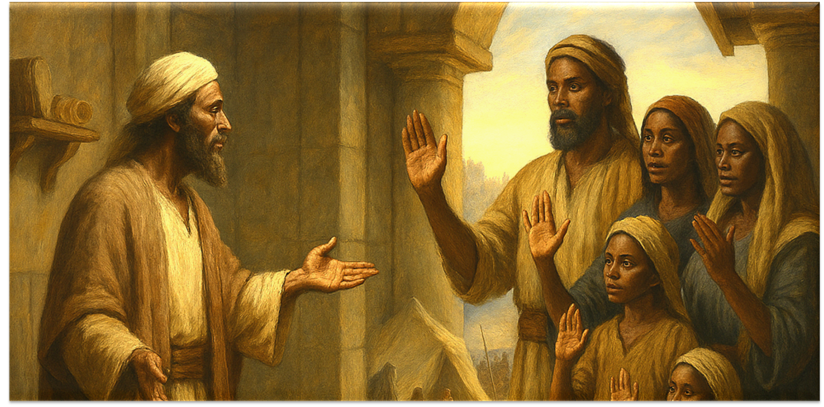


End
The Lord bless thee, and keep thee:
The Lord make his face shine upon thee, and be gracious unto thee:
The Lord lift up his countenance upon thee and give thee peace.
- Numbers 6:24-26,
Material adapted by Stanford W. Bowman Jr. from Echoes® Adult and Bible-in-Life® Adult Fall 2025 quarter with permission, © David C Cook, https://davidccook.org. May not be further reproduced. All rights reserved.

Slide 15
QUESTION & ANSWER
A FAMILY’S EXAMPLE
The Rekabite Vows
1 What does Jeremiah the prophet ask the Rekabites to do? Why?
5. What were the different roles of the soil in this parable?
3 What makes the Rekabites want to keep their traditions?
Jeremiah invites the family to come to the temple, where he sets before them bowls of wine and invites them to drink. This is an elaborate setup and test that will make an important demonstration. Jeremiah anticipates that his offer will be rejected.
The Rekabites come and patiently explain their traditions before Jeremiah and observers. They have been faithful to what their ancestor asked of them, and they will not make this the day that they drink wine. Keeping their traditions has been part of their identity as nomads, for centuries.
The promise of their ancestor was that these traditions would sustain his clan and would make their way of life possible. The Rekabites remember his promise: they shall retain the ability to live on their land if they abide by the traditions. Thus they avoid farming, drinking wine, and living in houses instead of tents.
Notes:
1 What does Jeremiah the prophet ask the Rekabites to do? Why?
Jeremiah invites the family to come to the temple, where he sets before them bowls of wine and invites them to drink. This is an elaborate setup and test that will make an important demonstration. Jeremiah anticipates that his offer will be rejected.
2 How do the Rekabites respond? Why?
The Rekabites come and patiently explain their traditions before Jeremiah and observers. They have been faithful to what their ancestor asked of them, and they will not make this the day that they drink wine. Keeping their traditions has been part of their identity as nomads, for centuries.
3 What makes the Rekabites want to keep their traditions?
The promise of their ancestor was that these traditions would sustain his clan and would make their way of life possible. The Rekabites remember his promise: they shall retain the ability to live on their land if they abide by the traditions. Thus they avoid farming, drinking wine, and living in houses instead of tents.

Slide 16
QUESTION & ANSWER
A FAMILY’S EXAMPLE
Radical Obedience
1 How have the Rekabites demonstrated obedience to their ancestors after relocating to Jerusalem?
2 Why does God want to highlight an example of extravagant faithfulness?
3 How does God reward the Rekabites?
Because they were used to a nomadic lifestyle, the Rekabites were able to flee to Jerusalem. Once there, they continued to live in tents within the walls of the city. They are keeping their traditions during a time of uncertainty and when others would have made a change.
God is not saying that the traditions of this family should be adopted universally. But God is on the hunt for faithfulness, because Judah has proven habitually unfaithful. Through Jeremiah, God demonstrates that people are finding it easier to keep human traditions than to keep the covenant.
God says that there shall always be a descendant of this family in His service. It means that the Rekabites will, at least in part, escape the destruction that is to come. Their family will survive and continue.
Notes:
Because they were used to a nomadic lifestyle, the Rekabites were able to flee to Jerusalem. Once there, they continued to live in tents within the walls of the city. They are keeping their traditions during a time of uncertainty and when others would have made a change.
2 Why does God want to highlight an example of extravagant faithfulness?
God is not saying that the traditions of this family should be adopted universally. But God is on the hunt for faithfulness, because Judah has proven habitually unfaithful. Through Jeremiah, God demonstrates that people are finding it easier to keep human traditions than to keep the covenant.
3 How does God reward the Rekabites?
God says that there shall always be a descendant of this family in His service. It means that the Rekabites will, at least in part, escape the destruction that is to come. Their family will survive and continue.

Slide 17
End
The Lord bless thee, and keep thee:
The Lord make his face shine upon thee, and be gracious unto thee:
The Lord lift up his countenance upon thee and give thee peace.
- Numbers 6:24-26,
Material adapted by Stanford W. Bowman Jr. from Echoes® Adult and Bible-in-Life® Adult Fall 2025 quarter with permission, © David C Cook, https://davidccook.org. May not be further reproduced. All rights reserved.

