Slide 1
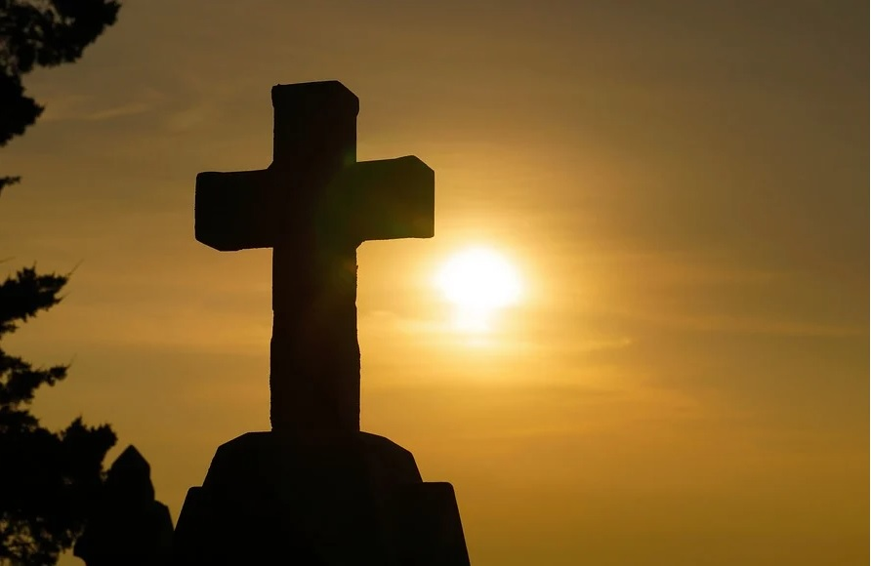
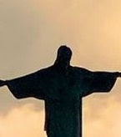
Changes Promised
  I will put my law in their inward parts, and write it in their hearts; and will be their God, And they shall be my people.
    —Jeremiah 31:33b KJV
October 26

Slide 2
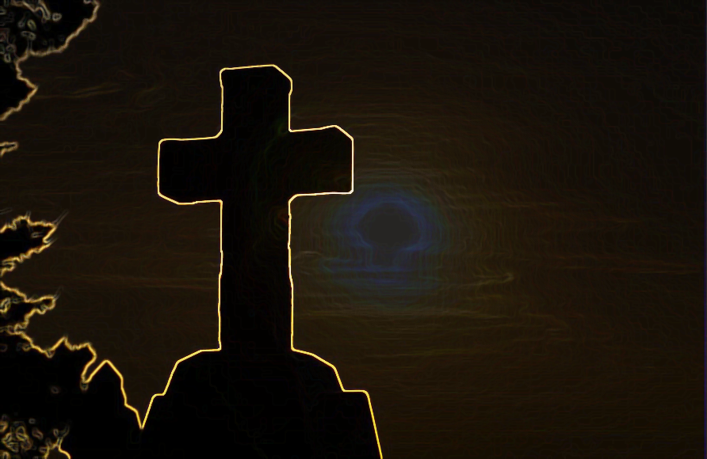
Prayer
Lord, we marvel at the new covenant mediated by Your Son, our Savior, Jesus Christ. We thrive because of Your grace and rejoice over Your truth. We thank You for giving us Your Spirit so we may truly know You. It is in Jesus’ name we pray. Amen.
Thought to Remember
Jesus mediates a new covenant based on grace.
Notes:
Lord, we marvel at the new covenant mediated by Your Son, our Savior, Jesus Christ. We thrive because of Your grace and rejoice over Your truth. We thank You for giving us Your Spirit so we may truly know You. It is in Jesus’ name we pray. Amen.
Thought to Remember
Jesus mediates a new covenant based on grace.

Slide 3
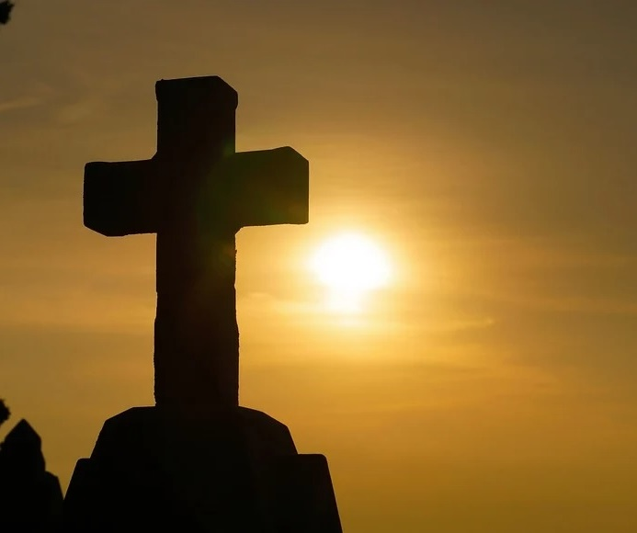
Agenda
Changes Promised
LESSON SCRIPTURE:
Jeremiah 31:29–34; John 1:17
    Review
    Introduction
    Lesson Context
    Overview
      A New Promise - Jeremiah 31:29–32 KJV
      A New Covenant - Jer. 31:33–34; John 1:17 KJV
    Conclusion
    Question & Answers
I will put my law in their inward parts, and write it in their hearts; and will be their God, And they shall be my people.
—Jeremiah 31:33b KJV
3
Notes:
A New Promise - Jeremiah 31:29–32 KJV
A New Covenant - Jer. 31:33–34; John 1:17 KJV
Jeremiah 31:29–34 — Summary
God ends blame-shifting: each person answers for personal sin. He promises a “new covenant,” not like Sinai, placing His law within—written on hearts—so He is truly their God and they His people. All will know Him, from least to greatest, because He will forgive and remember sins no more.
Jeremiah 31:29–34 — Commentary
This passage announces Spirit-wrought transformation: obedience moves from external tablets to internal desire. It cures covenant unfaithfulness through regenerated hearts, universal God-knowledge, and definitive pardon. In Baptist life, this undergirds believer’s regeneration, discipleship from the heart, and personal accountability before God—not inherited guilt but individual repentance and grace.
John 1:17 — Summary
The Law came through Moses; grace and truth came through Jesus Christ—God’s decisive gift that fulfills and surpasses Sinai’s administration.
John 1:17 — Commentary
Moses mediated commands that expose sin; Christ mediates the new covenant, supplying grace and reality. He does not abolish the Law’s holiness but accomplishes its goal—pardoning sinners and empowering heart-level obedience by the Spirit. Receive Him, and live the inward covenant Jeremiah promised.

Slide 4
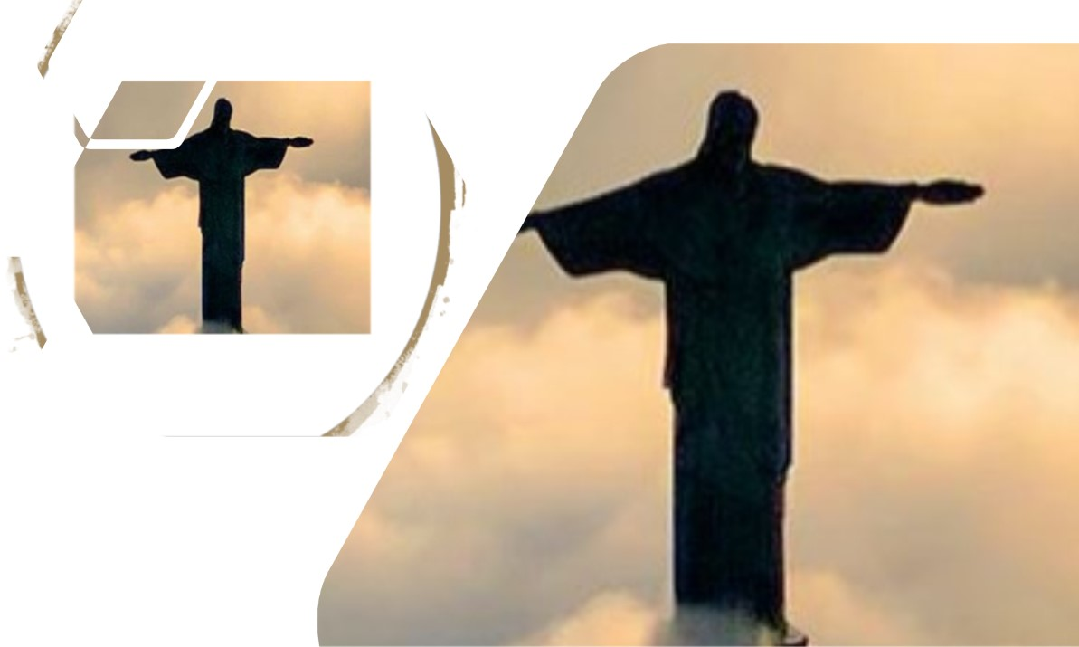
Better than Before
Changes Promised
Moving into a house with no built-in dishwasher, my father bought a used portable model, the kind that hooked up to the sink faucet with a hose. It was in good shape except for the top, a butcher block deeply scratched and stained. Dad decided to make it like new. It took him many months. Night after night, he would go out to our carport to sand it by hand. He must have sanded a half inch off the top of that butcher block to get past the deepest gouges.
When he was finally satisfied, he began to apply varnish. He would apply a coat, then sand it, and repeat. He must have applied 30 coats of varnish to that wood! When he was finished, it was clean and scratch-free, even better than new. That old butcher block was given a new life.
A vital theme of the Bible is the need and plan for a new covenant, a fresh beginning for God’s people. The gouges of sin were deep, and a thorough refresh was in order. Jeremiah was privileged to prophesy the future reality of that new covenant; we are privileged to experience it.
Notes:
Analysis
The story pictures God as a master craftsman. Sin’s “gouges” run deep; cosmetic fixes won’t do. Like painstaking sanding and layer-by-layer varnish, the new covenant (Jer 31:31–34) removes what is ruined and refinish­es the heart from within. The result isn’t merely restored; it’s “better than new.” Moses’ law revealed the scratches; Jesus brings “grace and truth” (Jn 1:17) to cleanse, rewrite God’s law on our hearts, and keep us in covenant fellowship.
Three Key Points
1. Sin’s damage is deep—beyond surface repair.
2. God’s restoration is patient, thorough, and internal.
3. The new covenant makes us “better than before”: forgiven, renewed, and God-taught.
Three Life Lessons
1. Submit to God’s slow work—sanctification is a process, not a quick patch.
2. True repentance involves removal (turning from sin) and renewal (Spirit-formed desires).
3. Grace doesn’t just pardon; it transforms character to love and obey from the heart.
Main Idea
In Christ, God doesn’t just fix what’s broken; He remakes us from the inside out—better than before.
Summary
A scratched butcher-block is patiently sanded and refinished until it surpasses its original condition. Likewise, the Bible promises a new covenant that addresses sin’s deep gouges not with surface rules but with heart renewal. Through Christ, God forgives, writes His law within, and forms a people who truly know Him—restored beyond their former state.

Slide 5

Key Points
Individual Responsibility Before God—
The proverb of sour grapes also appears in Ezekiel 18:2, amid an extensive discussion of individual culpability for sin. In Ezekiel’s day, this proverb is saying that God is punishing innocent people for their ancestors’ sin (compare Ex. 20:5; Deut. 5:9). But through the prophet, God asserts that only the one who sins will die (Ezek. 19:4). Likewise, the one who is righteous and follows God’s commands will live (vv. 5–9). If the righteous man has a wicked son, that son is responsible for his own death (vv. 10–13). Alternatively, if the wicked son has a child who decides to follow the Lord, the child will not be punished for a parent’s sin and will live (vv. 14–17). Most astonishing of all, if the wicked repent, the Lord spares them (v. 27). The point of the correction is this: God is merciful and just; He judges each person for their own conduct (v. 30).
Changes Promised
Notes:
Individual Responsibility Before God
The proverb of sour grapes also appears in Ezekiel 18:2, amid an extensive discussion of individual culpability for sin. In Ezekiel’s day, this proverb is saying that God is punishing innocent people for their ancestors’ sin (compare Ex. 20:5; Deut. 5:9). But through the prophet, God asserts that only the one who sins will die (Ezek. 19:4). Likewise, the one who is righteous and follows God’s commands will live (vv. 5–9). If the righteous man has a wicked son, that son is responsible for his own death (vv. 10–13). Alternatively, if the wicked son has a child who decides to follow the Lord, the child will not be punished for a parent’s sin and will live (vv. 14–17). Most astonishing of all, if the wicked repent, the Lord spares them (v. 27). The point of the correction is this: God is merciful and just; He judges each person for their own conduct (v. 30).
Analysis
Ezekiel 18 dismantles the fatalistic proverb of “sour grapes.” While Exodus 20:5/Deuteronomy 5:9 speak of sin’s generational consequences, Ezekiel clarifies judicial guilt: God judges each person for his own conduct. Righteousness isn’t inherited; neither is condemnation. Repentance changes outcomes—God delights to forgive the wicked who turn (v. 27). This restores moral agency and hope: no one is doomed by ancestry, and no one is saved by pedigree. The call is urgent—“Repent, and turn… why will ye die?” (v. 31–32 KJV).
Three Key Points
1. Personal culpability: “The soul that sinneth, it shall die.”
2. Righteousness/wickedness are not hereditary; choices matter.
3. God’s justice is matched by His mercy—repentance brings life.
Three Life Lessons
1. Stop blame-shifting; confess and turn—today.
2. Break unhealthy family patterns by Spirit-enabled obedience.
3. Extend hope to prodigals: God forgives truly repentant sinners.
Main Idea
God is just and merciful, holding each person accountable while offering real life to all who repent.
Summary
Israel’s proverb wrongly implied inherited punishment. Ezekiel corrects it: each person stands before God for his own sin or righteousness. A wicked son is judged for his deeds; a righteous child is not penalized for a parent’s sins. Most importantly, repentance reverses destiny—God pardons the wicked who turn. Therefore, abandon fatalism, embrace responsibility, and live.

Slide 6
Key Points
Changes Promised
God Likened to a Forgiving Husband—
God’s people maintained a covenant relationship with God: they were to be faithful and worship only Him. The prophets use the metaphor of marriage to describe this bond, since marriage also requires exclusive fidelity. If God’s people worship other gods, this is like adultery.
Jeremiah 3 provides an extended description of this unfaithfulness, likening the behavior to a marriage partner who chooses a life of prostitution. When Israel was unfaithful and unrepentant, God sent her away with a “certificate of divorce”—a metaphor for exile (v. 8). But when Judah saw this judgment, she remained unfaithful as well (v. 10). In contrast, God demonstrates faithfulness toward His people. He repeatedly calls them back. With a promise of restoration, He says, “I am faithful . . . I will not be angry forever. ” (v. 12).
Notes:
God Likened to a Forgiving Husband
God’s people maintained a covenant relationship with God: they were to be faithful and worship only Him. The prophets use the metaphor of marriage to describe this bond, since marriage also requires exclusive fidelity. If God’s people worship other gods, this is like adultery.
Jeremiah 3 provides an extended description of this unfaithfulness, likening the behavior to a marriage partner who chooses a life of prostitution. When Israel was unfaithful and unrepentant, God sent her away with a “certificate of divorce”—a metaphor for exile (v. 8). But when Judah saw this judgment, she remained unfaithful as well (v. 10). In contrast, God demonstrates faithfulness toward His people. He repeatedly calls them back. With a promise of restoration, He says, “I am faithful . . . I will not be angry forever. ” (v. 12).
Analysis
Jeremiah employs marriage to portray covenant life with God: exclusive fidelity, shared love, and public vows. Israel’s idolatry is spiritual adultery—persistent, brazen, and unrepentant. Exile functions as a “certificate of divorce” (Jer 3:8)—a just consequence, not God’s final word. Astonishingly, the Husband remains faithful: He summons His wayward spouse to return, promising mercy, healing, and restored intimacy—“I am merciful… I will not keep anger forever” (Jer 3:12 KJV/AMP). The message weds justice and grace: sin really ruptures; repentance really restores; God’s covenant love outlasts our betrayal.
Three Key Points
1. Idolatry = marital unfaithfulness; covenant demands exclusive devotion.
2. Exile is disciplined separation, not ultimate abandonment.
3. God initiates restoration, offering mercy to the repentant.
Three Life Lessons
1. Guard your heart’s loyalties—anything loved more than God becomes adultery.
2. Take sin seriously: consequences are real, but not irreversible.
3. Run to God quickly; His covenant love welcomes contrite return.
Main Idea
God is the faithful Husband whose justice disciplines but whose mercy restores any who genuinely repent.
Summary
Jeremiah 3 frames Israel’s idolatry as adultery, culminating in a “divorce” (exile). Judah, warned by Israel’s fate, still refuses fidelity. Yet God discloses His steadfast character: He calls, “Return,” pledging not perpetual wrath but compassionate restoration. The prophetic picture reveals both the gravity of covenant betrayal and the hope of reconciliation—God’s loyal love seeks, disciplines, and finally renews the bond with a repentant people.

Slide 7
Lesson Context
Changes Promised
Jeremiah often must convey difficult words from God, but today’s text is from his “Book of Consolation” (Jer. 30–32). This section is about a more distant context when these words will be fulfilled. God shall bring His people out of captivity and restore them to the land (30:1–3). This would happen within a single lifetime. But the promise is even greater: God shall increase and establish Israel and Judah and shall make a future covenant (31:27, 31–34). Future-focused announcements give hope and comfort to God’s people during the experience of exile. Even in an era of corporate judgment, God reveals commitment to His people and hope for the individual who responds to His word.
The book of Jeremiah serves more as a collection of episodes rather than a linear chronology of his ministry. As an example, the episode that begins in Jeremiah 32:1 occurs after the one that begins in chapter 36. Therefore we should not be surprised when tone and content change abruptly as the book moves from topic to topic. We see such an abrupt change as chapter 30 begins.
The way Jeremiah organized his material has led some to call Jeremiah 30–33 the “Book of Consolation” because its theme gives hope that the Babylonian captivity is not the final word. Today’s text takes us into the vital heart of this Book. As we consider our text, we keep in mind how it fits within the larger context: God promised to make the exiles His people once again (Jeremiah 30:22), to return them to their land (32:41), and to establish once and for all time the Davidic dynasty as originally promised (30:9; 33:15–26).
The overall theme of the Book of Consolation is: “I will cause their captivity to return” (Jeremiah 32:44; see also 30:3, 18; 33:7, 26). The covenant theme of “Ye shall be my people, and I will be your God” is also repeated (30:22; see also 31:1; 32:38). The seemingly incurable wound (30:12, 15) could be healed only by the Lord (30:17). Chapter 31 depicts the coming restoration as a time of great blessing, when mourning would be turned into joy (31:13).
Notes:
Analysis
Jeremiah 30–33 (“Book of Consolation”) interrupts judgment oracles with future hope. Within one generation God would end Babylonian exile, restore the land, and re-establish covenant life. Yet the promises reach beyond mere return: God will renew Israel/Judah, heal their “incurable wound,” and cut a future covenant that secures lasting relationship—“You shall be My people, and I will be your God.” This restoration includes Davidic reassurance (messianic horizon) and personal response: exiles are comforted corporately, yet called individually to hear, repent, and live under God’s faithful rule.
Three Key Points
1. Consolation in exile: judgment is not God’s final word; restoration is promised.
2. Covenant renewal: God pledges a future covenant ensuring enduring belonging to Him.
3. Davidic hope: God reaffirms His promise to David, anchoring restoration in a righteous ruler.
Three Life Lessons
1. Hold fast to God’s promises when discipline feels final—His mercy plans a return.
2. Let hope fuel obedience now: prepare your life for the restoration you’re praying for.
3. Read corporate promises personally: respond in repentance and trust to share the joy of renewal.
Main Idea
In the midst of deserved exile, God announces certain restoration—a renewed covenant people under His faithful, Davidic rule.
Summary
Jeremiah arranges his book episodically, and chapters 30–33 pivot from doom to hope. God vows to reverse captivity, return His people to their land, heal what seemed incurable, and renew the covenant so that they truly belong to Him. The restoration includes the reassertion of David’s line, anticipating a righteous king. These future-focused announcements comfort the exiles and summon individuals to respond in faith, proving that divine judgment is penultimate; God’s steadfast love writes the final chapter.

Slide 8

A New Promise - Jeremiah 31:29–32 KJV
Changes Promised
29 In those days they shall say no more, The fathers have eaten a sour grape, And the children’s teeth are set on edge.
30 But every one shall die for his own iniquity: Every man that eateth the sour grape, His teeth shall be set on edge.
31 Behold, the days come, saith the Lord, That I will make a new covenant With the house of Israel, and with the house of Judah:
32 Not according to the covenant that I made with their fathers In the day that I took them by the hand To bring them out of the land of Egypt; Which my covenant they brake, Although I was an husband unto them, saith the Lord:
The people feel as if God has been unfair.
God is fair to each individual.
God is so merciful, in fact, that He shall make a new agreement with unfaithful people.
8
Notes:
A New Promise
Analysis
Jeremiah rejects the fatalistic “sour grapes” proverb: God’s justice is personal—each bears his own guilt (Jer 31:29–30). Israel’s real problem isn’t God’s unfairness but their stubborn, generational unbelief (Jer 7:24–26; 11:1–8; 16:10–13). Because the Mosaic covenant exposed sin but couldn’t cure the heart, God promises a new covenant that reunites Israel and Judah and overcomes human unfaithfulness by divine initiative (Jer 31:31). This is mercy without myth: judgment is deserved, responsibility is individual, and hope arrives by God’s gracious, heart-renewing covenant.
Three Key Points
1. God judges individuals for their own sin; blame-shifting is condemned.
2. The Mosaic covenant revealed holiness but couldn’t transform hearts.
3. God inaugurates a new covenant to restore His divided people and secure faithful obedience.
Three Life Lessons
1. Own your choices: repentance begins where excuses end.
2. Stop citing your family history—seek God’s renewing work personally.
3. Anchor hope in God’s covenant faithfulness, not your willpower.
Main Idea
God’s justice is personal, our guilt is real, and our only hope is the new covenant God establishes to overcome our unfaithfulness.
Summary
Jeremiah counters the complaint that children suffer unjustly for their parents by affirming individual accountability: “whoever eats sour grapes—his teeth are set on edge.” The current generation is judged for its own refusal to repent. Yet God’s faithfulness shines in promise: He will make a new covenant that includes both Israel and Judah, surpassing Sinai by addressing the heart, not just behavior. Judgment exposes sin; the new covenant provides restoration through God’s gracious initiative.
><><><><><><><><><><><><><><
During Jeremiah’s day, individuals complain that God is unjustly punishing them for sins of their ancestors (see Lam. 5:7). Their attitude is captured by a proverb that states, “The parents have eaten sour grapes”—meaning have done what is wrong—“and the children’s teeth are set on edge”—the children face the consequences (Jer. 31:29). “Set on edge” translates a rare word in the Old Testament, appearing only three times (Eccl. 10:10; Jer. 31:29; Ezek. 18:2). In this context, “set on edge” refers to the “bluntness” or “numbness” of their teeth, a response to unpleasant taste. The people are blaming God for the consequences of their own sin by saying that it is their parents’ fault.
Jeremiah looks forward to a day when this proverb will not be repeated. He offers his own revised proverb, where each person dies for their own sins: “whoever eats sour grapes—their own teeth will be set on edge” (Jer. 31:30). He is correcting the idea that God punishes individuals for the sins of others. God is just, and He punishes each person according to their own behavior. While the people’s ancestors were guilty of disobedience, the present generation is equally culpable. Jeremiah warned them about their guilt, but they stubbornly refused to repent and turn back to God. Now, God can no longer hold back His judgment (see Jer. 7:24–26; 11:1–8; 16:10–13). But God promises to make a new covenant with His people (Jer. 31:31). The Lord is the one who will initiate and establish this new covenant with Israel and Judah. The two names refer to the division of the nation into two kingdoms: Israel in the north and Judah in the south. Under the new covenant, both are included. This promise requires nothing less than restoration of the twelve tribes of Israel, some which have been gone for centuries. The new covenant shall differ from the former Mosaic covenant, which God made with Israel at Mount Sinai and renewed on the plains of Moab. The Mosaic covenant established a relationship with Israel and specified obligations for God’s nation of priests and holy people (Ex. 19:5–6). But it was conditional: If you do this . . . I will do this. If Israel was obedient, then God would bless them; if Israel was rebellious, then God would punish them (see Deut. 28). The problem is that the people are not faithful. They violate the covenant with their disobedience, almost immediately (see Ex. 32). In contrast, God is faithful. God is so faithful that He shall make a new covenant to overcome their weakness.

Slide 9
A New Covenant - Jer. 31:33–34; John 1:17 KJV
Changes Promised
33 But this shall be the covenant that I will make with the house of Israel; After those days, saith the Lord, I will put my law in their inward parts, And write it in their hearts; And will be their God, And they shall be my people.
34 And they shall teach no more every man his neighbour, and every man his brother, saying, Know the Lord: For they shall all know me, From the least of them unto the greatest of them, saith the Lord: For I will forgive their iniquity, And I will remember their sin no more.
17 For the law was given by Moses, but grace and truth came by Jesus Christ.
JOHN 1:
The covenant that God promises shall be different from the covenant of Sinai.
God shall again “write” words of instruction, but on the hearts and minds of His people.
Everyone shall have equal access to God, for He offers forgiveness of sins.
Jesus offers the grace of God through the giving of Himself.
9
Notes:
Analysis
Jeremiah 31:33–34 contrasts Sinai’s external law with a Spirit-wrought, internal “instruction” written on hearts. The result is covenant intimacy—“I will be their God… they shall all know Me”—grounded in definitive forgiveness. This embraces the whole people (Israel/Judah) and anticipates return, rebuilding, and relational restoration. John 1:17 signals the fulfillment: Moses gave law; Jesus brings the grace and truth that pardon and transform, granting direct access to God apart from temple systems, by the Spirit.
Three Key Points
1. Internalization: God inscribes His law within, changing desires and wills.
2. Universal knowledge: From least to greatest, God’s people personally know Him.
3. Forgiveness foundation: Full pardon restores covenant fellowship permanently.
Three Life Lessons
1. Seek heart change, not mere rule-keeping—ask God to shape your loves and loyalties.
2. Live as a priestly people—draw near to God and help others know Him directly.
3. Stand in grace—guilt is not your home when God remembers sin no more.
Main Idea
God’s new covenant remakes people from the inside out—granting forgiveness, intimacy, and Spirit-enabled obedience through Jesus Christ.
Summary
After exile, God promises more than a return to land—He promises a return to Himself. The new covenant moves the law from stone to heart, unites a divided people in firsthand knowledge of God, and rests on once-for-all forgiveness. No temple or mediator can do what grace and truth in Christ accomplish: reconciled relationship and real obedience.
><><><><><><><><><><><><><><><><
A New Covenant
Beginning in verse 33, God describes the differences that set this new covenant apart. By referring to Israel here, He is not excluding Judah. He is speaking of the whole of Israel, which had divided into two (Israel and Judah). This new covenant would take place “after those days,” looking forward to the return of the exiles to the land. Previously, in verses 27–28, Jeremiah describes the building and planting of the people in the land. Now Jeremiah adds that the people shall experience restoration of their relationship with the Lord (see also Deut. 30:1–6; Ezek. 11:17–20).
God promises to put His “law” within them (v. 33). This law (which means “instruction”) would be written on their hearts and minds, not on stone—which refers to the old covenant on stone tablets (Ex. 32:19; Deut. 30:6). The old covenant failed because of people’s disobedience and wayward hearts, but in the new covenant, God says He shall give a new path forward. He offers inward transformation. His people’s attitudes, affections, and wills shall be changed, enabling them to actually obey the Lord. The result is that the Lord will be their God, and they will be His people (see also Jer. 24:7; 30:22; 31:1). The new covenant allows all to know the Lord (v. 34). There will be no need to exhort others to know the Lord, for they will already know Him. Whereas under the Mosaic covenant, people relied on human mediators to hear from God, the new covenant provides them with direct access (compare Heb. 4:14–16). All people, regardless of background, will know Him.
God’s final statement in verse 34 provides the rationale. The foundation of this new covenant is forgiveness of sins. With the removal of sins, the people will be able to experience a restored relationship with their Creator. They will not have to rely on the law, the temple, the sacrificial system, or the priesthood.
As John 1:17 acknowledges, for the followers of Christ, something new arrives through Jesus Christ. The law of Moses was a gift to God’s people, but it did not provide a path of forgiveness and inward transformation. Through Jesus, people are offered God’s abundant gifts: grace and truth. Jesus is God in the flesh, who has made God known and granted eternal life for those in Him (John 3:15).

Slide 10
Fresh Start
Changes Promised
Many Christians who read their Bibles faithfully struggle with understanding what to do with the commands and regulations they find in the Old Testament. Because we believe in the inspiration and value of the entire Bible, we must take these passages seriously. The prophecy in Jeremiah 31 helps us put other portions of the Old Testament into perspective. The Law of Moses revealed God’s will for the people of Israel and in so doing revealed many things about His nature and character. Jeremiah’s perspective shows that this initial covenant did not work for Israel. This was not because God failed, but because of the people’s disobedience. Eventually, Israel was punished by the destruction of Jerusalem and its temple followed by exile.
The new covenant Jeremiah speaks of is a fresh start for humanity. This new covenant defines its adherents not in terms of obedience to law, but as those who have experienced the grace of being forgiven through Jesus’ atonement for our sins.
As new covenant people, we have much we can learn from the old covenant, but we rejoice in the reality of the new covenant. What the prophets searched for diligently, we now experience (1 Peter 1:10–11).
Notes:
Analysis
Jeremiah 31 reframes the Old Testament law: holy, revelatory, yet powerless to change stubborn hearts. Israel’s exile exposes human failure, not divine flaw. God’s answer is the new covenant—pardon plus power—grounded in Christ’s atonement and the Spirit’s inward work. Thus Christians honor the Law’s revelation of God’s character while living by grace that justifies and transforms. What prophets longed to see, believers now experience: forgiven status, indwelling power, and heart-level obedience.
Three Key Points
1. The Law reveals God’s will and our need but cannot regenerate the heart.
2. The new covenant centers on grace: forgiveness through Jesus’ atonement.
3. New-covenant life is Spirit-empowered, fulfilling the Law’s intent from within.
Three Life Lessons
1. Read the Old Testament for God’s character; run to Christ for cleansing and power.
2. Trade rule-keeping anxiety for Spirit-led obedience—grace fuels holiness.
3. Let forgiveness define your identity; serve from acceptance, not for it.
Main Idea
God replaces law-on-stone with grace-in-the-heart: in Christ, forgiven people are empowered to become what the Law required.
Summary
The Mosaic covenant disclosed God’s holiness but exposed Israel’s disobedience, culminating in exile. Jeremiah promises a fresh start: a new covenant where sins are forgiven and God’s instruction is written on hearts. In Jesus, that promise arrives—grace and truth create a people who know God personally and obey from transformed desires. We still learn from the old covenant, but we rejoice to live in the reality prophets anticipated: pardon received, Spirit given, life made new.

Slide 11

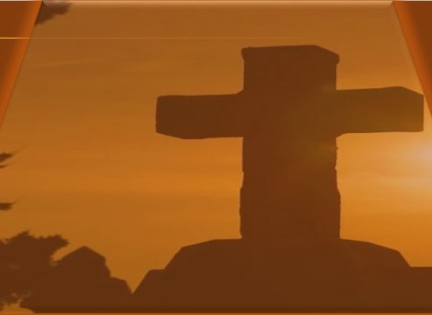
Apply the Message:
God grants hope for the future and renewal in all things.
What Hope Can Do
Changes Promised
My daughter suffers with depression, as do many who are reading these words, I’d guess. There are more people who have depression than statistics report, and it’s not something people like to talk about. But do you know what helps? Hope.
When life gets overwhelming for my daughter, and perhaps for you, hope is a wonderful antidote. It lifts the spirit and suggests that there may be better days ahead. I’ve seen her go from “can’t-get-out-of-bed” melancholy to actually looking forward to an anticipated event, all because she has grasped that elusive spirit of hope. When she’s looking forward to change, she’s hoping that better days are ahead, and the anticipated future makes all the difference.
In today’s lesson, Jeremiah shared a message of hope with God’s people. They had the Mosaic law, but were unable to keep it. God announces He will be making a new covenant, where people won’t complain for being held responsible for their parents’ mistakes. They won’t feel indebted to rules that feel impossible to keep, but God’s instruction will be written on their hearts. No doubt, Jeremiah’s audience doesn’t know what all that means, but it is a hopeful message. They could look forward to a future that was better than their present. What encouragement that must have provided! Hope does that.
God provided hope then, and He continues to give hope today. He is called the “God of hope” in Romans 15:13. As we continue to live in a world that is filled by disheartening realities, when many choose their own way rather than God’s, let’s take encouragement that better days are ahead for us too. No person knows the day or the hour, but Jesus is coming, in all His glory. We have blessed hope
Notes:
Analysis
Jeremiah’s new-covenant promise reframes despair with durable hope: God will write His instruction on the heart, forgive sins, and restore relationship. Hope here is not positive thinking but confidence in God’s future action—fulfilled in Christ and applied by the Spirit. Romans 15:13 names God as the source of hope, who fills believers with joy and peace so they “abound in hope.” This speaks tenderly to those weighed down by depression: circumstances may not change overnight, but God’s pledged future sustains today.
Three Key Points
1. Hope is anchored in God’s promises, not our performance.
2. The new covenant moves us from crushing rules to inward renewal and forgiveness.
3. Biblical hope energizes perseverance in present pain.
Three Life Lessons
1. Feed hope daily: pray Jeremiah 31 and Romans 15:13; rehearse God’s promises aloud.
2. Practice “small lights”: one next step—scripture, a short walk, a call—counts.
3. Become a hope-bearer: listen without fixing, remind loved ones of God’s nearness, invite community care.
Main Idea
Because God secures our future in Christ, we can face today with resilient hope that heals, steadies, and moves us forward.
Summary
Jeremiah’s audience sat in failure; God answered with a new covenant—heart change, full pardon, restored fellowship. That same God is the “God of hope,” who meets present heaviness with promised renewal and the blessed hope of Christ’s return. Hope doesn’t deny the dark; it declares that God’s dawn is certain and coming.
A Short Prayer
God of hope, fill us with Your joy and peace in believing, that by the Holy Spirit we may abound in hope. Write Your word on our hearts, lift the weary, and steady our steps until the day of Christ. Amen.

Slide 12
Apply the Message:
God grants hope for the future and renewal in all things.
What Hope Can Do
Changes Promised
1 Where have you encountered unexpected hope?
2 When have you felt responsible for the actions of someone else?
3 What promise or truth about God fills you with hope for the future?
Notes:
Discussion Questions and Answers
1 Where have you encountered unexpected hope?
This is an open-ended invitation to share what sorts of people or events we take as hopeful. For instance, it can be hopeful when we see the birth of a child or grandchild, when we solve a nagging problem, or when we witness accountability transform a bad situation. Hope is future focused.
2 When have you felt responsible for the actions of someone else?
The people of Judah felt like exile was someone else’s responsibility. We may feel that the circumstances that come to us were caused by others, like we are suffering for another person’s mistakes. For instance, patterns of broken relationships and harm affect multiple generations of a family.
3 What promise or truth about God fills you with hope for the future?
Many answers are possible for this question. We might list the hope of resurrection, the remaking of our physical bodies, the wiping away of every tear, seeing God face-to face, or having all our doubts dispelled. God is enough, and He gives us many reasons to hope.

Slide 13
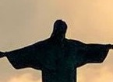
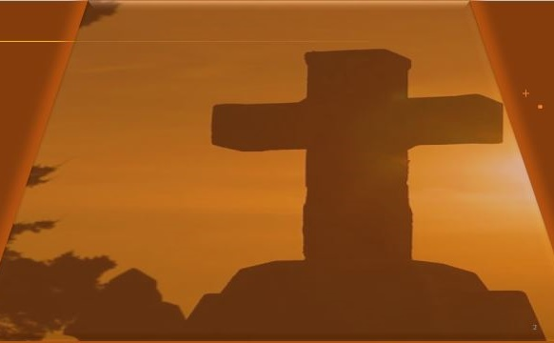
Live It Out: Ask God to renew your spirit and patterns of thinking.
Changes Promised
The new covenant that Jeremiah promises is fulfilled through the coming of Jesus and the sending of God’s Spirit. But we still find ways that we might not be living and walking in those truths. There is a kind of pattern-breaking renewal that only God can provide, and this is an opportunity for the class to request God’s intervention.
A God of Renewal
Jeremiah teaches the people that a solution to the sin problem is not something they can manage alone. There are situations and patterns that only God can fix. Like the people of Judah, we can trust in a God who is capable of performing great miracles.
13
Notes:
Live It Out — A God of Renewal
Analysis
Jeremiah’s new covenant promises what our effort cannot produce: a renewed mind and heart, forgiveness that frees, and the Spirit who empowers (Jer 31:33–34; Rom 12:2; Gal 5:16). Renewal is God’s work in us, yet we actively receive it—repenting, reshaping habits, and walking in the Spirit.
Three Key Points
Renewal is internal: God writes His instruction on the heart.
Renewal is relational: “I will be their God… they shall know Me.”
Renewal is empowered: the Spirit enables what law could not.
Three Life Lessons
Stop striving; start surrendering—yield daily to the Spirit.
Replace old ruts with new rhythms (Word, prayer, fellowship, service).
Expect progress, not perfection—keep short accounts with God.
Main Idea
Only God breaks sin’s patterns; our role is responsive surrender that welcomes His renewing work.
Summary
Jesus fulfills Jeremiah’s promise: forgiven, indwelt, transformed. We cooperate by renewing our minds and walking by the Spirit, trusting God to do what we cannot.
7-Day Renewal Plan (simple, repeatable)
Day 1 – Surrender: Pray Psalm 139:23–24; name one pattern to release.
Day 2 – Word: Read Jer 31:31–34; write one “law-on-my-heart” takeaway.
Day 3 – Prayer: 10 minutes of honest confession + gratitude (1 John 1:9).
Day 4 – Community: Share your focus with a trusted believer; invite prayer.
Day 5 – Practice: Do one Spirit-led act of love (Gal 5:22–23).
Day 6 – Replace: Swap one trigger habit (scrolling, snacking, snapping) with Scripture/quiet.
Day 7 – Review: Journal progress; set one next faithful step.
Short Guided Prayer (KJV cadence)
Lord, create in me a clean heart; renew a right spirit within me. Write Your word upon my heart; let Your Spirit lead my steps. Break old patterns, establish holy habits, and restore unto me the joy of Thy salvation. In Jesus’ name, Amen.

Slide 14
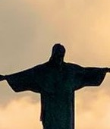
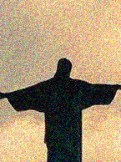



  The Lord bless thee, and keep thee:
  The Lord make his face shine upon thee, and be gracious unto thee:
  The Lord lift up his countenance upon thee and give thee peace.
  - Numbers 6:24-26,
Material adapted by Stanford W. Bowman Jr. from Echoes® Adult and Bible-in-Life® Adult FALL 2025 quarter with permission, © David C Cook, https://davidccook.org. May not be further reproduced. All rights reserved.

Slide 15
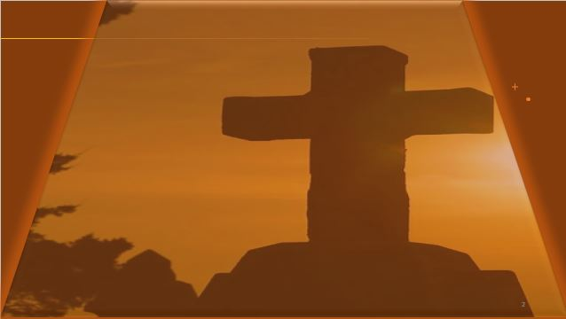
QUESTION & ANSWER
A New Promise
Changes Promised
1 What is the meaning of the proverb about sour grapes in Jeremiah 31:29?
2 According to Jeremiah, who bears the responsibility for sin?
3 For whom would God make a new covenant, and why is this significant?
The proverb illustrates the attitudes of the people toward God and their failure to take responsibility for their own sins. The people say that their parents ate sour grapes (did what is wrong) and the children’s teeth were set on edge or dulled (faced the consequences of sin). They accused God of being unfair by giving the punishment of exile.
eremiah revises the people’s proverb: those who eat sour grapes dull their own teeth. If someone sins, that person will bear the responsibility for their own failure, not the sins of their ancestors.
God says He will make a new covenant with the people of Israel and Judah. Historically, they had been one unified people: the twelve tribes of Israel. But because of their sin, their nation was split into two kingdoms—Judah and Israel. God’s promise of a new covenant anticipates a day when His people are regathered and unified.
Notes:
1 What is the meaning of the proverb about sour grapes in Jeremiah 31:29?
The proverb illustrates the attitudes of the people toward God and their failure to take responsibility for their own sins. The people say that their parents ate sour grapes (did what is wrong) and the children’s teeth were set on edge or dulled (faced the consequences of sin). They accused God of being unfair by giving the punishment of exile.
2 According to Jeremiah, who bears the responsibility for sin?
Jeremiah revises the people’s proverb: those who eat sour grapes dull their own teeth. If someone sins, that person will bear the responsibility for their own failure, not the sins of their ancestors.
3 For whom would God make a new covenant, and why is this significant?
God says He will make a new covenant with the people of Israel and Judah. Historically, they had been one unified people: the twelve tribes of Israel. But because of their sin, their nation was split into two kingdoms—Judah and Israel. God’s promise of a new covenant anticipates a day when His people are regathered and unified.

Slide 16

QUESTION & ANSWER
A New Covenant
Changes Promised
1 What is the meaning of the proverb
about sour grapes in Jeremiah 31:29?
2 According to Jeremiah, who bears the responsibility for sin?
The proverb illustrates the attitudes of the people toward God and their failure to take responsibility for their own sins. The people say that their parents ate sour grapes (did what is wrong) and the children’s teeth were set on edge or dulled (faced the consequences of sin). They accused God of being unfair by giving the punishment of exile.
3 For whom would God make a new covenant, and why is this significant?
God says He will make a new covenant with the people of Israel and Judah. Historically, they had been one unified people: the twelve tribes of Israel. But because of their sin, their nation was split into two kingdoms—Judah and Israel. God’s promise of a new covenant anticipates a day when His people are regathered and unified.
Jeremiah revises the people’s proverb: those who eat sour grapes dull their own teeth. If someone sins, that person will bear the responsibility for their own failure, not the sins of their ancestors
Notes:
1 What is the meaning of the proverb about sour grapes in Jeremiah 31:29?
The proverb illustrates the attitudes of the people toward God and their failure to take responsibility for their own sins. The people say that their parents ate sour grapes (did what is wrong) and the children’s teeth were set on edge or dulled (faced the consequences of sin). They accused God of being unfair by giving the punishment of exile.
2 According to Jeremiah, who bears the responsibility for sin?
Jeremiah revises the people’s proverb: those who eat sour grapes dull their own teeth. If someone sins, that person will bear the responsibility for their own failure, not the sins of their ancestors.
3 For whom would God make a new covenant, and why is this significant?
God says He will make a new covenant with the people of Israel and Judah. Historically, they had been one unified people: the twelve tribes of Israel. But because of their sin, their nation was split into two kingdoms—Judah and Israel. God’s promise of a new covenant anticipates a day when His people are regathered and unified.

Slide 17
  The Lord bless thee, and keep thee:
  The Lord make his face shine upon thee, and be gracious unto thee:
  The Lord lift up his countenance upon thee and give thee peace.
  - Numbers 6:24-26,
Material adapted by Stanford W. Bowman Jr. from Echoes® Adult and Bible-in-Life® Adult FALL 2025 quarter with permission, © David C Cook, https://davidccook.org. May not be further reproduced. All rights reserved.

