Slide 1
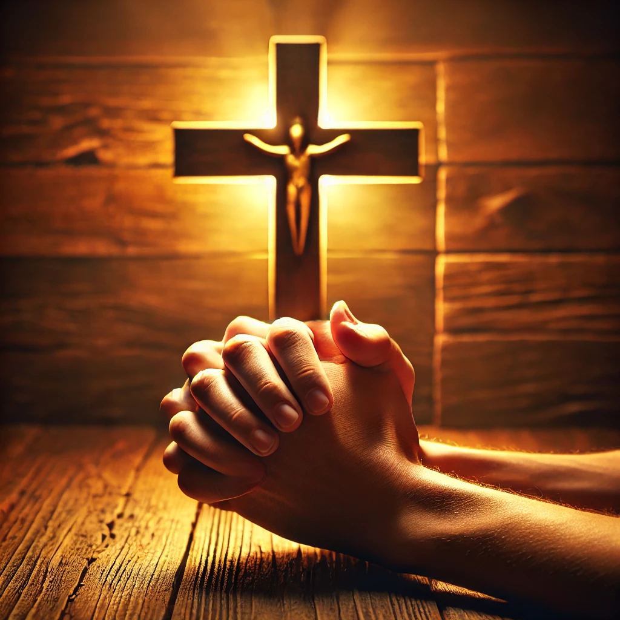
Worship Is Restored
All the people gave a great shout of praise to the Lord, because the foundation of the house of the Lord was laid. —Ezra 3:11b NIV
Week of May 18
Notes:
Worship Is Restored
Week of May 18

Slide 2
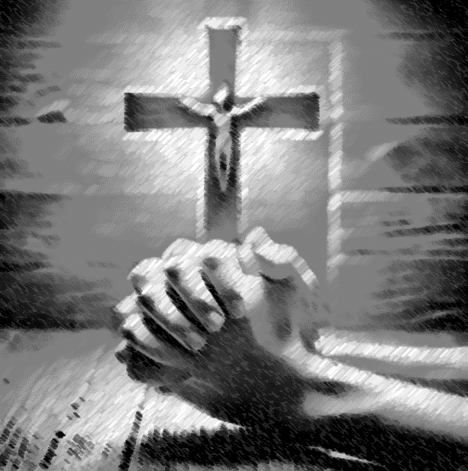
Prayer
  Father, help us to remember that there is always a bigger picture. We lose sight of that bigger picture when we shift our focus to life’s obstacles. May we never be guilty of such a shift nor of being the obstacles themselves. We pray in Jesus’ name. Amen
    Thought to Remember
      Praise God for His enduring mercy!
Notes:
Prayer
Father, help us to remember that there is always a bigger picture. We lose sight of that bigger picture when we shift our focus to life’s obstacles. May we never be guilty of such a shift nor of being the obstacles themselves. We pray in Jesus’ name. Amen.
Thought to Remember

Slide 3
Agenda
3
Worship Is Restored
  Review
  Introduction
  Lesson Context
  Overview
  Conclusion
  Question & Answers
All the people gave a great shout of praise to the Lord, because the foundation of the house of the Lord was laid.
—Ezra 3:11b NIV
  Rebuilding the Altar - Ezra 3:1–6 NIV
  The Temple Construction Begins - Ezra 3:10–13 NIV
Notes:
Rebuilding the Altar - Ezra 3:1–6 NIV
The Temple Construction Begins - Ezra 3:10–13 NIV
====================================
Clarifying user request
1. Summary (Ezra 3:1-6, 10-13)
Returning exiles gathered in Jerusalem during the seventh month. Led by priest Jeshua and Governor Zerubbabel, they rebuilt the altar on its original bases and immediately reinstated morning-and-evening sacrifices along with the Feast of Tabernacles, though the temple itself was still rubble. Their obedience overcame fear of hostile neighbors. When the new temple foundation was finally laid, priests and Levites—in full vestments with trumpets and cymbals—sang the refrain “He is good; His love endures forever.” Younger worshipers shouted with unrestrained joy, while elders who remembered Solomon’s splendor wept; the mingled sound resounded far beyond the city.
2. Theological Analysis
Ezra presents worship, not architecture, as Judah’s first priority: sacrifice re-establishes covenant life before walls rise. Rebuilding the altar on its historic spot honors Mosaic commands and proclaims continuity after judgment. Acting “despite their fear” models faith that answers external pressure with liturgy rooted in Scripture. The seventh-month timing ties the community to Israel’s festal calendar, especially atonement and harvest grace. Divergent reactions at the foundation reveal generational tension—memory laments lost magnificence, hope rejoices in new beginnings—yet prophets Haggai and Zechariah assure that future glory will surpass the past.
3. Contemporary Commentary/Application
These verses remind congregations emerging from trauma that the “altar” of Christ’s finished work must precede budgets, buildings, and programs. Courageous, unified worship—prayer, praise, and sacrificial giving—fortifies faith amid opposition. Churches should allow both joyful anticipation and honest grief to be voiced; blended trumpets and tears still honor God. Leaders are called to cherish heritage without idolizing former grandeur, guiding people to celebrate the foundations God is laying now. When believers praise in seasons of fear and disappointment, the testimony of steadfast love, like Judah’s collective shout, can be heard “afar off” and draw others to the Lord.

Slide 4
Weeping and Rejoicing Today
Worship Is Restored
For over 25 years, my friend Sandra has served as a missionary in several countries, including Croatia, Ukraine, and Iran. Sandra reports asking an Iranian friend how she came to faith in Christ. The friend told Sandra, “When I was walking across Turkey trying to get away, I had a vision of Jesus Christ. He told me, ‘I will be with you. ’” Sandra then taught her friend more about what being a Christian meant in light of God’s mercy and love.
We are wise to be skeptical of claimed visions, lest Revelation 22:19 be violated (compare Hebrews 1:1). But a claimed vision that aligns with the teaching of the Bible deserves further investigation. Such an occurrence may be the first step in being called to a saving relationship with God through Christ.
The experiences of Sandra and her friend remind us that Christians live in a world characterized by both pain and pleasure, grief and joy (compare John 16:21). And so it is with the Judeans of the mid-sixth century BC, today’s lesson from the book of Ezra.
Notes:
Analysis
The vignette contrasts present-day missionary accounts with Ezra’s post-exilic community to illustrate a timeless tension: believers often encounter God’s mercy amid flight, loss, and rebuilding. Sandra’s Iranian friend experiences Christ’s presence while fleeing persecution, echoing Judah’s exiles who rebuilt worship while still vulnerable. The narrative also models doctrinal discernment—visions must be tested against Scripture (Revelation 22:19; Hebrews 1:1). Together, these strands show that authentic faith integrates supernatural assurance, careful biblical evaluation, and honest lament/joy.
Main Idea
Christian life holds simultaneous sorrow and celebration; God meets people in distress, yet every perceived revelation must be weighed by Scripture.
Three Key Points
1. God’s Presence in Flight: Like Judah returning from exile, Sandra’s friend encountered Christ while displaced, underscoring that divine grace often breaks through during upheaval and migration.
2. Discernment of Visions: Revelation warns against unbiblical additions; therefore, any claimed vision—however comforting—must align with the Bible and prompt deeper scriptural teaching, as Sandra wisely provided.
3. Dual Emotions of Faith: Believers navigate pain and pleasure together (John 16:21). Weeping over loss and rejoicing in God’s mercy are not opposites but complementary responses that shape mature discipleship.
Summary
Sandra’s field story and Ezra’s account both reveal a God who comforts refugees and rebuilders alike, yet calls His people to test spiritual experiences by His Word. Followers of Christ should welcome genuine testimonies that harmonize with Scripture, offer instruction, and acknowledge the coexistence of grief and gladness in the journey of faith.

Slide 5
Key Points
Worship Is Restored
Restoration—
Ezra begins at the end of the exile. The Persian king, Cyrus, made a proclamation that allowed the exiles to return to their homeland. Ezra opens with Cyrus’s edict: he directed the exiles to return to Jerusalem to rebuild their temple; and he sent with them gold, silver, livestock, and other gifts for the project. Ezra lists the exiles who returned to the land, giving their names, number, and roles. In Ezra 3, the people return to reestablish the proper worship of Yahweh, sparking a celebration.
The Day of Atonement is a special celebration for the Jewish community. Families took time away from their daily activities and traveled to Jerusalem. This Day of Atonement was exceptional, since it came after a 70-year exile in Babylon. The people were busy trying to rebuild their houses and communities. But they made their spiritual obligations a priority.
Notes:
Restoration
Analysis — Post-exile Judah begins with Cyrus’s decree that funds and mobilizes temple reconstruction, signaling God’s sovereignty over pagan rulers and His fidelity to covenant promises. Ezra’s register of returning families underscores communal identity, while their choice to prioritize worship during the busy Day of Atonement reveals spiritual realignment over material concerns.
Main Idea — God initiates national renewal by moving hearts and kings so His people can restore worship first.
Key Points
1. Cyrus’s edict fulfills prophetic promises and provides resources for rebuilding.
2. Naming the returnees roots restoration in concrete families and roles.
3. Spiritual duty outranks personal rebuilding even after 70 years’ displacement.
Summary — Restoration begins when God opens political doors and His people answer by making worship their first task.

Slide 6
Key Points
Offerings—
Joshua and Zerubbabel took the lead in the rebuilding project. Although the temple had yet to be rebuilt, they restored the altar. It would be ready to receive the sacrifices and offerings.
Worship Is Restored
Tents—
During the Feast of Tabernacles which came after, families would camp out in tents to remember the flight from Egypt and time the wilderness. The returning exiles put up tents until they rebuilt their homes. So this feast took on a special meaning that year: God had allowed them to return home.
Joy and sadness—
The joy on this momentous occasion was also filled with weeping. Being on the grounds of the old temple brought back horrifying memories for those who witnessed its destruction. They knew this new temple would be different from the old one. It could never match the extravagance of Solomon’s construction project.
Notes:
Offerings
Analysis — High-priest Jeshua and governor Zerubbabel rebuild the altar on its original base before any walls rise, reinstating daily, festival, and freewill sacrifices according to Moses. Their act counters surrounding hostility by asserting covenant fidelity in public view.&x20;
Main Idea — True revival starts at the altar, not the architecture.
Key Points
1. Leadership joins priestly and civic authority to guide worship renewal.
2. Exact obedience to Torah patterns authenticates the community’s return.
3. Visible sacrifice demonstrates trust despite neighboring threats.
Summary — By restoring continual offerings first, the exiles proclaim dependence on God before seeking structural security.
Tents
Analysis — During the Feast of Tabernacles the people camp in booths, reenacting wilderness dependence while literally living in makeshift shelters until homes can be repaired—thus the festival gains fresh poignancy as a testimony that God has brought them “home” again.&x20;
Main Idea — Remembering past deliverance shapes present gratitude.
Key Points
1. Temporary tents mirror ancestral pilgrimage and current housing reality.
2. Observance in ruined Jerusalem expresses faith that God still provides.
3. The feast binds collective memory to present-day restoration.
Summary — Camping during Tabernacles lets the returnees celebrate both former and current journeys under God’s care.
Joy and Sadness
Analysis — Laying the new foundation triggers a cacophony: younger voices shout praise, elders weep over lost splendor. Ezra records both, illustrating that mixed emotions belong in corporate worship and that God receives lament alongside celebration.&x20;
Main Idea — Authentic worship holds grief and gladness in one sound.
Key Points
1. Memory of Solomon’s temple exposes the cost of past sin.
2. New beginnings inspire hope for God’s enduring mercy (Psalm 100:5).
3. Outsiders hear the blended cry, witnessing a community honest before God.
Summary — The foundation ceremony teaches that rebuilding faith communities must honor both loss and promise.

Slide 7
Key Points
Worship Is Restored
Faith—
The returning generation had been through a lot of loss and trauma. Still they turned to God in this moment. May God grant us the same determination to trust God, no matter the circumstances.
Notes:
Faith
Analysis — Traumatized yet determined, the returnees act “despite their fear,” modeling resolve to trust God amid uncertainty. Their example calls today’s believers to similar perseverance when circumstances appear overwhelming.&x20;
Main Idea — Faith moves forward while fear lingers.
Key Points
1. Courage is obedience in the presence of danger, not its absence.
2. Communal worship strengthens individual resolve.
3. God’s past faithfulness fuels present commitment.
Summary — Post-exilic Judah shows that steadfast trust in God, practiced together, overcomes trauma and propels restoration.

Slide 8
Context
FESTIVAL OF TABERNACLES
    The Festival of Tabernacles was one of three yearly religious festivals that required God’s people to make a pilgrimage to the temple in Jerusalem. God provided extensive instructions for the Festival of Tabernacles in Leviticus 23:33–44 and Deuteronomy 16:13–15. During this festival, the Israelites gathered branches from trees and built booths, or tents, to live in for the weeklong event. This festival was to remind the Israelites of God’s care for them as He brought them out of Egypt into the wilderness. It was an opportunity for everyone to celebrate God’s continued provision. Even in Jesus’ time, this festival continued to be a key celebration for the Jewish people. The Gospel of John describes Jesus participating in the festival (John 7:1–24).
Worship Is Restored
Notes:
FESTIVAL OF TABERNACLES
Analysis God required Israel to spend a week in makeshift booths each autumn, reenacting wilderness dependence and thanking Him for harvest provision; the command remained central through Jesus’ day.&x20;
Main Idea Living in tents teaches every generation that God shelters His people.
Key Points
1. One of three annual pilgrimages mandated by Torah (Leviticus 23; Deuteronomy 16).
2. Families built leafy booths to remember God’s care after Egypt.
3. Continued importance shown by Jesus attending the feast (John 7).
Summary The Tabernacles festival fused memory and gratitude, turning temporary shelters into symbols of God’s enduring provision.

Slide 9
Context
THE EXILE
For hundreds of years, God warned the Israelites about the consequences of their continued idolatry and disregard of the covenant. He sent prophets to them to warn them to repent and return to worship the one true God. One of these prophets, Jeremiah, prophesied that God would allow foreign nations to conquer Judah; and soon after, the Babylonians attacked and overthrew the city of Jerusalem. They destroyed the temple and took people as captives to Babylon and its surrounding lands. The former residents of Judah were exiled from the land for 70 years.
The significance of this event can hardly be overstated. The temple of God was destroyed, making the offerings and sacrificial worship system come to an abrupt halt. But in the context of exile in Babylon, God’s people were able to gather and to pray for the chance to return to their homes.
Worship Is Restored
SOLOMON’S TEMPLE
Since the wandering of the Israelites in the wilderness, God dwelled among His people in a tabernacle. The tabernacle was never meant to be a permanent home for God—it was designed to someday be replaced by a temple. As God would not allow King David to construct the temple himself, David purchased land for the temple foundation and organized the collection of the building materials (1 Chron. 21:18; 22:1–19). Timber, stone, gold, silver, brass, and iron were gathered for the future temple. God chose King Solomon, David’s son, to build His temple. During Solomon’s reign, the temple was constructed from the most luxurious materials of the time, a process that lasted seven years. It was approximately 90 feet long, 30 feet wide, and 45 feet high. Cherubim, palm trees, ornaments, blooming flowers, and gold furnishings decorated the interior (1 Kings 6).
Notes:
THE EXILE
Analysis Persistent idolatry led to Babylon’s 586 BC conquest, temple destruction, and 70-year captivity; yet exile birthed prayerful longing for return.&x20;
Main Idea Loss of land and temple exposed covenant breach but opened the way for renewal.
Key Points
1. Prophets like Jeremiah warned but Judah ignored.
2. Babylon removed leaders and halted sacrificial worship.
3. Exiles formed communities of faith, seeking God’s mercy.
Summary Exile was judgment and mercy intertwined—discipline for sin, preparation for restoration.
SOLOMON’S TEMPLE
Analysis David gathered materials, Solomon erected a lavish 90 × 30 × 45 ft sanctuary adorned with gold, cherubim, and carved flora over seven years
Main Idea The first temple embodied God’s majestic presence among His people.
Key Points
1. Replaced the portable tabernacle as a permanent dwelling.
2. Built from premier cedar, stone, and precious metals.
3. Became Israel’s worship center until its 586 BC ruin.
Summary Solomon’s temple showcased divine glory and covenant blessing, making its later destruction a devastating spiritual blow.

Slide 10
Context
PSALM 100:5 IN TEMPLE DEDICATION
In Ezra 3, the celebration of the temple’s foundation showed remarkable continuity with Israel’s worship before the exile. After the new foundation was laid, the Levites praised the Lord: “He is good; his love toward Israel endures forever” (Ezra 3:11). Their song was a quotation of Psalm 100:5, which appears many times throughout the Old Testament and in Israel’s worship practices. In 1 Chronicles 16:34, after David brought the ark of the covenant back to Jerusalem, he appointed the psalmist Asaph and his associates to praise the Lord using words from Psalm 100. Ezra 3:11, in turn, calls the Levites “sons of Asaph. ” In 2 Chronicles 5, Solomon completed the building of the temple and placed the ark within it. The priests and Levites played their instruments and sang praises from Psalm 100. Jeremiah prophesied that this psalm would be sung by the people after the destruction of Jerusalem (Jer. 33:11).
Worship Is Restored
THE PROPHETS SPEAK OF THE PEOPLE’S WEEPING
As the temple foundation was laid, the festive cheers mixed with the weeping of older priests and family leaders. The older generation had seen the glory of the former temple and recognized that a new temple would be an insufficient replacement. This scene demonstrates how much the Jews lost in their exile—but still God was restoring them.
Two prophets after the exile comment on this event. The prophet Haggai poses a series of questions to Zerubbabel, Joshua, and the remnant: “Who among you survivors saw the former splendor of this temple? How does it look to you now? Isn’t it nothing by comparison?” (Hag. 2:3). Then he relays God’s promise to restore the temple’s splendor in the future. The prophet Zechariah challenges those who mocked this day as a small beginning, for a greater temple was yet to come (Zech. 4:10). Many would have thought that this meant a better building.
Notes:
PSALM 100:5 IN TEMPLE DEDICATION
Analysis When Ezra’s builders finished the new foundation, Levites sang “He is good; His love endures forever,” a refrain used by David, Solomon, and promised by Jeremiah for post-exilic praise.
Main Idea Recycled liturgy linked broken present to hopeful past.
Key Points
1. Quote from Psalm 100:5 ties worship across eras.
2. Sons of Asaph led music, echoing Davidic order.
3. Text affirms God’s steadfast covenant love amid change.
Summary Singing the ancient psalm over new stones proclaimed that the God who was faithful before exile remained faithful after it.
THE PROPHETS SPEAK OF THE PEOPLE’S WEEPING
Analysis Haggai asked who recalled Solomon’s splendor; Zechariah rebuked those who despised the “day of small things,” promising greater glory ahead.&x20;
Main Idea Prophetic voices validated grief yet pointed to future magnificence beyond physical size.
Key Points
1. Elders’ tears revealed awareness of loss.
2. Haggai prophesied forthcoming divine splendor.
3. Zechariah reframed modest beginnings as seeds of greatness.
Summary Prophets transformed mourning at the second temple’s modest start into hope for God’s surpassing restoration.

Slide 11
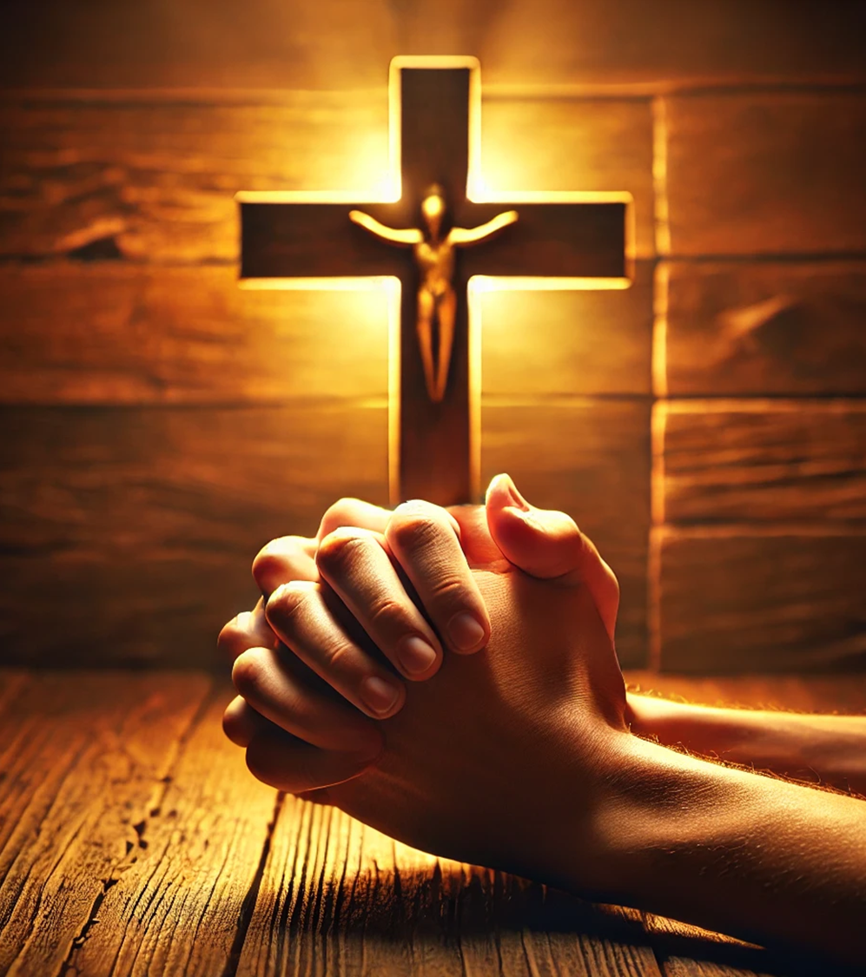
Context
ISRAELITE WORSHIP
In the Old Testament, the Israelites’ worship defined every aspect of their relationship with God. Deuteronomy 10:12–13 outlines the Israelites’ responsibilities toward the Lord: a relationship marked by reverence, honor, and love along with the confident trust in God’s faithfulness and provision. The Israelites were to serve Him by obeying His commands. Israelite worship included a wide array of liturgical expressions, both corporate and private: prayers, songs, laments, sacrifices, festivals, and reading and teaching the Law. These worship practices facilitated their relationship with God, but God was not pleased if they did not have the right heart attitude (Hosea 6:6).
Worship Is Restored
FAITHFUL TO HIS WORD
Just as God was faithful to restore the Jews to their homeland according to His promise in Jeremiah 29:10, He is faithful by preserving His people today. Paul writes to the Philippians with this encouragement: “I thank my God every time I remember you. . . He who began a good work in you will carry it on to completion until the day of Christ Jesus” (Phil. 1:3–6). God’s people can rest in Jesus, the Good Shepherd, amid the tumult of this restless world, with confidence that He will complete the good work He started in them—even when it is hard to see.
Notes:
ISRAELITE WORSHIP
Analysis Old-Testament worship encompassed reverence, obedience, and trust expressed through sacrifices, festivals, song, lament, and Torah instruction; rituals without right hearts offended God
Main Idea Relationship, not ritual alone, defined true worship.
Key Points
1. Deuteronomy 10:12–13 set the covenant ethic of love and service.
2. Practices ranged from private prayer to national feasts.
3. Prophets like Hosea condemned empty ceremony.
Summary Israel’s liturgy was a holistic lifestyle calling for sincere love manifest in obedient acts and honest emotions.
FAITHFUL TO HIS WORD
Analysis Just as Jeremiah’s 70-year promise of return proved true, Paul assures believers that God completes every work He begins (Philippians 1:6.
Main Idea God’s covenant faithfulness in history guarantees His perseverance in our lives.
Key Points
1. Return from exile fulfilled Jeremiah 29:10.
2. Christ’s shepherding sustains believers amid chaos.
3. Final completion awaits “the day of Christ Jesus.”
Summary Past restoration underlines present confidence: the same faithful God who rebuilt Israel is perfecting His church today.

Slide 12
Context
  The book of Ezra tells how Jews from the tribes of Judah and Benjamin returned to their homeland from exile in Babylon. That happened shortly after the fall of the Babylonian Empire to the Persians in 538 BC (Ezra 1:1–2:1), when the Persian king, Cyrus, issued a decree that allowed the return (Ezra 1:1-4; compare 2 Chronicles 36:22-23; Isaiah 44:28; 45:1, 13).
  The books of Ezra and Nehemiah chronicle the return in three distinct phases. Ezra 2:64- 65 reveals about 50,000 people in the first wave, making the arduous trip of over 800 miles. A later wave of returnees, coming under the leadership of Ezra, took exactly four months (Ezra 7:8-9).
  The primary purpose of the journey was to “[re]build the house of the Lord” in Jerusalem (Ezra 1:5). When that city was destroyed in 586 BC, there remained no nation of Judah, no capital city of Jerusalem, no temple, no royal palace, and no walls (2 Kings 25:8-17; compare 2 Chronicles 36:15-21). Normally, it would be impossible for a nation to come into existence again after an absence of more than half a century. But God was in this situation, and the impossible became not just possible but a reality. As Jeremiah stated, nothing is too difficult for God (Jeremiah 32:17).
  The temple’s rebuilding would require much effort, money, time, labor, and good leadership. An easier and quicker task would be to start rebuilding the temple’s altar of burnt offerings (see description in Exodus 38:1-7 and use in Leviticus 1:1-17; 6:8-13; also see lesson 4). And that’s where we begin our lesson.
Worship Is Restored
Notes:
CYRUS’S DECREE & FIRST RETURN
Analysis Ezra opens with King Cyrus’s 538 BC edict liberating Judean exiles and funding their journey, proving Yahweh can steer pagan powers.
Main Idea God initiates restoration through an unexpected ruler.
Key Points
1. Decree fulfills Isaiah’s prophecy of Cyrus (Isa 44–45).
2. Returnees are chiefly from Judah and Benjamin, preserving messianic lineage.
3. Divine sovereignty is evident in political history.
Summary The Persian proclamation turns exile into exodus, displaying God’s control over empires.
THREE-PHASE HOMECOMING
Analysis Ezra–Nehemiah records three waves: the first 50 000 travelers cover 800 mi, later groups follow under Ezra (458 BC) and Nehemiah (444 BC).
Main Idea Restoration unfolds incrementally through sustained obedience.
Key Points
1. The trek required months of perilous travel.
2. Leadership changed—Zerubbabel first, then Ezra, then Nehemiah.
3. Each phase addressed a fresh need: altar, teaching, walls.
Summary God’s plan advanced in stages, matching the community’s capacity and leadership gifts.
PURPOSE & DIVINE POSSIBILITY
Analysis Jerusalem lay without nation, palace, walls, or temple; rebuilding seemed impossible after fifty years, yet Jeremiah 32:17 declares nothing too hard for God.
Main Idea Human impossibility is God’s opportunity.
Key Points
1. Temple reconstruction defined the mission (“build the house of the Lord”).
2. National identity hinged on restored worship.
3. Prophetic assurance transformed despair into resolve.
Summary Although Judah’s institutions were ashes, covenant promise ensured rebirth beyond human capability.
ALTAR FIRST STRATEGY
Analysis Before tackling the costly temple, leaders rebuilt the burnt-offering altar—easier, quicker, but vital for daily sacrifice and communal atonement.
Main Idea Worship precedes infrastructure.
Key Points
1. Altar re-established covenant relationship immediately.
2. Early obedience fostered unity and courage amid opposition.
3. Setting sacrifices on the original base signaled continuity.
Summary By restoring the altar first, the exiles anchored their future in present worship, proving that right relationship with God is the true foundation of any rebuilding.

Slide 13
Rebuilding the Altar - Ezra 3:1–6 NIV
13
1 When the seventh month came and the Israelites had settled in their towns, the people assembled together as one in Jerusalem.
2 Then Joshua son of Jozadak and his fellow priests and Zerubbabel son of Shealtiel and his associates began to build the altar of the God of Israel to sacrifice burnt offerings on it, in accordance with what is written in the Law of Moses the man of God.
3 Despite their fear of the peoples around them, they built the altar on its foundation and sacrificed burnt offerings on it to the LORD, both the morning and evening sacrifices.
4 Then in accordance with what is written, they celebrated the Festival of Tabernacles with the required number of burnt offerings prescribed for each day.
5 After that, they presented the regular burnt offerings, the New Moon sacrifices and the sacrifices for all the appointed sacred festivals of the LORD, as well as those brought as freewill offerings to the LORD.
6 On the first day of the seventh month they began to offer burnt offerings to the LORD, though the foundation of the LORD temple had not yet been laid.
  Upon their return from exile, the Jews restored the altar first, for sacrifices were central to their worship.
  Joshua and Zerubbabel led the people of God in the process of building the altar.
  The Jews were careful to obey the Law of Moses.
  The people rebuilt the altar on its original foundation from before the exile.
  The daily sacrificial offerings needed to continue for the Jews to properly worship God.
  Even though they were afraid of the surrounding peoples, they celebrated festivals as the Law required.
Worship Is Restored
Notes:
><><><><><><><><><><><><><><><><><><>
Ezra 3:1–6 NIV
><><><><><><><><><><><><><><><><><><>
After the Jews returned to the promised land, their first task was to reinstitute their worship and sacrificial system. The people prioritized the rebuilding of the altar before anything else, even before they gathered the money and materials to rebuild the temple (v. 7). Without an altar, they were unable to offer sacrifices to the Lord. Ezra says the people “assembled together as one in Jerusalem” (v. 1). This communal atmosphere was crucial for their rebuilding efforts, which soon would face opposition. Sacrifices were supposed to begin on the first day of the seventh month, so the rebuilding had to be completed in time. Joshua and Zerubbabel led God’s people and organized the construction. Joshua’s name appears before Zerubbabel, who was the Jewish governor and heir to the Davidic throne. Joshua was a priest, so it was appropriate for him to initiate the reinstitution of Jewish worship. The Jews carefully built the altar according to the Law of Moses. The altar needed to be made with uncut fieldstones, and upon the foundation of the original altar (Ex. 20:25; Deut. 27:6). It was important to maintain the traditional place of sacrifices to the Lord; this showed continuity with the former temple and its system of worship— a true restoration and return to proper worship. By rebuilding the altar, the Jews expressed trust in God. The Jews were afraid of the neighboring people groups living within Judah who were not supportive of Jewish worship. When the Jews returned from exile, they met animosity and hostility from these people. The people restarted the daily offerings exactly as Moses had instructed (Num. 28:1–8) by sacrificing burnt offerings each day (v. 3). The people also celebrated the Festival of Tabernacles, a religious festival that recalled Israel’s wandering in the wilderness under God’s protection. Finally, the returned Jews offered proper sacrifices to commemorate the festivals, following Moses’ instructions in Leviticus 23:1–44. They brought freewill offerings to God, which meant they were worshiping Yahweh out of their own volition. Although the Jews had rebuilt the altar and established regular sacrifices, the temple was nonexistent, lacking even a foundation.
Analysis
Rebuilding the altar before collecting temple funds reveals the exiles’ conviction that restored relationship with God—through sacrifice—must precede any structural project. Jeshua the high priest rightly leads, emphasizing priestly priority, while governor Zerubbabel’s support blends religious and civic authority. Constructing the altar on its original foundation with uncut stones follows Torah mandates and signals continuity with pre-exilic worship. Fear of hostile neighbors heightens the act’s faith dimension: daily burnt offerings and the Festival of Tabernacles begin “exactly as Moses instructed,” demonstrating obedience and trust despite external threats.
Main Idea
True restoration starts at the altar: unified worship and covenant obedience anchor God’s people before any grand rebuilding can succeed.
Three Key Points
Altar-First Priority — Sacrifices had to recommence by the seventh-month deadline, so an altar—not a building—became step one in re-establishing communal life with God.
Law-Grounded Continuity — Using uncut fieldstones on the ancient base fulfilled Exodus 20:25 and Deuteronomy 27:6, visually linking post-exilic worship to Solomon’s era.
Courageous Obedience — Daily offerings and Tabernacles celebrations resumed “despite their fear” of surrounding peoples, showing that faith acts while danger persists.
Summary
Fresh from exile, Judah’s remnant “assembled as one” to rebuild the altar on its historic site before seeking money or materials for a new temple. Under Jeshua’s priestly leadership and Zerubbabel’s civil backing, they scrupulously followed Mosaic prescriptions, using unhewn stones and reinstating morning-and-evening burnt offerings, New-Moon rites, and the week-long Festival of Tabernacles. Performing these acts in the face of local hostility declared their dependence on God and continuity with their ancestors. The altar thus became both spiritual anchor and tactical starting point for the larger, slower work of temple reconstruction.
4. What did Joshua and Zerubbabel lead the people to do?
They tried to obey the Torah, which gives the time and manner for proper sacrifices. They rebuilt the altar of God, reestablished ongoing sacrifices, and celebrated the Feast of Tabernacles. The people did the best they could to honor God in a time of uncertainty.
5. Why did the Jews rebuild the altar first?
The altar of God was the place where God met His people and where they offered sacrifices for the atonement of sin. The altar was integral to Jewish worship, the most important way of showing honor to God.
6. How did the returning Jews view the people around them?
The Jews were surrounded by enemies and foreign peoples who had lived in the land during the time of exile. The Jews were afraid, yet rebuilt the altar despite their fear.
REBUILDING THE ALTAR

Slide 14
The Temple Construction Begins - Ezra 3:10–13 NIV
14
10 When the builders laid the foundation of the temple of the LORD, the priests in their vestments and with trumpets, and the Levites (the sons of Asaph) with cymbals, took their places to praise the LORD, as prescribed by David king of Israel.
11 With praise and thanksgiving they sang to the LORD: “He is good; his love toward Israel endures forever. ” And all the people gave a great shout of praise to the LORD, because the foundation of the house of the LORD was laid.
12 But many of the older priests and Levites and family heads, who had seen the former temple, wept aloud when they saw the foundation of this temple being laid, while many others shouted for joy.
13 No one could distinguish the sound of the shouts of joy from the sound of weeping, because the people made so much noise. And the sound was heard far away.
  The celebration at the completion of the temple’s foundation was similar to King Solomon’s celebration, which was held at the completion of the original temple.
  Despite the similarities between the two celebrations, this occasion was different, as the Jews had lost much.
  God’s people rejoiced at the completion of the temple’s foundation.
  God’s people mourned at the completion of the temple’s foundation. The sound of the joy and mourning was so loud that it could be heard from far away.
Worship Is Restored
Notes:
><><><><><><><><><><><><><><><><><><>
Ezra 3:10–13 NIV
><><><><><><><><><><><><><><><><><><>
As the builders constructed the temple’s foundation, the people responded in celebration. Ezra emphasizes the communal worship that took place, rather than dwelling on the details of the construction. The temple celebration in verses 10–13 is reminiscent of the celebration at the completion of Solomon’s temple (2 Chron. 5:1–14). In both celebrations, the priests sound trumpets and cymbals and lead a song of praise with the words of Psalm 100:5.
However, this celebration after the exile was different. There was no ark of the covenant, no visible glory of the Lord, and no great temple. As a people, the Jews had endured a great deal of suffering and humiliation, and the rebuilding of the altar was the first step in restoring God’s former dwelling place among them.
In verse 11, Ezra describes the people’s “great shout of praise. ” Their joy and thankfulness overflowed into enthusiastic exclamations. Still, their celebration was joined by weeping and sadness. The elders in the community remembered the grandeur of Solomon’s temple and recognized how inadequate the new altar appeared. The older generation might be disappointed with the new altar’s diminutive size, but the materials and craftsmanship were also inferior. The crowd’s mixed response of celebration and sadness was heard by neighboring peoples (v. 13).
Fresh from exile, Judah’s remnant “assembled together as one” in Jerusalem and rebuilt the altar before gathering a single stone for the temple. High-priest Jeshua and governor Zerubbabel blended religious and civic leadership, laying the altar on its original base and using uncut fieldstones—precisely as Torah required—thereby signaling continuity with pre-exilic worship .
Daily burnt offerings, New-Moon rites, and the week-long Festival of Tabernacles resumed “exactly as Moses instructed,” even though the temple foundation was absent .
Crucially, these acts were performed “despite their fear” of hostile neighbors, so worship itself became a public declaration of faith that God would protect and provide .
Main Idea
Restoration begins at the altar: unified, law-grounded worship and courageous obedience anchor God’s people before any grand rebuilding can succeed.
Three Key Points
1. Altar-First Priority Sacrifices had to restart on day one of the seventh month, so constructing an altar—not a building—was step one in re-establishing covenant life .
2. Law-Rooted Continuity Building on the original footprint with unhewn stones fulfilled Exodus 20:25 and Deuteronomy 27:6, visually linking post-exilic worship to Solomon’s era .
3. Courageous Obedience Daily offerings and Tabernacles celebrations resumed amid real danger, proving that faith acts while fear persists .
Summary
Returning exiles united to rebuild the burnt-offering altar on its historic site, enabling morning-and-evening sacrifices, New-Moon rites, and the Festival of Tabernacles long before a temple foundation existed. Led by priest Jeshua and governor Zerubbabel, they followed Mosaic specifications—uncut stones, original base—affirming seamless continuity with pre-exilic worship. Re-establishing sacrifice under hostile pressure expressed bold trust in God and welded the community together for the slower, costlier work ahead. Thus the altar became both spiritual anchor and tactical starting point, showing that genuine renewal of God’s people always begins with worship, not architecture&x20;
7. How did the Levites celebrate the rebuilding of the temple foundation?
To celebrate the rebuilding of the temple’s foundation, the priests dressed in ceremonial attire and carried their trumpets. The Levites, who were called the sons of Asaph, carried cymbals and praised God according to King David’s instructions. They sang praises to God, including a line from Psalm 100.
8. Why did some people weep?
Some of the older priests, Levites, and family leaders remembered the glory of the former temple. Solomon’s temple was adorned by the greatest craftsmen and was a wonder to behold. The second temple would not be the same. The older generation recognized what they had lost in the destruction of the temple, and they knew they would not be able to restore God’s dwelling place to its former grandeur.
THE TEMPLE CONSTRUCTION BEGINS

Slide 15
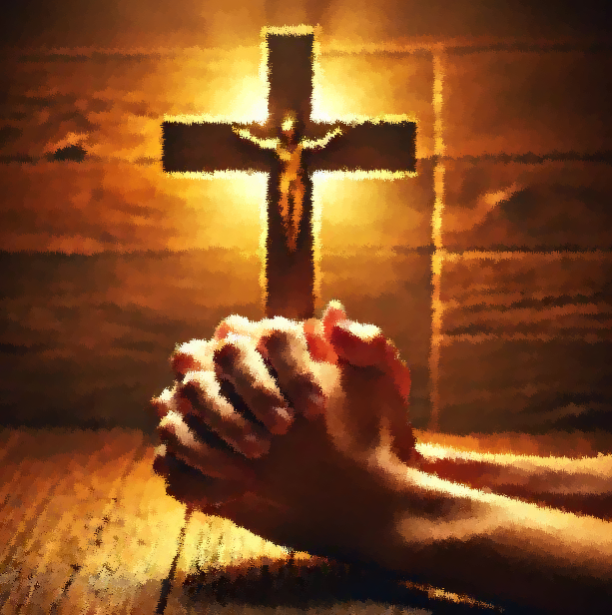
Bible Application:
Discuss how you might worship God when fearful circumstances arise.
15
WORSHIP GOD TO BATTLE FEAR
What if I am mocked for expressing my faith in Christ Jesus? What if people don’t like me? What if something bad happens? What if I die? These questions can tempt believers to fear. Fear has a way of grabbing our hearts and immobilizing us. In moments of fear or distress, it sometimes doesn’t make a lot of sense to worship God. Instead, we strain with our whole beings to fix the issue, to bring resolution to the situation, to do something! Or, we simply try not to think about the issue at all.
To pause and worship can feel nonsensical in the midst of trials. At least, it feels that way until we realize that we can’t fix our problems ourselves. As we come to realize that so many circumstances are out of our control, the idea of worship starts to make more sense. We must lay our quaking hearts at the feet of Jesus.
When we worship God, we are often reminded of the bigger context of our lives and gain the courage to face our fears. We remember who God is and who we are in Him. God is good (Ps. 100:5). He is in control. God is for us and not against us (Rom. 8:31–32). Our lives are secure in Him (Phil. 1:3–6). Death no longer has the last word upon our lives (1 Cor. 15:54–55). Through worship, we are bolstered with courage to face all kinds of fear. It is not that the feelings of fear necessarily go away, but that worship equips us with the courage we need to endure the fearful contexts that surround us.
Worship Is Restored
Notes:
Bible Application:
Summary
The article argues that worship is a God-given countermeasure to fear. When crises expose our inability to control outcomes, pausing to praise reframes reality: God is good (Psalm 100:5), for us (Romans 8:31-32), sovereign, and the giver of eternal security (Philippians 1:6; 1 Corinthians 15:54-55). Worship doesn’t erase fearful feelings but supplies courage to endure and act faithfully.

Slide 16
Bible Application:
Discuss how you might worship God when fearful circumstances arise.
16
WORSHIP GOD TO BATTLE FEAR
  9. How have you dealt with fearful situations in the past?
  10. How might worship change your perspective on the current, fearful contexts that you are in?
  11. How can you build a habit to worship God in the midst of fearful contexts?
Worship Is Restored
Notes:
9. Past responses to fear (62 words)
I’ve tended to fight, flee, or freeze—over-planning, seeking distractions, or succumbing to anxiety. Sometimes I rallied prayer partners or quoted Scripture, but often I relied on sheer willpower, which left me drained. Only when I deliberately turned to thanksgiving, singing psalms, and recalling God’s past faithfulness did my perspective shift from self-reliance to trust.
10. How worship reframes current fears (60 words)
Raising a song or prayer in the middle of uncertainty lifts my gaze from “what if” to “who is.” Declaring God’s character reminds me that trials are temporary scenes in a redemption story already won. Worship re-centers identity—I’m loved, secured, and indwelt by the Spirit—so threats lose their power to define my outlook or dictate my choices.
11. Building a worship habit amid fear (59 words)
Set trigger-points: every worry pang becomes a cue to recite a short doxology or Psalm 23 aloud. Schedule mini-liturgies—morning gratitude lists, midday worship playlists, bedtime Scripture songs. Join a small group committed to sharing testimonies weekly. Keep a journal of answered prayers to revisit during flare-ups. Regular practice trains the heart to default to praise instead of panic.

Slide 17

17
Conclusion
Worship Is Restored
Work as a Response to Grace
  Today’s Scripture text points not only to human endeavor but also to God’s mercy. His mercy makes our every endeavor possible and allows results. The story also signals God’s actions, to which humans respond. God had brought the Judeans home in something of a “second exodus,” allowing them to rebuild their world. The key question at that point was: Would their world also be His world? That question rings across the centuries to confront us today: Is your world His world?
Notes:
Analysis
Ezra’s narrative frames rebuilding as a two‑part movement: first God liberates and equips (grace); then the people labor (response). Mercy turns exile into “second exodus,” proving divine initiative precedes human effort. The ultimate issue is spiritual alignment: will the reconstructed society function as God’s domain or merely a self‑styled project?
Main Idea
All rebuilding efforts succeed only when they flow from—and remain surrendered to—God’s grace, making our restored world truly His.
Key Point 1
Grace precedes work: Persian permission, provision, and safe passage were God’s merciful gifts, without which labor was impossible; recognizing this prevents pride in human achievement.
Key Point 2
Work expresses gratitude: laying stones and restoring worship aren’t payback for grace but tangible thank‑yous, showing faith that God’s purposes guide civic and spiritual life.
Key Point 3
Continual discernment is vital: freshly built structures can quickly host old idols; the community must repeatedly ask whether policies, priorities, and daily rhythms reflect God’s rule.
Summary
Ezra pictures a gracious God initiating a “second exodus,” then inviting returned exiles to collaborate in rebuilding. Their craftsmanship, finances, and governance were meant to manifest allegiance to Him. The same question challenges modern believers: will our reconstructed careers, homes, and ministries serve God’s reign, or merely showcase human accomplishment? Our answer is measured in obedient, grace‑shaped labor.

Slide 18

Life Response:
Remember that life may shatter, but God’s love never does.
18
Worship Is Restored
The people of God had been exiled, removed from their home, their place of worship—it seemed like they had lost everything. But God hadn’t forsaken them, and He brought them back to their promised land. He was faithful, and always will be. The faithful God who brought His people out of exile is worthy to be praised
PRAY FOR WORSHIP
  Though life may shatter, God’s love never does. The exile effectively shattered the lives of the Jews. Yet many years later, God brought them back to their homeland. God was faithful to love His people then, and He will be faithful to His people now. He shows us His love by making us whole through the power of the Holy Spirit. Because of such love, we can worship Him amid fearful situations!
Notes:
LIFE RESPONSE: Remember that life may shatter, but God’s love never does.
.
Analysis
Exile shattered Israel’s sense of place, identity, and worship, yet God’s steadfast love orchestrated a return and restoration. The episode proves that divine faithfulness outlives human catastrophe. Today, the Spirit similarly heals fractured lives, inviting believers to worship even when fear or loss persists. Remembering past deliverance fuels present confidence in God’s unbreakable covenant love.
Main Idea
Human circumstances may crumble, but God’s loyal love endures, empowering His people to worship amid fear and brokenness.
Three Key Points
1. Unforsaken in Exile — Removal from land and temple felt like total loss, yet God’s promise remained active, guiding a “second exodus” home.
2. Love That Restores — The same covenant love that returned Judah now makes believers whole through the Holy Spirit’s renewing power.
3. Worship as Response — Remembering God’s faithfulness transforms fear into praise; adoration becomes a declaration that shattered lives are safe in Him.
SummaryIsrael’s exile shows that life can break, but God’s love cannot. He faithfully restored His people, proving worthy of praise. That unchanging love still heals fractured hearts through the Spirit, enabling worship in the face of fear. Thus, every believer can anchor hope not in unsteady circumstances but in God’s eternal, unshatterable fidelity.

Slide 19




  The Lord bless thee, and keep thee:
  The Lord make his face shine upon thee, and be gracious unto thee:
  The Lord lift up his countenance upon thee and give thee peace.
  - Numbers 6:24-26,
Material adapted by Stanford W. Bowman Jr. from Echoes® Adult and Bible-in-Life® Adult Spring 2025 quarter with permission, © David C Cook, https://davidccook.org. May not be further reproduced. All rights reserved.
Notes:
Prayer for Renewals and Restorations
Loving God, Your kindness and mercy never end. We come to You, knowing we need Your forgiveness. Please wash away our sins and give us clean hearts. Help us to have right attitudes and keep us close to You. Bring back the joy of following You, and help us live in a way that others can see Your love. In Jesus' name, we pray. Amen.
><><><><><><><><><
Merciful Father, Your love and compassions are boundless. We humbly come before You, acknowledging our deep need for Your endless grace. Cleanse us, O God, from our many sins, and create within us clean hearts. Renew right spirits within us. Cast us not away from Your presence, and restore to us the joy of Your salvation. Strengthen our spirits so we may walk in obedience and reflect Your mercy in our lives, that others may see and be drawn to You. In Jesus' name, we pray. Amen.

Slide 20
QUESTION & ANSWER
DAVID PLEADS FOR FORGIVENESS
Worship Is Restored
4. What was David’s state of mind as he wrote Psalm 51?
5. What did David ask of God in verse 2? Why?
6. Against whom did David sin? How did this affect his plea before God?
David is a broken man. He makes no attempt to justify himself, but rather confesses his sin to God and acknowledges his need for God’s mercy and forgiveness. David asks to be restored because of the nature of God’s character, “according to your unfailing love; according to your great compassion,” not because of anything he can do. David realizes that only God can “blot out [David’s] transgressions” (v. 1) and forgive him.
David asks God directly, “Wash away all my iniquity and cleanse me from my sin.” He then grieves over his sin and its effects upon him personally: “I know my transgressions, and my sin is always before me.” Because he recognizes his great offense before God, David’s sin and guilt are an unbearable weight.
“Against you, you only, have I sinned and done what is evil in your sight” (v. 4). Obviously, David had sinned against Uriah by arranging his death. But ultimately, David’s offense was against the God who had given them both life. God had seen it all, and He called David to account. Therefore, David had no defense; he would accept God’s judgment on him.
Notes:
DAVID PLEADS FOR FORGIVENESS
4. What was David’s state of mind as he wrote Psalm 51?
David is a broken man. He makes no attempt to justify himself, but rather confesses his sin to God and acknowledges his need for God’s mercy and forgiveness. David asks to be restored because of the nature of God’s character, “according to your unfailing love; according to your great compassion,” not because of anything he can do. David realizes that only God can “blot out [David’s] transgressions” (v. 1) and forgive him.
5. What did David ask of God in verse 2? Why?
David asks God directly, “Wash away all my iniquity and cleanse me from my sin.” He then grieves over his sin and its effects upon him personally: “I know my transgressions, and my sin is always before me.” Because he recognizes his great offense before God, David’s sin and guilt are an unbearable weight.
6. Against whom did David sin? How did this affect his plea before God?
“Against you, you only, have I sinned and done what is evil in your sight” (v. 4). Obviously, David had sinned against Uriah by arranging his death. But ultimately, David’s offense was against the God who had given them both life. God had seen it all, and He called David to account. Therefore, David had no defense; he would accept God’s judgment on him.

Slide 21
QUESTION & ANSWER
THE JOY OF SALVATION
Worship Is Restored
7. How did the focus of David’s prayer shift in verse 10?
8. What did David hope God would give him? How did David say he would respond?
9. What sacrifice did David believe God would accept?
Instead of repentance and pleading for forgiveness, David now focuses on restoration, of both his heart and his standing. He acknowledges that only God could “renew” him, and pleads, “Create in me a pure heart, O God, and renew a steadfast spirit within me” (v. 10). Only then will he be able to live in a steadfast way that pleases God.
David prays, “Restore to me the joy of your salvation and grant me a willing spirit, to sustain me” (v. 12). He asks that God will use him to “teach transgressors your ways, so that sinners will turn back to you” (v. 13). He hopes that God will “open my lips . . ., and my mouth will declare your praise” (v. 15). Freedom from sin will give David the freedom to sing God’s praises.
Once more, David acknowledges, “You do not delight in sacrifice, or I would bring it; you do not take pleasure in burnt offerings” (v. 16). There is but one thing that he can offer to God: “My sacrifice, O God, is a broken spirit; a broken and contrite heart, you, God, will not despise” (v. 17). A broken heart is an open heart, a sacrifice God can use.
Notes:
THE JOY OF SALVATION
7. How did the focus of David’s prayer shift in verse 10?
Instead of repentance and pleading for forgiveness, David now focuses on restoration, of both his heart and his standing. He acknowledges that only God could “renew” him, and pleads, “Create in me a pure heart, O God, and renew a steadfast spirit within me” (v. 10). Only then will he be able to live in a steadfast way that pleases God.
8. What did David hope God would give him? How did David say he would respond?
David prays, “Restore to me the joy of your salvation and grant me a willing spirit, to sustain me” (v. 12). He asks that God will use him to “teach transgressors your ways, so that sinners will turn back to you” (v. 13). He hopes that God will “open my lips . . ., and my mouth will declare your praise” (v. 15). Freedom from sin will give David the freedom to sing God’s praises
9. What sacrifice did David believe God would accept?
Once more, David acknowledges, “You do not delight in sacrifice, or I would bring it; you do not take pleasure in burnt offerings” (v. 16). There is but one thing that he can offer to God: “My sacrifice, O God, is a broken spirit; a broken and contrite heart, you, God, will not despise” (v. 17). A broken heart is an open heart, a sacrifice God can use.

Slide 22
  The Lord bless thee, and keep thee:
  The Lord make his face shine upon thee, and be gracious unto thee:
  The Lord lift up his countenance upon thee and give thee peace.
  - Numbers 6:24-26,
Material adapted by Stanford W. Bowman Jr. from Echoes® Adult and Bible-in-Life® Adult Spring 2025 quarter with permission, © David C Cook, https://davidccook.org. May not be further reproduced. All rights reserved.

