Slide 1
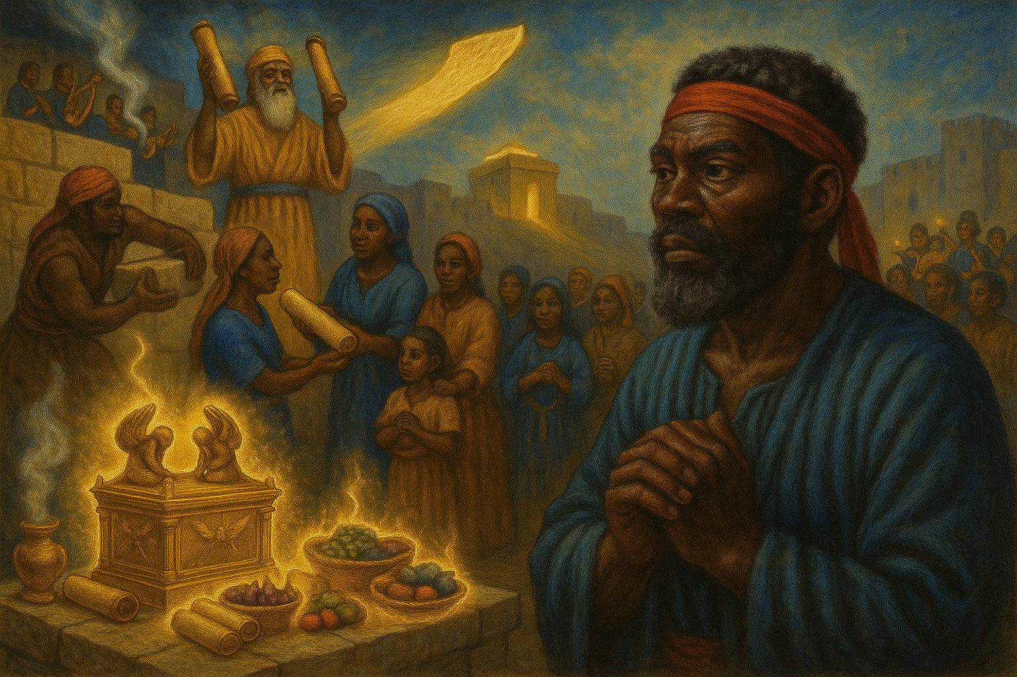
A Covenant Renewal
We will not forsake the house of our God.
—Nehemiah 10:39b KJV
Week of May 25

Slide 2
Prayer
  O God, our Creator and Sustainer, shape our commitments toward Your aims for our world. Grant us the rest that comes from trust in Your promises, the work that leads to a deeper love of our neighbors, and the confidence that You will be with us at all times. In Jesus’ name. Amen.
Thought to Remember
  Commitments translate into action; action translates into character.
Notes:
Prayer
O God, our Creator and Sustainer, shape our commitments toward Your aims for our world. Grant us the rest that comes from trust in Your promises, the work that leads to a deeper love of our neighbors, and the confidence that You will be with us at all times. In Jesus’ name. Amen.
Thought to Remember
Commitments translate into action; action translates into character.

Slide 3
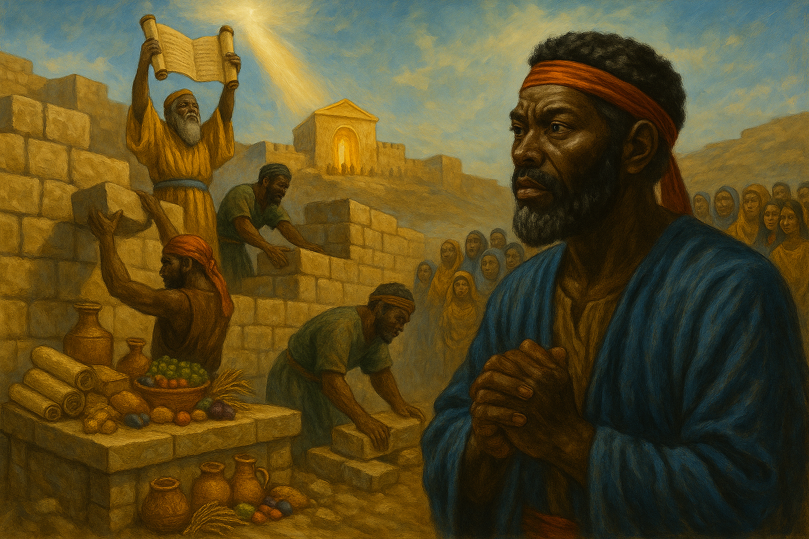
    Review
    Introduction
    Lesson Context
    Overview
      All The people Commit to Obey God’s Commands - Nehemiah 10:28–33 KJV
      All the People Commit to Care for the House of God - Nehemiah 10:34–39 KJV
    Bible Application
    Conclusion
    Question & Answers
  We will not forsake the house of our God.
—Nehemiah 10:39b KJV
Notes:
All The people Commit to Obey God’s Commands - Nehemiah 10:28–33 KJV
All the People Commit to Care for the House of God - Nehemiah 10:34–39 KJV
---------------------------------------------------------------------------------------------
Summary
Following Ezra’s public reading of the Law, every group in post-exilic Judah—priests, Levites, leaders, families—swears an oath (with a self-imposed curse) to live by Moses’ commands. They forbid intermarriage with pagan neighbors, refuse Sabbath trade, and pledge land rest plus debt release every seventh year. To keep worship functioning they impose an annual temple tax, rotate wood offerings, and present firstfruits, firstborn, and full tithes so sacrifices never cease and ministers are sustained. Their closing vow, “We will not forsake the house of our God,” seals this covenant renewal.
Commentary
Nehemiah’s generation understands that stone walls cannot protect a holy people unless obedience strengthens spiritual defenses. Their concrete, costly disciplines—protected marriages, economic restraint, sacrificial giving—repair the very breaches that once led Israel into exile: idolatry, Sabbath neglect, and temple abandonment. By sharing responsibilities across clans, they institutionalize faithfulness and place worship at the community’s core. For modern believers, the passage insists that covenant love still requires intentional structures—calendars, budgets, and relational boundaries—so God’s presence, not prevailing culture, shapes our identity and witness.

Slide 4
Identity in Uncertain Times
One of the great challenges of our time is maintaining our identity as Christians. This is important for reasons listed in Matthew 5:13-16; John 13:35; 2 Corinthians 8:21; etc. The apostle Paul stressed a personal goal to be “made all things to all men, that I might by all means save some”
(1 Corinthians 9:22). But he knew there were lines he could not cross lest his identity as a Christian be compromised. The enduring challenge is ensuring we do not allow surrounding culture to draw those lines. The Judeans of the mid-fifth century BC faced a similar challenge.
Notes:
Main Idea
Christian identity must be guarded by biblical boundaries—even while we adapt our methods to reach others—so that surrounding culture does not define who we are.
Three Key Points
Visible Witness Matters (Matt 5:13-16; John 13:35; 2 Cor 8:21): believers are called to be recognizable “salt” and “light,” displaying integrity that commends the gospel.
Flexible but Faithful (1 Cor 9:22): like Paul, Christians may adjust to different audiences, yet must never cross lines that compromise doctrine or holiness.
Historical Warning: Judeans in the mid-fifth century BC struggled with the same tension; capitulating to pagan norms threatened their covenant identity.
Analysis
The paragraph links present-day cultural pressures with biblical examples to show that identity preservation is a timeless struggle. Paul’s missionary strategy models cultural engagement without surrendering ethical distinctiveness. The reference to post-exilic Judeans underscores how losing spiritual markers—worship practices, marital purity, Sabbath observance—led to identity erosion. Thus, authentic Christian living requires conscious limits, drawn by Scripture rather than society.
Summary
Both Scripture and history teach that Christians must remain culturally aware yet scripturally anchored. We can adapt our approach to win people, but we cannot let culture redraw the moral and theological lines that define us in Christ.

Slide 5
Lesson Overview
Nehemiah begins by describing his tears over the state of Jerusalem, its gates broken and burned after God’s people were exiled. Nehemiah desired to reconstruct the city walls to protect the newly built temple. Walls would provide physical protection for the city, but Nehemiah knew there was a greater enemy: he warned that moral compromise might lead the Jews away from God.
Paul addressed judgment in the first part of his letter to the Romans. Then, in Romans 3:21, he began laying out teaching concerning justification. The focus: God’s forgiveness for every human being who believes in Him.
Paul outlined the new covenant in the Book of Romans. Jesus Christ extended His hands to all humanity when He died on the Cross and offered salvation. This new agreement has nothing to do with a personal merit system but with God’s grace. The Father’s righteousness is given through the Son, entirely apart from human effort.
Notes:
Nehemiah’s Burden for Jerusalem
Main Idea: Spiritual integrity, not masonry, is the city’s true defense.
Analysis
Nehemiah 1 shows a court official moved to tears when he learns Jerusalem’s walls and gates are shattered. His resolve to rebuild is practical—protecting temple and populace—but his deeper insight is theological: physical fortifications are meaningless if the nation again lapses into sin. By calling sin the “greater enemy,” Nehemiah reframes construction as an act of covenant faithfulness, linking social reform to spiritual renewal.
Three Key Points
1. Lament leads Nehemiah to prayer, repentance, and action.
2. Walls symbolize restored identity centered on God’s presence.
3. Moral vigilance must accompany civic projects.
Summary (≤ 100 words)
Nehemiah’s tears birth a plan to rebuild Jerusalem’s walls, yet he insists the real battle is against moral compromise that could nullify any physical security.

Slide 6
Lesson Overview
Nehemiah begins by describing his tears over the state of Jerusalem, its gates broken and burned after God’s people were exiled. Nehemiah desired to reconstruct the city walls to protect the newly built temple. Walls would provide physical protection for the city, but Nehemiah knew there was a greater enemy: he warned that moral compromise might lead the Jews away from God.
Renewed convent—
In Nehemiah 10, several prominent citizens of Judah seal a covenant renewal. The agreement includes Nehemiah, the governor, the community of priests and Levites, and the people’s chiefs. Their authority would influence the rest of the congregation, who agree to separate themselves from the foreigner practices around them. The remaining exiles make the same covenant. If they wandered away from the instructions of the Lord, they gave Him permission to correct them and bring them back into obedience.
First, they prohibit marriages between the remnant of Israel and foreigners. Parents vow not to give their daughters in marriage to the foreign residents of the land. Second, they promise not to buy or sells anything on the Sabbath. Third, they vow to be faithful to the system of worship. The people commit a yearly tax to support the maintenance of the temple. They also bring their firstborn of livestock and produce to go to God’s house.
Notes:
Covenant Renewal in Nehemiah 10
Main Idea: Judah’s leaders bind the nation to distinct, accountable holiness.
Analysis (≤ 100 words)
Chapter 10 records a public, written oath—sealed by Nehemiah, priests, Levites, and clan chiefs—that re-establishes boundaries eroded during exile. They invoke a self-curse if they betray Torah, stressing communal responsibility. Core pledges address three fault-lines that once triggered judgment: intermarriage, Sabbath commerce, and neglect of temple support. Annual taxes, firstfruits, and tithes finance continual worship, ensuring priests and Levites can minister.
Three Key Points
1. Leadership commitment inspires full congregational buy-in.
2. Separation safeguards covenant identity against foreign influence.
3. Financial and liturgical obligations keep worship central.
Summary (≤ 100 words)
Judah’s remnant signs a stringent covenant to guard marriages, Sabbaths, and temple worship, inviting divine discipline if they drift—thus institutionalizing faithfulness for future generations.

Slide 7
Lesson Overview
Nehemiah begins by describing his tears over the state of Jerusalem, its gates broken and burned after God’s people were exiled. Nehemiah desired to reconstruct the city walls to protect the newly built temple. Walls would provide physical protection for the city, but Nehemiah knew there was a greater enemy: he warned that moral compromise might lead the Jews away from God.
The new covenant—
Any agreement with God should begin with our praying, Father, You are Lord of my life, I will follow You without reserve. Obedience is better than giving up material things, and obedience can only come from the heart. Should we be in doubt or lack confidence, it would be wise to ask the Lord to examine us. Who knows the heart better than the Lord (see Pss. 26:2; 11:4)? According to Jeremiah, the Lord cares for those who are His and will perform His eternal promise (Jer. 31:31-34).
Notes:
3. The New-Covenant Perspective
Main Idea: True covenant starts with heart-level obedience grounded in God’s promise.
Analysis
Every agreement with God must begin, “Father, You are Lord of my life.” Outward sacrifices mean little without inward surrender. Psalmists plead for divine examination because only God discerns hidden motives. Jeremiah 31:31-34 foretells a covenant written on hearts, guaranteeing divine enablement and forgiveness. The emphasis moves from external compliance to internal transformation, underscoring that stewardship, worship, and ethical boundaries flow from a regenerated heart.
Three Key Points
1. Wholehearted submission precedes any material offering.
2. Obedience is a matter of inward renewal, not mere rule-keeping.
3. God pledges to inscribe His law and sustain His people eternally.
Summary
Lasting covenant life requires Spirit-empowered obedience springing from a yielded heart; God Himself secures this by writing His law within and fulfilling His eternal promises.

Slide 8
Lesson Overview
Failure of Leadership—
Israel and Judah’s rulers had a long history of moral compromise as they struggled to adhere to the Mosaic covenant. Before the exile, the rulers frequently strayed from God’s commandments. Starting with Solomon, many kings chased after foreign gods and led the people to worship those gods (1 Kings 11:1–8). After the exile, Nehemiah and Ezra called the people back to God by reading from the Law and asking the people of Judah to affirm their commitment to the covenant (Neh. 8:1–18). Their restored commitment required obedience to God’s standards (Neh. 10:28–39).
Notes:
Failure of Leadership
Main Idea
Israel’s kings repeatedly abandoned God’s standards, showing how compromised leaders endanger the covenant community.
Three Key Points
1. Solomon’s turn to foreign gods set the pattern for later royal apostasy (1 Ki 11:1-8).
2. Persistent disobedience by rulers dragged the nation into exile.
3. Ezra and Nehemiah countered that legacy by re-centering public life on God’s Law (Neh 8–10).
Analysis
Spiritual decline typically begins at the top; what leaders tolerate becomes normal for the people. Pre-exilic monarchs crossed God-given boundaries to secure political alliances, shrinking Yahweh to one deity among many. Exile proved the futility of that strategy. Post-exilic reformers therefore fused civic rebuilding with public Scripture reading and covenant renewal, teaching that Jerusalem’s security rests on obedient leadership.
Summary
When leaders trade holiness for expedience, the entire nation suffers; true restoration starts with leaders who submit to God’s Word.
---

Slide 9
Lesson Overview
Restoring the Covenant—
The language of “all” the people binding themselves to a “curse and an oath” in verse 29 echoes a parallel with the initial communal covenant found in Deuteronomy 27–29. In the wilderness, the people of Israel entered into a covenant with God, promising to obey the entirety of the Mosaic Law. This commitment entailed blessings for obedience and curses for disobedience (see Deut. 28). Similarly, the Israelites in Nehemiah 10 restored their covenant by publicly promising to follow God’s commandments. The restoration of their covenant involved three key elements outlined in verses 28–34: strict adherence to the marriage code, observance of the Sabbath, and care for God’s house. Just as in the wilderness, where covenant obedience led to blessings and disobedience resulted in curses, the people in Nehemiah 10 recognized the gravity of their commitment to God’s law.
Notes:
Restoring the Covenant
Main Idea
Nehemiah 10 reenacts Sinai: the whole community binds itself to blessings for obedience and curses for rebellion.
Three Key Points
1. The oath echoes Deuteronomy 27–29’s communal covenant ritual.
2. Core pledges cover marriages, Sabbaths, and temple support (Neh 10:30-34).
3. Public signatures make leaders and laity mutually accountable.
Analysis
By reviving the curse-and-oath formula, Judah signals that exile did not nullify God’s covenant; it highlighted its seriousness. The three specific pledges address failures that once triggered judgment. Written names and a self-imposed curse transform private piety into communal guardianship, creating structural safeguards for holiness.
Summary
Judah re-affirms Sinai in stone and ink, promising concrete obedience and accepting discipline if they stray.

Slide 10
Lesson Overview
Jesus, the Firstborn Son—
Covenant—
Nehemiah 10:36 echoes Exodus as the Israelites pledge to dedicate the firstborn of their livestock and children to God’s house. In Exodus 12, during the tenth plague, God instructed the Israelites to mark their doorposts with lamb’s blood, ensuring their households were spared. Even after their deliverance from Egypt, God commanded the dedication of firstborn livestock and sons (Ex. 13:12). Nehemiah asks Judah to continue this practice, emphasizing that even their posterity belong to God. This theme of the firstborn continued throughout the Old Testament, culminating in the New Testament at the advent of Jesus Christ. Jesus is acknowledged as the firstborn Son of God, consecrated for divine service (Luke 2:7; Rom. 8:29). However, Jesus’ role as the firstborn is unique: His blood as the Son of God can atone for the sins of the world. Through faith in Jesus, all believers attain to the status of God’s children (see Gal. 3:26).
A covenant is another term for an ancient agreement with mutual expectations between parties (and often includes consequences if the agreement is broken). Some examples of Old Testament covenants include God’s covenant with Noah in Genesis 9:11–17, where God promised that He would never deluge the earth with water ever again. The rainbow was a visible sign of this covenant, symbolizing His unwavering promise. God made an agreement with Abraham in Genesis 17:1–14, promising to bless him and multiply his descendants to be as numerous as the stars. God gave Abraham circumcision as a tangible sign of this covenant. The covenant being restored in Nehemiah 10 goes all the way back to Mount Sinai (Ex. 19–24). God promised to be Israel’s God with these as His people, as long as they obeyed the requirements that He gave. Among other laws, Sabbath served as a distinctive sign of this covenant relationship (Ex. 31:12–18).
Notes:
Jesus, the Firstborn Son
Main Idea
Jesus embodies the firstborn dedication motif, offering His blood for universal redemption.
Three Key Points
1. Exodus required consecrating every firstborn after the Passover deliverance (Ex 13:12-15).
2. Nehemiah revives the practice to remind Judah their progeny belong to God (Neh 10:36).
3. Christ, the Firstborn, is uniquely qualified to redeem humanity (Luke 2:7; Rom 8:29).
Analysis
The firstborn principle moves from animal substitution to Christ’s selfsacrifice. Whereas Israel redeemed firstborn sons with a lamb, God redeems the world with His Son. Believers, united to the Firstborn, gain filial status and inheritance (Gal 3:26).
Summary
The dedication of firstborns culminates in Jesus, whose atoning blood secures adoption for all who believe.
====================================================
Covenant
Main Idea
Biblical covenants are divine-human agreements sealed with signs, stipulations, and consequences.
Three Key Points
1. Noahic, Abrahamic, Mosaic, and other covenants feature promises plus visible tokens (rainbow, circumcision, Sabbath).
2. Sabbath served as Israel’s unique badge of allegiance (Ex 31:12-18).
3. Nehemiah’s renewal links directly to the Sinai covenant’s requirements.
Analysis
Each covenant reveals facets of God’s redemptive plan, escalating from universal mercy (Noah) to national vocation (Abraham, Sinai) to eschatological fulfillment (new covenant). Signs act as daily reminders of relational obligations and divine faithfulness.
Summary
Covenants stitch Scripture together, showcasing God’s steadfast promises and the human response of obedient trust.

Slide 11
Lesson Overview
God’s Great Love—
The people commit themselves to following God’s commandments because of His merciful character. Only a chapter earlier, several Levites led the people in a time of confession and petition. They recalled the failings of their forefathers and remembered that, despite Israel’s failure, God remained faithful to His “covenant of love” over and over again (9:32). They cried, “But in your great mercy you did not put an end to them or abandon them, for you are a gracious and merciful God” (9:31). Without God’s mercy, no hope would remain for the people of God.
Notes:
God’s Great Love
Main Idea
Divine mercy, not human resolve, makes covenant renewal possible.
Three Key Points
1. Israel’s history is a cycle of failure met by God’s “covenant of love” (Neh 9:32).
2. Confession precedes commitment; grace fuels obedience.
3. God’s gracious character sustains hope for restoration.
Analysis
Levitical leaders rehearse national sin to magnify God’s patience. Their prayer frames covenant faithfulness as divine initiative: despite rebellion, God preserves a remnant and invites renewed fellowship. Mercy thus becomes both the motive and the means for keeping His commands.
Summary
Every pledge of obedience rests on the bedrock of God’s unfailing grace, which repeatedly restores His people to Himself.

Slide 12
Lesson Context
The year was about 444 BC, and the Judeans, led by Nehemiah, formed a tiny part of the vast Persian Empire. Nehemiah held a high post in that empire as the king’s cupbearer (Nehemiah 1:11). Most of the empire’s subjects worshipped numerous fictitious gods. Therefore, the Judeans had to draw firm lines between themselves and their neighbors in order to maintain their distinctive identity as the consecrated people of the one true God. A failure to do so was what had led to the Babylonian exile in the first place (13:17-18). The stakes couldn’t be higher!
The book of Nehemiah as a whole recounts the story of a later generation of Judeans having returned to Jerusalem and Judah in the third of three waves to do so. As such, the Lesson Context from last week’s lesson also applies here. In particular, the original purpose of Nehemiah’s trip to Jerusalem was to rebuild the city’s walls (Nehemiah 1–4; 6:1-15). That was nearly 100 years after the first wave of exiles had returned!
Nehemiah, working with Ezra—a scribe of the law (Ezra 7:6; Nehemiah 8)—understood that while physically protecting the city was vital, maintaining the spiritual defenses of the people was even more critical. Nehemiah 8 records a time of concentrated teaching from God’s law followed in chapter 9 by confession of sin.
This recommitment to God involved two general categories: commitments to stop doing certain things and commitments to start or continue doing other things.
Notes:
Section 1 – Historical Context and Identity
Main Idea
A minority of Judeans inside a polytheistic Persian Empire had to draw unmistakable lines to preserve their covenant identity.
Three Key Points
Nehemiah, though cupbearer to Artaxerxes, felt acute grief for Jerusalem’s ruins.
Polytheism pressed the remnant to conform; previous compromise had triggered Babylonian exile.
Distinctiveness as God’s people was non-negotiable: failure meant repeating history.
Analysis
Nehemiah frames identity as a life-or-death matter. Political power cannot substitute for spiritual fidelity; the community’s survival hinges on visible separation from surrounding pagan practices.
Summary
In 444 BC the Judeans faced cultural assimilation on every side, so Nehemiah called them to renewed holiness that would guard them from another exile.
Section 2 – The Book of Nehemiah and the Return Waves
Main Idea
Nehemiah chronicles the third and final wave of returnees, nearly a century after the first, highlighting wall-building as a symbol of restored nationhood.
Three Key Points
Three staged returns mark a prolonged restoration process.
Rebuilding Jerusalem’s walls supplied civic protection and national morale.
The narrative sets physical reconstruction within God’s larger redemption plan.
Analysis
The book’s timeline shows how covenant repair is incremental and God-directed. Walls serve not merely as defenses but as public proof that Israel remains God’s chosen people despite exile.
Summary
Nehemiah’s memoir situates the wall project as the capstone of a hundred-year return, demonstrating God’s faithfulness and Israel’s incremental recovery.
Section 3 – Nehemiah, Ezra, and Spiritual Fortification
Main Idea
Physical security is meaningful only when coupled with teaching, confession, and obedience to God’s law.
Three Key Points
Ezra reads and explains Torah; Nehemiah administers civic renewal.
Public exposure to Scripture sparks collective repentance (Nehemiah 8–9).
Spiritual reformation safeguards the city more effectively than masonry alone.
Analysis
The partnership of statesman and scribe models holistic leadership: structural projects and scriptural instruction operate in tandem, each reinforcing the other.
Summary
Nehemiah and Ezra unite city-building with heart-building, proving that walls without worship are brittle defenses.
Section 4 – Two-Sided Recommitment
Main Idea
Renewal demanded abandoning former sins and embracing positive duties that kept covenant life vibrant.
Three Key Points
“Stop” list: intermarriage with pagans, Sabbath violations, temple neglect.
“Start/continue” list: Sabbath rest, financial support of worship, firstfruits offerings.
Public vows made every household accountable.
Analysis
By specifying both prohibitions and practices, the covenant becomes practical, measurable, and communal, turning abstract faith into daily habit.
Summary
The restored community pledges to cut ties with corrupting influences and to cultivate disciplines that express loyalty to the Lord, ensuring that their renewed walls enclose a truly holy people.

Slide 13
All The people Commit to Obey God’s Commands - Nehemiah 10:28–33 KJV
28 And the rest of the people, the priests, the Levites, the porters, the singers, the Nethinims, and all they that had separated themselves from the people of the lands unto the law of God, their wives, their sons, and their daughters, every one having knowledge, and having understanding;
29 They clave to their brethren, their nobles, and entered into a curse, and into an oath, to walk in God’s law, which was given by Moses the servant of God, and to observe and do all the commandments of the LORD our Lord, and his judgments and his statutes;
30 And that we would not give our daughters unto the people of the land, not take their daughters for our sons:
31 And if the people of the land bring ware or any victuals on the sabbath day to sell, that we would not buy it of them on the sabbath, or on the holy day: and that we would leave the seventh year, and the exaction of every debt.
32 Also we made ordinances for us, to charge ourselves yearly with the third part of a shekel for the service of the house of our God;
33 For the shewbread, and for the continual meat offering, and for the continual burnt offering, of the sabbaths, of the new moons, for the set feasts, and for the holy things, and for the sin offerings to make an atonement for Israel, and for all the work of the house of our God.
All the Jews gathered together in order to bind themselves to God with a curse and oath, which reflected their forefathers’ covenant with God.
The people separated themselves from the foreigners in the land in order to protect themselves from sinning against God, as was instructed in the Law.
The people sought to honor the Sabbath as a day of rest, which reminded them that they were once slaves in Egypt and could not rest.
Running God’s temple required regular offerings from the people.
The priests relied upon regular offerings from the people to sustain themselves and to offer sacrifices for sin.
Notes:
><><><><><><><><><><><><><><
Nehemiah 10:28–33 NIV
28 “The rest of the people— priests, Levites, gatekeepers, musicians, temple servants and all who separated themselves from the neighboring peoples for the sake of the Law of God, together with their wives and all their sons and daughters who are able to understand—
29 all these now join their fellow Israelites the nobles, and bind themselves with a curse and an oath to follow the Law of God given through Moses the servant of God and to obey carefully all the commands, regulations and decrees of the LORD our Lord.
30 “We promise not to give our daughters in marriage to the peoples around us or take their daughters for our sons.
31 “When the neighboring peoples bring merchandise or grain to sell on the Sabbath, we will not buy from them on the Sabbath or on any holy day. Every seventh year we will forgo working the land and will cancel all debts.
32 “We assume the responsibility for carrying out the commands to give a third of a shekel each year for the service of the house of our God:
33 for the bread set out on the table; for the regular grain offerings and burnt offerings; for the offerings on the Sabbaths, at the New Moon feasts and at the appointed festivals; for the holy offerings; for sin offerings to make atonement for Israel; and for all the duties of the house of our God.
><><><><><><><><><><><><><><
After gathering to celebrate the Festival of Tabernacles and hear Ezra read the Law, the people fasted, confessed their sins, and met to make a “binding agreement” (9:38) to obey the Lord. The “rest of the people” refers to the residents of Judah who were not numbered among the leaders in 10:1–27. The people gathered to separate from all foreigners who would tempt them to disobey the law. The Jews promised to keep their sons and daughters from marriage with foreigners who do not worship God (v. 30).
The people also promised that they would not purchase food on the Sabbath (v. 31). They would return to the strict observance of Sabbath as God required. The Sabbath day reminded God’s people that God was their creator and that they were once slaves in Egypt, without any allowance for rest (Deut. 5:12–15).
God’s people also agreed to offer “a third of a shekel” for the house of God every year. Priests, who had no inheritance of land, relied on the contributions of others in order to serve God in the temple. Only through regular offerings could the temple continue to operate and give the proper sacrifices for sin.
Main Idea
After corporate repentance, the post-exilic community seals a covenant that secures three pillars of identity—holy marriages, Sabbath integrity, and sustained worship—so Israel’s daily life remains visibly loyal to the Lord.
Three Key Points
1. Marital Boundaries (v. 30): Parents vow to prevent unions with idolatrous foreigners, protecting faith and lineage from syncretism.
2. Economic Sabbath (v. 31): Refusing to buy food on the Sabbath reasserts God’s creatorship and their redeemed freedom.
3. Temple Support (v. 32): An annual third-shekel tax underwrites sacrifices and priestly livelihood, keeping atonement central.
Analysis
Each promise repairs a fracture that once led to exile: intermarriage blurred covenant distinctions; Sabbath neglect exposed profit-driven hearts; and lapses in temple funding silenced sacrificial worship. By addressing family, commerce, and cult, the pledge integrates faith into all spheres. The voluntary self-binding (“binding agreement”) shows communal ownership of holiness, transforming abstract law into enforceable practice.
Summary
The remnant, freshly taught by Ezra and sobered by fasting, vows to guard marriages, honor Sabbath economics, and finance temple service—concrete steps that weave covenant fidelity into home, market, and sanctuary.

Slide 14
All the People Commit to Care for the House of God - Nehemiah 10:34–39 KJV
34 And we cast the lots among the priests, the Levites, and the people, for the wood offering, to bring it into the house of our God, after the houses of our fathers, at times appointed year by year, to burn upon the altar of the Lord our God, as it is written in the law:
35 And to bring the firstfruits of our ground, and the firstfruits of all fruit of all trees, year by year, unto the house of the Lord:
36 Also the firstborn of our sons, and of our cattle, as it is written in the law, and the firstlings of our herds and of our flocks, to bring to the house of our God, unto the priests that minister in the house of our God:
37 And that we should bring the firstfruits of our dough, and our offerings, and the fruit of all manner of trees, of wine and of oil, unto the priests, to the chambers of the house of our God; and the tithes of our ground unto the Levites, that the same Levites might have the tithes in all the cities of our tillage.
38 And the priest the son of Aaron shall be with the Levites, when the Levites take tithes: and the Levites shall bring up the tithe of the tithes unto the house of our God, to the chambers, into the treasure house.
39 For the children of Israel and the children of Levi shall bring the offering of the corn, of the new wine, and the oil, unto the chambers, where are the vessels of the sanctuary, and the priests that minister, and the porters, and the singers: and we will not forsake the house of our God.
Everyone commits to obey God’s commands.
The people provide wood to burn at the altar, to adhere to the Law (Lev. 6:12–13).
Firstfruit offerings would be given and display God’s ownership of all things.
The people will offer firstborns of livestock and male children for service to God, a reminder of the Passover and Israel’s rescue from Egypt.
The people promise to give regular financial support for the temple’s upkeep.
Notes:
><><><><><><><><><><><><><><
Nehemiah 10:34–39 NIV
34 “We—the priests, the Levites and the people—have cast lots to determine when each of our families is to bring to the house of our God at set times each year a contribution of wood to burn on the altar of the Lord our God, as it is written in the Law.
35 “We also assume responsibility for bringing to the house of the Lord each year the firstfruits of our crops and of every fruit tree.
36 “As it is also written in the Law, we will bring the firstborn of our sons and of our cattle, of our herds and of our flocks to the house of our God, to the priests ministering there.
37 “Moreover, we will bring to the storerooms of the house of our God, to the priests, the first of our ground meal, of our grain offerings, of the fruit of all our trees and of our new wine and olive oil. And we will bring a tithe of our crops to the Levites, for it is the Levites who collect the tithes in all the towns where we work.
38 A priest descended from Aaron is to accompany the Levites when they receive the tithes, and the Levites are to bring a tenth of the tithes up to the house of our God, to the storerooms of the treasury.
39 The people of Israel, including the Levites, are to bring their contributions of grain, new wine and olive oil to the storerooms, where the articles for the sanctuary and for the ministering priests, the gatekeepers and the musicians are also kept. “We will not neglect the house of our God. ”
><><><><><><><><><><><><><><
The Jewish people made four promises. First, they would supply the altar with wood for sacrifices (v. 34; see Lev. 6:12–13). Second, they promised to give the “firstfruits” of the harvest of crops and fruits (v. 35; see Lev. 23:9–14). The firstfruits supported the temple with food and were a reminder that God owned everything. Third, they promised to consecrate any firstborn livestock and firstborn male children to God’s service (v. 36). This reflected the time of the exodus, when God designated that every firstborn belonged to Him (see Ex. 13:2). Finally, the people promised to offer a tithe, meaning a tenth of their earnings, to stock the rest of the temple’s needs (v. 38). The temple’s operation depended on this financial support from all people. The section ends with an affirmative declaration from the residents of Judah: “We will not neglect the house of our God” (v. 39).
Main Idea
The covenant concludes with four concrete commitments that ensure continual worship and declare God’s ultimate ownership of Israel’s resources and future.
Three Key Points
Continuous Flame: Supplying wood keeps the altar fire uninterrupted, symbolizing unceasing devotion (v. 34; Lev 6:12-13).
Acknowledged Ownership: Firstfruits and firstborn offerings return the best of harvest, herds, and households to God, recalling Exodus deliverance (vv. 35-36; Ex 13:2).
Shared Provision: A full tithe from every family finances priests, Levites, and temple operations, making worship a collective responsibility (v. 38).
Analysis
Each promise repairs past neglect by addressing a specific temple need—fuel, food, personnel, and funding. Together they weave covenant faith into agrarian, familial, and economic life, teaching that true renewal costs something tangible. The climactic vow, “We will not neglect the house of our God,” turns pious intent into accountable action, anchoring national identity around sustained, God-centered worship.
Summary
By pledging wood, firstfruits, firstborn, and tithes, Judah publicly vows never again to starve, silence, or sideline temple worship, thereby safeguarding its covenant relationship with the Lord.

Slide 15
Bible Application:
Discuss that obedience requires trusting that God’s way is best.
Restorative Obedience
As the sermon began, I settled into my seat to listen. As the pastor spoke, the message hit me: Obeying God is hard. I don’t like to think about my sin, but obedience requires a level of internal recognition, requires me to recognize that I have selfish desires I need to overcome. It is easy to say that I love my spouse, but it’s a lot harder to do the unselfish things, like be the one to stay up with our child, when all I want is sleep. It is easy to say that I love my neighbor, but it’s hard to spend my day off helping him to move. “It’s easy to go about life as if you are the center of the universe,” said my pastor. As I processed those words, I found myself offering excuses. But as John says, “Let us not love with words . . . but with actions” (1 John 3:18). I don’t think obedience has ever been easy.
Today’s lesson displays God’s restoration, the offer to return to God in specific ways. The people of Judah commit to enter marriages only within their community. They provide the priests with all the items essential for the reinstitution of sacrifices. And they seek their God through heartfelt offerings. Obedience is not a cage that confines their lives. Through obedience, the people of God find abundant life and a future hope, one that will only be fulfilled by a new covenant and the freedom it offers.
Obeying God can be hard! That’s something I’m not proud to admit. When I am tired, all I can think about is how difficult it would be to serve my spouse. But obedience produces the fruit of life, and I can obey God because Jesus has set me free from the enslaving powers of sin. There is life and something good on the other side of restoration.
Notes:
True obedience demands trusting that God’s design, not our comfort, yields life. Judah’s post-exilic pledges—pure marriages, temple support, heartfelt offerings—show that obedience restores identity and hope. Likewise, believers move from self-centered excuses to action-based love (1 Jn 3:18), discovering that Christ’s freeing grace turns sacrifice into abundance.
9. Hardest times to obey God
Obedience feels toughest when fatigue, convenience, or self-interest dominate—late-night childcare, surrendering leisure to help others, or denying impulses for comfort or recognition. In such moments the heart resists self-emptying service, revealing the clash between ingrained selfishness and Christlike love.
10. Freedoms gained through obedience and restoration
Obedience liberates from slavery to ego and appetites, freeing us to love selflessly, enjoy Sabbath rest, and live unburdened by guilt. Restoration anchors identity in God’s covenant grace, releasing us from cultural pressures and the fear that provision or worth depends on us alone.
11. Good God can accomplish through our obedience
When we obey, God meets others’ needs through us, showcases His character of love and justice, strengthens marriages and communities, sustains worship, and multiplies gospel influence. Our surrendered actions become conduits for blessing, pointing people to Christ and planting seeds of eternal transformation.
9. What times do you find it hardest to obey God?
10. What kinds of freedoms can obedience and restoration bring?
11. What good things might God be able to do through our obedience?

Slide 16
Bible Application:
Discuss that obedience requires trusting that God’s way is best.
Restorative Obedience
9. What times do you find it hardest to obey God?
10. What kinds of freedoms can obedience and restoration bring?
11. What good things might God be able to do through our obedience?
Notes:
9. What times do you find it hardest to obey God?
Obedience feels toughest when fatigue, convenience, or self-interest dominate—late-night childcare, surrendering leisure to help others, or denying impulses for comfort or recognition. In such moments the heart resists self-emptying service, revealing the clash between ingrained selfishness and Christlike love.
10. What kinds of freedoms can obedience and restoration bring?
Obedience liberates from slavery to ego and appetites, freeing us to love selflessly, enjoy Sabbath rest, and live unburdened by guilt. Restoration anchors identity in God’s covenant grace, releasing us from cultural pressures and the fear that provision or worth depends on us alone.
11. What good things might God be able to do through our obedience?
When we obey, God meets others’ needs through us, showcases His character of love and justice, strengthens marriages and communities, sustains worship, and multiplies gospel influence. Our surrendered actions become conduits for blessing, pointing people to Christ and planting seeds of eternal transformation.

Slide 17
Conclusion
Practical Spiritual Life
It has been said that there are two great days in a person’s life: the day we’re born, and the day we discover why. This story concerns a religious community’s discovery of why it existed. Its goal was not merely to survive, or live a rich material life. Rather, the Israelites lived in order to grow closer to God and show others how that could happen. Nehemiah’s community made practical commitments that allowed them to do that.
Pitting religious teaching and practical actions against each other is both easy and popular. In fact, they go together. We do good things because we value the right things, and doing good actions reshapes our values and ideas. Nehemiah’s community understood this as they sought to follow the law of Moses. Their actions followed God’s desires for human well-being.
Notes:
Main Idea
Nehemiah’s community recognized that its true purpose was to draw near to God and model that intimacy for others, so they forged concrete habits that merged doctrine with daily life.
Three Key Points
Purpose-Driven Identity: Israel existed not for survival or wealth but to deepen fellowship with God and witness that path to the nations.
Practice Shapes Belief: Right actions (obedience to Moses’ law) and right values reinforce one another; neither stands alone.
Integrated Faith: Practical commitments—ethical conduct, worship support, Sabbath rest—flowed naturally from theological convictions, embodying holistic spirituality.
Analysis
The passage rejects a false dichotomy between religious teaching and practical deeds. Nehemiah’s reforms show that orthodoxy (right belief) energizes orthopraxy (right practice), and disciplined practice, in turn, refines belief. By codifying everyday behaviors—marriage choices, economic restraint, temple funding—the community linked its public witness to its covenant identity, ensuring that spiritual aspirations materialized in societal norms and personal routines.
Summary
Nehemiah’s generation discovered its “why”: living to know God and demonstrate His ways. They matched that vision with actionable pledges, proving that genuine spirituality demands—and thrives on—practical, value-shaping obedience.

Slide 18
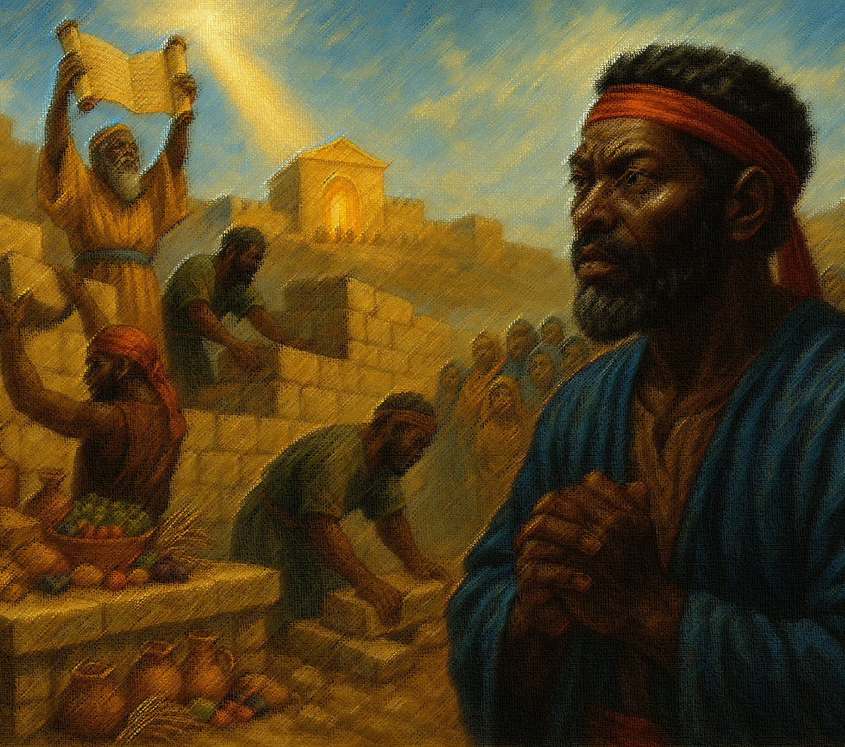
Life Response: Encourage one another to be intentional in following God’s commands.
We have considered how God’s people committed to obedience as part of a restoration of their covenant agreement. Obedience often means trusting that God’s way is best. The people who returned to Judah did not seek God because of their impressive character but because they knew they could rely on God to restore them. As students seek to obey God this week (and perhaps find themselves falling short), encourage them to be curious about their motives.
Intentional Actions
We listen to God because He knows what is best for us. God knows what we need in order to be sustained in every season, whether in need or plenty.
Notes:
Intentional obedience grows from trusting God’s restorative grace and is strengthened by believers who encourage one another toward faithful action.
Three Key Points
Reliance, not résumé: the returnees obeyed because God could restore them, not because they were morally impressive.
Motive check: when obedience falters, curiosity about our desires helps realign hearts with God’s will.
Sustaining wisdom: God’s commands nourish us in scarcity and abundance, so mutual encouragement keeps practices intentional.
Summary
True obedience springs from dependence on God’s goodness and flourishes when the community spurs one another to examine motives and live deliberately by His sustaining word.

Slide 19




  The Lord bless thee, and keep thee:
  The Lord make his face shine upon thee, and be gracious unto thee:
  The Lord lift up his countenance upon thee and give thee peace.
  - Numbers 6:24-26,
Material adapted by Stanford W. Bowman Jr. from Echoes® Adult and Bible-in-Life® Adult Spring 2025 quarter with permission, © David C Cook, https://davidccook.org. May not be further reproduced. All rights reserved.

Slide 20
QUESTION & ANSWER
All The people Commit to Obey God’s Commands
4. What promises do the Jews make in verses 28–33?
5. Why was it important for Jews to contribute to the temple?
They promise to avoid marrying foreigners, to keep the Sabbath free of buying and selling, and to give toward the temple’s operation.
The temple was the center of worship of God. Priests who worked in the temple had no income without the contributions of others, and the priests carried out the vital
Notes:
All The people Commit to Obey God’s Commands
4. What promises do the Jews make in verses 28–33?
They promise to avoid marrying foreigners, to keep the Sabbath free of buying and selling, and to give toward the temple’s operation.
5. Why was it important for Jews to contribute to the temple?
The temple was the center of worship of God. Priests who worked in the temple had no income without the contributions of others, and the priests carried out the vital work of making regular sacrifices for sin.

Slide 21
QUESTION & ANSWER
ALL THE PEOPLE COMMIT TO CARE FOR THE HOUSE OF GOD
6. What were the promises expressed in verses 34–39?
7. How did each promise care for the house of God?
8. Why was it important to care for the house of God?
The people promise to supply wood for the altar, to offer the firstfruits of their crops, to consecrate any firstborn sons for God’s service, and to give a tenth of their finances toward the temple.
These commitments supported the work of God’s temple. These commitments ensured sacrifices would be plentiful, and that the fire would never go out.
These commitments represent a larger commitment to stay faithful to God. Neglect of the temple would show that the people did not prioritize God. The temple was God’s way of dwelling with His people, and keeping it stocked and functioning meant that Yahweh would dwell in their midst and be their source of strength.
Notes:
ALL THE PEOPLE COMMIT TO CARE FOR THE HOUSE OF GOD
6. What were the promises expressed in verses 34–39?
The people promise to supply wood for the altar, to offer the firstfruits of their crops, to consecrate any firstborn sons for God’s service, and to give a tenth of their finances toward the temple.
7. How did each promise care for the house of God?
These commitments supported the work of God’s temple. These commitments ensured sacrifices would be plentiful, and that the fire would never go out.
8. Why was it important to care for the house of God?
These commitments represent a larger commitment to stay faithful to God. Neglect of the temple would show that the people did not prioritize God. The temple was God’s way of dwelling with His people, and keeping it stocked and functioning meant that Yahweh would dwell in their midst and be their source of strength.

Slide 22
  The Lord bless thee, and keep thee:
  The Lord make his face shine upon thee, and be gracious unto thee:
  The Lord lift up his countenance upon thee and give thee peace.
  - Numbers 6:24-26,
Material adapted by Stanford W. Bowman Jr. from Echoes® Adult and Bible-in-Life® Adult Spring 2025 quarter with permission, © David C Cook, https://davidccook.org. May not be further reproduced. All rights reserved.

