Slide 1


The Ordination of Priests
And thou shalt gird them with girdles, Aaron and his sons, and put the bonnets on them: and the priest’s office shall be theirs for a perpetual statute: and thou shalt consecrate Aaron and his sons.
—Exodus 29:9 KJV
Week of August 6

Slide 2
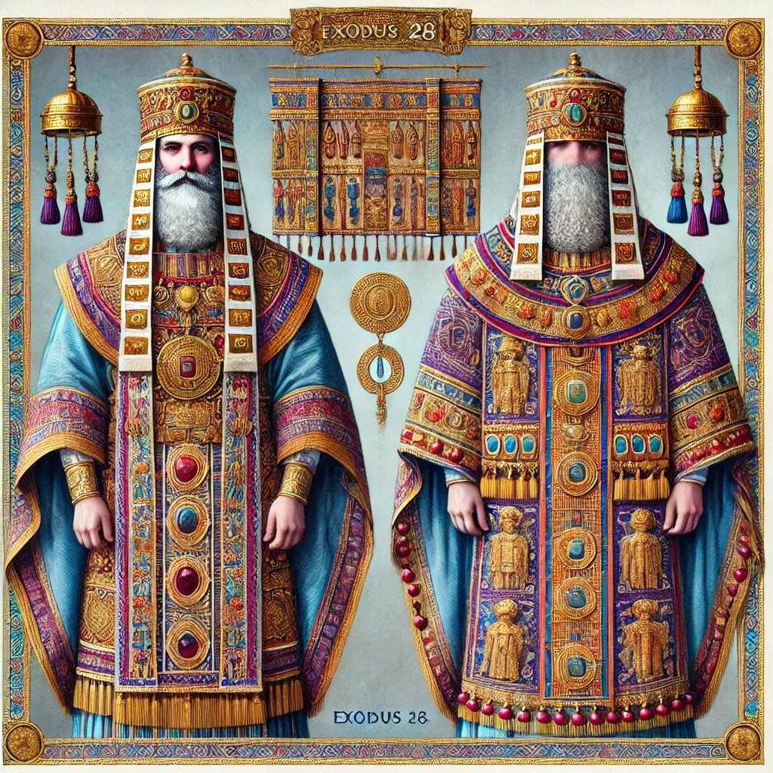
Prayer
Heavenly Father, may we honor Your plan to provide the priesthoods of both old and new covenants. Convict us on how we can do better at honoring our priesthood of all believers as it reflects Your holiness. We pray this is the name of our great high priest, the once-for-all sacrifice for our sins, Jesus. Amen.
Thought to Remember
    Freedom means becoming what God made us to be.
Notes:
Prayer
Heavenly Father, may we honor Your plan to provide the priesthoods of both old and new covenants. Convict us on how we can do better at honoring our priesthood of all believers as it reflects Your holiness. We pray this is the name of our great high priest, the once-for-all sacrifice for our sins, Jesus. Amen.
Thought to Remember
Honor your part in the priesthood of all believers.

Slide 3
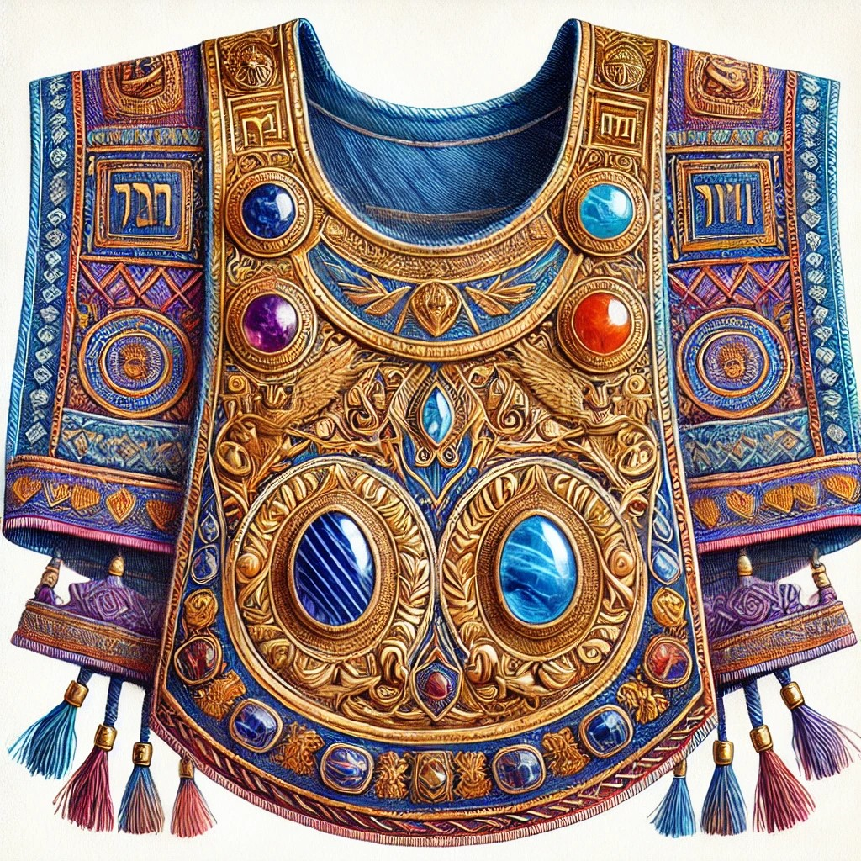
  Review
  Introduction
  Lesson Context
  Overview
    The Problem - Galatians 5:13-15, KJV
    The Conflict - Galatians 5:16-21, KJV
    The Alternative - Galatians 5:22-26, KJV
  Bible Application
  Conclusion
  Question & Answers
Notes:
The Problem - Galatians 5:13-15, KJV
The Conflict - Galatians 5:16-21, KJV
The Alternative - Galatians 5:22-26, KJV

Slide 4
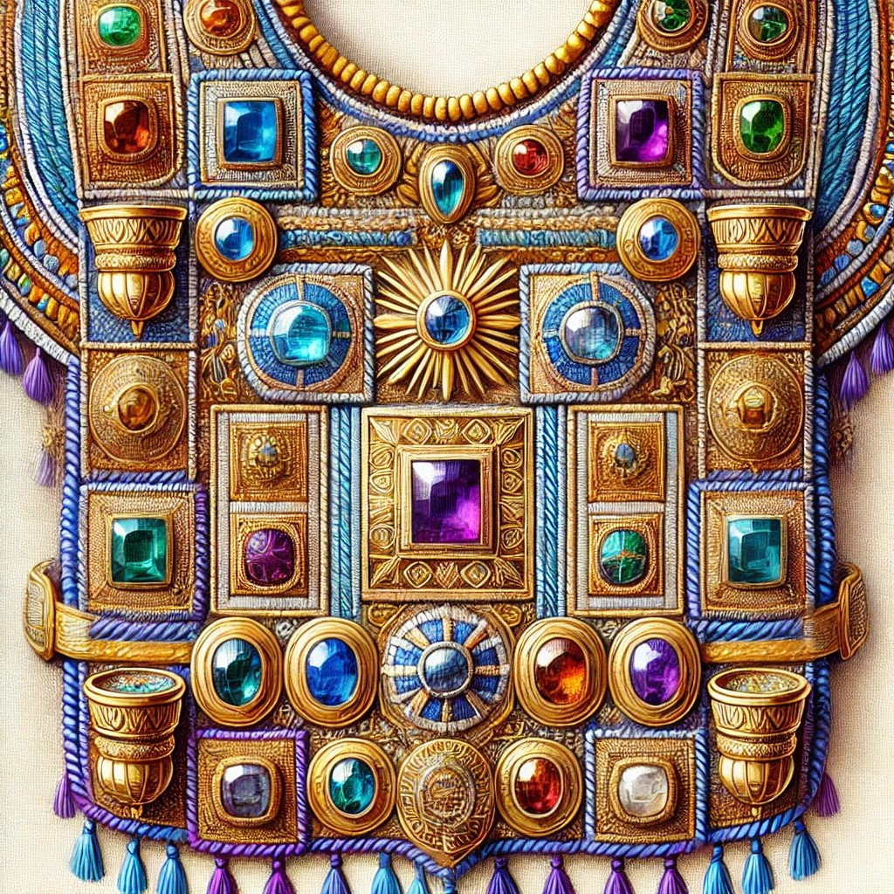
Ordination
  For those of an older generation, the designation “ordained minister” brings certain images to mind. Such images might include that of a devout person who has spent several years in seminary, preparing to be ordained after graduating with a degree in Bible, theology, or even counseling.
  This paradigm began to break down in the United States in the late 1960s. That was the decade the Universal Life Church started issuing certificates of ordination to anyone who desired one. These easily obtained certificates began to be recognized by local governments for performing weddings, etc. Thus, a privilege of the church became, in many instances, just a business opportunity —a chance to earn a living officiating at various functions.
  But that wasn’t the first time such a thing had happened. It also happened in ancient Israel’s ordained priesthood. What began in all holiness at God’s initiative eventually became an unholy travesty of sinful rulers (example: 1 Kings 12:31). The shocking picture of this decline is best appreciated by a consideration of priestly ordination at its ideal beginning—the subject of today’s lesson.
Notes:
Analysis & Summary
The concept of ordination traditionally signified deep spiritual preparation, requiring theological education and a commitment to ministry. However, this standard began to erode in the 1960s when organizations like the Universal Life Church began offering ordination without rigorous requirements. This shift transformed ordination into a business venture rather than a sacred calling. Similarly, in ancient Israel, the priesthood, which was originally established in holiness by God, later became corrupted by unworthy rulers. The decline in both cases highlights the importance of maintaining the sacred integrity of spiritual leadership.
Main Idea
Ordination, originally a sacred and rigorous process, has been diminished in both modern and biblical contexts, raising concerns about the loss of spiritual integrity.
Three Key Points
1. Traditional Ordination – Historically, becoming an ordained minister required deep theological training and commitment.
2. Commercialization of Ordination – The 1960s saw a shift where ordination became easily accessible, turning it into a business opportunity rather than a divine calling.
3. Biblical Parallels – Ancient Israel experienced a similar decline, where a once-holy priesthood became corrupt under sinful leadership.

Slide 5
PRIEST CONSECRATION—
Moses outlined detailed laws in Exodus and Leviticus about the procedures for the Israelite priest. Moses’s older brother Aaron and his descendants served as the original priestly line. Men ministered as mediators between people and God first in the tabernacle, and later in the temple. They were called to live holy lives and showed that they were set apart for God through unique clothing. Before practicing as a priest, they had to perform certain rituals.
MADE HOLY—
God gave Moses detailed instructions on how to consecrate, or make holy, Aaron and his sons as priests. They served as intermediaries between the people and God. Aaron and his sons needed to offer sacrifices, be anointed with sacred oil, and go through a process of purification. These rituals were established to set the priests apart for their duties.
Notes:
Priest Consecration
Moses, following God’s commands, established detailed procedures for consecrating priests. Aaron and his descendants were chosen as the first priests, serving as mediators between God and the people. Their consecration required specific rituals and clothing that signified their set-apart status.
Three Key Points:
1. God’s Chosen Priests – Aaron and his lineage were selected to serve as Israel’s priests.
2. Mediation Role – Priests acted as intermediaries between God and the people.
3. Holy Preparation – Before serving, priests underwent rituals to demonstrate their holiness.
Made Holy
God provided Moses with specific instructions to consecrate Aaron and his sons as priests. Their role required sacrifices, anointing with sacred oil, and purification rituals, all of which demonstrated their unique calling to serve God.
Three Key Points:
1. Divine Selection – Aaron and his sons were set apart for sacred service.
2. Ritual Purity – Their consecration involved sacrifices, anointing, and purification.

Slide 6
The sacrifice and the oil—
The animal sacrifice took place with a blemish-free bull and two rams. The sacrifice always included blood shedding. Foods symbolizing fellowship with the Father such as unleavened bread, wafers, and cakes sat at the door of the tabernacle.
THE PRIESTHOOD OF TODAY—
While Christians today do not adhere to the same ritual instructions, they are also called to live in holiness. One’s thinking, attitudes, and conduct are committed to the Father’s agenda, like Jesus did, rather than adhering to worldly success. God’s children should set themselves apart, represent God well, and share the good news of the new High Priest, Jesus.
Notes:
The Sacrifice and the Oil
The consecration of priests required a blemish-free bull and two rams as sacrifices, symbolizing purity and atonement. Alongside these offerings, unleavened bread, wafers, and cakes were presented as a sign of fellowship with God.
Three Key Points:
1. Unblemished Sacrifices – Only flawless animals were acceptable for priestly consecration.
2. Blood Atonement – The shedding of blood was essential for purification.
3. Fellowship Offerings – Unleavened bread symbolized communion with God.
---
The Priesthood of Today
Restated:
While modern Christians do not follow the same priestly rituals, they are still called to holiness. Believers should align their thoughts, actions, and attitudes with God’s will, living set-apart lives and proclaiming Jesus as the ultimate High Priest.
Three Key Points:
1. Call to Holiness – Christians are set apart to reflect God’s righteousness.
2. Spiritual Commitment – Believers should prioritize God’s agenda over worldly success.
3. Representation of Christ – Christians serve as ambassadors of Jesus, sharing the Gospel.

Slide 7

Lesson Context
Within the new nation of Israel, God planned for men of the tribe of Levi to be designated with tasks associated with the tabernacle and (later) the temple (Numbers 3:5-9; 8:5-26; 1 Chronicles 23:28-32). From this tribe were to come the priests (Deuteronomy 18:1-5; Joshua 18:7; contrast 1 Kings 12:31). Priests were mediators between God and the people. In this role, priests offered sacrifices for atonement on their behalf (Leviticus 4:13-35; 9:7); priests were to teach and model God’s distinctions between clean and unclean (10:10-11).
Setting the stage for today’s lesson is Exodus 28:41, which summarizes the detail that follows in Exodus 29 regarding the ordination of priests. Leviticus 8 offers a detailed account of Moses carrying out the actions God specifies in today’s lesson text.
In Israel’s earliest days, Aaron and his sons became the first priests under the nation’s leadership by Moses, who was Aaron’s brother (Exodus 7:1; 28:1). They were anointed, consecrated, and sanctified to do so (28:41). The act of anointing consisted of pouring oil on the priest’s head, done as a ritual to show a person had been selected. Consecration was the act of appointment through the authority of the congregation of the people. Sanctification was the “setting apart” of the person for the tasks of the priesthood, with the tacit agreement that the person would strive to live a holy, blameless life, observing the laws of Israel as given by God through Moses.
We can note at the outset that the possible meanings (semantic range) of English words shift over time, as do words in all languages. The words ordination and ordain do not appear in the text of the King James Version for today’s lesson text, although the concept is present. The KJV uses the verb ordain in a situation of gatekeepers (1 Chronicles 9:22) and the appointment of unqualified priests (2 Chronicles 11:15).
Notes:
Aaron and his sons were the first priests in Israel, appointed under Moses' leadership. Their consecration involved anointing, appointment, and sanctification—each step signifying their selection, approval by the people, and commitment to holiness. The Levites were later designated for priestly duties, acting as mediators between God and Israel through sacrifices and teachings. While the term "ordination" may not appear in early biblical texts, the concept was clearly present in priestly consecration. Exodus 28:41 and Leviticus 8 detail these sacred rituals, underscoring the importance of holiness and divine service.
Main Idea
The consecration of Israel’s priests was a divinely established process, ensuring their role as mediators between God and His people.
Three Key Points
1. Priestly Appointment – Aaron and his sons were anointed, consecrated, and sanctified for priestly service.
2. Levites’ Role – God designated the tribe of Levi for ongoing priestly responsibilities, including sacrifices and teaching.
3. Biblical Ordination – While the term "ordination" is not explicitly used, the concept is evident in the priestly consecration process.

Slide 8
Background
The High Priest
Be Holy as I Am Holy
Israel’s high priest was at the top of the nation’s religious hierarchy. While priests in general represented people before God, the high priest was their supreme representative. He was uniquely set apart through the anointing of his head with sacred oil (see also Lev. 8:12; 21:10; Ps. 133:2). Other priests had oil sprinkled on their garments instead. Fragrant oil was used to cleanse and refresh a person’s appearance.
The high priest would oversee the sanctuary, including its service and treasure. Throughout the year, he discharged all the customary priestly functions. But he alone could officiate on the Day of Atonement (in Hebrew, Yom Kippur). On that special day, the high priest passed through the veil of the tabernacle and entered the most Holy Place. There he applied the blood on the mercy seat, to provide atonement for the sins of the people.
The instructions for the consecration of Aaron and his sons can show the types of things that will matter for personal holiness, even into the new covenant context. In today’s lesson, ritual washings of the priests display God’s attention upon the physical body (Ex. 29:4). Many years later, the apostle Paul will claim that the physical body matter for believers who are seeking to be holy, which is why sexual immorality is so treacherous (see 1 Cor. 7:18–19).
The moral perfection of God is the standard we follow. When we are cleansed from sin to serve the Lord, our thoughts, words, and acts should be characterized by kindness and mercy, not egoism and selfish desire. Of course, that doesn’t mean we do not struggle with sinful desires. But the Spirit can enable us to obey and overcome sin.
Notes:
The High Priest
The high priest held the highest religious authority in Israel, acting as the supreme representative between the people and God. His role was distinct from other priests, as he was anointed with sacred oil, whereas others only had oil sprinkled on their garments. He oversaw the sanctuary and officiated the Day of Atonement, where he entered the Most Holy Place to make atonement for the people's sins.
Main Idea
The high priest was uniquely consecrated to mediate between God and Israel, emphasizing the importance of holiness and atonement.
Three Key Points
1. Supreme Representative – The high priest served as the ultimate intercessor for Israel before God.
2. Sacred Anointing – Unlike other priests, he was set apart through anointing with sacred oil.
3. Day of Atonement – His most critical role was entering the Most Holy Place to atone for the people's sins.
Be Holy as I Am Holy
God’s instructions for priestly consecration highlight the importance of personal holiness, extending into the New Testament context. Ritual washings signified physical and spiritual purity. Paul later emphasized that believers’ bodies should honor God, reinforcing that holiness includes moral purity. While struggles with sin persist, the Holy Spirit empowers believers to live according to God’s standards.
Main Idea
Holiness is a divine requirement that extends beyond external rituals to encompass moral and spiritual purity.
Three Key Points
1. Holiness Matters – God’s standard for His people requires both external and internal purity.
2. Physical and Spiritual Purity – The washing of priests prefigured the importance of moral cleanliness.
3. Empowered by the Spirit – Overcoming sin is possible through the Holy Spirit’s guidance.

Slide 9
Background
Priests in the New Covenant
Removing the Stain of Sin
The consecration of the priests was necessary so that God’s holy presence would be separate. Much like the layered sections of the tabernacle which separated one area from another, the priesthood made layers of separation from the ordinary people in the community, people with sinful failings and chaotic lives. But over time and through the centuries, the corruption of Israel’s priests became harder to ignore. Even Aaron’s sons could not be trusted to be faithful and to observe all that God had asked (see Num. 3:2–4).
But God had in mind to create a new priesthood, with Jesus at the center. According to Revelation 1:5–6, Jesus’ blood “freed” His followers from sin and also created them to be “a kingdom and priests. ” Unlike the priesthood of ancient Israel—which became another symbol of human inadequacy—the priesthood of those redeemed by Jesus can be a symbol of God’s redeeming power and love. God can transform human beings and give them a holy status, something that they could never do on their own.
The notion of purification through the offering of a sacrifice, whether applied to the Israel’s priesthood or altar (Ex. 29:4, 36), denoted a thorough cleansing from defilement. This truth is repeated in Hebrews 1:3, which says that Jesus provided “purification for sins. ” The underlying Greek noun for “purged” in the KJV means removing the defiling presence of sin from the very core of the believer’s innermost being (Heb. 9:14; 10:22).
The writer of Hebrews speaks in the past tense, which shows that the Messiah’s redemptive work on our behalf has already been accomplished. Jesus did once what the Israelite priests were required to do on a regular basis, like the offering that had to repeated seven days in Exodus 29:37. Now, as our great High Priest, Jesus can grant a “purification for sins,” what He obtained at the cross.
Notes:
Priests in the New Covenant
In ancient Israel, the priesthood created a division between the holy and the ordinary. However, corruption eventually pervaded the system, making it ineffective. Jesus established a new priesthood through His sacrifice, granting believers a holy status and a role in God’s kingdom. Unlike the old system, this new priesthood reflects God’s transformative power and love.
Main Idea
Jesus redefined the priesthood, making all believers a part of His holy kingdom through redemption.
Three Key Points
1. Separation from Sin – The priesthood initially served to keep God’s presence distinct from human corruption.
2. Corruption of the Old – The priesthood became tainted, failing to fulfill God’s intentions.
3. Jesus as the High Priest – His sacrifice established a new, redeemed priesthood for all believers.
Removing the Stain of Sin
In the Old Testament, sin offerings were required regularly to cleanse priests and the altar. However, Hebrews affirms that Jesus’ atoning work was completed once and for all. Unlike repeated sacrifices, His purification is permanent, removing sin from the believer’s innermost being.
Main Idea
Jesus’ sacrifice permanently removed sin, replacing the need for continual atonement rituals.
Three Key Points
1. Sin Requires Cleansing – Old Testament sacrifices symbolized purification from sin.
2. Jesus’ Sacrifice is Final – Unlike Israel’s repeated offerings, Christ’s work is complete.
3. Inner Transformation – His redemption cleanses believers from the core of their being.

Slide 10
Background
The High Priest
Be Holy as I Am Holy
Israel’s high priest was at the top of the nation’s religious hierarchy. While priests in general represented people before God, the high priest was their supreme representative. He was uniquely set apart through the anointing of his head with sacred oil (see also Lev. 8:12; 21:10; Ps. 133:2). Other priests had oil sprinkled on their garments instead. Fragrant oil was used to cleanse and refresh a person’s appearance.
The high priest would oversee the sanctuary, including its service and treasure. Throughout the year, he discharged all the customary priestly functions. But he alone could officiate on the Day of Atonement (in Hebrew, Yom Kippur). On that special day, the high priest passed through the veil of the tabernacle and entered the most Holy Place. There he applied the blood on the mercy seat, to provide atonement for the sins of the people.
The instructions for the consecration of Aaron and his sons can show the types of things that will matter for personal holiness, even into the new covenant context. In today’s lesson, ritual washings of the priests display God’s attention upon the physical body (Ex. 29:4). Many years later, the apostle Paul will claim that the physical body matter for believers who are seeking to be holy, which is why sexual immorality is so treacherous (see 1 Cor. 7:18–19).
The moral perfection of God is the standard we follow. When we are cleansed from sin to serve the Lord, our thoughts, words, and acts should be characterized by kindness and mercy, not egoism and selfish desire. Of course, that doesn’t mean we do not struggle with sinful desires. But the Spirit can enable us to obey and overcome sin.
Notes:
The High Priest
The high priest held the highest religious authority in Israel, acting as the supreme representative between the people and God. His role was distinct from other priests, as he was anointed with sacred oil, whereas others only had oil sprinkled on their garments. He oversaw the sanctuary and officiated the Day of Atonement, where he entered the Most Holy Place to make atonement for the people's sins.
Main Idea
The high priest was uniquely consecrated to mediate between God and Israel, emphasizing the importance of holiness and atonement.
Three Key Points
1. Supreme Representative – The high priest served as the ultimate intercessor for Israel before God.
2. Sacred Anointing – Unlike other priests, he was set apart through anointing with sacred oil.
3. Day of Atonement – His most critical role was entering the Most Holy Place to atone for the people's sins.
Be Holy as I Am Holy
God’s instructions for priestly consecration highlight the importance of personal holiness, extending into the New Testament context. Ritual washings signified physical and spiritual purity. Paul later emphasized that believers’ bodies should honor God, reinforcing that holiness includes moral purity. While struggles with sin persist, the Holy Spirit empowers believers to live according to God’s standards.
Main Idea
Holiness is a divine requirement that extends beyond external rituals to encompass moral and spiritual purity.
Three Key Points
1. Holiness Matters – God’s standard for His people requires both external and internal purity.
2. Physical and Spiritual Purity – The washing of priests prefigured the importance of moral cleanliness.
3. Empowered by the Spirit – Overcoming sin is possible through the Holy Spirit’s guidance.

Slide 11
Background
Lamb of God as a Sin Offering
The New Testament narrative of the cross sheds new light the consecration of the priests in Exodus 29. Setting apart the priests as holy involved rituals like the anointing with oil and the sprinkling of blood, for purification and dedication to God’s service.
These ceremonies also point towards Jesus’ crucifixion. The believers’ great High Priest offered Himself as the ultimate sacrifice for the remission of sins (Heb. 2:17; 4:14). Jesus, through His shed blood, became the ultimate mediator, who bridges the gap between humanity and God (see 1 Tim. 2:5; 1 John 2:1–2).
These two narratives are connected in the idea of atonement and forgiveness. The blood of sacrificial animals foreshadows the shedding of Jesus’ blood, which is the ultimate atonement for sin. Jesus becomes the “Lamb of God” (John 1:29, 36), who brings redemption and reconciliation with God.
Notes:
Lamb of God as a Sin Offering
The consecration rituals for priests in Exodus 29, including anointing and blood sprinkling, prefigured Jesus’ ultimate sacrifice. His death on the cross fulfilled and replaced the Old Testament sin offerings, making Him the eternal mediator between humanity and God. His blood provides the ultimate atonement, securing redemption and reconciliation.
Main Idea
Jesus, as the Lamb of God, became the perfect and final sacrifice, securing eternal atonement.
Three Key Points
1. Foreshadowed in the Law – Priestly consecration prefigured Christ’s ultimate sacrifice.
2. Jesus as Mediator – His death permanently bridges the gap between God and humanity.
3. Final Atonement – His blood replaces animal sacrifices, ensuring complete redemption.

Slide 12
LESSON OVERVIEW
The Ordination of Priests
Consecration of the Priests - Exodus 29:1–9 KJV
1 And this is the thing that thou shalt do unto them to hallow them, to minister unto me in the priest’s office: Take one young bullock, and two rams without blemish,
2 And unleavened bread, and cakes unleavened tempered with oil, and wafers unleavened anointed with oil: of wheaten flour shalt thou make them.
3 And thou shalt put them into one basket, and bring them in the basket, with the bullock and the two rams.
4 And Aaron and his sons thou shalt bring unto the door of the tabernacle of the congregation, and shalt wash them with water.
5 And thou shalt take the garments, and put upon Aaron the coat, and the robe of the ephod, and the ephod, and the breastplate, and gird him with the curious girdle of the ephod:
6 And thou shalt put the mitre upon his head, and put the holy crown upon the mitre.
7 Then shalt thou take the anointing oil, and pour it upon his head, and anoint him.
8 And thou shalt bring his sons, and put coats upon them.
9 And thou shalt gird them with girdles, Aaron and his sons, and put the bonnets on them: and the priest’s office shall be theirs for a perpetual statute: and thou shalt consecrate Aaron and his sons.
  Aaron and his sons were selected by God to serve as priests for the nation of Israel.
  As priests, they would undergo ritual washing and be clothed to serve in the presence of God.
  The Israelites were to bring offerings to the tabernacle, for Aaron and his sons to use.
  These offerings were to be from the best of the bulls, rams, and wheat.
  The clothing that Aaron would wear had reminders that he was representing Israel. On His breastpiece would be twelve stones, with names of the twelve tribes.
Notes:
Exodus 28–29 details the consecration of Aaron and his sons as priests, emphasizing their role as mediators between God and the people. Their special garments symbolized dignity, honor, and readiness for divine service. The priests were set apart through ritual washing, anointing, and sacrifices, reinforcing their holy calling. Their clothing, particularly the ephod and breastpiece engraved with Israel’s tribes, served as a reminder of God’s covenant. God’s desire to dwell among His people is evident in these instructions, showcasing His faithful love and commitment to His people.
Main Idea
The consecration of priests through garments, rituals, and sacrifices highlights their role as mediators and God’s intention to dwell among His people.
Three Key Points
1. Priestly Clothing – Special garments symbolized dignity and prepared priests for their sacred duties.
2. Consecration Rituals – Washing, anointing, and sacrifices set priests apart for divine service.
3. God’s Covenant – The high priest’s attire reminded Israel of God’s promises and His desire to be among His people.
><><><><><><><><><><><><><><><><><><><>
Exodus 29:1–9 NIV
1 “This is what you are to do to consecrate them, so they may serve me as priests: Take a young bull and two rams without defect.
2 And from the finest wheat flour make round loaves without yeast, thick loaves without yeast and with olive oil mixed in, and thin loaves without yeast and brushed with olive oil.
3 Put them in a basket and present them along with the bull and the two rams.
4 Then bring Aaron and his sons to the entrance to the tent of meeting and wash them with water.
5 Take the garments and dress Aaron with the tunic, the robe of the ephod, the ephod itself and the breastpiece. Fasten the ephod on him by its skillfully woven waistband.
6 Put the turban on his head and attach the sacred emblem to the turban.
7 Take the anointing oil and anoint him by pouring it on his head.
8 Bring his sons and dress them in tunics
9 and fasten caps on them. Then tie sashes on Aaron and his sons. The priesthood is theirs by a lasting ordinance. “Then you shall ordain Aaron and his sons.
><><><><><><><><><><><><><><><><><><><>
Exodus 28–29 says to clothe and consecrate Aaron and his sons as priests for the people. In the ancient world, priests had the job of mediating between humans and the world of heaven. For Israel—a whole nation of priests (Ex. 19:6, see Lesson 1)—special clothing would give Israel’s own priests dignity and honor in the eyes of others, and—more importantly—it would prepare them for the weighty task of approaching God’s holiness. The priests would be ritually set apart for divine service, down to their clothes and appearance. God is expressing a desire to dwell among His people because of His faithful love, and to meet with them.
Moses would instruct the Israelites to bring a young bull and two rams without any defects, along with unleavened bread mixed with oil (Ex. 29:1–2). These offerings, which remind us of the bread of Passover, were to be prepared and placed inside a “basket” (v. 3), almost like how we might wrap a gift. Aaron and the priests would then approach the tent of meeting, for they alone among the people shall enter. The priests are washed and clothed for their work, with a tunic, robe, ephod, and breastpiece (v. 5). The ephod was an ornate vest with shoulder pieces, precious stones, and fine gold chains (Ex. 28:6–14). Both the ephod and breastpiece contained engraved stones naming all the tribes of Israel, a “continuing memorial before the Lord” (Ex. 28:29). Each time that God would look upon the high priest, God would be reminded of His covenant and His promises.
Finally, a turban would be placed on Aaron’s head, and a sacred crest or medallion tied on the turban (v. 6). Moses would pour anointing oil on Aaron, setting him apart for his sacred duties. Then Moses would bring Aaron’s sons to the entrance of the tent, ready for their work.

Slide 13
LESSON OVERVIEW
The Ordination of Priests
Consecration of the Altar - Exodus 29:35–37 KJV
  35 And thus shalt thou do unto Aaron, and to his sons, according to all things which I have commanded thee: seven days shalt thou consecrate them.
  36 And thou shalt offer every day a bullock for a sin offering for atonement: and thou shalt cleanse the altar, when thou hast made an atonement for it, and thou shalt anoint it, to sanctify it.
  37 Seven days thou shalt make an atonement for the altar, and sanctify it; and it shall be an altar most holy: whatsoever toucheth the altar shall be holy.
The instructions given to Moses were to set the priests and the altar aside for their sacred purpose.
Aaron and his sons would give an offering whose purpose was, in part, to purify for sins they had committed.
For seven days, an offering would be repeated to consecrate the altar.
Seven is an important number in Scripture, signifying wholeness and the act of creation.
Since the altar would be holy, anything that came in contact with it would also be considered holy.
Notes:
Aaron and his sons were required to offer a bull as a sin offering at the entrance of God’s sacred tent, signifying purification. Even priests, despite their divine calling, needed atonement for their own sins and those of the people. The ordination ceremony, meaning "fill their hands," involved placing part of the sacrifice into their hands, symbolizing their priestly duty. The seven-day atonement ritual signified completeness, ensuring both priests and the altar remained holy. Remarkably, anything touching the altar became holy, emphasizing God’s power to sanctify.
Main Idea
The consecration of priests and the altar through sacrifices symbolized purification, divine calling, and the necessity of holiness in God’s service.
Three Key Points
1. Sin Offering for Priests – Even anointed priests needed sacrifices for their sins and those of the people.
2. Seven-Day Consecration – Atonement rituals ensured the holiness of priests and the altar.
3. Sanctification Through Contact – Anything touching the consecrated altar became holy, signifying God’s power to purify.
><><><><><><><><><><><><><><><><><><><>
At the entrance of the tent of God’s sacred presence, Aaron and his sons would offer a bull as a “sin offering” (v. 36). Leviticus 4:1–35 gives more details about this sacrifice, which seeks purification from sin. Leviticus 4:3 says that this is required when “the anointed priest sins. ” Even the priests—those who had been selected by God, ritually washed and anointed, and clothed in the finest garments— would offer sacrifices for their own guilt, as well as the ignorant sins of the community (see Lev. 4:13, 22).
Then God directs Moses and the Israelites to “consecrate” (KJV) or “ordain” (NIV) these priests, which are translations for the Hebrew that means “fill their hands” (v. 35). Part of the ceremony includes placing a portion of the sacrifice into the hands of the priests as a symbol of their role and responsibility to serve in the tabernacle. In this text, God requests a sacrifice for atonement for seven consecutive days (v. 37). The number seven signifies completeness and wholeness. Just as God created a good world and rested on the seventh day, God is creating a nation of chosen people and giving them a way to seek forgiveness for sin. The priests would be cleansed, and the altar would also be ceremonially set apart from any corruption. Objects which were created for service to God, like an altar, could be polluted by sin and improper use. To be an effective tool for seeking forgiveness, the altar would need to remain holy, and a weeklong ritual of sacrifice ensured that the priestly representatives would find favor with God, who would welcome their worship. In a surprising turn, anyone or anything that came in contact with the altar would be considered “holy” (v. 37).

Slide 14

Discuss how God’s people are called to live lives of holiness and to serve His kingdom purposes.
BIBLE APPLICATION:
Reflection of the Great High Priest
  When I was a teenager, people often described being set apart as a specific set of “don’t” rules: don’t dress a certain way, don’t listen to certain music, and don’t watch certain movies. Being set apart and holy was something I could only define by what I wasn’t: I wasn’t like the rest of the world. Or so I thought. But that only sets us apart from the culture where we find ourselves. I was a homeschooled girl living in California, and I didn’t know the latest pop culture references. But I don’t think that made me holy.
  I’m still learning what it means to live as one made holy by Christ’s sacrifice. I’ve learned that being “set apart” isn’t just a list of cultural prohibitions. I want the holiness of God to mark out what I do, not just what I avoid. Jesus’ death was the one sacrifice I needed: I don’t need to be consecrated in the same way as Aaron and his sons. Jesus has saved me, and He is making me holy.
  So I want to live like Jesus is most important in my life. And I want to have unfathomable joy, even in a world filled with darkness. I want to be kind to my neighbor, even though a person might be uncharitable to me. I want to praise Jesus, even when I feel embarrassed at the thought of sharing my voice.
  Sure, there are plenty of things that I avoid. But I want holiness to be visible by what I say and do. So that is my prayer: to live according to what Jesus has done for me, and what He is continuing to do.
Notes:
The author reflects on the meaning of holiness, realizing that it is not just about avoiding worldly behaviors but about actively living for Christ. Holiness is marked by joy, kindness, and devotion to God rather than mere cultural separation. Jesus' sacrifice is sufficient for salvation, and true holiness is demonstrated through actions, not just restrictions.

Slide 15
Discuss how God’s people are called to live lives of holiness and to serve His kingdom purposes.
BIBLE APPLICATION:
Reflection of the Great High Priest
  9. How has Jesus’ sacrifice altered the ways that we think about sin and holiness?
  10. How should believers, followers of Christ, look different from the world?
  11. How might holiness include the things that we actively do, not just what we avoid?
Notes:
9. How has Jesus’ sacrifice altered the ways that we think about sin and holiness?
Jesus’ sacrifice shifts holiness from following prohibitions to living a transformed life. Rather than ritual consecration, believers are made holy by Christ and called to reflect His love, grace, and righteousness.
10. How should believers, followers of Christ, look different from the world?
Believers should stand out by demonstrating Christ’s love, joy, and kindness. Their faith should shape their actions, attitudes, and priorities, showing devotion to God rather than conforming to worldly values.
11. How might holiness include the things that we actively do, not just what we avoid?
Holiness includes active expressions of faith—loving others, sharing the gospel, worshiping God, and serving with compassion. It is not just about avoiding sin but about living in a way that reflects Christ’s character.

Slide 16
CONCLUSION
The Old in the New
The importance of today’s lesson is seen in the fact that ordination to the priesthood was instructed in Exodus 29, carried out in detail in Leviticus 8, and viewed as an accomplished fact in Exodus 40. Such repetition should catch our attention!
Even so, we may wonder about modern relevance. Today’s text describes persons and events from over 3,000 years ago. Aaron and Moses are long dead. Neither the tabernacle nor the Jerusalem temple stands today. A natural, perhaps instinctive way of seeing relevance is to see parallels between the ordination of priests in the Old Testament and the modern practice of ordaining ministers of the gospel. There is value in doing so, but that’s not the primary point of relevance.
That primary relevance is at least twofold. The first is that the functions of the tabernacle, priests, and blood sacrifices form the framework for understanding Jesus’ sacrifice as an atonement (propitiation) for our sins (Romans 3:25; Hebrews 2:17; etc. ). The second concerns the fact and obligations of our own priesthood (Romans 12:1; 1 Peter 2:5; etc. ). We neglect facts of the old covenant as foundations for the new covenant at our peril (Romans 15:4; 1 Corinthians 10:11).
Notes:
The ordination of priests in Exodus and Leviticus emphasizes its significance through repetition. While the ancient priesthood may seem disconnected from modern times, it provides a foundation for understanding Christ’s atonement and believers’ role as a holy priesthood. The Old Testament is essential for comprehending the New Covenant and Christian responsibilities today.
Main Idea
The Old Testament priesthood foreshadows Christ’s sacrifice and establishes the framework for believers’ spiritual priesthood in the New Covenant.
Three Key Points
Historical Significance – Priesthood ordination was emphasized in Exodus and Leviticus, highlighting its importance.
Christ’s Atonement – The priestly system prefigured Jesus’ sacrifice, which fulfilled and replaced the Old Covenant sacrifices.
Believers as Priests – Christians are called to spiritual priesthood, offering their lives in service to God.

Slide 17

CONCLUSION
Life Response: Reflect God’s call to holiness in your life.
The priests of Israel were set apart with spiritual responsibilities. God takes holiness seriously, and the process of consecration should impress this upon us. God calls His followers to be holy. While we no longer use sacrifices, we could set aside time to ask God to show us behaviors or attitudes which fall short of God’s holy standards.
Surrender to God’s Holiness
  While their garments and rituals set the priests apart, what sets today’s believer apart is not any outward attire but a heart clothed in Christ’s righteousness.
Notes:
Life Response: Reflect God’s call to holiness in your life.
The priests of Israel were set apart with spiritual responsibilities. God takes holiness seriously, and the process of consecration should impress this upon us. God calls His followers to be holy. While we no longer use sacrifices, we could set aside time to ask God to show us behaviors or attitudes which fall short of God’s holy standards.
Surrender to God’s Holiness
While their garments and rituals set the priests apart, what sets today’s believer apart is not any outward attire but a heart clothed in Christ’s righteousness.

Slide 18



END
The Lord bless thee, and keep thee:
The Lord make his face shine upon thee, and be gracious unto thee:
The Lord lift up his countenance upon thee and give thee peace.
- Numbers 6:24-26, KJV
Material adapted by Stanford W. Bowman Jr. from Echoes® Adult and Bible-in-Life® Adult Spring 2025 quarter with permission, © David C Cook, https://davidccook.org. May not be further reproduced. All rights reserved.
2025
The Ordination of Priests
18

Slide 19
QUESTION & ANSWER
CONSECRATION OF THE PRIESTS
4. What is the job of Aaron and the other priests?
5. What offerings did the Israelites need to bring to the tabernacle entrance before readying the priests?
6. What do the priests’ garments represent about their role among the Israelites?
Priests, in particular the high priest, would come before God’s holy presence in the sanctuary of the tabernacle. They would tend the fires of offering and invite God to continue to dwell with His people, to be gracious toward them and guide them in the way to go.
Moses tells the Israelites to bring a young bull, two rams without defect, and unleavened bread mixed with olive oil (vv. 1–2). The unleavened bread could be a reminder of God’s rescue from Egypt and from slavery.
The priests’ garments symbolized their special status and solemn responsibility to stand for their peers before God. These garments are worn in the sacred duties of worship and sacrifice. On the high priest’s garments, the ephod and breastpiece, would be written names of all twelve tribes of Israel. Each time that God looked upon the high priest, this would be a reminder of the covenant relationship.
Notes:
CONSECRATION OF THE PRIESTS
4. What is the job of Aaron and the other priests?
Priests, in particular the high priest, would come before God’s holy presence in the sanctuary of the tabernacle. They would tend the fires of offering and invite God to continue to dwell with His people, to be gracious toward them and guide them in the way to go.
5. What offerings did the Israelites need to bring to the tabernacle entrance before readying the priests?
Moses tells the Israelites to bring a young bull, two rams without defect, and unleavened bread mixed with olive oil (vv. 1–2). The unleavened bread could be a reminder of God’s rescue from Egypt and from slavery.
6. What do the priests’ garments represent about their role among the Israelites?
The priests’ garments symbolized their special status and solemn responsibility to stand for their peers before God. These garments are worn in the sacred duties of worship and sacrifice. On the high priest’s garments, the ephod and breastpiece, would be written names of all twelve tribes of Israel. Each time that God looked upon the high priest, this would be a reminder of the covenant relationship.

Slide 20
QUESTION & ANSWER
CONSECRATION OF THE ALTAR
7. What is the purpose of the “sin offering” mentioned in verse 36?
8. For what purpose does God request seven days of sacrifices?
This is an offering that seeks purification for sins that have been committed, sometimes even by the priestly representatives of the people who are making sacrifices. It also is appropriate for sins that were committed in ignorance.
The sacrifice of a bulls ceremonially cleansed the altar and made it ready for sacred use. Just like the priests who were consecrated for the role, the altar would be kept free of corruption and become a place for God’s called and chosen people to seek atonement for sin. Since God created the world in seven days, seven days were required for this ceremony.
Notes:
CONSECRATION OF THE ALTAR
7. What is the purpose of the “sin offering” mentioned in verse 36?
This is an offering that seeks purification for sins that have been committed, sometimes even by the priestly representatives of the people who are making sacrifices. It also is appropriate for sins that were committed in ignorance.
8. For what purpose does God request seven days of sacrifices?
The sacrifice of a bulls ceremonially cleansed the altar and made it ready for sacred use. Just like the priests who were consecrated for the role, the altar would be kept free of corruption and become a place for God’s called and chosen people to seek atonement for sin. Since God created the world in seven days, seven days were required for this ceremony.

Slide 21
END
The Lord bless thee, and keep thee:
The Lord make his face shine upon thee, and be gracious unto thee:
The Lord lift up his countenance upon thee and give thee peace.
- Numbers 6:24-26, KJV
Material adapted by Stanford W. Bowman Jr. from Echoes® Adult and Bible-in-Life® Adult Spring 2025 quarter with permission, © David C Cook, https://davidccook.org. May not be further reproduced. All rights reserved.
2025
The Ordination of Priests
21

