Slide 1
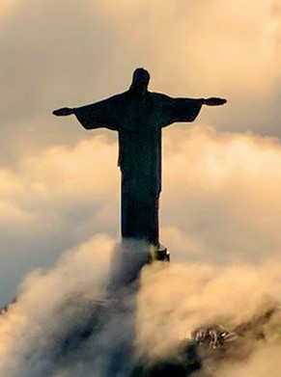
Christ’s Once-for-All Sacrifice
For Christ did not enter a sanctuary made with human hands that was only a copy of the true one; he entered heaven itself, now to appear for us in God’s presence.
—Hebrews 9:24 NIV
Week of April 6

Slide 2
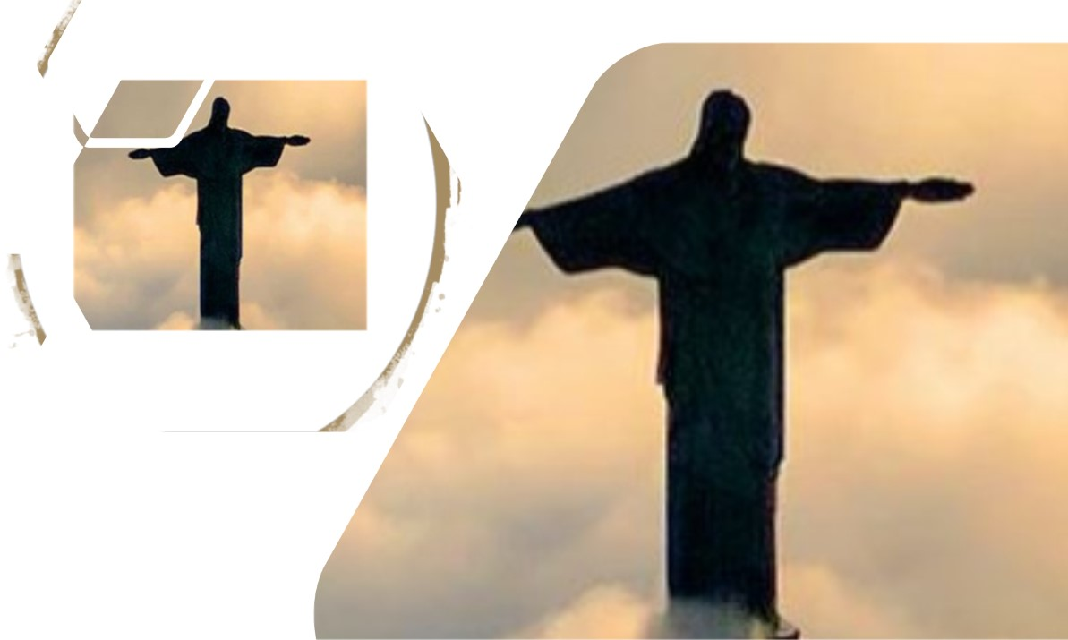

  Prayer
God of salvation, thank You for showing Your mercy. Help us welcome as we have been welcomed and love as we have been loved. Show us how we can proclaim to others Your plan for salvation. In the name of Jesus. Amen.
Thought to Remember
  Celebrate God’s merciful gift of redemption!
Notes:
Prayer
God of salvation, thank You for showing Your mercy. Help us welcome as we have been welcomed and love as we have been loved. Show us how we can proclaim to others Your plan for salvation. In the name of Jesus. Amen.
Thought to Remember
Celebrate God’s merciful gift of redemption!

Slide 3
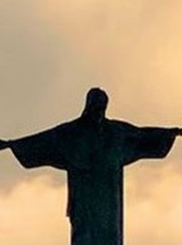
LESSON OUTLINE
Christ’s Once-for-All Sacrifice
Lesson Scripture: Hebrews 9:23–10:4, 11–14, 19–25
Lesson Focus: Draw near to God in confidence because of Jesus’ sacrifice.
Life Response: Find courage in Christ’s sacrifice and draw near to the throne of grace.
Bible Application: Talk about how Jesus’ sacrifice grants confidence to draw near to God.
      Introduction
      Review
      Lesson Context
      Overview
        Rest in God - Psalm 62:1–2 NIV
        My Rock and Salvation - Psalm 62:5–8 NIV
        Weighed in the Balance - Psalm 62:9–12 NIV
      Conclusion
      Question & Answers
3
Notes:
A Better Sacrifice - Hebrews 9:23–10:4 NIV
A New and Living Way - Hebrews 10:11–14, 19–25 NIV
><><><><><><><><><><><><><><><><><><><
Summary
Hebrews 9:23–10:4 explains that Christ’s sacrifice is superior to Old Testament offerings, which could not fully cleanse sin. His atonement, offered once for all, grants believers complete purification. Hebrews 10:11–14 highlights that while priests repeatedly sacrificed, Jesus' single offering perfected those being sanctified. Hebrews 10:19–25 encourages believers to confidently approach God, holding to faith, stirring one another to love, and staying steadfast in worship.
Commentary
Christ’s sacrifice replaces the inefficacy of the old system, granting believers direct access to God. This passage calls for unwavering faith, active encouragement within the Christian community, and faithful commitment to gathering in worship.

Slide 4
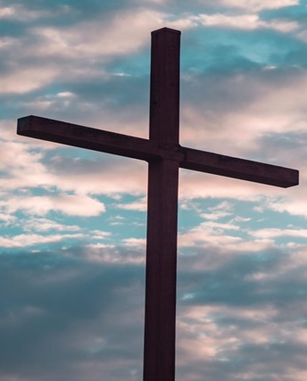
LESSON INTRODUCTION
Grandma’s House
My grandmother kept a very tidy house. The floors were always spotless, and the carpets were free of stains. She exemplified the philosophy, “A place for everything, and everything in its place. ”
I also knew her as a wonderful playmate. She would chase my sister and me around outside. She would play with us in the pool or the mud, teaching us to experience the world with our hands.
But we couldn’t enter her house while we were dirty. She had a shower outside by her pool, where we would wash off before going inside. We had to put on clean clothes and shoes. We knew Grandma loved us, but she needed to preserve her home. Her front door separated the earthy outside world from her pristine abode. Her threshold was a barrier that uncleanliness could not cross. Sound familiar?
Christ’s Once-for-All Sacrifice
4
Notes:
Summary
The author fondly recalls their grandmother's meticulous housekeeping and playful spirit. She encouraged outdoor fun but enforced strict cleanliness before entering her home. The front door symbolized the boundary between the messy outside world and her spotless home, drawing a parallel to spiritual purity and separation from sin.
Main Idea
The grandmother’s home represents purity and order, reinforcing the principle that certain spaces demand preparation and respect, much like spiritual sanctity.
Key Takeaways
1. True love balances joy and discipline.
2. Preparation is required before entering sacred spaces.
3. Purity requires boundaries and intentional effort.

Slide 5
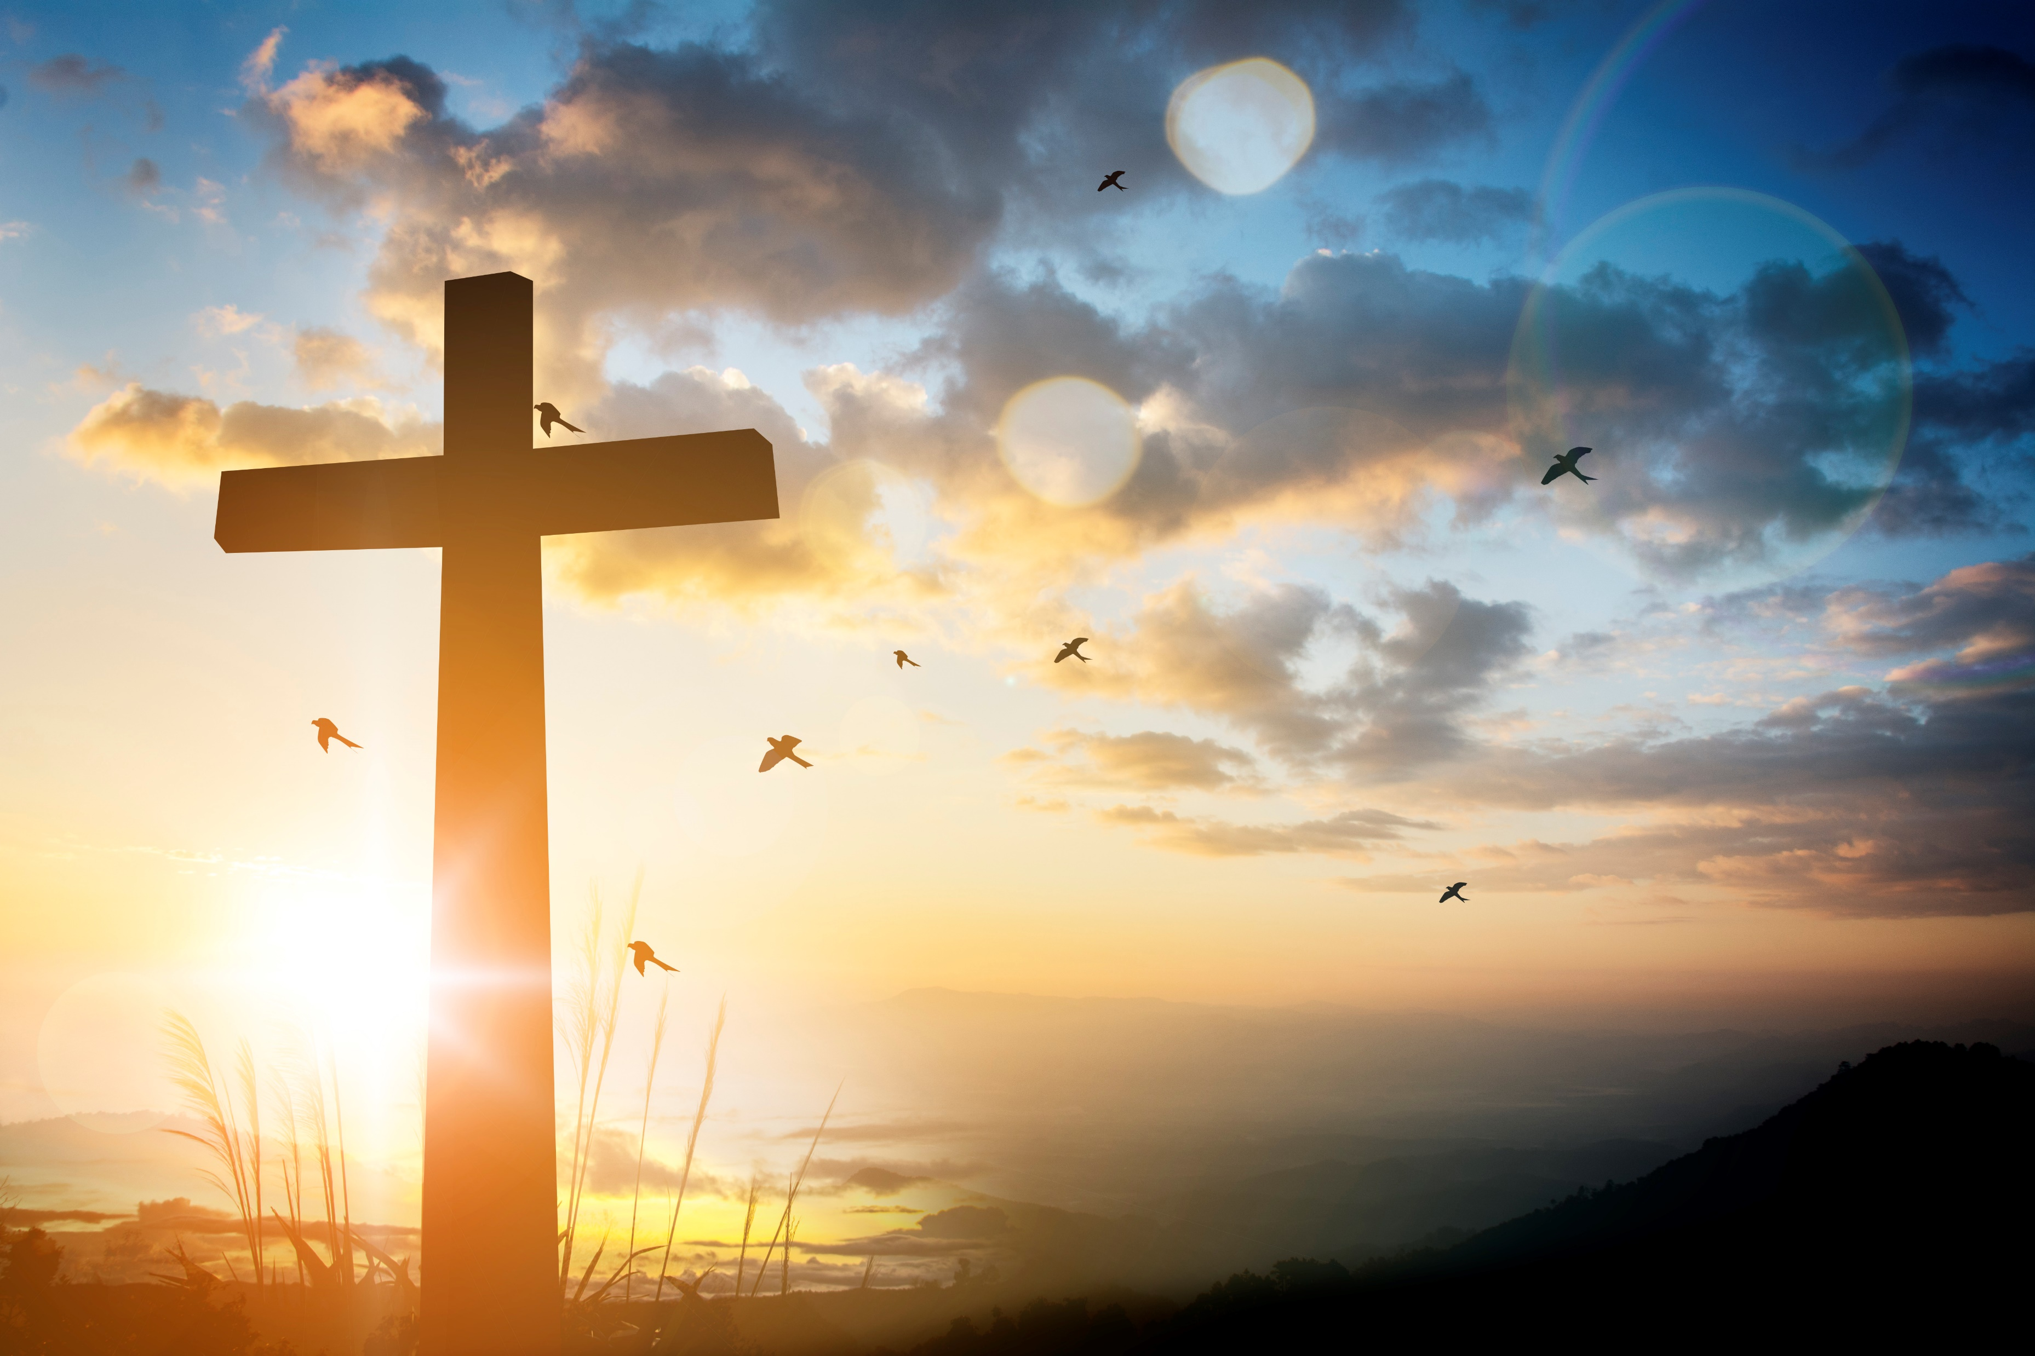
Before Christ’s death, the animal sacrifices were neither perfect nor eternal. Jesus became the perfect sacrifice when He offered Himself to God, without spot or blemish, on the cross. Now, people can intimately and eternally be in the presence of Yahweh.
OLD COVENANT—
Under the old covenant, the sacrifices never completely eradicated sin. Worshipers brought bulls and goats to be purified for a year, but they would have to repeat the ritual annually. Even then, sacrifices could only hide sin, not erase it. Colossians and Hebrews describe the law and Jewish rituals as a “mere shadow” of things to come. These practices formed an outline of Messiah (Col. 2:17; Heb. 8:5). But the picture of the Savior was incomplete and insufficient. The Old Testament rituals reminded the congregation of their insufficient and dire situation. The law could not wholly save them.
HALLELUJAH—
At the appointed time, Jesus established the way to eternal life by His perfect sacrifice. Now believers come before the throne of grace and receive salvation (Heb. 4:16). Christians now have an advocate with the Father who champions their salvation (1 John 2:1, 2). He also makes intercession for the redeemed (Heb. 7:25). We may assume that someone with the weight and responsibility Jesus holds would be performing constantly without rest, but after His sacrificial work, we find Him sitting! He’s seated at the right hand of God.
Christ’s Once-for-All Sacrifice
THE NEW COVENANT—
Laws that once existed on stone tablets now rest on the hearts of followers because of the new covenant. God will not hold sins against His followers, and they do not need to repeat sacrifices. Christians are covered by Jesus’ precious blood shed on Calvary.
The events of Jesus’ death and resurrection are a living reality in God’s mind. He’s no longer concentrating on dead animals or scapegoats. He sees Jesus escorting His children into His presence.
5
Notes:
Before Christ's death, His sacrifice replaced the old system, allowing for direct and eternal communion with God. The Old Covenant, while highlighting human sinfulness, was unable to offer full redemption. However, through Christ's work, which is now complete, He advocates for believers. His sacrifice ushered in the New Covenant, bringing about a personal and permanent relationship with God.
Animal sacrifices in the Old Covenant were temporary and insufficient to remove sin, serving only as a reminder of humanity’s need for true salvation. These sacrifices pointed forward to the coming work of Christ, who became the perfect and final sacrifice, granting believers eternal access to God’s presence. Jesus' sacrifice secured eternal salvation, and now, seated at God's right hand, He intercedes for believers, proving His work is finished. Through His blood, Jesus established a new covenant, replacing external laws with internal transformation, ensuring that God no longer remembers the sins of those who believe.
Key Takeaways:
Animal sacrifices only covered sin, not removed it.
Jesus’ perfect sacrifice grants eternal access to Yahweh.
Believers can now have a personal and intimate relationship with God.
The Old Covenant sacrifices temporarily covered sin.
The law foreshadowed Christ but was incomplete.
True salvation required a better and lasting sacrifice.
Jesus’ sacrifice opened the way to eternal life.
He intercedes for His followers before the Father.
His seated position signifies a finished, perfect work.
God’s law is now written on believers’ hearts.
Sin is no longer counted against Christ’s followers.
Jesus personally escorts believers into God’s presence.

Slide 6
THE MESSAGE OF HEBREWS
Hebrews is one of the most theologically complex works in the New Testament. The author is not named, but Paul, Barnabas, Apollos, and Luke have all been suggested as potential authors. While we do not know the author, the message is clear and focused. Hebrews explains how the Mosaic covenant relates to the “new covenant,” foretold by the prophet Jeremiah (Jer. 31:31–34). The author shows that the regulations of the old covenant prefigured the sacrificial work of Christ. Jesus is the high priest of the new covenant (Heb. 8:1–13), and the forms of worship that He instituted under the new covenant were already foreshadowed by the old. Like a priest of the Mosaic covenant, Christ enters a tabernacle to offer a sacrifice, but His tabernacle is not of this world (Heb. 9:11). The old covenant priests were subject to sin and death (Heb. 7:23–28), and their offerings were ineffective—mere shadows of Christ’s future sacrifice (Heb. 9:6–9). Hebrews 9–10 describe Christ’s role as this high priest and His self-offering on our behalf.
Christ’s Once-for-All Sacrifice
6
Notes:
The Message of Hebrews
Analysis: Hebrews clarifies the transition from the Mosaic covenant to the new covenant, showing how Old Testament rituals prefigured Christ’s priesthood and sacrifice.
Main Idea: Jesus, as the high priest of the new covenant, fulfills and surpasses the Old Testament sacrificial system.
Key Takeaways:
1. The old covenant foreshadowed Christ’s redemptive work.
2. Jesus, the true high priest, offers a perfect sacrifice.
3. The new covenant grants believers direct access to God.

Slide 7

LESSON INTRODUCTION
Patterns of Heavenly Things
To show how the old covenant foreshadows the new, the author claims that the earthly tabernacle, its paraphernalia, and its rites of worship were all modeled on heavenly originals (Heb. 9:11, 23–24). This idea circulated widely among first-century Jews (Acts 7:44). It was based on Exodus 25:8–9, in which Moses was told to construct the “tabernacle and all its furnishings exactly like the pattern” that God would “show” him. Many Jews understood the “pattern” that Moses saw as an actual heavenly tabernacle, complete with its accoutrements.
In fact, some Jews believed that the city of Jerusalem itself had a heavenly counterpart. For example, Paul seems to allude to this idea when he refers to the “Jerusalem above” in Galatians 4:26 (see also Rev. 21:2–3). The author of Hebrews claims that Christ has actually carried out His role as high priest in the true tabernacle made without human hands.
Christ’s Once-for-All Sacrifice
7
Notes:
Patterns of Heavenly Things
Analysis: The old covenant tabernacle and worship were earthly models of heavenly realities, with Christ ministering in the true heavenly sanctuary.
Main Idea: Earthly worship was a shadow of Christ’s true high-priestly work in heaven.
Key Takeaways:
1. The earthly tabernacle mirrored a greater heavenly one.
2. Christ ministers in the true tabernacle, not man-made.
3. Salvation is rooted in divine, not earthly, realities.

Slide 8
PURITY AND IMPURITY
Modern readers are often confused by the concepts of purity and impurity. People often use these terms as synonyms for “good” and “evil. ” While the New Testament authors sometimes use them in such a metaphorical sense, purity and impurity are better compared to ideas of dirty and clean. In a nutshell, purity and impurity relate to the maintenance of the space in which God can dwell. Sin renders the land impure, which makes it unfit for God’s residence. Humans and objects can also become ritually impure, making it impossible for them to enter God’s presence.
The purpose of the sacrificial system was to cleanse the stain of impurity from the sacred space. The author of Hebrews identifies a key problem with the old covenant sacrificial system: it could not permanently cleanse the sanctuary. Christ’s self-sacrifice, on the other hand, was perfect; it once-for-all dealt with humanity’s sin (v. 26) and “purified” the heavenly temple, allowing us into God’s presence forever.
Christ’s Once-for-All Sacrifice
8
Notes:
Purity and Impurity
Analysis: Purity laws maintained God’s dwelling space, but the old sacrifices couldn’t permanently cleanse sin—only Christ’s sacrifice could.
Main Idea: Jesus’ sacrifice purified believers once for all, granting permanent access to God.
Key Takeaways:
1. Purity allowed people to enter God’s presence.
2. The old sacrifices could not fully cleanse sin.
3. Christ’s sacrifice grants eternal spiritual purity.

Slide 9
LESSON CONTEXT
Christ’s Once-for-All Sacrifice
THE PRIEST-KING
Hebrews 10:11–13 offers a nuanced portrayal of Jesus’ identity as Israel’s Messiah. The term messiah means “anointed one,” referring to the person assigned a special role by God. Multiple roles could be designated a messiah. Many Jews were longing for the coming of the messianic king, a descendant of Israel’s greatest monarch, David. Others also hoped for the messianic prophet like Moses, who would speak for God as Moses once had (John 6:14). Still others looked forward to a priestly messiah, who would oversee proper worship of God in the temple in Jerusalem.
What most Jews did not expect was that the same person would fulfill all three roles. Yet the New Testament authors agree in their portrayals of Jesus as the prophet, riest, and king. Hebrews 10:11–13 weaves these two roles of Christ together: once He completed His priestly duties, He began to reign at the Father’s right hand.
THE SHADOW OF GOOD THINGS TO COME
In Hebrews 10:1, the author transitions to arguing for the inferiority of animal sacrifices to the sacrifice of Christ. In a move that might have surprised his original audience, he grounds his argument in the temporary nature of the Torah, the Mosaic Law. Many first-century Jews believed the Torah held a central and enduring place in God’s plans. Some traced its origins back to the patriarchs, others to Noah, and still others to before creation.
On the other hand, the earliest Christ-followers believed the Law had a much more limited role in God’s purposes. In Galatians 3:17, Paul rejects the claim that the Torah arrived before the events at Sinai. Instead of the height of creation, Torah was a temporary custodian of God’s people (Gal. 3:24). Hebrews likewise portrays the Law as a mere “shadow” of the “good things” God planned for His people.
9
Notes:
The Priest-King
Jesus fulfills the roles of prophet, priest, and king, reigning at God’s right hand after completing His priestly work.
Main Idea: Christ uniquely unites all messianic roles, reigning as priest-king.
Key Takeaways:
1. Jesus is prophet, priest, and king.
2. His priestly work is complete, so He now reigns.
3. Christ’s kingship ensures eternal authority and intercession.
The Shadow of Good Things to Come
The Mosaic Law was temporary, serving as a shadow of the greater redemption found in Christ.
Main Idea: The Law pointed toward Christ but was never the final plan for salvation.
Key Takeaways:
1. The Law foreshadowed, but could not replace, Christ.
2. Christ is the fulfillment of God’s redemptive plan.
3. Salvation is in Christ, not in keeping the Law.

Slide 10
LESSON CONTEXT
Christ’s Once-for-All Sacrifice
Don’t Neglect Meeting Together
Many Christians read Hebrews 10:25 as a commandment, a blanket prohibition against missing church. Some churches have even placed members under church discipline for missing too many services. While this passage supports regular church attendance, it does not function in this way. Verse 25 builds off of verse 24, in which the author exhorts his audience to contemplate ways to “spur one another on toward love and good deeds. ” Verse 25 is not a separate command; it continues the sentence from verse 24. The point is that the gathering of believers is the space to find opportunities to “spur one another on. ” Instead of a prohibition of missing church, this is encouragement to enter spaces where we can minister and receive ministry from fellow believers. Hebrews 10:25 might exhort us to make church attendance a priority, but it should not be wielded like a club.
10
Notes:
Don’t Neglect Meeting Together
Analysis: Hebrews 10:25 encourages believers to gather for mutual encouragement, not as a legalistic command.
Main Idea: Christian gatherings are essential for strengthening faith and spurring one another to good works.
Key Takeaways:
1. Fellowship is vital for spiritual growth.
2. Church gatherings encourage love and good deeds.
3. Attendance should be about support, not obligation.

Slide 11
LESSON CONTEXT
The Confidence of Paul
  Paul gives us an example of what it looks like to have confidence in Christ Jesus. Paul writes to the Romans, “Who will rescue me from this body that is subject to death? Thanks be to God, who delivers me through Jesus Christ our Lord!” (Rom. 7:24–25). Paul’s confidence comes from Christ’s better sacrifice, which atones for all of his sins. He steadies himself upon salvation that God provides. When condemnation and despair grip our hearts, we can cling to the better sacrifice of Jesus Christ and find hope in the throne room of God. We can confidently say with Paul, “Therefore, there is now no condemnation for those who are in Christ Jesus” (Rom. 8:1).
  .
Christ’s Once-for-All Sacrifice
11
Notes:
The Confidence of Paul
Analysis: Paul’s confidence in Christ’s sacrifice allows him to reject condemnation and embrace hope.
Main Idea: Faith in Jesus’ sacrifice removes condemnation and secures our confidence in salvation.
Key Takeaways:
1. Christ’s sacrifice delivers us from sin’s grip.
2. There is no condemnation for those in Christ.
3. Confidence in salvation brings lasting hope.

Slide 12
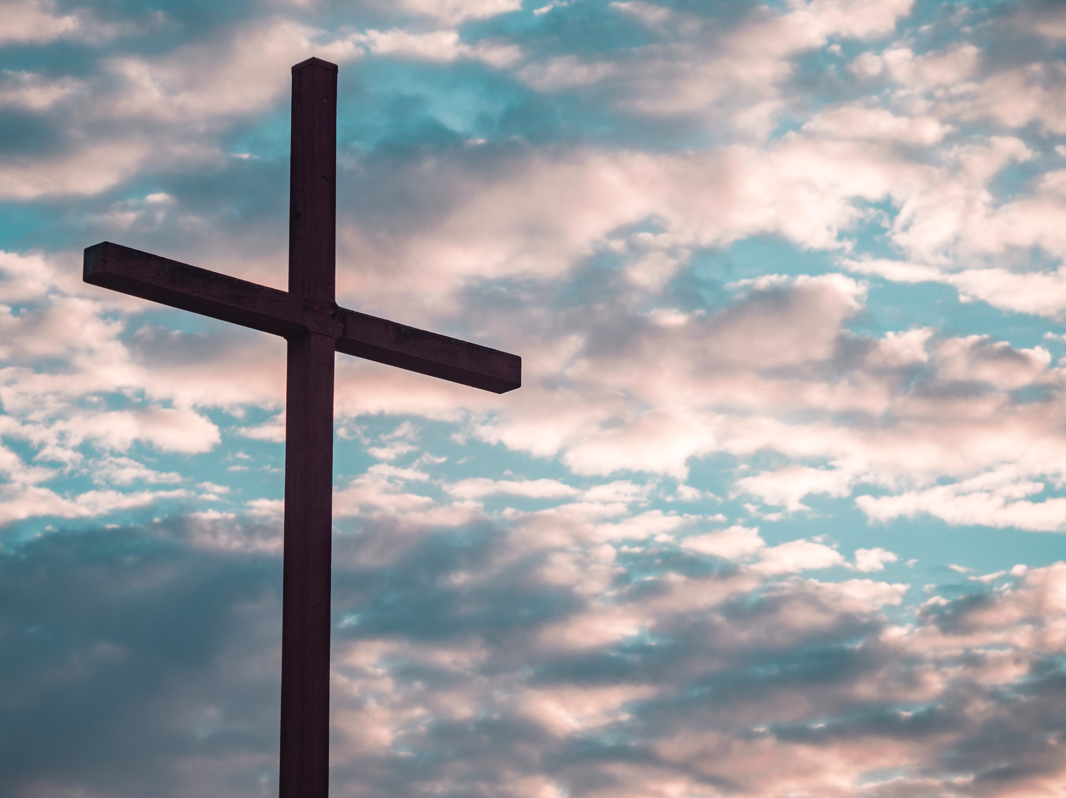
LESSON OVERVIEW
Christ’s Once-for-All Sacrifice
A Better Sacrifice - Hebrews 9:23–10:4 NIV
The earthly tabernacle, the one which the people of Israel first constructed at the foot of Mount Sinai, was modeled after a greater one in heaven.
Jesus is a heavenly priest who enters the heavenly tabernacle, where He serves as our representative before God.
The sacrifice that Jesus offers is Himself, but He had to die only once.
Jesus’ sacrifice is superior: it actually can overcome the powers of sin and death.
The sacrificial system reminded people of sin but didn’t take sin away.
23 It was necessary, then, for the copies of the heavenly things to be purified with these sacrifices, but the heavenly things themselves with better sacrifices than these.
24 For Christ did not enter a sanctuary made with human hands that was only a copy of the true one; he entered heaven itself, now to appear for us in God’s presence.
25 Nor did he enter heaven to offer himself again and again, the way the high priest enters the Most Holy Place every year with blood that is not his own.
26 Otherwise Christ would have had to suffer many times since the creation of the world. But he has appeared once for all at the culmination of the ages to do away with sin by the sacrifice of himself.
27 Just as people are destined to die once, and after that to face judgment,
28 so Christ was sacrificed once to take away the sins of many; and he will appear a second time, not to bear sin, but to bring salvation to those who are waiting for him.
10:1 The law is only a shadow of the good things that are themselves. For this reason it can never, by the same sacrifices repeated endlessly year after year, make perfect those who draw near to worship.
2 Otherwise, would they not have stopped being offered? For the worshipers would have been cleansed once for all, and would no longer have felt guilty for their sins.
3 But those sacrifices are an annual reminder of sins.
4 It is impossible for the blood of bulls and goats to take away sins.
12
Notes:
Christ’s priestly work fulfilled and surpassed the old covenant by providing a perfect, once-for-all sacrifice. The earthly tabernacle was purified with animal blood, but the heavenly sanctuary required a greater offering—Christ Himself. Unlike earthly priests who repeatedly offered sacrifices, Christ's single sacrifice was sufficient for all time. The Law and its sacrifices were only shadows, unable to truly remove sin, but instead served as reminders of humanity’s need for real purification.
Summary:
Christ’s sacrifice replaced the ineffective animal sacrifices of the Old Covenant. His priestly role was superior, as He entered the heavenly sanctuary to offer Himself once for all. The Law foreshadowed true purification, proving that repeated sacrifices could never remove sin completely.
Main Idea:
Jesus’ once-for-all sacrifice fulfilled the Old Covenant, achieving true purification and replacing ineffective animal sacrifices.
Three Key Takeaways:
Christ’s priestly work transcended the old covenant, offering true and final purification.
Animal sacrifices were repetitive and insufficient, only serving as reminders of sin.
Christ’s single sacrifice in the heavenly tabernacle fully cleansed believers forever.
><><><><><><><><><><><><><
Christ’s priestly work fulfilled and transcended the old covenant patterns of worship. Since the earthly tabernacle was purified with animal sacrifices, the cleansing of its heavenly counterpart required a more precious sacrifice. Christ entered that heavenly tabernacle to offer Himself on our behalf. Unlike earthly high priests, who must offer the same sacrifices year after year, Christ sacrificed Himself only once. In Hebrews 10:1–4, the author explains why Christ’s sacrifice and priestly service were necessary: the Law was intended to foreshadow the true purification that Christ would bring. Animal sacrifices of the old covenant were never sufficient on their own. To defend this claim, the writer points to the repetitive nature of past sacrifices. If they were truly effective at cleansing God’s people, they would not need repeating again and again. Rather than purifying God’s people, animal sacrifices served to remind them of their need for more purification. In truth, the sacrifice of animals could never deal with human sinfulness.

Slide 13
LESSON OVERVIEW
Christ’s Once-for-All Sacrifice
A New and Living Way - Hebrews 10:11–14, 19–25 NIV
11 Day after day every priest stands and performs his religious duties; again and again he offers the same sacrifices, which can never take away sins.
12 But when this priest had offered for all time one sacrifice for sins, he sat down at the right hand of God,
13 and since that time he waits for his enemies to be made his footstool.
14 For by one sacrifice he has made perfect forever those who are being made holy.
19 Therefore, brothers and sisters, since we have confidence to enter the Most Holy Place by the blood of Jesus,
20 by a new and living way opened for us through the curtain, that is, his body,
21 and since we have a great priest over the house of God,
22 let us draw near to God with a sincere heart and with the full assurance that faith brings, having our hearts sprinkled to cleanse us from a guilty conscience and having our bodies washed with pure water.
23Let us hold unswervingly to the hope we profess, for he who promised is faithful.
24 And let us consider how we may spur one another on toward love and good deeds,
25 not giving up meeting together, as some are in the habit of doing, but encouraging one another—and all the more as you see the Day approaching.
Just like the sacrifice of Jesus is superior, the priestly work of Jesus is superior to any other.
The work of Jesus was so effective that he sat down in God’s presence, a sign God was pleased.
Jesus’ priestly work is able to make people perfect and holy in the sight of God.
As a result, we can have confidence to enter God’s presence with assurance that comes from faith.
Those made clean by Jesus should be encouraging one another to keep showing love and doing what is good.
We await a day of Christ’s glorious return.
13
Notes:
The author contrasts Christ’s priestly work with that of Old Covenant priests, who continually offered ineffective sacrifices. Unlike them, Christ’s single, perfect sacrifice fully removed sin, allowing believers to stand guilt-free before God. His death tore down the separation between humanity and God, symbolized by the temple curtain tearing at His crucifixion. Now, Christ’s blood grants believers direct access to God, enabling them to approach Him with confidence. As our high priest, He sustains our faith, calling us to remain steadfast in our Christian community, encouraging one another in love and good works.
Summary:
Christ’s once-for-all sacrifice accomplished what Old Covenant priests never could—true and lasting purification. His death removed the barrier between God and humanity, allowing believers to approach God with confidence. As our high priest, Christ calls us to remain faithful, encouraging each other as we await His return.
Main Idea:
Through His perfect sacrifice, Christ granted believers direct access to God, replacing fear with confidence and calling us to remain steadfast in faith and community.
Three Key Takeaways:
Christ’s single sacrifice fully removed sin, unlike the repetitive sacrifices of Old Testament priests.
His death tore down the barrier between God and humanity, giving believers direct access to God.
As our high priest, Christ sustains our faith, calling us to encourage one another in love and good deeds.
><><><><><><><><><><><><><
The author draws more contrast between Christ and the priests of the old covenant. In the past, priests never saw an end to their duties; they performed the same ineffectual sacrifices every day. Christ, on the other hand, offered Himself as a sacrifice once for all and took His rightful seat as king at the right hand of God the Father. Unlike offerings of animals, Christ’s self-sacrifice was effective in making God’s holy people “perfect,” free from the guilt of their sins. Verse 20 makes a metaphorical comparison between the temple’s curtain—which separated sinful humans from God’s holy presence—and “body” or “flesh” of Jesus. At the same time that Jesus was killed, the separation between God and humanity could end (compare Matt. 27:51).
Christ’s blood opened a new way for us to enter God’s presence, with confidence instead of fear. As the high priest of God’s heavenly temple, Christ enables us to “draw near to God” with security in our salvation, purified of sin and guilt in our innermost beings. As our faithful high priest sustains our hope, we encourage one another “toward love and good deeds” (v. 24). We must remain engaged in the community of God’s people, encouraging each other as the day of Christ’s return draws near.

Slide 14
LESSON OVERVIEW
Christ’s Once-for-All Sacrifice
Bible Application: Talk about how Jesus’ sacrifice grants confidence to draw near to God.
A Job Done Well Doesn’t Need Repeating
“If you want something done well, do it right the first time. ” That’s what my father used to say. As a landscaper who specialized in building retaining walls, a big part of his job was fixing the faulty work of others. Weather has a way of testing what we build; unless someone takes the time to dig deeply into the soil to prepare a firm foundation, nothing can keep a wall from falling—even a wall built of heavy stones.
We often forget that it was God who created the old system of sacrifice. The ancient priests weren’t doing the wrong things, but it was a system of endless repetition. Priests of Israel were always flawed and sinful, so how could their work be effective? Jesus wasn’t like them at all. He wasn’t even a priest who worked in the physical temple of Jerusalem, but His work went to the foundation of the problem. He entered the heavenly sanctuary, where He offered a perfect sacrifice—the firmest foundation of all. And He sat down because the job was done.
There is nothing that we need to add, no work that we could offer in return. But it is our responsibility to proclaim Christ to the world. While we wait for the day that Jesus puts an end to evil, we continue in the “love and good deeds” that encourage one another (Heb. 10:24). Our confidence isn’t based in what we do; it is based in what has already been done. We can be confident that Jesus does things right the first time.
14
Notes:
1. A Job Done Well Doesn’t Need Repeating: A job well done doesn’t need to be redone. My father, a landscaper, stressed doing things right the first time. Building a firm foundation ensures long-lasting results, just as Jesus' perfect sacrifice addressed the root problem of sin, completing the work once and for all.
2. The Ancient Sacrifice System: The old sacrificial system was repetitive, ineffective because the priests were flawed. Jesus, unlike these priests, entered the heavenly sanctuary, offering a perfect sacrifice that resolved the issue of sin, making further sacrifices unnecessary. His work is finished, symbolized by Him sitting down.
3. Confidence in Christ's Completed Work: Our confidence is not in our actions but in Christ's completed work. While awaiting His return, we must continue loving and doing good deeds, encouraging one another. Our belief rests on what Jesus has already done, not on anything we do.
4. Difference Between Repetition and Completion: Repeated tasks often stem from imperfections or inadequate foundations. Jesus’ work, unlike repeated sacrifices, was completed once and for all, offering a perfect and lasting solution. His sacrifice doesn’t require repetition because it was flawless from the beginning.
5. Confidence in Jesus' Completed Work: It can be challenging to trust in the completed work of Jesus due to doubts or human inclination to contribute. However, recognizing that Christ’s sacrifice is sufficient, without needing our additions, fosters confidence in His finished work.
6. Acts of “Love and Good Deeds”: Acts of love and good deeds, like sharing the gospel, helping the needy, and showing kindness, reflect the work of Christ. These actions encourage others by strengthening faith, fostering community, and embodying the love Christ showed through His sacrifice.

Slide 15
LESSON OVERVIEW
Christ’s Once-for-All Sacrifice
Bible Application: Talk about how Jesus’ sacrifice grants confidence to draw near to God.
Postures of Prayer
  8. What is the difference between things that are done repeatedly and things that are done only once?
  9. Do you find it easy or difficult to be confident in the completed work of Jesus?
  10. What are examples of acts of “love and good deeds” that proclaim the work of Christ? How do these actions encourage one another?
15
Notes:
8. What is the difference between things that are done repeatedly and things that are done only once?
Repeated actions often reflect imperfection, requiring correction or redoing. In contrast, actions done once and done right reflect perfection, like Jesus' sacrifice, which needed no repetition.
9. Do you find it easy or difficult to be confident in the completed work of Jesus?
Confidence in Jesus' completed work can be difficult due to personal doubts or life challenges, but trusting in His perfect sacrifice provides assurance that it is sufficient for salvation.
10. What are examples of acts of “love and good deeds” that proclaim the work of Christ? How do these actions encourage one another?
Examples include acts of kindness, service, and sharing the gospel. These actions encourage one another by fostering unity, building faith, and spreading Christ's love.

Slide 16
CONCLUSION:
One Sacrifice
Christ’s Once-for-All Sacrifice
  Most people in the ancient Greco-Roman world believed that their gods were remote and cared little for them. Some Jewish people of the time between the Testaments also viewed God as distant, so they developed (imagined) elaborate systems of angels to bridge the gap between God and humanity. It is easy for us to believe that God is distant. His silence can lead us to think He doesn’t care about us.
  But such a belief is proven false when we consider the actions of Jesus, our great high priest. He put on flesh and came to earth to offer himself as a sacrifice for our sins—those aren’t the actions of a “distant” God!
  The next time you feel distant from God, perhaps the best question to ask yourself is: Which of us moved?
16

Slide 17
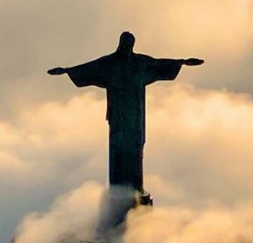
CONCLUSION
Christ’s Once-for-All Sacrifice
Life Response: Find courage in Christ’s sacrifice and draw near to the throne of grace.
We can steady ourselves upon the salvation that God provides. When condemnation and despair grip our hearts, we can cling to the better sacrifice of Jesus Christ and find hope in the throne room of God. We can confidently say, “There is now no condemnation for those who are in Christ Jesus” (Rom. 8:1).
Proclaiming the Work of Christ
Nothing we do can add to the effectiveness of Christ’s sacrifice. But if we are confident to come before God, that should also make us confident to share with our friends and neighbors who might not know Jesus. Easter Sunday is one time each year when many people are receptive to an invitation, either to share a meal or even to come to church for the first time.
17

Slide 18



End
  The Lord bless thee, and keep thee:
  The Lord make his face shine upon thee, and be gracious unto thee:
  The Lord lift up his countenance upon thee and give thee peace.
  - Numbers 6:24-26,
Material adapted by Stanford W. Bowman Jr. from Echoes® Adult and Bible-in-Life® Adult Spring 2025 quarter with permission, © David C Cook, https://davidccook.org. May not be further reproduced. All rights reserved.

Slide 19

Lesson Focus: Don’t restrict the Gospel with needless rules and traditions.
Life Response: Identify examples of unbiblical rules that may needlessly restrict the Gospel today.
QUESTION & ANSWER
Christ’s Once-for-All Sacrifice
A BETTER SACRIFICE
4. How does Christ’s sacrifice differ from those performed under the old covenant?
5. How do we know that the law was not intended to take away sins?
Christ’s sacrifice is offered once and cleanses the heavenly tabernacle, which is superior to its earthly copy. It also cleanses human hearts, which animal sacrifices cannot.
Animal sacrifices under the old covenant had to be repeated over and over every year. Sacrifices effective at dealing with sin would not need to be repeated.
19
Notes:
A BETTER SACRIFICE
4. How does Christ’s sacrifice differ from those performed under the old covenant?
Christ’s sacrifice is offered once and cleanses the heavenly tabernacle, which is superior to its earthly copy. It also cleanses human hearts, which animal sacrifices cannot.
5. How do we know that the law was not intended to take away sins?
Animal sacrifices under the old covenant had to be repeated over and over every year. Sacrifices effective at dealing with sin would not need to be repeated.

Slide 20
Lesson Focus: Don’t restrict the Gospel with needless rules and traditions.
Life Response: Identify examples of unbiblical rules that may needlessly restrict the Gospel today.
QUESTION & ANSWER
Christ’s Once-for-All Sacrifice
A NEW AND LIVING WAY
6. How do the duties of priests under the old covenant differ from Christ’s?
7. What does Christ’s sacrifice enable us to do?
Old covenant priests had to offer their sacrifices over and over without ceasing. After Christ performed His unique sacrifice, He sat down at the Father’s right hand.
It allows us to approach God’s very presence, to be confident that our innermost beings are washed clean of the guilt of sin. Instead of the Old Testament priests who had to shield themselves, we have God’s love on full display in the person of Jesus.
20
Notes:
A NEW AND LIVING WAY
6. How do the duties of priests under the old covenant differ from Christ’s?
Old covenant priests had to offer their sacrifices over and over without ceasing. After Christ performed His unique sacrifice, He sat down at the Father’s right hand.
7. What does Christ’s sacrifice enable us to do?
It allows us to approach God’s very presence, to be confident that our innermost beings are washed clean of the guilt of sin. Instead of the Old Testament priests who had to shield themselves, we have God’s love on full display in the person of Jesus.

Slide 21
End
  The Lord bless thee, and keep thee:
  The Lord make his face shine upon thee, and be gracious unto thee:
  The Lord lift up his countenance upon thee and give thee peace.
  - Numbers 6:24-26,
Material adapted by Stanford W. Bowman Jr. from Echoes® Adult and Bible-in-Life® Adult Spring 2025 quarter with permission, © David C Cook, https://davidccook.org. May not be further reproduced. All rights reserved.

