Slide 1

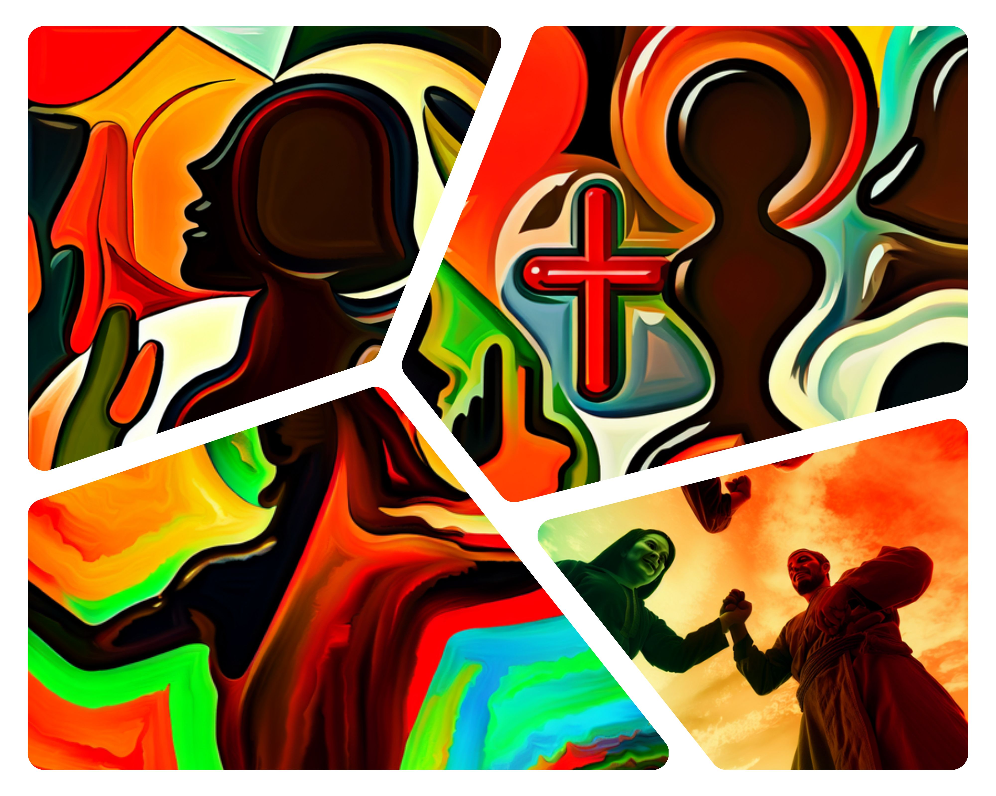
Christ the Atoning Sacrifice
Herein is love, not that we loved God, but that he loved us, and sent his Son to be the propitiation for our sins.
—1 John 4:10 KJV
Week of April 13

Slide 2





Prayer
Lord God, Your love surpasses our imagination. We are filled with thanksgiving because Christ died and rose for us. Lead us to love one another as You have loved us. In Jesus’ name. Amen.
      Thought to Remember
        Christ’s death for us moves us to a life of love for others.
Notes:
Prayer
Lord God, Your love surpasses our imagination. We are filled with thanksgiving because Christ died and rose for us. Lead us to love one another as You have loved us. In Jesus’ name. Amen.
Thought to Remember
Christ’s death for us moves us to a life of love for others.

Slide 3

Agenda
Herein is love, not that we loved God, but that he loved us, and sent his Son to be the propitiation for our sins.
—1 John 4:10 KJV
3
    Review
    Introduction
    Lesson Context
    Overview
    Our Advocate - 1 John 2:1–6 KJV
    Our Sacrifice – 1 John 4:9–12 KJV
    Our Response - 1 John 4:13–17 KJV
    Conclusion
    Question & Answers
Christ the Atoning Sacrifice
Notes:
Our Advocate - 1 John 2:1–6 KJV
Our Sacrifice – 1 John 4:9–12 KJV
Our Response - 1 John 4:13–17 KJV
><><><><><><><><><><><><><><
Sure! Here's a version of your text restated for a 7th-grade reading level:
1 John 2:1–6 (Simplified):
Jesus speaks to God for us when we mess up, helping us get forgiven.
We show we love Jesus by doing what He tells us to do.
If someone says they follow Jesus, they should try to live like He did.
Commentary:
These verses teach us that Jesus stands up for us when we sin. They also show that obeying Him proves we really love and follow Him, and we should try to live like He lived.
1 John 4:9–17 (Simplified):
God showed His love by sending Jesus to save us.
When we love others, it shows that God lives in us.
If we keep living in love, we don’t have to be afraid when God judges the world.
Commentary:
This part shows how much God loves us through Jesus. It also reminds us that loving each other is proof that God is with us, and that love gives us peace about the future.

Slide 4
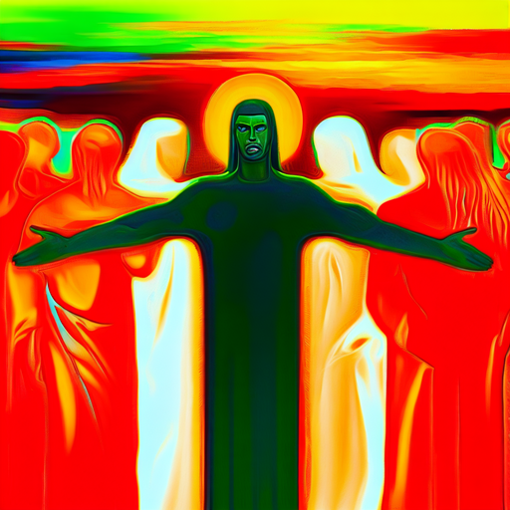
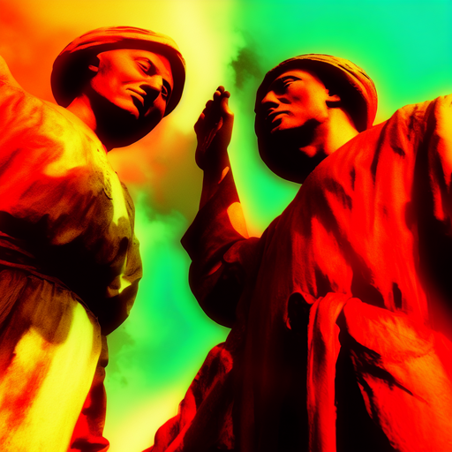
Surprising Symbol
Christ the Atoning Sacrifice
Today, the cross of Christ is recognized the world over. We see it on church buildings, use it for headstones, depict it in paintings, and wear it as jewelry. The latter is particularly surprising for becoming so common, given that the cross was the instrument of torture and death for notorious criminals in the Roman world. In that era, crosses along roadsides symbolized the ultimate consequence for challenging the Roman Empire’s power.
How could such a terrible object become the universal symbol of a faith that preaches love and offers new life? The answer to that question lies in the purpose of Jesus’ death on the cross: today’s lesson.
Notes:
"Surprising Symbol"
The cross, once a symbol of shame and brutal execution for criminals under Roman rule, has become the universal emblem of Christianity. Its transformation into a revered symbol of faith, love, and eternal life is astonishing. This shift is rooted in the purpose of Jesus' sacrificial death, which redefined the cross not as an instrument of fear, but of hope and salvation.
Main Idea:
The cross, though once a terrifying tool of execution, became a powerful symbol of love, redemption, and new life through Jesus Christ’s death.
Three Key Points:
1. The cross was a feared instrument of Roman punishment.
2. Its use in Christian symbolism is surprisingly widespread today.
3. Jesus’ death redefined the cross from a symbol of death to one of life and love.

Slide 5

Key Points
Christ the Atoning Sacrifice
THE LOVE OF GOD—
We call 1 John a letter, but it is more like a sermon. John encourages his “dear children,” perhaps children in the faith, to avoid sin and to love one another (1 John 2:1). Why? Well, because God first loved us. Through the atoning sacrifice of Jesus, God forgave sins and gave the ability to “live through him” (1 John 4:9). Followers of Christ can “rely on the love God has,” rather than their own diminished resources (1 John 4:16).
The Father reaches out to people through His compassion. Living in His love is the best life, and it is not earned but freely given (see Deut. 7:7-8; Rom. 5:8). In the same way, Christ followers should freely give their love to others and reflect God’s compassion so that others may know the love of God.
Notes:
The Love of God
Analysis:
This section emphasizes that God's love is foundational to the Christian life. John's encouragement for believers to love one another is rooted not in obligation, but in God’s initiating love, demonstrated through Jesus’ sacrificial death. This love is not earned but freely given, and believers are called to reflect it.
Summary:
John calls believers to avoid sin and love one another because of God’s initiating love, shown through Jesus’ sacrifice. God’s love is a gift, not something earned, and it empowers believers to live through Him. As recipients of divine love, Christians are urged to share that love with others, showing God’s compassion in the world.
Main Idea:
God's love, freely given through Jesus, empowers believers to live in Him and extend love to others.
Three Key Points:
1. God first loved us, making it possible to live through Christ.
2. His love is freely given, not earned.
3. Christians are called to reflect this love in how they treat others.

Slide 6
TRANSFORMATION—
Key Points
Christ the Atoning Sacrifice
SIMPLICITY—
The biblical story shows God’s initiation. Once a person commits to Christ, the Spirit makes His dwelling place within the believer. The Holy Spirit begins the transformational work of making followers look like Jesus. God’s love then flows through His children, enabling the Holy Spirit to love others through them.
The language of 1 John is deceptively simple. John doesn’t use many words. Instead, he repeats certain words many times. For instance, you might count the appearances of the word “live” in the NIV (the same word that the KJV translates “abideth” or “remaineth” in 1 John 2:6, 10, 14, 17, 19, 24, 27, 28, etc. ). Behind that single word is an important question that John wants to address: What does it mean to live in Jesus, or to let Jesus abide in you?
After this life, Christians will experience the complete love of God. God walks with His children on earth and will continue throughout eternity. As you prepare to teach the lesson and share the message of salvation, invite God to be active in the hearts of your students, especially those who may need to receive the love of God.
Notes:
Transformation
This portion highlights the inner change that begins when someone commits to Christ. Through the indwelling of the Holy Spirit, believers undergo transformation, becoming more like Jesus. This isn’t merely behavior modification but a deep, spiritual metamorphosis fueled by God’s love.
Summary:
Transformation in the Christian life begins when one accepts Christ. The Holy Spirit takes residence within the believer and begins reshaping them to reflect Christ. This divine transformation allows God’s love to flow through the believer, enabling them to love others as He does.
Main Idea:
The Holy Spirit transforms believers into Christ’s likeness, enabling them to love through God’s power.
Three Key Points:
1. Transformation starts with commitment to Christ.
2. The Holy Spirit dwells within and reshapes believers.
3. God’s love flows through transformed lives to others.
Simplicity
Although 1 John uses simple, repetitive language, it carries profound meaning. The frequent use of the word “live” (or “abide”) invites deep reflection on what it means to remain in Christ. This abiding results in a lasting relationship with God both now and in eternity.
Summary:
1 John’s language is simple but rich in meaning. Repetition of words like “live” or “abide” urges believers to consider what it truly means to remain in Christ. This abiding relationship is not just for the present but continues into eternity. Teachers are encouraged to guide students to embrace and respond to God’s love.
Main Idea:
True Christian living means abiding in Christ—now and forever.
Three Key Points:
1. John’s simple language points to profound spiritual truths.
2. “Living” or “abiding” in Christ is central to faith.
3. Believers will continue in God’s love throughout eternity.

Slide 7
Lesson Context
7
Christ the Atoning Sacrifice
Our text comes from two parallel sections of the New Testament epistle designated 1 John. It is one of three letters by John among the General Epistles. This is a section of the New Testament consisting of the eight letters: Hebrews; James; 1 and 2 Peter; 1, 2, and 3 John; and Jude.
The epistles of 1, 2, and 3 John are not explicitly ascribed to the apostle John by name, yet the early church ascribed these epistles to him, just as they did with the Gospel of John.
The three letters have close connections to the language and themes of the Gospel of John, so it is reasonable to conclude that all came from the same author. In doing so, we carefully distinguish the apostle John from John the Baptist or John Mark (Acts 1:5; 12:12; etc. ).
The letter 1 John and the Gospel of John explicitly state that the author was an eyewitness of Jesus’ life and ministry (John 1:14; 1 John 1:1-3). These two works of Scripture have similar purpose statements (compare John 20:31; 1 John 5:13). Both purpose statements find their basis in what the readers can “know” as a certainty. This is a distinctive emphasis of the author. He wrote about 14 percent of the New Testament, but his writings feature over one-third of the New Testament’s
250 uses of the Greek word that is underneath the idea of “to know” (more on this in the commentary below).
The letter 1 John addresses growing controversies in the first-century church about the nature of Christ and the Christian life. It seems some believers were influenced by a common concept of that day that said all material things are by nature evil, but that which is spirit is by nature good. On this basis, some began to deny that Jesus was both fully divine and fully human. After all, if material things are evil, then it would be impossible for the good God to exist as a human in a body. The letter of 1 John refutes this. Some students see the growing heresies of Gnosticism and Docetism as playing a part in this problem.
Notes:
What 1 John Is About and Why It Was Written (Simplified):
The book of 1 John was probably written by the apostle John, who also wrote the Gospel of John. Even though his name isn’t mentioned in the letter, early Christians believed he was the author, and the writing style is very similar to the Gospel.
John wrote this letter to help people understand the truth about Jesus. At the time, some false teachers were saying Jesus wasn’t really human or wasn’t really God. John wanted to correct that and make sure believers knew Jesus is both fully God and fully human.
He also wanted Christians to feel sure about their faith and to help them stay strong when others were teaching lies.
Main Idea:
1 John teaches the truth about who Jesus is and helps believers be confident in their faith.
Three Main Points (Simplified):
The early church and the way the letter is written point to John as the author.
The letter was written to fight against wrong ideas about Jesus not being fully God or fully human.
John’s goal was to help Christians really know Jesus and feel sure about what they believe.

Slide 8
THE ADVOCATE—
Key Points
Christ the Atoning Sacrifice
Although the title advocate only appears in the New Testament, a related Greek word is used for divine “comfort” or “consolation” in translations of Psalm 94:19 and Jeremiah 31:9. In the New Testament, both the Gospel of John and epistle of 1 John use the title paraclete (Greek for “comforter” or “advocate”). This common vocabulary supports the close connection between Johannine texts.
But one notable difference is that, while the Gospel of John calls the Holy Spirit “comforter” or “advocate” (see John 14:16–17), 1 John uses the same title for Jesus, rather than the Spirit: “If anybody does sin, we have an advocate with the Father—Jesus Christ” (1 John 2:1). One theory holds that, while Jesus was still present with His disciples on earth, He was not yet in heaven, where 1 John says that He is now the advocate before the Father. Since the Spirit is also called “his Spirit” in 1 John 4:13, this common title for Jesus and the Spirit shows the affinity of their work as the second and third persons of the triune God. Just as the Holy Spirit can comfort and guide believers who remain on earth, the risen Christ can advocate on their behalf in heaven.
Notes:
“The Advocate”:
In the Bible, John calls both **Jesus** and the **Holy Spirit** an "advocate." This word comes from Greek and means someone who helps, supports, or speaks up for others.
In **1 John**, Jesus is our advocate in **heaven**, speaking to God for us when we sin.
In the **Gospel of John**, the Holy Spirit is also called an advocate, but He helps us **here on earth**—comforting, guiding, and teaching us.
This shows that both Jesus and the Holy Spirit work together to help us—Jesus from heaven, and the Spirit in our hearts.
---
**Main Idea:**
Jesus helps us from heaven, and the Holy Spirit helps us here on earth.
---
**Three Main Points (Simplified):**
1. The Bible calls both Jesus and the Holy Spirit "advocates."
2. Jesus speaks up for us in heaven; the Holy Spirit helps and guides us on earth.
3. They are united in helping believers—they work as a team in God's plan.

Slide 9
PROPITIATION: Christ’s Two Natures—
Key Points
Christ the Atoning Sacrifice
In 1 John 4:10 (as well as 2:2), the Greek word is rendered with two different translations: “propitiation” (KJV) or “atoning sacrifice” (NIV). Neither of these translations is easy to understand without more explanation.
On the one hand, propitiation refers to what Jesus does before the Father. God’s justice requires a punishment for sin. In place of us, Jesus satisfies the requirements of righteousness. Jesus—the perfect, sinless man—was the only one capable of bearing sins. On the other hand, atoning sacrifice directs attention to what Jesus does for us. His blood cleanses those who believe from sin, restoring their relationship with the Father.
The ancient Christian theologian named Athanasius is the most famous defender of Jesus’ two natures—fully God and fully man—as requirements of salvation. Only as fully human could Jesus be a fair substitute for us, but only as fully God could His sacrifice apply to the sins of the whole world.
Thus, regardless of which translation is most “correct,” the two terms are two sides of the same coin. Jesus’ atoning sacrifice to cleanse us also satisfied God’s justice and made our salvation possible.
Notes:
Propitiation: Christ’s Two Natures
1 John uses the term propitiation or atoning sacrifice to describe Jesus' work. These highlight both God’s justice (satisfied by Jesus' death) and His mercy (shown to us). Jesus’ dual nature—fully human and fully divine—is essential for salvation, allowing Him to substitute for us and atone for the world's sins.
Summary:
The term propitiation emphasizes how Jesus satisfies God’s justice, while atoning sacrifice focuses on how His blood cleanses believers. Both describe Christ’s redemptive work. Only as fully God and fully man could Jesus offer a valid, universal atonement. His perfect life and divine nature make Him the only one capable of restoring the broken relationship between humanity and God.
Main Idea:
Jesus’ dual nature makes His atonement both just and effective for all.
Three Key Points:
1. Propitiation and atoning sacrifice describe two aspects of salvation.
2. Jesus’ full divinity and humanity are essential for true atonement.
3. His sacrifice satisfies justice and cleanses believers.

Slide 10
A Real Jesus, A Real Atonement—
Key Points
Christ the Atoning Sacrifice
Verse 14 is relevant to another major argument throughout 1 John: Jesus had truly come to earth as a human, not just God in disguise. Much of 1 John was useful for arguing against the later teachings of Docetism, a Christian heresy that claimed that Jesus only seemed to take a physical body or die a physical death. These are similar to the views of later gnostics, who taught that material bodies were inherently evil, making Jesus’s humanity offensive. But orthodox Christians rejected those beliefs, since without a physical death, Christ’s sacrifice would be a lie (see 1 Cor. 15:12–14).
John declares, “This is how you can recognize the Spirit of God: Every spirit that acknowledges that Jesus Christ has come in the flesh is from God, but every spirit that does not acknowledge Jesus is not from God” (1 John 4:2). Verse 14 continues the language of testimony: the life of Jesus is part of the testimony of Christians who saw Him and walked with Him.
Notes:
A Real Jesus, A Real Atonement
Analysis:
John refutes early heresies like Docetism, which denied Jesus’ true humanity. Emphasizing that Jesus “came in the flesh” confirms the physical reality of His life and death—necessary for the atonement to be valid. Faith in a real, incarnate Christ is essential to Christian doctrine and salvation.
Summary:
1 John firmly asserts Jesus’ real humanity to counter false teachings like Docetism, which denied that Christ had a physical body. Such denial undermines the reality of the cross and resurrection. John insists that genuine faith must affirm Jesus’ incarnation, as only a real, physical death could accomplish atonement. Christians affirm this truth as part of their core testimony.
Main Idea:
Jesus truly came in the flesh—His real life and death are essential to our faith.
Three Key Points:
1. Heresies denied Jesus’ humanity and real death.
2. John affirms Christ’s physical life as essential truth.
3. Real atonement requires a real, bodily sacrifice.

Slide 11
JOHN’S AUDIENCE—
Key Points
Christ the Atoning Sacrifice
THE GREATEST IS LOVE—
Most scholars believe that John’s first letter was intended for several churches that had been established in Asia Minor, perhaps by the apostle Paul and others. This likely included, but was not limited to the seven churches addressed in the early chapters of Revelation. According to some traditions, John’s own adopted hometown was Ephesus, but Revelation includes letters to Smyrna, Thyatira, Pergamum, Sardis, Philadelphia, and Laodicea (Rev. 2–3).
Faith, hope and love are powerful, but the greatest is love (1 Cor. 13:13). This “love chapter” of 1 Corinthians 13 is not just for weddings! The gift of prophecy to reveal hidden mysteries and the kind of faith to move mountains—these pale in comparison. Give all your material possessions to the poor, but devoid of love, it would gain you nothing (1 Cor. 13:1–3). Those aren’t words that devalue prophecy, faith, or charity; but Paul is saying that love binds them all together. Love gives our words and actions meaning and makes the Christian life compelling to others.
Notes:
John’s Audience
1 John was likely written to churches in Asia Minor, many of which are mentioned in Revelation. These early Christian communities were grappling with false teachings and needed reaffirmation of Christ’s nature and love. John’s message was both pastoral and corrective for a broad audience.
Summary:
John’s first epistle was likely written to multiple churches in Asia Minor, including those later addressed in Revelation. These churches were facing internal divisions and doctrinal errors, especially regarding the identity and nature of Christ. John’s pastoral message was to reaffirm the truth of Jesus and encourage unity through love and sound teaching.
Main Idea:
John wrote to churches in Asia Minor to affirm truth and counter false teaching.
Three Key Points:
1. The letter was intended for multiple churches in Asia Minor.
2. It addressed internal conflict and doctrinal confusion.
3. John's focus was on truth, unity, and love.
The Greatest is LOVE
Paul’s teaching in 1 Corinthians 13 emphasizes that love surpasses all spiritual gifts and religious acts. Without love, even powerful expressions of faith or generosity are empty. This love is foundational to the Christian life, making faith and service truly meaningful.
Summary:
Love is greater than even the most impressive spiritual gifts, such as prophecy or miracle-working faith. Paul teaches that love is the essence that gives value to all other actions. Charity without love is empty; powerful speech or deep knowledge without love is useless. Love gives meaning to the Christian life and draws others to Christ. It is the highest expression of God’s nature and our faith.
Main Idea:
Love is the supreme virtue that gives meaning to all other Christian actions.
Three Key Points:
1. Love surpasses prophecy, faith, and generosity.
2. Without love, spiritual acts are meaningless.
3. Love makes the Christian witness authentic and compelling.

Slide 12


Our Advocate - 1 John 2:1–6 KJV
12
Christ the Atoning Sacrifice
1 My little children, these things write I unto you, that ye sin not. And if any man sin, we have an advocate with the Father, Jesus Christ the righteous:
2 And he is the propitiation for our sins: and not for ours only, but also for the sins of the whole world.
3 And hereby we do know that we know him, if we keep his commandments.
4He that saith, I know him, and keepeth not his commandments, is a liar, and the truth is not in him.
5 But whoso keepeth his word, in him verily is the love of God perfected: hereby know we that we are in him.
6 He that saith he abideth in him ought himself also so to walk, even as he walked.
We are urged not to sin; but if we do sin, Jesus will be our advocate.
An advocate is someone who pleads on someone else’s behalf.
Jesus, the completely righteous Son of God, will stand for us.
There is a difference between claiming to know God and following God’s commands.
If we want to be followers of Jesus, we must live like Jesus and follow His commands.
Notes:
"Obedience, Advocacy, and Assurance": John calls all believers “dear children” to show his love and care for them. He wants them to live right, but he knows they might still make mistakes. When that happens, Jesus stands up for them in front of God. Jesus, who never sinned, speaks to God on their behalf.
John explains that if someone really knows Jesus, they will do what He says. Saying you know Jesus but not obeying Him is a lie. Real faith means living like Jesus—showing God’s love through how you act.
Summary:
John tells believers not to sin, but reminds them that if they do, Jesus is there to help. Jesus speaks to God for us and took the punishment for our sins. John says that if we really know Jesus, we will follow His commands. Just saying you believe isn’t enough—your life should show it. True faith looks like Jesus' life.
Main Idea:
We show we know Jesus by obeying Him, and when we mess up, Jesus is always there to speak to God for us.
Three Main Points:
Jesus Helps Us with God: When we sin, Jesus—who is perfect—speaks to God for us and defends us.
Obedience Shows We Know Jesus: People who truly know Jesus will follow His teachings. If they don’t, they are not being honest.
Faith Is More Than Words: Being a Christian means living like Jesus, not just saying you believe.
Let me know if you'd like this turned into a student handout, slide, or coloring-page style version for a younger group!
><><><><><><><><><><><><><><><>
John addresses “dear children” (v. 1). This has nothing to do with their relative age, since the audience includes “fathers” and “young people” (2:13). John writes “so that [they] will not sin” (1 John 2:1). Yet, if they did sin, they would “have an advocate with the Father—Jesus Christ, the Righteous One” (1 John 2:1). Sometimes the letter of 1 John appears to say that believers do not sin at all (see 1 John 3:7–10). But verses like this one show that forgiveness of sins isn’t something that we receive once and will never need again. Jesus will continue to advocate for His people, precisely because “He is the atoning sacrifice” (v. 2). Only Jesus can appear before God to continually advocate on our behalf, as the “Righteous One” with no sin. The former priests represented Israel (Lesson 3); Jesus shall represent His followers and be a superior priest in heaven (Lesson 6).
John’s readers can be certain that they know Jesus “if [they] keep his commands” (v. 3). The opposite must also be true: “Whoever says, ‘I know him,’ but does not do what he commands is a liar, and the truth is not in that person” (v. 3). Those words of warning may sound harsh, but how can anyone know and love Jesus, but reject what He says? How would that person be His follower? But for those who obey, “love for God is truly made complete in them” (v. 5). Words alone mean nothing (“[claiming] to live in him”) unless matched with actions (“[living] as Jesus did,” v. 6). Thus, listening to and obeying God’s Son is what makes us God’s children.

Slide 13
Our Sacrifice – 1 John 4:9–12 KJV
13
Christ the Atoning Sacrifice
9 In this was manifested the love of God toward us, because that God sent his only begotten Son into the world, that we might live through him.
10 Herein is love, not that we loved God, but that he loved us, and sent his Son to be the propitiation for our sins.
11 Beloved, if God so loved us, we ought also to love one another.
12 No man hath seen God at any time. If we love one another, God dwelleth in us, and his love is perfected in us.
God demonstrated His love for us by sending His only Son.
God gave this beautiful demonstration of love, not because we loved God
and received what we deserved, but because He took the initiative.
Jesus is the atoning sacrifice for our sins, the fulfillment of the plan of salvation.
Because God so loved us, we love each other; Jesus showed us the way.
God’s love is complete in us, when we love one another.
Notes:
“The Source and Model of True Love”:
Where Real Love Comes From: John teaches that real love comes from God, not from people. God showed His love by sending Jesus to take the punishment for our sins, even when we didn’t deserve it. That’s the kind of love God has—sacrificial and forgiving. Because God loved us first, we should love others the same way. Even though we can’t see God, people can feel and see His love through our actions when we love each other.
Summary:
God showed His love by sending Jesus so we could have life through Him. We didn’t earn this love—God gave it freely, even when we were lost in sin. Jesus’ death shows how deep God’s love is. Now, Christians are called to love others like Jesus did. When we do, people see God’s love in action, even though they can’t see Him with their eyes.
Main Idea:
God started love by giving us Jesus, and when we love others like Him, we show the world what God is like.
Three Main Points (Simplified):
God Loved First:
Love didn’t start with us. God made the first move by sending Jesus.
Jesus Shows God’s Love:
Jesus’ death on the cross is the biggest proof of God’s love for the world.
Love Makes God Visible:
People see God’s love through us when we love others in real, unselfish ways.
><><><><><><><><><><><><><><><>
1 John 4:9–12 NIV
9 This is how God showed his love among us: He sent his one and only Son into the world that we might live through him.
10 This is love: not that we loved God, but that he loved us and sent his Son as an atoning sacrifice for our sins.
11 Dear friends, since God so loved us, we also ought to love one another.
12 No one has ever seen God; but if we love one another, God lives in us and his love is made complete in us.
><><><><><><><><><><><><><><><>
In 1 John 4, John describes the central message of the Christian faith: God shows His love to the world by sending “his one and only Son . . . that we might live through him” (v. 9). Love does not—cannot—originate in God’s people, apart from God. Love comes “not [because] we loved God, but [because] he loved us and sent his Son as an atoning sacrifice for our sins” (v. 10). God took the initiative, sending Jesus to die while people remained hopelessly lost to sin. Those who trust in Him have the opportunity to experience God’s love and share it with others. John encourages readers to love one another with the selfless and sacrificial love that only God can model: “since God so loved us, we also ought to love one another” (v. 11). We have never seen God’s throne, but our love for one another becomes all the evidence we need: “God lives in us and his love is made complete in us” (v. 12).

Slide 14
Our Response - 1 John 4:13–17 KJV
14
Christ the Atoning Sacrifice
13 Hereby know we that we dwell in him, and he in us, because he hath given us of his Spirit.
14 And we have seen and do testify that the Father sent the Son to be the Saviour of the world.
15 Whosoever shall confess that Jesus is the Son of God, God dwelleth in him, and he in God.
16 And we have known and believed the love that God hath to us. God is love; and he that dwelleth in love dwelleth in God, and God in him.
17 Herein is our love made perfect, that we may have boldness in the day of judgment: because as he is, so are we in this world.
We can know that God is in us, since God gave the Spirit the dwell within us
God’s followers testify that Jesus is the Son of God, the Messiah.
God is love, and we can be confident before the day of judgment.
Notes:
Feeling Sure About God’s Love
John wants Christians to know they really belong to God. How? Because God gives them the Holy Spirit, who lives inside them. Even if we can’t see Jesus with our eyes, we can feel His love and see it through the way our lives change. When we believe that Jesus is God’s Son, God lives in us. His love helps us not be afraid, even when we think about judgment day. Instead, we can feel safe and confident because His love fills us and helps us live like Jesus.
Summary:
John says we can be sure we belong to God because He gave us the Holy Spirit. Even though we haven’t seen Jesus, our lives change when we believe in Him. When we say Jesus is God’s Son, God comes to live in us. Because God is love, we don’t have to be afraid of judgment. His love helps us live like Jesus, full of faith, love, and confidence.
Main Idea:
God gives us His Spirit to help us feel sure of our faith, so we can live in love without fear.
Three Main Points:
The Holy Spirit Shows We’re God’s: God puts His Spirit inside believers to prove they’re part of His family.
Faith and Love Are Signs: If we believe in Jesus and love others, it shows we really belong to God.
Love Takes Away Fear: God’s perfect love helps us feel confident, not scared, even when we think about judgment day.
Let me know if you'd like a coloring sheet or youth group activity based on this!
><><><><><><><><><><><><><><><>
John declares that believers can “know that we live in him and he in us” (v. 13). They have an experiential knowledge because “He has given us of his Spirit” (v. 13). Through the atoning work of Jesus and gift of His Spirit (see John 20:22), believers experience communion and relationship with God. They can be “in God” (1 John 4:15).
Followers of Jesus have an inner and outer testimony (v. 14). The original apostles could say, after years of being with Jesus, “We have seen. ” People today have not been with Jesus in the flesh, haven’t seen in the physical sense meant here. But followers of Christ also testify through their changed lives. All believers can be certain of their inclusion: “If anyone acknowledges that Jesus is the Son of God, God lives in them and they in God” (v. 15). None of Jesus’ followers have missed inclusion in God’s kingdom and God’s redemptive purposes, for “God is love” (v. 16).
God’s love is not some abstract ideal of positivity. John tells readers to stand in “confidence on the day of judgment” (v. 17). In other words, divine love isn’t perpetual relativism; God’s justice is still coming! One response would be to quake with fear, to hide from the light of God’s presence. But believers can live like Jesus, empowered by His Spirit. They can stand before God on the day of judgment, with confidence.

Slide 15
Bible Application:
Explore how to truly love God and our neighbors.
15
Christ the Atoning Sacrifice
Love Manifested
It was the first Christmas without our elderly mother, who had passed away in July. As a family, we wanted to do something in her honor. We thought about various gifts we could give, perhaps trips we could take together. But in the end, we decided to spend our Christmas assembling care packages for the homeless people in our city. After all, we thought, Mom was such a giver herself.
Our city and state continue to have thousands of people without a place to go. On Christmas night, we arrived to an endless city of tents, and the need felt overwhelming. What we didn’t know was that most of the tents had been recently donated; for every tent there was another person with a shelter constructed of tarps, blankets, plastic, and sticks. There was more need than we even realized.
As we were handing out clothes and food and supplies, I was struck to notice the humble decorations—even a few Christmas trees—around us. As we greeted people and spent a few moments getting to know them, I kept wanting to bring up my mom. It was because of her that we had come, but none of the people we met would know that. A few times I caught a flash of a smile and thought, “Mom would be pleased. ”
My experience of reflecting my mother’s kindness is a reminder of what God asks us to do, in all circumstances. God didn’t wait until we were accomplished or worthy. Neither does God make us wait, if we want to feel confident before God. If we want confidence before our day of judgment, we can have it. We find communion and relationship with God by following the way of Jesus.
Notes:
Review and Analysis:
This reflection recounts a family choosing to serve the homeless during their first Christmas without their mother. The author is reminded that God calls us to show love through action, mirroring divine love that takes initiative. Through service and compassion, we grow in relationship with God and reflect His nature.
Summary:
In memory of their giving mother, a family distributed care packages to the homeless. This act of love helped them understand God’s call to initiate love without waiting. Their service brought them closer to God's heart and showed how love in action gives confidence before God, echoing Jesus’ life and teachings.
Bible Application:
Loving one another is the result of God’s love because God first loved us. Our acts of love reflect His character and confirm our relationship with Him.

Slide 16
Bible Application:
Explore how to truly love God and our neighbors.
16
Christ the Atoning Sacrifice
Love Manifested
            11. What concrete demonstrations of love does God expect us to show?
            12. What is the difference between love that “waits” and love that initiates?
            13. How can we feel confident before final judgment?
Notes:
11. What concrete demonstrations of love does God expect us to show?
Serving others in need, giving sacrificially, showing kindness without expecting recognition, and reflecting God’s love through action.
12. What is the difference between love that “waits” and love that initiates?
Love that waits is conditional or hesitant; initiating love mirrors God’s love—it acts first, without waiting for others to be worthy.
13. How can we feel confident before final judgment?
By living in communion with God, following Jesus' example, and showing active love, we gain assurance of God's presence and judgment-day confidence.

Slide 17

17
Conclusion
Christ the Atoning Sacrifice
Transformed Reality
  Symbols are intended to be meaningful, but people must acknowledge that meaning for the symbols to have their desired effect. I may know a red light means “stop,” but I will stop at the red light only if I honor its intended meaning.
  So it is with the cross. This central symbol of Christianity reminds us of Christ’s death, the saving work He accomplished on it, His resurrection, and the love that motivated every part of His ministry. Our failure to love others will indicate that we don’t honor the symbol of the cross—we betray the cross instead. What can you do to honor the intent of that symbol today?
Notes:
What the Cross Really Means
Think about a red light. It only works if people stop when they see it. In the same way, the cross is a powerful symbol—but only if we live out what it means. The cross shows Jesus’ love and sacrifice. If we say we believe in the cross but don’t love others, we’re not really honoring it. The best way to show we understand the cross is to love like Jesus—with kindness, forgiveness, and care for everyone.
Summary:
The cross is more than just a symbol—it shows how much Jesus loved us. But it only has meaning if we live like He did. When we love others, we show respect for what Jesus did on the cross. But if we don’t love, we miss the whole point of it.
Main Idea:
The cross means love—and we honor it by loving others the way Jesus loved us.
Three Main Points (Simplified):
Symbols Need Action:
Just like a red light needs people to stop, the cross needs us to live out its message.
Love Shows Respect:
Loving others is how we show we really understand and respect Jesus’ sacrifice.
Without Love, the Cross Means Nothing:
If we don’t love, we turn the cross into just a decoration instead of a true sign of God’s love.
Let me know if you’d like a visual or short skit idea to help kids understand this better!

Slide 18
Life Response: Take time to contemplate God’s love for us.
18
Christ the Atoning Sacrifice
God showed how much He loved the world by sending His Son. Believers love one another in light of the love that God first showed; we love because God loved.
God Loves Me
  When you think about God being the creator of heaven and earth, it can be overwhelming to realize that He loves you. How do we respond to that fact? We pass along His love to others. We love others as He first loved us.
Notes:
Analysis
This passage emphasizes a personal reflection on God's immense love. It underscores that God initiated love by sending His Son, and our appropriate response is to love others. It ties theological truth to personal experience, calling believers to both contemplate and imitate divine love.
Summary
God, the Creator of all, showed His deep love by sending Jesus. In response, believers are called to reflect on that love and express it by loving others. Our ability to love is rooted in the love God first extended to us.
Main Idea
We love others as a response to God’s love for us, shown through Jesus. Three Key Conclusions
1. God’s love is personal—He loves each of us despite His vastness as Creator.
2. Love originates with God—we love because He first loved us.
3. Our response to God’s love is active—sharing His love with others is our calling.

Slide 19
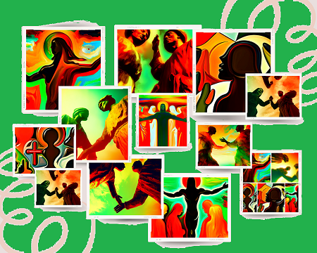



19
  The Lord bless thee, and keep thee:
  The Lord make his face shine upon thee, and be gracious unto thee:
  The Lord lift up his countenance upon thee and give thee peace.
  - Numbers 6:24-26,
Material adapted by Stanford W. Bowman Jr. from Echoes® Adult and Bible-in-Life® Adult Spring 2025 quarter with permission, © David C Cook, https://davidccook.org. May not be further reproduced. All rights reserved.

Slide 20
QUESTION & ANSWER
OUR ADVOCATE
20
Christ the Atoning Sacrifice
4. What can John’s “dear children” do if they sin?
5. How can we be sure that we truly know God?
John’s purpose for writing is “so that you will not sin” (v. 1). Nonetheless, he consoles that if they sin, they have “an advocate with the Father—Jesus Christ, the Righteous One” (v. 1). Jesus can appeal to the Father on behalf of those who call upon His name. Jesus is an atoning sacrifice for sins, a sacrifice which can take sins away and make them powerless.
John’s answer was simple and direct: “if we keep his commands. ” He goes on, “Whoever says, ‘I know him,’ but does not do what he commands is a liar” (v. 3). Those who know and love Jesus will not choose to live in disobedience. Rather, “if anyone obeys his word, love for God is truly made complete in them” (v. 4). Obedience in Jesus is the evidence of salvation.
Notes:
OUR ADVOCATE
4. What can John’s “dear children” do if they sin?
John’s purpose for writing is “so that you will not sin” (v. 1). Nonetheless, he consoles that if they sin, they have “an advocate with the Father—Jesus Christ, the Righteous One” (v. 1). Jesus can appeal to the Father on behalf of those who call upon His name. Jesus is an atoning sacrifice for sins, a sacrifice which can take sins away and make them powerless.
5. How can we be sure that we truly know God?
John’s answer was simple and direct: “if we keep his commands. ” He goes on, “Whoever says, ‘I know him,’ but does not do what he commands is a liar” (v. 3). Those who know and love Jesus will not choose to live in disobedience. Rather, “if anyone obeys his word, love for God is truly made complete in them” (v. 4). Obedience in Jesus is the evidence of salvation.

Slide 21
QUESTION & ANSWER
OUR SACRIFICE
21
Christ the Atoning Sacrifice
6. What kind of love has God shown by sending Jesus?
7. How are John’s readers to respond? What evidence can display God’s love?
God showed perfect love by sending “his one and only Son into the world that we might live through him” (v. 9). Love does not originate from us. But God sent His Son to die for the world while it was still lost in sin, “not that we loved God, but that he loved us and sent his Son as an atoning sacrifice for our sins” (v. 10).
Followers of Christ are to love one another, with the love God has given them: “since God so loved us, we also ought to love one another” (v. 11). This love is evidence that “God lives in us” (v. 12).
Notes:
OUR SACRIFICE
6. What kind of love has God shown by sending Jesus?
God showed perfect love by sending “his one and only Son into the world that we might live through him” (v. 9). Love does not originate from us. But God sent His Son to die for the world while it was still lost in sin, “not that we loved God, but that he loved us and sent his Son as an atoning sacrifice for our sins” (v. 10).
7. How are John’s readers to respond? What evidence can display God’s love?
Followers of Christ are to love one another, with the love God has given them: “since God so loved us, we also ought to love one another” (v. 11). This love is evidence that “God lives in us” (v. 12).

Slide 22
QUESTION & ANSWER
OUR RESPONSE
22
Christ the Atoning Sacrifice
8. How can believers be certain they know God (using the words of verses 13–15)?
9. What confidence can believers have, according to verses 16–17?
10. What does the short statement “God is love” really mean?
They can know because “He has given us of his Spirit” (v. 13). Through the Spirit, “God lives in them and they in God” (v. 15).
There is a day of judgment coming, when God’s justice will be experienced by all people. For many, judgment triggers fear that our sins will find us out or that we will be turned away. But according to these verses, we can actually have confidence to stand for judgment, since we are invited to be “like Jesus” (v. 17).
“God is love” describes the essence of who He is, but it does not describe everything about Him. He is also holy, righteous, and just. “God is love” does not mean He tolerates everything. Yet His perfect love can transform us into loving people who have nothing to fear from judgment.
Notes:
OUR RESPONSE
8. How can believers be certain they know God (using the words of verses 13–15)?
They can know because “He has given us of his Spirit” (v. 13). Through the Spirit, “God lives in them and they in God” (v. 15).
9. What confidence can believers have, according to verses 16–17?
There is a day of judgment coming, when God’s justice will be experienced by all people. For many, judgment triggers fear that our sins will find us out or that we will be turned away. But according to these verses, we can actually have confidence to stand for judgment, since we are invited to be “like Jesus” (v. 17).
10. What does the short statement “God is love” really mean?
“God is love” describes the essence of who He is, but it does not describe everything about Him. He is also holy, righteous, and just. “God is love” does not mean He tolerates everything. Yet His perfect love can transform us into loving people who have nothing to fear from judgment.

Slide 23
23
  The Lord bless thee, and keep thee:
  The Lord make his face shine upon thee, and be gracious unto thee:
  The Lord lift up his countenance upon thee and give thee peace.
  - Numbers 6:24-26,
Material adapted by Stanford W. Bowman Jr. from Echoes® Adult and Bible-in-Life® Adult Spring 2025 quarter with permission, © David C Cook, https://davidccook.org. May not be further reproduced. All rights reserved.

