Slide 1
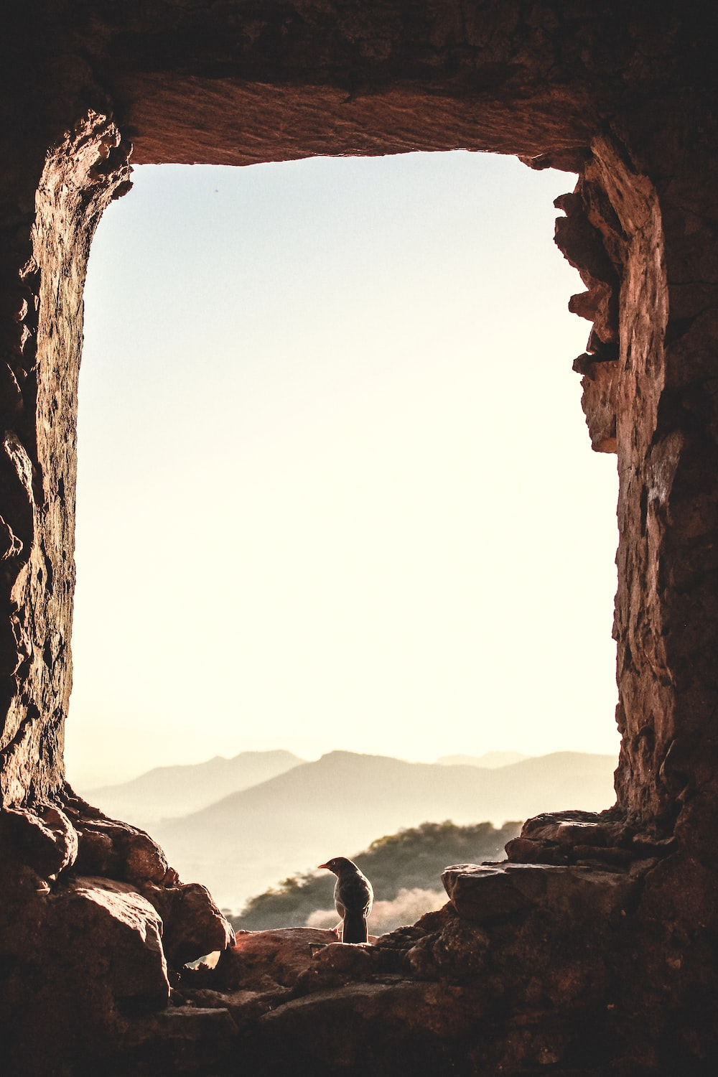
The Lamb Is Worthy
And they sang a new song, saying: “You are worthy to take the scroll and to open its seals, because you were slain, and with your blood you purchased for God persons from every tribe and language and people and nation.
—Revelation 5:9 NIV
Week of November 5

Slide 2

  Prayer
Heavenly Father, guide our hearts to value what You value, not worldly things. ​ Teach us to live selflessly like Jesus did. ​ Jesus alone deserves all honor and praise.
Thought to Remember
  Jesus alone is worthy of all honor and praise.
Notes:
PRAYER
Heavenly Father, guide our hearts to value what You value, not worldly things. ​ Teach us to live selflessly like Jesus did. ​ Jesus alone deserves all honor and praise. ​
Thought to Remember.
Jesus alone is worthy of all honor and praise.

Slide 3
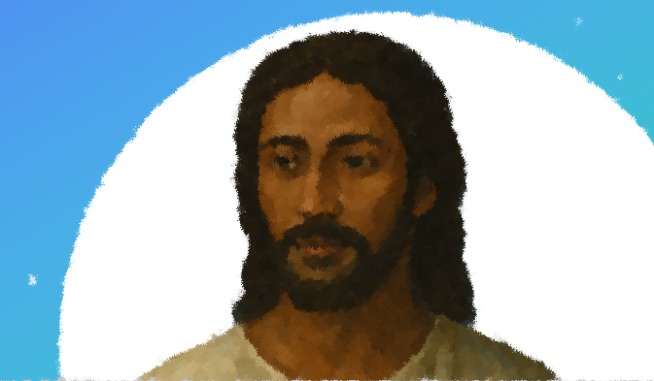
LESSON OUTLINE
The Lamb Is Worthy
Lesson Scripture: Acts 15:1-11
Lesson Focus: Don’t restrict the Gospel with needless rules and traditions.
Life Response: Identify examples of unbiblical rules that may needlessly restrict the Gospel today.
Bible Application: Identify examples of unbiblical rules that may needlessly restrict the Gospel today.
      Introduction
      Review
      Lesson Context
      Overview
        Who Is Worthy? - Revelation 5:1–5 NIV
        The Slain Lamb - Revelation 5:6–10 NIV
      Conclusion
      Question & Answer
Notes:
Who Is Worthy? - Revelation 5:1–5 NIV
The Slain Lamb - Revelation 5:6–10 NIV
1. The Sealed Scroll and the Search for Worthiness (vv. 1–4)
John sees a scroll in God's right hand, sealed with seven seals, symbolizing divine authority and completeness. A mighty angel calls out for someone worthy to open it, but no one in heaven, earth, or under the earth is found. John weeps, realizing that without someone worthy, God’s redemptive plan cannot move forward. This moment expresses humanity’s helplessness apart from divine intervention.
2. The Lion of Judah Has Triumphed (v. 5)
An elder comforts John, declaring that the “Lion of the tribe of Judah” and the “Root of David” has triumphed and is worthy. These titles tie Jesus to Old Testament prophecy, fulfilling Israel’s hope for a messianic king. This victorious identity reveals that Jesus possesses the authority, lineage, and power to carry out God’s will for creation.
3. The Slain Lamb Stands at the Throne (v. 6)
John looks expecting a lion, but sees a Lamb that appears slain—yet standing. This startling image shows Jesus conquered not through force, but sacrifice. The Lamb has seven horns (complete power) and seven eyes (complete knowledge), representing the fullness of the Spirit. His place at the throne signifies His unity with God and divine authority to act.
4. Worship and a New Song (vv. 7–8)
When the Lamb takes the scroll, heavenly beings—four living creatures and 24 elders—fall in worship. They hold harps and golden bowls filled with the prayers of the saints, showing that Christ's victory is tied to the worship and petitions of God’s people. Their immediate worship affirms Jesus' divine status and initiates celebration of redemption.
5. The Lamb is Worthy—Why? (v. 9)
The new song declares Jesus worthy because He was slain and redeemed people by His blood. His sacrifice was not for one nation, but for people from every tribe, language, and nation. This underscores Jesus' universal work of salvation. His death is not defeat but triumph, securing a global, multiethnic people for God’s kingdom.
6. A Kingdom and Priests (v. 10)
Jesus not only redeems, but also elevates the redeemed to serve as “kings and priests.” Believers now share in His rule and priestly work—representing God to the world through praise, prayer, and love. This is a fulfillment of Exodus 19:6, expanding God’s mission beyond Israel to all nations, and revealing the church’s calling in the world.

Slide 4

LESSON INTRODUCTION
The Lamb Is Worthy
What Is Worth?
People have very different ideas about what makes someone worthy of honor. In modern cultures, a person’s worthiness for various honors often seems to be based on the person’s wealth, success, or popularity in the public eye.
My friend Joe does not fit this model of a worthy person. Joe works as a mid-level manager of a small company that makes medical equipment. By some standards, Joe is not rich. In the eyes of the world, his life is simple and unremarkable. But Joe has a wife and four children whom he loves dearly. He goes to work every day and works hard in a thankless profession to provide for his family. His wife and children never go without, even though Joe often does. He models self-sacrificial love daily. Were you offered a choice between being a famous but self-serving person or being unknown but self-sacrificial, whom do you think God would consider more worthy of honor?
Notes:
Analysis & Summary
This reflection challenges the worldly definition of worth, which often centers on wealth, fame, or public status. It introduces Joe, an ordinary man who lives selflessly for his family, sacrificing his own comfort to care for others. Joe’s quiet, faithful service illustrates a deeper, godly worth based on humility and love rather than external success. The text invites us to reevaluate what it means to be truly worthy in God’s eyes.
Main Idea
True worth is defined not by status or wealth but by self-sacrificial love and faithfulness to others.
Three Key Takeaway Statements
The world often values fame and fortune, but God honors selfless, unseen service.
A life of quiet sacrifice for others reflects true spiritual worth.
God's view of honor rewards love in action, not popularity or prestige.

Slide 5
LESSON CONTEXT
The Lamb Is Worthy
Revelation is the record of a vision God gave to John while he was on the island of Patmos. The vision was meant to strengthen the faith of readers by emphasizing God’s sovereign power, Jesus’ triumph over the powers of darkness, and God’s plan for the renewal of all things—even in the face of great evil. God allowed John to behold heavenly events so that we might have faith and confidence when we also face trial.
John observes the Father sitting on a throne while holding a mysterious scroll, which is sealed and stamped by seven signets. John also observes a mighty angel crying out, looking for someone with the legitimate authority to break the seals and reveal God’s plan. John weeps that no one is worthy to read the scroll.
The book—
Notes:
Analysis & Summary
This passage introduces the context of Revelation, a vision given to John during his exile on Patmos. The vision serves to reassure believers of God’s sovereignty, Christ’s victory, and the ultimate restoration of creation. John sees God holding a sealed scroll—symbolizing His divine plan—and laments when no one is found worthy to open it, revealing the spiritual urgency of redemption and the need for a worthy Savior.
Main Idea
Revelation unveils God’s plan of redemption and Christ’s authority in the face of evil and despair.
Three Key Takeaway Statements
1. Revelation encourages believers to trust God’s power amid trials and darkness.
2. The sealed scroll represents God’s plan, requiring divine worthiness to fulfill.
3. John’s sorrow reflects humanity’s need for a Savior to carry out God’s will.

Slide 6
LESSON CONTEXT
The Lamb Is Worthy
Then one of the elders consoles him: “the Lion of the tribe of Judah, the Root of David” is worthy (Rev. 5:5). In a twist, instead of looking like a lion, Jesus appears like a lamb in heaven. In fact, Revelation refers to Jesus as a lamb 29 times. This is no ordinary lamb either: He has seven horns and eyes, which show that He possesses all power and all knowledge.
Jesus takes the scroll, reveals its contents, and ends the waiting in heaven. The living creatures and the 24 elders join a song of countless angels (Rev. 5:11). They all bow down and sing like never before, and eventually, every creature in all places join in the song of praise (Rev. 5:13).
Lion and lamb—
Notes:
Analysis & Summary
This passage contrasts the titles and appearance of Jesus as both the Lion of Judah and the slain Lamb. Though announced as a lion, He appears as a lamb—symbolizing sacrificial love rather than conquering power. His seven horns and eyes symbolize perfect power and wisdom. Jesus alone is worthy to open the scroll, and His act sparks universal worship, as all creation praises Him for His redemptive victory.
Main Idea
Jesus, both Lion and Lamb, is uniquely worthy to fulfill God’s plan and receive universal worship.
Three Key Takeaway Statements
1. Jesus conquers not by force but through sacrificial love as the Lamb.
2. His power and knowledge are complete, symbolized by seven horns and eyes.
3. All creation praises Christ, acknowledging His worthiness to reveal God’s plan.

Slide 7
LESSON CONTEXT
The Lamb Is Worthy
They praise Jesus for His servanthood. He came down from heaven and sacrificed His life willingly, shedding His blood for the world’s salvation. He is worthy of all praise, not for His aggression but for His humility. Instead of a conquering ruler who defended Himself, Jesus gave His life to purchase the victory.
Unfortunately, many in society think of themselves as worthy to be praised. They strut around, attempting to be the big boss and make people recognize their importance and value. But the believer follows the Lord’s example. Jesus served; therefore, the host in heaven sings, “Worthy is the Lamb who was slain” (Rev. 5:12). It may be time to wash some feet.
Worthy—
Notes:
Analysis & Summary
This passage emphasizes that Jesus is praised not for dominance but for humility and sacrificial love. His worthiness comes from serving others and giving His life for humanity’s salvation. In contrast, the world often celebrates pride and self-importance. Believers are called to model Christ’s servant heart, recognizing that true greatness is found in selfless love. Heavenly worship rightly honors Jesus as the Lamb who was slain, not as a forceful ruler.
Main Idea
Jesus is worthy of all praise because He humbly served and sacrificed Himself to save humanity.
Three Key Takeaway Statements
1. Jesus' worthiness comes from humility, not power or pride.
2. True greatness is measured by service, not self-promotion.
3. Believers reflect Christ best by living with a servant’s heart.

Slide 8
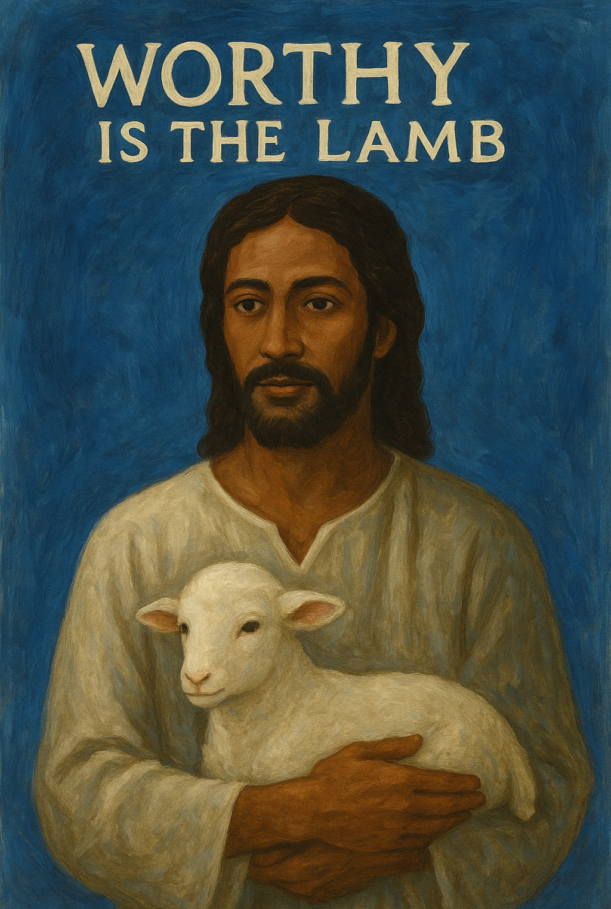
Lesson Context
The Lamb Is Worthy
Revelation 4 and 5 narrate the apostle John’s vision of the divine throne room. This vision immediately follows the appearance of the “one like unto the Son of man” (Revelation 1:13; compare Daniel 7:13), who dictates letters to seven churches in the province of Asia Minor. These letters offered both encouragement and caution to churches that ranged from being faithful to unfaithful.
Two good questions to ask in many life situations are “What’s so?” and “So what?” In answer to the first question, Revelation 1–3 establishes the facts regarding the status of seven churches; in answer to the second question, the visions of Revelation 4 and following describe rewards and consequences. This allows us to see God’s authority and power, the reality that He remains in charge even when earthly events would suggest otherwise (compare Psalm 47:8).
John’s visions begin in Revelation 4:1 with a glimpse of God in His throne room (compare Isaiah 6:1). This is the location of the true and ultimate ruler of the universe. While “in the spirit” (Revelation 4:2), John witnesses startling and glorious things: precious stones, elders with crowns, fiery lamps, creatures who worship God day and night, etc. After this broad look around the throne room, John’s vision zooms in to focus on a specific object
Notes:
Analysis & Summary
This context sets the stage for Revelation 4–5, where John, after writing letters to seven churches, is given a heavenly vision. These chapters transition from assessing the church’s spiritual health to unveiling God’s throne room, emphasizing divine authority over history. John sees God’s glory and governance despite worldly chaos. The vision affirms that God's power reigns above all, and His purposes unfold, even when human perspective falters.
Main Idea
Revelation 4–5 reveals God's supreme authority and reassures believers that He is in control, even amid worldly uncertainty.
Three Key Takeaway Statements
1. God reigns from His throne regardless of earthly chaos.
2. Revelation shifts from earthly warnings to heavenly assurance.
3. John's vision reminds us that worship and judgment flow from God's sovereign rule.

Slide 9
LESSON INTRODUCTION
The Lamb Is Worthy
When Jesus is called “the Lion of the tribe of Judah” and “the Root of David” in Revelation 5:5, this shows that Old Testament expectations are fulfilled in the coming coronation of Jesus as king. In 2 Samuel 7:12–16, God promised to establish the throne of David’s kingdom forever (2 Sam. 7:13, 16). God’s reign over the earth shall involve a descendant of David sitting on the throne. These hopes were challenged when the days of Israel’s kings ended. The Jews of the first century wondered, What will become of David’s line? The answer comes when a baby is born, a descendant of David, born in the town of David. Before Jesus’ birth, the angel Gabriel appeared to Mary and said, “He will be great and will be called the Son of the Most High. The Lord God will give him the throne of his father David, and he will reign over Jacob’s descendants forever; his kingdom will never end” (Luke 1:32–33).
Revelation records the vision God gave to John while he was on the island of Patmos. Original recipients of John’s vision were seven churches who lived in the increasingly hostile environment of the Roman Empire.
Among the greatest paradoxes of Christian faith is this: Jesus triumphs through suffering instead of fighting. When He dealt the decisive blow to the powers of darkness, it was not through violent force. It was through willingly laying down His life. His death on the cross looked like a defeat, but it was what God used to defeat death and make a way for people to part of His kingdom. On the cross, Jesus “disarmed the powers and authorities” and “made a public spectacle of them” (Col. 2:15). Death no longer has the final word for any person: in Jesus, a power greater than death has triumphed. And now Jesus gets the final word. The paradox is also present in Revelation 5, when the Lion of Judah appears like a helpless lamb who has already been killed. But He is worthy because He was slain (Rev. 5:9). His victory came through sacrifice, for He gave of Himself for the good of others.
A Descendant of David
The Public Spectacle
The number seven is often associated with completeness, fullness, or perfection. The number shows up several times in Revelation 5:1–10. The mysterious scroll is sealed with seven seals. The lamb who appears slain has seven horns and seven eyes, which are the seven spirits of God. Ancient contracts and wills were often tied up with thread and sealed with wax, which was impressed by the signet ring of various witnesses. Wax is easily broken, but the seven-sealed scroll in Revelation 5 is perfectly sealed. Likewise, the seven horns of the lamb communicate perfect power, and seven eyes may indicate perfect vision or knowledge. The seven spirits of God (sometimes called the sevenfold Spirit) are thought to represent the fullness of God’s Holy Spirit.
The Number Seven
Notes:
A Descendant of David
This passage highlights Jesus’ fulfillment of the long-anticipated promise that a descendant of David would reign eternally. Revelation 5:5 refers to Jesus as both the “Lion of Judah” and “Root of David,” directly linking Him to the Old Testament prophecy in 2 Samuel 7. Although Israel’s monarchy ceased, hope endured. The angel’s announcement to Mary affirmed that Jesus, born in David’s city, would reign forever—ushering in God’s eternal kingdom.
Main Idea
Jesus fulfills God's covenant with David by reigning as the promised eternal King.
Three Key Takeaway Statements
1. Jesus’ identity confirms He is the long-awaited heir to David’s throne.
2. God's promises endure beyond earthly kingdoms and timelines.
3. Christ’s eternal reign affirms God's faithfulness and sovereign plan.
The Public Spectacle
This section emphasizes the paradoxical nature of Jesus’ triumph. Unlike worldly rulers, Jesus conquered not by force but through sacrificial love. His crucifixion, though appearing as defeat, was God’s victory over sin and death. Revelation 5 echoes this truth, portraying the mighty Lion of Judah as a slain Lamb. This image reveals that Christ's worthiness and authority come through His willingness to suffer and serve others, making Him the ultimate victor and ruler.
Main Idea
Jesus' victory came not through violence but through sacrificial love, proving Him worthy to rule.
Three Key Takeaway Statements
1. Jesus overcame evil by surrendering His life, not wielding force.
2. The cross transformed defeat into eternal triumph over death.
3. Christ’s worth is grounded in His sacrifice for others, not outward strength.
The Number Seven
This passage explores the symbolic use of the number seven in Revelation 5:1–10. Biblically, seven represents completeness or perfection. The scroll with seven seals signifies the fullness and security of God’s hidden plan. The slain Lamb’s seven horns and seven eyes symbolize complete power and omniscience, while the “seven spirits of God” are understood as the fullness of the Holy Spirit. Together, these elements emphasize the Lamb’s divine authority and qualification to fulfill God’s redemptive purposes.
Main Idea
The repeated use of seven in Revelation underscores the perfect power, knowledge, and authority of Christ.
Three Key Takeaway Statements
1. Seven seals represent the totality and security of God’s divine plan.
2. The Lamb’s seven horns and eyes reflect perfect strength and insight.
3. The seven spirits symbolize the complete and active presence of God’s Spirit.

Slide 10
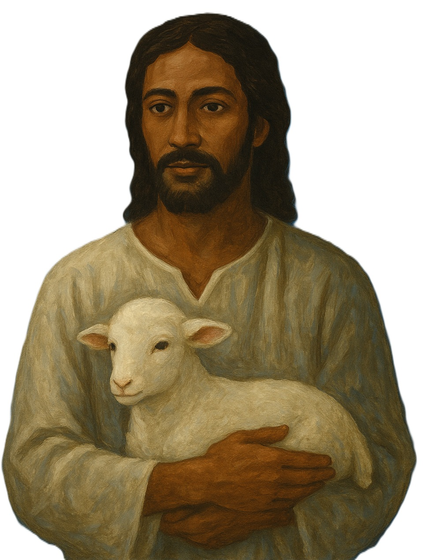
LESSON INTRODUCTION
The Lamb Is Worthy
There is a church building in North Carolina that houses two congregations: a predominately white church and a Hispanic church. One meets on Sunday mornings, the other in the afternoon. But on Christmas Eve one year, they came together for a candlelight service. Those gathered took turns fumbling through the words of familiar carols in either Spanish or English, exchanging encouraging glances with members of the other congregation— brothers and sisters with a different language, but the same Spirit. Each pastor preached with the help of translators. The sermons moved slowly, but a patient gladness filled the room. Together the two congregations worshiped the Son of God and glimpsed His kingdom of “every tribe and language and people and nation” (Rev. 5:9).
Glimpsing the Kingdom
Jesus makes those He has purchased into “a kingdom and priests to serve our God” (v. 10). This recalls the job which God gave the Israelites as a “kingdom of priests and a holy nation” (Ex. 19:6), after He delivered them from bondage in Egypt. Now through the work of Jesus, this vocation belongs to “persons from every tribe and language and people and nation” (Rev. 5:9). God’s plan for His people has not been sidetracked or altered; He always intended for salvation to reach beyond Israel and to the ends of the earth (Isa. 49:6). Followers of Jesus serve as God’s priests among a watching world. It is a vocation of prayer and praise, born out of nearness to God and made possible by Jesus’ saving work.
A Kingdom and Priests
There are parallels between the exodus story and the rescue by the lamb in Revelation 5. The image of the slaughtered lamb recalls the Passover lamb, whose blood saved God’s people from death and judgment during the final plague on Egypt in Exodus 12:1–30. God instructed each household to kill a lamb and spread some of its blood around the doorframe of their home. When God went through the land to strike down the firstborn of the Egyptians, He passed over the houses of the Israelites which were adorned with blood. God’s people were spared because of the blood of the lamb. Likewise, the deliverance of God’s people in Revelation 5 is tied to the suffering of the lamb who was slain, whose blood purchased for God “persons from every tribe and language and people and nation” (Rev. 5:9).
The Passover Lamb
Notes:
A Kingdom and Priests
This passage highlights how Jesus’ redemptive work fulfills and expands God’s original calling for Israel to be a “kingdom of priests.” Now, through Christ, this sacred role extends to believers from every nation. All who are redeemed become part of a global priesthood, tasked with representing God through prayer, praise, and service. This priestly identity reflects both access to God and responsibility to reflect His holiness in the world.
Main Idea
Jesus empowers all believers to serve as a global kingdom of priests, fulfilling God’s redemptive plan.
Three Key Takeaway Statements
1. Christ’s sacrifice forms a diverse kingdom of priests from all nations.
2. God’s purpose has always been worldwide salvation and service.
3. Believers now represent God through worship, prayer, and faithful witness.
The Passover Lamb
This passage draws a strong parallel between the Passover lamb in Exodus and the Lamb in Revelation 5. In Exodus, the blood of the lamb protected Israel from judgment. Similarly, in Revelation, the blood of Jesus—the slain Lamb—secures salvation for people from every nation. Both events highlight the power of sacrificial blood to deliver and redeem, demonstrating that Jesus' death is the ultimate fulfillment of God's saving work foreshadowed in the Passover.
Main Idea
Jesus, the Lamb of God, fulfills the Passover by shedding His blood to redeem all people.
Three Key Takeaway Statements
1. Jesus’ sacrifice mirrors the Passover lamb’s role in sparing God's people.
2. His blood delivers believers from judgment and grants eternal life.
3. Redemption through Christ reaches across all cultures and nations.
Glimpsing the Kingdom
There is a church building in North Carolina that houses two congregations: a predominately white church and a Hispanic church. One meets on Sunday mornings, the other in the afternoon. But on Christmas Eve one year, they came together for a candlelight service. Those gathered took turns fumbling through the words of familiar carols in either Spanish or English, exchanging encouraging glances with members of the other congregation— brothers and sisters with a different language, but the same Spirit. Each pastor preached with the help of translators. The sermons moved slowly, but a patient gladness filled the room. Together the two congregations worshiped the Son of God and glimpsed His kingdom of “every tribe and language and people and nation” (Rev. 5:9).
Analysis & Summary
This anecdote illustrates a real-life moment that mirrors the vision of Revelation 5:9—believers from every nation united in worship. Despite language differences, the two congregations shared one Spirit and one Savior. Their joint service offered a foretaste of God’s eternal kingdom, where unity in Christ transcends cultural and linguistic divides. It’s a reminder that the Church’s diversity is not a barrier but a reflection of God’s universal redemptive plan.
Main Idea
Unified worship across cultures gives us a living glimpse of God’s diverse, eternal kingdom.
Three Key Takeaway Statements
1. Worship unites believers beyond language and cultural boundaries.
2. The Church reflects heaven when it embraces diverse unity.
3. God’s kingdom includes every tribe, language, and nation—starting now.

Slide 11
LESSON OVERVIEW
The Lamb Is Worthy
Who Is Worthy? - Revelation 5:1–5 NIV
1Then I saw in the right hand of him who sat on the throne a scroll with writing on both sides and sealed with seven seals.
John sees a scroll in God’s right hand. It has to do with God’s plan to deliver creation from the powers of darkness.
No one in all creation is worthy to take the scroll from the hand of God.
John weeps because he understands that God’s plan for creation and humanity cannot move forward.
“Lion of the tribe of Judah” and “Root of David” are titles that belong to the Messiah, recalling Israel’s hope for a deliverer who would sit on David’s throne and usher in God’s kingdom rule.
2 And I saw a mighty angel proclaiming in a loud voice, “Who is worthy to break the seals and open the scroll?”
3 But no one in heaven or on earth or under the earth could open the scroll or even look inside it.
4 I wept and wept because no one was found who was worthy to open the scroll or look inside.
5 Then one of the elders said to me, “Do not weep! See, the Lion of the tribe of Judah, the Root of David, has triumphed. He is able to open the scroll and its seven seals. ”
Notes:
Main Idea
Only Jesus, the triumphant Messiah, is worthy to carry out God's plan to redeem and restore creation.
>=<>=<>=<>=<>=<>=<>=<>=<>=<>=<>=<>=<>=<>=<>=<>=<>=<>=<>
John’s attention is drawn to the scroll in the right hand of God, who sits on heaven’s throne. In the story of the exodus, when God delivered the Israelites from bondage in Egypt, God’s right hand is associated with His power to deliver and defeat His enemies (Ex. 15:6). The contents of the scroll are mysterious, but it has to do with God’s plan to deliver creation from the powers of darkness. But it is sealed shut with seven seals.
“Who is worthy to break the seals and open the scroll?” asks a powerful angel (v. 2). In the previous chapter, God is declared worthy “to receive glory and honor and power” because He created all things (Rev. 4:11). Who then is worthy to take the scroll from the hand of the creator, God, and to open it? Who could possibly be qualified for such a task? The question is proclaimed so loudly that it rings throughout heaven, earth, and under the earth—all of creation. The renewal of all things hangs in the balance, and God’s plan requires a chosen agent. But tragically, no one is worthy for this job (v. 3). No one can open the scroll. At this point, John weeps and makes a display of great mourning, because he grasps the gravity of the situation (v. 4). God’s plan for creation depends on someone worthy to open the scroll and look inside. If there is no one, what does that mean for humanity? God’s plan requires a servant who is worthy to rule and judge with complete impartiality. God’s plan requires someone to perfectly reflect God’s will. One of the elders surrounding the throne breaks the tension. He tells John to stop weeping because “the Lion of the tribe of Judah, the Root of David, has triumphed” (v. 5). These titles belong to the Messiah and remind us of Israel’s hope for a deliverer who would sit on the throne of David and usher in God’s eternal kingdom (see Gen 49:9–10; Isa. 11:1; 2 Sam. 7:12–16). The lion has triumphed, and the victory has already been assured. Jesus, God’s Messiah, is able to break the seven seals and reveal God’s plan.
Analysis & Summary
This passage paints a dramatic scene in heaven where God's scroll—symbolizing His redemptive plan—is sealed and inaccessible. John weeps when no one is found worthy to open it, revealing the dire need for a righteous deliverer. But hope emerges as an elder announces that the Lion of Judah, the Root of David—titles for the Messiah—has triumphed. Jesus alone is worthy to unveil God’s plan, fulfilling the ancient hope of a just and eternal King.
Three Key Takeaway Statements
1. God's redemptive plan requires a perfectly worthy servant to enact it.
2. Jesus, the Lion of Judah, fulfills messianic prophecy and secures victory.
3. Christ alone is qualified to reveal and execute God’s eternal purposes.

Slide 12
LESSON OVERVIEW
The Lamb Is Worthy
The Slain Lamb - Revelation 5:6–10 NIV
The lion from verse 5 appeared as a lamb who has been killed, and the lamb stands at the center of God’s throne.
God’s victory came not by force, but through the sacrifice of Jesus.
The lamb’s position shows His identity, sharing God’s reign.
Jesus, the Son of God, is king. When the lamb takes the scroll, those around
the throne worship the lamb, offering prayers of God’s people, and singing a new song of deliverance.
Jesus is worthy because He triumphed through self-giving love, which brings salvation and victory for all God’s people.
His is a kingdom from “every tribe and language and people and nation” (v. 9), purchased with His blood.
They are “a kingdom and priests” (v. 10), whose lives are marked by praise, prayer, and Christlike love.
6 Then I saw a Lamb, looking as if it had been slain, standing at the center of the throne, encircled by the four living creatures and the elders. The Lamb had seven horns and seven eyes, which are the seven spirits of God sent out into all the earth.
7 He went and took the scroll from the right hand of him who sat on the throne.
8And when he had taken it, the four living creatures and the twenty four elders fell down before the Lamb. Each one had a harp and they were holding golden bowls full of incense, which are the prayers of God’s people.
9 And they sang a new song, saying: “You are worthy to take the scroll and to open its seals, because you were slain, and with your blood you purchased for God persons from every tribe and language and people and nation.
10 You have made them to be a kingdom and priests to serve our God, and they will reign on the earth. ”
Notes:
John might have expected to see a lion arrive on the scene. But instead, he sees “a lamb, looking as if it had been slain, standing at the center of the throne” (v. 6). The “Lion” is also the “Lamb,” one who has been killed. Yet the elder has just told John that the Messiah has triumphed. God’s conquering power has come, not by force, but through sacrifice. Jesus defeated death by dying and rising again. He has given of Himself in love, for the good of others.
The lamb stands at the center of the throne. This suggests something important about the identity of the lamb, for who besides God can share God’s throne? The lamb has seven horns and seven eyes. A horn is an image of power in the Old Testament (Deut. 33:17; Ps. 132:17). And John comes right out and tells us that the eyes are the “seven spirits of God sent out into all the earth” (v. 6). Therefore, the eyes may represent God’s all-seeing, all-knowing, and ever present nature. In Zechariah 4:10, the seven eyes belong to Yahweh, and here they are attributed to the lamb. This again suggests something important about the identity of this person: He possesses the complete power and knowledge of Yahweh, and He rules as king from the throne of heaven.
In verse 7, the lamb takes the scroll from the right hand of God. In verses 8–9, those surrounding the throne respond by falling down to worship the lamb, offering prayers of God’s people and singing a “new song. ”
The worshipers sing of Jesus’ worthiness to take the scroll, for He was slain. He triumphed through self-giving love, bringing salvation and victory for all God’s people. With His own blood, Jesus purchased people from “every tribe and language and people and nation” (v. 9). As in the exodus event, when God set people free from bondage in Egypt, Jesus now brings an even greater deliverance: He extends salvation to the ends of the earth and for all people (Isa. 49:6). In doing so, He has inaugurated a new kingdom, established free people as “a kingdom and priests” to serve God and reign on the earth (Rev. 5:10). This reenacts and extends the calling that God gave Israel, after delivering His people from Egypt (Ex. 19:6). Life in God’s kingdom is now marked by praise, prayer, and Christlike love.
Analysis & Summary
John anticipates a fierce lion but instead sees a slain Lamb—Jesus—standing at the throne’s center, a profound symbol of divine power through sacrificial love. Though appearing wounded, the Lamb is alive, embodying victory over death. His seven horns and eyes represent perfect power and knowledge, affirming His divine identity. Jesus alone is worthy to open the scroll, having redeemed people from all nations by His blood. He establishes a kingdom of priests who now live in worship, prayer, and service, echoing God’s original calling to Israel and extending it to the whole world.
Main Idea
Jesus triumphs as the slain Lamb, ruling in power through sacrificial love and redeeming a global people for God.
Three Key Takeaway Statements
1. Jesus reigns as both Lamb and Lord, showing that true power is found in sacrifice.
2. Christ’s blood redeems people from every nation, forming one kingdom of priests.
3. God’s kingdom is now marked by praise, prayer, and Christlike love through His redeemed people.

Slide 13
LESSON OVERVIEW
The Lamb Is Worthy
Bible Application: Discuss why Jesus’ identity and actions matter to all people and all of creation.
If Jesus is King
I wonder if she knows I’m a fraud. I remember thinking those words during a summer internship at my family church. I had been assigned to help a woman run a children’s outreach at a low-income housing development. This woman had a reputation. She seemed strange to people— strange to me—and her strangeness had to do with her willingness to run headlong into risky places.
I didn’t know her well. I knew she was sometimes gone for months or years at a time, following Jesus to some corner of a city or to a town damaged by a big storm. She would come back with stories that challenged the complacency of our church, and it made me uncomfortable.
By this time, I had been a Christian for many years. I knew the story. I confessed Jesus as Lord and believed He rose from the dead. But when I was around her, I couldn’t shake the feeling she understood something, and I didn’t. She was gripped by the truth. Jesus was her king and she was willing to follow Him wherever He went. I paid lip service to that idea, but I’m not sure I was willing to let the rubber meet the road.
As I watched her jump into action, it finally dawned on me: If Jesus is who Scripture says He is, that changes everything. If He is the rightful king over all creation and has made a way for all people to be part of His kingdom, then I owe Him my unchecked allegiance. Certainly I can endure a little awkwardness for my Savior. It’s time for the rubber to meet the road.
Notes:
This reflection explores the difference between claiming Jesus as Lord and truly living as if He is King. The writer is challenged by a woman whose life of risk and sacrifice demonstrates total devotion to Christ. Her bold actions reveal what it looks like when someone is fully gripped by Jesus’ kingship. The writer comes to realize that true belief demands total allegiance.
Bible Application: Why Jesus’ Identity and Actions Matter
Jesus’ identity as King calls every person to respond with full surrender. His actions—especially His sacrificial love—invite all people into a new way of life marked by courage, service, and obedience. If Jesus truly rules all creation, then no part of life can remain untouched by His authority.

Slide 14
LESSON OVERVIEW
The Lamb Is Worthy
Bible Application: Identify examples of unbiblical rules that may needlessly restrict the Gospel today.
If Jesus is King
  10. Can you think of someone else who has modeled sacrificial love for the good of others? Who?
  11. If Jesus is king, and His kingdom has begun, what are the implications for us?
  12. What obstacles keep people from giving full allegiance to Jesus?
Notes:
10. Can you think of someone else who has modeled sacrificial love for the good of others? Who?
Mother Teresa modeled sacrificial love by serving the poor and dying in India, giving her life for the most vulnerable without seeking recognition or reward.
11. If Jesus is king, and His kingdom has begun, what are the implications for us?
We must align every part of our lives with His values—loving others, serving selflessly, and spreading the gospel—living as citizens of His kingdom now.
12. What obstacles keep people from giving full allegiance to Jesus?
Fear of discomfort, desire for control, peer pressure, and complacency often prevent people from fully surrendering to Jesus’ reign in their lives..

Slide 15
CONCLUSION:
Jesus Is Worthy
The Lamb Is Worthy
  The answer to the question What makes a person worthy of honor? depends greatly on who is bestowing the honor. In God's economy, earthly success does not draw His praise. Ultimately, Jesus alone is worthy of all glory and honor. He alone is worthy to unbind the scroll. While Jesus will always reign supreme, we will be honored by being called to reign with Him. But our worthiness will be tested! Expect it.
Notes:
This passage contrasts worldly measures of worth with God’s standard. Human success and status don’t impress God; rather, Jesus alone is worthy of ultimate honor and authority. He is uniquely qualified to open the scroll and reign forever. Believers are invited to reign with Him, but must be prepared for their worthiness to be tested through trials.
Main Idea
True worthiness comes from God’s perspective—Jesus alone is worthy, and we share in His reign through tested faith.
Three Key Takeaway Statements
1. Earthly success does not equate to spiritual worth in God's eyes.
2. Jesus is solely worthy to receive glory and fulfill God's plan.
3. Believers will be tested but are called to reign with Christ through faith.

Slide 16
CONCLUSION
The Lamb Is Worthy
Life Response: Pray that you might acknowledge Jesus as king and live for His kingdom.
People attach their hopes to all kinds of things, longing for the world to be made right. In Revelation 5:1–10, Jesus is revealed as the one worthy to deliver creation from the powers of darkness. Jesus is worthy of worship because He is the lamb who was slain, triumphing over death. On the cross, He gave of Himself in love for the good of others, bringing salvation to all people and establishing a kingdom from “every tribe and language and people and nation” (Rev. 5:9). Now Jesus is enthroned as king, and life in His kingdom means that we must wait for His rule to be revealed to all creation, in God’s timing.
Living for the Kingdom
Jesus, the lamb who was slain and has risen, is worthy of worship. Through His sacrificial death, He defeated the powers of darkness and made a way for all people to be a part of His kingdom to follow Him as king.
Notes:
This reflection invites believers to center their lives around Jesus as King. While people often place hope in temporary things, Revelation 5 reveals that only Jesus is worthy to bring lasting salvation. As the slain Lamb, He triumphed over death and darkness, establishing a global kingdom. Living for His kingdom means worshiping Him, serving others, and waiting faithfully for His full reign.
Main Idea
Jesus, the slain Lamb and risen King, alone is worthy to rule, redeem, and receive our worship and allegiance.
Three Key Takeaway Statements
1. Jesus’ sacrificial love makes Him the only one worthy to rule creation.
2. All nations are invited into His kingdom through faith and worship.
3. Living for Jesus means trusting His timing and following His example daily.

Slide 17
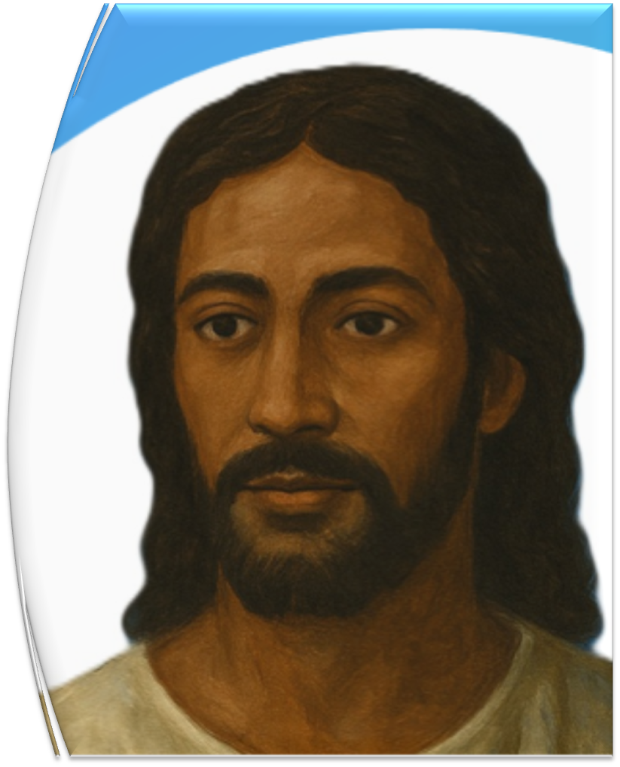



End
  The Lord bless thee, and keep thee:
  The Lord make his face shine upon thee, and be gracious unto thee:
  The Lord lift up his countenance upon thee and give thee peace.
  - Numbers 6:24-26,
Material adapted by Stanford W. Bowman Jr. from Echoes® Adult and Bible-in-Life® Adult Spring 2025 quarter with permission, © David C Cook, https://davidccook.org. May not be further reproduced. All rights reserved.

Slide 18

Lesson Focus: Don’t restrict the Gospel with needless rules and traditions.
Life Response: Identify examples of unbiblical rules that may needlessly restrict the Gospel today.
QUESTION & ANSWER
The Lamb Is Worthy
WHO IS WORTHY?
4. The contents of the scroll remain a mystery, but what do we know about it?
5. Why does John weep in verse 4?
6. What does verse 5 tell us about the one who is worthy?
The scene around God’s throne suggests that the scroll is enormously important. Its place in God’s right hand means it has to do with God’s plan of deliverance. It will take someone worthy—not a sinful human—to fulfill this plan.
No one is worthy to open the scroll or look inside. The scroll remains mysterious, God’s design unfulfilled. If the scroll cannot be opened, God’s plan cannot move forward.
He is the one who fulfills Israel’s hope for a deliverer from the line of David. He has triumphed, meaning the victory is already won. His ability to open the scroll means He can fulfill God’s plan; and, somehow, He already has.
Notes:
WHO IS WORTHY?
4. The contents of the scroll remain a mystery, but what do we know about it?
The scene around God’s throne suggests that the scroll is enormously important. Its place in God’s right hand means it has to do with God’s plan of deliverance. It will take someone worthy—not a sinful human—to fulfill this plan.
5. Why does John weep in verse 4?
No one is worthy to open the scroll or look inside. The scroll remains mysterious, God’s design unfulfilled. If the scroll cannot be opened, God’s plan cannot move forward.
6. What does verse 5 tell us about the one who is worthy?
He is the one who fulfills Israel’s hope for a deliverer from the line of David. He has triumphed, meaning the victory is already won. His ability to open the scroll means He can fulfill God’s plan; and, somehow, He already has.

Slide 19
Lesson Focus: Don’t restrict the Gospel with needless rules and traditions.
Life Response: Identify examples of unbiblical rules that may needlessly restrict the Gospel today.
QUESTION & ANSWER
The Lamb Is Worthy
THE SLAIN LAMB
7. What do these verses tell us about the lamb’s identity?
8. The lamb appears to have been killed (v. 6). How then did He triumph?
9. What is the result of Jesus’ triumph (vv. 9–10)?
He stands at the center of heaven’s throne and possesses divine power and knowledge. He receives praise and prayer. He is none other than the Son of God, who is one with the Father and the Spirit, sharing in God’s reign.
He did not triumph through force but sacrifice. He triumphed through self-giving love for the good of others. He shed His blood on the cross, defeating death and making a way for the forgiveness of sins.
With His blood He purchased all believers to serve God as “a kingdom and priests. ” Jesus established His kingdom rule and made a way for all people to be part of it, living in fellowship with God.
Notes:
THE SLAIN LAMB
7. What do these verses tell us about the lamb’s identity?
He stands at the center of heaven’s throne and possesses divine power and knowledge. He receives praise and prayer. He is none other than the Son of God, who is one with the Father and the Spirit, sharing in God’s reign.
8. The lamb appears to have been killed (v. 6). How then did He triumph?
He did not triumph through force but sacrifice. He triumphed through self-giving love for the good of others. He shed His blood on the cross, defeating death and making a way for the forgiveness of sins.
9. What is the result of Jesus’ triumph (vv. 9–10)?
With His blood He purchased all believers to serve God as “a kingdom and priests. ” Jesus established His kingdom rule and made a way for all people to be part of it, living in fellowship with God.

Slide 20
End
  The Lord bless thee, and keep thee:
  The Lord make his face shine upon thee, and be gracious unto thee:
  The Lord lift up his countenance upon thee and give thee peace.
  - Numbers 6:24-26,
Material adapted by Stanford W. Bowman Jr. from Echoes® Adult and Bible-in-Life® Adult Spring 2025 quarter with permission, © David C Cook, https://davidccook.org. May not be further reproduced. All rights reserved.

