Slide 1
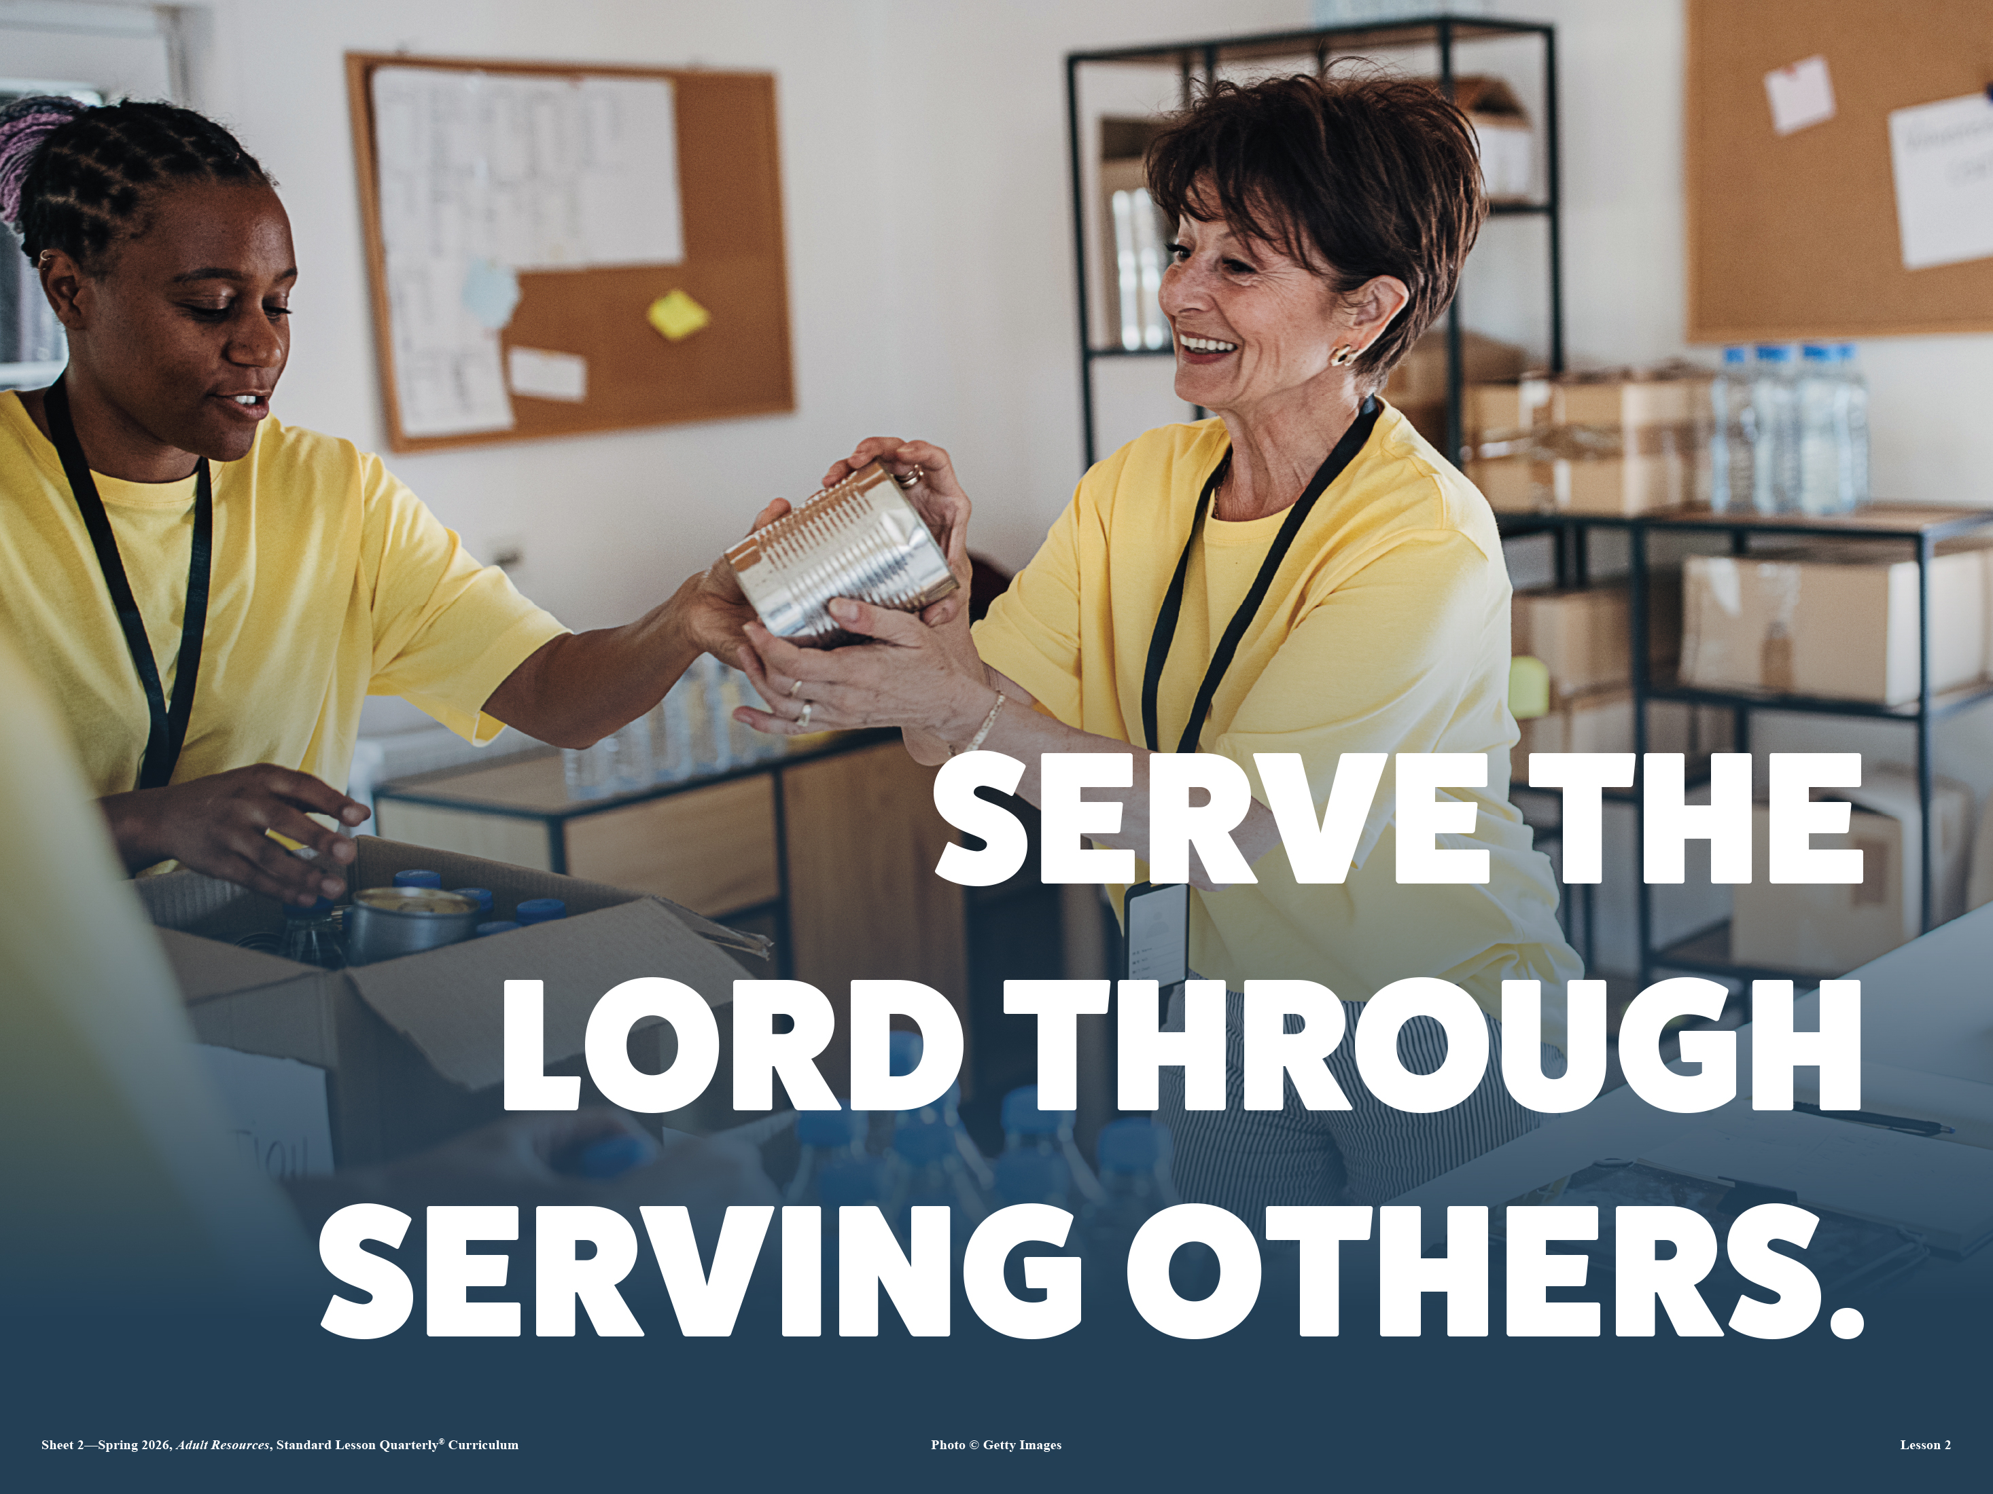
GIVING TO THE COMMUNITY
For the poor shall never cease out of the land: therefore I command thee, saying, Thou shalt open thine hand wide unto thy brother, to thy poor, and to thy needy, in thy land.
—Deuteronomy 15:11 KJV
Week of March 15

Slide 2
Prayer
Father God, give us loving hearts open wide to all people. Protect us from the sin of selfishness. Open our hands in generosity. Help us remember that everything we have comes as a gift from You. In Jesus’ name we pray. Amen.
Thought to Remember
Give out of your rich inheritance!
Notes:
Prayer
Father God, give us loving hearts open wide to all people. Protect us from the sin of selfishness. Open our hands in generosity. Help us remember that everything we have comes as a gift from You. In Jesus’ name we pray. Amen.
Thought to Remember
Give out of your rich inheritance!

Slide 3
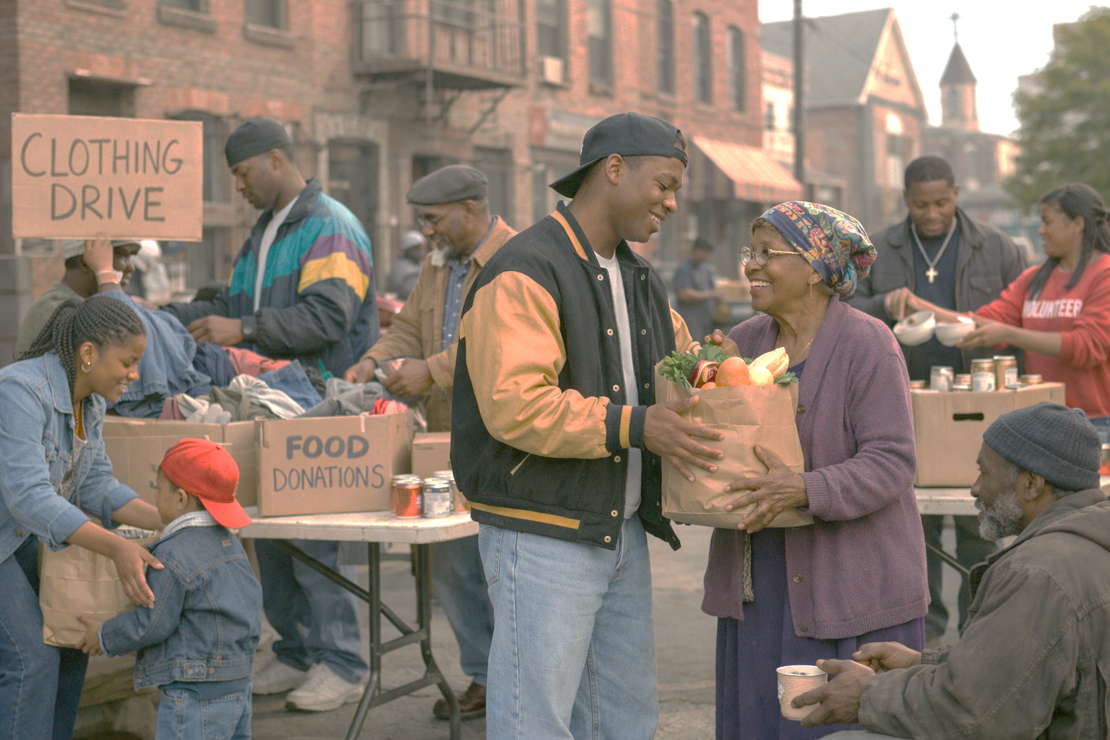
LESSON OUTLINE
GIVING TO THE COMMUNITY
Lesson Scripture: Deuteronomy 15:4–11; Matthew 25:42–45
Lesson Focus: God prompts us to use money to help others.
Apply the Message: We can use resources to bless others.
Live It Out: Ask God to shape the way you view financial needs.
Review
Introduction
Lesson Context
Overview
A Generous and Just Nation - Deuteronomy 15:4–11 KJV
WWYDFJ - Matthew 25:42–45 KJV
Summary
Conclusion
Question & Answers
Notes:
A Generous and Just Nation - Deuteronomy 15:4–11 KJV
WWYDFJ - Matthew 25:42–45 KJV
=========================
Deuteronomy 15:4–11
Summary
God commands Israel to live as a compassionate community where poverty is addressed through generosity and obedience. If the people faithfully follow God’s commands, there would ideally be no poor among them. However, because human need will always exist, God instructs His people not to harden their hearts but to open their hands to the poor and needy. Lending, giving, and caring for others are presented as covenant responsibilities. God promises blessing to those who obey this command and live with generosity toward the less fortunate.
Commentary
This passage reveals God’s heart for justice and mercy. Poverty was not to be ignored but confronted through generosity within the covenant community. The command to “open thine hand wide” (v. 8) shows that compassion must be intentional and practical. In Baptist understanding, this reflects stewardship—recognizing that all resources belong to God and should bless others. Generosity is not optional charity but covenant obedience. The principle teaches believers that caring for the poor reflects God’s character and demonstrates faithful love toward both God and neighbor.
Matthew 25:42–45
Summary
Jesus teaches that neglecting the needs of others is equivalent to neglecting Him. In the final judgment, the King rebukes those who failed to feed the hungry, give drink to the thirsty, welcome the stranger, clothe the naked, or visit the sick and imprisoned. They protest that they never saw Him in need, but Jesus explains that whatever they failed to do for “the least of these” they failed to do for Him. The passage reveals that genuine faith is demonstrated through compassionate action toward those in need.
Commentary
Jesus identifies Himself with the vulnerable and marginalized. This teaching exposes the difference between empty religion and living faith. Service to others becomes evidence of devotion to Christ. The judgment scene emphasizes that believers cannot separate worship from compassion. From a Baptist theological perspective, salvation is by grace through faith, yet true faith produces works of love. The church is called to be Christ’s hands and feet in the world—feeding, caring, welcoming, and serving—because how we treat others reflects how we respond to Christ Himself.

Slide 4
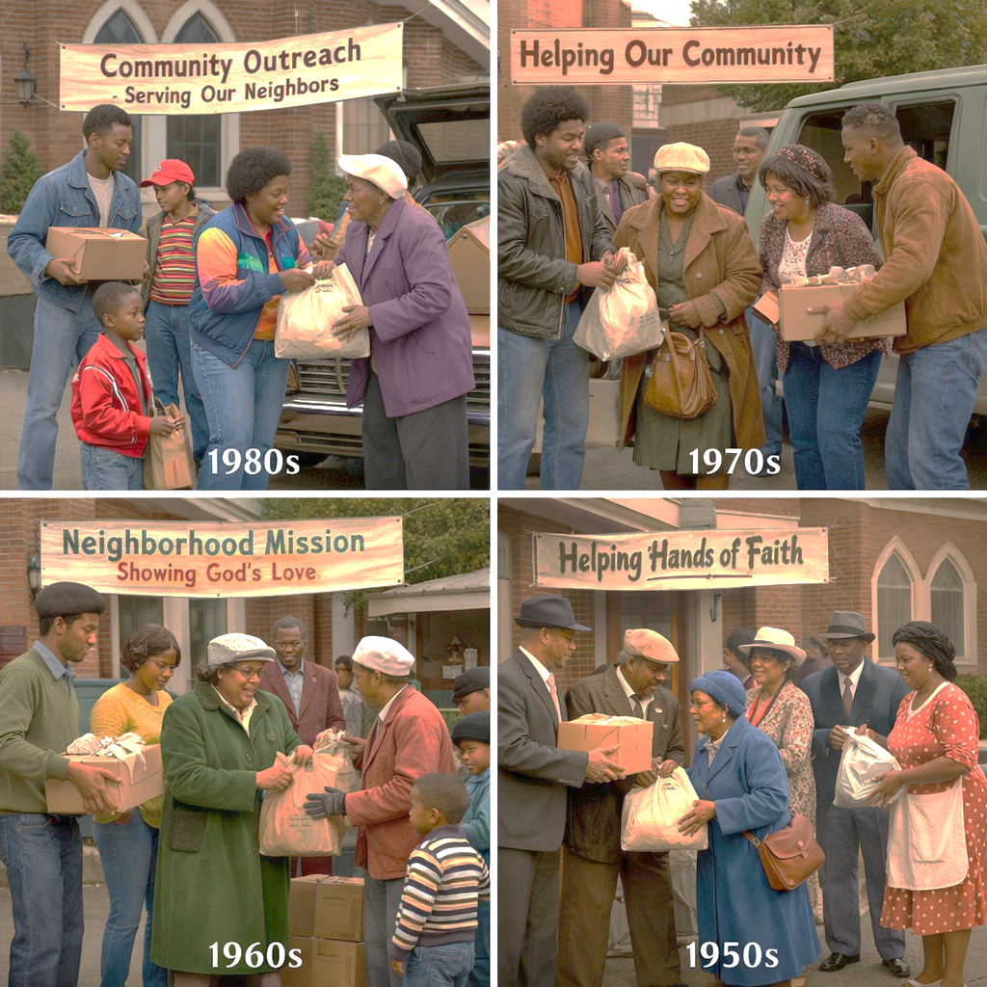
LESSON CONTEXT
GIVING TO THE COMMUNITY
Endless Blessings
I live on a farm. My family primarily raises cattle and sheep, though we also raise chickens. In the past, we enjoyed raising hogs, goats, and horses. To make money with cattle and sheep, one must sell them appropriately. You must consider timing, weight, breeding quality, and other marketing factors. When we sell an animal, that animal is gone for good. We will never have it back. The finality of it makes selling livestock difficult.
Chickens, on the other hand, differ because they produce eggs. We can take the eggs, knowing more will appear tomorrow. No matter how often we collect the eggs, the chickens will lay more if they are healthy.
Sometimes, we reject generosity because we fear we will face a lack. However, generosity is like chickens and eggs. Our giving does not equate to permanent depletion. As you think about today’s lesson, consider the blessings of God. God supplies the needs of His people; therefore, what we are gifted is to be used generously.
Notes:
Main Idea
God’s blessings are not limited resources; when we trust Him and give generously, He continues to provide for our needs.
Analysis
The illustration contrasts livestock with chickens to teach a spiritual truth about generosity. Selling cattle or sheep represents a one-time loss because the animal is gone permanently. In contrast, chickens continually produce eggs, demonstrating an ongoing supply. The comparison shows that many people hesitate to give because they fear losing what they have. However, God’s provision works differently. When believers give generously, they are not depleting their resources permanently because God continues to supply their needs. The lesson emphasizes trust in God’s provision and encourages believers to see generosity as participation in God’s ongoing blessings rather than a loss.
Three Key Points
1. Fear Often Prevents Generosity People hesitate to give because they believe their resources are limited and cannot be replaced.
2. God’s Provision Is Ongoing Like chickens continually producing eggs, God continually supplies what His people need.
3. Generosity Reflects Trust in God When believers give freely, they demonstrate faith that God will continue to provide.
Three Life Lessons Learned
1. Trust God’s Provision Believers should rely on God rather than fear running out of resources.
2. View Giving as Participation in God’s Work Generosity allows believers to share in God’s blessings and help meet the needs of others.
3. Recognize That God’s Blessings Are Renewable What God provides today can continue tomorrow when we steward His gifts faithfully.
Summary
The farm illustration teaches that generosity should not be viewed as permanent loss. While selling livestock represents a final transaction, chickens laying eggs symbolize continual provision. In the same way, God’s blessings are not exhausted when believers give. Instead, God faithfully supplies what His people need. When believers trust God’s provision, they can give freely and generously, confident that the Lord will continue to care for them and use their resources to bless others.

Slide 5
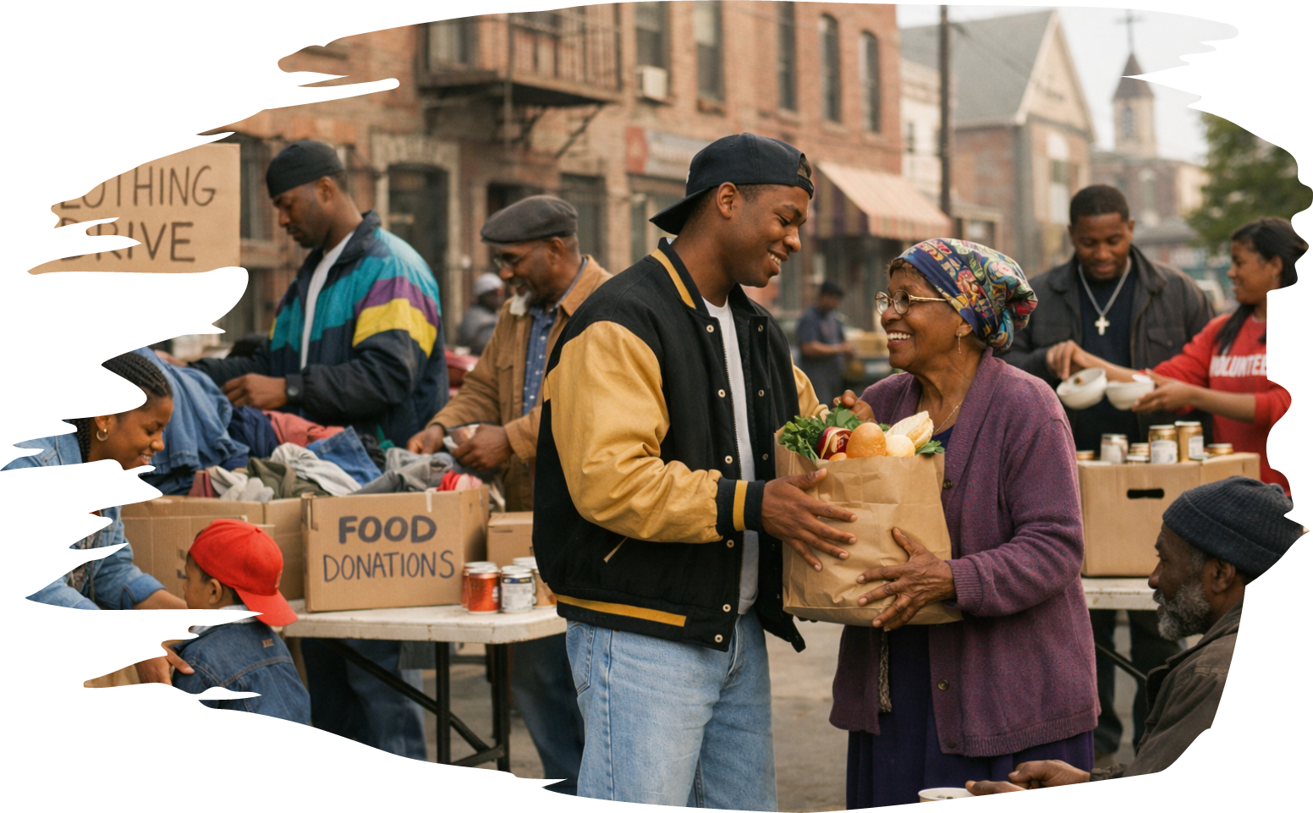
Daily Bible Readings
GIVING TO THE COMMUNITY
These passages teach that God’s people should live with love, unity, and strong relationships with one another. The friendship between David and Jonathan shows how true friends care for each other with loyalty and sacrifice. John explains that real love comes from God and should be seen in how believers treat others. Isaiah teaches that God welcomes everyone who seeks Him, no matter their background. The Psalms remind us that it is a blessing when God’s people live together in peace and worship Him. Paul explains that through faith in Jesus, all believers become God’s children and share in His promises. Together, these scriptures show that God’s family is built on faith, love, unity, and worship.
Daily Bible Readings
Week of March 16 through March 21
• 1 Samuel 18:1–5—Souls Bound Together.
• 1 John 4:7–16—Abide in God’s Love.
• 1 John 4:17–21—Loving God and Each Other.
• Isaiah 56:3–8—All Peoples Will Worship God.
• Psalm 133–134—Living Together in Unity.
• Galatians 3:25–29—Children of God Through Faith.
Notes:
A Generous and Just Nation - Deuteronomy 15:4–11 KJV
WWYDFJ - Matthew 25:42–45 KJV
=========================
Deuteronomy 15:4–11
Summary
God commands Israel to live as a compassionate community where poverty is addressed through generosity and obedience. If the people faithfully follow God’s commands, there would ideally be no poor among them. However, because human need will always exist, God instructs His people not to harden their hearts but to open their hands to the poor and needy. Lending, giving, and caring for others are presented as covenant responsibilities. God promises blessing to those who obey this command and live with generosity toward the less fortunate.
Commentary
This passage reveals God’s heart for justice and mercy. Poverty was not to be ignored but confronted through generosity within the covenant community. The command to “open thine hand wide” (v. 8) shows that compassion must be intentional and practical. In Baptist understanding, this reflects stewardship—recognizing that all resources belong to God and should bless others. Generosity is not optional charity but covenant obedience. The principle teaches believers that caring for the poor reflects God’s character and demonstrates faithful love toward both God and neighbor.
Matthew 25:42–45
Summary
Jesus teaches that neglecting the needs of others is equivalent to neglecting Him. In the final judgment, the King rebukes those who failed to feed the hungry, give drink to the thirsty, welcome the stranger, clothe the naked, or visit the sick and imprisoned. They protest that they never saw Him in need, but Jesus explains that whatever they failed to do for “the least of these” they failed to do for Him. The passage reveals that genuine faith is demonstrated through compassionate action toward those in need.
Commentary
Jesus identifies Himself with the vulnerable and marginalized. This teaching exposes the difference between empty religion and living faith. Service to others becomes evidence of devotion to Christ. The judgment scene emphasizes that believers cannot separate worship from compassion. From a Baptist theological perspective, salvation is by grace through faith, yet true faith produces works of love. The church is called to be Christ’s hands and feet in the world—feeding, caring, welcoming, and serving—because how we treat others reflects how we respond to Christ Himself.

Slide 6
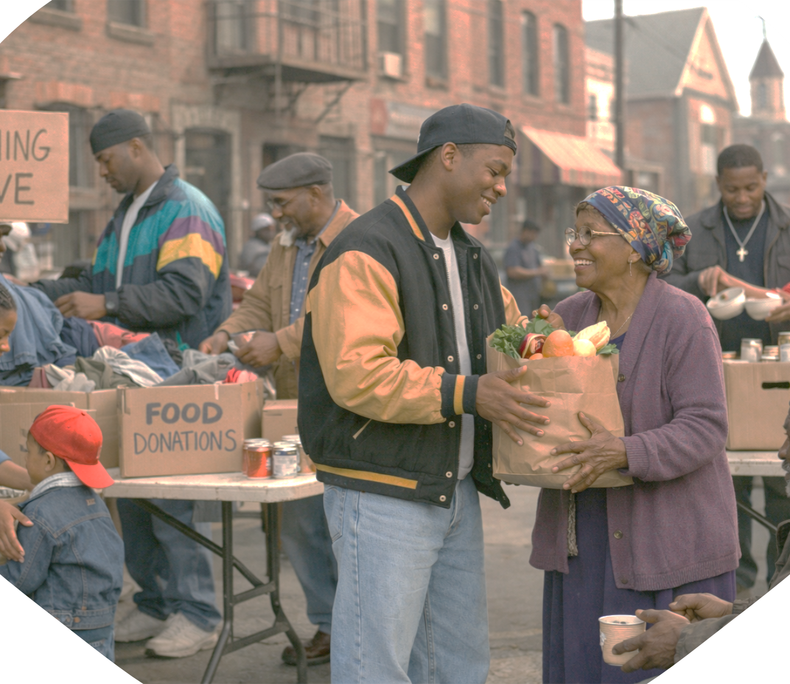
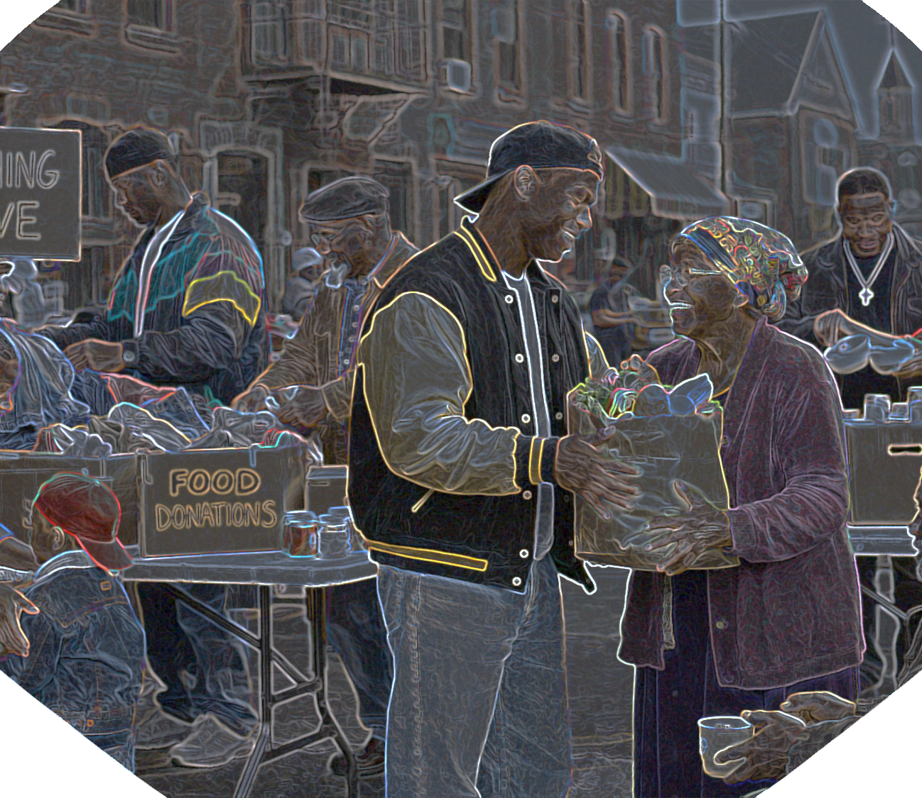

LESSON OUTLINE
GIVING TO THE COMMUNITY
Endless Blessings—
I live on a farm. My family primarily raises cattle and sheep, though we also raise chickens. In the past, we enjoyed raising hogs, goats, and horses. To make money with cattle and sheep, one must sell them appropriately. You must consider timing, weight, breeding quality, and other marketing factors. When we sell an animal, that animal is gone for good. We will never have it back. The finality of it makes selling livestock difficult.
Chickens, on the other hand, differ because they produce eggs. We can take the eggs, knowing more will appear tomorrow. No matter how often we collect the eggs, the chickens will lay more if they are healthy.
Sometimes, we reject generosity because we fear we will face a lack. However, generosity is like chickens and eggs. Our giving does not equate to permanent depletion. As you think about today’s lesson, consider the blessings of God. God supplies the needs of His people; therefore, what we are gifted is to be used generously.
Notes:
Main Idea
God’s blessings are not limited resources; when we trust Him and give generously, He continues to provide for our needs.
Analysis
The illustration contrasts livestock with chickens to teach a spiritual truth about generosity. Selling cattle or sheep represents a one-time loss because the animal is gone permanently. In contrast, chickens continually produce eggs, demonstrating an ongoing supply. The comparison shows that many people hesitate to give because they fear losing what they have. However, God’s provision works differently. When believers give generously, they are not depleting their resources permanently because God continues to supply their needs. The lesson emphasizes trust in God’s provision and encourages believers to see generosity as participation in God’s ongoing blessings rather than a loss.
Three Key Points
1. Fear Often Prevents Generosity People hesitate to give because they believe their resources are limited and cannot be replaced.
2. God’s Provision Is Ongoing Like chickens continually producing eggs, God continually supplies what His people need.
3. Generosity Reflects Trust in God When believers give freely, they demonstrate faith that God will continue to provide.
Three Life Lessons Learned
1. Trust God’s Provision Believers should rely on God rather than fear running out of resources.
2. View Giving as Participation in God’s Work Generosity allows believers to share in God’s blessings and help meet the needs of others.
3. Recognize That God’s Blessings Are Renewable What God provides today can continue tomorrow when we steward His gifts faithfully.
Summary
The farm illustration teaches that generosity should not be viewed as permanent loss. While selling livestock represents a final transaction, chickens laying eggs symbolize continual provision. In the same way, God’s blessings are not exhausted when believers give. Instead, God faithfully supplies what His people need. When believers trust God’s provision, they can give freely and generously, confident that the Lord will continue to care for them and use their resources to bless others.

Slide 7
LESSON CONTEXT
GIVING TO THE COMMUNITY
Psalm 145:9 states, “The Lord is good to all; He has compassion on all He has made. ” Deuteronomy 15 and Matthew 25 each challenge God’s people to reflect His generosity in their shared life together. Deuteronomy is like a sermon from Moses, spoken to the people of Israel who were about to take possession of the land of Canaan. Matthew 25 is addressed to the followers of Jesus, brothers and sisters in a shared family.
DEUTERONOMY
The title Deuteronomy is a combination of two Greek words meaning “second law. ” Moses spoke and wrote the words in this book after the Israelites served their 40-year sentence in the wilderness (Numbers 32:13; Deuteronomy 2:7; 8:2). A new generation replaced the previous one, and that new generation needed to hear the Law of Moses for themselves. Thus Deuteronomy refers to the second giving of the law (compare the Ten Commandments in both Exodus 20 and Deuteronomy 5).
Law codes directly shape (and are shaped by) culture. They articulate societal norms and expectations. Throughout the ancient Near East, law codes included common themes such as repayment of debts, release of enslaved people, and establishing land rights. The Law of Moses speaks to similar themes. It also calls for the release of debts, people, and land, although on a different timeline (Leviticus 25:10; Deuteronomy 15:1–2).
The Law of Moses bears striking similarities to other codes of the ancient world, including the Code of Hammurabi. But the combination of political, governmental, and spiritual leadership within the Law of Moses is ultimately unique. The one true God is the spiritual leader and king. He calls His people to reflect His holiness and generosity.
MATTHEW
Roughly fourteen centuries pass before the nation that received the Law of Moses receives the Gospel of Matthew. In that long interval, the Law of Moses received various “creative” reinterpretations (compare Matthew 23:13–26; Mark 7:8–13). Matthew and other New Testament writers document the birth, life, death, resurrection, and ascension of Jesus. These events transitioned God’s people from the rules of the old covenant to the expectations of the new. Does this transition mean that the Law of Moses is without value today? Do practitioners of the new covenant need to uphold the expectations of the old? Today’s lesson explores one aspect of these questions.
Notes:
Main Idea
God’s people are called to reflect His goodness and compassion by living generously and caring for others.
Analysis
Psalm 145:9 declares that God is good and compassionate toward all creation. This truth becomes the foundation for how God’s people should live. In Deuteronomy, Moses reminds a new generation of Israel about God’s law and instructs them to live with justice, generosity, and care for the needy as they enter the Promised Land. The law shaped Israel’s culture and reflected God’s holiness and mercy. Many centuries later, the Gospel of Matthew shows how Jesus fulfilled and clarified these principles. Under the new covenant, believers continue to practice generosity and compassion, demonstrating God’s character in their community.
Three Key Points
1. God’s Character Is Good and Compassionate Scripture teaches that God shows kindness and mercy to all people.
2. God’s Law Taught Generosity and Justice Through Moses, Israel learned to care for the poor, release debts, and live fairly.
3. Jesus Calls Believers to Continue These Values The teachings of Jesus reaffirm that God’s people should live with compassion and generosity.
Three Life Lessons Learned
1. God’s Goodness Should Shape Our Behavior Believers should treat others with kindness because God treats us with mercy.
2. Generosity Is Part of Faithful Living Caring for those in need reflects obedience to God.
3. God’s Word Guides Every Generation Each generation must learn and apply God’s truth in their own time.
Summary
The passage shows that God’s compassion forms the foundation for how His people should live. In Deuteronomy, Moses restates the law to a new generation so they would understand God’s expectations of justice and generosity. The law shaped Israel’s society and reflected God’s holiness. Centuries later, the Gospel of Matthew records how Jesus fulfilled and clarified God’s will for His people. Although the covenant changed, God’s desire for His people to live with compassion, generosity, and obedience remains the same.

Slide 8
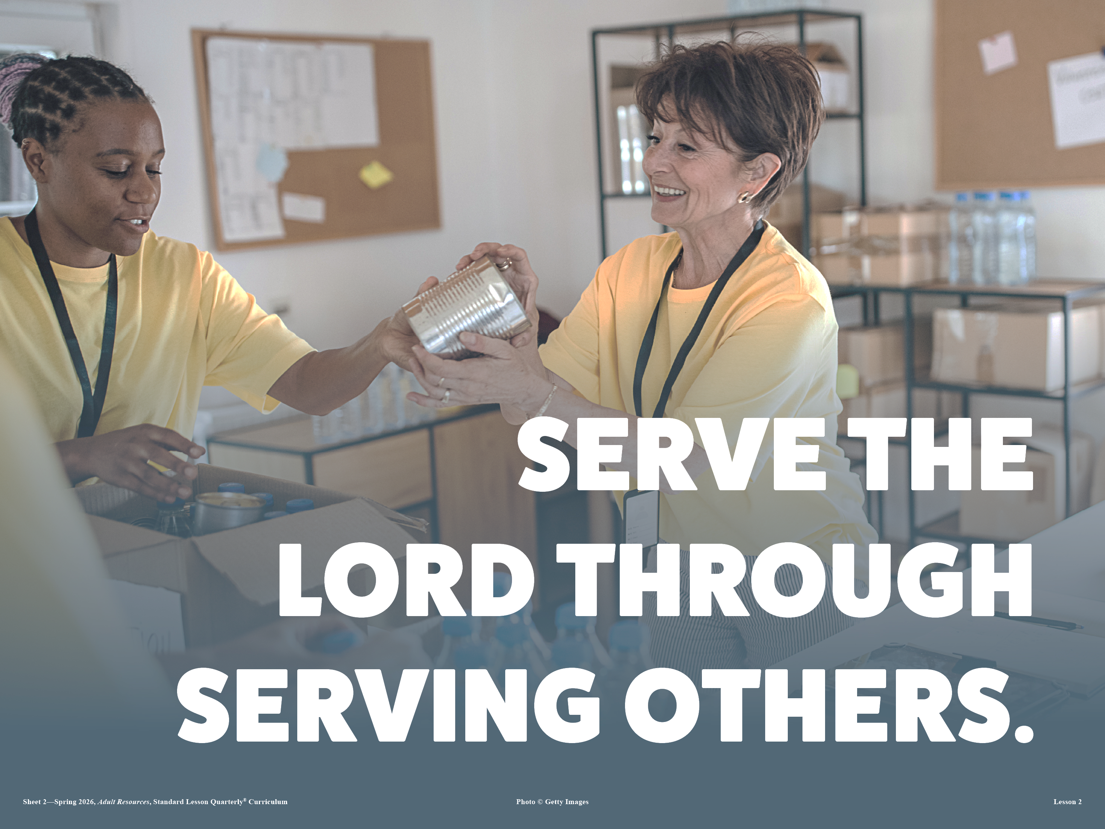
LESSON CONTEXT
GIVING TO THE COMMUNITY
Year of Jubilee
If a seven-year cycle of forgiving debts seems a difficult system to maintain, the expectation for Israel was greater still. After seven cycles of seven years (in other words,every fifty years), God required a Year of Jubilee, which goes beyond the normal release of debts, returning the ownership of all land to the ancestral holders (see Lev. 25:8–55). While the seven-year release pertained to financial debts, the Jubilee would keep land distributed equitably among the Israelites. If an entire family had fallen on hard times, they could all be redeemed and awarded their family land as a fresh start.
God promises a superabundant harvest to make the Year of Jubilee a time without the need for sowing and reaping (Lev. 25:20–22). Even the land is given a regular rest—still an important aspect for effective agriculture.
Do Not Overlook Family
When Paul writes about care for widows and children, he is careful to say that looking after family is important (1 Tim. 5:1–8). From the words of Exodus 20:12, God instructs His people to show respect for parents, which includes giving help when they age. In the new covenant context, the definition of family expands but does not overlook biological family. In fact, Paul says that it would only be a poor witness if believers neglected their families and failed to provide (1 Tim. 5:8).
Notes:
Main Idea
God designed the Year of Jubilee to restore people, prevent long-term poverty, and remind Israel that the land ultimately belonged to Him.
Analysis
The Year of Jubilee occurred every fifty years after seven cycles of seven years. During this time, debts were released and family land returned to its original owners. This prevented wealth from remaining permanently in the hands of a few and protected families from generational poverty. God also promised abundant harvests to provide for the people while the land rested. The system demonstrated that economic life in Israel was meant to reflect God’s justice, mercy, and provision.
Three Key Points
1. Restoration for Families – Land returned to original families, giving them a fresh start.
2. God Owns the Land – Israel was reminded that everything ultimately belonged to God.
3. Trust in God’s Provision – God promised abundant harvests during this time.
Three Life Lessons
1. God cares about fairness and restoration in society.
2. Believers should trust God’s provision rather than hoard resources.
3. Systems of mercy help prevent long-term injustice.
Summary
The Year of Jubilee was a special time every fifty years when debts were forgiven and land returned to original families. This system protected families from permanent poverty and reminded Israel that God was the true owner of the land. By promising abundant harvests, God showed that obedience and trust in Him would bring provision and renewal.
Main Idea
Believers must care for their families, because honoring and providing for family members is a key part of faithful living.
Analysis
Scripture teaches that caring for parents, widows, and children is a spiritual responsibility. Paul emphasizes that believers should first provide for their own families before expecting the church to meet those needs. This instruction builds on the commandment to honor parents. While the Christian family includes all believers, biological family responsibilities remain important. Neglecting family care harms a believer’s witness and contradicts the teachings of Christ.
Three Key Points
1. Family Care Is a Biblical Command – Scripture calls believers to support parents and relatives.
2. Faith Begins at Home – Providing for family reflects genuine faith.
3. Witness Matters – Neglecting family damages Christian testimony.
Three Life Lessons
1. Caring for aging parents and relatives honors God.
2. Spiritual devotion must include practical responsibility.
3. A strong family example strengthens the church community.
Summary
The Bible teaches that believers must care for their families, especially widows, children, and aging parents. Paul warns that failing to provide for family contradicts faith and harms a believer’s witness. While the Christian community expands the idea of family, biological family responsibilities remain essential.

Slide 9
LESSON OUTLINE
GIVING TO THE COMMUNITY
A Cheerful Giver
“God loves a cheerful giver” (2 Cor. 9:7), but this verse portrays giving as optional. Some have reasoned that God may love a cheerful giver, but He’ll take a reluctant one anyway— ha! How can we be cheerful while giving from hardearned resources? God does not usually coerce people, even when asking them to do the right thing. We can begin by applying a sense of prudence: What would it take to set aside a small amount? To take giving to the next level, it often helps to keep a particular goal in mind. Like Paul—who shared about the great need of Jerusalem believers—we can make the need our focus by investigating the ministries that our gift would support. Whether addressing hunger, sharing the gospel, or contributing to an important project, our gifts should always have the greater goal of bringing glory to God.
Notes:
Main Idea
God desires believers to give willingly and joyfully, motivated by love and purpose rather than pressure.
Analysis
Second Corinthians teaches that God loves cheerful giving. Generosity should not come from guilt or compulsion but from gratitude and faith. When believers understand how their gifts help others—such as feeding the hungry, supporting ministry, or spreading the gospel—their giving becomes purposeful and joyful. Giving becomes an act of worship that honors God and advances His work.
Three Key Points
1. Giving Should Be Voluntary – God does not force generosity.
2. Giving Has Purpose – Resources support ministry and meet real needs.
3. Giving Honors God – Generosity becomes an act of worship.
Three Life Lessons
1. Joyful giving reflects gratitude for God’s blessings.
2. Understanding the purpose of giving encourages generosity.
3. Giving helps believers participate in God’s work.
Summary
God calls believers to give with cheerful hearts. Generosity should not come from pressure but from gratitude and faith. When believers see how their gifts help others and support God’s mission, giving becomes joyful and meaningful, bringing glory to God.

Slide 10
LESSON CONTEXT
GIVING TO THE COMMUNITY
Giving Gone Wrong
Is it possible to sin while giving? The early church had an exact situation like this recorded in Acts 5:1–11. Ananias and his wife, Sapphira, owned a piece of property. The church in Jerusalem had many poor and destitute believers. They decided to sell their land and give the proceeds to the church. But the problem was that their goal was not to bless others or glorify God. They wanted to glorify themselves. They decided to keep some of the funds from the land sale—not wrong in itself—but they boasted that they were giving it all. The Holy Spirit revealed the lie and even ended their earthly lives.
Notes:
Main Idea
Giving that seeks personal recognition rather than honoring God is sinful and dishonest.
Analysis
The story of Ananias and Sapphira reveals that generosity must come from sincere motives. The couple sold property and claimed to give all the proceeds to the church while secretly keeping part for themselves. Their sin was not keeping some money but lying to gain praise. God judged their deception, showing that hypocrisy and pride have no place in Christian giving.
Three Key Points
1. Motives Matter – Giving should glorify God, not self.
2. Honesty Is Essential – Deception dishonors God.
3. God Sees the Heart – True generosity flows from sincere faith.
Three Life Lessons
1. Giving should be done with humility and integrity.
2. Seeking praise for generosity leads to spiritual danger.
3. God values honesty more than outward appearances.
Summary
The account of Ananias and Sapphira warns that giving can become sinful when it is motivated by pride or dishonesty. Their desire for recognition led them to lie about their generosity. The story reminds believers that God cares about the heart behind giving, and true generosity must be sincere and humble.

Slide 11
LESSON OVERVIEW
GIVING TO THE COMMUNITY
A Generous and Just Nation - Deuteronomy 15:4–11 KJV
4 Save when there shall be no poor among you; for the Lord shall greatly bless thee in the land which the Lord thy God giveth thee for an inheritance to possess it:
5 Only if thou carefully hearken unto the voice of the Lord thy God, to observe to do all these commandments which I command thee this day.
6 For the Lord thy God blesseth thee, as he promised thee: and thou shalt lend unto many nations, but thou shalt not borrow; and thou shalt reign over many nations, but they shall not reign over thee.
7 If there be among you a poor man of one of thy brethren within any of thy gates in thy land which the Lord thy God giveth thee, thou shalt not harden thine heart, nor shut thine hand from thy poor brother:
8 But thou shalt open thine hand wide unto him, and shalt surely lend him sufficient for his need, in that which he wanteth.
9 Beware that there be not a thought in thy wicked heart, saying, The seventh year, the year of release, is at hand; and thine eye be evil against thy poor brother, and thou givest him nought; and he cry unto the Lord against thee, and it be sin unto thee.
10 Thou shalt surely give him, and thine heart shall not be grieved when thou givest unto him: because that for this thing the Lord thy God shall bless thee in all thy works, and in all that thou puttest thine hand unto.
11 For the poor shall never cease out of the land: therefore I command thee, saying, Thou shalt open thine hand wide unto thy brother, to thy poor, and to thy needy, in thy land.
God created the nation of Israel from slaves who were freed from Egypt, where they were manipulated for financial gain of others.
God instructs Israel to make financial dealings fair and equitable.
For Israel, everyone should be “openhanded” with one another, lending to anyone who has need.
Even though God commands that loans be forgiven every seven years, that should not discourage the people from lending in the first place.
If followed, God’s ways will bring blessing.
God expects responsiveness to the needs of the poor.
Notes:
><><><><><><><><><><><><><><><><><
Deuteronomy 15:4–11 NIV
4 However, there need be no poor people among you, for in the land the Lord your God is giving you to possess as your inheritance, he will richly bless you,
5 if only you fully obey the Lord your God and are careful to follow all these commands I am giving you today.
6 For the Lord your God will bless you as he has promised, and you will lend to many nations but will borrow from none. You will rule over many nations but none will rule over you.
7 If anyone is poor among your fellow Israelites in any of the towns of the land the Lord your God is giving you, do not be hardhearted or tightfisted toward them.
8 Rather, be openhanded and freely lend them whatever they need.
9 Be careful not to harbor this wicked thought: “The seventh year, the year for canceling debts, is near,” so that you do not show ill will toward the needy among your fellow Israelites and give them nothing. They may then appeal to the Lord against you, and you will be found guilty of sin.
10 Give generously to them and do so without a grudging heart; then because of this the Lord your God will bless you in all your work and in everything you put your hand to.
11 There will always be poor people in the land. Therefore I command you to be openhanded toward your fellow Israelites who are poor and needy in your land.
><><><><><><><><><><><><><><><><><
A Generous and Just Nation
God brings the Israelites out of Egypt, calling them His people. He gives instructions to set them apart from every other nation. Some laws are about how to worship the Creator, but others regulate the treatment of other humans.
The Israelites are to demonstrate justice in all financial dealings. Under Pharaoh, they were exploited for financial gain. This is not to be the pattern for God’s people. They should be generous with one another, “openhanded” instead of “tightfisted” or “hardhearted” (Deut. 15:7–8). God says, “There need be no poor among you” (Deut. 15:4).
One way to follow those words is to lend money freely, instead of seeking the highest return. Every seven years, God commands a year of “release” (see Deut. 15:1–3). Debts would be canceled and lands returned to their ancestral owners on a regular basis. Thus Israel would not be a nation of haves and have-nots, a place where poverty becomes inescapable.
But will this make wealthy people unwilling to loan money at all, if debts will eventually be forgiven? God calls the lender to put the thought aside, or else the poor will “appeal to the Lord against you” (v. 9). Such generosity would bankrupt other nations, but God guarantees blessing, if Israel shall obey (v. 10).
It is helpful to reverse the logic of this. Since God can bless His people with abundant resources, they can be generous in turn, sharing resources and forgiving loans. The result is that there shall be no destitute people in the entire nation! Someone in a tough situation shall have a community ready and eager to help. This is the just community that God wants for Israel: a community where generosity is normalized.
Main Idea
God calls His people to build a just and generous community where no one is abandoned in poverty.
Analysis
When God delivered Israel from slavery in Egypt, He intended them to live differently from other nations. Their laws were designed not only to guide worship but also to regulate how people treated one another. Having experienced oppression under Pharaoh, Israel was commanded to avoid exploiting others. Instead, they were to practice generosity, lending freely and caring for the poor. The system of debt release every seven years prevented permanent poverty and protected families from economic oppression. God promised that obedience and generosity would bring His blessing, allowing the nation to thrive while caring for all its members.
Three Key Points
1. God Calls for Justice in Financial Dealings Israel was commanded to avoid exploitation and treat one another fairly.
2. Generosity Should Replace Hardheartedness God instructed His people to be openhanded and willing to help the poor.
3. Debt Release Prevented Generational Poverty The seven-year release ensured that no family would remain trapped in debt forever.
Three Life Lessons Learned
1. Remember Past Deliverance Because Israel experienced oppression, they were called to show compassion toward others.
2. Generosity Builds Strong Communities When people share resources, fewer individuals fall into desperate situations.
3. Trust God’s Provision God promises to bless those who obey His commands and care for others.
Summary
God rescued Israel from slavery and called them to live as a just and compassionate nation. Their laws required fairness in financial matters and generosity toward the poor. By canceling debts regularly and encouraging openhanded lending, God prevented long-term poverty and created a community where people cared for one another. This system reflected God’s character and ensured that no one would be left without help.

Slide 12
LESSON OVERVIEW
GIVING TO THE COMMUNITY
WWYDFJ - Matthew 25:42–45 KJV
42 For I was an hungred, and ye gave me no meat: I was thirsty, and ye gave me no drink:
43 I was a stranger, and ye took me not in: naked, and ye clothed me not: sick, and in prison, and ye visited me not.
44 Then shall they also answer him, saying, Lord, when saw we thee an hungred, or athirst, or a stranger, or naked, or sick, or in prison, and did not minister unto thee?
45 Then shall he answer them, saying, Verily I say unto you, Inasmuch as ye did it not to one of the least of these, ye did it not to me.
Jesus speaks to His followers about the judgment that awaits all people.
The Son of Man shall give an unfavorable judgment to those who overlook the needs of others.
The hungry, strangers without a place to stay, those without clothes and other necessities—these are the people that Jesus elevates.
Some people will act surprised that Jesus identifies with the poor and persecuted.
Caring for these needs is also caring for Jesus.
Notes:
><><><><><><><><><><><><><><><><><
NIV Matthew 25:42–45
42 “For I was hungry and you gave me nothing to eat, I was thirsty and you gave me nothing to drink,
43 I was a stranger and you did not invite me in, I needed clothes and you did not clothe me, I was sick and in prison and you did not look after me. ’
44 “They also will answer, ‘Lord, when did we see you hungry or thirsty or a stranger or needing clothes or sick or in prison, and did not help you?’
45 “He will reply, ‘Truly I tell you, whatever you did not do for one of the least of these, you did not do for me. ’”
><><><><><><><><><><><><><><><><><
WWYDFJ
The ancient Israelites fall short of the just requirements of God. Yet Israel is reconstituted around God’s own Son. Jesus sends twelve disciples to proclaim the kingdom of God to the “lost sheep of Israel,” offering blessing on those who repent and respond to the good news (Matt. 10:6). Their welcome of Christ’s messengers is as important as the welcome of Christ Himself (Matt. 10:40–42).
He expands this message in Matthew 25 with an image of final judgment. Jews knew that God would judge all people, separating those deserving of reward and punishment. And when Jesus says that “all the nations” shall be presented to the Son of Man, listeners would anticipate God’s favor for Jews and harsh judgment for Gentiles—certainly those who, like Rome, had oppressed others for selfish gain (v. 32). At last, they might think, God’s justice unveiled.
Jesus makes an unexpected pronouncement. It’s not ethnicity that the judge sees, nor membership in Israel. The judge—Jesus Himself, called “Son of Man”—decides based upon the treatment of others. He doesn’t provide a list of works to do, but He points to the defining trait of His true disciples: serving others in need (v. 31).
Treatment of brothers and sisters determines how Jesus feels treated by us. If we do not care for the needs of others, we reject Jesus, since He identifies with those in need. He says, “I was a stranger . . . I needed clothes . . . I was sick and in prison” (Matt. 25:43). When followers of Jesus see others in need, they should imagine how Jesus would want to be treated. Instead of, What would Jesus do? the question is, What would you do for Jesus?
In Jesus’ telling, the test catches people off guard (Matt. 25:44). They call Jesus “Lord,” but they did not realize their treatment of “the least” was relevant (vv. 44–45). God has a special heart for the most vulnerable. Anyone who receives unmerited favor must open their eyes to the needs all around—to Jesus in disguise.
Main Idea
Jesus teaches that true discipleship is shown by how we treat people in need, because serving others is the same as serving Him.
Analysis
Israel often failed to live up to God’s standards of justice and compassion. Through Jesus, God renews His people and calls them to a deeper understanding of righteousness. Jesus sends His disciples to preach to the “lost sheep of Israel,” teaching that welcoming His messengers is the same as welcoming Him. In Matthew 25, Jesus describes the final judgment where all nations stand before Him. Instead of judging by ethnicity or national identity, Jesus judges based on how people treated the needy. Those who cared for the hungry, sick, and poor demonstrated true faith. Compassion toward others becomes the evidence of belonging to Christ.
Three Key Points
1. Jesus Redefines True Righteousness Faith is not measured by ethnicity or status but by compassion and obedience.
2. Serving Others Is Serving Christ Jesus identifies Himself with the hungry, sick, and vulnerable.
3. Judgment Reveals True Faith The treatment of the needy exposes whether someone truly follows Christ.
Three Life Lessons Learned
1. Compassion Must Be Active Believers should respond to the needs they see around them.
2. Every Person Has Value to God Serving the vulnerable reflects God’s heart.
3. Faith Must Be Lived Out True discipleship shows itself through acts of kindness and service.
Summary
Jesus teaches that God’s judgment will reveal the true character of His followers. While many expected God to judge based on nationality or religious identity, Jesus declares that the real test is how people treat others in need. He identifies Himself with the vulnerable, teaching that serving them is the same as serving Him. True disciples of Christ demonstrate their faith through compassion, generosity, and care for those who are struggling.

Slide 13

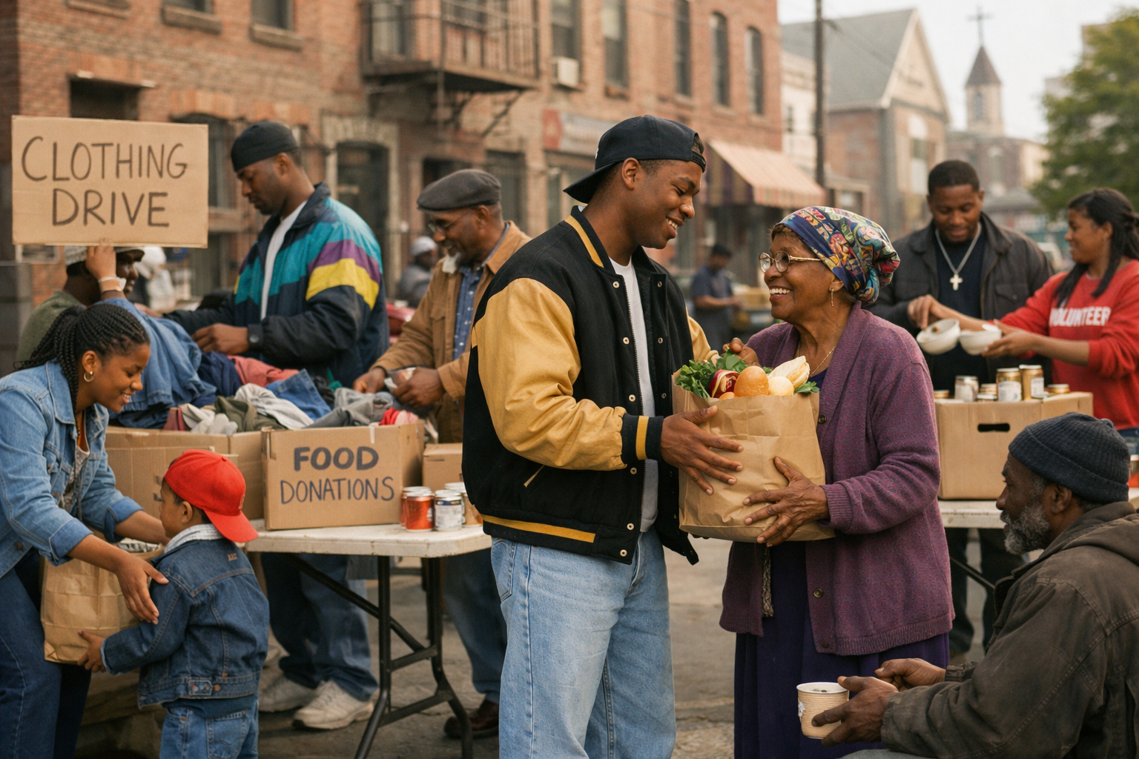
One Bible, One Story
GIVING TO THE COMMUNITY
A God Who Loves Giving
In Mark 12:41–44, Jesus selected the most unlikely person as a model for giving. She was a poor widow—the kind of person who had no extra resources to be giving in the first place. Nonetheless, she gave two tiny copper coins. Others’ massive gifts did not impress Jesus as much as the widow’s offering. Jesus knew that the rich were giving large amounts. But the widow was extremely poor, and her heart’s desire was to demonstrate her love for God by giving everything she could. God is able to multiply and do far more with what is given, but the heart is what God sees.
Notes:
Main Idea
God values the heart behind giving more than the amount that is given.
Analysis
In Mark 12:41–44, Jesus observes people placing their offerings in the temple treasury. Many wealthy individuals give large sums, but a poor widow quietly gives two small copper coins—everything she has. Jesus teaches that her gift is greater than the others because it reflects true sacrifice and devotion. The rich gave from their abundance, while the widow gave out of her poverty. This story reveals that God measures generosity by the sincerity and faith behind the gift rather than the size of the offering.
Three Key Points
1. God Sees the Heart Behind Giving True generosity is measured by the motive, not the amount.
2. Sacrificial Giving Honors God The widow gave despite her limited resources, showing deep trust in God.
3. Faithful Giving Reflects Love for God Giving becomes an expression of worship and devotion.
Three Life Lessons Learned
1. Generosity Is Not About Wealth Anyone can give faithfully, regardless of financial status.
2. God Values Sacrifice and Faith Gifts offered with trust and devotion please God.
3. Small Acts Can Have Great Impact God can multiply even the smallest offerings given with sincere faith.
Summary
Jesus uses the example of a poor widow to teach a powerful lesson about generosity. While wealthy people gave large gifts, the widow’s small offering meant more because it represented her entire livelihood. Her giving demonstrated trust, faith, and love for God. The story reminds believers that God values the heart behind generosity and can use even the smallest gift offered with sincere devotion.
Zacharias, after being speechless for nine months, joyfully proclaimed the fulfillment of God’s promises through the birth of John, which pointed to the coming of Jesus. Believers today, as recipients of these promises, should express gratitude and joy with the same vividness, acknowledging the salvation, mercy, and light found in Christ.
1. Zacharias' song marked the fulfillment of ancient prophecies, celebrating the arrival of God’s promises, especially through Jesus Christ.
2. Believers today are beneficiaries of these promises, gaining salvation, mercy, and light through Jesus, as revealed in the Scriptures.
3. Our response to God’s fulfillment of promises should be filled with vivid joy and gratitude, reflecting the magnitude of His work in Christ.

Slide 14
Apply the Message:
We can use resources to bless others.
GIVING TO THE COMMUNITY
What Is Money For?
Think about some things people have used as currency in history: shells, beads, salt, gold, whale teeth, and now even cryptocurrency. At its core, money is a tool to convey value. Unless you are a collector, you value money because of what it promises: freedom, time, esteem, relaxation, and more.
We are always tempted to project value onto the possessors of money, but Jesus reforms our understanding of value. Being rich is not a mark of our worth, just as being poor is not a knock against us. When Jesus tells of a man who enjoys the status of riches, the man loses it all because he is not “rich toward God” (Luke 12:16–21). If money is to have value to Jesus’ followers, it is for what they use it to accomplish, who they are able to help, and what glory they bring to God.
We shouldn’t forget that money is a tool. We might have a goal to earn more, but the next goal should be to surrender it for God to use. After all, earthly riches are temporary; they pass from our control when we die. Heavenly treasures last forever: faith, relationships, the love we show (Matt. 6:19–21). More money doesn’t signal spiritual success. But what we do with it is surely relevant.
Like the community of ancient Israel, the Body of Christ is called to embrace justice and decency for anyone in need. The witness of the community in Acts 2:45 was that “anyone” had enough. As individuals, we can’t make ourselves responsible for every need we encounter. But as a community that follows a just God, generosity should be a distinctive act of worship.
Notes:
Main Idea
Money is a tool given by God to bless others and bring glory to Him, not a measure of a person’s worth.
Analysis
Throughout history, different objects have served as money because they represent value. People often associate wealth with success or status, but Jesus challenges this idea. In Luke 12:16–21, the rich man loses everything because he values wealth more than God. Jesus teaches that the true value of money lies in how it is used to serve others and honor God. Earthly wealth is temporary, but acts of faith, love, and generosity create lasting spiritual treasures. Like the early church, believers are called to use resources to help those in need and build a compassionate community.
Three Key Points
1. Money Is a Tool, Not a Measure of Worth Wealth does not determine a person’s value before God.
2. True Riches Come from Being “Rich Toward God” Spiritual treasures matter more than material possessions.
3. Generosity Is a Form of Worship Using resources to help others reflects God’s justice and love.
Three Life Lessons Learned
1. Use Money with Purpose Believers should view money as a resource for serving God and helping others.
2. Invest in Eternal Values Faith, love, and relationships are treasures that last beyond this life.
3. Practice Community Generosity
When believers share resources, the church becomes a place where everyone’s needs are met.
Summary
Money is a tool that represents value, but Jesus teaches that wealth should not define a person’s worth. Instead, the true value of money lies in how it is used to serve others and honor God. Earthly riches are temporary, but generosity and faithful living produce lasting spiritual treasures. Like the early church, believers are called to use their resources to help those in need and reflect God’s love through acts of generosity.
1 Imagine you were given a 150% raise at work. What would you do?
An answer to this question will depend upon the individual situation, but it can stretch us to consider. People love to say that they would give a windfall of new money to charity or to helping family, but this might only be what we wish we would do! We should remember Jesus’ words of warning, that it is more difficult to enter the kingdom as a rich person. This is because the more we steward, the more difficult it can be to demonstrate costly generosity.
2 Where have you seen someone valued according to how much money they have?
This question could go either way. It might be that wealthy people who join a community are treated with extra respect and favor, receiving a special seat at the table. Likewise, we might see people without resources who are looked down upon or taken for granted.
3 Has your church community been known for generosity? How?
The community of Christ’s followers is asked to support the needs in their midst. You may have seen churchgoers receive special support during difficult seasons. Churches often come together for young parents, aging elders, and people who are sick. The way that church members support one another (and also outsiders) is a direct witness to the wider world. It is worth celebrating!

Slide 15
Apply the Message:
We can use resources to bless others.
GIVING TO THE COMMUNITY
What Is Money For?
1 Imagine you were given a 150% raise at work. What would you do?
2 Where have you seen someone valued according to how much money they have?
3 Has your church community been known for generosity? How?
Notes:
1 Imagine you were given a 150% raise at work. What would you do?
An answer to this question will depend upon the individual situation, but it can stretch us to consider. People love to say that they would give a windfall of new money to charity or to helping family, but this might only be what we wish we would do! We should remember Jesus’ words of warning, that it is more difficult to enter the kingdom as a rich person. This is because the more we steward, the more difficult it can be to demonstrate costly generosity.
2 Where have you seen someone valued according to how much money they have?
This question could go either way. It might be that wealthy people who join a community are treated with extra respect and favor, receiving a special seat at the table. Likewise, we might see people without resources who are looked down upon or taken for granted.
3 Has your church community been known for generosity? How?
The community of Christ’s followers is asked to support the needs in their midst. You may have seen churchgoers receive special support during difficult seasons. Churches often come together for young parents, aging elders, and people who are sick. The way that church members support one another (and also outsiders) is a direct witness to the wider world. It is worth celebrating!

Slide 16
Conclusion
GIVING TO THE COMMUNITY
Open Hands, Hearts, and Eyes
God calls His people to pay particular attention to orphans, widows, the poor, the needy, and foreigners. He gives similar-sounding laws as those prescribed in the nations around Israel (consider the Code of Hammurabi; see Lesson Context) but adds a significant layer of generosity to His commands. God wants His people to see and comprehend needs and then be moved by compassion into action. He wants us to serve one another as though we are serving Him. Jesus radically teaches that compassion for the poor and needy is one way to recognize true disciples.
Our God is full of incredible generosity. We reflect His glory and charitable nature when we give. Benevolence helps us remember that our abundance and blessing come from the Lord. As God’s children, we need not worry about lack or loss. Our heavenly Father provides for our needs. Therefore, if it is within our means to help another person, we are to do so. The help Jesus calls us toward is not difficult or complicated. It is simple and reflects His heart, compassion, grace, and love. We are to be open-handed.
God loves a cheerful giver (2 Corinthians 9:7). He does not consider the gifts and blessings He bestows as something that harms or bankrupts Him. Instead, God blesses His children because He loves them. He desires His people to reflect His nature. God calls us to live with open hearts.
Jesus asks us to see and serve others as if we are seeing and serving Him. This requires new eyes of compassion. There is no room for prejudice, racism, judgment, or favoritism among the people of God. Jesus does not want His people to have an “everyone for themselves” mentality. He calls His people to vibrantly compassionate community life. The poor, needy, hungry, thirsty, migrant, homeless, shirtless, sick, and imprisoned all deserve our loving kindness, care, and attention. Although society might reject these people, God sees them as children created in His image. The care we extend impacts the inheritance we receive. God calls us to live with open eyes.
Notes:
Main Idea
God calls His people to live with open hands, open hearts, and open eyes by showing compassion and generosity to those in need.
Analysis
God consistently commands His people to care for the most vulnerable—orphans, widows, foreigners, and the poor. While ancient laws in surrounding nations addressed justice, God’s law added a deeper requirement: compassion and generosity. Jesus reinforces this teaching by identifying Himself with the needy and declaring that caring for them reflects true discipleship. Generosity reminds believers that their blessings come from God and are meant to be shared. When believers give cheerfully and serve others without prejudice, they reflect God’s character and create a compassionate community that honors Him.
Three Key Points
1. God Commands Compassion for the Vulnerable Believers must care for the poor, widows, orphans, and strangers.
2. Generosity Reflects God’s Character Openhanded giving shows that believers trust God’s provision.
3. True Discipleship Requires Compassionate Action Serving people in need is equivalent to serving Christ.
Three Life Lessons Learned
1. See Needs Around You Believers should be attentive to the struggles of others.
2. Give with Joy and Trust Generosity reflects faith that God will continue to provide.
3. Reject Prejudice and Favoritism Every person deserves dignity because they are created in God’s image.
Summary
God calls His people to practice generosity and compassion toward those in need. Caring for the vulnerable reflects God’s love and demonstrates true faith. Believers are encouraged to give with open hands, motivated by cheerful hearts and guided by compassionate eyes. By serving others as if they are serving Christ Himself, God’s people build a community marked by love, justice, and generosity.
Zacharias, after being speechless for nine months, joyfully proclaimed the fulfillment of God’s promises through the birth of John, which pointed to the coming of Jesus. Believers today, as recipients of these promises, should express gratitude and joy with the same vividness, acknowledging the salvation, mercy, and light found in Christ.
1. Zacharias' song marked the fulfillment of ancient prophecies, celebrating the arrival of God’s promises, especially through Jesus Christ.
2. Believers today are beneficiaries of these promises, gaining salvation, mercy, and light through Jesus, as revealed in the Scriptures.
3. Our response to God’s fulfillment of promises should be filled with vivid joy and gratitude, reflecting the magnitude of His work in Christ.

Slide 17
CONCLUSION
GIVING TO THE COMMUNITY
Lesson Focus: God prompts us to use money to help others.
Live It Out:
Ask God to shape the way you view financial needs.
We are asked to consider the needs of the community. There are ways of supporting one another that go beyond financial giving, but we never want to limit the ways that God might ask us to serve others. Make this a season where you are openhanded to the people you meet.
Seeing Need as God Does
Make a list of needs in your local community (your church’s prayer list; requests from your small group; or other needs of your neighborhood, workplace, or school). Commit to pray for these needs today and in the week ahead. Pray for your openhandedness toward God’s invitations to you. Perhaps it will be a phone call for encouragement, an offering, or some other way that God will use you to be the hands and feet of Jesus.
Notes:
Main Idea
God calls believers to see needs around them and respond with prayer, compassion, and practical help.
Analysis
Believers are encouraged to ask God to reshape their perspective on financial and personal needs within their community. Generosity is not limited to money; it includes encouragement, prayer, time, and acts of service. When believers become aware of the struggles around them—through prayer lists, church needs, or community concerns—they begin to see people through God’s eyes. Prayer prepares the heart to respond when God presents opportunities to help. Living openhandedly means being ready for God to use us in simple but meaningful ways.
Three Key Points
1. Prayer Helps Us Recognize Needs Seeking God in prayer opens our eyes to the struggles around us.
2. Generosity Goes Beyond Money Encouragement, time, and service can bless others.
3. God Uses Believers to Help Others Christians become the hands and feet of Jesus in their communities.
Three Life Lessons Learned
1. Be Aware of the Needs Around You Paying attention to others’ struggles helps believers respond with compassion.
2. Stay Open to God’s Direction God may lead believers to help in unexpected ways.
3. Small Acts of Kindness Matter A phone call, prayer, or simple act of service can make a meaningful difference.
Summary
Believers are encouraged to pray and ask God to help them see the needs of others clearly. By listing and praying for community concerns, Christians develop compassion and readiness to serve. Generosity is not limited to financial giving; it includes encouragement, time, and acts of service. When believers remain open to God’s guidance, they can respond to needs and become living examples of Christ’s love.

Slide 18
End
The Lord bless thee, and keep thee:
The Lord make his face shine upon thee, and be gracious unto thee:
The Lord lift up his countenance upon thee and give thee peace.
- Numbers 6:24-26,

Slide 19

QUESTION & ANSWER
GIVING TO THE COMMUNITY
Lesson Focus: God prompts us to use money to help others.
A Generous and Just Nation
1 Where do you see poverty becoming like a trap today?
2 If God commanded generosity for the Israelites, what will God ask for believers today?
3 Are business relationships a place to show generosity? Why or why not?
An old saying goes, “Life is more expensive when you are poor. ” This proves true in a variety of circumstances. Those who have less spend more on what they need to survive. We may think of rising consumer debt, rising costs on staple goods, and cycles of unemployment. To this day, people who fall on tough times often struggle to get out of the hole. Children who are born into poverty face seemingly insurmountable obstacles.
Believers under Christ are also children of Abraham (Gal. 3:7). Thus, the regulations that God gave to Israel are relevant for Christians to study and understand, not because they should all be replicated, but because God does not change. If God expected generosity for the poor in the land of Canaan, then God will expect generosity toward the poor in our communities too (as the next text will show).
This text is addressing the generosity to be shown to the poor within the community of Israel. There are separate expectations upon the business relationships with foreigners and those outside of Israel (see Deut. 15:3). On the one hand, we should exhibit Christian virtue in all our dealings. But on the other hand, that still leaves room to be exceptionally generous to fellow brothers and sisters in Christ.
Notes:
A Generous and Just Nation
1 Where do you see poverty becoming like a trap today?
An old saying goes, “Life is more expensive when you are poor. ” This proves true in a variety of circumstances. Those who have less spend more on what they need to survive. We may think of rising consumer debt, rising costs on staple goods, and cycles of unemployment. To this day, people who fall on tough times often struggle to get out of the hole. Children who are born into poverty face seemingly insurmountable obstacles.
2 If God commanded generosity for the Israelites, what will God ask for believers today?
Believers under Christ are also children of Abraham (Gal. 3:7). Thus, the regulations that God gave to Israel are relevant for Christians to study and understand, not because they should all be replicated, but because God does not change. If God expected generosity for the poor in the land of Canaan, then God will expect generosity toward the poor in our communities too (as the next text will show).
3 Are business relationships a place to show generosity? Why or why not?
This text is addressing the generosity to be shown to the poor within the community of Israel. There are separate expectations upon the business relationships with foreigners and those outside of Israel (see Deut. 15:3). On the one hand, we should exhibit Christian virtue in all our dealings. But on the other hand, that still leaves room to be exceptionally generous to fellow brothers and sisters in Christ.

Slide 20
QUESTION & ANSWER
GIVING TO THE COMMUNITY
Lesson Focus: God prompts us to use money to help others.
WWYDFJ
1 What kind of people does Jesus mean by “the least of these” (v. 45)?
2 Why does care for these people matter to Jesus?
3 Why would Jesus preview future judgment?
The words are unspecific, but point to the lowest and humblest. From the description of their needs, these are people without enough food or water, without a permanent place to live, or who are being persecuted.
In the kingdom of Jesus, outward markers like wealth and position are not indicators of our worth. Jesus identifies with the humble and the meek, even blesses them (Matt. 5:3–10). Jesus identifies with the poor and persecuted. Helping them is like serving Jesus.
Jesus wants His followers to change their perspective, to value the people who have nothing. Jesus wants us to be prepared to face the day of judgment with confidence, rather than being surprised that our love for others is relevant to God. Caring for others shows the love of God is in us.
Notes:
1 What kind of people does Jesus mean by “the least of these” (v. 45)?
The words are unspecific, but point to the lowest and humblest. From the description of their needs, these are people without enough food or water, without a permanent place to live, or who are being persecuted.
2 Why does care for these people matter to Jesus?
In the kingdom of Jesus, outward markers like wealth and position are not indicators of our worth. Jesus identifies with the humble and the meek, even blesses them (Matt. 5:3–10). Jesus identifies with the poor and persecuted. Helping them is like serving Jesus.
3 Why would Jesus preview future judgment?
Jesus wants His followers to change their perspective, to value the people who have nothing. Jesus wants us to be prepared to face the day of judgment with confidence, rather than being surprised that our love for others is relevant to God. Caring for others shows the love of God is in us.

Slide 21
End
The Lord bless thee, and keep thee:
The Lord make his face shine upon thee, and be gracious unto thee:
The Lord lift up his countenance upon thee and give thee peace.
- Numbers 6:24-26,

