Slide 1
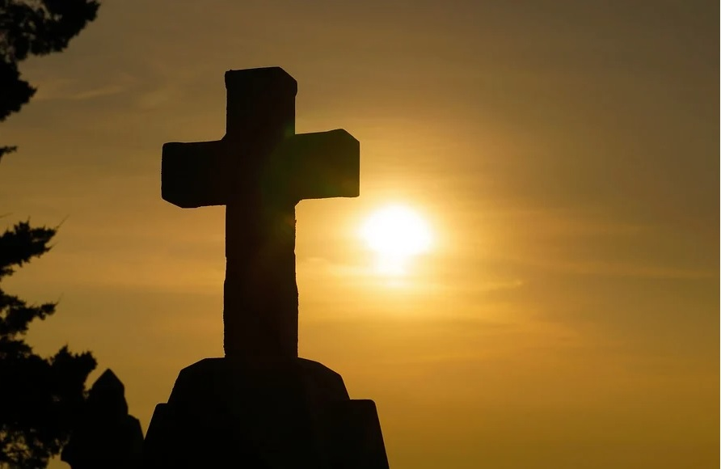
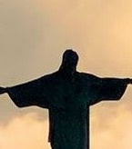
WELCOMING OTHERS IN CHRIST
  There is neither Jew nor Greek, there is neither bond nor free, there is neither male nor female: for ye are all one in Christ Jesus.
  —Galatians 3:28 KJV
March 22

Slide 2
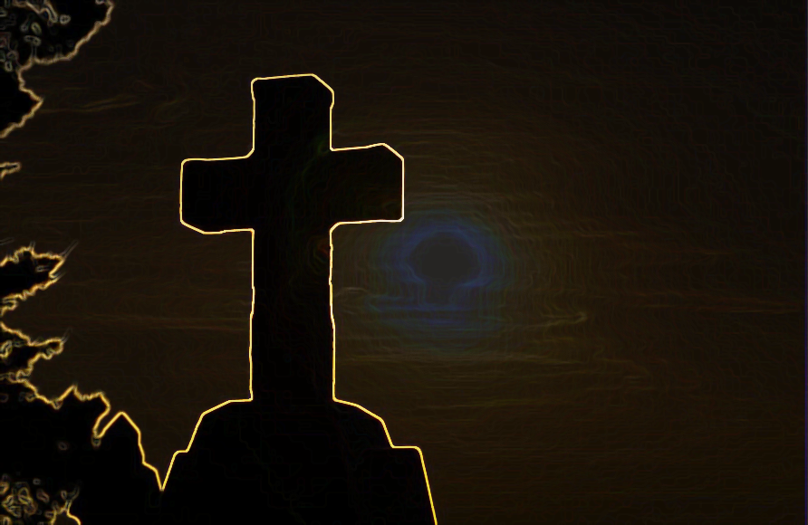
Prayer
Lord God, forgive us for the times we’ve failed to consider every believer in Christ as an equal member of Your family. Unite us to see no distinctions in Your salvation. In Jesus’ name we pray. Amen.
Thought to Remember
Christ’s salvation is available to all people without distinction.
Notes:
Prayer
Lord God, forgive us for the times we’ve failed to consider every believer in Christ as an equal member of Your family. Unite us to see no distinctions in Your salvation. In Jesus’ name we pray. Amen.
Thought to Remember
Christ’s salvation is available to all people without distinction.

Slide 3
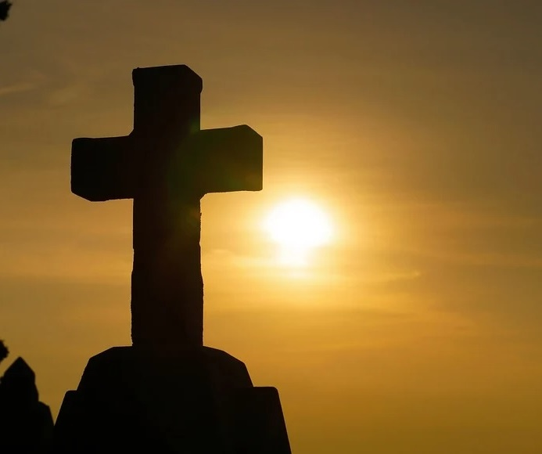
Agenda
WELCOMING OTHERS IN CHRIST
    Review
    Introduction
    Lesson Context
    Overview
      A Shocking Command - Acts 10:9–15 KJV
      Equality in Jesus - Acts 10:30-35; Galatians 3:28-29 KJV
    Conclusion
    Question & Answers
LESSON SCRIPTURE:
Acts 10:9–15, 30–35; Galatians 3:28–29
3
Notes:
A Shocking Command - Acts 10:9–15 KJV
Equality in Jesus - Acts 10:30-35; Galatians 3:28-29 KJV
===================================
1. God Shows No Partiality
Acts 10 teaches that God does not favor one nation or group. The gospel is offered to all who fear Him and seek righteousness.
2. Salvation Is Through Faith in Christ
Galatians 3 explains that acceptance before God comes through faith in Jesus, not heritage, law, or social status.
3. The Church Is One Family in Christ
Believers from every background become one body in Christ, united as equal members of God’s family.
Scripture: Acts 10:9–15, 30–35
Summary
Peter receives a vision from God showing a sheet filled with animals that Jewish law considered unclean. God commands Peter to eat, teaching him that what God has cleansed should not be called unclean. Soon afterward, Peter meets Cornelius, a Gentile, and realizes the meaning of the vision: God does not show favoritism. Salvation through Jesus Christ is offered to people of every nation who fear God and seek righteousness. This moment marks a turning point in the early church as the gospel begins to be clearly extended beyond the Jewish people to the Gentile world.
Commentary
Peter’s vision corrects a deeply rooted cultural and religious barrier. Under the Old Covenant, distinctions between clean and unclean foods symbolized Israel’s separation from other nations. Through Christ, those ceremonial boundaries are removed. The vision prepares Peter to preach to Cornelius, showing that the gospel is not restricted by ethnicity or tradition. In Baptist theology, this passage demonstrates God’s sovereign grace and the universal scope of the gospel. Faith in Christ—not national identity, heritage, or ritual—determines membership in God’s people. The church must therefore welcome all whom God calls.
Scripture: Galatians 3:28–29
Summary
Paul teaches that all who belong to Christ share equal standing before God. Distinctions that once divided people—Jew or Greek, slave or free, male or female—do not determine spiritual status in Christ. Through faith in Jesus, believers become one spiritual family. Those who trust Christ are Abraham’s true descendants and heirs of the promises God made long ago. Salvation and inheritance in God’s kingdom come through faith in Christ, not through ethnicity, social status, or human achievement.
Commentary
Paul emphasizes unity within the body of Christ. While human differences remain in society, they do not affect a believer’s acceptance before God. Justification comes by faith alone, and every believer shares the same spiritual inheritance. This teaching reinforces the truth revealed in Acts 10: the gospel removes barriers that once separated people. The church is therefore a new covenant community united in Christ. From a Baptist perspective, the local church should reflect this gospel unity, welcoming believers from every background as equal members of God’s redeemed family.

Slide 4
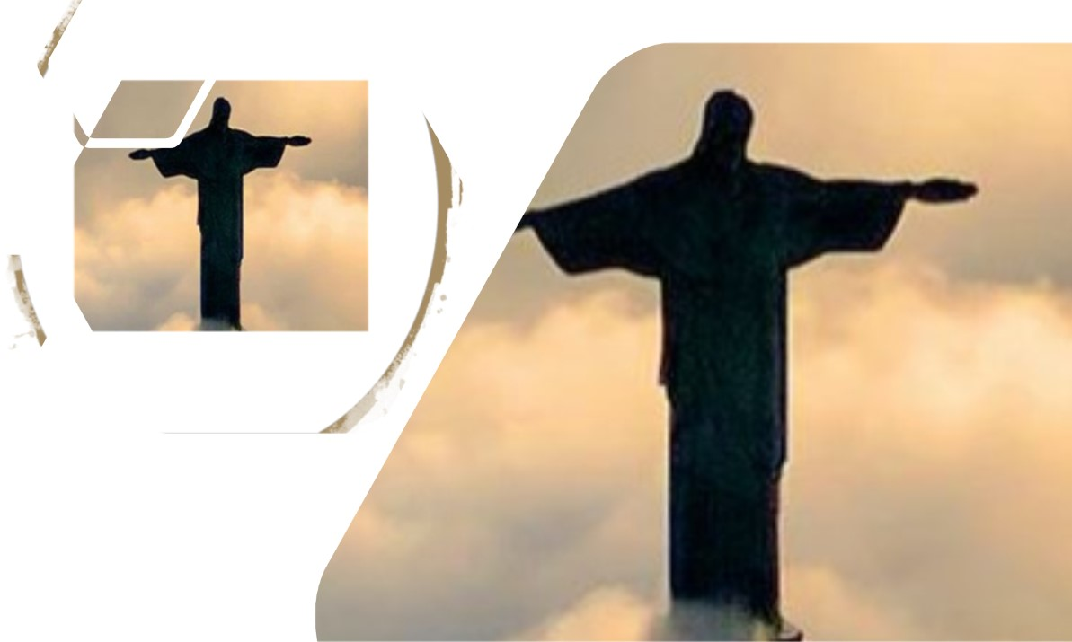
Equal Worth, Equal Access
WELCOMING OTHERS IN CHRIST
In 1863, President Abraham Lincoln delivered a two-minute speech at the dedication of the National Cemetery in Gettysburg, Pennsylvania. The speech, now known as the “Gettysburg Address,” contains several phrases that have become iconic in American culture. Boldly, Lincoln declares that “all men are created equal. ” His words echo the Declaration of Independence, where the phrase appears as one of Thomas Jefferson’s “self-evident truths. ” Jefferson himself probably borrowed the statement from earlier philosophers. In fact, historians found examples of the phrase as early as 1381!
However, neither Jefferson nor Lincoln nor any other philosophers originated the concept of equality. Human equality was established by our Creator God, who formed everyone in His image (Genesis 1:26–27). We all possess equivalent worth in God’s sight. The concept of equal worth is bound up in the notion of equal access to God’s grace. Today’s lesson explores that connection.
Notes:
Main Idea
All people have equal worth because they are created in God’s image, and therefore all have equal access to God’s grace through Christ.
Analysis
Human history often celebrates equality through political or philosophical statements such as those expressed in the Declaration of Independence and Abraham Lincoln’s Gettysburg Address. Yet the true origin of equality is not political thought but divine creation. Scripture teaches that God created every person in His image (Genesis 1:26–27). Because of this, every human life possesses equal dignity and value before God. This spiritual truth also means that God’s grace is available to all people. No race, culture, or social group has greater access to God than another.
Three Key Points
1. Equality Originates with God
Human equality begins with the truth that all people are created in the image of God.
2. Every Person Has Equal Worth
Because every human bears God’s image, each life possesses dignity and value in God’s sight.
3. God’s Grace Is Available to All
Equal worth leads to equal access to salvation and God’s grace.
Three Life Lessons
1. Respect Every Person
Believers should treat all people with dignity because every person reflects God’s image.
2. Reject Prejudice and Favoritism
The gospel calls Christians to remove barriers that divide people.
3. Share the Gospel With Everyone
Since God’s grace is offered to all, believers should welcome and reach every person with the message of Christ.
Summary
True equality did not originate with human philosophy or political declarations. It begins with God, who created every person in His image. Because all people have equal worth before God, everyone also has equal access to His grace. This truth calls believers to treat others with dignity and to share the gospel with all people.

Slide 5
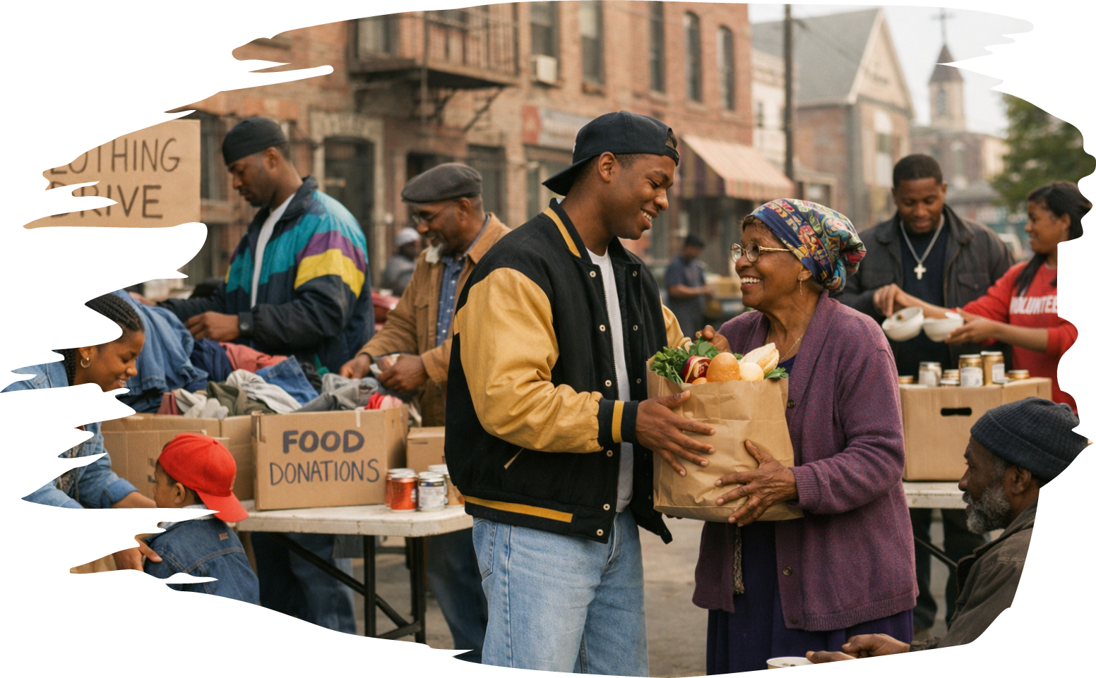
Daily Bible Readings
GIVING TO THE COMMUNITY
  These scriptures reveal that God rules over all nations and invites every people into His kingdom. Jesus declares that His kingdom is spiritual and founded on truth. God blesses His people with peace and remains a refuge amid global turmoil. Though nations rise and fall, God directs their destiny and promises restoration through the Messiah. Ultimately, the nations will gather before God, bringing their honor into His eternal kingdom. From creation to the new Jerusalem, Scripture shows that God’s plan includes all peoples, calling them to live under His rule, walk in His truth, and share in His peace.
  Daily Bible Readings
    Week of March 23 through March 28
        John 18:28–38—A Kingdom Not of This World.
        Numbers 6:22–26—The Lord’s Peace.
        Psalm 46—God Is Exalted Among the Nations.
        Amos 9:7–12—God Guides the Destiny of the Nations
        Revelation 21:21–27—Glory and Honor of the Nations.
        Isaiah 2:1–5—The Nations Shall Gather to God. .
Notes:
God Sovereignly Rules Over All Nations - God governs the rise and fall of nations and directs history according to His divine plan.
Christ’s Kingdom Is Spiritual and Founded on Truth - Jesus established a kingdom not based on worldly power but on truth, peace, and righteousness.
God’s Plan Includes All People - Scripture reveals that people from every nation will ultimately gather before God and share in His eternal kingdom.
John 18:28–38 — A Kingdom Not of This World
Analysis
Jesus stands before Pilate during His trial. Pilate questions whether Jesus claims to be a king. Jesus explains that His kingdom is not of this world and is not established by political force or earthly power. His mission is to testify to the truth, and those who belong to the truth hear His voice. Pilate’s question, “What is truth?” reveals the spiritual blindness of earthly authority when confronted with divine reality.
Summary
Jesus declares that His kingdom is spiritual rather than political. His rule is based on truth and obedience to God rather than military power or earthly authority.
Commentary
Christ’s kingdom transcends human governments. While earthly kingdoms rely on power, Christ’s reign is established through truth, redemption, and the hearts of believers. This passage reminds the church that its allegiance is ultimately to Christ rather than worldly systems.
Numbers 6:22–26 — The Lord’s Peace
Analysis
God instructs Moses to teach Aaron and the priests a blessing for the people of Israel. The blessing asks God to bless, protect, show favor, and grant peace to His people. This priestly benediction emphasizes God’s personal care and covenant relationship with His people.
Summary
The Lord promises blessing, protection, grace, and peace to His people through His covenant presence.
Commentary
The priestly blessing reflects God’s desire to dwell with and care for His people. In Christ, believers experience the fullness of this blessing—God’s grace, favor, and peace.
Psalm 46 — God Is Exalted Among the Nations
Analysis
Psalm 46 celebrates God as a refuge and strength in times of trouble. Though nations rage and kingdoms shake, God remains sovereign. His presence brings stability and peace to His people. The psalm ends with the declaration that God will be exalted among the nations.
Summary
God is the unshakable refuge of His people and will ultimately be honored by all nations.
Commentary
This psalm affirms God’s sovereignty over world events. Even amid chaos and conflict, God rules and will reveal His glory among all nations.
Amos 9:7–12 — God Guides the Destiny of the Nations
Analysis
God reminds Israel that He rules over all nations, not just Israel. Though He disciplines His people for disobedience, He promises restoration. The fallen house of David will be rebuilt, and other nations will seek the Lord.
Summary
God governs all nations and promises restoration through the future reign of David’s line.
Commentary
This prophecy points toward the Messianic kingdom fulfilled in Christ. God’s plan includes not only Israel but also the nations who will seek Him.
Revelation 21:21–27 — Glory and Honor of the Nations
Analysis
John describes the New Jerusalem where God dwells with His redeemed people. The nations walk in God’s light, and their glory and honor are brought into the city. Nothing impure enters it—only those written in the Lamb’s book of life.
Summary
In the new creation, redeemed nations bring their glory into God’s eternal kingdom.
Commentary
This vision shows the fulfillment of God’s redemptive plan. The nations are gathered into God’s presence, purified through Christ and living in eternal fellowship with Him.
Isaiah 2:1–5 — The Nations Shall Gather to God
Analysis
Isaiah foresees a future when the Lord’s house will be established above all others. People from many nations will come to learn God’s ways. God will judge between nations, bringing peace and ending war.
Summary
In the future kingdom of God, the nations will gather to worship Him and live in peace.
Commentary
This prophecy points to the universal reign of God through the Messiah. God’s truth will guide the nations, and His justice will establish lasting peace.

Slide 6
Lesson Context
WELCOMING OTHERS IN CHRIST
The Gospels recount the ministry of Jesus, and Acts continues the story through the growth of the early church. Acts 1:6 shows that Jesus’ disciples are still longing for a restoration of the kingdom of Israel. Acts reveals a shocking twist. God’s newly formed people are called to offer the good news to everyone. This includes Roman oppressors! The book is a theological narrative, rooted in the real experience of the earliest missionaries.
LESSON CONTEXT: ACTS
  The church birthed on the day of Pentecost stemmed from a core of believers with Jewish backgrounds (Acts 2:5). The twelve apostles, seven deacons in Jerusalem (6:5–6), Paul and Barnabas (14:1), and Jesus Himself were all ethnically Jewish or converts to Judaism. Most Jews in the Roman Empire kept themselves apart from Gentiles, forming distinct communities in their cities. Observant Jews saw Gentiles as unclean pagans who endangered Jewish religious and moral purity. They would not eat with Gentiles nor visit their homes (10:28).
  Jewish faith drew a significant number of non- Jewish people. Some of these Gentiles became “proselytes,” complete converts to Judaism who were circumcised and followed the Law of Moses (Acts 2:10; 6:5; 13:43). Other Gentiles worshiped God but did not become total converts. These people were called “devout,” or those who “feareth God” (13:16, 26; 17:4, 17).
LESSON CONTEXT: GALATIANS
  apostle Paul to the church at Galatia. Paul wrote it to clarify the relationship between Jewish and Gentile Christians. Arguments arose debating whether Gentiles must follow the Law of Moses and be circumcised into the Jewish faith to be faithful Christians. Paul posits that Jesus fulfilled the law and Gentiles were not bound to follow it. Paul’s knowledge of Hebrew law and tradition, paired with his sincere love for Gentile believers, created the necessary opening for God to bring unity to a diverse community.
Notes:
Main Idea
God’s plan of salvation extends beyond Israel to all people, uniting Jews and Gentiles in one faith through Jesus Christ.
Analysis
The book of Acts continues the story of Jesus’ ministry by showing how the early church expanded after Pentecost. Initially, the first believers were Jewish, and many expected the restoration of Israel’s national kingdom. However, God revealed a broader plan: the gospel was to be preached to all nations, including Gentiles and even Roman oppressors. This challenged Jewish cultural boundaries, since Jews traditionally avoided close interaction with Gentiles. Paul’s letter to the Galatians later clarified that Gentile believers did not need to follow the Jewish Law to be saved. Instead, Jesus fulfilled the Law, creating unity among diverse believers.
Three Key Points
1. The Gospel Is for All Nations
God expanded His mission beyond Israel, calling the church to share the good news with every people group.
2. Cultural Barriers Were Broken
Jewish traditions separated Jews and Gentiles, but the gospel removed these divisions.
3. Faith in Christ Brings Unity
Paul taught that salvation comes through faith in Jesus, not through keeping the Law of Moses.
Three Life Lessons
1. Share the Gospel Without Prejudice
Believers should reach people of every background, culture, and nation.
2. Value Unity in the Church
Christ unites diverse people into one spiritual family.
3. Focus on Grace, Not Legalism
Salvation is based on faith in Christ rather than religious rituals or traditions.
Summary
The early church began primarily among Jewish believers who expected God to restore Israel’s kingdom. However, Acts reveals that God’s plan was much greater: the gospel was meant for all nations. Cultural barriers between Jews and Gentiles were challenged as the church grew. Paul’s teaching in Galatians clarified that Gentiles did not need to follow the Jewish Law to be saved. Instead, salvation comes through faith in Christ alone, creating a unified community of believers from every background.

Slide 7

Key Points
Food Laws—
While we do not know for certain why God forbade the consumption of certain animals for the ancient Israelites, we can speculate, based on what science tells us. There would be an elevated health risk when consuming pork, reptiles, fish without scales, and even birds of prey—considering the limited cooking and food storage options available to ancient people. Pigs carry a parasite that can be fatal if undercooked, shellfish spoils quickly, reptiles carry salmonella, and consuming birds of prey can lead to transmission of zoonotic diseases.
Of course, not every Old Testament rule has this type of explanation. Levitical laws are designed not only to protect the ancient Israelites but to set them apart as a holy people. But in the early church and new covenant context, strict adherence to food laws would divide the Body of Christ along ethnic lines. If Jews and Gentiles could not eat together, how could they display the unity of their new identity under one Lord (see Eph. 4:4–6)?
WELCOMING OTHERS IN CHRIST
Notes:
Food Laws
Main Idea
Old Testament food laws helped set Israel apart as God’s holy people, but under the new covenant those restrictions could not divide believers in Christ.
Analysis
The dietary laws given to Israel in the Old Testament restricted certain animals from being eaten. Some of these prohibitions may have had health benefits in ancient times when food preparation and preservation were limited. However, the deeper purpose of these laws was spiritual. They marked Israel as a distinct and holy people set apart for God. In the early church, strict adherence to these food laws created tension between Jewish and Gentile believers. The gospel removed these barriers so believers from different cultures could share fellowship and unity under one Lord. Unity in Christ became more important than ceremonial distinctions.
Three Key Points
1. Food laws marked Israel as a holy people.
2. Some restrictions may have protected health in ancient times.
3. In Christ, ceremonial food laws could not divide the church.
Three Life Lessons
1. God’s people should pursue holiness and obedience.
2. Cultural practices should never divide believers in Christ.
3. Christian unity should be stronger than tradition or preference.
Summary
Old Testament dietary laws helped distinguish Israel as God’s covenant people and may also have provided health protections. However, in the new covenant these laws could not become barriers between Jewish and Gentile believers. Through Christ, the church is called to unity, fellowship, and shared identity under one Lord.

Slide 8
Key Points
God Listens to Gentiles—
The phrase “God has heard your prayer” (Acts 10:31) echoes statements made to prophets and devout Israelites—like Hezekiah (Isa. 38:5) and Hannah (1 Sam. 1:17)—further illustrating the seismic shift that God is revealing to Peter. Cornelius’s prayers were not only heard but honored, even though he stood outside the Sinai covenant. This moment, when an angel speaks to a Roman official with the same dignity and assurance as one of Israel’s heroes, confirms that God hears the sincere prayers of all who seek Him. It challenges any assumptions that ethnicity, social status, or past behavior could disqualify someone from God’s forgiveness and love.
WELCOMING OTHERS IN CHRIST
Notes:
God Listens to Gentiles
Main Idea
God hears and responds to sincere prayers from all people, including those outside the traditional boundaries of Israel.
Analysis
In Acts 10, the angel tells Cornelius that God has heard his prayers. This statement echoes earlier biblical assurances given to faithful Israelites such as Hezekiah and Hannah. The significance is profound because Cornelius is a Gentile Roman officer. This moment reveals that God’s attention and grace are not limited to Israel alone. Cornelius’s devotion shows that God recognizes sincere seekers regardless of their background. The event challenges assumptions that ethnicity, social status, or religious history determines access to God. Instead, God welcomes all who seek Him with genuine faith.
Three Key Points
1. God hears sincere prayers from all people.
2. Cornelius’s experience reveals a major shift in God’s redemptive plan.
3. Access to God is not determined by ethnicity or status.
Three Life Lessons
1. Anyone can approach God in prayer.
2. Believers should not limit whom God may call.
3. God values sincere faith over religious identity.
Summary
Cornelius’s story demonstrates that God listens to and honors the prayers of those who sincerely seek Him, even outside Israel’s covenant community. This moment signals a turning point in the early church, revealing that God’s grace extends beyond ethnic and cultural boundaries.

Slide 9
Key Points
WELCOMING OTHERS IN CHRIST
God Fearers” Filled with the Spirit—
What distinguished Gentile converts from becoming Jews was that they did not align with markers like circumcision and food laws. Jews probably held differing opinions about Gentiles who wanted to worship God, but none of them would anticipate the giving of God’s Spirit to Gentiles. The Spirit was supposed to come to God’s people in the eschatological age (see Isa. 44:3; Ezek. 39:29), and it would be a clear demonstration of God’s acceptance. God’s Spirit had, in the past, fallen selectively upon men and women who were singled out for leadership or for special roles.
Notes:
“God Fearers” Filled with the Spirit
Main Idea
God confirmed His acceptance of Gentile believers by giving them the Holy Spirit just as He had given it to Jewish believers.
Analysis
Gentile worshipers known as “God-fearers” respected the God of Israel but did not fully convert to Judaism by adopting practices like circumcision and dietary laws. Jewish believers might have expected Gentiles to follow these customs before being fully accepted. However, God dramatically demonstrated His approval of Gentile believers by giving them the Holy Spirit. In the Old Testament, the Spirit was often given selectively for leadership or special tasks. The outpouring of the Spirit on Gentiles revealed that the promised new era of God’s kingdom had arrived and that Gentiles were fully included in God’s people.
Three Key Points
1. God-fearers worshiped Israel’s God without becoming full Jewish converts.
2. The Holy Spirit was given to Gentiles as proof of God’s acceptance.
3. The Spirit’s outpouring signaled the fulfillment of God’s promises.
Three Life Lessons
1. God welcomes sincere seekers from every background.
2. The Holy Spirit unites believers across cultural boundaries.
3. God often surprises His people by expanding His work.
Summary
God-fearers respected the God of Israel but did not fully adopt Jewish customs. When God gave the Holy Spirit to Gentile believers, He clearly showed that they were accepted as full members of His people. This event confirmed that the gospel and the gift of the Spirit were meant for all nations.

Slide 10
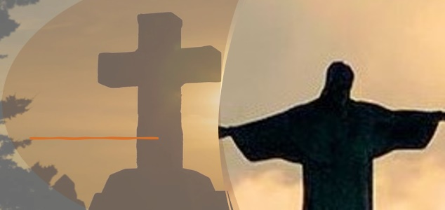
A Shocking Command - Acts 10:9–15 KJV
WELCOMING OTHERS IN CHRIST
9 On the morrow, as they went on their journey, and drew nigh unto the city, Peter went up upon the housetop to pray about the sixth hour:
10 And he became very hungry, and would have eaten: but while they made ready, he fell into a trance,
11 And saw heaven opened, and a certain vessel descending upon him, as it had been a great sheet knit at the four corners, and let down to the earth:
12 Wherein were all manner of fourfooted beasts of the earth, and wild beasts, and creeping things, and fowls of the air.
13 And there came a voice to him, Rise, Peter; kill, and eat.
14 But Peter said, Not so, Lord; for I have never eaten any thing that is common or unclean.
15 And the voice spake unto him again the second time, What God hath cleansed, that call not thou common.
The people feel as if God has been unfair.
God Peter is about to be met by messengers from a Roman centurion.
To prepare Peter to give a hospitable response, God gives him a vision.
While hungry, Peter sees a variety of creatures descending on a sheet from heaven.
Peter initially rejects the invitation to eat what appears unclean to him.
The voice from heaven challenges Peter not to reject what God has made clean.
is fair to each individual.
God is so merciful, in fact, that He shall make a new agreement with unfaithful people.
10
Notes:
><><><><><>><><><><><>><><
NIV Acts 10:9–15
9 About noon the following day as they were on their journey and approaching the city, Peter went up on the roof to pray.
10 He became hungry and wanted something to eat, and while the meal was being prepared, he fell into a trance.
11 He saw heaven opened and something like a large sheet being let down to earth by its four corners.
12 It contained all kinds of four-footed animals, as well as reptiles and birds.
13 Then a voice told him, “Get up, Peter. Kill and eat. ”
14 “Surely not, Lord!” Peter replied. “I have never eaten anything impure or unclean. ”
15 The voice spoke to him a second time, “Do not call anything impure that God has made clean. ”
><><><><><>><><><><><>><><
A Shocking Command
At the time of Peter’s vision, Cornelius’s trusted messengers were on their way to find him. God had been moved by Cornelius’s generosity to the poor and devout prayers, and God sent him a message about Christ (Acts 10:4–6). Cornelius was to meet Peter, but God needed to prepare Peter for was about to happen.
Peter is a man of action, with a strong sense of justice. It is Peter who leaps to Jesus’ defense and cuts off the ear of the servant of the high priest when Jesus is being arrested (John 18:10–11). One can easily imagine that the Holy Spirit (ever a gentle and good teacher) knows how difficult it will be for Peter to accept that the gospel is even for his Roman oppressors. To prepare Peter, God sends a vision.
It was noon, and Peter—an itinerant preacher traveling on foot— would be hungry. Two meals a day were normal in first-century Jewish culture, and the noon meal was often the first substantial food of the day. As a meal is being prepared, Peter goes up on the roof to pray and falls into a trance (v. 10).
He sees heaven opened, with a sheet descending, one filled with animals, reptiles, and birds—several creatures Jews were forbidden to consume according to the Sinai covenant (see Lev. 11:13–30). Then a voice comes from heaven, inviting Peter to eat from these animals (Acts 10:13).
Peter reacts with repulsion. As a devout Jew, he rejects food that is unclean. Eating it would make him ceremonially unclean—excluded from sacred spaces, needing to wash himself and his clothes, remaining unclean for a period of time (see Lev. 17:15–16).
But the voice rebukes Peter. The declaration raises the question, What is it that God has made clean? Peter—who has studied for years at the feet of a Lord who often used metaphors to describe the kingdom of God—realizes that this vision isn’t only about dietary laws. God is talking about people!
A Shocking Command
Main Idea
God used Peter’s vision to show that the gospel is for all people, even those previously considered unclean or outsiders.
Analysis
While Cornelius’s servants were traveling to find Peter, God prepared Peter through a vision. Cornelius, a Roman officer, had gained God’s attention through prayer and generosity, even though he was a Gentile. Peter, a devout Jew, had long followed strict dietary laws that separated Jews from Gentiles. In the vision, God commands Peter to eat animals considered unclean under Jewish law. Peter refuses, but God declares that what He has made clean should not be called unclean. The vision was not merely about food but about people—revealing that Gentiles were now included in God’s redemptive plan through Christ.
Three Key Points
1. God Prepared Peter for a Major Change
The vision challenged Peter’s long-held religious traditions and cultural assumptions.
2. The Vision Symbolized People, Not Just Food
God used the imagery of unclean animals to teach Peter that Gentiles were no longer excluded.
3. The Gospel Is for All People
God was preparing Peter to bring the message of Christ even to Roman Gentiles like Cornelius.
Three Life Lessons
1. God Sometimes Challenges Our Traditions
Believers must be willing to rethink cultural assumptions in light of God’s truth.
2. The Gospel Removes Barriers Between People
Christ calls His followers to welcome those who were once considered outsiders.
3. God Prepares Us for His Mission
Before sending believers to serve others, God often reshapes their hearts and perspectives.
Summary
God gave Peter a vision of animals considered unclean to challenge his understanding of purity and separation. Though Peter initially resisted, God revealed that the vision symbolized people rather than food. Through Christ, Gentiles were no longer excluded from God’s covenant community. This moment prepared Peter to share the gospel with Cornelius and marked a turning point in the church’s mission to reach all nations.
Points to Emphasize

Slide 11
Equality in Jesus - Acts 10:30-35; Galatians 3:28-29 KJV
WELCOMING OTHERS IN CHRIST
30 And Cornelius said, Four days ago I was fasting until this hour; and at the ninth hour I prayed in my house, and, behold, a man stood before me in bright clothing,
31 And said, Cornelius, thy prayer is heard, and thine alms are had in remembrance in the sight of God.
32 Send therefore to Joppa, and call hither Simon, whose surname is Peter; he is lodged in the house of one Simon a tanner by the sea side: who, when he cometh, shall speak unto thee.
33 Immediately therefore I sent to thee; and thou hast well done that thou art come. Now therefore are we all here present before God, to hear all things that are commanded thee of God.
34 Then Peter opened his mouth, and said, Of a truth I perceive that God is no respecter of persons:
35 But in every nation he that feareth him, and worketh righteousness, is accepted with him.
. . .
28 There is neither Jew nor Greek, there is neither bond nor free, there is neither male nor female: for ye are all one in Christ Jesus.
29 And if ye be Christ’s, then are ye Abraham’s seed, and heirs according to the promise.
Cornelius tells about a vision that he had, when an angel appeared to him.
The angel instructed Cornelius where Peter could be found.
When Peter sees a home of devout Gentiles who are eager to hear about Jesus, he is struck by God’s open invitation to all nations.
The apostle Paul writes of the same theological truth in his letter to the churches of Galatia.
God looks at people without favoritism, without a regard for whether they are Jewish or Gentile, slave or free, male or female.
11
Notes:
><><><><><>><><><><><>><><
Acts 10:30-35; Galatians 3:28-29 NIV
30 Cornelius answered: “Three days ago I was in my house praying at this hour, at three in the afternoon. Suddenly a man in shining clothes stood before me
31 and said, ‘Cornelius, God has heard your prayer and remembered your gifts to the poor.
32 Send to Joppa for Simon who is called Peter. He is a guest in the home of Simon the tanner, who lives by the sea. ’
33 So I sent for you immediately, and it was good of you to come. Now we are all here in the presence of God to listen to everything the Lord has commanded you to tell us. ”
34 Then Peter began to speak: “I now realize how true it is that God does not show favoritism
35 but accepts from every nation the one who fears him and does what is right.
. . .
28 There is neither Jew nor Gentile, neither slave nor free, nor is there male and female, for you are all one in Christ Jesus.
29 If you belong to Christ, then you are Abraham’s seed, and heirs according to the promise.
><><><><><>><><><><><>><><
Equality in Jesus
Cornelius’s story must have floored Peter. First of all, Peter learns that this was happening at the same time as his vision, which shows God’s hand. Secondly, “a man in shining clothes” (v. 30) is a description of angels (compare Luke 24:4; Acts 1:10). It would be shocking that a Gentile would be singled out for a visit from angels who declare, “God has heard your prayer” (v. 31). Cornelius’s role as a Roman centurion could make him responsible for quelling rebellions, upholding Rome’s violent control of Judea. Peter must have noticed the irony: a man from the very system that killed Jesus now stood before him saying, “We are all here . . . to listen” (Acts 10:33).
Meanwhile, the Jewish leaders felt threatened and were responding harshly to those who called Jesus the Messiah. Peter had already been arrested and flogged (Acts 4–5), and Stephen had been martyred (Acts 6–7). Some of the Jewish authorities were persecuting the messengers of the new covenant, while here a Roman commander was ready to hear.
Peter accepts this as God’s doing. He declares, “I now realize how true it is that God does not show favoritism but accepts from every nation the one who fears him and does what is right” (Acts 10:34–35). Paul echoes and expands this truth in Galatians, insisting that not only are Gentiles equal before God, but in God’s sight, there is “neither slave nor free, nor is there male and female” (Gal. 3:28). Ethnicity, class, and gender are not barriers to becoming God’s child.
For Peter and Paul, the Spirit is the great equalizer. If the Spirit had come upon Cornelius and his household, then they were already holy—living temples of God. And if every believer is a temple, then no ethnicity, social rank, or gender can give advantage in the kingdom of Jesus.
Equality in Jesus
Main Idea
In Christ, all people are equal before God, and the Holy Spirit confirms that believers from every nation belong fully to God’s family.
Analysis
Cornelius’s experience deeply challenged Peter’s expectations. A Roman centurion—part of the empire that oppressed Israel and crucified Jesus—received a visit from an angel and assurance that God had heard his prayers. At the same time, many Jewish leaders were persecuting followers of Christ. This contrast revealed that God’s grace was not limited by nationality or status. Peter realized that God accepts anyone who fears Him and seeks righteousness. Paul later reinforced this truth in Galatians, teaching that distinctions such as ethnicity, social class, and gender do not determine a person’s standing before God. The Holy Spirit unites all believers equally in Christ.
Three Key Points
1. God Shows No Favoritism
God accepts people from every nation who sincerely seek Him.
2. Jesus Removes Human Barriers
Ethnicity, class, and gender do not determine a person’s place in God’s kingdom.
3. The Holy Spirit Confirms Equality
The Spirit’s presence in believers proves that all are equally part of God’s family.
Three Life Lessons
1. Treat Every Person with Equal Respect
Every person has equal value before God.
2. Reject Spiritual Pride or Prejudice
No background, culture, or status gives anyone greater standing with God.
3. Celebrate Unity in the Church
The Holy Spirit brings believers from many backgrounds into one family.
Summary
Cornelius’s encounter with Peter revealed that God’s grace extends beyond traditional boundaries. Though Cornelius was a Roman centurion, God heard his prayers and prepared him to receive the gospel. Peter recognized that God does not show favoritism but welcomes people from every nation. Paul later affirmed that in Christ there is no division based on ethnicity, class, or gender. Through the Holy Spirit, all believers become equal members of God’s family and living temples of His presence.
Points to Emphasize

Slide 12
One Bible, One Story: Always the Plan
WELCOMING OTHERS IN CHRIST
From the beginning, God’s redemptive plan has extended to every nation, not only Israel. His covenant with Abraham promised “all peoples on earth will be blessed through you” (Gen. 12:3). The Old Testament offers glimpses of this—welcoming outsiders like Rahab and Ruth and proclaiming through Isaiah that “foreigners who bind themselves to the Lord . . . will be accepted” (Isa. 56:6–7). The prophet Joel foresaw a day when God would pour out His Spirit on “all people, sons and daughters, old and young, even servants” (Joel 2:28-29). Jesus anticipated this inclusion. He praised the faith of Gentiles, spoke with women as disciples, and declared, “I have other sheep that are not of this sheep pen . . . and there shall be one flock and one shepherd” (John 10:16). Jesus lived in the reality of the kingdom.
The boundaries of the early church’s worldview explode when the Spirit is poured out on Cornelius, a Roman centurion. What was foreshadowed in Scripture and in Jesus’ actions becomes reality for the church: God shows no favoritism, and His desire is to draw all people to Himself. In Christ, all are equal, beloved, and empowered members of one Spirit-filled family.
Notes:
One Bible, One Story — Always the Plan
Main Idea
From the beginning of Scripture, God’s plan has been to redeem people from every nation and unite them in one family through Christ.
Analysis
God’s plan of salvation was never limited to Israel alone. His covenant with Abraham promised that all nations would be blessed through his descendants. Throughout the Old Testament, God welcomed outsiders such as Rahab and Ruth and spoke through prophets like Isaiah and Joel about a future when people from every nation would worship Him and receive His Spirit. Jesus affirmed this vision during His ministry by praising the faith of Gentiles and declaring that there would be one flock under one shepherd. When the Holy Spirit came upon Cornelius and his household, the early church realized that God’s global plan had become a reality.
Three Key Points
1. God’s Plan Was Always Global
From Abraham onward, God intended to bless all nations.
2. Scripture Foreshadowed Inclusion
Prophets and historical accounts showed that Gentiles would be welcomed into God’s people.
3. Christ Fulfilled God’s Plan
Through Jesus and the gift of the Holy Spirit, believers from every nation became one family.
Three Life Lessons
1. God’s Heart Is for All People
Believers should care about reaching every nation and culture with the gospel.
2. Scripture Reveals One Unified Story
The entire Bible points toward God’s plan to redeem humanity through Christ.
3. Unity Reflects God’s Kingdom
The church should demonstrate the unity of people from diverse backgrounds.
Summary
The Bible tells one continuous story of God’s plan to redeem the world. Beginning with His promise to Abraham, Scripture reveals that God intended to bless all nations. The prophets foretold a time when people from every background would seek the Lord and receive His Spirit. Jesus demonstrated this inclusive kingdom during His ministry, and the outpouring of the Spirit on Cornelius confirmed it for the early church. Through Christ, people from every nation are welcomed into one Spirit-filled family under one Lord.

Slide 13

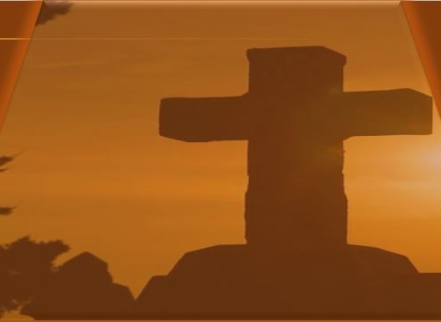
Apply the Message:
The Spirit leads us to welcome outsiders.
The Spirit Leads
WELCOMING OTHERS IN CHRIST
Peter’s encounter with Cornelius marks a powerful turning point in history. It is not only a story of one group of Gentiles receiving the gospel. It is a revelation of the heart of God, a revelation that God’s kingdom includes people from all backgrounds and contexts. For Peter—a devout Jew shaped by cultural memory and prejudice— a vision on the rooftop prepared him to change his assumptions about who is acceptable to God. God was expanding the new covenant to people without regard to whether they were Jews or Gentiles.
God had actually been preparing this moment for generations. From the promise to Abraham, to the words of the prophets, to Jesus’ ministry among outsiders, we see evidence of God’s intention all along. The same Spirit who came in power upon the Jewish believers at Pentecost was now filling Gentiles—even a Roman centurion, whose rank is a symbol of imperial power.
The fact that Peter could recognize Cornelius as a full member of God’s family speaks to the transforming work of the Holy Spirit—not only in Cornelius’s life, but also in Peter’s. Peter began to see others the way God does, as beloved by God and invited into the family without reservation. This truth is echoed in Paul’s bold declaration in Galatians 3:28. The limitless reach of the gospel levels human division. In Christ, our ethnicity, gender, or status does not determine power or significance any more than the size of our bank account or social media following.
The Spirit is still preparing us, forming one new people—beloved and equal in God’s eyes. We are all commanded to follow in the footsteps of our Lord, declaring the gospel to our enemies and setting aside worldly evaluations of one another.
Notes:
The Spirit Leads Us to Welcome Outsiders
Main Idea
The Holy Spirit transforms believers so they see others as God sees them and welcome all people into the family of Christ.
Analysis
Peter’s encounter with Cornelius reveals a turning point in the history of the church. Through a vision and the work of the Holy Spirit, Peter realized that God’s kingdom includes people from every nation. Cultural barriers that once separated Jews and Gentiles were removed through Christ. This moment fulfilled God’s long-standing promise to bless all nations, a promise seen throughout the Old Testament and in Jesus’ ministry. The Spirit not only transformed Cornelius’s life but also changed Peter’s perspective. As Paul later affirmed, the gospel removes human divisions. In Christ, believers become one unified family.
Three Key Points
1. The Holy Spirit Expands the Church
God’s kingdom includes people from every nation and background.
2. The Spirit Changes Our Perspective
Peter learned to see Gentiles the way God sees them—worthy of grace.
3. The Gospel Removes Human Divisions
Ethnicity, status, and social standing do not determine value in Christ.
Three Life Lessons
1. Welcome Those Who Seem Different
Believers should extend God’s love to people from every culture and background.
2. Allow the Spirit to Change Our Hearts
God often challenges our assumptions and prejudices.
3. Share the Gospel with Everyone
Christ calls believers to proclaim the good news even to those we might consider outsiders.
Summary
Peter’s meeting with Cornelius reveals how the Holy Spirit expands the church beyond cultural and ethnic boundaries. Through this event, Peter learned that God shows no favoritism and welcomes all who seek Him. This truth fulfilled God’s plan to bless all nations through Christ. The Spirit transformed both Cornelius and Peter, teaching that believers from every background are equal members of God’s family. Today, the Holy Spirit continues to lead Christians to welcome outsiders, reject human divisions, and proclaim the gospel to the world.
1 When has God slowly prepared you for something new?
Perhaps you received a raise at work, just before needing to move. Perhaps you developed a hobby or skill that turned out to be just what was needed in your community, but you didn’t discover that until years later. Maybe it has taken years to build up the courage and the closeness of relationship to share your testimony with a particular person.
2 What are some scriptural stories showing God’s inclusion?
Throughout the Bible, God extends a hand to foreigners. The Law of Moses requires fair treatment of non-Israelites (see Ex. 22:21; Lev. 19:33–34). Some exceptional examples are Rahab (Josh. 2), Naaman the Syrian (2 Kings 19), and Ruth.
3 Do you think that equality before God obliterates all distinctions? Why or why not?
Even though all are equal before God, we are not identical. God intends for His people to be diverse, representing all nations and backgrounds. For instance, we don’t give up everything that identifies us as male and female. The important idea is that categories that we might invent are not what will define our appearance to God (denominations, political parties, other markers of cultural currency).

Slide 14
Apply the Message:
The Spirit leads us to welcome outsiders.
The Spirit Leads
WELCOMING OTHERS IN CHRIST
1 When has God slowly prepared you for something new?
2 What are some scriptural stories showing God’s inclusion?
3 Do you think that equality before God obliterates all distinctions? Why or why not?
Notes:
The Spirit Leads Us to Welcome Outsiders
1 When has God slowly prepared you for something new?
Perhaps you received a raise at work, just before needing to move. Perhaps you developed a hobby or skill that turned out to be just what was needed in your community, but you didn’t discover that until years later. Maybe it has taken years to build up the courage and the closeness of relationship to share your testimony with a particular person.
2 What are some scriptural stories showing God’s inclusion?
Throughout the Bible, God extends a hand to foreigners. The Law of Moses requires fair treatment of non-Israelites (see Ex. 22:21; Lev. 19:33–34). Some exceptional examples are Rahab (Josh. 2), Naaman the Syrian (2 Kings 19), and Ruth.
3 Do you think that equality before God obliterates all distinctions? Why or why not?
Even though all are equal before God, we are not identical. God intends for His people to be diverse, representing all nations and backgrounds. For instance, we don’t give up everything that identifies us as male and female. The important idea is that categories that we might invent are not what will define our appearance to God (denominations, political parties, other markers of cultural currency).

Slide 15
Conclusion: Breaking Down Walls
WELCOMING OTHERS IN CHRIST
The account of Peter and Cornelius is the longest single narrative in the book of Acts. The length of the account highlights the importance of what their experiences represent: the acceptance of Gentiles into the new covenant.
While the Bible teaches that Jesus meant for the gospel to be shared with all people (Mark 16:15; Luke 24:47; Acts 1:8), the first-century church struggled to overcome divisions. They needed a reminder that anyone, through faith in Christ, could become a full member of God’s people. Today, new sources of division rear their ugly heads in the church. Christians argue and divide over politics, worship styles, and preaching preferences.
The events of Acts 10 show how Peter and Cornelius shifted their understanding and widened their acceptance of each other to achieve unity in Christ. God did not impose their cooperation but led them to conclusions that broke the cultural walls between them. Paul’s words in Galatians 3 emphasize the stripping away of divisive categories and focusing on the commonality that comes from faith in Christ Jesus. If we focus on Jesus and recognize that He alone is the Lord of the church, our divisions may melt away.
Notes:
Breaking Down Walls
Main Idea
Faith in Jesus Christ removes barriers between people and unites believers as one family in God’s kingdom.
Analysis
The story of Peter and Cornelius is the longest narrative in Acts because it marks a major turning point: the acceptance of Gentiles into the new covenant community. Although Jesus commanded that the gospel be shared with all nations, the early church struggled with cultural divisions between Jews and Gentiles. Through God’s guidance, Peter and Cornelius learned to accept one another as equal members of God’s people. This transformation illustrates how faith in Christ breaks down cultural, ethnic, and social barriers. Paul later emphasized the same truth in Galatians 3, teaching that unity in Christ removes the divisions that once separated people.
Three Key Points
1. Acts 10 Shows the Inclusion of Gentiles
Peter and Cornelius represent the breaking of long-standing cultural barriers.
2. The Early Church Struggled with Division
Even believers needed God’s guidance to accept people different from themselves.
3. Faith in Christ Creates True Unity
In Christ, believers share a common identity that transcends human differences.
Three Life Lessons
1. Focus on Christ, Not Differences
Unity grows when believers keep Jesus at the center.
2. Allow God to Change Our Attitudes
God can reshape our perspectives about others.
3. Work Toward Unity in the Church
Christians should resist divisions based on preferences or cultural differences.
Summary
The account of Peter and Cornelius demonstrates how God broke down the cultural barriers that separated Jews and Gentiles. Though Jesus commanded that the gospel be preached to all nations, the early church needed time to understand this truth. Through God’s guidance, Peter and Cornelius came to accept one another as fellow members of God’s family. Paul later reinforced this message, teaching that faith in Christ removes divisions. When believers focus on Jesus as the Lord of the church, the walls that divide people can be replaced with unity in Christ.

Slide 16
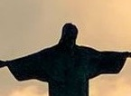
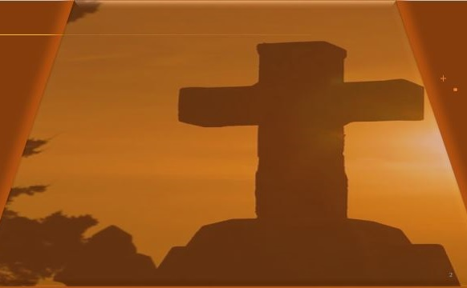
Live It Out: Observe others with an attitude of welcome.
WELCOMING OTHERS IN CHRIST
We do not have to go it alone. God is with us, bringing the right people into our proximity to hear and to engage with the gospel message. Our job is to prepare to step into these opportunities with courage and charity for all of the different experiences that disciples of Jesus bring. The invitation in this final week before Easter is to plan a deliberate time of “prayer in public,” to give God the opportunity to reshape our expectations.
The Gospel for All People
The good news of Jesus is available to everyone: those who look and act like us and those who are vastly different. This week, you are invited to a silent reflection before God, and it only requires that you put yourself in a position to see others. While you are in a public area (a park, shopping mall, airport, etc. ), allow extra time for people watching. As people pass—various ages, nationalities, and backgrounds—pray these words. Feel free to record any observations as you pray.
16
Notes:
Live It Out
Main Idea
Believers should intentionally welcome others and share the gospel, trusting that God places people in our lives for His purpose.
Analysis
God continues to guide believers to people who need to hear the gospel. Just as Peter encountered Cornelius through God’s direction, Christians today are placed in environments where they can interact with people from many backgrounds. Instead of withdrawing or judging others, believers should approach people with compassion, humility, and openness. A simple act such as prayer in a public place can help believers develop awareness of the diverse people God loves. By observing others with a welcoming attitude and praying for them, Christians allow the Holy Spirit to reshape their perspective and prepare them to share Christ’s message with everyone.
Three Key Points
1. God Places People in Our Path
Opportunities to share the gospel often come through everyday encounters.
2. The Gospel Is for Everyone
People of every age, culture, and background are invited to receive Christ.
3. Prayer Prepares the Heart for Ministry
Praying for others helps believers develop compassion and awareness.
Three Life Lessons
1. Approach Others with Compassion
See people as individuals loved by God rather than strangers or outsiders.
2. Be Ready to Share the Gospel
God may use ordinary moments to create meaningful spiritual conversations.
3. Pray for People You Encounter
Prayer opens our hearts to God’s mission and deepens our concern for others.
Summary
God invites believers to observe others with a welcoming spirit and recognize that the gospel is meant for everyone. Just as God brought Peter and Cornelius together, He continues to place people in our paths today. By praying in public spaces and reflecting on the diverse lives around us, Christians can grow in compassion and readiness to share the good news of Jesus with all people.

Slide 17
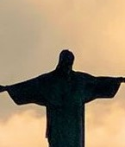
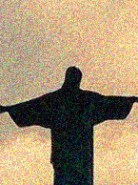



  The Lord bless thee, and keep thee:
  The Lord make his face shine upon thee, and be gracious unto thee:
  The Lord lift up his countenance upon thee and give thee peace.
  - Numbers 6:24-26,
Material adapted by Stanford W. Bowman Jr. from Echoes® Adult and Bible-in-Life® Adult Spring 2026 quarter with permission, © David C Cook, https://davidccook.org. May not be further reproduced. All rights reserved.

Slide 18
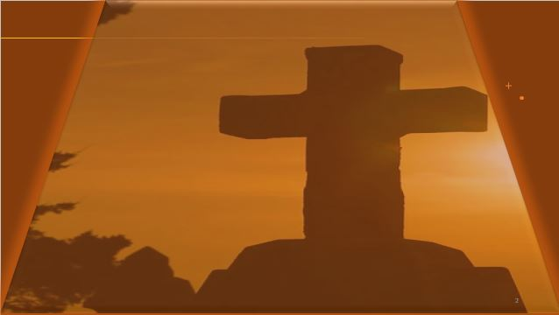
QUESTION & ANSWER
A Shocking Command
1 Is there a group of people that your church community might struggle to include?
2 Why do you think God uses this roundabout way to tell Peter His plan? Wouldn’t it have just been easier to come right out and say it?
3 What else do you notice about the phrase “that God has made clean” (v. 15)?
WELCOMING OTHERS IN CHRIST
It’s easy to miss groups of people, even those closest to us. Perhaps we are challenged to meet the needs of the neighborhood, despite outreach programs. Or, perhaps we find it easiest to attract new people of a particular stage of faith.
God chooses to give Peter a powerful vision that would have been shocking to a devout Jew. God was about to reveal something that would be even more shocking, and this vision prepared Peter to respond with welcome and hospitality.
God is free to cleanse what He wills. Clean doesn’t apply only to food, does it? Even though God is showing Peter food, the thrust of these words will only become clear when Peter is in the presence of Gentiles who have been redeemed by God, without becoming Jews.
Notes:
1 Is there a group of people that your church community might struggle to include?
It’s easy to miss groups of people, even those closest to us. Perhaps we are challenged to meet the needs of the neighborhood, despite outreach programs. Or, perhaps we find it easiest to attract new people of a particular stage of faith.
2 Why do you think God uses this roundabout way to tell Peter His plan? Wouldn’t it have just been easier to come right out and say it?
God chooses to give Peter a powerful vision that would have been shocking to a devout Jew. God was about to reveal something that would be even more shocking, and this vision prepared Peter to respond with welcome and hospitality.
3 What else do you notice about the phrase “that God has made clean” (v. 15)?
God is free to cleanse what He wills. Clean doesn’t apply only to food, does it? Even though God is showing Peter food, the thrust of these words will only become clear when Peter is in the presence of Gentiles who have been redeemed by God, without becoming Jews.

Slide 19
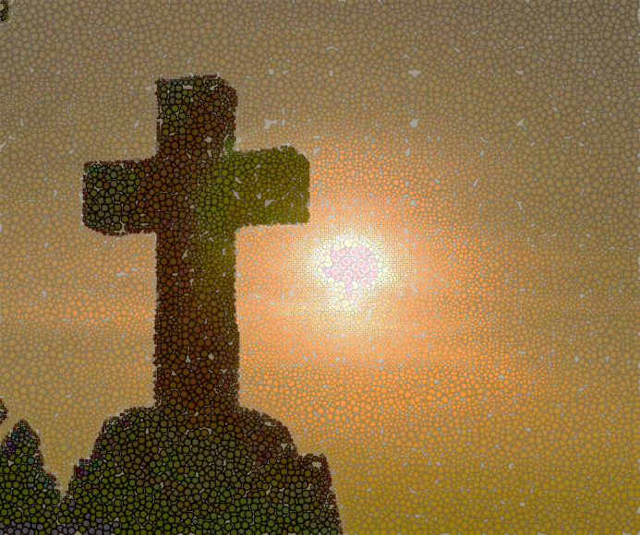
QUESTION & ANSWER
A New Covenant
WELCOMING OTHERS IN CHRIST
1 Why do you think God mentions Cornelius’s
gifts to the poor?
As we learned in Lesson 2, our generosity with one another is relevant to God, since it displays love in action. It stands out that Cornelius is living in a way that reflects God’s generosity, even before his receipt of the Spirit and the good news of Jesus. Cornelius was caring for the people in his community and selflessly giving what he had.
2 What does Cornelius’s declaration, “We are all here in the presence of God to listen,” signal about him as a person (Acts 10:35)?
Cornelius was faithful, even in his limited knowledge. He was ready to listen and learn about the salvation that is available through Jesus. Many Christians have had the experience of bringing the gospel to “fertile ground,” meaning people whose hearts God has softened and sensitized in advance. Like the believers in Acts, God gives His messengers today the words to say.
Notes:
1 Why do you think God mentions Cornelius’s gifts to the poor?
As we learned in Lesson 2, our generosity with one another is relevant to God, since it displays love in action. It stands out that Cornelius is living in a way that reflects God’s generosity, even before his receipt of the Spirit and the good news of Jesus. Cornelius was caring for the people in his community and selflessly giving what he had.
2 What does Cornelius’s declaration, “We are all here in the presence of God to listen,” signal about him as a person (Acts 10:35)?
Cornelius was faithful, even in his limited knowledge. He was ready to listen and learn about the salvation that is available through Jesus. Many Christians have had the experience of bringing the gospel to “fertile ground,” meaning people whose hearts God has softened and sensitized in advance. Like the believers in Acts, God gives His messengers today the words to say.

Slide 20
  The Lord bless thee, and keep thee:
  The Lord make his face shine upon thee, and be gracious unto thee:
  The Lord lift up his countenance upon thee and give thee peace.
  - Numbers 6:24-26,
Material adapted by Stanford W. Bowman Jr. from Echoes® Adult and Bible-in-Life® Adult Spring 2026 quarter with permission, © David C Cook, https://davidccook.org. May not be further reproduced. All rights reserved.

