Slide 1
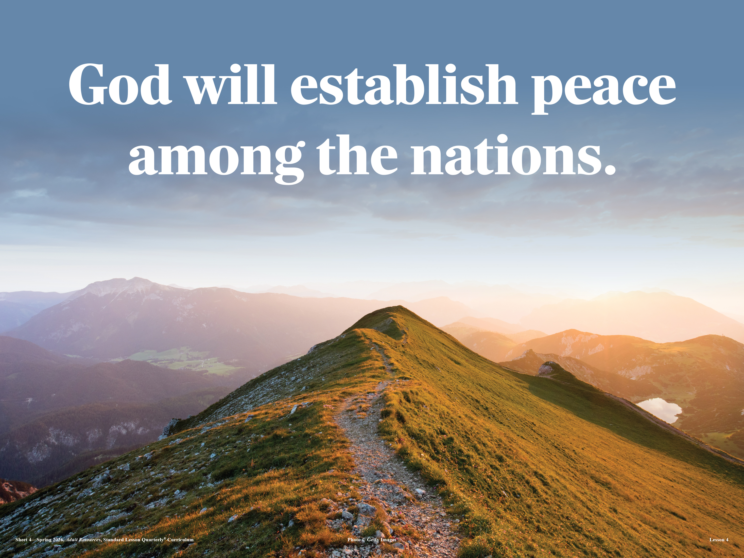
Waiting for God’s Peace
  Many peoples will come and say, “Come, let us go up to the mountain of the Lord, to the temple of the God of Jacob. He will teach us his ways, so that we may walk in his paths. ” The law will go out from Zion, the word of the Lord from Jerusalem.
  —Isaiah 2:3 NIV
Week of March 29
Notes:
The Bible presents one unified story of God’s plan to bring peace to a broken world. From Isaiah’s prophecy to Paul’s preaching in Athens, Scripture reveals that God rules over all nations and desires all people to know Him. Though sin has caused division and conflict, God’s redemptive plan through Jesus Christ ensures that peace will ultimately be restored.

Slide 2

  Prayer
Lord God, we pray for peace among the nations. Work among the nations through us, God, to move them toward peace and toward You. May they seek Your face. In Jesus’ name we pray. Amen.
    Thought to Remember
      Nations will find peace only when they find God.
Notes:
Prayer
Lord God, we pray for peace among the nations. Work among the nations through us, God, to move them toward peace and toward You. May they seek Your face. In Jesus’ name we pray. Amen.
Thought to Remember
Nations will find peace only when they find God.

Slide 3
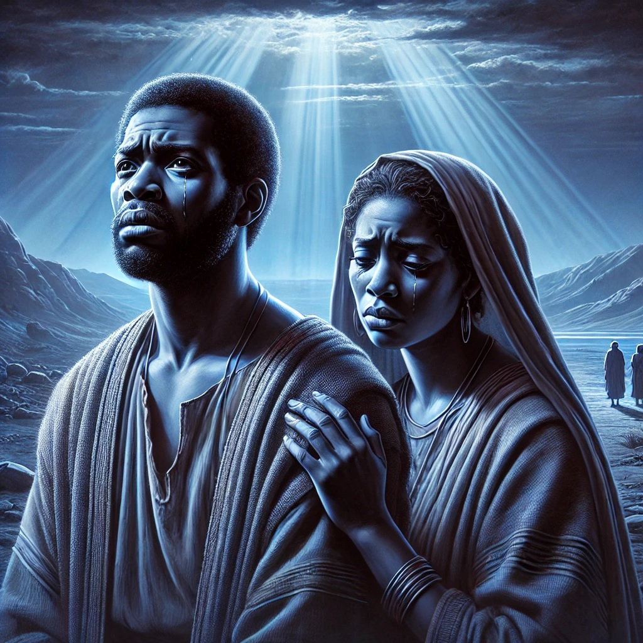
LESSON OUTLINE
Waiting for God’s Peace
Lesson Scripture: Isaiah 2:2–4; Acts 17:26–28
Lesson Focus: God will bring peace to all nations.
      Introduction
      Review
      Lesson Context
      Overview
        The Mountain of God - Isaiah 2:2–4 NIV
        God’s Desire for the Nations - Acts 17:26–28 NIV
      Conclusion
      Question & Answers
3
Notes:
The Mountain of God - Isaiah 2:2–4 NIV
God’s Desire for the Nations - Acts 17:26–28 NIV
=====================================
God sovereignly rules over all nations and desires all people to seek Him. Isaiah reveals a future kingdom where nations unite under God’s truth, experiencing peace and righteousness. Acts teaches that all humanity comes from one source, lives by God’s power, and is called into relationship with Him. Together, these passages show God’s plan is both universal and redemptive—bringing all people into His kingdom through Christ, with the church called to proclaim this truth to every nation.
Isaiah 2:2–4
Analysis
Isaiah prophesies a future where the “mountain of the Lord’s house” is exalted above all nations. People from every nation will come to learn God’s ways. God Himself will judge among them, bringing justice and peace. Weapons of war will be transformed into tools for productivity, symbolizing the end of conflict and the reign of divine righteousness.
Summary
God promises a future kingdom where all nations are united under His authority. This kingdom is marked by peace, justice, and obedience to God’s truth. Human conflict is replaced by harmony, and God’s Word becomes the guiding standard for all people.
Commentary
From a Baptist perspective, this points to both Christ’s present spiritual kingdom and its future fulfillment. Jesus is the center of this gathering (John 12:32). The transformation from war to peace reflects the power of the gospel to change hearts. The church now serves as a preview of this kingdom, calling all people to salvation and discipleship. This aligns with God’s redemptive plan to include all nations .
Acts 17:26–28
Analysis
Paul teaches that God created all nations from one blood and determined their times and boundaries. His purpose is that people would seek Him. God is not distant; He is near to every person. Paul affirms that all humanity lives, moves, and exists in God, emphasizing dependence upon Him.
Summary
God is sovereign over all humanity and history. Every person and nation exists by His design. His desire is that all people seek Him and come into relationship with Him, recognizing their complete dependence on Him for life.
Commentary
This passage affirms God’s universal sovereignty and human unity. There are no superior nations—all are created by God. Salvation is offered to all through Christ. Paul confronts human pride and calls for repentance
(Acts 17:30). In Baptist theology, this supports missions and evangelism: since all people are made by God and for God, the gospel must be proclaimed to every nation. This aligns with the church’s mission empowered by the Spirit to reach the world .

Slide 4
CONCLUSION
Waiting for God’s Peace
Support Scripture for Lesson - Week of March 30 through April 4
► John 14:1–4—Many Dwellings in the Father’s House.
► 1 Thessalonians 4:13–18—Encouraging Words of Hope.
► Job 19:23–27—I Know That My Redeemer Lives.
► Isaiah 26:12–19—Awake and Sing for Joy.
► Psalm 118:15–24—Give Thanks to the Lord.
► 1 Corinthians 15:13–20—Christ Is Risen from the Dead.
God gives believers a living hope that overcomes suffering, death, and uncertainty through Christ. These scriptures collectively teach that the believer’s hope is secure in God’s promises—eternal life, resurrection, and victory through Jesus Christ. Whether facing grief, suffering, or uncertainty, we are called to trust God, remain faithful, and rejoice in His salvation. The lesson is clear: because Christ lives and will return, we can live with confidence, endure trials with hope, and give thanks knowing our future with God is certain.
4
Notes:
God gives believers a living hope that overcomes suffering, death, and uncertainty through Christ. These scriptures collectively teach that the believer’s hope is secure in God’s promises—eternal life, resurrection, and victory through Jesus Christ. Whether facing grief, suffering, or uncertainty, we are called to trust God, remain faithful, and rejoice in His salvation. The lesson is clear: because Christ lives and will return, we can live with confidence, endure trials with hope, and give thanks knowing our future with God is certain.
John 14:1–4 — Many Dwellings in the Father’s House
Analysis
Jesus comforts His disciples before His departure, calling them to trust in God and in Him. He reveals that He is preparing a place for them in the Father’s house and will return to receive them. This affirms both His divine authority and the certainty of eternal life.
Summary
Jesus promises believers a prepared place in heaven and assures His return to bring them to be with Him.
Commentary
This passage emphasizes Christ as the only way to eternal life (v.6 context). In Baptist theology, salvation secures a future home with God. The believer’s hope rests not in this world, but in Christ’s promise and return.
1 Thessalonians 4:13–18 — Encouraging Words of Hope
Analysis
Paul addresses grief over deceased believers, teaching that those in Christ will rise first at His return. The living will be caught up with them to meet the Lord. This reveals the resurrection and the rapture as sources of hope.
Summary
Believers who have died will be raised, and all Christians will be united with Christ forever.
Commentary
This passage brings comfort grounded in resurrection truth. Death is not the end for believers. It calls the church to encourage one another with the assurance of Christ’s return and eternal reunion.
Job 19:23–27 — I Know That My Redeemer Lives
Analysis
In suffering, Job declares unwavering faith that his Redeemer lives and that he will see God personally. This reflects deep confidence in vindication beyond present affliction.
Summary
Even in suffering, Job trusts that he will ultimately see God and be redeemed.
Commentary
Job’s confession foreshadows Christ, the living Redeemer. It teaches that true faith endures suffering with hope in future restoration and personal fellowship with God.
Isaiah 26:12–19 — Awake and Sing for Joy
Analysis
Isaiah proclaims God as the source of peace and victory. He speaks of resurrection hope, declaring that the dead will live again and rise to joy.
Summary
God promises peace now and resurrection life in the future.
Commentary
This passage points to God’s ultimate victory over death. It reinforces that life beyond the grave is certain for God’s people, encouraging perseverance and trust.
Psalm 118:15–24 — Give Thanks to the Lord
Analysis
The psalm celebrates God’s deliverance, victory, and steadfast love. It acknowledges that the Lord is the source of salvation and joy.
Summary
God brings victory and salvation, leading His people to rejoice and give thanks.
Commentary
Often connected to Christ (v.22), this passage highlights God’s saving power. Believers respond with gratitude, recognizing that victory comes from the Lord alone.

Slide 5
LESSON INTRODUCTION
Yearning for Peace
Throughout history, war is a constant reality. Examples of conflict are not hard to find; you can pick any century. In modern times, many of us grow weary of seeing headlines about wars and threats of war on a regular basis. We live in a world that is often gripped by terrorism and violence. Nevertheless, most people desire peace. We yearn for it. But how can such peace arrive? Where will it come from?
The Bible tells us that true, lasting peace will only come from God. The total peace He promises has two aspects. The first is peace between us and God. The second is peace between humans, nations, and people groups. The first aspect has already been achieved through Jesus (Romans 5:1). This week, our Scripture texts reveal the path toward the second aspect.
Waiting for God’s Peace
5
Notes:
Isaiah 2:2–4 & Acts 17:26–28
Analysis
Both passages reveal God’s sovereignty over nations and His redemptive purpose for humanity. Isaiah presents a future kingdom where all nations gather to learn God’s ways and live in peace. Acts affirms that God created all people, determines their existence, and desires that they seek Him. Together, they show that history is not random—God is directing it toward a unified, righteous kingdom centered in truth and relationship with Him.
Summary
God rules over all nations and created all people to seek Him. His ultimate plan is to unite humanity under His authority, bringing peace, justice, and truth through His kingdom.
Main Idea
God sovereignly guides all nations and invites all people into His peaceful, truth-centered kingdom through Christ.
Three Key Points
God Controls Nations – He determines times, boundaries, and history.
God Invites All People – Every nation is called to seek and know Him.
God Establishes Peace – His kingdom replaces conflict with righteousness.
Three Life Lessons
Seek God Personally – You were created to know Him (Acts 17:27).
Trust God’s Sovereignty – Even global events are under His control.
Promote Peace and Truth – Live as a reflection of God’s coming kingdom.

Slide 6
Out from Jerusalem
Like “the word of the Lord [going out] from Jerusalem” (v. 3), the New Testament talks about the spread of the gospel, beginning at Jerusalem and reaching the nations. After His resurrection, Jesus explains, “Repentance for the forgiveness of sins will be preached in [the Messiah’s] name to all nations, beginning at Jerusalem” (Luke 24:47). Jesus’ commission in Acts 1:8 also sees the good news starting in Jerusalem, but expanding to the ends of the earth. This expansion plays out in the book of Acts, including during Paul’s missionary work in Athens. Ultimately, it is the good news about Jesus—who He is and what He has accomplished— that draws all nations to worship the God of Jacob, making a way for them to live as God’s redeemed
Hills and High Places
In the ancient near east, mountains and hills held religious and political significance. For example, capital cities were often built in topographically high locations, giving them a strategic advantage against enemies and a symbolic air of importance. Moreover, temples were typically located at the highest point of a city. This was true in Jerusalem, which was built at a higher elevation than its surroundings, so that people always had to travel up to the city.
Babylonian and Assyrian literature envision their great cities and temples elevated among the nations. But Isaiah 2:2 makes the political and religious claim that all rival kingdoms and gods will someday shrink away before Yahweh and the great mountain of the Lord’s temple. We should imagine that these inferior “hills” include the high places, with altars to foreign gods. Whenever Israel strayed from Yahweh and went after foreign gods, their leaders would worship at these alternative high places. But in the last days, God’s restored people (including all nations), will acknowledge and worship God for who He really is.
Waiting for God’s Peace
6
Notes:
Out from Jerusalem
God’s plan is to spread the gospel from Jerusalem to all nations. The gospel begins in Jerusalem and spreads to the entire world, calling all people to repentance and salvation through Jesus Christ.
Three Key Points
The gospel has a clear starting point—Jerusalem.
The mission expands globally to all nations.
Jesus is the message that draws people to God.
Three Life Lessons
Share the gospel where you are first.
Support missions beyond your local community.
Christ is the center of all true worship.
Analysis
This section shows the fulfillment of Isaiah 2:3 through the spread of the gospel. The message of salvation begins in Jerusalem and extends outward to all nations, as commanded by Christ (Luke 24:47; Acts 1:8). The book of Acts demonstrates this movement, especially through Paul’s ministry. The gospel is the means by which all nations are drawn to God, fulfilling His redemptive plan.
=============================
Hills and High Places
God alone will be exalted above all false gods and earthly powers. All false systems of power and worship will be brought low as God alone is exalted and worshiped by all nations.
Three Key Points
High places symbolized power and false worship.
Human systems cannot rival God’s authority.
God’s kingdom will ultimately prevail.
Three Life Lessons
Remove idols from your life.
Do not trust worldly power over God.
Worship God alone in truth.
Analysis
This section explains the cultural and spiritual significance of elevated places in the ancient world. Nations viewed their high places as symbols of power and religious authority. Isaiah declares that all these will be humbled before God’s kingdom. False worship and idolatry will be replaced by true worship of Yahweh, as all nations recognize His supremacy.

Slide 7
Paul’s Philosopher-Rivals
Paul resolved to preach in the marketplace and not only the synagogue. In the marketplace, Paul encountered a mixing pot of people and ideas. Paul’s preaching led him to debate with Epicurean and Stoic philosophers (see Acts 17:18). These two groups are different from each other, which only highlights the number of competing opinions in Athens. Epicureans taught that fulfillment comes through the pursuit of pleasure in moderation, while avoiding pain and suffering. They considered the gods as mostly uninvolved in human life. Ancient Stoics, on the other hand, believed that fulfillment comes by accepting fate. They encouraged quiet endurance of pain. Together they took Paul to the meeting of the Areopagus, a council named after their original meeting place at the Hill of Ares (Mars Hill).
Waiting for God’s Peace
7
Notes:
Paul’s Philosopher-Rivals
The gospel confronts and surpasses all human philosophies. Paul shares the gospel in a culture filled with competing ideas, showing that Christ is the true answer to life’s deepest questions.
Three Key Points
Many worldviews compete for truth.
Human wisdom is incomplete without God.
The gospel must engage culture directly.
Three Life Lessons
Be prepared to defend your faith.
Engage culture without compromising truth.
True fulfillment is found only in God.
Analysis
Paul enters a culture filled with competing philosophies. Epicureans and Stoics represent different views of life—pleasure versus endurance—but both lack true knowledge of God. Paul engages them in the marketplace and at the Areopagus, bringing the gospel into intellectual and cultural spaces. This reflects the church’s mission to confront all worldviews with truth.

Slide 8
LESSON CONTEXT
Waiting for God’s Peace
Paul and Socrates
Scholars sometimes draw parallels between Paul and Socrates, suggesting that Luke (the author of Acts) is intentionally highlighting parallels to commend Paul as an ideal philosopher for Greek readers. Socrates died in Athens about 450 years before Paul arrived. Like Paul, he was accused of “advocating foreign gods” (see Acts 17:18), leading to the “corruption of the youth. ” It was viewed as a threat to fail to honor the pantheon of deities in Athens. Like Paul, Socrates was taken before the Areopagus, where he also gave a speech. Socrates’ trial led to his imprisonment and eventual death, by drinking poisonous hemlock.
Paul’s case ends with a different outcome. The meeting of the Areopagus in Acts 17 seems less official than the trial of Socrates. Paul’s audience appears more open to hearing and collecting new ideas, rather than condemning or punishing Paul. This reflects the altered cultural situation in Athens during the first century.
8
Notes:
4. Paul and Socrates
God preserves and advances His truth even in challenging environments Paul boldly proclaims truth in a philosophical setting, and God allows the message to be heard rather than silenced.
Main Idea
.
Three Key Points
Truth may be challenged but must be proclaimed.
God controls outcomes, not man.
The gospel stands firm in any culture.
Three Life Lessons
Speak truth with boldness and wisdom.
Trust God with the results.
Remain faithful even in opposition.
Analysis
This section compares Paul with Socrates, highlighting similarities in their defense of truth before the Areopagus. Both were accused of introducing new ideas, yet Paul’s message centers on the living God and resurrection. Unlike Socrates, Paul is not condemned, reflecting a cultural openness and God’s providence in advancing the gospel.

Slide 9
LESSON CONTEXT
Waiting for God’s Peace
Isaiah 2 comes on the heels of an indictment against Judah and Jerusalem for their unfaithfulness to God. Nonetheless, Isaiah 2:2–4 gives a glimpse of what will happen at the far end of history, revealing that God’s redemptive purposes will prevail as He restores Jerusalem and brings peace to the nations.
The second reading, Acts 17:26–28, is when the apostle Paul is preaching in Athens, during his missionary work around the Aegean Sea. His Greek audience is curious, desiring new ideas. Paul proclaims that all nations are seeking after the one true God—now revealed in Jesus.
ISAIAH IN JUDAH
Isaiah began prophesying at the end of the reign of Uzziah, king of Judah, in about 740 BC (Isaiah 1:1; 6:1). During Isaiah’s lifetime, the kingdom of Judah faced threats from within and without. Whether the danger came from war with the massive Assyrian Empire (7:17) or injustice and violence within Judah itself (1:21–23), the future of its capital, Jerusalem, was uncertain.
The beginning of the book of Isaiah warns Judah against an even deeper conflict: a war of rebellion that the people were waging against God. The people of Jerusalem led lives filled with unrighteousness, idolatry, and oppression; the once “faithful city” had become a “harlot” (Isaiah 1:21). Isaiah explains that the Judeans will have no peace with other nations or among their own people until they first accept God’s terms of peace. Thus, Isaiah calls Judah to repent (1:16–17). Amid promises of fearsome judgment, however, Isaiah also announces a message of hope: Jerusalem would once again become a “city of righteousness” through God’s redeeming work (1:26–27). The first of today’s texts (which has a parallel in Micah 4:1–3) picks up on this theme.
9
Notes:
Paul in Athens
On his second missionary journey (AD 52–54), Paul traveled through the region of Macedonia (modern-day northern Greece). During this journey, he planted churches in the cities of Philippi and Thessalonica (Acts 16:6–15; 17:1–9). Due to persecution in Thessalonica, Paul fled to Athens, some 300 miles to the south (17:14–15).
As Paul walked around Athens, he became distressed by all the city’s idolatry (Acts 17:16). He responded by engaging fellow Jews, God-fearing Gentiles, and others in conversation about Jesus. Paul’s teaching drew the attention of local philosophers, who invited him to speak at the Areopagus, the space in which the city’s political council met (17:19). The Areopagus council likely had authority over which religious teachings were allowed into the city. These men had a rich knowledge of Greek philosophy but almost no familiarity with Hebrew Scripture. Today’s passage comes as Paul addresses this new, highly educated audience with the gospel.
Isaiah’s message reveals that Judah’s greatest problem was not political danger but spiritual rebellion against God. Though judgment was deserved because of sin, idolatry, and injustice, God promised restoration, righteousness, and peace if the people repented. This prophetic hope points forward to God’s greater redemptive plan. In Acts 17, Paul proclaims that fulfillment in Athens, declaring that the one true God created all nations and now calls all people to seek Him through Jesus Christ. Together, these contexts show a unified truth: God confronts sin, calls for repentance, and extends salvation beyond Israel to all nations. His plan moves from judgment to redemption, from Jerusalem to the world. Believers are called to trust God’s sovereign plan, live in repentance, and boldly share the gospel across all cultures.
Lesson Context
Analysis
Isaiah addresses Judah’s sin while revealing God’s future restoration and global peace. Though judgment is deserved, God’s redemptive plan will prevail. Acts 17 shows Paul proclaiming this fulfillment—God as Creator of all nations and Savior through Christ—to a Gentile audience. Together, the passages connect prophecy and fulfillment: God calls His people to repentance while extending salvation to all nations through the gospel.
Summary
Though Judah was unfaithful, God promised restoration and peace. This promise is fulfilled as the gospel reaches all nations through Christ.
Main Idea
God’s redemptive plan overcomes sin and extends salvation to all nations through Christ.
Three Key Points
God judges sin but promises restoration.
Prophecy in Isaiah is fulfilled through the gospel.
Salvation is for all people, not one nation.
Three Life Lessons
Repentance is necessary for peace with God.
Trust God’s plan even in difficult times.
Share the gospel with all people.
Isaiah in Judah
Analysis
Isaiah ministers during political instability and spiritual rebellion. Judah faces external threats and internal corruption, but their greatest problem is sin against God. The people’s idolatry and injustice separate them from peace. Yet God offers hope—restoration and righteousness—if they repent. Judgment and grace are held together, showing God’s holiness and mercy.
Summary
Judah’s greatest danger was sin, not enemies. God calls them to repentance and promises restoration through His grace.
Main Idea
True peace comes only through repentance and restoration with God.
Three Key Points
Sin leads to judgment and instability.
External problems reflect internal rebellion.
God offers restoration through repentance.
Three Life Lessons
Address spiritual issues before external ones.
Turn from sin to receive God’s peace.
God’s mercy is available even after failure.
Context: Paul in Athens
Analysis
Paul enters a highly intellectual but idolatrous culture. Troubled by widespread idol worship, he engages people in discussion and proclaims the true God. His message introduces a personal Creator who desires relationship with humanity. Speaking at the Areopagus, Paul bridges cultural gaps to present the gospel to those unfamiliar with Scripture.
Summary
Paul boldly shares the gospel in an idolatrous, intellectual culture, revealing the true God to those seeking truth.
Main Idea
The gospel must be clearly presented to all cultures, regardless of their beliefs.
Three Key Points
Culture may be intelligent yet spiritually blind.
The gospel confronts idolatry.
God desires all people to know Him.
Three Life Lessons
Engage culture with truth, not fear.
Do not be intimidated by intellectual opposition.
Always point people to the one true God.

Slide 10
LESSON CONTEXT
Isaiah 2 comes on the heels of an indictment against Judah and Jerusalem for their unfaithfulness to God. Nonetheless, Isaiah 2:2–4 gives a glimpse of what will happen at the far end of history, revealing that God’s redemptive purposes will prevail as He restores Jerusalem and brings peace to the nations.
The second reading, Acts 17:26–28, is when the apostle Paul is preaching in Athens, during his missionary work around the Aegean Sea. His Greek audience is curious, desiring new ideas. Paul proclaims that all nations are seeking after the one true God—now revealed in Jesus.
PAUL IN ATHENS
On his second missionary journey (AD 52–54), Paul traveled through the region of Macedonia (modern-day northern Greece). During this journey, he planted churches in the cities of Philippi and Thessalonica (Acts 16:6–15; 17:1–9). Due to persecution in Thessalonica, Paul fled to Athens, some 300 miles to the south (17:14–15).
As Paul walked around Athens, he became distressed by all the city’s idolatry (Acts 17:16). He responded by engaging fellow Jews, God-fearing Gentiles, and others in conversation about Jesus. Paul’s teaching drew the attention of local philosophers, who invited him to speak at the Areopagus, the space in which the city’s political council met (17:19). The Areopagus council likely had authority over which religious teachings were allowed into the city. These men had a rich knowledge of Greek philosophy but almost no familiarity with Hebrew Scripture. Today’s passage comes as Paul addresses this new, highly educated audience with the gospel.
Isaiah’s message reveals that Judah’s greatest problem was not political danger but spiritual rebellion against God. Though judgment was deserved because of sin, idolatry, and injustice, God promised restoration, righteousness, and peace if the people repented. This prophetic hope points forward to God’s greater redemptive plan. In Acts 17, Paul proclaims that fulfillment in Athens, declaring that the one true God created all nations and now calls all people to seek Him through Jesus Christ. Together, these contexts show a unified truth: God confronts sin, calls for repentance, and extends salvation beyond Israel to all nations. His plan moves from judgment to redemption, from Jerusalem to the world. Believers are called to trust God’s sovereign plan, live in repentance, and boldly share the gospel across all cultures.
Waiting for God’s Peace
10
Notes:
Lesson Context
Analysis
Isaiah addresses Judah’s sin while revealing God’s future restoration and global peace. Though judgment is deserved, God’s redemptive plan will prevail. Acts 17 shows Paul proclaiming this fulfillment—God as Creator of all nations and Savior through Christ—to a Gentile audience. Together, the passages connect prophecy and fulfillment: God calls His people to repentance while extending salvation to all nations through the gospel.
Summary
Though Judah was unfaithful, God promised restoration and peace. This promise is fulfilled as the gospel reaches all nations through Christ.
Main Idea
God’s redemptive plan overcomes sin and extends salvation to all nations through Christ.
Three Key Points
God judges sin but promises restoration.
Prophecy in Isaiah is fulfilled through the gospel.
Salvation is for all people, not one nation.
Three Life Lessons
Repentance is necessary for peace with God.
Trust God’s plan even in difficult times.
Share the gospel with all people.
Isaiah in Judah
Analysis
Isaiah ministers during political instability and spiritual rebellion. Judah faces external threats and internal corruption, but their greatest problem is sin against God. The people’s idolatry and injustice separate them from peace. Yet God offers hope—restoration and righteousness—if they repent. Judgment and grace are held together, showing God’s holiness and mercy.
Summary
Judah’s greatest danger was sin, not enemies. God calls them to repentance and promises restoration through His grace.
Main Idea
True peace comes only through repentance and restoration with God.
Three Key Points
Sin leads to judgment and instability.
External problems reflect internal rebellion.
God offers restoration through repentance.
Three Life Lessons
Address spiritual issues before external ones.
Turn from sin to receive God’s peace.
God’s mercy is available even after failure.
Context: Paul in Athens
Analysis
Paul enters a highly intellectual but idolatrous culture. Troubled by widespread idol worship, he engages people in discussion and proclaims the true God. His message introduces a personal Creator who desires relationship with humanity. Speaking at the Areopagus, Paul bridges cultural gaps to present the gospel to those unfamiliar with Scripture.
Summary
Paul boldly shares the gospel in an idolatrous, intellectual culture, revealing the true God to those seeking truth.
Main Idea
The gospel must be clearly presented to all cultures, regardless of their beliefs.
Three Key Points
Culture may be intelligent yet spiritually blind.
The gospel confronts idolatry.
God desires all people to know Him.
Three Life Lessons
Engage culture with truth, not fear.
Do not be intimidated by intellectual opposition.
Always point people to the one true God.

Slide 11
LESSON OVERVIEW
Waiting for God’s Peace
The Mountain of God - Isaiah 2:2–4 NIV
2 In the last days the mountain of the Lord’s temple will be established as the highest of the mountains; it will be exalted above the hills, and all nations will stream to it.
3 Many peoples will come and say, “Come, let us go up to the mountain of the Lord, to the temple of the God of Jacob. He will teach us his ways, so that we may walk in his paths. ” The law will go out from Zion, the word of the Lord from Jerusalem.
4 He will judge between the nations and will settle disputes for many peoples. They will beat their swords into plowshares and their spears into pruning hooks. Nation will not take up sword against nation, nor will they train for war anymore.
These words are for “the last days,” when God’s forever kingdom is revealed.
Judah’s capital of Jerusalem, with its temple to the one true God becomes center to all the world.
All people will come to worship Yahweh, as Lord of all the earth. They will want to learn God’s ways.
God will be a fair judge to these nations, giving them confidence in abiding peace.
People will have no need for weapons any longer.
Tools that were once used to harm and to kill will be refashioned into useful tools to grow food.
11
Notes:
><><><><><><><><><><><><><><><><><
NIV Isaiah 2:2–4
Isaiah 2:2-4
Common English Bible
² In the days to come
the mountain of the Lord’s house
will be the highest of the mountains.
It will be lifted above the hills;
peoples will stream to it.
³ Many nations will go and say,
“Come, let’s go up to the Lord’s mountain,
to the house of Jacob’s God
so that he may teach us his ways
and we may walk in God’s paths.”
Instruction will come from Zion;
the Lord’s word from Jerusalem.
⁴ God will judge between the nations,
and settle disputes of mighty nations.
Then they will beat their swords into iron plows
and their spears into pruning tools.
Nation will not take up sword against nation;
they will no longer learn how to make war.
><><><><><><><><><><><><><><><><><
The Mountain of God
Isaiah—God’s prophet to the nation of Judah—envisions restoration, not only for his people, but for all nations. It exceeds what God’s people might naturally expect. Isaiah writes, “The mountain of the Lord’s temple will be established as the highest of the mountains” (Isa. 2:2), meaning it will be recognized for its enduring importance. Rival hills—representing rival kingdoms and their gods— shrink away to nothing. All will see the true God for who He is: the center of Israel’s worship, which will become the center of the whole world. The nations will come to worship Yahweh, “streaming” to the place of His presence, like a flowing river.
Isaiah reveals that many will long to be part of God’s people, going up to His mountain and to “the temple of the God of Jacob” (Isa. 2:3). Jacob had inherited the promises God made to Abraham and Isaac that God would make Abraham’s family into a great nation and bless all people through his family (see Gen. 12:1–3). From Jacob came the twelve tribes of Israel, who inherited God’s covenant after being rescued from slavery in Egypt. Isaiah 2 reveals that the nations will come to embrace the God of Jacob and be included in the Lord’s tribe. People from all nations will become a part of God’s people. They will come with the purpose of learning God’s ways and walking in His paths. This will result in the law—the word of the Lord—going forth from exalted Zion, borne by the nations to spread throughout the earth.
In verse 4, Isaiah speaks of God as the righteous judge who will bring peace to the nations as they submit to Him. He will “settle disputes for many peoples” (Isa. 2:4). As a result, the nations will put away war and violence against one another, turning their pointless weapons into useful tools for farming.
Here, “plowshares” refers to the metal tip of a plow used to break up dirt or dig a furrow for planting (v. 4). The shards of broken swords would serve this purpose well. Similarly, the head of a spear can be fashioned into a curved knife for pruning. The transformation of weapons into tools means the ground will no longer be covered with the blood of violence, but cultivated for the good of earth’s inhabitants. The nations will no longer need to “train for war” (Isa. 2:4), since God brings a lasting, abiding peace.
The Mountain of God
Analysis
Isaiah presents a prophetic vision of God’s ultimate kingdom where He is exalted above all nations and false systems. The “mountain of the Lord” symbolizes God’s supreme authority and presence. Nations will abandon idols and come to worship Yahweh, fulfilling the Abrahamic promise that all peoples will be blessed. This kingdom is marked by obedience to God’s Word and global peace, where conflict is replaced with productivity. God, as righteous Judge, establishes lasting peace. This vision points forward to Christ’s kingdom, where salvation extends to all nations and transforms hearts and societies.
Summary
God will establish His kingdom above all others, drawing all nations to worship Him, learn His ways, and live in peace under His righteous rule.
Main Idea
God’s kingdom will be exalted above all, bringing all nations into true worship, obedience, and lasting peace.
Three Key Points
God’s Supremacy – All rival powers and false gods will be humbled.
Global Inclusion – People from every nation will become part of God’s people.
Peace Through God’s Rule – War will cease as God establishes righteousness.
Three Life Lessons
Exalt God Above All – Remove anything that competes with God in your life.
Pursue God’s Ways – Commit to learning and living by His Word.
Be an Agent of Peace – Reflect God’s kingdom by promoting peace and righteousness.
Points to Emphasize
Read Isaiah 2:2–4, and note the following:

Slide 12
LESSON OVERVIEW
Waiting for God’s Peace
God’s Desire for the Nations - Acts 17:26–28 NIV
26 From one man he made all the nations, that they should inhabit the whole earth; and he marked out their appointed times in history and the boundaries of their lands.
27 God did this so that they would seek him and perhaps reach out for him and find him, though he is not far from any one of us.
28 ‘For in him we live and move and have our being. ’ As some of your own poets have said, ‘We are his offspring. ’
The context is early in the era of the church, where the apostle Paul is preaching a defense of his faith in the city of Athens.
Paul knows the Greek poets and important sources, but he applies a distinctively Jewish and Christian interpretation to their meaning.
Paul says that God is Creator and Father for all, and He is the one in sovereign control of the nations.
God is near to all people, and God wants all people to come to Him.
12
Notes:
><><><><><><><><><><><><><><><><><
NIV Acts 17:26–28
Acts 17:26-28
Common English Bible
²⁶ From one person God created every human nation to live on the whole earth, having determined their appointed times and the boundaries of their lands. ²⁷ God made the nations so they would seek him, perhaps even reach out to him and find him. In fact, God isn’t far away from any of us. ²⁸ In God we live, move, and exist. As some of your own poets said, ‘We are his offspring.’
><><><><><><><><><><><><><><><><><
God’s Desire for the Nations
Acts 17:26–28 finds Paul in the midst of a speech in the city of Athens— where residents fashion themselves to be educated and intellectual, open to all of the latest ideas. What a place to give a sermon! The Areopagus is where all of the best teachers and philosophers would come to speak, and Paul had inflamed opposition by debating Greek philosophers, who accused him of “advocating foreign gods” (Acts 17:18), a serious offence. Still, the Athenians seem curious.
As a springboard for his words, Paul mentions an altar he has seen, “to an unknown god” (Acts 17:23). Seizing upon this show of religious devotion, Paul says that he is not so much advocating foreign gods as he is proclaiming the one, true God who the Athenians are ignorant of—the Creator who is Lord of heaven and earth (Acts 17:24). In verse 26, he proclaims that all nations are a result of God’s creative work and intention. Moreover, God is over them and their leaders as their rightful Lord. Throughout history, nations rise, expand, and fall—all according to the will of God.
In verse 27, Paul conveys God’s intention by appointing times and boundaries for the nations. Paul says, “God did this so that they would seek Him” (Acts 17:27). Yet the seeking is not without difficulty. According to Paul, those seeking can “perhaps reach out for him and find him” (Acts 17:27). This language conveys the idea of groping in the dark. Paul reassures the gathered crowd, “[God] is not far from any one of us” (Acts 17:27). It explains Paul’s mission, for it is tragic when God is not known by men and women who might be seekers. The city of Athens was full of idols and competing religious ideas (see Acts 17:16, 18). The true God remained unknown to them, obscured by pagan beliefs. Paul desperately wants the people of Athens to know the truth of the gospel, which is not only for Jews, but for all nations.
As he continues, Paul appeals to literary sources that would be familiar to his Greek audience. He shows that he has studied their poets and religious ideas, not only his Jewish Scriptures. Since the words of famous philosophers and poets carry weight for his audience, he quotes what serves his argument. This does not amount to wholesale approval for everything these writers say, but Paul knows that all truth is God’s truth. In other words, if something is wise and true, it belongs to God—no matter the source.
In verse 28, Paul says about God, “For in him we live and move and have our being. ” He is actually quoting a line from the Cretan philosopher, Epimenides. Paul uses it to argue that all people owe their existence to the Creator—the “unknown God” who is in entirely knowable. Paul adds the poetic phrase, “We are his offspring” (Acts 17:28), originally attributed to the Stoic philosopher Aratus. Aratus wrote the phrase in a poem to Zeus—the right idea about the wrong deity! Paul makes the phrase point back to the true Creator, for all nations are from His creative design.
God’s Desire for the Nations (Acts 17:26–28)
Analysis
Paul addresses an intellectual yet spiritually blind culture, using their altar to an “unknown god” to reveal the true Creator. He teaches that God made all nations, governs history, and desires that people seek Him. Though humanity struggles in spiritual darkness, God is near and knowable. Paul wisely connects truth from their culture to point them to the living God, showing that all existence depends on Him.
Summary
God created and governs all nations so that people would seek Him, and though many are spiritually blind, He is near and desires to be known through truth.
Main Idea
God sovereignly created all people and desires that every nation seek, know, and worship Him.
Three Key Points
God Created All Nations – Every people group exists by His design.
God Directs History – Times and boundaries are under His control.
God Desires Relationship – He is near and wants all to seek Him.
Three Life Lessons
Seek God Intentionally – Do not remain spiritually unaware when God is near.
Recognize God’s Sovereignty – Trust His control over your life and the world.
Share Truth Wisely – Use understanding of culture to point others to Christ.
Points to Emphasize
Read Acts 17:26–28, and note the following:

Slide 13
One Bible, One Story
Waiting for God’s Peace
Jesus and the Blessing of All Nations
Jesus made a way for the salvation of the nations and the peace of God’s kingdom rule. He is the suffering servant of Isaiah, the one who would not only restore the tribes of Jacob but become a light to the Gentiles, so that God’s salvation might reach to the ends of the earth (see Isa. 49:6). Simeon, the righteous Jew who was waiting for the consolation of Israel, praises God when he meets the infant Jesus, saying, “My eyes have seen your salvation, which you have prepared in the sight of all nations: a light for revelation to the Gentiles, and the glory of your people Israel”
(Luke 2:30–32). Moved by the Spirit, Simeon recognizes that, in Jesus, God fulfills His covenant promises. The blessing of all peoples through Abraham’s family is fulfilled through Jesus, a descendant of Abraham (see Gen. 12:3; Matt. 1:1–17; Gal. 3:7–14). His death broke the power of sin, making way for Jew and Gentile alike to be part of God’s forever family. Jesus made real the promise of Isaiah 2:2–4. It is confirmed in the vision of Revelation 7:9–10, where a multitude “from every nation, tribe, people and language” stands before the throne of God and the Lamb, in worship.
13
Notes:
One Bible, One Story — Jesus and the Blessing of All Nations
Jesus is the fulfillment of God’s plan to bring salvation and unity to all nations. Jesus fulfills God’s promise by bringing salvation to all nations, uniting people everywhere into one family through His redemptive work.
.Three Key Points
Promise Fulfilled in Christ – Jesus fulfills God’s covenant with Abraham.
Salvation for All People – Both Jews and Gentiles are included.
Global Worship Realized – All nations will worship God through Christ.
Three Life Lessons
Trust in Christ Alone – He is the only way to salvation.
Embrace Unity in Christ – All believers are one family.
Live with a Global Vision – Support and participate in God’s mission to reach all nations.
Analysis
This passage connects the entire biblical narrative, showing Jesus as the fulfillment of God’s promise to bless all nations through Abraham. He is the suffering servant (Isaiah 49:6) and the light to the Gentiles, bringing salvation beyond Israel. Simeon’s testimony confirms that Jesus is God’s revealed salvation for all people. Through His death, Christ removes the barrier of sin, uniting Jew and Gentile into one family. This fulfills Isaiah’s vision and culminates in Revelation’s picture of global worship.

Slide 14
LESSON OVERVIEW
Waiting for God’s Peace
Apply the Message: We live in the gap before God’s peace has been realized.
Longing for Peace
“Hey dad, do you know about the attacks of September 11?” My son was sitting in the kitchen reading a children’s history book. Oh boy, I thought, I wonder what a kid’s book says on that topic.
I stopped washing the dishes. “Yeah,” I said, “I remember when it happened. It was a pretty big deal. ”
As we talked, I was trying to figure out how much he already knew. Kids grow and pick up all kinds of knowledge about how dark the world can be; but my heart as a dad thinks, Not yet. He doesn’t need to know just yet.
“Wasn’t there something about Afghanistan?” he asked, and I explained that many countries went to war after the attacks.
“Are there wars going on today?” he asked. “What are they about?”
I remember I said something clumsy about “land disputes,” but then kind of trailed off. What I really wanted to say was, War is terrible, violence begets violence, but someday God will make it all right. Blessed are the peacemakers, for they will be called children of God.
But before I could open my mouth, my son had already moved on. He was roaming the house in search of his next game or adventure. I turned back to the dishes. I felt myself longing for peace, the way people sometimes do at Christmas or when they hear a song imagining a better world.
Can such longings be realized? Do prayers for peace get stuck in the ceiling, or do they reach the ears of someone who can actually bring peace to the nations? Scripture teaches that Jesus’ death and resurrection changes everything. The kingdom of God has good news for the nations! If we could only glimpse the end of history, we would see an abiding peace.
14
Notes:
Believers live between present brokenness and future peace, trusting Christ’s promise while longing for His perfect kingdom. Though the world is filled with conflict, believers have hope because Christ has secured peace, which will be fully realized in the future.
Three Key Points
The World Is Broken – Conflict and suffering are real and ongoing.
Peace Is Promised – Christ has secured ultimate peace through His work.
Hope Sustains Us – God’s future peace gives meaning to present struggles.
Three Life Lessons
Hold Onto Hope – Trust God even when peace seems distant.
Speak Truth with Wisdom – Share hope appropriately in a broken world.
Live as Peacemakers – Reflect God’s coming peace in daily life.
Analysis
This reflection captures the tension of living in a broken world while longing for God’s promised peace. Human conflict, seen even through a child’s questions, reveals the depth of sin and suffering. Yet Scripture affirms that peace is not an illusion—Christ’s death and resurrection have already secured it, though its fullness awaits His return. This “gap” calls believers to trust God’s promise and live as witnesses of His coming kingdom.

Slide 15
LESSON OVERVIEW
Waiting for God’s Peace
Apply the Message: We live in the gap before God’s peace has been realized.
Longing for Peace
  1 How do you answer a question like, “What causes war and conflict in the world today?”
  2 What is the last event that made you long for peace?
  3 How can followers of Jesus share a message of peace for the nations?
15
Notes:
1 How do you answer a question like, “What causes war and conflict in the world today?”
This is a hard question, but one we need to think about from a Christian perspective. We live in a world where rulers push for more and more, where violence is still around us. One thing that all believers can say is that war will come to an end; violence will one day end. God alone is able to bring this blessed future to reality.
2 What is the last event that made you long for peace?
Participants might share about historical events like wars or terrorist attacks, or perhaps even family arguments or local community disputes. Some might share about personal experience serving in the military or in a war zone. Some might share regrets over times they sought division or harm over peace.
3 How can followers of Jesus share a message of peace for the nations?
Like Paul, followers of Jesus today can spread the good news about Jesus, the resurrection, and the kingdom of God. Followers of Jesus can seek to live at peace with others and find ways to promote peace in the face of conflict and violence.

Slide 16
CONCLUSION:
Promised Peace
Waiting for God’s Peace
  When we suffer, or see others suffering, from the devastating effects of conflicts between nations, any hope for lasting peace may seem unrealistic. Christians might be tempted to imagine that God has left the nations to fend for themselves. But today’s texts tell a different story.
  The Lord promises in Isaiah 2:2–4 that, eventually, people will end their conflicts with each other when they embrace His ways. Peace between humanity and God will ultimately result in peace between nations. Christians can rest assured that peace has been established between God and people through Jesus Christ (Romans 5:1; 2 Peter 3:14). Yet while God’s reign of peace has begun, it is not yet fully complete. Until Jesus returns, there will always be wrongs to make right in the world. As His disciples, we are called to be peacemakers (Matthew 5:9; James 3:18). Through Christ’s power, the church can be a shining example of peace in the world, starting within our own relationships. We must seek to live peaceably with everyone as far as it depends on us to do so (Romans 12:18). By leading the way in peacemaking, the church can truly be a light to the nations.
  Although conflicts sometimes appear too deep to heal, Acts 17:24–26 reminds us that God has made each of these different groups for the purpose of seeking Him. Like Paul before the Areopagus council, we can use these differences as a launchpad to share the hope of the gospel.
  One day, people from every nation and region, from every ethnic group and language, will stand before the throne of God and enjoy God’s peace (Revelation 7:9–12). This will happen when God renews all things, and the new heaven and new earth appear (21:1–4). Finally, all the kingdoms of this world will become one kingdom in our Lord.
16
Notes:
God has established peace through Christ and calls His people to live as peacemakers until His perfect peace is fully revealed. God promises ultimate peace among nations through Christ. While not fully realized yet, believers are called to live as peacemakers and reflect God’s coming kingdom.
Three Key Points
Peace Begins with God – Reconciliation with God leads to peace among people.
Peace Is Present but Incomplete – Christ has begun it; His return will complete it.
The Church Models Peace – Believers are called to demonstrate God’s peace now.
Three Life Lessons
Pursue Peace Actively – Live peaceably with others (Romans 12:18).
Trust God’s Final Victory – Lasting peace will come through Christ.
Be a Witness of Peace – Let your life reflect God’s kingdom to the world.
Analysis
This passage affirms that despite present conflict, God has not abandoned the nations. Isaiah promises future global peace through submission to God’s rule. Through Christ, peace with God is already established, though not yet fully realized in the world. Believers live in the “already but not yet,” called to reflect God’s peace now. Acts reminds us all nations were created to seek God, and Revelation assures final unity and peace. The church serves as God’s instrument of peace, demonstrating His kingdom in a broken world.

Slide 17
CONCLUSION
Waiting for God’s Peace
Live It Out: Pray for peace in response to the news.
Peace Forevermore
In a world where conflict and violence are ever-present, the anticipation of a new heaven and new earth, marked by eternal peace, is an incredible promise.
It is not up to us to “solve” all the problems that beset the world. The nations don’t always feel like they are inching closer to submission to God and worship of Jesus, do they? But we are Christ’s witnesses, wherever we go. We can pray for peace without it seeming foolish or too improbable. Christians seek peace because they know it is what God holds out for our collective future.
17
Notes:
Live It Out — Pray for Peace
Analysis
This section emphasizes faithful living in light of God’s promised peace. Though the world remains filled with conflict, believers are not responsible for fixing every problem but are called to witness and pray. Prayer aligns our hearts with God’s future reality—eternal peace in the new creation. Even when peace seems distant, it is not unrealistic because it is grounded in God’s promise. The church lives with confidence that God will ultimately fulfill His plan.
Summary
Believers are called to pray for peace and live as witnesses, trusting God to ultimately bring eternal peace.
Main Idea
Christians live in hope of God’s promised peace, expressing that hope through prayer and faithful witness.
Three Key Points
God Promises Eternal Peace – A new heaven and earth will be free from conflict.
We Are Not the Savior – God alone brings ultimate restoration.
Prayer Is Our Response – We actively seek peace through prayer and witness.
Three Life Lessons
Pray Consistently for Peace – Trust God to work beyond what you can see.
Rest in God’s Sovereignty – You are called to faithfulness, not control.
Live as a Witness – Reflect hope and peace wherever you go.

Slide 18
  Prayer
Lord God,
We look around our world and are heartbroken over the way people fight one another. You are the God of peace. Not only have you made peace between us and You through the blood of Your Son, but You are establishing a kingdom of peace that we will enjoy with You forever. We can’t wait for that day! But until then, help us to be peacemakers in our homes, workplaces, schools, and communities. Amen.

Slide 19



End
  The Lord bless thee, and keep thee:
  The Lord make his face shine upon thee, and be gracious unto thee:
  The Lord lift up his countenance upon thee and give thee peace.
  - Numbers 6:24-26,
Material adapted by Stanford W. Bowman Jr. from Echoes® Adult and Bible-in-Life® Adult Spring 2026 quarter with permission, © David C Cook, https://davidccook.org. May not be further reproduced. All rights reserved.

Slide 20
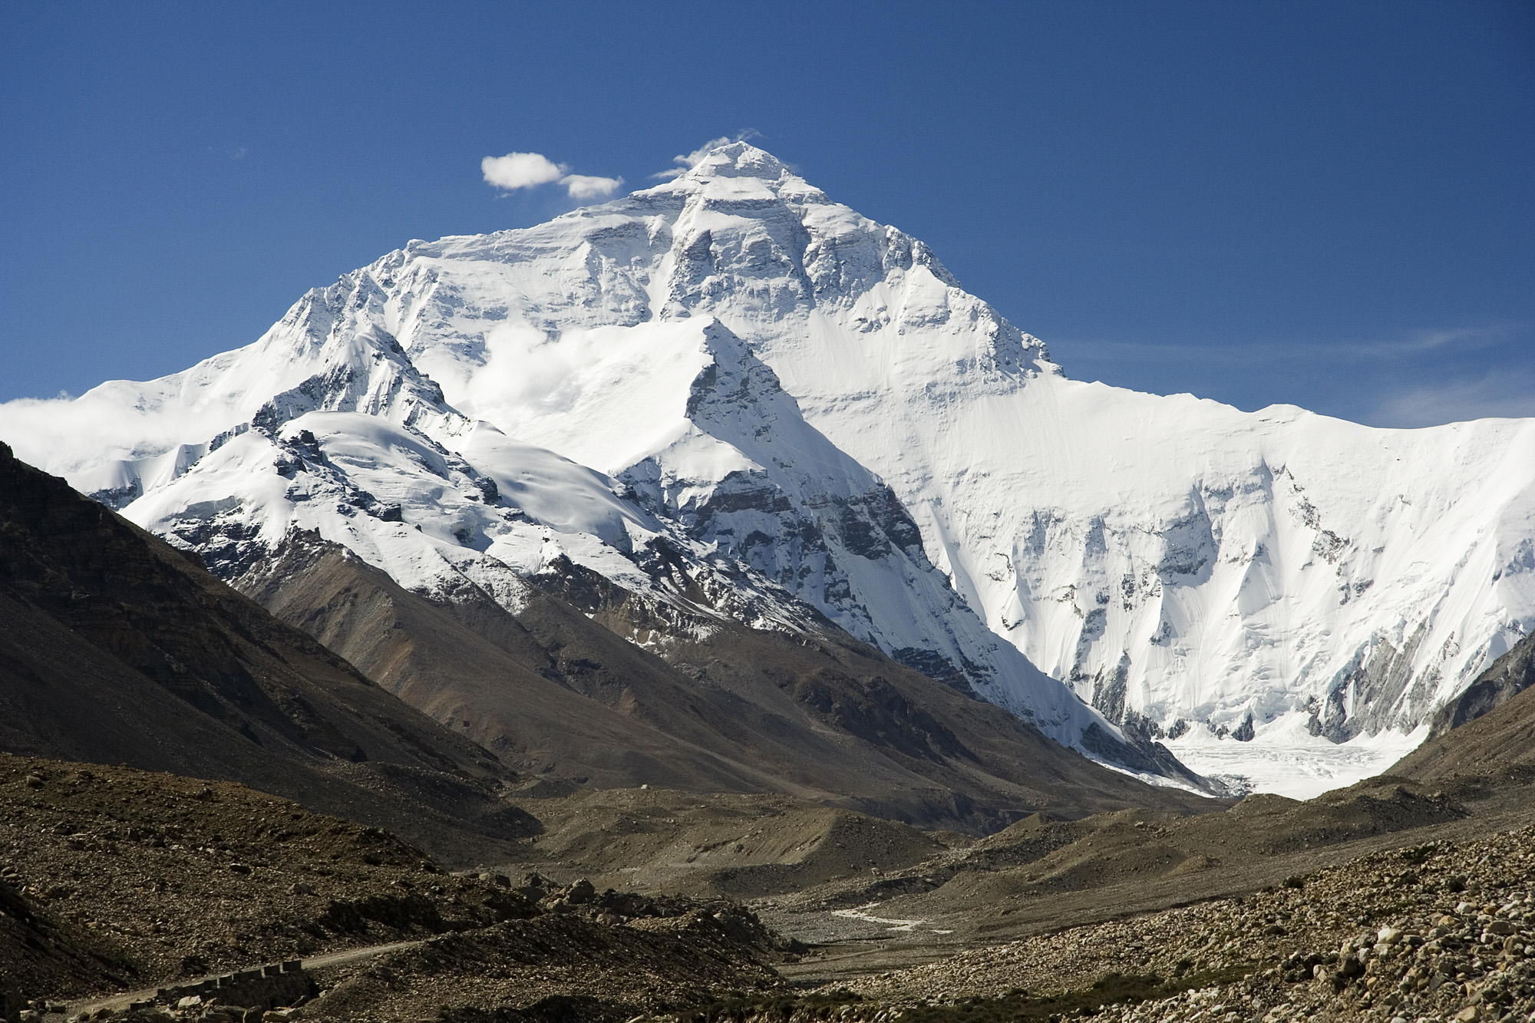
Lesson Focus: Don’t restrict the Gospel with needless rules and traditions.
Life Response: Identify examples of unbiblical rules that may needlessly restrict the Gospel today.
QUESTION & ANSWER
Waiting for God’s Peace
The Mountain of God
1 What does it mean for God’s mountain to be established as the highest?
2 How are these verses related to God’s promise to bless the nations through Abraham?
3 What will happen when people from all nations turn to the true God?
The exaltation of the mountain of the Lord’s temple means that the true God will be seen and worshiped for who He is. It also means His kingdom will endure. Rival kingdoms and false gods will shrink in relevance and give way to God’s rightful rule over all the earth.
They show that God’s promise will be fulfilled. People from all nations will come to be part of Yahweh’s tribe, worshiping and submitting to the law of the God of Jacob.
The word or message of the Lord will spread throughout the earth, and He will bring peace to the nations. The nations will no longer train for war. Even former weapons will be transformed into useful, agricultural tools.
20
Notes:
The Mountain of God
1 What does it mean for God’s mountain to be established as the highest?
The exaltation of the mountain of the Lord’s temple means that the true God will be seen and worshiped for who He is. It also means His kingdom will endure. Rival kingdoms and false gods will shrink in relevance and give way to God’s rightful rule over all the earth.
2 How are these verses related to God’s promise to bless the nations through Abraham?
They show that God’s promise will be fulfilled. People from all nations will come to be part of Yahweh’s tribe, worshiping and submitting to the law of the God of Jacob.
3 What will happen when people from all nations turn to the true God?
The word or message of the Lord will spread throughout the earth, and He will bring peace to the nations. The nations will no longer train for war. Even former weapons will be transformed into useful, agricultural tools.

Slide 21
Lesson Focus: Don’t restrict the Gospel with needless rules and traditions.
Life Response: Identify examples of unbiblical rules that may needlessly restrict the Gospel today.
QUESTION & ANSWER
Waiting for God’s Peace
God’s Desire for the Nations
1 What is God’s desire for people of all nations?
2 Given that God is always near, what keeps some people from finding Him?
3 What can we learn from Paul’s strategy of quoting sources familiar to the Athenians?
God desires that all people seek Him, turning away from false gods and wayward ideas, recognizing Him as the true God—the one who has set boundaries on all.
We hear the noise of competing ideas, or the distraction of entertainment and endless information. Some people have cultural experience that obscures truths about God. Frankly, some people have no interest in seeking the one God or in submitting to His ways.
Paul’s seizes on the idea that all truth is God’s truth. It is possible to proclaim the gospel by using sources familiar to any audience. For example, a popular movie or song might reflect a common human longing for contentment or peace. A Christian who shares the good news today can validate that longing, explaining that it points to God and can only be satisfied in relationship with Jesus.
21
Notes:
God’s Desire for the Nations
1 What is God’s desire for people of all nations?
God desires that all people seek Him, turning away from false gods and wayward ideas, recognizing Him as the true God—the one who has set boundaries on all.
2 Given that God is always near, what keeps some people from finding Him?
We hear the noise of competing ideas, or the distraction of entertainment and endless information. Some people have cultural experience that obscures truths about God. Frankly, some people have no interest in seeking the one God or in submitting to His ways.
3 What can we learn from Paul’s strategy of quoting sources familiar to the Athenians?
Paul’s seizes on the idea that all truth is God’s truth. It is possible to proclaim the gospel by using sources familiar to any audience. For example, a popular movie or song might reflect a common human longing for contentment or peace. A Christian who shares the good news today can validate that longing, explaining that it points to God and can only be satisfied in relationship with Jesus.

Slide 22
End
  The Lord bless thee, and keep thee:
  The Lord make his face shine upon thee, and be gracious unto thee:
  The Lord lift up his countenance upon thee and give thee peace.
  - Numbers 6:24-26,
Material adapted by Stanford W. Bowman Jr. from Echoes® Adult and Bible-in-Life® Adult Spring 2026 quarter with permission, © David C Cook, https://davidccook.org. May not be further reproduced. All rights reserved.

