Slide 1

CHILDREN GIFT AND MODEL
Truly I tell you, anyone who will not receive the kingdom of God like a little child will never enter it.
—Mark 10:15 NIV
Week of April 19

Slide 2

Prayer
Heavenly Father, we thank You for welcoming us into Your kingdom as You welcomed the little children. Teach us to depend on You as a child depends on an adult. In Jesus’ name we pray. Amen.
Thought to Remember
The kingdom of God belongs to the childlike.
Notes:
Prayer
Heavenly Father, we thank You for welcoming us into Your kingdom as You welcomed the little children. Teach us to depend on You as a child depends on an adult. In Jesus’ name we pray. Amen.
Thought to Remember The kingdom of God belongs to the childlike.

Slide 3

LESSON OUTLINE
CHILDREN GIFT AND MODEL
Lesson Scripture: Mark 9:36–37, 42; 10:13–16
LESSON FOCUS: Come to Christ with the wonder of a child.
Apply the Message: We can trust God without inhibition, like children.
Live It Out: Review childhood memories that spur us to wonder.
Review
Introduction
Lesson Context
Overview
Welcoming the Children - Mark 9:36–37, 42 NIV
Blessing the Children - Mark 10:13–16 NIV
Conclusion
Question & Answers
Notes:
Welcoming the Children - Mark 9:36–37, 42 NIV
Blessing the Children - Mark 10:13–16 NIV
=-=-=-=-=-=-=-=-=-=-=-=-=-=
Jesus teaches that true greatness in God’s kingdom is marked by humility, receiving the lowly, and protecting the faith of others. Welcoming a child reflects welcoming Christ Himself, while causing believers to stumble brings serious judgment. Christ shows that the kingdom belongs to those with childlike faith—simple trust, dependence, and sincerity. Together, these passages reveal God’s heart: He values humility over status, guards the vulnerable, and graciously welcomes all who come to Him in genuine faith, reminding us to live responsibly and love others as representatives of Christ.
Mark 9:36–37 — Receiving a Child
Analysis Jesus places a child before His disciples to correct their misunderstanding of greatness. In a culture where children had little status, Christ uses the child to illustrate humility and dependence.
Summary True greatness in God’s kingdom is shown by receiving the lowly with love and honor, as if receiving Christ Himself.
Commentary Jesus teaches that humility and service define kingdom leadership. To receive a child is to embrace those with no power or status. This reflects God’s heart and aligns with the lesson that God welcomes the undeserving.
Mark 9:42 — Warning Against Causing Offense
Analysis Jesus gives a severe warning against causing “little ones” who believe in Him to stumble, emphasizing accountability.
Summary Leading others—especially the vulnerable—into sin brings serious judgment before God.
Commentary This reveals God’s protective nature toward believers, especially the humble. Spiritual influence carries responsibility. The severity underscores the value God places on faith and innocence, aligning with the broader teaching of repentance and care for others.
Mark 10:13–16 — Jesus Blesses the Children
Analysis People bring children to Jesus, but the disciples rebuke them. Jesus responds with indignation and invites the children.
Summary The kingdom of God belongs to those who receive it with childlike faith—simple trust and dependence.
Commentary Jesus affirms that access to God is not based on status but on faith. Childlike faith reflects humility, trust, and openness. Christ’s embrace of children mirrors God’s grace—He welcomes all who come sincerely, reinforcing the theme that God does not turn away those who seek Him.

Slide 4
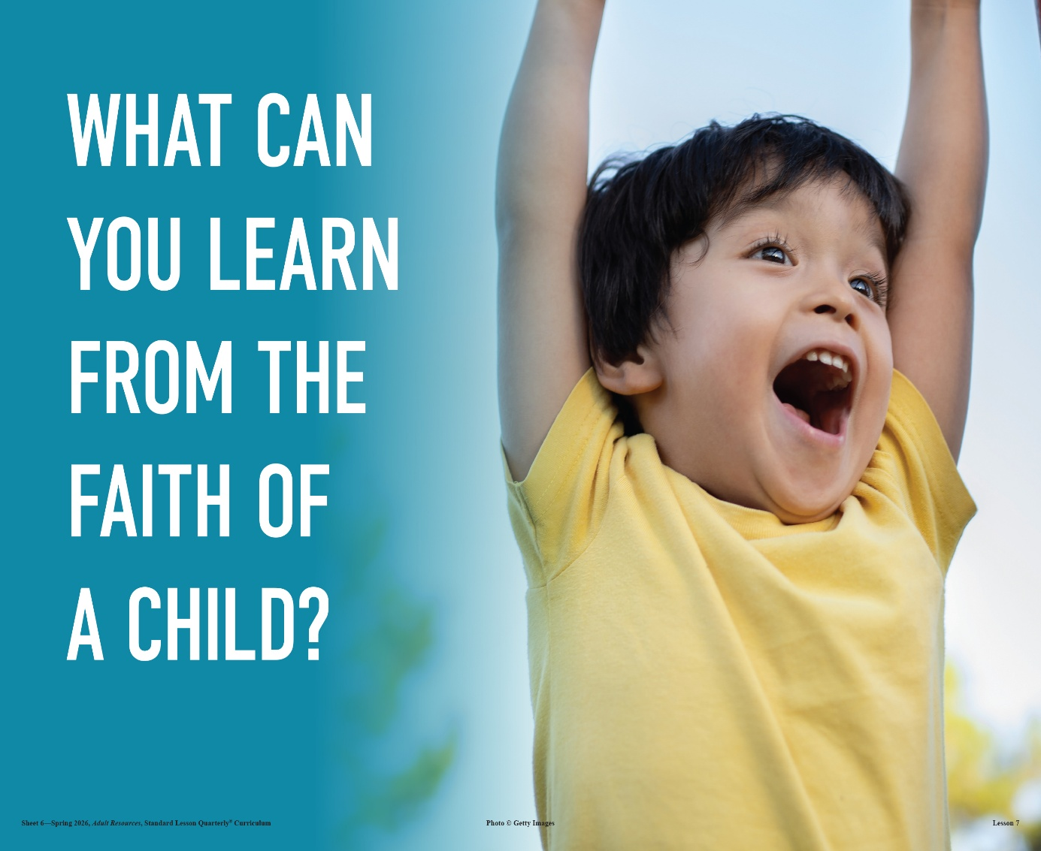
LESSON INTRODUCTION
CHILDREN GIFT AND MODEL
Role Models
“Being a role model is the most powerful form of educating,” said John Wooden, a well-known and successful NCAA basketball coach. “Modeling” is the process of teaching skills and behaviors through observable actions and imitation. It is more than being told how to do something; consider that “actions speak louder than words. ” Therefore, role models positively influence our lives by sharing their wisdom, knowledge, and experience through observational learning. They live alongside us and teach by demonstrating exemplary attitudes, behaviors, skills, and habits. A role model can make a big difference in a young, impressionable life.
In today’s text, Jesus speaks and models His lesson to the disciples. As the most significant role model in history, we seek to learn and imitate His values and ways.
Notes:
Analysis
Role models teach primarily through example rather than words. Their influence comes from observable behavior that others can imitate. The passage emphasizes that lived actions shape attitudes, habits, and character, especially in young and impressionable individuals. Jesus is presented as the perfect role model, demonstrating truth through both teaching and living, making His example the standard for believers.
Summary
Role models influence others through their actions, not just their words. Jesus is the ultimate example, teaching His disciples by both instruction and demonstration, calling us to imitate His life and values.
Main Idea
True teaching happens through consistent, godly example, with Jesus as the supreme model for all believers to follow.
Three Key Takeaways
Actions Teach More Than Words People learn best by observing consistent behavior. A role model’s daily actions communicate truth more powerfully than spoken instruction, shaping attitudes and habits in lasting ways.
Jesus Is the Perfect Role Model Christ not only taught truth but lived it. His life provides the ultimate example of humility, love, and obedience that believers are called to imitate.
Influence Carries Responsibility Being a role model impacts others deeply, especially the young. Believers must live intentionally, knowing their example can guide others toward godliness or lead them astray.

Slide 5

CHILDREN GIFT AND MODEL
Daily Bible Readings
Week of April 20 through April 25
Proverbs 24:1–6—By Wisdom a House Is Built.
Luke 2:40–52—Growing in Divine and Human Favor.
Ephesians 5:21–33—Submit to One Another.
Joshua 24:15–21—Choose Whom You Will Serve.
Joshua 24:22–28—We Will Serve the Lord.
Matthew 19:3–9—An Inseparable Union.
These passages teach that a godly life, family, and relationships are built on wisdom, intentional commitment, and obedience to God’s design. From personal growth to marriage and service, God calls His people to choose Him daily, live with wisdom, and honor His covenant principles. The lesson is clear: lasting success and unity come when we align our lives, homes, and relationships with God’s truth, faithfully committing to serve Him in every area.
Notes:
Proverbs 24:1–6 — By Wisdom a House Is Built
Analysis This passage contrasts envy of the wicked with the value of wisdom. A “house” represents both family and life structure, built through wisdom, understanding, and knowledge.
Summary True success and stability come from godly wisdom, not worldly gain.
Commentary God teaches that strong families and lives are established by His wisdom. Victory and guidance come through wise counsel, not selfish ambition.
Luke 2:40–52 — Growing in Divine and Human Favor
Analysis Jesus grows in wisdom and favor with God and man, demonstrating balanced spiritual and human development.
Summary Spiritual maturity includes growth in wisdom, obedience, and relationships.
Commentary Even Christ modeled submission and growth. Believers must develop spiritually and socially, honoring God while growing in understanding and responsibility.
Ephesians 5:21–33 — Submit to One Another
Analysis Paul teaches mutual submission rooted in reverence for Christ, with specific roles in marriage reflecting Christ and the church.
Summary Godly relationships are built on love, respect, and sacrificial leadership.
Commentary Marriage is a divine picture of Christ’s love. Submission is not weakness but obedience to God’s design, producing unity and harmony.
Joshua 24:15–21 — Choose Whom You Will Serve
Analysis Joshua challenges Israel to make a clear decision between God and false gods.
Summary Serving God requires a deliberate and personal commitment.
Commentary Faith is not inherited or casual; it demands choice. Joshua models leadership by declaring, “as for me and my house,” emphasizing personal responsibility.
Joshua 24:22–28 — We Will Serve the Lord
Analysis The people affirm their commitment to God, and Joshua establishes a covenant as a witness.
Summary Commitment to God must be confirmed and remembered.
Commentary Verbal commitment must be followed by faithful living. God holds His people accountable to their declared devotion.
Matthew 19:3–9 — An Inseparable Union
Analysis Jesus affirms God’s original design for marriage as a lifelong union between one man and one woman.
Summary Marriage is a sacred covenant that should not be broken by human will.
Commentary Jesus restores God’s standard, showing that marriage reflects divine intention, not cultural convenience. Faithfulness honors God.
Unified Summary (Main Idea & Lesson)

Slide 6

LESSON CONTEXT
CHILDREN GIFT AND MODEL
In Mark 9, Jesus is nearing the end of His ministry. He has just warned his disciples a second time about his impending death, although they still fail to grasp it (Mark 9:31–32). Instead, they’re more concerned about jockeying for position in His kingdom. But as they journey to Jerusalem, Jesus takes two opportunities to use children—nuisances to the disciples (10:13)—to demonstrate the value of every person, no matter how small, and to model what following God should look like.
CONTEXT: HISTORICAL
Our text lands between Peter’s confession of Jesus, “Thou art the Christ” (Mark 8:29), and the triumphal entry (11:1–10). Sandwiched between these events are clarifying motifs defining God’s kingdom as upside down and backward to natural human instinct. Examples of these motifs are the high cost of discipleship (10:21–22), the difficulties of wealth (10:24–31), and a redefinition of greatness (10:36–45). Throughout this section, Jesus exalts the weak and lowly while humbling the powerful and proud.
Just prior to today’s text, Jesus and His disciples traveled the 25 miles between Caesarea Philippi and Capernaum (Mark 8:27; 9:33). Caesarea Philippi was a town in the hill country at the base of Mount Hermon. Capernaum was a small fishing village that Jesus used as the home base of His ministry on the northern shore of the Sea of Galilee (Matthew 4:13). Capernaum is mentioned in all four Gospels and named more than any other town in the New Testament except Jerusalem. It is where the centurion asks for Jesus’ help and where He heals the paralytic who was dropped through the roof (Matthew 8:5; Mark 2:1–12). In contrast, Scripture mentions Caesarea Philippi only twice: in Matthew 16:13 and its parallel in Mark 8:27.
CHILDREN
In the Greco-Roman world of the first century AD, children held little significance. Adults viewed them as lacking reason and requiring training. The aim of their training was to learn their parents’ business and duties. Their value was in their contribution to the family. In the extreme, children were considered property—to be nurtured or disposed of as the head of household determined. The same was true in Jewish households, but God also taught His people to consider children as a blessing (Psalm 127:3–5). God instructed parents to teach Israel’s faith to their children and train them properly in behavior and wisdom (Deuteronomy 11:19; 31:12–13; Proverbs 22:6). Still, they had little power or status.
Notes:
Lesson Context
In Mark 9, Jesus is nearing the end of His ministry. He has just warned his disciples a second time about his impending death, although they still fail to grasp it (Mark 9:31–32). Instead, they’re more concerned about jockeying for position in His kingdom. But as they journey to Jerusalem, Jesus takes two opportunities to use children—nuisances to the disciples (10:13)—to demonstrate the value of every person, no matter how small, and to model what following God should look like.
Lesson Context: Historical
Our text lands between Peter’s confession of Jesus, “Thou art the Christ” (Mark 8:29), and the triumphal entry (11:1–10). Sandwiched between these events are clarifying motifs defining God’s kingdom as upside down and backward to natural human instinct. Examples of these motifs are the high cost of discipleship (10:21–22), the difficulties of wealth (10:24–31), and a redefinition of greatness (10:36–45). Throughout this section, Jesus exalts the weak and lowly while humbling the powerful and proud.
Just prior to today’s text, Jesus and His disciples traveled the 25 miles between Caesarea Philippi and Capernaum (Mark 8:27; 9:33). Caesarea Philippi was a town in the hill country at the base of Mount Hermon. Capernaum was a small fishing village that Jesus used as the home base of His ministry on the northern shore of the Sea of Galilee (Matthew 4:13). Capernaum is mentioned in all four Gospels and named more than any other town in the New Testament except Jerusalem. It is where the centurion asks for Jesus’ help and where He heals the paralytic who was dropped through the roof (Matthew 8:5; Mark 2:1–12). In contrast, Scripture mentions Caesarea Philippi only twice: in Matthew 16:13 and its parallel in Mark 8:27.
C. Lesson Context: Children
In the Greco-Roman world of the first century AD, children held little significance. Adults viewed them as lacking reason and requiring training. The aim of their training was to learn their parents’ business and duties. Their value was in their contribution to the family. In the extreme, children were considered property—to be nurtured or disposed of as the head of household determined. The same was true in Jewish households, but God also taught His people to consider children as a blessing (Psalm 127:3–5). God instructed parents to teach Israel’s faith to their children and train them properly in behavior and wisdom (Deuteronomy 11:19; 31:12–13; Proverbs 22:6). Still, they had little power or status.
Analysis
This lesson context reveals the disciples’ misunderstanding of Christ’s mission, focusing on status while Jesus teaches humility. Jesus uses children—considered insignificant in that culture—to redefine greatness. Historically, this section highlights the “upside-down” nature of God’s kingdom, where the weak are exalted and pride is humbled. The journey from Caesarea Philippi to Capernaum sets the stage for teaching, while the cultural view of children magnifies Christ’s radical message of valuing the lowly.
Main Idea
God’s kingdom reverses human values—true greatness is found in humility, service, and valuing the least.
Summary
As Jesus approaches the end of His ministry, He corrects His disciples’ focus on power by teaching that greatness comes through humility. Using children as examples, He elevates those considered least important. In a culture that valued status and power, Jesus reveals that God’s kingdom honors the lowly and calls believers to servant-hearted living.
Three Key Points
Disciples Misunderstood Greatness Despite Jesus’ warnings about His death, the disciples focused on position and status, revealing a worldly mindset.
Jesus Redefines Value Through Children By using children as examples, Jesus shows that those with no status are highly valued in God’s kingdom.
God’s Kingdom Is Upside Down The weak are exalted, and the proud are humbled, demonstrating that God’s ways differ from human thinking.
Three Life Lessons
Humility Is the Path to Greatness We must reject pride and embrace a servant’s heart to align with God’s kingdom.
Value Every Person God honors those society overlooks; we must treat all people with dignity and love.
Seek God’s Perspective, Not the World’s True success is not measured by status or power but by obedience and humility before God.

Slide 7
LESSON CONTEXT
CHILDREN GIFT AND MODEL
Millstones
Millstones were common in Bible days and used to grind grain. The size of the millstone depended on the size of the task involved. A small millstone could be used by a woman to grind the amount of grain needed for that day by hand. On the other hand, larger millstones were often turned by donkeys, in order to grind a large amount of grain all together. The example here suggests that Jesus is referring to this larger kind of millstone.
It was also the practice among some nations, particularly the Syrians and Romans, to use millstones as a form of capital punishment, actually using them to drown criminal offenders. Such a punishment would be horrific. And yet, Jesus declares those who cause children to stumble would be better off having this sort of thing happen to them.
Stumbling
The verb for “stumble” and the closely associated noun appear forty times in the New Testament. The contextual meaning owes a lot to the way the words are used in Greek translations of the Old Testament. A person’s relation to God is always part of the point. It is not simply about leading a person into a simple mistake. In this context, the meaning is clearly about causing a loss of faith (which has eternal significance to the victim). That is what makes this so heinous.
Notes:
Millstones
Analysis
Millstones symbolize both daily provision and severe judgment. Jesus references the larger millstone—used for heavy grinding and even execution—to illustrate the seriousness of causing believers, especially children, to fall spiritually. The imagery conveys extreme consequences for spiritual harm.
Main Idea
God severely judges those who harm the faith of others.
Summary
Jesus uses the image of a large millstone to emphasize the grave consequence of leading others into sin, showing that such actions bring serious judgment.
Key Points
Millstones were tools of work and judgment.
Jesus uses a severe image to stress accountability.
Spiritual harm is treated as a serious offense.
Life Lessons
Our influence carries eternal weight.
Causing others to fall is a grave sin.
Protecting others’ faith is a sacred duty.
Stumbling
Analysis
“Stumble” refers not to minor error but to causing someone to lose faith. The term carries deep spiritual meaning tied to one’s relationship with God, highlighting eternal consequences.
Main Idea
Leading others away from faith is a serious spiritual offense.
Summary
To cause someone to stumble means to lead them into spiritual failure or loss of faith, making it a deeply serious and harmful act.
Key Points
Stumbling involves spiritual, not just physical failure.
It affects one’s relationship with God.
Its consequences are eternal in nature.
Life Lessons
Be careful not to weaken others’ faith.
Encourage spiritual growth in others.
Recognize the eternal impact of our actions.

Slide 8
LESSON INTRODUCTION
CHILDREN GIFT AND MODEL
Children in Jesus’ Day—
In a culture that is highly conscious of honor and shame— like the Greco-Roman world of Jesus’ day—social status, reputation, and power play an outsized role in the way that people are treated. Children were loved, but they were treated a bit like property. They were viewed as senseless and in need of training. They were supposed to be deferential, honoring elders, getting out of the way whenever possible. It was their duty to learn their parents’ trade and responsibilities. Children were seen as valuable for what they contributed to the family. They were most parents’ only “retirement plan. ”
When Jesus honors a child, it is scandalous. No one except Jesus at this time would think to tell others to imitate a child! But God’s Word says that children are a gift and a blessing (Ps. 127:3–5). As we will continue to discuss next week, God instructs parents to raise children in the faith and to train them properly in behavior and wisdom (Deut. 11:19; 31:12–13; Prov. 22:6).
Notes:
Children in Jesus’ Day
Analysis
Children had little status in society, often viewed as property or future contributors. Jesus’ elevation of children challenges cultural norms and reveals God’s value system.
Main Idea
God values those whom society considers least important.
Summary
In a culture that minimized children, Jesus honored them, showing that God esteems the humble and lowly.
Key Points
Children had low social status.
Jesus elevated their value.
God sees children as a blessing.
Life Lessons
Value people regardless of status.
Embrace humility like a child.
Teach and guide the next generation faithfully.

Slide 9
LESSON INTRODUCTION
CHILDREN GIFT AND MODEL
The Importance of Blessing
Parents valued having a great rabbi’s blessing of their children. It was not unusual in Bible times, as in many churches today, to bring children forward in the synagogue for a blessing, to be dedicated to God (compare Gen. 48:9, 13–16), especially after a child’s first birthday. And here was a rabbi whose authority excelled that of other rabbis in the synagogue (Matt. 7:29)!
It is possible that some of the children were sick, and that the parents hoped that Jesus’ blessing would also bring healing from physical or spiritual ailments, as it had for some in Capernaum (Mark 9:14–27). And, of course, because of their expected future contributions to the family, a blessing of children was, by extension, a blessing upon the entire family.
Notes:
The Importance of Blessing
Analysis
Blessing children was both spiritual and practical, impacting the entire family. Jesus’ authority made His blessing especially meaningful, possibly including healing and future provision.
Main Idea
God’s blessing brings spiritual covering and extends to families.
Summary
Parents sought Jesus’ blessing for their children, recognizing its power to impact both their lives and the future of the family.
Key Points
Blessings were highly valued in biblical culture.
Jesus’ authority made His blessing unique.
Blessing children affected the whole family.
Life Lessons
Seek God’s blessing over your family.
Recognize the spiritual importance of children.
Trust God to guide and protect future generations.

Slide 10
LESSON OVERVIEW
CHILDREN GIFT AND MODEL
Welcoming the Children - Mark 9:36–37, 42 NIV
36 He took a little child whom he placed among them. Taking the child in his arms, he said to them,
37 “Whoever welcomes one of these little children in my name welcomes me; and whoever welcomes me does not welcome me but the one who sent me. ”
…………………………..
42 “If anyone causes one of these little ones—those who believe in me—to stumble, it would be better for them if a large millstone were hung around their neck
The disciples and Jesus are on their way to Jerusalem, where Jesus will be killed.
The disciples are unaware of what is about to take place, and they are thinking about their own greatness.
To challenge them, Jesus sets a child in their midst.
Jesus has a lesson to teach about children: they had better welcome and look after little ones.
Children can believe in Jesus too, and adults have a responsibility to look after this tiny faith.
Harming children is a grave offense to God.
Notes:
><><><><><><><><><><><><><><><
Welcoming the Children
The disciples argue among themselves as they travel to Capernaum. Once they arrive, Jesus asks, “What were you arguing about on the road?” (Mark 9:33). They are quiet, probably because they are ashamed. They had been debating who would be greatest in Jesus’ kingdom once He took over—perhaps imagining an imminent physical and political kingdom to replace Roman rule.
So Jesus does something to teach them what true greatness looks like: “Anyone who wants to be first must be the very last, and the servant of all” (v. 35).
He does something strange. He takes a child—a person of the lowest social status in first-century Judean society—and puts the child “among them” (v. 36). Jesus treats the child as one made in God’s image, every bit as worthy of God’s love and respect as the adult disciples.
Here they are, trying to vie for position and leadership. But their teacher puts a child before them. If only they could have some of the best qualities of children: wonder, dependence, enthusiasm, guilelessness. If only they weren’t so concerned about whether a task was beneath them. No task was be too lowly for Jesus—emphasized when He washes their feet (John 13:1–17; compare Mark 10:42–45).
While Jesus embraces the child, He says to His disciples, anyone who welcomes and serves a little one in Jesus’ name welcomes Jesus— and also the Father (Mark 9:37). Those who care for others in Jesus’s name, especially those who cannot care for themselves, are caring for Jesus Himself, and would be rewarded accordingly (Mark 9:41; compare Matt. 25:31–46). Jesus desires generosity toward young and old, regardless of social standing.
Everyone who believes in Jesus is of great value; so much so that anyone who “causes one of these little ones—those who believe in me—to stumble” will face enormous consequences (v. 42). Just as every good deed is remembered and rewarded, every act with evil intent shall be remembered and repaid. In fact, Jesus declares,
it would be better if those who cause one of God’s “little ones” to stumble were to lose their lives. You can see how greatly Jesus wants to protect the tiny faith of a child!
Welcoming the Children
Analysis
The disciples reveal a worldly mindset, seeking status, while Jesus teaches kingdom values through humility. By placing a child—socially insignificant—among them, He redefines greatness as servanthood. Jesus identifies Himself with the vulnerable, teaching that caring for them is equivalent to serving God. He also warns strongly against causing believers, especially the “little ones,” to stumble, showing God’s deep concern for their faith.
Main Idea
True greatness in God’s kingdom is found in humility, service, and valuing the least, while protecting the faith of others.
Summary
Jesus corrects His disciples’ pursuit of status by teaching that greatness comes through humility and service. Using a child as an example, He shows that welcoming and caring for the least is the same as serving Him and the Father. He also warns that causing believers to stumble brings serious consequences, revealing God’s deep value for every person.
Three Key Points
Greatness Is Redefined by Servanthood Jesus teaches that being first in God’s kingdom means being last and serving others, not seeking power or recognition.
The Lowly Are Highly Valued By elevating a child, Jesus shows that those with the least status are precious and worthy of honor in God’s sight.
Spiritual Responsibility Is Serious Causing others, especially believers, to stumble invites severe judgment, highlighting the importance of protecting faith.
Three Life Lessons
Choose Humility Over Status True greatness comes from serving others selflessly, not seeking recognition or position.
Serve and Value Everyone We must treat all people—especially the vulnerable—with dignity, recognizing their worth before God.
Guard the Faith of Others Our actions should strengthen, not weaken, others’ faith, understanding the eternal impact of our influence.

Slide 11
LESSON OVERVIEW
CHILDREN GIFT AND MODEL
Blessing the Children - Mark 10:13–16 NIV
13 People were bringing little children to Jesus for him to place his hands on them, but the disciples rebuked them.
14 When Jesus saw this, he was indignant. He said to them, “Let the little children come to me, and do not hinder them, for the kingdom of God belongs to such as these.
15 Truly I tell you, anyone who will not receive the kingdom of God like a little child will never enter it. ”
16 And he took the children in his arms, placed his hands on them and blessed them.
Now in Judea, there are parents who have heard something about Jesus’ reputation. They bring children to receive a blessing.
When the disciples object, Jesus insists that they make way for the children.
Jesus says that receiving the kingdom of God “like a little child” is the only way to enter.
Jesus does exactly what the people want by blessing the children and embracing them.
Notes:
><><><><><><><><><><><><><><><
Blessing the Children
Jesus and His disciples go from Capernaum to Judea and across the Jordan (Mark 10:1). After debating with the Pharisees as to what constitutes grounds for divorce, Jesus goes into a house, where He continues to teach. There in the cramped quarters of an ancient house, people bring their children to Jesus “for him to place his hands on them” (v. 13). It could be that Jesus is in the habit of offering this kind of blessing, as a rabbi.
But the disciples rebuke the parents for approaching Jesus with their children. Can’t they see that Jesus is in the middle of important theological matters while he debates the Pharisees? The disciples are probably trying to protect their weary master. After all, neither they nor Jesus would have had much time or space for themselves as they traveled.
They are projecting their own exhaustion and frustration onto Jesus. And perhaps Jesus’ warnings about His impending death are starting to sink in, making the disciples sense that something important and dangerous is about to happen as they get nearer to Jerusalem. Jesus has an urgent mission that can’t be interrupted! But, of course, Mark is showing that the disciples had completely missed the significance of Jesus’ earlier teaching to them.
Jesus is thus “indignant” at the disciples’ actions (v. 14). Soon after this moment, He will again foretell His death (see vv. 32–34). Time is of the essence. But the disciples need to get it, to understand what being a disciple actually requires, while Jesus is there to teach them. He tells the disciples to let the children come, “for the kingdom of God belongs to such as these” (v. 14). Jesus wants no one to be barred from coming to Him, regardless of their status. Every person has value, created in God’s image. The children reflect that truth without question—and it is the disciples who are missing it.
Jesus then states His point in a plain manner. Children are not only an example of innocence, but they illustrate something central about faith. People who come to Jesus thinking they have all the right answers and thoughts are not really submitting to Jesus as a teacher. On the other hand, children are persistently listening and learning—using their eyes and ears to put lessons into practice.
Anyone who refuses to receive the kingdom of God as a child will never be ready to enter it (v. 15). The adults who follow Jesus should be more like children, receiving Jesus and His kingdom with a sense of wonder and enthusiasm. Like children, the disciples need to be fully present before God and to trust His rule in their lives, without precondition. As Jesus declared in Capernaum, those who wish to be great in God’s kingdom will humble themselves to become a “servant of all” (Mark 9:35). That kind of obedience requires a childlike spirit.
Jesus rebukes the disciples, but He blesses the children. With open hands, Jesus shows the meaning of welcome. On His mission to Jerusalem, on His way to die, Jesus has all the time in the world to spend with them.
Blessing the Children
Analysis
This passage reveals the disciples’ continued misunderstanding of Jesus’ mission. They prioritize status and urgency, while Jesus prioritizes people—especially the overlooked. His indignation shows that excluding anyone from Him contradicts the kingdom. Children model the posture required for salvation: humility, trust, and receptivity. Jesus demonstrates that true discipleship is not intellectual pride but childlike dependence and openness to God.
Main Idea
The kingdom of God belongs to those who approach Christ with childlike humility, trust, and openness.
Summary
As people bring children to Jesus, the disciples attempt to stop them, thinking the moment is too important. Jesus rebukes them and welcomes the children, teaching that the kingdom belongs to those who receive it like a child. He emphasizes humility, trust, and openness as essential for entering God’s kingdom and models love by blessing the children.
Three Key Points
No One Is Too Small for Jesus Jesus welcomes all, regardless of status, showing that every person has value and access to Him.
Childlike Faith Is Essential Entering God’s kingdom requires humility, trust, and a willingness to learn—qualities seen in children.
Discipleship Requires Right Perspective The disciples’ misunderstanding highlights the need to value people over position and mission over status.
Three Life Lessons
Approach God with Humility and Trust We must come to God without pride, fully dependent on Him like a child.
Never Block Others from Christ Our attitudes and actions should invite people to Jesus, not hinder them.
Value What Jesus Values People—especially the overlooked—matter more than status, busyness, or personal priorities.

Slide 12
One Bible, One Story
CHILDREN GIFT AND MODEL
The Disciples and Their “Children”
The disciples just weren’t “getting it. ” Their dismissal of children, no matter what their motivation might be, showed that they did not prioritize their needs. The words of John’s Gospel apply, as with so many other things that Jesus said and did: “You do not realize now what I am doing, but later you will understand” (John 13:7). Given their zeal, humility, and self-sacrifice after Jesus’ death and resurrection, after the Spirit came upon them at Pentecost, the disciples finally “got it. ” Notice that, in the Johannine Epistles, the writer addresses his readers as “dear children” or “children” about a dozen times. The sometimes stubborn “rock” of Peter finally grasped the import of Jesus’ words, as he addressed scattered churches: “As obedient children, do not conform to the evil desires you had” (1 Peter 1:14). Jesus’ first generation of disciples started using quite a lot of familial language, projecting the love and attention that Jesus showed toward literal children onto adults, spiritual children.
Notes:
The Disciples and Their “Children”
Analysis
This section shows the disciples’ initial failure to understand Jesus’ teaching about humility and valuing the least. Their growth becomes evident after Christ’s resurrection and the coming of the Holy Spirit. They begin to reflect Jesus’ heart, using familial language like “children,” showing spiritual care and maturity. What they once dismissed, they later embraced, demonstrating transformation through divine revelation and experience.
Main Idea
Spiritual growth transforms misunderstanding into Christlike care, leading believers to nurture others with humility and love.
Summary
The disciples initially failed to value children, revealing their lack of understanding. After Jesus’ resurrection and the Holy Spirit’s work, they matured and began to reflect His teachings. They adopted language of spiritual family, calling believers “children,” showing that they had learned to care for others with love, humility, and responsibility.
Three Key Points
Initial Misunderstanding The disciples did not grasp Jesus’ teaching, shown by their dismissal of children and misplaced priorities.
Transformation Through the Spirit After Pentecost, they grew in understanding, humility, and Christlike behavior.
Adoption of Spiritual Family Language They began calling believers “children,” reflecting love, care, and responsibility for spiritual growth.
Three Life Lessons
Spiritual Growth Takes Time Even devoted followers may misunderstand at first, but growth comes through learning and the Holy Spirit.
Transformation Should Be Evident True faith produces change, leading us to reflect Christ’s love and humility in our actions.
Care for Others Spiritually We are called to nurture and guide others in faith, treating them with the same love Christ showed.

Slide 13
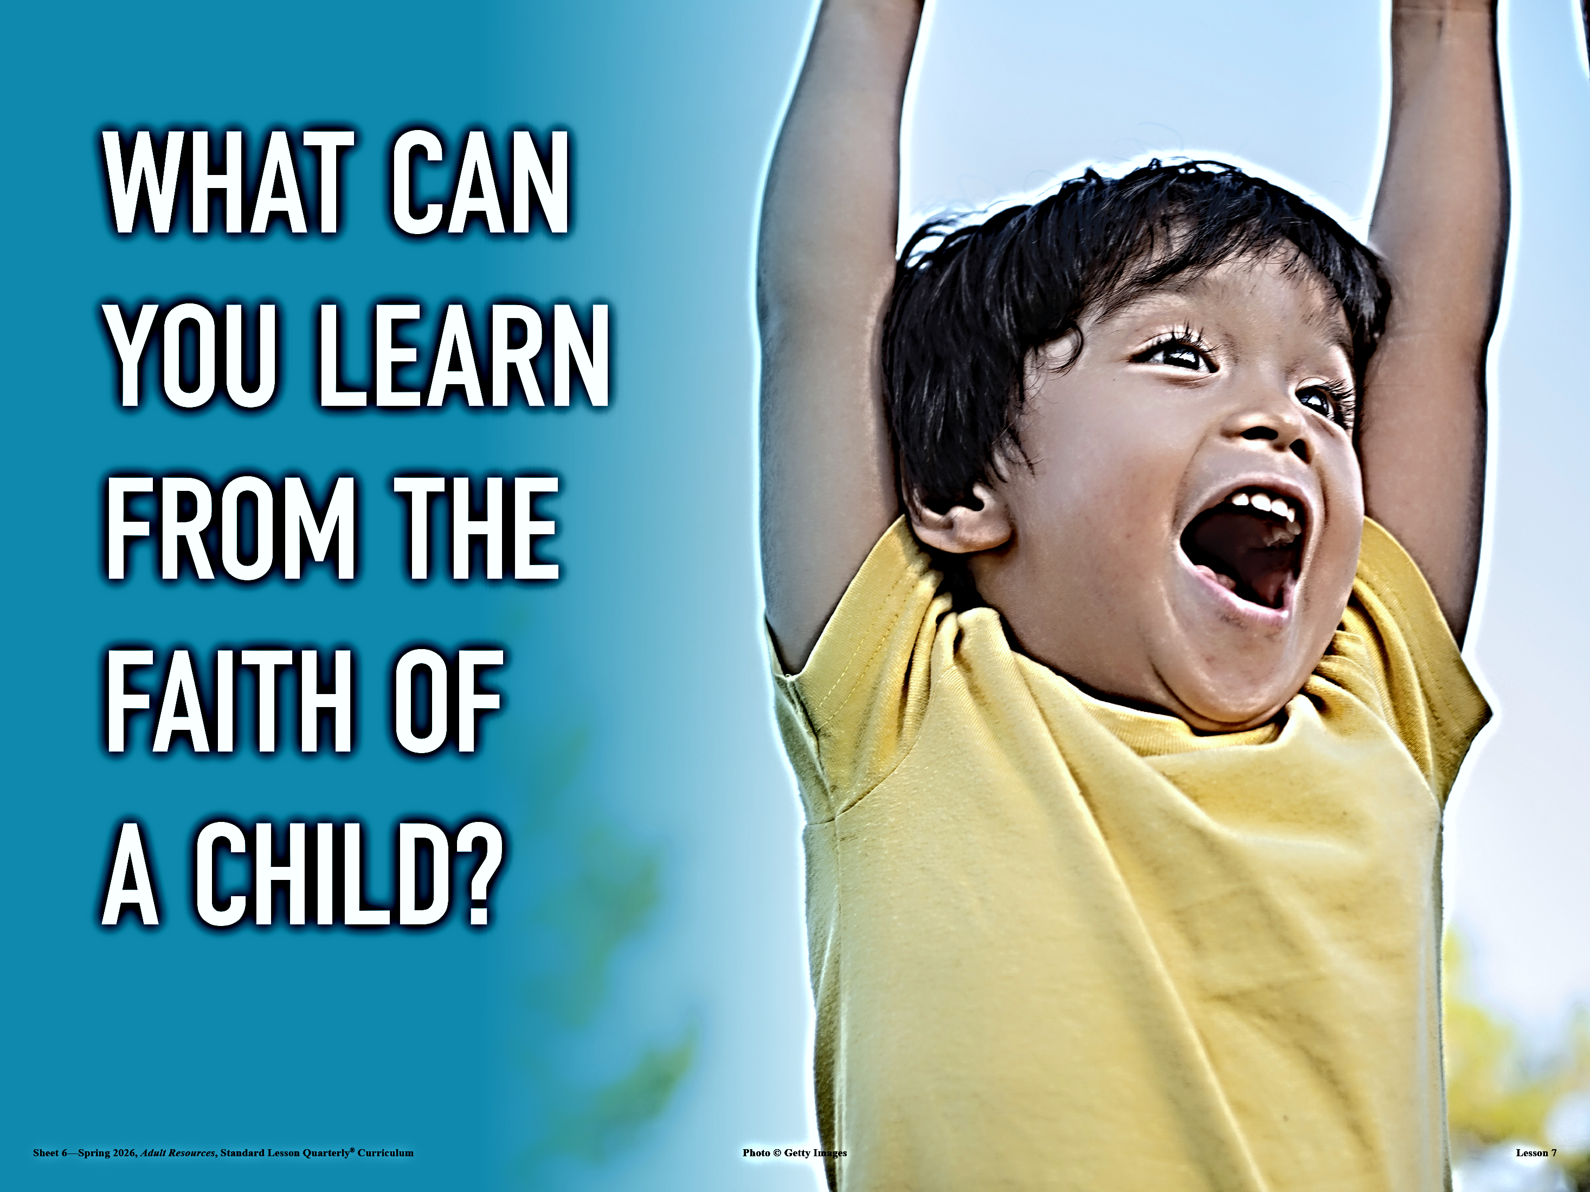
Apply the Message
CHILDREN GIFT AND MODEL
We can trust God without inhibition, like children.
This devotion and conclusion focuses on what it means— and doesn’t mean—to receive God’s kingdom as a child.
Becoming “Like a Little Child”
Jesus gives us an challenging assignment: we must receive the kingdom like a little child, or we will not receive it at all. We are left with questions—not unlike the questions of Nicodemus in John 3 who wondered about being “born again. ” What does it mean to receive the kingdom like a little child? What if we are fully grown and don’t remember what it is like to be a child?
Put simply, a child trusts. A child embraces. A child looks at the world as if it were enchanted. A child helps others and asks for help. That’s how we should be with our heavenly Father, who gives “good gifts” when we ask (Matt. 7:11).
As adults, many of us struggle with trust, wonder, or receiving help. Many of us choose to work things out on our own, out of pride, fear, or both. But we can unlearn the coping mechanisms we’ve developed as adults in order to learn to trust God again. We can let go of our control. Parents and caregivers appreciate when a child asks for help. We need to trust God with the things that we can’t handle.
Of course, there is a difference between childlike faith and merely childish ways. Other parts of Scripture urge adults to welcome the maturity and wisdom that comes with age and experience (1 Cor. 3:1–2; 13:11; Heb. 5:12–14). But we never cease to be God’s children (1 John 3:1). As we walk in the guidance and confidence from the Spirit, we learn the real meaning of trust.
Notes:
Becoming “Like a Little Child”
Analysis
This passage clarifies that childlike faith is not immaturity but wholehearted trust, dependence, and openness toward God. Adults often struggle with control, pride, and self-reliance, which hinder trust. Jesus calls believers to relearn trust, embracing God’s care as children do, while still growing in spiritual maturity and wisdom.
Main Idea
Receiving God’s kingdom requires childlike trust, dependence, and openness, balanced with spiritual maturity.
Summary
Jesus teaches that entering God’s kingdom requires a childlike posture—trusting, dependent, and open. While adults often rely on themselves, believers must learn to trust God fully. This does not mean remaining immature, but growing in wisdom while maintaining humble, childlike faith and dependence on the Father.
Three Key Points
Childlike Faith Means Trust and Dependence Children naturally trust and rely on others, modeling how believers should depend on God.
Self-Reliance Hinders Faith Pride and fear lead adults to depend on themselves instead of trusting God fully.
Faith Requires Both Trust and Maturity Believers must grow in wisdom while maintaining humility and openness before God.
Three Life Lessons
Trust God Without Reservation Let go of control and rely on God fully, especially in areas beyond your ability.
Ask God for Help Freely Like children, we should seek God’s guidance and provision without hesitation.
Grow Spiritually While Staying Humble Mature in faith, but never lose the trust, wonder, and dependence that define childlike faith.

Slide 14

Apply the Message
CHILDREN GIFT AND MODEL
We can trust God without inhibition, like children.
This devotion and conclusion focuses on what it means— and doesn’t mean—to receive God’s kingdom as a child.
1 What does it mean to receive God’s kingdom like a child?
2 What qualities should we not adopt, to receive God’s kingdom like a child?
3 Where do you struggle most with having a childlike faith?
Notes:
1 What does it mean to receive God’s kingdom like a child?
There are a lot of potential answers to this question. The typical child shows humility, acceptance, dependence upon God, a willingness to help others, wonder, enthusiasm, and more. A child enjoys the “good gifts” (Matt. 7:11) God gives. We might find inspiration from children we know or from examining stories of our past.
2 What qualities should we not adopt, to receive God’s kingdom like a child?
We don’t literally have to give up all knowledge and understanding. God still invites us to a renewal of the mind (Rom. 12:2) and to ask for wisdom (James 1:5). Children have all sorts of patterns of behavior that adults don’t need to emulate to share the same kind of trust in God’s provision and kingdom.
3 Where do you struggle most with having a childlike faith?
This question is intentionally open-ended, and will lead into the reflection activity for the week ahead. Perhaps we are closed-minded or fearful of surrendering to what God wants us to do. If we think back to our most cherished memories of being welcomed and included as a child, that might get close to the way that children look at God when they are nurtured in the faith.

Slide 15
CONCLUSION:
CHILDREN GIFT AND MODEL
Remembering the Whole Truth
Culture teaches us that the “good life” is for the smart, powerful, and accomplished. This concept is a constant refrain heralded by academia, work environments, media, and social circles. Even our children express this outlook—bragging about how good they are at something, how well they do in school, or how much bigger they are than younger siblings. This behavior points to social and cultural values that promote competition and comparison to determine who’s in and who’s not. Jesus’ point is quite the opposite.
Jesus teaches a nonhierarchical mindset among His followers. He challenges His disciples to recalibrate their values and embrace a new kingdom mindset. Jesus encourages unity, service, and childlike faith. He calls His people to accept entry into His kingdom with the delight of a child receiving a gift. To be sure, there are childish attitudes and actions we must avoid, correct, or other-wise put behind us (1 Corinthians 13:11; 14:20; Ephesians 4:14; Hebrews 5:13–14; 1 Peter 2:2). Knowing what those are and how to grow beyond them while honoring and embracing Jesus’ viewpoint is our continuing challenge.
How might you adjust your goals, vantage points, and perceptions to better align with Jesus’ directives? In what ways might you embrace childlikeness, vulnerability, innocence, and trust on a day-to-day basis?
Notes:
Greatness Is Childlikeness
Analysis
This section contrasts worldly values of success—power, intelligence, and achievement—with Jesus’ kingdom values of humility, unity, and trust. Culture promotes comparison and competition, but Jesus calls for a nonhierarchical mindset. Childlikeness reflects dependence, openness, and joy in receiving from God. At the same time, Scripture warns against immaturity, requiring believers to balance spiritual growth with childlike faith.
Main Idea
True greatness in God’s kingdom is found in humble, childlike faith rather than worldly status or achievement.
Summary
While culture defines greatness by power and success, Jesus teaches that greatness comes through humility, service, and childlike trust. Believers are called to embrace a mindset of dependence on God while growing in spiritual maturity, rejecting pride and comparison in favor of unity and faith.
Three Key Points
Worldly Greatness Is Misleading Society promotes competition and status, shaping values that conflict with God’s kingdom.
Jesus Redefines Greatness Christ calls for humility, unity, service, and a childlike trust in God.
Balance Childlikeness with Maturity Believers must grow spiritually while maintaining humility, trust, and openness to God.
Three Life Lessons
Reject Pride and Comparison Do not measure success by worldly standards; seek God’s approval instead.
Embrace Childlike Trust Daily Approach God with dependence, joy, and openness, trusting Him fully.
Grow While Staying Humble Mature in faith without losing the humility and sincerity that reflect Christ.

Slide 16
CONCLUSION
CHILDREN GIFT AND MODEL
Live It Out : Review childhood memories that spur us to wonder.
Childlike Wonder
The older we get, the harder it can be to experience awe over something new. Jesus invites us to receive His kingdom with the wide-eyed wonder of a child. This week, your invitation is to take a trip down memory lane to recall a cherished moment when you (or, perhaps, another child) experienced something new, exciting, or overwhelming. It wouldn’t hurt to break out the photo books to remember the occasion.
Notes:
Childlike Wonder
Analysis
This section emphasizes that spiritual dullness can come with age as familiarity replaces wonder. Jesus calls believers to reclaim a sense of awe and openness toward God. Remembering childhood experiences helps rekindle gratitude, humility, and sensitivity to God’s presence, restoring a heart that is receptive to His kingdom.
Main Idea
God calls us to approach Him with renewed wonder, humility, and openness like a child.
Summary
As people grow older, they often lose their sense of awe. Jesus invites believers to rediscover childlike wonder in their relationship with God. Reflecting on meaningful childhood experiences can help reignite gratitude, trust, and appreciation for God’s work, encouraging a fresh and humble perspective toward His kingdom.
Three Key Points
Wonder Fades with Age Life experience can dull our sense of awe, making spiritual things feel routine.
Jesus Invites Renewed Awe Believers are called to approach God with curiosity, excitement, and openness.
Reflection Rekindles Faith Revisiting meaningful memories can restore gratitude and spiritual sensitivity.
Three Life Lessons
Cultivate Awe in Your Walk with God Intentionally seek to see God’s work with fresh eyes and a grateful heart.
Remember God’s Past Faithfulness Reflecting on meaningful moments strengthens trust and appreciation for God.
Stay Spiritually Open and Receptive Maintain a heart that is ready to receive, learn, and respond to God’s presence.

Slide 17




End
The Lord bless thee, and keep thee:
The Lord make his face shine upon thee, and be gracious unto thee:
The Lord lift up his countenance upon thee and give thee peace.
Numbers 6:24-26,
Material adapted by Stanford W. Bowman Jr. from Echoes® Adult and Bible-in-Life® Adult Spring 2026 quarter with permission, © David C Cook, https://davidccook.org. May not be further reproduced. All rights reserved.

Slide 18
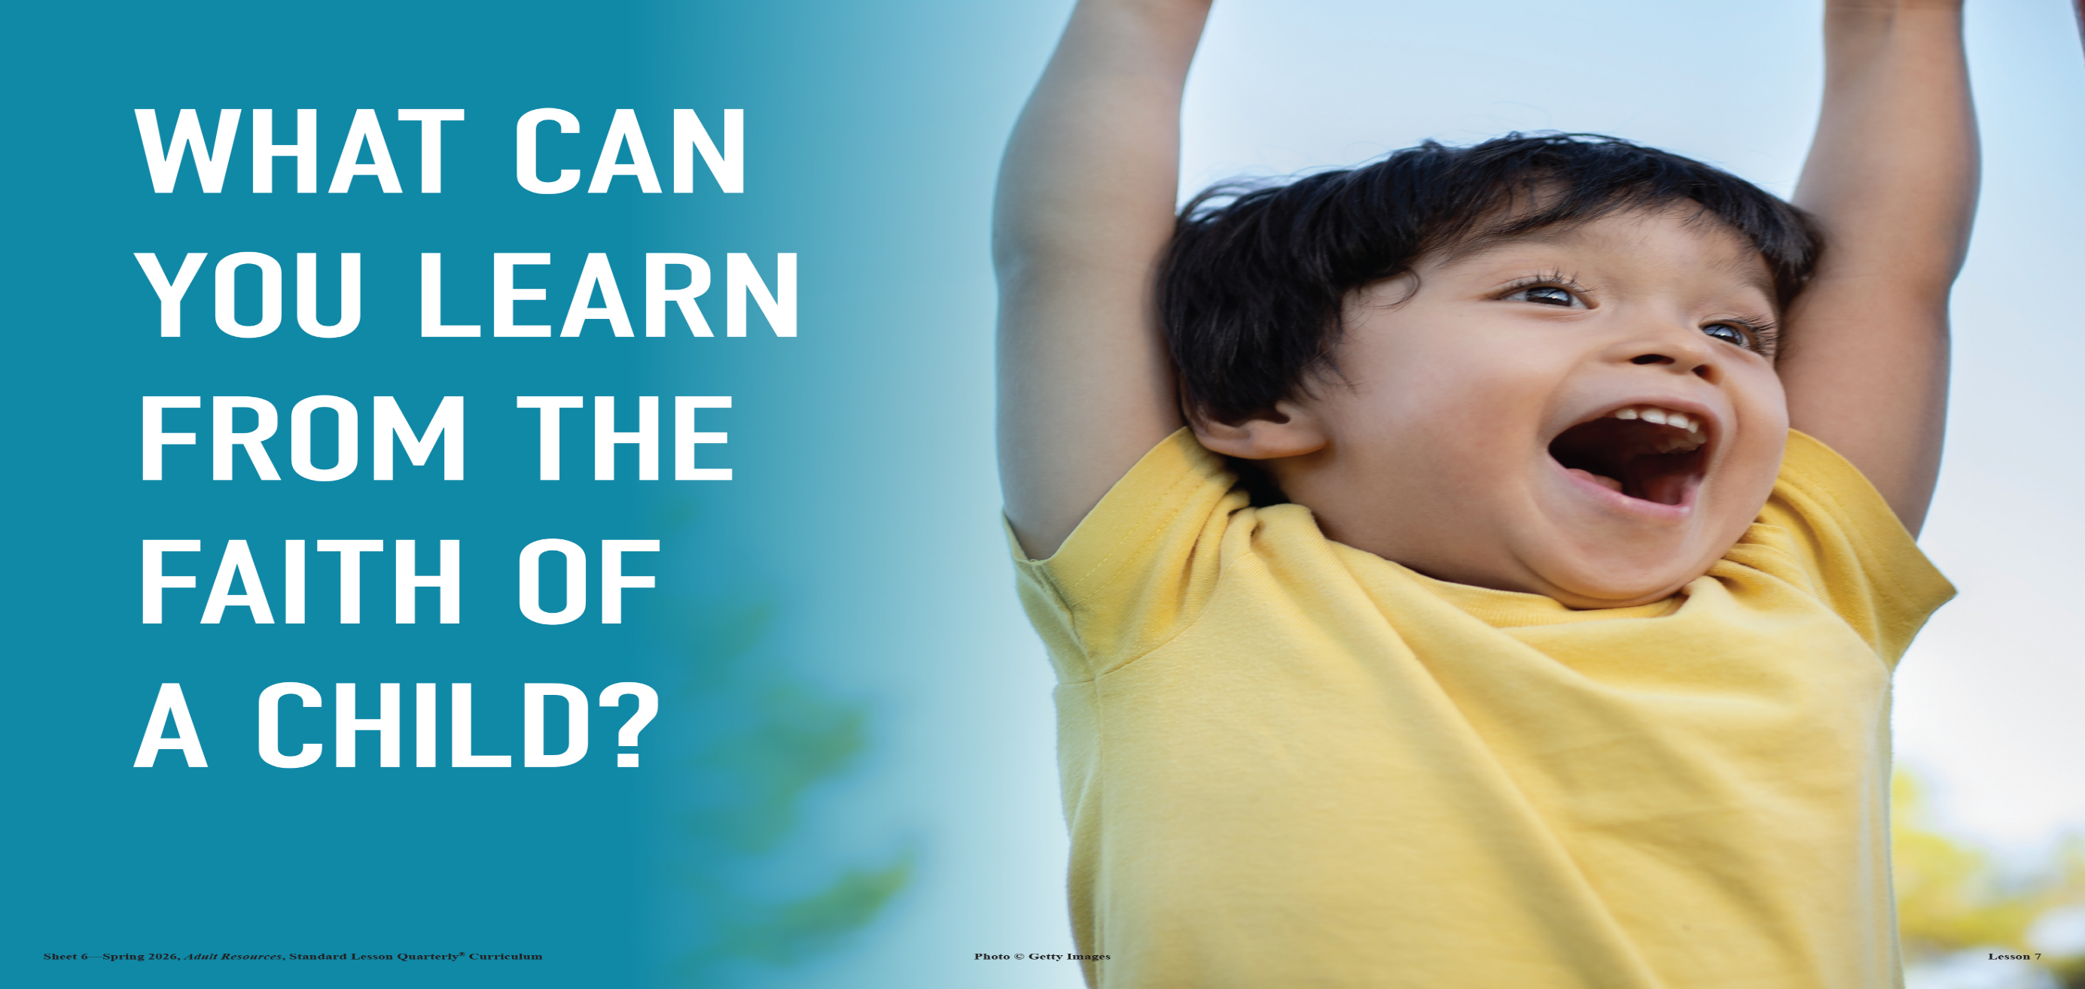
QUESTION & ANSWER
CHILDREN GIFT AND MODEL
WELCOMING THE CHILDREN
Live It Out: Review childhood memories that spur us to wonder.
1 Why is a child such an important example to the disciples?
2 What does it mean to “welcome” a child?
3 Why does Jesus warn about terrible consequences for anyone who harms children?
Jesus’ disciples are still trying to gain position and had just been arguing about which of them was greatest (v. 33). It was after confronting their behavior that Jesus places the child before them. The disciples themselves are behaving like children (in a negative sense). But Jesus would rather they have faith and believe wholeheartedly, to be more like children (in a positive sense). Anyone who welcomes a child in Jesus’ name welcomes Jesus—by extension, also welcomes the Father, “the one who sent [Him]” (v. 37).
Welcoming is about hospitality, being a good host by addressing the needs of others. This could literally mean, opening up a home to a child, or it could mean a more general hospitable attitude—welcoming children to the family of faith, so to speak.
Jesus suggests that the fate of those who harmed these “little ones” is terrible! Just as every good deed done to God’s children would be remembered by God, so every act of evil intent is judged by God. If someone’s harmful actions are the cause of a child’s loss of faith, it would be better if that guilty party had died a terrible death.
Notes:
Welcoming the Children
1 Why is a child such an important example to the disciples?
Jesus’ disciples are still trying to gain position and had just been arguing about which of them was greatest (v. 33). It was after confronting their behavior that Jesus places the child before them. The disciples themselves are behaving like children (in a negative sense). But Jesus would rather they have faith and believe wholeheartedly, to be more like children (in a positive sense). Anyone who welcomes a child in Jesus’ name welcomes Jesus—by extension, also welcomes the Father, “the one who sent [Him]” (v. 37).
2 What does it mean to “welcome” a child?
Welcoming is about hospitality, being a good host by addressing the needs of others. This could literally mean, opening up a home to a child, or it could mean a more general hospitable attitude—welcoming children to the family of faith, so to speak.
3 Why does Jesus warn about terrible consequences for anyone who harms children?
Jesus suggests that the fate of those who harmed these “little ones” is terrible! Just as every good deed done to God’s children would be remembered by God, so every act of evil intent is judged by God. If someone’s harmful actions are the cause of a child’s loss of faith, it would be better if that guilty party had died a terrible death.

Slide 19
QUESTION & ANSWER
CHILDREN GIFT AND MODEL
BLESSING THE CHILDREN
Live It Out: Review childhood memories that spur us to wonder.
1 Why do you think that people wanted Jesus’ blessing of their children?
2 What is Jesus’ definition of His greatest disciple?
3 Where do we fall short of giving time to children?
The children are brought to Jesus “for him to place his hands on them” (v. 13), so that He could bless them. These parents might hope for healing or just an indication of God’s favor. And Jesus was eager to oblige.
Jesus does not want a troop of hotshots. He wants His disciples to be like humble servants to others. When it comes to receiving from God and anticipating God’s blessing, Jesus wants His ideal disciples to be like children. In this way, children are eager and ready for whatever they receive.
We can examine our own experiences for times that we were put off by a simple request for time and attention. Whether we have biological children or not, we have the same responsibility to be hospitable to children. Jesus was not a parent, but He connected immediately with them.
Notes:
Blessing the Children
1 Why do you think that people wanted Jesus’ blessing of their children?
The children are brought to Jesus “for him to place his hands on them” (v. 13), so that He could bless them. These parents might hope for healing or just an indication of God’s favor. And Jesus was eager to oblige.
2 What is Jesus’ definition of His greatest disciple?
Jesus does not want a troop of hotshots. He wants His disciples to be like humble servants to others. When it comes to receiving from God and anticipating God’s blessing, Jesus wants His ideal disciples to be like children. In this way, children are eager and ready for whatever they receive.
3 Where do we fall short of giving time to children?
We can examine our own experiences for times that we were put off by a simple request for time and attention. Whether we have biological children or not, we have the same responsibility to be hospitable to children. Jesus was not a parent, but He connected immediately with them.

Slide 20
End
The Lord bless thee, and keep thee:
The Lord make his face shine upon thee, and be gracious unto thee:
The Lord lift up his countenance upon thee and give thee peace.
Numbers 6:24-26,
Material adapted by Stanford W. Bowman Jr. from Echoes® Adult and Bible-in-Life® Adult Spring 2026 quarter with permission, © David C Cook, https://davidccook.org. May not be further reproduced. All rights reserved.

