Slide 1
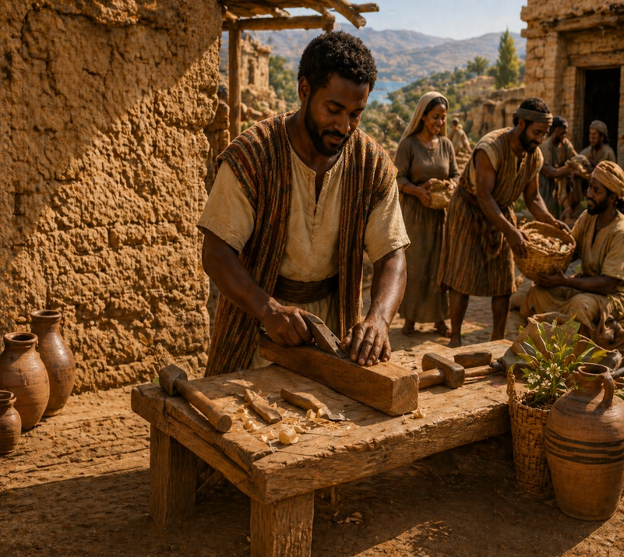

WORK AS CHRISTIAN DUTY
I have shewed you all things, how that so labouring ye ought to support the weak, and to remember the words of the Lord Jesus, how he said, It is more blessed to give than to receive.
—Acts 20:35 KJV
May 10

Slide 2
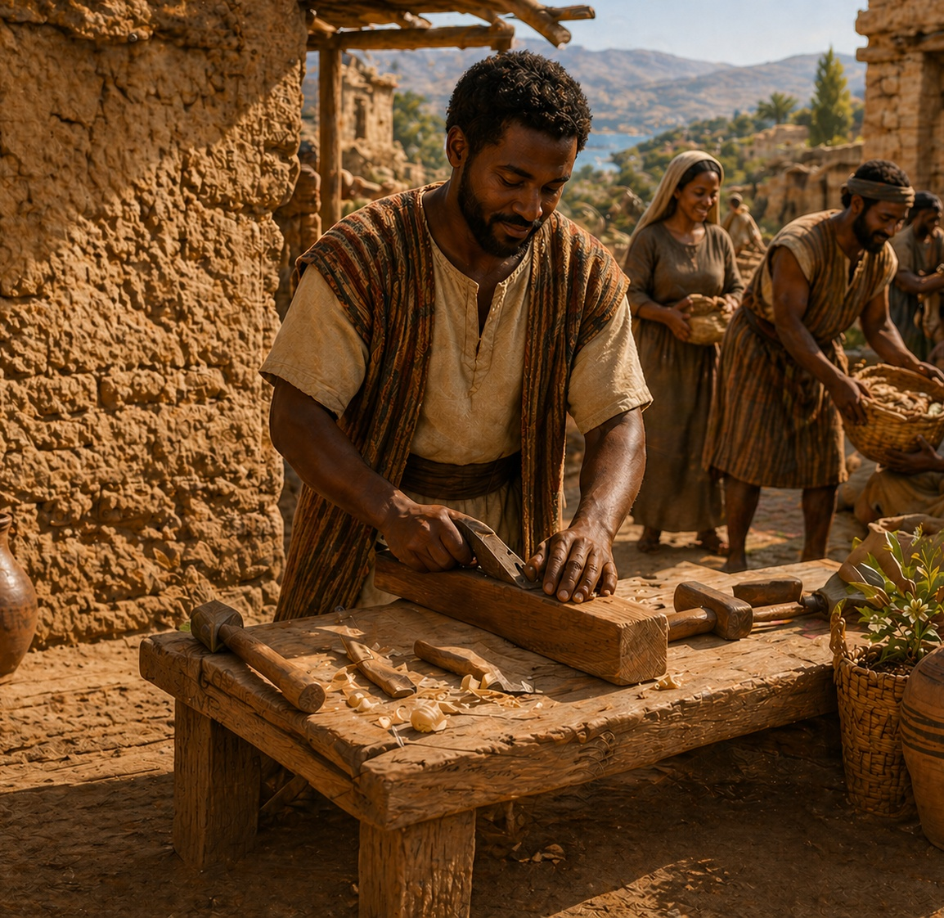

Devotion
Heavenly Father, thank You for reminding us why we are called to work. Help us embrace this message and maintain a positive attitude toward the work You have given us. We pray this in Jesus’ name.
Amen
Thought to Remember
Those who are able should engage in good work.
Notes:
Heavenly Father, thank You for reminding us why we are called to work. Help us embrace this message and maintain a positive attitude toward the work You have given us. We pray this in Jesus’ name. Amen.
Thought to Remember
Those who are able should engage in good work.

Slide 3

LESSON OUTLINE
WORK AS CHRISTIAN DUTY
Lesson Scripture:
Lesson Focus: Be creative and productive in all you do.
Apply the Message:
Genesis 2:15; Exodus 20:9; John 5:17; 9:4; Acts 20:33–35; 2 Thessalonians 3:6–12
Work is not a burden to bear.
Review
Introduction
Lesson Context
Overview
Created for Service - Genesis 2:15; Exodus 20:9; John 5:17; 9:4; Acts 20:33–35
Case Study: The Church of Thessalonica - 2 Thessalonians 3:6-12 KJV
Summary
Bible Application
Conclusion
Question & Answers
Notes:
Created for Service - Genesis 2:15; Exodus 20:9; John 5:17; 9:4; Acts 20:33–35
Case Study: The Church of Thessalonica - 2 Thessalonians 3:6-12 KJV
======================
God’s Word calls all people to repentance, and His mercy extends far beyond human boundaries. In Jonah, we see a God who patiently restores His servant and compassionately warns a sinful city. While Nineveh humbles itself and receives grace, Jonah struggles with selfishness and misplaced priorities. Through this contrast, God teaches that true faith is not only obeying His command but also sharing His heart. The lesson reveals that God desires repentance, values every soul, and calls His people to reflect His mercy, not resist it.
Jonah 3:1–5 — Analysis
God’s word comes a second time to Jonah, revealing divine mercy not only toward Nineveh but toward His servant. Jonah obeys and proclaims, “Yet forty days, and Nineveh shall be overthrown.” The message is brief but authoritative, showing that God’s Word carries power independent of the messenger’s enthusiasm. Nineveh, a great and wicked city, is confronted with impending judgment.
Summary
Jonah delivers God’s warning, and the people of Nineveh respond immediately with belief, fasting, and humility. Even without a detailed sermon, the conviction of God’s message pierces their hearts, leading to repentance.
Commentary
This passage demonstrates that repentance begins with hearing and believing God’s Word (Romans 10:17). It affirms that no people are beyond God’s reach. God’s willingness to send Jonah again reflects His grace, while Nineveh’s response shows that true repentance involves both inward belief and outward action.
Jonah 4:6–8 — Analysis
God prepares a gourd to provide Jonah shade, easing his discomfort. Jonah rejoices greatly in this provision. However, God then appoints a worm to destroy the plant and a vehement east wind to intensify Jonah’s suffering, exposing his fragile joy and misplaced priorities.
Summary
Jonah’s happiness is tied to personal comfort rather than God’s purposes. When the gourd is removed, his emotional state collapses, revealing spiritual immaturity.
Commentary
God uses circumstances as teaching tools. The gourd represents temporal blessings, while its removal exposes Jonah’s self-centeredness. This reveals how easily believers can value comfort over compassion and personal relief over God’s mission.
Jonah 4:9–11 — Analysis
God confronts Jonah, asking if his anger over the gourd is justified. Jonah admits his anger, even unto death. God contrasts Jonah’s concern for a plant with His own compassion for Nineveh, a city with over 120,000 souls lacking spiritual understanding.
Summary
God reveals Jonah’s distorted values—mourning a plant while lacking concern for human souls. God affirms His rightful compassion for all people.
Commentary
This passage exposes the danger of spiritual pride and narrow mercy. God’s character is gracious and longsuffering (Exodus 34:6). The lesson is clear: God values people above possessions, and His servants must align their hearts with His compassion.

Slide 4

Introduction - Valuing Work
WORK AS CHRISTIAN DUTY
My grandfather taught me the value of hard work. After retiring from the military, he started his own construction business, enlisting the help of his teenage grandsons. We spent our summers pouring concrete and building homes from the ground up, laboring tirelessly from sunrise to sunset. After a long day of construction work, we would return to his 80-acre farm to tend to the cattle and handle various farm duties. We repeated this routine every weekday.
My grandfather grew up during the Great Depression (1929–1939), a fact I never fully appreciated as a teenager. His father and grandfather desperately wanted to work but struggled to find employment, making my grandfather’s formative years challenging. Witnessing their struggle, he developed a strong work ethic, which he passed to his grandsons by example.
In today’s lesson, we will explore God’s design for work, starting from creation and continuing through the life of the first-century church with application for today. While this lesson reviews a variety of Scripture texts, those of primary interest will be Acts 20:33–35 and 2 Thessalonians 3:6– 12, both focusing on words from the apostle Paul.
Notes:
Work is a God-ordained responsibility that shapes character, provides for needs, and reflects faith through disciplined, consistent effort. The writer recalls learning the value of hard work from his grandfather, who modeled diligence through construction labor and farming. Influenced by the hardship of the Great Depression, the grandfather viewed work as essential and honorable. This personal testimony connects to biblical principles, where Scripture teaches that work is part of God’s design and a reflection of faithful living. Paul’s teachings reinforce that believers should work responsibly, avoid idleness, and use their labor to support themselves and others.
Three Key Points
1. Work is learned through example and shaped by life experience.
2. Hard work builds discipline, responsibility, and character.
3. Biblical teaching affirms work as a spiritual duty, not just a necessity.
Three Life Lessons Learned
1. Value the opportunity to work—it is a blessing, not a burden.
2. Consistent effort today builds strength and stability for tomorrow.
3. A strong work ethic honors God and serves others through provision and generosity.
Analysis
This passage presents work as a learned value shaped by both experience and necessity. The grandfather’s life—formed during the Great Depression—instilled in him a deep appreciation for labor, not as a burden but as a privilege. He passed this ethic down through consistent example, not mere instruction. The narrative connects personal experience with biblical teaching, especially through Paul’s emphasis on diligence, responsibility, and self-sufficiency (Acts 20:33–35; 2 Thessalonians 3:6–12). Work is shown as both practical and spiritual.

Slide 5

LESSON OUTLINE
WORK AS CHRISTIAN DUTY
Daily Bible Readings
Week of May 11 through May 16
Proverbs 10:1–5, 15–16—Work Diligently Before God.
Matthew 20:1–16—The Workers and Their Wages.
Amos 5:6–15—God Demands Justice for All.
James 5:1–11—Wait Patiently for God’s Justice.
Colossians 3:12–17—Serving with Enthusiasm.
Deuteronomy 24:14–21—Justice for the Worker.
These scriptures reveal that work is not merely an economic activity but a moral and spiritual responsibility before God. Believers are called to labor diligently, serve with a Christlike spirit, and treat others with justice and fairness. While human effort is important, God’s grace governs ultimate reward. He condemns exploitation and calls for compassion toward workers, especially the vulnerable. When injustice occurs, believers are to trust God’s righteous judgment and remain patient.
Notes:
Proverbs 10:1–5, 15–16 — Work Diligently Before God
Analysis & Summary:
These proverbs contrast diligence with laziness. The wise work faithfully and gather in season, while the slothful bring shame and lack.
Commentary:
God honors disciplined labor. Wealth gained through righteousness sustains life, while idle living leads to ruin. Work reflects wisdom and reverence for God.
Matthew 20:1–16 — The Workers and Their Wages
Analysis & Summary:
Jesus teaches through a parable that all workers receive equal pay, regardless of hours worked, revealing the generosity of the landowner.
Commentary:
God’s grace is not earned by effort alone. While diligence matters, reward ultimately flows from divine mercy, not human comparison.
Amos 5:6–15 — God Demands Justice for All
Analysis & Summary:
God calls His people to seek Him by practicing justice, condemning those who oppress workers and distort fairness.
Commentary:
Work must be governed by righteousness. Exploiting others invites God’s judgment. True worship includes justice, fairness, and integrity in labor practices.
James 5:1–11 — Wait Patiently for God’s Justice
Analysis & Summary:
James warns the rich who oppress laborers and encourages believers to endure patiently until the Lord’s return.
Commentary:
God sees injustice and will judge it. Workers are called to patience and faith, trusting God’s timing rather than responding in bitterness.
Colossians 3:12–17 — Serving with Enthusiasm
Analysis & Summary:
Believers are called to clothe themselves with Christlike character and do all things in His name with gratitude.
Commentary:
Work is an act of worship. Serving others with love, humility, and thankfulness transforms ordinary labor into spiritual service unto the Lord.
Deuteronomy 24:14–21 — Justice for the Worker
Analysis & Summary:
God commands fair treatment of workers, timely wages, and provision for the vulnerable.
Commentary:
God defends the laborer. Ethical treatment in work is a divine requirement, reflecting His compassion and justice toward the poor and marginalized.
Unified Summary (Main Idea & Lesson)
Lesson:
God desires that we approach work with diligence, integrity, humility, and justice—honoring Him through both how we labor and how we treat others—while trusting His grace and timing for reward and justice.

Slide 6

LESSON CONTEXT
WORK AS CHRISTIAN DUTY
Purpose of Sabbath
Exodus 20:9 is part of God’s instructions about Sabbath, from the Ten Commandments. On the one hand, Sabbath is not new by the time that the Israelites are told to practice it. God’s rest on the final day of the week of creation is not because God was tired (Gen. 2:2–3). Instead, God’s seventh-day rest shows His favor. That is why God uses the
occasion to give a blessing. You may have noticed how it feels to enjoy a job well-done. If we create a piece of art that we are proud of, we probably want to hang it on the wall to enjoy it—part of the same idea. Remembering Sabbath is about honoring God’s work.
At the same time, Sabbath is also about freedom. Since the Hebrews had been enslaved in Egypt, God is especially interested to reinforce their freedom. Because of God’s miraculous provision, even when we are at rest, crops continue to grow; rain continues to fall; and the world doesn’t stop. Sabbath is a constant reminder that we are not at the center. We depend on God to provide.
6
Notes:
Purpose of Sabbath
Analysis
The Sabbath originates in God’s rest at creation, not from fatigue but as a declaration of completion and blessing. It teaches both reverence for God’s work and dependence on His provision. For Israel, it also symbolized freedom from slavery, reminding them they were no longer driven by endless labor but sustained by God’s grace.
Main Idea
The Sabbath teaches worship through rest, recognizing God as Creator and Provider.
Summary
Sabbath is rooted in God’s example of rest after creation, signifying satisfaction and blessing. It calls believers to honor God’s completed work while trusting Him for ongoing provision. For Israel, it reinforced their liberation from Egypt, teaching that life is sustained by God, not constant human effort.
Three Key Points
1. Sabbath reflects God’s completed and blessed work.
2. It reminds believers of their dependence on God’s provision.
3. It symbolizes freedom from bondage and endless labor.
Three Life Lessons Learned
1. Rest is an act of faith, trusting God to provide.
2. We are not sustained by work alone but by God’s grace.
3. Honoring God includes pausing to reflect on His goodness.

Slide 7
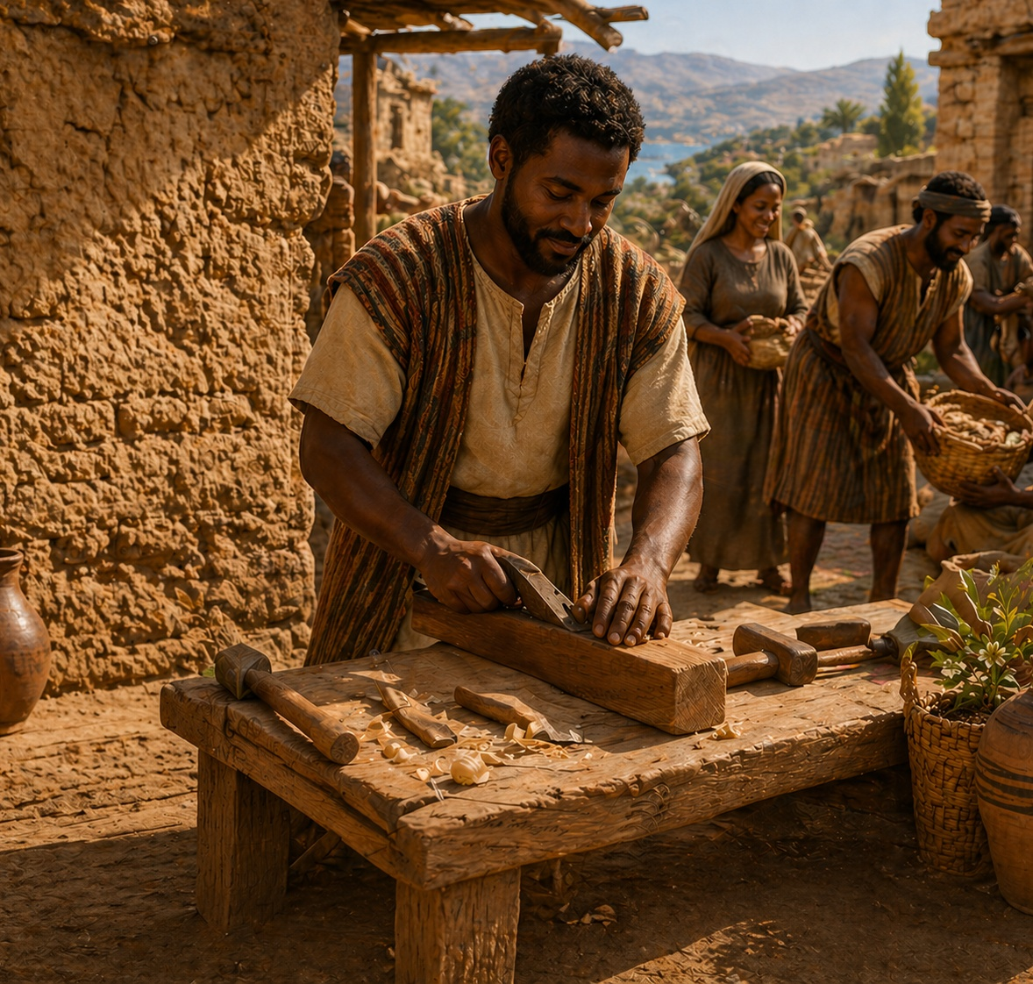
LESSON OUTLINE
WORK AS CHRISTIAN DUTY
Bonus Quote from Jesus
You may have noticed that the reading in Acts 20:35 contains a saying from Jesus. It might be surprising to also notice that the words are not found in any of the four Gospels. Why? John shares that the teachings of Jesus were too big to fit in a book (John 20:30–31). At the same time, there is close alignment with some of Jesus’ other teachings (Matthew 10:8; 25:34–36; Mark 10:21–22; Luke 14:12–14 ).
Paul’s Occupation
Even Paul, the one who first brought the gospel message to Thessalonica, was someone who worked with his hands. Acts 18:4 tells us Paul’s trade was “tentmaker. ” That would mean that he worked with various fabrics and textiles, repairing woven fabrics and leather goods. As a former rabbi, Paul would have learned his trade as his means of supporting himself. Jewish rabbis were expected to pair their knowledge of Torah with a secular occupation.
7
Notes:
BONUS QUOTE FROM JESUS
Jesus’ teachings emphasize generosity as a core expression of godliness. Though not recorded in the Gospels, the saying “It is more blessed to give than to receive” reflects Jesus’ broader teaching. Scripture confirms that His words and works exceeded what was written, yet consistently pointed toward sacrificial giving and compassion.
Three Key Points
1. Not all of Jesus’ teachings are recorded in Scripture.
2. His message consistently promotes generosity.
3. Giving reflects the heart of Christ.
Three Life Lessons Learned
1. True blessing is found in giving, not receiving.
2. Generosity aligns us with Christ’s character.
3. God’s truth is consistent, even beyond recorded words.
Analysis
Acts 20:35 preserves a saying of Jesus not recorded in the Gospels, showing that His teachings extended beyond written accounts. The statement aligns with His consistent emphasis on generosity and selflessness.
===========================================
PAUL’S OCCUPATION
Faithful ministry includes personal responsibility and diligent work. Paul supported himself through tentmaking, showing that spiritual leadership does not eliminate the need for practical labor. His example models integrity, independence, and a refusal to exploit others while serving God.
Three Key Points
1. Paul balanced ministry with manual labor.
2. Work supports independence and integrity.
3. Spiritual leaders model responsibility.
Three Life Lessons Learned
1. Work and ministry should complement each other.
2. Self-sufficiency strengthens credibility.
3. Serving God includes practical responsibility.
Analysis
Paul’s trade as a tentmaker demonstrates the integration of faith and work. His self-support reinforced his credibility and avoided burdening others. This reflects a Jewish tradition where spiritual leaders maintained practical skills.

Slide 8

LESSON CONTEXT
WORK AS CHRISTIAN DUTY
Traveling Preachers and Teachers
The Greco-Roman world was familiar with the phenomenon of traveling teachers and prophets. Sometimes these were well-meaning philosophers or preachers, but itinerant people could be swindlers too. The Greek iter Lucian of Samosota
writer (second century AD) tells a comedic story about a traveling “false prophet”—someone whose only goal was to get rich from the people he deceived. Paul warns churches not to be taken in by someone unwilling to work for their supper.
8
Notes:
Traveling Preachers and Teachers
Analysis
The presence of itinerant teachers created both opportunity and risk. While some were sincere, others exploited people for gain. Paul instructs discernment, warning against those unwilling to work.
Main Idea
Discernment is necessary to distinguish true servants from exploiters.
Summary
In a culture familiar with traveling teachers, not all were genuine. Paul cautions believers to evaluate character and work ethic, rejecting those who seek gain without contributing, protecting the integrity of the church.
Three Key Points
1. Not all spiritual leaders are trustworthy.
2. Genuine servants demonstrate integrity and diligence.
3. The church must practice discernment.
Three Life Lessons Learned
1. Evaluate leaders by character and actions.
2. Avoid supporting those who exploit others.
3. True ministry reflects humility, not greed.

Slide 9

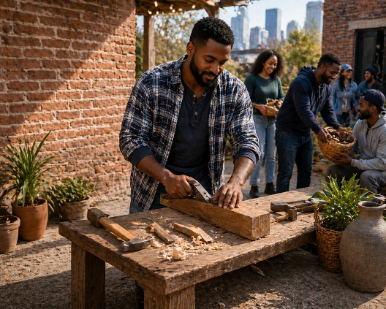

LESSON CONTEXT
WORK AS CHRISTIAN DUTY
The readings in this lesson cover the creation of humans, the pattern of Sabbath, and various examples in the New Testament. Through all these different books, the consistent pattern is that God designed us for creative work (even God “works” in a way). By being productive, we are conforming to this image. But work does not define our worth.
The book of Acts covers events from about AD 30 to 63. Our lesson segment from that book takes us almost to the end of that period.
In about AD 58, Paul traveled to Jerusalem after concluding his third missionary journey. Some members of the church in Jerusalem had fallen into poverty. Therefore, Paul’s trip included collecting offerings from the churches in Macedonia and Achaia (Romans 15:25–26; 1 Corinthians 16:1–4; 2 Corinthians 8:1–4). This offering allowed Christians who were predominately of Gentile background to support the Christians in Jerusalem who were predominately of Jewish background.
Paul initially planned to sail to Syria from Greece to deliver the offering. But discovering a plot against him, he traveled by land through Macedonia (Acts 20:3). Paul aimed to arrive in
Jerusalem by Pentecost (20:16), which would mark the anniversary of the church’s beginning (2:1). This would be a significant occasion for one group of Christians to receive a life-sustaining gift from fellow believers of different backgrounds.
Paul took the message of the gospel to the city of Thessalonica during his second missionary journey (AD 52–54). What we know about his effort to plant a church there and the immediate aftershock of doing so are recorded in Acts 17:1–9, 13. The apostle did not start a church in every town or city he visited. But the demographics of Thessalonica made that city a good candidate for a church plant. First, the city had one or more synagogues, where Paul liked to begin voicing his message (Acts 17:2, 10, 16). Second, the city was large—by some estimates, nearly 200,000 people lived there in the Roman era. Third, Thessalonica sat astride major trade routes of land and sea.
Some commentators think that the letters we call 1 and 2 Thessalonians were the very first of the New Testament documents written. Since our study concerns 2 Thessalonians, the most immediate literary context for it is 1 Thessalonians. That letter features a mixture of expressions of Paul’s gratitude, a summary of his ministry in the city, doctrinal clarifications, and instructions for daily life. The tone of 2 Thessalonians is direct, as Paul finds it necessary to review some of the same topics again.
9
Notes:
Analysis
This passage connects God’s design for work with the historical example of Paul’s ministry. From creation, humans are made to reflect God through productive, meaningful labor, yet their identity is not rooted in work itself. The New Testament example shows work expressed through generosity, unity, and mission. Paul’s collection for Jerusalem demonstrates that work produces resources not just for self, but for supporting others. His ministry in Thessalonica further emphasizes discipline, responsibility, and instruction for daily living.
Main Idea
God designed work as a reflection of His nature, but its purpose is to serve others, not define personal worth.
Summary
Scripture reveals a consistent pattern: God created humans for productive work, reflecting His own activity, yet human value is not determined by labor. In the New Testament, this principle is lived out through Paul’s ministry. His efforts to collect offerings for struggling believers in Jerusalem demonstrate how work supports unity and generosity across cultural lines. His ministry in Thessalonica further reinforces disciplined living and responsible work. Together, these teachings show that work is both purposeful and relational, serving God and others.
Three Key Points
1. Work reflects God’s creative nature but does not define human identity.
2. The fruit of work should support and unify others in the faith.
3. Christian living requires discipline, responsibility, and generosity.
Three Life Lessons Learned
1. Your worth comes from God, not your productivity.
2. Use what you earn or produce to bless others and build unity.
3. Faithful living includes consistent work, wise stewardship, and generosity.

Slide 10
LESSON OVERVIEW
WORK AS CHRISTIAN DUTY
Created for Service - Genesis 2:15; Exodus 20:9; John 5:17; 9:4; Acts 20:33–35
GENESIS 2:15 KJV 15 And the Lord God took the man, and put him into the garden of Eden to dress it and to keep it. |  | ACTS 20:33-35 KJV 33 I have coveted no man's silver, or gold, or apparel. 34 Yea, ye yourselves know, that these hands have ministered unto my necessities, and to them that were with me. 35 I have shewed you all things, how that so labouring ye ought to support the weak, and to remember the words of the Lord Jesus, how he said, It is more blessed to give than to receive.
EXODUS 20:9 KJV 9 Six days shalt thou labour, and do all thy work:
JOHN 5:17 KJV 17 But Jesus answered them, My Father worketh hitherto, and I work.
JOHN 9:4 KJV 4 I must work the works of him that sent me, while it is day: the night cometh, when no man can work.
• God created humanity as gardeners. They are like the Creator: giving order and tending to creation in their own capacity.
• Because of sin, humans can tend to value themselves by what they produce.
• God created Sabbath, a built-in way of showing that humans are not valuable only for their work.
• God’s work of redemption continued in Jesus.
• Our productive work continues, for the good of others.
Notes:
><><><><><><><><><><><><><><><
Genesis 2:15 NIV
15 The Lord God took the man and put him in the Garden of Eden to work it and take care of it.
- - - -
Exodus 20:9 NIV
9 Six days you shall labor and do all your work,
- - - -
John 5:17 NIV
17 In his defense Jesus said to them, “My Father is always at his work to this very day, and I too am working. ”
- - - -
John 9:4 NIV
4 As long as it is day, we must do the works of him who sent me. Night is coming, when no one can work.
- - - -
Acts 20:33-35 NIV
33 I have not coveted anyone’s silver or gold or clothing.
34 You yourselves know that these hands of mine have supplied my own needs and the needs of my companions.
35 In everything I did, I showed you that by this kind of hard work we must help the weak, remembering the words the Lord Jesus himself said: ‘It is more blessed to give than to receive. ’ ”
><><><><><><><><><><><><><><><
=---------------------------------------------------------------------
Created for Service
In the beginning, there was work to be done. In the narrative of the world’s creation, even before the introduction of sin, humans are made with a productive capacity and for the purpose of expanding God’s ordered creation—tending the primordial garden. The writer of Genesis 2 even anticipates this and calls out the need for someone to bring order to the earth: before humans, “there was no one to work the ground” (Gen. 2:5). God creates humanity from the ground for the purpose of bringing order to the ground.
In one form or another, all work is a continuation of these gardening skills. When Genesis is written, everyone inherits a farming or shepherding lifestyle, growing food and tending the earth directly. But in the modern age, when humans specialize in countless other professions, we still depend on the earth for food.
Even though God created humans to tend the ground, God’s favor does not derive from humanity’s productive efforts. In Egypt, Israel experienced what it means to be slaves—people valued only for what they can do. But as soon as God frees the Israelites from Egypt, He grants them the gift of Sabbath rest, a weekly reprieve from all work (Ex. 20:9). God loves us, even when we are unproductive. When the Father sends His Son to show this love, Jesus says that the work of God is not finished (John 5:17). God is carrying out the plan of salvation, bringing order back to creation. God has a plan to deal with sin and death, to ensure that His work is not in vain—that our work can align with what God continues to do. Thus, when Jesus breathes His last and gives His life, He signals the completion with the words, “It is finished” (John 19:30). His work is done.
So what are Christ’s followers to do? Are they invited to a life devoid of work, since the great work of redemption is at an end? Far from it! For the kingdom of God is at hand, reversing the fortunes of the weak and powerless. In all things, God’s people are to work for the good of others, ensuring that the message of Jesus goes forth unhindered. Jesus spent His labor and His life to serve others, and His followers will do no less. Paul reminds church leaders of Christ’s words: “It is more blessed to give than to receive” (Acts 20:35).
Analysis
This passage presents work as part of God’s original design, rooted in creation before sin. Humanity is created to bring order, reflecting God’s creative activity. Yet, it corrects a false view—human worth is not based on productivity. Israel’s slavery contrasts with God’s gift of Sabbath, showing His love apart from work. Christ fulfills the work of redemption, yet believers are called to continue working—not for salvation, but for service, aligning their labor with God’s ongoing purpose of restoration and compassion.
Main Idea
God created us to work as an expression of His image, but our work is meant for service, not self-worth.
Summary
From creation, humans were designed to work, cultivating and ordering God’s creation. Though work continues in many forms today, its purpose remains the same. However, Scripture makes clear that God’s love is not based on productivity, as seen in the Sabbath and Israel’s deliverance from slavery. Christ completed the work of redemption, yet His followers are still called to labor—not to earn worth, but to serve others and advance God’s kingdom. True work reflects generosity, service, and alignment with God’s purpose.
Three Key Points
1. Work is part of God’s original design and reflects His creative nature.
2. Human value is not determined by productivity but by God’s love.
3. Believers are called to serve others through their work in God’s kingdom.
Three Life Lessons Learned
1. Work faithfully, but never tie your identity to what you produce.
2. Rest in God’s love, knowing He values you beyond your labor.
3. Use your work as a means to serve others and advance God’s purpose.

Slide 11
LESSON OVERVIEW
WORK AS CHRISTIAN DUTY
Case Study: The Church of Thessalonica - 2 Thessalonians 3:6-12 KJV
⁶ Now we command you, brethren, in the name of our Lord Jesus Christ, that ye withdraw yourselves from every brother that walketh disorderly, and not after the tradition which he received of us.
⁷ For yourselves know how ye ought to follow us: for we behaved not ourselves disorderly among you;
⁸ Neither did we eat any man's bread for nought; but wrought with labour and travail night and day, that we might not be chargeable to any of you:
⁹ Not because we have not power, but to make ourselves an ensample unto you to follow us.
¹⁰ For even when we were with you, this we commanded you, that if any would not work, neither should he eat.
¹¹ For we hear that there are some which walk among you disorderly, working not at all, but are busybodies.
¹² Now them that are such we command and exhort by our Lord Jesus Christ, that with quietness they work, and eat their own bread.
• Paul writes to answer questions from a church he founded in Thessalonica.
• They heard rumors about the day of the Lord.
• The church was mixed up about the ongoing purpose of work.
• Paul says not to neglect productive work. Don’t rely on others to do all the work for you.
• Even though Paul was a leader, he showed leadership by working with his hands too.
• As we await Christ’s return, there is work to keep us busy.
Notes:
><><><><><><><><><><><><><><><
- 2 Thessalonians 3:6-12 NIV
Warning Against Idleness
⁶ In the name of the Lord Jesus Christ, we command you, brothers and sisters, to keep away from every believer who is idle and disruptive and does not live according to the teaching^{[a]} you received from us.
⁷ For you yourselves know how you ought to follow our example. We were not idle when we were with you,
⁸ nor did we eat anyone’s food without paying for it. On the contrary, we worked night and day, laboring and toiling so that we would not be a burden to any of you.
⁹ We did this, not because we do not have the right to such help, but in order to offer ourselves as a model for you to imitate.
¹⁰ For even when we were with you, we gave you this rule: “The one who is unwilling to work shall not eat. ”
¹¹ We hear that some among you are idle and disruptive. They are not busy; they are busybodies.
¹² Such people we command and urge in the Lord Jesus Christ to settle down and earn the food they eat.
><><><><><><><><><><><><><><><
Case Study: The Church of Thessalonica
In Acts 20:33–35, we read about Paul’s advice for Christians to continue to work on behalf of the weak, giving generously in the same way that Christ spent His time. Probably early in the apostle Paul’s ministry, he faced a challenge from the church he had founded in the large city of Thessalonica (see Acts 17:1–9). As we read what Paul says to this church, we hear him correct a misunderstanding of work that is repeated, even to this day.
For one thing, the Thessalonians were confused about the coming day of the Lord (2 Thess. 2:1–2). Since the earthly work of Christ is complete, and salvation is already at hand, these early Christians were understandably eager to hear news of Christ’s return. Some of them—perhaps certain that Christ’s return would shortly make their work valueless—had given themselves over to idleness or even quiting their jobs. If Jesus is about to appear, they thought, why continue to worry about earthly things like money?
Paul’s words against this perspective are sharp and specific. Do not let “idle” and “disruptive” people disrupt the kingdom mission (2 Thess. 3:6). The day of the Lord has not come, nor will Christ’s appearance invalidate the efforts of those who continue their work so that they can eat and to use money to live (vv. 8–10). Paul is perfectly willing to say that working in order to eat is natural: it’s the continuation of the gardening work that God gave humans.
But Paul and his companions could probably have argued that they were too important, too busy to be troubled to work with their hands. Instead, Paul and his ministry companions were as active at work as anyone else, providing a model for other leaders (vv. 7, 9). Does this mean that Paul would be against pastors earning a salary? Not at all, for in another context he says that ministry workers are worthy of financial support (see 1 Tim. 5:17–18). But Paul uses his own work as an example for this church: no one should spend their days with nothing to do, simply waiting for Christ’s return. What kind of example would that be? The work of the kingdom is simply too important, and the work continues.
Analysis
This case study addresses a misunderstanding of work within the Thessalonian church. Believers, expecting Christ’s imminent return, abandoned responsibility and became idle. Paul corrects this by affirming that work remains essential, even in light of future hope. He emphasizes that labor is part of God’s design and necessary for sustaining life and supporting others. By modeling diligence himself, Paul shows that spiritual leadership includes responsibility and example. Work is not negated by salvation but redirected toward kingdom purpose.
Main Idea
The expectation of Christ’s return does not eliminate work but reinforces the need for faithful, responsible labor.
Summary
Some Thessalonian believers stopped working because they believed Christ’s return was imminent. Paul strongly rebukes this behavior, teaching that idleness disrupts both personal life and the church’s mission. He affirms that work is natural, necessary, and part of God’s design. Paul himself worked to set an example, demonstrating that even those in ministry should model diligence. While ministry may be supported financially, no believer should live irresponsibly. Until Christ returns, work continues as part of faithful Christian living.
Three Key Points
1. Misunderstanding spiritual truth can lead to irresponsibility and idleness.
2. Work remains a necessary and God-ordained responsibility.
3. Leaders must model diligence and integrity through their actions.
Three Life Lessons Learned
1. Do not use spiritual expectations as an excuse to avoid responsibility.
2. Faithful living includes consistent work and self-discipline.
3. Your example in work influences others and reflects your faith.
1 When have you seen people become too concerned with knowing the day when Jesus returns?
It is good to pray for Christ’s return, as Christians have always done. But many Christian movements have been sidetracked and threatened by speculative claims about the day of Christ’s return. Jesus Himself says, “About that day or hour no one knows . . . but only the Father” (Matt. 24:36). Jesus’ return should never be an excuse for giving up on this world, since our consistent stewardship and love is what God expects.
2 How does Paul’s example of ministry work challenge misconceptions of leadership?
Paul was perhaps the greatest missionary of the early church. He traveled around from place to place, and he drew crowds almost everywhere he went. But this attention never went to his head or caused him to privilege his time more than the time of others. Paul didn’t consider himself too good to get his hands dirty and to earn a living. Leadership is not about leisure, bossing others around, or having things handed to us.
3 When have you been tempted to undervalue your own contributions, to let kingdom work be the responsibility of others?
Maybe we think we’re too insignificant, too young, too old, too limited, too poor, or too busy to make a difference for Christ. Jesus consistently invites us to meaningful work, a responsibility for managing God’s good world. Paul claims that our management responsibilities continue in the world to come (see 1 Cor. 6:2–3). This current life is preparation for greater responsibilities in the future.

Slide 12
One Bible, One Story
WORK AS CHRISTIAN DUTY
The Work of Eternity
You might suspect that, once Jesus returns, our productive lives are at an end, with nothing more to be done. Setting aside whether that sounds heavenly or not, what does Scripture say? In the image of a restored Eden in Revelation 22, John describes a renewed tree of life whose leaves are “for the healing of the nations” (v. 2). Of course this is highly symbolic imagery, but it would seem to suggest that the healing and sharing of new life still requires our creative participation. It sounds like a completely new kind of gardening experience!
Notes:
True hope in Christ produces faithful work, not idleness. Believers in Thessalonica misunderstood the timing of Christ’s return and stopped working. Paul rebukes this behavior, teaching that idleness harms both the individual and the church. Work is affirmed as God-ordained and necessary for sustaining life and serving others. Paul models diligence by working alongside his ministry, showing that no believer is exempt from responsibility. While ministry may receive support, all Christians are called to live disciplined, productive lives. Until Christ returns, believers must remain engaged in faithful labor and kingdom service.
Three Key Points
1. Incorrect beliefs about the future can lead to present-day irresponsibility.
2. Work is part of God’s design and continues after salvation.
3. Spiritual leaders must model the behavior they teach.
Three Life Lessons Learned
1. Hope in Christ should motivate diligence, not passivity.
2. Daily responsibilities are part of faithful Christian living.
3. A disciplined life strengthens both personal faith and the church’s witness.
Analysis
This case reveals how faulty doctrine can distort daily living. The Thessalonians, expecting Christ’s immediate return, abandoned work and became disorderly. Paul corrects them by reaffirming that labor is part of God’s created order and remains necessary even in light of future hope. He teaches that salvation does not remove responsibility but redirects it toward kingdom purpose. By working himself, Paul demonstrates that spiritual leadership requires discipline, humility, and example. Idleness is not spiritual—it is disruptive to both personal faith and the church’s mission.

Slide 13


Conclusion
WORK AS CHRISTIAN DUTY
Embracing Work
As fraught with difficulty as work may be in the fallen world we currently inhabit, work remains good. Given as a gift to humanity prior to the fall—and part of our purpose—we are invited to work alongside our heavenly Father and His Son, Jesus Christ. The Holy Spirit enables us to walk obediently, joining our worker God in His good work. The old axiom “We don’t work to live; we live to work” helps engage our thinking on this.
Paul reminds us that work serves both to meet our own material needs and the needs of those around us. Beyond earning a living, we can leverage our work and the resources it provides to serve others.
Through our work, we follow the example of our Creator and set a positive example for others to follow. Ignoring this example can lead to disunity and a weakening of the church, diminishing its testimony to the world. However, when the church works together and supports those who are weak and unable to work, unity is strengthened, God is glorified, and the church presents a powerful testimony to the world.
Notes:
Analysis
This passage affirms that work, though affected by the fall, remains a good and God-given calling. It is rooted in creation and continues as a means of partnering with God in His ongoing work. Through the Holy Spirit, believers are empowered to labor in obedience, using their work not only for personal provision but for the benefit of others. Work becomes both a reflection of God’s character and a witness to the world. Neglecting this responsibility weakens unity, while faithful, shared labor strengthens the church and glorifies God.
Main Idea
Work is a God-given calling that serves both personal provision and the unity and witness of the church.
Summary
Work, though challenging in a fallen world, remains a gift and purpose established by God. Believers are called to work alongside God through the power of the Holy Spirit, reflecting His character in their labor. Paul teaches that work provides not only for individual needs but also enables service to others. When believers embrace this calling, they strengthen the unity of the church and present a powerful testimony. Neglecting work leads to disunity, but faithful labor glorifies God and builds His kingdom.
Three Key Points
1. Work is a divine calling that reflects God’s nature.
2. Work provides for both personal needs and the needs of others.
3. Faithful work strengthens the unity and witness of the church.
Three Life Lessons Learned
1. Embrace work as a gift and opportunity to serve God.
2. Use your labor and resources to help others.
3. Your work ethic contributes to the strength and testimony of the church.

Slide 14
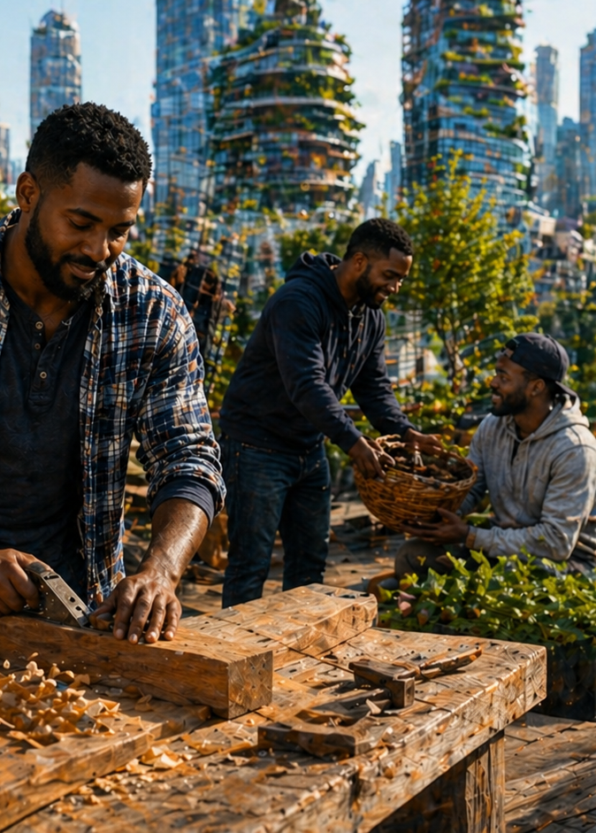
Apply the Message:
WORK AS CHRISTIAN DUTY
Work is not a burden to bear.
Set Free from Boredom
There is a particular week each summer when I take a vacation from my job. This isn’t an ordinary vacation, however. On this particular week, I join with dozens of other volunteers who give up their time to run a camp that is exclusively for children who have been touched by the foster system. One week a year, these campers arrive to find a group of counselors, leaders, and support staff who create a world with abundant choices, good food, and a safe environment for fun and friendship.
When new volunteers show up each year, the veterans have to remind them that this will be one of the craziest and most fatiguing weeks of their lives. Even for those who have been parents, nothing can prepare someone for the amount of running around and the excitement packed into a single week. I don’t think I could ever be as tired as I feel at the end of camp. It is hard work
At the same time, we get the chance to see God working in the lives of the most precious children. For campers who come back, year after year, we might see growth and new confidence rise as they return to a place that so generously displays the love of Christ. But when I come back to the “real world” and to my working routine, it will often take me two weeks to process the experience and to share with my wife everything I witnessed.
We all need rest and respite; we all need times of silence and solitude. But a world without anything to do would leave us empty and cold. God created us to be spiritual beings in action, cultivators of the order of creation, and useful to our church family. Whatever confidence we have in God’s good future, we can just as confident that meaningful work is at hand.
Notes:
Main Idea
Work is fulfilling when it serves God’s purpose and blesses others.
Summary
The writer describes volunteering at a demanding summer camp for children in the foster system. Though physically exhausting, the experience is deeply rewarding because it reveals God’s work in the lives of others. This demonstrates that meaningful work brings purpose and fulfillment. While rest is important, a life without purposeful activity leads to emptiness. God created people to be active participants in His work, serving others and contributing to His kingdom.
Three Key Points
1. Meaningful work often requires effort but brings deep fulfillment.
2. Serving others transforms work into a spiritual experience.
3. God created us for purposeful activity, not idleness.
Three Life Lessons Learned
1. Do not avoid hard work—embrace it when it serves a greater purpose.
2. The most rewarding work is often the most sacrificial.
3. True fulfillment comes from serving God and others, not from ease or comfort.
Analysis
This passage reframes work as meaningful service rather than a burden. The camp experience illustrates that even exhausting labor becomes fulfilling when it serves others and reflects God’s love. It highlights a biblical truth: humans are created for purposeful activity. While rest is necessary, complete idleness leads to emptiness. True satisfaction comes from participating in God’s work—serving, building, and impacting lives. Work becomes spiritually significant when aligned with God’s purpose and done for others.

Slide 15
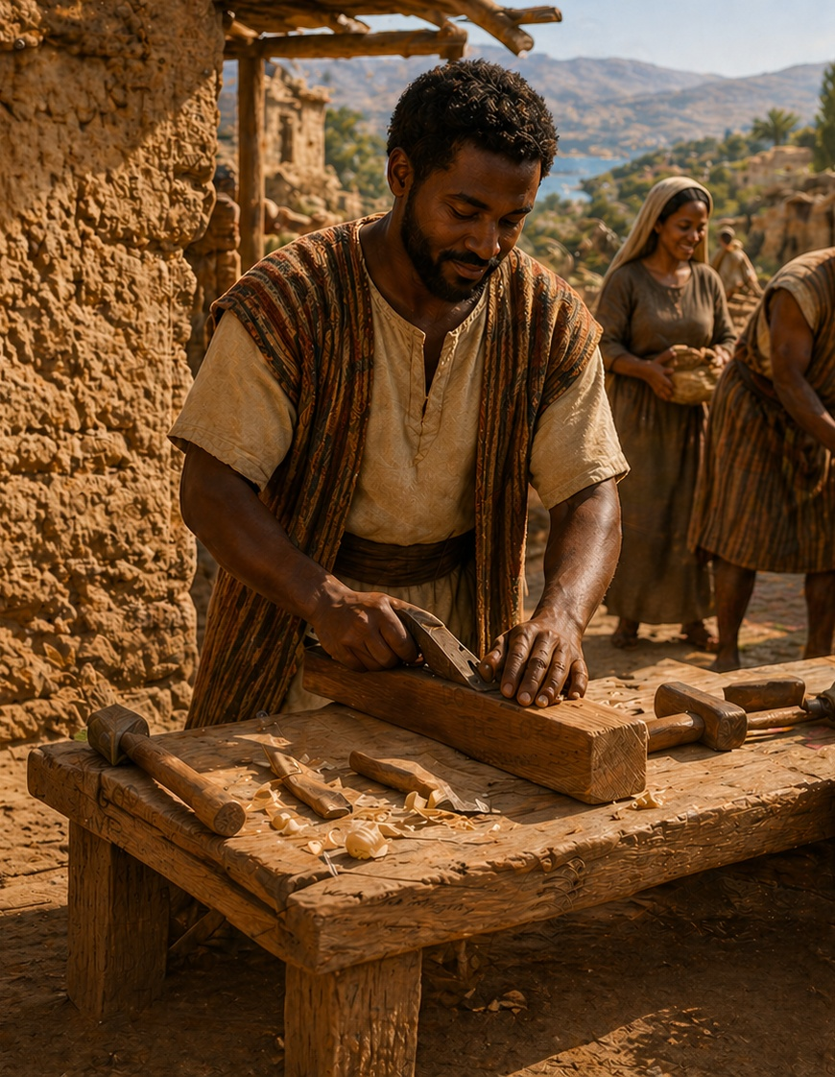
Apply the Message:
WORK AS CHRISTIAN DUTY
Work is not a burden to bear.
Set Free from Boredom
1 What kind of activity and hard work leaves you with joy?
2 When have you been challenged to find meaningful work?
3 In God’s kingdom, what is the kind of responsibility that you have been given?
Notes:
1 What kind of activity and hard work leaves you with joy?
Maybe you are a caregiver, and you can’t get enough warm snuggles from your kids. Maybe you host guests for a meal, and you love making delicious food. Maybe you are a carpenter by trade, and you feel immense satisfaction when you see all the edges of trim line up as they should. However God wired you, there is something in this world that you are created to do. It doesn’t mean you are competing to be the best.
2 When have you been challenged to find meaningful work?
Those of us who have strunot be able ggled with underemployment or unemployment know how hard it can be to want to work and to find work. Others find a trade that pays the bills, but they keep wanting something more from their work. Take that request to God.
3 In God’s kingdom, what is the kind of responsibility that you have been given?
God created each of us for a purpose, and sometimes it takes years to discern what ministry role we are meant to play. Some people discover that the “retirement” they planned turns out to keep them very busy—serving at church, welcoming the stranger, being someone who can be called upon. We can be confident in the future plans that God has for us.

Slide 16
CONCLUSION
WORK AS CHRISTIAN DUTY
Live It Out:
Find ways to offer gratitude for the work you have.
We are not meant to be idle. While it is good to enjoy regular rest as God intends, we come back to our work refreshed and ready to be productive. It is part of the meaning of being created in God’s image. We are poets, songwriters, gardeners, and creators. This week, invite God to show you how to take joy in your work.
Work as unto the Lord
It can be tempting to divide our lives into two categories: sacred and secular. But even before the introduction of sin, God gave humans work to do, so we can rightfully view our work— whether as a professional, a student, a homemaker— as an important part of our greater call to ministry.
Notes:
All work, when done unto the Lord, is sacred and part of our God-given purpose. Believers are encouraged to give thanks for their work and recognize it as part of God’s design. While rest is necessary, work remains central to human purpose as image-bearers of God. Whether in professional, academic, or home settings, all labor can be viewed as ministry. By inviting God into daily work, believers can find renewed joy, purpose, and fulfillment in what they do.
Three Key Points
Work is part of being created in God’s image.
There is no division between sacred and secular work.
Gratitude transforms how we experience our labor.
Three Life Lessons Learned
Thank God for your work, regardless of the task.
Treat every responsibility as an opportunity to serve God.
Find joy in your work by aligning it with God’s purpose.
Analysis
This passage teaches that work is not separate from spiritual life but an expression of it. Created in God’s image, humans are designed to create, serve, and contribute. Rest renews us, but work fulfills purpose. The false divide between “sacred” and “secular” is corrected—every role becomes ministry when done unto the Lord. Gratitude transforms perspective, allowing believers to find joy and meaning in their daily labor.

Slide 17
Devotion
Heavenly Father,
Although it can be hard to say, thank You for the privilege of having work to do. We see You at work and are grateful to partner with You as we labor on earth. Give us joy and energy throughout our days, and help us to see Your purposes in our work.
Amen.
Notes:
.
Heavenly Father,
Thank You for creating us in Your image and giving us meaningful work. Forgive us when we complain or tie our worth to what we produce instead of who we are in You.
Teach us to work diligently with integrity and joy, as unto You. Help us balance labor with rest, trusting in Your provision. Strengthen us to serve others, reflecting Christ’s love and generosity.
Holy Spirit, renew our strength and guide our efforts so that all we do glorifies You. When our work is finished, may we hear, “Well done. ”
In Jesus’ name, Amen.
God calls us to work diligently with integrity, serve others generously, and trust Him, knowing our worth rests in His grace.
God created us to work as His image bearers—serving with diligence, integrity, and generosity. Our labor does not define our worth but fulfills our purpose, glorifies God, strengthens the church, and blesses others while we faithfully await Christ’s return.

Slide 18



End
May God Bless and Keep you…
Material adapted by Stanford W. Bowman Jr. from Echoes® Adult and Bible-in-Life® Adult Spring 2026 quarter with permission, © David C Cook, https://davidccook.org. May not be further reproduced. All rights reserved.

Slide 19
QUESTION & ANSWER
WORK AS CHRISTIAN DUTY
Lesson Focus: Love “those people” like Jesus did.
Created for Service
1 Do you tend to think of work as an imposition or a blessing?
2 What are some ways that we overvalue our own work and let it define us?
3 Where do we see evidence that the work of God is still continuing to this day?
It’s natural for us to seek leisure and to minimize what we think of as “work. ” But from a theological standpoint, there has never been a world without a job for humans to do. While we each might take a different path in our working lives—perhaps longing for retirement, when the fruits of our past work can sustain us—many people find alternative habits of work and service, even when they don’t have need for more income. Our work can be a blessing to us, but it can also bless others.
Who among us has not felt the need to define ourselves by our profession and our work? If we have a good job with important responsibilities, perhaps we feel like an important person too. If we are unemployed or underemployed, it can easily cut us to the core and make us feel powerless. Ultimately, work is not what substantiates our value to God. God does not need anything from us, and we can ask God to help us to keep a healthy open-handedness about the way we earn a living.
We might see changes that God has wrought among our friends and neighbors. Or perhaps we think of desperate needs remaining in the world. When we see famines, war, and fractured relationships, we also know that God’s world is not yet remade, not yet fully conformed to the image of Christ. Where we see the gaps, we know God is not distant.
Notes:
1 Do you tend to think of work as an imposition or a blessing?
It’s natural for us to seek leisure and to minimize what we think of as “work. ” But from a theological standpoint, there has never been a world without a job for humans to do. While we each might take a different path in our working lives—perhaps longing for retirement, when the fruits of our past work can sustain us—many people find alternative habits of work and service, even when they don’t have need for more income. Our work can be a blessing to us, but it can also bless others.
2 What are some ways that we overvalue our own work and let it define us?
Who among us has not felt the need to define ourselves by our profession and our work? If we have a good job with important responsibilities, perhaps we feel like an important person too. If we are unemployed or underemployed, it can easily cut us to the core and make us feel powerless. Ultimately, work is not what substantiates our value to God. God does not need anything from us, and we can ask God to help us to keep a healthy open-handedness about the way we earn a living.
3 Where do we see evidence that the work of God is still continuing to this day?
We might see changes that God has wrought among our friends and neighbors. Or perhaps we think of desperate needs remaining in the world. When we see famines, war, and fractured relationships, we also know that God’s world is not yet remade, not yet fully conformed to the image of Christ. Where we see the gaps, we know God is not distant.

Slide 20
QUESTION & ANSWER
WORK AS CHRISTIAN DUTY
Lesson Focus: Love “those people” like Jesus did.
Case Study: The Church of Thessalonica
1 When have you seen people become too concerned with knowing the day when Jesus returns?
2 How does Paul’s example of ministry work challenge misconceptions of leadership?
3 When have you been tempted to undervalue your own contributions, to let kingdom work be the responsibility of others?
It is good to pray for Christ’s return, as Christians have always done. But many Christian movements have been sidetracked and threatened by speculative claims about the day of Christ’s return. Jesus Himself says, “About that day or hour no one knows . . . but only the Father” (Matt. 24:36). Jesus’ return should never be an excuse for giving up on this world, since our consistent stewardship and love is what God expects.
Who among us has not felt the need to define ourselves by our profession and our work? If we have a good job with important responsibilities, perhaps we feel like an important person too. If we are unemployed or underemployed, it can easily cut us to the core and make us feel powerless. Ultimately, work is not what substantiates our value to God. God does not need anything from us, and we can ask God to help us to keep a healthy open-handedness about the way we earn a living.
Maybe we think we’re too insignificant, too young, too old, too limited, too poor, or too busy to make a difference for Christ. Jesus consistently invites us to meaningful work, a responsibility for managing God’s good world. Paul claims that our management responsibilities continue in the world to come (see 1 Cor. 6:2–3). This current life is preparation for greater responsibilities in the future
Notes:
1 When have you seen people become too concerned with knowing the day when Jesus returns?
It is good to pray for Christ’s return, as Christians have always done. But many Christian movements have been sidetracked and threatened by speculative claims about the day of Christ’s return. Jesus Himself says, “About that day or hour no one knows . . . but only the Father” (Matt. 24:36). Jesus’ return should never be an excuse for giving up on this world, since our consistent stewardship and love is what God expects.
2 How does Paul’s example of ministry work challenge misconceptions of leadership?
Paul was perhaps the greatest missionary of the early church. He traveled around from place to place, and he drew crowds almost everywhere he went. But this attention never went to his head or caused him to privilege his time more than the time of others. Paul didn’t consider himself too good to get his hands dirty and to earn a living. Leadership is not about leisure, bossing others around, or having things handed to us.
3 When have you been tempted to undervalue your own contributions, to let kingdom work be the responsibility of others?
Maybe we think we’re too insignificant, too young, too old, too limited, too poor, or too busy to make a difference for Christ. Jesus consistently invites us to meaningful work, a responsibility for managing God’s good world. Paul claims that our management responsibilities continue in the world to come (see 1 Cor. 6:2–3). This current life is preparation for greater responsibilities in the future.

Slide 21
End
May God Bless and Keep you…
Material adapted by Stanford W. Bowman Jr. from Echoes® Adult and Bible-in-Life® Adult Spring 2026 quarter with permission, © David C Cook, https://davidccook.org. May not be further reproduced. All rights reserved.

