Slide 1
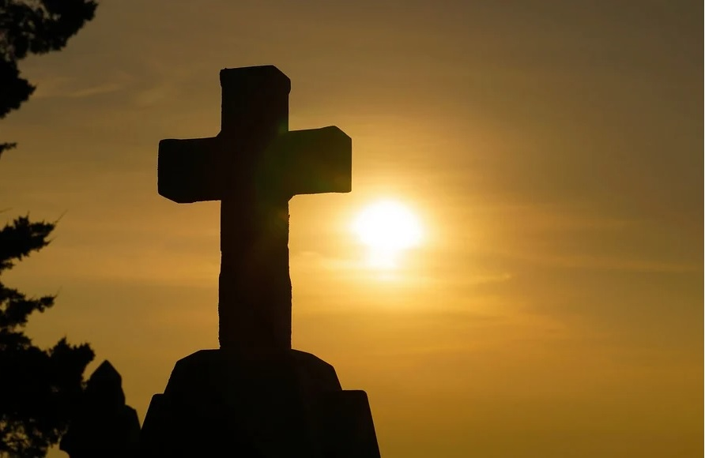

CHRISTIAN RHYTHMS OF LIFE
And he said unto them, The sabbath was made for man, and not man for the sabbath: Therefore the Son of man is Lord also of the sabbath.
—Mark 2:27–28 KJV
May 24

Slide 2

Prayer
Heavenly Father, may we depend on You in every act of devotion and every rhythm of life. Whether we are feasting in joy or fasting in sadness, working or resting, may we keep our eyes fixed on You, our Lord and king. In Jesus’ name we pray. Amen.
Thought to Remember
Christ is Lord over the rhythms of our lives.
Notes:
Prayer
Heavenly Father, may we depend on You in every act of devotion and every rhythm of life. Whether we are feasting in joy or fasting in sadness, working or resting, may we keep our eyes fixed on You, our Lord and king. In Jesus’ name we pray. Amen.
Thought to Remember
Christ is Lord over the rhythms of our lives.

Slide 3
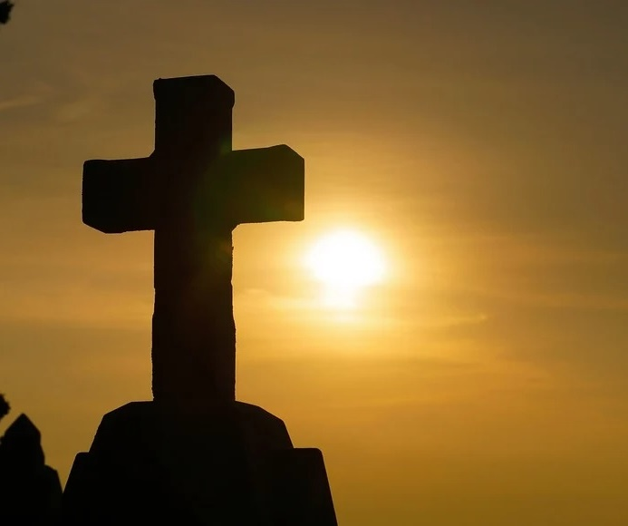
Agenda
CHRISTIAN RHYTHMS OF LIFE
LESSON SCRIPTURE:
Mark 2:18–28
Review
Introduction
Lesson Context
Overview
A Time for Feasting and Fasting - Mark 2:18–22 KJV
People Come First - Mark 2:23–28 KJV
Conclusion
Question & Answers
3
Notes:
A Time for Feasting and Fasting - Mark 2:18–22 KJV
People Come First - Mark 2:23–28 KJV
===================================
Mark 2:18–28 teaches that Jesus did not come to preserve empty religious traditions but to bring new life, grace, and true relationship with God. The Pharisees focused on rules and outward rituals, while Jesus emphasized mercy, compassion, and transformed hearts.
By calling Himself “Lord also of the sabbath,” Jesus revealed His authority over religious customs and taught that God’s laws were meant to help people, not burden them. The lesson reminds believers that true faith is centered on following Christ, not merely performing religious acts.
The lesson God desires us to learn is that faith must center on Christ Himself, not merely on rituals, routines, or external performances. God calls His people to worship Him with sincerity, receive the new life Christ offers, and extend mercy, wisdom, and compassion to others. True obedience is not legalistic bondage but joyful submission to the Lordship of Jesus Christ.
Summary — Mark 2:18–22
People questioned Jesus because His disciples did not fast like the Pharisees and John’s disciples. Jesus answered by comparing Himself to a bridegroom at a wedding. While the bridegroom is present, celebration—not mourning—is appropriate. Jesus then used the illustrations of new cloth on old garments and new wine in old bottles to show that His ministry introduced a new covenant that could not simply fit within old religious traditions. Christ came not merely to reform Judaism’s external rituals, but to fulfill God’s redemptive plan through grace, truth, and spiritual transformation.
Commentary — Mark 2:18–22
Jesus did not reject fasting itself; He corrected the misunderstanding behind empty religious practice. The Pharisees emphasized outward rituals, but Jesus emphasized relationship with God through Himself. Calling Himself the bridegroom revealed His divine identity and the joy of salvation found in His presence. The parables of the cloth and wine demonstrate that the gospel cannot be confined to legalism or tradition alone. Genuine faith requires inward renewal through Christ. Jesus teaches that the kingdom of God brings transformation, not merely external conformity. His followers must be spiritually renewed to receive the fullness of the new life He offers.
---
Summary — Mark 2:23–28
Jesus and His disciples walked through grainfields on the Sabbath, and the disciples picked grain to eat. The Pharisees accused them of violating Sabbath law. Jesus responded by referring to David eating the consecrated bread when in need. He then declared that “The sabbath was made for man, and not man for the sabbath,” and proclaimed Himself “Lord also of the sabbath.” Jesus taught that human need and mercy are consistent with God’s purpose for the Sabbath. The Sabbath was intended as a blessing, not a burdensome legal restriction.
Commentary — Mark 2:23–28
The Pharisees had turned God’s gift of rest into a system of rigid control. Jesus restored the true meaning of the Sabbath by emphasizing mercy, compassion, and God’s intent for humanity’s good. By referencing David, Jesus showed that preserving life and meeting genuine need take precedence over man-made interpretations of religious rules. His declaration as “Lord of the sabbath” affirmed His divine authority over both the Law and its interpretation. Christ teaches that obedience to God flows from love and relationship rather than legalistic performance. True worship honors both God’s holiness and His compassion toward people.

Slide 4
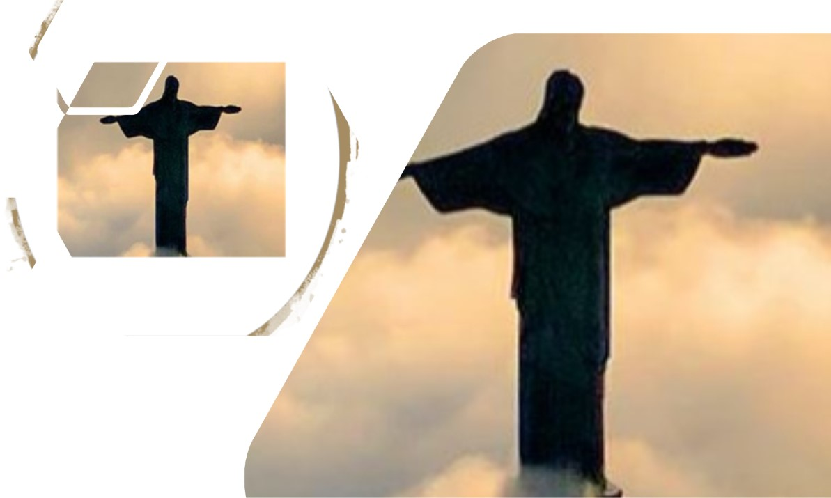
Challenging Cherished Customs
CHRISTIAN RHYTHMS OF LIFE
Every culture has customs that are widely practiced and deeply respected. In the United States, for instance, many people enjoy flying the flag and watching fireworks displays on the Fourth of July. At Thanksgiving dinner, people anticipate eating dishes like turkey and mashed potatoes. A sudden shift in traditional expectations comes as a shock. For example, suggesting a quiet evening indoors for Independence Day feels strange. Likewise, anyone invited to a Thanksgiving meal might feel confused if they receive only rice and beans. As with all traditions, the details matter.
Jesus challenged people to rethink old customs in light of the new things God was doing. Some people interpreted His teachings as contentious or controversial. Our text today highlights two specific traditions: fasting and the Sabbath.
Notes:
Jesus challenged religious traditions that had lost their true spiritual purpose. He taught that God’s work through Him required people to move beyond empty ritual and understand the deeper meaning of worship, grace, mercy, and relationship with God. Every culture values traditions and customs that shape expectations and identity. Changes to familiar practices often feel uncomfortable or even offensive because traditions become deeply rooted in daily life. In Jesus’ day, fasting and Sabbath observance were highly respected religious customs. However, Jesus challenged the way many people practiced these traditions. He showed that some religious leaders focused more on preserving rituals than understanding God’s heart. Through His teaching, Jesus revealed that God desired sincerity, compassion, and spiritual renewal rather than rigid legalism. His message called people to embrace the new work God was accomplishing through Him.
Three Key Points
Traditions Can Lose Their True Purpose Religious customs are valuable when they point people toward God, but they become harmful when they replace genuine faith and obedience.
Jesus Introduced a New Understanding of God’s Kingdom Jesus taught that His coming fulfilled God’s plan and required people to rethink old assumptions and traditions in light of God’s grace and truth.
God Values Mercy Over Legalism Jesus emphasized compassion, spiritual transformation, and relationship with God above rigid rule-keeping and outward appearances.
Three Life Lessons Learned
Examine Traditions Carefully Believers should honor meaningful traditions while ensuring they remain consistent with Scripture and God’s purpose.
Stay Open to Spiritual Growth God may challenge long-held assumptions in order to deepen faith, understanding, and obedience.
Prioritize Relationship Over Ritual True Christianity is not merely performing religious activities; it is living in loving fellowship with God through Christ.

Slide 5
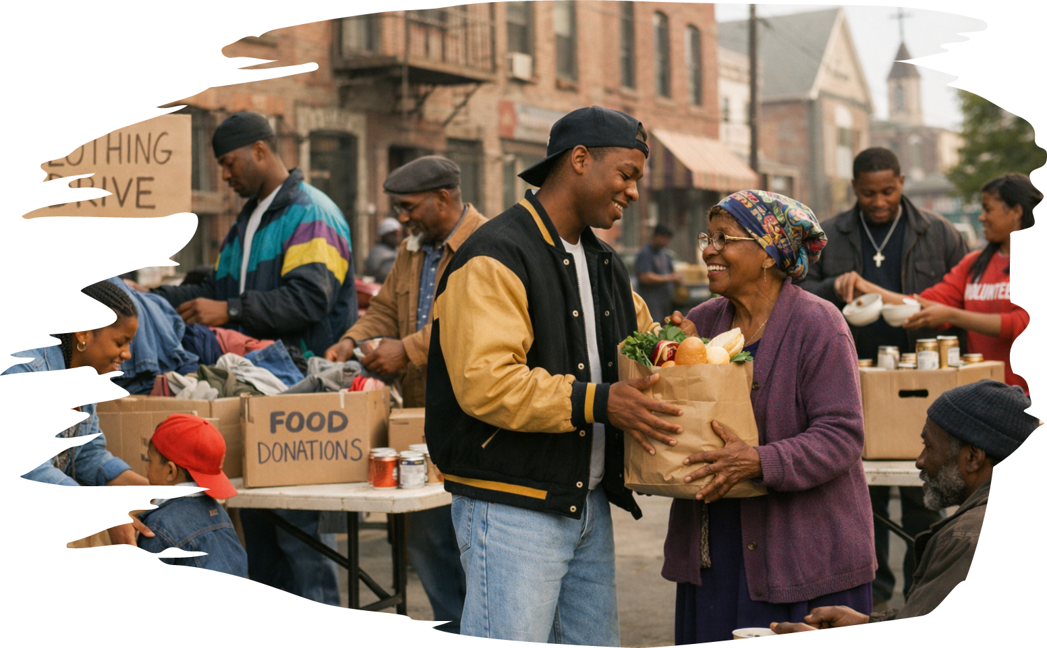
Daily Bible Readings
CHRISTIAN RHYTHMS OF LIFE
These passages reveal God’s desire for a worshiping, unified, joyful, and spiritually healthy people. True worship includes praise, obedience, repentance, reconciliation, service, and generosity. God calls believers to gather together in unity, care for one another, use their gifts faithfully, and restore broken relationships with love and humility. The church is meant to reflect God’s grace through joyful worship, transformed lives, peaceful fellowship, and sacrificial care for others.
Daily Bible Readings
Week of May 25 through May 30
Psalm 95—Let Us Sing to the Lord.
Psalm 122—Gladness in the House of the Lord.
Romans 12:1–8—Members of the Body of Christ.
Nehemiah 8:9–12—A Holy Day of Rejoicing.
Matthew 18:15–20—Restoring Healthy Relationships.
Acts 4:32–37—Fellowship Through Common Property
Notes:
God desires His people to live as one body in Christ—worshiping sincerely, serving faithfully, reconciling lovingly, and giving generously. True faith is not merely personal devotion but a transformed life expressed through unity, compassion, holiness, and joyful obedience within the community of believers.
=-=-=-=-=-=-=-=-=-=-=-=-=-
Psalm 95 — Let Us Sing to the Lord
Summary
Psalm 95 is a call to joyful worship and humble obedience. God’s people are urged to sing, rejoice, and bow before the Lord because He is the great Creator and Shepherd. The psalm also warns against hardening the heart as Israel did in the wilderness. Worship must involve both praise and faithful obedience to God’s voice.
Commentary
This psalm teaches that worship is more than music or celebration. True worship flows from recognizing God’s authority, goodness, and care. The warning against rebellion reminds believers that outward worship without obedient hearts displeases God. Joy and reverence must exist together in the life of God’s people.
Psalm 122 — Gladness in the House of the Lord
Summary
Psalm 122 expresses joy in gathering for worship in Jerusalem. The psalmist celebrates unity among God’s people and prays for peace within the city. The house of the Lord is presented as a place of worship, fellowship, justice, and blessing.
Commentary
Believers are strengthened when they gather together in worship. God designed His people to live in unity and peace, not isolation. Worship gatherings encourage spiritual growth, mutual support, and shared devotion to God. The church should remain a place where peace, righteousness, and love flourish.
Romans 12:1–8 — Members of the Body of Christ
Summary
Paul urges believers to present themselves as living sacrifices to God. Christians are not to conform to the world but to be transformed through renewed minds. The passage teaches that believers form one body in Christ, with different spiritual gifts given for serving one another faithfully.
Commentary
Christian life requires surrender, humility, and service. Every believer has value and purpose within the body of Christ. Spiritual gifts are not for pride or competition but for building up the church. Transformation begins inwardly and produces outward acts of faithful ministry and unity.
Nehemiah 8:9–12 — A Holy Day of Rejoicing
Summary
After hearing God’s Law read, the people wept because they recognized their sin. Nehemiah, Ezra, and the Levites encouraged them not to mourn but to rejoice because the day was holy unto the Lord. The people celebrated with gladness, generosity, and understanding of God’s Word.
Commentary
Conviction of sin should lead to repentance and renewed joy in God’s grace. God does not desire His people to remain defeated by guilt when forgiveness and restoration are available. Spiritual understanding produces rejoicing, worship, and compassion toward others in need.
Matthew 18:15–20 — Restoring Healthy Relationships
Summary
Jesus teaches believers how to handle sin and conflict within relationships. Private correction should come first, followed by additional witnesses if necessary. The goal is repentance and restoration, not humiliation. Jesus promises His presence wherever believers gather in His name and seek unity.
Commentary
God values reconciliation among His people. Healthy relationships require truth, humility, accountability, and forgiveness. Conflict should be handled carefully and biblically rather than through gossip or division. Christ desires restored fellowship and unity within the church community.
Acts 4:32–37 — Fellowship Through Common Property
Summary
The early believers lived in deep unity, sharing possessions and caring for one another’s needs. The apostles preached Christ’s resurrection with power, and God’s grace rested upon the community. Generosity became evidence of genuine fellowship and spiritual transformation.
Commentary
The early church demonstrated that faith affects how believers treat one another. Christian fellowship involves sacrifice, compassion, and stewardship. Unity grows when believers place God’s kingdom above selfish ambition. Generosity reflects the love and grace believers have received through Christ.

Slide 6
Lesson Context
CHRISTIAN RHYTHMS OF LIFE
The Gospel of Mark is known for its fast-paced action. It begins with John the Baptist’s ministry, preparing the way for Jesus (1:1–8). Once Jesus is baptized, His ministry begins with a proclamation of kingdom (1:15). He calls disciples, casts out demons, and performs miracles (1:16–45). But already by the second chapter of Mark, Jesus is facing one challenge after another. This lesson examines two controversies, when Jesus is challenged to explain and defend His actions. He has authority unlike anyone the people have heard before.
FASTING
In the Old Testament, God required only one formalized day of fasting (abstaining from food) for all of Israel. He called it the Day of Atonement (Leviticus 16:29–31; 23:26–32). Yearly, everyone in Israel was to observe the Day of Atonement on the tenth day of the seventh month (in late September or early October). On this day, the high priest sacrificed collectively for all the nation’s sins. His priestly act cleansed the people from impurity. The community participated through confession, prayer, and fasting.
Fasting was also associated with situations of grief, anxiety, or remorse. It was used in worship and preparation to draw near to God and to seek revelation, discernment, or help in overcoming temptation. Moses fasted for 40 days when he met God on Mount Sinai and received the Ten Commandments (Exodus 34:28). Soldiers fasted before entering battle (Judges 20:26; 1 Samuel 7:6), the nation fasted at Saul’s death (31:12–13), and parents fasted in distress over the illness of a child (2 Samuel 12:16). All Israel fasted in repentance when they recommitted to God’s covenant ways and heard the Mosaic law read aloud in Jerusalem after exile (Nehemiah 9:1).
We see continued evidence of fasting as a spiritual discipline in the New Testament. The prophetess Anna used fasting as a part of her perpetual worship in the temple (Luke 2:36–37). Jesus fasted for 40 days and 40 nights when the Spirit drove Him into the wilderness after His baptism (Matthew 4:2). The Pharisees were known for fasting twice weekly (Luke 18:12). Looking ahead to the practices of the early church, we see the apostles utilizing fasting in worship, for discernment, and when appointing elders (Acts 13:2; 14:23).
The passages of Matthew 9:14–17 and Luke 5:33–39 are parallels to today’s text on fasting.
6
Notes:
Section 1 — The Gospel of Mark and the Growing Controversy
The Gospel of Mark presents Jesus as the authoritative Son of God whose teachings, miracles, and actions challenged established religious expectations and revealed the arrival of God’s kingdom. Mark’s Gospel moves quickly from John the Baptist preparing the way for Jesus to Jesus beginning His public ministry. Jesus preached repentance, called disciples, healed the sick, cast out demons, and demonstrated divine authority. Yet His authority immediately created tension with religious leaders. By chapter two, Jesus faced criticism and opposition because His actions challenged traditional interpretations of religious practice. These controversies revealed that Jesus possessed authority greater than religious customs and human traditions.
Three Key Points
Jesus Came Proclaiming God’s Kingdom - His ministry announced that God’s reign had arrived through Him.
Jesus Demonstrated Divine Authority - His miracles, teachings, and power over demons showed authority unlike any ordinary teacher.
Religious Leaders Resisted Change - Many people struggled to accept Jesus because His teaching challenged established traditions and expectations.
Three Life Lessons Learned
God’s Truth May Challenge Comfortable Traditions - Believers must remain open to God’s correction and leading.
Jesus Has Absolute Authority - Christ’s words and actions must take priority over human opinions and customs.
Following Jesus Requires Faith and Flexibility - Discipleship often calls believers to rethink long-held assumptions.
Section 2 — Lesson Context: Fasting
Biblical fasting was intended to draw people closer to God through humility, repentance, prayer, and spiritual dependence rather than outward religious display. In the Old Testament, fasting was closely connected to worship, repentance, grief, prayer, and seeking God’s guidance. The Day of Atonement was the only required national fast for Israel, emphasizing confession and cleansing from sin. Throughout Scripture, people fasted during times of mourning, danger, repentance, and spiritual preparation. Moses, soldiers, grieving parents, prophets, Jesus, and the early church all practiced fasting. Over time, however, some religious leaders transformed fasting into an external ritual focused more on appearance and legalism than sincere devotion to God.
Three Key Points
Fasting Was Meant to Humble the Heart - It expressed dependence upon God rather than human strength.
Fasting Accompanied Prayer and Repentance - People fasted when seeking God’s forgiveness, wisdom, or intervention.
Religious Ritual Can Lose Spiritual Meaning - Some leaders focused more on outward performance than inward sincerity.
Three Life Lessons Learned
Spiritual Disciplines Should Deepen Relationship with God - Practices like fasting must flow from sincere faith.
God Desires the Heart More Than Ritual - External religious acts are empty without true devotion.
Believers Should Seek God in Times of Need - Prayer, fasting, and repentance help strengthen spiritual dependence upon Him.

Slide 7
Lesson Context
CHRISTIAN RHYTHMS OF LIFE
The Gospel of Mark is known for its fast-paced action. It begins with John the Baptist’s ministry, preparing the way for Jesus (1:1–8). Once Jesus is baptized, His ministry begins with a proclamation of kingdom (1:15). He calls disciples, casts out demons, and performs miracles (1:16–45). But already by the second chapter of Mark, Jesus is facing one challenge after another. This lesson examines two controversies, when Jesus is challenged to explain and defend His actions. He has authority unlike anyone the people have heard before.
Sabbath
Sabbath observance began after Israel escaped from slavery under Pharaoh in Egypt. The Law of Moses formalized the Sabbath as a commemoration of God’s rest after creation (Exodus 20:8–11; see lesson 10). As a liberated community, Israel learned a new pattern of healthy living, rewriting their mindset after being enslaved (Deuteronomy 5:15). Unlike other cultures of their time, God required His people to balance labor and toil with rest to reflect on His sovereignty. Their weekly rhythm required abstaining from work on the seventh day of every week. Obedience indicated reliance on God’s provision rather than human effort and achievement. Adherence to the imperative of Sabbath rest was a regular reminder of their dependence upon God.
7
Notes:
Lesson Context: Sabbath
God established the Sabbath as a blessing of rest, worship, and dependence upon Him, but human traditions eventually distorted it into burdensome legalism. The Sabbath originated after Israel’s deliverance from Egypt and became part of God’s covenant law. It reminded Israel that God was Creator, Provider, and Deliverer. By resting on the seventh day, the people demonstrated trust in God rather than constant labor and self-reliance. Over time, religious leaders added detailed regulations defining prohibited activities. What began as a gift of rest became a rigid system of legalism. Many focused more on technical rule-keeping than on honoring God with sincere hearts and compassionate living.
Three Key Points
The Sabbath Celebrated God’s Provision - Rest reminded Israel that God sustained their lives.
The Sabbath Was Intended for Human Good -God designed rest to bring spiritual renewal and worship.
Legalism Distorted God’s Purpose - Human traditions transformed a blessing into a burden.
Three Life Lessons Learned
Rest Is Part of God’s Design for Healthy Living - Believers need regular spiritual and physical renewal.
Trust God More Than Human Effort - The Sabbath teaches dependence upon God’s provision.
Avoid Empty Legalism - God cares about sincere worship, mercy, and obedience from the heart rather than rigid rule enforcement.
JESUS CONFRONTED RELIGIOUS LEGALISM BY RESTORING THE TRUE PURPOSE OF FASTING AND SABBATH OBSERVANCE. HE TAUGHT THAT GOD DESIRES SINCERE WORSHIP, SPIRITUAL RENEWAL, MERCY, AND DEPENDENCE ON HIM RATHER THAN EMPTY TRADITIONS AND OUTWARD RELIGIOUS PERFORMANCE.

Slide 8

Key Points
Jesus’ Practice of Fasting
CHRISTIAN RHYTHMS OF LIFE
A cursory reading of Mark 2:18–22 might leave the impression that Jesus never fasted or considered it necessary. However, the Gospels record a time when Jesus did fast. After His baptism, Jesus goes into the wilderness to be tempted (Matt. 4:1–2; Luke 4:2). As typical for Mark, this episode is more abbreviated (Mark 1:12–13). During this time of temptation, Jesus fasts for forty days and nights. He faces Satan, but He resists by relying on God’s Word. And in Matthew 6:16–18, Jesus His instructs disciples how to fast. He warns them not to look gloomy or sullen, which is what hypocrites do to attract attention while fasting. Instead, they are to fast in a way that God alone will see, and God will reward them in secret. Thus Jesus criticizes fasting that is performative or inappropriate, even while He expects disciples to fast under the right circumstances (see Mark 2:20 and the words “they will fast”).
Notes:
Jesus restored the true spiritual purpose of fasting and Sabbath observance by emphasizing heartfelt devotion, mercy, dependence on God, and obedience over empty religious tradition and legalistic performance. The Gospels show that Jesus did practice and value fasting, especially during His forty days of temptation in the wilderness, where He relied upon God’s Word to resist Satan. Jesus also taught His disciples how to fast properly—not for public attention, but sincerely before God. In contrast, many Pharisees focused heavily on outward religious traditions and strict interpretations of the Law while neglecting the condition of the heart. Their conflicts with Jesus centered on authority, mercy, and true obedience. Likewise, the Sabbath, originally established as God’s gift of rest and worship, had become burdened by legalism. Jesus clarified that the Sabbath was designed to bless people and glorify God through rest, worship, and acts of compassion. The New Testament ultimately presents both fasting and Sabbath observance as spiritual practices rooted in relationship with God rather than rigid rule-keeping.
Three Key Points
Jesus Affirmed Proper Fasting - Jesus practiced fasting Himself and taught His followers to fast with humility, sincerity, and dependence upon God rather than for human recognition.
The Pharisees Focused on Tradition More Than Transformation - The Pharisees emphasized external religious rules and traditions while often neglecting mercy, humility, and true spiritual devotion.
The Sabbath Was Created as a Blessing, Not a Burden - God designed the Sabbath to provide rest, worship, renewal, and trust in His provision, not oppressive legal restrictions.
Three Life Lessons Learned
Spiritual Disciplines Must Come from the Heart - Prayer, fasting, worship, and obedience should be sincere acts of devotion rather than performances meant to impress others.
Avoid Legalism in Faith - Believers must guard against elevating traditions or personal rules above God’s greater purposes of love, mercy, and truth.
Rest and Worship Are Gifts from God - Healthy spiritual living includes intentional times of worship, renewal, and dependence upon God rather than constant striving through human effort.

Slide 9
Key Points
Pharisees in Mark’s Gospel —
CHRISTIAN RHYTHMS OF LIFE
In Mark, the Pharisees are portrayed as primary opponents of Jesus. They represent a Jewish sect known for strict interpretation of the Mosaic law and the development of extensive oral traditions, all meant to maintain religious purity and devotion. The term Pharisee comes from an Aramaic word meaning “separate” or “distinguish. ” Mark depicts Pharisees in conflict with Jesus. They question why He eats with tax collectors and sinners, implying that He should not do so (Mark 2:13–17). They criticize His disciples for not washing their hands before eating (7:1–4). Jesus rebukes them for prioritizing human traditions over God’s commandments (7:8). He criticizes them together with servants of Herod—each following a mistaken ideal (8:15). The Pharisees resist Jesus’ authority, focusing on preserving their traditions instead of what is important to God: the heart. They would not follow Jesus, or put Him at the center!
Notes:
The Pharisees opposed Jesus because they valued religious traditions, external purity, and human rules more than true obedience to God and a transformed heart centered on Christ. In Mark’s Gospel, the Pharisees are presented as major opponents of Jesus. They belonged to a Jewish religious group committed to strict observance of the Mosaic Law and oral traditions intended to preserve ceremonial purity and devotion. However, their emphasis on rules and separation often caused them to miss God’s greater purpose. They criticized Jesus for associating with sinners, questioned His disciples’ actions, and condemned practices that did not conform to their traditions. Jesus rebuked them because they elevated human customs above God’s commandments and neglected matters of the heart. Their refusal to recognize Jesus’ authority revealed spiritual blindness and misplaced priorities.
Three Key Points
The Pharisees Prioritized Tradition Over Relationship - They focused heavily on external religious rules while overlooking inward transformation, mercy, and genuine devotion to God.
Jesus Challenged Empty Religion - Jesus exposed the danger of obeying traditions outwardly while neglecting the heart, compassion, and true obedience.
Resistance to Christ Often Comes from Pride - The Pharisees resisted Jesus because His authority threatened their control, status, and interpretation of religion.
Three Life Lessons Learned
God Looks at the Heart - True spirituality is measured by humility, obedience, love, and faithfulness—not merely outward religious activity.
Traditions Must Never Replace God’s Truth - Religious customs are helpful only when they support God’s Word rather than compete with it.
Keep Christ at the Center - Believers must continually examine whether their worship, service, and practices truly honor Jesus or simply maintain routine and tradition.

Slide 10
Key Points
New Testament Perspective on Sabbath
CHRISTIAN RHYTHMS OF LIFE
In the Old Testament, God instituted the Sabbath as a sacred day for rest and devotion to Him. It was modeled after the creation week—six days of work and a seventh day of rest (Gen. 2:2–3; Ex. 20:8–11). The Sabbath was a sign of God’s covenant with Israel and a reminder of His provision for them. During Jesus’ ministry, He clarifies the purpose of Sabbath observance. According to Luke 4:16, it was His custom to attend synagogue on the Sabbath. He also frequently heals people on this day (Luke 6:6–9; 13:14; 14:1–6), showing that doing good is consistent with God’s intent for Sabbath. The Sabbath remained important in the early church. Paul often attended synagogues on the Sabbath, during his missionary journeys (Acts 13:13-52; 16:11-15; 17:1-9; 18:1-4). In Colossians 2:16, Paul warns believers not to let anyone judge them regarding Sabbath observance. Ultimately, the New Testament portrays the Sabbath not as a legalistic requirement but as a gift for God’s people.
Notes:
The New Testament teaches that the Sabbath is God’s gift of rest, worship, renewal, and dependence upon Him—not a burdensome system of legalistic rule-keeping. The Sabbath originated in creation when God rested on the seventh day, establishing a pattern of work and rest for His people. Under the Mosaic covenant, the Sabbath became a sacred sign reminding Israel of God’s provision, deliverance, and sovereignty. During His earthly ministry, Jesus honored the Sabbath by attending synagogue regularly, yet He also corrected false interpretations surrounding it. By healing and helping people on the Sabbath, Jesus demonstrated that acts of mercy and compassion fulfilled God’s intent for the day. The early church continued to recognize the importance of worship and teaching connected to the Sabbath. However, the New Testament warns believers against turning Sabbath observance into a legalistic standard for judging others. Instead, the Sabbath is presented as a blessing meant to refresh God’s people spiritually and physically.
Three Key Points
The Sabbath Originated with God - The Sabbath was established during creation as a divine pattern of rest, worship, and trust in God’s provision.
Jesus Clarified the True Purpose of Sabbath - Jesus showed that the Sabbath should promote mercy, healing, worship, and restoration rather than rigid legalism.
The New Testament Emphasizes Freedom in Christ - Believers are warned not to judge one another over Sabbath practices, recognizing it as a gift rather than a burdensome requirement.
Three Life Lessons Learned
Rest Is Spiritually Necessary - God designed humanity to pause from constant labor in order to worship, reflect, and renew strength in Him.
Mercy Reflects God’s Heart - Helping people, showing compassion, and doing good honor God more than strict religious formalism.
Avoid Legalistic Judgment - Believers should focus on honoring God sincerely rather than condemning others over differing personal practices regarding worship and rest.

Slide 11
Key Points
Abiathar or Ahimelech?
CHRISTIAN RHYTHMS OF LIFE
Mark 2:25–26 contains a textual issue that has puzzled interpreters for centuries. In this passage, Jesus tells the story of David eating the consecrated bread, mentioning that this occurs in the days of Abiathar the high priest. However, in 1 Samuel 21:1–6, the high priest is identified as Ahimelech, the father of Abiathar (who is not mentioned until 22:20). One plausible explanation is to interpret “in the days of” as referring to a section in the Old Testament when Abiathar is mentioned. Before the Old Testament was divided into chapters and verses, it was common to refer to sections of Scripture using notable figures. Since Abiathar became high priest after Ahimelech and was more prominent, it makes sense that his name is used.
Notes:
The reference to Abiathar in Mark 2:25–26 does not undermine Scripture’s reliability but reflects a common ancient way of identifying a well-known section of biblical history through a prominent figure. In Mark 2:25–26, Jesus refers to David eating the consecrated bread “in the days of Abiathar the high priest.” However, 1 Samuel 21:1–6 identifies Ahimelech, Abiathar’s father, as the acting high priest at that moment. This apparent difficulty has led to much discussion among interpreters. One reasonable explanation is that Jesus referred to the broader historical period associated with Abiathar, who later became a far more prominent high priest connected closely with David’s reign. In ancient Jewish practice, sections of Scripture were often identified by notable individuals rather than precise chapter references, since chapters and verses did not yet exist.
Three Key Points
Ancient References Often Used Prominent Figures Biblical passages were commonly identified by well-known names connected to larger events or historical periods.
Abiathar Became Closely Associated with David - Although Ahimelech served as priest during the immediate event, Abiathar later became the more recognized priest in David’s life and kingdom.
The Focus of Jesus’ Teaching Was Mercy and Need - Jesus used David’s example to show that human need and God’s mercy take precedence over rigid legalistic interpretations.
Three Life Lessons Learned
Study Scripture Carefully and Contextually - Apparent difficulties in Scripture often become clearer through historical understanding and careful interpretation.
Do Not Miss the Main Spiritual Message - The central lesson in the passage concerns God’s mercy and the purpose of the Sabbath, not merely a technical detail.
Trust the Reliability of God’s Word - Questions in Scripture should encourage deeper study rather than weaken faith, revealing the richness and historical depth of the Bible.

Slide 12

A Time for Feasting and Fasting - Mark 2:18–22 KJV
CHRISTIAN RHYTHMS OF LIFE
18 And the disciples of John and of the Pharisees used to fast: and they come and say unto him, Why do the disciples of John and of the Pharisees fast, but thy disciples fast not?
19 And Jesus said unto them, Can the children of the bridechamber fast, while the bridegroom is with them? as long as they have the bridegroom with them, they cannot fast.
20 But the days will come, when the bridegroom shall be taken away from them, and then shall they fast in those days.
21 No man also seweth a piece of new cloth on an old garment: else the new piece that filled it up taketh away from the old, and the rent is made worse.
22 And no man putteth new wine into old bottles: else the new wine doth burst the bottles, and the wine is spilled, and the bottles will be marred: but new wine must be put into new bottles.
Jesus is getting questioned by two groups of people: disciples of John the Baptist and the Pharisees.
These religious conservatives are noticing that Jesus’ disciples do not habitually fast.
Jesus says that fasting is for a time when He is not with them (since Jesus brings the party).
He uses two additional illustrations to show that His ministry is something new.
12
Notes:
Jesus taught that His presence introduced a new work of God that could not be contained within old religious expectations, traditions, or outward rituals alone. People questioned why Jesus’ disciples did not fast like the disciples of John and the Pharisees. Since fasting was deeply connected to repentance, prayer, mourning, and devotion in Jewish life, the absence of fasting seemed unusual and possibly irreverent. Jesus answered by comparing Himself to a bridegroom at a wedding feast. Weddings were occasions of joy and celebration, not mourning and fasting. Jesus explained that while He was physically present with His disciples, it was a time of rejoicing. However, He also hinted at His future suffering and death by saying the bridegroom would eventually be taken away, and then His followers would fast. Through the illustrations of new cloth and new wine, Jesus showed that His kingdom could not simply fit into old religious systems. Something new, greater, and transformative had arrived through Him.
Three Key Points
Jesus Affirmed the Proper Place of Fasting - Jesus did not reject fasting but taught that spiritual practices must align with the proper season and purpose.
Jesus Identified Himself as the Bridegroom - By using wedding imagery, Jesus revealed His unique authority and the joyful nature of God’s kingdom arriving through Him.
The Kingdom of God Brings Something New - The illustrations of cloth and wineskins show that Jesus came not merely to preserve old systems but to bring spiritual renewal and transformation.
Three Life Lessons Learned
Relationship with Christ Brings Joy - The Christian life is not based only on ritual or sorrow but on joyful fellowship with Jesus.
Avoid Rigid Religious Thinking - Believers must remain open to God’s work rather than forcing His truth into human traditions or expectations.
Spiritual Practices Must Have Right Motives - Fasting, worship, and obedience should flow from sincere devotion to God rather than external pressure or performance.
><><><><><><><><><><><><><<><><><><><
A Time for Feasting and Fasting
Why no fasting? the people are asking Jesus. They observe that John the Baptist’s disciples and Pharisees are in the habit, but Jesus’ disciples are not (Mark 2:18). It strikes them as remarkable, maybe even a sign that Jesus is not as devout as He seems.
Fasting was a significant practice in Judaism. The Old Testament prescribes fasting on the Day of Atonement. Even though weekly fasting was not required by the law, regular fasts were common. They showed a commitment to prayer, repentance, or even lament for national crises: war, famine, and plagues (see 2 Sam 12:16; Ps 35:13; Zech 7:3–4; 8:19). Fasting was an integral part of Jewish life, so much so that it raised doubts if Jesus’ disciples were not participating. Didn’t Jesus care about the nation? Of course He did! Was Jesus setting aside time for prayer? More than most! Does Jesus keep the ancestral traditions? In most cases, He does!
Jesus responds with a wedding analogy: “How can the guests of the bridegroom fast while he is with them?” (v. 19). Subtly, Jesus is communicating that today is a special time, a joyous celebration. As long as the bridegroom is at the wedding, no one should be fasting. Jesus does not dismiss the legitimacy of fasting. He assures them that the bridegroom will eventually be taken away. When that day comes, His disciples will fast (v. 20). In the analogy, Jesus is the bridegroom. He is talking about His coming arrest and death. But for now, He’s right here. When Jesus is with you, it is time to celebrate. There will be time for grief and mourning later.
To emphasize that He is not just any important teacher, Jesus tells two miniparables. First, new cloth cannot be sewn onto an old garment. New cloth shrinks, and the clothes would tear (v. 21). Second, one tries to reuse old wineskins to store new wine. As the wine ages, the old wineskins would not stretch but burst (v. 22).
These tiny analogies are not as familiar to us as the original hearers, but the point is not hard to understand: something new is at hand. If people around Jesus are expecting Him to confirm everything they already think to be true, they will struggle. Jesus is the bridegroom, the most honored guest. Everything that came before was leading up to this moment. When He teaches, the people recognize that His words are full of authority (Mark 1:27). Mark doesn’t want to spoil the surprise, but if you are paying attention, you’ll know that Jesus is reconfiguring His contemporaries’ imaginations.

Slide 13
People Come First - Mark 2:23–28 KJV
CHRISTIAN RHYTHMS OF LIFE
23 And it came to pass, that he went through the corn fields on the sabbath day; and his disciples began, as they went, to pluck the ears of corn.
24 And the Pharisees said unto him, Behold, why do they on the sabbath day that which is not lawful?
25 And he said unto them, Have ye never read what David did, when he had need, and was an hungred, he, and they that were with him?
26 How he went into the house of God in the days of Abiathar the high priest, and did eat the shewbread, which is not lawful to eat but for the priests, and gave also to them which were with him?
27 And he said unto them, The sabbath was made for man, and not man for the sabbath:
28 Therefore the Son of man is Lord also of the sabbath.
The Pharisees see Jesus’ disciples picking grain to eat and accuse them of not keeping the Sabbath.
Jesus counters their accusation by reminding them that David and his men ate the consecrated bread, which only priests were allowed to eat, when they were starving on a mission.
Jesus told the Pharisees that God intended the Sabbath for people; He didn’t create people for the purpose of rigidly observing the Sabbath.
Jesus claims authority over the Sabbath.
13
Notes:
Jesus taught that God established the Sabbath to benefit people, not to burden them with legalistic rules, and He declared His divine authority as Lord over the Sabbath. While walking through grainfields on the Sabbath, Jesus’ disciples picked grain to eat because they were hungry. The Pharisees accused them of breaking Sabbath law by performing what they considered “work.” Their interpretation came from detailed religious traditions that expanded the Law beyond Scripture itself. Jesus responded by recalling how David ate consecrated bread reserved for priests when he and his men were in desperate need. By using this example, Jesus demonstrated that human need and mercy take priority over rigid ceremonial regulations. Jesus then declared that “The Sabbath was made for man, not man for the Sabbath,” teaching that God created the Sabbath as a gift of rest, worship, and blessing. Finally, Jesus revealed His authority by proclaiming Himself “Lord even of the Sabbath.”
Three Key Points
Human Need Matters to God Jesus showed that compassion and caring for people are consistent with God’s purpose and should never be overshadowed by rigid legalism.
The Sabbath Was Designed as a Blessing God created the Sabbath to provide rest, renewal, worship, and dependence upon Him rather than oppressive religious burdens.
Jesus Possesses Divine Authority By calling Himself “Lord of the Sabbath,” Jesus claimed authority over God’s law and revealed His divine identity.
Three Life Lessons Learned
People Are More Important Than Religious Formalism Believers should never value rules, traditions, or appearances above compassion, mercy, and helping others.
God Desires Rest and Renewal for His People The Sabbath principle reminds believers to trust God, pause from constant striving, and devote time to worship and spiritual renewal.
Submit to Christ’s Authority Jesus alone has the authority to define true obedience, worship, and spiritual priorities because He is Lord over all.
><><><><><><><><><><><><><<><><><><><
Mark 2:23–28
23 One Sabbath Jesus was going through the grainfields, and as his disciples walked along, they began to pick some heads of grain.
24 The Pharisees said to him, “Look, why are they doing what is unlawful on the Sabbath?”
25 He answered, “Have you never read what David did when he and his companions were hungry and in need?
26 In the days of Abiathar the high priest, he entered the house of God and ate the consecrated bread, which is lawful only for priests to eat. And he also gave some to his companions. ”
27 Then he said to them, “The Sabbath was made for man, not man for the Sabbath.
28 So the Son of Man is Lord even of the Sabbath. ”
People Come First
Mark 2:23 introduces another controversial event in Jesus’ ministry. On the Sabbath, Jesus and His disciples are walking through some grainfields, and the disciples pick heads of grain to eat. The Pharisees see this and, once again, confront Jesus. The Pharisees accuse the disciples of doing something unlawful on the Sabbath (v. 24). But what starts out as a question of Sabbath rules turns into a deeper conversation about Jesus and His authority.
The Pharisees’ accusation against the disciples is rooted in their interpretation of the Mosaic law. They argue that by picking grain, the disciples violate Exodus 20:8–11, which prohibits work on the Sabbath. Even though Exodus 20 does not define “work,” rabbinic tradition identified thirty-nine categories of work, all prohibited on the Sabbath. Among the prohibitions is reaping. Isn’t that what the disciples are doing by picking grain?
Jesus responds with a compelling scriptural argument (2:25–26). He references a story from 1 Samuel 21:1–6, when David broke normal regulations. He and his men were starving and facing deadly peril. David asked the priest for bread; and he accepted consecrated bread, the kind placed before God’s holy presence. Only priests were permitted to eat it.
David’s actions are more serious than picking heads of grain, yet he is not condemned for them. In his case, hunger took precedence over the law. Sabbath was not intended as a rigid system of onerous observances, and Jesus knows better.
In Mark 2:27, Jesus makes a stunningly simple observation: “The Sabbath was made for man, not man for the Sabbath. ” The Pharisees are focused on displaying religious devotion. They placed a heavy burden on the people (see Matt. 23:4). But Jesus reorients the conversation, pointing them to the story of creation. Which came first, humans or Sabbath?
As Jesus reasons, people are not created to observe Sabbath. The Sabbath is intended for them. It is not designed as a burden, one that leaves hungry people unable to eat. Even the word Sabbath means simply “rest” or “cease. ” Sabbath belongs to God, when all people turn their attention to the one who rescued them (see Ex. 31:13).
Jesus concludes His argument by saying, “The Son of Man is Lord even of the Sabbath” (Mark 2:28). Here, “Son of Man” is Jesus’ title for Himself. Jesus is saying that He is the one who has authority over Sabbath. He has the rightful authority to interpret and to make judgments about Sabbath. The day that belongs to God is something Jesus claims is under His authority.

Slide 14
One Bible, One Story: The Bridegroom
CHRISTIAN RHYTHMS OF LIFE
The imagery of the bridegroom is deeply rooted in the Old Testament. Throughout the prophetic literature, God is portrayed as a husband and lover of His people, Israel. Through prophets like Isaiah and Hosea, God communicates His covenant love for His people in marital terms. For example, Isaiah 62:4–5 says, “As a bridegroom rejoices over his bride, so will your God rejoice over you” (see also Isa. 54:5-6). Hosea 2:16 anticipates a day when Israel will call the Lord “my husband,” as He lovingly restores His bride, even though she has been unfaithful.
Interestingly, the Old Testament never presents the Messiah as a bridegroom. So when Jesus identifies Himself as bridegroom, the connection to Himself and the Messiah seems unique to Jesus. Jesus is the divine bridegroom— God in the flesh, lovingly pursuing a relationship with His people. Paul later describes the church as a bride awaiting her heavenly groom (2 Cor. 11:2); and Revelation 19:7–9 picks up on this wedding imagery, depicting a joyful wedding supper of the Lamb.
Notes:
By identifying Himself as the bridegroom, Jesus revealed His divine identity and His loving covenant relationship with His people, fulfilling God’s promise to dwell with and redeem His bride. The image of the bridegroom in Scripture originates in the Old Testament, where God describes His covenant relationship with Israel in terms of marriage. Through prophets like Isaiah and Hosea, God portrays Himself as a faithful husband who loves, restores, and rejoices over His people despite their unfaithfulness. However, the Old Testament does not explicitly describe the Messiah as the bridegroom. Therefore, Jesus’ use of this title is highly significant. By calling Himself the bridegroom, Jesus declares that He is God’s promised presence among His people. He is the divine Savior pursuing a loving relationship with humanity. The New Testament expands this imagery by describing the church as Christ’s bride awaiting the final heavenly marriage supper.
Three Key Points
God’s Covenant Love Is Described as Marriage - The Old Testament repeatedly portrays God’s relationship with His people through the language of faithful marital love.
Jesus Reveals Himself as the Divine Bridegroom - By identifying Himself as the bridegroom, Jesus connects Himself directly with God’s covenant promises and divine identity.
The Church Awaits Final Union with Christ - The New Testament presents believers as Christ’s bride, anticipating eternal fellowship and celebration with Him.
Three Life Lessons Learned
God Pursues His People with Love - Even when people fail or wander, God continues seeking restoration, faithfulness, and relationship with them.
Jesus Desires Relationship, Not Mere Religion - Christian faith is more than ritual or duty; it is a loving covenant relationship with Christ.
Believers Should Live with Expectation and Faithfulness - Like a bride awaiting her groom, Christians should live prepared, devoted, and joyful as they anticipate Christ’s return.

Slide 15


Apply the Message:
Jesus is the authority over how we live.
Jesus at the Center
CHRISTIAN RHYTHMS OF LIFE
Fasting and Sabbath observance are practices that can seem strange and foreign to the modern world. But notice that many people are obsessed with productivity, self-care, time-management, and dieting. We track steps, schedule rest, and follow rules about what we should and should not do with our bodies and our time. While we don’t face the same religious pressures, many of us can relate to the burden of constantly trying to “do it right. ” Whether it’s how we eat, rest, or work, the pressure to live by human-imposed rules can feel relentless.
This is what makes Jesus’ teaching in Mark 2:18–28 so striking. He does not dismiss fasting or observing the Sabbath as outdated or irrelevant. Rather, He redefines these practices, centering them on Himself. When questioned about fasting, Jesus reminds the people that His presence invites joyous celebration. The time for fasting and mourning comes when He is absent. When His disciples are criticized for not following Sabbath traditions, Jesus responds by saying that the Sabbath is for people, not vice versa. As Lord of the Sabbath, He has authority to interpret a God-honoring Sabbath routine.
It is easy for people to focus on outward appearances, But Scripture shows that God observes the heart (see 1 Sam. 16:7). Fasting, which is useful in times of intense prayer, expresses dependence on God. Likewise, Sabbath serves as a reminder that God is our provider, giving rest to the weary.
Fasting and Sabbath are not ends in themselves, but they should point us to Jesus. He fulfills our deepest hunger and gives us true rest. He should be at the center of our fasting, prayer, rest, and work. When our lives revolve around Jesus, these practices become life-giving instead of burdensome. Only through Him can we find true rest and fulfillment.
Notes:
Jesus must be the center and authority of every aspect of life, including worship, fasting, work, rest, and spiritual discipline, because only He provides true fulfillment and rest for the soul. Modern life places constant pressure on people to perform, succeed, manage time perfectly, and follow endless rules about productivity, health, and self-care. Although these pressures differ from the religious burdens faced in Jesus’ day, they can create the same exhausting struggle to “do everything right.” In Mark 2:18–28, Jesus redirects attention away from outward performance and toward Himself. He teaches that fasting and Sabbath observance are not empty rituals but practices meant to deepen dependence on God and bring spiritual renewal. Jesus declares Himself Lord of the Sabbath and explains that God designed these practices for humanity’s benefit. True rest, peace, and fulfillment come only when life is centered on Christ rather than human expectations or legalistic systems.
Three Key Points
Jesus Has Authority Over How Believers Live - Christ alone defines the proper purpose of worship, fasting, rest, and spiritual discipline.
Spiritual Practices Should Point to Christ - Fasting and Sabbath observance are valuable when they strengthen faith, dependence, worship, and relationship with Jesus.
God Desires the Heart More Than Outward Performance - The Lord looks beyond appearances and values sincere devotion, trust, humility, and obedience.
Three Life Lessons Learned
Do Not Let Human Expectations Control Your Life - Believers must avoid becoming consumed by performance, legalism, or constant pressure to appear successful or spiritual.
Find Rest in Christ - Jesus provides spiritual rest, peace, and renewal that no human system, schedule, or achievement can supply.
Center Every Part of Life on Jesus - Work, worship, fasting, rest, prayer, and daily living should all revolve around Christ as Lord and Savior.

Slide 16
Apply the Message:
Jesus is the authority over how we live.
Jesus at the Center
CHRISTIAN RHYTHMS OF LIFE
1 In what ways can people miss the point of fasting and observing the Sabbath today?
2 How might knowing that the Sabbath was made for people challenge your view of rest?
3 What are some practical ways we can keep Jesus as the center of our lives?
Notes:
1 In what ways can people miss the point of fasting and observing the Sabbath today?
One of the easiest ways to miss the point of fasting and Sabbath is to turn them into a rigid system of rules that must be followed. When people focus on outward actions and performance (especially to impress others), they stray from God’s intent. He wants these practices to be a means for people to connect with Him in relationship.
2 How might knowing that the Sabbath was made for people challenge your view of rest?
While it can be tempting to see the Sabbath as a burden, it should be regarded as a gift. God has given it to people for their own good. No one needs to feel guilty for enjoying rest, nor should they feel bad for doing necessary things that help others on the Sabbath.
3 What are some practical ways we can keep Jesus as the center of our lives?
Spending regular time in prayer and Scripture is perhaps the best way to keep Jesus at the center. Fasting is a way we can express dependence on Him, and Sabbath rest can be a wonderful time to enjoy His presence. We can closely examine our daily habits to find ways to include Jesus in our lives.

Slide 17
Conclusion: Centering Customs on Christ
CHRISTIAN RHYTHMS OF LIFE
Christians around the globe hold differing viewpoints on the practices of fasting and Sabbath-keeping. Their practices reflect tradition, doctrinal convictions, and/or personal choice.
Today’s lesson gives a reason for this variety: Jesus, unlike the Pharisees, did not present set rules about fasting or the Sabbath. Instead, He pointed to their intent and His authority and presence. He taught new ways of living in God’s kingdom, focusing on freedom and well-being rather than strict adherence to rules and regulations (compare Colossians 2:16). Jesus calls us to center our spiritual practices on Him as the source of life. God designed humans to follow cycles of work, rest, feasting, and fasting. Jesus, as our Lord, invites us to trust Him on this. His way offers rest from burdens, not additional weight (Matthew 11:28–30; 1 John 5:3). Life with Jesus presents opportunities for both celebration and mourning, with Scripture guiding us in what is appropriate at any given time (Romans 12:15; 1 Corinthians 5:2; 2 Corinthians 7:11). If our spiritual disciplines strengthen our dependence on Jesus, then they are beneficial, regardless of the specifics (Romans 14:22; 1 Corinthians 8:8).
Ultimately, the goal is not to find the perfect formula for any rhythm of life but to thrive in our relationship with Jesus. May He be the heartbeat, center, origin, and director of all we do.
Notes:
Main Idea
Spiritual practices such as fasting and Sabbath observance are meaningful only when they are centered on Christ and strengthen a believer’s relationship, dependence, and obedience to Him.
Summary
Christians throughout the world hold different views regarding fasting and Sabbath practices because Jesus emphasized their purpose more than rigid regulations. Unlike the Pharisees, Jesus focused on the heart, human well-being, and God’s kingdom rather than burdensome legalism. He taught that spiritual disciplines should lead believers into deeper trust, freedom, worship, and dependence upon Him. God designed life with rhythms of work, rest, celebration, mourning, feasting, and fasting. Scripture teaches that there are proper seasons for each. Rather than searching for a perfect religious formula, believers are called to make Christ the center of every practice and decision. Spiritual disciplines become beneficial when they draw people closer to Jesus and help them live faithfully under His lordship.
Three Key Points
Jesus Focused on Purpose Rather Than Legalism Christ emphasized the spiritual intent behind fasting and Sabbath observance instead of enforcing rigid man-made rules.
Spiritual Disciplines Should Strengthen Dependence on Christ Practices such as fasting, worship, and rest are valuable when they deepen faith, obedience, and relationship with Jesus.
Christ Must Remain the Center of Christian Living The goal of spiritual life is not perfect rule-keeping but a thriving relationship with Christ as Lord and Savior.
Three Life Lessons Learned
Avoid Turning Spiritual Practices into Burdens Religious habits should refresh and strengthen faith rather than produce guilt, pride, or oppressive legalism.
Seek Balance Through God’s Design Believers need healthy rhythms of work, rest, worship, celebration, repentance, and spiritual reflection.
Keep Jesus at the Center of Everything Every spiritual discipline, tradition, and decision should point believers toward deeper love, trust, and obedience to Christ.

Slide 18


Live It Out: Plan a Sabbath that is all about Jesus.
CHRISTIAN RHYTHMS OF LIFE
Sabbath is traditionally celebrated from Friday evening until Saturday evening. But since we serve the Lord of the Sabbath, maybe there is another habit of restraint and rest that
God invites you to try. As we plan a respite with Jesus, ask whether your Lord would want you to include anyone else. We have to make time.
Embracing Rest
The Sabbath is a gift from God, designed not as a burden but a delight. Once a week we are invited to rest and enjoy the Creator and His creation. If a Sabbath is already part of your rhythm, write down how you hope to spend it. If Sabbath is not your routine, plan a Sabbath with the Lord of Sabbath.
18
Notes:
God designed Sabbath rest as a gracious gift that draws believers into deeper fellowship, worship, peace, and renewal through Jesus Christ. The Sabbath was never intended to be a burdensome obligation but a time of joyful rest and renewed focus on God. Scripture teaches that believers need intentional rhythms of stopping, resting, worshiping, and delighting in the Lord. Jesus, the Lord of the Sabbath, invites His followers into spiritual and physical renewal through Him. Whether observed traditionally or through another intentional practice of rest and restraint, Sabbath reminds believers that life is sustained by God’s grace rather than constant striving. A Christ-centered Sabbath creates space for prayer, worship, reflection, family, fellowship, and gratitude. It also encourages believers to consider whether others should share in this time of encouragement, peace, and renewal.
Three Key Points
The Sabbath Is a Gift from God - God established Sabbath rest for humanity’s benefit, renewal, worship, and delight rather than legalistic obligation.
Jesus Is the Center of True Rest - Sabbath finds its deepest meaning in Christ, who gives peace, restoration, and rest for weary souls.
Rest Requires Intentional Planning - Believers must intentionally make time to step away from constant activity and focus on God’s presence.
Three Life Lessons Learned
Rest Is Part of Healthy Spiritual Living - Constant busyness can weaken spiritual health, but intentional rest renews the mind, body, and spirit.
Trust God More Than Productivity - Sabbath teaches believers to rely on God’s provision instead of believing life depends entirely on human effort.
Make Space for Worship and Relationships - Times of rest create opportunities to deepen fellowship with God, strengthen family relationships, and encourage others.

Slide 19
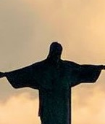
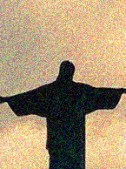



The Lord bless thee, and keep thee:
The Lord make his face shine upon thee, and be gracious unto thee:
The Lord lift up his countenance upon thee and give thee peace.
- Numbers 6:24-26,
Material adapted by Stanford W. Bowman Jr. from Echoes® Adult and Bible-in-Life® Adult Spring 2026 quarter with permission, © David C Cook, https://davidccook.org. May not be further reproduced. All rights reserved.

Slide 20
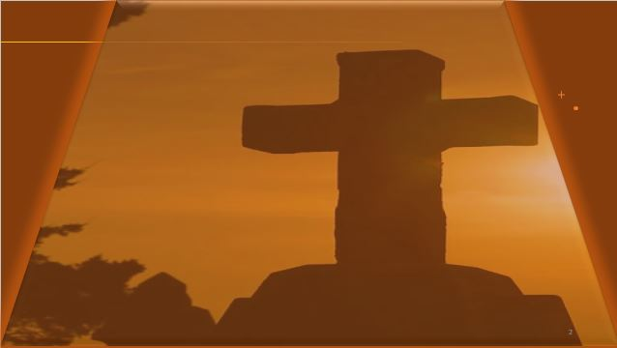
A Time for Feasting and Fasting
QUESTION & ANSWER
CHRISTIAN RHYTHMS OF LIFE
1 Why didn’t Jesus’ disciples fast?
2 Why can’t Jesus just go along with everything that the religious people thought to be important?
3 When have you had the experience of struggling to explain something about Jesus?
They were following the wishes of their teacher, and Jesus had not indicated it was time for fasting. Fasting is a tool for intense prayer and supplication, even during times of lament. Jesus describes Himself as the bridegroom at a feast, and fasting is not what you do when the guest of honor arrives! Jesus says they will fast, when He is taken.
I’m sorry, but it just doesn’t work like that. How can anyone really be giving Jesus the authority and honor that He deserves if they think that they already know everything? Many of the devoutly religious people of Jesus’ day were expecting something like a restoration of Israel’s past. God had a plan for an even better future.
It is normal to struggle to explain God. God is transcendent and not like things in the world that we describe every day. If we seek wisdom from God, we can be sure to find the words we need as witnesses in His name (see Mark 13:11).
Notes:
1 Why didn’t Jesus’ disciples fast?
They were following the wishes of their teacher, and Jesus had not indicated it was time for fasting. Fasting is a tool for intense prayer and supplication, even during times of lament. Jesus describes Himself as the bridegroom at a feast, and fasting is not what you do when the guest of honor arrives! Jesus says they will fast, when He is taken.
2 Why can’t Jesus just go along with everything that the religious people thought to be important?
I’m sorry, but it just doesn’t work like that. How can anyone really be giving Jesus the authority and honor that He deserves if they think that they already know everything? Many of the devoutly religious people of Jesus’ day were expecting something like a restoration of Israel’s past. God had a plan for an even better future.
3 When have you had the experience of struggling to explain something about Jesus?
It is normal to struggle to explain God. God is transcendent and not like things in the world that we describe every day. If we seek wisdom from God, we can be sure to find the words we need as witnesses in His name (see Mark 13:11).

Slide 21
People Come First
QUESTION & ANSWER
CHRISTIAN RHYTHMS OF LIFE
1 What makes the gleaning of the disciples objectionable to the Pharisees?
2 Why does Jesus refer back to David and the bread he ate?
3 What are the implications if Jesus is Lord of the Sabbath?
Gleaning looks like they are harvesting and processing food, which are traditionally not allowed during Sabbath. Sabbath is a day of rest, and food preparations must usually be completed in advance.
David was a king on mission, and his men were in desperate need. Jesus and His disciples are not fleeing for their lives yet (that comes later), but they are on a kingdom mission. If Israel’s king could allow his men to eat bread of the Presence, Jesus could allow His disciples to eat food they find in this presence.
Sabbath is God’s. God made it, regulated it, and expected His covenant people to remember it (thus, remembering God too). If Jesus is in charge of Sabbath, it sounds like important evidence that He is the Lord of all creation. In fact, He is.
Notes:
1 What makes the gleaning of the disciples objectionable to the Pharisees?
Gleaning looks like they are harvesting and processing food, which are traditionally not allowed during Sabbath. Sabbath is a day of rest, and food preparations must usually be completed in advance.
2 Why does Jesus refer back to David and the bread he ate?
David was a king on mission, and his men were in desperate need. Jesus and His disciples are not fleeing for their lives yet (that comes later), but they are on a kingdom mission. If Israel’s king could allow his men to eat bread of the Presence, Jesus could allow His disciples to eat food they find in this presence.
3 What are the implications if Jesus is Lord of the Sabbath?
Sabbath is God’s. God made it, regulated it, and expected His covenant people to remember it (thus, remembering God too). If Jesus is in charge of Sabbath, it sounds like important evidence that He is the Lord of all creation. In fact, He is.

Slide 22
The Lord bless thee, and keep thee:
The Lord make his face shine upon thee, and be gracious unto thee:
The Lord lift up his countenance upon thee and give thee peace.
- Numbers 6:24-26,
Material adapted by Stanford W. Bowman Jr. from Echoes® Adult and Bible-in-Life® Adult Spring 2026 quarter with permission, © David C Cook, https://davidccook.org. May not be further reproduced. All rights reserved.

