Slide 1
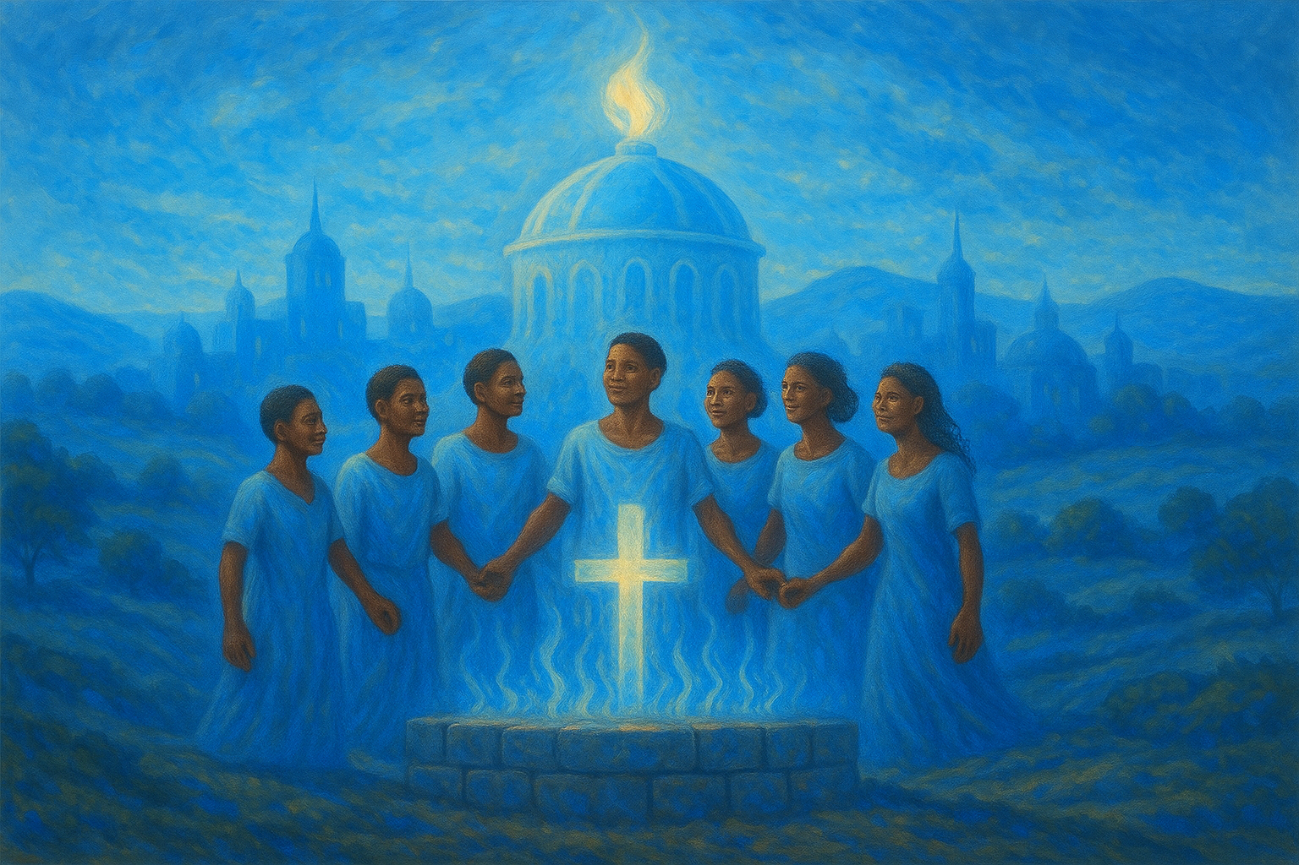
Christians as God’s Temple
For other foundation can no man lay than that is laid, which is Jesus Christ.
—1 Corinthians 3:11 KJV
Week of August 3
Notes:
Corinthian pagan temples, such as those in ancient Corinth, were grand structures dedicated to Greek and Roman deities. They served as centers of worship, ritual, and community life, where sacrifices and offerings were made to honor gods like Apollo, Aphrodite, and Poseidon. These temples often featured large courtyards, altars for sacrifices, and inner sanctuaries (naos) believed to house the deity’s image or presence. Architecturally, they showcased classical columns, intricate carvings, and elevated platforms, reflecting the power and glory of the gods they honored.
The Temple of Apollo in Corinth, one of the city’s most iconic structures, was built around 540 BC. It originally had 38 massive Doric columns (seven of which remain standing today) and was constructed from local limestone. It dominated the city’s landscape as a visible symbol of religious devotion and civic pride.
Here is an image of the Temple of Apollo from Corinth:

Slide 2
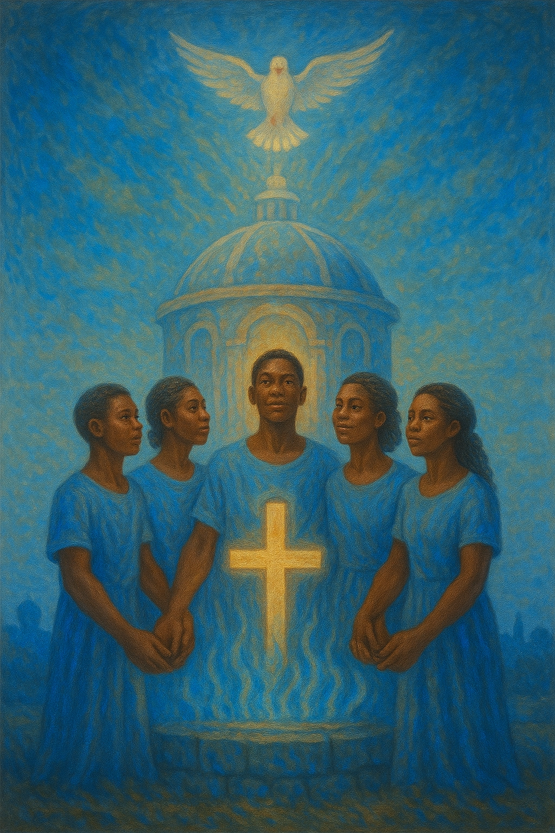
Prayer
Father God, thank You for choosing to live in us as Your temple. Teach us to honor one another as those blessed to carry Your presence. In Jesus’ name.
Amen.
Thought to Remember
    We carry God’s presence in the world.
Notes:
Prayer
Father God, thank You for choosing to live in us as Your temple. Teach us to honor one another as those blessed to carry Your presence. In Jesus’ name. Amen.
Thought to Remember
We carry God’s presence in the world.

Slide 3
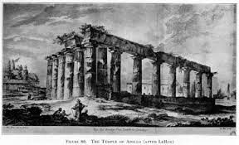
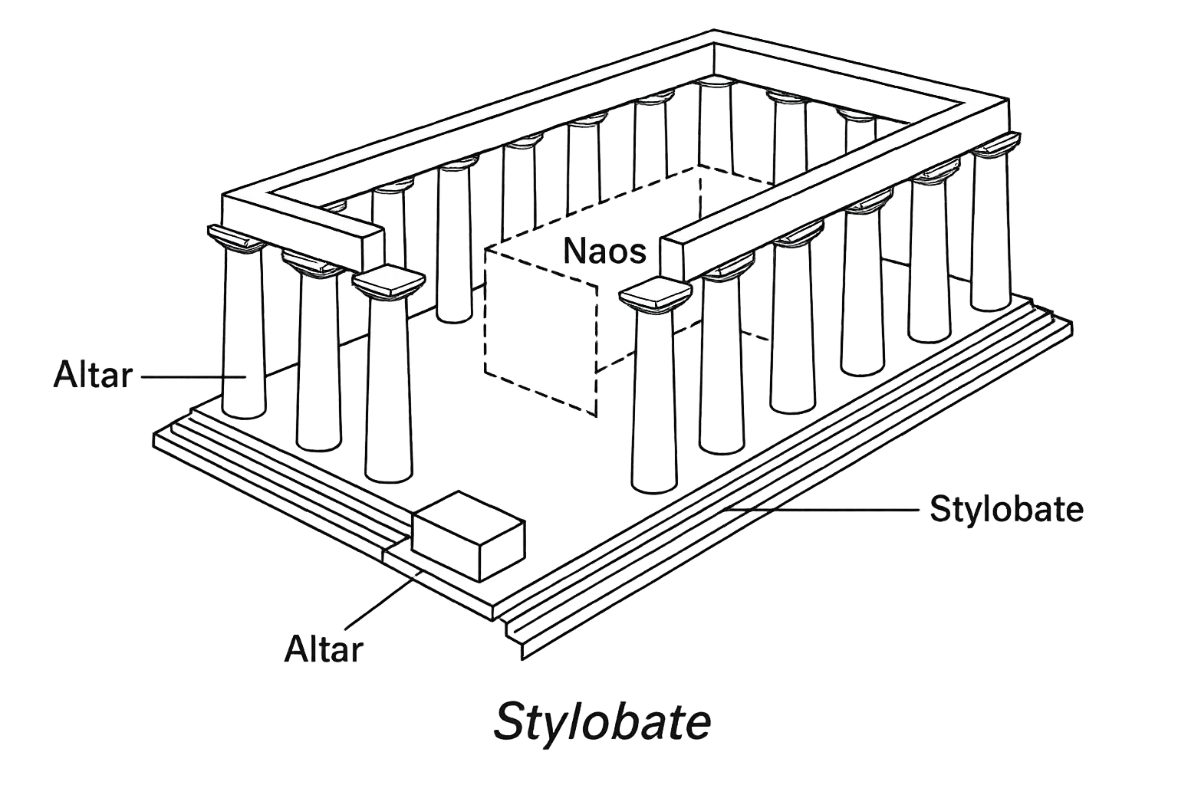
Christians as God’s Temple
Corinthian pagan temples were large, ornate structures devoted to gods like Apollo, Aphrodite, and Poseidon. They acted as centers for worship, rituals, and sacrifices, featuring open courtyards, altars, and inner sanctuaries (naos) believed to hold the deity’s image. Built with classical columns, carvings, and raised platforms, they symbolized the gods’ power and majesty.
Week of August 3
Notes:
Corinthian pagan temples, such as those in ancient Corinth, were grand structures dedicated to Greek and Roman deities. They served as centers of worship, ritual, and community life, where sacrifices and offerings were made to honor gods like Apollo, Aphrodite, and Poseidon. These temples often featured large courtyards, altars for sacrifices, and inner sanctuaries (naos) believed to house the deity’s image or presence. Architecturally, they showcased classical columns, intricate carvings, and elevated platforms, reflecting the power and glory of the gods they honored.
The Temple of Apollo in Corinth, one of the city’s most iconic structures, was built around 540 BC. It originally had 38 massive Doric columns (seven of which remain standing today) and was constructed from local limestone. It dominated the city’s landscape as a visible symbol of religious devotion and civic pride.
Here is an image of the Temple of Apollo from Corinth:

Slide 4
  Review
  Introduction
  Lesson Context
  Overview
    Building Faithfully - 1 Corinthians 3:10–15 KJV
    God’s Temple - 1 Corinthians 3:16–23 KJV
  Bible Application
  Conclusion
  Question & Answers
Notes:
Summary of 1 Corinthians 3:10–23
Paul teaches that Jesus Christ is the only true foundation for God’s church. Believers must build carefully, using enduring “materials” like faithfulness and truth, because every work will be tested by God’s judgment (vv. 10–15). The church is God’s temple, inhabited by His Spirit (vv. 16–17). Those who damage or divide it face God’s judgment. Worldly wisdom must be rejected, as it is foolishness before God. All things—life, death, present, and future—belong to God’s people, but they must live under Christ’s authority (vv. 18–23).
Commentary on 1 Corinthians 3:10–23
Paul warns church leaders and members to build upon Christ, the sole foundation, with care and integrity. The “fire” of the Day of the Lord will reveal whether their labor reflects eternal values or fleeting pursuits. The church, as God’s holy temple, carries His presence on earth, demanding unity and holiness. Paul rebukes prideful reliance on human wisdom and leaders, calling for humility and submission to God’s wisdom. By reminding believers that all things are theirs in Christ, Paul redirects their focus to God’s kingdom rather than worldly divisions or honors.

Slide 5
Strong Foundation
  My grandfather owned a real estate company, but his first love was general contracting. He was a frugal and conscientious man, deeply shaped by the Great Depression. As a result, he always advocated doing things well and right the first time. He believed in making things that would last.
  When I was 12 years old, my grandfather invited me out for a drive around our town. We spent the day visiting the buildings his company had constructed over the years. We saw office buildings, shopping centers, and apartment complexes. My grandfather would tell me an interesting story about each building and its construction.
  Just before dusk, we pulled into a neighborhood that, at first glance, seemed filled with large, new houses. But as we drove on, the houses became smaller and older. We finally stopped at a small, two-story home with blue siding and a gray roof. My grandfather said, “I built this house for my parents when I was 19 years old. It still stands today because I built it with care on a strong foundation. Everything that lasts has a strong foundation. ”
  I’ve never forgotten my grandfather’s lesson. In every pursuit, one’s work only lasts if the foundation is strong.
Notes:
My grandfather taught me that anything built to last must have a strong foundation. He showed me buildings he had built, including a small house he constructed for his parents when he was 19. Decades later, it still stood because he worked carefully and built it right. His lesson was clear: lasting success depends on a solid foundation.
Key Lesson:
True strength and lasting value in life or work come from building on a strong foundation, whether in construction, relationships, or faith.
Main Idea:
A lasting life or work requires a strong foundation built with care and integrity.
Three Key Points:
Building carefully and correctly creates durability and value.
A strong foundation supports endurance through time and challenges.
Lessons from past generations show that quality and care ensure lasting impact.
Summary:
The story highlights a grandfather’s belief that everything lasting begins with a solid foundation. Through visiting buildings he had built, especially a small home for his parents that still stood, he taught the value of building carefully and with quality. His lesson emphasizes that durability, whether in life or projects, depends on the foundation’s strength.

Slide 6
The Holy Spirit lives in you. In Paul’s letter to the Corinthians, the believers are called dwelling places for the Holy Spirit. The moment a person says yes to Jesus Christ and accepts His forgiveness, God’s sacred presence comes to dwell in their life.
What’s your foundation?—
Paul uses a picture of a building to emphasize his point. First, all structures stand on a foundation. He identifies that foundation as Jesus Christ (1 Cor. 2:1-2). Jesus alone is the structure upon which to build. But in Corinth, some were boosting their own preferred leaders. I follow Paul. I follow Apollos. Paul doesn’t stand for any of this. No! Jesus is the only one to be lifted up. Paul warns about building one’s foundation on any person—the building will wobble. What happens to a building with an unstable foundation? Eventually, it collapses.
Precious stones—
Paul continues to explain the materials used for a strong structure. Certain houses are made with wood, straw, or hay. These are cheap, temporary materials and easy to find. But understand, in a fire, those houses are gone. Materials that survive a fire are gold, silver, and other precious stones. Building with these (metaphorically) means building with something that can withstand the coming fire. The activities of a teacher and leader should be like precious stones. On judgment day, when fire is applied, the hope is that they shall remain. Paul is clear that this isn’t grounds for salvation, for “the builder [with only wood and hay] will suffer loss but yet will be saved” (1 Cor. 3:15). It matters to God what the body of believers is made of, how they represent Him, and how the brothers and sisters treat each other.
Notes:
BELIEVERS MUST LIVE AS VESSELS OF GOD’S SPIRIT, HONORING HIS PRESENCE IN THEIR LIVES.
================================
WHAT’S YOUR FOUNDATION?
Paul warns that Jesus is the only true foundation. Building life or faith on leaders or anything else leads to collapse because nothing else can hold steady.
Key Lesson:
Our faith and life must rest on Jesus alone, not on people or worldly preferences.
Main Idea:
Jesus Christ is the sole foundation for faith; building on anything else leads to ruin.
Three Key Points:
Paul rebukes the Corinthians for elevating leaders over Christ.
A foundation built on people is unstable and doomed.
Jesus alone can sustain the church and believers’ lives.
Summary:
Paul uses the image of a building to teach that Jesus is the only foundation. Corinthian believers, divided by loyalty to leaders, risked spiritual collapse. True faith must rest solely on Christ.
===================================
LIVE IN HIS PRESENCE
Paul says stop chasing worldly wisdom and pride. Instead, trust God, live in His care, and let His Spirit guide your life.
Key Lesson:
Living for God means rejecting empty pride and worldly thinking, embracing His Spirit’s presence.
Main Idea:
Christians must reject prideful, worldly wisdom and live in God’s Spirit and care.
Three Key Points:
Worldly wisdom and pride lack eternal value.
Believers must rely on God’s Spirit, not self-glory.
Living in God’s presence brings true guidance and strength.
Summary:
Paul warns believers not to trust in human wisdom or self-importance. True life and guidance come from living in God’s presence, letting His Spirit lead and sustain them.

Slide 7
The Holy Spirit lives in you. In Paul’s letter to the Corinthians, the believers are called dwelling places for the Holy Spirit. The moment a person says yes to Jesus Christ and accepts His forgiveness, God’s sacred presence comes to dwell in their life.
Live in His presence—
Paul warns to stop lying to ourselves. It’s foolish to cling to worldly wisdom and philosophies. Those thoughts and behaviors that puff us up hold no eternal value. Instead, we are to understand that we are in Christ’s care. Ask God to help you comprehend what it means to live in His presence, to be filled with His powerful Spirit.
Notes:
ChatGPT said:
Section 1: The Holy Spirit Lives in You
When you accept Jesus as Lord, God’s Spirit lives in you. You become His dwelling place, carrying His presence wherever you go.
Key Lesson:
Believers must live as vessels of God’s Spirit, honoring His presence in their lives.
Main Idea:
Christians are God’s dwelling place, filled with His Spirit after accepting Christ.
Three Key Points:
God’s Spirit enters the believer at salvation.
Each believer carries God’s sacred presence.
Living as God’s temple calls for holiness and awareness of His presence.
Summary:
Paul reminds believers that the Holy Spirit dwells within them, making them God’s temple. From the moment of faith and forgiveness, God’s presence resides in their lives, guiding and sanctifying them as His dwelling place.
Section 2: What’s Your Foundation?
Paul warns that Jesus is the only true foundation. Building life or faith on leaders or anything else leads to collapse because nothing else can hold steady.
Key Lesson:
Our faith and life must rest on Jesus alone, not on people or worldly preferences.
Main Idea:
Jesus Christ is the sole foundation for faith; building on anything else leads to ruin.
Three Key Points:
Paul rebukes the Corinthians for elevating leaders over Christ.
A foundation built on people is unstable and doomed.
Jesus alone can sustain the church and believers’ lives.
Summary:
Paul uses the image of a building to teach that Jesus is the only foundation. Corinthian believers, divided by loyalty to leaders, risked spiritual collapse. True faith must rest solely on Christ.
Section 3: Precious Stones
Paul says our work for God must be like gold and gems, lasting and strong. Cheap, shallow efforts won’t survive God’s testing, though salvation is still possible.
Key Lesson:
What we build for God must endure His testing; quality and faithfulness matter.
Main Idea:
God values lasting, faithful work over shallow or temporary efforts in building His church.
Three Key Points:
Gold, silver, and gems represent lasting, faithful work.
Wood, hay, and straw symbolize cheap, fleeting efforts.
God will test all work, rewarding what endures, even if the builder is saved without reward.
Summary:
Paul contrasts valuable, enduring materials with weak, temporary ones. Leaders and believers must build their service with enduring quality, as God’s judgment will reveal the true worth of their work.
Section 4: Live in His Presence
Paul says stop chasing worldly wisdom and pride. Instead, trust God, live in His care, and let His Spirit guide your life.
Key Lesson:
Living for God means rejecting empty pride and worldly thinking, embracing His Spirit’s presence.
Main Idea:
Christians must reject prideful, worldly wisdom and live in God’s Spirit and care.
Three Key Points:
Worldly wisdom and pride lack eternal value.
Believers must rely on God’s Spirit, not self-glory.
Living in God’s presence brings true guidance and strength.
Summary:
Paul warns believers not to trust in human wisdom or self-importance. True life and guidance come from living in God’s presence, letting His Spirit lead and sustain them.

Slide 8
Lesson Context
Acts 18:4 tells us that Corinth had a synagogue (as was the case in most of the large trading cities of the Roman Empire). Paul began his preaching in that synagogue, which was composed of both Jews and Greeks (18:4-5). But opposition caused him to leave and focus on the Gentiles of the city (18:6-7). Nevertheless, there was a strong contingent of Jewish believers in the Corinthian church (18:8).
It was to this mixed congregation that Paul wrote the two Corinthian letters while on his third missionary journey. The four years that elapsed between Paul’s time in Corinth and his first letter back witnessed the development of ungodly trends—trends that needed to be corrected.
Paul’s second missionary journey began as a trip to visit the congregations he had planted on his first journey (Acts 15:36). After doing so (15:41), the restless Paul desired to move on to new territory with the message of the gospel.
God influenced Paul’s itinerary through a vision that directed him to cross the Aegean Sea to the region known as Macedonia (Acts 16:9-10). Paul eventually arrived in Corinth in about AD 52, where he remained for some 18 months (18:11, 18). Corinth was a busy and wealthy center of trade in Paul’s day, a cosmopolitan city with residents from many regions. It was a place of lax morals and influential pagan religions.
Notes:
Paul traveled on his second missionary journey to revisit churches he had started, but God led him to Macedonia and eventually to Corinth. Corinth was wealthy, diverse, and morally corrupt. Paul preached there for 18 months, first to Jews, then to Gentiles. Later, he wrote letters to correct problems that arose in the church after his departure.
Key Lesson:
God directs His servants to challenging places, and churches must stay true to His ways despite cultural pressures.
Main Idea:
Paul, guided by God, ministered in Corinth, a diverse but morally corrupt city, and later addressed spiritual issues that developed in the church.
Three Key Points:
God redirected Paul’s journey, leading him to Corinth through a vision.
Corinth was a major trade hub with diverse people but rampant immorality and paganism.
Paul’s letters to the Corinthians addressed problems that arose after his ministry there.
Summary:
On his second missionary journey, Paul revisited earlier churches but was guided by God to Macedonia and then Corinth, where he ministered for 18 months. Corinth’s wealth, diversity, and moral corruption posed challenges. After Paul left, ungodly trends emerged in the church, prompting his letters to correct and guide the congregation.

Slide 9
Background
Precious Materials
The Day of the Lord
Gold, silver, and precious stones do not seem like practical building materials. However, Paul here probably draws upon biblical descriptions of the temple and the idealized Jerusalem. Gold and silver overlaid the walls of Solomon’s temple, and gemstones were also used in the construction (1 Chron. 29:1–9). Moreover, Isaiah 54:11–12 envisions a future Jerusalem with foundations, walls, and gates built from a variety of precious stones. Paul identifies this future Jerusalem of Isaiah 54 as the “Jerusalem which is above” (Gal. 4:26–27), the heavenly and perfected twin of the earthly city. Revelation 21 similarly describes this idealized Jerusalem as constructed of gold and gemstones (vv. 18–21). Paul may thus be identifying the church with this heavenly Jerusalem. In fact, Revelation 21:9 calls the ideal city “the bride, the wife of the Lamb,” and Ephesians 5:29–32 famously compares the church to Christ’s bride.
The Day of the Lord is a concept progressively developed and explained across the Scriptures. “Day” in this expression refers to the beginning of an important period in history, rather than a specific twenty-four-hour term. Some of the prophets of the Old Testament refer to the Day of the Lord as a recurring event, times that God judges the nations for their cruelty toward His people. Isaiah 13:6–10 envisions God’s judgment against Babylon, while Jeremiah 46:10 foretells God’s use of the Babylonians to judge Egypt (see also Ezek. 30). Other prophets anticipate that Israel and Judah will also face judgment (Amos 5:18– 27; Zeph. 1; Joel 1:1–2:17). Later prophets and the New Testament authors envision an ultimate end-time Day of the Lord, in which God delivers His people while judging the wicked and purifying His world (see Joel 2:18–32; Mal. 4:1–6; Phil. 1:6, 10; 2:16; 1 Thess. 5:2; 2 Peter 2:10, 13).
Notes:
Paul compares the church to the heavenly Jerusalem, described in Scripture as being made of gold, silver, and gems. These materials reflect beauty and permanence, connecting the church to God’s eternal city and to Christ, its bridegroom.
Key Lesson:
The church is not just earthly—it reflects God’s eternal, heavenly kingdom and must be built with qualities that last.
Main Idea:
Paul links the church to the heavenly Jerusalem, symbolizing its eternal value and connection to Christ.
Three Key Points:
The heavenly Jerusalem is described as built with gold, silver, and gemstones in the Bible.
Paul identifies the church with this eternal city, showing its heavenly nature.
The church, like the bride of Christ, reflects lasting beauty and God’s eternal plan.
Summary:
Paul’s imagery of gold, silver, and gems points to the heavenly Jerusalem, which Scripture describes as God’s eternal city. By linking the church to this city, Paul emphasizes its eternal significance and connection to Christ, portraying it as the bride of the Lamb and a reflection of God’s enduring kingdom.
The “Day of the Lord” isn’t just one day but marks times when God brings judgment and deliverance. In the Old Testament, it included judgments on nations and even Israel and Judah. Ultimately, it points to a final time when God will save His people, judge the wicked, and cleanse the world.
Key Lesson:
The Day of the Lord reminds us that God will bring justice, save His people, and hold the world accountable.
Main Idea:
The Day of the Lord represents times when God intervenes in history to judge the wicked and deliver His people, culminating in a final end-time fulfillment.
Three Key Points:
The “Day” signifies important periods of God’s judgment and deliverance, not a single 24-hour day.
Prophets described it as both recurring historical judgments and a future ultimate event.
Its ultimate fulfillment brings salvation for God’s people and purification of the world.
Summary:
The Day of the Lord, a recurring biblical theme, refers to God’s decisive intervention in history. It includes past judgments on nations and Israel, and points to a final future event where God saves His people, judges the wicked, and purifies His creation.

Slide 10
Background
Abiding Work
In 1 Corinthians 3:14–15, Paul contrasts the results of carefully building up the church with doing so carelessly. Those whose works survive God’s fiery testing will receive a reward, while those whose work is consumed will not. Christians often understand this passage as describing any vocation that a Christian pursues. Many find this interpretation attractive, as it implies that our labor has eternal import, whether or not we pursue traditional ministry. However, without denying that God cares about how we conduct ourselves in our careers, the scope of the warning in this passage is likely limited to those involved in ministry. Paul singles out himself, Apollos, and other leaders within the early church. The warning and consequences noted in this text most likely fall upon those who aspire to lead God’s people and directly build up His church. They have a higher responsibility and a “greater judgment” (James 3:1 KJV).
Notes:
Paul teaches that church leaders will face a special judgment for how they build up God’s people. Work that survives God’s testing will be rewarded, but work that fails will bring loss, even though the leader is still saved. This warning applies mainly to pastors and teachers, who carry greater responsibility.
Key Lesson:
Leaders in God’s church are held to a higher standard because their work impacts His people and must withstand His judgment.
Main Idea:
Paul warns that those who lead and build up the church will face testing, with rewards for faithful work and loss for careless labor.
Three Key Points:
God will test every leader’s work to reveal its quality.
Faithful, lasting efforts bring reward; careless efforts bring loss.
Church leaders bear greater responsibility and will face stricter judgment.
Summary:
Paul contrasts faithful and careless ministry, warning that God will test every leader’s work. Those whose labor endures will be rewarded, while those whose efforts fail will suffer loss, though still saved. This passage highlights the higher responsibility and accountability of church leaders before God.

Slide 11
Background
The Sanctuary of God
Temples were sacred sites where ancient people believed the divine and earthly realities met. The most sacred part of the temple was the naos, the inner sanctuary where the deity was thought to dwell. Paul actually uses this Greek word to describe the Corinthian church (vv. 16–17). They are not merely a temple complex. They are the Holy Place, where God resides on earth.
Paul’s description of the Corinthians is powerful and surprising, as most Jews in Paul’s day believed that the God of Israel lived in the Jerusalem temple. But Paul and the other early Christ followers believed that God had fulfilled the prophecy of Joel 2:28–29 and filled His people with His Holy Spirit (Acts 2:1–4, 14–21). Within a few years of Paul’s death, the Romans would destroy the Jerusalem temple, but God’s presence continues to reside in the brothers and sisters of Christ.
Notes:
Paul says the church is God’s holy sanctuary, not just a building. God’s Spirit now lives in His people, not in a temple of stone. Even after the Jerusalem temple was destroyed, God’s presence remained with believers through the Holy Spirit.
Key Lesson:
God’s true dwelling is within His people, so the church must live as His holy sanctuary on earth.
Main Idea:
Paul declares that God’s presence now resides in His people, making the church His holy sanctuary, not a physical temple.
Three Key Points:
The church is the naos—God’s inner sanctuary where He dwells on earth.
God fulfilled Joel’s prophecy by filling His people with His Spirit.
Even after the Jerusalem temple’s destruction, God’s presence remains in His people.
Summary:
Paul calls the Corinthian church God’s naos, His inner sanctuary, where His Spirit dwells. This fulfilled Joel’s prophecy as God moved from a temple of stone to living among His people. Even after the temple’s destruction, God’s presence continues in the church, making believers His holy dwelling on earth.

Slide 12
Background
All Things Are Ours
The rival groups in the Corinthian church were likely inspired by the ancient schools of philosophy, which grew up around famous teachers and competed with other schools for fame. In 1 Corinthians 3:21–23, Paul turns this way of thinking on its head. The Corinthians do not serve the apostles, like students of influential philosophers. Instead, the apostles were called by God to serve the Corinthians, to put the community’s needs first, rather than pursue glory.
Not only that, but the world, life, death, things present, and things to come also belong to the Corinthians. Paul makes similar claims in Romans 8:38–39, where the last four items of the list appear as things that “shall not be able to separate us from the love of God, which is in Christ Jesus our Lord” (KJV). In Romans 4:13, Paul also says that Abraham and his descendants would inherit the “world. ” Paul has a very high view of the community of God’s people!
Notes:
Paul reminds the Corinthians that they don’t belong to church leaders; instead, leaders serve them. Even more, all things—life, death, the present, and the future—belong to God’s people because they are united with Christ.
Key Lesson:
Believers share in Christ’s victory and blessings, so they should avoid pride and division, living as God’s honored people.
Main Idea:
Paul teaches that all things, including life, death, and the future, belong to God’s people, who are served by leaders and united in Christ.
Three Key Points:
Church leaders exist to serve believers, not to gain fame.
All things, even life and death, belong to God’s people.
Believers’ unity in Christ gives them a secure, honored place in God’s plan.
Summary:
Paul counters Corinthian pride by explaining that apostles serve the church, not rule over it. Through Christ, believers inherit all things—life, death, the present, and the future—showing their high standing in God’s plan. This truth calls for humility, unity, and gratitude rather than division and rivalry.

Slide 13
LESSON OVERVIEW
Christians as God’s Temple
Building Faithfully - 1 Corinthians 3:10–15 KJV
  10 According to the grace of God which is given unto me, as a wise master builder, I have laid the foundation, and another buildeth thereon. But let every man take heed how he buildeth thereupon.
  11 For other foundation can no man lay than that is laid, which is Jesus Christ.
  12 Now if any man build upon this foundation gold, silver, precious stones, wood, hay, stubble;
  13 Every man’s work shall be made manifest: for the day shall declare it, because it shall be revealed by fire; and the fire shall try every man’s work of what sort it is.
  14 If any man’s work abide which he hath built thereupon, he shall receive a reward.
  15 If any man’s work shall be burned, he shall suffer loss: but he himself shall be saved; yet so as by fire.
  Paul describes his work in the Corinthian church as if he were constructing a building; and in his absence, Apollos had continued the work.
  Anyone who contributes to the building must do quality work.
  Jesus is the foundation of the church.
  The work of leaders and all people will be tested by God to determine its quality.
  Some peoples’ work will receive no reward, even though they will experience God’s salvation.
Notes:
<><><><><><><><><><><><><><><><><><><><><
1 Corinthians 3:10–15 NIV
10 By the grace God has given me, I laid a foundation as a wise builder, and someone else is building on it. But each one should build with care.
11 For no one can lay any foundation other than the one already laid, which is Jesus Christ.
12 If anyone builds on this foundation using gold, silver, costly stones, wood, hay or straw,
13 their work will be shown for what it is, because the Day will bring it to light. It will be revealed with fire, and the fire will test the quality of each person’s work.
14 If what has been built survives, the builder will receive a reward.
15 If it is burned up, the builder will suffer loss but yet will be saved—even though only as one escaping through the flames.
<><><><><><><><><><><><><><><><><><><><><
Paul calls the letter’s recipients “God’s building” in verse 9. Paul portrays himself and the gifted speaker Apollos (see 1 Cor. 3:4–6; Acts 18:24–26) as laborers on this building. Paul rejects the view that he and Apollos are rivals. Instead, he describes their relationship as cooperative laborers working together toward a common goal. Paul’s role is that of the wise master builder, the person who manages a group of workers on a building project. In Acts, Paul had founded the church at Corinth (Acts 18:1–11, 18), and Apollos came later to continue the work sometime after Paul left.
Paul warns that believers must be careful how they build on this foundation. Paul and the other apostles’ duties are not to be taken lightly, and the quality of their work will be tested. They do not have the luxury of petty rivalries or self-glory. At the same time, this exhortation also addresses the leaders of the Corinthian community. God will hold them responsible for how they build His church, because Jesus Christ is its unique foundation (v. 11).
In verse 12, Paul compares the way one builds to constructing with different materials. Some would use valuable materials that last through time and reflect the importance of the building. Others use wood, hay, and stubble, which are neither precious nor long-lasting. The nature of one’s work will ultimately come to light, because the day shall declare it (v. 13). Paul here likely refers to the Day of the Lord, the time when Christ returns, judges the living and the dead, and establishes justice in the world (2 Cor. 1:14; 1 Thess. 5:1–4; 2 Thess. 2:2–3; 2 Tim. 4:8). The Scriptures sometimes associate this day with purging fire (2 Pet. 2:10, 13), and Paul probably draws on that same imagery here. The fires of God’s judgment show the character of a leader’s work. Leaders who build well will see their work survive the flames and receive a reward (v. 14). Others will find that their labor burns away; but while they will not receive a reward, God still brings them His promised salvation (Rom. 10:13). Paul thus emphasizes God’s grace even toward those who fail in the work that God has given them.
Paul says he and Apollos worked together to build the church, not as rivals but as co-laborers. Jesus is the only true foundation, so leaders must build carefully with lasting work. On the Day of the Lord, God will test each leader’s work. Some will be rewarded; others will lose reward but still be saved by God’s grace.
Key Lesson:
Church leaders must build carefully on Christ, knowing God will test their work, yet His grace remains even when their efforts fall short.
Main Idea:
Paul calls leaders to work together and build carefully on Christ, knowing their work will be tested and rewarded or lost under God’s judgment.
Three Key Points:
Paul and Apollos labored together, with Christ as the sole foundation.
Leaders must build with lasting, valuable work, not weak or temporary efforts.
God will test each work by fire; rewards follow faithful service, but salvation is still by grace.
Summary:
Paul presents himself and Apollos as co-workers, not competitors, building on Christ, the only true foundation. He warns that the quality of each leader’s work will be tested by God’s judgment. While faithful labor earns reward, those whose efforts fail will still be saved by God’s grace, though without reward, showing His mercy even in correction.

Slide 14
LESSON OVERVIEW
Christians as God’s Temple
God’s Temple - 1 Corinthians 3:16–23 KJV
  16 Know ye not that ye are the temple of God, and that the Spirit of God dwelleth in you?
  17 If any man defile the temple of God, him shall God destroy; for the temple of God is holy, which temple ye are.
  18 Let no man deceive himself. If any man among you seemeth to be wise in this world, let him become a fool, that he may be wise.
  19 For the wisdom of this world is foolishness with God. For it is written, He taketh the wise in their own craftiness.
  20 And again, The Lord knoweth the thoughts of the wise, that they are vain.
  21 Therefore let no man glory in men. For all things are yours;
  22 Whether Paul, or Apollos, or Cephas, or the world, or life, or death, or things present, or things to come; all are yours;
  23 And ye are Christ’s; and Christ is God’s.
  Paul defines the church as the temple— the holy sanctuary of God.
  Temples were considered a place where gods would dwell in ancient cultures.
  Similarly, God’s Spirit dwells within all believers as a collective community.
  God will protect the church and maintain the temple’s purity.
Notes:
<><><><><><><><><><><><><><><><><><><><><
1 Corinthians 3:16–23 NIV
16 Don’t you know that you yourselves are God’s temple and that God’s Spirit dwells in your midst?
17 If anyone destroys God’s temple, God will destroy that person; for God’s temple is sacred, and you together are that temple.
18 Do not deceive yourselves. If any of you think you are wise by the standards of this age, you should become “fools” so that you may become wise.
19 For the wisdom of this world is foolishness in God’s sight. As it is written: “He catches the wise in their craftiness”;
20 and again, “The Lord knows that the thoughts of the wise are futile. ”
21 So then, no more boasting about human leaders! All things are yours,
22 whether Paul or Apollos or Cephas or the world or life or death or the present or the future—all are yours,
23 and you are of Christ, and Christ is of God.
<><><><><><><><><><><><><><><><><><><><><
Here Paul identifies the type of building in view, calling the Corinthian community the temple of God (v. 16). Greeks, Romans, and Jews alike thought of temples as places where a deity’s presence could reside.
Paul can describe the Corinthian community this way because, “the Spirit of God dwelleth in you” (v. 16 KJV). The Greek pronoun translated “you” in this verse is plural, referring to the entire church. Paul’s focus here is on the Spirit’s role within the community, which functions collectively as God’s temple.
In verse 17, Paul issues a warning based on the temple metaphor. Since the community is God’s holy temple, God will destroy those who defile the community. Paul frames his warning with a play on words, as the verbs for “destroy” and “defile” (KJV) are the same Greek verb. The wordplay emphasizes the balance of God’s justice: the one who destroys God’s temple will be destroyed. Paul is again warning that the community’s leaders should protect— not harm—the community.
Verses 18–23 weave together the major threads of Paul’s response to the divisions in Corinth. The ironic contrast between the wise person and the fool returns to a theme that came up earlier in 1 Corinthians 1:18–31, where Paul argues that the divine wisdom of the gospel transcends the philosophy and values of the Greek and Roman world. Paul goes further here, saying that the world’s “wisdom” is actually foolishness with God.
To support his claim, Paul quotes Job 5:13 and Psalm 94:11. Job 5 is a speech of Eliphaz (one of Job’s friends), who highlights God’s concern for the lowly, impoverished, and weak, rather than those the world considers rich, powerful, and wise. In Psalm 94, the speaker asks how long the wicked will prosper in their schemes (vv. 3–7); but the psalmist affirms God’s attention and coming judgment against them (vv. 8–23).
Although the Corinthian Christ-followers thought they served the apostles, it would be more accurate to say that the apostles serve them, as do the world and its spiritual forces (v. 22; compare Rom. 8:38–39). The Corinthians themselves are also servants of Christ (v. 23).
Paul says the whole Corinthian church is God’s temple because the Holy Spirit lives among them. He warns that anyone who harms this community will face God’s judgment. Paul reminds them that worldly wisdom is foolish to God and that apostles serve the church, not the other way around. Believers, in turn, belong to Christ.
Key Lesson:
The church must protect its unity, trust God’s wisdom, and live as His holy temple, serving Christ above all.
Main Idea:
Paul calls the Corinthian church God’s temple, warns against harming it, rejects worldly wisdom, and reminds believers that all things serve them as they serve Christ.
Three Key Points:
The church, as a whole, is God’s temple where His Spirit dwells.
God will judge anyone, including leaders, who harms His holy community.
Worldly wisdom is worthless; believers must rely on God and live as Christ’s servants.
Summary:
Paul identifies the Corinthian church as God’s temple because the Spirit dwells among them. He warns leaders and members not to harm the community, for God will judge those who do. Paul contrasts worldly wisdom with God’s truth, affirming that apostles and even spiritual realities serve the church, while all believers ultimately serve Christ, who is subject to God.

Slide 15
BIBLE APPLICATION: Consider that God is at home in your church community.
God’s Home, With Us
  In the course of my life, I’ve lived in ten different houses and three different states. I’ve transitioned from my role as a child in my parents’ home, to a single adult with roommates, to a married mother of four. With each new phase, I had to reimagine what it meant to be “at home. ”
  One thing remains clear: a home is more than the four walls that contain it. A house might be made of drywall and ceiling tiles, of dirt and wood, of marble and gold— but a home is the life lived inside. Even with all the shifting containers, some things remained, no matter where I settled. The rhythms we practice, the meals we decide to cook, the activities we engage in—these are what determine the culture of a home.
  For centuries, the Israelites connected God’s “home” to the temple. The walls of the temple, the materials that fashioned it, the symbolism etched into every object—all of these helped form their ideas of what it means to be at home with God. But now, God was on the move! Imagine what a transition that would have meant for them. Paul wants his readers to understand that God is bigger than the walls of the temple. His Spirit is not the building; it is the life inside. And now, that Spirit is moving beyond the walls of the temple and into every follower of Jesus.
  If God’s Spirit is not bound to a building, then the universal church isn’t, either. It is the life lived among believers that constitutes God’s true home. When we come together, God’s presence can be shared among us. That is why Paul says, “you together” are the temple. It’s why unity is so important.
Notes:
Analysis & Summary:
The text explains that a true home is not about walls or materials but the life within. Paul teaches that God no longer dwells in temples of stone but in His people. The church, as a unified body filled with the Holy Spirit, becomes God’s true home, revealing His presence through shared life and unity.
10. What do you think makes a house a home?
A house becomes a home through shared life—relationships, daily rhythms, and love—not just its walls or materials.
11. Why do you think God chose to make His home among followers of Christ, rather than a building?
God desires a living, active relationship with His people. His Spirit dwells in believers, reflecting His presence beyond physical walls.
12. How might being filled with the Holy Spirit make God’s presence known “on earth as it is in heaven”?
The Spirit empowers believers to show God’s love, unity, and holiness, allowing His presence to be seen through their lives and community.
10. What do you think makes a house a home?
11. Why do you think God chose to make His home among followers of Christ, rather than a building?
12. How might being filled with the Holy Spirit make God’s presence known “on earth as it is in heaven”?

Slide 16

BIBLE APPLICATION: Consider that God is at home in your church community.
God’s Home, With Us
      10. What do you think makes a house a home?
      11. Why do you think God chose to make His home among followers of Christ, rather than a building?
      12. How might being filled with the Holy Spirit make God’s presence known “on earth as it is in heaven”?
Notes:
10. What do you think makes a house a home?
A house becomes a home through shared life—relationships, daily rhythms, and love—not just its walls or materials.
11. Why do you think God chose to make His home among followers of Christ, rather than a building?
God desires a living, active relationship with His people. His Spirit dwells in believers, reflecting His presence beyond physical walls.
12. How might being filled with the Holy Spirit make God’s presence known “on earth as it is in heaven”?
The Spirit empowers believers to show God’s love, unity, and holiness, allowing His presence to be seen through their lives and community.

Slide 17
CONCLUSION
God’s Earthly Temple
  Paul composed this letter about two decades before the Romans destroyed the temple in Jerusalem in AD 70. Yet even before the temple’s destruction, the earliest Christians believed that God was with His people rather than in a physical building (Acts 17:24). Yet today, the Holy Spirit, given at baptism (2:38), resides in each person who trusts in Jesus as Lord. Therefore, Christians, collectively as the church, are God’s temple on earth.
  We have the duty and privilege of bearing God’s presence in and to the world. Therefore, we must live in a way that honors ourselves and our fellow Christians. We avoid division and factionalism, especially when motivated by the values of the world. God will call to account all who dishonor His temple. Let us conduct ourselves in the world as those in whom God dwells.
  As we do, we remember that we answer to God, not to the court of public opinion or cultural trends. We need to think only of shifts in cultural values that have resulted in shifts in church doctrine to see the tragedy of failure in this regard.
Notes:
Paul teaches that God no longer dwells in a building but in His people through the Holy Spirit. As God’s living temple, Christians must avoid division, honor one another, and live by God’s standards—not cultural trends.
Key Lesson:
Believers must live as God’s temple on earth, united and holy, representing His presence above the influence of the world.
Main Idea:
Christians, as God’s temple, must live in unity and holiness, bearing His presence while rejecting worldly influences and divisions.
Three Key Points:
God dwells in His people through the Holy Spirit, not a physical temple.
Christians must honor one another and avoid worldly divisions or influences.
Our conduct should reflect God’s presence, answering to Him rather than cultural pressures.
Summary:
Paul reminds believers that God’s presence now resides in His people, making the church His temple on earth. This calling requires unity, holiness, and faithfulness, avoiding division and cultural compromise. Christians must live as God’s dwelling place, reflecting His presence and honoring Him above societal trends.

Slide 18
CONCLUSION
Life Response: Pray for the Spirit to guide your church leaders to pursue wisdom.
  On the one hand, the message from today’s text has a lot of guidance for the leaders of a church. But on the other hand, we can all devote ourselves to God, whether we are in the ministry field or working a different job to pay the bills (see Col. 3:23). Paul did that too. But we also have a special responsibility to support and pray for our community leaders.
The Responsibility of Leaders
  Again and again in today’s text, Paul calls attention to the unique call for leaders of God’s people. Because God’s people are a temple, together, those charged with building this community will be held to a high standard. If you have a leadership position in your church community, answer the first prompt. If you do not, you can respond to the second prompt to pray for your leaders.
Notes:
Life Response:
We must pray for our church leaders, asking God’s Spirit to guide them with wisdom. While everyone can serve God in their work, leaders carry greater responsibility because they help build God’s temple—His people—and will be held to a higher standard.
Key Lesson:
Believers must support and pray for their leaders, recognizing their heavy responsibility before God.
Main Idea:
Church leaders carry a high responsibility in guiding God’s people, so all believers must pray for them and seek to serve God faithfully in every part of life.
Three Key Points:
All believers can serve God, no matter their work.
Church leaders face stricter accountability as they build God’s community.
Prayer and support for leaders help them lead with wisdom and integrity.
Summary:
Paul reminds the church that while everyone can honor God in daily work, leaders hold a special calling and stricter accountability as they build His people. Because of this, believers must faithfully pray for and support their leaders, asking God’s Spirit to give them wisdom and strength for their role.

Slide 19



END
The Lord bless thee, and keep thee:
The Lord make his face shine upon thee, and be gracious unto thee:
The Lord lift up his countenance upon thee and give thee peace.
- Numbers 6:24-26, KJV
Material adapted by Stanford W. Bowman Jr. from Echoes® Adult and Bible-in-Life® Adult Summer 2025 quarter with permission, © David C Cook, https://davidccook.org. May not be further reproduced. All rights reserved.
2025
Christians as God’s Temple
19

Slide 20
QUESTION & ANSWER
BUILDING FAITHFULLY
4. Why must church leaders build carefully upon the foundation Paul laid?
5. Why might this passage be relevant to those who aren’t involved in explicitly Christian ministry?
The foundation is Jesus Christ, and He deserves all honor. To build something unworthy upon the foundation would be like when the church is not living up to its potential.
Paul urged them to let the law of love be their guide. Following this law, to love others as we love ourselves, should result in humility and a desire to serve others.
Notes:
BUILDING FAITHFULLY
4. Why must church leaders build carefully upon the foundation Paul laid?
The foundation is Jesus Christ, and He deserves all honor. To build something unworthy upon the foundation would be like when the church is not living up to its potential.
5. Why might this passage be relevant to those who aren’t involved in explicitly Christian ministry?
Answers to this question will vary. Even Paul did not earn his living as a church leader. The work that each of us does, whether in or out of church, can have dignity and can be honoring to the Lord.

Slide 21
QUESTION & ANSWER
GOD’S TEMPLE
6. Why does Paul call the Corinthian church the temple of God?
7. What does Paul say will happen to those who defile God’s temple?
8. Why does Paul say the Corinthians should not pursue the glory of humans?
Temples are places where gods can reside, or at least were thought to reside in a pagan religious environment. But the true God’s own Holy Spirit dwells in the church, so the church is a temple. Paul does not mean the heart of individual believers here; he means the whole group of believers are a temple.
Using a play on words, Paul says that those who destroy God’s temple will be destroyed. He might be talking about leaders who set a poor example, who do not care for the people under their care, or who are seeking selfish gain instead of the wisdom of God.
The whole world belongs to the followers of Christ, regardless of how things seem right now. Chasing after the esteem of culture is neglecting the fact that God has already raised the church community up to a high position of honor. If God’s Spirit dwells in the community, it would be silly to seek praise from those who do not know God.
Notes:
GOD’S TEMPLE
6. Why does Paul call the Corinthian church the temple of God?
Temples are places where gods can reside, or at least were thought to reside in a pagan religious environment. But the true God’s own Holy Spirit dwells in the church, so the church is a temple. Paul does not mean the heart of individual believers here; he means the whole group of believers are a temple.
7. What does Paul say will happen to those who defile God’s temple?
Using a play on words, Paul says that those who destroy God’s temple will be destroyed. He might be talking about leaders who set a poor example, who do not care for the people under their care, or who are seeking selfish gain instead of the wisdom of God.
8. Why does Paul say the Corinthians should not pursue the glory of humans?
The whole world belongs to the followers of Christ, regardless of how things seem right now. Chasing after the esteem of culture is neglecting the fact that God has already raised the church community up to a high position of honor. If God’s Spirit dwells in the community, it would be silly to seek praise from those who do not know God.

Slide 22
END
The Lord bless thee, and keep thee:
The Lord make his face shine upon thee, and be gracious unto thee:
The Lord lift up his countenance upon thee and give thee peace.
- Numbers 6:24-26, KJV
Material adapted by Stanford W. Bowman Jr. from Echoes® Adult and Bible-in-Life® Adult Summer 2025 quarter with permission, © David C Cook, https://davidccook.org. May not be further reproduced. All rights reserved.
2025
Christians as God’s Temple
22

