Slide 1
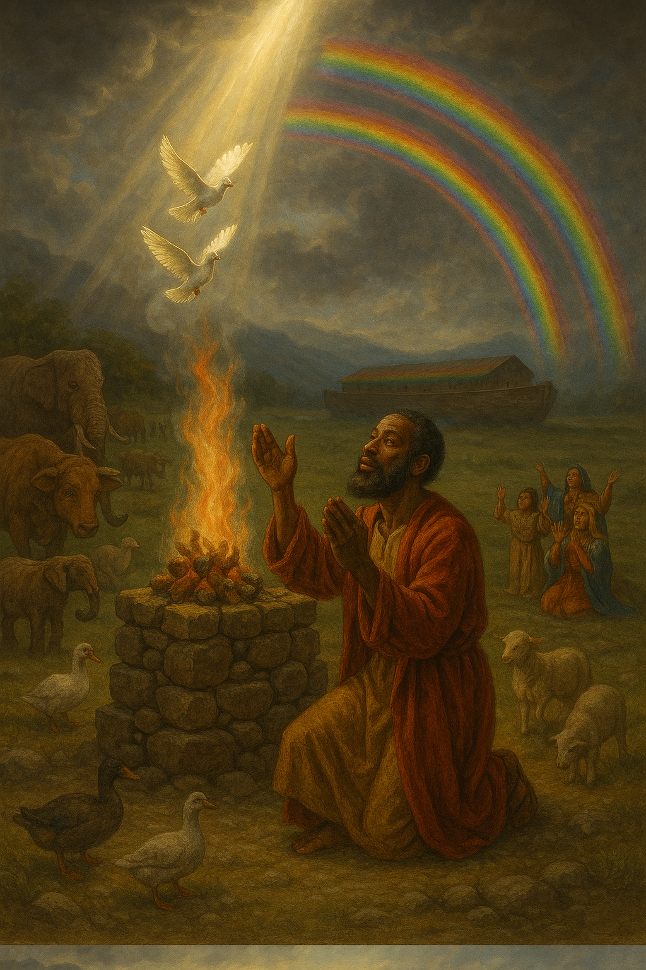
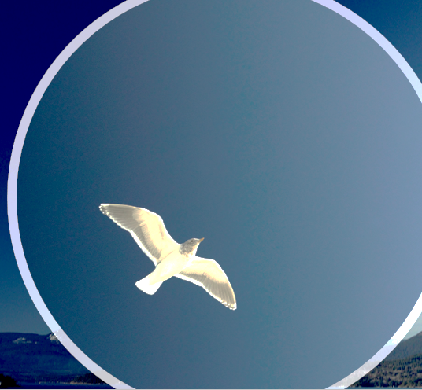

Noah Builds an Altar
I do set my bow in the cloud, and it shall be for a token of a covenant between me and the earth. ‘
—Genesis 9:13 KJV
Week of June 8
Notes:
Noah Builds an Altar
Week of June 8
.

Slide 2
Devotion
Prayer
    Lord, thank You for how You deliver us as You delivered Noah. Thank You for Noah’s example in that when You spoke, he listened and obeyed. May we learn to do the same. In Jesus’ name.
    Amen.
  Thought to Remember
      Wait for God’s command and then obey it!.
Notes:
Lord, thank You for how You deliver us as You delivered Noah. Thank You for Noah’s example in that when You spoke, he listened and obeyed. May we learn to do the same. In Jesus’ name, Amen.
Thought to Remember
Wait for God’s command and then obey it!

Slide 3
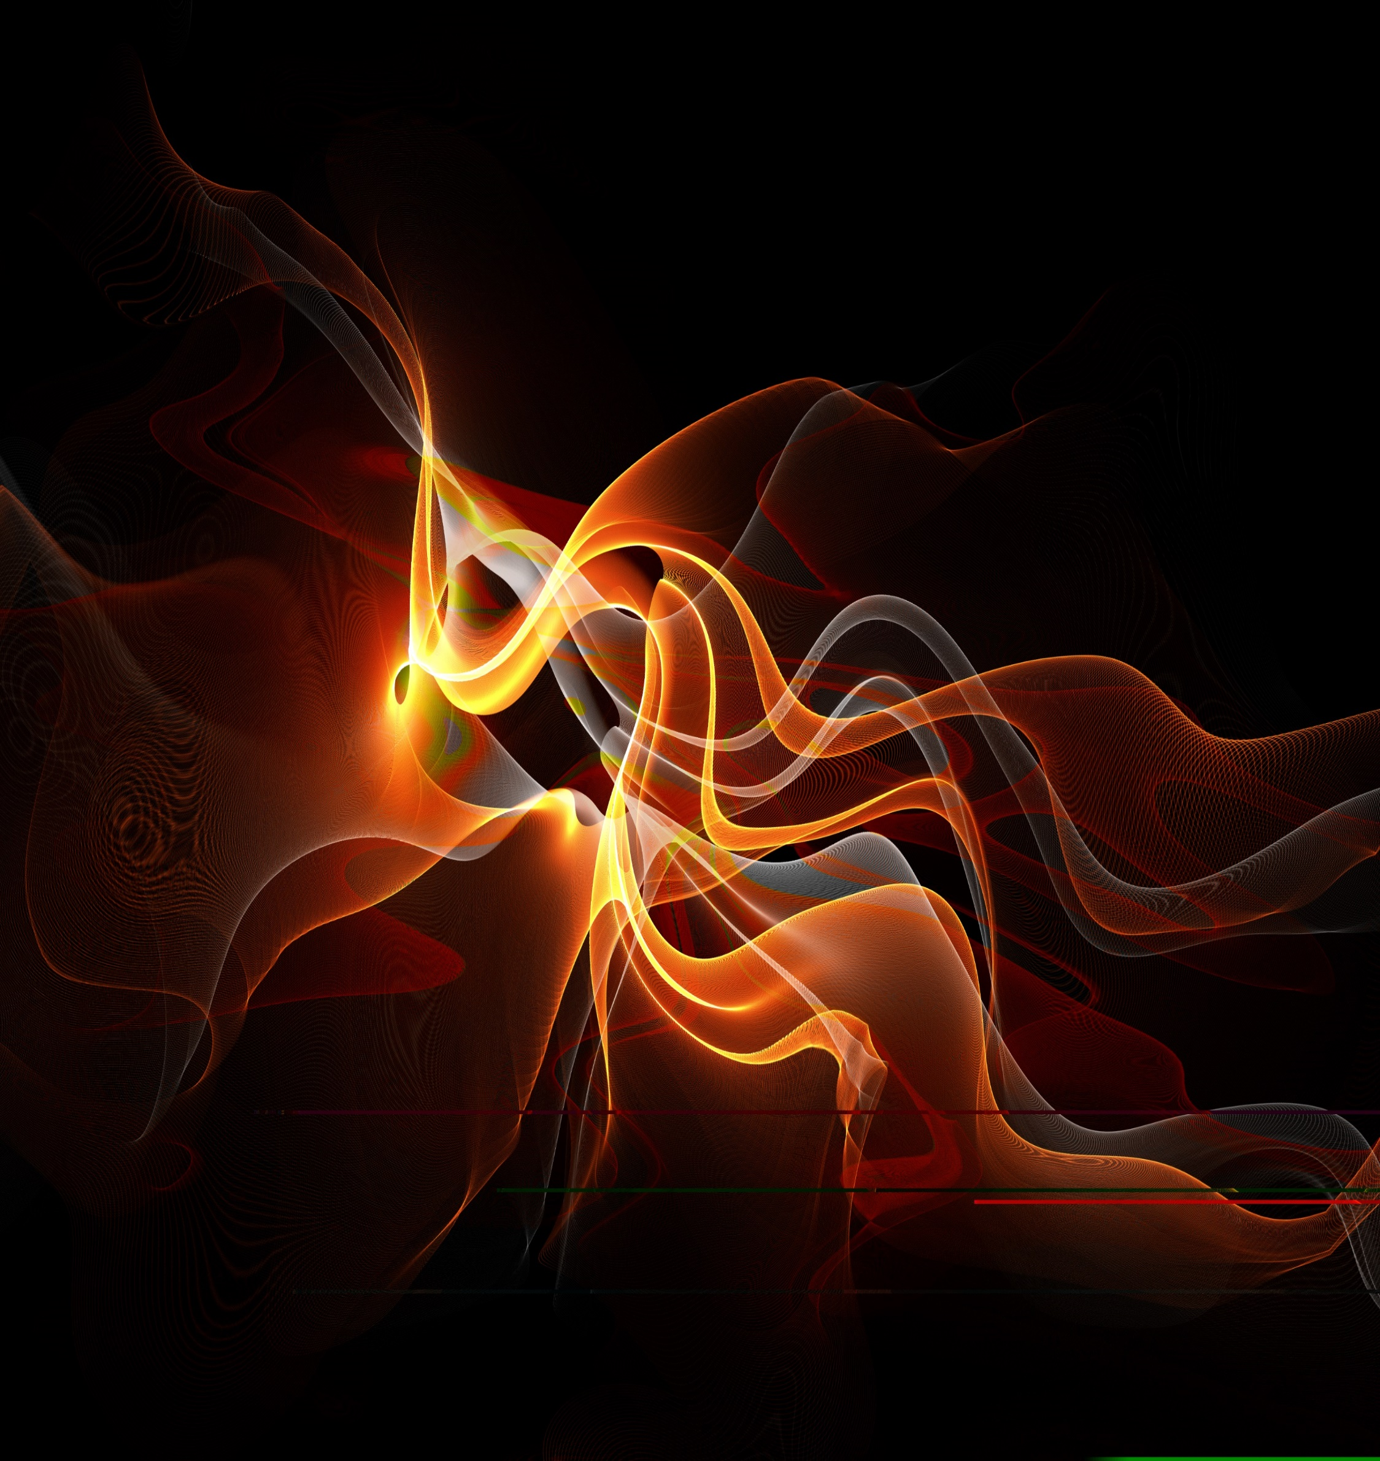
LESSON OUTLINE
Noah Builds an Altar
  Lesson Scripture: Genesis 8:13–22; 9:11–13
  Lesson Focus: God shows mercy when we wander away.
  Life Response:
Reflect on our own history with God and the times that He has shown us kindness.
      Review
      Introduction
      Lesson Context
      Overview
        Dry Land - Genesis 8:13–17 KJV
        An Altar - Genesis 8:18–22 KJV
        An Agreement - Genesis 9:11–13 KJV
      Summary
      Bible Application
      Conclusion
      Question & Answers
Notes:
Dry Land - Genesis 8:13–17 KJV
An Altar - Genesis 8:18–22 KJV
An Agreement - Genesis 9:11–13 KJV
-------------------------------------------
Genesis 8:13–22 – Summary:
After the floodwaters receded, Noah removed the ark’s covering and saw dry ground. God instructed him to leave the ark with his family and the animals. Noah built an altar and offered burnt offerings. The LORD received the offering and promised never again to curse the ground or destroy all living things, acknowledging human sinfulness from youth.
Genesis 9:11–13 – Summary:
God established a covenant with Noah and all life, promising never again to destroy the earth by flood. The rainbow was given as a sign of this everlasting covenant between God and all creation.
Commentary:
This passage reflects God's mercy and covenant faithfulness. After judgment through the flood, God responds to Noah’s worship with a gracious promise: never again will He destroy the earth with water. Human sin remains, but God chooses to show patience. The rainbow becomes a visible symbol of divine restraint and enduring hope. Noah’s obedience, worship, and God’s covenant together point to a new beginning—one rooted in grace rather than destruction. This anticipates the greater covenant fulfilled in Christ, where mercy triumphs over judgment (James 2:13).

Slide 4
LESSON CONTEXT
Noah Builds an Altar
Getting Out of the Boat
At age 36, I decided to enter a 340-mile river race on the Missouri River between Kansas City and St. Charles, Missouri. I had entered the race some years before but did not finish. I knew from experience that it was going to be a physical test. Long stretches of the race required that I remain in an 18-foot-long kayak in the middle of the river with no way to get out of the vessel. I was able to dock the kayak at rest stops periodically. But I only slept about 10 hours during the four-day race.
About 82 hours after I started the race, I found the finish line. I was proud of my accomplishment, but by the end of the race, I was ready to get out of the kayak and feel the dry ground beneath my stiff legs; I was eager to get out of that boat!
So was Noah. However, some significant differences exist between my getting out of the kayak and Noah getting out of the ark. God did not tell me to get in or out of the kayak; if I had to, I could have paddled the kayak to the riverbank and disembarked the vessel. Noah did not have that option. He had to trust that God would tell him when to leave the ark—even though Noah did not know how long it would be until he could feel the dry ground beneath his legs.
Notes:
Noah’s patience and trust in God’s timing after the flood contrasts with human tendencies toward self-reliance, highlighting the importance of waiting on the Lord's direction in times of uncertainty.
---
Three Key Points:
1. Personal Control vs. Divine Instruction: The author had freedom to leave the kayak at will, but Noah’s exit from the ark depended entirely on God’s command, emphasizing obedience over self-determination.
2. Trust in God’s Timing: Noah’s faith is seen in his willingness to wait without knowing how long, trusting God's perfect timing rather than acting on his own.
3. Spiritual Endurance: Like the author enduring physical strain, Noah endured confinement and uncertainty, but his endurance was rooted in faith and obedience, not personal choice.
Summary:
The narrative compares a modern river race with Noah’s experience in the ark, illustrating how Noah's trust in God contrasts with our tendency to act independently. Unlike the writer, who could choose towhen exit his kayak, Noah had to wait patiently for God’s instruction. The reflection urges believers to practice patient obedience and to trust God's timing, even when the path forward isn’t clear.

Slide 5
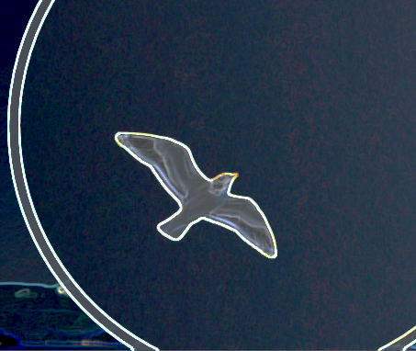
Noah Builds an Altar
LESSON OUTLINE
Judgment—
Satan, with his baggage of evil, made it into the garden of Eden. He deceived Adam and Eve, causing them to disobey God. He continued his destructive work on their oldest son, Cain, who ended up murdering his brother, Abel. Then Satan’s poison spread throughout the world, causing the heavenly Father to say, “Enough!” God proceeded to destroy the world with a flood. However, God saved one righteous man named Noah, together with his family. The flood waters of God’s judgment exploded on the earth. But God mercifully instructed Noah to build an ark and preserve his family so that humanity would continue.
It was about a year before the flood waters subsided. God instructs Noah to leave the ark and welcomes the family to repopulate the earth. The Lord even repeats the same words spoken to Adam and Eve, “Be fruitful and multiply” (Gen. 8:17; compare Gen. 1:22, 28).
Covenant—
Once Noah left the ark, he built an altar for the Lord, which demonstrates worship and thanksgiving. The sweet aroma of Noah’s sacrifice rose to heaven and pleased God. God declared no further judgment on the earth and established the Noahic covenant. It is an unconditional agreement—nothing depends on humans; and everything rests on the faithfulness of God.
Notes:
Main Idea:
God’s judgment through the flood was a response to the unchecked spread of sin, yet He extended mercy by preserving Noah and his family to restart humanity.
Three Key Points:
Sin's Spread: Satan's influence began in Eden and escalated to Cain’s murder of Abel, ultimately corrupting the world.
God’s Judgment: In response to global wickedness, God brought the flood but preserved a remnant through Noah’s obedience.
New Beginning: After the flood, God repeated His original command to humanity—“Be fruitful and multiply”—signaling a fresh start for creation.
Summary:
Sin entered the world through deception and grew until God judged it with a flood. Yet, He showed mercy by sparing Noah’s family, allowing humanity to begin again under divine direction and blessing.
---------------------------------------------
Main Idea:
After the flood, God initiated the Noahic covenant, an act of divine grace that rested solely on His faithfulness, not on human behavior.
Three Key Points:
Worshipful Response: Noah’s first act after leaving the ark was worship, showing gratitude for God’s salvation.
Divine Pleasure: God was pleased with Noah’s offering, indicating restored fellowship between God and humanity.
Unconditional Covenant: God promised never to destroy the earth again in such a way, affirming that His mercy is not dependent on human worthiness.
Summary:
Noah’s altar of worship ushered in a covenant of mercy. God, moved by Noah’s sacrifice, declared an end to universal judgment and established a lasting, unconditional promise anchored in divine faithfulness.

Slide 6
LESSON OUTLINE
Noah Builds an Altar
Promises—
God makes this covenant with all of creation, not one family or group. God even names the generations to come and seals the promise with a rainbow. A beautiful spray of colors in the sky reminded God (or perhaps more often, reminds us) that the floodwaters shall not return. Noah, his family, and generations could sing the old gospel song, “The Storm Is Passing Over. ”
No one is without sin, but our grace-filled heavenly Father is patient toward those He has made. Every day, every moment, God stands ready to shower forgiveness and kindness—not a punishing storm.
Notes:
Main Idea:
God’s promise to never again flood the earth is a universal, grace-filled assurance, symbolized by the rainbow, and extended to all generations.
Three Key Points:
Universal Scope: The covenant covers all living beings, not just Noah’s descendants.
Symbol of Grace: The rainbow serves as a visible sign of God’s mercy and a reminder of His promise.
Ongoing Mercy: Despite human sinfulness, God offers forgiveness and patience instead of wrath.
Summary:
God’s covenant promise is a declaration of enduring grace. The rainbow stands as a sign of His restraint, offering hope to all creation that His mercy will prevail over judgment.

Slide 7
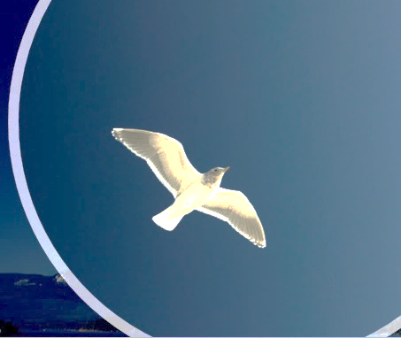

LESSON CONTEXT
Noah Builds an Altar
Today’s lesson focuses on events directly after the flood wiped out all creation, except for all living creatures—human and otherwise—in the ark. Interestingly, the flood is one of the most well-attested accounts in history.
The biblical account of the flood is but one of at least five ancient flood stories. The existence of the latter leads some to believe that the biblical account used them as sources and that the flood is a legendary myth of an ancient and ignorant people. But if there truly was a great flood in ancient times, then stories of the event would be passed down from generation to generation.
As people spread over the earth and formed distinct cultures, these stories would take on the characteristics of those cultures. It would be strange indeed if accounts of the actual flood were absent altogether from ancient writings! So, the existence of the nonbiblical stories serves to confirm that there was indeed a great flood at some point in history. The Bible’s account of this flood is the accurate one.
The biblical account of the great flood is detailed in giving specifics for the beginning of the flood, the length of time the rain fell, how long the floodwaters covered the earth, and how long it took for the waters to recede. The total amount of time adds up to more than a year (Genesis 7:11; 8:14).
Having made it safely through the flood, creation and humankind had another chance. But even as that new chance began, God was fully aware of the still-present reality of man’s brokenness. Sadly, even before the end of Genesis 9, sin manifested itself again. Humanity’s brokenness becomes apparent.
Notes:
Main Idea:
The biblical flood account is not a myth but a historically grounded narrative supported by global traditions, and it highlights God's mercy in giving humanity a second chance despite the persistent reality of human sin.
Three Key Points:
1. Historical Credibility: Numerous ancient cultures have flood stories, which supports the plausibility of a real, cataclysmic flood. These accounts, though culturally shaped, point to a shared historical event.
2. Biblical Reliability: The Genesis narrative stands out for its detailed chronology and theological depth, marking it as the most accurate and divinely inspired version of the flood.
3. Second Chance with Caution: After the flood, creation received a fresh start. However, sin quickly reemerged, demonstrating that external cleansing cannot remove internal brokenness.
Summary:
Though flood myths exist in many cultures, their presence actually supports the reality of a global flood, not the dismissal of it. The Bible offers the most detailed and divinely inspired account. After the flood, God graciously granted a second beginning for humanity—yet the persistence of sin reveals that mankind’s inner corruption remains a problem only God can truly fix.

Slide 8
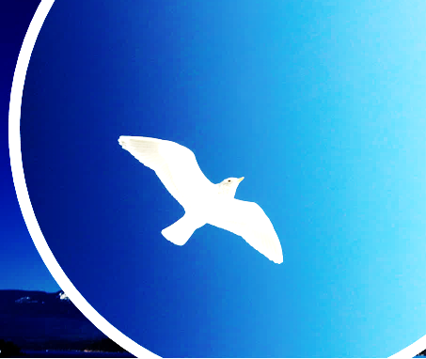
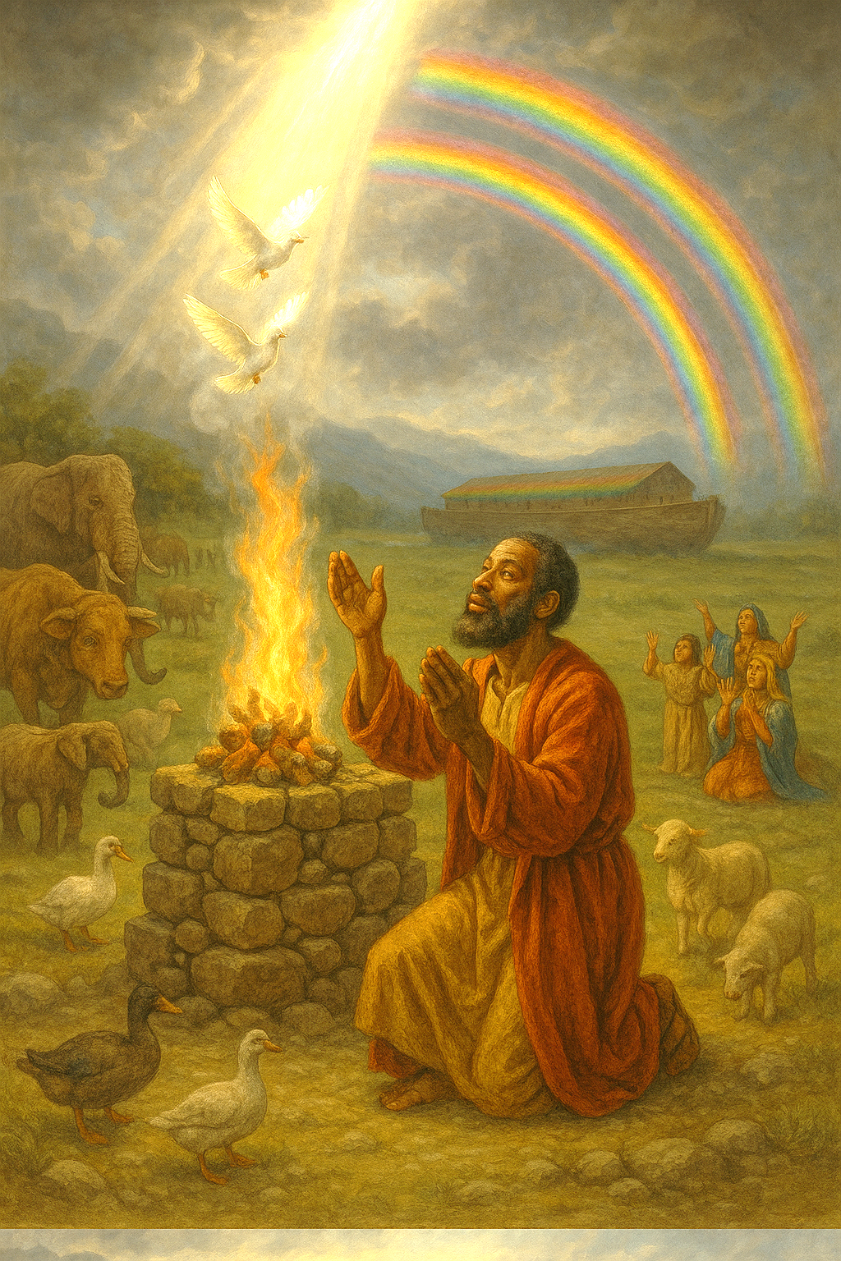
LESSON CONTEXT
Noah Builds an Altar
It’s About Time!
  Noah and his family’s time on the ark stands as a testament to their unwavering faith and obedience to God’s commands. According to Genesis 7–8, the humans and animals aboard the ark (probably not the most comfortable of accommodations) spent more than a year on a wooden zoo. The extensive period of flooding shows the severity of God’s judgment against evil. But even when the waters recede and the ark comes to rest on dry land, Noah and his family don’t just jump out to stretch their legs. After about eight months afloat, they spend about two months waiting for God to signal that the time has come for them to disembark. That kind of patience is consistent with what the author of Hebrews deems true of Noah: he was a person of patient faith. (Hebrews 11:7 mentions faithful obedience to build the ark in the first place. )
Notes:
Noah’s patient faith is demonstrated by his waiting on God’s timing, even after surviving the flood.
Three Key Points:
Noah and his family remained over a year on the ark, reflecting endurance and trust in God’s direction.
They waited two additional months after resting on dry ground before exiting—only when God instructed.
Hebrews 11:7 affirms Noah's obedience as an act of true faith, emphasizing that patience is integral to trust.
Summary:
Noah’s time on the ark shows that faithful obedience includes waiting on God’s signal, not acting presumptuously—even when circumstances seem safe.

Slide 9
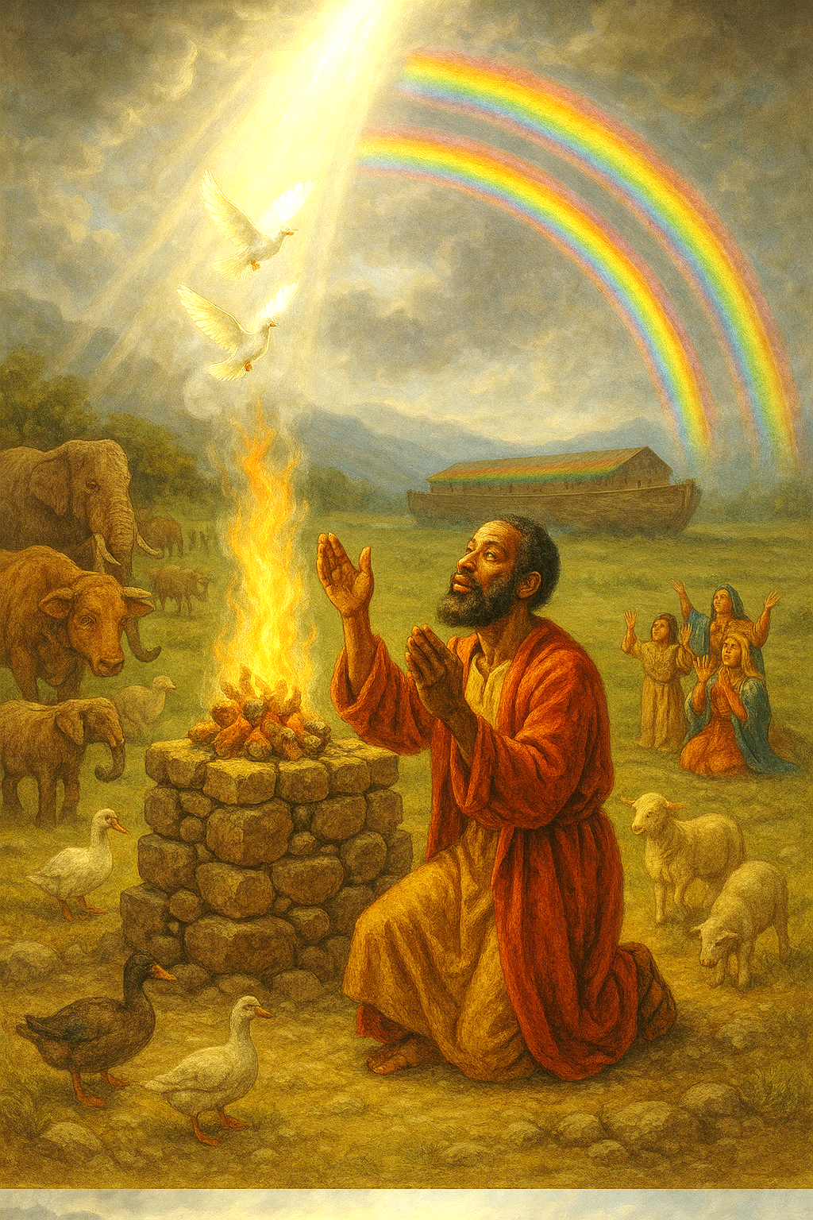
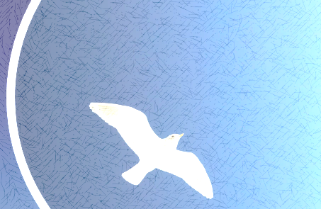
LESSON CONTEXT
Noah Builds an Altar
A Burnt Offering
  Noah’s building of an altar and his sacrificial offering after exiting the ark are not specific requests from God, even though God prepared him with the clean animals he would need (Gen. 7:2–3). The “burnt offering” of Genesis 8:20 is a type of sacrifice that could be used for a variety of functions (see Lev. 1:3–17). The burnt offering is entirely consumed by fire and for God alone, and it might signify the devotion of the worshiper— holding nothing back and demonstrating God’s provision. The offering is certainly not a “sin offering” (Lev. 4:1–25), which is intended to atone for sins or bring purification. Noah’s sacrifice does not turn away God’s anger or act as a request for mercy. God has already shown favor by reducing the flood waters and inviting the people to exit in safety. God has already spoken words of blessing (Gen. 8:17).
  Thus Noah makes a sacrifice because he determines that is the right thing to do. God’s provision of the clean animals is also the case in the story of Genesis 22 (the text for next week’s lesson). When God provides what is needed for a sacrifice, His servants honor the gift by offering it back to Him (Gen. 22:13–14).
Notes:
Noah’s sacrifice upon leaving the ark was voluntary, symbolizing total devotion and gratitude, not a plea for mercy.
Three Key Points:
The burnt offering was not commanded but flowed from Noah’s worshipful heart.
It demonstrated wholehearted devotion, using clean animals God had provided beforehand.
This mirrors Abraham’s later sacrifice in Genesis 22—returning to God what He has graciously given.
Summary:
Noah’s offering wasn’t about atonement but devotion. His act of worship honored God’s provision and acknowledged divine mercy and faithfulness.

Slide 10
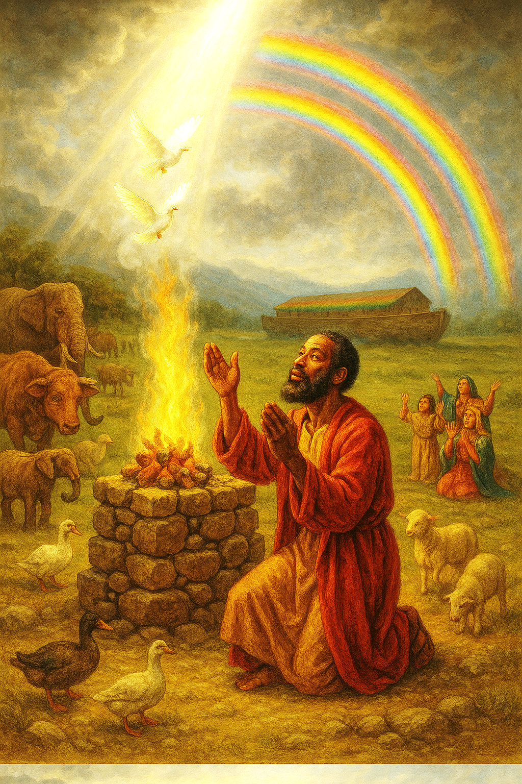
LESSON CONTEXT
Noah Builds an Altar
The Covenant Explained
We understand that God made a covenant with Noah. But what exactly does this agreement entail, and what does it mean for us today? This is but the first of several covenants to appear in the Bible, and most have expectations on both sides. In this case, the covenant with Noah and humanity is not entirely one-sided, with no expectations in return. In Genesis 9:4–6, God says that He will demand an accounting of every person for the shedding of blood. Since humans are created in God’s image, God reserves the right to hold anyone accountable who takes a life (as had Cain in Gen. 4:8). This patience that God offers is a temporary accommodation to the reality of human sinfulness.
.
By presenting burnt offerings of clean animals and birds to the Lord, Noah demonstrates his gratitude, reverence, and commitment to God, acknowledging Him as the ultimate authority and source of salvation. This act of worship did not go unnoticed by God, prompting His response in Genesis 8:21–22. The sacrificial offering may have symbolized Noah’s recognition of humanity’s dependence on God’s grace and mercy. God smells this pleasing aroma, accepts the sacrifice, and responds with words that lay the foundation for the covenant in Genesis 9 (Gen. 8:21–22). Noah’s act of worship culminates in the establishment of a covenant that endures as a testament to God’s enduring faithfulness and love for creation
Notes:
God’s covenant with Noah confirms His mercy, yet includes a call to accountability and the sanctity of life.
Three Key Points:
The covenant includes the prohibition of murder, affirming that human life bears God’s image.
God’s mercy is evident, but justice remains part of His moral order.
Noah’s sacrifice led to God’s declaration never again to curse the ground, forming the covenant’s foundation.
Summary:
God’s covenant with Noah is both merciful and moral. It underscores human responsibility while establishing a divine promise grounded in grace.

Slide 11
LESSON CONTEXT
Noah Builds an Altar
Family Bonding
Noah, his wife, his three sons—Shem, Ham, and Japheth—and their respective wives were the sole human inhabitants of the ark, chosen by God to survive the cataclysmic flood that engulfed the earth. Their exclusive presence aboard the vessel underscores the uniqueness of Noah’s righteousness in a world overrun by wickedness.
Noah’s obedience and commitment to God’s commands set his entire family apart, positioning them as vessels of divine preservation amidst the deluge of judgment. Noah’s sons and their respective wives separated from one another and would eventually go on to lay the foundations for early civilizations.
Notes:
Noah’s righteousness extended God’s favor to his family, setting them apart to restart civilization after the flood.
Three Key Points:
Noah’s obedience resulted in the salvation of his entire family.
Their unity in the ark contrasts with the judgment outside.
His sons would later populate and form distinct nations and cultures.
Summary:
God honored Noah’s righteousness by preserving his family, who became the foundation of renewed human civilization.

Slide 12
LESSON CONTEXT
Noah Builds an Altar
God’s Bow
The symbol tied to this covenant, the rainbow, holds a special significance in the original language. In Hebrew, the word qeshet (“rainbow” in the NIV) is used for ordinary bows—the kind used to shoot arrows (compare Gen. 27:3). That is why the KJV translates this straightforwardly as God’s “bow” (Gen. 8:13). Following the flood, God’s bow is hung in the clouds as a massive display of forbearance, since God is relinquishing a tool of destruction. The clouds, which had brought the rain and turned against humans, would now display a marvel of God’s handiwork in this colorful display. repay wrongdoing.
When humans look to the sky to see this sign of peace, they will remember that God has restrained Himself and offered a reprieve from the type of judgment in the time of Noah. At the same time, the “bow in the clouds” can remind humans of God’s power over creation and the ability that He retains to
Notes:
The rainbow is a powerful sign of God’s covenant mercy and a visual reminder of His power and restraint.
Three Key Points:
The Hebrew “bow” implies a weapon set aside, symbolizing divine forbearance.
It transforms the image of storm clouds into a reminder of peace.
It assures humanity of God's mercy while reminding us of His sovereign authority.
Summary:
The rainbow is both a sign of God’s promise and a symbol of His self-restraint, offering peace while still affirming His righteous power.

Slide 13
LESSON OVERVIEW
Noah Builds an Altar
Dry Land - Genesis 8:13–17 KJV
13 And it came to pass in the six hundredth and first year, in the first month, the first day of the month, the waters were dried up from off the earth: and Noah removed the covering of the ark, and looked, and, behold, the face of the ground was dry.
14 And in the second month, on the seven and twentieth day of the month, was the earth dried.
15 And God spake unto Noah, saying,
16 Go forth of the ark, thou, and thy wife, and thy sons, and thy sons’ wives with thee.
17 Bring forth with thee every living thing that is with thee, of all flesh, both of fowl, and of cattle, and of every creeping thing that creepeth upon the earth; that they may breed abundantly in the earth, and be fruitful, and multiply upon the earth.
God tells Noah and his family to leave the ark and to fill the earth.
God reiterates the blessing to be fruitful and multiply.
God’s plan to repopulate the earth through Noah and the contents of the ark is a success.
Notes:
Main Idea:
God’s renewal of creation after the flood shows His continued commitment to bless humanity despite judgment, reaffirming His original purposes.
---
Three Key Points:
1. Journey's End: After more than a year aboard the ark, Noah and his family receive God’s signal to exit safely into a renewed world (Gen. 8:13–16).
2. Creation Restored: God echoes the original command from Genesis 1:28, affirming His intention for life to flourish again through fruitfulness and multiplication.
3. Mercy After Judgment: Though the flood was just, God’s blessings remain intact, showing He has not abandoned His creation despite human sinfulness.
---
Summary:
As Noah's family steps into a renewed earth, God reaffirms His original blessing to be fruitful and multiply. The flood, though a just act of judgment, is not the end of God's relationship with creation—it marks a new beginning filled with mercy and purpose.
><><><><><><><><><><><><><><><><><
Genesis 8:13–17 NIV
13 By the first day of the first month of Noah’s six hundred and first year, the water had dried up from the earth. Noah then removed the covering from the ark and saw that the surface of the ground was dry.
14 By the twenty-seventh day of the second month the earth was completely dry.
15 Then God said to Noah,
16 “Come out of the ark, you and your wife and your sons and their wives.
17 Bring out every kind of living creature that is with you—the birds, the animals, and all the creatures that move along the ground—so they can multiply on the earth and be fruitful and increase in number on it. ”
><><><><><><><><><><><><><><><><><
Noah and his family’s journey comes to an end as the floodwaters subside and the earth becomes dry once more (Gen. 8:13). They would emerge from the ark to inhabit an unfamiliar world. From the dates in Genesis 7:11 and Genesis 8:14, it appears that the family spent over a year aboard. But at last, God lets Noah know when it is safe to exit (Gen. 8:16).
God instructs Noah with many of the same words as the initial blessing upon humanity in Genesis 1:28: “Be fruitful and increase in number. ” God has not rejected creation, and He is renewing it by allowing creatures to fill the earth, just as originally intended. God’s judgment, while an entirely fair response to the murder and wickedness that had spread across the earth, did not mean that He withdraws the blessing.

Slide 14
LESSON OVERVIEW
Noah Builds an Altar
An Altar - Genesis 8:18–22 KJV
18 And Noah went forth, and his sons, and his wife, and his sons’ wives with him:
19 Every beast, every creeping thing, and every fowl, and whatsoever creepeth upon the earth, after their kinds, went forth out of the ark.
20 And Noah builded an altar unto the LORD; and took of every clean beast, and of every clean fowl, and offered burnt offerings on the altar.
21 And the LORD smelled a sweet savour; and the LORD said in his heart, I will not again curse the ground any more for man’s sake; for the imagination of man’s heart is evil from his youth; neither will I again smite any more every thing living, as I have done.
22 While the earth remaineth, seedtime and harvest, and cold and heat, and summer and winter, and day and night shall not cease.
Noah, his family, and all the animals exit the ark onto dry land.
Noah’s first act is to build an altar for offering sacrifices to God.
God once again offers words of blessing and promises not to curse the ground or destroy all living things on account of human sin.
God retains complete power over all the earth, and He keeps all things in motion.
Notes:
><><><><><><><><><><><><><><><><><
Genesis 8:18–22 NIV
18 So Noah came out, together with his sons and his wife and his sons’ wives.
19 All the animals and all the creatures that move along the ground and all the birds—everything that moves on land—came out of the ark, one kind after another.
20 Then Noah built an altar to the LORD and, taking some of all the clean animals and clean birds, he sacrificed burnt offerings on it.
21 The LORD smelled the pleasing aroma and said in his heart: “Never again will I curse the ground because of humans, even though every inclination of the human heart is evil from childhood. And never again will I destroy all living creatures, as I have done. ”
22 “As long as the earth endures, seedtime and harvest, cold and heat, summer and winter, day and night will never cease. ”
><><><><><><><><><><><><><><><><><
Noah, his family, and all the animals step from the ark onto dry land—for the first time in over a year. Noah’s first action is to display gratitude: he builds an altar to the Lord, giving reverence to God for abundant faithfulness and deliverance. By offering burnt sacrifices on the altar, Noah acknowledges God’s sovereignty and provision. For that matter, God had even instructed Noah to bring along enough animals to account for the sacrifice (Gen. 7:2–3).
God responds with favor on Noah’s sacrifice: He accepts Noah’s offering, signified by the language of its “pleasing aroma” (Gen. 8: 21). Already, God begins describing the foundations for what will become a covenant agreement (Gen. 8:21–22). God vows to never again curse the ground or destroy all living creatures, despite the evil in the human heart. This proclamation reveals God’s sovereign decision to extend a measure of mercy and grace, despite humanity’s sin.
The passage concludes with a commitment from God to supervise the continuity of creation (v. 22). “As long as the earth endures,” God shall ensure the smooth transitions of everything that humans need for life: the changing seasons, cycles of day and night, and the passage of time.
Main Idea:
God's command to Noah to repopulate the earth shows that, despite judgment, He remains faithful to His original plan to bless and sustain creation.
Three Key Points:
Divine Timing: After over a year aboard the ark, Noah waits patiently until God gives the command to exit (Gen. 8:13–16), showing faith and obedience.
Restated Blessing: God reaffirms the Genesis 1:28 blessing—"Be fruitful and increase"—indicating a fresh start for humanity and all living creatures.
Mercy in Judgment: Though the flood was a just response to widespread sin, God does not abandon His creation, but renews it with purpose and grace.
Summary:
Noah’s family leaves the ark after a long year, stepping into a renewed world under God’s direction. God's reaffirmation of His original blessing shows that divine judgment did not cancel His love or plans for creation—it simply prepared the way for a new beginning.

Slide 15
LESSON OVERVIEW
Noah Builds an Altar
An Agreement - Genesis 9:11–13 KJV
11 And I will establish my covenant with you; neither shall all flesh be cut off any more by the waters of a flood; neither shall there any more be a flood to destroy the earth.
12 And God said, this is the token of the covenant which I make between me and you and every living creature that is with you, for perpetual generations:
13 I do set my bow in the cloud, and it shall be for a token of a covenant between me and the earth.
God makes a covenant with Noah that He will never flood the earth again.
The rainbow is a sign of the covenant. Rain will be a sign of God’s mercy.
God’s covenant also reveals His mercy and desire to restore humanity.
God’s covenant isn’t only for Noah and his family, but for all people and all time.
Notes:
><><><><><><><><><><><><><><><><><
Genesis 9:11–13 NIV
11 I establish my covenant with you: Never again will all life be destroyed by the waters of a flood; never again will there be a flood to destroy the earth. ”
12 And God said, “This is the sign of the covenant I am making between me and you and every living creature with you, a covenant for all generations to come:
13 I have set my rainbow in the clouds, and it will be the sign of the covenant between me and the earth. ”
><><><><><><><><><><><><><><><><><
After the flood, God establishes a covenant—a binding agreement—with Noah and all life (v. 11). This covenant is a promise that God will never again flood the earth in response to human sinfulness. The promise sets up the world that we face, where sin is allowed to persist for now, even though we can count on the fact that God will uphold justice on an eternal timeline. God extends these assurances to all future generations (v. 12). God’s covenant is accompanied by a symbol: the rainbow (v. 13). It is a visible sign of God’s power and a reminder of His mercy and grace, even in the aftermath of harsh judgment.
The first covenant that God makes is foundational for displaying His character and desire for relationship with creation. It reveals God’s patience, willingness to extend grace, and His desire for reconciliation. God wants life to continue. The rainbow reminds humans of their reconciling God.
Main Idea:
God’s covenant with Noah reveals His enduring mercy and commitment to creation, marked by the rainbow as a sign of grace, restraint, and reconciliation.
---
Three Key Points:
1. Covenant of Restraint: God promises never again to destroy the earth by flood, allowing sin to persist temporarily while assuring justice in eternity (Genesis 9:11–12).
2. Universal and Eternal: The covenant applies to all living creatures and future generations, demonstrating God’s inclusive mercy and long-term faithfulness.
3. The Rainbow’s Meaning: As a divine symbol, the rainbow reflects God's power, grace, and desire to remain in relationship with His creation—even after judgment.
---
Summary:
After the flood, God makes a covenant with Noah and all creation, promising not to flood the earth again. The rainbow serves as a visible reminder of God’s mercy, patience, and desire for reconciliation, highlighting His faithful character and ongoing commitment to life and justice.

Slide 16
BIBLE APPLICATION
Noah Builds an Altar
Discuss that God is faithful when we stray.
God’s Daughter
My sisters and I grew up in a small town in Pennsylvania, where we attended the local African Methodist Episcopal church. Our church membership was a little more than a hundred people, including children. We were not anonymous! We had to participate in Sunday school and services every Sunday. If there was an afternoon worship service, we had to stay for that too. Vacation Bible school was also mandatory, at least in my family.
You might think, with all that church training, my siblings and I were prepared for whatever life would throw at us. But as adults, we had more than our share of struggles. Many of us lost the habit of going to church at all. I thought I was too busy with a career, one of my sisters fell into addiction, and another was on the verge of divorce when diagnosed with late-stage colon cancer.
And God was faithful to each of us, despite the ways we had prioritized things other than God. It took several years before I was ready to rededicate my life to Christ, but God was ready for me. As for my sister, God performed a miracle by reconciling her marriage. With her husband at her side, she faced the cancer treatment with courage and support.
God is merciful and compassionate. I’ve seen it. Even though my sister’s cancer treatments failed, she never lost hope for God to heal her. She found a nearby church during her treatment, where she began walking faithfully with Christ. She told us one day, “I feel the presence of God in my bedroom. ” In one of her last moments, she whispered to me, “I’m God’s daughter, and He loves me. ”
Notes:
Bible Application:
Reflect on the ways that God responds to us. God can be faithful to us, even when we are not walking faithfully with Him.
Analysis & Summary:
This personal testimony emphasizes that despite seasons of spiritual drifting, God remains faithful. Though raised in church, the sisters experienced hardship—addiction, illness, and spiritual distance. Yet God responded with patience, healing, and presence. His mercy was shown not through removal of suffering, but through companionship, restoration, and renewed relationship. God’s love remained constant, even when theirs did not.
9. How is God’s mercy demonstrated to us?
God’s mercy is demonstrated by His constant presence, willingness to forgive, and His work in restoring relationships and faith, even when we stray or suffer.
10. Do you tend to think that God provides extra protections and blessings on some people, or do you think that God treats all people the same?
God offers mercy and grace to all, but His blessings may appear differently. He responds uniquely to each person’s journey, yet always with love and justice.
11. When has God demonstrated patience and mercy in your life?
God showed me mercy when I turned away from Him, yet He welcomed me back without condemnation, patiently waiting until I was ready to return.
9. How is God’s mercy demonstrated to us?
10. Do you tend to think that God provides extra protections and blessings on some people, or do you think that God treats all people the same?
11. When has God demonstrated patience and mercy in your life?

Slide 17
BIBLE APPLICATION
Noah Builds an Altar
Discuss that God is faithful when we stray.
God’s Daughter
9. How is God’s mercy demonstrated to us?
10. Do you tend to think that God provides extra protections and blessings on some people, or do you think that God treats all people the same?
11. When has God demonstrated patience and mercy in your life?
Notes:
9. How is God’s mercy demonstrated to us?
God’s mercy is demonstrated by His constant presence, willingness to forgive, and His work in restoring relationships and faith, even when we stray or suffer.
10. Do you tend to think that God provides extra protections and blessings on some people, or do you think that God treats all people the same?
God offers mercy and grace to all, but His blessings may appear differently. He responds uniquely to each person’s journey, yet always with love and justice.
11. When has God demonstrated patience and mercy in your life?
God showed me mercy when I turned away from Him, yet He welcomed me back without condemnation, patiently waiting until I was ready to return.

Slide 18
Conclusion
Noah Builds an Altar
Learn to Wait. Learn to Act!
Most people know what it means to be impatient. As a parent, I have three highly mobile balls of impatience. And when you throw my wife and I in the mix, waiting for things becomes agony. The people in the Old Testament were not any different. King Saul had a major failure due to his lack of patience as he waited for Samuel to offer the sacrifice
Saul offered the sacrifice himself even though he was not a priest and had no authority to do so, and it became a great sin (1 Samuel 13).
Waiting can be even more difficult when under challenging conditions. Saul’s army was melting away from him in the face of the Philistine threat, and seemingly, that is why he offered the sacrifice before Samuel got there to keep his army together (1 Samuel 13:11-12). Impatience is a feature of many chapters of the book of Psalms (examples: Psalms 6:3; 13:1; 119:84). It’s easy to imagine Noah as having felt that strain too.
Yet, when God told him to do something, he did it. He chose to operate on God’s timeline; he did not expect God to operate on his own (contrast Genesis 15:2-5; 16:1-4). Noah’s patience and obedience serves as a model for Christians. But there’s a caution here: sometimes, believers who are waiting impatiently for God to do something have already been given the command to take care of it themselves. But you aren’t one of those, are you?
Notes:
Main Idea:
True faith requires discerning when to wait on God and when to act in obedience—both must align with God's will, not our impatience.
---
Three Key Points:
1. Impatience Leads to Error: King Saul’s disobedience in offering a sacrifice without authority (1 Samuel 13) stemmed from impatience and fear, resulting in sin.
2. Waiting Is Hard but Holy: Even faithful believers like Noah and psalmists struggled with waiting, yet Noah remained obedient to God's timing.
3. Balance Waiting and Acting: Some situations call for patient trust, while others require obedient action—discernment is key to avoiding spiritual stagnation or presumption.
Summary:
Impatience can lead to disobedience, as seen in Saul's failure. In contrast, Noah modeled patient trust by following God's timing exactly. Believers must learn both to wait when God commands it and to act when He has already spoken—knowing the difference is a mark of spiritual maturity.

Slide 19
CONCLUSION
Noah Builds an Altar
Life Response
Reflect on our own history with God and the times that He has shown us kindness.
This lesson has covered the aftermath of God’s first way of cleansing the earth from sin and evil. But what we learn from the covenant with Noah is that God didn’t hold any false impressions that sin had gone away, or that His own chosen people would be sinless. Quite the opposite! God graciously provides the opportunity for us to be restored to close relationship with Him. And God uses creation to remind us of Himself
God’s Patience and Kindness
Take a moment with God to review your history of walking with Him. You might ask God to remind you of a time that mercy was available to you. Perhaps the moment that comes to mind was when you were walking closely with God. Or, perhaps God will remind you of a moment that He protected and restored you, even when nothing else was going well.
Notes:
Main Idea:
God’s covenant with Noah reveals that, despite ongoing sin, God patiently extends mercy and restoration, inviting us into lasting relationship with Him.
Three Key Points:
1. God Understands Human Sin: The covenant shows God wasn’t expecting perfection—He knew sin remained, yet chose to show grace.
2. Mercy Despite Failure: God’s kindness isn’t based on our righteousness, but on His enduring desire to restore and protect us.
3. Creation as a Reminder: Natural signs, like the rainbow, serve as ongoing reminders of God’s patience and faithfulness.
Summary:
God’s covenant with Noah teaches that He doesn’t demand perfection but offers relationship, mercy, and restoration. Reflecting on our personal journey with God can help us see His kindness—even in our failures—and deepen our trust in His enduring grace.

Slide 20



End
May God Bless and Keep you…
Material adapted by Stanford W. Bowman Jr. from Echoes® Adult and Bible-in-Life® Adult Winter 2024 quarter with permission, © David C Cook, https://davidccook.org. May not be further reproduced. All rights reserved.

Slide 21

QUESTION & ANSWER
Noah Builds an Altar
DRY LAND
3. What kinds of questions would Noah have after witnessing God’s cataclysmic flood?
4. How are the words “multiply” or “be fruitful” words of blessing?
Noah has just witnessed God’s overwhelming response against sin and wickedness. We can imagine that he had several questions! He might have wondered, Did that fix the sin problem? Or perhaps he was even wondering, Will I be next? As God soon says, the sin problem has not gone away, but He will continue to speak to people and call individuals into a close relationship with Him.
Most of all, we know these are words of blessing because that is what they are called in Genesis 1:28. These words are part of God’s plan for humanity as a whole—to fill the earth and to share God’s order and goodness. Either as parents themselves or as a wider church family who supports parents, God’s people see that new life comes from God.
Notes:
DRY LAND
3. What kinds of questions would Noah have after witnessing God’s cataclysmic flood?
Noah has just witnessed God’s overwhelming response against sin and wickedness. We can imagine that he had several questions! He might have wondered, Did that fix the sin problem? Or perhaps he was even wondering, Will I be next? As God soon says, the sin problem has not gone away, but He will continue to speak to people and call individuals into a close relationship with Him.
4. How are the words “multiply” or “be fruitful” words of blessing?
Most of all, we know these are words of blessing because that is what they are called in Genesis 1:28. These words are part of God’s plan for humanity as a whole—to fill the earth and to share God’s order and goodness. Either as parents themselves or as a wider church family who supports parents, God’s people see that new life comes from God.

Slide 22
QUESTION & ANSWER
Noah Builds an Altar
AN ALTAR
5. Why does Noah build an altar after leaving the ark?
6. What commitments in this text show God’s compassion and mercy?
Noah has just had a front-row seat to witness God’s judgment of sin. Among all the families, Noah’s was chosen and spared, and his offering shows gratitude for the protection that he received.
God states that He will never again curse the ground as a result of humans, “even though every inclination of the human heart is evil from childhood” (Gen. 8:21).
Notes:
AN ALTAR
5. Why does Noah build an altar after leaving the ark?
Noah has just had a front-row seat to witness God’s judgment of sin. Among all the families, Noah’s was chosen and spared, and his offering shows gratitude for the protection that he received.
6. What commitments in this text show God’s compassion and mercy?
God states that He will never again curse the ground as a result of humans, “even though every inclination of the human heart is evil from childhood” (Gen. 8:21).

Slide 23
QUESTION & ANSWER
Noah Builds an Altar
AN AGREEMENT
7. How does the world change after the covenant with Noah and the promises that God makes?
8. What can we learn about God’s reconciling character from this chapter?
We take for granted what this covenant means. God is not going to deal with sin in this way again—by unmaking the world through a flood. As a result, we live in a world with persistent evil and sin, which appears to go unnoticed by God (a frequent complaint of the psalmists). But on the other hand, God has the freedom to deal with sin in a permanent way—by sending Jesus as a sacrifice.
God is trustworthy, has a plan, and fulfills His purposes. Even though we are sinful, God’s plan is going to continue. No matter what we might do, God is not going to be deterred from rescuing the world that He has made.
Notes:
AN AGREEMENT
7. How does the world change after the covenant with Noah and the promises that God makes?
We take for granted what this covenant means. God is not going to deal with sin in this way again—by unmaking the world through a flood. As a result, we live in a world with persistent evil and sin, which appears to go unnoticed by God (a frequent complaint of the psalmists). But on the other hand, God has the freedom to deal with sin in a permanent way—by sending Jesus as a sacrifice.
8. What can we learn about God’s reconciling character from this chapter?
God is trustworthy, has a plan, and fulfills His purposes. Even though we are sinful, God’s plan is going to continue. No matter what we might do, God is not going to be deterred from rescuing the world that He has made.

Slide 24
End
May God Bless and Keep you…
Material adapted by Stanford W. Bowman Jr. from Echoes® Adult and Bible-in-Life® Adult Winter 2024 quarter with permission, © David C Cook, https://davidccook.org. May not be further reproduced. All rights reserved.

