Slide 1

Abraham Makes an Offering
So Abraham called that place The Lord Will Provide. And to this day it is said, “On the mountain of the Lord it will be provided. ”
—Genesis 22:14 NIV
Week of December 8
Notes:
Abraham Makes an Offering
Week of June 15
We have now entered the section of Genesis where the focus shifts to one individual and his family line. The Bible has given us the origins of the two main elements that affect all of us today: The natural world and how it has become what it is – Noah's flood. The moral and social condition of the world, how and why we came to be what we are – sin of Adam, tower of Babel.
1. Shift in Focus: The narrative in Genesis shifts to Abram (Abraham) and his family line, through whom God will bring about the Savior.
2. Foundations of Human Condition: The natural world is shaped by Noah's flood, while the moral and social condition is rooted in Adam's sin and the tower of Babel.

Slide 2
Devotion
Prayer
  Lord God, we call on You to be in our lives what You have been for our forefathers and foremothers of the faith. Give us faith to trust in Your provision and empower us through Your Spirit to remain faithful to You. We want to grow our faith in strength and witness. We trust You and love You. In Jesus’ name we pray.
Amen.
  Thought to Remember
      God always provides, but not always in the ways we expect.
Notes:
Prayer
Lord God, we call on You to be in our lives what You have been for our forefathers and foremothers of the faith. Give us faith to trust in Your provision and empower us through Your Spirit to remain faithful to You. We want to grow our faith in strength and witness. We trust You and love You. In Jesus’ name we pray. Amen.
Thought to Remember
God always provides, but not always in the ways we expect.

Slide 3
Agenda
Abraham Makes an Offering
  Lesson Scripture: Genesis 22:1–14
  Lesson Focus: Give God your devotion, especially when you don’t understand.
  Life Response: Contemplate how we practice devotion in times of confusion.
  Bible Application: Examine that devotion requires courage.
  Review
  Introduction
  Lesson Context
  Overview
    God Requests a Sacrifice - Genesis 22:1–8 NIV
    God Provides a Sacrifice - Genesis 22:9–14 NIV
  Summary
  Bible Application
  Conclusion
  Question & Answers
Notes:
God Requests a Sacrifice - Genesis 22:1–8 NIV
God Provides a Sacrifice - Genesis 22:9–14 NIV
Analysis of Genesis 22:1–14
This passage recounts Abraham’s ultimate test of faith as God commands him to sacrifice his beloved son, Isaac. Abraham obeys without hesitation, trusting God's character. As he prepares the altar, God intervenes, providing a ram in Isaac’s place. This act reveals Abraham’s unwavering obedience and God’s provision, introducing the name Jehovah-Jireh—"The Lord Will Provide."
Summary
God tested Abraham’s faith by commanding him to sacrifice Isaac. Abraham trusted God completely, even when he didn’t understand. At the crucial moment, God stopped him and provided a ram for the offering. This story highlights faith, obedience, and God's provision.
Commentary
Genesis 22 foreshadows the Gospel: just as Abraham offered his son, God would one day offer His only Son. Abraham’s obedience and God’s intervention teach that genuine faith involves trust beyond understanding. God provides what is needed when we surrender fully. Jehovah-Jireh becomes a name to remember: when God calls us to give, He also provides the sacrifice.

Slide 4
Introduction
Abraham Makes an Offering
Testing Commitment
As a competitive swimmer in high school, I had to practice every weekday. One wintry Friday evening, our coach assigned us to swim an extraordinarily long set. He didn’t explain why he selected the grueling workout, only that it would test both our physical endurance and mental strength. Some teammates complained that the workout would upset their Friday night plans, so they refused to complete it. Others started the set but couldn’t finish. Only four of us completed the workout—a completion rate of 10 percent of the team!
When we arrived at practice the following Monday, our coach revealed that he had selected the team captains based on the workout from Friday night. He said that the four who finished—me and three others—had proven themselves committed and “mentally tough” enough to accept the responsibility of being team captains.
Numerous examples from Scripture describe times when God tested His people’s commitment (Exodus 20:20; Deuteronomy 8:2; Job 23:10; Psalm 66:10; etc. ). God challenges His people to remain faithful to and obey Him even in the most difficult circumstances. This week’s lesson will address one of the most famous examples of divine testing.
4
Notes:
True commitment is revealed under pressure. Just as physical training tests endurance and character, God uses trials to test and refine our spiritual faithfulness and obedience.
Three Key Points:
1. Testing Reveals Character – The swim coach used a difficult challenge to identify who was truly committed. Similarly, God uses tests to expose the depth of our loyalty and trust in Him (Deuteronomy 8:2).
2. Faithfulness in Difficulty – Only a few completed the challenge, showing that perseverance under pressure distinguishes the truly faithful, a theme reflected in Job 23:10 and Psalm 66:10.
3. Testing Prepares for Leadership – The coach chose captains based on their endurance, mirroring how God often uses trials to prepare believers for greater responsibility and purpose (Exodus 20:20).
---
Summary:
Just as a coach tested his team’s commitment through a demanding workout, God tests His people’s faith and obedience through life’s challenges. These tests don’t just reveal who we are—they prepare us for future responsibility and spiritual growth. Scripture consistently shows that God uses trials to develop perseverance, refine our faith, and set apart those ready for greater service.

Slide 5
LESSON OUTLINE
Abraham Makes an Offering
Abraham could have easily worn a shirt that read, My Way. But somewhere along the path of following God, he tossed out that shirt. Abraham grew to trust God and follow His ways. In Abraham’s later years, he faced his hardest challenge. It involved Isaac, his dearly beloved son. Abraham demonstrates how to stay committed, even when God’s ways are beyond human comprehension.
Learning to obey—
The Lord instructs Abraham to take Isaac to a mountain called Moriah, to offer his son as a burnt sacrifice before the Lord. At this point, Isaac was not married and had no children. Abraham does not say anything in reply! The very next day, he and Isaac set out for three days to reach the mountain. Abraham tells his servants to stay behind and wait. He says with apparent faith, “We will come back” (v. 5).
Isaac already knows all about sacrifice and notices the missing lamb. He questions his father, but Abraham assures him of God’s ability to provide. Then, he lays Isaac on the altar. Abraham is prepared to take his son’s life, but God stops the sacrifice, just in time. Abraham did not even withhold his son from God. Abraham—who had so longed for an heir—still listened and stayed committed to God’s plan.
Learning to surrender—
A year after finishing college, I heard God call me to a ministry position. But I had intended to further my education to obtain a better job. To join a ministry, raise my own financial support, and make hardly any money made no sense to me. But I could not deny God’s call. I took the ministry position. Years later, I realized that God’s plan, instead of mine, had furthered my writing career. I wonder if you have ever had a similar experience, of following God’s way to find Him leading you to an unexpected end.
5
Notes:
Abraham’s spiritual growth led him from doing things his way to complete trust and obedience to God, even in the most difficult test of his life.
------------------------------------------------------------------------------------------
Three Key Points:
1. Abraham matured from self-reliance to deep faith, shown by his unwavering obedience.
2. His greatest test came when God asked him to sacrifice Isaac, his beloved son.
3. Abraham models how faith remains firm even when God's commands seem beyond understanding.
Summary:
Abraham learned to surrender his will to God’s. His decision to obey God's command concerning Isaac reflects a trust that surpassed human logic, showing the depth of his faith and commitment.
------------------------------------------------------------------------------------------
Learning to Obey
Abraham obeyed God's command immediately and faithfully, trusting God even when the outcome seemed impossible.
Three Key Points:
1. Abraham journeyed without delay, revealing immediate obedience despite the cost.
2. His words—“we will come back”—show faith in God’s power to provide or resurrect.
3. Abraham’s willingness to sacrifice Isaac revealed a deep trust that placed God above even his dearest relationship.
Summary:
Abraham didn’t hesitate to follow God’s hard command. His faith that “we will come back” and his actions at Moriah show full obedience and belief in God's provision and promise.
------------------------------------------------------------------------------------------
Learning to Surrender
Main Idea:
Personal surrender often means abandoning well-laid plans for a path that seems uncertain but ultimately proves to be God's best.
Three Key Points:
1. God sometimes redirects us away from personal ambition to divine purpose.
2. Following God’s call may involve sacrifice but results in unexpected blessings.
3. Trusting God’s direction reveals His long-term wisdom and provision.

Slide 6
LESSON OUTLINE
Abraham Makes an Offering
Abraham could have easily worn a shirt that read, My Way. But somewhere along the path of following God, he tossed out that shirt. Abraham grew to trust God and follow His ways. In Abraham’s later years, he faced his hardest challenge. It involved Isaac, his dearly beloved son. Abraham demonstrates how to stay committed, even when God’s ways are beyond human comprehension.
Surrender—
I’ve worn a My Way shirt so many times. It’s still in my bottom drawer. But I’m gradually learning to cling closer to the Lord and to be steadfast. His ways and His plans are always better.
6
Notes:
Surrender
Main Idea:
The journey of faith includes a lifelong struggle between personal will and God's will, but steadfast trust leads to peace and purpose.
Three Key Points:
1. Human nature resists surrender, but spiritual growth brings deeper dependence on God.
2. Choosing God's way over self-will becomes a continual, daily decision.
3. God’s plans consistently prove to be better than our own, even when delayed.
Summary:
Though the temptation to follow “my way” remains, the faithful grow in trusting God’s better path. True peace and purpose are found by surrendering to His will daily.

Slide 7
LESSON OUTLINE
Abraham Makes an Offering
Tempt or Test
Genesis 22:1 says that God tested Abraham by asking him to offer up Isaac as a sacrifice. The words for “test” (NIV) and “tempt” (KJV) are interchangeable in both Hebrew and Greek. The Bible makes it clear that God does not tempt anyone to sin (James 1:13), but we do see that God tests people. The Israelites are tested in the wilderness (Deut. 8:2), God allows Job to be tested (Job 1), and Jesus is led by the Spirit into the desert to be tempted by the devil (Matt. 4:1). God tests in order to strengthen faith and to develop perseverance and maturity (James 1:2–4). The devil, however, can turn tests into temptations. He twists and manipulates, tempting toward sin and away from what is good. In this passage, Abraham passes his test with flying colors as he trusts in God’s promises and provision.
First Use of Love
In Genesis 22:2, God says to Abraham, “Take your son, your only son, whom you love—Isaac— and go to the region of Moriah. ” In fact, this is the first occurrence of the word for “love” in the Bible. In the rest of Genesis, the word appears frequently to denote close family relationships: love of children (25:28; 37:3–4; 44:20) and love of spouses (24:67; 29:18, 30).
It is always useful to note the first use of a word, which might set the tone for the rest of a text. Here, the first use of love in Scripture is the love that a father shows toward his son, even as he is willing to sacrifice this son. The word becomes even more important in the context of the New Testament, when we read in John 3:16, for instance, “God so loved the world that he gave his one and only Son. ” This exemplifies the love of a Father, one willing to sacrifice His Son for the salvation of the world.
7
Notes:
Tempt or Test
Main Idea:
God tests to build faith and character, while Satan tempts to destroy. Abraham’s trial was a divine test, not a sinful temptation.
Key Points:
1. The Hebrew/Greek word can mean either "test" or "tempt," but context determines the purpose.
2. God tests to refine and strengthen (James 1:2–4); Satan tempts to deceive and destroy (James 1:13).
3. Abraham’s successful test shows mature faith and trust in God’s promises.
Summary:
God tested Abraham to build his faith, not to cause him to sin. While Satan twists trials to tempt, God uses them to develop spiritual maturity. Abraham proved faithful by trusting God's provision.
-----------------------------------------------------------------------------------------------------
First Use of Love
The first biblical mention of "love" highlights a father’s deep affection for his son, pointing forward to God’s love shown in Christ.
Key Points:
1. Genesis 22:2 contains the Bible’s first use of the word “love,” emphasizing father-son devotion.
2. This sets a precedent for understanding love as sacrificial and deeply relational.
3. John 3:16 mirrors this idea—God gives His Son out of divine love for the world.
Summary:
The first mention of “love” in Scripture describes Abraham’s love for Isaac, highlighting the emotional depth of his test. This foreshadows God’s ultimate expression of love—sacrificing His Son for our salvation.

Slide 8
LESSON OUTLINE
Abraham Makes an Offering
The Importance of Moriah
God instructs Abraham to bring Isaac to the region of Moriah to sacrifice him on a mountain that He will show him. Moriah is only specifically mentioned one other time in the scriptures, in 2 Chronicles 3. Solomon builds the temple on Mount Moriah because that is where the Lord had appeared to his father, King David (2 Chron. 3:1). In 2 Samuel 24, there was a plague sweeping across the land of Israel as a punishment from God. The Lord stops the plague at the threshing floor of Araunah the Jebusite. David buys the threshing floor from Araunah and builds an altar to the Lord, devoting burnt offerings to Him on that spot (2 Sam. 24:25). David says that the house of the Lord—the temple—is to be built in that spot (1 Chron. 22:1), which is what Solomon does years later.
8
Notes:
The Importance of Moriah
Mount Moriah is a sacred place of divine encounter, sacrifice, and ultimately, temple worship.
Key Points:
1. Moriah is the location of Isaac’s near-sacrifice and later becomes the site of Solomon’s temple.
2. It connects key moments: Abraham’s test, David’s altar (2 Sam. 24), and Solomon’s temple (2 Chron. 3:1).
3. It symbolizes God's mercy, presence, and provision throughout Israel’s history.
Summary:
Mount Moriah links Abraham’s obedience, David’s repentance, and temple worship. It becomes a lasting symbol of God’s mercy and faithfulness—a holy ground where divine presence and sacrifice meet.

Slide 9
LESSON OUTLINE
Abraham Makes an Offering
Human Sacrifice in the Ancient Near East
It is jarring to read that God asks Abraham to take the son of promise—the very same child through whom the whole world will be blessed— and sacrifice him on an altar. It is easy to see God’s request as horrifying and against His character. But God’s demand for human sacrifice may not have shocked Abraham as much as it shocks us. In the ancient Near East, people worshiped many false gods, some that required child sacrifice. The Canaanites who lived in the land, worshiped a god named Molek; and the Bible explicitly condemns those who offer their children in worship to him (Lev. 20:1–5). We must keep in mind, however, that Abraham receives this command from God before the Mosaic law is given. Abraham is still learning about God. The command to sacrifice his son is confusing, but it would not have been a new concept to Abraham. Even still, Abraham learns something about the character of his God through this process. Yahweh does not require human sacrifice. He is altogether different.
A Type of Christ
The story of the binding of Isaac in Genesis 22 is often seen as a prefiguration of Christ in the Old Testament. Abraham is a father who is asked to sacrifice his son, and Isaac doesn’t seem to put up a fight. These details remind us of Jesus. Ultimately, Abraham’s words that God will provide the offering (Gen. 22:8) come true in this specific story, when God provides a ram caught by its horns. But God also provides an alternative sacrifice at the cross. The sinless offering was Christ Himself, the “Lamb of God, who takes away the sins of the world” (John 1:29). But the binding of Isaac is a fascinating story in itself, demonstrating the journey of faith for Abraham. Abraham’s name appears in a variety of New Testament texts as a champion of faith (see John 8:39–40, 56; Rom. 4:12–13, 16–21; Gal. 3:6–9; Heb. 11:8–12, 17–19; James 2:21–23).
9
Notes:
Human Sacrifice in the Ancient Near East
Though human sacrifice was common in Abraham’s culture, God used the test to show that He is unlike pagan gods—He does not demand it.
Key Points:
1. Abraham lived in a culture where child sacrifice existed (e.g., Molek worship).
2. God’s command tested Abraham’s faith but ultimately revealed God's true nature.
3. Yahweh is different—He stops the sacrifice and provides an alternative.
Summary:
While child sacrifice was familiar in Abraham’s world, God’s intervention teaches that He is not like false gods. The test reveals God’s mercy and holiness—He demands obedience, not cruelty.
----------------------------------------------------------------------------------------
A Type of Christ
The binding of Isaac foreshadows the Gospel, portraying Abraham and Isaac as a type of God the Father and Christ the Son.
Key Points:
1. Abraham offering Isaac parallels God offering Jesus—both involve beloved, obedient sons.
2. Isaac’s quiet submission resembles Jesus’ willing sacrifice.
3. God provides a ram for Isaac and later provides Christ, the Lamb of God, for all.
Summary:
Genesis 22 points ahead to the crucifixion. Abraham’s story mirrors the sacrifice of Christ—both involving trust, obedience, and divine provision. Isaac’s near-death symbolizes the ultimate offering fulfilled in Jesus.

Slide 10
LESSON CONTEXT
Abraham Makes an Offering
1 Some time later God tested Abraham. He said to him, “Abraham!” “Here I am,” he replied.
2 Then God said, “Take your son, your only son, whom you love—Isaac—and go to the region of Moriah. Sacrifice him there as a burnt offering on a mountain I will show you. ”
3 Early the next morning Abraham got up and loaded his donkey. He took with him two of his servants and his son Isaac. When he had cut enough wood for the burnt offering, he set out for the place God had told him about.
4 On the third day Abraham looked up and saw the place in the distance.
5 He said to his servants, “Stay here with the donkey while I and the boy go over there. We will worship and then we will come back to you. ”
6 Abraham took the wood for the burnt offering and placed it on his son Isaac, and he himself carried the fire and the knife. As the two of them went on together,
7 Isaac spoke up and said to his father Abraham, “Father?” “Yes, my son?” Abraham replied. “The fire and wood are here,” Isaac said, “but where is the lamb for the burnt offering?”
8 Abraham answered, “God himself will provide the lamb for the burnt offering, my son. ” And the two of them went on together.
• Before this text, God made a covenant with Abraham. As a fulfillment of one of those promises, God gave Abraham a son and heir, Isaac.
• God tests Abraham, telling him to sacrifice this beloved son.
• Abraham takes Isaac with him to Moriah, appearing ready to sacrifice Isaac.
• Abraham shows trust in God when he tells the servants that he and Isaac will return.
• Abraham is confident that God will provide a sacrificial lamb.
God Requests a Sacrifice - Genesis 22:1–8 NIV
10
Notes:
God tests Abraham’s faith and obedience through a heart-wrenching request that appears to contradict His promises, revealing Abraham’s trust in God’s provision even amid confusion.
---
Three Key Points:
1. God’s Covenant and the Unthinkable Test
God promised Abraham a son and global blessing through his offspring (Gen. 12, 15, 17). Yet shortly after fulfilling that promise through Isaac, God commands Abraham to offer Isaac as a sacrifice, placing the covenant itself on the line.
2. Testing, Not Tempting
While the KJV says “tempt,” and the NIV says “test,” the context shows this is not a temptation to sin but a divine test of loyalty and obedience—designed to refine, not destroy. The test appears contrary to God's character, challenging Abraham’s understanding and faith.
3. Obedience Despite Uncertainty
Abraham rises early and obeys without hesitation. His faith in God’s character and provision is evident in his words: “We will come back.” Even without knowing how, Abraham trusts that God will resolve the apparent contradiction.
---
Summary:
God gave Abraham the long-awaited son, Isaac, and then asked for what seemed unthinkable—his sacrifice. Though the request tested Abraham’s faith in God’s promise and character, Abraham obeyed, trusting in God’s ability to provide and fulfill His covenant. His story reveals how genuine faith clings to God even when circumstances are unclear and obedience is costly.
><><><><><><><><><><><><><><><><><><><><
God initiated a covenant with Abraham by promising to bless the whole world through many offspring (Gen. 12:2–3; 15:2–4; 17:1–8). Even though Abraham and Sarah were childless, God worked a miracle by giving a biological heir to them, a son named Isaac. But as soon as Abraham receives this assurance of God’s favor, God requests a sacrifice that puts everything at stake.
In verse 1, the two translations—“tempt” (KJV) and “test” (NIV)—seem very different to our ears. In this case, the trial is not a temptation to sin but a test of Abraham’s priorities and obedience. Abraham is to go to Mount Moriah to offer his son as a human sacrifice. The request sounds like it is in direct opposition to the promises God has made and the kind of character that God has shown. Human sacrifice is one of the detestable ways that other people might worship their gods (Deut. 12:31), and nothing in Abraham’s experience would prepare him for this request from Yahweh.
Whether Abraham understands he’s being tested or not, he decides to obey. He gets up the next morning and sets out with Isaac and enough wood for the offering (v. 3). When they arrive, Abraham tells his servants that he and Isaac will go ahead to worship and return (v. 5). Abraham and Isaac are both familiar with sacrificial offerings in the ancient Near Eastern context, so Isaac wonders where the sacrifice could be, and Abraham assures him of God’s provision. His devotion to God is compelling his action, even if he doesn’t understand what God is doing.

Slide 11
LESSON CONTEXT
Abraham Makes an Offering
9 When they reached the place God had told him about, Abraham built an altar there and arranged the wood on it. He bound his son Isaac and laid him on the altar, on top of the wood.
10 Then he reached out his hand and took the knife to slay his son. 11 But the angel of the LORD called out to him from heaven, “Abraham! Abraham!” “Here I am,” he replied.
12 “Do not lay a hand on the boy,” he said. “Do not do anything to him. Now I know that you fear God, because you have not withheld from me your son, your only son. ”
13 Abraham looked up and there in a thicket he saw a ram caught by its horns. He went over and took the ram and sacrificed it as a burnt offering instead of his son.
14 So Abraham called that place The LORD Will Provide. And to this day it is said, “On the mountain of the LORD it will be provided. ”
• Abraham is obedient to God. He reaches the place with Isaac and prepares to offer his son.
• The text doesn’t say how Isaac reacted in that moment. But the angel of God keeps Isaac from harm.
• Abraham shows that he fears God.
• God provides an alternative sacrifice, which demonstrates the provision that Abraham has come to expect.
God Provides a Sacrifice - Genesis 22:9–14 NIV
11
Notes:
Main Idea:
Abraham’s willingness to sacrifice Isaac demonstrates that true faith involves both belief and action, revealing deep trust in God’s provision and authority.
---
Three Key Points:
1. Obedience in the Face of Painful Faith
Abraham’s actions—climbing the mountain, building the altar, binding Isaac—are deliberate steps of obedience, even when they break his heart. His trust in God outweighs his personal anguish.
2. Reverent Fear and Faith in Action
Abraham’s “fear of God” reflects reverence, not terror. His readiness to obey, even at great cost, is faith in action, affirming James 2:14–24’s message that true faith is shown by what we do.
3. God’s Provision and Memorial
God provides a ram at the last moment, revealing His character as Yahweh-Yireh—“The Lord Will Provide.” Abraham’s naming of the site marks the event as a lasting testimony of divine faithfulness.
---
Summary:
Abraham fully obeyed God, even when the command seemed unbearable. His actions reflected not fear alone, but reverent faith that trusted God’s goodness. When God stopped the sacrifice and provided a ram, Abraham saw that faith and obedience lead to divine provision. The mountain became a sacred place, forever remembered as a symbol of God’s faithful care.
><><><><><><><><><><><><><><><><><><><><
Genesis 22:9–14 NIV
><><><><><><><><><><><><><><><><><><><><
We have to imagine Abraham—climbing a mountain, building an altar stone by stone, hoisting wood onto it— all with the knowledge that it is meant for the sacrifice of his son. Abraham follows God’s instructions, even binding Isaac and placing him on the altar (v. 9). Abraham, who trusts God’s provision, takes the knife and prepares to kill his own son (v. 10). And at the last moment, the angel of the Lord calls out to Abraham, and Abraham responds as a humble servant: “Here I am” (v. 11). God tells Abraham not to touch Isaac and affirms Abraham. His “fear” of God is evident, because he was willing to sacrifice his son. Fear in this context does not mean that Abraham was afraid (though that is certainly possible too). It means that Abraham shows devotion to God and places God’s will above his own desires. Abraham had previously believed God (Gen. 15:6), but now he has acted in faith as well. The biblical definition of faith is always a combination of belief and action—they go hand-in-hand (James 2:14–24). Abraham finds God’s provision for sacrifice, a ram that he offers to God in Isaac’s place (v. 13). Abraham names the place “Yahweh will provide. ” This place will be a permanent reminder of God’s provision (v. 14).
Here is the analysis, main idea, three key points, and summary for the passage:
---

Slide 12
BIBLE APPLICATION: Examine that devotion requires courage.
Jeremy’s Sandwich Shop
Abraham Makes an Offering
Jeremy smiled as he turned the sign from closed to open on his shop’s first day. Soon customers began entering, and Jeremy got to do what he was good at: making the best hot sandwiches in town. Jeremy’s shop did well for many years after that opening day. His little shop didn’t make him rich, but neither did he struggle to pay the bills. He hired reliable workers and had many regular customers who grew to be his friends. His business made Jeremy feel like he had a place in the community. Unfortunately, the economy took a downturn, and it wasn’t long before his business faltered. It felt like he was being asked to give up what he loved. He adored his shop, but most of all, he cared for the employees and knew they needed jobs. But the day came when he planned to lay off half the staff. As he invited the first person to his office to give the news, she knew what was coming and broke down in tears. At that moment, Jeremy decided he would rather lose his home than his employees. He cashed in his retirement, sold the house, and put everything into reviving the shop. Though he didn’t know how he was going to make it, the economy turned a corner, and business picked up. Just as Jeremy remained devoted to his employees, God wants us to be devoted to Him in times of uncertainty. We see this in Abraham’s story. He risked what he loved, since he believed that God provides. In that moment, Abraham found that his relationship with God meant more than anything.
12
Notes:
This story highlights the courageous devotion of a small business owner who sacrifices personal security for the well-being of others. Jeremy’s commitment to his employees mirrors the kind of sacrificial faith seen in Abraham’s willingness to give up Isaac. Devotion to others—and to God—often requires letting go of what we love in order to honor a greater purpose.
---

Slide 13
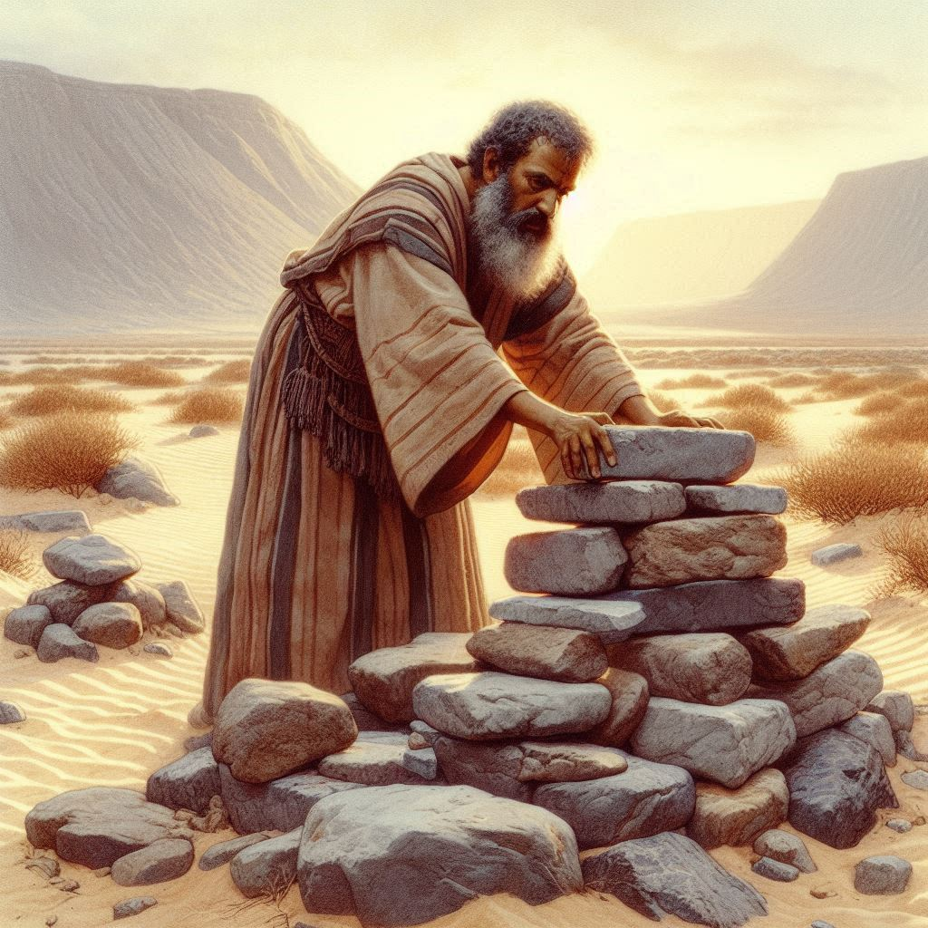
BIBLE APPLICATION: Consider how you can honor God where you live.
Wherever
Abraham Makes an Offering
10. Does uncertainty draw you closer to God, or do you feel distant in those times?
11. Has God ever revealed the need for you to let go of something that didn’t make sense? When?
12. What does devotion look like, when we are asked to let go of something that is good?
13
Notes:
10. Does uncertainty draw you closer to God, or do you feel distant in those times?
Uncertainty can draw us closer to God when we choose to trust Him. Like Abraham and Jeremy, clinging to God during hardship reveals the depth of our faith and devotion.
---
11. Has God ever revealed the need for you to let go of something that didn’t make sense? When?
Yes, God sometimes asks us to surrender things that seem good to grow our faith. Like Jeremy giving up his house, such moments test our trust in His plan.
---
12. What does devotion look like, when we are asked to let go of something that is good?
Devotion means obeying God even when it’s painful. It involves trusting His purpose above our own comfort, just as Abraham trusted God with Isaac, and Jeremy with his livelihood.

Slide 14
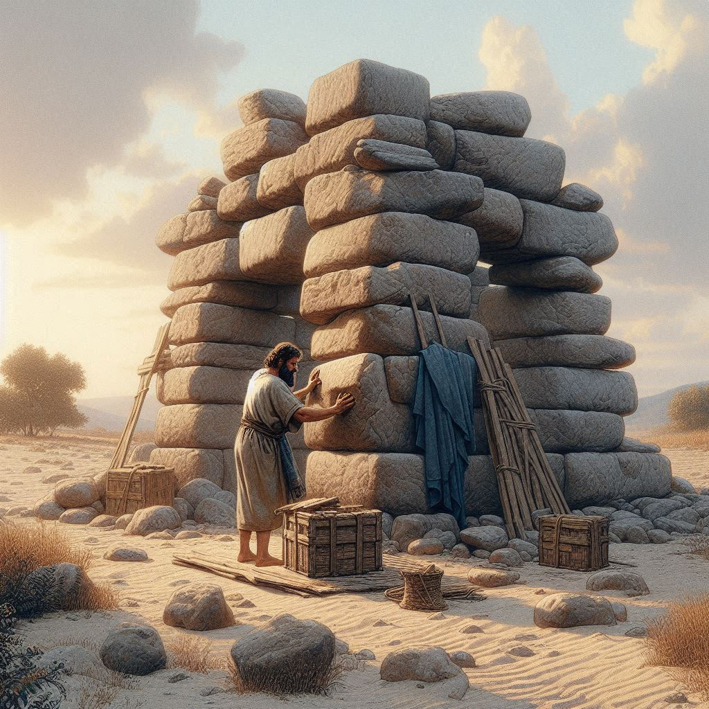
CONCLUSION
Abraham Makes an Offering
Testing and Faith
Tests reveal the preparation of the one tested. Some tests also expose the character of the person being tested. God’s testing of Abraham in today’s Scripture text exposed that man’s trust, loyalty, and devotion. It proved the authenticity of his faith, the faith for which God pronounced Abraham righteous (Genesis 15:6; see James 2:21-23).
The testing of Abraham also revealed God’s faithfulness and promises to His people. God preserved the life of Isaac and, therefore, reiterated His promises to multiply Abraham’s descendants and bless all nations.
God’s people will continue to face tests and trials. Not all of these trials will be from God in the same manner as Abraham’s test. Trials prove the strength and sincerity of our faith (1 Peter 1:6-7). While we may never hear a voice from God at the test’s conclusion, we can be confident that God will be with us in our trials as we grow in faith, perseverance, and maturity (James 1:2-4).
14
Notes:
Main Idea:
God uses tests to reveal and strengthen the faith of His people, just as He did with Abraham, proving both human devotion and divine faithfulness.
Three Key Points:
Faith Revealed by Testing
Abraham’s test demonstrated his genuine trust and loyalty to God, validating the righteousness credited to him through faith (Genesis 15:6; James 2:21–23).
God’s Faithfulness Confirmed
By sparing Isaac, God reaffirmed His covenant, showing He remains faithful to His promises of blessing and multiplication.
Trials Produce Spiritual Growth
Today’s believers face trials that, while not always divinely appointed like Abraham’s, still refine faith and build perseverance (1 Peter 1:6–7; James 1:2–4).
Summary:
Abraham’s test showed the depth of his faith and God’s unwavering faithfulness. Likewise, our trials today serve to refine and mature us. Though we may not hear God’s voice audibly, we can trust He walks with us through every challenge, strengthening our devotion.

Slide 15
CONCLUSION
Abraham Makes an Offering
Life Response:
Contemplate how we practice devotion in times of confusion. daily.
As human beings, it is natural to want to understand. We want to know what will happen tomorrow, next week, even five years from now. Good stewardship requires that we plan ahead, but we know our own limits. In this world, we face uncertainties. In some cases, God might even invite us to take a difficult path that requires taking a risk: inviting a neighbor to church, devoting time to service, or entering a career of ministry. Whatever mission God has for us, we can say with assurance that God is with us and wants us to be fully devoted to Him.
Following God in All Circumstances
We serve a heavenly Father who wants to give us good things—everything that we need for our mission in God’s kingdom (Matt. 7:11). At the same time, we face uncertainty and trouble in this world. When the trouble comes, we might let fear of losing something keep us from stepping out in faith. Try to complete each of these sentences as a reminder for yourself. How does God want you to demonstrate unshakable faith?
15
Notes:
Life Response:
Main Idea:
Devotion to God often requires trust beyond understanding. In times of confusion or uncertainty, true faith is demonstrated by obeying God even when the path is unclear.
Three Key Points:
Faith Beyond Clarity
We naturally seek control through understanding, but God sometimes leads us into unknowns to build our trust and dependence on Him.
Devotion Requires Risk
Whether it’s sharing faith, serving others, or following a call to ministry, God may ask us to step out courageously despite the risk.
God’s Presence is Certain
Even when outcomes are uncertain, we can be confident in God’s provision and presence (Matthew 7:11), empowering us for His purposes.
Summary:
Practicing devotion during confusion means surrendering control, trusting God’s character, and obeying His call without full understanding. Though we may fear loss or risk, God promises His presence and provision as we walk in faith and fulfill His mission.

Slide 16
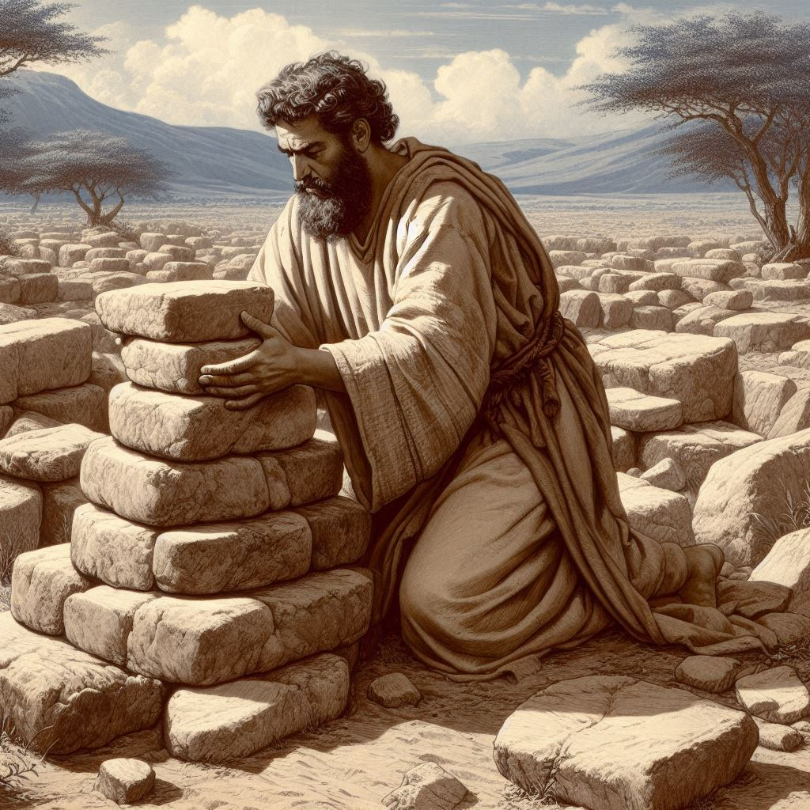



End
The Lord bless thee, and keep thee:
The Lord make his face shine upon thee, and be gracious unto thee:
The Lord lift up his countenance upon thee and give thee peace.
- Numbers 6:24-26, KJV
Material adapted by Stanford W. Bowman Jr. from Echoes® Adult and Bible-in-Life® Adult SUMMER 2025 quarter with permission, © David C Cook, https://davidccook.org. May not be further reproduced. All rights reserved.
Notes:
Five key lessons learned from the account of Abraham Makes an Offering (Genesis 22:1–14), drawn from the previous analysis and reflections in this thread:
1. True Faith Requires Obedience, Not Just Belief
Abraham didn’t just believe God—he acted on that belief by preparing to sacrifice Isaac. Faith is not passive; it is proven genuine when it results in trusting obedience, even when the command is costly or unclear (James 2:21–23).
2. God’s Tests Reveal Our Devotion
God tested Abraham to reveal his priorities, loyalty, and spiritual maturity. Testing is not meant to destroy us but to develop and display the strength of our faith (1 Peter 1:6–7).
3. God Always Provides in His Timing
When Abraham trusted God fully, even preparing to offer Isaac, God provided a ram. This moment teaches that Yahweh-Yireh ("The Lord Will Provide") is a name we can trust—God provides what we need when we need it.
4. Devotion Requires Letting Go
Abraham’s willingness to surrender Isaac teaches that our devotion to God must surpass our love for even the most cherished blessings. Sometimes we must let go of what is good to receive what is greater—God’s will.
5. God's Faithfulness Never Fails
Despite the challenge, God reaffirmed His covenant with Abraham, preserving Isaac and ensuring the promise would continue. God’s faithfulness to His word anchors us, even when His methods seem mysterious (Genesis 15:6; 22:15–18).

Slide 17

Abraham Makes an Offering
GOD REQUESTS A SACRIFICE
4. Why do you think God tests us?
5. Why might Abraham appear willing to obey God in this situation?
6. Do you think Abraham believed he would actually have to kill Isaac?
There might be a variety of reasons that we experience testing from God: to strengthen our faith, to develop perseverance, to show that He is trustworthy, or to bring us to maturity.
For one thing, Abraham has a history with God at this point. God brought him to a new home, gave him security from his enemies, and made it possible for Sarah to have a child in the first place.
Answers to this question may vary. On the one hand, Abraham does everything possible to seem like he is serious about going through with this. He brings everything necessary, and he will raise the knife in verse 10. But the author of Hebrews says that Abraham suspected all along that God would provide another way—perhaps God was even planning to raise his son from the dead (Heb. 11:19).
17
Notes:
GOD REQUESTS A SACRIFICE
4. Why do you think God tests us?
There might be a variety of reasons that we experience testing from God: to strengthen our faith, to develop perseverance, to show that He is trustworthy, or to bring us to maturity.
5. Why might Abraham appear willing to obey God in this situation?
For one thing, Abraham has a history with God at this point. God brought him to a new home, gave him security from his enemies, and made it possible for Sarah to have a child in the first place.
6. Do you think Abraham believed he would actually have to kill Isaac?
Answers to this question may vary. On the one hand, Abraham does everything possible to seem like he is serious about going through with this. He brings everything necessary, and he will raise the knife in verse 10. But the author of Hebrews says that Abraham suspected all along that God would provide another way—perhaps God was even planning to raise his son from the dead (Heb. 11:19).

Slide 18
Abraham Makes an Offering
GOD PROVIDES A SACRIFICE
7. What do we learn about God’s character from this situation?
8. When did you go through a time of testing? How did it affect your faith?
9. Why does Abram build an altar?
God promises to give Abram a great deal of land, all the territory that his eyes can see. This will be his family’s possession forever. Also, God promises to give Abram a large family, so many children that they will number like the dust he was kicking up with his shoes.
Answers will vary, based on each person’s experience.
Answers will vary, but one consistency is that all good things in our lives are from God. Since God is the Creator and the source of it all, God is the only one deserving total devotion.
18
Notes:
GOD PROVIDES A SACRIFICE
7. What do we learn about God’s character from this situation?
God can test His people, but He is not the type of god that requires human sacrifice. God rewards faithfulness and can provide for our needs.
8. When did you go through a time of testing? How did it affect your faith?
Answers will vary, based on each person’s experience.
9. When did God provide for you?
Answers will vary, but one consistency is that all good things in our lives are from God. Since God is the Creator and the source of it all, God is the only one deserving total devotion.

Slide 19
End
The Lord bless thee, and keep thee:
The Lord make his face shine upon thee, and be gracious unto thee:
The Lord lift up his countenance upon thee and give thee peace.
- Numbers 6:24-26, KJV
Material adapted by Stanford W. Bowman Jr. from Echoes® Adult and Bible-in-Life® Adult SUMMER 2025 quarter with permission, © David C Cook, https://davidccook.org. May not be further reproduced. All rights reserved.
Notes:
Five key lessons learned from the account of Abraham Makes an Offering (Genesis 22:1–14), drawn from the previous analysis and reflections in this thread:
1. True Faith Requires Obedience, Not Just Belief
Abraham didn’t just believe God—he acted on that belief by preparing to sacrifice Isaac. Faith is not passive; it is proven genuine when it results in trusting obedience, even when the command is costly or unclear (James 2:21–23).
2. God’s Tests Reveal Our Devotion
God tested Abraham to reveal his priorities, loyalty, and spiritual maturity. Testing is not meant to destroy us but to develop and display the strength of our faith (1 Peter 1:6–7).
3. God Always Provides in His Timing
When Abraham trusted God fully, even preparing to offer Isaac, God provided a ram. This moment teaches that Yahweh-Yireh ("The Lord Will Provide") is a name we can trust—God provides what we need when we need it.
4. Devotion Requires Letting Go
Abraham’s willingness to surrender Isaac teaches that our devotion to God must surpass our love for even the most cherished blessings. Sometimes we must let go of what is good to receive what is greater—God’s will.
5. God's Faithfulness Never Fails
Despite the challenge, God reaffirmed His covenant with Abraham, preserving Isaac and ensuring the promise would continue. God’s faithfulness to His word anchors us, even when His methods seem mysterious (Genesis 15:6; 22:15–18).

