Slide 1
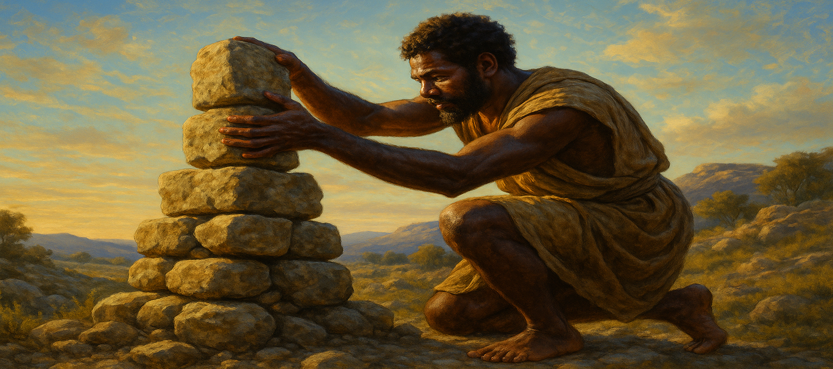
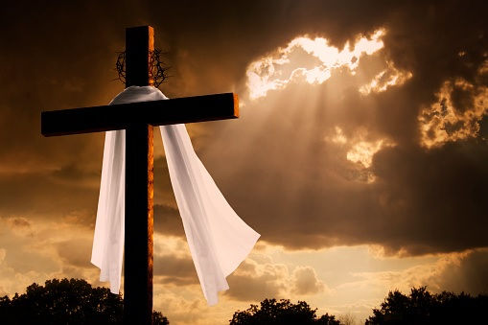
Jacob Sets Up a Sacred Pillar
And Jacob rose up early in the morning, and took the stone that he had put for his pillows, and set it up for a pillar, and poured oil upon the top of it. And he called the name of that place Bethel: but the name of that city was called Luz at the first.
—Genesis 28:18–19 KJV
Week of June 29
Notes:
Jacob Sets Up a Sacred Pillar
Week of June 29

Slide 2
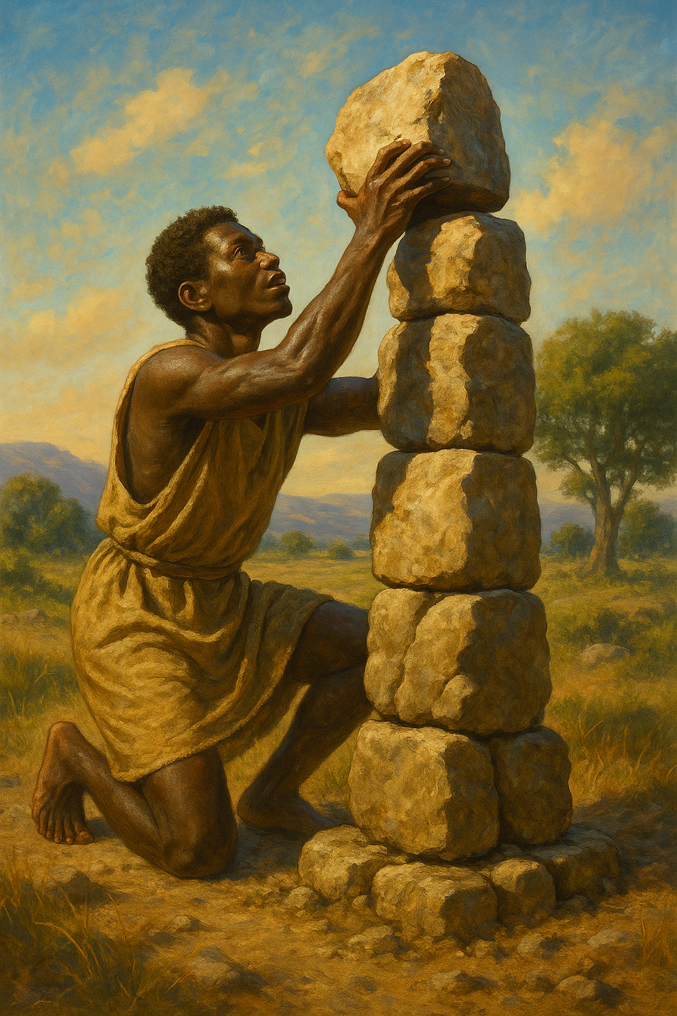
    Prayer
  God of our ancestors in faith, we thank You for abiding with us generation after generation. You seek us when we don’t seek You. Abide with us still, and help us to abide with You. In Jesus’ name. Amen.
Thought to Remember
  Find your purpose, and do your duty.
Notes:
God of our ancestors in faith, we thank You for abiding with us generation after generation. You seek us when we don’t seek You. Abide with us still, and help us to abide with You. In Jesus’ name. Amen.
C. Thought to Remember
Find your purpose, and do your duty.

Slide 3
LESSON OUTLINE
Jacob Sets Up a Sacred Pillar
Lesson Scripture: Genesis 28:10–22
Lesson Focus: Invite God to be with you on the way.
Life Response:
Bible Application:
Discuss how we can invite God to be with us in every circumstance.
Discuss how we can invite God to be with us in every circumstance.
      Review
      Introduction
      Lesson Context
      Overview
        A Dream - Genesis 28:10–15 KJV
        A Dedication = Genesis 28:16–22 KJV
      Bible Application
      Conclusion
      Question & Answers
Notes:
A Dream - Genesis 28:10–15 KJV
A Dedication = Genesis 28:16–22 KJV
Summary
Jacob, fleeing to Haran, rests at Bethel and dreams of a ladder to heaven with angels and the Lord above it. God reaffirms His covenant, promising land, descendants, and His presence. Awaking in awe, Jacob names the place Bethel and vows to worship God and give a tenth if God protects and provides for him.---
Commentary
This passage marks Jacob’s personal encounter with God, transforming a fearful escape into a sacred moment. The vision of the ladder symbolizes divine access and activity between heaven and earth. God's reaffirmation of the covenant shows that grace precedes Jacob’s reform. His vow, though conditional, reflects a developing faith. Bethel becomes a place of revelation and commitment, highlighting that God meets people in unlikely places, turning their journey into sacred ground. The tithe vow reveals Jacob's intention to acknowledge God's provision with tangible worship, foreshadowing deeper spiritual maturity.

Slide 4
LESSON INTRODUCTION
Jacob Sets Up a Sacred Pillar
Common Experiences, Different Paths
  Those who work with people may often find themselves traveling in unexpected (and perhaps unwanted) directions. This is true spiritually as well as physically, and one may result in the other. In the process, people find themselves taking roads much less traveled by others. The temptations of envy, pride, contempt, and indifference are common to all, but their intensities and timings threaten to derail our travels at our most vulnerable times. Moments of despair and a sense of defeat can overtake us as we search for that exit ramp that will lead to something different. When we go through painful experiences, we may think we are unique. But we are not unusual in that regard; we see it often in the Old Testament descendants of Abraham.
Notes:
Everyone faces trials, temptations, and detours in life. Though our struggles may feel personal and isolating, they are shared across generations—even among biblical figures. When we serve others, challenges like pride, discouragement, and despair often arise. Yet Scripture reminds us that God is always present, guiding us faithfully through every hardship and unexpected turn.
---
Three Key Points:
1. Unexpected Journeys – Serving and interacting with others may lead to detours in life—physically and spiritually—that are not always welcomed but are often part of God's shaping process.
2. Shared Struggles – While experiences differ, temptations like pride, envy, and despair are universal. We are not alone in our trials.
3. Biblical Parallels – The struggles we face echo those of Abraham's descendants, reminding us that even God's chosen people walked difficult, painful paths toward purpose.
---
Summary (under 100 words):

Slide 5
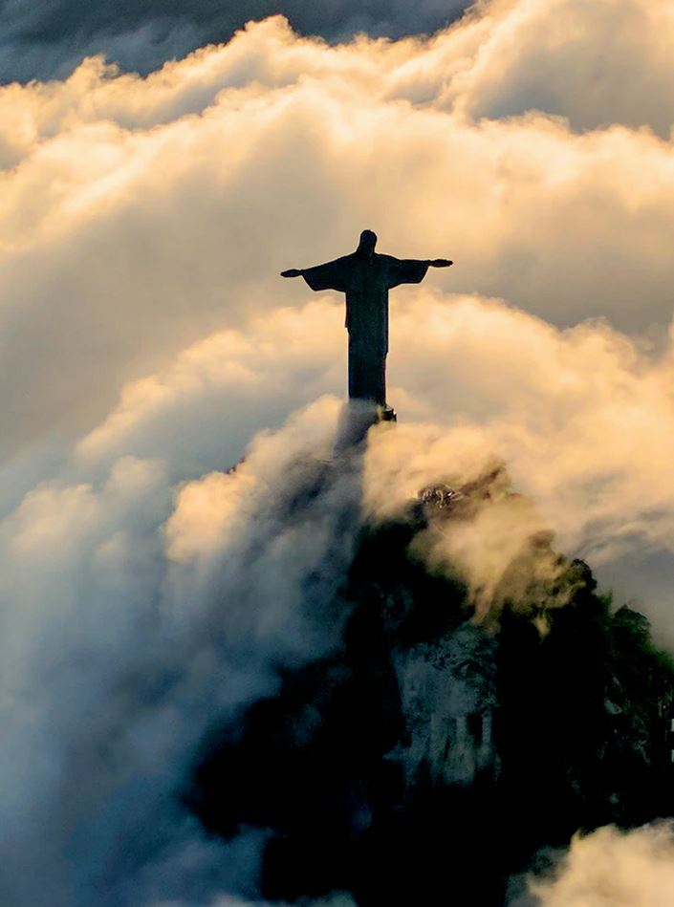
LESSON INTRODUCTION
Jacob Sets Up a Sacred Pillar
Jacob, through trickery, stole his older brother Esau’s blessing from their father, Isaac. Esau exploded with anger and threatened to kill Jacob. Rebekah, the mother of these two sons, suggested to Jacob, “Go live among my people,” about five hundred miles away (Gen. 27:43). So Jacob became a fugitive, running for his life. God allowed Jacob to return home almost twenty years later. But in the meantime, God had special blessings for him along the way.
The promise—
The prayer—
But in Jacob’s dream, God speaks directly to him. He comforts and assures the frightened fugitive of His heavenly Father’s constant presence: “I am with you” (Gen. 28:15). These words solidified God’s permanent companionship with Jacob on this journey. Jacob wakes and worships. He names the place “Bethel,” which means “the house of God. ” Jacob was beginning to understand that God was with him, wherever he might go.
Jacob traveled east to Harran. His brother was the hunter and outdoorsy type, but now he was the one on the outside and in the middle of nowhere. This could have been his first time away from home, and perhaps he was homesick. Jacob laid on a stone at night, perhaps for protection more than a pillow. And he dreamed. He dreamed about a ladder or stairway reaching from earth to heaven. This symbolized God’s interest and concern about things, not only in heaven but also on earth. In Jacob’s dream, God speaks to him, confirming the calling of his grandfather, Abraham, and his father, Isaac. Isaac told his sons about God’s appearances and promises (Gen. 26:2–5). And Isaac prayed over Jacob and passed the covenant blessing to him (Gen. 28:3–4).
Some Bible students see Jacob saying “if’s” to God as bargaining with God. But others interpret the word as “since,” meaning that Jacob is confident that God will do this. Jacob confirms his faith, “Yes, God, I hear Your promises to me, and I’m inviting You into this journey. You will bring me back to the place where I belong. ” Believers today can pray a similar prayer to the Father.
Notes:
Jacob’s journey starts with trickery and running away, but it turns into a story of change. While escaping Esau, Jacob has a dream where God shows him a ladder to heaven and promises to protect him and bring him home. Realizing God is with him, Jacob names the place Bethel and promises to serve God. His story reminds us that even when we mess up, God is still with us, ready to guide and change us.

Slide 6
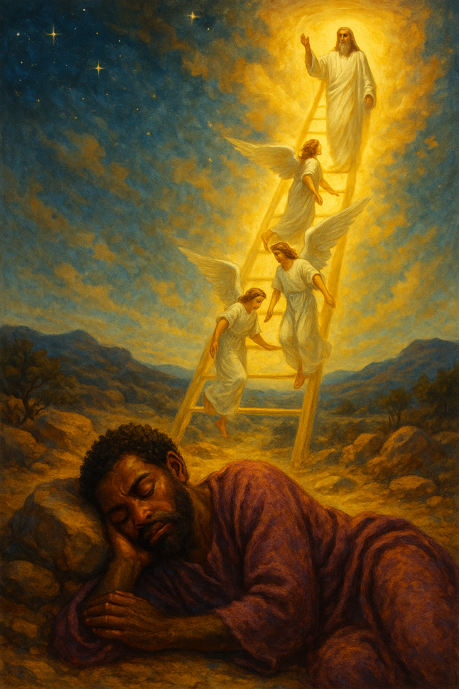
LESSON CONTEXT
Jacob Sets Up a Sacred Pillar
Genesis 12:1-3 begins the account of a family chosen to be a conduit of blessings to all nations. The text does not explain why God chose this family. The sins and various foibles of the members of that family line may sometimes leave us astonished.
All that is no less true regarding a grandson of Abraham known as Jacob. The book of Genesis presents him as a deceitful person who schemed to take advantage of others. He swindled his brother, Esau, out of his birthright (Genesis 25:27-34). He deceived their father, Isaac, in taking Esau’s blessing (27:1-40). Later, Jacob was tricked by his father-in-law, Laban (29:15-27). Jacob tricked Laban in return (30:37-43), with even more deceit following (31:17-21).
Indeed, in the journey he was on in today’s lesson, Jacob was on the run from trouble— trouble of his own making. In conspiracy with his mother, his trip was one of self-exile so his brother wouldn’t kill him because of a deception (Genesis 27:41). Such a character would hardly seem to be a key person in God’s plan to bless all nations!
Yet God worked His will through Jacob nonetheless. Ultimately, Jacob’s story is not about his search for God but God’s search for him. When found on a physical journey, Jacob began a spiritual journey as well.
Notes:
God chose to work through Jacob not because Jacob was perfect, but because of His own grace. Jacob lied, cheated, and ran from his problems, but God still showed up in his life. Jacob’s story shows that even when we mess up, God can still use us. God’s promises don’t depend on us being perfect—they depend on His mercy.
Key Lesson Learned:
God’s grace is bigger than our failures. He can use broken people to fulfill His good plan and meet us even when we’re running the wrong way.

Slide 7

LESSON INTRODUCTION
Jacob Sets Up a Sacred Pillar
Abraham’s Dream
Jacob’s dream echoes a similar dream experience of his grandfather, Abraham, which is described in Genesis 15. In Abraham’s vision, God reveals Himself through a smoking firepot and a flaming torch that pass between the halves of sacrificed animals. While this imagery is not altogether clear to a modern audience, most read this as symbolizing the ratification of the covenant agreement (Gen. 15:17). This dream sequence signifies God’s promise to Abraham, assuring him of a multitude of descendants and the gift of the land. Both narratives underscore the theme of divine provision and promise. For Jacob, the dream at Bethel reaffirms God’s covenant promises made to Abraham, but God also personalizes these promises and grants Jacob confidence in his divine protection.
God called Abraham to leave his home and to go out to a new land (Gen 12:1). Now God is traveling with Jacob while he searches for a place of refuge. When Jacob finds himself without hope and far from home, he discovers the profound truth that God is with him on his journey. His realization of God’s presence causes him to dedicate the rest of his life to serving and worshiping Yahweh, the one true God of Abraham and Isaac. Though Jacob is in a desolate place, God will keep His promise to bring him back into his father’s house and reunite him with his brother in the years to come.
Ascending and Descending on the Son In the Gospel of John, Jesus makes a profound declaration related to the content of this lesson: “Very truly I tell you, you will see heaven open, and the angels of God ascending and descending on the Son of Man” (John 1:51). This statement not only captures the attention of His disciples but also draws a direct parallel to the story of Jacob’s dream in Genesis 28:12. The angels ascending and descending in Genesis 28 serve to illustrate a deeper theological truth about Jesus’ own person and work. Like in the story of Jacob, Jesus is showing that God is active in the world.
Additionally, by aligning Himself with the imagery of the stairway to heaven, Jesus indicates that He is the ultimate bridge between God and humans. This connection suggests that—through Jesus’ life, death, and resurrection—the divine promises of accessibility and closeness to God, first symbolized in Jacob’s dream, are fulfilled in Jesus. His ministry represents the actualization of God’s presence and salvation in the world, offering a living testimony of God’s purposes in heaven and on earth.
Notes:
God spoke to both Abraham, Issac and Jacob through dreams to remind them of His promises. Abraham’s dream showed God’s covenant using symbols, while Jacob’s dream made the promise personal—God would protect and guide him. These dreams prove that God keeps His word and stays involved in our lives, even when things are uncertain.
Key Lesson Learned:
God is faithful across generations. He keeps His promises and personally guides those He calls, no matter the situation.

Slide 8
LESSON INTRODUCTION
Jacob Sets Up a Sacred Pillar
The Promised Seed
The promise of a “seed” (Gen. 28:14, KJV) for Jacob connects to an important theme in Scripture. Genesis 3:15 first tells of an ongoing conflict between the seed of the woman and the seed of the serpent: each will deal a deadly blow to the other. This story of the seed sets the stage for the entire redemptive narrative that unfolds across the Bible. This theme of conflict and promise underscores the struggle between the forces of good and evil, with God’s promise acting as a beacon of hope and divine assurance that good will win.
Esau’s animosity toward Jacob serves as one example of God’s seed facing threats. Esau wants to get revenge, but Jacob is God’s chosen instrument. God is not going to allow Jacob to come to harm, since God will use the family of Jacob to overcome evil once and for all. The message of this theme is that God is sovereign. He is committed to preserving the lineage through which the Messiah, the ultimate seed of the woman, would come.
Notes:
Jacob is part of the special family line promised back in Genesis 3:15. His story shows the battle between good and evil—like Esau wanting to hurt him—but God protects Jacob to keep His promise. Jacob’s family line would eventually lead to Jesus, proving that God always keeps His plan to save the world.
Key Lesson Learned:
God’s plan to save us never fails. Even when evil tries to stop it, God protects His promise and uses people like Jacob to bring His plan to life.

Slide 9
LESSON INTRODUCTION
Jacob Sets Up a Sacred Pillar
Pillar Worship
Jacob’s declaration of Bethel as “the house of God” and his act of setting up a pillar in response to his dream has sparked important questions about what is appropriate within the context of later biblical commands. Specifically, Leviticus 26:1 cautions against the creation of idols, the setting up of images, or a “sacred stone. ” The command of Leviticus also prohibits bowing down to “carved stones” (which is probably the meaning of a “sacred stone” as well).
In the ancient Near East, it would be common to set up pillars or standing stones as symbols of dwelling places for the gods. Jacob’s action, therefore, is reflective of his context. His intention does not seem to be the creation of a place of regular worship, nor does the text say that he carved any relief image into the stone. He used the ordinary stone to mark the place where he had an extraordinary encounter with God. When Jacob calls his location “the house of God” (v. 17), he does not mean that God dwells only in this place. Otherwise, how would God be accompanying him on the journey?
In any case, Jacob’s actions are descriptive, rather than prescriptive for later readers. The overarching theme is God’s decision to bless and use Jacob, despite any shortcomings.
Bethel, the House of God?
While Bethel was originally dedicated by Jacob as “the house of God,” Bethel’s later history is marked by deviation from monotheistic worship. In 1 Kings 12, the city becomes emblematic of apostasy under King Jeroboam’s reign. Jeroboam erects two golden calves in Bethel, encouraging the Israelites to worship these idols to keep the people from traveling to Judah to worship in Jerusalem. This act of idolatry contrasts with the place’s original sanctification by Jacob and represents a violation of the commandment against idol worship (Ex. 20:4). Further condemnation of Bethel’s idolatrous practices comes in 1 Kings 13, when a man of God prophesies against the altar at Bethel. This prophecy anticipates the eventual destruction of the altar and high places by King Josiah, as recorded in 2 Kings 23. Josiah’s reforms, which include tearing down the altars and high places in Bethel, are seen as a return to the covenant requirements of God.
Although Bethel began as a holy site, its later history reveals how sacred spaces can be corrupted by idolatry.
Notes:
Jacob set up Bethel as a holy place after meeting God there. Sadly, years later, it became a center for idol worship under King Jeroboam. Later, King Josiah tore down the idols to bring people back to true worship. Jacob’s stone pillar wasn’t an idol—it was just his way of showing respect and remembering God’s presence.
Key Lesson Learned:
Holy places and symbols must stay centered on God. What starts as a place of worship can lose its meaning if we turn from God’s truth. God wants our worship to be real, not based on man-made idols.

Slide 10
LESSON OVERVIEW
Jacob Sets Up a Sacred Pillar
A Dream - Genesis 28:10–15 KJV
10 And Jacob went out from Beersheba, and went toward Haran.
11 And he lighted upon a certain place, and tarried there all night, because the sun was set; and he took of the stones of that place, and put them for his pillows, and lay down in that place to sleep.
12 And he dreamed, and behold a ladder set up on the earth, and the top of it reached to heaven: and behold the angels of God ascending and descending on it.
13 And, behold, the LORD stood above it, and said, I am the LORD God of Abraham thy father, and the God of Isaac: the land whereon thou liest, to thee will I give it, and to thy seed;
14 And thy seed shall be as the dust of the earth, and thou shalt spread abroad to the west, and to the east, and to the north, and to the south: and in thee and in thy seed shall all the families of the earth be blessed.
15 And, behold, I am with thee, and will keep thee in all places whither thou goest, and will bring thee again into this land; for I will not leave thee, until I have done that which I have spoken to thee of.
• Jacob has deceitfully stolen Esau’s birthright, and Isaac sends Jacob to Haran to escape his brother’s wrath.
• Jacob also hoped to find a relative to marry (after the custom of that time).
• Although Jacob has been promised the blessing, he is not experiencing it yet.
• While on the way, Jacob dreams of a ladder reaching to heaven, which symbolizes the connection between heaven and earth.
• On the ladder are servants of God—angels— moving up and down. This shows their role and presence on earth.
• God appears at the top of the walkway and speaks words of blessing to Jacob.
Notes:
Jacob tricked his father and stole his brother Esau’s blessing. This made Esau furious and forced Jacob to run away. Alone and afraid in the desert, Jacob had a dream of a stairway reaching heaven with angels on it and God standing above. God spoke to Jacob, repeating the promises made to Abraham and Isaac—land, family, and blessings—and promised to stay with him. Even though Jacob had done wrong, God still chose to be with him and guide him. This shows that God’s promises are based on grace, not on how good we are.
Key Lesson Learned:
God’s grace meets us even when we don’t deserve it. Jacob's story proves that no matter how far we’ve messed up, God still works in our lives and keeps His promises.

Slide 11
LESSON OVERVIEW
Jacob Sets Up a Sacred Pillar
A Dedication - Genesis 28:16–22 KJV
16 And Jacob awaked out of his sleep, and he said, Surely the LORD is in this place; and I knew it not.
17 And he was afraid, and said, how dreadful is this place! this is none other but the house of God, and this is the gate of heaven.
18 And Jacob rose up early in the morning, and took the stone that he had put for his pillows, and set it up for a pillar, and poured oil upon the top of it.
19 And he called the name of that place Bethel: but the name of that city was called Luz at the first.
20 And Jacob vowed a vow, saying, If God will be with me, and will keep me in this way that I go, and will give me bread to eat, and raiment to put on,
21 So that I come again to my father’s house in peace; then shall the LORD be my God:
22 And this stone, which I have set for a pillar, shall be God’s house: and of all that thou shalt give me I will surely give the tenth unto thee.
• When Jacob wakes, he immediately becomes aware of God’s unseen presence.
• Jacob sets the stone he had used for a pillow as a memorial of remembrance, which expresses his devotion to God.
• Jacob vows to return a tenth of all he receives if God brings him safely back to his home.
• God’s presence assures Jacob that he will one day return home and that he has nothing to fear.
Notes:
After his dream, Jacob realizes God was with him all along. He’s filled with awe, not fear, and names the place “Bethel”—God’s house. He sets up a stone pillar, pours oil on it as an offering, and promises to worship and give God a tenth of all he gets if God keeps him safe. This moment marks the beginning of Jacob’s personal relationship with God and shows that God can change us even in our lowest moments.
Key Lesson Learned:
God meets us where we are and calls us to respond with faith. When we recognize His presence, our fear turns to worship, and our lives begin to change.
Tools

Slide 12
BIBLE APPLICATION
Jacob Sets Up a Sacred Pillar
Discuss how we can invite God to be with us in every circumstance.
Enduring Presence
I hadn’t been to church in years. Years later, the pain of what went wrong felt as raw as when it happened. I had given up working as a pastor. In an effort to leave it all behind, I stepped into a different job and worked for the freedom of weekends with my family.
It seemed that the more I worked, the more I was discontent. My wife and kids went to church without me. It hurt to see them trying to seek Jesus while I was running the other way. Work wasn’t satisfying and left me with an unavoidable pit that couldn’t be filled with success.
After feeling guilt and shame as I watched my family go to church each Sunday, I finally chose to go with them one week. But it didn’t go well. Fear overtook me, and I had a panic attack. But then, I started praying again. I had conversations with my wife and with wise counselors, and went back. This time there wasn’t a panic attack, just a sermon. The message spoke of a God who was breathing life into dry and dead places. I knew, right then He was breathing life into me. God has never left me, and His enduring presence is with me still.
Not long after my return, the church held a special event for one of my daughters. I remember the day well. It was that day when I sensed a calling to step back into ministry. I remember praying, “Lord, if I’m going to do this, I need You to come with me. ” A pastoral position opened at our church, and I stepped back into what I thought I would never do again.
Notes:
How can we invite God to be with us in every circumstance?
We invite God through honest prayer, seeking wise counsel, and opening ourselves to His presence—even when we feel unworthy or afraid. Returning to worship and saying, “Lord, come with me,” reopens the door for God’s guidance and healing in every moment of our lives.

Slide 13
BIBLE APPLICATION
Jacob Sets Up a Sacred Pillar
Discuss how we can invite God to be with us in every circumstance.
Enduring Presence
10. When have you struggled to see that God was with you?
11. When have you looked back after going through something difficult, only to realize that God was with you?
12. How can you remember that God is there when you are hurting?
Notes:
10. When have we struggled to see that God was with us?
We’ve struggled to see God when we’ve been distant from church, burdened by guilt and shame, and chasing things that left us feeling empty and unfulfilled.
11. When have we looked back after going through something difficult, only to realize that God was with us?
Looking back after hard moments, we’ve realized that God was with us the whole time—breathing life into our brokenness, even when we had turned away.
12. How can we remember that God is there when we are hurting?
We can remember God’s presence by reflecting on how He has helped us before, leaning on the support of faithful people, and trusting that He brings life even in painful seasons.

Slide 14
CONCLUSION:
Jacob Sets Up a Sacred Pillar
God’s Surprises
God surprised Jacob with a vision of the magnitude of mercy that the young man would receive in life. Although Jacob would face many future problems, often of his own making, his life went on to be marked by God’s merciful provisions. In the big-picture view, Jacob was to be a key man through whom the ancient promises to his ancestors were to come to fruition.
But in addition to that big picture, there’s a more personal one: the story doesn’t feature Jacob’s search for God, but rather it features God’s search for him. After being found, Jacob had to begin viewing his life differently, searching for the meaning of what he had experienced. That search lasted the rest of his life (Genesis 46:1–47:11; 47:28–49:33).
The same will be true for us. Though we have much more of God’s revealed will than Jacob had, we still struggle to know our place in the bigger picture of Matthew 28:19-20. On a personal level, we might hope only for survival, but we end up finding much more from the God of mercy and grace.
Regardless of the situations of life, the primary question, per Luke 17:10, is this: What is my duty in my current situation? When you ask that question in light of biblical precepts and principles, you won’t need to expect God to answer that in a dream.
Notes:
God’s mercy shows up even when we’re not looking for it. Jacob wasn’t seeking God, but God reached out to him anyway and gave his life new direction. Like Jacob, we grow spiritually over time and must learn to ask daily, “What does God want me to do today?” Faithfulness starts with small, obedient steps.
Key Lesson Learned:
God finds us before we find Him, and He calls us to live with purpose every day.

Slide 15
CONCLUSION
Jacob Sets Up a Sacred Pillar
Life Response: Pray for God’s presence in even the most mundane moments.
It can be hard to remember God’s presence. Even in the most mundane parts of our lives, we can feel distant from God. But just as Jacob responds to God’s presence in worship and remembrance, we too can respond to God’s presence.
A Memory Stone
In today’s lesson, Jacob set up a stone to help him remember that the unseen God was with him. It even made him afraid to think that God had been present all along, but he was unconscious of this reality.
Notes:
God is present even in our most ordinary moments, though we may not always recognize Him. Like Jacob, we are called to respond in worship and remembrance.
Jacob’s story reminds us that God is always near, even when we don’t see Him. In a time of fear and isolation, Jacob encountered God and was awakened to His presence. He marked the moment with a stone, an act of remembrance that inspired worship. His journey teaches us to slow down, notice God’s nearness, and respond with trust and reverence.
Like Jacob, we are often unaware that God is in the midst of our daily lives—until He makes Himself known. This lesson calls us to become more spiritually attentive. When we set aside time to reflect, worship, and pray, we invite God into every step of our journey. Whether facing trials, transitions, or quiet routines, let us carry the simple but powerful prayer: “Lord, go with me.” And just as God met Jacob in a desolate place, He will meet us too—with guidance, grace, and purpose.
Three Key Points:
God’s Presence Is Often Unnoticed
Just as Jacob was unaware of God’s presence until his dream, we too can miss God's nearness in our everyday routines.
Remembrance Cultivates Awareness
Jacob set up a stone to mark the moment he realized God was with him. Tangible acts of remembrance help us stay mindful of spiritual truths.
Worship Is the Right Response
Jacob's awe and worship show that awareness of God’s presence—even in mundane places—should lead us to reverence, gratitude, and commitment.

Slide 16



End
  The Lord bless thee, and keep thee:
  The Lord make his face shine upon thee, and be gracious unto thee:
  The Lord lift up his countenance upon thee and give thee peace.
  - Numbers 6:24-26,
Material adapted by Stanford W. Bowman Jr. from Echoes® Adult and Bible-in-Life® Adult SUMMER 2025 quarter with permission, © David C Cook, https://davidccook.org. May not be further reproduced. All rights reserved.

Slide 17
QUESTION & ANSWER
Jacob Sets Up a Sacred Pillar
Life Response: Pray for God’s presence in even the most mundane moments.
A DREAM
4. Why does Jacob leave his father’s house?
5. What does Jacob’s dream mean?
6. What does God promise to Jacob?
Jacob’s journey to Harran is initiated by his need to escape Esau’s wrath, following Jacob’s deceptive act of impersonating Esau to obtain the blessing. His trickery fuels Esau’s hatred toward Jacob, prompting Isaac and Rebekah to send Jacob to Harran, where he might find a suitable wife.
Jacob’s dream means several things. First, God is unseen but still with Jacob at all times. Second, God is active in the world and not remote in heaven. Third, God has not rejected Jacob for his behavior.
God promises Jacob that he shall receive an inheritance of land, many children, and a blessing from other nations. These are the same promises as made to Abraham and Isaac. God specifically promises to bring Jacob back in safety.
Notes:
A DREAM
4. Why does Jacob leave his father’s house?
Jacob’s journey to Harran is initiated by his need to escape Esau’s wrath, following Jacob’s deceptive act of impersonating Esau to obtain the blessing. His trickery fuels Esau’s hatred toward Jacob, prompting Isaac and Rebekah to send Jacob to Harran, where he might find a suitable wife.
5. What does Jacob’s dream mean?
Jacob’s dream means several things. First, God is unseen but still with Jacob at all times. Second, God is active in the world and not remote in heaven. Third, God has not rejected Jacob for his behavior.
6. What does God promise to Jacob?
God promises Jacob that he shall receive an inheritance of land, many children, and a blessing from other nations. These are the same promises as made to Abraham and Isaac. God specifically promises to bring Jacob back in safety.

Slide 18
QUESTION & ANSWER
Jacob Sets Up a Sacred Pillar
Life Response: Pray for God’s presence in even the most mundane moments.
A DEDICATION
7. When have you become intensely aware of God’s presence and felt the need to respond?
8. What is Jacob’s response?
9. What is the difference between the fear that Jacob has of Esau and the fear
that Jacob shows to God?
This is an open-ended question and a chance for your students to share experiences of God’s presence.
Jacob responds to his realization by setting up a stone pillar in remembrance of God’s presence. He poured an offering of oil over the stone, revealing his trust and thankfulness for God’s provision. Jacob then promises to give a tenth of everything he owns to the Lord.
Fear can mean the intense emotion of being afraid, or it can mean reverence and awe. In this case, Jacob is afraid of his brother’s anger. But the fear that he expresses toward God is from his awareness of God’s authority and power.
Notes:
A DEDICATION
7. When have you become intensely aware of God’s presence and felt the need to respond?
This is an open-ended question and a chance for your students to share experiences of God’s presence.
8. What is Jacob’s response?
Jacob responds to his realization by setting up a stone pillar in remembrance of God’s presence. He poured an offering of oil over the stone, revealing his trust and thankfulness for God’s provision. Jacob then promises to give a tenth of everything he owns to the Lord.
9. What is the difference between the fear that Jacob has of Esau and the fear that Jacob shows to God?
Fear can mean the intense emotion of being afraid, or it can mean reverence and awe. In this case, Jacob is afraid of his brother’s anger. But the fear that he expresses toward God is from his awareness of God’s authority and power.

Slide 19
End
  The Lord bless thee, and keep thee:
  The Lord make his face shine upon thee, and be gracious unto thee:
  The Lord lift up his countenance upon thee and give thee peace.
  - Numbers 6:24-26,
Material adapted by Stanford W. Bowman Jr. from Echoes® Adult and Bible-in-Life® Adult SUMMER 2025 quarter with permission, © David C Cook, https://davidccook.org. May not be further reproduced. All rights reserved.

