Slide 1
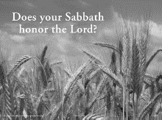
Lord of the Sabbath
But I say unto you, That in this place is one greater than the temple. —Matthew 12:6 KJV
Week of July 13

Slide 2
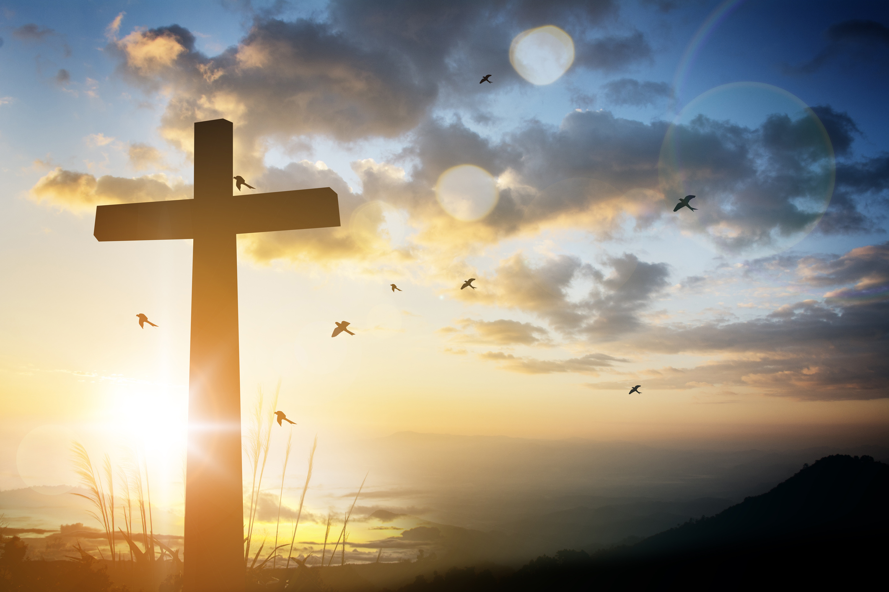

  Prayer
Lord Jesus, in You we see the power of God. Help us to find our rest in You. As You have shown us forgiveness and mercy, help us to offer mercy to others. Remind us that we are Your disciples on a holy mission with You. In Jesus’ name. Amen.
Thought to Remember
  Jesus gives His people true rest.
Notes:
Lord Jesus, in You we see the power of God. Help us to find our rest in You. As You have shown us forgiveness and mercy, help us to offer mercy to others. Remind us that we are Your disciples on a holy mission with You. In Jesus’ name. Amen.
Thought to Remember
Jesus gives His people true rest.

Slide 3

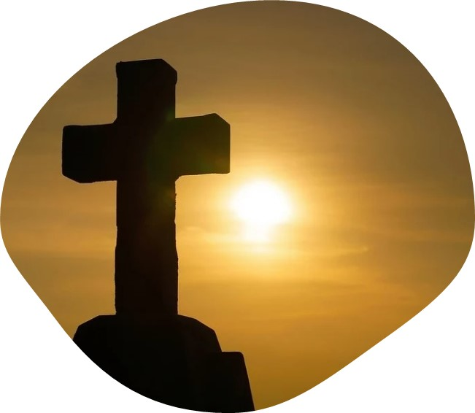
LESSON OUTLINE
Lord of the Sabbath
Lesson Scripture: Matthew 12:1–8
Lesson Focus: Recognize Jesus’ authority as Lord and God.
Life Response: Commit ourselves to recognizing Jesus’ ultimate authority.
Bible Application: Notice the way that Jesus uses His authority to remind us about mercy.
      Introduction
      Review
      Lesson Context
      Overview
        The Disciples Glean; the Pharisees Complain - Matthew 12:1–4 KJV
        Mercy Greater Than Sacrifice - Matthew 12:5–8 KJV
      Conclusion
      Question & Answers
3
Notes:
The Disciples Glean; the Pharisees Complain - Matthew 12:1–4 KJV
Mercy Greater Than Sacrifice - Matthew 12:5–8 KJV
><><><><><><><><><><><><>><><><><><
Analysis
Jesus confronts the Pharisees’ rigid interpretation of Sabbath law after His disciples pluck grain to eat on the Sabbath. By appealing to Scripture and referencing David’s actions, priestly duties, and prophetic words, Jesus shifts the focus from legalistic ritual to divine mercy and authority. He asserts His identity as one greater than the temple and declares Himself “Lord of the Sabbath,” affirming His divine prerogative to define true Sabbath observance.
---
Summary (≤100 words)
In Matthew 12:1–8, Jesus defends His disciples who pluck grain on the Sabbath, challenging the Pharisees' strict rules. Citing David’s actions and priestly duties, He emphasizes that human need outweighs ritual law. Quoting Hosea, Jesus declares God desires mercy, not sacrifice. Ultimately, Jesus claims to be “greater than the temple” and “Lord of the Sabbath,” revealing His divine authority. The passage shifts focus from legalism to mercy, rest, and recognition of Christ’s lordship.
---
Commentary (≤100 words)
This passage highlights the conflict between religious tradition and divine intention. The Pharisees’ focus on external compliance misses the heart of God’s law—compassion. Jesus, by invoking David and temple priests, doesn’t discard the Law but reorients it around mercy and Himself. His declaration as “Lord of the Sabbath” elevates the discussion: the Sabbath is not merely about rest but about recognizing the presence and authority of Christ. True rest is not found in rules but in relationship with the Redeemer. Believers are challenged to value mercy over ritual and submit fully to Jesus’ authority.

Slide 4
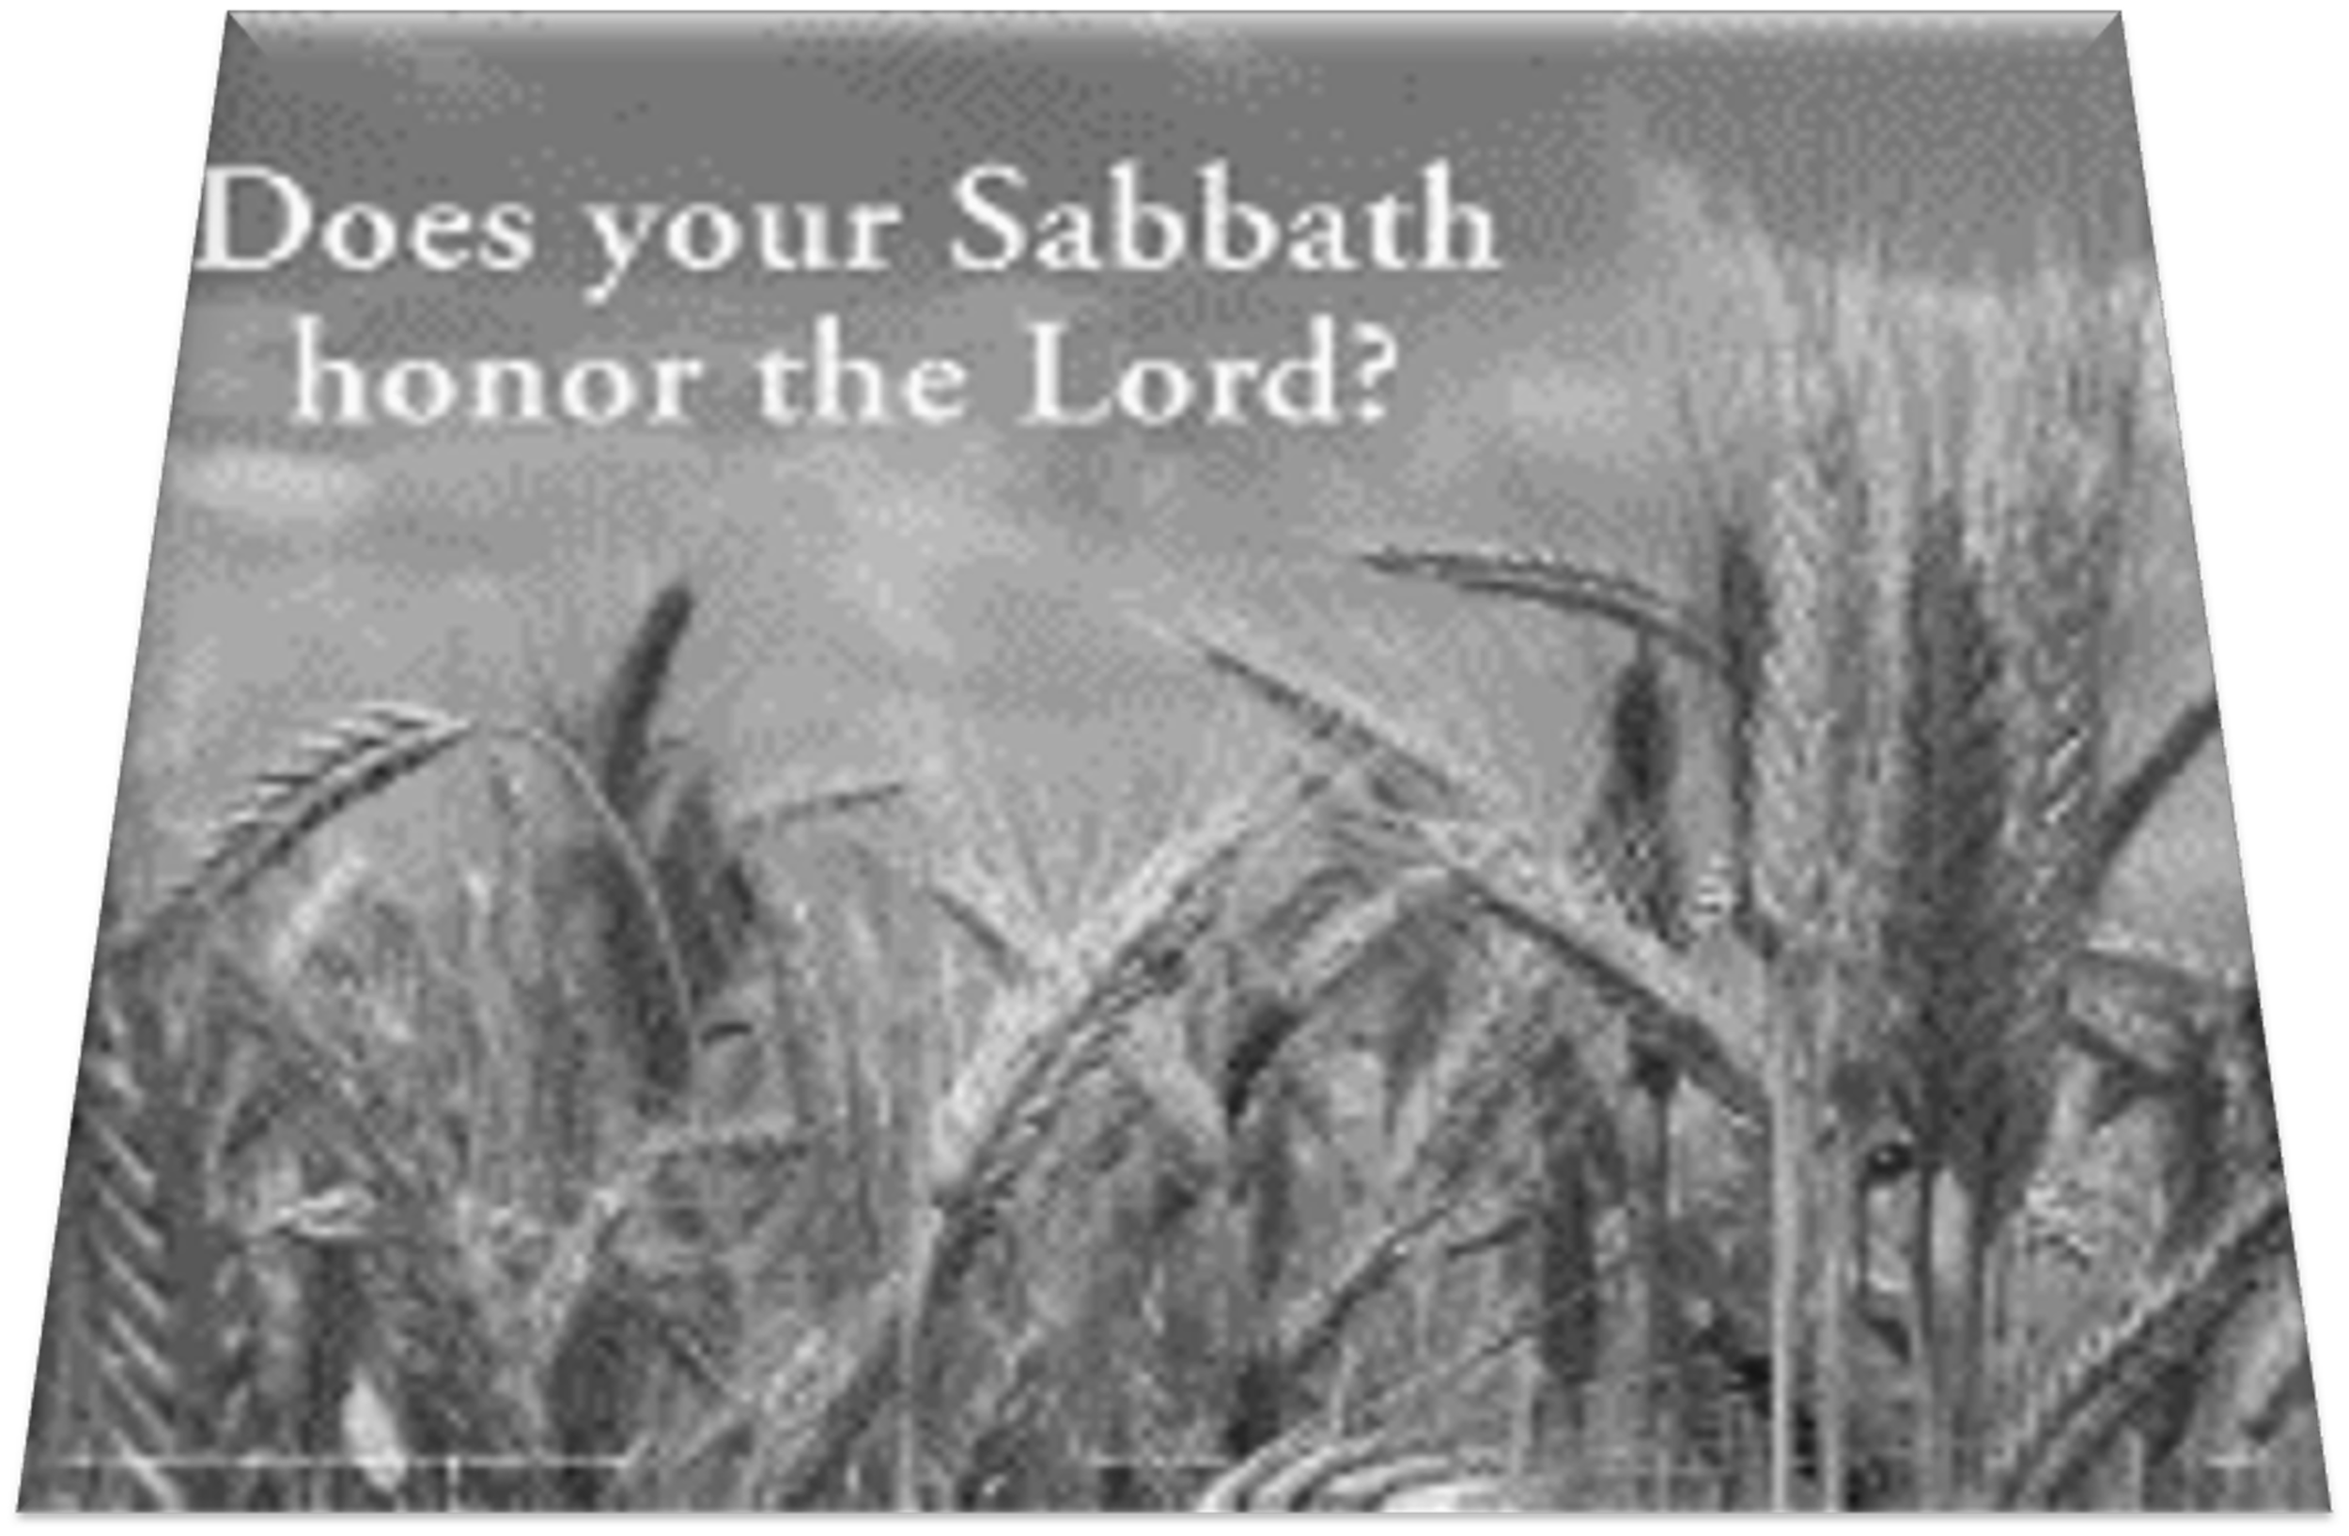
LESSON INTRODUCTION
Lord of the Sabbath
What Are We Talking About?
In the middle of a conversation, have you ever stopped to ask yourself, “Wait, what are we really talking about?” Imagine you’re discussing loading the dishwasher. “Everyone knows the bowls go in the top rack!” you say, but as you feel the tension grow, you realize you are arguing over something else. Whose job is it to fix this? Am I the only one who cares if the dishes come out clean? Am I seen? Many of our “disagreements” turn out to be about values, whether or not we acknowledge that reason.
Jesus knew how to take a conversation and use it to reveal a person’s heart. His discussion about Sabbath is like this. You might anticipate a legal discussion of Sabbath rules—what is or is not permitted. But Jesus turned the discussion around to reveal the motives of the Pharisees. He was more interested in talking about showing mercy. At the same time, His sweeping claims left everyone wondering, “Who is this person who calls himself Son of Man and Lord of the Sabbath? Who gave Him the right?”
4
Notes:
Arguments often aren’t about what they seem—they're really about deeper feelings or beliefs. Jesus did the same with the Pharisees: He didn’t just argue Sabbath rules, but showed that what really mattered was mercy and that He had the authority of God.
Key Lesson Learned
Jesus cares more about our hearts than our habits. He wants us to show mercy, not just follow rules.
==================================
Analysis of “What Are We Talking About?”
This section begins with a relatable analogy to expose how surface-level disagreements often mask deeper value-based conflicts. The author then connects this to Jesus’ interaction with the Pharisees about Sabbath law, showing how Jesus redirects the debate from legalism to the heart—particularly the value of mercy and the revelation of His divine identity.
---
Main Idea
Jesus used the Sabbath controversy not just to address law but to expose deeper issues of the heart—revealing both the Pharisees' lack of mercy and His divine authority.
---
Three Key Points
1. Disagreements Often Mask Deeper Issues: Like a dishwasher argument that’s really about feeling unseen, the Sabbath debate exposed hidden values and motives.
2. Jesus Prioritized Mercy Over Rules: Rather than engage in legal debates, Jesus highlighted the greater spiritual principle of showing compassion.
3. Jesus Revealed His Divine Identity: By calling Himself “Lord of the Sabbath,” Jesus shifted the conversation to His authority as God’s Son.
---
Summary
The text uses a household argument to illustrate how minor debates often reflect deeper concerns. In the same way, Jesus' Sabbath conversation wasn’t about legal minutiae but about deeper truths—mercy, motives, and His divine authority. He challenged the Pharisees’ rigid rule-keeping to show that God values mercy, not mere compliance, and asserted Himself as the Lord with ultimate authority.

Slide 5
Observing a seven-day week that included one day of rest (Sabbath) was a distinctive practice of ancient Israel. An ancient king might declare a rest day to celebrate a great victory, but regular, periodic rest was a revolutionary idea. For the most part, ancient peoples were expected to work every day.
Sabbath was a gift that God gave through the Law of Moses (Exodus 20:8-11; Deuteronomy 5:12-15). It commemorated two of God’s mighty acts. First, God completed the work of creation and rested on the seventh day (Genesis 2:1-3; compare Exodus 20:11). Second, God liberated His people from oppression in the land of Egypt, a place where they were not allowed rest. Rest was a gift from God—even the animals got a day off (Deuteronomy 5:12-15).
Thus, Sabbath was not only a blessing but also an expression of faith. The challenge was to trust God that six days of labor would be enough to sustain life as God provided for His people. That required a lot of faith in a pre-industrial agrarian era!
The Law of Moses extended observance of Sabbath to include one year out of seven; on every seventh year, the fields were to remain uncultivated, debts would be forgiven, and enslaved people emancipated (Leviticus 25:1-8; Deuteronomy 15:1-18). In the Year of Jubilee—which came after seven Sabbath years (49 years total)—any land that had been sold would return to its original owners (Leviticus 25:8-22). Through these commands, God promised blessing and fruitfulness in the land He had given Israel as an inheritance.
But keeping Sabbath had been a controversial topic for centuries by Jesus’ day. Israel’s prophets had spoken out against hypocritical Sabbath observance (examples: Isaiah 1:13; Amos 8:3- 6). Jeremiah had warned Jerusalem that failure to keep Sabbath would lead to destruction (Jeremiah 17:27). The prophets also looked forward to a day when Sabbath would be kept properly, when God’s blessing would be restored to the nation of Israel, and even other nations would join in worshiping God for His mighty acts (Isaiah 66:22-23; Jeremiah 17:24-26).
The Pharisees of Jesus’ day responded by emphasizing meticulous observance of Sabbath. Their “oral Torah” (traditions passed down by word of mouth) had amplified regulations that prevented a person from even coming close to breaking the commandments. Such traditions defined what constituted “work” that could and could not be performed on the Sabbath.
Lord of the Sabbath
5
Notes:
God gave the Sabbath as a gift of rest and trust, reminding people of creation and freedom from slavery. But by Jesus’ time, religious leaders had turned it into a list of rules. Jesus reminded everyone that it was meant to bless people, not burden them.
Key Lesson Learned
God's commands are meant to bring life and freedom—not control. We honor Him by resting and trusting, not by adding man-made restrictions.
==================================
Analysis
This section traces the historical and theological background of the Sabbath. Originally intended as a gift and symbol of trust in God, Sabbath observance became a strict, rule-laden practice by Jesus’ time. What began as divine rest and liberation was distorted into burdensome legalism, particularly by the Pharisees, who focused on preventing even the appearance of violation.
Main Idea
The Sabbath was a God-given gift of rest and trust, later distorted into rigid tradition by religious leaders.
Three Key Points
Sabbath Originated as a Gift: It commemorated creation and Israel’s liberation, offering rest to all—including animals.
Sabbath Required Faith: Trusting God’s provision for six days demanded deep dependence, especially in an agrarian society.
Traditions Distorted Its Purpose: By Jesus’ day, Pharisaic additions turned Sabbath into a burden, masking its original grace.
Summary
The Sabbath was instituted by God as a symbol of rest, liberation, and trust. Over time, human traditions layered burdens upon it, shifting focus from grace to rule-keeping. Jesus’ ministry called people back to the heart of Sabbath: a divine gift meant to bless, not bind.

Slide 6
LESSON CONTEXT
Lord of the Sabbath
The Sabbath—
  God establishes Sabbath as a precious gift. Individuals are to work diligently for six days. But on the seventh day, everyone is to stop working, and acknowledge God for giving the ability to work. Over the years, the religious leaders created a “burden day” instead of a “Sabbath Day. ” Everything had to be carried out in a particular manner and done absolutely right on that day. But when the leaders accused the disciples of violating the Sabbath, Jesus asserted His authority over the day He created.
Sabbath violations—
  One Sabbath, Jesus’ hungry disciples started picking grain, rolling it in their hands, and eating it. The Pharisees immediately protested. According to their Sabbath list of rules, no one gleaned in the field or prepared meals. The Law allowed travelers to glean grain for a meal (Deut. 23:25). But the religious leaders had inserted their extra “two cents. ” This gleaning could not be done on the Sabbath.
  Jesus cites David as an example. David and his soldiers stood before the priest with an urgent need for food. The priest gave these men the sacred showbread, which was only reserved for the priest (see Lev. 24:9). Jesus emphasizes the importance of putting a person’s need over ceremonial rituals.
The real Sabbath—
  Jesus adds to this teaching about the Sabbath a claim to His deity. “Something greater than the temple is here,” He says (Matt. 12:6). He claims lordship over a day ordained by God. Jesus, as Creator, was there for the first Sabbath. He alone holds the authority over activities performed on that day. At this point, after hearing His divine proclamation, everyone, under the sound of His voice, should have dropped to their knees, in recognition of the Messiah’s presence. Instead, the religious leaders continued to plan how to get rid of this troublesome figure.
  When Christians today refuse to grant authority to Christ, they are behaving like the Pharisees. What Jesus requires of us, we must do.
6
Notes:
1. The Sabbath
God gave the Sabbath as a special day to rest and worship. Over time, religious leaders added too many rules and made it hard to enjoy. Jesus reminded everyone that He has the power to say what the Sabbath really means.
Key Lesson Learned:
God’s gifts are meant to help us, not to weigh us down with rules.
2. Sabbath Violations
Jesus' disciples picked grain on the Sabbath, and the Pharisees said they were breaking the rules. Jesus showed from Scripture that mercy is more important than tradition—especially when people are hungry or in need.
Key Lesson Learned:
God values caring for people more than following religious rituals.
3. The Real Sabbath
Jesus didn’t just argue about Sabbath rules—He said something bigger: He is Lord of the Sabbath. That means He’s greater than the temple and has full authority from God.
Key Lesson Learned:
Recognizing Jesus’ authority helps us focus on Him—not just the rules—when we worship and rest.
==============================
1. The Sabbath
Analysis:
The Sabbath was instituted by God as a blessing and a day of rest. Over time, religious leaders turned it into a burden through rigid rules. Jesus reclaims the Sabbath's true purpose and asserts His divine authority over it.
Main Idea:
God gave the Sabbath as a gift, but Jesus has the authority to define and fulfill its purpose.
Three Key Points:
Sabbath is a divine gift, not a human burden.
Religious traditions distorted God’s intention.
Jesus, as Creator, claims authority over the Sabbath.
Summary:
The Sabbath was meant to be a day of rest and worship, but religious leaders turned it into legalistic observance. Jesus challenges this distortion and reasserts His divine lordship over the day He created.
---
2. Sabbath Violations
Analysis:
Jesus’ disciples are accused of breaking Sabbath law by picking grain. Jesus counters with Scripture, showing how mercy and human need outweigh rigid rule-following.
Main Idea:
Jesus highlights the priority of compassion over ritual when it comes to Sabbath observance.
Three Key Points:
Disciples acted lawfully by gleaning for food.
Jesus uses David’s example to justify mercy over ceremony.
Human need takes precedence over ritual restrictions.
Summary:
Accused of breaking Sabbath law, Jesus defends His disciples by citing David’s actions. He emphasizes that mercy matters more to God than rigid ceremonial observance.
3. The Real Sabbath
Analysis:
Jesus doesn’t stop at defending actions; He reveals His divine identity. He is greater than the temple and Lord of the Sabbath, a claim to deity.
Main Idea:
Jesus reveals His divine authority and identity through the Sabbath discussion.
Three Key Points:
Jesus claims to be greater than the temple.
He asserts authority as Lord of the Sabbath.
The failure to recognize His identity reveals hardened hearts.
Summary:
Jesus shifts the discussion from rules to revelation. By declaring Himself Lord of the Sabbath, He unveils His divine authority. The Pharisees’ rejection shows their spiritual blindness.

Slide 7
LESSON INTRODUCTION
The Purpose of Sabbath
The Sabbath was a gift God gave to His people, first after His provision of manna and quail to the Israelites in the desert, and then codified weeks later in the law of Moses (Ex. 16:1–30; 20:8–11). The people were to work six days and rest on the seventh, just as God had done when creating the world (Gen. 2:1–3). But in addition, the Sabbath gives recognition to God’s liberation of the people from Egypt, which was a place where they were never given rest (see Deut. 5:14–15).
In short, the Sabbath is a time for God’s people to remember and worship their Creator and provider, and it is also an expression of faith in His continued provision. As Jesus says in Mark, “The Sabbath was made for man, not man for the Sabbath” (Mark 2:27).
David and the Consecrated Bread
After King Saul determined to kill him, David fled. His first stop was Nob, a village near Jerusalem, where many priests lived. He met the priest Ahimelek and requested bread for himself and his companions, claiming to be on a mission for the king. For context, every Sabbath there are twelve loaves offered to God, which the priests are eventually allowed to eat (Lev. 24:5–9). This bread was all Ahimelek had to offer. However, after some discussion, Ahimelek agreed to give it to David and his companions (1 Sam. 21:1–6).
Unfortunately, this story has a tragic ending. One of Saul’s servants, Doeg the Edomite, was also present and reported back to Saul (2 Sam. 21:7). When Doeg reports what he has seen, Saul orders his guards to kill the priests. Saul’s armed men refuse, for they fear God. But Saul has Doeg complete the task, and he slaughters Ahimilek and the entire town of Nob (1 Sam. 22:6–19). This story shows the depravity of Saul and why God had chosen David to be the anointed king to lead the people.
Lord of the Sabbath
7
Notes:
4. The Purpose of Sabbath
The Sabbath wasn’t just a break—it was a gift from God to help people remember creation, freedom from slavery, and their need to trust Him. It’s about rest and worship, not just following a rule.
Key Lesson Learned:
The Sabbath is a chance to pause, trust God, and remember all He’s done for us.
5. David and the Consecrated Bread
David ate holy bread when he was in need, even though it was usually just for priests. The priest showed mercy, and Jesus used this to explain why caring for people matters more than keeping rules exactly.
Key Lesson Learned:
God honors mercy. Helping people is more important than sticking to ritual rules when someone is in need.
===============================
4. The Purpose of Sabbath
Analysis:
The Sabbath was not just about rest but a reminder of God’s creation and redemption. It was meant to be a blessing, a sign of trust in God’s provision.
Main Idea:
Sabbath is a God-given gift for rest, remembrance, and worship.
Three Key Points:
It honors God’s rest after creation.
It commemorates deliverance from slavery in Egypt.
Observing Sabbath expresses faith in God’s ongoing care.
Summary:
The Sabbath is more than a rule; it’s a symbol of God’s care and liberation. It reminds God’s people to rest in His provision and reflect on His goodness.
5. David and the Consecrated Bread
Analysis:
Jesus uses David’s example to show that ceremonial laws can yield to human need when exercised with wisdom and mercy.
Main Idea:
Scripture supports mercy over rigid ceremony in times of need.
Three Key Points:
David ate priestly bread in a time of need.
Mercy guided the priest’s decision.
Jesus applies the same principle to His disciples.
Summary:
David, in desperate need, was given sacred bread, showing that human need can supersede ritual law. Jesus uses this to justify His disciples’ actions and teach compassion.

Slide 8
“Greater Than the Temple”
As believers in Christ, Christians do not struggle with Jesus’ statement that “something greater than the temple is here” in the same way that the Pharisees did. Yet, Jesus’ words should challenge believers to see that the worship of His “temple” means something more—not only as an occasion to “sacrifice” but also an opportunity to experience and exhibit God’s mercy. It might be helpful to remember the positive aspects of temple worship:
The temple was admired and visited with joy (Ps. 27:4; Luke 21:5).
The temple was holy (2 Chron. 7:16).
The temple was a place of sacrificial service (Deut. 12:5–7).
The temple was a place for worship and prayer (Isa. 56:7).
How much more, then, should the worship of Jesus include these today?
Lord of the Sabbath
The Son of Man
Jesus used this unusual phrase twenty-nine times in Matthew and eighty-six times in the Gospels. It also appears in the Old Testament, but usually it means something as simple as a “human being” in those places. That prompts readers to wonder, Why does Jesus seem to apply the title Son of Man to describe Himself?
One view is that “Son of Man” became a wellknown title for a heavenly figure, one who would receive rule of the kingdom of God, a development on the theme from Daniel 7:13. In Matthew, Jesus uses this title to refer to His earthly ministry (8:20; 9:6); His suffering and death (17:22–23; 26:2), and His future role as judge and Savior (10:23; 16:27–28). Stephen, the first martyr, cries out as he is being killed: “Look . . . I see heaven open and the Son of Man standing at the right hand of God” (Acts 7:56). In using this title, Jesus declares Himself to be God’s chosen representative and king, one who has authority to judge between people.
8
Notes:
6. Greater Than the Temple
Jesus said He is greater than the temple, the most important place of worship for the Jews. He wants people to focus on Him, not just on rituals, because true worship is about mercy and knowing God—not just tradition.
Key Lesson Learned:
Jesus is the new center of worship, and showing mercy honors Him more than just following rituals.
7. The Son of Man
When Jesus called Himself the “Son of Man,” He was connecting to Old Testament prophecy. This title shows He came to suffer, rule, and one day judge the world. It proved He is more than a teacher—He is the chosen King.
Key Lesson Learned:
Jesus is the promised Savior with real authority from God, and we should trust His mission and message.
================================
Greater Than the Temple
Analysis:
Jesus elevates Himself above the most sacred place in Jewish worship—the temple—calling people to see worship not as ritual but as relationship centered in Him.
Main Idea:
Jesus, not the temple, is the true center of worship and mercy.
Three Key Points:
Jesus is greater than the temple.
True worship reflects God’s mercy.
Jesus fulfills what the temple symbolized.
Summary:
Jesus challenges His audience to see Him as the new center of worship. Like the temple, He is holy, sacrificial, and prayer-centered—but far greater.
7. The Son of Man
Analysis:
Jesus uses the title “Son of Man” to connect with prophecy and to describe His mission: suffering, ruling, and judging.
Main Idea:
Jesus uses “Son of Man” to reveal His divine mission and authority.
Three Key Points:
The title ties to Daniel’s vision of divine rule.
Jesus uses it for His earthly, suffering, and future roles.
It affirms His identity as God’s representative King.
Summary:
By calling Himself the Son of Man, Jesus links to Daniel’s prophetic figure who would rule eternally. He claims divine authority, a role misunderstood by His enemies but affirmed by God.

Slide 9
LESSON CONTEXT
Lord of the Sabbath
Jesus’ Reputation by this Time
  In this text Jesus is at about the midpoint of His three-year ministry. By this time, Jesus’ teachings and miracles had already astounded and polarized those who heard and observed Him. The sin-sick sinners who knew they needed a physician (Matt. 9:11–13) recognized His authority and were drawn to Him. Most of the religious leaders of the day, however, saw their own authority being threatened, and they became increasingly critical.
  In Matthew, Jesus has just declared to those following Him, “Come to me, all you who are weary and burdened, and I will give you rest. . . . For my yoke is easy and my burden is light” (Matt. 11:28, 30). Now, on the Sabbath day, Jesus shall further illustrate this truth and deepen the line in the sand between His way and His religious detractors.
Later That Day . . .
  This is not the last time Jesus would violate appear to go against human traditions of Sabbath. Immediately after these events, Jesus goes “from that place . . . into their synagogue” (Matt. 12:9). Upon His arrival He finds “a man with a shriveled hand. ” Rather than seizing the opportunity to show the mercy Jesus had just commanded in verse 7, the Pharisees see another opportunity to entrap Him: “Is it lawful to heal on the Sabbath?” (v. 10).
  Jesus’ response is compassionate and consistent: “If any of you has a sheep and it falls into a pit on the Sabbath, will you not take hold of it and lift it out? How much more valuable is a person than a sheep!” (vv. 11–12). Jesus, of course, heals the man. But instead of celebrating the good they witness, Jesus’ enemies scheme about how they can kill Him (v. 14). They become even more entrenched in their opposition to Jesus and to what He says and does.
9
Notes:
8. Jesus’ Reputation by This Time
By now, Jesus is well-known. Hurting people loved Him, but the religious leaders felt threatened by His growing influence. His teachings challenged their control and revealed what was really in their hearts.
Key Lesson Learned:
Jesus’ truth brings comfort to the humble and conviction to the proud—it exposes what’s really inside us.
Later That Day...
Jesus healed someone on the Sabbath to show compassion, but instead of celebrating, the Pharisees got angrier and started planning to kill Him. They cared more about rules than people.
Key Lesson Learned:
When we put rules above love and mercy, we miss what God truly values. Compassion should always come first.
======================
8. Jesus’ Reputation by This Time
Analysis:
By this point in His ministry, Jesus is well known and polarizing. The needy accept Him; religious leaders oppose Him out of fear of losing control.
Main Idea:
Jesus’ rising influence challenged religious power and exposed hearts.
Three Key Points:
Jesus attracted the broken, but offended the proud.
His miracles revealed divine authority.
His invitation to rest clashed with religious burdens.
Summary:
Jesus’ fame and claims stirred conflict. While sinners welcomed Him as Savior, religious leaders saw Him as a threat. His teaching exposed hearts and divided the crowds.
Later That Day...
Analysis:
Jesus demonstrates consistent mercy by healing on the Sabbath. The Pharisees, instead of celebrating, plot His death—highlighting their hardened hearts.
Main Idea:
Jesus uses the Sabbath to demonstrate mercy, while His enemies plot to destroy Him.
Three Key Points:
Jesus heals to show compassion, even on the Sabbath.
The Pharisees care more about trapping Him than helping others.
Their hatred grows stronger in the face of mercy.
Summary:
Jesus heals a man on the Sabbath, reinforcing His call to mercy over ritual. Instead of rejoicing, the Pharisees plan His death. Their legalism blinds them to God’s grace in action.

Slide 10
LESSON OVERVIEW
Lord of the Sabbath
The Disciples Glean; the Pharisees Complain - Matthew 12:1–4 KJV
1 At that time Jesus went on the sabbath day through the corn; and his disciples were an hungred, and began to pluck the ears of corn, and to eat.
2 But when the Pharisees saw it, they said unto him, behold, thy disciples do that which is not lawful to do upon the sabbath day.
3 But he said unto them, have ye not read what David did, when he was an hungred, and they that were with him;
4 How he entered into the house of God, and did eat the shewbread, which was not lawful for him to eat, neither for them which were with him, but only for the priests?
While walking through a field on the Sabbath, Jesus’ disciples begin plucking and eating grain that they find.
The Pharisees rebuke them and say that they are violating the Sabbath.
Jesus has come to fulfill the law. He defends the actions of His disciples.
Jesus compares Himself to King David, who ate consecrated bread while in need.
Jesus’ disciples are on a mission for their king.
10
Notes:
The Pharisees thought Jesus' disciples were breaking Sabbath law by picking grain, but Jesus pointed to Scripture and King David’s story to show that helping others matters more than strict rule-following. He didn’t cancel the Sabbath—He showed its deeper meaning.
Key Lesson Learned:
God’s laws were made to bless people, not burden them. Mercy and purpose matter more than rigid rules.
><><><>><><><>><><>><><><><><>><><><
It is the Sabbath, and Jesus and his disciples are hungry as they walk through a field. The disciples “began to pick some heads of grain” that had spouted up in the field “and eat them” (v. 1). Although there is no indication that Jesus joined them, there was nothing wrong in the disciples’ actions, let alone any suggestion that this was stealing. The Mosaic law permitted gleaning by and instructed farmers to harvest crops so as to leave a remainder that travelers could eat (Deut. 23:25).
However, this was the Sabbath, and the Pharisees had apparently followed Jesus and His disciples through the fields. Upon watching the disciples pluck the grains to eat, they pounce on the opportunity to condemn these actions. “Look!” they say to Jesus. “Your disciples are doing what is unlawful on the Sabbath” (v. 2). In essence, the Pharisees are declaring that by gleaning the fields, the disciples were working on the Sabbath day—which forbidden by the Law (Ex. 20:8–11; Deut. 5:12–15).
Jesus, however, saw it differently and responded to the Pharisees by pointing them back to the Scripture. At no point in His responses will Jesus downplay the importance of keeping the Sabbath holy, which, after all, was one of the Ten Commandments (Ex. 20:8–11). Jesus says during His Sermon on the Mount, “Do not think that I have come to abolish the Law or the Prophets; I have not come to abolish them but to fulfill them” (Matt. 5:17). Jesus is careful to show that He is not contravening God’s own instructions in the Sinai covenant. Jesus is going to argue that there is no violation of Sabbath by His disciples. Moreover, He is going to show that the rigid interpretation of Sabbath reveals more about the distorted mindset of the Pharisees, who lack a sense of gracious mercy in this circumstance.
Jesus begins by raising an example about David, when he and his fighting men were fleeing from King Saul (see 1 Sam. 21:1–6). Since they were in desperate need and required food, the future king “entered the house of God” and took “consecrated bread” for himself and others (Matt. 12:4).
So why was David allowed to do this? One explanation is that David was God’s anointed king, chosen for a particular role of leading the people of Israel. Like David, Jesus is a king. And like David, Jesus and His disciples are on a mission, but their mission is devoted to the proclamation of the kingdom of God. David had the authority to share this bread in a time of need, and Jesus has even more authority to permit His disciples to glean grain.
Analysis
This passage captures a moment of confrontation between Jesus and the Pharisees. The disciples pluck grain on the Sabbath, which the Pharisees interpret as labor. While the action is legal under Mosaic law, its timing becomes the point of contention. Jesus appeals to Scripture and uses King David’s example to defend the disciples, highlighting that mercy and mission outweigh ritual rigidity. He doesn’t reject the Sabbath but reframes its purpose in light of His authority and the deeper values of God’s law.
---
Main Idea
Jesus corrects the Pharisees’ rigid interpretation of the Sabbath by showing that mercy and divine mission take precedence over legalistic judgment.
---
Three Key Points
1. Gleaning Was Lawful but Misunderstood: The disciples’ actions were allowed under Mosaic law (Deut. 23:25), but the Pharisees misapplied Sabbath restrictions to accuse them.
2. Jesus Honors the Sabbath’s Intent: He does not abolish the Law but fulfills it by showing its true purpose—compassion over ceremony.
3. Jesus’ Authority Exceeds David’s: Like David in need, Jesus and His followers are on a divine mission, and He has greater authority to define what is lawful.
---
Summary
When Jesus’ hungry disciples picked grain on the Sabbath, the Pharisees accused them of breaking the law. Jesus defended them by citing Scripture and King David’s example, showing that human need and divine mission override legalistic views. Rather than rejecting the Sabbath, Jesus reaffirms its purpose and reveals His greater authority as King and fulfillment of the Law.

Slide 11
LESSON OVERVIEW
Lord of the Sabbath
Mercy Greater Than Sacrifice - Matthew 12:5–8 KJV
5 Or have ye not read in the law, how that on the sabbath days the priests in the temple profane the sabbath, and are blameless? 6 But I say unto you, that in this place is one greater than the temple.
7 But if ye had known what this meaneth, I will have mercy, and not sacrifice, ye would not have condemned the guiltless.
8 For the Son of man is Lord even of the sabbath day.
Jesus points out that the priests work on the Sabbath to fulfill their religious duties, and they are blameless.
By implication, Jesus’ disciples are like priests who work in the presence of God.
Jesus is greater than the temple.
Jesus is Lord of the Sabbath, one with authority over creation.
11
Notes:
Jesus used the example of temple priests working on the Sabbath to show that not all work is wrong. Then He said something huge—He is greater than the temple and Lord of the Sabbath. That means He has God’s authority, and He values mercy over rules.
Key Lesson Learned:
True worship means showing mercy. Jesus has full authority, and He wants us to follow Him by being compassionate, not just rule-keepers.
><><><>><><><>><><>><><><><><>><><><
Matthew 12:5–8 NIV
5 Or haven’t you read in the Law that the priests on Sabbath duty in the temple desecrate the Sabbath and yet are innocent? 6 I tell you that something greater than the temple is here. 7 If you had known what these words mean, ‘I desire mercy, not sacrifice,’ you would not have condemned the innocent. 8 For the Son of Man is Lord of the Sabbath. ”
><><><>><><><>><><>><><><><><>><><><
Jesus continues His defense of His disciples’ actions by making a second comparison to what His disciples are doing. For context, not all labor and work is impermissible. The traditions of this day permitted saving a life, as in the rescue of an animal from a pit (see Matt. 12:11–12).
But there is a more common exception: one of the tribes of Israel, the Levites, are given the role of priests for the people. For priests, work does not stop on the Sabbath. In fact, they have added work to make an additional burnt offering (Num. 28:9–10). Temple work included the preparation of fires and slaughter of animals—acts explicitly forbidden on the Sabbath (Ex. 20:10; 35:3). Given a rigid application of Sabbath rules, according to the Pharisees’ logic, the priests are chronic breakers of Sabbath law (v. 5).
Now, the priests are not doing anything wrong by the labor they perform on the Sabbath. Jesus says they are “innocent” (v. 5). Their actions are conducted at the request of God and on behalf of His people (Lev. 6:9–13). These “desecrators” are innocent of any wrongdoing.
Then Jesus makes a remarkable declaration: “I tell you that something greater than the temple is here” (v. 6). The Pharisees are probably flummoxed by this statement. The temple is the center of worship, the place of God’s holy presence. But Jesus fulfills the function of the temple; He is Immanuel, “God with us” (Matt. 1:23). By implication, Jesus’ disciples are like priests in the service of the temple, wherever He and His disciples go.
Jesus uses the words of Hosea 6:6 to upstage the Pharisees: “I desire mercy, not sacrifice” (v. 7). This is not the first time that Jesus has quoted these words. He shares the same response when He is criticized for dining with “tax collectors and sinners” (Matt. 9:10–13). Jesus criticizes the hypocrisy of claiming to worship God while displaying none of the “justice, mercy, and faithfulness” that are more important to the Father (Matt. 23:23).
Jesus concludes with what are perhaps the most audacious words of all. Not only does He defend the disciples’ actions, but he puts an exclamation point on His own authority to decide and declares Himself “Lord of the Sabbath” (v. 8). Sabbath was a gift from God and not an arbitrary set of rules, but here Jesus claims authority to interpret it. He is not simply a commentator; He is the author of Sabbath. As Lord of the Sabbath, Jesus can resolve any disputes about interpretation.
If the Pharisees had not yet grasped who Jesus claims to be, there was no longer any mistaking it. Immediately after these words, the Lord of the Sabbath will take debate to the Pharisees in their own synagogue and continue His restorative work (see Matt. 12:9–14). Every aspect of worship, when viewed from Jesus’ perspective, should lead God’s people to show mercy.
Jesus expands His argument by pointing to priests who “work” in the temple on the Sabbath yet are considered innocent. He then declares something revolutionary—He is greater than the temple itself. By quoting Hosea and affirming mercy over ritual, Jesus exposes the Pharisees' shallow legalism. He concludes by asserting His divine authority: He is not just interpreting the Sabbath—He is Lord over it. This is a direct claim to deity and a bold reminder that true worship leads to mercy, not just rule-following.
---
Main Idea
Jesus declares His authority as Lord of the Sabbath and emphasizes that mercy is the true spirit of worship.
---
Three Key Points
1. Priests Work on the Sabbath Without Guilt: Their temple duties were commanded by God, showing that not all labor violates the Sabbath.
2. Jesus Is Greater Than the Temple: His presence redefines holiness and worship, making His disciples like priests in His service.
3. Mercy Over Sacrifice: Jesus prioritizes compassion and reveals His divine right to interpret and govern the Sabbath.
---
Summary
Jesus deepens His defense by showing that even temple priests labor on the Sabbath without guilt. He then makes a stunning claim—He is greater than the temple and the Lord of the Sabbath. This reveals His divine identity and authority. Citing Hosea, He reminds us that God desires mercy, not sacrifice. True worship isn’t about rituals but about reflecting God’s heart. Jesus redefines the Sabbath around Himself and calls all who follow Him to live out mercy as the highest form of obedience.

Slide 12
LESSON OVERVIEW
Lord of the Sabbath
Bible Application: Notice the way that Jesus uses His authority to remind us about mercy.
On Whose Authority?
“I cannot wait to be a grown up. Then I’ll be in charge. ” My daughter and I were having a difficult afternoon. I had told her to finish her schoolwork before doing something else, and she was not having it. But in the end, she relented and went back to writing sentences.
Later that night I had to tell her the truth. “You know what,” I said, “no matter how grown up you get, there will always be a greater authority. ” I reminded her of when I got a speeding ticket for driving too fast and that I have boss at work who holds me accountable if I don’t do what I am asked.
“But the greatest authority of all is Jesus,” I said. No matter what my plans and desires might be, I have to submit them to God. His authority goes beyond any earthly government or organization. All that context probably went over the head of an eight-year-old.
But maybe I was using those words to remind myself. When I look at the diversity of Christian churches and denominations, it would be easy for me to apply my own standards of evaluation. Sometimes it is hard to step back and to say to myself, “Jesus can work out our differences in the end. ”
As Lord and king, Jesus invites people to join His redemptive mission. While Jesus’ followers might respectfully disagree about many things, Jesus says to them all, “How are you doing at your job of showing mercy?” That is how Jesus exercises His authority.
12
Notes:
A parent teaches their child that no matter how old we get, someone is always in charge—and that someone is Jesus. He calls us to live with kindness and mercy, not just follow rules. Even with different opinions, Jesus wants His people to focus on love.
Key Lesson Learned:
Jesus has the highest authority, and He uses it to lead with mercy. We should follow His example by showing love, not just keeping rules.
Review & Analyze:
This personal reflection contrasts earthly authority with Christ's divine authority. A parent explains to their child that true authority is always above us, culminating in Jesus. Despite human disagreements, Jesus remains the highest standard, calling His followers to live by mercy rather than mere rule enforcement.
Summary:
Jesus’ authority is grounded in mercy, not control. All human structures are secondary to His rule. True submission to Christ is shown by extending compassion, not by enforcing rules. His lordship unifies His diverse followers through acts of love.
10. What is a time that you have reacted negatively
to someone else’s show of authority?
11. How do you relate to the way that the Pharisees in today’s lesson were more obsessed with rules than with showing mercy?
12. What does it look like to submit to the authority of Jesus in this world?
---
Answers (Each ≤60 words)
10. What is a time that you have reacted negatively to someone else’s show of authority?
I once resented a supervisor’s correction at work. I felt unfairly judged, but later realized my pride was resisting rightful accountability. It reminded me that all authority—flawed or not—should be respected in light of God’s greater authority.
11. How do you relate to the way that the Pharisees in today’s lesson were more obsessed with rules than with showing mercy?
Sometimes I focus more on doing things “the right way” than showing grace. Like the Pharisees, I can become rigid, forgetting that people’s needs matter more to God than perfect procedures.
12. What does it look like to submit to the authority of Jesus in this world?
It means trusting His Word over my opinions, showing mercy over judgment, and living each day as a servant in His mission. True submission places Jesus’ values above my comfort, pride, or control.

Slide 13
LESSON OVERVIEW
Lord of the Sabbath
Bible Application: Notice the way that Jesus uses His authority to remind us about mercy.
On Whose Authority?
10. What is a time that you have reacted negatively
to someone else’s show of authority?
11. How do you relate to the way that the Pharisees in today’s lesson were more obsessed with rules than with showing mercy?
12. What does it look like to submit to the authority of Jesus in this world?
13
Notes:
10. What is a time that you have reacted negatively to someone else’s show of authority?
I once resented a supervisor’s correction at work. I felt unfairly judged, but later realized my pride was resisting rightful accountability. It reminded me that all authority—flawed or not—should be respected in light of God’s greater authority.
11. How do you relate to the way that the Pharisees in today’s lesson were more obsessed with rules than with showing mercy?
Sometimes I focus more on doing things “the right way” than showing grace. Like the Pharisees, I can become rigid, forgetting that people’s needs matter more to God than perfect procedures.
12. What does it look like to submit to the authority of Jesus in this world?
It means trusting His Word over my opinions, showing mercy over judgment, and living each day as a servant in His mission. True submission places Jesus’ values above my comfort, pride, or control.

Slide 14
CONCLUSION:
Lordship Is the Issue
Lord of the Sabbath
  This story looks at first like it will show how to observe Sabbath: as a gift and not a burden. Instead, the story is about the one who fulfills what Sabbath promises. It is about His authority and the blessing He brings. Jesus is a King, greater than His ancestor David. Jesus’ disciples were like priests because they served a person greater than the temple. And Jesus is the Son of Man, for He is the Creator and Redeemer. He is God, who gave Sabbath in the first place.
  Regardless of our understanding of Sabbath observance, all Christians can affirm that Jesus is Lord—even Lord of the Sabbath. Today’s text challenges readers to acknowledge Jesus’ authority. As King, He is able to provide good things: forgiveness, rest, and an eternal kingdom. The Lord of the Sabbath has given himself freely for our sakes, and we are responsible for showing mercy. If you want to honor the one with authority over Sabbath, start there.
14
Notes:
The Sabbath isn’t just a rule—it points to Jesus. He gives real rest, forgiveness, and hope. Jesus is greater than any tradition or place of worship. When we truly follow Him, we live with mercy, not legalism.
Key Lesson Learned:
Honoring Jesus as Lord means resting in His grace and showing mercy to others—not just keeping rules.
This concluding reflection shifts focus from Sabbath rules to Christ’s identity. It emphasizes that the Sabbath is not merely a day of rest but a signpost pointing to Jesus—the Creator, Redeemer, and rightful Lord. Recognizing His lordship means embracing His authority, receiving His blessings, and living with mercy toward others.
---
Main Idea
Jesus, as Lord of the Sabbath, fulfills its purpose by offering forgiveness, rest, and divine authority—and calls us to reflect His mercy.
---
Three Key Points
1. Jesus Fulfills the Sabbath’s Promise: He is greater than David, the temple, and any observance.
2. True Sabbath Is Found in Christ: He offers rest, redemption, and eternal blessing.
3. Mercy Reflects His Lordship: Honoring Jesus means showing mercy as He did.
---
Summary
The passage affirms Jesus as Lord of the Sabbath, greater than the temple and David. He fulfills the Sabbath’s true purpose by offering rest and redemption. Believers honor His authority by embracing His mercy and extending it to others. Sabbath observance, then, is not about legalism but living in light of Christ’s lordship.

Slide 15
CONCLUSION
Lord of the Sabbath
Life Response: Give all circumstances to the Lord of all.
We have focused on an example of Jesus gave as authoritative interpretation of Scripture. Sometimes people have the wrong impression, that Jesus is playing fast and loose with the rules. But Jesus is the Creator and the one with the authority to set the rules in the first place!
Time Enough to Show Mercy
In the lesson today, Pharisees criticize Jesus’ followers, but Jesus calls attention back to what is central in God’s eyes: whether or not we are showing a compassionate care and understanding for one another.
15
Notes:
This closing reflection calls believers to trust Jesus with every situation, recognizing His authority not only to interpret Scripture but to establish it
We’re reminded to give everything in life to Jesus because He’s not just a teacher—He’s the One who made the rules. The Pharisees were focused on rules, but Jesus showed that what really matters is showing love and compassion to others.
Key Lesson Learned:
Jesus wants us to trust His authority and show mercy in all we do. Obedience to Him means living with compassion, not just following rules.
. The Pharisees clung to rules, but Jesus revealed God’s priority—

Slide 16



End
  The Lord bless thee, and keep thee:
  The Lord make his face shine upon thee, and be gracious unto thee:
  The Lord lift up his countenance upon thee and give thee peace.
  - Numbers 6:24-26,
Material adapted by Stanford W. Bowman Jr. from Echoes® Adult and Bible-in-Life® Adult Summer 2025 quarter with permission, © David C Cook, https://davidccook.org. May not be further reproduced. All rights reserved.

Slide 17
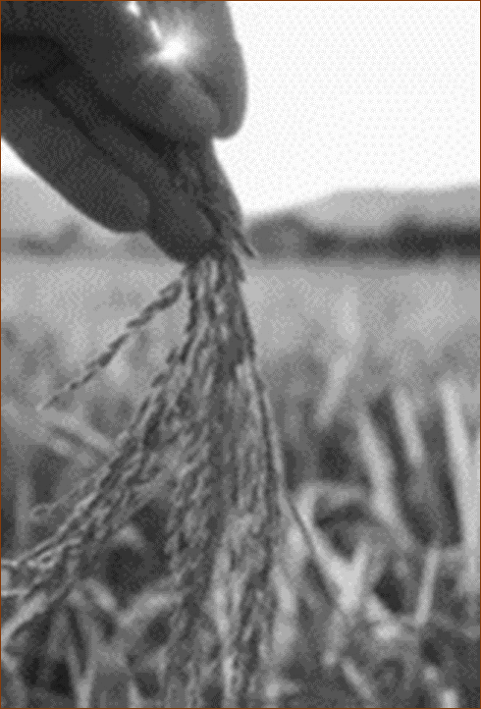
Lesson Focus: Don’t restrict the Gospel with needless rules and traditions.
Life Response: Identify examples of unbiblical rules that may needlessly restrict the Gospel today.
QUESTION & ANSWER
Lord of the Sabbath
DISCIPLES GLEAN; THE PHARISEES COMPLAIN
4. What do Jesus’ disciples do on the Sabbath day? Why might this be considered controversial?
5. How does Jesus respond to the Pharisees?
6. How is Jesus in any way like David?
Jesus and His disciples are walking through a field when some of them pluck grain to eat. What makes this controversial is that anything considered “labor” is forbidden on the Sabbath. What they are doing has the appearance of “reaping,” which is considered labor.
Because Jesus is speaking to an audience of learned teachers, He cites examples from Scripture to justify His disciples’ actions. Jesus does not say that laws and rules don’t matter, but He argues that the Pharisees are not properly interpreting the Sabbath laws
Jesus cites the example of when David took “consecrated bread” (1 Sam. 21:1–6). This is a story about God’s anointed king in desperate need. The priest in David’s day agrees to give him bread since David is on a holy mission (2 Sam. 21:5). Like David, Jesus is a king on a mission. His disciples are not on the run for their lives, but they are in need. If David had the authority to give sacred bread, Jesus has more authority to permit His disciples to glean the fields.
17
Notes:
DISCIPLES GLEAN; THE PHARISEES COMPLAIN
4. What do Jesus’ disciples do on the Sabbath day? Why might this be considered controversial?
Jesus and His disciples are walking through a field when some of them pluck grain to eat. What makes this controversial is that anything considered “labor” is forbidden on the Sabbath. What they are doing has the appearance of “reaping,” which is considered labor.
5. How does Jesus respond to the Pharisees?
Because Jesus is speaking to an audience of learned teachers, He cites examples from Scripture to justify His disciples’ actions. Jesus does not say that laws and rules don’t matter, but He argues that the Pharisees are not properly interpreting the Sabbath laws.
6. How is Jesus in any way like David?
Jesus cites the example of when David took “consecrated bread” (1 Sam. 21:1–6). This is a story about God’s anointed king in desperate need. The priest in David’s day agrees to give him bread since David is on a holy mission (2 Sam. 21:5). Like David, Jesus is a king on a mission. His disciples are not on the run for their lives, but they are in need. If David had the authority to give sacred bread, Jesus has more authority to permit His disciples to glean the fields.

Slide 18
Lesson Focus: Don’t restrict the Gospel with needless rules and traditions.
Life Response: Identify examples of unbiblical rules that may needlessly restrict the Gospel today.
QUESTION & ANSWER
Lord of the Sabbath
MERCY GREATER THAN SACRIFICE
7. How could Jesus say that His disciples were in any way like the priests who work in the temple?
8. What values does God say are most important when we approach Him in worship?
9. What sort of authority does Jesus claim for Himself in this text?
Jesus points out that the priests work on the Sabbath, and they actually have added duties. By implication, Jesus is comparing His disciples to priests in the presence of God. The reason is that Jesus is God, and the disciples with Him are also serving God.
Jesus tells the Pharisees: “If you had known what these words mean, ‘I desire mercy, not sacrifice,’ you would not have condemned the innocent” (v. 7). Jesus is not against sacrifice, but He is putting it in perspective. What we do not want to do is to be hypocrites before God. Above all, God asks us to show justice, mercy, and faithfulness.
The authority that Jesus claims includes several things. First, Jesus is like a king on a mission. Second, Jesus’ followers are like priests who serve the presence of God. Jesus is like a replacement temple. Third, Jesus is “Lord of the Sabbath,” which means that Jesus must be a ruler over creation. He is the one through whom God’s kingdom is revealed on earth.
18
Notes:
MERCY GREATER THAN SACRIFICE
7. How could Jesus say that His disciples were in any way like the priests who work in the temple?
Jesus points out that the priests work on the Sabbath, and they actually have added duties. By implication, Jesus is comparing His disciples to priests in the presence of God. The reason is that Jesus is God, and the disciples with Him are also serving God.
8. What values does God say are most important when we approach Him in worship?
Jesus tells the Pharisees: “If you had known what these words mean, ‘I desire mercy, not sacrifice,’ you would not have condemned the innocent” (v. 7). Jesus is not against sacrifice, but He is putting it in perspective. What we do not want to do is to be hypocrites before God. Above all, God asks us to show justice, mercy, and faithfulness.
9. What sort of authority does Jesus claim for Himself in this text?
The authority that Jesus claims includes several things. First, Jesus is like a king on a mission. Second, Jesus’ followers are like priests who serve the presence of God. Jesus is like a replacement temple. Third, Jesus is “Lord of the Sabbath,” which means that Jesus must be a ruler over creation. He is the one through whom God’s kingdom is revealed on earth.

Slide 19
End
  The Lord bless thee, and keep thee:
  The Lord make his face shine upon thee, and be gracious unto thee:
  The Lord lift up his countenance upon thee and give thee peace.
  - Numbers 6:24-26,
Material adapted by Stanford W. Bowman Jr. from Echoes® Adult and Bible-in-Life® Adult Summer 2025 quarter with permission, © David C Cook, https://davidccook.org. May not be further reproduced. All rights reserved.

