Slide 1
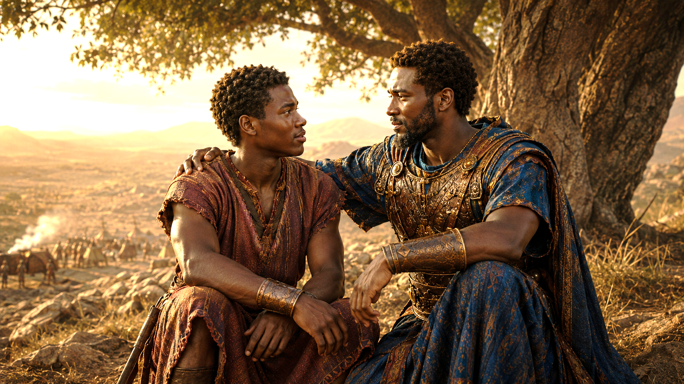
JONATHAN AND DAVID, RESOLUTE FRIENDS
And Jonathan said to David, Go in peace, forasmuch as we have sworn both of us in the name of the Lord, saying, The Lord be between me and thee, and between my seed and thy seed for ever. And he arose and departed: and Jonathan went into the city.
—1 Samuel 20:42 KJV

Slide 2
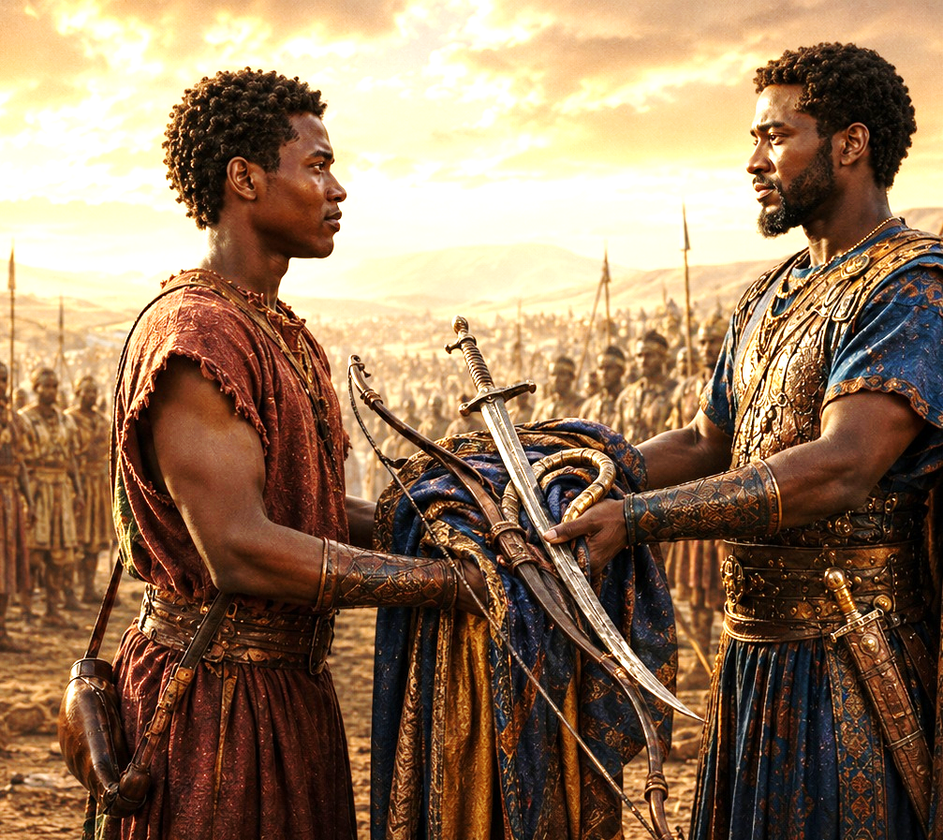
Devotion
Prayer
Heavenly Father, lead us to create unshakable bonds of friendship like we see between David and Jonathan. Help us to be faithful and loyal to one another, even when it is difficult. Build us into healthy communities through which You carry out Your work. In Jesus’ name we pray. Amen.
  Thought to Remember
      Honor God in your friendships.
Notes:
Prayer
Heavenly Father, lead us to create unshakable bonds of friendship like we see between David and Jonathan. Help us to be faithful and loyal to one another, even when it is difficult. Build us into healthy communities through which You carry out Your work. In Jesus’ name we pray. Amen.
Thought to Remember
Honor God in your friendships.

Slide 3
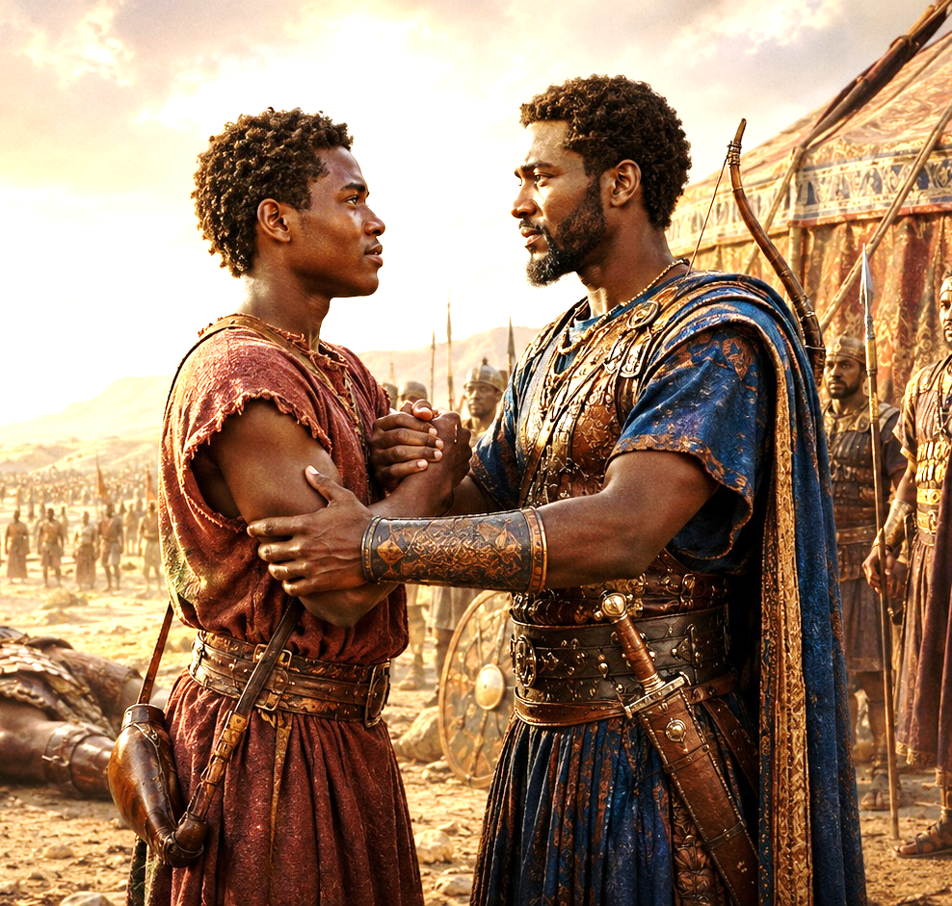
LESSON OUTLINE
JONATHAN AND DAVID, RESOLUTE FRIENDS
  Lesson Scripture:
  Lesson Focus: Lean into the roles that God has for you.
Apply the Message: God’s plans are best.
Live It Out: Show gratitude for godly friends and supporters.
  1 Samuel 18:1–4; 20:16–17, 32–34, 42;
  2 Samuel 1:26–27; 21:7
  Review
  Introduction
  Lesson Context
  Overview
    Unexpected Allies - Samuel 18:1–4; 20:16–17, 32–34 KJV
    A Covenant Remembered - 1 Samuel 20:42; 2 Samuel 1:26–27; 21:7 KJV
  Summary
  Conclusion
  Question & Answers
Notes:
Unexpected Allies - Samuel 18:1–4; 20:16–17, 32–34 KJV
A Covenant Remembered - 1 Samuel 20:42; 2 Samuel 1:26–27; 21:7 KJV
=========================================
Lesson Theme: Jonathan and David, Resolute Friends
The attached lesson focuses on this truth: “Lean into the roles that God has for you.” Jonathan supports what God is doing through David, even when it costs him personally. The lesson also stresses that God’s plans are best, and that godly friendship honors the Lord through loyalty, sacrifice, and covenant faithfulness.
The main idea of this lesson is that godly friendship submits to God’s plan, sacrifices personal ambition, speaks truth with courage, and keeps promises even after the cost becomes great. Jonathan could have viewed David as a rival, but instead he recognized God’s hand on David and supported him. David later honored Jonathan through grief, respect, and mercy toward Mephibosheth.
THEIR FRIENDSHIP TEACHES THAT COVENANT LOYALTY IS NOT SHALLOW FEELING; IT IS FAITHFUL LOVE LIVED BEFORE GOD.
1 Samuel 18:1–4
Summary:
After David’s victory over Goliath, Jonathan’s heart is joined to David’s. Jonathan loves David as his own soul and makes a covenant with him. He gives David his robe, garments, sword, bow, and belt, showing honor, loyalty, and acceptance.
Commentary:
Jonathan is Saul’s son and natural heir to the throne, but he does not treat David as a threat. His gifts symbolize more than friendship; they show surrender to God’s will. Jonathan recognizes God’s hand on David and willingly takes a supporting role instead of fighting for personal position.
1 Samuel 20:16–17
Summary:
Jonathan expands his covenant with David to include David’s household. He asks David to swear again because he loves him deeply. Their friendship becomes a family covenant before the Lord.
Commentary:
Jonathan’s covenant shows that true friendship thinks beyond the present moment. He knows David may become king, so he asks for mercy toward his family. This is not selfish manipulation; it is faithful trust. Jonathan places the future under God’s authority and chooses peace over rivalry.
1 Samuel 20:32–34
Summary:
Jonathan defends David before Saul, asking why David should die. Saul responds by throwing a spear at Jonathan. Jonathan now knows Saul is determined to kill David, and he leaves the table angry and grieved.
Commentary:
Jonathan’s loyalty is tested by family pressure, political pressure, and danger. He chooses righteousness over blind loyalty to his father. His grief shows that Saul’s sin has brought shame on the royal house. Godly friendship sometimes requires courage to speak truth, even when it costs us.
1 Samuel 20:42
Summary:
Jonathan sends David away in peace. They remember their oath before the Lord, promising that the Lord will remain witness between them and between their descendants forever. David departs, and Jonathan returns to the city.
Commentary:
This farewell is painful but faithful. Jonathan cannot go with David, but he blesses him in peace. Their covenant is not based only on emotion; it is sworn in the name of the Lord. Their friendship is placed under God’s watchful care and extended to future generations.
2 Samuel 1:26–27
Summary:
After Jonathan dies in battle, David mourns him deeply. David calls Jonathan his brother and says his love was wonderful. David laments, “How are the mighty fallen, and the weapons of war perished!”
Commentary:
David’s grief is sincere and honorable. He does not celebrate the death of Saul’s house, even though Saul had tried to kill him. David honors Jonathan as a beloved friend and brave defender of Israel. This passage shows that godly love can be deep, pure, loyal, and full of respect.
2 Samuel 21:7
Summary:
Years later, David spares Mephibosheth, Jonathan’s son, because of the oath made between David and Jonathan before the Lord. David remembers his promise and protects Jonathan’s family.
Commentary:
David’s loyalty did not end when Jonathan died. He honored the covenant by showing mercy to Mephibosheth. This is covenant love in action. A godly promise is not temporary; it continues when circumstances change. David’s mercy reflects the steadfast kindness God shows His people.
Main Lesson:
When we honor God in our relationships, we learn to support His will, protect others, keep our word, and show kindness that lasts beyond the moment.

Slide 4
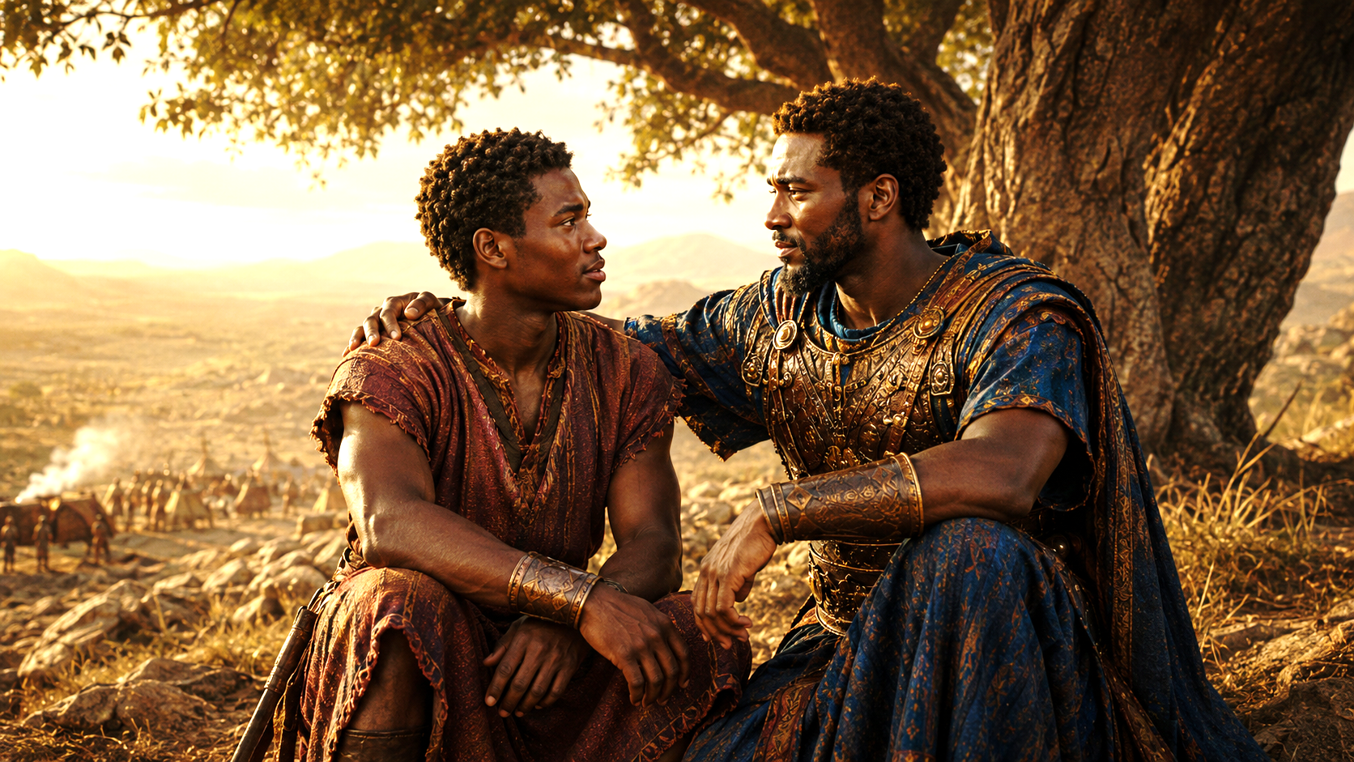
LESSON Introduction
JONATHAN AND DAVID, RESOLUTE FRIENDS
Rivals Turned Friends
C. S. Lewis and J. R. R. Tolkien’s friendship is no secret to their readers. Each was an English professor at Merton College in Oxford during the 1920s, 30s, and 40s. They met during a faculty meeting in 1926 and went on to enjoy forty years of mutual encouragement and support. Tolkien played a vital role in Lewis’s Christian conversion, and Lewis pressed Tolkien to finish several important writing projects.
Although they each held literary aspirations, their initial impression of one another was sour. Their different interests and personalities— combined with initially contradictory religious beliefs—made conflict and rivalry seem inevitable. But over time, the two set aside their differences and recognized their shared passions for curriculum, language, and creative writing. The pair developed such a strong bond that Tolkien would later refer to Lewis’s death as leaving a permanent wound in his heart.
Today’s lesson considers another famous friendship. Their relationship shows loyalty to one another and God.
4
Notes:
True friendship can grow even between people who seem different or unlikely to connect when they choose humility, shared purpose, encouragement, and loyalty over rivalry. C. S. Lewis and J. R. R. Tolkien began as unlikely friends. They were both professors at Oxford and both loved literature, language, and writing, but their personalities, interests, and religious beliefs were different. At first, friendship did not seem likely. However, over time, they discovered common ground and became close companions. Tolkien helped influence Lewis’s conversion to Christianity, and Lewis encouraged Tolkien to complete important writings. Their friendship became a powerful example of mutual support. This introduction prepares us to study David and Jonathan, whose friendship also showed loyalty to each other and faithfulness to God.
Three Key Points
1. First impressions do not always reveal God’s future purpose. Lewis and Tolkien did not begin as close friends. Their early differences could have kept them apart, but time revealed that they had more in common than they first realized.
2. God can use friendship to strengthen faith and purpose. Tolkien helped Lewis move toward faith in Christ, while Lewis encouraged Tolkien to finish his writing. Their friendship helped both men become stronger.
3. True friendship is built on loyalty, encouragement, and shared values. Their friendship lasted because it moved beyond competition. They supported each other’s calling and helped each other fulfill meaningful work.
Three Life Lessons Learned
1. Do not reject people too quickly. Someone who seems different from you may become a blessing in your life. God often uses unexpected people to encourage, guide, and strengthen us.
2. Good friends help us become better. A godly friend does not just agree with us; they help us grow in faith, discipline, courage, and purpose.
3. Shared purpose can overcome personal differences. Lewis and Tolkien were not exactly alike, but they respected each other and focused on what they shared. In Christian friendship, unity does not require sameness; it requires love, humility, and commitment.
Analysis
This story shows how rivalry can become friendship when people stop focusing on differences and begin recognizing shared purpose. Lewis and Tolkien could have remained distant because of their personalities, beliefs, and ambitions. Instead, they allowed their relationship to grow. Their friendship became fruitful because each man helped the other become stronger.
From a Christian viewpoint, this reminds us that God often works through relationships. Proverbs 27:17 says, “Iron sharpeneth iron; so a man sharpeneth the countenance of his friend.” A faithful friend sharpens us by encouragement, correction, prayer, and support.
This also prepares us for the friendship of David and Jonathan. Jonathan could have seen David as a rival for the throne, but instead he accepted God’s plan and loved David faithfully. Like Lewis and Tolkien, David and Jonathan show that deep friendship is not based on convenience. It is built on loyalty, sacrifice, and a willingness to support what God is doing in someone else’s life.
The lesson teaches that friendship is more than companionship. Godly friendship helps people walk in purpose, remain faithful, and honor God together.

Slide 5
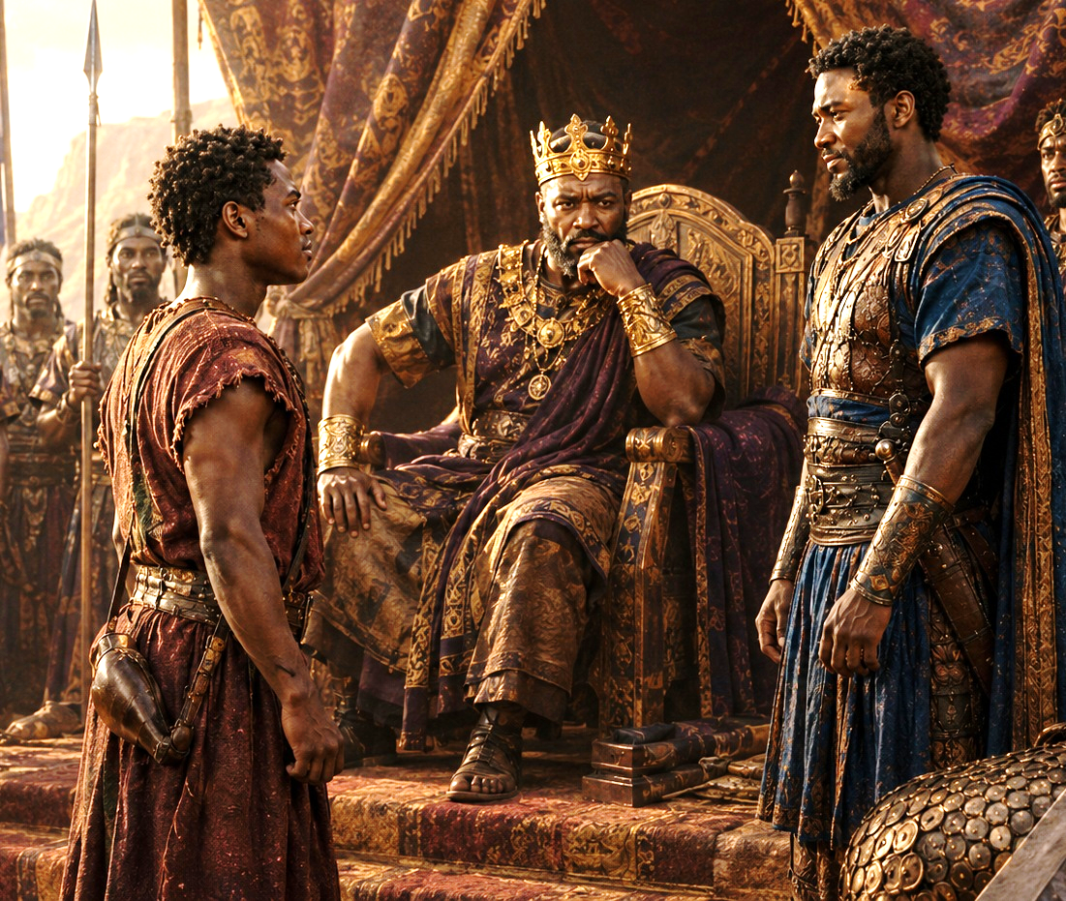
Support Scripture for Lesson
JONATHAN AND DAVID, RESOLUTE FRIENDS
Week of June 22 through June 27
► Isaiah 61:4–9—Prophecy: Toward Restoration.
► Luke 15:1–7—A Shepherd Rejoices.
► Amos 5:16–20—Prophecy: The Day of the Lord.
► Amos 5:21–27—Prophecy: Let Justice Roll.
► John 10:1–9—Know the Shepherd’s Voice.
► John 10:10–18—The Good Shepherd.
These passages show God as both Restorer and Shepherd. He restores broken people, seeks the lost, warns the rebellious, rejects empty religion, and calls His people to follow His voice. Isaiah shows God rebuilding what was ruined. Luke shows God rejoicing over repentance. Amos warns that worship without justice is unacceptable. John reveals Jesus as the Good Shepherd who protects, leads, and lays down His life for His sheep.
5
Notes:
God wants us to understand that He does not desire empty religion; He desires restored hearts, repentant lives, righteous actions, and faithful obedience to Christ. The Lord seeks the lost, restores the broken, judges hypocrisy, and leads His people into abundant life through Jesus, the Good Shepherd.
Isaiah 61:4–9 — Prophecy: Toward Restoration
Analysis:
Isaiah speaks of a future time when God’s people will rebuild ruined places and be restored after shame, loss, and judgment. God promises justice, blessing, and an everlasting covenant.
Summary:
God will restore what was broken, give His people honor instead of shame, and make them known as people blessed by the Lord.
Commentary:
This passage reminds us that God is a restorer. What sin, suffering, and exile damage, God can rebuild. His restoration is not temporary; it is covenant-based and rooted in His faithful love.
Luke 15:1–7 — A Shepherd Rejoices
Analysis:
Jesus tells this parable because religious leaders criticized Him for welcoming sinners. The shepherd leaves the ninety-nine to find one lost sheep, showing God’s heart for the lost.
Summary:
Jesus teaches that heaven rejoices when one sinner repents and returns to God.
Commentary:
God does not treat lost people as disposable. He seeks, rescues, and rejoices over them. This passage teaches that repentance brings joy to God, not irritation or reluctance.
Amos 5:16–20 — Prophecy: The Day of the Lord
Analysis:
Amos warns Israel that the Day of the Lord will not be a day of easy victory for sinful people. It will bring judgment, darkness, and accountability.
Summary:
Israel expected God’s day to bring blessing, but Amos warns that unrepentant sin will bring judgment instead.
Commentary:
This passage teaches that religious confidence without obedience is dangerous. God’s people cannot claim His favor while ignoring His commands. The Day of the Lord exposes the truth of the heart.
Amos 5:21–27 — Prophecy: Let Justice Roll
Analysis:
God rejects Israel’s worship because their sacrifices, songs, and ceremonies are not joined with justice and righteousness. He calls for justice to flow like waters.
Summary:
God does not accept worship that is separated from righteous living and concern for justice.
Commentary:
True worship is more than church attendance, music, or offerings. God wants hearts that obey Him and lives that reflect His justice. Worship must be matched by righteousness.
John 10:1–9 — Know the Shepherd’s Voice
Analysis:
Jesus describes Himself as the true shepherd and the door of the sheep. His sheep know His voice, follow Him, and find safety through Him.
Summary:
Jesus is the only true entrance into salvation, protection, and spiritual life.
Commentary:
Believers must learn to recognize the voice of Christ through His Word. False voices lead away from God, but Jesus leads His people into safety, truth, and life.
John 10:10–18 — The Good Shepherd
Analysis:
Jesus contrasts Himself with thieves and hirelings. He gives abundant life, lays down His life for the sheep, and gathers all who belong to Him.
Summary:
Jesus is the Good Shepherd who willingly gives His life so His sheep may live.
Commentary:
This passage points clearly to the cross. Jesus did not die by accident or weakness. He willingly laid down His life and took it up again, proving His love, authority, and saving power.

Slide 6
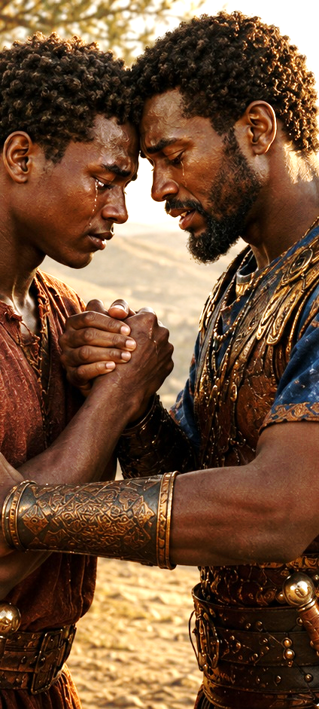
LESSON CONTEXT
JONATHAN AND DAVID, RESOLUTE FRIENDS
    Jonathan is the oldest son of Saul, the first king of Israel. But because of Saul’s disobedience, God has already decided that Jonathan will not follow his father as king (1 Sam. 15:26–28). Instead, God sends Samuel to anoint an unexpected person of God’s own choosing—the young shepherd named David (1 Sam. 13:14; 16:1–13). The reading begins as David has just slain the giant, Goliath (see 1 Sam. 17). Jonathan is probably older than David, but he treats him as an equal.
    The books of 1 & 2 Samuel introduce three key figures: Samuel, Saul, and David. The boy Samuel grew up to be an important transitional figure, taking Israel from the era of judges to the time of Israel’s united monarchy (see lesson 2). He first anointed Saul, then David as king (1 Samuel 10:1; 16:13). Kings at this time (eleventh century BC) were seen especially as military protectors, able to lead their subjects in battle (example: 8:11–12).
    Before Saul’s disastrous rule ended, God prepared David to take over as leader in Saul’s place. The secret anointing of David and plan to make him king created a potential conflict with Saul and his household, especially with Saul’s firstborn son and heir, Jonathan. Jonathan had the most to lose and could have easily rejected God’s choice of king.
    Jonathan is first mentioned in 1 Samuel 13–14, where he proves to be an impressive captain of fighting men himself. In one exploit, Jonathan
    and his armor-bearer manage to single-handedly defeat about twenty Philistines, turning the tide in favor of the Israelites (1 Samuel 14:1–14). Jonathan speaks like a virtuous leader, one who knows “there is no restraint to the Lord to save by many or by few” (14:6; compare 17:45).
    But God’s choice of David, “a man after [God’s] own heart” (1 Samuel 13:14), interrupts the dynastic rule and demonstrates that God is in charge. Both then and in the future, the rise and fall of rulers and empires is subject to God’s control (see Daniel 7:27).
6
Notes:
God’s choice of David shows that the Lord rules over leadership, position, and promotion. Jonathan had every earthly reason to resist David, but he chose to honor God’s plan instead of protecting his own future. Jonathan was the oldest son of King Saul and would normally have been expected to become the next king of Israel. However, Saul’s disobedience caused God to reject his dynasty. God chose David, a young shepherd, to become the next king. This created a difficult situation for Jonathan because David’s rise meant Jonathan would not inherit the throne.
Jonathan was not weak or unqualified. He was a brave military leader who trusted God in battle. Yet when God chose David, Jonathan did not respond with jealousy. Instead, he treated David with respect and friendship. This lesson shows that God controls the rise and fall of leaders, and faithful people must submit to His will even when it changes their personal plans.
Three Key Points
1. God’s plan overruled human expectation.
Jonathan was Saul’s firstborn son, so people naturally expected him to become king. But God had already chosen David. This shows that God is not bound by human traditions, family lines, or political expectations.
2. Jonathan had the most to lose.
David’s anointing directly affected Jonathan’s future. Jonathan could have seen David as a threat, rival, or enemy. Instead, he accepted God’s decision and treated David with honor.
3. God uses humble people who trust Him.
David was an unexpected choice, and Jonathan was a willing servant. Both men show faith in different ways. David trusted God to lift him up, and Jonathan trusted God enough to step aside.
Three Life Lessons Learned
1. God’s will is greater than personal ambition.
Sometimes God’s plan may not give us the position, title, or recognition we expected. Faith means trusting that God knows best.
2. A godly heart can celebrate someone else’s calling.
Jonathan teaches us not to be jealous when God blesses or promotes someone else. A mature believer can support God’s work even when someone else is chosen.
3. True leadership begins with submission to God.
Jonathan was already a brave leader, but his greatest strength was spiritual humility. He understood that leadership is not about holding power but honoring God.
Analysis
This lesson context sets up the tension behind the friendship of David and Jonathan. Jonathan was not an ordinary friend. He was the crown prince of Israel. Under normal circumstances, he would have followed Saul as king. But Saul’s sin changed the direction of the kingdom. In 1 Samuel 15:26–28, Samuel told Saul that the Lord had rejected him from being king and had given the kingdom to someone better than he.
David’s anointing in 1 Samuel 16:1–13 shows that God looks beyond outward appearance and chooses according to His own purpose. David was not the oldest, strongest, or most obvious choice. He was the shepherd boy God selected. This reminds us that God often prepares people in hidden places before He brings them into public service.
Jonathan’s response is what makes this lesson so powerful. He was a proven warrior. In 1 Samuel 14:6, Jonathan declared, “there is no restraint to the Lord to save by many or by few.” That statement shows his faith. Jonathan knew victory came from God, not from numbers, rank, or human strength.
Because Jonathan trusted God, he could accept David. He did not need to fight God’s plan to protect his own future. This is a mark of spiritual maturity. Jonathan shows us that a believer can be strong, gifted, and qualified, yet still humble enough to step into the role God assigns.
From a Baptist theological view, this passage reminds us of God’s sovereignty. God rules over kings, kingdoms, churches, families, and individual lives. As Daniel 7:27 teaches, dominion ultimately belongs to God’s kingdom. Saul tried to hold power through disobedience and fear, but Jonathan chose the better way: faith, humility, and surrender.
The lesson prepares us to understand why Jonathan’s friendship with David was so remarkable. He did not simply like David; he honored what God was doing through David. That is the heart of godly friendship: supporting God’s purpose in another person’s life, even when it requires personal sacrifice.

Slide 7
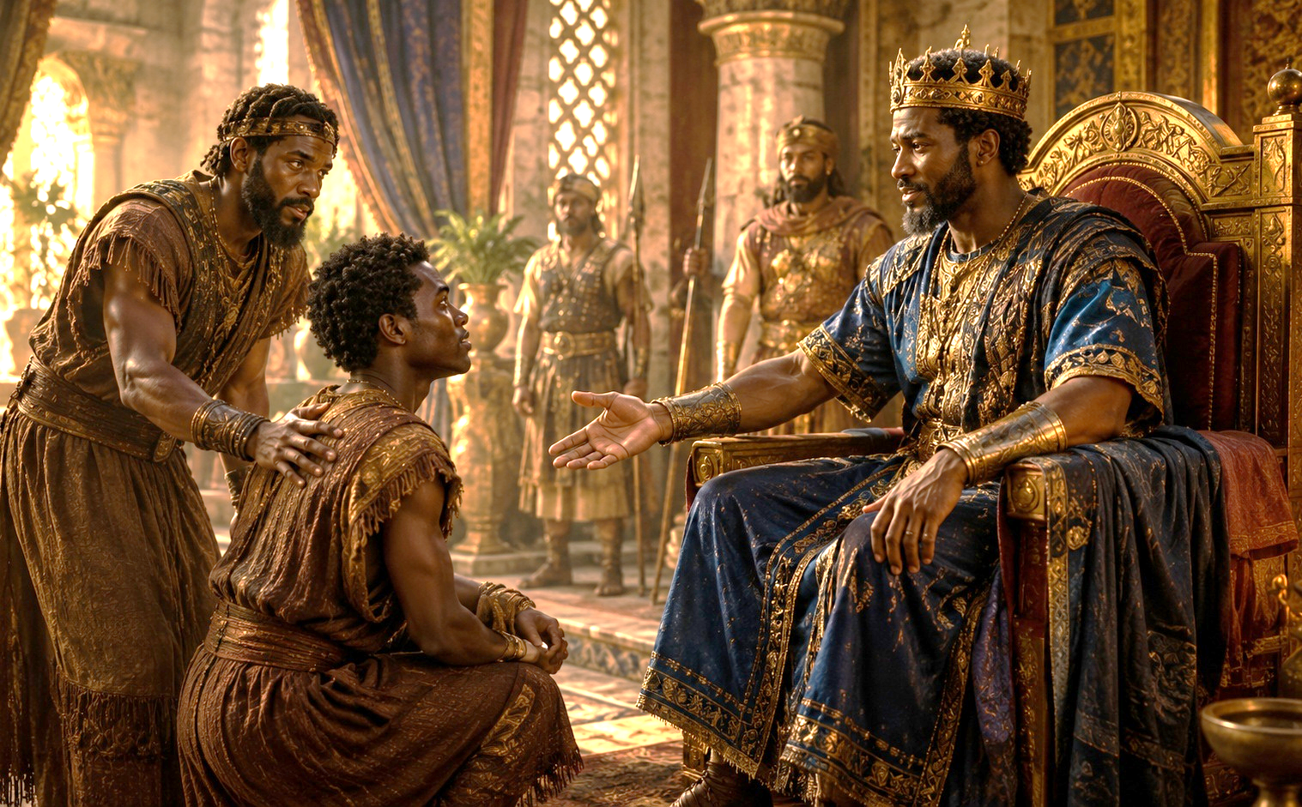
LESSON CONTEXT
JONATHAN AND DAVID, RESOLUTE FRIENDS
PARITY COVENANT
Covenants in Old Testament times took a variety of forms. There is a special category of covenants that God makes. Whenever God is involved, covenants are one-sided—God does not need anything in return. Some of these are with Noah (Gen. 9:8–17), with Abraham (Gen. 12; 15; 17), with Israel at Mount Sinai (Ex. 19–24), and with David (2 Sam. 7). God even makes a new covenant through Jesus, which can repair our relationship with God (Luke 22:20; compare Jer. 31:31–33).
But David and Jonathan’s covenant is a bit different. It is a parity covenant: two (approximate) equals pledge themselves to each other, to help and protect each other and provide mutual benefits. In modern times, a marriage covenant has the same pattern. Just like when two families come together, David’s and Jonathan’s families are pledged to support one another.
7
Notes:
PARITY COVENANT
David and Jonathan made a mutual covenant of loyalty, protection, and support before God. In the Old Testament, some covenants were made by God and depended completely on His faithfulness. Examples include God’s covenants with Noah, Abraham, Israel, and David. David and Jonathan’s covenant was different. It was a parity covenant, meaning both men pledged themselves to one another as faithful partners. Their covenant included love, protection, loyalty, and concern for each other’s families.
Three Key Points
God’s covenants reveal His faithfulness. When God makes a covenant, He does not need anything from man. His promises are based on His own character.
David and Jonathan’s covenant was mutual. They both pledged loyalty, care, and protection to one another.
Their covenant included their families. Their promise was not only for themselves but also for their descendants.
Three Life Lessons Learned
Godly relationships should be built on commitment, not convenience. True friendship remains faithful even when circumstances change.
Promises made before God should be taken seriously. A believer’s word should reflect honesty, faithfulness, and integrity.
Faithful love thinks beyond the present moment.
David and Jonathan cared about future generations, not just their immediate needs.
Analysis
This section teaches that biblical friendship can have covenant weight. David and Jonathan were not casual friends; they made a solemn promise before the Lord. Jonathan could have seen David as a threat, but instead he pledged loyalty to him. This shows spiritual maturity. Their covenant reminds us that godly relationships are strengthened when both people seek to honor God. In a Baptist understanding, this also points us toward the greater covenant in Christ. Through Jesus, God repairs our broken relationship with Him and calls us to live faithfully with one another.

Slide 8
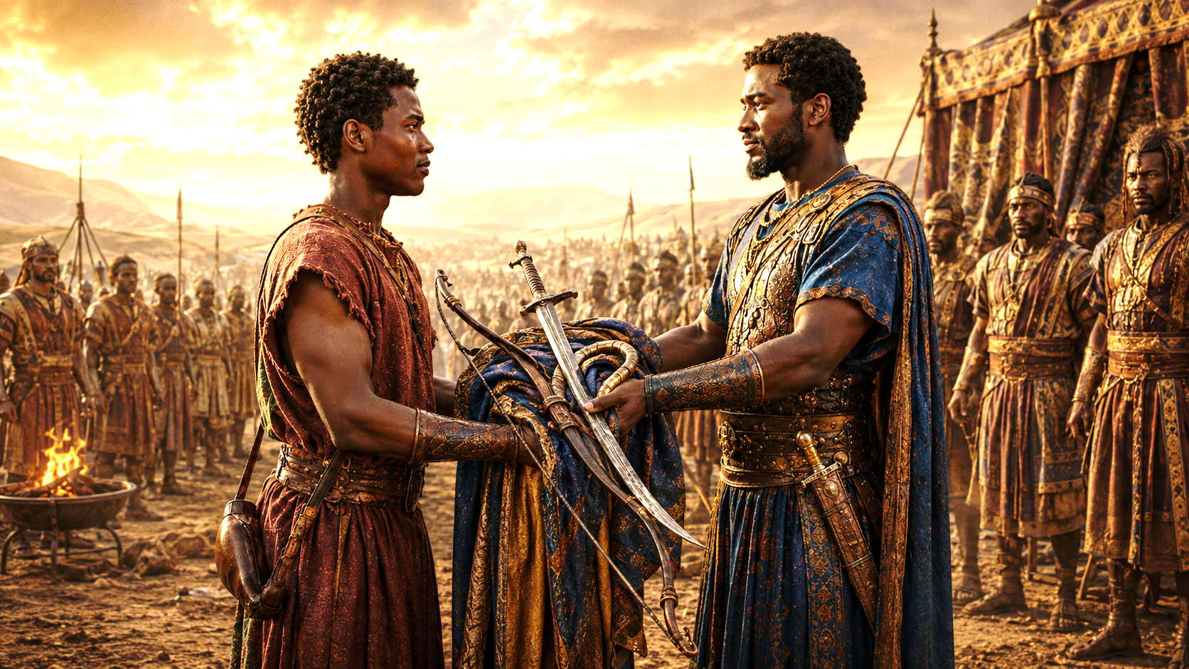
LESSON CONTEXT
JONATHAN AND DAVID, RESOLUTE FRIENDS
LOVE BETWEEN DAVID AND JONATHAN
It is easy to read into statements about a bond of love shared between these two men. Modern audiences tend to mistake any reference to deep love as inherently sexual. Yet the ancient audience had an appreciation for deep friendships between members of the same sex. Moreover, David’s poetic statement in 2 Samuel 1:26, that Jonathan’s “love to me was wonderful, passing the love of women,” is a play on the dual meaning of the Hebrew word for love. Jonathan’s (platonic) love for David was so precious that it exceeded (sexual) love (“the love of women”).
8
Notes:
LOVE BETWEEN DAVID AND JONATHAN
David and Jonathan shared a deep, loyal, and pure friendship that reflected honor, sacrifice, and godly affection. Modern readers may misunderstand the love between David and Jonathan because today people often view deep love in a romantic or sexual way. However, in the ancient world, people understood that same-sex friendships could be deeply affectionate without being sexual. David’s statement that Jonathan’s love was “wonderful, passing the love of women” means Jonathan’s friendship was loyal, precious, and deeply meaningful.
Three Key Points
Their love was rooted in friendship and covenant. David and Jonathan’s bond was built on loyalty, not romance.
Ancient people valued deep friendships. They understood strong emotional bonds between friends in a way modern readers sometimes miss.
Jonathan’s love was sacrificial. He protected David even though David’s rise meant Jonathan would not become king.
Three Life Lessons Learned
True friendship is not shallow. Godly friends can love deeply, encourage strongly, and stand faithfully.
We should not misread Scripture through modern assumptions. The Bible must be understood in its proper historical and spiritual context.
Love is proven by loyalty and sacrifice. Jonathan’s love was shown by his actions, not merely his words.
Analysis
The love between David and Jonathan reveals the beauty of godly friendship. Jonathan loved David “as his own soul” because he recognized God’s hand on David. His love was not selfish, jealous, or possessive. It was a love that protected, supported, and blessed. David later mourned Jonathan deeply because Jonathan had been a faithful friend in dangerous times. This kind of friendship reflects Proverbs 17:17: “A friend loveth at all times, and a brother is born for adversity.” Their love teaches us that Christian friendship should be marked by purity, loyalty, courage, and faithfulness before God.

Slide 9
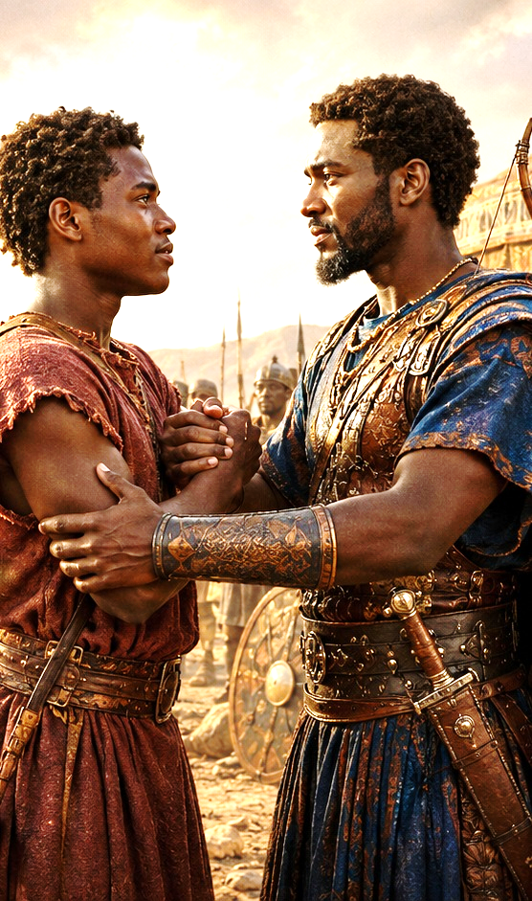
LESSON CONTEXT
JONATHAN AND DAVID, RESOLUTE FRIENDS
HESED
The kindness we see David show Mephibosheth is more than simple generosity or kindness as we use the word today. The Hebrew word hesed (sometimes translated “lovingkindness”) indicates lasting, self-sacrificing concern for another. It appears five times in the context of the relationship between David and Jonathan (1 Sam. 20:8, 14–15). First Jonathan shows kindness by saving the life of David, then David returns kindness and concern by being compassionate toward Jonathan’s surviving family. The text draws an explicit parallel to the love that God shows to us: “unfailing kindness like the Lord’s kindness” (1 Sam. 20:14).
This key word frequently expresses God’s attachment to His people, appearing about two hundred and fifty times in the Old Testament. God reveals Himself as “abounding in love [hesed],” according to the words of Exodus 34:6. Hesed is displayed in the covenant between God and Abraham (Gen. 19:19; 20:13), in Rahab’s request for kindness at Jericho (Josh. 2:12, 14), and in the care that Boaz shows toward his relatives (Ruth 2:20; 3:10).
9
Notes:
The main idea across all three sections is that godly friendship is covenantal, loyal, pure, and sacrificial. David and Jonathan’s relationship was not built on personal advantage. It was built on faith in God, commitment to one another, and trust in God’s plan. Jonathan loved David enough to support him, even when David’s calling affected Jonathan’s future. David loved Jonathan enough to keep his promise long after Jonathan died.
Lesson God Wants Us to Learn
God wants us to learn that true love is faithful, not selfish. True friendship honors God, keeps promises, supports His will, and shows mercy that lasts. Like David and Jonathan, believers are called to live with loyalty, humility, and covenant kindness. In Christ, we have received God’s greater hesed, His steadfast love; therefore, we should show steadfast love to others.
Hesed
Hesed is covenant love expressed through lasting, loyal, self-sacrificing kindness. The Hebrew word hesed means more than simple kindness. It refers to faithful, covenant-based love that continues even when it is costly. Jonathan showed hesed by protecting David’s life. Later, David showed hesed by sparing and caring for Jonathan’s son, Mephibosheth. This kind of love reflects God’s own lovingkindness toward His people.
Three Key Points
Hesed is loyal love in action. It is not just a feeling; it is proven through faithfulness and sacrifice.
Jonathan first showed hesed to David. He protected David from Saul’s murderous intentions.
David later returned hesed to Jonathan’s family. He honored his covenant by showing mercy to Mephibosheth.
Three Life Lessons Learned
Godly kindness should last beyond the moment. Real love does not disappear when the original person is gone.
We should show mercy because God has shown mercy to us. David’s kindness reflects the Lord’s unfailing kindness.
Faithfulness is measured over time. David proved his loyalty years later by keeping his promise.
Analysis
Hesed is one of the richest words in the Old Testament. It describes the faithful love God shows to His people and the kind of faithful love people should show to one another. David did not forget Jonathan after his death. He honored their covenant by protecting Mephibosheth. This shows that hesed is not temporary emotion; it is dependable love. From a Christian view, hesed points us to the grace of God in Christ. We were helpless, yet God showed us mercy. Therefore, believers should practice loyal love, mercy, and compassion toward others.

Slide 10
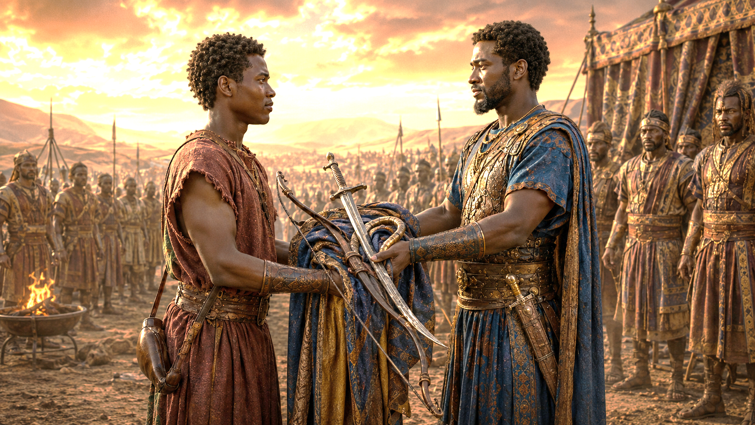
LESSON OVERVIEW
JONATHAN AND DAVID, RESOLUTE FRIENDS
Unexpected Allies - Samuel 18:1–4; 20:16–17, 32–34 KJV
1 And it came to pass, when he had made an end of speaking unto Saul, that the soul of Jonathan was knit with the soul of David, and Jonathan loved him as his own soul.
2 And Saul took him that day, and would let him go no more home to his father’s house.
3 Then Jonathan and David made a covenant, because he loved him as his own soul.
4 And Jonathan stripped himself of the robe that was upon him, and gave it to David, and his garments, even to his sword, and to his bow, and to his girdle.
. . . . . . . . . . . . . . . . . .
16 So Jonathan made a covenant with the house of David, saying, Let the Lord even require it at the hand of David’s enemies.
17 And Jonathan caused David to swear again, because he loved him: for he loved him as he loved his own soul.
. . . . . . . . . . . . . . . . . .
32 And Jonathan answered Saul his father, and said unto him, Wherefore shall he be slain? what hath he done?
33 And Saul cast a javelin at him to smite him: whereby Jonathan knew that it was determined of his father to slay David.
34 So Jonathan arose from the table in fierce anger, and did eat no meat the second day of the month: for he was grieved for David, because his father had done him shame.
Fresh off his victory over Goliath, David presents himself to King Saul and his son Jonathan.
Jonathan is not jealous of David’s growing popularity.
Whereas Saul is trying to control David, Jonathan makes an alliance with him.
Jonathan gives David gifts that treat him like a prince.
The crown prince, Jonathan, stands up to his father on behalf of David.
Saul even throws as spear at his son, whom he thinks is acting foolish.
Notes:
Unexpected Allies
Jonathan recognized God’s hand on David and chose covenant loyalty, while Saul became jealous and resisted God’s plan. After David defeated Goliath, Saul welcomed him into the royal court, and Jonathan formed a deep friendship with him. Jonathan made a covenant with David and gave him royal and military items, showing honor and acceptance. As David kept winning battles and gaining favor with the people, Saul became jealous and saw him as a threat. Saul tried to kill David, but Jonathan chose to protect him. When Saul threw a spear at Jonathan for defending David, Jonathan clearly saw his father’s evil intentions and grieved over David’s mistreatment.
Three Key Points
1. Jonathan accepted David as God’s chosen servant.
Jonathan did not treat David as a rival. Even though David’s rise meant Jonathan would not become king, Jonathan honored him and accepted God’s plan.
2. Saul’s jealousy turned favor into hatred.
At first, Saul welcomed David because David was useful to him. But when David became popular and successful, Saul’s insecurity turned into anger and attempted murder.
3. Jonathan chose righteousness over family pressure.
Jonathan loved his father, but he would not support Saul’s sinful plan. He defended David and stood for what was right, even when it put him in danger.
Three Life Lessons Learned
1. God’s plan may require us to support someone else’s calling. Jonathan teaches us that faithfulness sometimes means helping another person succeed instead of demanding the spotlight for ourselves.
2. Jealousy can destroy relationships and judgment. Saul’s jealousy blinded him. Instead of seeing David as a blessing to Israel, he saw him as a threat. Jealousy can make people fight against what God is doing.
3. True friendship requires courage. Jonathan’s loyalty was not just emotional; it was active and costly. A godly friend speaks up, protects, and stands for truth, even when it is difficult.
Analysis
This section shows the difference between a surrendered heart and a jealous heart. Jonathan had every human reason to oppose David. He was Saul’s son and the natural heir to the throne. Yet Jonathan saw something greater than personal ambition. He saw that God was working through David.
Jonathan’s gift of his robe, garments, sword, bow, and belt was a powerful sign. These were not casual gifts. They represented his status as prince and warrior. By giving them to David, Jonathan showed respect and submission to God’s choice. He was willing to step aside because he trusted the Lord.
Saul responded in the opposite way. David’s victories should have brought Saul joy because Israel was being protected. Instead, Saul became angry because David received praise. Saul’s heart revealed pride, fear, and rebellion against God’s will.
Jonathan’s defense of David shows moral courage. He asked a fair question: “Wherefore shall he be slain? what hath he done?” Saul had no righteous answer. His violent response exposed the darkness in his heart. When Saul threw the spear at Jonathan, Jonathan finally understood that Saul truly intended to kill David.
From a spiritual standpoint, this passage teaches that believers must decide whether they will cooperate with God’s plan or fight against it. Jonathan chose humility, loyalty, and truth. Saul chose jealousy, control, and violence. The lesson is clear: God blesses surrendered hearts, but jealousy can make a person resist the very work of God.
><><><><><><><><><><><><><><><><><><
Unexpected Allies
Fresh from David’s victory over Goliath, David is welcomed by Saul and Jonathan. David has been anointed as a future king, and God has been faithful in orchestrating the details for his future. While God has already made known to Saul that the throne would be removed from his family, the text at this point does not indicate that Saul realizes it is David who has been anointed as the future king (see 1 Sam. 15:28).
Thus David gains favor in Saul’s eyes, and his friendship with Jonathan increases. Jonathan even makes a covenant of loyalty and friendship with David, accepting David as his equal and loving him “as himself” (v. 3). The text does not describe David and Jonathan’s initial agreement. But in a remarkable sign of acceptance and submission, Jonathan gifts David tokens of his own office (v. 4). Jonathan’s princely clothing and soldier’s armor are fitting gifts to Israel’s future king.
Whenever David goes to battle, he comes back victorious. Thus Saul makes David an officer in the army, and David continues to excel and increase in popularity (see vv. 5–9). When Saul realizes that David’s abilities are recognized beyond his own, Saul becomes angry. He repeatedly tries to kill this rival, without success (18:10–11, 25; 19:9–10). Even though Jonathan doubts his father will follow through, he agrees to protect David. Thus they expand their covenant agreement. Just as Jonathan promises to protect David’s “house” (20:16)—which includes family and descendants—Jonathan requests David’s future protection (vv. 14–15).
The two plan a test for Saul, to see whether he truly intends to kill David. As planned, Jonathan makes excuses for David’s absence at a feast. This provokes the king’s fury, as David has escaped a trap (20:24–31). Jonathan advocates for David, only for Saul to hurl a spear at his own, supposedly disloyal, son (vv. 32–33). With no more lingering doubts, Jonathan is “grieved at his father’s shameful treatment of David” (v. 34).

Slide 11
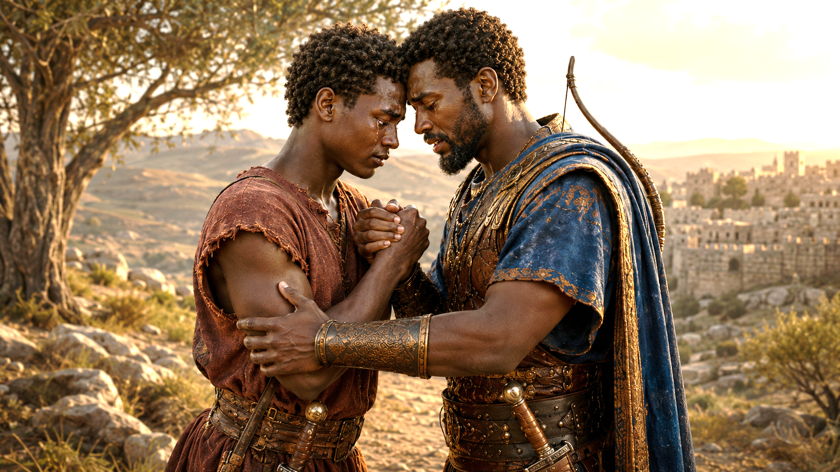
LESSON OVERVIEW
JONATHAN AND DAVID, RESOLUTE FRIENDS
A Covenant Remembered - 1 Samuel 20:42; 2 Samuel 1:26–27; 21:7 KJV
1 Samuel 20:42 And Jonathan said to David, Go in peace, forasmuch as we have sworn both of us in the name of the Lord, saying, The Lord be between me and thee, and between my seed and thy seed for ever. And he arose and departed: and Jonathan went into the city.
. . . . . . . . . . . . . . . . . .
2 Samuel 1:26 I am distressed for thee, my brother Jonathan: very pleasant hast thou been unto me: thy love to me was wonderful, passing the love of women.
27 How are the mighty fallen, and the weapons of war perished!
. . . . . . . . . . . . . . . . . .
2 Samuel 21:7 But the king spared Mephibosheth, the son of Jonathan the son of Saul, because of the Lord’s oath that was between them, between David and Jonathan the son of Saul.
Jonathan and David part in friendship, vowing to be loyal to the families of each other forever.
Later Jonathan is killed in battle, alongside his father.
David memorializes these men in song and poetry and praises his fallen friend.
When David is king, he shows kindness to Jonathan’s son, Mephibosheth.
Notes:
A Covenant Remembered
David and Jonathan’s covenant did not end with separation, death, or political change. Their promise before the Lord continued to shape David’s actions, showing that godly loyalty keeps its word even when circumstances change. After Jonathan confirms that Saul still wants David dead, David must flee. Before they separate, David and Jonathan weep together and renew their covenant before the Lord. Jonathan remains with Saul and later dies beside him in battle against the Philistines. When David hears of Saul and Jonathan’s deaths, he does not rejoice over Saul’s fall. Instead, he honors both Saul and Jonathan in a song of lament. Later, David remembers his covenant with Jonathan by sparing Mephibosheth, Jonathan’s disabled son. David’s actions show respect, grief, mercy, and covenant faithfulness.
Three Key Points
David and Jonathan’s covenant was made before God. Their friendship was not based only on emotion. They called on the Lord as witness, making their promise sacred and lasting.
David honored Saul even though Saul had wronged him. David did not celebrate Saul’s death. He respected Saul’s office as king and left judgment in God’s hands.
David kept his promise to Jonathan’s family. By sparing Mephibosheth, David showed that covenant loyalty continues beyond death and personal convenience.
Three Life Lessons Learned
1. Godly people keep their promises. David remembered his oath even after Jonathan died. A promise made before God should not be forgotten when circumstances change.
2. We should not rejoice when enemies fall. David had suffered because of Saul, yet he mourned Saul’s death with dignity. Believers should leave revenge to God and walk in grace.
3. True friendship leaves a legacy of mercy. Jonathan’s love protected David, and David’s love later protected Jonathan’s son. Godly friendship can bless future generations.
Analysis
This section shows covenant faithfulness under pressure. David and Jonathan knew their separation might be permanent, yet they renewed their promise before the Lord. Their tears reveal the depth of their bond, but their covenant reveals the seriousness of their faith. They were not merely saying goodbye as friends; they were entrusting their families and future to God.
Jonathan’s death is tragic because he was faithful, courageous, and honorable, yet he died beside Saul. This shows that righteous people sometimes suffer because of the brokenness around them. Jonathan did not follow Saul’s wickedness, but he remained loyal to his father and nation in battle.
David’s response to Saul’s death is spiritually powerful. Saul had hunted David, falsely accused him, and tried to kill him. Yet David did not speak with bitterness. He honored Saul as the Lord’s anointed and mourned the fall of Israel’s defenders. This shows David’s humility and trust in God’s timing.
David’s treatment of Mephibosheth proves that his grief and loyalty were genuine. He did not use Saul’s death as an excuse to destroy Saul’s family line. Instead, because of his covenant with Jonathan, David showed mercy. This reflects the heart of God, who remembers His covenant and shows steadfast love.
The lesson is clear: godly loyalty is not temporary. It honors God, keeps promises, shows mercy, and refuses revenge. David teaches us that faithfulness means doing what is right even after the moment has passed and even when no one can force us to keep our word.
><><><><><><><><><><><><><><><><><><
1 Samuel 20:42; 2 Samuel 1:26–27; 21:7 NIV
1 Samuel 20:42 Jonathan said to David, “Go in peace, for we have sworn friendship with each other in the name of the Lord, saying, ‘The Lord is witness between you and me, and between your descendants and my descendants forever. ’ ” Then David left, and Jonathan went back to the town
. . . . . . . . . . . . . . . . . .
2 Samuel 1:26 I grieve for you, Jonathan my brother; you were very dear to me. Your love for me was wonderful, more wonderful than that of women.
27 “How the mighty have fallen! The weapons of war have perished!”
. . . . . . . . . . . . . . . . . .
2 Samuel 21:7 The king spared Mephibosheth son of Jonathan, the son of Saul, because of the oath before the Lord between David and Jonathan son of Saul.
><><><><><><><><><><><><><><><><><><
A Covenant Remembered
After confronting his father, Jonathan confirms David’s suspicions: Saul is still seeking David’s death. He needs to leave immediately. Realizing this, the pair “wept together—but David wept the most” (1 Sam. 20:41). They renew their covenant of mutual friendship. And this time, they invoke God as a permanent witness to their alliance, promising a never-ending alliance among their houses. David flees, but Jonathan cannot go with him. He returns to serve his father, the king.
Ever loyal to his father, Jonathan dies beside him in battle while they fight the Philistines. It is a tragic end to the life of a man who did not follow in his father’s crimes. In the same battle, Saul dies by his own hand, falling upon his sword rather than being captured (1 Sam. 31:1–4).
In the face of this news, it is David’s turn to show graciousness in his reaction to the deaths of rival leaders. He composes a song of lament—weaving together words of tribute to Saul and Jonathan. For the man who tried to kill him, David writes, “the shield of the mighty was despised, the shield of Saul” (2 Sam. 1:21). It demonstrates respect for Saul’s kingly office; David does not speak ill of the dead.
David has even more to say over the death of Jonathan: “How the mighty have fallen,” he repeats (2 Sam. 1:25, 27). He calls Jonathan “my brother” as he grieves the loss of the closest of friends (v. 26). David’s psalm refers to Saul and Jonathan as “weapons of war” now destroyed (v. 27)—a personification of their heroic roles as defenders of the nation.
Although 1–2 Samuel is sometimes critical of David’s conduct, he is never portrayed as seeking to rule until God’s timing is fulfilled. And even after Jonathan’s death, David continues to honor their covenant. When he negotiates with the Gibeonites—whom Saul tried to annihilate—David spares the life of Jonathan’s disabled son, Mephibosheth. Any descendant of Saul could be held responsible for his grandfather’s crimes. But David spares him on account of his oath, honoring his friend one more time (2 Sam. 21:7).

Slide 12
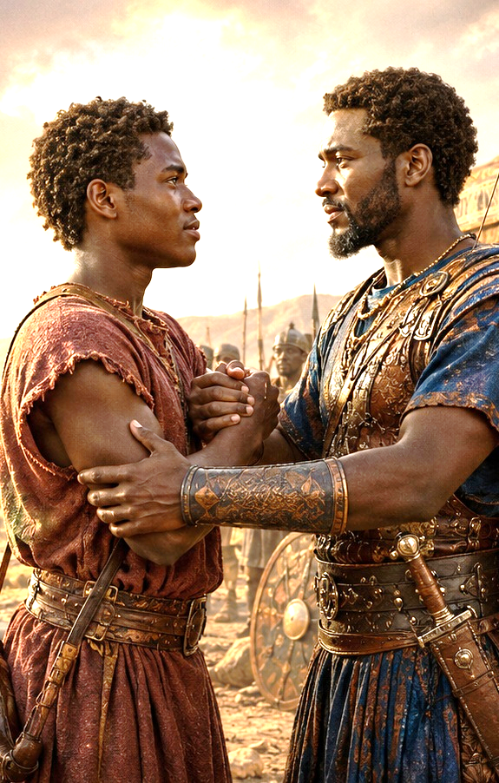
One Bible, One Story
JONATHAN AND DAVID, RESOLUTE FRIENDS
Friends of Jesus
Those who serve in the military can attest to the depth of love that each person shows for one another. This recalls Jesus’ words, “Greater love has no one than this: to lay down one’s life for one’s friends” (John 15:13). Paul notes, “Very rarely will anyone die for a righteous person, though for a good person someone might possibly dare to die” (Rom. 5:7).
Jesus took things one infinitely big step further. Jesus submitted to God’s plan—and in doing so, secured freedom from sin and its consequences for all who believe in him (Gal. 5:1). Jesus says this about His friends: “You did not choose me, but I chose you and appointed you so that you might go and bear fruit” (John 15:16).
12
Notes:
Friends of Jesus
Jesus shows the greatest form of love by laying down His life for sinners and then calling believers His friends, chosen to live fruitful lives for God. This section compares deep human loyalty, such as the bond often formed among soldiers, with the greater love of Jesus Christ. Human beings may sometimes risk their lives for close friends or honorable people. But Jesus went far beyond that. He gave His life for sinners so that all who believe in Him could be freed from sin. Jesus did not wait for us to choose Him first. He chose us, loved us, saved us, and appointed us to bear spiritual fruit.
Three Key Points
1. True love is sacrificial.
Jesus said, “Greater love hath no man than this, that a man lay down his life for his friends” — John 15:13, KJV. Love is not only spoken; it is proven through sacrifice.
2. Jesus’ love is greater than human friendship.
People may die for someone they consider good or worthy, but Jesus died for sinners. His love reaches beyond human loyalty because He gave Himself for those who could not save themselves.
3. Jesus chooses and appoints His followers.
In John 15:16, Jesus reminds His disciples that they did not choose Him first. He chose them and appointed them to bear fruit. Salvation leads to purpose.
Three Life Lessons Learned
1. We are loved more deeply than we deserve.
Jesus did not die for us because we were perfect. He died because He is gracious, merciful, and full of saving love.
2. Christian friendship should reflect Christ’s love.
If Jesus sacrificed Himself for us, we should love others with loyalty, humility, forgiveness, and service.
3. Being chosen by Jesus comes with responsibility.
Jesus saves us not just to sit still, but to bear fruit. Our lives should show faith, love, obedience, witness, and service.
Analysis
This section moves the lesson from the friendship of David and Jonathan to the greater friendship offered by Jesus Christ. David and Jonathan showed covenant loyalty, but Jesus fulfills the highest meaning of covenant love. Jonathan risked his life for David, but Jesus actually gave His life for sinners.
Romans 5:7 shows how rare it is for a person to die even for someone righteous. But Romans 5:8 gives the greater truth: “But God commendeth his love toward us, in that, while we were yet sinners, Christ died for us.” This means Christ’s love is not based on our worthiness. It is based on His grace.
Galatians 5:1 reminds believers that Christ gives freedom. He frees us from sin’s guilt, bondage, and final penalty. This freedom is not permission to live selfishly; it is the power to live for God.
John 15:16 also teaches divine initiative. Jesus says, “Ye have not chosen me, but I have chosen you.” That means our relationship with Christ begins with His grace. He calls us friends, saves us by His sacrifice, and appoints us to bear lasting fruit.
The lesson God wants us to learn is this: Jesus is the greatest Friend because He loved us first, died for us willingly, freed us completely, and chose us to live fruitful lives for His glory.

Slide 13
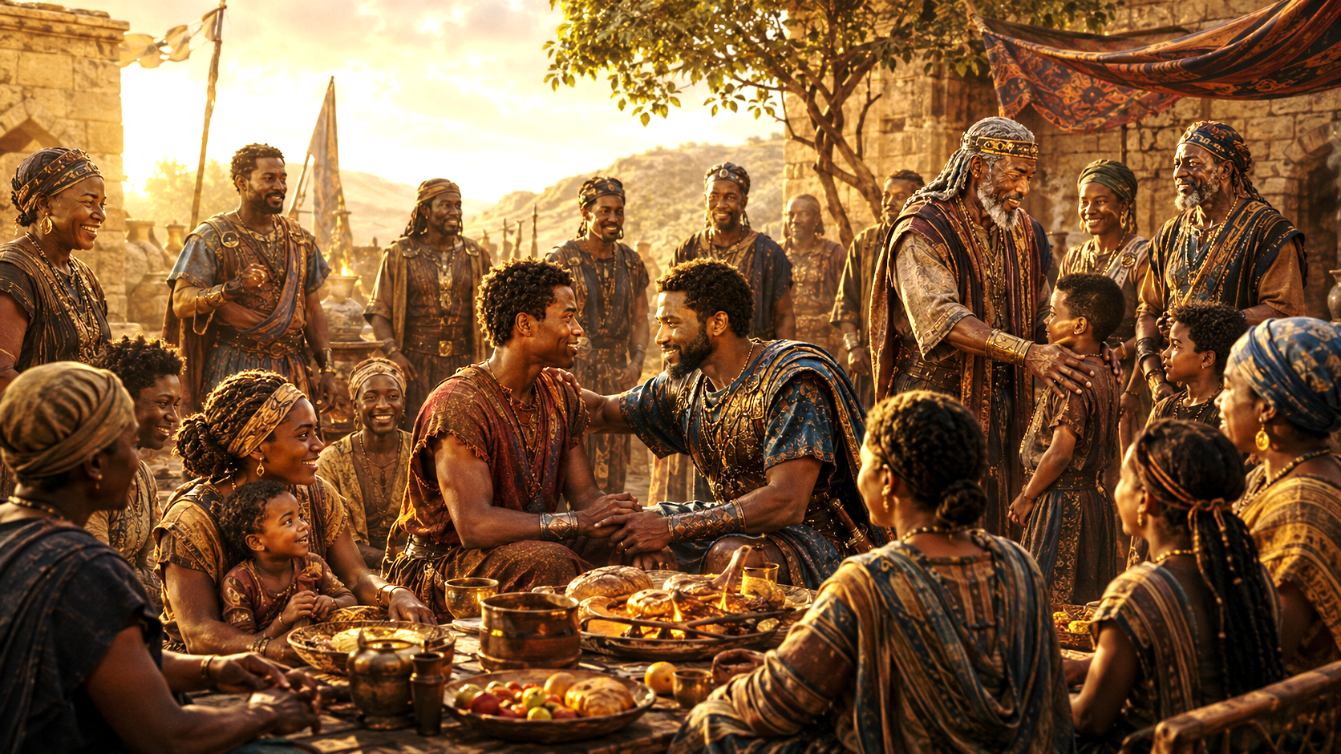
Apply the Message: God’s plans are best.
JONATHAN AND DAVID, RESOLUTE FRIENDS
SEEKING GOD’S INTERESTS
      Jonathan’s enthusiastic alliance with David is staggering, even as we look at it thousands of years later. As the son of a king, Jonathan could have used his power to keep David in line, even kill him to prevent losing the throne. Instead, Jonathan does not cling to the throne of his father but submits to God’s choice in the matter. Jonathan could not have known that God had a longer-term plan to renew the very meaning of kingship through David’s future descendant, the King of Kings and Lord of Lords (1 Tim. 6:15; Rev. 17:14). From Jonathan’s perspective, David is just God’s choice—inscrutable as it might have seemed.
      And yet, Jonathan saw plenty of evidence of God’s favor upon David. We don’t know whether David shared that he had been anointed by Samuel, but Jonathan witnessed David’s heroic defeat of a giant who had stood against the God of Israel (see 1 Sam. 17). Jonathan—a heroic warrior himself (1 Sam. 14:1–14)—still was not the one whom God chose to go against the Philistine champion. Later, Jonathan’s actions were driven both by genuine love and concern for David, reflecting Jonathan’s support for what God was doing in and through him. Instead of protecting his own interests, Jonathan did what was best for the nation. He stood in the breach between Saul’s troubled rule and David’s eventual kingship.
      Submitting to God’s plans can contradict our self-interest or desire for recognition. We dare not expect God to endorse our plans instead of His. Jesus modeled the selfless submission to God’s will when He laid aside His life (Luke 22:42). As we humbly seek God’s will, we are freed from obliging our self-interest, free to choose the path that brings glory to God.
13
Notes:
Apply the Message: God’s Plans Are Best
Jonathan shows us that God’s plans are better than personal ambition, and true faith means supporting what God is doing even when it costs us recognition, position, or advantage. Jonathan’s support of David is remarkable because Jonathan had the most to lose. As Saul’s son, Jonathan could have tried to protect his claim to the throne. Instead, he accepted that God had chosen David. Jonathan saw God’s favor on David through David’s victory over Goliath and his growing leadership. Rather than fighting against God’s will, Jonathan stood beside David and helped protect the future God was building. His actions show humility, faith, and a willingness to place God’s interests above his own.
Three Key Points
1. Jonathan chose God’s will over personal gain. Jonathan could have defended his own future as Saul’s heir, but he submitted to God’s choice of David.
2. Jonathan recognized God’s favor on David. David’s victory over Goliath revealed that God was working through him. Jonathan saw the evidence and responded with support instead of jealousy.
3. Jonathan became a bridge between Saul’s failure and David’s future. Jonathan stood between Saul’s troubled leadership and David’s coming kingship. He protected David and helped preserve God’s plan for Israel.
Three Life Lessons Learned
1. God’s plan may not place us in the position we expected. Jonathan reminds us that faithfulness is not always about being first. Sometimes God calls us to support someone else’s assignment.
2. Jealousy fades when we trust God’s wisdom. Jonathan did not compete with David because he trusted God’s choice. When we trust God, we can celebrate what He is doing through others.
3. Submission to God brings freedom from selfish ambition. When we stop demanding our own way, we become free to choose what glorifies God. Jesus modeled this in Luke 22:42 when He prayed, “not my will, but thine, be done.”
Analysis
This section highlights the spiritual greatness of Jonathan. He was not weak, passive, or unqualified. He was a courageous warrior who had already trusted God in battle. In 1 Samuel 14:6, Jonathan declared that the Lord could save “by many or by few.” He knew victory came from God, not human status.
That makes his support of David even more powerful. Jonathan was capable, brave, and royal, but God had chosen David. Instead of resisting God’s plan, Jonathan accepted it. He did not cling to the throne. He did not use his power to destroy David. He did not let ambition blind him. He chose humility.
David’s victory over Goliath likely confirmed what Jonathan already believed: God’s hand was on David. Jonathan had courage, but David was the one God chose to face the Philistine champion. Jonathan’s response was not bitterness but covenant loyalty.
This points us forward to Jesus Christ. Jonathan submitted to God’s plan in a limited way, but Jesus submitted perfectly. In the Garden of Gethsemane, Jesus prayed, “Father, if thou be willing, remove this cup from me: nevertheless not my will, but thine, be done” — Luke 22:42. Jesus laid down His life so that sinners could be saved.
The lesson is clear: God’s plans are always better than our personal ambitions. We should not ask God to approve our plans while ignoring His will. Instead, we should seek His interests, support His work, and trust that His way brings the greatest glory. Jonathan teaches us that real faith is willing to step aside, stand beside, and serve God’s purpose.
1 Do you imagine that you would have deferred to God’s choice of David, the way that Jonathan did? Why or why not?
Jonathan could have listed several reasons why he should get to be king. He could have argued that it was unfair to lose the throne for his father’s misdeeds. “I’m not my father!” you could imagine someone saying. In a modern context, it might be easier to think about work supervisors, leaders in other churches, or even siblings. Is it easy to root for their success as much as your own?
2 What does the witness of Jonathan show us?
We can learn several lessons from Jonathan. For instance, God’s ways and God’s choices are best. God sees the things that we don’t see, and we should be as concerned for the success of others as our own. Jesus calls us to “submit to one another out of reverence for Christ” (Eph. 5:21), to love others as we love ourselves (Matt. 22:39).
3 Where do you struggle the most to give control to God?
Maybe you struggle in situations that feel unjust or unfair. It is hard to trust God when we feel threatened and sensitive to others’ successes. Good friends remind us to look to the future, which is in God’s hands.

Slide 14
Apply the Message: God’s plans are best.
JONATHAN AND DAVID, RESOLUTE FRIENDS
Seeking God’s Interests
      1 Do you imagine that you would have deferred to God’s choice of David, the way that Jonathan did? Why or why not?
      2 What does the witness of Jonathan show us?
      3 Where do you struggle the most to give control to God?
14
Notes:
1 Do you imagine that you would have deferred to God’s choice of David, the way that Jonathan did? Why or why not?
Jonathan could have listed several reasons why he should get to be king. He could have argued that it was unfair to lose the throne for his father’s misdeeds. “I’m not my father!” you could imagine someone saying. In a modern context, it might be easier to think about work supervisors, leaders in other churches, or even siblings. Is it easy to root for their success as much as your own?
2 What does the witness of Jonathan show us?
We can learn several lessons from Jonathan. For instance, God’s ways and God’s choices are best. God sees the things that we don’t see, and we should be as concerned for the success of others as our own. Jesus calls us to “submit to one another out of reverence for Christ” (Eph. 5:21), to love others as we love ourselves (Matt. 22:39).
3 Where do you struggle the most to give control to God?
Maybe you struggle in situations that feel unjust or unfair. It is hard to trust God when we feel threatened and sensitive to others’ successes. Good friends remind us to look to the future, which is in God’s hands.

Slide 15
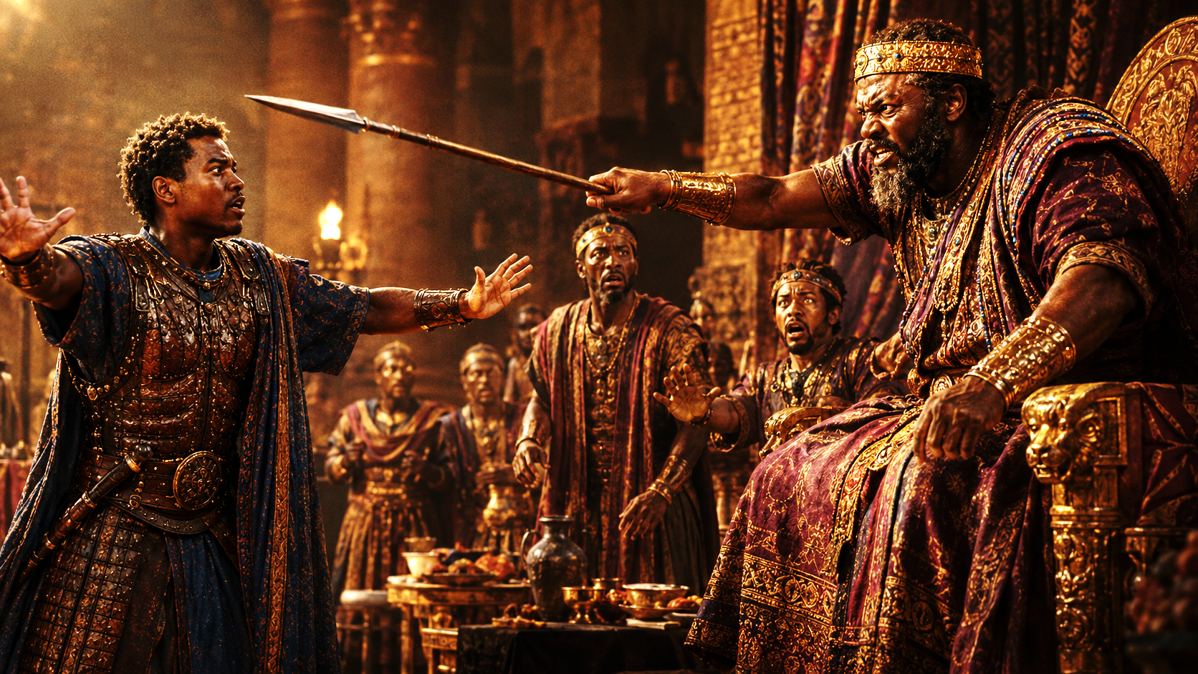
One Bible, One Story
JONATHAN AND DAVID, RESOLUTE FRIENDS
New Covenant Loyalty
Friendship, like that between David and Jonathan, doesn’t just happen—it must be cultivated. The world has a way of predisposing people toward self-gain and narcissism, leaving us disinclined to connect with one another, much less show the kind of loyalty that Jonathan shows at his own expense.
But the church can become a place where people are willing to serve one another sacrificially. It begins with individuals who look beyond their own needs. Simple acts of friendship and loyalty can make a difference: inviting someone to coffee, checking in with a friend, sharing a meal, and keeping confidences are just a few examples. These simple actions can open the door to a deeper relationship wherein both people recognize the dignity of the other and serve one another under Christ.
This is not a foolproof strategy; some will not reciprocate. But Christians are called to hospitality (Romans 12:13; 1 Timothy 5:10; Hebrews 13:2; 3 John 8; see lesson 13), even generosity and love for enemies (Proverbs 25:21; Matthew 5:43–44). If kindness goes unreciprocated, it remains kindness well-spent.
15
Notes:
New Covenant Loyalty
Christian friendship must be intentionally cultivated through sacrificial love, faithful service, hospitality, and kindness that reflects the love of Christ. This section teaches that deep friendship does not happen automatically. The world often encourages selfishness, personal gain, and shallow relationships. However, the church should be different. Believers are called to build relationships marked by loyalty, service, hospitality, and love. Simple acts such as sharing a meal, checking on someone, inviting someone to coffee, or keeping confidences can open the door to deeper Christian fellowship. Even when kindness is not returned, it is still pleasing to God because Christians are called to love, serve, and show hospitality.
Three Key Points
1. Godly friendship must be cultivated. David and Jonathan’s friendship did not grow by accident. It was built through loyalty, trust, sacrifice, and covenant faithfulness.
2. The church should be a place of sacrificial love. The body of Christ should resist selfishness and become a community where people serve, support, and care for one another.
3. Kindness is never wasted. Even when love, hospitality, or friendship is not returned, the act still honors God and reflects the character of Christ.
Three Life Lessons Learned
1. Friendship requires intentional effort. Strong relationships are built through small, faithful actions over time. A call, a meal, a visit, or a word of encouragement can strengthen the bond between believers.
2. Christian love looks beyond self-interest. The world often teaches people to ask, “What can I gain?” Christ teaches us to ask, “How can I serve?”
3. We should do good even when others do not respond. Some people may not return our kindness. Still, believers are called to love, show hospitality, and do good because Christ first loved us.
Analysis
This section moves the lesson from David and Jonathan’s covenant friendship to life in the New Covenant community, the church. David and Jonathan showed loyal love in a time of danger, but Christians now live under the greater covenant made through Jesus Christ. Because Christ gave Himself for us, believers are called to give themselves in love and service to others.
The text rightly notes that friendship must be cultivated. In a sinful world, people often drift toward selfishness, pride, and self-protection. But the church should be a witness against that spirit. The people of God should practice a different way of life: humility, hospitality, loyalty, forgiveness, and sacrificial care.
Simple acts matter. Inviting someone to coffee may seem small, but it may communicate dignity. Checking on a friend may remind them they are not forgotten. Sharing a meal can create fellowship. Keeping confidences builds trust. These small acts can become the foundation of deeper Christian friendship.
Romans 12:13 says believers should be “given to hospitality.” Hebrews 13:2 reminds us, “Be not forgetful to entertain strangers.” Jesus goes even further in Matthew 5:44, saying, “Love your enemies, bless them that curse you, do good to them that hate you.” This means Christian love is not limited to people who are easy to love.
The final point is especially important: kindness is still valuable even when it is not returned. Christians do not love merely to receive love back. We love because Christ loved us first. New Covenant loyalty means we reflect Jesus by serving others, honoring their dignity, and trusting God with the results.
The lesson God wants us to learn:
God wants His people to build relationships that reflect Christ’s covenant love. We are called to move beyond selfishness, practice hospitality, serve sacrificially, and show kindness that honors God whether or not it is returned.

Slide 16
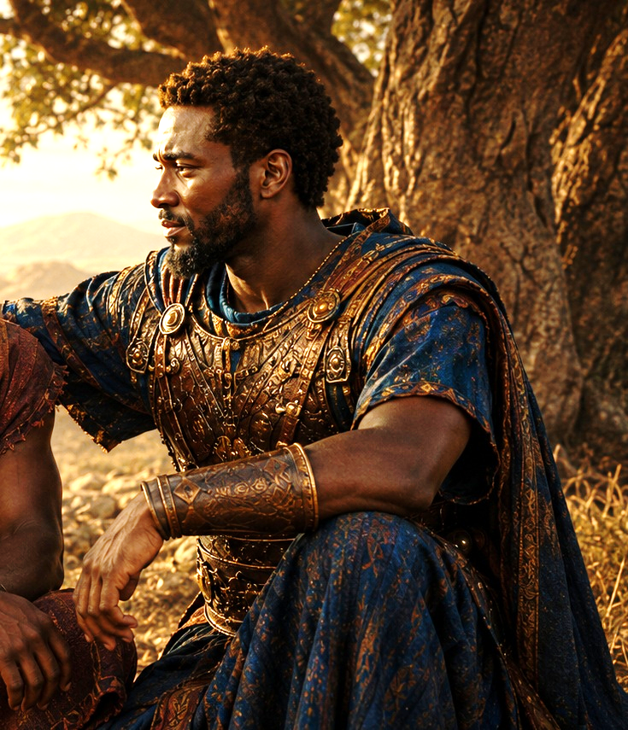
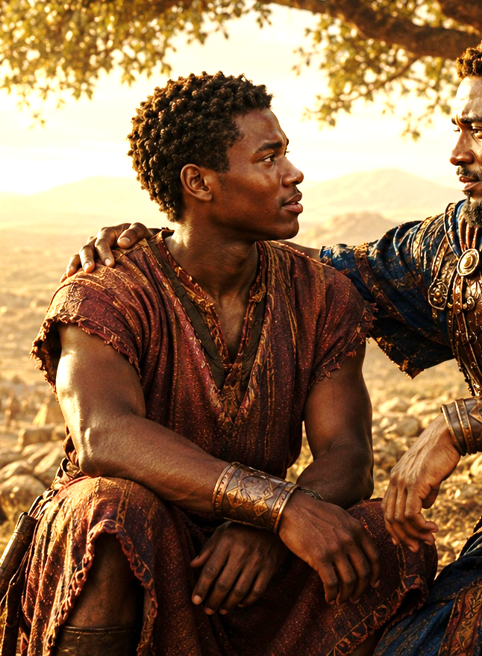
LIVE IT OUT:
JONATHAN AND DAVID, RESOLUTE FRIENDS
Show gratitude for godly friends and supporters.
A GODLY LEGACY
This week, reflect on the godly friends and mentors in your life, past or present. Try to name at least three individuals whom God placed beside you to give support and counsel, and hold these names before God in grateful prayer. Later, if you feel led, reach out to the surviving family of departed friends, to share what the relationship meant to you.
Notes:
Live It Out: Show Gratitude for Godly Friends and Supporters
Godly friends and mentors are gifts from the Lord, and we should remember them with gratitude, prayer, and honor. This section encourages believers to reflect on the people God has placed in their lives for support, guidance, correction, and encouragement. These friends and mentors may be living or departed, but their influence continues. The lesson calls us to name at least three people who have helped shape our faith and thank God for them in prayer. It also encourages reaching out to the families of departed friends to share how much their loved one meant to us.
Three Key Points
1. God places people beside us for a reason. God often uses friends, mentors, teachers, pastors, family members, and church members to guide us, encourage us, and strengthen our faith.
2. Gratitude should be intentional. We should not wait until people are gone to appreciate them. Naming them before God helps us remember how the Lord has blessed us through others.
3. A godly legacy continues after death. The influence of faithful people does not end when they pass away. Their love, wisdom, prayers, and example continue to bless those they touched.
Three Life Lessons Learned
1. Do not take faithful people for granted. Godly friends and mentors are blessings. We should recognize their value while we have the opportunity.
2. Gratitude strengthens humility. When we remember those who helped us, we are reminded that we did not become who we are by ourselves. God used others to help shape us.
3. Encouragement can bless future generations. Reaching out to the family of a departed friend can bring comfort and remind them that their loved one’s life mattered.
Analysis
This section connects directly to the legacy of Jonathan and David. Jonathan supported David, protected him, and encouraged him during a dangerous season. Later, David remembered Jonathan’s love and honored his family through Mephibosheth. Their relationship teaches that godly friendship leaves a lasting mark.
The call to name three godly friends or mentors is more than a memory exercise. It is an act of worship. It reminds us that God often answers prayers through people. He sends someone to listen, someone to advise, someone to correct, someone to pray, and someone to stand beside us when life becomes difficult.
This also teaches the importance of honoring legacy. When we tell a family how their loved one blessed us, we help preserve that person’s witness. We also practice Christian encouragement. Sometimes a simple message such as, “Your father helped me grow in faith,” or “Your mother’s prayers strengthened me,” can deeply comfort a family.
From a Christian perspective, gratitude is part of faithful living. Paul often thanked God for believers who supported him, prayed for him, and partnered with him in ministry. In the same way, we should thank God for the people who helped us along the journey.
The lesson God wants us to learn:
God wants us to recognize, remember, and give thanks for the faithful people He has used in our lives. Their support is part of His grace, and our gratitude honors both them and the Lord who placed them beside us.

Slide 17
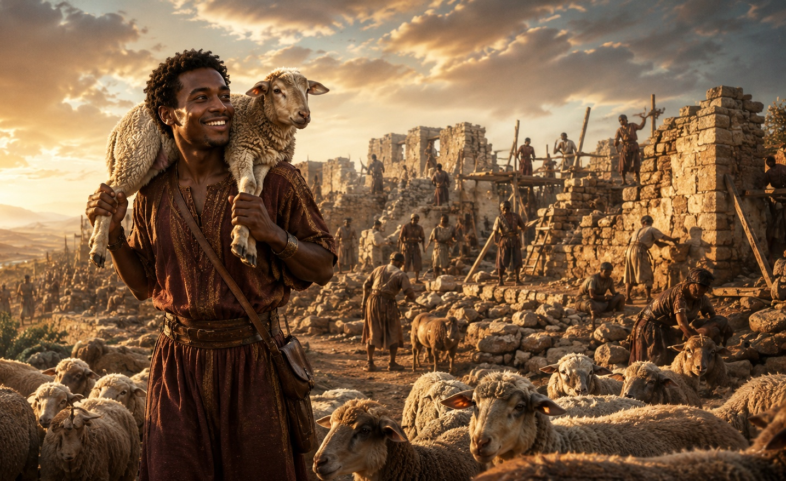



End
May God Bless and Keep you…
Material adapted by Stanford W. Bowman Jr. from Echoes® Adult and Bible-in-Life® Adult Summer 2026 quarter with permission, © David C Cook, https://davidccook.org. May not be further reproduced. All rights reserved.
Material adapted by Stanford W. Bowman Jr. from Echoes® Adult and Bible-in-Life® Adult Fall 2020 quarter with permission, © David C Cook, https://davidccook.org. May not be further reproduced. All rights reserved.

Slide 18
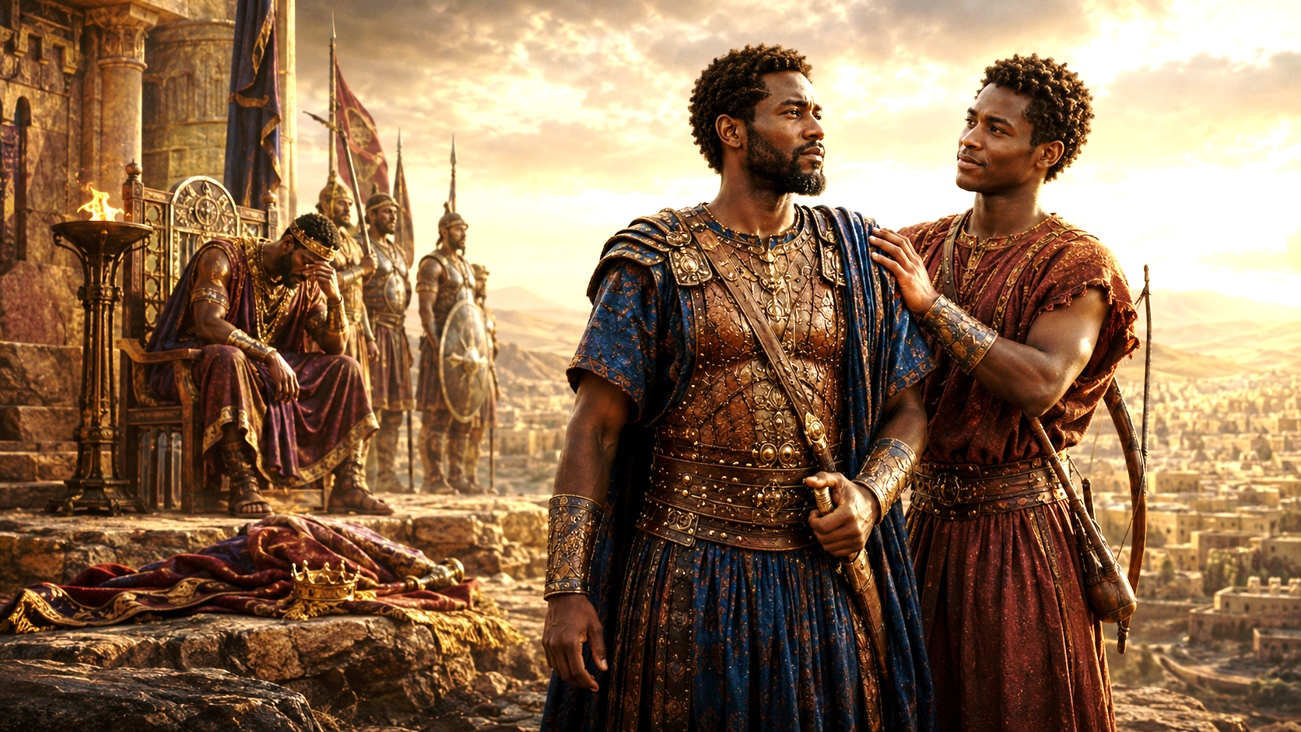
QUESTION & ANSWER
JONATHAN AND DAVID, RESOLUTE FRIENDS
Unexpected Allies
1 How do Saul’s and Jonathan’s attitudes toward David differ?
2 How do you explain Jonathan’s reaction to David’s growing role?
3 Where have you observed the destructive effects of jealousy?
Saul considers David to be a threat and a rival. David’s successes make him jealous and suspicious, even though David does nothing to oppose him. Saul even tries to murder him. Jonathan, however, welcomes what God is doing through David. Jonathan does not show concern over his right to the throne. He loves David and offers loyalty and friendship.
Jonathan can see evidence that David would make a good king. Kings were supposed to be protectors and military leaders, and David has shown that ability. He does not appear jealous, perhaps caring more for Israel’s collective success than his own personal status.
Saul’s jealousy poisons his mind against David. Scripture even says that Saul is being tormented by an evil spirit (1 Sam. 16:14). This trouble comes upon him before he becomes acquainted with David, but this certainly could be a contributing factor to some of Saul’s heinous behavior. Jealousy has the ability to ruin our relationships. It blinds us and makes us willing to do irrational things.
Notes:
Unexpected Allies
1 How do Saul’s and Jonathan’s attitudes toward David differ?
Saul considers David to be a threat and a rival. David’s successes make him jealous and suspicious, even though David does nothing to oppose him. Saul even tries to murder him. Jonathan, however, welcomes what God is doing through David. Jonathan does not show concern over his right to the throne. He loves David and offers loyalty and friendship.
2 How do you explain Jonathan’s reaction to David’s growing role?
Jonathan can see evidence that David would make a good king. Kings were supposed to be protectors and military leaders, and David has shown that ability. He does not appear jealous, perhaps caring more for Israel’s collective success than his own personal status.
3 Where have you observed the destructive effects of jealousy?
Saul’s jealousy poisons his mind against David. Scripture even says that Saul is being tormented by an evil spirit (1 Sam. 16:14). This trouble comes upon him before he becomes acquainted with David, but this certainly could be a contributing factor to some of Saul’s heinous behavior. Jealousy has the ability to ruin our relationships. It blinds us and makes us willing to do irrational things.

Slide 19
QUESTION & ANSWER
JONATHAN AND DAVID, RESOLUTE FRIENDS
A Covenant Remembered
1 How do David and Jonathan each defer to God’s plan?
2 How does David keep his covenant after Jonathan is gone?
3 What is a fitting tribute you have heard for someone’s life?
In David’s case, he may be anointed as king, but he doesn’t take the throne by force or do anything to oppose Saul and Jonathan. He waits for God to act. In Jonathan’s case, he shows no possessiveness about inheriting the throne. He welcomes friendship with David and defends him. Jonathan is willing to let God’s choice prevail.
Even after allowing the Gibeonites to seek retribution for Saul’s crimes, David spares Jonathan’s son, Mephibosheth. As the son of Saul’s firstborn, Mephibosheth should have been the first to be held responsible. Instead, David spared him “because of [his] oath before the Lord” (v. 7).
Perhaps someone was well-loved in your community, and this person’s death was a blow. Funerals are occasions for people to come together to express gratitude for a friend or family member. That is why the word eulogy literally means “good speech. ” When remembering Jonathan who died, David writes a psalm to praise and eulogize his friend, even including Saul as God’s anointed king. “How the mighty have fallen!” he mourns (2 Sam. 1:27).
Notes:
A Covenant Remembered
1 How do David and Jonathan each defer to God’s plan?
In David’s case, he may be anointed as king, but he doesn’t take the throne by force or do anything to oppose Saul and Jonathan. He waits for God to act. In Jonathan’s case, he shows no possessiveness about inheriting the throne. He welcomes friendship with David and defends him. Jonathan is willing to let God’s choice prevail.
2 How does David keep his covenant after Jonathan is gone?
Even after allowing the Gibeonites to seek retribution for Saul’s crimes, David spares Jonathan’s son, Mephibosheth. As the son of Saul’s firstborn, Mephibosheth should have been the first to be held responsible. Instead, David spared him “because of [his] oath before the Lord” (v. 7).
3 What is a fitting tribute you have heard for someone’s life?
Perhaps someone was well-loved in your community, and this person’s death was a blow. Funerals are occasions for people to come together to express gratitude for a friend or family member. That is why the word eulogy literally means “good speech. ” When remembering Jonathan who died, David writes a psalm to praise and eulogize his friend, even including Saul as God’s anointed king. “How the mighty have fallen!” he mourns (2 Sam. 1:27).

Slide 20
End
The Lord bless thee, and keep thee:
The Lord make his face shine upon thee, and be gracious unto thee:
The Lord lift up his countenance upon thee and give thee peace.
- Numbers 6:24-26, KJV
Material adapted by Stanford W. Bowman Jr. from Echoes® Adult and Bible-in-Life® Adult Summer 2026 quarter with permission, © David C Cook, https://davidccook.org. May not be further reproduced. All rights reserved.
Material adapted by Stanford W. Bowman Jr. from Echoes® Adult and Bible-in-Life® Adult Fall 2020 quarter with permission, © David C Cook, https://davidccook.org. May not be further reproduced. All rights reserved.

Slide 21
