Slide 1
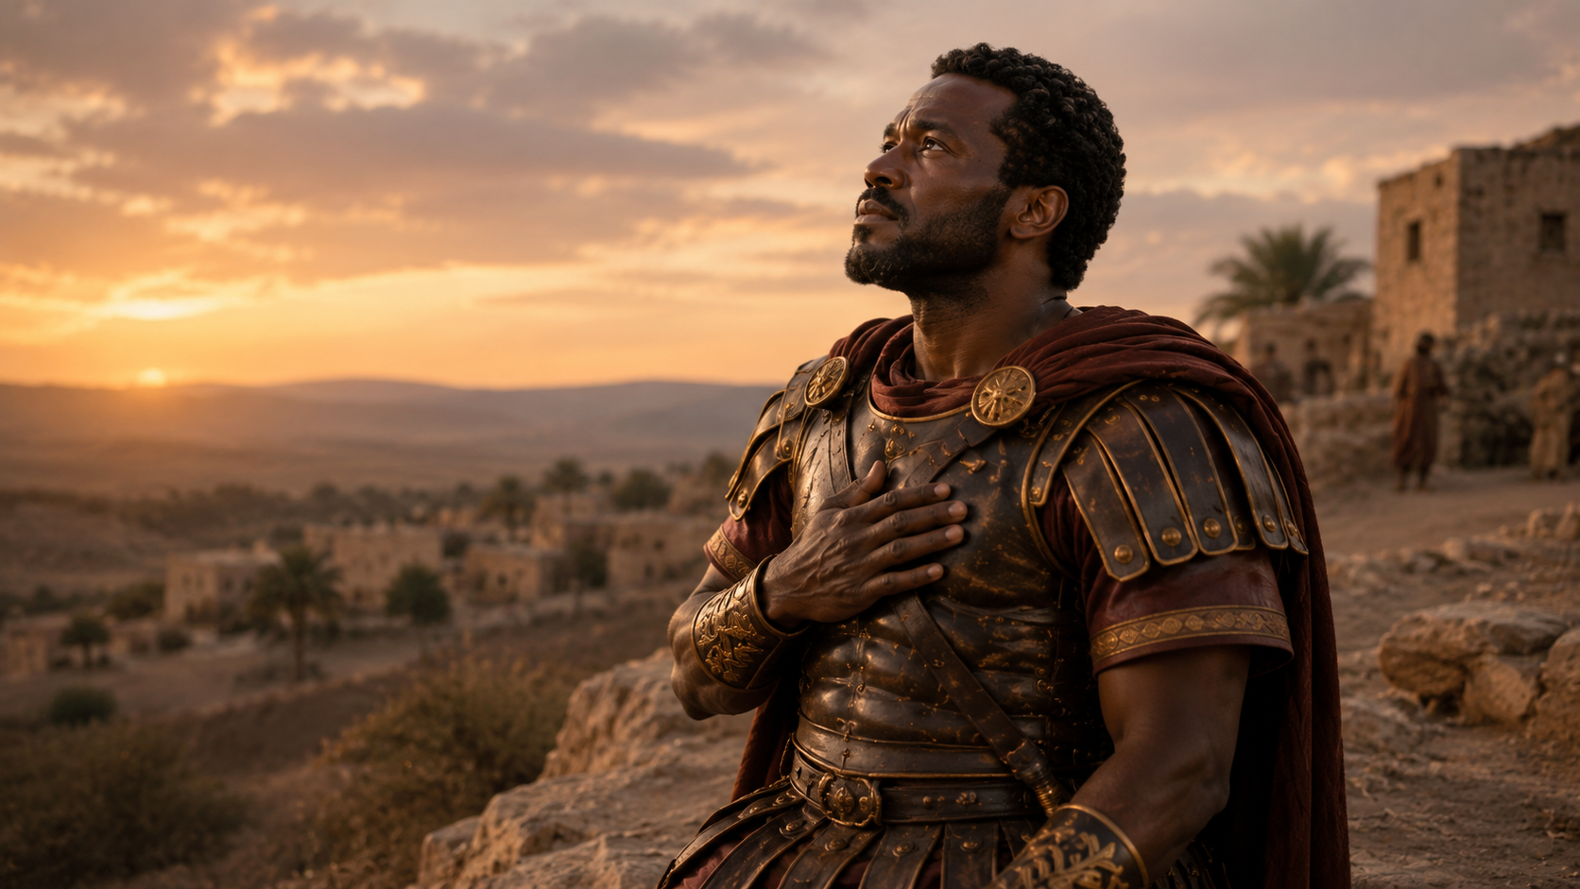
THE BELIEVING CENTURION
When Jesus heard it, he marvelled, and said to them that followed, Verily I say unto you, I have not found so great faith, no, not in Israel.
—Matthew 8:10 KJV
Week of July 5
Notes:
THE BELIEVING CENTURION
Week of June 30
============
8:1-17 The powerful words of the Sermon on the Mount were matched by miracles of unmistakable might. Matthew grouped these events topically rather than chronologically, accounting for the difference in the order of events in this book when compared to Mark and Luke.
Leprosy was one of the most despised diseases of the first century. A leper was banished from society. Jesus broke the social customs of His time by reaching out and touching a such a person.
In contrast, Jesus healed the servant of a centurion from a great distance. Both the man with leprosy and the centurion were outcasts from Jewish society, but Jesus took time for both of them. Matthew completed this sampling of Jesus’ healing with the account of a person known to many in his Jewish audience—Peter’s mother-in-law. A reference to many other healings demonstrated the power that
was prophesied centuries earlier (Isaiah 53:4, 5).

Slide 2
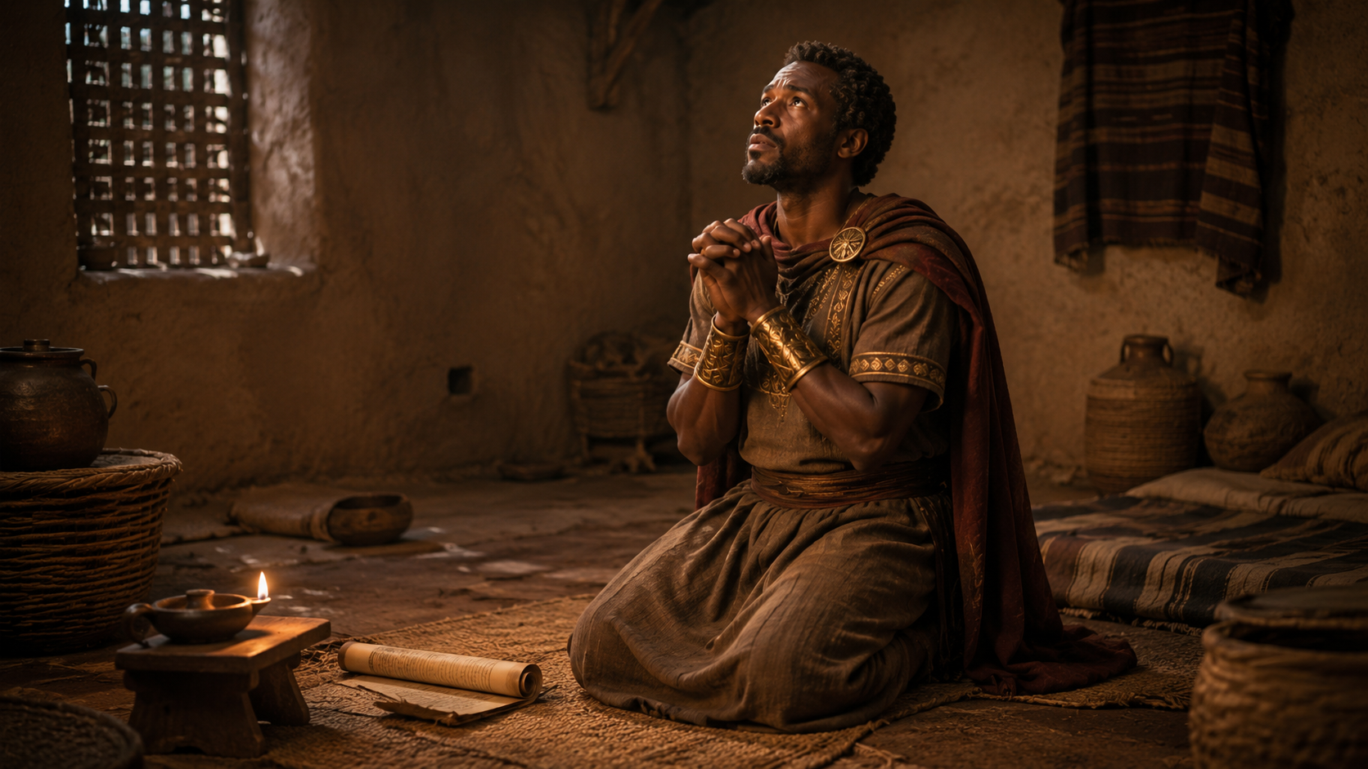
Prayer
Heavenly Father, teach us to approach You like the centurion. May we boldly intercede on behalf of those who suffer. Grant us complete faith in Your authority. In Jesus’ name we pray. Amen.
    Thought to Remember
    Jesus holds complete authority.
Notes:
Heavenly Father, teach us to approach You like the centurion. May we boldly intercede on behalf of those who suffer. Grant us complete faith in Your authority. In Jesus’ name we pray. Amen.
Thought to Remember
Jesus holds complete authority.

Slide 3
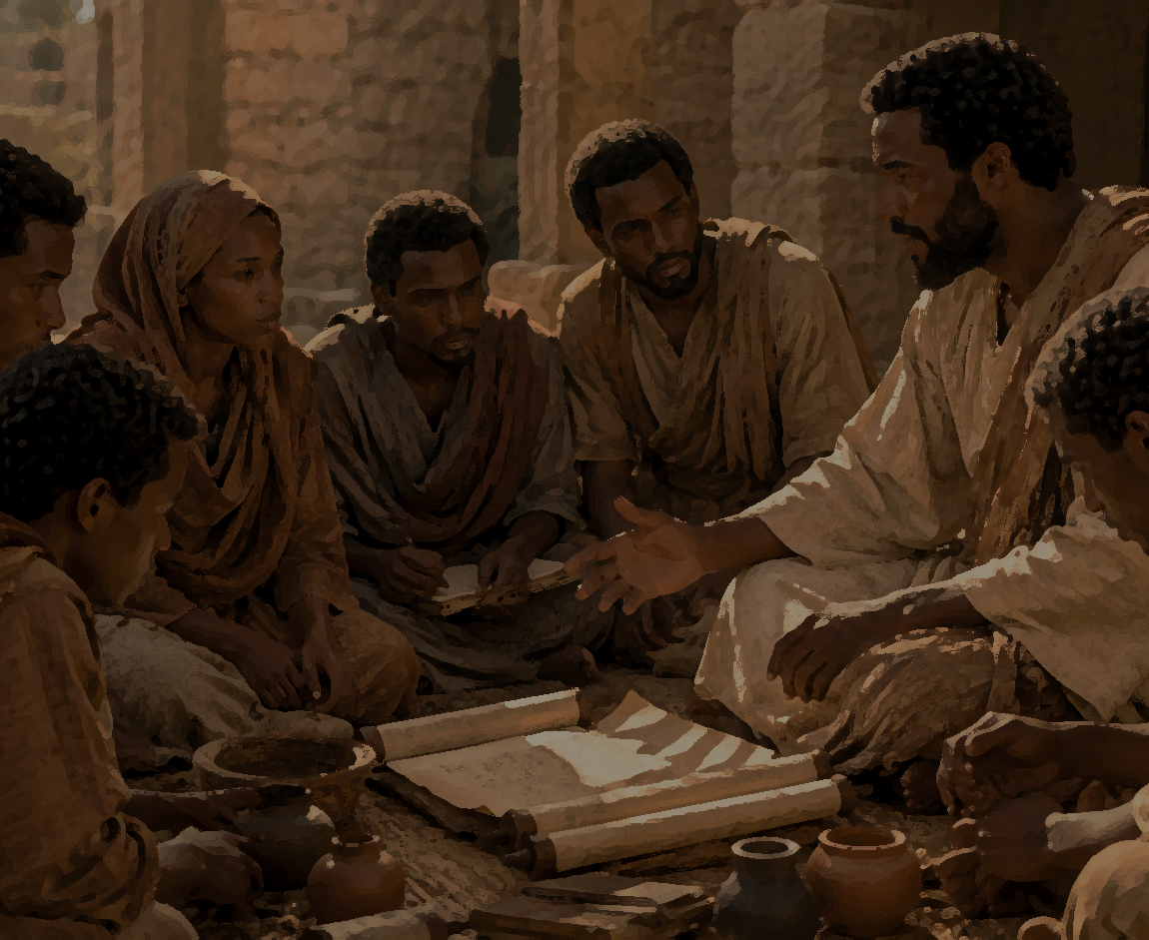
LESSON OUTLINE
THE BELIEVING CENTURION
  LESSON FOCUS: Jesus recognizes and rewards great faith.
  LESSON SCRIPTURE: Matthew 8:5–13
  APPLY THE MESSAGE: Great faith is what we need, and it appears in surprising places.
  LIVE IT OUT: Ask God to grow our faith as we make bold requests.
  Review
  Introduction
  Lesson Context
  Overview
  Conclusion
  Question & Answers
A Man of Authority - Matthew 8:5–9 KJV
Examples of Faith- Matthew 8:10–13 KJV
Notes:
A Man of Authority - Matthew 8:5–9 KJV
Examples of Faith- Matthew 8:10–13 KJV
=================================
Jesus honors humble faith wherever He finds it. Faith is not measured by religious position, nationality, or background. It is measured by trust in Christ. The centurion believed that Jesus had authority over sickness, distance, and life itself. That kind of faith still pleases the Lord today.
=====================
Great faith humbly recognizes the authority of Jesus, trusts His word completely, and comes to Him boldly for needs only He can meet. Jesus is not impressed by status, background, or outward success; He is pleased by humble faith wherever He finds it.
=================================
Matthew 8:5–13 teaches that great faith recognizes the authority of Jesus, comes to Him humbly, and trusts His word completely. The centurion was an unlikely example of faith: a Roman officer, a Gentile, and an outsider. Yet he showed compassion for his servant, humility before Christ, and confidence that Jesus could heal by simply speaking.
><><><><><><><><><><><><><><><><>
Matthew 8:5–13 — The Believing Centurion
The attached lesson identifies the focus clearly: “Jesus recognizes and rewards great faith.” It also stresses that great faith may appear in surprising people and places, even in a Roman centurion who would have been viewed as an outsider by many Jews.
Matthew 8:5–6 — The Centurion’s Request
Summary:
When Jesus entered Capernaum, a Roman centurion came to Him pleading for help. His servant was sick with palsy, paralyzed, and “grievously tormented.”
Commentary:
The centurion was a man of military authority, yet he came humbly to Jesus. He did not ask for himself but for his suffering servant. This shows compassion, humility, and faith. Though he was a Gentile and part of Rome’s occupying force, he recognized that Jesus had power greater than his own rank.
Matthew 8:7 — Jesus’ Willingness
Summary:
Jesus responded, “I will come and heal him.” Jesus was willing to enter the centurion’s situation and bring healing.
Commentary:
Jesus’ answer shows His mercy. He did not reject the centurion because he was Roman, Gentile, or outside Israel’s covenant community. Christ’s compassion reached beyond social, racial, and religious barriers. This reminds us that Jesus responds to sincere faith, not human status.
Matthew 8:8–9 — Faith in Jesus’ Authority
Summary:
The centurion said he was not worthy for Jesus to come under his roof. He believed Jesus only needed to speak the word, and his servant would be healed.
Commentary:
This is the heart of the passage. The centurion understood authority because he lived under authority and commanded others. He believed Jesus’ word carried divine power. His faith was not based on sight, touch, or ritual. He trusted the authority of Christ’s spoken word.
Matthew 8:10 — Jesus Marvels
Summary:
When Jesus heard the centurion’s words, He marveled and said He had not found such great faith in Israel.
Commentary:
Jesus was amazed because this Gentile soldier understood what many in Israel had missed. He saw Jesus as Lord over sickness, distance, and authority. True faith is not merely religious background; it is humble trust in who Jesus is and what He can do.
Matthew 8:11–12 — Outsiders Included, Insiders Warned
Summary:
Jesus said many would come from the east and west and sit with Abraham, Isaac, and Jacob in the kingdom, while some expected insiders would be cast out.
Commentary:
Jesus revealed that God’s kingdom is entered by faith, not heritage alone. Many Gentiles would be welcomed, while unbelieving Israelites would be judged. This is a warning against empty religion and a promise that salvation reaches all who trust Christ.
Matthew 8:13 — Healing According to Faith
Summary:
Jesus told the centurion, “Go thy way; and as thou hast believed, so be it done unto thee.” His servant was healed that same hour.
Commentary:
Jesus honored the centurion’s faith. The healing happened without Jesus physically going to the house. This proves Christ’s authority is not limited by distance. His word is enough. Faith rests in the power of Jesus, not in visible proof.

Slide 4
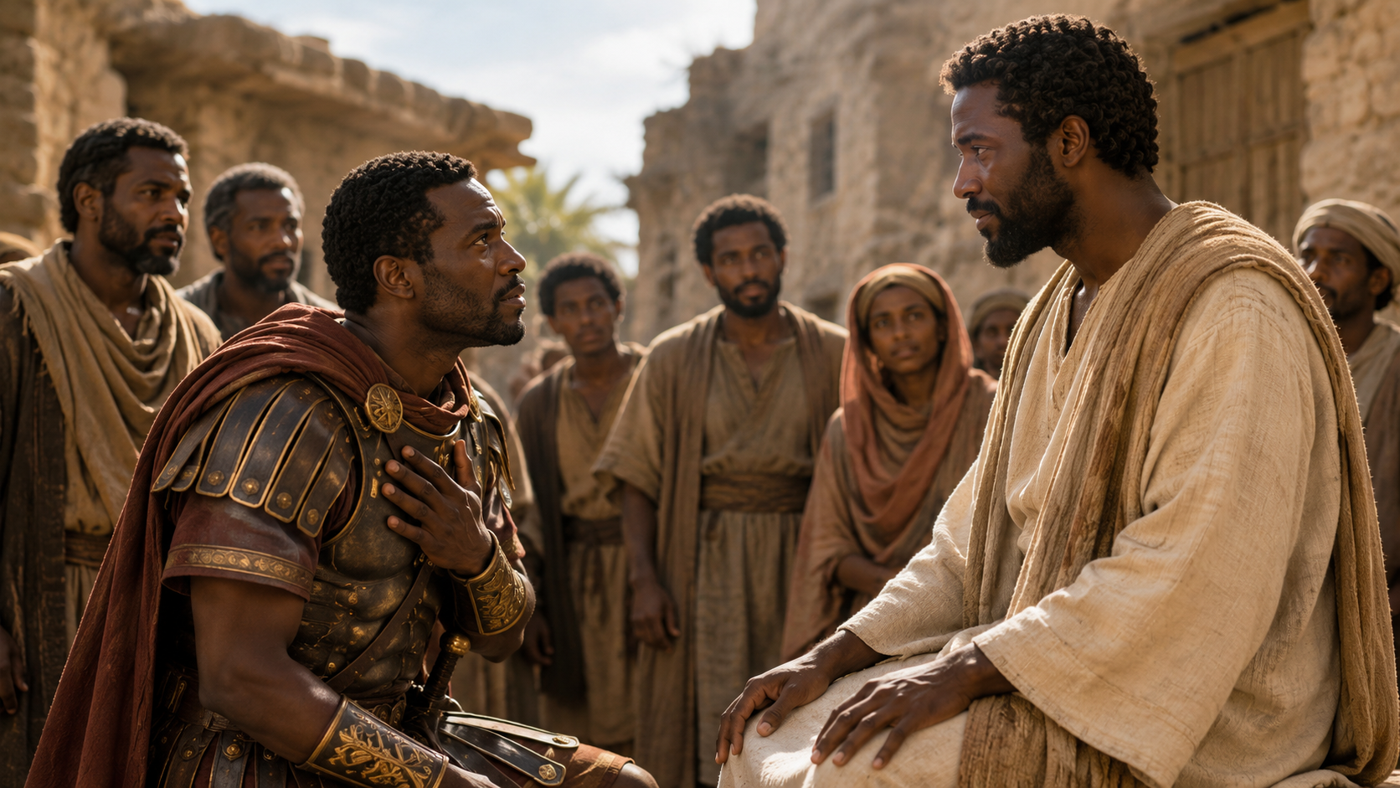
THE BELIEVING CENTURION
INTRODUCTION
Please Fix It, Daddy!
  My young children run to me when something is amiss. They fully expect that I can fix whatever has gone wrong: a broken toy, a skinned knee, or a swing that won’t push itself. In their eyes, I am the big, experienced adult who has been there for them since they were born. In their eyes, I seem completely trustworthy and capable of doing whatever they need. (They’re still young enough to be enchanted by my capacity!) This trust is constant —whether they are behaving well or poorly, whether they are healthy or sick, whether I am full of energy or exhausted.
  If children can place this radical trust in an earthly father, how much more might the children of God run to a faithful and capable heavenly Father! Yet, we often hesitate to bring specific requests or intercessions. We waver when we feel unworthy of attention, or that our situation is too much. But like the centurion in Matthew 8:5–13, we can trust God’s capability and willingness to act. God will respond when we come to Him, full of faith. He does not tire.
Notes:
God invites His children to trust Him with the same confidence that young children place in a loving father. Because God is faithful, capable, and never weary, we can bring our needs to Him boldly and believe that He is able to act. The passage compares the trust children have in their earthly father to the faith believers should have in God. Children run to their father when something is broken, painful, or difficult because they believe he can fix it. In the same way, God’s children should run to their heavenly Father with confidence. However, adults often hesitate because they feel unworthy, doubtful, or afraid their problem is too great. Like the centurion in Matthew 8:5–13, believers are called to trust God’s power, goodness, and willingness to respond.
Three Key Points
1. Children naturally trust their father’s care. The children do not question whether their father is capable. They simply bring their problems to him, believing he can help.
2. God is more faithful than any earthly parent.
If children can trust an imperfect earthly father, believers can trust the perfect heavenly Father even more.
3. Faith brings specific needs to God. The centurion did not pray vaguely. He brought a clear need to Jesus and trusted His authority to heal.
Three Life Lessons Learned
1. Bring your problems to God first. Instead of carrying fear, shame, or worry alone, believers should go to God in prayer with honest and specific needs.
2. Do not let unworthiness stop your faith. The centurion admitted he was not worthy, but he still trusted Jesus. Humility should lead us closer to God, not away from Him.
3. God’s power is not limited by our situation. No problem is too large, too distant, or too complicated for the Lord. Jesus can act by His word alone.
Analysis
This reflection uses a simple family image to explain a deep spiritual truth. A child’s trust is direct, innocent, and confident. The child does not analyze every weakness in the father; the child remembers relationship, care, and past help. That is the kind of trust believers are encouraged to have in God.
The comparison points to Matthew 8:5–13, where the centurion approached Jesus on behalf of his suffering servant. The centurion knew he was not worthy for Jesus to come under his roof, but he also knew Jesus had authority. His faith rested in the power of Christ’s word: “speak the word only, and my servant shall be healed” (Matthew 8:8, KJV).
The passage challenges believers who hesitate to pray. Sometimes we act as though God is too busy, too distant, or unwilling to hear us. But Scripture reveals God as a loving Father who welcomes His children. He is not weakened by our repeated needs, and He does not grow tired of our prayers.
The spiritual lesson is clear: faith is not pretending we deserve God’s help; faith is trusting that God is good, able, and merciful enough to help us anyway.

Slide 5
LESSON CONTEXT
Roman Authority—
The centurion holds a high rank in the Roman army. A centurion comes from the same Latin word as century, meaning that the typical centurion commands about one hundred soldiers. This was not a position for the faint of heart! He earned his rank by excelling in leadership and in battle. As a commander, his declarative authority comes from Rome and not himself, so when he gives a command, his troops listen because his word carries Caesar’s authority. In the same way, the centurion recognizes Jesus as one whose authority comes from heaven. Ironically, the centurion is able to recognize God’s authority because of his experience as commander in the occupying force—typically enemies of Jews.
THE BELIEVING CENTURION
Notes:
The centurion understood Jesus’ authority because he himself lived under authority and exercised authority over others. The centurion was a respected Roman military officer who commanded about one hundred soldiers. His authority did not come from himself but from Rome. When he spoke, his soldiers obeyed because his command carried the power of Caesar’s government. In the same way, the centurion recognized that Jesus’ authority came from heaven. Though he was a Gentile and part of the occupying Roman force, he understood something spiritually powerful: Jesus only needed to speak, and sickness had to obey.
=======================
This lesson centers on Matthew 8:5–13, where a Roman centurion approaches Jesus in Capernaum on behalf of his suffering servant. The teacher commentary states the lesson focus clearly: “Jesus recognizes and rewards great faith.” It also frames the lesson around four movements: starting with the truth that God is near to people of faith, studying the centurion’s astonishing faith, applying the message that great faith can appear in surprising places, and living it out by asking God to grow our faith as we make bold requests.
The setting is early in Jesus’ ministry, shortly after the Sermon on the Mount. Jesus has already been recognized for teaching with authority, but Matthew now shows that His authority is not limited to words of instruction. Jesus heals a man with leprosy by touch, then heals the centurion’s servant from a distance, proving that His word carries divine power.
The centurion is surprising because he is a Gentile, a Roman officer, and part of an occupying military force. Yet he comes to Jesus with humility, compassion, and confidence. He does not come for himself, but for a servant in pain. He calls Jesus “Lord” and believes Jesus can heal by speaking only a word.
=======================
Three Key Points
1. The centurion was a man of rank and discipline. He earned his position through leadership, courage, and military ability.
2. His authority was delegated authority. His commands carried weight because they represented Rome, not merely his personal opinion.
3. He recognized Jesus’ higher authority. The centurion saw that Jesus’ word carried the authority of heaven.
Three Life Lessons Learned
1. True faith recognizes who Jesus is. The centurion saw beyond Jesus’ appearance and understood His divine authority.
2. Humility can come from unexpected people. A Roman officer, viewed by many Jews as an enemy, became an example of great faith.
3. Authority should teach us submission. The centurion understood command because he knew what it meant to be both under authority and in authority.
Analysis
This section highlights the irony of the story. The centurion was part of the Roman system that oppressed Israel, yet he understood Jesus’ authority better than many within Israel. His military experience helped him grasp a spiritual truth: authority does not require physical presence. Just as his soldiers obeyed his commands from a distance, he believed sickness would obey Christ’s command from a distance. His faith was not based on ritual, nationality, or religious privilege. It was based on confidence in the power of Jesus’ word. As Matthew 8:8 says, “Speak the word only, and my servant shall be healed.”

Slide 6
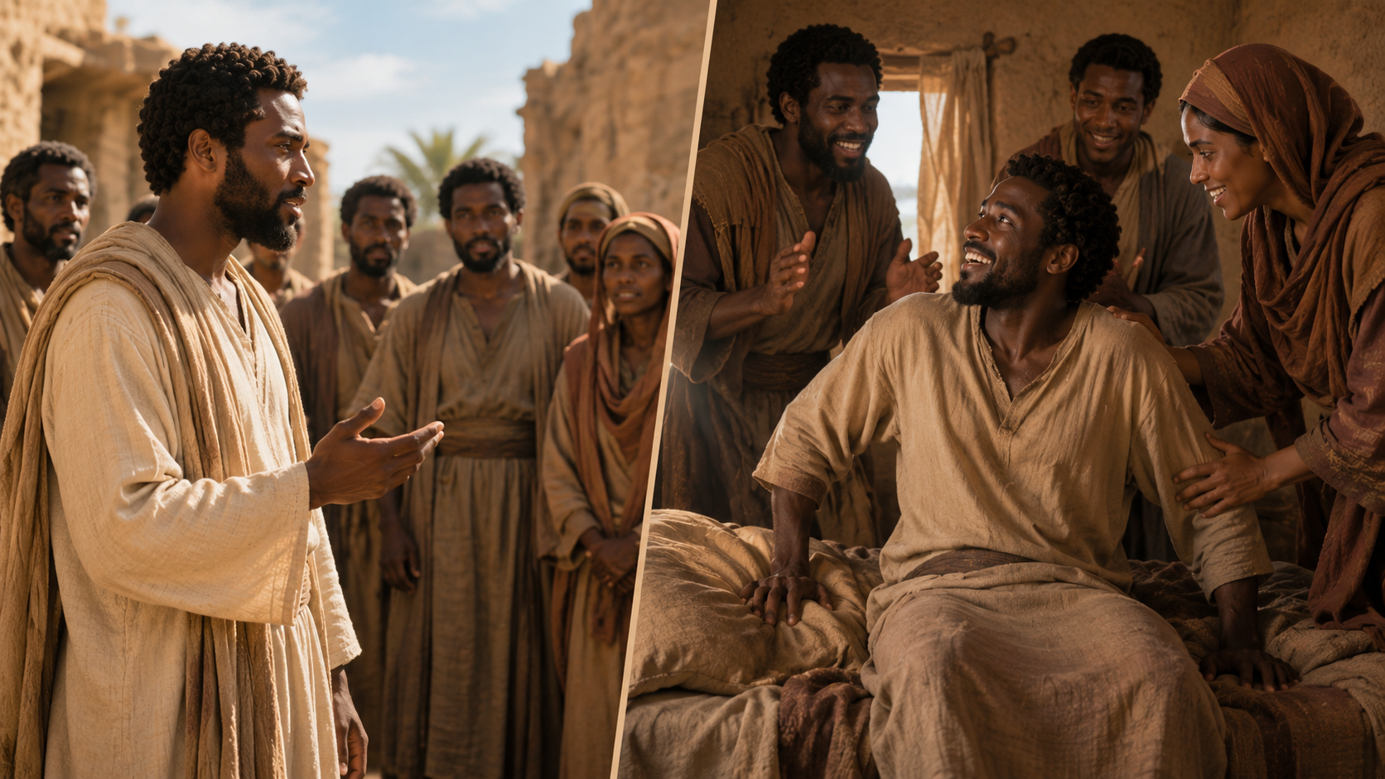
Support Scripture for Lesson
AMOS, COURAGEOUS PROPHET
Week of July 6 through July 11
► Acts 2:14–21—Peter: Bold Gospel Preacher.
► Psalm 34:1–9—I Sought the Lord.
► Psalm 34:10–22—The Lord Delivers.
► Mark 8:27–33—Peter Misunderstands.
► Isaiah 41:8–13—God Will Strengthen and Help.
► Mark 14:55–72—Peter Denies Jesus.
These scriptures show the movement from fear to faith, from weakness to witness, and from failure to restoration. Peter misunderstood Jesus, denied Jesus, and later preached Jesus boldly through the power of the Holy Ghost. Psalm 34 teaches us to seek the Lord, trust His deliverance, and praise Him in trouble. Isaiah reminds us that God strengthens His chosen servants.
6
Notes:
God strengthens weak people, restores failing people, and empowers surrendered people to boldly witness for Christ. Do not trust your own strength. Seek the Lord, repent when you fail, receive His help, and let the Holy Spirit make you a bold witness for Jesus Christ.
==================================
Acts 2:14–21 — Peter: Bold Gospel Preacher
Analyze:
Peter stands publicly at Pentecost and explains that the miracle of tongues is the fulfillment of Joel’s prophecy. The Holy Spirit is being poured out, not just on prophets, priests, and kings, but on “all flesh.” This is the promised new age of gospel witness.
Summarize:
Peter boldly declares that what the crowd is seeing is God’s work. Sons, daughters, young, old, servants, and handmaids will prophesy. The message ends with hope: “Whosoever shall call on the name of the Lord shall be saved.”
Commentary:
This is a transformed Peter. The man who once denied Jesus now preaches with courage. The difference is the power of the Holy Ghost. God can take a fearful believer, restore him, fill him, and use him to proclaim salvation through Christ.
Psalm 34:1–9 — I Sought the Lord
Analyze:
David praises the Lord personally and publicly. His testimony is simple: “I sought the Lord, and he heard me.” The psalm moves from private prayer to public invitation, calling others to “taste and see that the Lord is good.”
Summarize:
The psalmist blesses the Lord at all times. He remembers how God delivered him from fear, gave him joy, and protected him. Those who look to God are not ashamed. Those who fear the Lord lack no good thing.
Commentary:
This passage teaches that praise is rooted in experience with God. David does not speak theory; he speaks testimony. God hears, delivers, protects, and satisfies. The believer’s confidence grows when prayer becomes personal and praise becomes public.
Psalm 34:10–22 — The Lord Delivers
Analyze:
This section teaches righteous living and divine deliverance. God’s people must guard their speech, depart from evil, do good, and seek peace. Yet the righteous are not promised a trouble-free life; they are promised God’s nearness and deliverance.
Summarize:
The Lord sees the righteous and hears their cry. He is near to the brokenhearted and saves those with a contrite spirit. The righteous may suffer many afflictions, but the Lord delivers them. He redeems His servants.
Commentary:
This psalm balances holiness and hardship. Living right does not remove every trial, but God does not abandon His people in trouble. The Lord is especially close to the brokenhearted. Deliverance may not always be instant, but it is sure.
Mark 8:27–33 — Peter Misunderstands
Analyze:
Peter correctly confesses Jesus as the Christ, but immediately misunderstands the mission of Christ. He wants glory without suffering, a crown without a cross. Jesus rebukes him because Peter’s thinking reflects human desire rather than God’s redemptive plan.
Summarize:
Jesus asks His disciples who they believe He is. Peter answers, “Thou art the Christ.” But when Jesus teaches that He must suffer, die, and rise again, Peter rebukes Him. Jesus responds, “Get thee behind me, Satan.”
Commentary:
Peter had the right title for Jesus but the wrong understanding of His mission. Christ came not merely to reign, but to suffer, die, and rise for sinners. We must let Jesus define discipleship, not our expectations of success.
Isaiah 41:8–13 — God Will Strengthen and Help
Analyze:
God speaks to Israel as His chosen servant. He reminds them that they are not rejected but upheld by covenant grace. The repeated command is “fear not,” because God Himself promises strength, help, and victory.
Summarize:
God tells His people that He has chosen them and will not cast them away. They need not fear, because He is with them. He will strengthen them, help them, uphold them, and hold their right hand.
Commentary:
This passage gives comfort to weak and fearful believers. God does not merely give instructions from a distance; He holds His people by the hand. His presence is the answer to fear, and His strength is enough for obedience.
Mark 14:55–72 — Peter Denies Jesus
Analyze:
This passage contrasts Jesus’ faithfulness with Peter’s failure. Jesus stands before false witnesses and remains true to His identity. Peter stands near a fire and denies knowing Him. Yet Peter’s tears show conviction, not final rejection.
Summarize:
Religious leaders seek false testimony against Jesus. Jesus confesses that He is the Christ, the Son of the Blessed. Meanwhile, Peter denies Jesus three times. When the rooster crows, Peter remembers Jesus’ word and weeps.
Commentary:
Peter’s denial shows the danger of self-confidence without spiritual strength. He wanted to be brave, but fear overcame him. Yet his tears reveal a heart not beyond grace. Failure is serious, but with Christ, failure is not final.

Slide 7
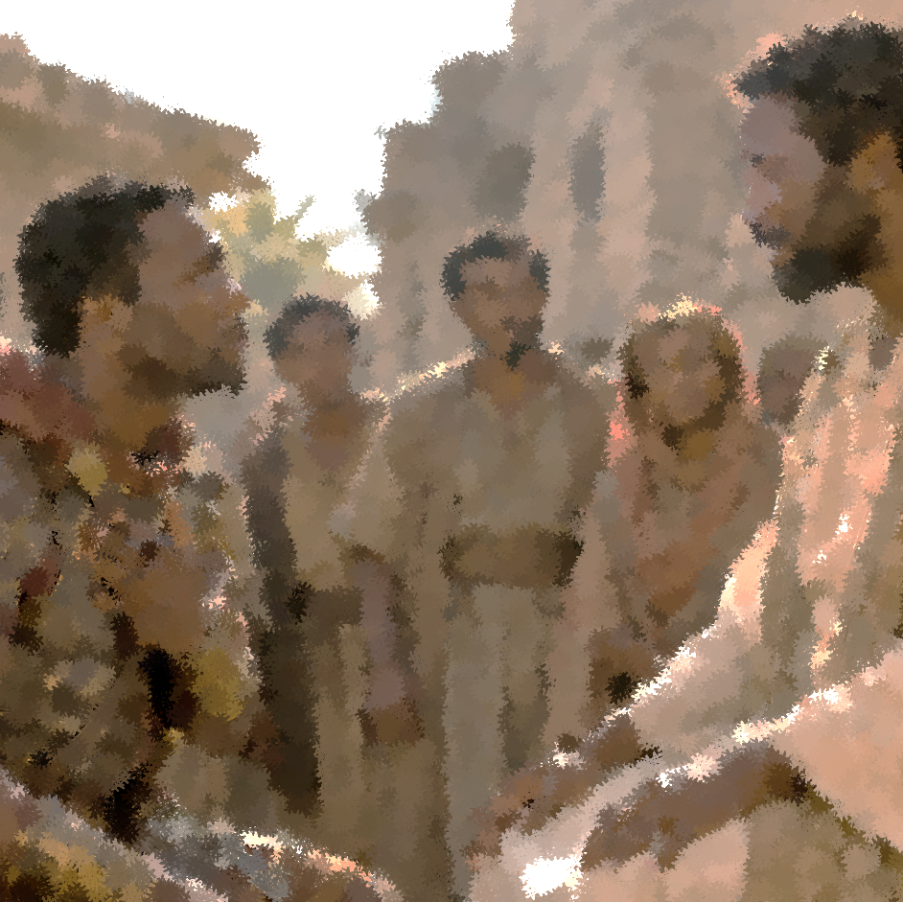
LESSON CONTEXT
Is Jesus Worried About Ritual Purity?
Sometimes people say that Jews were not allowed to enter Gentile homes, for fear of becoming unclean. With this theory in mind, the same readers will suggest that rules of purity might have prevented Jesus from traveling to the centurion’s home.
But that is actually a misunderstanding of the role of purity rules. Ordinary Jews—those who did not serve in the temple—would often enter the homes of non- Jews; this presents no moral problem. In fact, nearly all first-century Jews spent the majority of their lives as ritually impure. Only those about to enter the temple courts or holy spaces required ritual purity, which meant the correct preparation.
Thus the centurion is not trying to respect Jesus’ need for Jewish purity by asking Him to heal at a distance. Jesus had just touched a man with leprosy, after all (Matt. 8:3). Rather, the centurion is displaying great humility and respect for Jesus’ time.
THE BELIEVING CENTURION
Notes:
The centurion’s request for Jesus to heal from a distance was not mainly about ritual purity; it revealed humility, respect, and faith in Jesus’ authority. Some people believe Jesus could not enter a Gentile home because of Jewish purity laws. However, this misunderstands how ritual purity worked. Ordinary Jews often entered Gentile homes, and ritual impurity was not the same as sin. Purity was especially important for entering temple spaces. Jesus had already touched a man with leprosy, showing that He was not afraid of uncleanness. The centurion was not protecting Jesus from impurity. He was humbly saying he was unworthy of Jesus entering his home and believed Jesus could heal by His word alone.
Three Key Points
1. Ritual impurity was not always a moral failure. It often related to temple preparation, not everyday sinfulness.
2. Jesus was not limited by purity concerns. He had just touched and healed a man with leprosy.
3. The centurion’s words revealed humility. He did not demand Jesus’ presence; he trusted Jesus’ word.
Three Life Lessons Learned
1. Do not misunderstand religious rules as barriers to grace. Jesus came to bring mercy, healing, and restoration.
2. Humility is a mark of real faith. The centurion said, “I am not worthy,” yet still trusted Christ completely.
3. Jesus is not afraid of human brokenness. He touches the unclean, heals the suffering, and receives the outsider.
Analysis
This section corrects a common misunderstanding. The issue is not that Jesus was unable or unwilling to enter a Gentile home. The deeper point is the centurion’s humble confidence in Christ. He did not feel worthy to host Jesus, but he believed Jesus’ word was enough. That humility is central to faith. The centurion does not command Jesus; he appeals to Him. He does not rely on personal merit; he relies on Christ’s authority. This is a powerful Baptist teaching point: salvation and answered prayer are not based on human worthiness but on the mercy and power of Christ.

Slide 8
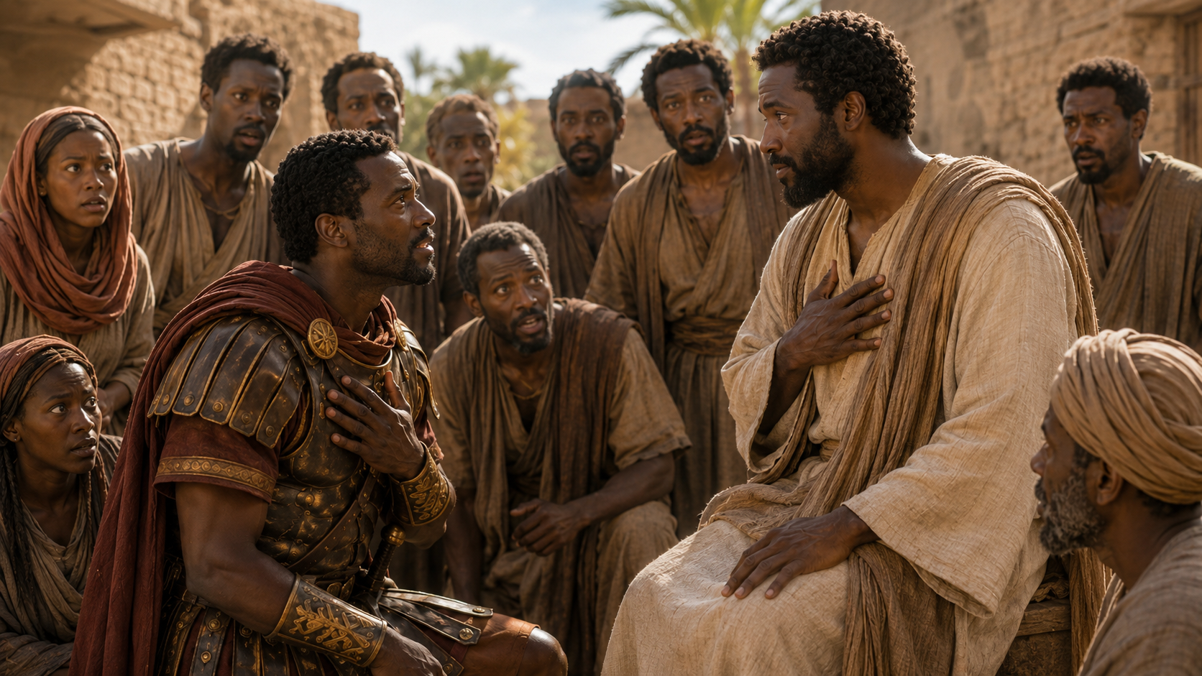
THE BELIEVING CENTURION
LESSON CONTEXT
Messianic Feast
The imagery of a messianic feast is a recurring theme Matthew (8:11; 22:1–14; 25:1–13; 26:29). Feasts in the presence of God are found throughout other parts of Scripture too: from the covenant meal celebrated by Moses and the elders to the marriage supper of the lamb (Ex. 24:9–11; Rev. 19:9). These always demonstrate an intimate communion with God, leading up to the great celebration in the presence of God’s Messiah. A first-century Jew would assume that invitees were mostly Jews. But Jesus highlights the amazing faith of a Gentile in this text. And not just any Gentile, a Gentile who commands Roman troops— foreign occupiers at the time. The reader is supposed to feel great surprise: it is by faith that all can be invited to feast with Jesus.
Gentile Inclusion in Matthew
The centurion’s faith is only one story demonstrating God’s promise to Abraham, that through his offspring “all peoples on earth will be blessed” (Gen. 12:3). This passage fits perfectly into Matthew’s larger story about Jesus’ mission to every nation, tribe, and tongue. From the very beginning of Matthew’s Gospel, he want us to know that Gentiles are included in the people of God. Matthew includes unlikely Gentiles in the genealogy of Jesus, including Tamar, Rahab, Ruth, and even Bathsheba (former wife of a Hittite). Gentile inclusion continues with the coming of Magi from the east who worship Jesus (Matt. 2:1–12). The closing scene of Matthew finishes with the Great Commission to “make disciples of all nations” (Matt. 28:19–20).
Notes:
Jesus teaches that the kingdom feast will include people from every direction who come by faith, not merely those who assume they belong by heritage. The image of a great feast appears throughout Scripture. It represents fellowship, celebration, and communion with God. In Matthew, Jesus uses this image to point toward the kingdom of heaven. Many first-century Jews would have expected the feast to include mainly Jews. But in Matthew 8, Jesus praises the faith of a Gentile Roman centurion and says many will come from the east and west to sit with Abraham, Isaac, and Jacob. This shows that faith in Christ opens the door to God’s kingdom.
The kingdom feast in Matthew 8:11 pictures the future joy of God’s people gathered with Him in heaven. It represents eternal fellowship, peace, welcome, and salvation. Jesus teaches that entry into God’s kingdom comes by faith in Him, not by race, status, family background, or personal worthiness.
Three Key Points
1. The feast represents fellowship with God. Eating in God’s presence symbolizes joy, acceptance, and covenant blessing.
2. Jesus expands the expected guest list. People from “east and west” will be welcomed into the kingdom.
3. Faith is the invitation. The centurion’s faith shows that Gentiles can share in the promises of God.
Three Life Lessons Learned
1. God’s kingdom is bigger than human expectations. The Lord welcomes people we may not expect.
2. Religious background alone does not save. Faith in Christ is necessary.
3. Heaven’s table is a table of grace. Those who trust Jesus are invited into fellowship with God.
Analysis
The messianic feast points to the final joy of God’s people in the presence of Christ. Jesus’ statement would have surprised His listeners because He placed a Gentile Roman soldier in the story as an example of kingdom faith. This challenged the assumption that ethnic connection to Abraham was enough. Jesus teaches that those who truly belong to the kingdom are those who believe. The feast language also points forward to the marriage supper of the Lamb in Revelation 19:9. The kingdom is not entered through pride, heritage, or religious confidence, but through humble faith in the Messiah.
====================================
Gentile Inclusion in Matthew
Matthew’s Gospel shows that Jesus came not only for Israel but to bring God’s blessing to all nations. The centurion’s faith fits into Matthew’s larger message that Gentiles are included in God’s redemptive plan. This reaches back to God’s promise to Abraham that all families of the earth would be blessed through him. Matthew signals this from the beginning by including women with Gentile or outsider connections in Jesus’ genealogy, such as Tamar, Rahab, Ruth, and Bathsheba, who is connected to Uriah the Hittite. The Magi from the east also come to worship Jesus. Finally, Matthew ends with the Great Commission: “Go ye therefore, and teach all nations” (Matthew 28:19, KJV).
Three Key Points
1. God’s promise to Abraham included all nations. Genesis 12:3 points beyond Israel to worldwide blessing.
2. Matthew highlights outsiders from the beginning. Jesus’ genealogy includes people with surprising and Gentile connections.
3. Matthew ends with a global mission. The gospel is to be carried to “all nations.”
Three Life Lessons Learned
1. No person is outside the reach of God’s grace. The gospel is for every nation, background, and people group.
2. God often works through unexpected people. The centurion, the Magi, Rahab, and Ruth remind us that God’s grace crosses boundaries.
3. The church must be missionary-minded. Believers are called to carry the gospel beyond familiar circles.
Analysis
This section shows that the centurion is not an isolated example. His story belongs to Matthew’s larger theme: Jesus is Israel’s Messiah and the Savior of the world. Matthew begins with a genealogy that already hints at Gentile inclusion and ends with a command to disciple all nations. The centurion’s faith becomes a preview of the worldwide church. From a Baptist perspective, this supports the missionary calling of the church. Christ has all authority, and because of that authority, His people must proclaim the gospel to all nations. The same Jesus who healed the centurion’s servant is the risen Lord who sends His church into the world.
Unified Summary
Together, these four sections show that Jesus has divine authority, welcomes humble faith, breaks expected boundaries, and opens the kingdom to all who believe. The Roman centurion understood authority because he lived under authority. He recognized that Jesus did not need to be physically present to heal; His word was enough. The issue was not ritual purity but humble faith. Jesus then used the centurion’s faith to reveal a greater kingdom truth: many outsiders would be welcomed into God’s kingdom feast, while some presumed insiders would be judged for unbelief. Matthew’s Gospel makes this message clear from beginning to end—Jesus came as the promised Messiah, and through Him, God’s blessing reaches all nations.

Slide 9
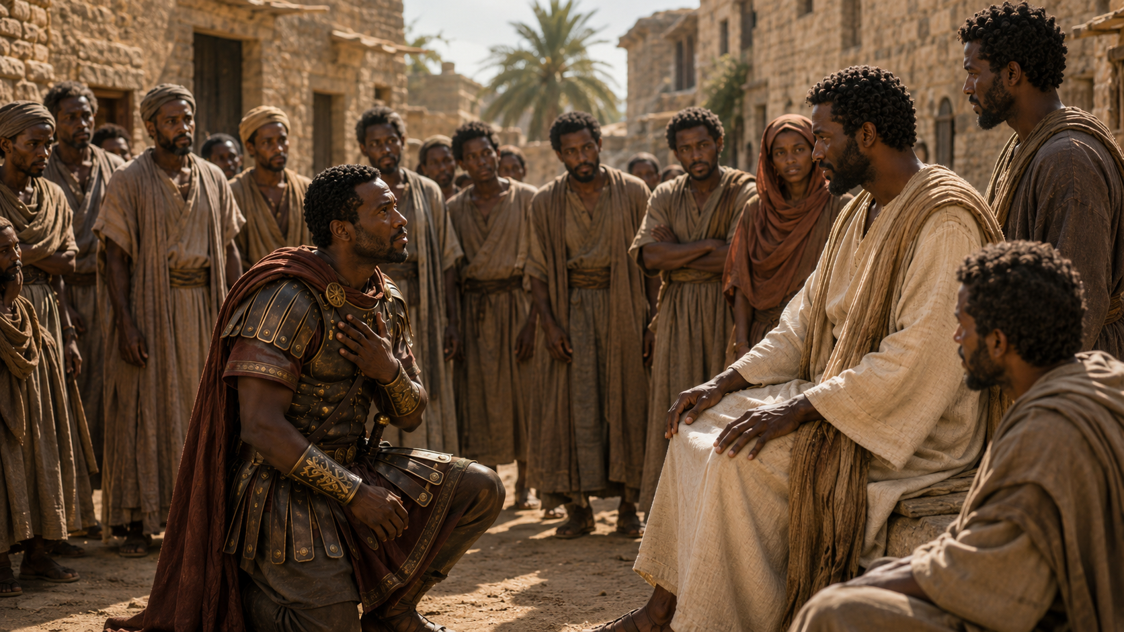
LESSON OVERVIEW
THE BELIEVING CENTURION
A Man of Authority - Matthew 8:5–9 KJV
5 And when Jesus was entered into Capernaum, there came unto him a centurion, beseeching him,
6 And saying, Lord, my servant lieth at home sick of the palsy, grievously tormented.
7 And Jesus saith unto him, I will come and heal him.
8 The centurion answered and said, Lord, I am not worthy that thou shouldest come under my roof: but speak the word only, and my servant shall be healed.
9 For I am a man under authority, having soldiers under me: and I say to this man, Go, and he goeth; and to another, Come, and he cometh; and to my servant, Do this, and he doeth it.
    The context is rather early in Jesus’ ministry.
    A centurion commander comes to Jesus with a request for Him to heal a servant, bedridden at home.
    Jesus seems willing to come, but the centurion suggests that a home-visit is unnecessary.
    He respects Jesus’ authority, and He thinks Jesus might just as well heal at a distance.
Notes:
The centurion’s greatness was not found in his Roman rank, but in his humble faith that recognized Jesus’ supreme authority. He believed Jesus could heal by His word alone. This section explains why the centurion was an unexpected example of faith. As a Roman officer, he was a Gentile outsider and part of the occupying force over Israel. Yet he approached Jesus with respect, calling Him “Lord,” and asked for healing on behalf of his suffering servant. Instead of demanding Jesus’ presence, the centurion trusted that Jesus only needed to speak. His military experience helped him understand authority, but his humility revealed his faith. Jesus’ word was enough.
Three Key Points
1. The centurion seemed undeserving by human standards. He was a Roman officer, a Gentile, and part of the military power ruling over the Jews.
2. The centurion showed compassion and humility. He did not come for personal gain. He came pleading for his suffering servant, someone beneath him socially.
3. The centurion understood Jesus’ authority. He knew that just as soldiers obeyed his commands, sickness would obey the command of Christ.
Three Life Lessons Learned
1. Faith may appear in unexpected people. God can reveal sincere faith in people others might overlook, judge, or reject.
2. True authority recognizes higher authority. The centurion had earthly power, but he bowed before the greater authority of Jesus.
3. Compassion moves faith into action. The centurion’s faith was not selfish. He used his access to Jesus to help someone in need.
The deeper lesson is that great faith does not begin with self-worth; it begins with Christ’s worth. The centurion did not say, “I deserve this.” He said, in effect, “Jesus, Your word is enough.” That is the kind of faith that honors the Lord.
Analysis
This passage challenges the question of who “deserves” Jesus’ attention. By cultural and religious expectations, the centurion appeared unlikely to receive special notice from the Jewish Messiah. He was Roman, Gentile, military, and connected to Israel’s oppression. Yet Jesus did not measure him by background. Jesus looked at his faith.
The centurion’s request reveals both humility and confidence. He says, “Lord, I am not worthy that thou shouldest come under my roof” (Matthew 8:8, KJV). That is humility. Then he says, “but speak the word only, and my servant shall be healed.” That is faith.
His understanding of authority becomes the bridge to his understanding of Jesus. He knew orders could travel without the commander being physically present. If his word carried Roman authority, then Jesus’ word carried heavenly authority. The centurion believed that disease, distance, and suffering were all subject to Christ.
><><><><><><><><><><><><><><>
A Man of Authority
What does anyone “deserve” from Jesus? While Jesus walked the earth, not every person met Him or experienced His healing touch. Not every person had a life transformed by an encounter with the Son of God.
Matthew tells us about a person who doesn’t deserve attention from Jesus. The man is a centurion—a Roman officer and outsider to “the lost sheep of Israel” (Matt. 15:24). Roman soldiers were an occupying military force, sometimes responsible for heinous treatment of Jews. It is hard to imagine a person less worthy of attention from the Jewish Messiah who inherits David’s throne.
But the centurion has a unique approach. For one thing, he gives respect to Jesus, even calls Him “Lord” (Matt. 8:6). That doesn’t fit what we anticipate a Roman officer to say. Immediately we notice another surprising detail: this powerful man is not seeking attention for himself at all. He is asking Jesus to pay attention to another person, one with lower social standing. What sent this centurion to Jesus is his servant’s suffering, physical pain that has reached a breaking point. The centurion is showing a selfless concern for others, which is conduct in keeping with Jesus’ own words: “Do to others what you would have them do to you” (Matt. 7:12).
Jesus is already sold. He seems ready to get on the road and to pay a visit to the servant in distress. But instead of leading Jesus along in a hurried fashion, the centurion squares himself up to Jesus to suggest an alternative. The commander of Roman soldiers reasons, Would a high-ranking officer run from place to place to see his orders obeyed? Of course not! The centurion might not be a Jew, but he knows a thing or two about rank and the way that orders are conveyed. It is Jesus who holds all authority in heaven and on earth (see Matt. 28:18).
The centurion looks upon the Lord of heaven and earth and suggests, “Just say the word, and my servant will be healed” (v. 8). He is confident that whatever Jesus ordains is certain to be followed. He does not need Jesus to visit his home, and he would rather not waste any more of Jesus’ precious time. Can you hear the humility behind his thoughts?
With prudent insight, the centurion shows that he is absolutely clear about Jesus’ identity and cosmic power. Jesus could merely speak a word, and that would be enough. The world’s creation came through the authoritative speech of God, and Jesus is capable of no less. Thus, the person who appeared unworthy of Christ’s attention turns out to be someone with great faith.
A Man of Authority
Main Idea
The centurion’s greatness was not found in his Roman rank, but in his humble faith that recognized Jesus’ supreme authority. He believed Jesus could heal by His word alone.
Summary
This section explains why the centurion was an unexpected example of faith. As a Roman officer, he was a Gentile outsider and part of the occupying force over Israel. Yet he approached Jesus with respect, calling Him “Lord,” and asked for healing on behalf of his suffering servant. Instead of demanding Jesus’ presence, the centurion trusted that Jesus only needed to speak. His military experience helped him understand authority, but his humility revealed his faith. Jesus’ word was enough.

Slide 10
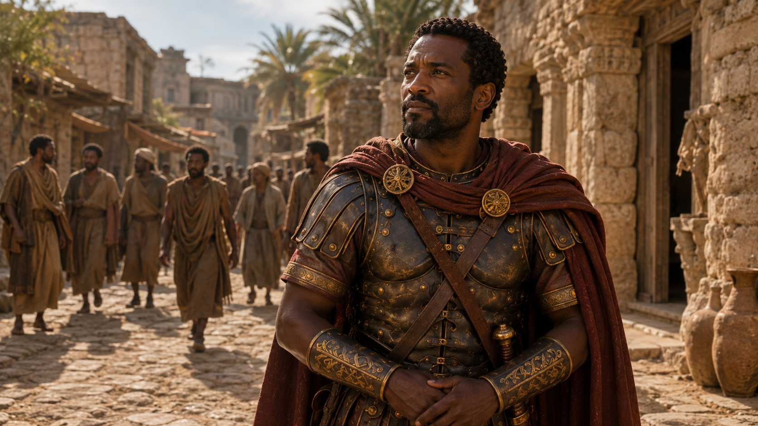
LESSON OVERVIEW
THE BELIEVING CENTURION
Examples of Faith- Matthew 8:10–13 KJV
10 When Jesus heard it, he marvelled, and said to them that followed, Verily I say unto you, I have not found so great faith, no, not in Israel.
11 And I say unto you, That many shall come from the east and west, and shall sit down with Abraham, and Isaac, and Jacob, in the kingdom of heaven.
12 But the children of the kingdom shall be cast out into outer darkness: there shall be weeping and gnashing of teeth.
13 And Jesus said unto the centurion, Go thy way; and as thou hast believed, so be it done unto thee. And his servant was healed in the selfsame hour.
  Jesus is pleasantly surprised at the faith that is displayed by this Gentile soldier.
  Jesus deems this greater faith than He has seen among fellow Jews.
  Jesus describes the coming day when all God’s people, Jews and Gentiles, shall be gathered for a feast.
  Jesus dismisses the centurion, and his servant is instantly healed.
Notes:
Examples of Faith
Jesus looks for faith, and the centurion becomes an unexpected example of “great faith” because he trusts the authority of Jesus’ word completely. This section shows that faith is a major theme in Matthew’s Gospel. Jesus often corrects those with little faith, including His own disciples, and He refuses to perform miracles where faith is absent. Yet the first person Jesus praises for “great faith” is not a Jewish religious leader, but a Gentile Roman centurion. This surprises the audience because many expected Israel’s religious leaders to recognize the Messiah first. Instead, Jesus teaches that people from every nation will join Abraham, Isaac, and Jacob in God’s kingdom by faith. The centurion’s servant is healed by Jesus’ spoken word alone.
Three Key Points
1. Jesus values genuine faith. Throughout Matthew, Jesus notices whether people trust Him or doubt Him. Faith is not a side issue; it is central to responding rightly to Christ.
2. Great faith can come from unexpected people. The centurion was a Gentile and Roman soldier, yet he trusted Jesus more clearly than many religious insiders.
3. God’s kingdom is entered by faith, not heritage alone. Jesus teaches that many from the east and west will sit at the kingdom feast, while some who assume they belong may be left out because of unbelief.
Three Life Lessons Learned
1. Religious background is not a substitute for faith. Knowing Scripture, attending worship, or being near religious activity does not replace personal trust in Jesus Christ.
2. God welcomes all who believe. The centurion reminds us that Christ receives people from every background when they come to Him in humble faith.
3. Jesus’ word is powerful enough to accomplish His will. The servant was healed without touch, ceremony, or delay. When Jesus speaks, His word carries divine authority.
Concluding Thought
Great faith does not depend on status, nationality, or religious reputation. Great faith humbly trusts that Jesus is Lord and that His word is enough.
Analysis
This section highlights the surprising nature of faith in Matthew 8. The people expected to recognize Jesus were the covenant people of Israel, especially those trained in the Scriptures. Yet many of the religious leaders resisted Him. They had knowledge, but not submission. They had tradition, but not trust. They had position, but not faith.
The centurion, by contrast, had none of the expected religious qualifications. He was a Gentile, a Roman, and a military officer connected to Israel’s occupation. Yet he recognized Jesus’ authority with remarkable clarity. His faith was not based on seeing Jesus perform the miracle in person. He believed Jesus could simply speak, and the healing would happen.
Jesus uses this moment to teach a larger kingdom truth. The promise given to Abraham was never meant to stop with Israel alone. God told Abraham that through him all families of the earth would be blessed. Jesus now shows that Gentiles who believe will share in the kingdom banquet with Abraham, Isaac, and Jacob. This points forward to the gospel mission to all nations.
The warning is serious. Some “children of the kingdom” would miss the feast because they rejected the Messiah. Their religious privilege could not save them without faith. At the same time, the invitation is full of grace. Those once considered outsiders can come into the light through faith in Christ.
The healing at the end confirms the lesson. Jesus says, “Go; and as thou hast believed, so be it done unto thee” (Matthew 8:13, KJV). His word accomplishes what it declares. The centurion believed the word of Christ, and his servant was healed that same hour.
><><><><><><><><><><><><><><>
Examples of Faith
Jesus is looking for faith. It is hard to miss in Matthew’s Gospel. In the Sermon on the Mount, He remarks about tiny faith from those who listen (Matt. 6:30). When tested by storms and crashing waves, Jesus’ own disciples turn out to need more of it (Matt. 8:26; 14:31). And later, Jesus will refuse to perform signs and miracles where faith is lacking (Matt. 13:58). But the first person that Jesus commends for “great faith” is this centurion (Matt. 8:10).
The amazement of Jesus begs an important question: Who are the ones who should have faith? Jewish contemporaries would expect religious people—those having studied the Scriptures—to show faith in what God is doing. In contrast, many of the religious leaders organize against Jesus and force Him to warn against following their teaching (Matt. 16:11–12).
Instead of meeting listeners’ expectations, Jesus declares that “many will come from the east and the west, and will take their places at the feast with Abraham, Isaac and Jacob in the kingdom of heaven” (v. 11). This imagery draws from the idea of a great feast and messianic banquet to include “all peoples” (Isa. 25:6). But rather than emphasize the prime place of Israel over the nations, Jesus democratizes the vision, describing “Abraham, Isaac, and Jacob” as seated at the same table as a greater crowd.
Beginning with the call of Abraham, promises of God are for all who put their faith in Jesus. The patriarchs of Israel will not be shamed to share a common table with Gentiles. In fact, the legacy of Abraham is a legacy of faith! Paul makes a similar point when he says, “Abram believed God [in Greek, showed faith], and it was credited to him as righteousness” (Gal. 3:6). And again, “If you belong to Christ, then you are Abraham’s seed, and heirs according to the promise” (Gal. 3:29). By faith, Gentiles come to the banquet with Jesus, even while unbelieving Jews miss the party.
Jesus does not neglect an opportunity to speak a word of warning. He acknowledges a privileged position for Jews, “subjects of the kingdom” (Matt. 8:12). But the warning about darkness is, at the same time, a welcome to those who come into the light. These concepts are central to Jesus’ preaching ministry: “a light has dawned . . . the kingdom of heaven has come near” (Matt. 4:16–17). Therefore, the centurion’s faith fulfills the word of Israel’s prophets, who knew that Gentiles would turn to the Jewish Messiah.
Jesus tells the centurion, “Go! Let it be done just as you believed it would. ” The power of Jesus’ word accomplishes what it declares. There is no physical touch, no ritual, no further exchange—simply the divine speech of Jesus. The centurion leaves to find that his servant was healed at the very same moment.

Slide 11
One Bible, One Story
THE BELIEVING CENTURION
Jesus’ Authoritative Word
The centurion’s faith in Jesus’ powerful word connects Jesus’ authority—speaking life into renewed existence— with the God of the universe, who creates by using only a word. In Genesis 1, God speaks the universe into existence by divine command: “God said, ‘Let there be light,’ and there was light” (Gen. 1:3). The psalmist declares, “By the word of the Lord the heavens were made . . . for he spoke, and it came to be” (Ps. 33:6, 9). Isaiah promises that God’s word “will not return . . . empty, but will accomplish what I [God] desire” (Isa. 56:11). Here in the New Testament, we see the same authority and power ascribed to Jesus, who can heal with just a word or calm the storms by His command (Matt. 8:27). Jesus shares the same authority and divine nature as God the Father; He “sustains all things by his powerful word” (Heb. 1:3).
Notes:
Jesus’ Authoritative Word
Jesus’ word carries divine authority because He shares the nature and power of God. Just as God created by speaking, Jesus heals, restores, sustains, and commands by His word. This section connects the centurion’s faith in Matthew 8 to the creative power of God’s word throughout Scripture. In Genesis, God speaks creation into existence. In the Psalms, the heavens are made by the word of the Lord. Isaiah teaches that God’s word always accomplishes His purpose. In Matthew, Jesus demonstrates that same divine authority by healing the centurion’s servant from a distance and calming storms by command. The centurion trusted that Jesus did not need to touch the servant. His word alone was enough.
Note: The reference should be Isaiah 55:11, not Isaiah 56:11.
Three Key Points
1. God’s word creates and accomplishes. Genesis 1:3 says, “And God said, Let there be light: and there was light” (KJV). God speaks, and reality obeys.
2. Jesus’ word heals and commands. In Matthew 8, Jesus heals by speaking. Later in the same chapter, He commands the winds and sea, and they obey Him.
3. Jesus shares divine authority with the Father. Hebrews 1:3 teaches that Christ upholds “all things by the word of his power” (KJV). His word is not ordinary speech; it carries divine power.
Three Life Lessons Learned
1. Trust the word of Christ even before you see the result. The centurion believed Jesus’ word before he saw the healing. Faith rests on Christ’s authority, not visible proof.
2. God’s word never fails. When God speaks, His purpose stands. His promises are dependable because His power supports His word.
3. Bring impossible situations to Jesus. Distance, sickness, storms, and human weakness do not limit Christ. His word can reach places we cannot.
Concluding Thought
Faith believes that Jesus’ word is enough because Jesus Himself is Lord over all creation.
Analysis
The centurion’s faith is remarkable because he understands something deeply true about Jesus: His word has power because of who He is. The centurion does not ask Jesus for a ritual, a touch, or a physical visit. He says, “Speak the word only, and my servant shall be healed” (Matthew 8:8, KJV). That statement shows confidence in Jesus’ authority.
Scripture consistently teaches that God’s word is active and effective. God did not struggle to create the universe; He spoke. Psalm 33:9 says, “For he spake, and it was done; he commanded, and it stood fast” (KJV). Isaiah 55:11 says God’s word “shall not return unto me void,” but it will accomplish what He pleases.
Matthew presents Jesus with that same divine authority. He teaches with authority, heals with authority, forgives with authority, and commands creation with authority. When Jesus speaks, sickness must yield, storms must calm, demons must flee, and sinners can be saved.
From a Baptist, Christ-centered perspective, this passage strengthens our confidence in the Lordship of Jesus. Jesus is not merely a prophet speaking about God. He is the Son of God speaking with divine power. His word is sufficient for salvation, healing, obedience, and hope.
1 If you were to summarize, what does the witness of the centurion teach us?
Jesus is more impressed by humble faith than by our gifts, status, finances, or abilities. Jesus does not look at the outward signs of success. We should approach God with bold requests for the kinds of miracles that only God can accomplish.
2 What are signs of outward success that might be misleading?
We might be proud of what we have, the successful career we’ve built, or the number of people who have been baptized in our church. Those are all good things! But Jesus is on the throne, and His authoritative word spoke us into existence. As we have been learning this quarter, God also works at unexpected times and in unexpected ways. God can use the “wrong” people to do great things.
3 Where have you spotted God working at the margins and in unexpected places?
Perhaps you have observed great faith in the midst of your ministry to the poor, or in a children’s classroom, or at death’s doorstep. God is near to those who are eager for the world to change, eager for Jesus to return.

Slide 12
Apply the Message:
Great faith is what we need, and it appears in surprising places.
What Really Amazes Jesus
Think for a moment about all the ways we might try to puff up our chests to distinguish ourselves. Maybe we try to amaze others by our gifts, status, or abilities. Or, from a Christian perspective, we might find ourselves impressed by great learning, spiritual development, or success in ministry.
But the centurion’s example demonstrates that Jesus is looking for faith. Ask yourself, do we try to present ourselves as worthy of God’s favor and attention for other reasons? The message is especially encouraging for anyone who feels like an outsider. Perhaps you did not grow up reading Scripture or attending church. Or perhaps you have a past that you try not to bring up in the company of Christian friends. None of that disqualified the centurion. He lacked the right background, education, or religious experience to seem worthy of approaching Jesus. Yet his colorful past and inopportune career made his faith all the more impressive.
It should encourage our own search for faith in unlikely places and from unexpected people. To most of Jesus’ followers, a centurion was a person who needed correction. From a strictly logical perspective, anyone involved in the repressive Roman army needed to be put in their place, not affirmed.
But Jesus demonstrates God’s willingness to shower unworthy people with grace and attention. In our context, instead of demanding signs and expecting God to work in a visible way, we can look for God’s attention at the margins. If we lack the outward signs of “success,” we can still show faith through quiet obedience to Jesus’ authority. What God is doing is what matters.
AMOS, COURAGEOUS PROPHET
12
Notes:
What Really Amazes Jesus
Jesus is amazed by humble faith, not by human status, religious background, personal achievement, or outward success. This section teaches that people often try to prove their worth through gifts, status, ability, education, spiritual reputation, or ministry success. However, the centurion’s story shows that Jesus looks for faith. The centurion seemed like an outsider because he was a Gentile and a Roman officer, yet Jesus praised him because he trusted Christ’s authority. His past, position, and lack of Jewish religious background did not disqualify him. Instead, his faith became an example for others.
Three Key Points
1. Human beings often try to impress others. People may seek attention through talent, position, education, ministry success, or religious appearance.
2. Jesus looks for faith above all else. The centurion did not come with religious credentials, but he came with humble trust in Jesus’ authority.
3. God’s grace reaches unlikely people. Jesus showed mercy and attention to a man many would have considered unworthy or outside the covenant community.
Three Life Lessons Learned
1. Your past does not disqualify you from coming to Jesus. The centurion’s background was complicated, but his faith was real. Jesus received him.
2. Do not judge where faith can appear. God may be working in people we would not expect, including outsiders, doubters, or people with difficult histories.
3. Quiet obedience matters more than outward success. Even when we lack visible achievement, we can honor God by trusting and obeying Jesus.
Concluding Thought
What matters most is not how impressive we appear before people, but whether we truly trust and obey Jesus.
Analysis
This section challenges pride and religious self-confidence. People naturally want to prove they deserve attention, respect, or blessing. Even in Christian settings, believers can become impressed by Bible knowledge, church position, ministry visibility, or spiritual language. But the centurion teaches that Jesus is not looking for performance. He is looking for faith.
The centurion was an unlikely model. He was part of the Roman military system, which many Jews would have viewed as oppressive. By human judgment, he seemed more like someone who needed rebuke than someone who deserved praise. Yet Jesus saw what others may have missed: humility, compassion, and confidence in Christ’s authority.
This is encouraging for anyone who feels like an outsider. A person may not have grown up in church, may not know much Scripture, or may carry shame from the past. But none of that prevents a person from coming to Jesus. The issue is not whether we can make ourselves impressive. The issue is whether we trust Christ.
The section also calls believers to look for God’s work at the margins. Faith may be found in unexpected people and unexpected places. Some who appear successful may lack trust, while some who seem far away may be closer to the kingdom than we think.

Slide 13
Apply the Message:
Great faith is what we need, and it appears in surprising places.
AMOS, COURAGEOUS PROPHET
What Really Amazes Jesus
  1 If you were to summarize, what does the witness of the centurion teach us?
  2 What are signs of outward success that might be misleading?
  3 Where have you spotted God working at the margins and in unexpected places?
13
Notes:
1 If you were to summarize, what does the witness of the centurion teach us?
Jesus is more impressed by humble faith than by our gifts, status, finances, or abilities. Jesus does not look at the outward signs of success. We should approach God with bold requests for the kinds of miracles that only God can accomplish.
2 What are signs of outward success that might be misleading?
We might be proud of what we have, the successful career we’ve built, or the number of people who have been baptized in our church. Those are all good things! But Jesus is on the throne, and His authoritative word spoke us into existence. As we have been learning this quarter, God also works at unexpected times and in unexpected ways. God can use the “wrong” people to do great things.
3 Where have you spotted God working at the margins and in unexpected places?
Perhaps you have observed great faith in the midst of your ministry to the poor, or in a children’s classroom, or at death’s doorstep. God is near to those who are eager for the world to change, eager for Jesus to return.

Slide 14
CONCLUSION:
According to Your Faith
THE BELIEVING CENTURION
The centurion in today’s lesson gives us a refreshing example of approaching God properly. Our methodology is critical as we intercede for those who are suffering. The centurion showcases essential aspects of a faithful petition: acknowledge Jesus as Lord, submit to God’s authority, and do so with great humility. The centurion also appeals to the Lord’s mercy. He holds complete confidence in Jesus’ ability to alleviate suffering, even from a distance. This story demonstrates that we can be confident like the centurion—in Christ’s authority over sickness, death, and every power.
This story shows that faith sees beyond the physical to perceive spiritual realities that are deep and salient. Faith perceives Jesus’ divine jurisdiction; faith gives us boldness to act with adept confidence; faith makes us children of God.
14
Notes:
Conclusion: According to Your Faith
True faith approaches Jesus with humility, recognizes His authority, trusts His mercy, and believes that His word is powerful enough to meet every need. The centurion gives a strong example of how believers should come to God, especially when praying for others. He approaches Jesus with respect, humility, and confidence. He acknowledges Jesus as Lord, submits to His authority, and trusts His power to heal even from a distance. His faith is not casual or proud; it is bold because it rests in who Jesus is. This story teaches that Christ has authority over sickness, suffering, death, distance, and every earthly or spiritual power.
Three Key Points
1. Faith begins by recognizing Jesus as Lord. The centurion did not treat Jesus as an ordinary teacher or healer. He approached Him as one with divine authority.
2. Faith intercedes for others. The centurion came to Jesus not for himself, but for his suffering servant. His faith was compassionate and selfless.
3. Faith trusts Christ’s authority completely. The centurion believed Jesus did not need to be physically present. His word alone was enough.
Three Life Lessons Learned
1. Pray with humility. We do not come to God demanding what we deserve. We come depending on His mercy, grace, and goodness.
2. Pray with confidence. Humility does not mean weak faith. The centurion was humble, yet bold, because he trusted Jesus’ authority.
3. Pray for others faithfully. Intercession is an act of love. Like the centurion, we should carry the needs of suffering people to Jesus.
Concluding Thought
Faith does not say, “I am worthy.” Faith says, “Jesus is Lord, His mercy is sufficient, and His word is enough.”
Analysis
This conclusion rightly emphasizes the centurion’s method of approaching Jesus. He does not come proudly, as though his rank gives him special privilege. He comes humbly, saying, “Lord, I am not worthy that thou shouldest come under my roof” (Matthew 8:8, KJV). Yet his humility does not weaken his faith. Instead, it strengthens it. He knows he is unworthy, but he also knows Jesus is able.
The centurion’s faith includes three important movements: recognition, submission, and confidence. He recognizes Jesus as Lord. He submits to Jesus’ authority. Then he confidently believes Jesus can heal by speaking only a word. This is why Jesus commends him.
The statement “According to Your Faith” reminds us that faith is not wishful thinking. Biblical faith sees spiritual reality clearly. It understands that Jesus has divine jurisdiction—He rules over sickness, suffering, distance, creation, and death. The centurion saw what others missed: Jesus’ authority was not limited by location or circumstance.
This also teaches the church how to pray for the suffering. We should not pray as if God is reluctant, weak, or distant. We should pray knowing that Jesus is merciful and mighty. At the same time, we submit to God’s will, trusting His wisdom and timing.
From a Baptist, Christ-centered perspective, this passage points us to saving faith as well. Faith does not rest in human worthiness, religious background, or personal achievement. Faith rests in Christ alone. As John 1:12 says, “as many as received him, to them gave he power to become the sons of God, even to them that believe on his name.”

Slide 15
Live It Out: Ask God to grow our faith as we make bold requests.
THE BELIEVING CENTURION
Prayer has come up in multiple lessons, and we have been invited to welcome God’s answer according to His will and timing. But that need not discourage us from making bold requests! The centurion had great faith because he already knew that Jesus was capable of healing. This week, let us pray for God to heal the parts of our lives that only Jesus can fix.
Grow My Faith
Ask God to bring to mind one area of life where you need the Savior’s touch. Is there a broken relationship? A dream for the future? A powerful addiction? A feeling of loss? Whether you feel like your faith is strong or weak, use this week to boldly pray for God to intervene, to show the power of Jesus and to grow your faith.
15
Notes:
Live It Out: Grow My Faith
God invites us to make bold requests in prayer, trusting that Jesus is able to heal, restore, deliver, and strengthen our faith according to His will and timing. This section encourages believers not to be afraid of praying boldly. Prayer has been discussed in several lessons as a way of trusting God’s will and timing. However, trusting God’s timing does not mean praying weak prayers. The centurion showed great faith because he believed Jesus was able to heal by His word alone. In the same way, believers are invited to ask God to reveal the areas of life that only Jesus can fix and to pray for His healing power, intervention, and faith-building work.
Three Key Points
1. Bold prayer is an expression of faith. The centurion came to Jesus believing He was able to heal. Faith does not hide need; faith brings need to Christ.
2. Jesus can heal what we cannot fix. Broken relationships, addictions, grief, disappointment, fear, and lost hope are not beyond the Savior’s power.
3. God grows our faith through prayer. As we pray and wait on God, He shapes our trust, strengthens our dependence, and teaches us to rely on Christ.
Three Life Lessons Learned
1. Do not let weakness stop you from praying. Whether faith feels strong or weak, believers can still come to Jesus honestly and boldly.
2. Name the area where you need God’s help. Faith becomes practical when we bring specific needs before the Lord instead of speaking only in general terms.
3. Trust God’s answer and timing. Bold prayer should be joined with surrender. God may heal immediately, gradually, or in a way we did not expect.
Concluding Thought
Faith grows when we stop pretending we can fix everything and start bringing our deepest needs to Jesus, trusting that His word, His power, and His timing are enough.
Analysis
This section moves the lesson from biblical understanding to personal application. The centurion’s faith was not passive. He acted on what he believed. He came to Jesus with a specific need and trusted that Jesus had authority over the situation. His servant’s condition was beyond human control, but not beyond Christ’s command.
The invitation to “Grow My Faith” asks believers to identify the place where they most need Jesus’ touch. This is important because many people pray around their deepest pain instead of bringing it directly to God. A broken relationship, a hidden addiction, a painful loss, or an uncertain future can feel too heavy to name. Yet the lesson reminds us that Jesus is not intimidated by what is broken.
Bold prayer does not mean demanding our own way. It means trusting God enough to ask, believing He is able, and submitting to His wisdom. The centurion did not approach Jesus with arrogance; he approached with humility and confidence. That is the model for Christian prayer.
From a Baptist, Christ-centered perspective, this section also reminds us that prayer is not a ritual for earning God’s favor. Prayer is the cry of a dependent child to a faithful Father. We pray because Christ has opened the way. We ask boldly because Jesus is Lord. We wait faithfully because God is wise.

Slide 16
Prayer
Lord Jesus,
Thank You for the example of the centurion’s faith. As we bring our own needs before You this week, we ask that You would grow our faith. We want to trust You with the deepest hurts and needs, ready for You to answer in Your way and in Your perfect timing. Give us great faith as we pray for Your kingdom to come quickly. In the healing name of Jesus we pray. Amen.
Notes:
Heavenly Father,
We come in the name of Jesus, humbled by the faith of the centurion. Teach us to trust You with confidence, knowing we are not worthy by our own goodness, yet welcomed by Your mercy. Help us believe that Jesus is Lord over sickness, distance, fear, brokenness, and every burden we cannot fix.
Lord, grow our faith. Just as You spoke creation into being and Jesus spoke healing over the centurion’s servant, speak life, peace, and restoration into our weakness.
Teach us to pray boldly for others who suffer. Open our eyes to those needing compassion and hope. Keep us from judging who is worthy of Your attention, and remind us that Your grace reaches all who come by faith.
Help us seek not status, but quiet obedience to Christ. Heal what is broken, restore what is lost, and deepen our trust in Your word, power, and timing.
In Jesus’ name, Amen.

Slide 17



  End
    The Lord bless thee, and keep thee:
    The Lord make his face shine upon thee, and be gracious unto thee:
    The Lord lift up his countenance upon thee and give thee peace.
    - Numbers 6:24-26,
Material adapted by Stanford W. Bowman Jr. from Echoes® Adult and Bible-in-Life® Adult Summer 2026 quarter with permission, © David C Cook, https://davidccook.org. May not be further reproduced. All rights reserved.

Slide 18
QUESTION & ANSWER
THE BELIEVING CENTURION
A Man of Authority
1 What is surprising about the way that a centurion decides to approach Jesus?
2 What might have happened if the centurion had said, “Sure! Please come”?
3 What prepared the centurion to grasp the meaning of Jesus’ authority?
We might be surprised by a humble approach from this powerful Gentile. Though a man of authority, he treats Jesus as the one deserving greater respect. Moreover, the Roman commander is acting like an idealized listener to Jesus’ message—as someone who is seeking the good of others.
For one thing, the servant in physical pain might have had the opportunity to meet Jesus! But it would also change the nature of this story. Maybe it would seem like the centurion really wanted a visit from Jesus as much as the a miraculous healing. Instead, he leaves the choice to Jesus, which displays profound faith.
For one thing, the servant in physical pain might have had the opportunity to meet Jesus! But it would also change the nature of this story. Maybe it would seem like the centurion really wanted a visit from Jesus as much as the a miraculous healing. Instead, he leaves the choice to Jesus, which displays profound faith.
18
Notes:
A Man of Authority
1 What is surprising about the way that a centurion decides to approach Jesus?
We might be surprised by a humble approach from this powerful Gentile. Though a man of authority, he treats Jesus as the one deserving greater respect. Moreover, the Roman commander is acting like an idealized listener to Jesus’ message—as someone who is seeking the good of others.
2 What might have happened if the centurion had said, “Sure! Please come”?
For one thing, the servant in physical pain might have had the opportunity to meet Jesus! But it would also change the nature of this story. Maybe it would seem like the centurion really wanted a visit from Jesus as much as the a miraculous healing. Instead, he leaves the choice to Jesus, which displays profound faith.
3 What prepared the centurion to grasp the meaning of Jesus’ authority?
The centurion understood that authoritative commanders trust their word to be obeyed. In a chain of command, orders can be communicated without requiring a leader’s physical presence. In the context of Jesus’ authority, the centurion sees Jesus as a commander over the powers of life and death.

Slide 19
QUESTION & ANSWER
THE BELIEVING CENTURION
Life Response: Testify about your hope in Christ.
Examples of Faith- Matthew
1 Jesus seems to be looking for a certain kind of faith. What kind?
2 Do you think that Jesus is harsh in His warning about a life in utter darkness? Why or why not?
3 What do you imagine it will be like to feast beside Abraham, Isaac, and Jacob?
Jesus commends “great faith” in this text, which seems to go beyond an ordinary expectation. Jesus appreciates the way that this man has credited Him with the respect that He deserves. Great faith from us means living so that our lives only make sense if Jesus is on the throne. Great faith means resisting temptation, holding fast to Christ’s teaching, and laying our lives down for others.
Jesus uses the opportunity to warn us what it would mean to reject God. Rejecting Jesus’ Lordship means remaining in our sins, deceiving ourselves, and choosing a life apart from God. Nothing could be more horrifying than the person who rejects Jesus and gets exactly what they want.
You may have questions to ask and observations you expect to make. You may shudder to think of being seated beside the heroes of the faith. But if we take Jesus’ words to be true, this is the kind of celebration awaiting every believer.
19
Notes:
Examples of Faith- Matthew 8:10–13 KJV
1 Jesus seems to be looking for a certain kind of faith. What kind?
Jesus commends “great faith” in this text, which seems to go beyond an ordinary expectation. Jesus appreciates the way that this man has credited Him with the respect that He deserves. Great faith from us means living so that our lives only make sense if Jesus is on the throne. Great faith means resisting temptation, holding fast to Christ’s teaching, and laying our lives down for others.
2 Do you think that Jesus is harsh in His warning about a life in utter darkness? Why or why not?
Jesus uses the opportunity to warn us what it would mean to reject God. Rejecting Jesus’ Lordship means remaining in our sins, deceiving ourselves, and choosing a life apart from God. Nothing could be more horrifying than the person who rejects Jesus and gets exactly what they want.
3 What do you imagine it will be like to feast beside Abraham, Isaac, and Jacob?
You may have questions to ask and observations you expect to make. You may shudder to think of being seated beside the heroes of the faith. But if we take Jesus’ words to be true, this is the kind of celebration awaiting every believer.

Slide 20
  End
    The Lord bless thee, and keep thee:
    The Lord make his face shine upon thee, and be gracious unto thee:
    The Lord lift up his countenance upon thee and give thee peace.
    - Numbers 6:24-26,
Material adapted by Stanford W. Bowman Jr. from Echoes® Adult and Bible-in-Life® Adult Summer 2026 quarter with permission, © David C Cook, https://davidccook.org. May not be further reproduced. All rights reserved.

