Slide 1
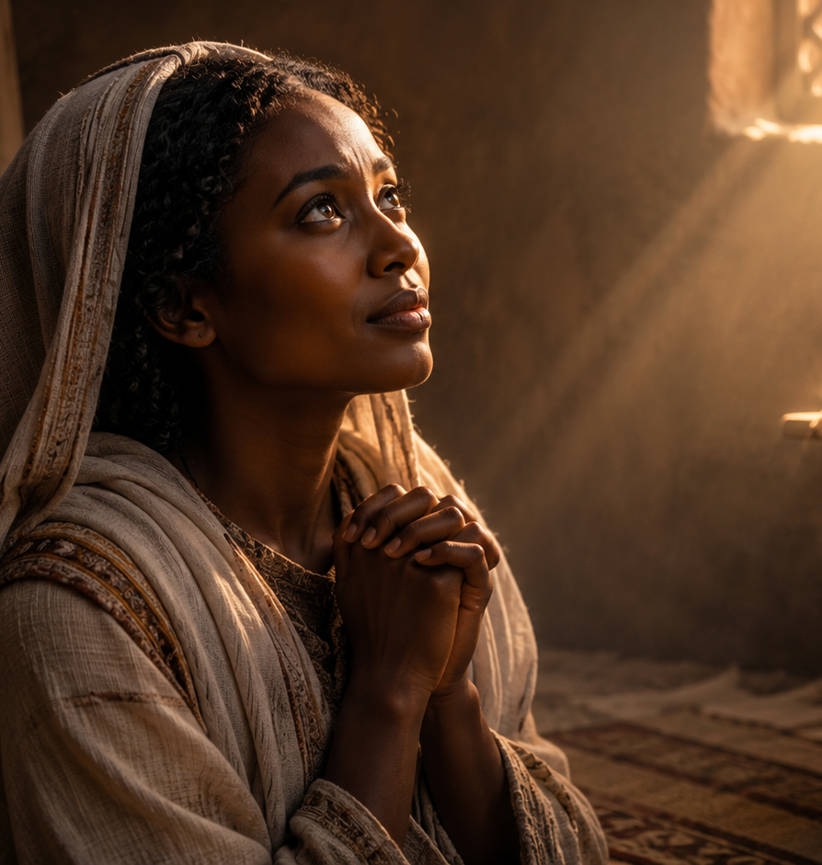
MARY, LOYAL MOTHER
Lesson 08 | Week of July 26
“But Mary kept all these things, and pondered them in her heart.”
-Luke 2:19 KJV
We can have faith even when we do not see the big picture.
MARY, LOYAL MOTHER | LESSON 08 | 1
Notes:
Introduce the lesson. Explain that Mary is an example of loyal faith, but Jesus remains the Savior and center of the lesson.
Timing: 1 minute.

Slide 2
Prayer
Heavenly Father, thank You for sending Jesus and for giving us examples of faithful trust. Help us listen to Your Word, bring our needs to Jesus, and stay close to Him when life is joyful, confusing, or painful. Teach us to trust Your plan even when we do not see the whole picture. In Jesus' name, Amen.
Thought to Remember:
  Trust God before you see the whole plan.
MARY, LOYAL MOTHER | LESSON 08 | 2
2
Notes:
Open with prayer. Set a calm, reflective tone for the class.
Transition: “Today we will follow Mary through three moments when faith had to keep trusting God.”
Timing: 3 minutes.

Slide 3
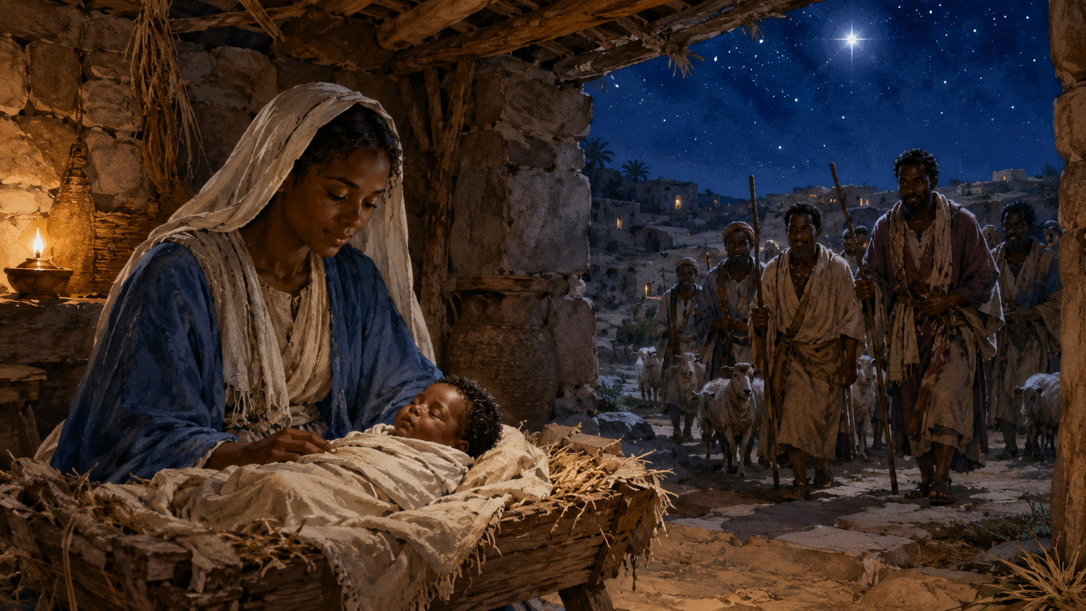
Lesson Outline MARY, LOYAL MOTHER
Review | Introduction | Lesson Context | Overview | Application | Q&A
LESSON FOCUS
We can have faith even when we do not see the big picture.
LESSON SCRIPTURE:
Luke 2:15-19; John 2:1-5; John 19:25-27
OVERVIEW
A King for the Lowly - Luke 2:15–19 KJV
A Mother Knows Her Son - John 2:1–5; 19:25–27 KJV
MARY, LOYAL MOTHER | LESSON 08 | 3
3
Notes:
Use this slide to orient learners. Explain that the lesson moves from birth, to ministry, to the cross.
Timing: 2 minutes.

Slide 4

MARY, LOYAL MOTHER
LESSON introduction
Hidden Treasure
  My children love a good mystery, and we often listen to podcasts as a family when we travel. It is common for us to choose enigmatic tales. One such recent story involved the so-called eighth wonder of the world—Prussia’s Amber Room. The Amber Room was built between 1701 and 1714 for King Frederick I of Prussia. It was given to Peter the Great, the Tzar of Russia, and moved to the Catherine Palace near St. Petersburg in 1716.
  The Amber Room was considered one of Rus¬sia’s most beloved artifacts for 200 years, a cultural treasure. But the Nazis stole the room in 1941. It was reconstructed in Germany and then
  disassembled and packed up for protection from the war in 1944. No one has seen it since. Historians believe it was stored in crates in the basement of a castle museum that collapsed from wartime bombing.
  In pictures of the replica, the Amber Room glows with golden light. It is a wonder to behold. Unfortunately, its beauty was stolen and hidden, resulting in great loss.
  Today’s lesson tells of a different kind of hidden treasure—the identity, capabilities, and calling of the Lord, Jesus Christ. It focuses on Jesus’ mother, Mary, and how she trusted the slow unfolding of Jesus’ person and work.
Notes:
THE GREATEST HIDDEN TREASURE IS NOT A LOST EARTHLY ARTIFACT, BUT THE TRUE IDENTITY, POWER, AND CALLING OF JESUS CHRIST, WHICH GOD REVEALED OVER TIME AS MARY TRUSTED HIM. The story begins with the mystery of Prussia’s Amber Room, a beautiful treasure that was stolen, hidden, and eventually lost. Its beauty once brought wonder, but its disappearance brought sadness and loss. The lesson then points to a greater kind of hidden treasure: Jesus Christ. His identity, power, and mission were not fully understood all at once. Mary, His mother, had to trust God as Jesus’ person and work slowly unfolded before her. Like Mary, believers are called to treasure what God reveals, trust Him while waiting, and keep faith even before the whole picture is clear.
Three Key Points
Earthly treasures can be beautiful but temporary. The Amber Room was admired for many years, but it was stolen and lost. Human treasures can fade, disappear, or be taken away.
Jesus is the greater treasure God reveals. The lesson shifts from a lost golden room to Christ, whose identity and mission are of eternal value.
Mary trusted God as Jesus’ glory unfolded. Mary did not understand everything at once, but she remained faithful as God revealed more about Jesus over time.
Three Life Lessons Learned
Do not place your deepest hope in earthly treasures. Beautiful possessions, memories, and achievements can be lost, but Christ remains forever.
Treasure what God reveals about Jesus. When God shows us truth through His Word, we should hold it close, think on it, and let it shape our faith.
Trust God while His plan unfolds slowly. Like Mary, we may not see the whole picture immediately, but we can still believe that God is working.
Analysis
This introduction uses the Amber Room as a strong object lesson. The Amber Room was valuable, beautiful, and admired, but it was also vulnerable. Its loss reminds us that earthly beauty can be hidden, stolen, or destroyed. That contrast prepares the learner to think about a better treasure: Jesus Christ.
The phrase “hidden treasure” works well because Jesus’ full identity was not understood by everyone at once. Mary saw more than most people, yet even she had to grow in understanding. She heard God’s promises, watched Jesus’ life unfold, and trusted God through ordinary moments, joyful moments, and painful moments.
The lesson keeps the focus in the right place. Mary is important as a faithful witness, but Jesus is the true treasure. The point is not to exalt Mary above Christ, but to learn from her trust as she watched God reveal the Savior.
Spiritually, this section teaches that faith often begins before full understanding. God may reveal His plan step by step. Our calling is to treasure Christ, trust God’s timing, and remain faithful while His purpose becomes clearer.

Slide 5
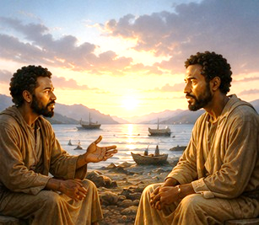
LESSON introduction
MARY, LOYAL MOTHER
Daily Bible Readings
July 27 through August 1
Isaiah 55:6–11—Seek the Lord.
Jude 20–25—Wait for Christ’s Mercy.
John 14:1–7—Jesus is the Way.
Psalm 50:7–15—Call on the Lord.
Deuteronomy 4:27–31—God is Merciful.
John 20:19–23—Jesus Appears to the Disciples.
These Scriptures teach that God mercifully calls sinners to seek Him, trust His Word, receive Christ, depend on His mercy, and live as witnesses of His forgiveness. God’s Word does not fail. Jesus is the only way to the Father. The Lord invites His people to call on Him in trouble, return after failure, wait for Christ’s mercy, and share His peace with others.
Notes:
God wants us to seek Him with sincere hearts, turn from sin, trust Jesus as the only way to salvation, and live in the peace of His mercy. We are not saved by empty religion or human strength. We are restored by God’s grace, kept by His power, and sent to help others find forgiveness through Christ.
======================================
Isaiah 55:6–11 — Seek the Lord
Summary:
Isaiah calls people to seek the Lord while He may be found. The wicked are invited to forsake sinful ways and return to God, who abundantly pardons. God’s thoughts and ways are higher than ours, and His Word always accomplishes His purpose.
Analysis:
This passage shows both urgency and mercy. God does not merely command people to turn; He welcomes them back. His Word is compared to rain and snow because it gives life, produces fruit, and never fails.
Commentary:
God’s mercy is greater than human sin, but people must respond while they have opportunity. Seeking the Lord means turning from sin, trusting His promise, and believing that His Word has power to change lives.
Jude 20–25 — Wait for Christ’s Mercy
Summary:
Jude encourages believers to build themselves up in faith, pray in the Holy Spirit, remain in God’s love, and wait for the mercy of Jesus Christ. Believers are also called to show mercy to others while trusting God to keep them from falling.
Analysis:
This passage balances responsibility and dependence. Christians must grow, pray, love, wait, and help others. Yet the final confidence is not in human strength but in God, who is able to preserve His people.
Commentary:
The Christian life requires watchfulness. Believers must stay close to God while living in a confused world. Jude reminds us that mercy is not only something we receive; it is something we extend to others.
John 14:1–7 — Jesus Is the Way
Summary:
Jesus comforts His disciples by telling them not to let their hearts be troubled. He promises a prepared place in His Father’s house and declares that He is the way, the truth, and the life. No one comes to the Father except through Him.
Analysis:
This passage points to Christ as the only Savior and the sure hope of believers. Jesus does not simply show the way to God; He Himself is the way. Faith in Him brings comfort, direction, and eternal hope.
Commentary:
Troubled hearts need Christ-centered faith. Jesus offers more than comfort for the moment; He gives eternal assurance. The believer’s hope rests in His person, His promise, and His finished work.
Psalm 50:7–15 — Call on the Lord
Summary:
God reminds His people that He does not depend on their sacrifices because everything already belongs to Him. What He desires is thanksgiving, obedience, and sincere worship. He invites His people to call on Him in trouble, promising deliverance and glory to God.
Analysis:
This passage corrects empty religion. God is not impressed by outward rituals when the heart is distant. True worship includes gratitude, dependence, and trust. Calling on God shows that we know He is our source and deliverer.
Commentary:
God wants relationship, not religious performance. Worship must come from the heart. When believers call on the Lord in trouble, they confess their need, trust His power, and honor Him through grateful obedience.
Deuteronomy 4:27–31 — God Is Merciful
Summary:
Moses warns Israel that disobedience will lead to scattering among the nations. Yet even in exile, if they seek the Lord with all their heart and soul, they will find Him. God is merciful and will not forget His covenant.
Analysis:
This passage shows that sin has consequences, but judgment is not God’s final word for the repentant. God remains faithful even when His people fail. Wholehearted seeking leads to restoration because God is merciful.
Commentary:
God’s mercy does not cancel His holiness, but it gives hope after failure. When people return to Him sincerely, He receives them. His covenant faithfulness proves that repentance is never useless.
John 20:19–23 — Jesus Appears to the Disciples
Summary:
After His resurrection, Jesus appears to the fearful disciples behind locked doors. He speaks peace, shows His wounds, sends them as the Father sent Him, breathes on them, and speaks of the Holy Spirit and forgiveness.
Analysis:
This passage moves the disciples from fear to mission. The risen Christ brings peace, proves His victory, and sends His followers into the world. Their message centers on forgiveness made possible through His death and resurrection.
Commentary:
Jesus meets fearful believers with peace and purpose. He does not leave His disciples hiding; He sends them out as witnesses. The church’s mission depends on the risen Christ, the Holy Spirit, and the message of forgiveness.

Slide 6
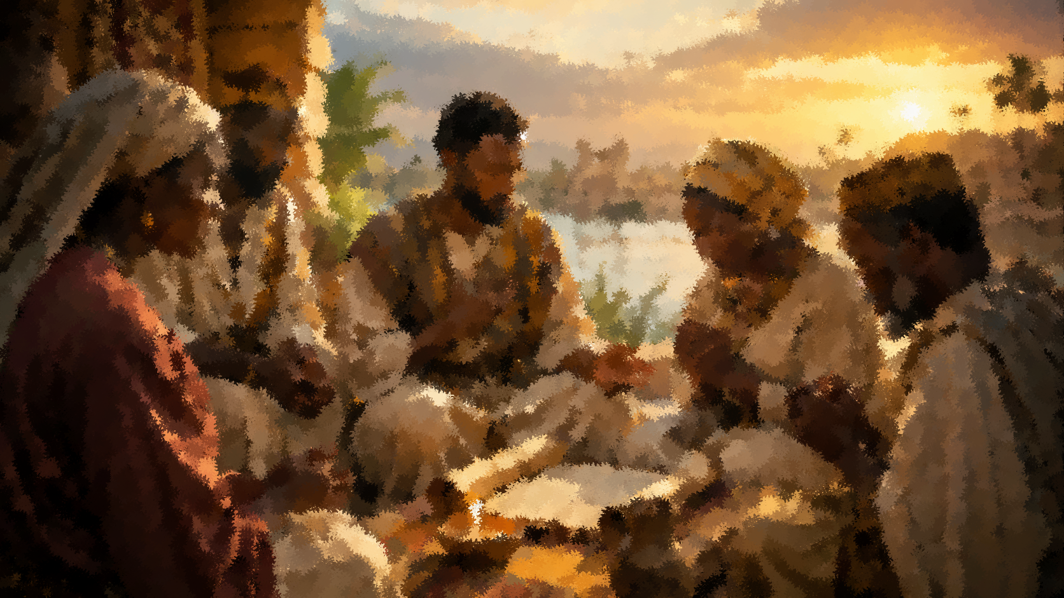
LESSON CONTEXT
Draw Near Through Faith and ObedienT-
While the stories in this lesson are all different, they’re unified in theme. Mary is a role model for relying on God on the journey from faith to understanding. Anselm of Canterbury (eleventh-century theologian) wrote, “I do not seek to understand in order that I may believe, but rather, I believe in order that I may understand.” It sounds like a paradox; but when it comes to theological issues or life experiences that are beyond us, this attitude is essential.
MARY, LOYAL MOTHER
Notes:
God wants us to learn that faith is not waiting until everything makes sense; faith is trusting God enough to obey while He teaches us along the way. Faith comes before full understanding. Like Mary, believers are called to draw near to God by trusting Him, obeying Him, and continuing to walk with Him even when they do not fully understand His plan. This passage teaches that Mary’s life shows the journey from faith to deeper understanding. She did not always know everything God was doing, but she trusted Him and remained obedient. The quote from Anselm of Canterbury reminds us that Christian faith does not demand complete understanding before believing. Instead, faith opens the door to understanding. When life is confusing, difficult, or beyond human explanation, believers must draw near to God through trust, obedience, and patience.
Three Key Points
Faith begins before full understanding. Mary believed God even when His plan was greater than what she could fully grasp.
Obedience keeps faith moving forward. Faith is not just agreeing with God; it is walking with God and responding to His will.
Understanding grows through relationship with God. As believers continue trusting the Lord, He gives greater wisdom, strength, and spiritual clarity.
Three Life Lessons Learned
You do not have to understand everything to trust God. Some parts of life only become clearer after we keep walking by faith.
Obedience is proof that faith is real. When we trust God, we follow Him even when the next step is hard or unclear.
God uses the journey to deepen our understanding. Spiritual growth often happens slowly as we pray, listen, obey, and reflect on what God is doing.
Analysis
The statement presents faith as a journey, not a single moment. Mary is shown as a faithful example because she trusted God’s Word, pondered what she experienced, and continued to obey as God’s plan unfolded. The quote from Anselm supports the biblical idea that faith is not blind foolishness, but trust in God before all answers are visible.
The passage also challenges the modern desire to understand everything before committing. In Christian discipleship, God often calls believers to obey before they see the full picture. This does not mean believers should avoid study or wisdom. It means that human understanding must submit to God’s truth. Faith draws us near to God; obedience keeps us close; and over time, God gives understanding according to His will.

Slide 7
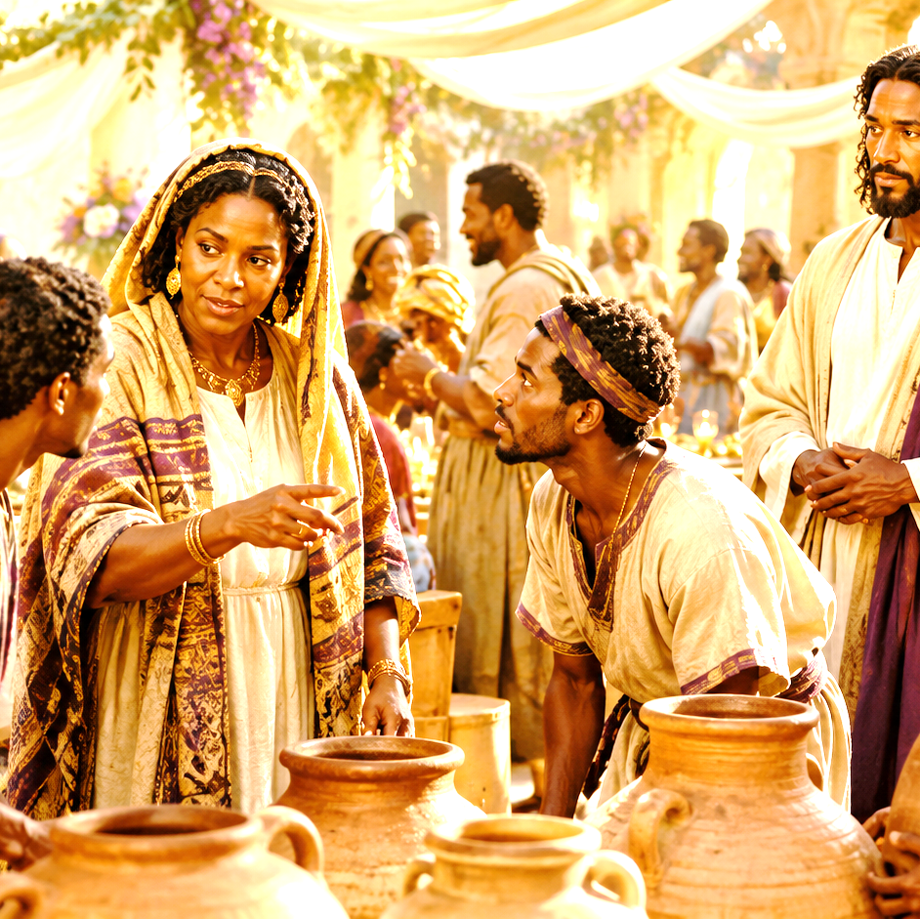
LESSON CONTEXT
A MOTHER KNEW—
  While the spiritual significance of the miracle in John 2 is deep, one can’t help but smile: it is also a dear and familiar picture on a human level. We see a mother who, perhaps bursting at the seams with pride, wants her son to use His abilities to help. Is it irreverent to see Jesus’ response as exasperated, as if He says, “Oh, Mom”? If Jesus experienced human emotions, He could experience embarrassment when His mother was putting Him on the spot. It’s hard to believe that Mary hadn’t seen Jesus do something miraculous before this occasion. Otherwise, it’s a bizarre conversation that they share. Like a lot of conversations with family, not everything is communicated with words. You can almost feel the meaningful look Mary must have given Him. “They’re out of wine.” She acts as if she knows He can do something about it.
MARY, LOYAL MOTHER
Notes:
Mary trusted that Jesus could meet a need before others fully understood who He was, showing a mother’s quiet confidence in her Son and His divine ability. This section reflects on the wedding miracle in John 2, where Mary notices that the wine has run out and brings the problem to Jesus. On a human level, the moment feels familiar: a mother sees a need and believes her son can help. Mary does not give Jesus a long explanation; she simply tells Him, “They have no wine.” Her words suggest confidence that Jesus can do something. Though Jesus’ response shows that His public ministry must follow His Father’s timing, Mary still trusts Him. Her faith is shown when she tells the servants to do whatever Jesus says.
Three Key Points
Mary recognized a need before others understood its importance. She saw that the wedding family faced embarrassment and quietly brought the concern to Jesus.
Mary believed Jesus had the power to respond. Her statement shows confidence that Jesus could do something meaningful, even before His miracle became public.
Mary trusted Jesus’ authority. She did not argue or explain further; she simply directed the servants to obey Him.
Three Life Lessons Learned
Bring problems to Jesus first. Mary teaches believers to take needs, concerns, and burdens directly to Christ.
Trust Jesus even when His answer is not fully explained. Jesus may not respond the way we expect, but His timing and purpose are always right.
Obedience prepares the way for God’s work. Mary’s instruction, “Whatsoever he saith unto you, do it,” remains a powerful lesson for every believer.
Analysis
This reflection highlights both the humanity of Jesus and the faith of Mary. John 2 is not only a miracle story; it is also a family moment. Mary speaks to Jesus as His mother, but she also shows faith in Him as someone uniquely able to help. Her words are brief, but they carry confidence. She does not command Him, but she presents the need.
Jesus’ response, “Mine hour is not yet come,” reminds us that His mission was guided by the Father’s will, not by human pressure. Even Mary could not control His divine timetable. Yet Mary’s faith does not collapse when Jesus responds carefully. Instead, she turns to the servants and says, “Whatsoever he saith unto you, do it.”
That statement is the heart of the lesson. Mary knew enough to trust Jesus, even when she did not know exactly what He would do. Her confidence was not based on controlling the outcome but on trusting His character.
The miracle that follows reveals Jesus’ glory and causes His disciples to believe in Him. What began as a quiet concern at a wedding became a sign pointing to Christ’s divine power. Mary’s example teaches believers to notice needs, bring them to Jesus, trust His timing, and obey His Word.

Slide 8
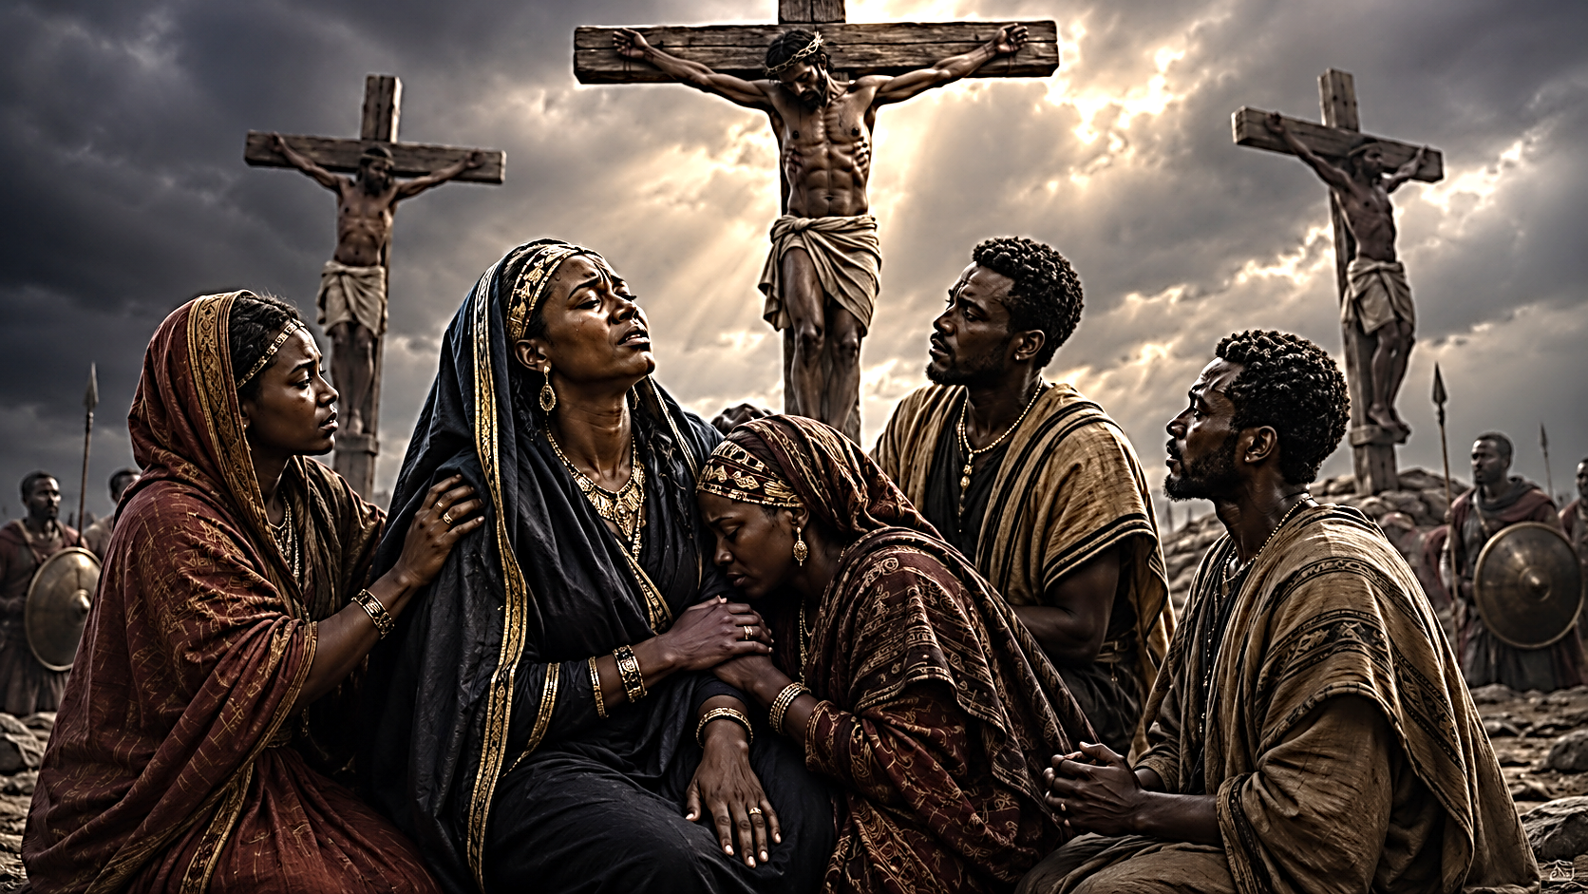
MARY, LOYAL MOTHER
LESSON CONTEXT
THE SMALL GROUP AT THE CROSS—
In John 19, Mary is at the foot of the cross, losing the pride of her life, her miracle child. Her loyal sister clings to her in grief. But where are Jesus’ half-siblings? Where is the rest of the family? The wife of Clopas is there, but where is Clopas? Beside them is Mary Magdalene, delivered from seven demons (Luke 8:2). Lastly, there is the beloved disciple, who many identify as John. Where is everyone else?
Jesus’ disciples are terrified. Jesus was executed as “King of the Jews,” a charge branding Him and His movement as rebellious. Rome was notorious for crushing revolts with brutal force. About two decades earlier, another Galilean named Judas had led a revolt that was violently suppressed. It’s understandable that most are petrified. But despite the risk, a small group came.
These followers love Jesus more than their own lives, embodying His words: “Whoever loses his life for my sake will find it” (Matt. 16:25). They put their lives on the line, went through the hour of darkness with Jesus, and later had the honor of witnessing all that God would do.
Notes:
True loyalty to Jesus is proven when love remains faithful, even in danger, grief, and uncertainty. The cross separates casual interest from committed love. The lesson God wants us to learn is that true followers remain faithful to Christ even when the moment is painful, unpopular, or unclear. Mary and the small group teach us to stay near Jesus, trust His purpose, and believe that God can bring victory out of the darkest hour.
Summary
This passage focuses on the small group of faithful followers who stayed near Jesus at the cross. While many disciples were afraid and absent, Mary, her sister, Mary the wife of Clopas, Mary Magdalene, and the beloved disciple remained close. Their presence was risky because Jesus had been executed under a political charge that Rome could treat as rebellion. Yet their love for Jesus was stronger than their fear. They stood with Him in His suffering and later became witnesses to the greater work God would reveal through the cross and resurrection.
Three Key Points
Faithfulness is tested in hard places. It is one thing to follow Jesus when crowds are cheering; it is another thing to stand near Him when danger is present.
Love for Christ can overcome fear. The small group at the cross stayed because their devotion to Jesus was greater than their concern for personal safety.
Those who remain faithful in darkness may witness God’s glory. They endured the sorrow of the cross, but they would later see the victory of the resurrection.
Three Life Lessons Learned
Do not measure faithfulness by crowd size. Sometimes the most faithful people are not the largest group but the small group that refuses to leave.
Following Jesus may require courage. True discipleship is not always comfortable. There are moments when standing with Christ may cost reputation, comfort, or safety.
God honors loyal faith. Those who stay close to Jesus in painful seasons are often strengthened to see His purpose more clearly later.
Analysis
This passage highlights the cost of discipleship. At the cross, Jesus appears rejected, defeated, and condemned. Many who once followed Him are absent because fear has taken hold of them. Rome’s power was real, and being publicly connected to Jesus could have brought danger. The disciples’ fear was understandable, but the courage of the small group is remarkable.
Mary’s presence is especially powerful. She is not only witnessing the death of her Son; she is watching the miracle child promised by God suffer in public shame. Her loyalty does not remove her pain, but it keeps her near Jesus. Mary Magdalene’s presence also speaks loudly. The woman whom Jesus delivered now stands with Him in His suffering.
The beloved disciple represents faithful discipleship. While others scattered, he remained close enough for Jesus to entrust Mary into his care. This shows that love is not only emotional; it accepts responsibility.
Theologically, this moment teaches that the cross was not a failure. It was the painful center of God’s saving plan. The small group could not yet see the fullness of the resurrection, but they stayed through the darkness. Their example reminds believers that faith is not proven only by what we say in worship, but by where we stand when following Jesus becomes costly.

Slide 9
Lesson Focus MARY, LOYAL MOTHER
Trusting God when the whole picture is not clear
We can have faith even when we do not see the big picture.
Start the Conversation
When have you had to trust before you understood?
What helps you stay faithful when answers are delayed?
How can remembering God’s Word help you wait?
MARY, LOYAL MOTHER | LESSON 08 | 4
9
Notes:
Ask for one or two brief responses. Keep the conversation safe and age-appropriate.
Timing: 4 minutes.
Transition: Mary did not understand everything at once, but she kept trusting God.

Slide 10
A King for the Lowly
WHAT HAPPENED?
Shepherds came after hearing the angel’s message.
The people were amazed by what they heard.
Mary treasured these things and pondered them in her heart.
Luke 2:15–19 KJV
15 And it came to pass, as the angels were gone away
from them into heaven, the shepherds said one to another,
Let us now go even unto Bethlehem, and see this
thing which is come to pass, which the Lord hath made
known unto us.
16 And they came with haste, and found Mary, and Joseph,
and the babe lying in a manger.
17 And when they
had seen it, they made known abroad the saying which
was told them concerning this child.
18 And all they that
heard it wondered at those things which were told them
by the shepherds.
19 But Mary kept all these things, and
pondered them in her heart.
MARY, LOYAL MOTHER | LESSON 08 | 6
10
Notes:
Mary’s life shows that knowing Jesus requires faith, patience, and trust as God’s plan unfolds through ordinary and difficult circumstances. Today’s readings focus on Mary, the mother of Jesus, and what her experiences teach us about faith. Mary knew Jesus longer than anyone else, yet she still had to trust God as His identity and mission unfolded. In Luke 2, Mary gives birth to Jesus in Bethlehem after Caesar Augustus orders a census. Though Caesar thought he was exercising political power, God was using even that decree to fulfill prophecy. Shepherds, not rulers or priests, became the first public witnesses to the Messiah’s birth. Mary’s story shows that God’s promises are true, even when the path is uncomfortable, unexpected, or humble.
God wants us to learn that His promises are reliable, even when the road is hard. Like Mary, we must trust Him in humble places, remember His Word, and believe that He is working out His purpose through Jesus Christ.

Slide 11
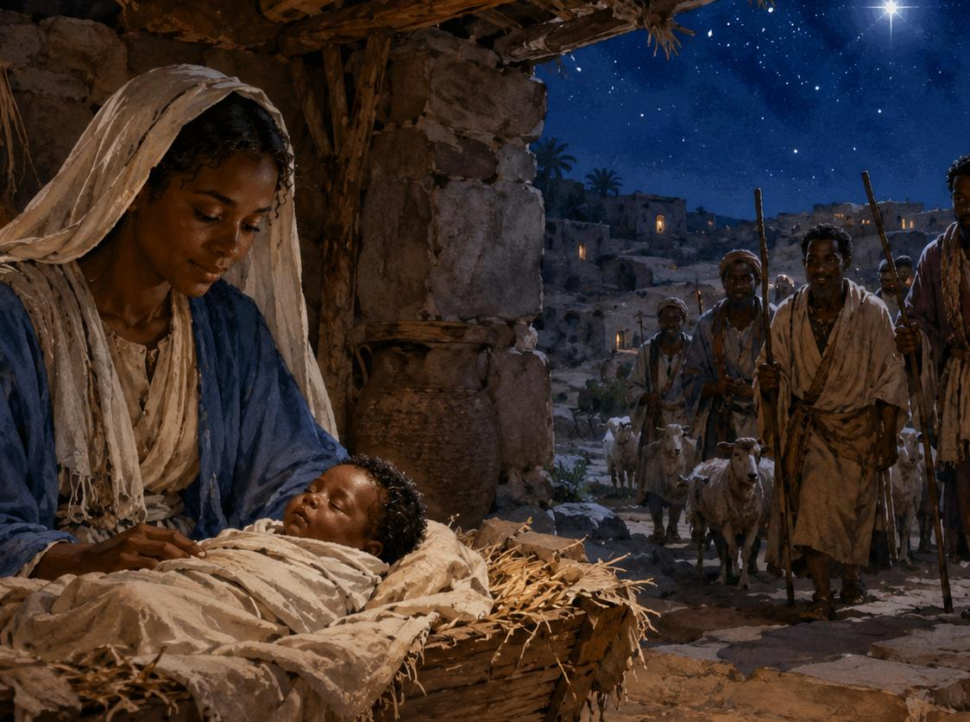
A King for the Lowly
WHAT HAPPENED?
Shepherds came after hearing the angel’s message.
The people were amazed by what they heard.
Mary treasured these things and pondered them in her heart.
God works even when His plan surprises us
God often works in ways people do not expect.
Mary had accepted the role that Gabriel announced, that she would be mother to the Messiah.
Mary’s pregnancy is beset by one twist after another, until she winds up giving birth away from home and without a private room.
As Jesus is born, shepherds in the fields nearby are visited by announcing angels.
The shepherds go in search of the signs they are told to seek: a child wrapped in cloth and lying in a feeding trough for animals.
When they find Mary and Joseph, the shepherds share what they have seen.
They depart and begin spreading the news of this miracle, to everyone’s amazement.
Mary’s reaction is different; she ponders these memories.
Jesus came in humility, not earthly power.
Mary did not control the circumstances.
She trusted God while her understanding grew.
God was working, even when Mary did not understand everything.
Faith means staying with God while your understanding grows.
MARY, LOYAL MOTHER | LESSON 08 | 7
11
Notes:
Three Key Points
Mary had a unique view of Jesus’ life. As His mother, she saw His birth, growth, ministry, suffering, and mission in a personal way.
God used ordinary and difficult circumstances to fulfill His promise. The census, the journey to Bethlehem, and the humble birth setting all fit into God’s plan.
God welcomed the humble first. Poor shepherds became the Messiah’s first welcome party, showing that Jesus came for ordinary people, not just the powerful.
Three Life Lessons Learned
God’s plan may unfold in uncomfortable places. Mary’s journey reminds us that obedience does not always mean ease, but God is still working.
Faith requires remembering what God has spoken. Mary had Gabriel’s promise, and she had to hold onto it when circumstances looked difficult.
God often works through people the world overlooks. The shepherds teach us that God values humble hearts and uses unexpected witnesses.
Analysis
This passage presents Mary as a faithful witness to the unfolding work of God. She had already received a divine promise from Gabriel that her Son would receive David’s throne and reign forever. Yet the circumstances surrounding His birth did not look royal. Instead of comfort, Mary faced travel, displacement, and a lack of privacy. This contrast teaches that God’s promises are not always wrapped in human comfort.
Caesar Augustus believed he was ruling the world through his census, but God was ruling over Caesar’s decree. The journey to Bethlehem fulfilled Micah 5:2, showing that human authority cannot interrupt God’s plan. God can use government decisions, family movement, hardship, and timing to accomplish His Word.
The shepherds also carry deep meaning. They were poor and ordinary, yet God chose them to hear the angelic announcement and welcome the newborn Messiah. This shows the heart of the gospel: Jesus came not only for the respected and powerful, but also for the humble, working, and overlooked.
Mary’s example teaches believers to trust God when life does not match what they expected. She did not understand everything at once, but she remained faithful. Her life shows that spiritual maturity grows as we watch God keep His Word over time.

Slide 12
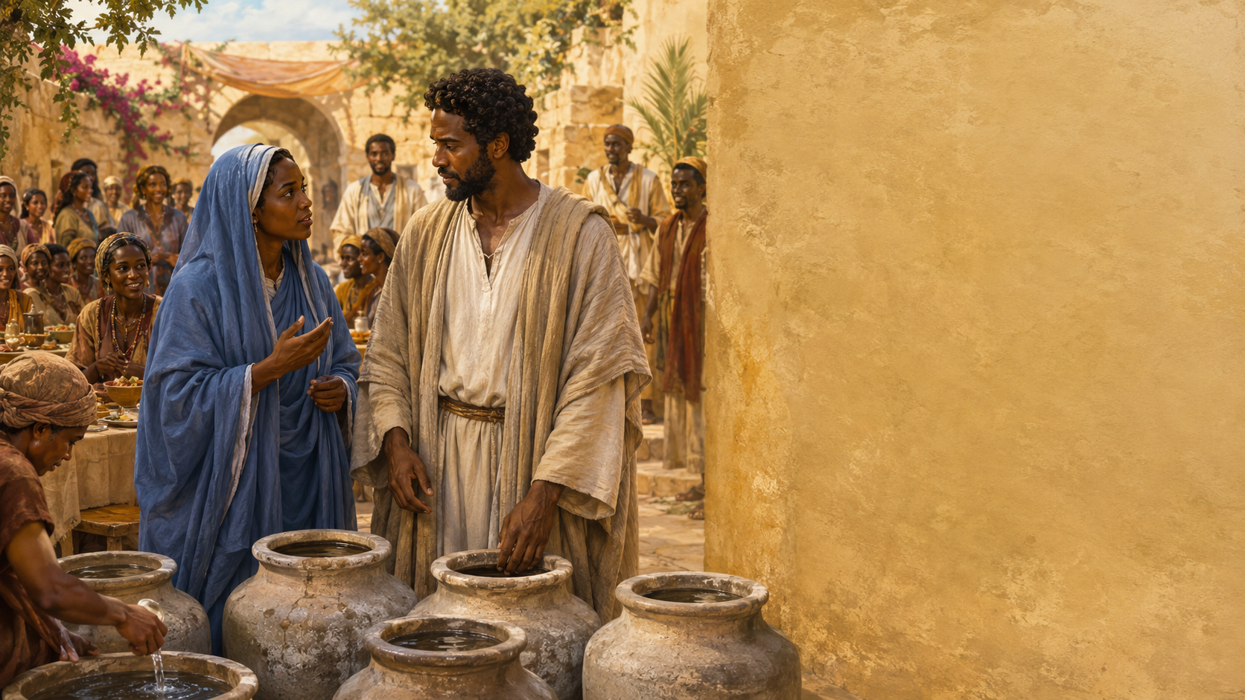
Mother Knows Her Son
What happened?
John 2:1-5
The wine ran out at the wedding.
Mary brought the need to Jesus.
Jesus acted according to the Father’s timing and mission.
John 2:1–5; KJV
1 And the third day there was a marriage in Cana of Galilee; and the mother of Jesus was there:
2 And both Jesus was called, and his disciples, to the marriage.
3 And when they wanted wine, the mother of Jesus saith unto him, They have no wine.
4 Jesus saith unto her, Woman, what have I to do with thee? mine hour is not yet come.
5 His mother saith unto the servants, Whatsoever he saith unto you, do it.
. . .
John 19:25–27 KJV
25 Now there stood by the cross of Jesus his mother, and his mother’s sister, Mary the wife of Cleophas, and Mary
Magdalene.
26 When Jesus therefore saw his mother, and the disciple standing by, whom he loved, he saith unto his mother, Woman, behold thy son!
27 Then saith he to the disciple, Behold thy mother! And from that hour that disciple took her unto his own home.
MARY, LOYAL MOTHER | LESSON 08 | 8
12
Notes:
MARY TRUSTED JESUS BECAUSE SHE KNEW HIS HEART, AND JESUS REVEALED HIS GLORY BY TURNING A HUMAN NEED INTO A SIGN OF GOD’S ABUNDANT BLESSING. At a wedding in Galilee, the host family ran out of wine, which would have brought shame and embarrassment during a celebration that could last several days. Mary noticed the problem and brought it to Jesus. Although Jesus reminded her that His mission was controlled by the Father’s timing, Mary responded with quiet faith. She told the servants, “Do whatever he tells you to do.” Jesus then turned water into fine wine, showing His power, compassion, and ability to bring abundant blessing. This miracle revealed that Jesus brings new life, joy, and provision beyond human ability.

Slide 13
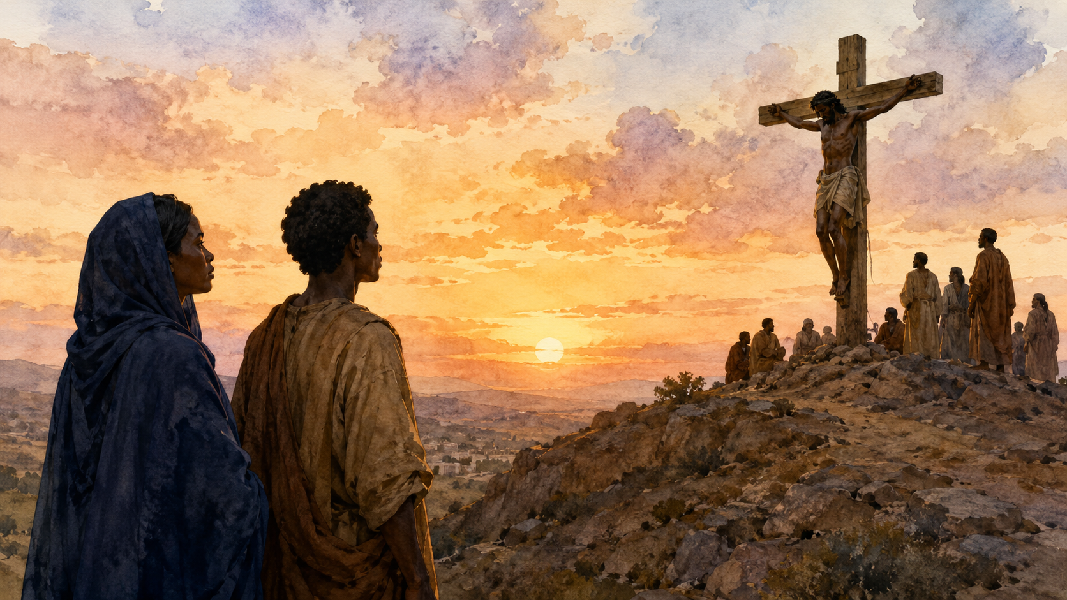
Mother Knows Her Son
At Cana
Need-Prayer-Obedience
Trust Jesus with every need, and stay close to Him in grief.
Mary brought the need to Jesus.
Faith waits on His timing.
Faith obeys before it sees the result.
Mary trusted Jesus in joy and sorrow.
Faith brings real needs to Jesus.
Faith waits on His timing.
Faith obeys even before it sees the result.
At the Cross
Grief-Care-Hope
Mary stayed near Jesus in sorrow.
Jesus cared for His mother while suffering.
A family of care formed around Jesus.
Mary stayed close when she could not understand everything.
Jesus showed love and responsibility even at the cross.
The church is called to be a family of care.
AT CANA - Mary asks Jesus to do something about
the lack of wine at a wedding.
Mary tells servants to follow Jesus’ instructions, which results in a great sign: water turned to wine.
At the Cross - Mary stands by as Jesus dies.
With His dying breaths, Jesus asks His disciple to care for His mother.
MARY, LOYAL MOTHER | LESSON 08 | 9–11
13
Notes:
What need should you bring to Jesus this week?
Stay with Jesus in joy, waiting, and sorrow.
-------------------------------------------
Three Key Points
Mary recognized the need and brought it to Jesus. She did not try to solve the problem herself. She trusted that Jesus could respond in the right way.
Mary showed faith even when she did not know exactly what Jesus would do. Her instruction to the servants, “Do whatever he tells you,” showed confidence in His wisdom and authority.
Jesus’ miracle revealed His glory and abundant provision. Turning water into wine showed that Jesus has divine power and that life with Him brings blessing beyond expectation.
Three Life Lessons Learned
Bring your concerns to Jesus. Even ordinary problems matter to Him. We can trust Him with both spiritual needs and everyday burdens.
Obedience prepares the way for blessing. The servants had to follow Jesus’ instructions before they saw the miracle. Faith is shown by doing what He says.
Jesus can turn lack into abundance. What seemed like embarrassment and failure became a moment that revealed Christ’s glory.
Analysis
This scene shows Mary as a faithful mother who understands her Son’s character, even though she does not fully control or direct His mission. Her words are simple, but her faith is strong. She notices a social crisis, brings it to Jesus, and then steps back in trust.
Jesus’ response, calling her “woman,” may sound distant to modern readers, but it was not disrespectful. It showed that His earthly relationships could not control His divine mission. His “hour” pointed forward to the cross, resurrection, and full revelation of His glory.
The miracle itself is rich with meaning. Wine in Scripture often represents joy, blessing, and abundance. By turning water into fine wine, Jesus revealed that He does more than meet needs; He gives better than expected. The lesson is clear: Mary trusted Jesus’ heart, the servants obeyed His word, and Jesus revealed His glory through abundant grace.

Slide 14
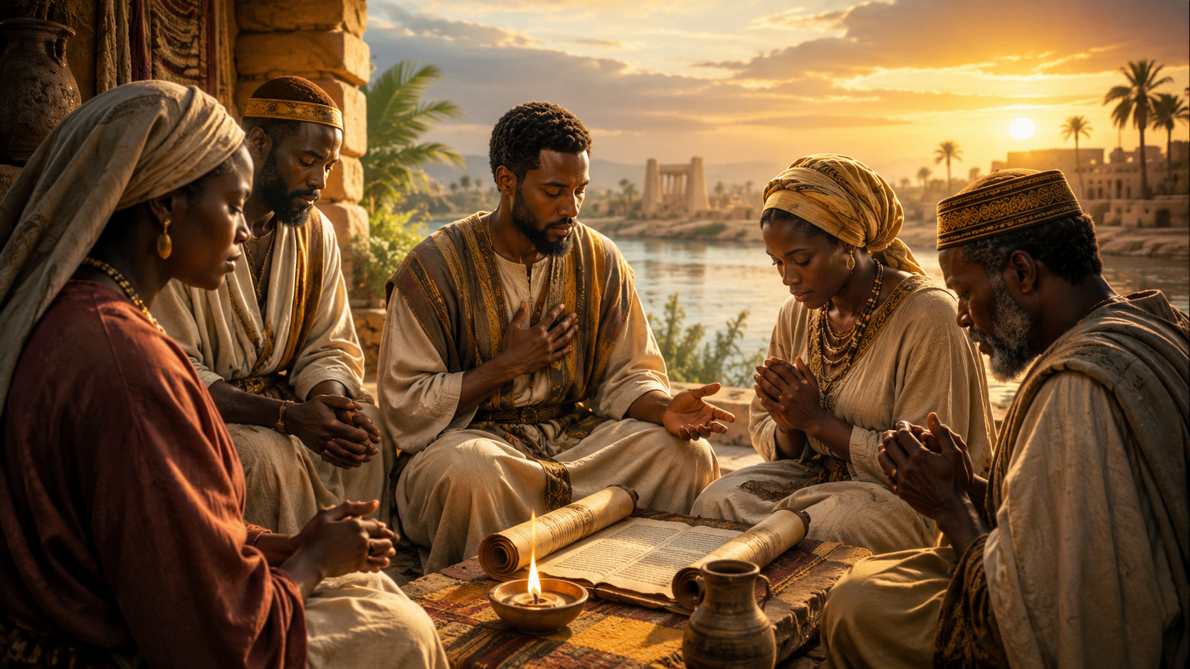
APPLY THE MESSAGE MARY, LOYAL MOTHER
Faith takes one faithful step
FAMILY OF FAITH
In our own walk of faith, we will face some of the same kinds of interactions with God as Mary faced. None of us will be asked to be a parent to Jesus, but we will face moments of profound calling and treasured contemplation, or joy and blessing beyond wildest expectations. We will also have moments when our mundane needs go unmet, and we plead with our beloved Lord. And—true enough—we face moments at the foot of the cross, when questions of “Why” and “How” sear our souls and when grief feels overwhelming. We might feel like we are losing all that we hold dear.
Yet God will always be with us; Mary experienced this truth too. She treasured God’s words and the promises she received. She endured to see the glory of resurrection. Mary’s insight and understanding of Jesus also grew over time. The longer that she was with Jesus, the better she was able to understand what God was doing through Him.
Perhaps you have experienced something like this. You might start out thinking that God’s solution to a problem is so obvious, only to find yourself waiting and wondering. Over time, we can find a new understanding of the depths of God’s love. You might find yourself relating to different parts of Mary’s story:
  • Joyful at words of salvation and a message from God
  • Curious about ways that God configures the details of your life
  • Expectant for God to act to do great and miraculous things
  • Grief-stricken by injustice or pain and struggling to comprehend what God is doing
Like Mary, we should be prepared to be with Jesus through all of these times. Mary welcomed the invitation to be God’s servant before she knew all that would be required. She would tell us to make the same choice.
MARY, LOYAL MOTHER | LESSON 08 | 12
14
Notes:
ENJOY BEING WITH JESUS THROUGH EVERY SEASON OF LIFE, TRUSTING THAT HIS PRESENCE REMAINS STEADY EVEN WHEN OUR UNDERSTANDING IS STILL GROWING. Mary’s walk with Jesus included joy, calling, waiting, confusion, grief, and hope. She experienced the wonder of God’s promises, the joy of Jesus’ works, the pain of unmet expectations, and the sorrow of standing near the cross. Yet through every change, God was with her. Over time, Mary’s understanding of Jesus deepened. Her life teaches believers to stay close to Jesus when life is joyful, confusing, painful, or uncertain. Like Mary, we are called to trust God before we know every detail.
Three Key Points
Faith grows through changing seasons. Mary’s relationship with Jesus did not stay in one moment. She moved from receiving God’s promise, to watching Jesus minister, to grieving at the cross, and later seeing resurrection hope.
God is present even when life is painful or unclear. Mary faced questions, grief, and uncertainty, but God did not abandon her. His presence remained faithful even when the path was difficult.
Following Jesus requires trust before full understanding. Mary said yes to God before she knew all that obedience would cost. Believers must also choose to walk with Jesus even when the future is not clear.
Three Life Lessons Learned
Stay with Jesus in every season. Do not follow Him only when life feels joyful or blessed. Remain close to Him in sorrow, waiting, disappointment, and confusion.
Treasure God’s Word while you wait. Like Mary, believers should hold tightly to what God has spoken. His promises help us endure seasons we do not fully understand.
Spiritual understanding grows over time. We may not see God’s plan clearly at first, but the longer we walk with Jesus, the more we learn His heart, His timing, and His purpose.
Analysis
This passage presents Mary as an example of faithful endurance. Her journey with Jesus was not simple or easy. She experienced the joy of divine calling, the wonder of miraculous blessing, the concern of ordinary human need, and the deep sorrow of watching Jesus suffer. Her faith was not built on having every answer. It was built on trusting God’s character.
The phrase “Enjoy being with Jesus through all the changes” is important because Christian faith is not only about receiving answers. It is about remaining in relationship with Christ. Life changes, emotions change, needs change, and circumstances change, but Jesus remains faithful.
Mary’s story also teaches that God’s work may unfold slowly. At times, we may think we know exactly how God should solve a problem. Yet God’s timing and purpose are deeper than our first understanding. The believer must learn to wait, watch, trust, and grow.
The strongest lesson is this: faithfulness means staying with Jesus when we rejoice, when we wonder, when we wait, and when we weep. Mary followed Jesus through all of it, and we are called to do the same.

Slide 15
APPLY THE MESSAGE MARY, LOYAL MOTHER
Faith takes one faithful step
FAMILY OF FAITH
1 What part of Mary’s story draws your attention, perhaps because you relate to the emotions she was experiencing?
2 How has your understanding of Jesus stayed consistent over time?
3 How have you come to know Jesus better?
MARY, LOYAL MOTHER | LESSON 08 | 12
15
Notes:
1 What part of Mary’s story draws your attention, perhaps because you relate to the emotions she was experiencing?
She experienced joy and pride in her parenting journey. She experienced concern and moments of uncertainty. She was called to be the mother of Jesus. We all are called to a ministry of care in a broken world. Maybe you are experiencing curiosity after reading Mary’s story, or you are expectant of what God is doing in your life.
2 How has your understanding of Jesus stayed consistent over time?
No matter what is happening around us, we know that Jesus is always with us. God made promises to His people and we experience the fulfillment of many of those same promises today. God doesn’t change, and neither does the message of salvation.
3 How have you come to know Jesus better?
We are all at different points in our faith. Maybe you have been walking with Jesus for many years, or maybe you are early in your discipleship journey. Our invitation is the same: watch and learn from Jesus’ way of doing things. Perhaps you have come to know Jesus better when you have been at the end of your rope, crying out to God, and He has met you in that grief.

Slide 16
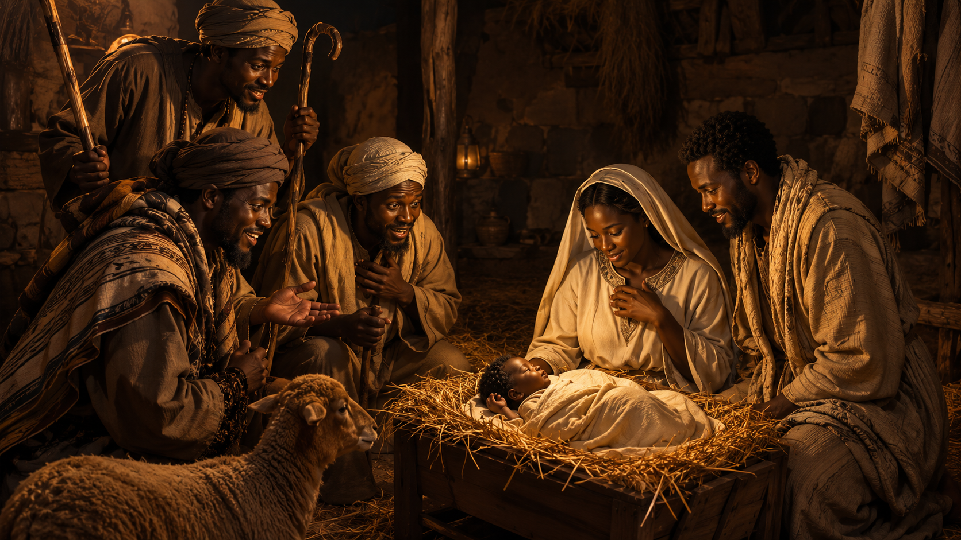
Live It Out MARY, LOYAL MOTHER
One action step for the week
Pray daily.
Remember God’s Word.
Take one faithful step.
Surrender to God’s ability to provide even in trying times.
Trusting God to See Me Through
Mary was present for Christ’s birth, His first public signs, and His crucifixion. We have the advantage of hindsight to know the miraculous outcome of each of these scenes, but Mary only had her trust in God to give her hope. In what area of your life are you relying on God’s power to see you through? Share with a partner what it means to be with Jesus and trust Him at this time.
MARY, LOYAL MOTHER | LESSON 08 | 16
16
Notes:
SURRENDER TO GOD’S POWER TO PROVIDE, TRUSTING HIM THROUGH TRYING TIMES EVEN WHEN YOU CANNOT YET SEE THE OUTCOME. This passage encourages believers to look at Mary’s life with fresh eyes. Because we already know the full Gospel story, we may forget how difficult Mary’s journey must have been. She saw Jesus’ birth, His first miracle, His suffering, and His death. Through every season, she had to keep surrendering to God’s plan. Her faith teaches us to trust God when life is uncertain, painful, or beyond our understanding. The prayer asks God to grow our faith so we can respond with hope, confidence, and trust in His provision.
Three Key Points
Mary’s faith required repeated surrender. Mary did not only trust God once. She had to keep trusting Him through many seasons of joy, uncertainty, grief, and hope.
God is able to provide in trying times. The passage reminds believers that God’s power is not limited by difficult circumstances. He can sustain, guide, and provide when life feels unclear.
Faith responds with hope and confidence. The prayer asks God to help believers face hardship without despair, trusting that He will see them through and be honored in every situation.
Three Life Lessons Learned
Do not rush past the struggle of faithful people. Mary’s story was glorious, but it was not easy. Her faith grew through real pressure, waiting, and pain.
Trust God before the ending is clear. We know the resurrection came after the cross, but Mary had to stand in the moment without seeing the full outcome. We must also trust God while we wait.
Let trying times become places of deeper surrender. Hard seasons can teach us to depend more fully on God’s wisdom, timing, and provision.
Analysis
This passage focuses on the practical response of faith: surrender. Mary’s life is a powerful example because she trusted God through events she could not fully understand at the time. She accepted God’s calling, raised Jesus, watched Him minister, saw Him suffer, and had to keep believing God’s promise even when the path was painful.
The phrase “we know the glorious end of the story” is important. Modern believers read the Gospels with hindsight. We know Jesus rose from the dead. We know the cross was part of God’s saving plan. But Mary lived through those events one moment at a time. Her faith was not based on knowing every detail ahead of time. It was based on trusting God’s character.
The prayer turns Mary’s example into personal application. It asks God to help us believe He will see us through our own trying times. This keeps the lesson from being only about admiring Mary. It calls us to imitate her faith by surrendering, trusting, hoping, and allowing God to be honored in every situation.
The strongest lesson is this: God may not show us the whole plan at once, but He calls us to trust His provision step by step.

Slide 17
Closing Prayer
Faith, trust, surrender, and hope in Jesus
  Father, thank You for sending Jesus and for showing us how to trust You through Mary’s example. Help us stay close to Jesus when life is joyful, confusing, or painful. Teach us to bring our needs to Him, ponder Your Word, and trust Your plan even when we do not see the whole picture. In Jesus’ name, Amen.
The Lord bless thee, and keep thee: The Lord make his face shine upon thee, and be gracious unto thee.
- Numbers 6:24-25
MARY, LOYAL MOTHER | LESSON 08 | 17
17
Notes:
Close with this prayer or adapt for the class. Final charge: “Stay close to Jesus this week.”
Timing: 3 minutes.

