Slide 1
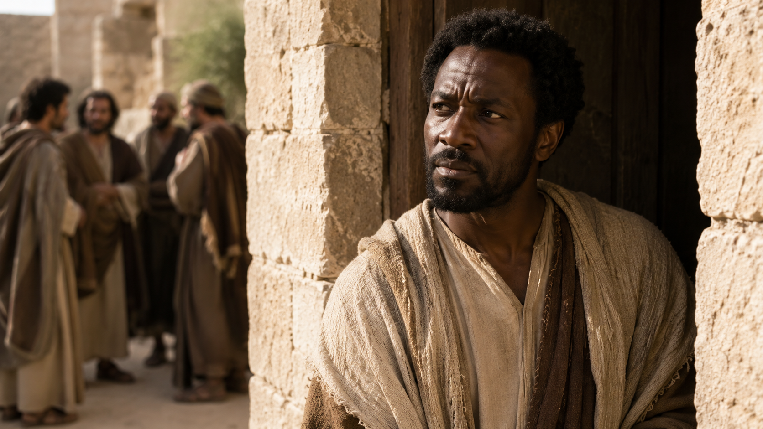
Thomas, the Hesitant Believer
Faith That Finds the Way
-11:14-16;
-14:5-8;
-20:24-29;
-21:1-2
John
“Blessed are they that have not seen, and yet have believed.”
- John 20:29 KJV
Week of August 2
Notes:
Open the lesson by presenting Thomas as more than a nickname. Say: “Many people call him Doubting Thomas, but the Bible shows a fuller story. Thomas was loyal, honest, and eventually worshiped Jesus with one of the strongest confessions in the New Testament. Today we will see how Jesus meets sincere questions and leads us toward faith.”

Slide 2

Prayer
Gracious Father, open our hearts and minds as we study Thomas. Help us bring our questions honestly to You and receive the truth of Your Word. Replace fear with courage, confusion with understanding, and hesitation with faith. May this lesson lead us to confess Jesus as our Lord and our God.
In Jesus’ name, Amen.
Key Truth:
  Jesus meets honest seekers with grace, leads them through questions, and calls them to confident faith in the risen Lord.
2
Notes:
Opening Prayer
Gracious Father, open our hearts and minds as we study Thomas. Help us bring our questions honestly to You and receive the truth of Your Word. Replace fear with courage, confusion with understanding, and hesitation with faith. May this lesson lead us to confess Jesus as our Lord and our God. In Jesus’ name, Amen.

Slide 3

Lesson Outline Thomas, the Hesitant Believer
Review | Introduction | Lesson Context | Overview | Application | Q&A
LESSON FOCUS
Jesus meets us in our search for understanding.
LESSON SCRIPTURE:
John 11:14–16; 14:5–8; 20:24–29; 21:1–2
OVERVIEW
Thomas Seeks the Way - John 11:14–16; 14:5–8
Thomas Seeks Confirmation - John 20:24–29; 21:1–2
3
Notes:
Jesus patiently transforms honest questions, incomplete understanding, and hesitation into courageous faith, personal confession, and faithful witness. Thomas was loyal enough to follow Jesus toward danger, honest enough to admit confusion, cautious enough to seek confirmation, and humble enough to worship when confronted with the truth. His journey shows that sincere questions do not have to destroy faith. When brought to Christ, they can lead to deeper understanding.
Jesus revealed Himself as the only way to the Father, proved His bodily resurrection, and welcomed Thomas into continued fellowship. Thomas’s final identity was not “the doubter,” but a disciple who confessed Jesus as “My Lord and my God.”
John 11:14–16 — Courage in the Face of Danger
Analysis
Jesus plainly announced Lazarus’s death and explained that the coming miracle would strengthen the disciples’ faith. Thomas understood that returning toward Jerusalem could place Jesus and His followers in danger. His response, “Let us also go, that we may die with him,” reveals loyalty and courage, although it may also contain pessimism. Thomas did not fully understand Jesus’ plan, but he was willing to follow Him into danger.
Summary
Lazarus had died, but Jesus intended to use the situation to reveal God’s glory and deepen the disciples’ belief. Thomas encouraged the other disciples to accompany Jesus, even though he expected the journey might lead to death.
Commentary
Thomas should not be remembered only for doubting the resurrection. Before the crucifixion, he demonstrated devotion by being willing to risk his life beside Jesus. His faith was incomplete, but his commitment was genuine. This passage teaches that a believer may possess courage and loyalty while still struggling to understand what God is doing.
John 14:5–8 — An Honest Question Reveals the Way
Analysis
Thomas admitted that he did not know where Jesus was going or how to follow Him. His honest question opened the door for one of Christ’s greatest declarations: “I am the way, the truth, and the life.” Jesus did not merely point toward a path; He declared that He Himself is the only way to the Father. Knowing Jesus means knowing the Father because Christ perfectly reveals God.
Summary
Thomas asked Jesus how the disciples could know the way to His destination. Jesus answered that access to the Father comes through Him alone. Philip then requested a visible revelation of the Father, showing that the disciples still struggled to understand Jesus’ divine identity.
Commentary
Thomas’s question was not disrespectful; it expressed genuine confusion. Jesus responded by giving truth greater than the question Thomas asked. Believers do not need to understand every detail of God’s plan before following Christ. They need to know and trust Jesus, who is the exclusive way of salvation, the complete truth of God, and the source of eternal life.
John 20:24–29 — Doubt Becomes Worship
Analysis
Thomas was absent when Jesus first appeared to the disciples. Because he had not received their experience, he requested physical confirmation that the crucified Jesus had truly risen bodily. Eight days later, Jesus appeared, addressed Thomas directly, and invited him to examine His wounds. Thomas answered with the powerful confession, “My Lord and my God.” Jesus then pronounced a blessing upon those who believe through apostolic testimony without physically seeing Him.
Summary
Thomas initially rejected the disciples’ resurrection report without visible evidence. Jesus graciously returned and provided the confirmation Thomas requested. Confronted by the risen Christ, Thomas moved immediately from hesitation to personal faith and worship.
Commentary
Jesus neither ignored Thomas’s questions nor allowed him to remain in unbelief. He offered grace, evidence, and correction: “Be not faithless, but believing.” The wounds proved that the risen Lord was the same Jesus who had been crucified. Thomas’s confession recognized both Christ’s personal authority and divine nature. His story encourages sincere questioning but warns against making doubt a permanent spiritual home.
John 21:1–2 — Faith Continues in Fellowship
Analysis
Thomas remained among the disciples after his confession of faith. He traveled with them to Galilee and witnessed another appearance of the risen Christ. His presence demonstrates that his earlier doubt did not permanently disqualify or isolate him. Thomas continued learning, witnessing, and sharing life with the community Jesus was preparing for ministry.
Summary
Jesus appeared again beside the Sea of Galilee. Thomas was among seven disciples gathered there, ready to witness another miracle and Christ’s restoration of Peter.
Commentary
Thomas’s story does not end with his moment of doubt. It continues with fellowship, spiritual growth, and repeated encounters with the risen Lord. Mature faith is not created by one emotional moment; it grows through continued obedience, Christian community, and attention to Christ. The believer who once struggled can become a strong witness when he remains close to Jesus and His people.

Slide 4
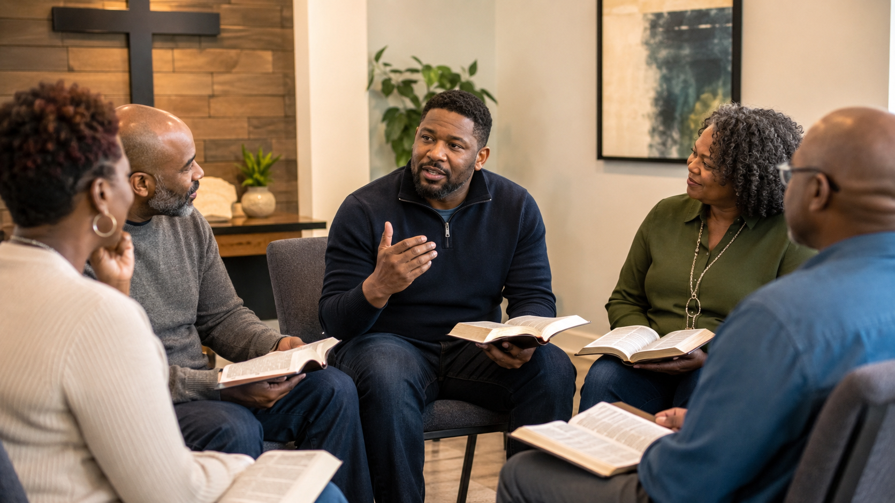
LESSON introduction
Thomas, the Hesitant Believer
“I Need to See It for Myself”
After Sunday worship, Marcus heard several church members talking excitedly in the fellowship hall.
“Did you hear? Mr. Johnson is back home!” one woman said. “The doctors did not expect him to recover so quickly.”
Marcus shook his head. Mr. Johnson had been seriously ill for weeks. The last report Marcus heard was that his condition had grown worse.
“I will believe it when I see him,” Marcus replied. “People sometimes repeat things before they know whether they are true.”
The next Wednesday evening, Marcus entered Bible study and stopped at the doorway. Mr. Johnson was sitting in his usual seat with his Bible open. He looked weaker than before, but he was smiling.
Marcus walked over slowly. “I heard you were home,” he said, “but I was not sure it was true.”
Mr. Johnson reached out his hand. “I understand,” he replied. “Sometimes good news is difficult to believe when disappointment has prepared us for bad news.”
Marcus had not rejected the report because he hated Mr. Johnson. He hesitated because the news seemed too wonderful after such a frightening situation. Seeing Mr. Johnson changed uncertainty into joy.
Thomas faced a much greater report: the other disciples told him that Jesus had risen from the dead. After witnessing the crucifixion, Thomas struggled to accept their testimony. He wanted personal evidence. Jesus did not abandon him. He came near, addressed his questions, and called him to believe.
Thomas teaches us that sincere questions do not have to become permanent unbelief. When we bring our doubts honestly to Jesus, He can move us from hesitation to the confident confession:
“My Lord and my God.”
4
Notes:
Sincere questions and honest examination can become part of a genuine journey from skepticism to saving faith in Jesus Christ. A man first attended church only to support his family and openly identified himself as an atheist. Over time, he began asking serious questions about the bodily resurrection of Jesus. Through honest discussion and careful examination of the evidence, his skepticism began to change. He eventually trusted Jesus as Savior and publicly expressed his faith through baptism.
His story connects with Thomas, who also questioned, sought confirmation, and came to sincere belief.
Three Key Points
1. Doubt Does Not Always Mean Rejection Some people question Christianity because they are sincerely searching for truth. Honest doubt can become the beginning of deeper investigation rather than the end of faith.
2. The Resurrection Is Central to Christian Faith The man focused on the evidence for Jesus’ bodily resurrection because Christianity stands upon the truth that Christ died and rose again. The resurrection confirms Jesus’ identity and victory over death.
3. Faith Requires a Personal Response The man moved beyond discussion and evidence to personal trust. He accepted Jesus as Savior and demonstrated his commitment through baptism.
Three Life Lessons Learned
1. Treat Questioning People with Patience and Respect Believers should not shame people who struggle with doubt. Honest conversation, careful listening, and truthful answers may help someone move closer to Christ.
2. Seek Answers Instead of Hiding Questions Questions about God, Scripture, and the resurrection should be explored honestly. Strong faith is not afraid to examine truth.
3. Knowledge Should Lead to Commitment Evidence can remove barriers, but salvation requires personal faith. A person must move from learning about Jesus to trusting and following Him.
Analysis
This story shows that journeys toward faith do not all look the same. Some people believe quickly, while others travel through skepticism, investigation, and reflection. The man did not begin with confidence in God, but his questions revealed that his heart was becoming open to truth.
The church played an important role by giving him space to ask difficult questions without ridicule. The discussion was described as honest, thoughtful, and open. This kind of environment helps seekers examine Christianity seriously.
The focus on the bodily resurrection is significant. Christianity does not claim that Jesus merely lived on in His followers’ memories. It declares that He physically rose from the dead. Once the man became convinced that the resurrection was trustworthy, he was faced with the need to respond personally.
Like Thomas, he moved from doubt to confession. His baptism showed that his faith had become public, personal, and life-changing. The passage teaches that skepticism is not always an enemy of faith; when combined with humility and a sincere search for truth, it can become part of the road to belief.

Slide 5
From Fear to Faith:
  The Risen Christ Is No Ghost
LESSON CONTEXT
Ancient cultures generally believed that a person’s spirit continued after death. Mesopotamians feared restless spirits, Egyptians preserved the body for the afterlife, Greeks spoke of shadowy spirits in Hades, and Romans honored ancestral spirits. These beliefs shaped how people interpreted strange events, dreams, illness, and unexpected appearances.
Ancient Jewish beliefs also included awareness of the spiritual world, but Scripture clearly prohibited consulting the dead, mediums, and fortune-tellers. God’s people were commanded to seek truth and guidance from the Lord alone.
The disciples’ fear in Matthew 14:26 and Luke 24:37 reflected the beliefs of their culture. When they saw Jesus doing what seemed physically impossible, they first thought He was a spirit. Jesus corrected their fear with truth and evidence.
The resurrection of Jesus was not the return of a ghost. Jesus rose bodily, showed His wounds, invited examination, spoke with His followers, and ate food. His resurrection proved that He had conquered death.
Thomas, the Hesitant Believer
Ancient people often believed that the dead continued as spirits who could appear, warn, help, or harm the living. These cultural ideas influenced the disciples when they saw Jesus walking on water and after His resurrection. However, Jesus showed that He was not a ghost or imaginary vision. He had risen bodily and victoriously. Christians must judge spiritual claims by Scripture rather than fear, tradition, or popular culture.
5
Notes:
Jesus replaces cultural fear and human assumptions with the revealed truth of His bodily resurrection and victory over death.
Three Life Lessons Learned
1. Fear can distort our understanding The disciples saw something they did not understand and immediately assumed the worst. Fear can cause us to accept false explanations before examining the truth. Believers should pause, pray, and compare every experience with God’s Word.
2. Culture must be tested by Scripture People often inherit beliefs from family, entertainment, community traditions, and society. Some ideas may sound spiritual but still conflict with biblical teaching. God’s Word must remain the believer’s final authority.
3. The resurrection gives believers confidence Jesus did not rise as a shadowy spirit. He rose in a real, transformed body. Because Christ defeated death, believers do not have to live in fear of death, ghosts, or unseen powers. Our hope rests in the risen Lord.
Three Key Takeaway Statements
Ancient beliefs about ghosts help explain the disciples’ fear, but they do not establish Christian doctrine. Their first reaction came from cultural assumptions. Jesus corrected those assumptions by speaking truth, showing His body, and proving that He had physically risen from the dead.
Powerful feelings are not always reliable evidence. Fear may offer a quick explanation, but Christ calls believers to examine every experience through Scripture. Spiritual discernment requires prayer, biblical truth, and confidence that God—not superstition, tradition, or popular culture—has the final word.
The resurrection is greater than every ancient story about restless spirits. Jesus did not return because something remained unfinished. He rose because His saving work was completed. The empty tomb declares that sin was defeated, death was conquered, and Jesus Christ is the living and victorious Lord.

Slide 6
Who Was Thomas?
  From Hesitation to Holy Confession
LESSON CONTEXT
Thomas was more than a doubter. Scripture presents him as loyal, courageous, honest, thoughtful, and willing to follow Jesus even when danger was expected. His difficulty was not a lack of love for Christ, but a struggle to understand events that seemed impossible after the crucifixion.
Thomas openly admitted what he did not understand. His question in John 14 allowed Jesus to reveal, “I am the way, the truth, and the life.” After the resurrection, Thomas wanted personal evidence before accepting the testimony of the other disciples. Jesus responded with grace, but He also commanded Thomas to stop resisting and believe.
Thomas’s story moves from loyalty, to confusion, to doubt, to encounter, and finally to worship. His confession, “My Lord and my God,” reveals that his hesitation did not become permanent unbelief. When confronted with the risen Christ, Thomas personally surrendered to Jesus as Lord and recognized His deity.
Thomas was one of Jesus’ twelve apostles. He courageously followed Christ, asked honest questions, and struggled to believe the resurrection testimony. Jesus met him graciously, answered his doubt, and called him to faith. Thomas responded with one of Scripture’s greatest confessions: “My Lord and my God.” His life shows that sincere doubt can become strong faith when brought honestly to Christ.
Thomas, the Hesitant Believer
6
Notes:
Jesus does not reject sincere seekers. He meets honest doubt with truth and grace, then calls every person to move from uncertainty into confident faith.
Three Life Lessons Learned
1. Faithful people may still experience doubt Thomas loved Jesus and was willing to face danger with Him, yet he struggled after the crucifixion. Believers should not assume that questions mean someone has no faith. Seasons of grief, disappointment, and fear can temporarily weaken confidence, but they do not have to destroy devotion to Christ.
2. Honest questions can lead to deeper truth Thomas admitted when he did not understand. Because he asked, Jesus explained that He is the only way to the Father. God is not threatened by sincere questions. When questions are brought humbly to Scripture, prayer, and Christian fellowship, they can produce greater understanding and stronger spiritual maturity.
3. Jesus calls us beyond doubt into worship Jesus showed patience toward Thomas, but He did not allow him to remain in unbelief. Christ commanded him to believe. Grace does not simply comfort us where we are; it moves us forward. True faith responds to Jesus personally, submitting to Him as both Lord and God.
Three Key Takeaway Statements
Thomas reminds us that a moment of doubt does not define an entire life. He was courageous, loyal, and deeply devoted to Jesus. His struggle became part of his spiritual growth because he remained connected to Christ and the community of believers.
Jesus met Thomas with both compassion and correction. He provided the assurance Thomas needed, yet He also challenged him to stop living by unbelief. Christ welcomes honest seekers, but His purpose is always to lead them toward trust, obedience, and mature faith.
Thomas’s greatest moment was not his doubt but his confession: “My Lord and my God.” His story teaches that faith becomes personal when we move beyond knowing facts about Jesus and surrender to Him as our Savior, Master, and divine Lord.

Slide 7
The Risen Christ: From Doubt to Devotion
LESSON CONTEXT
The resurrection is the central truth of the Christian faith. Jesus truly died, was buried, rose bodily with a glorified body, and appeared to many witnesses. His resurrection confirms His divine identity, proves the saving work of the cross was accepted, defeats the power of death, and gives believers hope of eternal life.
Thomas represents those who struggle to accept what they cannot personally see. Jesus did not shame him or abandon him. He met Thomas with evidence, grace, and a command to believe. Thomas responded with worship: “My Lord and my God” (John 20:28, KJV).
Thomas, the Hesitant Believer
The resurrection transformed fearful disciples into courageous witnesses. Their faith rested not on imagination, emotion, or legend, but on repeated encounters with the living Christ. Their testimony, preserved in Scripture, continues to call people from doubt to faith and from hesitation to faithful service.
Jesus’ resurrection was a real, bodily victory over death. The empty tomb, eyewitness appearances, visible wounds, and transformed disciples confirm that Christ rose as He promised. His resurrection proves that He is Lord, confirms the power of the cross, and guarantees future resurrection for believers. Like Thomas, every person must respond personally to the risen Christ.
7
Notes:
Because Jesus truly rose from the dead, believers can trust His Word, receive eternal hope, and boldly confess Him as Lord and God.
Three Life Lessons Learned
1. Honest Questions Should Lead Us Toward Jesus Thomas struggled, but he remained connected to the disciples and was present when Jesus returned. Questions are not necessarily the enemy of faith. When brought humbly to Christ, they can lead to deeper understanding, stronger trust, and sincere worship.
2. The Resurrection Gives Hope Beyond Suffering Jesus’ wounds remained visible, but they no longer represented defeat. They became evidence of victory. Believers may experience injustice, grief, disappointment, and death, but the resurrection assures us that suffering will not have the final word.
3. Encountering Christ Should Produce Courageous Witnesses The disciples moved from locked rooms to public proclamation. Knowing that Jesus is alive should change how believers live. Resurrection faith gives courage to speak truth, serve faithfully, endure opposition, and share the gospel with confidence.
Three Key Takeaway Statements
Jesus did not rise as a spirit, memory, or vision. He rose bodily, showed His wounds, spoke with His followers, and ate with them. The risen Christ was the same Jesus who died, yet He now possessed a glorified body that would never die again.
The resurrection confirms that Jesus is the Son of God and that His sacrifice for sin was accepted. The empty tomb declares that redemption succeeded, death was defeated, and everyone who belongs to Christ has the promise of resurrection and eternal life.
Thomas moved from hesitation to worship when he encountered the risen Jesus. His story teaches that faith is not ignoring questions but allowing the truth of Christ to overcome doubt. The proper response to the resurrection is still: “My Lord and my God.”

Slide 8
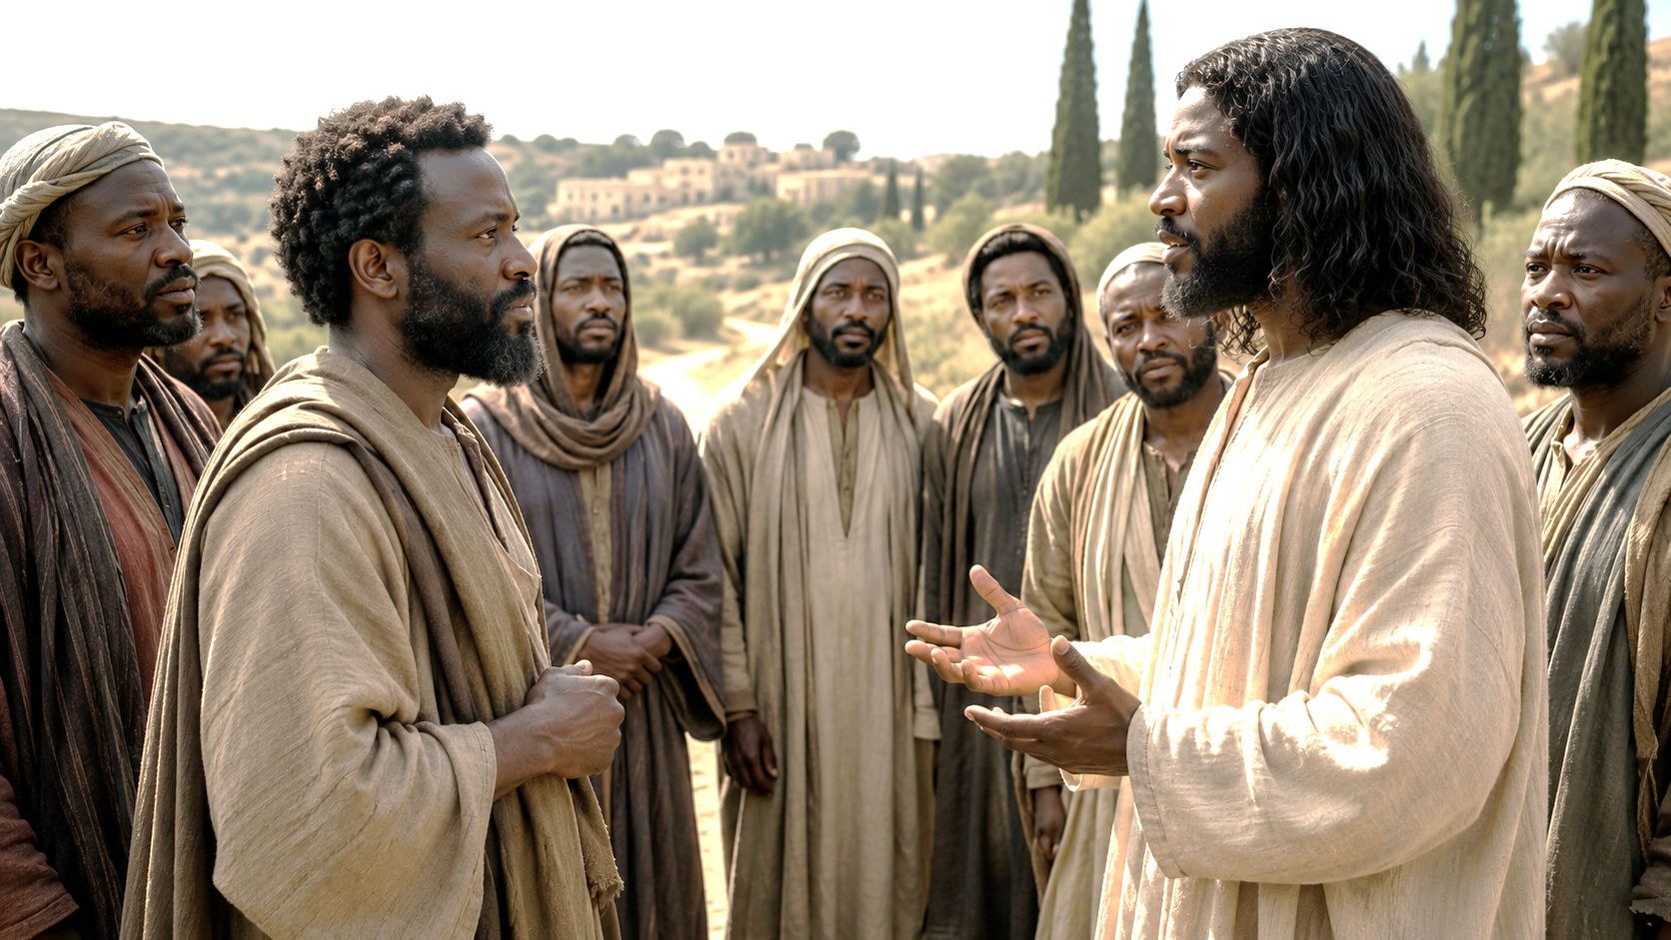
“Then said Thomas, which is called Didymus, unto his fellow disciples, Let us also go, that we may die with him.- John 11:16 KJV
Thomas saith unto him, Lord, we know not whither thou goest; and how can we know the way? - John 14:5 KJV
Thomas Seeks the Way
John 11:14–16; 14:5–8 KJV
Jesus was returning toward danger.
Thomas understood the risk.
Hesitation did not erase loyalty.
  14 Then said Jesus unto them plainly, Lazarus is dead.
  15 And I am glad for your sakes that I was not there, to the intent ye may believe; nevertheless let us go unto him.
  16 Then said Thomas, which is called Didymus, unto his fellow disciples, Let us also go, that we may die with him.
. . .
  5 Thomas saith unto him, Lord, we know not whither thou goest; and how can we know the way?
  6 Jesus saith unto him, I am the way, the truth, and the life: no man cometh unto the Father, but by me.
Thomas asked honestly.
Jesus answered personally.
Questions can lead to clearer faith.
  7 If ye had known me, ye should have known my Father also: and from henceforth ye know him, and have seen him.
  8 Philip saith unto him, Lord, show us the Father, and it sufficeth us.
Faith sometimes begins by staying with Jesus when the road looks hard.
Jesus answered: “I am the way, the truth, and the life.”
8
Notes:
Jesus patiently met Thomas in his uncertainty, gave him sufficient confirmation of the resurrection, and called him to move from doubt to confident faith. Thomas was absent when Jesus first appeared to the gathered disciples after His resurrection. When the others told him, “We have seen the Lord,” Thomas wanted the same direct evidence they had received. He asked to see Jesus’ wounds and confirm that the One who appeared was truly the crucified Christ.
A week later, Jesus returned while the doors were locked. He greeted the disciples with peace and invited Thomas to examine His hands and side. Jesus did not ridicule Thomas, but He also did not permit him to remain in doubt. He commanded him to believe.
Thomas responded with worship: “My Lord and my God!” His declaration recognized Jesus as both his personal Lord and the divine Son of God. John 21 later shows Thomas remaining among the disciples as a confirmed witness of the risen Christ.
Three Key Points
1. Thomas Wanted Confirmation, Not a Convenient Excuse Thomas had not seen what the other disciples had seen. His request for evidence was understandable because resurrection was unexpected, and claims about spirits or apparitions were common. He wanted assurance that Jesus had truly risen bodily.
2. Jesus Answered Thomas with Grace and Truth Jesus knew Thomas’ exact words and concerns. He returned, offered the requested evidence, and called Thomas to stop doubting. Christ’s grace met Thomas where he was, while His truth challenged Thomas to move forward.
3. Thomas’ Doubt Became a Declaration of Faith Thomas did not merely admit that Jesus was alive. He confessed, “My Lord and my God.” His personal encounter changed hesitation into conviction, worship, and faithful witness.
Three Life Lessons Learned
1. Honest Questions Should Be Brought to Jesus Believers should not hide sincere questions or pretend they understand everything. Questions can become pathways to stronger faith when they are brought humbly to Christ, examined through Scripture, and discussed within the community of believers.
2. Jesus Comforts Us but Also Calls Us to Grow Christ is patient with people who struggle, yet His patience is not permission to remain spiritually stuck. Jesus gives truth so that fear, confusion, and uncertainty can be replaced with faith and obedience.
3. Faith Must Become Personal The testimony of others can lead us toward Christ, but every person must respond personally. Thomas moved from hearing what others believed to confessing Jesus as his Lord and his God.
Analysis
Thomas is frequently reduced to the label “Doubting Thomas,” but this description does not present his whole character. Earlier passages show him as loyal enough to follow Jesus toward danger and honest enough to admit when he did not understand. His hesitation after the crucifixion developed within a setting of grief, fear, and shattered expectations.
Thomas requested the same kind of confirmation the other disciples had already received. They had seen Jesus, heard His voice, and viewed His wounds. Thomas was not asking for something entirely different; he wanted a personal encounter with the risen Lord.
Jesus’ response joined compassion with correction. He appeared in peace, addressed Thomas directly, and offered visible confirmation. However, Jesus’ goal was not simply to satisfy curiosity. He wanted Thomas to believe and become a witness.
The wounds were especially important. They showed that the risen Jesus was the same Jesus who had been crucified. His resurrection was not the appearance of a ghost, the survival of a memory, or a replacement by someone else. The crucified Christ had risen bodily and victoriously.
Thomas’ confession is one of the clearest declarations of Jesus’ divine identity in John’s Gospel. His journey reached beyond intellectual agreement. He surrendered personally and worshipfully: **“My Lord and my God.”**
Jesus then extended the lesson beyond Thomas to later generations: **“Blessed are they that have not seen, and yet have believed.”** Present-day believers do not see Jesus physically as Thomas did, but they receive the trustworthy eyewitness testimony preserved in Scripture.
Lesson Context
The risen Jesus meets sincere seekers with grace, provides trustworthy reasons for faith, and calls every person to confess Him as Lord and God. John 20 records several different journeys toward resurrection faith. Mary Magdalene believed after Jesus called her name. Peter and John examined the empty tomb. The gathered disciples believed after Jesus appeared behind locked doors. Thomas believed after Christ personally addressed his concerns.
Thomas’ experience occurred after the trauma of the crucifixion. The disciples had watched their Teacher be arrested, condemned, killed, and buried. They were hiding behind locked doors because of fear. In that setting, the report that Jesus was alive sounded extraordinary.
The passage also emphasizes the bodily resurrection. Jesus displayed the wounds from the cross and invited Thomas to examine them. The One who had died now stood alive before him. His scars were no longer signs of defeat; they had become evidence of victory over sin and death.
John 21 completes the picture. Thomas remained with the disciples and witnessed another appearance of Jesus. His earlier skepticism did not become his final identity. His faith continued to grow, and he became part of the company commissioned to spread the good news.
Conclusion
Main Message: Jesus does not abandon sincere people who struggle, but He lovingly calls them from uncertainty into faith, worship, and witness. Thomas teaches us that a season of doubt does not have to define an entire life. He missed the first appearance, questioned the disciples’ testimony, and requested confirmation. Yet he remained near the community of faith, and Jesus came to meet him.
Christ gave Thomas what he needed, but then challenged him to believe. Thomas responded by surrendering his heart and declaring, **“My Lord and my God.”**
The lesson calls believers to treat struggling people with patience rather than shame. It also warns us not to make doubt a permanent home. Jesus has given the testimony of Scripture, the witness of the apostles, and the work of the Holy Spirit so that we may believe.
Like Thomas, we are called to move:
From questions to understanding.
From fear to peace.
From doubt to belief.
From evidence to worship.
From hesitation to faithful witness.
1 Why do you think Thomas wanted to see and touch Jesus for
himself?
2 How would you describe Jesus’ response to Thomas’s doubts?
3 How should Thomas be remembered?

Slide 9
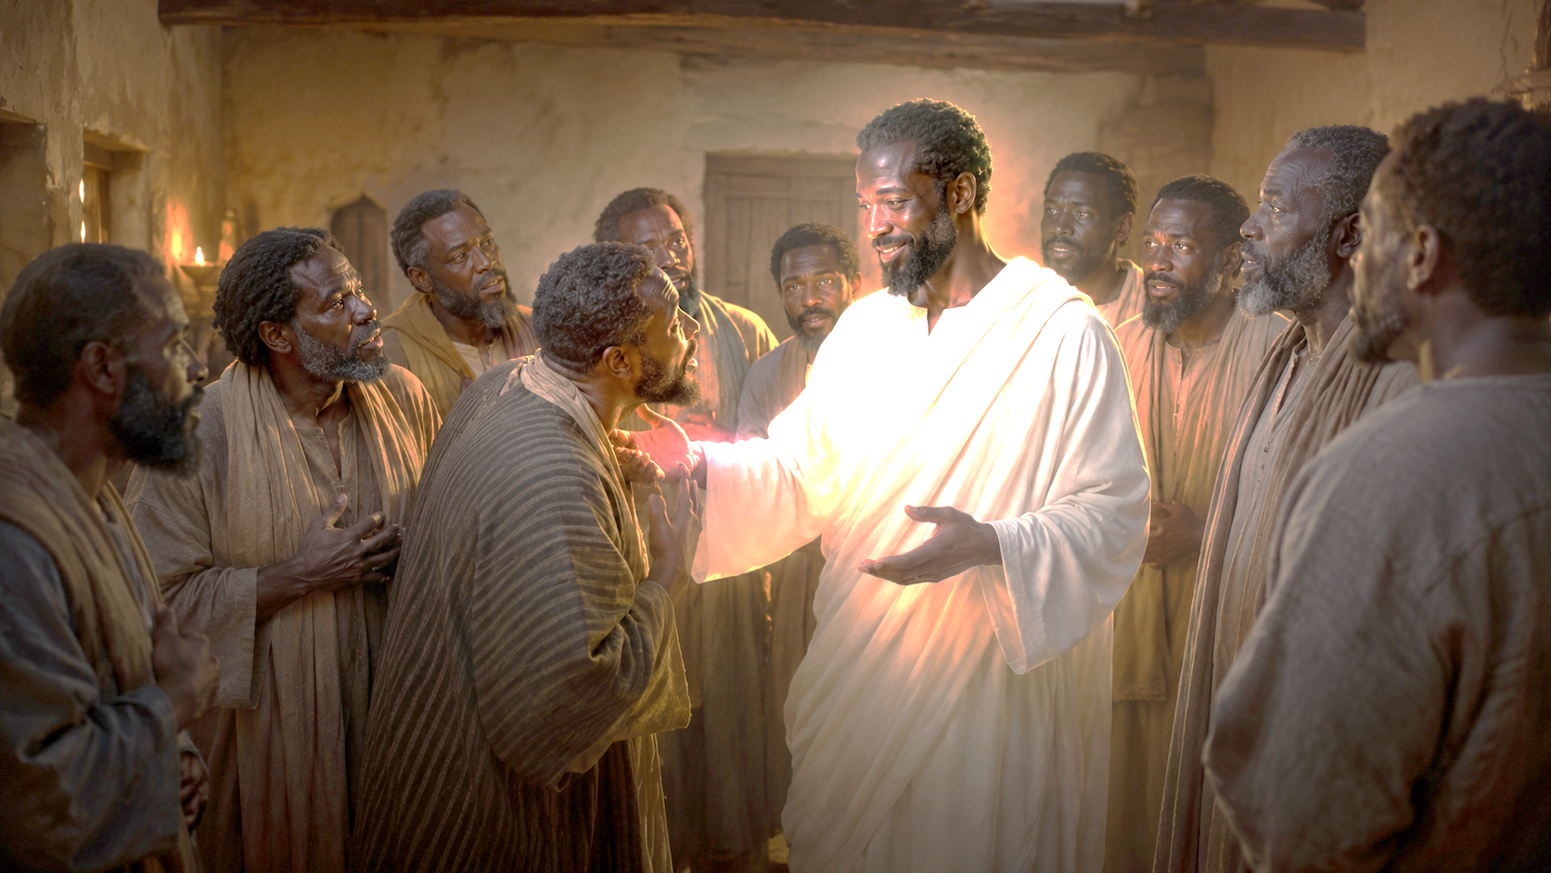
Thomas Seeks Confirmation
John 20:24–29; 21:1–2 KJV
24 But Thomas, one of the twelve, called Didymus, was not with them when Jesus came.
25 The other disciples therefore said unto him, We have seen the Lord. But he said unto them, Except I shall see in his hands the print of the nails, and put my finger into the print of the nails, and thrust my hand into his side, I will not believe.
26 And after eight days again his disciples were within, and Thomas with them: then came Jesus, the doors being shut, and stood in the midst, and said, Peace be unto you.
27 Then saith he to Thomas, Reach hither thy finger, and behold my hands; and reach hither thy hand, and thrust it into my side: and be not faithless, but believing.
28 And Thomas answered and said unto him, My Lord and my God.
Thomas, the Hesitant Believer
Thomas missed the first appearance.
He wanted to know the risen Jesus was real.
Jesus came again and spoke peace.
Thomas confessed: “My Lord and my God.”
29 Jesus saith unto him, Thomas, because thou hast seen me, thou hast believed: blessed are they that have not seen, and yet have believed.
. . .
1 After these things Jesus shewed himself again to the disciples at the sea of Tiberias; and on this wise shewed he himself.
2 There were together Simon Peter, and Thomas called Didymus, and Nathanael of Cana in Galilee, and the sons of Zebedee, and two other of his disciples.
9
Notes:
Saving faith does not require a complete understanding of every doctrine; it requires trusting Jesus Christ as Lord, believing in His resurrection, and following the light God gives for the next step. The passage explains that a person becomes a Christian through faith in Jesus, not by mastering every theological explanation of the cross. Romans 10:9 teaches that salvation involves confessing Jesus as Lord and believing that God raised Him from the dead.
Growing in biblical knowledge is valuable, but knowledge alone does not save. Jesus patiently guides believers as they learn. Like Thomas, we may struggle with questions, yet Christ gives enough truth for us to trust Him and move forward.
Three Key Points
1. Faith in Christ Is the Foundation of Salvation A person is not saved by understanding every theory of atonement. Salvation begins with believing the gospel, confessing Jesus as Lord, and trusting His death and resurrection.
2. Spiritual Understanding Grows Over Time Believers should continue studying Scripture and learning about Christ. However, incomplete knowledge does not mean faith is false. Christian growth is a lifelong process.
3. God Provides Light for the Next Step God does not always reveal His entire plan at once. He gives enough truth for present obedience. Faith strengthens when we act upon what He has already shown us.
Three Life Lessons Learned
1. Do Not Allow Unanswered Questions t o Stop You from Trusting Jesus There will always be mysteries beyond our full understanding. Faith rests on the trustworthy character of Christ, not on our ability to explain everything.
2. Value Learning Without Trusting in Your Own Knowledge Education and theology can deepen faith, but they can also create pride if knowledge becomes a substitute for dependence on God. Christ, not personal expertise, is the source of salvation.
3. Take the Next Step God Has Revealed Faith grows through obedience. When God gives direction through Scripture, prayer, or wise counsel, believers should respond rather than waiting for every detail to become clear.
Analysis
The statement that a Christian may initially understand “very little” does not suggest that doctrine is unimportant. It distinguishes between the simple way salvation is received and the deeper understanding that develops afterward.
A new believer may not be able to explain justification, substitution, reconciliation, or redemption. Yet that person can genuinely trust Jesus as Savior and Lord. Spiritual understanding should continue to grow, but salvation is received by grace through faith.
The writer’s seminary experience reveals another danger: knowledge can create false confidence. A person may understand many theological terms while failing to depend personally upon Christ. Christian identity rests not in intellectual achievement but in a living relationship with Jesus, who declared Himself to be “the way, the truth, and the life.”
Thomas illustrates patient spiritual development. He followed Jesus, listened to His teaching, asked honest questions, and sometimes struggled to understand. Jesus did not abandon him. At the proper time, Christ answered Thomas and gave him what he needed to believe.
The image of God giving “just enough light for the next step” captures the nature of faith. God often leads gradually. We see enough to obey, and obedience prepares us to receive greater understanding. Christ carries His followers along—not by answering every question immediately, but by faithfully guiding them toward mature belief.

Slide 10
One Bible, One Story
Thomas, the Hesitant Believer
The One Who Undoes Death
  “I am the resurrection and the life. The one who believes in me will live, even though they die” (John 11:25). These were Jesus’ words to Martha before raising Lazarus from the dead. She was holding on to the hope that Lazarus
  would rise on the last day, but a power greater than death was standing right before her. When Jesus called Lazarus out of the grave, it was a signpost pointing to where history was heading. Soon Jesus would submit to a terrible death, even death on a cross. And then? Resurrection!
  Jesus triumphed over the grave. He revealed Himself as the answer to the human condition since Adam and Eve took fruit in the garden. They believed the serpent’s words, “You will not certainly die” (Gen. 3:4). But because of sin, all humans face death (Rom. 5:12). Yet Jesus lives, “the firstfruits of those who have fallen asleep” (see 1 Cor. 15:20). The first—but not the last to rise from the dead. Jesus’ resurrection means that death no longer gets the final word. It is this truth that Thomas names. He encountered the risen Christ, God who has power over death itself.
  Soul Food: A faithful church should be a safe place to ask honest questions and grow toward truth.
10
Notes:
Jesus Christ is the One who defeats death and gives eternal life to everyone who believes in Him. The Bible tells one great story: sin brought death, but Jesus came to undo death’s power. Raising Lazarus showed His authority, while His own resurrection proved His complete victory over the grave. Jesus is the first to rise into glorified life, and everyone who believes in Him shares the hope of future resurrection. Death no longer has the final word—Jesus does.
Three Key Points
1. Sin Brought Death into the World Adam and Eve rejected God’s command, and sin entered human experience. Because all people are affected by sin, physical death became part of the human condition.
2. Jesus Has Authority Over Death When Jesus raised Lazarus, He demonstrated that death must obey His command. This miracle pointed forward to His own resurrection and revealed His divine power.
3. Christ’s Resurrection Guarantees Future Hope Jesus is called the “firstfruits” of those who have died. His resurrection is the beginning of a greater harvest, promising that believers will also be raised to eternal life.
Three Life Lessons Learned
1. Trust Jesus Even When Circumstances Appear Hopeless Martha saw only the reality of Lazarus’ death, but Jesus stood before her as the source of life. Believers can trust Christ even when they cannot see how a situation can change.
2. Death Is Not the End for the Believer Christians grieve, but they do not grieve without hope. Because Jesus lives, those who trust Him have the promise of resurrection and eternal fellowship with God.
3. Encountering the Risen Christ Calls for a Personal Response Thomas did more than accept a fact. He confessed Jesus as “My Lord and my God.” Resurrection truth should lead to personal faith, worship, obedience, and courageous witness.
Analysis
This passage presents the Bible as one unified story of humanity’s fall into sin and God’s victory over death through Jesus Christ. Death entered the world because of sin, beginning with Adam and Eve’s disobedience. Lazarus’ resurrection showed that Jesus had authority over death, but it was only a sign pointing to the greater miracle of Christ’s own resurrection.
Jesus did not merely teach about resurrection; He declared, “I am the resurrection and the life.” His victory over the grave proves that death does not have the final word. Thomas recognized this truth when he encountered the risen Christ and confessed Him as Lord and God.

Slide 11
Apply the Message: God is powerful to carry us through doubt or dismay.
He Carries Us Along
I was listening to an interview with a well known New Testament scholar. He was asked, “How much does a person need to understand about Jesus and the cross to be a Christian?” The answer surprised me! He said, “Very little.” He paused to explain that a Christian confesses Jesus as Lord and believes God raised Him from the dead (Rom. 10:9). A Christian trusts that what Jesus did on the cross somehow overcomes death to restore a relationship with God. But understanding the mechanics of how all that works? That’s not a requirement. Faith is what matters, childlike faith.
Thomas, the Hesitant Believer
I was a little taken aback, coming off the heels of a seminary education. I remember slogging through systematic theology textbooks in a library basement. I felt overwhelmed by the complex ways of describing precisely how Jesus saves—what theologians call theories of atonement. I still want to know how it all works, or at least be a pastor with informed opinions! But my self-assurance is not what makes me a Christian. Faith in Jesus as the way, the truth, and the life— that is what makes me His follower.
By all means, let us seek an ever-deepening understanding of who Christ is and what He has accomplished. But let us not despair if there are things about God that we don’t understand. Jesus meets us in our quest for understanding. When given the opportunity, He graciously carries us along, if only to surprise us from time to time.
A teacher told me, “God doesn’t always display the big picture. God gives us just enough light for the next step. Faith grows when we see that next step, and we take it.” I think of Thomas as he followed Jesus around, listening, watching, struggling to wrap his mind around it all. Jesus eventually answered Thomas’s questions when the time was right. He gave Thomas exactly what he needed.
11
Notes:
Jesus graciously meets sincere seekers and calls them to trust Him, even when they do not yet understand everything. Salvation does not depend on mastering every theological explanation. It begins with trusting Jesus Christ as Lord, believing that God raised Him from the dead, and allowing that faith to lead us forward in obedience. Thomas was not a careless unbeliever. He had followed Jesus, displayed courage, and openly asked questions when he did not understand. In John 14, his question allowed Jesus to declare, “I am the way, the truth, and the life.” After the crucifixion, grief and disappointment made Thomas hesitant to accept the resurrection testimony of the other disciples.
The lesson follows Thomas through John 11:14–16; 14:5–8; 20:24–29; and 21:1–2. These passages show his loyalty, his search for understanding, his encounter with the risen Christ, and his continued fellowship with the disciples.
First-century people were familiar with stories about ghosts and apparitions, while many Jews expected resurrection only at the end of history. Thomas therefore wanted assurance that the disciples had encountered the physically risen Jesus, not merely a vision or spirit. Jesus graciously answered him and called him to believe.
Faith does not require complete understanding before taking the next step; it requires trusting the risen Christ with the light He has already given us. The passage explains that becoming a Christian is not the reward for understanding every detail of theology. Salvation comes through faith in Jesus Christ—confessing Him as Lord and believing that God raised Him from the dead.
Studying Scripture and growing in knowledge remain important, but intellectual achievement cannot replace personal trust. Thomas demonstrates this truth. He followed Jesus while still carrying questions, confusion, and uncertainty. Jesus did not reject him. At the proper time, Christ provided what Thomas needed and called him from hesitation to belief.
God does not always reveal the entire journey at once. He often gives enough truth for the next obedient step. Faith grows as believers trust that light, move forward, and discover that Jesus remains faithful.
Three Key Points
1. Salvation Is Received by Faith, Not Earned Through Knowledge A person does not need to understand every doctrine or theory of Christ’s atoning work before trusting Him. The gospel calls people to confess Jesus as Lord and believe in His resurrection. Deeper understanding should follow faith, but it does not create or earn salvation.
2. Honest Questions Can Become Pathways to Stronger Faith Thomas asked questions because he desired clarity. Jesus did not condemn his search for understanding; He met Thomas personally and invited him to believe. The lesson materials emphasize that believers need not fear bringing sincere questions to God because those questions can help faith mature.
3. God Usually Gives Light for the Next Step Faith does not always receive the entire plan in advance. God reveals enough truth for believers to obey Him today. Each faithful step prepares the heart to receive greater understanding tomorrow.
Three Life Lessons Learned
1. Do Not Confuse Spiritual Knowledge with Saving Faith Education, Bible study, and sound theology are valuable, but they cannot replace a personal relationship with Jesus. We are saved by grace through faith, not by our ability to explain every mystery of redemption.
2. Bring Confusion to Christ Instead of Walking Away Questions should lead us closer to Jesus, Scripture, prayer, and Christian fellowship. Thomas missed the first resurrection appearance, but he returned to the gathered disciples. There he encountered Christ and moved from uncertainty to confession.
3. Obey the Truth You Already Understand Waiting until every question is answered can become an excuse for spiritual delay. Faith acts upon the truth God has already revealed. As believers take the next step, God strengthens them for the steps that follow.
Analysis
The scholar’s statement that a new believer may understand “very little” should not be interpreted to mean that truth is unimportant. Rather, it distinguishes the simplicity of receiving salvation from the lifelong work of understanding salvation.
A child can genuinely trust a parent without understanding everything the parent knows. In the same way, a sinner may truly trust Christ before being able to explain justification, substitution, reconciliation, redemption, or other doctrines connected to the cross. Faith may begin simply, but healthy faith should not remain uninformed or immature.
Thomas illustrates the difference between limited understanding and final rejection. He struggled to believe the testimony he heard, yet he stayed close enough to the believing community to encounter Jesus. Christ gave him evidence, but He also commanded him, “Be not faithless, but believing.” Thomas then offered one of Scripture’s clearest declarations of Christ’s deity: “My Lord and my God.” Jesus moved him from questioning to conviction and from conviction to worship.
The larger lesson presents Thomas as a faithful witness whose life continued beyond his moment of hesitation. John 21 places him among the disciples who again encountered the risen Lord. His faith grew beyond initial skepticism, showing that a difficult season does not have to define the rest of a believer’s life.
Thomas teaches us that faith is not having every mystery solved. Faith is recognizing who Jesus is and placing our lives in His hands. Christ does not always show us the whole road, but He gives enough light to move forward.
Thomas began with questions, faced the risen Savior, and ended with worship: “My Lord and my God.” That is the goal of this lesson. We should study deeply, ask honestly, and seek understanding faithfully—but we must never allow unanswered questions to keep us from obeying the truth already revealed.
The next step may appear small: pray, return to fellowship, open the Scriptures, forgive someone, serve, or publicly confess Christ. Yet faith grows through such steps. When we follow the light Jesus gives, we discover that He is already present on the road ahead.

Slide 12
Apply the Message: God is powerful to carry us through doubt or dismay.
He Carries Us Along
1 How much did you understand about Jesus
early in your faith journey?
2 How does Jesus meet people who are trying
to understand?
3 Share a time when you had enough light for
the next step of faith.
Thomas, the Hesitant Believer
12
Notes:
1 How much did you understand about Jesus early in your faith journey?
We will all have different answers. Maybe you first learned to trust Jesus as a child. A child will have a different level of understanding than someone who comes to faith later in life. You might say, “I understood that Jesus was God’s Son” or “I knew He loved me” or “He saved me from my sins.”
2 How does Jesus meet people who are trying to understand?
Jesus meets us through Scripture, prayer, worship, mission, the empowering presence of the Holy Spirit, the witness of the church, and the fellowship of other believers. He also works through the circumstances of our lives to give clarity of thought and deeper understanding of His ways.
3 Share a time when you had enough light for the next step of faith.
You might think about God’s gracious provision during a time of transition or suffering. Consider ways that a community of brothers and sisters in Christ might have supported you and brought clarity about where God was leading you.

Slide 13
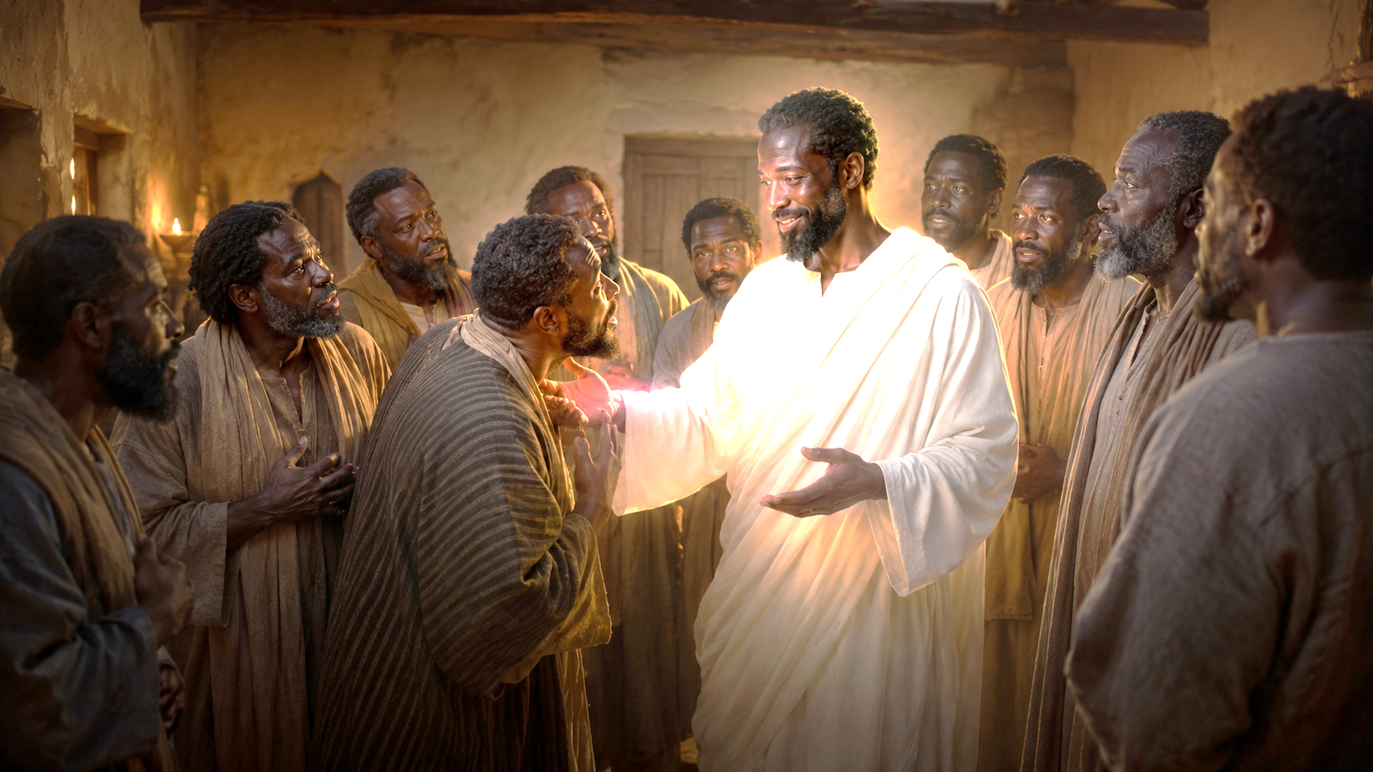
Closing Prayer & Charge
Lord Jesus, thank You for meeting us with patience, truth, and grace. When doubt rises, draw us closer instead of allowing us to turn away. Strengthen our faith through Scripture and the Holy Spirit. Help us trust You without seeing, boldly share the resurrection, and live each day declaring, “My Lord and my God.” Amen.
Thomas, the Hesitant Believer
Lord Jesus, strengthen our faith where it feels weak. Lead our questions toward truth and our hearts toward worship.
Confession: “My Lord and my God.”
Do not let a label define someone.
Do not let doubt isolate you.
Do let Jesus lead you to faith.
13
Notes:
Closing Prayer
Lord Jesus, thank You for meeting us with patience, truth, and grace. When doubt rises, draw us closer instead of allowing us to turn away. Strengthen our faith through Scripture and the Holy Spirit. Help us trust You without seeing, boldly share the resurrection, and live each day declaring, “My Lord and my God.” Amen.

