Slide 1
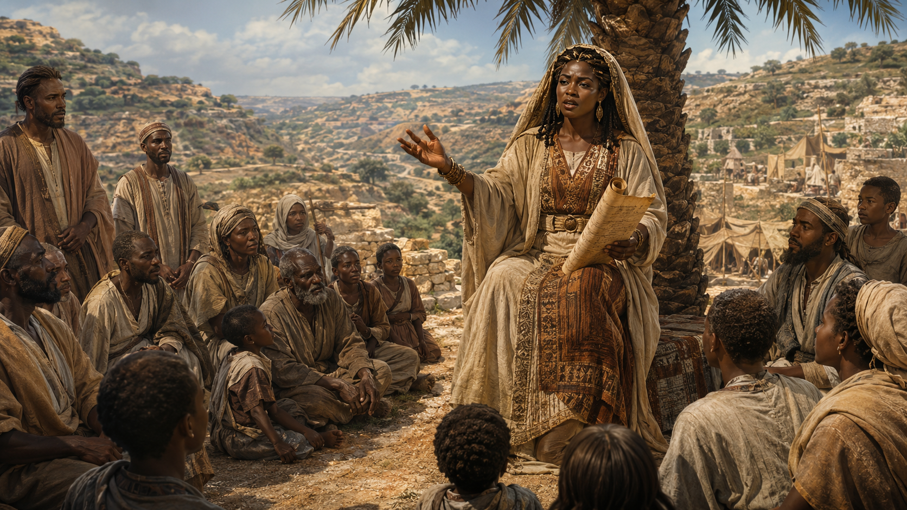
DEBORAH, DUTIFUL JUDGE
Now Deborah, a prophet, the wife of Lappidoth, was leading Israel at that time. She held court under the Palm of Deborah between Ramah and Bethel in the hill country of Ephraim, and the Israelites went up to her to have their disputes decided.
  —Judges 4:4–5 NIV
Week of June 7
Notes:
Week of June 7

Slide 2
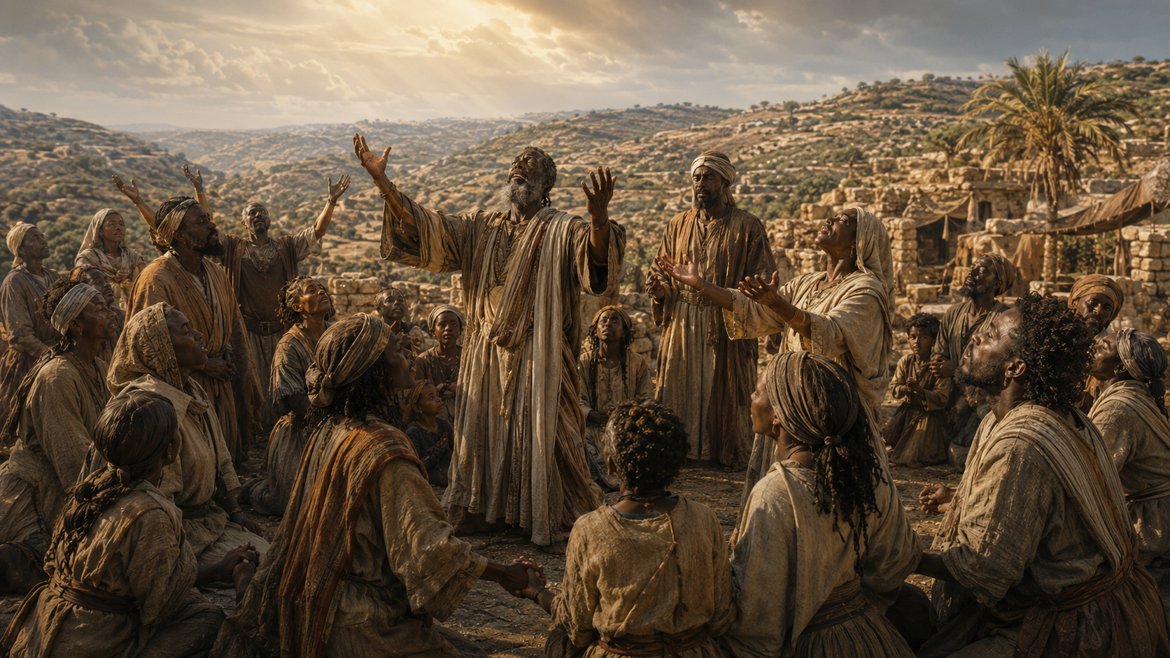
    Prayer
Almighty God, help us remember that the victory is Yours. Thank You for using people of all shapes, sizes, backgrounds, and skills to implement Your will. May You embolden us to answer Your call whenever and however it comes. In Jesus’ name we pray. Amen.
        Thought to Remember
          God spoke a faithful word through Deborah.
Notes:
Almighty God, help us remember that the victory is Yours. Thank You for using people of all shapes, sizes, backgrounds, and skills to implement Your will. May You embolden us to answer Your call whenever and however it comes. In Jesus’ name we pray. Amen.
Thought to Remember
God spoke a faithful word through Deborah.

Slide 3
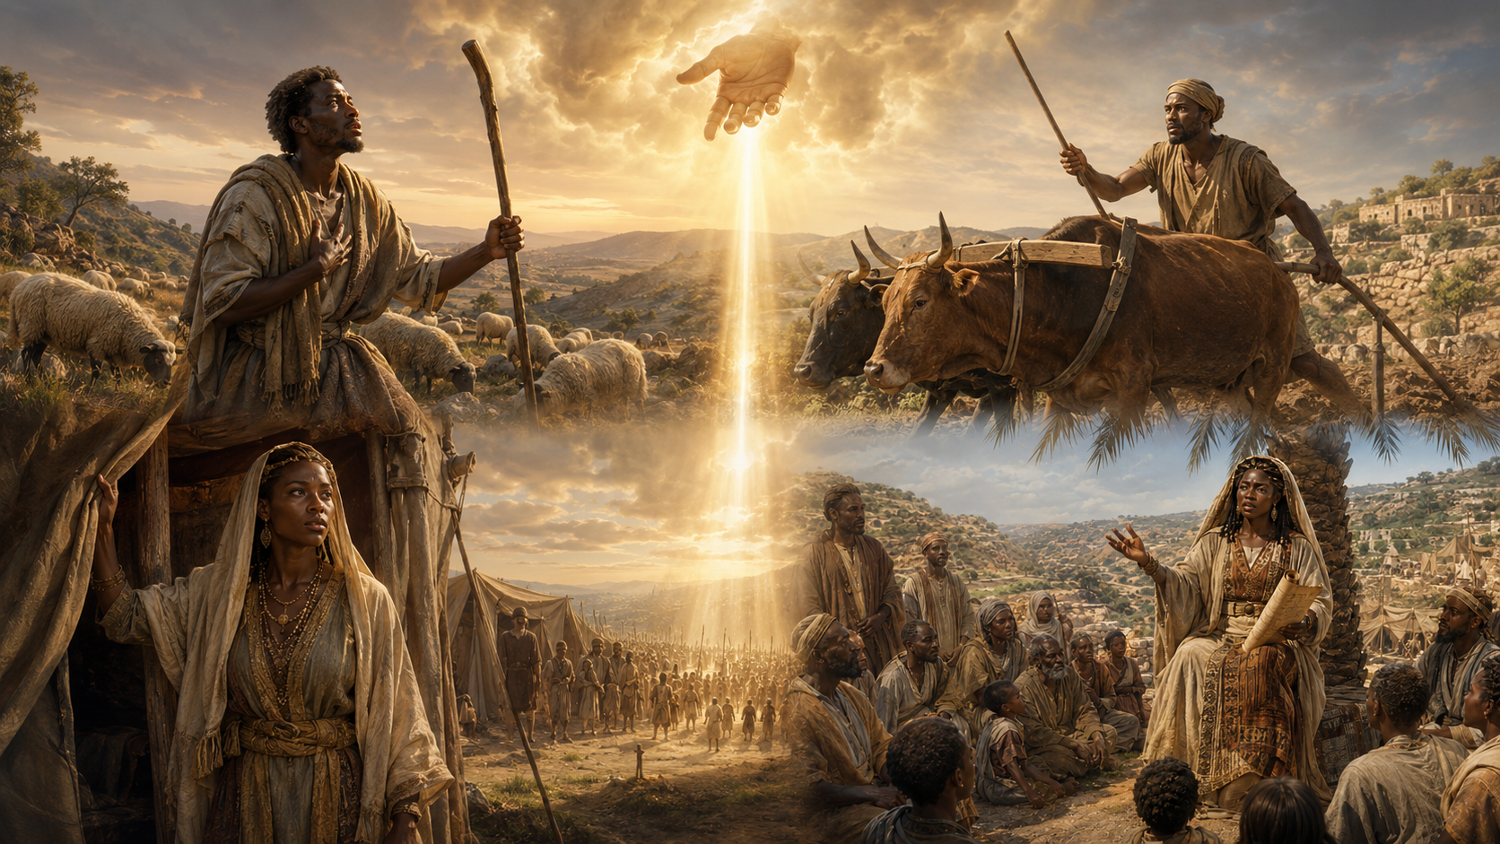
LESSON OUTLINE
DEBORAH, DUTIFUL JUDGE
  Lesson Scripture: Judges 4:4–10, 14, 21–22
  Lesson Focus: God delivers, but not always as we expect.
  Apply the Message :
  Live It Out:
Only God can be our ultimate deliverer.
Be courageous in faith, in every situation.
        Review
        Introduction
        Lesson Context
        Overview
            God’s Rescue Plan -Judges 4:4–10, 14 NIV
            An Unlikely Champion - Judges 4:21–22 NIV
          Bible Application
        Conclusion
        Question & Answers
3
Notes:
God’s Rescue Plan -Judges 4:4–10, 14 NIV
An Unlikely Champion - Judges 4:21–22 NIV

Slide 4
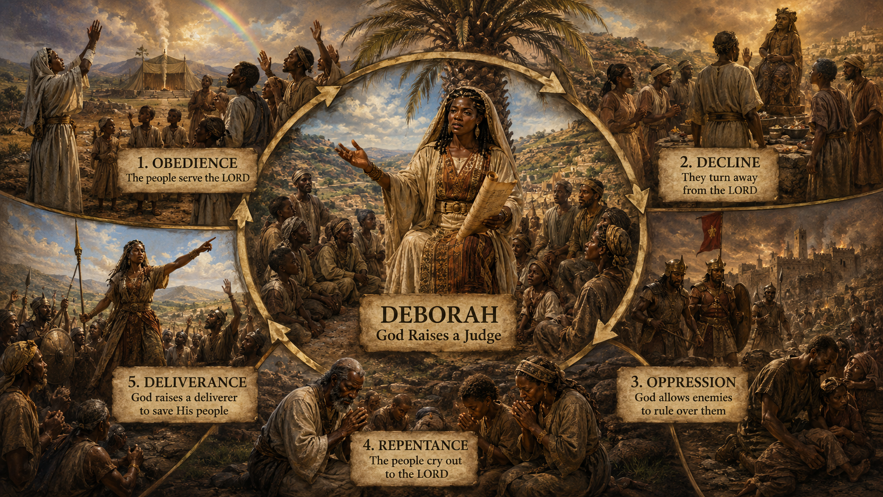
LESSON INTRODUCTION
DEBORAH, DUTIFUL JUDGE
Supportive Greatness
Numerous world records were broken during the 2024 Olympic Games. One was for sport climbing, set by Sam Watson (USA). Sam claimed the climbing record by completing the course in just 4. 74 seconds! Amazingly, Sam also held the previous record of 4. 75 seconds. He beat his own record by . 01 second! Sometimes, the smallest victories require the most extraordinary dedication.
Sam is a fantastic athlete, but like anyone attempting an audacious goal, he needed help and support. Enter the role of a coach! Sam’s coach enabled his growth capacity through knowledge, confidence, and courage. He emboldened Sam toward consistent training and offered encouragement when doubts crept in. Coaches are rarely seen or noticed, but their impact is esteemed when their students succeed. As you ponder today’s lesson, consider the out-in-front and behind-the-scenes roles of Deborah and Jael in Israel’s victory. Leadership comes in many forms.
3
4
Notes:
Main Idea
Greatness is rarely achieved alone. Even when one person appears to stand in the spotlight, there are often faithful supporters, encouragers, and guides working behind the scenes to help make the victory possible.
Summary
The story of Sam Watson’s world-record sport climb reminds us that even the smallest improvement can require great effort, discipline, and support. Although Sam was the athlete who broke the record, his coach played an important role by building his confidence, sharpening his training, and encouraging him through moments of doubt. This example connects to the lesson of Deborah and Jael, showing that leadership does not always look the same. Some leaders stand publicly in front, while others serve quietly behind the scenes. Both roles matter in God’s work.
Three Key Points
Small victories can require great dedication.
Sam Watson improved his own record by only .01 second, but that tiny gain reflected discipline, training, and determination.
Supportive leadership helps others succeed.
A coach may not receive the applause, but the coach’s guidance, encouragement, and wisdom can help bring out greatness in others.
Leadership comes in many forms.
Deborah led openly with wisdom and courage, while Jael acted decisively in a less visible role. Both were used in Israel’s victory.
Three Life Lessons Learned
Do not overlook the people who help you grow.
Behind many accomplishments are people who prayed, encouraged, taught, corrected, and strengthened us along the way.
You can make a difference without being in the spotlight.
God can use quiet supporters, faithful helpers, and behind-the-scenes workers to accomplish important things.
Courage is strengthened through encouragement.
When doubts arise, a wise and faithful voice can help us keep moving toward what God has called us to do.

Slide 5
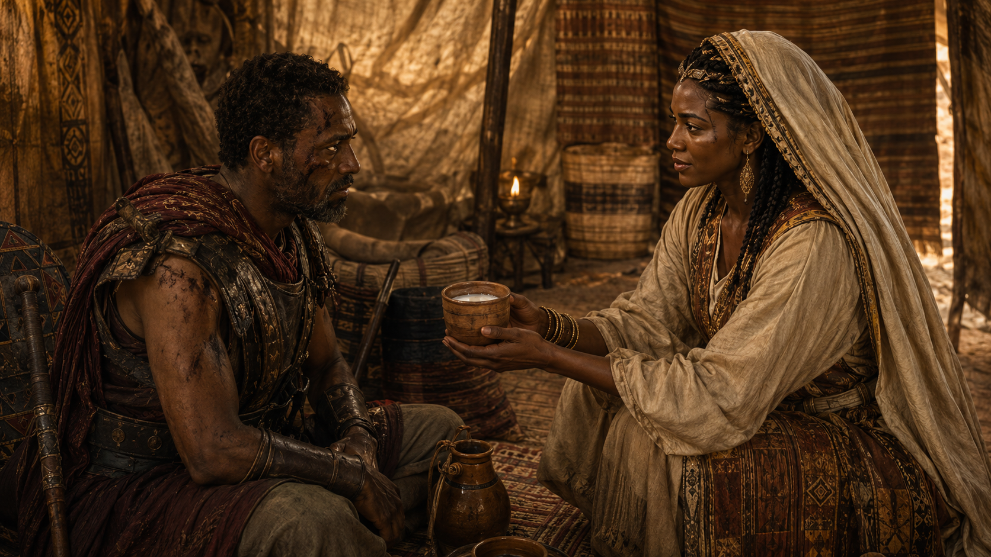
CONCLUSION
LIVING IN CHRISTIAN COMMUNITY
Support Scripture for Lesson - Week of June 8 through June 13
► Ezekiel 18:5–9—Living a Righteous Life.
► Genesis 16:1, 4–16—Trusting a God Who Sees.
► Proverbs 6:20–22—Keeping Wise Counsel.
► Psalm 113—Praising the Lord.
► Isaiah 66:9–13—Comforting like a Mother.
► Luke 1:46–55—Rejoicing in God’s Deliverance.
God sees, guides, comforts, corrects, and delivers His people. He calls us to live righteously, listen to wise counsel, trust Him in hardship, praise Him in all seasons, and rejoice in His saving power. Whether through justice, mercy, comfort, or deliverance, God reveals Himself as faithful and compassionate.
5
Notes:
The lesson God wants us to learn is this: live faithfully before Him, trust that He sees every situation, and praise Him because His mercy reaches both the humble and the hurting.
Ezekiel 18:5–9 — Living a Righteous Life
Analysis:
This passage describes the character of a righteous person. Righteousness is shown through justice, faithfulness, moral purity, honesty, mercy, and obedience to God’s commands.
Summary:
God honors the person who lives rightly, treats others fairly, avoids sin, helps the needy, and walks faithfully in His statutes.
Commentary:
A righteous life is not only about religious words but daily conduct. God wants His people to practice justice, compassion, integrity, and obedience in ordinary life.
Genesis 16:1, 4–16 — Trusting a God Who Sees
Analysis:
Hagar is mistreated, rejected, and alone, but God sees her pain. He meets her in the wilderness and gives her hope, direction, and a promise.
Summary:
Although Sarai and Abram acted impatiently, God showed mercy to Hagar and revealed Himself as the God who sees and cares.
Commentary:
This passage teaches that God notices people others overlook. Even in rejection, confusion, or hardship, God sees, hears, speaks, and provides purpose.
Proverbs 6:20–22 — Keeping Wise Counsel
Analysis:
This passage urges children to hold closely to the teaching and instruction of godly parents. Wise counsel protects, guides, and speaks to us throughout life.
Summary:
Godly instruction should be treasured, carried in the heart, and allowed to guide our steps, rest, and decisions.
Commentary:
Wisdom is not meant to be heard once and forgotten. God uses faithful teaching to guard us from danger and help us make righteous choices.
Psalm 113 — Praising the Lord
Analysis:
Psalm 113 calls God’s servants to praise Him because He is high above all nations, yet lovingly reaches down to lift the poor and needy.
Summary:
The Lord is exalted above heaven and earth, but He cares for the lowly, raises the poor, and gives joy to the barren.
Commentary:
God’s greatness does not make Him distant. His power is joined with compassion. He sees the humble and lifts those who cannot lift themselves.
Isaiah 66:9–13 — Comforting Like a Mother
Analysis:
God promises restoration, joy, and comfort to His people. Like a mother comforting her child, the Lord brings peace, nourishment, and hope.
Summary:
God assures His people that He will complete what He begins and comfort Jerusalem with tenderness, abundance, and peace.
Commentary:
This passage reveals God’s gentle care. He is not only mighty to deliver but tender enough to comfort His people in their pain.
Luke 1:46–55 — Rejoicing in God’s Deliverance
Analysis:
Mary praises God for His mercy, power, and faithfulness. She rejoices because God lifts the humble, scatters the proud, and remembers His promises.
Summary:
Mary magnifies the Lord for choosing her, showing mercy, reversing human pride, and fulfilling His covenant promise to Israel.
Commentary:
Mary’s song teaches that true worship flows from remembering God’s mercy. God delivers not by human status, but by His grace and faithfulness.

Slide 6
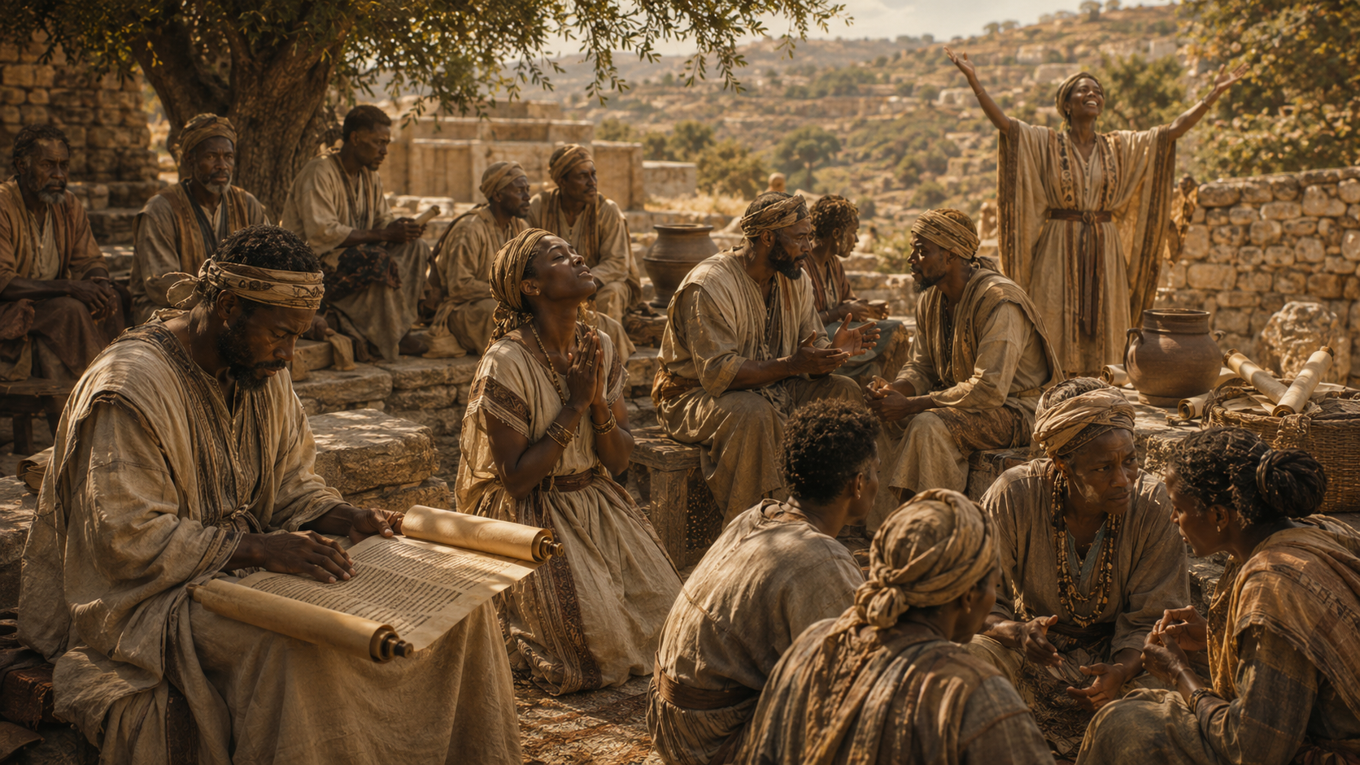
LESSON CONTEXT
DEBORAH, DUTIFUL JUDGE
Judges examines the time between Joshua’s conquest of the land of Canaan and the introduction of kingship to the nation of Israel. During this time, there is no formal leadership in the land. God’s people fall into cycles of sin and rebellion and find themselves calling out to God for rescue. God then raises up judges to save the Israelites from their enemies. The third of these cycles introduces us to Deborah, a prophet and judge who leads Israel during a time of military crisis.
The book of Judges opens with the news that Joshua, Moses’ successor, has died. His death signals a transition to what we now call “the period of the judges” (about 1373–1043 BC). The firm, centralized leadership that nomadic Israel knew under Moses and Joshua is gone. A theocracy remains in its place—a rule by God.
Before the tribes of Israel went to their respective portions of land, they agreed to serve God (Joshua 24:14–28). But that didn’t happen; the Israelites’ commitment to God faded as the generation of the conquest died. The new generation worshiped fictitious Canaanite gods such as Baal and Ashtoreth (Judges 2:10–13) as “every man did that which was right in his own eyes” (17:6; 21:25). Because of their idolatry, God handed His people over to their enemies. Oppression and hardship resulted (2:14–15).
A cyclical pattern characterizes the book of Judges: (1) obedience to God brings peace and stability to Israel; (2) the people’s resolve weakens, and faithfulness to God’s covenant falters; (3) a
disintegration of spiritual well-being breaks down the community, leaving God’s people vulnerable to repression and attacks from external enemies; (4) oppression and suffering trigger repentance; and (5) God mercifully raises a leader to deliver them from their enemies.
Typically, when we hear the noun judge, we think of a magistrate who renders legal decisions in a court of law. The Old Testament use of the term is much broader, however. The book of Judges uses the word judge to describe a leader who renders decisions for the nation. As such, the word is used to describe officials who make legal decisions in civil and criminal cases (example: Deuteronomy 25:1–2), prophets (Judges 4:4), military commanders (2:18), and even the Lord Himself (11:27). In all instances, the “judge” was to lead in accordance with the will of God.
Today’s text takes us to approximately 1225 BC, where we consider the fourth of Israel’s judges.
6
Notes:
Lesson Context
Analysis
This lesson context explains the spiritual and historical background of Deborah’s ministry. After Joshua died, Israel entered a difficult season without strong central human leadership. God remained their true ruler, but the people failed to remain faithful to Him. As each generation drifted farther from the covenant, Israel turned to false gods and followed personal desires instead of God’s commands. This rebellion brought oppression and hardship. Yet God continued to show mercy by raising judges to lead, correct, and deliver His people. Deborah appears as a prophet and judge during one of these rescue moments.
Main Idea
When Israel drifted from God and suffered the consequences, God mercifully raised judges like Deborah to guide, correct, and deliver His people.
Summary
The book of Judges covers the period between Joshua’s leadership and the rise of Israel’s kings. After Joshua died, Israel no longer had the same centralized leadership it had known under Moses and Joshua. Although the tribes had promised to serve the Lord, their commitment weakened over time. The next generation turned to false gods such as Baal and Ashtoreth and did what was right in their own eyes. This led to oppression, suffering, repentance, and God’s merciful rescue. Judges were not only legal officials; they were leaders, prophets, commanders, and deliverers called to act according to God’s will.
Three Key Points
Israel entered a leadership transition after Joshua’s death.
The nation moved from strong visible leadership under Moses and Joshua into the period of the judges, where God remained the true ruler.
Spiritual decline brought national consequences.
Israel’s failure to remain faithful led to idolatry, moral confusion, oppression, and hardship.
God raised judges as instruments of mercy and deliverance.
Judges were called to lead the people, settle matters, command armies, speak God’s word, and help restore Israel according to God’s will.
Three Life Lessons Learned
Every generation must personally choose to follow God.
Faith cannot survive on memory alone. Each generation must be taught God’s Word and must decide to obey Him.
Life becomes unstable when people do what is right in their own eyes.
When God’s truth is ignored, personal opinion replaces obedience, and disorder follows.
God remains merciful even when His people fail.
Israel’s rebellion brought consequences, but when they cried out, God raised deliverers. His compassion was greater than their repeated failures.

Slide 7
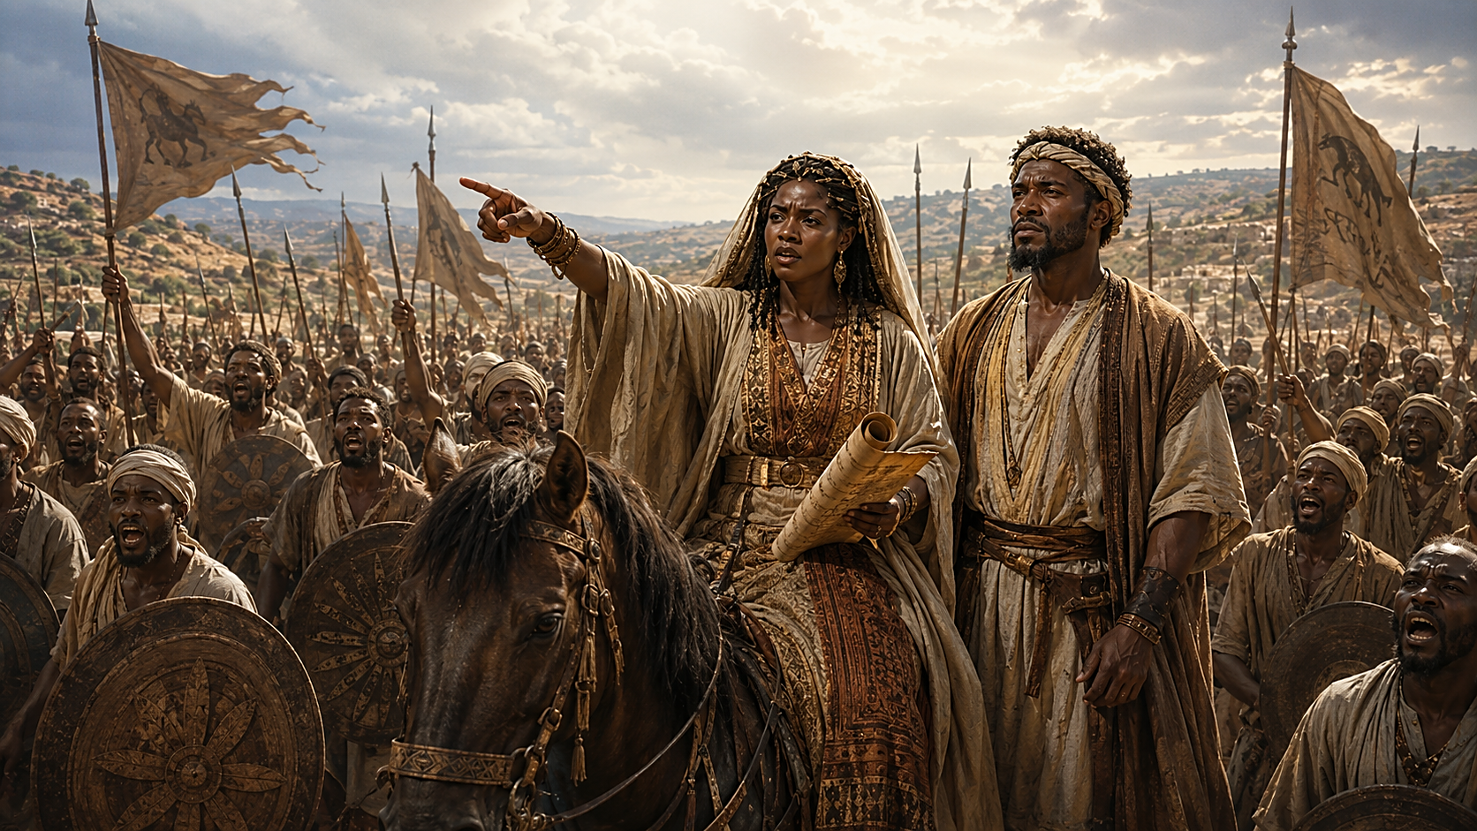
LESSON CONTEXT
DEBORAH, DUTIFUL JUDGE
Judges—Anarchy and God’s Faithfulness
The book of Judges is one of the most graphic and depressing books of the Bible. It shows a vicious cycle of sin and rebellion; and by the end of the book, things have descended into complete anarchy. But Judges also shows us the faithfulness of God. Despite the sinfulness of His people and the consequences of that sin, time and time again, God is willing to step in to rescue the Israelites. They cry out to the Lord in their oppression, and He raises up a judge to rescue them. These judges have a variety of personalities and character issues—some are upstanding, others are morally corrupt, others are afraid and some are foolish. But God works with each of them, showing His compassion, His faithfulness, and His willingness to rescue His people no matter the circumstances.
Female Prophets
Deborah is called a prophet in Judges 4; and she is acting as a judge of Israel, listening to disputes and handing out decisions. She is the only female judge mentioned in the book. But Deborah is not the only female prophet in the Bible. Miriam, Moses’ sister, is called a prophet in Exodus 15:20; and 2 Kings 22:14 recognizes Huldah as God’s prophetic messenger to Josiah. In the New Testament, Anna speaks about the baby Jesus to everyone (Luke 2:36–38). Philip’s daughters in Acts 21:9 are also called prophets. God’s Spirit is poured out on both men and women who prophesy, declaring the messages of God and sharing the good news about Jesus (Joel 2:28-29; Acts 2:14-18).
7
Notes:
1. Female Prophets
Analysis
This section shows that God has used women throughout Scripture to speak His message and guide His people. Deborah served as both prophet and judge, giving spiritual direction and settling disputes. She was not an exception to God’s ability to use women in ministry. Miriam, Huldah, Anna, and Philip’s daughters also carried prophetic roles. The larger message is that God’s Spirit is not limited by gender, status, or human expectations.
Main Idea
God calls and uses both men and women to proclaim His truth and serve His people.
Summary
Deborah was a prophet and judge in Israel, leading with wisdom and spiritual authority. She was the only female judge named in the book of Judges, but she was not the only female prophet in the Bible. Other women, such as Miriam, Huldah, Anna, and Philip’s daughters, also spoke or proclaimed God’s message. This shows that God’s Spirit works through both men and women to declare His Word and advance His purpose.
Three Key Points
Deborah served as both a prophet and judge in Israel.
Other women in Scripture also carried prophetic roles.
God pours out His Spirit on both men and women to declare His message.
Three Life Lessons Learned
We should not limit who God can use.
Faithful leadership is based on obedience to God, not human expectations.
Every believer should be open to serving when God calls.
2. Judges—Anarchy and God’s Faithfulness
Analysis
This section explains the tragic pattern found in Judges: Israel sins, suffers, cries out, and God raises a deliverer. The book is dark because it shows what happens when people reject God and live by their own desires. Yet it is also hopeful because God continues to respond with mercy. Even when His people are rebellious, fearful, or morally weak, God remains faithful. His compassion is greater than their failure.
Main Idea
Even when people fall into sin and disorder, God remains faithful and willing to rescue those who cry out to Him.
Summary
The book of Judges shows Israel repeatedly turning away from God and falling into sin, rebellion, and chaos. Their disobedience brings painful consequences, including oppression by enemies. Yet when the people cry out to God, He raises judges to deliver them. These judges are not perfect people. Some are brave, some are afraid, some are foolish, and some are deeply flawed. Still, God works through them to show His mercy, faithfulness, and power to rescue.
Three Key Points
Israel repeatedly fell into a cycle of sin and rebellion.
Sin brought disorder, oppression, and suffering.
God faithfully raised deliverers when His people cried out.
Three Life Lessons Learned
Life becomes unstable when people reject God’s direction.
God’s mercy is available even after repeated failure.
God can use imperfect people to accomplish His purpose.

Slide 8

LESSON CONTEXT
DEBORAH, DUTIFUL JUDGE
God’s Presence in Battle
In the ancient Near East, wars were always considered theological. Nations fought one another, and the combatants believed that whichever side’s gods were more powerful would be victorious (because gods were supposedly as violent and jealous for power as humans). Thus, before going to battle, ancient leaders would seek the sanction of gods, offering sacrifices to ensure victory.
We see a similar mindset in the people of Israel. Deborah knows that God has gone before them into battle (Judg. 4:14). But God does the unexpected, time and again. In another example of this, the Israelites bring the ark of the covenant into battle, assuming that they’ll inevitably win with God’s presence (1 Sam. 4). But God is not a talisman to be used like a charm. He allows them to lose the battle, only to bring the ark back to Israel without the army’s help (1 Sam. 6:1–16)! God does bring victory to His people, but only in a way that demonstrates His supreme authority.
8
Notes:
3. God’s Presence in Battle
Analysis
This section teaches that God’s presence cannot be controlled or used like a good-luck charm. In ancient times, people often believed battles proved which god was stronger. Israel also struggled with this thinking when they brought the ark into battle, assuming victory would automatically follow. Deborah, however, understood that victory came because God had gone before them. God brings deliverance in His own way, at His own time, and for His own glory.
Main Idea
God gives victory according to His authority, not according to human assumptions, rituals, or attempts to control Him.
Summary
In the ancient Near East, warfare was often viewed as a contest between gods. Nations sought divine approval before battle, believing victory showed whose god was greater. Israel sometimes adopted a similar mindset, thinking God’s presence could guarantee success on their terms. However, God cannot be manipulated. Deborah knew God had gone before Israel in battle, but the story of the ark in 1 Samuel shows that God’s presence must never be treated like a charm. God brings victory in ways that reveal His supreme authority.
Three Key Points
Ancient battles were often understood as spiritual or theological events.
Israel sometimes wrongly assumed God’s presence could be used to guarantee victory.
God gives victory in ways that prove His power and authority.
Three Life Lessons Learned
We must trust God, not religious symbols or routines alone.
God’s presence is a gift, not something we control.
True victory comes when God leads and receives the glory.

Slide 9
LESSON OVERVIEW
DEBORAH, DUTIFUL JUDGE
God’s Rescue Plan -Judges 4:4–10, 14 NIV
  4 Now Deborah, a prophet, the wife of Lappidoth, was leading Israel at that time.
  5 She held court under the Palm of Deborah between Ramah and Bethel in the hill country of Ephraim, and the Israelites went up to her to have their disputes decided.
  6 She sent for Barak son of Abinoam from Kedesh in Naphtali and said to him, “The Lord, the God of Israel, commands you: ‘Go, take with you ten thousand men of Naphtali and Zebulun and lead them up to Mount Tabor.
  7 I will lead Sisera, the commander of Jabin’s army, with his chariots and his troops to the Kishon River and give him into your hands. ’”
  8 Barak said to her, “If you go with me, I will go; but if you don’t go with me, I won’t go. ”
  9 “Certainly I will go with you,” said Deborah. “But because of the course you are taking, the honor will not be yours, for the Lord will deliver Sisera into the hands of a woman. ” So Deborah went with Barak to Kedesh.
  10 There Barak summoned Zebulun and Naphtali, and ten thousand men went up under his command. Deborah also went up with him.
  14 Then Deborah said to Barak, “Go! This is the day the Lord has given Sisera into your hands. Has not the Lord gone ahead of you?” So Barak went down Mount Tabor, with ten thousand men following him.
  It is a time of tumult and unrest: Israel is oppressed by a Canaanite king and his commander, Sisera.
  For twenty years, the iron chariots of Sisara have kept the tribes of Israel in line.
  Israel’s leader is the prophet named Deborah.
  Deborah calls for a man named Barak, whom God wants to assemble an army.
  Instead of listening immediately, Barak will obey only if Deborah accompanies him.
  Deborah agrees, but prophesies that the honor will pass to a woman.
  Barak and Deborah marshal an army of ten thousand at Mount Tabor.
9
Notes:
><><><><><><><><><><><><><><><><><><
Judges 4:4–10, 14 NIV
><><><><><><><><><><><><><><><><><><
God’s Rescue Plan
The setting is a period of upheaval during the era of judges. God was with Moses during the wilderness journey and with Joshua as Israel came into the land of promise. But Joshua’s death left a vacuum of spiritual and military leadership. The book of Judges describes Israel’s habit of doing what is “right” in their own eyes (Judg. 17:6; 21:25). Despite their religious compromises and rampant idolatry, God does not stop responding to their prayers and sending deliverers to rescue them from the hand of enemies.
The chapter begins by noting that Israel has been oppressed by the Canaanites for two decades. Sisera commands an army of nine hundred ironclad chariots and makes a fearsome foe (Judg. 4:1–3). The leader of Israel at this time is a woman: a prophet named Deborah. The Hebrew text says that she “sits” beneath a palm tree, where she settles conflicts (v. 5). Like other prophets, she is able to share God’s perspective on current events and acts as Israel’s judge, as Moses had first done (see Ex. 18:13).
As the Lord’s representative and mouthpiece, Deborah commands a man named Barak to assemble the army that shall defeat Sisera’s powerful chariots: God shall give the victory (vv. 6–7). Instead of showing courage, Barak agrees only if Deborah accompanies him and risks her own life (v. 8). Deborah does go, but she prophesies that “the Lord will deliver Sisera into the hands of a woman” (v. 9). Since women at the time do not fight in the army, this is an unexpected or even shameful twist: a woman showing courage where a man is not. Thus together, Barak and Deborah gather the tribes of Zebulun and Naphtali and prepare ten thousand men for battle (v. 10). Deborah reassures them that Yahweh shall be at the forefront of any battle, and victory over Sisera will be theirs (v. 14).
God’s Rescue Plan
Analysis
This section shows Israel in a time of spiritual weakness, national oppression, and military danger. After Joshua’s death, the people lacked strong spiritual leadership and repeatedly did what was right in their own eyes. Yet God continued to hear their cries and send deliverers. Deborah stands out as a faithful prophet and judge who speaks God’s command with courage. Barak hesitates, but Deborah obeys and encourages him. The victory would not come from military strength, but from God going before His people.
Main Idea
God delivers His people through His own power, often using unexpected leaders and unlikely methods to accomplish His purpose.
Summary
During the period of the judges, Israel was oppressed by the Canaanites for twenty years. Sisera, the enemy commander, had nine hundred iron chariots, making him a powerful threat. Deborah, a prophet and judge, received God’s command and called Barak to gather ten thousand men for battle. Barak agreed to go only if Deborah went with him. Deborah went, but declared that the honor of victory would go to a woman. She assured Barak that the Lord had gone before them and would give them victory.
Three Key Points
Israel was in spiritual and national crisis.
The people had drifted from God, followed their own ways, and suffered under Canaanite oppression.
Deborah provided faithful leadership.
As prophet and judge, she spoke God’s word, settled disputes, encouraged obedience, and gave courage in a fearful time.
God promised the victory.
Sisera had chariots and military strength, but Deborah reminded Barak that the Lord had already gone before Israel.
Three Life Lessons Learned
God hears His people even after failure.
Israel had sinned and compromised, yet God still responded when they cried out for help.
Courage grows when we trust God’s word.
Barak feared the battle, but Deborah’s confidence came from knowing what God had spoken.
God can use unexpected people to accomplish His will.
Deborah’s leadership and the promised role of a woman in Sisera’s defeat show that God is not limited by human expectations.

Slide 10
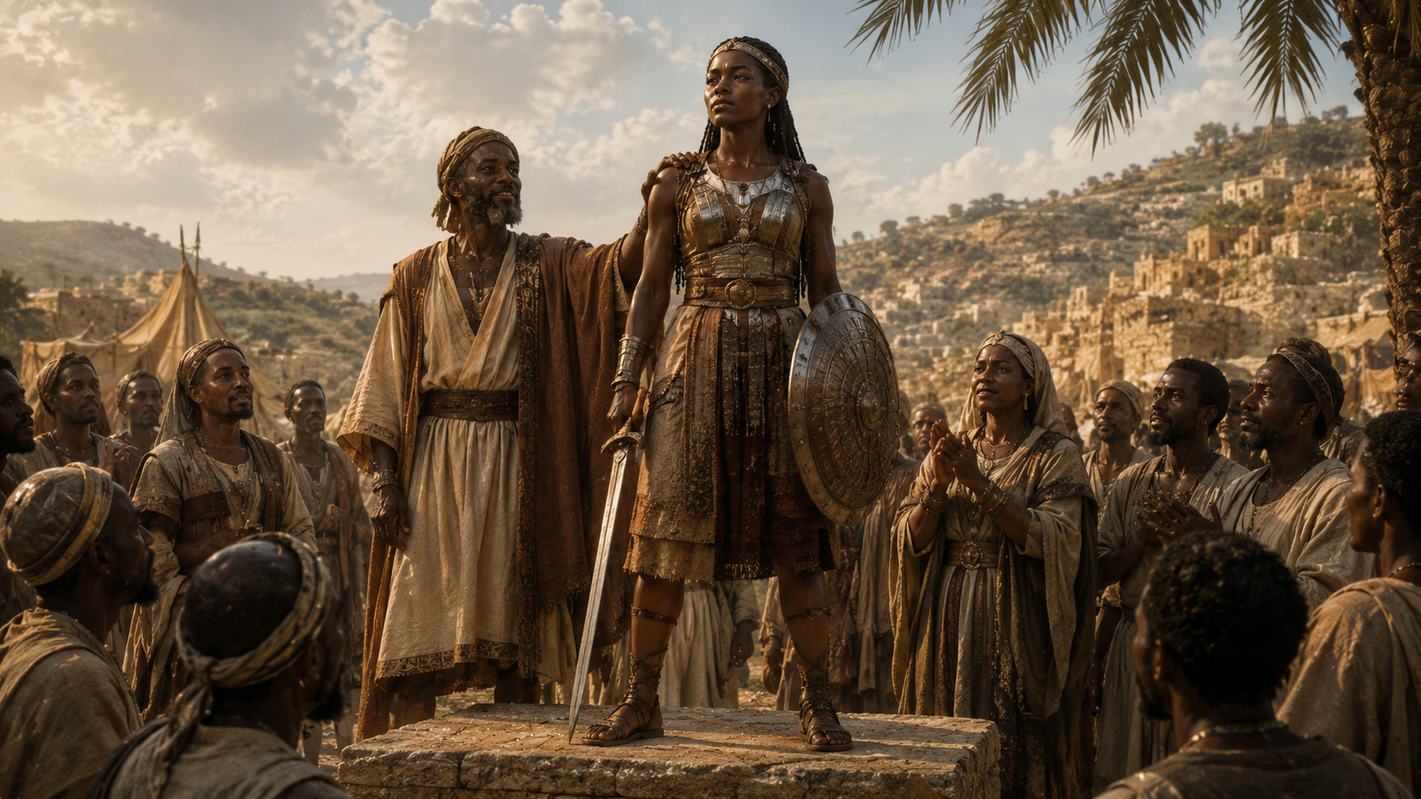
LESSON OVERVIEW
DEBORAH, DUTIFUL JUDGE
An Unlikely Champion - Judges 4:21–22 NIV
  21 But Jael, Heber’s wife, picked up a tent peg and a hammer and went quietly to him while he lay fast asleep, exhausted. She drove the peg through his temple into the ground, and he died.
  22 Just then Barak came by in pursuit of Sisera, and Jael went out to meet him. “Come,” she said, “I will show you the man you’re looking for. ” So he went in with her, and there lay Sisera with the tent peg through his temple—dead.
  Sisera has escaped the defeat of his powerful army with its ironclad chariots.
  Sisera flees on foot, coming to the home of his allies, a family of Kenites.
  The wife of this Kenite leader is Jael, who invites Sisera to hide in her tent.
  While Sisera hides under a blanket, Jael pounds a tent peg through his head.
  Barak arrives and finds Sisera dead, the oppression of Israel at an end for many years.
10
Notes:
><><><><><><><><><><><><><><><><><><
><><><><><><><><><><><><><><><><><><
An Unlikely Champion
Readers might expect that Deborah will be heralded a victor over Sisera, as fulfillment of deliverance through “the hands of a woman” (v. 9). But Deborah isn’t mentioned in the account of the battle. Sisera—arrogant and eager to face rebel leaders—amasses his force to oppose Barak, taking all of his chariots to Mount Tabor where they are camped (vv. 12–13). Instead of holding the higher ground, Deborah sends Barak and his ten thousand foot soldiers down the mountainside to attack the ironclad chariots.
The description of fighting is short, but the text says that God sent the Canaanite chariots into confusion (v. 15). Later, Deborah taunts their defeat: “swept away” in the river (Judg. 5:21). This is similar to the way that Pharaoh’s army was lost (see Ex. 14–15). God is true to His word, and the chariot riders are defeated. Sisera has to climb down from his chariot to flee on foot, with danger close behind. He tries to escape to the neighboring territory controlled by a clan of Kenites, his allies (Judg. 4:17).
Right before the reading picks up again, we meet a second woman in the story: Jael, wife to the leader of this family of Kenites. These are Sisera’s allies: non-Israelites who Sisera fully expects to shield and hide him from the pursuit. But Judges tells us that Moses’ fatherin- law was a Kenite (Judg. 1:16). At least some Kenites have been on friendly terms with Israel in the past. We soon realize that Jael is not the ally she appears to be.
Sisera is glad to have safety and shelter, as Jael invites him to enter her tent. She gives him milk to drink, invites him to lie down beneath a thick blanket (vv. 18–19). Sisera falls asleep, thinking that this woman is standing guard to protect him.
Jael does the unexpected. She has no weapons and is clearly not a soldier. She reaches for what tools are at hand: a hammer and tent pegs. While the mighty Sisera slumbers, she drives a spike through his sleeping head and puts an end to this haughty leader who oppressed Israel. Just as Deborah prophesied, he is overcome by the hands of a woman. Barak soon arrives, too late to claim a captive (v. 22).
Later, in Judges 5, both Deborah and Barak sing of the Lord’s unexpected plan for His deliverance. They marvel at Jael’s victory, calling her blessed among women (Judg. 5:24). We learn from this song that, if Sisera and his army been the victorious, they would have taken “a woman or two for each man” as spoils of war (Judg. 5:30). Instead, it was two women—Deborah and Jael—whom God used to save His people.
An Unlikely Champion
Analysis
This section shows that God’s deliverance did not happen in the expected way. Deborah had prophesied that Sisera would fall “into the hand of a woman,” but the fulfillment came through Jael, not Deborah. Sisera trusted in military power, alliances, and his own status, yet God confused his army and reduced him to a fleeing soldier. Jael, who had no battlefield weapons and no public military role, used what was available to defeat him. God turned human expectations upside down and proved that victory belonged to Him.
Main Idea
God can use unexpected people, unexpected places, and unexpected methods to accomplish His deliverance and display His power.
Summary
Sisera came against Barak with iron chariots and military confidence, but God threw the Canaanite army into confusion. Sisera escaped the battlefield on foot and sought shelter among the Kenites, believing Jael would protect him. Instead, Jael welcomed him into her tent, gave him milk, covered him, and waited until he fell asleep. Then she used a hammer and tent peg to kill him. When Barak arrived, Sisera was already dead. Deborah’s prophecy was fulfilled: God delivered Sisera through the hand of a woman.
Three Key Points
God defeated superior military power.
Sisera’s iron chariots seemed unstoppable, but God confused the army and made their strength useless.
Sisera trusted the wrong sources of safety.
He trusted his chariots, his alliances, and Jael’s tent, but none could protect him from God’s judgment.
Jael became the unexpected instrument of deliverance.
She was not a soldier and had no weapon of war, yet God used her courage and ordinary tools to end Israel’s oppression.
Three Life Lessons Learned
Never assume God must work in predictable ways.
God’s plan may come through people, places, and methods we did not expect.
Human strength cannot stand against God’s purpose.
Sisera had chariots, power, and position, but he could not escape the Lord’s will.
Use what God has placed in your hands.
Jael did not have military weapons, but she used what was available. God can use ordinary tools and ordinary people for extraordinary purposes.
1 Why are Jael’s actions surprising?
It is unusual in the ancient world for a woman to be the person to kill a mighty warrior. If Sisera was killed, readers would expect him to die in combat at the battle against Barak. Jael is not even an Israelite, and she was not expected to be an enemy of Sisera.
2 Why would the text emphasize that women overcame Sisera?
God does not achieve victory by having the strongest fighters, the best chariots, or the visible advantage. By using women to overcome Sisera, God shows that He is the real victor. God is able to bring deliverance with the most unlikely of people and through the most unlikely of methods.
3 What does this show us about God?
There are a many things we can learn about God through this text: God is involved in the details; He enjoys surprises; God uses ordinary people. Even when we are hesitant to heed God’s call to action, we should show courage.

Slide 11
LESSON CONTEXT
DEBORAH, DUTIFUL JUDGE
One Bible, One Story
DEBORAH, DUTIFUL JUDGE
God’s Surprising Plan of Salvation
  Throughout Scripture, God’s rescue plans often look different from what the world would expect. A group of slaves overcome Pharaoh and the most powerful nation in the world. These former slaves and wanderers form a strong nation in the land that God gives to them. The youngest son of Jesse, David, is chosen over his brothers, becoming the greatest king of Israel.
  It may seem upside down to us, but the kingdom of God reorients how we look at power. The way of God brings salvation to the whole world by surprising us, again. The world in need of rescue is saved by God’s incarnate Son— without a display of visible power but by dying on the cross. Jesus is born through unusual circumstances (a virgin’s conception). He does not appear like a conquering king with trappings of authority. Instead, He grows up in Galilee and lives a simple life. His rescue involves sacrifice and suffering—giving Himself. As the greatest surprise, Jesus secures victory over death and sin for anyone who turns to Him.
11
Notes:
God’s Surprising Plan of Salvation
Analysis
This section shows that God’s way of saving and delivering people often does not match human expectations. The world often looks for strength, status, armies, wealth, and visible power. God often works through the weak, overlooked, humble, and unexpected. He delivered Israel from Pharaoh, chose David over his brothers, used Deborah and Jael in Judges, and finally brought salvation through Jesus Christ. The greatest victory came not through worldly power, but through Christ’s suffering, death, and resurrection.
Main Idea
God’s salvation often comes through unexpected people and unexpected ways, proving that true victory belongs to Him alone.
Summary
Throughout Scripture, God repeatedly delivers His people in surprising ways. He used former slaves to overcome Pharaoh, raised a wandering people into a nation, and chose David, the youngest son of Jesse, to become Israel’s greatest king. This pattern reaches its highest point in Jesus Christ. He was born through a virgin, lived humbly, and did not come as a worldly ruler. Instead, He saved the world through sacrifice, suffering, the cross, and resurrection. God’s kingdom changes how we understand power and victory.
Three Key Points
God often chooses the unlikely.
He used slaves, wanderers, the youngest son, faithful women, and humble servants to accomplish His will.
God’s power does not depend on worldly strength.
Armies, status, wealth, and position are not required for God to bring victory.
Jesus is the greatest example of unexpected deliverance.
Salvation came through His humble birth, simple life, sacrificial death, and victorious resurrection.
Three Life Lessons Learned
Do not judge God’s plan by human appearances.
What looks weak or small to people may be the very thing God uses for His greatest purpose.
Trust God when His way does not make sense.
God’s methods may surprise us, but His wisdom is always greater than our understanding.
True victory comes through surrender to Christ.
Jesus conquered sin and death not by worldly force, but by giving Himself for us.
Unified Lesson
God wants us to learn that His saving power is greater than human expectation. He does not need the strongest army, the highest position, or the most impressive person to accomplish His will. He can use the humble, the overlooked, and the unexpected. The cross proves that what looks like defeat can become God’s greatest victory. Therefore, we should trust His plan, follow His Son, and give Him the glory for every deliverance.

Slide 12
LESSON CONTEXT
DEBORAH, DUTIFUL JUDGE
CONCLUSION:
DEBORAH, DUTIFUL JUDGE
Emboldened Leader
  When a prophet’s words demonstrate truth and accuracy, they confirm the prophet’s calling and legitimacy. God proves Deborah’s predictions and faithfulness throughout the narrative. Judge Deborah is an emboldened witness of God’s fidelity and integrity.
  As prophetess, Deborah called Barak to her palm tree to relay God’s commands. She boldly informed him he was to go into battle and that God would bring about victory. Her initiative set Barak into action. Deborah remained steadfast despite Barak’s doubts and courageously followed him into the war, taking her place in military leadership for the sake of her people. She reminded Barak along the way that God planned their success, serving him through exhortation. She also assisted in discerning the correct timing and movement of the army (the role of both prophet and strategist). After their victory, Deborah led God’s people in praise: “Praise ye the Lord for the avenging of Israel, when the people willingly offered themselves” (Judges 5:2). She proved herself a loyal and dutiful deliverer for Israel, continually giving all glory and honor to the Lord.
  When the word of the Lord prompted Deborah, she responded with obedience. May her example inspire us all toward deferential submission to God’s instructions. Like Deborah, may we encourage others to take God at His word.
12
Notes:
Emboldened Leader
Analysis
This section presents Deborah as a faithful, courageous, and obedient leader. Her prophetic words were proven true, confirming that she spoke on behalf of God. She did not simply give Barak instructions and remain distant; she went with him, encouraged him, and helped guide the timing of Israel’s response. Deborah’s leadership was spiritual, strategic, and courageous. She strengthened Barak’s faith, served the people, and gave glory to God after the victory.
Main Idea
Deborah’s courage came from trusting God’s Word, and her leadership helped others obey God with confidence.
Summary
Deborah was an emboldened leader because she believed and obeyed the word of the Lord. As prophetess and judge, she called Barak, delivered God’s command, and assured him that God would bring victory. Even when Barak hesitated, Deborah remained steady and agreed to go with him into battle. She helped guide the army’s timing and movement and later led the people in praise. Her leadership pointed others to God, not to herself.
Three Key Points
Deborah’s words were confirmed by God.
Her prophecy came true, proving that she spoke faithfully as God’s messenger.
Deborah encouraged obedience in others.
She helped Barak move from hesitation to action by reminding him of God’s promise.
Deborah gave glory to God.
After the victory, she led the people in praise and recognized that the deliverance belonged to the Lord.
Three Life Lessons Learned
Godly leaders help others trust God’s Word.
Deborah did not seek attention for herself; she encouraged Barak to believe and obey what God had spoken.
Courage means standing firm even when others hesitate.
Deborah remained faithful when Barak was uncertain and continued moving forward in obedience.
Victory should lead to worship, not pride.
Deborah’s response to success was praise. She reminds us that every true victory belongs to God.

Slide 13
CONCLUSION:
DEBORAH, DUTIFUL JUDGE
Apply the Message: Only God can be our ultimate deliverer.
Clues Point Back to God
  The biblical text tells us that Deborah is a prophet. We readers are waiting to see her words proved true, since this is the mark of valid prophecy (see Deut. 18:21–22). But imagine the suspense from her perspective, which we only see in bits and pieces! Deborah was courageous enough to call God’s people to the defense of their territory against the superior foe. And when the confidence of Barak wavered, Deborah’s word remained the same.
  She was willing to risk her safety to accompany the army, and she gave the word for the attack. Before that day, no one would have predicted strong chariots becoming useless, or that the arrogant Canaanite commander would die by tent peg. Perhaps you have played a murder mystery game where you have tried to guess the circumstances of a person’s death. Would anyone following the clues guess, “The woman Jael, in a tent, with a tent peg”?
  But God uses the unlikely and improbable circumstances to drive the message: victory belongs to Him. Without relying on God’s miraculous intervention, the scattered tribes of Israelites would never control or manage the important land they were possessing. It calls to mind the words of Moses to his successors: “The Lord himself goes before you and will be with you; . . . Do not be afraid; do not be discouraged” (Deut. 31:8).
  Sometimes we need the unexpected to wake us up to our inability to save ourselves. If Barak had summarily marched the army to a conventional victory, there would be songs written in his honor. Instead, the song of Deborah and Barak praises God and the people who answered His call (Judg. 5:1–31). The conclusion of God’s mighty work is this: “The land had peace forty years” (v. 31).
13
Notes:
Only God Can Be Our Ultimate Deliverer
“Clues Point Back to God”
Analysis
This section teaches that the events in Deborah’s story were arranged so that the final credit would point back to God. Deborah’s prophecy was proven true, Barak’s hesitation did not stop God’s plan, Sisera’s military advantage failed, and Jael’s unexpected action fulfilled God’s word. The unusual details make it clear that Israel’s victory was not based on human strength, strategy, or bravery alone. God used unlikely people and surprising circumstances to show that deliverance belongs to Him.
Main Idea
God often works through unexpected people and unlikely circumstances so that everyone can see that true deliverance comes from Him alone.
Summary
Deborah’s role as a prophet meant her words needed to be proven true. She courageously called Israel to battle, stood firm when Barak hesitated, and went with the army into danger. God then fulfilled His word in a surprising way. Sisera’s powerful chariots became useless, and the mighty commander was defeated by Jael using a tent peg. These unexpected events pointed back to God’s power. Instead of Barak receiving all the honor, Deborah and Barak praised the Lord, and the land enjoyed peace for forty years.
Three Key Points
Deborah’s prophecy proved God’s faithfulness.
Her words came true, showing that she spoke according to the will and message of God.
God used unlikely circumstances to reveal His power.
Iron chariots failed, Sisera fled on foot, and Jael became the unexpected instrument of victory.
The victory belonged to God, not human ability.
Barak fought, Deborah led, and Jael acted, but the deliverance came from the Lord.
Three Life Lessons Learned
We must trust God even when His plan seems unusual.
God’s way may not match our expectations, but His wisdom is greater than ours.
God can use our weakness to display His strength.
Israel could not defeat Sisera alone, but God worked through their obedience and His power.
Every victory should lead us to praise God.
When God delivers, the proper response is not pride but worship, gratitude, and testimony.
Lesson God Wants Us to Learn
God wants us to learn that He alone is our ultimate Deliverer. Human strength, planning, courage, and leadership all have value, but none can replace God’s power. Sometimes He allows the unexpected so we will stop trusting ourselves and recognize His hand at work. Like Deborah, we must stand on God’s Word. Like Barak, we must move forward even when afraid. Like Jael, we must be ready to act with what God has placed in our hands. Victory belongs to the Lord.

Slide 14
CONCLUSION:
DEBORAH, DUTIFUL JUDGE
Apply the Message: Only God can be our ultimate deliverer.
Inclusive Grace
    1 What feels different about resolving a problem with God’s help instead of on your own?
    2 Where and when are you tempted to credit your own ingenuity or work ethic for success?
    3 Where do you recognize the faith and courage of others who are following God into risky situations?
Notes:
1 What feels different about resolving a problem with God’s help instead of on your own?
When we solve problems with God’s help, we become aware of how much we rely upon Him. We can trust that God knows our troubles and has a plan for the future. Solving problems on our own can leave us anxious and unsettled, just waiting for the next thing to go wrong.
2 Where and when are you tempted to credit your own ingenuity or work ethic for success?
It can be easy to list our accolades, accomplishments, and skills as a way of saying to ourselves, I did this on my own. When we take the credit, we miss the greater context: God is the one who provided all the skills we have in the first place.
3 Where do you recognize the faith and courage of others who are following God into risky situations?
We can be encouraged by the example of other people who live courageous lives of faith. We might think immediately of people who are involved in missionary work in parts of the world that are hostile to Christianity. Or, we might have friends and family who set their own interests aside to help others (displaying confidence in God’s provision).

Slide 15
CONCLUSION
DEBORAH, DUTIFUL JUDGE
Live It Out:
Be courageous in faith, in every situation.
  Document what courageous faith means for us, either from our past experience or for the next challenge we might face. We should always be looking for ways that God can be credited for extraordinary provision. Our weakness is His strength.
Following when I’m Afraid
Courage is not the absence of fear but the willingness to act in the midst of fear. Deborah and Jael were not fearless, but God was able to use them to bring deliverance. The invitation for this week is to journal about an example of God’s provision in your own life.
Notes:
Be Courageous in Faith, in Every Situation
“Following When I’m Afraid”
Analysis
This section teaches that courageous faith is not the absence of fear. It is trusting God enough to obey Him while fear is still present. Deborah and Jael were placed in dangerous situations, yet God used their obedience to bring deliverance. Their courage did not come from personal strength alone, but from God’s power working through them. The lesson calls believers to remember past examples of God’s provision and to face future challenges with faith, knowing that God’s strength is made clear in human weakness.
Main Idea
Courageous faith means obeying God even when we are afraid, trusting that His strength is greater than our weakness.
Summary
The lesson encourages believers to live with courageous faith in every situation. Courage does not mean we never feel fear. It means we choose to trust and follow God despite fear. Deborah and Jael were not fearless, but God used them to bring deliverance to Israel. Their examples remind us to look for ways God has provided in the past and to trust Him with the challenges ahead. Journaling about God’s provision can help us remember that our weakness becomes a place where His strength is revealed.
Three Key Points
Courage is not the absence of fear.
Faithful people may still feel afraid, but they do not allow fear to stop their obedience.
God uses ordinary people in difficult moments.
Deborah and Jael were not powerful soldiers, yet God used them to accomplish His purpose.
God should receive credit for every provision.
When God strengthens us, protects us, or opens a way, we should recognize and testify that He made the difference.
Three Life Lessons Learned
Fear does not disqualify us from being used by God.
God can still work through us when we feel uncertain, weak, or overwhelmed.
Remembering past provision strengthens present faith.
When we look back at how God has helped us before, we gain courage to trust Him again.
Our weakness can become a testimony of God’s strength.
When we cannot do something in our own power, God’s help becomes more visible and meaningful.
Lesson God Wants Us to Learn
God wants us to learn that courageous faith is active trust. We do not have to wait until fear disappears before we obey Him. Like Deborah, we can encourage others to believe God’s Word. Like Jael, we can use what is available and act when God gives opportunity. When we face the next hard challenge, we should remember that God has already provided before. Our fear may be real, but God’s strength is greater.

Slide 16


End
  The Lord bless thee, and keep thee:
  The Lord make his face shine upon thee, and be gracious unto thee:
  The Lord lift up his countenance upon thee and give thee peace.
  - Numbers 6:24-26,
Material adapted by Stanford W. Bowman Jr. from Echoes® Adult and Bible-in-Life® Adult
Summer -2026 quarter with permission, © David C Cook, https://davidccook.org. May not be further reproduced. All rights reserved.

Slide 17
QUESTION & ANSWER
DEBORAH, DUTIFUL JUDGE
God’s Rescue Plan
1 Why do you think the text emphasizes Deborah’s leadership role as a woman?
2 What would cause Barak to hesitate when commanded to assemble an army?
3 When have you struggled to follow through on something that God asks?
It subverts the expectations of ancient readers. In the culture at the time, men were expected to be courageous in battle. Yet Barak is willing to go only if Deborah accompanies him. As a woman, Deborah is not expected to participate in a battle.
It would be terrifying to receive the call to go to war against a superior force. Even though Deborah says that Barak will be victorious with God’s help, that doesn’t make the enemy less formidable. Barak might doubt Deborah’s words or the authenticity of her prophecy. He might not even be certain that God will be faithful in this way.
God sometimes requires us to do things that are uncomfortable, even frightening. We might wonder whether we’re hearing His call correctly.
Notes:
God’s Rescue Plan
1 Why do you think the text emphasizes Deborah’s leadership role as a woman?
It subverts the expectations of ancient readers. In the culture at the time, men were expected to be courageous in battle. Yet Barak is willing to go only if Deborah accompanies him. As a woman, Deborah is not expected to participate in a battle.
2 What would cause Barak to hesitate when commanded to assemble an army?
It would be terrifying to receive the call to go to war against a superior force. Even though Deborah says that Barak will be victorious with God’s help, that doesn’t make the enemy less formidable. Barak might doubt Deborah’s words or the authenticity of her prophecy. He might not even be certain that God will be faithful in this way.
3 When have you struggled to follow through on something that God asks?
God sometimes requires us to do things that are uncomfortable, even frightening. We might wonder whether we’re hearing His call correctly.

Slide 18
QUESTION & ANSWER
DEBORAH, DUTIFUL JUDGE
An Unlikely Champion
1 Why do you think the text emphasizes Deborah’s leadership role as a woman?
2 Why would the text emphasize that women overcame Sisera?
3 What does this show us about God?
It is unusual in the ancient world for a woman to be the person to kill a mighty warrior. If Sisera was killed, readers would expect him to die in combat at the battle against Barak. Jael is not even an Israelite, and she was not expected to be an enemy of Sisera.
God does not achieve victory by having the strongest fighters, the best chariots, or the visible advantage. By using women to overcome Sisera, God shows that He is the real victor. God is able to bring deliverance with the most unlikely of people and through the most unlikely of methods.
There are a many things we can learn about God through this text: God is involved in the details; He enjoys surprises; God uses ordinary people. Even when we are hesitant to heed God’s call to action, we should show courage.
Notes:
An Unlikely Champion
1 Why are Jael’s actions surprising?
It is unusual in the ancient world for a woman to be the person to kill a mighty warrior. If Sisera was killed, readers would expect him to die in combat at the battle against Barak. Jael is not even an Israelite, and she was not expected to be an enemy of Sisera.
2 Why would the text emphasize that women overcame Sisera?
God does not achieve victory by having the strongest fighters, the best chariots, or the visible advantage. By using women to overcome Sisera, God shows that He is the real victor. God is able to bring deliverance with the most unlikely of people and through the most unlikely of methods.
3 What does this show us about God?
There are a many things we can learn about God through this text: God is involved in the details; He enjoys surprises; God uses ordinary people. Even when we are hesitant to heed God’s call to action, we should show courage.

Slide 19
End
  The Lord bless thee, and keep thee:
  The Lord make his face shine upon thee, and be gracious unto thee:
  The Lord lift up his countenance upon thee and give thee peace.
  - Numbers 6:24-26,
Material adapted by Stanford W. Bowman Jr. from Echoes® Adult and Bible-in-Life® Adult
Summer -2026 quarter with permission, © David C Cook, https://davidccook.org. May not be further reproduced. All rights reserved.

