Slide 1
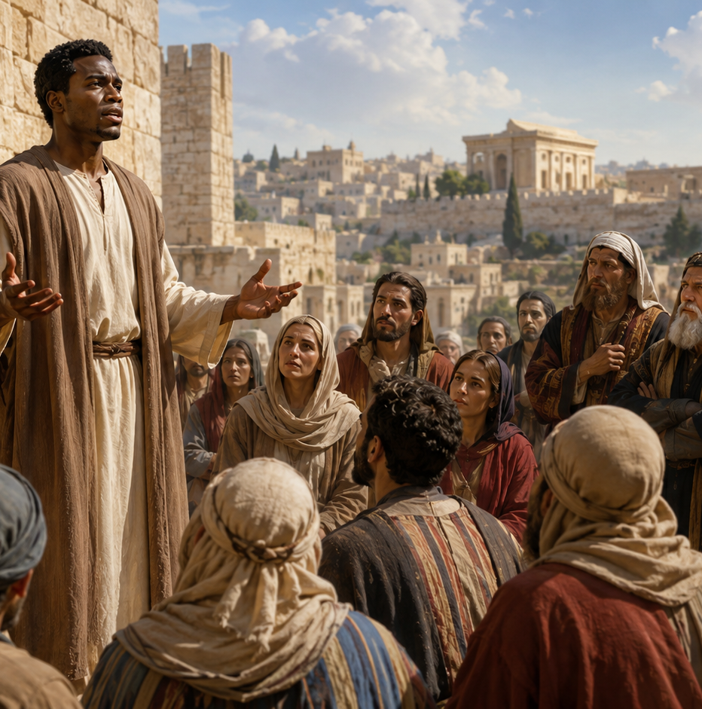
LESSON 10
STEPHEN, UNWAVERING MARTYR
Acts 6:7–10; 7:54–60
Main Message: Faithful witnesses stand for Jesus, even when truth brings opposition.
Lesson Focus: Nothing will stop the message of Jesus from going forth.
Key Text
And Stephen, full of faith and power, did great wonders and miracles among the people.
—Acts 6:8 KJV
1
Notes:
Main Idea: Stephen shows that faithful witness is measured by obedience to Christ, not by public approval or personal safety. His courage came from the Holy Ghost, not from human confidence alone.
Summary: The lesson begins with gospel growth in Jerusalem and ends with Stephen giving his life as the first Christian martyr. His story proves that opposition can harm the messenger, but it cannot stop the message of Jesus.
Commentary: Stephen served the church, spoke with wisdom, saw Christ in glory, and forgave his enemies. His life points us to Jesus, who also spoke truth, suffered unjustly, and prayed for His persecutors.

Slide 2
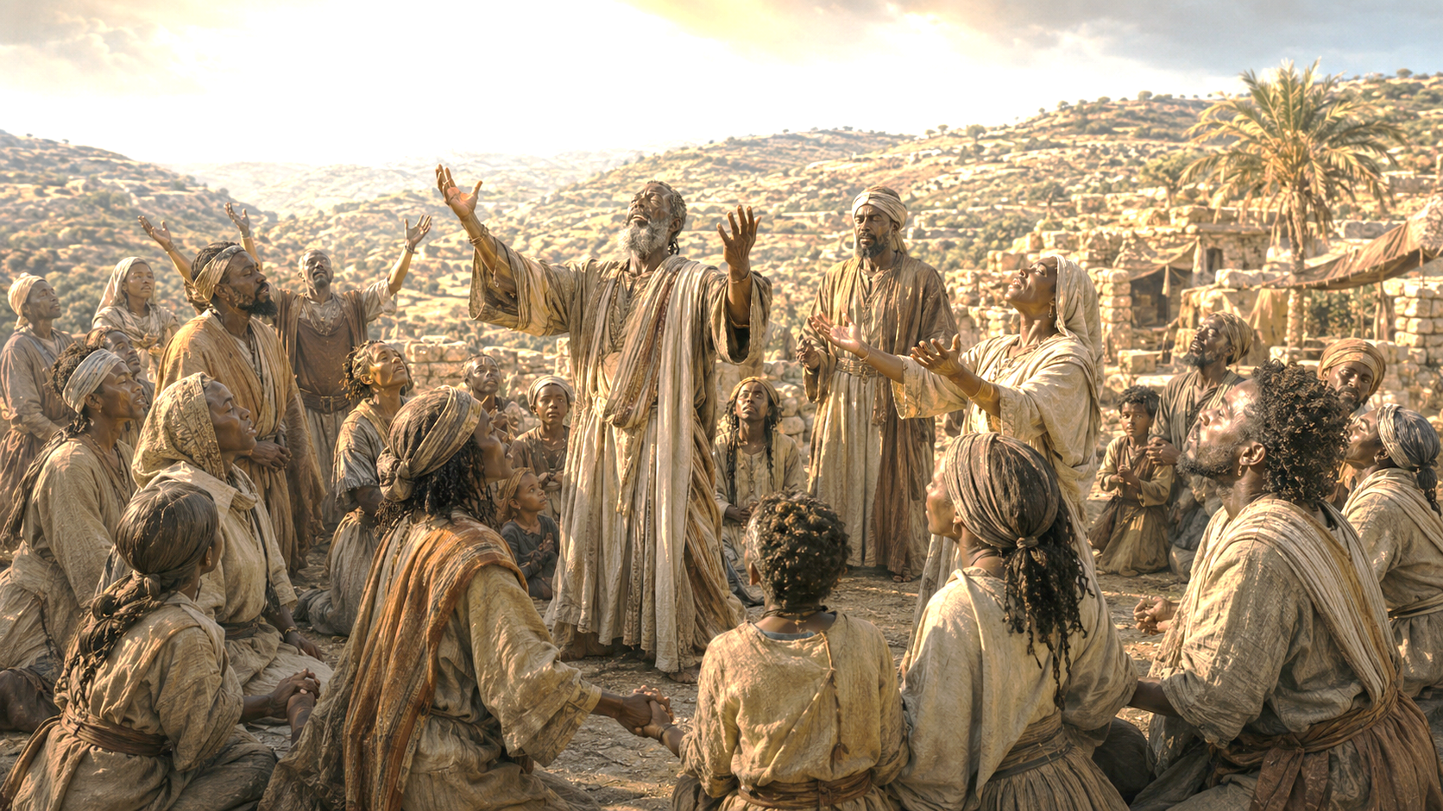
    Prayer
Father God, empower us to be courageous witnesses to Your Son in our own settings. Enable us to respond to opposition with as much wisdom, love, and dependence on the Spirit as possible. In Jesus’ name we pray.
Amen.
        Thought to Remember
          Respond to opposition as Jesus and Stephen did.
Notes:
Father God, empower us to be courageous witnesses to Your Son in our own settings.Enable us to respond to opposition with as much wisdom, love, and dependence on the Spirit as possible.In Jesus’ name we pray.Amen.
Thought to Remember
Respond to opposition as Jesus and Stephen did.

Slide 3
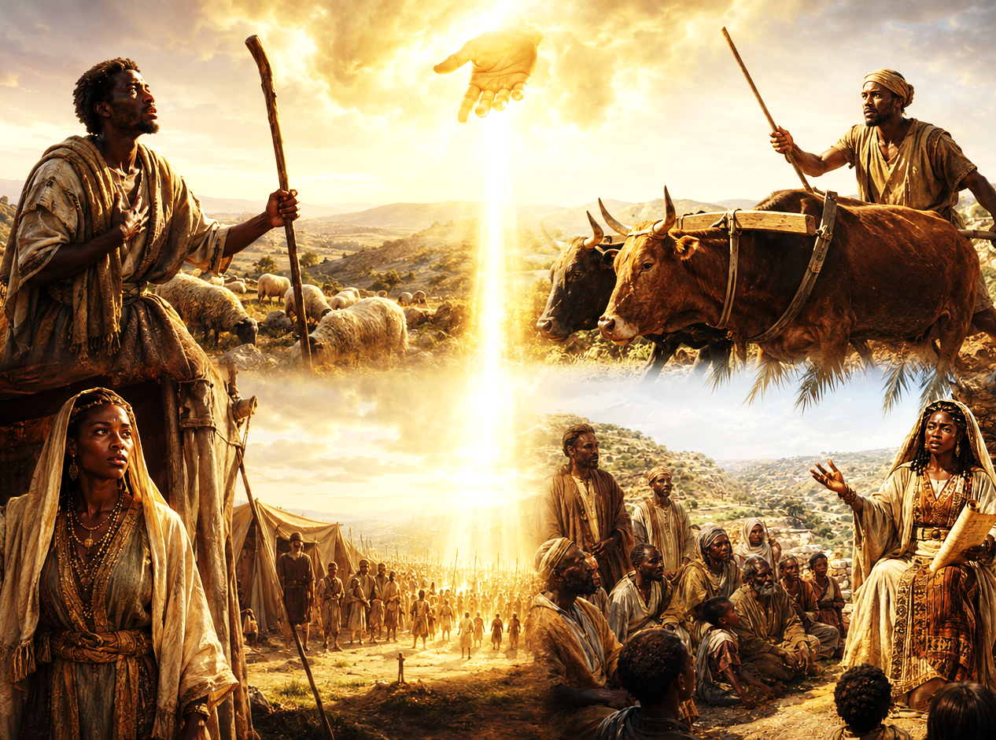
LESSON OUTLINE
STEPHEN, UNWAVERING MARTYR
  Lesson Scripture: Acts 6:7–10; 7:54–60
  Lesson Focus: Nothing will stop the message of Jesus from going forth.
  Apply the Message :
  Live It Out:
Opposition cannot stand in the way of what God is doing.
Trust God to bring hope out of desperation and opposition.
        Review
        Introduction
        Lesson Context
        Overview
            Disciple of Jesus - Acts 6:7–10 KJV
            Disciple Like Jesus - Acts 7:54–60 KJV
          Bible Application
        Conclusion
        Question & Answers
3
Notes:
Disciple of Jesus - Acts 6:7–10 KJV
Disciple Like Jesus - Acts 7:54–60 KJV
=================================
Main Idea: Nothing can stop the message of Jesus when His people remain faithful witnesses. Stephen served, spoke, suffered, and died under the power of the Holy Ghost. His opponents rejected the truth, but they could not defeat God’s purpose. Stephen’s faithfulness was measured not by personal safety or immediate results, but by his obedience and Christlike character. He teaches believers to serve humbly, speak truth wisely, trust Jesus completely, and forgive others under pressure. Earth rejected Stephen, but heaven received and honored him.
Analysis
The early church was experiencing remarkable growth. God’s Word spread, disciples multiplied, and many priests accepted the faith. Stephen’s ministry combined compassionate service, spiritual power, and courageous proclamation. When synagogue members opposed him, they could not refute the wisdom given by the Holy Ghost. The passage shows that gospel growth often attracts resistance, but opposition cannot remove the truth or silence a Spirit-filled witness.
Summary
God blessed the Jerusalem church with continued growth. Stephen, full of faith and power, performed wonders and spoke boldly. Members of several synagogues debated him, but they could not overcome the wisdom and spiritual authority with which he spoke.
Commentary
Stephen was selected to help meet practical needs, but his ministry extended beyond distributing food. He demonstrated that Christian service and gospel witness belong together. His effectiveness did not come merely from intelligence or speaking ability; it came from being controlled by the Holy Ghost. Faithfulness did not prevent conflict. Instead, Stephen’s growing influence exposed resistance among those unwilling to accept the message of Jesus.
Acts 7:54–60
Analysis
Stephen’s sermon convicted the Sanhedrin, but conviction did not produce repentance. Their hardened hearts turned truth into rage. In contrast, Stephen remained filled with the Holy Ghost and focused upon heaven. He saw God’s glory and Jesus standing at God’s right hand. Although condemned by an earthly council, Stephen was approved by heaven. His final prayers reveal that the Spirit had formed the forgiving character of Jesus within him.
Summary
The council became furious, rejected Stephen’s testimony, and stoned him outside the city. Stephen saw Jesus standing at God’s right hand and entrusted his spirit to the Lord. Before dying, he prayed that God would not hold his killers’ sin against them. Saul witnessed the execution.
Commentary
Stephen died as a disciple who reflected his Master. Like Jesus, he was falsely accused, rejected by religious authorities, committed his spirit to God, and prayed for his enemies. His vision assured him that death was not defeat. The presence of Saul also shows that faithful witness can influence people in ways the believer may never see. Stephen’s voice was silenced, but his testimony continued shaping the gospel’s advance.

Slide 4
OVERVIEW
STEPHEN, UNWAVERING MARTYR
LESSON CONTEXT
A growing church faced rising tension.
Spirit-Led Speech
Speech guided by the Holy Spirit is a frequent pattern in Acts. The Spirit-led speech takes a variety of forms: speaking in other languages (2:7–8), prophecy (21:10–11), proclamation of Jesus (5:29–32), and careful arguments and debates (17:24–28). In each case, believers are following the advice of Jesus, who encouraged them that the Spirit would give words at the right time, “when you are brought before synagogues, rulers and authorities” (Luke 12:11–12).
Even as God gives people the right words to say, they continue meet resistance. Here, Stephen speaks with wisdom to his opponents in a local synagogue and the members of the Sanhedrin. His speech refutes the charges brought against him while accusing his opponents of wrongdoing. It prepares them for God to work on their hearts. Even
though it did not save his life, Stephen’s witness would be instrumental in shaping the ministry of the apostle Paul.
Faithful service prepares believers for faithful witness.
4
Notes:
God uses Spirit-filled servants who unite compassionate ministry with courageous truth, even when their faithful witness faces resistance. Stephen served within a rapidly growing church that needed both practical care and spiritual leadership. His character—faith, wisdom, power, and fullness of the Holy Ghost—prepared him to care for people, proclaim Christ, and defend the gospel.
Three Key Points
Character qualifies believers for service. Stephen was selected because he was full of faith, wisdom, and the Holy Ghost—not merely because he possessed natural ability.
Christian witness joins compassion with proclamation. Stephen served neglected people while also teaching, defending, and demonstrating the gospel.
The Holy Ghost provides wisdom under opposition. Stephen’s opponents could argue against him, but they could not refute the Spirit-given wisdom by which he spoke.
Three Life Lessons Learned
No faithful act of service is insignificant. Caring for people’s practical needs can become a powerful expression of Christ’s love and open opportunities for witness.
Prepare your character before seeking a position. The church needed trustworthy servants whose spiritual lives matched the responsibilities they were given.
Faithfulness is not measured by immediate acceptance. People may reject biblical truth, but obedient witness can influence lives and advance God’s purpose beyond what we presently see.
Summary
As the Jerusalem church grew, the apostles appointed seven qualified servants to care for neglected widows while they remained devoted to prayer and the ministry of the Word. Stephen stood out as a man full of faith and the Holy Ghost. He served people compassionately, performed wonders, and spoke with Spirit-given wisdom. Although his opponents could not refute him, they continued resisting his message. His faithful witness eventually cost him his life, yet it contributed to the gospel’s advance and left a lasting impression on Saul.
Commentary
The early church did not treat practical service and spiritual proclamation as competing ministries. Caring for widows was a sacred responsibility, just as preaching and prayer were sacred. Stephen demonstrated that a believer can serve physical needs while also addressing spiritual needs.
His speech followed a repeated pattern in Acts: the Holy Ghost empowered believers to speak clearly in different circumstances. Spirit-led speech included proclamation, prophecy, other languages, and careful debate. Jesus had promised that the Spirit would provide wisdom when His followers stood before hostile authorities.
However, Spirit-given words do not guarantee acceptance. Stephen’s opponents could not defeat his wisdom, but they refused his message. His witness did not preserve his earthly life, yet it exposed hardened hearts, glorified Christ, strengthened the church, and became part of the spiritual background to Saul’s later ministry.
Analysis
Stephen’s story reveals how the church should respond to growth, internal needs, and outside opposition. The apostles protected prayer and biblical teaching without ignoring neglected widows. They shared responsibility with spiritually mature servants, preserving both unity and ministry effectiveness.
Stephen then moved naturally from practical service to public witness. His ministry was not divided into “social work” and “spiritual work”; everything he did flowed from the Holy Ghost. His opponents’ inability to answer him showed the strength of God’s wisdom, while their continued resistance revealed that unbelief is often a heart problem rather than a lack of evidence.
Stephen’s earthly outcome appeared tragic, but his witness was not wasted. His faithfulness modeled Jesus, helped move the gospel beyond Jerusalem, and remained in Saul’s memory. The lesson is clear: serve people faithfully, speak God’s truth courageously, depend upon the Holy Ghost, and trust God with the results.

Slide 5
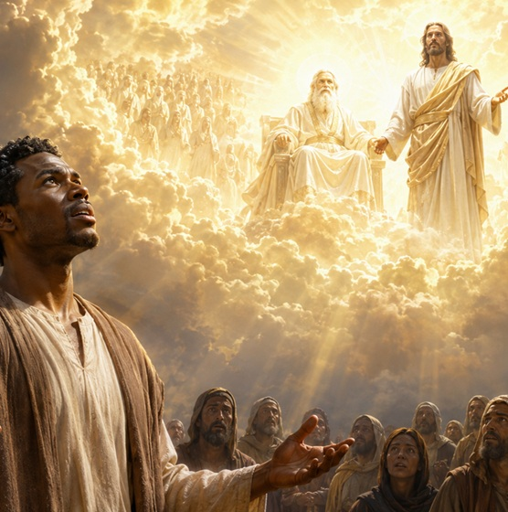
OVERVIEW
STEPHEN, UNWAVERING MARTYR
LESSON CONTEXT
A growing church faced rising tension.
A Vision of Jesus
When the Sanhedrin hears Stephen’s speech, they grind their teeth at him. This is a visceral sign of their contempt and a clear indication that they reject his testimony. But Stephen’s vision, in addition to being a personal comfort to him in an extremely tense situation, is a vindication of his testimony. The glorious vision establishes Stephen as the one who is in touch with the truth and who truly sees God. For a moment, Stephen, along with the readers of Acts, sees what is happening in heaven. The text doesn’t say why Jesus is standing, but it is suggestive of a kind of attentiveness that sitting would not communicate. It is as if Jesus is standing to behold the scene and to give His own
testimony in favor of Stephen and against the Sanhedrin. In Romans 8:34, Paul notes that Jesus’ presence at the right hand of God means that He “is also interceding for us.”
Faithful service prepares believers for faithful witness.
5
Notes:
Stephen shows that a Spirit-filled disciple serves people compassionately, speaks God’s truth wisely, and remains Christlike under opposition. Although rejected by earthly authorities, he was approved and vindicated by heaven. Acts 6 presents a rapidly growing church that needed practical care and spiritual leadership. Stephen was chosen because he was full of faith, wisdom, power, and the Holy Ghost. He served neglected people while also proclaiming Christ. His opponents could not refute his Spirit-given wisdom.
When the Sanhedrin rejected his testimony, Stephen saw God’s glory and Jesus standing at God’s right hand. His vision confirmed that his witness was true. Though killed for his faith, Stephen trusted Christ, forgave his attackers, and left a testimony that influenced Saul’s future ministry.
Three Key Points
1. Christian service combines compassion and proclamation Stephen was chosen to help meet the church’s practical needs, but his ministry did not end there. He cared for people, performed wonders, and proclaimed the gospel. The early church understood that meeting physical needs and sharing spiritual truth are both essential parts of Christian witness.
2. The Holy Ghost gives wisdom, but truth may still face resistance Stephen’s opponents could not overcome the wisdom and Spirit by which he spoke. Nevertheless, they refused to repent. Spirit-led speech does not guarantee human acceptance; it guarantees that believers can faithfully communicate God’s truth when challenged.
3. Heaven vindicated the witness rejected on earth The Sanhedrin expressed rage, but Stephen saw God’s glory and Jesus standing at God’s right hand. Scripture does not explain why Jesus stood, but the image may suggest divine attention, approval, and welcome. The earthly council condemned Stephen, but heaven affirmed him.
Three Life Lessons Learned
1. Character prepares us for service Stephen was selected because his life matched the responsibility. Godly service requires faith, wisdom, spiritual maturity, and dependence upon the Holy Ghost.
2. Opposition does not mean our witness has failed Stephen’s message did not save his life, but it exposed unbelief, honored Christ, strengthened the church, and helped prepare the way for the gospel’s continued advance.
3. A true disciple responds like Jesus under pressure Stephen entrusted his spirit to Christ and prayed for his killers. Christian maturity is revealed not only by what we say when life is comfortable, but by whether we show faith, mercy, and forgiveness while suffering.
Analysis
This material presents Stephen as both a servant and a witness. His ministry began within a growing church where neglected widows needed care. The apostles protected their responsibility to prayer and the Word by appointing qualified servants. Stephen’s spiritual character made him effective in both practical ministry and public proclamation.
The Sanhedrin’s grinding of their teeth revealed more than disagreement; it showed contempt and hardened resistance. Instead of receiving conviction as an opportunity to repent, they turned conviction into hostility. Stephen, however, remained controlled by the Holy Ghost rather than by fear or anger.
His heavenly vision reversed the council’s judgment. The leaders believed Stephen was opposing God, yet God allowed him to see divine glory and the exalted Christ. Jesus standing at God’s right hand may suggest attentiveness, advocacy, and approval, but the text does not directly explain the posture.
Stephen’s death appeared to be a defeat, but it became part of the gospel’s advance. Saul witnessed the execution, later remembered his involvement, and eventually became a powerful apostle of Jesus Christ. Stephen teaches that faithful witness is measured by obedience, not immediate acceptance, safety, or visible success.

Slide 6
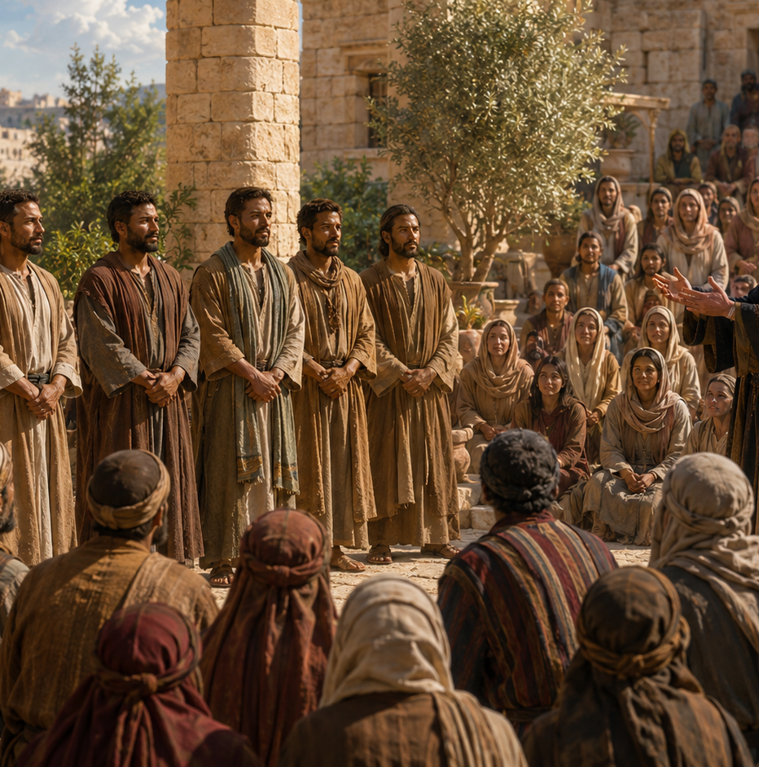
OVERVIEW
STEPHEN, UNWAVERING MARTYR
LESSON CONTEXT
A growing church faced rising tension.
Paul Was There
The passing reference to Saul (Paul) might seem like a minor element in the story, but it is an important detail. It means that Paul is complicit in the murder of Stephen as an observer. This prepares us for the revelation later in Acts that Paul actively persecutes Christians. Indeed, persecuting Christians is what he is on his way to do when he has a vision of the risen Christ. We are told that a great persecution arose in Jerusalem in connection with Stephen’s stoning. Paul was one of the persons responsible, and he worked to have Christians bound, beaten, and imprisoned. Stephen’s death and Saul’s role made a lasting impression. When Paul defends his faith, he refers to being present on this occasion: “I stood there giving my approval and guarding the clothes of those who were killing him” (Acts 22:20). Servant leaders were chosen to meet real needs. Stephen served faithfully and became a bold witness.
Faithful service prepares believers for faithful witness.
6
Notes:
Concluding Truth
God uses Spirit-filled servants to meet real needs, proclaim Christ, and leave lasting witnesses. Even persecution cannot stop the gospel, and even a persecutor can be transformed by the grace of Jesus Christ.
Stephen’s faithful service and courageous witness helped advance the gospel, while Saul’s participation in his death revealed how far a hardened heart can resist God’s truth. Acts presents Stephen as a Spirit-filled servant chosen to help meet practical needs within the growing church. His faithfulness in service developed into bold public witness. When he was stoned, Saul stood nearby, approved the execution, and guarded the killers’ garments. This detail prepares readers for Saul’s later persecution of Christians. Yet Stephen’s death was not meaningless. His Christlike courage and forgiveness became part of the testimony Saul remembered after encountering the risen Jesus.
Three Key Points
1. Stephen’s character qualified him for service Stephen was chosen because he was full of faith, wisdom, and the Holy Ghost. The church needed someone who could be trusted to care for neglected widows with fairness and compassion.
2. Christian service and gospel proclamation belong together Stephen did not limit ministry to practical assistance. He served people’s needs while also boldly proclaiming Jesus. Compassion supported his message, and his witness gave spiritual meaning to his service.
3. Saul was involved in Stephen’s persecution Saul did not merely observe Stephen’s death as a neutral spectator. He approved the execution and guarded the garments of those who carried it out. This became the beginning of his active campaign against the church.
Three Life Lessons Learned
1. Faithfulness in s mall responsibilities prepares us for greater service Stephen first accepted a practical assignment. His faithful character opened opportunities for him to become a powerful witness for Christ.
2. People may remember our Christian response under pressure Stephen’s courage, prayer, and forgiveness left a lasting impression. Believers may never fully know how their faithful example affects those who observe them.
3. No sinner is beyond the transforming grace of God Saul participated in persecution, yet Christ later confronted, saved, and called him. His life demonstrates that God can transform an enemy of the gospel into a servant of the gospel.
Analysis
The reference to Saul connects Stephen’s martyrdom with the next major movement in Acts. Stephen’s death triggered widespread persecution, but that persecution scattered believers and carried the gospel beyond Jerusalem. Saul attempted to destroy the church by imprisoning and beating Christians, yet God used the witness of those believers as part of Saul’s preparation for conversion.
Stephen and Saul represent two opposing responses to Christ. Stephen surrendered to the Holy Ghost and became increasingly like Jesus. Saul resisted the truth and became increasingly violent. However, the risen Christ interrupted Saul’s path and changed his direction. Stephen’s witness therefore was not defeated by death; it became part of the gospel story that eventually included Saul’s transformation into Paul.

Slide 7
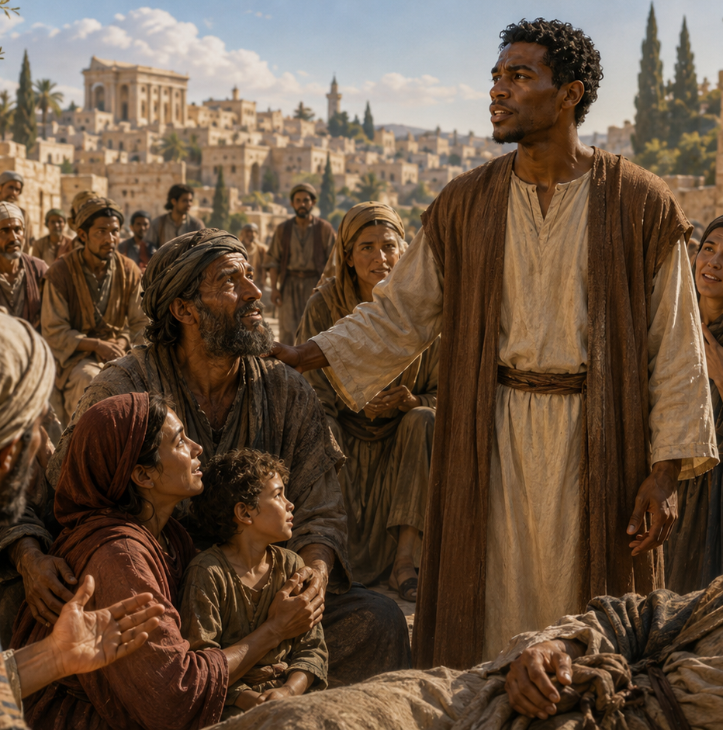
STEPHEN, UNWAVERING MARTYR
Disciple of Jesus - Acts 6:7–10 KJV
  A disciple of Jesus is shaped by God’s Word and empowered by the Holy Spirit. Like Stephen, true disciples serve faithfully, speak with wisdom, stand firm under pressure, and trust God when truth is opposed.
The Word grew, and Stephen served.
7 And the word of God increased; and the number of the disciples multiplied in Jerusalem greatly; and a great company of the priests were obedient to the faith.
8 And Stephen, full of faith and power, did great wonders and miracles among the people.
9 Then there arose certain of the synagogue, which is called the synagogue of the Libertines, and Cyrenians, and Alexandrians, and of them of Cilicia and of Asia, disputing with Stephen.
10 And they were not able to resist the wisdom and the spirit by which he spake.
God can use ordinary service to make an extraordinary witness.
Christian courage speaks truth with wisdom and peace.
God wants us to serve, speak, and depend on the Holy Ghost.
7
Notes:
God wants believers to remain faithful regardless of the response they receive. We must serve others, speak truth with wisdom, depend upon the Holy Ghost, keep our attention upon Jesus, and forgive those who mistreat us. True Christian success is not measured by comfort, popularity, or immediate results. It is measured by obedience and Christlike faithfulness.
A faithful disciple serves humbly, speaks God’s truth courageously, trusts Jesus under pressure, and forgives those who cause suffering. God’s Word continued spreading, and the church multiplied. Stephen, filled with faith, wisdom, power, and the Holy Ghost, served the people and boldly proclaimed Christ. His opponents could not overcome the wisdom with which he spoke. Later, the religious council rejected his message and stoned him. Stephen saw Jesus standing at God’s right hand, entrusted his spirit to the Lord, and prayed for the forgiveness of his killers.
Three Key Points
1. The gospel continued to advance The number of disciples increased because God’s Word was faithfully taught and received. Even strong opposition could not stop the growth of the church.
2. Stephen depended upon the Holy Ghost Stephen’s wisdom, courage, and power did not come from human ability alone. His ministry was effective because he was filled with faith and controlled by the Holy Ghost.
3. Stephen reflected the character of Jesus As he died, Stephen trusted Jesus and forgave his enemies. His final words closely reflected Christ’s prayers from the cross.
Three Life Lessons Learned
1. Faithful service can lead to greater opportunities Stephen began by helping meet practical needs, but God also used him as a powerful witness. No act of Christian service is insignificant.
2. Opposition does not always mean failure Stephen was rejected and killed, yet he remained successful in God’s sight because he obeyed his calling and remained faithful.
3. Forgiveness reveals spiritual maturity Stephen refused to answer hatred with hatred. A mature disciple places judgment in God’s hands and responds to mistreatment with Christlike mercy.
Analysis
The passage presents two opposite responses to God’s truth. Stephen received the truth, submitted to the Holy Ghost, and became increasingly like Christ. The council heard the truth but hardened their hearts, allowing conviction to become anger and violence. Stephen looked toward heaven while his enemies focused upon destroying him. Although earth rejected Stephen, heaven approved him. His death did not stop the gospel; it became part of God’s plan to spread the message beyond Jerusalem.

Slide 8
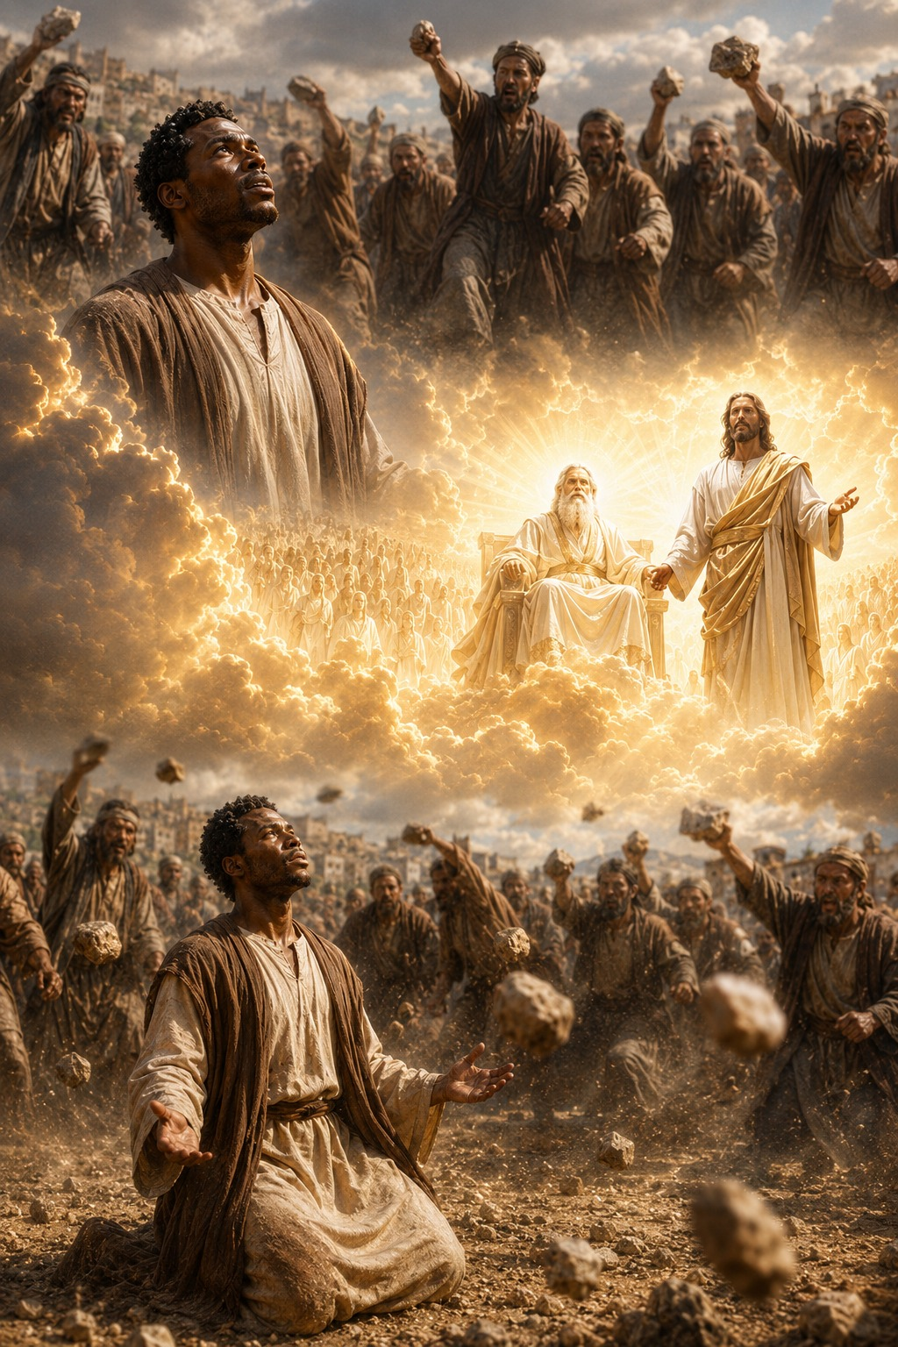
STEPHEN, UNWAVERING MARTYR
Disciple Like Jesus - Acts 7:54–60 KJV
Conviction turned into rage.
54 When they heard these things, they were cut to the heart, and they gnashed on him with their teeth.
55 But he, being full of the Holy Ghost, looked up stedfastly into heaven, and saw the glory of God, and Jesus standing on the right hand of God, 56 And said, Behold, I see the heavens opened, and the Son of man standing on the right hand of God.
57 Then they cried out with a loud voice, and stopped their ears, and ran upon him with one accord, 58 And cast him out of the city, and stoned him: and the witnesses laid down their clothes at a young man’s feet, whose name was Saul.
59 And they stoned Stephen, calling upon God, and saying, Lord Jesus, receive my spirit.
60 And he kneeled down, and cried with a loud voice, Lord, lay not this sin to their charge. And when he had said this, he fell asleep.
Stephen’s final moments reveal true discipleship. Though rejected on earth, he was approved by heaven. Facing death, he trusted Jesus, forgave his killers, and showed that Christlike faith speaks truth, trusts God, and extends mercy under suffering.
  Truth can expose the heart before it changes the heart.
  When believers look to Christ, suffering loses the final word.
  His final witness was prayer, trust, and forgiveness.
8
Notes:
A disciple like Jesus remains faithful to God’s truth, looks to Christ in suffering, and responds to hostility with mercy. Stephen’s sermon brought conviction, but the council chose resistance instead of repentance. Although rejected by earthly authorities, Stephen was approved by heaven and strengthened by a vision of the risen Jesus. Even while being killed, he trusted Christ and prayed for his enemies. Stephen teaches that spiritual victory is not always escape from suffering. Sometimes victory means remaining faithful within suffering and allowing the character of Jesus to be seen through our courage, trust, and forgiveness.
The leaders heard God’s truth, but pride turned conviction into rage instead of repentance. Stephen reviewed Israel’s history and exposed a repeated pattern of resisting God, rejecting His messengers, and disobeying His Word. He accused the council of resisting the Holy Ghost and participating in the rejection of Jesus, the Righteous One. His words reached their hearts, but instead of confessing their sin, they became furious and attacked him.
Three Key Points
Stephen used Scripture to reveal the truth. His message was grounded in Israel’s history, the law, and the prophets.
The council experienced conviction. They were “cut to the heart,” showing that Stephen’s words affected them deeply.
Pride prevented repentance. Rather than receiving correction, they hardened themselves and became violent.
Three Life Lessons Learned
Conviction should lead us to repentance. When God’s Word exposes sin, we should confess it rather than defend ourselves.
Strong emotions do not prove that truth is wrong. Anger may reveal that truth has touched an area we do not want to surrender.
We must remain faithful when others reject the message. Our responsibility is to speak God’s truth with wisdom and leave the results to Him.
Analysis
The council’s reaction reveals the danger of religious pride. These leaders knew Scripture, valued the temple, and defended their traditions, yet they resisted the Holy Ghost working through Stephen. Their problem was not a lack of information but an unwillingness to submit. Conviction is an act of mercy because it gives sinners an opportunity to turn back to God. However, repeated resistance can harden the heart until correction is treated as an attack and truth is answered with hostility.
Heaven Vindicates Stephen
Although Stephen was condemned on earth, heaven approved him, and Jesus stood with His faithful servant. While the council surrounded Stephen with anger, he remained full of the Holy Ghost and looked steadfastly toward heaven. God allowed him to see divine glory and Jesus standing at the right hand of God. Stephen openly testified that the heavens were opened and that he saw the Son of man in His exalted position.
Three Key Points
Stephen remained filled with the Holy Ghost. The hostility around him did not control the spirit within him.
Stephen looked above his circumstances. He focused upon God’s glory rather than the rage of the council.
Jesus was alive, exalted, and attentive. Stephen’s vision confirmed that the risen Lord ruled from heaven and stood with him.
Three Life Lessons Learned
Keep your eyes upon Christ during suffering. Circumstances may be frightening, but Jesus remains present and sovereign.
Human rejection does not cancel God’s approval. Others may misunderstand or condemn faithful believers, but God knows the truth.
The Holy Ghost supplies courage under pressure. Spiritual strength comes from God’s presence, not merely from personal determination.
Analysis
Stephen’s vision was both comfort and vindication. The earthly court declared him guilty, but heaven testified that he belonged to Christ. The source material notes that Jesus’ standing suggests unusual attention and support, as though the Lord were bearing witness in Stephen’s favor. Stephen did not escape suffering, but he was not abandoned within it. The believer’s security rests not in avoiding opposition but in knowing that the risen Christ sees, receives, and stands with His people.
3. Christlike Faith and Forgiveness
Main Idea
Stephen’s final words reflected Jesus: he trusted Christ with his spirit and extended mercy to his killers.
Summary
The mob dragged Stephen outside Jerusalem and stoned him while Saul watched over the witnesses’ garments. As Stephen suffered, he prayed, “Lord Jesus, receive my spirit.” Then he knelt and asked the Lord not to lay the sin of his murderers to their charge. Having entrusted himself and his enemies to God, Stephen died.
Three Key Points
Stephen trusted Jesus completely. He placed his life, death, and eternal future into the Lord’s hands.
Stephen forgave while suffering. He prayed for mercy instead of demanding revenge.
Stephen’s death resembled Christ’s death. Like Jesus, he committed his spirit to God and prayed for those killing him.
Three Life Lessons Learned
Faith is revealed most clearly under pressure. Difficult moments expose what we truly believe about God.
Forgiveness is a powerful Christian witness. Mercy toward an enemy shows that Christ has transformed the heart.
We can trust Jesus beyond death. The believer’s final hope is not earthly survival but eternal life with the Lord.
Analysis
Stephen’s greatest display of spiritual power was not escaping the stones but responding with Christlike grace. His prayer did not excuse the crowd’s sin; it surrendered judgment to God and asked for mercy. The Holy Ghost enabled Stephen to resemble Jesus at the moment of greatest suffering. His enemies controlled what happened to his body, but they could not control his faith, destroy his hope, or fill his heart with hatred.
4. Disciple Like Jesus
Main Idea
A true disciple increasingly reflects the words, actions, courage, trust, and mercy of Jesus.
Summary
Stephen’s ministry and death closely followed the example of Christ. He was full of the Holy Ghost, performed wonders, taught God’s Word, faced false accusations, appeared before religious authorities, and suffered an unjust death. Like Jesus, Stephen entrusted his spirit to the Lord and prayed for those responsible for his suffering.
Three Key Points
Stephen imitated Jesus in ministry.
He served people, proclaimed truth, and depended upon the Holy Ghost.
Stephen imitated Jesus in suffering.
He remained faithful despite rejection, false accusations, and violence.
Stephen imitated Jesus in character.
His final response was trust and forgiveness rather than fear and hatred.
Three Life Lessons Learned
Discipleship is more than knowing about Jesus.
It means becoming like Him in character and conduct.
Faithfulness may involve sacrifice.
Following Christ does not guarantee comfort, approval, or protection from suffering.
Our response to hostility reveals spiritual maturity.
Christlike believers speak truth without hatred and show mercy without compromising righteousness.
Analysis
Stephen’s life demonstrates that Christian discipleship is imitation shaped by the Holy Ghost. He did not merely repeat Jesus’ teachings; he reflected Jesus when facing the same kind of rejection. His courage, surrender, and forgiveness showed that Christ’s life was being reproduced in him. Stephen became a martyr in the fullest sense—a witness whose life and death directed attention to Jesus. His treatment also emphasizes the serious consequences of refusing God’s messengers and resisting the Holy Ghost.

Slide 9
CONCLUSION:
STEPHEN, UNWAVERING MARTYR
Apply the Message: Opposition cannot stand in the way of what God is doing.
More Than Results
  “What a waste!” Can you remember a time that you heard or said these words? Perhaps it was about an unwise purchase or some unused food being thrown away.
  Sometimes we say things like this about a human life when tragedy strikes. We might be tempted to look at Stephen’s horrific death and say, “What a waste!” He had so much potential. He was selected as a leader in the church in Jerusalem. He was recognized for his ability to serve others in desperate need. And he was killed before his time by opponents who made up false charges. They should have recognized the source of his wisdom was from God!
  Our society is often driven by bottom lines and the question “What have you done for me lately?” But the story of Stephen encourages us to ponder more deeply. If Stephen’s encounter with the Sanhedrin were evaluated for its immediate results, then we would consider it a failure. He preached the sermon of his life, but to what end? No fanfare—not even a single convert. His audience murdered him for bearing witness to the truth. If results were the only criterion, then “failure” could be the only reasonable judgment.
  But in God’s eyes, Stephen’s life and testimony are not a waste. God values virtue, not only results. God sees our character, even when we fail to achieve the results that we expected. Stephen’s witness has value apart from whatever consequences came. Sometimes people full of faith, grace, and the Holy Spirit are still overcome by their enemies. “You shall receive power”— Jesus’ promise in Acts 1:8—does not mean, “You will always win.” The gospel does not depend only on the results we achieve.
9
Notes:
God measures faithfulness by character and obedience, not merely by visible results. Stephen’s death looked like failure to the world, but God counted his witness as valuable and victorious. Stephen was a gifted, Spirit-filled servant with great potential, yet false accusations led to his death. From a human viewpoint, his final sermon appeared unsuccessful because the council rejected his message and killed him. However, Stephen’s ministry was not wasted. His faithfulness, courage, wisdom, and Christlike character honored God. The value of his witness did not depend upon immediate conversions or public success.
Three Key Points
Visible results are not the only measure of success. Stephen preached faithfully even though his audience refused to repent.
God values character and obedience. Stephen remained full of faith, grace, wisdom, and the Holy Ghost under deadly opposition.
Spiritual power does not guarantee earthly victory. The power promised in Acts 1:8 enables believers to witness faithfully, not necessarily to avoid suffering or defeat.
Three Life Lessons Learned
Do not call faithful service a waste because results are delayed or unseen. God may use our witness in ways we cannot immediately recognize.
Obedience is success when outcomes are beyond our control. Our responsibility is to speak truth, serve faithfully, and trust God with the response.
Suffering does not mean God has abandoned us. Faithful believers may experience rejection, injustice, or loss while still fulfilling God’s purpose.
Analysis
The passage challenges a results-driven understanding of Christian ministry. Society often evaluates success through numbers, recognition, influence, or immediate accomplishment. By those standards, Stephen’s final sermon might seem ineffective. Yet Scripture presents him as faithful, Spirit-filled, and approved by heaven.
Stephen could control his obedience, but he could not control the council’s response. Their rejection did not invalidate his message. His death also became part of a larger movement: persecution scattered believers, the gospel spread, and Saul witnessed Stephen’s testimony.
The promise of power in Acts 1:8 is power to witness, endure, forgive, and remain faithful. It is not a promise that believers will always escape opposition. Stephen’s life teaches that God’s definition of victory is often different from the world’s. A faithful life is never wasted when it glorifies Christ.

Slide 10
CONCLUSION:
STEPHEN, UNWAVERING MARTYR
Apply the Message: Opposition cannot stand in the way of what God is doing.
More Than Results
    1 How can we know if we are preoccupied with the results of our actions in an unhealthy way?
    2 How can we encourage others to trust God to redeem situations that seem like a total waste?
    3 Where can we find courage to proclaim the truth when it is unlikely that others will respond positively to the message?
10
Notes:
1 How can we know if we are preoccupied with the results of our actions in an unhealthy way?
Here are some questions to ask ourselves: Do I stress the outcomes of my actions more than my attitude toward the things that I do? Do I genuinely desire the good for its own sake or simply go through the motions because I know that I must, as if I were forcing myself to eat a healthy food whose taste I do not enjoy? Do I reflect on the motivations for my actions in addition to the outcomes?
2 How can we encourage others to trust God to redeem situations that seem like a total waste?
God has already redeemed Jesus’ unjust death, a seeming “waste,” and used it to bring salvation to the world. God continues to work in the world, sometimes in ways that we cannot see or imagine, to bring something out of what seems to be nothing.
3 Where can we find courage to proclaim the truth when it is unlikely that others will respond positively to the message?
We are not alone and are not the first to face circumstances like these. We stand in a long tradition of faithful messengers of God who continued to share the truth when they were opposed. When we are following God’s leading, rather than our own initiatives, we are in fine company of people like Stephen.

Slide 11
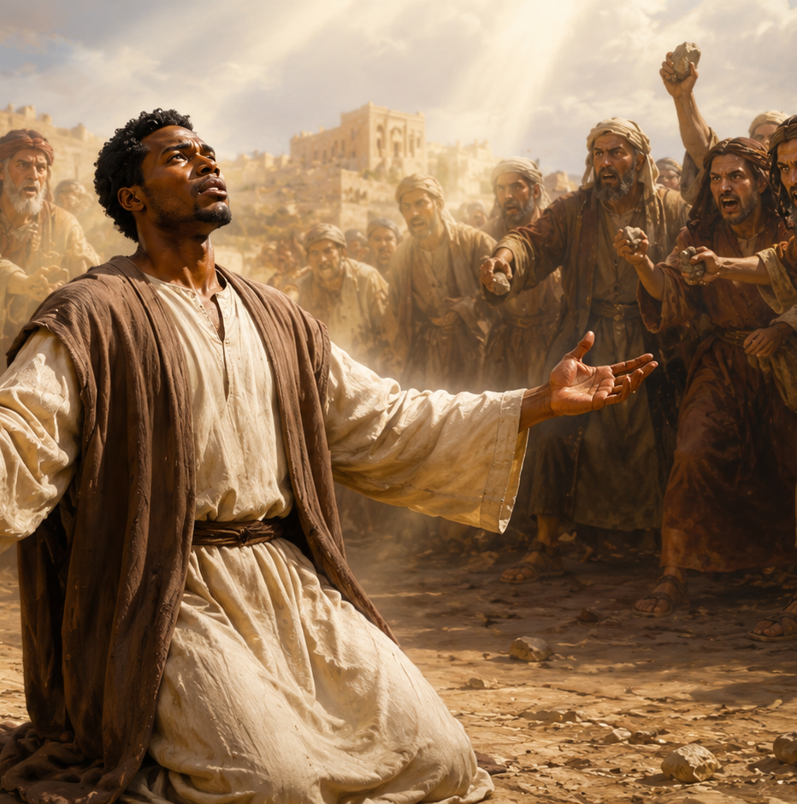
CONCLUSION
STEPHEN, UNWAVERING MARTYR
UNIFIED LESSON
Nothing can stop the message of Jesus.
Stephen: A Faithful Witness to the End
Stephen’s journey moved from humble service to courageous witness, from opposition to martyrdom. Filled with faith, wisdom, power, and the Holy Ghost, he proclaimed Jesus without fear. Though his hearers rejected the truth and killed him, Stephen remained faithful. He looked to Christ, entrusted his spirit to the Lord, and forgave those who were taking his life.
Stephen’s story teaches that spiritual power does not always remove suffering. Instead, it enables believers to serve without pride, speak truth without fear, endure opposition without hatred, forgive without revenge, and trust God with every outcome. His death appeared to be defeat, but persecution could not stop God’s purpose or silence the gospel.
Stephen died, but his witness continued. His martyrdom helped move the church beyond Jerusalem, strengthened its mission, and left a lasting impression upon Saul, who later carried the gospel to the nations. Stephen’s life was not wasted, because every life faithfully surrendered to Christ possesses eternal value.
Faithful witness may suffer, but the gospel keeps moving.
11
Notes:
Stephen’s story moves from service to witness, from witness to opposition, and from opposition to martyrdom. Yet the message of Jesus continues forward. Christian success is not always rescue from suffering. Sometimes success is remaining faithful within suffering, reflecting Jesus in courage, truth, prayer, and forgiveness.
God calls believers to stand for Jesus without hatred, serve without pride, speak without fear, forgive without revenge, and trust Him with every outcome. God measures Christian success by faithful obedience and Christlike character—not merely by comfort, acceptance, or immediate results.
Conclusion: Stephen died, but the gospel did not die. His witness helped shape the church’s mission and left a mark on Saul, who later carried the gospel to the nations.
[Sources] Scripture: Acts 6:7-10; Acts 7:54-60, KJV. User-provided lesson files: Lesson_10.zip, J26-L10-A_Teacher_Commentary.docx, J26-L10-A_Student_CBS-ECH.pdf, Summer26-L10-KJV Bible Teacher Guide.pdf, Stephen_Unwavering_Martyr_Linear_Teacher_Commentary.docx, and the prior chat analysis.

Slide 12
CONCLUSION
STEPHEN, UNWAVERING MARTYR
Live It Out:
Trust God to bring hope out of desperation and opposition.
  Document what courageous faith means for us, either from our past experience or for the next challenge we might face. We should always be looking for ways that God can be credited for extraordinary provision. Our weakness is His strength.
Following when I’m Afraid
Courage is not the absence of fear but the willingness to act in the midst of fear. Deborah and Jael were not fearless, but God was able to use them to bring deliverance. The invitation for this week is to journal about an example of God’s provision in your own life.
12
Notes:
God wants us to serve faithfully, speak truth wisely, and depend upon the Holy Ghost rather than fearing those who oppose the gospel. Faithful Christian witness is measured by obedience to Christ, not by immediate acceptance, visible success, or personal safety.
Acts 6:7–10 presents growth and resistance side by side.
As the gospel succeeds, opposition increases. Stephen’s experience corrects the false idea that spiritual faithfulness always produces public approval. God measured Stephen by obedience, not popularity. His ministry moved from service to debate, from debate to trial, and from trial to martyrdom. A healthy church must care for people’s needs while clearly teaching salvation through Jesus Christ. We must tell the truth without hatred, face opposition without surrender, and show mercy without approving wrongdoing.

Slide 13
CONCLUSION
STEPHEN, UNWAVERING MARTYR
CLOSING PRAYER
Nothing can stop the message of Jesus.
Heavenly Father, fill us with the Holy Ghost and give us the courage of Stephen. Help us serve without pride, speak truth with love, stand without fear, forgive without revenge, and trust You with every outcome. When criticism, rejection, or suffering comes, keep us faithful and free from hatred. May our lives reflect Jesus, show mercy without compromising truth, and help carry the gospel forward. In Jesus’ name.
Amen.
Faithful witness may suffer, but the gospel keeps moving.
13
Notes:
Closing Prayer
Heavenly Father, fill us with the Holy Ghost and give us the courage of Stephen. Help us serve without pride, speak truth with love, stand without fear, forgive without revenge, and trust You with every outcome. When criticism, rejection, or suffering comes, keep us faithful and free from hatred. May our lives reflect Jesus, show mercy without compromising truth, and help carry the gospel forward. In Jesus’ name, Amen.

Slide 14


End
  The Lord bless thee, and keep thee:
  The Lord make his face shine upon thee, and be gracious unto thee:
  The Lord lift up his countenance upon thee and give thee peace.
  - Numbers 6:24-26,
Material adapted by Stanford W. Bowman Jr. from Echoes® Adult and Bible-in-Life® Adult
Summer -2026 quarter with permission, © David C Cook, https://davidccook.org. May not be further reproduced. All rights reserved.
14

