Slide 1
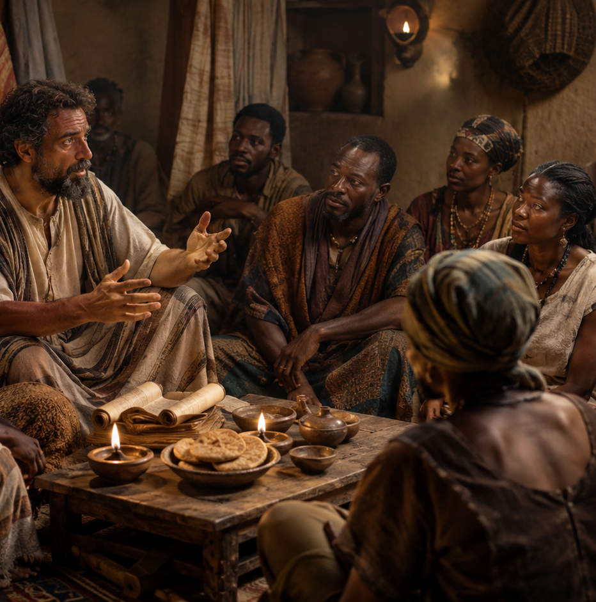
SAUL OF TARSUS THE UNLIKELY APOSTLE
Acts 22:3–15 Lesson 11
Main Message:
  God's grace can transform the most unlikely person into a faithful servant. Saul of Tarsus demonstrates that no one is beyond the reach of Christ's saving power and calling.
Lesson Focus:
  God shows us the truth: Jesus is Lord.
Key Text
“Then he said: ‘The God of our ancestors has chosen you to know his will and to see the Righteous One and to hear words from his mouth. You will be his witness to all people of what you have seen and heard. ’” —Acts 22:14–15 NIV
1
Notes:
Jesus can turn the most unlikely person into a faithful witness. Christ can redirect a life that seems too far gone. Paul’s story shows grace, truth, surrender, and mission.

Slide 2
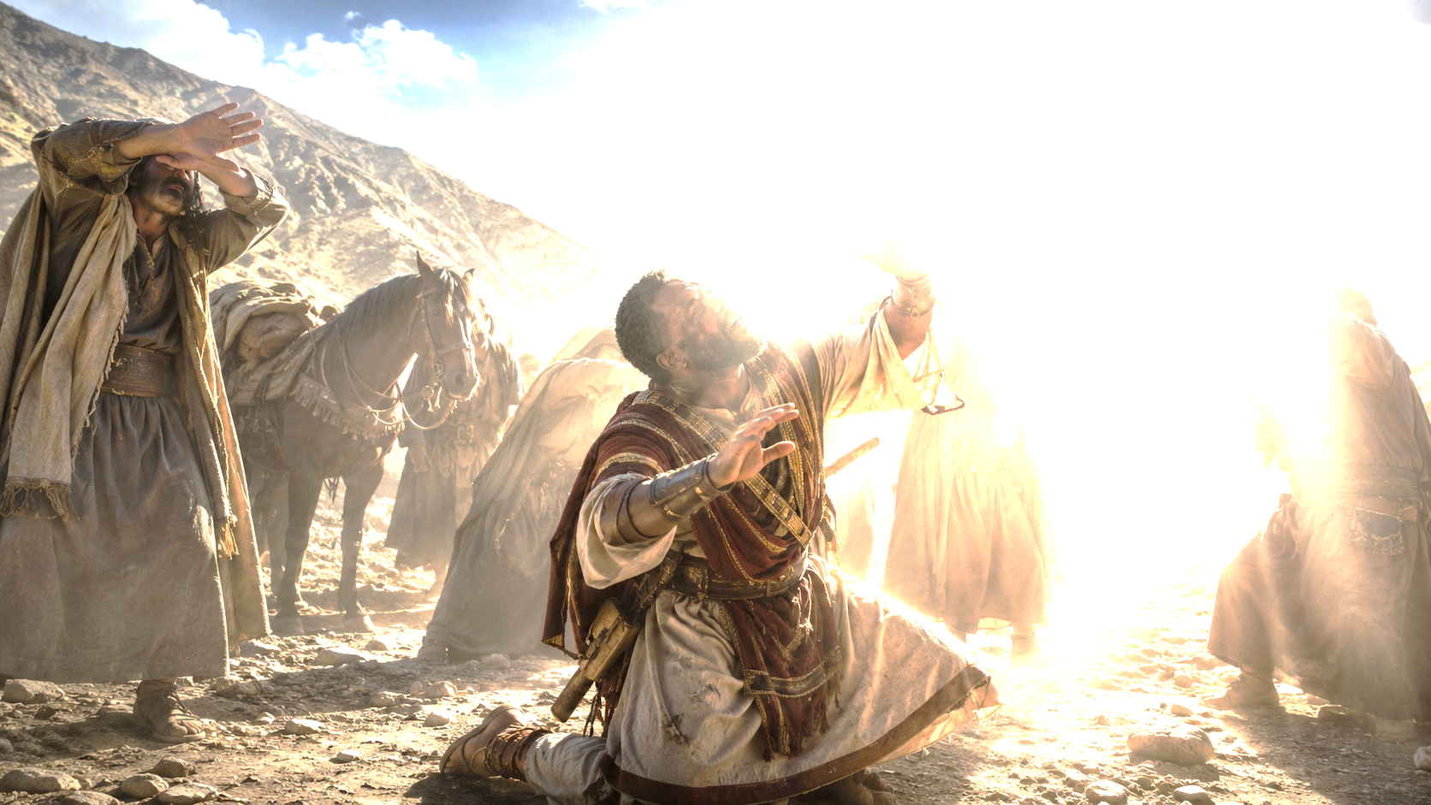
    Prayer
God of our ancestors in the faith, help us meld our stories into Yours! Guide and empower us to be witnesses so that others may know Your salvation. In Jesus’ name we pray.
Amen.
        Thought to Remember
          Let God use you for His purposes.
Notes:
God of our ancestors in the faith, help us meld our stories into Yours! Guide and empower us to be witnesses so that others may know Your salvation. In Jesus’ name we pray. Amen.
Thought to Remember
Let God use you for His purposes.

Slide 3
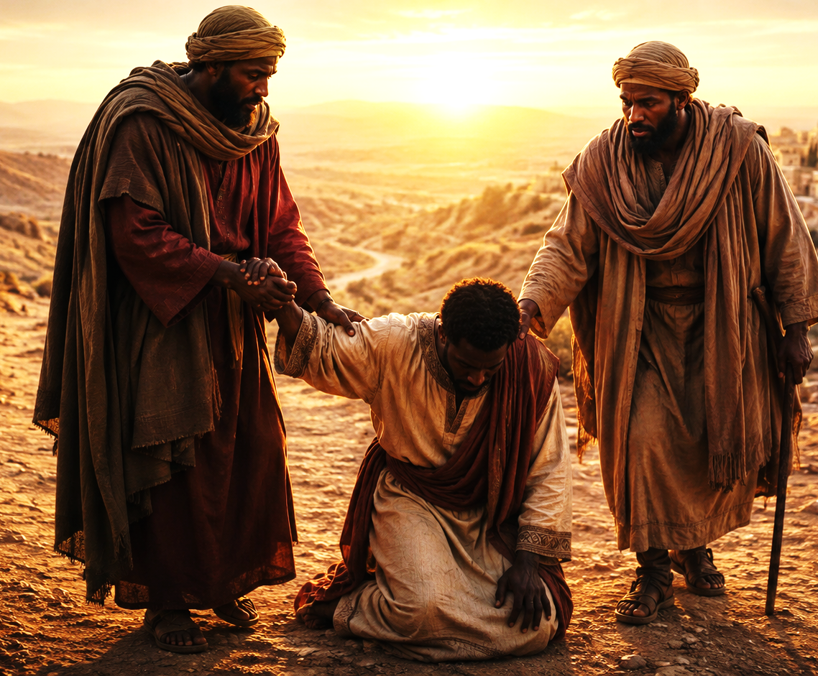
LESSON OUTLINE
STEPHEN, UNWAVERING MARTYR
  Lesson Scripture: Acts 22:3–15
  Lesson Focus: God shows us the truth: Jesus is Lord.
  Apply the Message :
  Live It Out:
God turns us around when we have been going the wrong direction.
Expect Jesus to save people you see as enemies.
        Review
        Introduction
        Lesson Context
        Overview
            That’s One Way to Meet Jesus... - Acts 22:3–9 NIV
            That’s One Way to Meet Jesus...- Acts 22:10–15 NIV
          Bible Application
        Conclusion
        Question & Answers
3
Notes:
Jesus Christ can open spiritually blinded eyes, redirect misguided zeal, transform an enemy into a disciple, and send that transformed person into the world as a faithful witness. Paul’s story is ultimately not about how extraordinary Paul was. It is about how powerful Jesus is.
Acts 22:3–15 presents Paul’s life in three movements: before Christ, encountering Christ, and living under Christ’s calling. Saul was educated, sincere, religious, and zealous, yet spiritually mistaken. Jesus confronted him, revealed Himself as Lord, humbled him through blindness, restored him through Ananias, and commissioned him as a witness. His testimony demonstrates that Christ can turn someone traveling completely in the wrong direction into a servant who carries the gospel to others.
Meaning
Paul believed he could see clearly before Damascus, but spiritually he was blind. After the heavenly light temporarily took away his physical sight, Christ gave him true spiritual vision. The great discovery of Acts 22 is that Jesus is Lord. Once Saul understood who Jesus was, everything else—his direction, priorities, relationships, zeal, and purpose—had to change.
The Lesson God Wants Us to Learn
Never decide that someone is beyond the saving power of Jesus Christ.
If Christ could turn Saul the persecutor into Paul the witness, He can transform people we consider hostile, resistant, or unreachable. The lesson materials therefore challenge believers to “expect Jesus to save people you see as enemies.”
God also wants us to examine ourselves. Religious activity is not enough; sincerity is not enough; knowledge is not enough. We must see Jesus rightly and submit to Him as Lord.
The Christian response remains Saul’s question:
“What shall I do, Lord?” — Acts 22:10, KJV
When Jesus opens our eyes, He changes our direction. When He changes our direction, He gives us a purpose. And when He gives us a purpose, our transformed life becomes part of our testimony.
=============================
Acts 22:3–15 — Saul of Tarsus, the Unlikely Apostle
The lesson material identifies the central focus clearly: “God shows us the truth: Jesus is Lord.” Paul’s testimony moves from his former zeal, to his encounter with Christ, to his new commission as a witness.
Acts 22:3–5 — Zealous, Religious, but Wrong
Analyze:
Paul begins by establishing his Jewish credentials. He was born in Tarsus, raised in Jerusalem, educated under Gamaliel, trained carefully in Jewish law, and intensely zealous for God. Yet that zeal led him to imprison and persecute followers of Jesus. Paul’s testimony demonstrates that education, religion, sincerity, and passion do not guarantee spiritual correctness. A person can sincerely believe he is defending God while actually resisting what God is doing.
Summary:
Paul had an impressive religious background and believed he was serving God faithfully. His devotion became so extreme that he persecuted Christians and traveled toward Damascus with authority to arrest them. His past establishes the dramatic nature of what follows: this was not a man searching for Christianity. He was actively fighting against it.
Commentary:
Zeal is valuable only when it is governed by truth. Paul possessed tremendous passion before meeting Jesus, but his understanding was wrong. God did not destroy Paul’s zeal; He redirected it. The same determination once used to persecute Christ’s followers would eventually be used to preach Christ. God can take abilities that have been misdirected and place them under Christ’s lordship for His glory.
Acts 22:6–9 — Jesus Interrupts Saul’s Direction
Analyze:
Near Damascus, a heavenly light suddenly surrounded Saul. He fell to the ground and heard Jesus ask, “Saul, Saul, why persecutest thou me?” The statement reveals Christ’s intimate identification with His church. Saul thought he was persecuting Christians; Jesus declared that Saul was persecuting Him. Saul’s greatest problem was therefore not merely his treatment of people—it was his opposition to the risen Lord.
Summary:
Saul’s journey was interrupted by Jesus Himself. The persecutor discovered that Jesus of Nazareth was alive and that the people Saul opposed truly belonged to Him. Saul’s entire understanding of Jesus, God, and his own religious mission was suddenly overturned.
Commentary:
Sometimes God must confront the direction of our lives before He redirects them. Saul was physically traveling toward Damascus, but spiritually he was traveling away from God’s truth. The brilliant light exposed his spiritual blindness. Christ’s intervention demonstrates grace: Jesus could have judged Saul immediately, but instead He confronted him so that Saul might become the very witness he had been trying to silence.
Acts 22:10–11 — “What Shall I Do, Lord?”
Analyze:
Saul’s question marks the turning point: “What shall I do, Lord?” Previously, Saul determined what others should do; now he submits himself to Christ’s authority. The once-confident persecutor becomes physically blind and must be led into Damascus by the hand. The lesson commentary describes this as movement from persecutor to disciple and from “blind zeal” to dependence upon God.
Summary:
After recognizing Jesus as Lord, Saul stops directing his own mission and begins receiving direction from Christ. His blindness forces him to depend upon others while waiting for God’s instructions.
Commentary:
True conversion involves more than changing opinions about Jesus. It involves surrendering authority to Jesus. Saul’s most important question was not, “Why did this happen to me?” but, “What shall I do, Lord?” That remains a powerful question for every Christian. Recognizing Jesus as Savior must lead to obeying Jesus as Lord.
Acts 22:12–13 — Grace Comes Through Ananias
Analyze:
God sends Ananias, described as a devout man respected among the Jews, to Saul. His first recorded words are remarkable: “Brother Saul.” The man who had come to Damascus intending to imprison Christians is welcomed into fellowship by a Christian. When Ananias tells Saul to receive his sight, Saul immediately sees again.
Summary:
God used Ananias to restore Saul’s physical sight and welcome him into the community he had previously persecuted. Saul experienced God’s grace not only through a supernatural encounter with Jesus but through the obedience and compassion of another believer.
Commentary:
Ananias demonstrates what Christian grace looks like. He did not allow Saul’s past to have the final word. Calling him “Brother Saul” illustrates reconciliation made possible by Christ. Sometimes God calls believers to welcome people whose history makes them difficult to trust. Grace does not pretend the past never happened; grace believes Christ can give someone a genuinely different future.
Acts 22:14–15 — Chosen to Become a Witness
Analyze:
Ananias reveals God’s purpose for Saul: he was chosen to know God’s will, see “that Just One,” hear His voice, and become His witness “unto all men.” Saul’s salvation therefore included a commission. The man who once carried authorization to arrest Christians now carried authorization from God to proclaim Christ.
Summary:
God did not simply stop Saul from persecuting Christians. He gave Saul a completely new mission. Saul would testify about what he had personally seen and heard concerning Jesus Christ.
Commentary:
God’s grace does more than rescue us from something; it calls us to something. Saul was saved from spiritual blindness and called into faithful witness. Our testimony may not include a Damascus-road light, but every believer who has experienced Christ’s saving grace has something to tell. The lesson appropriately emphasizes that every believer has a story of meeting Jesus.

Slide 4
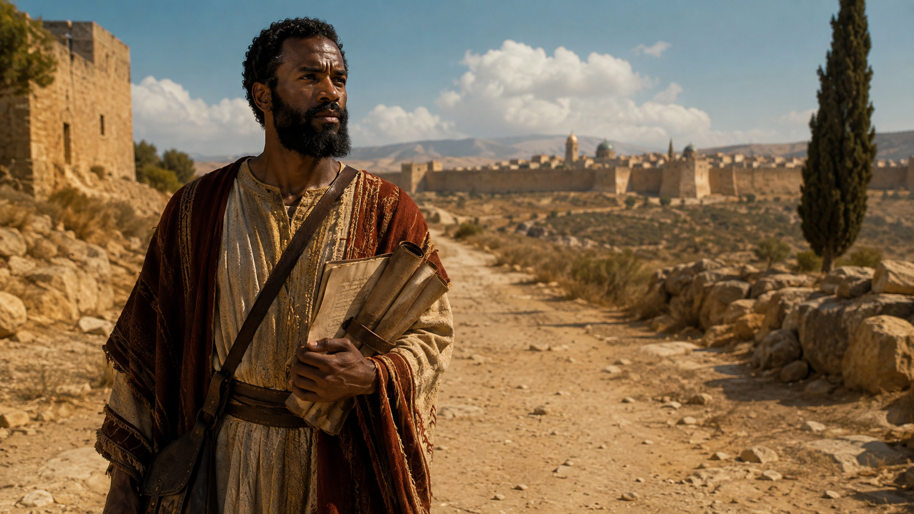
Lesson Context
In about AD 58, at the end of his third missionary journey, Paul returned to Jerusalem for the final time (Acts 21:17). The centerpiece of that third missionary trip was his lengthy ministry in Ephesus (19:1, 8–10; 20:31), a stay marked by no little controversy. His forebodings and those of others did not indicate that his visit to Jerusalem would be any less controversial—quite the opposite, in fact (20:17–38; 21:4, 10–14). But Paul made the trip anyway.
Upon his arrival, Paul met with leaders of the Jerusalem church and reported on his ministry (Acts 21:17–19). Those leaders also warned Paul of the danger his presence posed (21:20–24). When that danger materialized, Paul was arrested on a false charge of defiling the temple (21:27). Had it not been for the presence of Roman troops to restore order, Paul probably would have been killed right then and there (21:30–36). After being rescued, Paul then surprisingly asked to address the mob that had just tried to kill him. The Roman commander gave permission (21:40– 22:2), and that’s where our lesson text opens.
Acts 22:3–15
Notes:
Paul remained faithful to God’s calling even when obedience placed him in danger. Instead of allowing opposition, false accusations, arrest, or violence to silence him, Paul used the crisis as an opportunity to testify about what Jesus had done in his life. Near the end of his third missionary journey, Paul returned to Jerusalem even though he knew serious trouble awaited him. After reporting to church leaders about his ministry, Paul was falsely accused of defiling the temple. An angry crowd seized him and attempted to kill him until Roman soldiers intervened. Remarkably, Paul did not use his rescue simply to escape. He asked permission to speak to the same people who had attacked him. His difficult situation became an opportunity to witness about Christ and introduce the testimony recorded in Acts 22.
Three Key Points
Paul obeyed God despite the danger. Paul had received repeated warnings concerning suffering in Jerusalem, yet he continued because he believed obedience to God was more important than personal safety.
Paul faced false accusations and violent opposition. Paul was accused of defiling the temple even though the charge was false. His experience demonstrates that faithful believers may sometimes suffer for doing what is right.
Paul turned opposition into an opportunity to witness. Instead of responding with anger or revenge, Paul asked to speak to the crowd. He transformed a dangerous confrontation into an opportunity to tell what Christ had done for him.
Three Life Lessons Learned
Obedience to God may require courage. Following God does not guarantee an easy path. Sometimes faithfulness means continuing forward even when difficulties are expected.
Do not allow mistreatment to determine your response. Paul did not become bitter toward the people who attacked him. Christians are called to respond to hostility in a way that still honors Christ.
Every situation can become an opportunity for witness. Paul recognized that the crowd who wanted him dead was also a crowd that needed to hear about Jesus. Believers should look for opportunities to share Christ even in uncomfortable circumstances.
Analysis
This background is important because it explains the setting of Acts 22:3–15. Paul is not preaching from a comfortable church setting. He is standing before people who had just tried to kill him. Yet he does not begin by attacking them. Instead, he tells his story.
Paul understood something important about Christian witness: your testimony can reach people who may refuse to hear an argument. He would explain that he had once been just as zealous and opposed to Christ as many people in the crowd. That connection prepared them to hear how Jesus changed his life.
Paul's actions also reveal the difference between self-preservation and Kingdom purpose. After the Roman soldiers rescued him, Paul could have remained silent and allowed them to carry him away. Instead, he saw people who needed the gospel.
The passage therefore prepares us for the central truth of Paul's testimony: Jesus Christ can completely change a person's direction. The man who once persecuted believers became a courageous witness for the very Lord he had opposed.
God’s Lesson for Us
God wants us to remain faithful when following Christ becomes difficult. Opposition does not cancel our calling. Sometimes the very situation we would rather escape becomes the place where God gives us our greatest opportunity to witness.
Paul teaches us not merely to ask, “Lord, get me out of this situation,” but also, “Lord, how can You use me in this situation?”
His example points toward the message that follows in Acts 22: Christ can transform an enemy into a servant, a persecutor into a preacher, and a painful past into a powerful testimony.

Slide 5
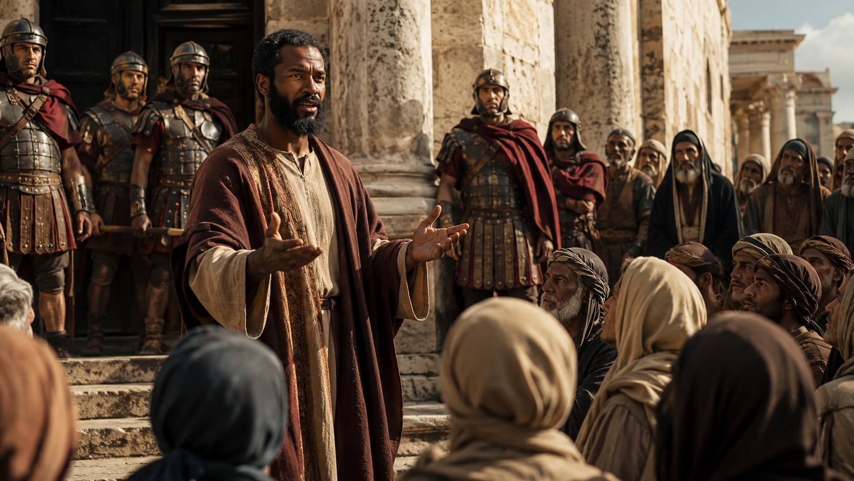
BACKGROUND
Setting the Scene
Paul stood before a hostile Jerusalem crowd after being rescued by Roman soldiers. Instead of only defending himself, Paul used the moment to tell what Jesus had done.
A faithful witness does not waste hard moments. God can turn pressure into testimony.
Acts 22:3–15
Notes:
Paul’s testimony was not spoken in a safe room. He spoke after violence and false accusation. This helps students see that Christian witness often requires courage.

Slide 6
Introduction
Fire for Good or Fire for Bad?
Early in 2024, my small town in the Texas Panhandle was among those affected by a series of wildfires that devastated over 1. 2 million acres of land. This was not the first time our town had suffered severe damage from a wildfire. Thankfully, there were no fatalities, but the damage was substantial.
We know all too well the destructive capabilities of fire! It’s not surprising, then, that fire is prime imagery for anger, wrath, and destruction. Even so, we continue to use fire in various ways— for warmth, cooking, incineration, and even for controlling other fires.
Our relationship with fire is complicated. We acknowledge it can be both helpful and harmful. So it is with the fiery disposition of zeal. It can ignite a passion for good or unleash a destructive force. Ultimately, it all depends on how and for what purpose zeal is used.
Acts 22:3–15
Notes:
Zeal is powerful like fire: it can produce good or cause destruction depending on what controls it, what motivates it, and where it is directed. God desires our passion to be guided by truth and used for His purposes. Fire has the ability to destroy, but it also provides warmth, prepares food, removes waste, and can even help control other fires. In the same way, zeal—strong passion and determination—is neither automatically good nor bad. Its value depends on its purpose and direction. Passion without truth can harm people, while passion surrendered to God can become a powerful force for service, witness, and righteousness.
Three Key Points
Zeal is powerful. Like fire, zeal gives energy and intensity to our actions. Strong convictions can motivate people to make sacrifices, overcome obstacles, and pursue a cause with determination.
Zeal without truth can become destructive. Passion alone does not guarantee that we are doing what is right. A person may sincerely believe in a cause and still be sincerely wrong. Strong emotion must therefore be guided by God's truth.
God can redirect misguided zeal. Zeal does not have to be destroyed; it can be redirected. God can take the same determination once used wrongly and transform it into faithful service for His kingdom.
Three Life Lessons Learned
1. Examine what is fueling your passion.
Before acting strongly, believers should ask whether their motivation comes from God's Word, love, pride, anger, fear, or personal opinion. Good intentions are not enough; our zeal must agree with God's truth.
2. Passion should be controlled by spiritual wisdom.
Strong feelings should never replace prayer, Scripture, discernment, and obedience. Proverbs 19:2 warns, “Also, that the soul be without knowledge, it is not good.” Passion needs knowledge and direction.
3. God can transform our strongest weaknesses into useful strengths.
The qualities that once caused damage can become powerful tools when surrendered to Christ. Determination, boldness, leadership, and intensity can be redirected toward witnessing, serving, encouraging, and defending biblical truth.
Analysis
The illustration prepares us to understand Saul of Tarsus in Acts 22. Saul was not indifferent toward God; he was intensely religious and described himself as “zealous toward God” (Acts 22:3, KJV). Yet his zeal was wrongly directed. Believing he was defending God's truth, Saul persecuted followers of Jesus, imprisoning both men and women. His passion had become destructive because it was operating without the full truth about Christ.
The problem was therefore not that Saul possessed zeal. The problem was the direction of his zeal. When Jesus confronted him on the Damascus road, Christ did not remove Saul's passion, courage, intelligence, or determination. He redirected them. The persecutor eventually became a preacher, missionary, church planter, and witness for Jesus. The lesson materials summarize this transformation by emphasizing that God shows us the truth that Jesus is Lord and that God can turn us around when we are traveling in the wrong direction.
This teaches an important spiritual truth: sincerity is not the same as truth. Saul was sincere before meeting Christ, but he was sincerely wrong. Jesus changed what Saul believed, and that changed how Saul used his zeal.
The Spiritual Meaning
Fire controlled in the proper place can provide light, warmth, protection, and usefulness. Fire out of control can destroy everything around it.
The same is true spiritually:
Zeal + Pride = Destruction
Zeal + Anger = Harm
Zeal + Ignorance = Misguided Action
But:
Zeal + Truth = Conviction
Zeal + Love = Service
Zeal + Christ = Faithful Witness
Lesson God Wants Us to Learn
God wants our passion surrendered to Him. Being enthusiastic, sincere, or deeply committed is not enough; we must know the truth and follow Jesus Christ. When Christ controls our zeal, the same fire that once could have harmed others can become a light that points others to Him.
Saul's life reminds us:
Don't ask only, “Am I passionate?” Ask, “Is my passion directed by Christ?”

Slide 7
Temple Controversy
As Paul completed some vows in the temple (Acts 21:26), he is spotted with a Gentile companion (20:4). Mistakenly assuming Paul had brought him beyond the Court of Gentiles—a capital offense—these observers incited a mob (21:27–29). Archaeological evidence shows that bilingual temple warnings threatened death for trespassing Gentiles, a policy Rome enforced to keep peace. The first-century Jewish historian Josephus records similar temple riots over purity violations.
Acts says that the entire city was on high alert (20:30). The crowd dragged Paul from the temple courts, perhaps to prevent further desecration. Paul’s predicament reveals the volatile intersection of Jewish custom and Roman law. Though innocent (Trophimus wasn’t actually in the temple), assumptions triggered chaos. The incident mirrors earlier conflicts over the temple, even accusations made against Jesus (see John 11:48).
Notes:
Temple Controversy
Main Idea
Paul’s temple crisis shows how quickly false assumptions, religious tension, and fear can turn into public violence. Although Paul had not committed the offense of which he was accused, the crowd reacted before confirming the truth. The incident warns believers against allowing suspicion, tradition, or emotion to outrun facts, justice, and godly discernment. While Paul was completing vows at the Jerusalem temple, some observers saw him associated with the Gentile Trophimus and assumed Paul had taken him into a restricted area of the temple. That accusation stirred the crowd and created a dangerous confrontation.
The controversy exposed the tension between Jewish religious customs and Roman political authority. Paul’s innocence did not prevent disorder because the accusation was accepted before the facts were established. The temple became the setting where misunderstanding, religious passion, and public fear combined to produce violence.
God calls His people to seek truth before judgment, evidence before accusation, and righteousness before emotional reaction. The temple controversy reminds us that sincere religious conviction can become destructive when it is mixed with fear, rumor, prejudice, and unchecked assumptions. Christians should therefore be people who slow down, listen carefully, investigate fairly, and treat others justly.
Paul's experience teaches a lasting principle: Never allow what you assume about someone to become more important than what is actually true about them.
Three Key Points
An Assumption Became an Accusation Paul was seen with Trophimus, but seeing them together did not prove that Paul had brought him into a prohibited part of the temple. The crowd treated suspicion as certainty.
Religious Tension Made the Situation Explosive The temple represented holiness, identity, worship, and national heritage. An accusation of violating its sacred boundaries could therefore provoke an intense reaction.
Paul Was Condemned Before the Facts Were Known The crowd responded to what people believed Paul had done rather than what had actually happened. Emotion overtook investigation, creating confusion and violence.
Three Life Lessons Learned
Do Not Turn Assumptions Into Facts Christians must be careful about accepting accusations without evidence. Proverbs 18:13 teaches the danger of answering a matter before hearing it fully. Wisdom listens, investigates, and seeks truth.
Religious Passion Must Be Controlled by Truth Strong convictions do not excuse unjust behavior. People may believe they are defending something sacred while acting contrary to God's standards of justice, mercy, and truth.
God Can Sustain Us When We Are Misunderstood Paul faced hostility because people falsely interpreted his actions. Believers may also experience misunderstanding or unfair judgment. Our responsibility is to remain faithful, truthful, and dependent upon God rather than responding with the same hostility directed toward us.
Analyze
This controversy is especially important because Paul was not entering the temple as someone rejecting his Jewish heritage. According to the material, he was participating in temple vows when the accusation arose. This makes the charge particularly ironic: while demonstrating respect for Jewish practice, he was accused of dishonoring the temple.
The presence of Trophimus became the foundation for the crowd’s conclusion. The problem was not what they knew, but what they supposed. Acts 21:29 captures that distinction: they had previously seen Trophimus with Paul and “supposed that Paul had brought into the temple.” Their interpretation became more powerful than the evidence.
The incident also demonstrates how fear can intensify conflict. The concern was larger than one Gentile entering a restricted area. The temple represented Jewish religious identity under Roman occupation. Therefore, the accusation touched spiritual, cultural, and political nerves at the same time.
There is also a parallel with Jesus. In both situations, religious concerns surrounding the temple became connected with accusations, fear, and attempts to eliminate a perceived threat. People believed that protecting their religious system justified extreme action.
The deeper spiritual danger is clear: people can become so convinced that they are defending God that they fail to behave like God.

Slide 8
ACTS 22:3–5
Paul of Tarsus: A Man Between Worlds
Paul stood at the crossroads of three cultures—Jewish by birth and conviction (Phil. 3:5-6), Greek by language and education, and Roman by citizenship (Acts 22:25–28). This identity made him God’s ideal ambassador. Born in the Hellenistic city of Tarsus (Acts 21:39), Paul received elite Jewish training in Jerusalem under Gamaliel (Acts 22:3). His knowledge of Greek rhetoric allowed him to debate philosophers in Athens (see Acts 17:22–31) while his Roman citizenship protected him during missionary journeys (Acts 16:37–38).
Paul’s cultural fluency shaped his revolutionary vision of the church. He could argue Torah with rabbis while still insisting Gentiles didn’t need to become Jews to follow Christ (Acts 28:23; Gal. 2:11–14). He could reference Greek poetry and explain Abraham’s covenant from Genesis. The cross-cultural apostle became living proof that in Christ “there is neither Jew nor Gentile” (Gal. 3:28)—not by erasing differences but by transcending them through faith.
Acts 22:3–15
Notes:
God can use where we have been to prepare us for where He is sending us.
Paul’s life teaches us that God may have already placed experiences, education, relationships, cultural understanding, and abilities within our lives that He intends to use for His kingdom.
We should therefore ask not only, “Where did I come from?” but also, “How can God use where I came from to help me reach someone for Christ?”
Paul crossed cultural boundaries without compromising biblical truth. That remains an important model for the church today: Different backgrounds. Different experiences. Different cultures. One Lord, one gospel, and one family in Christ.
Main Idea
God used Paul’s Jewish heritage, Greek cultural awareness, and Roman citizenship to prepare him for a unique mission: carrying the gospel of Jesus Christ across cultural, religious, and political boundaries without changing the truth of the message. Paul lived comfortably within several worlds. He was Jewish by ancestry and religious training, born in the Hellenistic city of Tarsus, educated under Gamaliel in Jerusalem, and possessed Roman citizenship. These overlapping identities gave him access to audiences that might otherwise have remained separated.
Paul could reason from the Hebrew Scriptures with Jewish listeners, communicate with Greek-speaking audiences, and use his Roman citizenship when necessary. God transformed Paul’s diverse background into a powerful instrument for spreading the gospel among both Jews and Gentiles.
Three Key Points
1. God Prepared Paul Before Paul Understood His Purpose Paul’s birthplace, education, citizenship, language, and religious training existed before his encounter with Christ. After his conversion, those same experiences became valuable tools for ministry.
2. Paul Could Cross Cultural Boundaries Without Changing the Gospel Paul adjusted his approach according to his audience. He could reason from Scripture in a synagogue and speak differently before Greek thinkers, yet his central message remained Jesus Christ.
3. Christ Creates Unity Without Demanding Cultural Sameness Paul’s ministry demonstrated that Gentiles did not first have to become culturally Jewish to belong to Christ. Salvation created one spiritual family while allowing believers to come from different peoples and backgrounds.
Three Life Lessons Learned
1. God Can Use Every Part of Our Background Education, culture, work experience, family history, language, and even difficult experiences can become useful when surrendered to Christ. Nothing in a redeemed life must be wasted.
2. We Should Learn How to Communicate Across Differences Effective Christian witness requires understanding the people we are trying to reach. We should communicate clearly and respectfully without weakening biblical truth.
3. Unity in Christ Is Greater Than Cultural Division Race, nationality, social background, and culture should never become barriers to Christian fellowship. Our differences remain real, but our common faith in Christ is greater.
Analyze
Paul’s life demonstrates remarkable providence. Before he understood Christ’s calling, God had already placed him at the intersection of several important worlds.
Acts 22:3 presents Paul as a Jew born in Tarsus but educated in Jerusalem under Gamaliel. Philippians 3:5–6 shows how deeply Paul identified with his Jewish heritage. He was not a man who abandoned Judaism because he knew little about it. He had been thoroughly trained within it.
At the same time, Tarsus placed Paul within a broader Hellenistic environment. This helped him communicate in the Greek-speaking world in which the early church expanded. Acts 17 shows Paul speaking in Athens in a manner suited to people familiar with philosophy and Greek culture.
His Roman citizenship added another dimension. In Acts 22:25–28, Paul’s citizenship becomes legally significant. It provided protections and opportunities that assisted him as he traveled throughout the Roman world.
Yet the most important feature of Paul’s identity was not Jewish, Greek, or Roman. After meeting Christ, his controlling identity became servant and apostle of Jesus Christ.
This explains his understanding of the church. Galatians 3:28 does not teach that ethnic, social, or gender distinctions cease to exist. Rather, those distinctions do not determine a person’s standing before God. All believers come to God on the same basis: faith in Jesus Christ.
Paul therefore became a living example of the gospel’s power to cross boundaries. He did not have to stop being Jewish in order to minister to Gentiles, nor did Gentiles have to become Jews before they could belong to Christ.

Slide 9
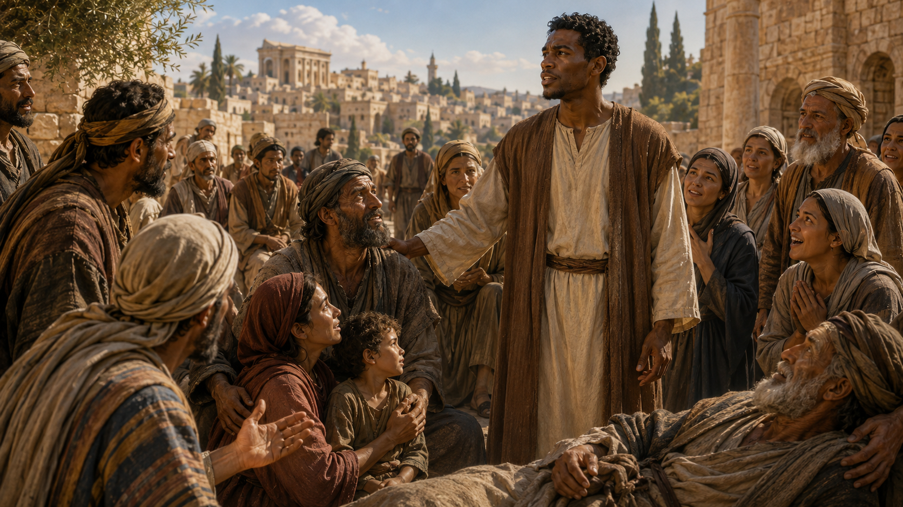
STEPHEN, UNWAVERING MARTYR
That’s One Way to Meet Jesus... - Acts 22:3–9 NIV
When Christ becomes Lord, our question changes from “What do I want to do?” to “What shall I do, Lord?”And when that surrender is genuine, God can turn even a former enemy of the gospel into a faithful witness for Christ.
3 “I am a Jew, born in Tarsus of Cilicia, but brought up in this city. I studied under Gamaliel and was thoroughly trained in the law of our ancestors. I was just as zealous for God as any of you are today.
4 I persecuted the followers of this Way to their death, arresting both men and women and throwing them into prison,
5 as the high priest and all the Council can themselves testify. I even obtained letters from them to their associates in Damascus, and went there to bring these people as prisoners to Jerusalem to be punished.
6 “About noon as I came near Damascus, suddenly a bright light from heaven flashed around me.
7 I fell to the ground and heard a voice say to me, ‘Saul! Saul! Why do you persecute me?’
8 “‘Who are you, Lord?’ I asked. “ ‘I am Jesus of Nazareth, whom you are persecuting,’ he replied.
9 My companions saw the light, but they did not understand the voice of him who was speaking to me. ’ ”
Paul has been arrested for causing a riot in the temple
of Jerusalem, all over a misunderstanding.
Paul receives permission to speak, and he treats this as
an opportunity to share the good news of Jesus.
He tells the story of his encounter with Jesus, focusing
on consistency with Jewish faith.
Paul had been “blindly” persecuting Christians, and
he becomes physically blind from the light of heaven.
9
Notes:
><><><><><<<><><><><><><><
Acts 22:3–9 NIV
><><><><><<<><><><><><><><
That’s One Way to Meet Jesus...- Acts 22:10–15 KJV
Paul finds himself in the midst of an uproar in the temple of Jerusalem (Acts 21:27–32). It is exactly what God had revealed would happen, but Paul went to Jerusalem fully aware that it might mean his death (Acts 21:10–14). The crowd seizes him for supposedly preaching against the law and temple. The crowds drag Paul from the temple courts, shut the gates, and plan to kill him.
Ironically, it is a Roman commander who arrives to stop the beating (Acts 21:32). As the soldiers prepare to take Paul to the barracks, Paul asks for the privilege to speak and to address his fellow Jews (Acts 21:39). Paul speaks to them in Aramaic, the common language of Judea. Hearing this, the crowd grows silent to hear his defense.
Instead of giving a point-by-point denial of the charges, Paul builds rapport with his audience and wants them to understand his Jewish credentials: raised in Jerusalem, a student of one of the finest rabbis of the day, an expert in the law. Paul uses the word “zealous” to describe his devotion to God (Acts 22:3). It means that he was willing to go to whatever lengths were necessary to defend what is right.
But that very tenacity and zeal is what led Paul to persecute followers of “this Way”—a nickname for followers of Jesus (v. 4). With permission from the high priest, Paul sent men and women to prison and sought their deaths. He was there, supervising the stoning of Stephen from last week’s lesson (Acts 7:58).
All of this setup helps listeners understand what a change and a turnaround had happened. On the way to obtain more prisoners, Paul was confronted by a light that shone from heaven (Acts 22:6). What he heard next was the voice of Jesus—the very person he had opposed. Jesus spoke to him saying, “I am . . . whom you are persecuting” (Acts 22:8). To show that this message was for him, Paul’s companions on the road are able to see the light but can’t understand the voice (v. 9).
1 Why does Paul emphasize his Jewish background when telling his story?
This shows Paul’s dramatic turnaround after encountering the risen Jesus. He didn’t think of himself as converting but as redirecting his zeal toward what was true. Paul came to understand the mission of Israel as fulfilled in Jesus, God’s Son.
2 Why would Jesus say that Paul was persecuting Him and not just His followers?
Jesus identifies with those who are persecuted and facing hardship. He blesses people who are persecuted in His name (Matt. 5:11). Jesus’ answer to Paul shows that Jesus is not distant or removed from His followers. He is with them always.
3 When has God needed to send a proverbial blinding light to get your attention? How did you respond?
Your own answer will vary. You might have a time when Jesus stopped you from doing something that was wrong, or perhaps God convicted your indifference and apathy toward the needs of others. Sometimes Jesus turns us around suddenly, but sometimes it takes longer.
============================================================
That’s One Way to Meet Jesus... — Acts 22:10–15 KJV
Main Idea
Paul’s testimony shows that meeting Jesus changes a person’s direction, identity, and purpose. The same zeal Paul once used to persecute believers was redirected by Christ into faithful witness. Jesus did not merely stop Paul; He transformed him and sent him to serve.
Summary
Paul stood before an angry Jerusalem crowd that wanted him killed. Rather than simply defend himself, he told how deeply committed he had once been to Judaism and how fiercely he had opposed followers of Jesus.
Everything changed on the road to Damascus. A heavenly light surrounded him, and Jesus confronted him personally. Paul discovered that the One he thought he was opposing was truly Lord. His encounter with Christ turned a persecutor into a disciple and prepared him to become a witness.
Three Key Points
1. Paul’s Zeal Was Real but Misguided
Paul was sincere, educated, and deeply committed to what he believed was right. Yet his zeal led him to persecute Christians. Sincerity alone does not guarantee truth.
2. Jesus Personally Confronted Paul
The turning point was not an argument or debate. Jesus revealed Himself directly to Paul. The persecutor learned that opposing Christ’s followers meant opposing Christ Himself.
3. Paul’s Encounter Produced a New Direction
Paul went toward Damascus intending to imprison believers. After meeting Jesus, he entered Damascus waiting for instructions from the Lord. His mission had completely changed.
Three Life Lessons Learned
1. Religious Passion Must Be Guided by Truth
We can be deeply committed and still be wrong. Our beliefs, traditions, and convictions must remain submitted to the truth of God’s Word and the lordship of Jesus Christ.
2. Jesus Can Reach People Who Seem Unreachable
Paul was not merely uninterested in Christianity; he actively opposed it. His transformation reminds believers never to assume anyone is beyond Christ’s saving power.
3. A Genuine Encounter With Christ Changes Our Direction
Paul did not simply add Jesus to his previous lifestyle. Jesus redirected his priorities, relationships, mission, and future. True faith produces a changed life.
Analyze
The setting makes Paul’s testimony especially powerful. He was surrounded by people who believed he had dishonored the temple and abandoned his Jewish heritage. Instead of responding angrily, Paul began by emphasizing how closely his earlier life resembled theirs.
He had been raised in Jerusalem, educated under Gamaliel, instructed carefully in the law, and zealous toward God. In other words, Paul understood his audience because he had once stood where they stood.
His description of persecuting “this Way” makes the transformation even more dramatic. Paul had not been casually opposed to Christianity. He had pursued believers, imprisoned both men and women, and participated in the campaign against the church.
Then Jesus interrupted him.
The words, “I am Jesus of Nazareth, whom thou persecutest” change everything. Paul believed Jesus was dead and His followers were dangerous. Instead, the risen Christ revealed that He was alive and personally identified Himself with His persecuted people.
Paul’s encounter also reveals an important spiritual truth: the brightest religious confidence can exist alongside spiritual blindness. Paul thought he could see clearly, yet Jesus had to open his understanding before Paul could recognize the truth.
His first response became the question every believer must eventually ask:
“What shall I do, Lord?” — Acts 22:10, KJV
That question marks the movement from self-direction to surrender.
Lesson God Wants Us to Learn
Jesus is able to interrupt the wrong direction of our lives, reveal the truth about Himself, and give us a new purpose.
Paul’s past did not prevent God from using him. His zeal, courage, education, and determination were not discarded; they were placed under new leadership.
The lesson is therefore not simply that Paul changed.
The greater truth is that Jesus changed Paul.
When Christ becomes Lord, our question changes from “What do I want to do?” to “What shall I do, Lord?”
And when that surrender is genuine, God can turn even a former enemy of the gospel into a faithful witness for Christ.

Slide 10
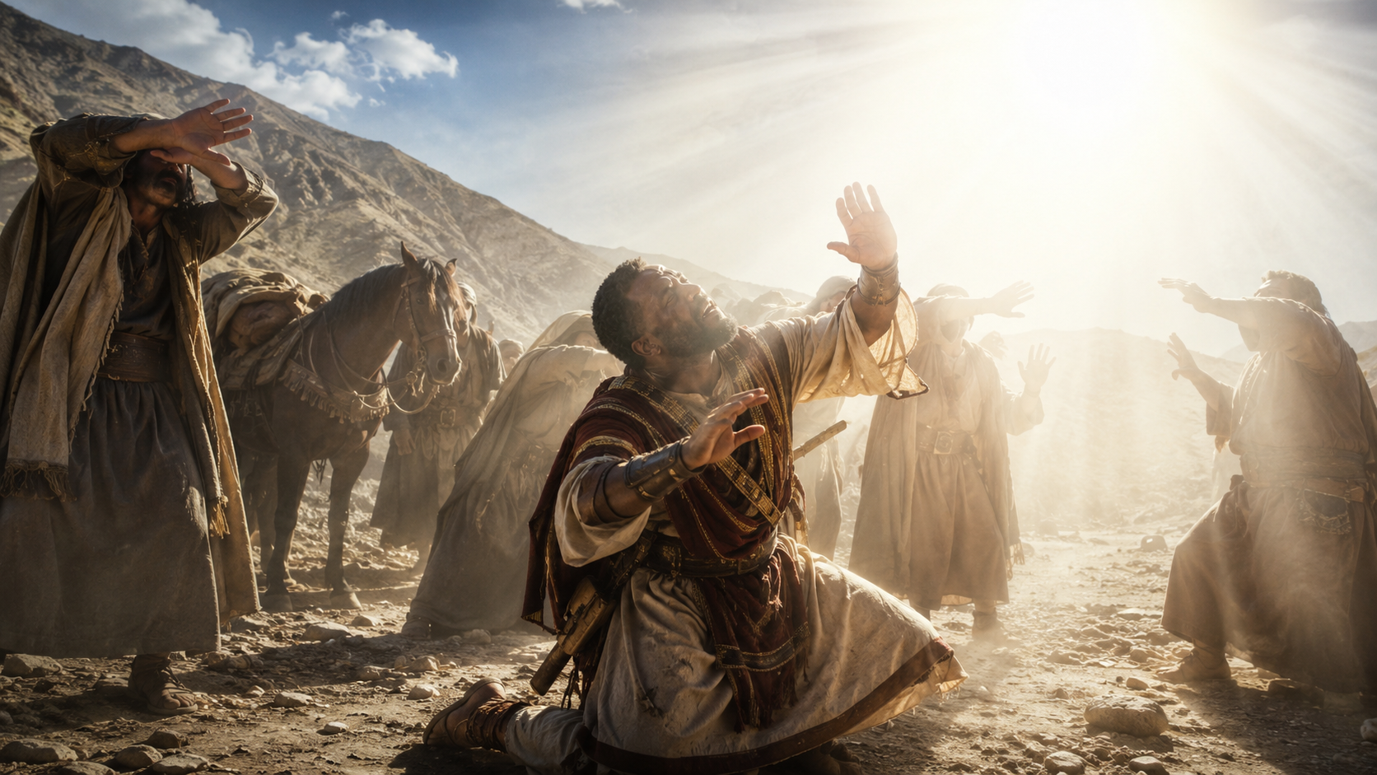
STEPHEN, UNWAVERING MARTYR
Meeting Jesus Changes Everything - Acts 22:10–15 NIV
When Christ truly becomes Lord, He can redirect our zeal, use our past, restore our vision, place us in fellowship with His people, and send us out as witnesses.
Meeting Jesus changes everything because Jesus changes the person who meets Him.
10 “‘What shall I do, Lord?’ I asked. “ ‘Get up,’ the Lord said, ‘and go into Damascus. There you will be told all that you have been assigned to do. ’
11 My companions led me by the hand into Damascus, because the brilliance of the light had blinded me.
12 “A man named Ananias came to see me. He was a devout observer of the law and highly respected by all the Jews living there.
13 He stood beside me and said, ‘Brother Saul, receive your sight!’ And at that very moment I was able to see him.
14 “Then he said: ‘The God of our ancestors has chosen you to know his will and to see the Righteous One and to hear words from his mouth.
15 You will be his witness to all people of what you have seen and heard. ’”
  Paul responds with submission to Jesus after being blinded on the road to Damascus.
  His traveling companions lead him into the city, where he waits.
  Ananias, a Jewish Christian, comes to Paul (called Saul here) and restores his sight.
  Ananias declares Paul’s mission will be to witness to all people about what he has seen and heard, that Jesus is “the Righteous One,” God’s Son.
10
Notes:
><><><><><<<><><><><><><><
Acts 22:10–15 NIV
><><><><><<<><><><><><><><
Meeting Jesus Changes Everything
Paul continues his testimony of meeting Jesus in verses 10–15. His humble question of “What shall I do, Lord?” marks a transformation from persecutor to disciple. The simple plea reveals the heart of true change through submission to Christ’s authority. Like Abraham before him, Paul will “go” in accordance with God’s plan and to a place that God directs him (compare Gen. 12:1).
The Messiah whom Paul had been persecuting gives him directions to continue into Damascus (v. 10). But Jesus asks him to wait to receive word of what he shall do next. Paul had been operating with what might be called “blind zeal” for God’s reputation. Thus, the bright light from heaven had left him physically blind and dependent upon others to guide him (v. 11).
As a reminder, since Paul is retelling this story from Acts 9, he is selecting critical details that demonstrate the validity of his message to Jewish listeners. Ananias, the man who came to him in Damascus, is “a devout observer of the law and highly respected by all the Jews living there” (v. 12). And it is by the power of “the God of our ancestors” that Paul will be commissioned (v. 14). Paul is undercutting the false accusation that his ministry would encourage people to ignore the law (see Acts 21:28). At the same time, Paul is describing why Jesus—whom he calls “the Righteous One” (v. 14; compare Isa. 53:11)—is the fulfillment of what Israel had longed to find. The Righteous One of Israel was able to call Paul to a new life and a new direction. What zeal for God had led him to oppose Jesus’ followers would give way to a courageous ministry as Jesus’ apostle.
But back to Paul’s retelling. He remains physically blind in the city of Damascus when Ananias comes to him. From Acts 9:10–16, readers know that Ananias received a vision of his own from Jesus. When he arrived to greet Paul, Ananias addresses “Brother Saul,” which uses Paul’s Jewish name (v. 13). Paul says it is that moment that his sight was restored. For the first time, he is looking with eyes attuned to what he had been too blind to see.
It is a fellow Jew and faithful follower of Jesus who welcomes Jesus’ newest witness. With a remarkable show of grace to a previous enemy, Ananias alludes to Paul’s new role as a witness for Jesus. Paul has been chosen to “know [God’s] will and to see the Righteous One and to hear words from his mouth” (v. 14). Paul’s testimony will be heard far and wide, as the good news of Jesus goes forth. No doubt, Paul hopes this message would grip the hearts of his current listeners.
1 Why is it important for Paul to connect his message to the hope of Israel?
Believing in Jesus wasn’t about rejecting Jewish faith but fulfilling it. Ananias was a well-respected man and brought credibility to Paul’s story for a Jewish audience.
2 What does Paul’s temporary blindness show about him? And what does it show when his sight is restored?
Blindness can be either physical or spiritual. When Paul is a persecutor, he is metaphorically or spiritually blind. Being released from physical blindness coincides with his ability to “see” God’s plan for Jesus.
3 When have you witnessed someone make a dramatic turnaround after becoming a follower of Jesus?
We will all have different responses and stories we might share. Perhaps you have prayed faithfully for someone for years and years, only for God to turn them around with a sudden jolt. But notice that Paul also emphasizes the continuity of his story. God was always trying to reach him, even when he was not ready to listen.
============================================
Meeting Jesus Changes Everything
Main Idea
A true encounter with Jesus changes a person’s direction, dependence, vision, and purpose. Paul moved from persecuting Christ’s followers to submitting to Christ’s authority, receiving grace through Ananias, and accepting God’s call to become a faithful witness.
Summary
Paul’s question, “What shall I do, Lord?”, reveals the heart of his transformation. The man who had confidently directed his own mission now waited for Christ’s instructions. His physical blindness reflected the spiritual blindness that had shaped his former zeal.
God sent Ananias, a devout and respected Jew, to restore Paul’s sight and confirm his calling. Paul learned that Jesus was the promised Righteous One and that God had chosen him to know His will, hear Christ’s words, and testify about what he had experienced.
Three Key Points
1. Submission Replaced Self-Direction
Paul’s question, “What shall I do, Lord?” shows that he now recognized Jesus’ authority. Conversion moved him from determining his own path to obeying the direction Christ provided.
2. Blindness Became a Lesson in Dependence
Paul had previously acted with confidence and “blind zeal.” After encountering Christ, he became physically blind and needed others to lead him. God used weakness to teach dependence.
3. Grace Prepared Paul for His New Mission
Ananias welcomed his former enemy as “Brother Saul.” Through Ananias, God restored Paul’s sight and confirmed that he had been chosen to become a witness for Jesus.
Three Life Lessons Learned
1. True Faith Begins With Surrender
Following Jesus means more than believing facts about Him. It requires asking, “Lord, what do You want me to do?” and being willing to obey His answer.
2. God May Use Weakness to Redirect Us
Paul’s blindness removed his independence. Sometimes God allows circumstances that expose our limitations so that we learn to trust His guidance instead of our own understanding.
3. Grace Can Turn Enemies Into Family
Ananias called the persecutor “Brother Saul.” The gospel creates relationships that human history alone would never produce. Christ’s grace can reconcile former enemies and give them a shared mission.
Analyze
Paul’s transformation is demonstrated most clearly through the change in authority over his life. Before Damascus, Paul operated according to his own understanding of how God should be served. After encountering Jesus, he immediately asked for direction.
His statement, “What shall I do, Lord?”, is therefore more than a request for information. It is an act of surrender.
The comparison with Abraham strengthens this idea. Like Abraham, Paul would have to go where God directed him without yet knowing every detail of what his future would involve. Faith would require obedience before complete understanding.
Paul’s blindness also carries strong symbolic significance within the account. He had believed he saw religious truth clearly, but his zeal had actually led him to oppose Jesus. The heavenly light exposed that blindness. Only after depending upon others and receiving God’s appointed messenger could Paul see again.
Luke’s inclusion of Ananias is especially important for Paul’s Jewish audience. Ananias is presented as a devout man respected by the Jews. Paul therefore emphasizes that his calling did not come from contempt for Israel’s Scriptures or heritage. His commission was connected with “the God of our fathers.”
Paul also identifies Jesus as “that Just One” or the Righteous One. This places Jesus within Israel’s hope rather than outside of it. Paul’s argument is that following Jesus was not abandoning God’s purposes but recognizing their fulfillment.
The words “Brother Saul” reveal the depth of Christian grace. Ananias welcomed a man who had been persecuting people like him. He did not pretend Paul’s past was harmless, but he accepted what Christ had done in Paul’s life.
Finally, Paul’s restored sight points beyond physical healing. He could now see Jesus differently, his past differently, other believers differently, and his future differently.
Lesson God Wants Us to Learn
Meeting Jesus should change not only what we believe, but who directs our lives.
Paul teaches us to move from self-confidence to surrender, from spiritual blindness to spiritual sight, and from personal ambition to God-given purpose.
The question every disciple must eventually ask is the same question Paul asked:
“What shall I do, Lord?” — Acts 22:10, KJV

Slide 11
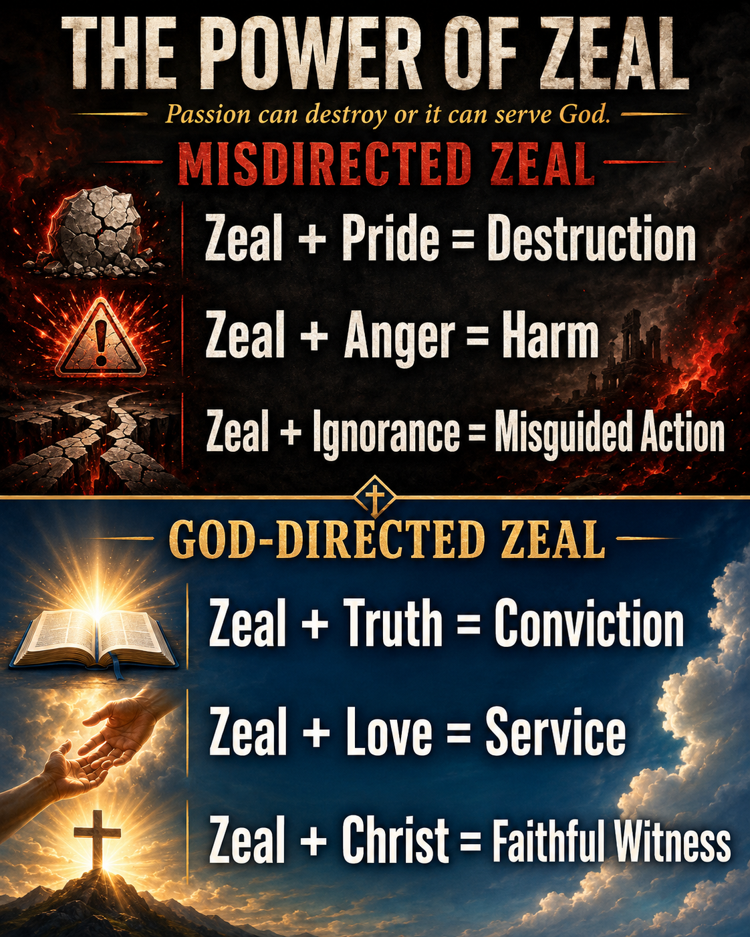
One Bible, One Story
Go, and I’ll Show You
Pivotal moments often begin with simple commands requiring radical obedience. Paul’s Damascus road experience (Acts 22:6–10) echoes Abraham’s call, demonstrating how faith means stepping into the unknown when God says, “Go. ” The striking similarity between God’s command to Abraham—“Go . . . to the land I will show you” (Gen. 12:1)—and Jesus’ instruction to Paul—“Get up and go into Damascus” (Acts 22:10)—reveals a biblical pattern. Both received directives to embark on journeys without full knowledge of the outcome. Abraham left his homeland for an unspecified land, while Paul entered Damascus blinded and awaiting guidance.
These calls each launched world-changing missions. Abraham’s obedience set in motion God’s plan to bless all nations (Gen. 12:3), while Paul’s compliance initiated his ministry to Gentiles (Acts 22:15, 21). Both narratives highlight God’s pattern of calling individuals into uncertain circumstances to advance His redemptive plan.
Acts 22:3–15
Notes:
One Bible, One Story
Go, and I’ll Show You
Pivotal moments often begin with simple commands requiring radical obedience. Paul’s Damascus road experience (Acts 22:6–10) echoes Abraham’s call, demonstrating how faith means stepping into the unknown when God says, “Go. ” The striking similarity between God’s command to Abraham—“Go . . . to the land I will show you” (Gen. 12:1)—and Jesus’ instruction to Paul—“Get up and go into Damascus” (Acts 22:10)—reveals a biblical pattern. Both received directives to embark on journeys without full knowledge of the outcome. Abraham left his homeland for an unspecified land, while Paul entered Damascus blinded and awaiting guidance.
These calls each launched world-changing missions. Abraham’s obedience set in motion God’s plan to bless all nations (Gen. 12:3), while Paul’s compliance initiated his ministry to Gentiles (Acts 22:15, 21). Both narratives highlight God’s pattern of calling individuals into uncertain circumstances to advance His redemptive plan.

Slide 12
Opened Eyes Can Open Other Eyes
It is vital to remember that whenever we read accounts of God’s appearing to people, such stories are never the end goal in and of themselves. Such an appearance (called a theophany) happens in order to certify something or someone as being of God.
Today, we have the completed witness of the New Testament to guide us. We don’t need a theophany, like the one Paul received, to motivate us toward our duty to witness—the New Testament itself is intended to encourage us! God calls His people to align their lives with His path revealed through His Word. Through this alignment, God’s Spirit transforms our lives to serve God. As a result, we become agents of the gospel in the world.
Paul’s encounter with the risen Jesus was the first step in incorporating him into Christ’s body—the church. Our individual stories are part of this larger narrative. Like Paul, who began his extensive work after this encounter, part of glorifying God is edifying others. Let us reflect on our personal life stories in light of what God has done for us so that we may edify others and glorify Him.
God opens our eyes to His truth so that we can help others see the truth of Jesus Christ.
  Our testimony should become ministry.
  Our knowledge of Scripture should become obedience.
  Our spiritual growth should become encouragement.
  Our salvation should lead to service.
  Like Paul, we should ask how the story of what God has done in our lives can strengthen someone else.
God does not open our eyes merely so that we can see. He opens our eyes so that, through faithful witness, others may come to see Jesus too.
Notes:
Opened Eyes Can Open Other Eyes
Main Idea
God opens our spiritual eyes so that our changed lives can help point others toward His truth. Paul’s encounter with Christ was not meant to remain a private experience; it prepared him to serve the church, witness to others, strengthen believers, and glorify God.
Summary
Paul’s encounter with the risen Jesus confirmed God’s call upon his life, but the experience itself was not the final goal. God opened Paul’s eyes so that Paul could become a faithful witness.
Today, believers are guided by the completed witness of the New Testament. Through God’s Word and the work of the Holy Spirit, Christians are transformed and equipped to serve. Our personal salvation stories become part of God’s larger work through the church as we encourage others and proclaim what Christ has done.
Three Key Points
1. Spiritual Experiences Point Beyond Themselves
Paul’s encounter with Jesus had a purpose. It authenticated Christ’s call and prepared Paul for ministry. The experience was not simply something remarkable for Paul to remember; it moved him toward obedience and witness.
2. God’s Word Guides Believers Today
Believers do not need Paul’s Damascus-road experience in order to know their responsibility. Scripture provides the truth, instruction, and testimony necessary to guide Christians in faithful living and witness.
3. Changed People Become Gospel Witnesses
When God transforms a life, that transformation can strengthen others. Paul became part of Christ’s church and used his testimony, teaching, and ministry to build up other believers and spread the gospel.
Three Life Lessons Learned
1. Do Not Keep Your Testimony to Yourself
What God has done in your life can encourage someone else. Your testimony should point attention away from yourself and toward the grace and power of Jesus Christ.
2. Allow Scripture to Shape Your Direction
Christian living is not based primarily upon dramatic experiences. God has given His Word to teach us how to believe, live, serve, and witness.
3. Spiritual Growth Should Benefit Others
God does not transform believers only for personal improvement. Mature Christians should help strengthen the church, encourage others, and participate in spreading the gospel.
Analyze
This section moves the lesson from Paul’s experience to our responsibility.
Paul received an extraordinary encounter with the risen Christ, but the lesson correctly emphasizes that the encounter was a beginning rather than an ending. Paul did not spend the rest of his life merely talking about the brightness of the light. The experience redirected him into service.
That distinction is important. Spiritual experiences can become unhealthy when people focus more on the experience than on the God who gave it or the obedience that should follow it. Paul’s encounter had purpose: his eyes were opened so that his life could become useful in opening the spiritual understanding of others.
The section then makes an important transition to believers today. We have the testimony of Scripture. The New Testament records Christ’s life, death, resurrection, teaching, and the witness of those who encountered Him. Therefore, Christian obedience does not depend upon receiving a dramatic supernatural experience like Paul’s.
Instead, believers are called to align themselves with the truth God has already revealed.
The Holy Spirit then works through that truth to transform our character and direct our service. Transformation should produce participation in God’s mission.
Paul’s personal story also became part of something larger than Paul. His conversion brought him into the body of Christ—the church. Christianity is not merely “Jesus and me.” God saves individuals and places them within a community where their gifts, experiences, testimony, and service can strengthen others.
This is why the phrase “Opened Eyes Can Open Other Eyes” is so effective. Paul’s spiritual sight led to spiritual service.

Slide 13
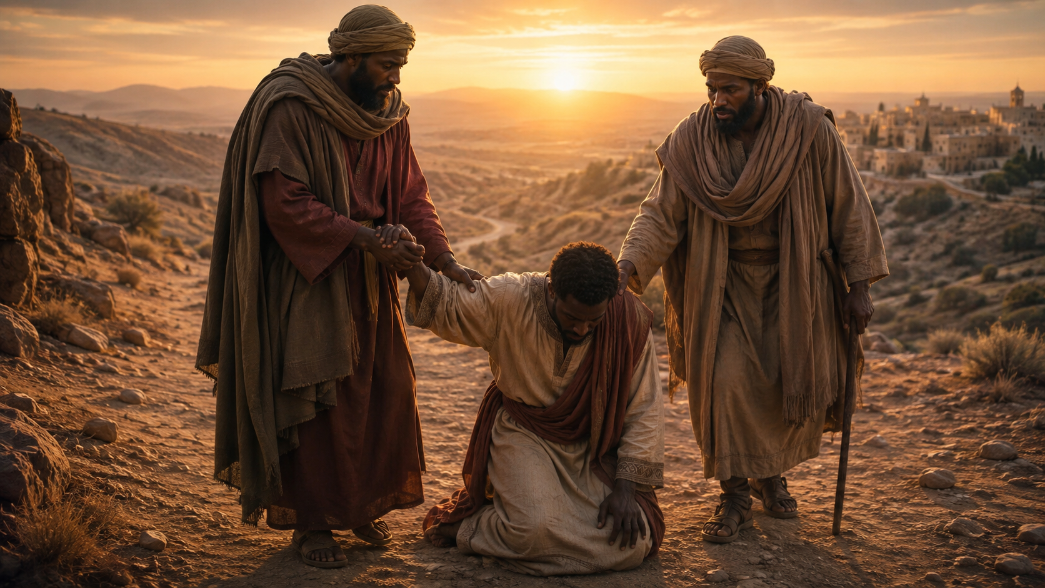
Apply the Message: God turns us around when we have been going the wrong direction.
The Lord of All
The hardest year of my marriage came while I was in seminary. My wife and I were both working full-time jobs, trying to balance all the things of life: work, children, commutes, studies, and you name it. Many days she and I felt like ships passing in the darkness. But worst of all, she was facing a boss who was driving her to the breaking point. This person was demanding, demeaning, even cruel—not at all what we needed. We shared some desperate prayers about this person who had become almost like an enemy to us. Lord, if you reign over all, you can turn this person around.
It’s probably not too far off from the kind of desperate prayers that early Christians might have prayed about Saul, the persecutor. The Lord shattered Paul’s hatred for followers of Jesus. He turned the murderous persecutor into an exceptional missionary. Paul’s encounter with Jesus proves that no person is beyond reaching. At the same time, what stands out in Paul’s own testimony is the theme of blindness and misdirection. Paul was doing what he thought was right and good, and he discovered that he and been persecuting God’s Son in the process. What was the key that unlocked this new understanding? It was a clear understanding of Jesus as lord.
You might respond to Paul’s testimony the way that I do, taking comfort that Jesus can change enemies into allies. Or perhaps you respond to his testimony by examining yourself for any ways that you have been misdirected and blind to spiritual realities. Whether in your relationships, your commitments, or your presentation of yourself, make room to ask the question that Paul asked when he saw what he had done: “What shall I do, Lord?” (Acts 22:10).
God can turn around both the person we think will never change and the person staring back at us in the mirror.
  Paul teaches us to believe that Christ can transform enemies while also remaining humble enough to admit that we ourselves may be wrong.
  We should therefore pray for difficult people without giving up on them, examine our own hearts without excusing ourselves, and submit every area of life to the lordship of Jesus Christ.
When Jesus is truly Lord, He has the authority to change our hearts, correct our direction, and redirect our lives toward His purpose.
Notes:
Jesus is Lord over people, circumstances, enemies, and our own mistaken direction. Paul’s transformation shows that no one is beyond Christ’s reach, and no believer should assume that sincerity alone means they are spiritually correct. When Jesus reveals the truth, our proper response is, “What shall I do, Lord?” Paul’s testimony gives hope in two directions. First, Jesus can transform people we consider hostile, difficult, or unreachable. Saul was once a violent persecutor, yet Christ turned him into a powerful missionary.
Second, Paul’s story challenges us to examine ourselves. Saul believed he was serving God while actually opposing Jesus. His greatest discovery was that Jesus is Lord. Once Paul recognized Christ’s authority, he became willing to change direction and obey.
Three Key Points
1. Jesus Can Transform Our Enemies The early Christians had strong reasons to fear Saul. Yet the man threatening believers became one of Christianity’s greatest witnesses. Christ’s authority reaches even those we believe are least likely to change.
2. Sincerity Does Not Guarantee Correct Direction Paul sincerely believed he was defending God. His zeal was genuine, but his understanding was wrong. Religious passion must always remain submitted to the truth of Christ.
3. Recognizing Jesus as Lord Changes Everything Paul’s transformation began when he understood who Jesus truly was. His question, “What shall I do, Lord?”, shows that Christ had become the authority directing his life.
Three Life Lessons Learned
1. Never Stop Praying for Difficult People People who seem hostile today may become faithful servants tomorrow. We should not limit what Christ can do in another person’s heart.
2. Regularly Examine Your Own Direction Paul’s story warns us against assuming that strong conviction automatically equals spiritual correctness. We should continually compare our attitudes, relationships, priorities, and actions with God’s Word.
3. Be Willing to Change When God Corrects You Spiritual maturity includes admitting when we have been wrong. The proper response to conviction is not defensiveness but surrender: “What shall I do, Lord?”
Analyze
The illustration about the difficult employer connects Paul’s story to ordinary Christian experience. Most believers will never face someone like Saul the persecutor, but nearly everyone encounters people who seem impossible to change.
The prayer, “Lord, if you reign over all, you can turn this person around,” expresses confidence in Christ’s sovereignty. Paul becomes the biblical proof that such confidence is not misplaced.
Saul was not merely indifferent toward Christianity. He was actively attempting to destroy the Christian movement. Yet Jesus reached him.
That gives believers reason to pray for people we might otherwise label enemies.
However, the application moves in an important second direction. Paul’s testimony should not only make us think about other people who need to change. It should make us ask whether we need to change.
Paul believed he saw clearly. In reality, he was spiritually blind.
He believed he was defending God. In reality, he was persecuting God's Son.
He believed he was moving in the right direction. Jesus revealed that he was traveling the wrong way.
The central issue was therefore lordship.
When Paul asked,
“What shall I do, Lord?” — Acts 22:10, KJV
he surrendered the right to determine his own direction.
This remains one of the most important questions a Christian can ask. It applies to our marriages, friendships, church relationships, careers, attitudes, finances, commitments, conflicts, and personal ambitions.
The question is not merely, “What do I want?”
It is, “Lord, what would You have me do?”

Slide 14
Apply the Message: God turns us around when we have been going the wrong direction.
The Lord of All
  1 What changes in us when we are able to confess that Jesus is Lord?
  2 How did Paul stay the same, and how did he change?
  3 How might we gain new vision to see realities that we might have been missing?
God can turn around both the person we think will never change and the person staring back at us in the mirror.
  Paul teaches us to believe that Christ can transform enemies while also remaining humble enough to admit that we ourselves may be wrong.
  We should therefore pray for difficult people without giving up on them, examine our own hearts without excusing ourselves, and submit every area of life to the lordship of Jesus Christ.
When Jesus is truly Lord, He has the authority to change our hearts, correct our direction, and redirect our lives toward His purpose.
Notes:
1 What changes in us when we are able to confess that Jesus is Lord?
When we make Jesus our Lord, He displaces any false people or things we might have otherwise been serving. We give up serving idols of self-sufficiency, pride, and more. The stain of sin that has ruled since Adam is overcome by the sacrifice of Jesus’ blood.
2 How did Paul stay the same, and how did he change?
Paul was a zealous Jew before he followed Jesus. He did not give up that Jewish background, but he redirected the intensity of his commitments toward following Jesus as the Messiah. He describes the feeling that “the commandment that was intended to bring life actually brought death” (Rom. 7:10). Following Jesus altered his attitude toward those who place their faith in Jesus. Paul became the most zealous defender of faith.
3 How might we gain new vision to see realities that we might have been missing?
We need Jesus to give us vision. If we have been misled or misdirected, we need to ask Jesus to turn us around. If we see people as hopeless sinners, we need Jesus to give us new insight into their humanity.

Slide 15
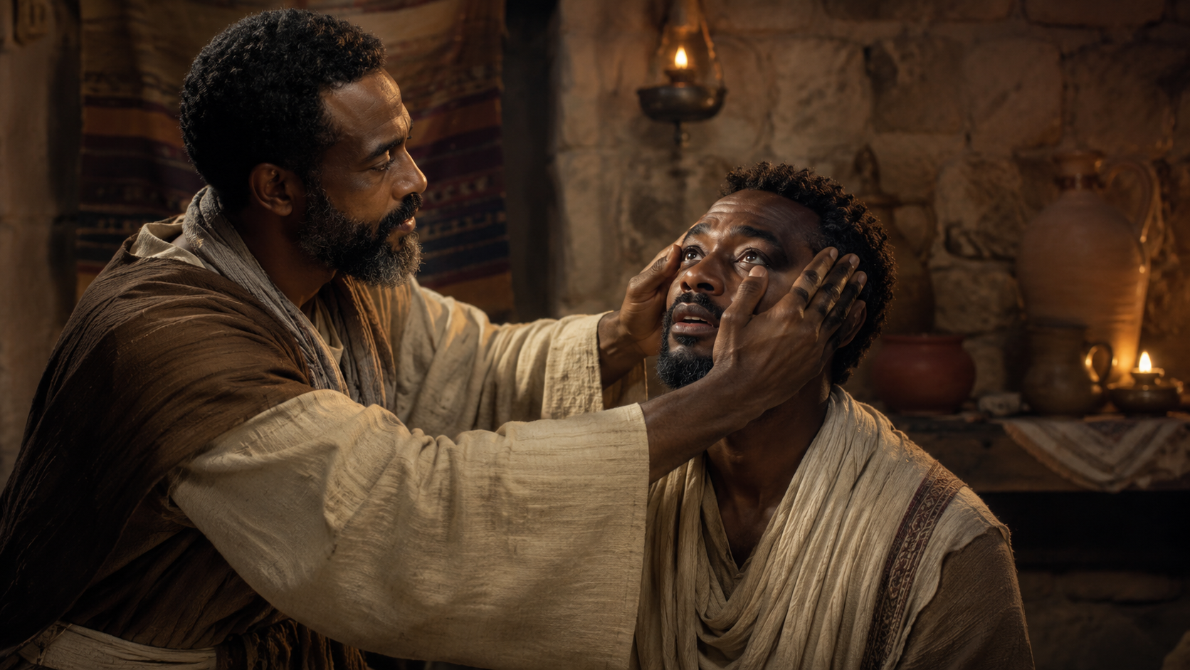
Live It Out Expect: Jesus to save people you see as enemies.
Never allow another person’s present hostility to make you doubt Christ’s power to transform them.
  The person you presently regard as an opponent may someday become your brother or sister in Christ.
  The hardened person may become a worshiper.
  The critic may become a witness.
  The persecutor may become a preacher.
  Saul’s conversion reminds us that Jesus specializes in unlikely disciples.
  So choose a name. Pray specifically. Refuse to declare anyone spiritually hopeless. And pray with expectation:
“Lord, if You could turn Saul around, You can turn this person around too.”
Paul is an enemy-turned-hero of the early church, and his testimony is able to grant each of us hope. There is no person too far gone, no sin that is unforgivable. The invitation this week is to pray over a name that we have treated as unforgivable or beyond conceivable hope. Pray for Jesus to turn one person around in a powerful way.
UNLIKELY APOSTLES
  Saul was the least likely candidate for helping to spread the gospel, but the Lord had great plans for this one-time opponent of the faith. Who are some people in your life that seem too antagonistic, too close-minded, too wounded to find Jesus? Pray for them by name, asking the Lord to break down whatever walls are preventing them from receiving the gift of salvation.
Notes:
Paul’s transformation teaches us never to decide that another person is beyond the saving reach of Jesus Christ. Instead of writing off difficult, hostile, wounded, or resistant people, believers should pray for them, love them, and trust Christ to do what only He can do—change the heart. Saul appeared to be one of Christianity’s greatest enemies. He opposed believers, imprisoned them, and attempted to stop the spread of the gospel. Yet Jesus confronted him, saved him, and transformed him into a faithful witness.
Paul’s story challenges Christians to identify people they have considered hopeless or unreachable and begin praying for them by name. The person who seems least likely to follow Jesus today may become a powerful servant of Christ tomorrow.
Three Key Points
1. No Person Should Be Considered Beyond Christ’s Reach Saul was not merely uninterested in Christianity; he was actively attacking Christians. His conversion demonstrates the extraordinary reach of God’s grace. We should be careful about labeling anyone hopeless when Christ has the power to transform even determined opposition.
2. Our Enemies Should Become Subjects of Prayer The Christian response to hostility is not merely avoidance, resentment, or retaliation. Jesus calls believers to pray for those who oppose them. Instead of continually rehearsing what someone has done against us, we can begin asking God to reveal Christ to that person.
3. God Can Turn Opponents Into Servants Saul those prayers to remove bitterness, prejudice, anger, or hopelessness from our own hearts.
Analyze
The phrase “Unlikely Apostles” captures one of the remarkable features of Paul’s story. From a human perspective, Saul was an extremely unlikely candidate for Christian ministry.
The church had every reason to fear him.
He had persecuted believers.
He had approved actions against Christians.
He traveled toward Damascus intending to arrest more followers of Jesus.
Yet Jesus saw something no frightened Christian could have seen: what Saul could become through grace.
That is the challenge of this application.
We often evaluate people according to what they are right now. God knows what His grace can make them.
Acts 9:15 records the Lord describing Saul as “a chosen vessel unto me.” The Christians saw a persecutor; Christ saw a future preacher. They saw danger; Christ saw an instrument through whom the gospel would travel across nations.
This does not mean Christians ignore harmful behavior or abandon appropriate boundaries. Paul truly had been dangerous. But appropriate caution should never become spiritual hopelessness.
There is also an important difference between forgiving someone and assuming that person has already repented. We can release personal vengeance to God while continuing to pray for genuine repentance and salvation.
Paul’s story therefore teaches believers to replace the sentence,
“That person will never change,”
with the prayer,
“Lord Jesus, reveal Yourself to them and change their heart.”
Lesson God Wants Us to Learn

Slide 16


End
  The Lord bless thee, and keep thee:
  The Lord make his face shine upon thee, and be gracious unto thee:
  The Lord lift up his countenance upon thee and give thee peace.
  - Numbers 6:24-26,
Material adapted by Stanford W. Bowman Jr. from Echoes® Adult and Bible-in-Life® Adult
Summer -2026 quarter with permission, © David C Cook, https://davidccook.org. May not be further reproduced. All rights reserved.
16

