Slide 1
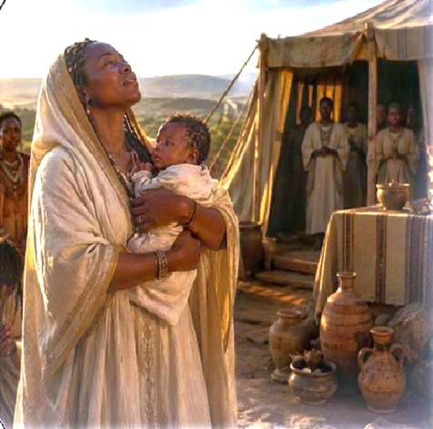
Hannah, the Faithful Supplicant
Wherefore it came to pass, when the time was come about after Hannah had conceived, that she bare a son, and called his name Samuel, saying, Because I have asked him of the Lord.
—1 Samuel 1:20 KJV
Notes:
Hannah, the Faithful Supplicant
In the ancient Near East, a woman’s life was often closely connected to marriage, family, and children. Having children, especially sons, was seen as a great blessing because children helped carry on the family name, inheritance, and future. Because of this, women who could not have children often felt deep sorrow, shame, and pressure from society.
This helps us understand Hannah’s pain. Her barrenness was not only a private struggle; it affected how others saw her and how she saw herself. Peninnah’s teasing made her grief even heavier. Yet Hannah did not give up. She carried her sorrow to God in prayer. Her story teaches us that God sees hidden pain, hears sincere prayer, and can turn deep anguish into joy.

Slide 2
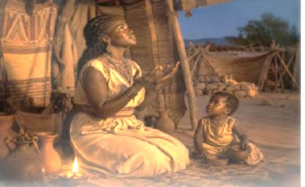
    Prayer
Heavenly Father, God of impossible things, thank You for Your miraculous provisions. May we relish them with delight while they are ours and release them back to You when required. In Jesus’ name we pray. Amen.
        Thought to Remember
          God listens and gives good gifts.
Notes:
Prayer
Heavenly Father, God of impossible things, thank You for Your miraculous provisions. May we relish them with delight while they are ours and release them back to You when required. In Jesus’ name we pray. Amen.
Thought to Remember
God listens and gives good gifts.

Slide 3
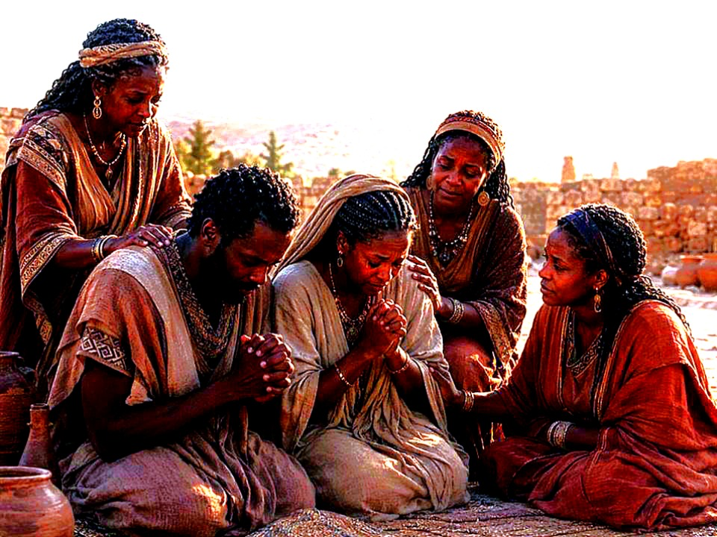
LESSON OUTLINE
Hannah, the Faithful Supplicant
  Lesson Scripture: Samuel 1:9–20, 25
  Lesson Focus: Find your treasure in heaven, not on earth.
  Life Response:
  Bible Application:
Commit to finding our treasures in heaven.
Discuss the ways that Jesus invites us to unburden ourselves.
        Review
        Introduction
        Lesson Context
        Overview
            Misunderstood Grief - 1 Samuel 1:9–16 KJV
            Rekindled Hope - 1 Samuel 1:17–20, 25 KJV
          Bible Application
        Conclusion
        Question & Answers
Notes:
Misunderstood Grief - 1 Samuel 1:9–16 KJV
Rekindled Hope - 1 Samuel 1:17–20, 25 KJV
===========================1 Samuel 1:9–20, 25 =============
Brief Summary with Contextual Meaning
Hannah’s story in 1 Samuel 1:9–20, 25 teaches that God can turn deep anguish into lasting joy. Hannah was barren, mocked, misunderstood, and emotionally broken, yet she took her pain directly to the Lord in honest prayer. Her vow showed that she did not merely want a son for personal satisfaction; she was willing to dedicate the child back to God’s service. When God answered, Samuel’s birth became more than a family blessing—it became part of God’s plan to raise up spiritual leadership for Israel during a troubled time.
Contextual Meaning:
This lesson takes place near the end of the period of the Judges, when Israel was spiritually weak and priestly leadership was failing. While Hannah was praying for relief from personal sorrow, God was preparing Samuel to become a prophet, priest, and judge for the nation. The lesson reminds us that our private pain is not hidden from God. When we pray faithfully and surrender our desires to Him, God may answer in ways that bless us and serve a purpose far greater than we first imagined.

Slide 4
LESSON CONTEXT
Hannah, the Faithful Supplicant
INTRODUCTION
Experiencing God’s Mercy
  We enjoy telling and retelling stories of dogged persistence. Consider Thomas Edison’s countless attempts at creating a functioning light bulb, or Walt Disney’s commercial failures that gave rise to an entertainment empire. Such stories inspire us to keep trying, even in the face of adversity.
  But not all stories of persistence are so grandiose; many are personal. A husband and wife were desperate to have a child, but like many couples, struggled to make that hope a reality. Despite every medical intervention, it appeared their chances were slim. Fears and uncertainty clouded their prayers, and they even felt ashamed for wanting so badly what God had not made possible.
  My friends’ story has a happy ending. After nearly giving up, God granted them a healthy baby girl! Her infant cries were music to their ears. Afterward, one said, “We didn’t know if we were praying for the right thing. But we knew that God would show us mercy in one way or another. ”
4
Notes:
God’s mercy is trustworthy even when our prayers are filled with uncertainty, longing, and pain. Persistence matters, but the deeper lesson is that God meets people with compassion, whether His answer comes as expected or in another merciful way. This passage teaches that persistence and faith are closely connected, but not in a mechanical way. The couple’s story is not simply about “trying hard enough” until God gives the desired result. Rather, it shows the tension between human longing and divine mercy. Their struggle involved emotional pain, medical disappointment, spiritual uncertainty, and shame. Yet their faith remained open to God’s goodness.
The final statement is the heart of the passage: THEY DID NOT KNOW WHETHER THEY WERE PRAYING FOR THE RIGHT THING, BUT THEY TRUSTED GOD’S MERCY. This reveals mature faith. True faith does not always have certainty about the request, but it has confidence in God’s character. The story encourages believers to bring their deepest desires to God while trusting that His mercy will meet them, one way or another.
Three Key Points
1. Persistence is not only public and heroic; it is often private and painful. Some of the greatest acts of endurance happen in unseen places, such as prayer, grief, waiting, and personal struggle.
2. Honest prayer can include fear and uncertainty. The couple did not pray with perfect confidence. They wondered whether they were asking for the right thing, yet they still brought their longing to God.
3. God’s mercy is greater than human control. Medical efforts could not guarantee the outcome, but the couple trusted that God would show mercy in some way, whether or not the answer came as they desired.
Three Life Lessons Learned
1. Keep praying even when the answer is unclear. Faith does not require knowing exactly how God will respond. It means continuing to trust His goodness while waiting.
2. Do not be ashamed of deep longing. Wanting something strongly does not make a person faithless. Honest desire can become a place where we encounter God’s compassion.
3. God’s mercy may come in expected or unexpected ways. The couple received the child they hoped for, but their faith rested in the belief that God would be merciful regardless of the outcome.
Summary
The passage compares famous stories of persistence, like Thomas Edison and Walt Disney, with quieter personal stories of endurance. It focuses on a couple who desperately wanted a child but faced disappointment, fear, and uncertainty despite medical efforts. Their prayers were clouded by doubt and even shame, yet they still trusted that God would show mercy. In time, God blessed them with a healthy baby girl. Their testimony shows that God’s mercy may come in ways we hope for, but faith trusts Him even before the answer is clear.

Slide 5
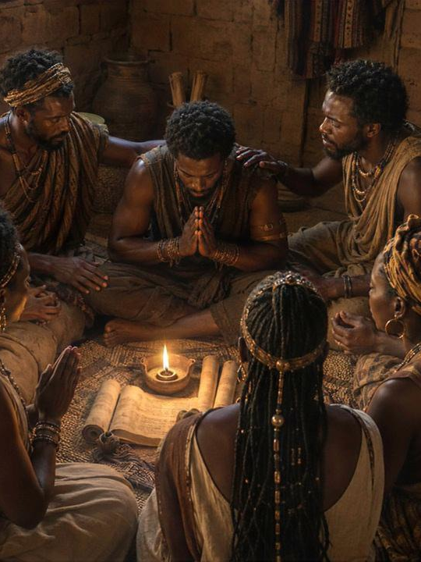
Support Scripture for Lesson
Hannah, the Faithful Supplicant
Week of June 15 through June 20
► Romans 1:8–12—A Praying Friend.
► 1 Corinthians 15:30–34—Choose Your Friends Wisely.
► Proverbs 18:19–24—A Friend Closer than a Brother.
► Ruth 1:11–18—Friends Stick Together.
► John 15:9–17—Friends Love Radically.
► 1 Samuel 20:16–17, 32–34, 42—Sworn Friendship.
Biblical friendship is more than companionship. It is prayerful, wise, loyal, sacrificial, truthful, and rooted in God. Paul shows that friends pray and encourage. Corinthians warns that friends influence character. Proverbs teaches that faithful friends remain close.
Ruth shows loyal love. Jesus reveals radical, self-giving friendship. Jonathan and David demonstrate covenant loyalty. The main idea is that godly friendship reflects God’s love and helps people remain faithful.
5
Notes:
God wants us to choose, become, and cherish friends who draw us closer to Him. A true friend prays, speaks wisely, remains loyal, sacrifices in love, tells the truth, and keeps covenant faithfulness. Godly friendship is not selfish or shallow; it reflects Christ’s love and strengthens others for righteous living.
Friendship in Scripture
Romans 1:8–12 — A Praying Friend
Summary:
Paul thanks God for the Roman believers and prays continually for them. He longs to visit them so they may be spiritually strengthened and mutually encouraged by one another’s faith.
Commentary:
A true friend prays, gives thanks, and desires another person’s spiritual growth. Paul does not seek friendship for personal gain only; he expects mutual encouragement. Christian friendship strengthens both people.
Analysis:
This passage shows that friendship is rooted in prayer, gratitude, and shared faith. Paul’s love is active, not distant. He remembers them before God and longs to build them up.
1 Corinthians 15:30–34 — Choose Your Friends Wisely
Summary:
Paul warns that bad company corrupts good character. He urges believers to wake up spiritually, stop sinning, and reject influences that deny the truth of God and the resurrection.
Commentary:
Friendships shape beliefs, behavior, and spiritual direction. Companions who reject truth can slowly weaken faith. Wise believers choose relationships that encourage righteousness rather than pull them toward sin.
Analysis:
This passage teaches discernment. Love people, but do not let corrupt influences guide your life. The people closest to us can either strengthen our faith or damage our character.
Proverbs 18:19–24 — A Friend Closer than a Brother
Summary:
Proverbs teaches that words have power, offenses can divide deeply, and not all companions are true friends. Yet there is a kind of friend who remains closer than family.
Commentary:
Friendship requires wisdom, careful speech, loyalty, and reconciliation. Casual companions may disappear, but a faithful friend stays through conflict, hardship, and need.
Analysis:
This passage contrasts shallow relationships with covenant-like friendship. True friendship is not measured by popularity but by faithfulness, trust, and the ability to remain present when relationships are tested.
Ruth 1:11–18 — Friends Stick Together
Summary:
Naomi urges Ruth to return home, but Ruth refuses to leave her. Ruth pledges loyalty to Naomi, her people, and her God, choosing commitment over convenience.
Commentary:
Ruth shows friendship through sacrifice, loyalty, and steadfast love. She does not stay because life will be easy; she stays because love is faithful even when the future is uncertain.
Analysis:
This passage reveals the cost of faithful friendship. Ruth’s loyalty goes beyond emotion. She binds her life to Naomi’s life, showing that true friendship often requires sacrifice and devotion.
John 15:9–17 — Friends Love Radically
Summary:
Jesus commands His disciples to remain in His love and love one another. He calls them friends, not servants, and teaches that the greatest love lays down its life for others.
Commentary:
Jesus defines friendship by sacrificial love, obedience, openness, and chosen relationship. Christian friendship is modeled after Christ’s love, which gives freely and completely.
Analysis:
This passage gives the highest standard for friendship. Friendship is not merely affection; it is Christlike love in action. Jesus shows that love gives, serves, reveals truth, and remains faithful.
1 Samuel 20:16–17, 32–34, 42 — Sworn Friendship
Summary:
Jonathan makes a covenant with David because he loves him deeply. He defends David before Saul and grieves over Saul’s injustice. Jonathan and David part in peace under their sworn bond before the Lord.
Commentary:
Jonathan’s friendship is loyal, costly, and covenantal. He protects David even when doing so places him against his father’s anger and his own claim to the throne.
Analysis:
This passage shows friendship tested by danger and loyalty. Jonathan loves David with integrity, courage, and sacrifice. True friendship honors God, protects the innocent, and keeps promises.

Slide 6
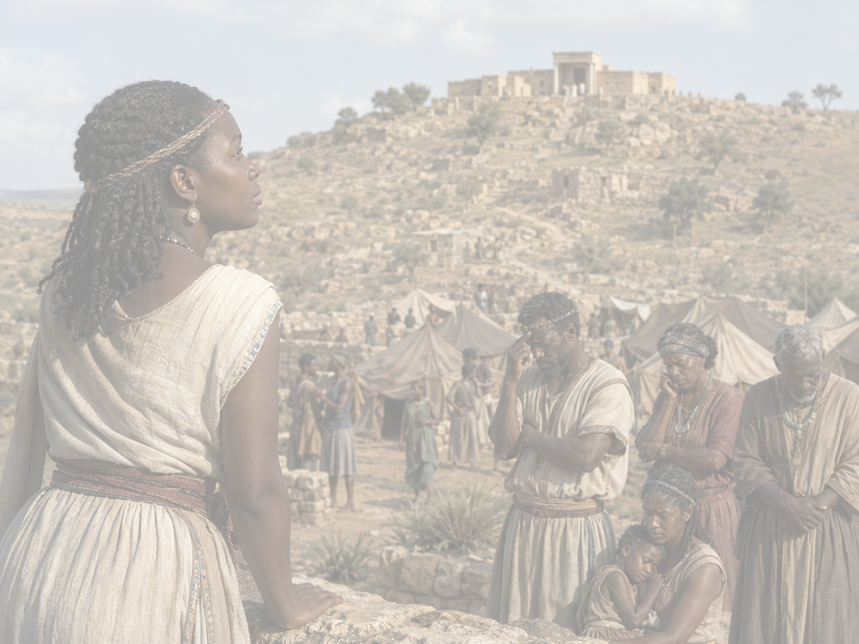
LESSON CONTEXT
Hannah, the Faithful Supplicant
The events of today’s text occurred late in the period of the Judges, perhaps around 1100 BC. In 1 Samuel 1:1–8, Elkanah is introduced with two wives: Peninnah and Hannah. Elkanah may have been an important individual of the priestly Levitical tribe (1 Chronicles 6:23). Although Elkanah loved Hannah very much, she was unable to bear children (1 Samuel 1:8). Peninnah mocked Hannah, perhaps jealous that Elkanah gave her a greater share of their family’s annual sacrifice (1:5–6). Even though Hannah was childless, Elkanah gave her a “worthy portion,” the amount typically given to a firstborn son and heir (1:5; see Deuteronomy 21:15–17).
Scripture often frames the ability to conceive children as a capacity under the sole discretion of God (Genesis 29:31; 30:22; 1 Samuel 1:6). This is a perfectly reasonable perspective in an age before medical interventions. Just like the fertility of crops and the success of a harvest, the blessing of bearing children was attributed to God (Psalm 127:3–5). But this left many ancient women in a difficult social position. The anxiety and sorrow of infertility became a special place of God’s intervention, often signaling the coming of a remarkable child: Isaac (Genesis 21:1–2); Jacob and Esau (25:21); Joseph (30:23–24); Samson (Judges 13:2–3); and, even later, John the Baptist (Luke 1:13, 24–25). As we examine Hannah’s story, we see God’s attention turned toward her. The child of her penitent prayers will be a leader for a leaderless generation.
6
Notes:
God was working through Hannah’s personal pain to provide spiritual leadership for a troubled nation. Her infertility was not ignored by God; it became the setting for His mercy, intervention, and larger purpose. Hannah’s story is about more than wanting a child. It shows God’s mercy during a hard time for Israel. The nation was spiritually weak, and its leaders were failing. Hannah was also hurting because of sorrow, family conflict, and unanswered prayer.
God did not ignore Hannah’s pain. He used her prayer and trust to do something greater. Samuel’s birth comforted Hannah, but it also gave Israel a faithful leader. This lesson shows that God often works through weakness, tears, and waiting. He can turn personal pain into a blessing that helps many people.
Three Key Points
1. Israel needed faithful leadership. The nation was divided, troubled, and spiritually weak. Eli’s household represented failing priestly leadership, but God was already preparing Samuel as a new leader.
2. Hannah’s pain was both personal and social. Her childlessness brought sorrow, shame, and mockery. Although Elkanah loved her, Hannah still carried deep grief that only God could fully answer.
3. God often works through impossible situations. The Bible repeatedly shows God bringing important children through women who struggled with infertility, including Sarah, Rebekah, Rachel, Samson’s mother, and Elizabeth.
Three Life Lessons Learned
1. God sees private pain. Hannah’s sorrow may have seemed hidden or misunderstood by others, but God saw her need and heard her prayer.
2. Difficult seasons can become places of divine purpose. What felt like Hannah’s personal burden became part of God’s plan to bless Israel through Samuel.
3. God’s timing may be bigger than our desire. Hannah wanted a son, but God intended to raise up a prophet, priest, and judge for a leaderless generation.
Summary
The lesson context places Hannah’s story near the end of the period of the Judges, when Israel was spiritually divided and its priestly leadership was corrupt. Hannah, one of Elkanah’s two wives, was loved by her husband but deeply grieved because she could not have children and was mocked by Peninnah. In that culture, infertility brought emotional and social pain. Yet Scripture shows that God often intervened in such situations to bring forth remarkable children. Hannah’s prayer would result in Samuel, a leader God would use for a spiritually needy generation.

Slide 7
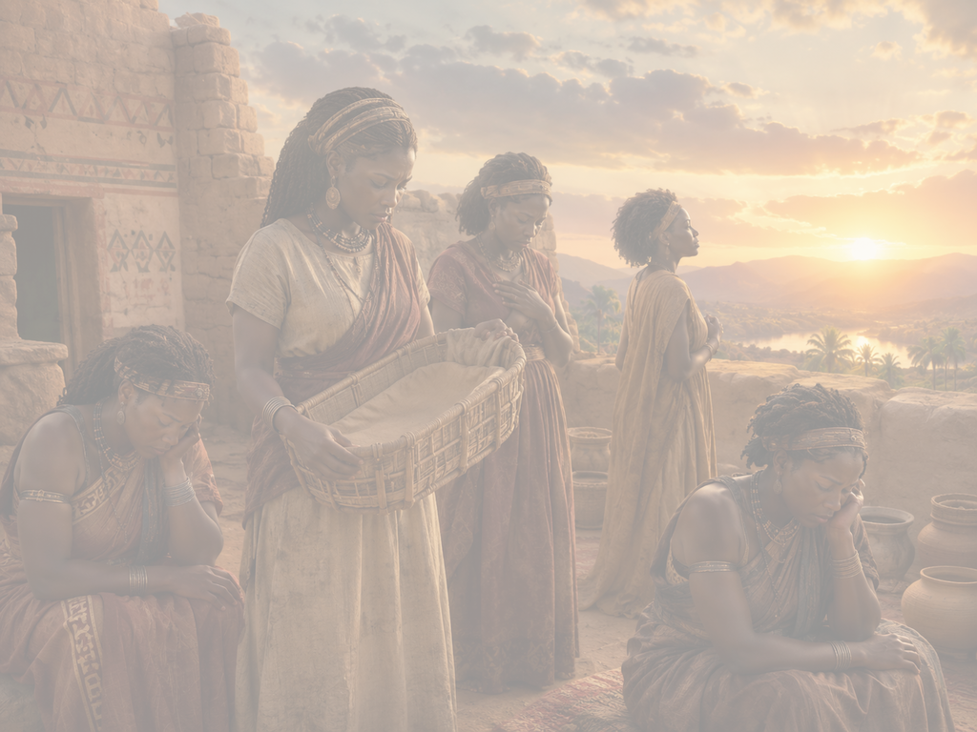
LESSON CONTEXT
Hannah, the Faithful Supplicant
Infertility in the Bible
Before medical interventions, children are naturally seen as a blessing that God enjoys giving, often in great measure (see Ps. 127:3–5). Yet from Sarah to Rebekah, Rachel to Hannah, infertility is a frequent problem for the women in Scripture. As a consequence for sin, humans die. There is pressure upon men and women (especially women) to conceive and to carry on a family’s name. Scripture frames conception
as within the power of God to directly control (see Gen. 29:31; 30:22; 1 Sam. 1:6). The anxiety and sorrow of infertility becomes a special place of
God’s gracious intervention, usually signaling the coming of a special child: Isaac (Gen. 21:1–2); Jacob and Esau (25:21); Joseph (30:23–24); Samson (Judg. 13:2–3); and John the Baptist (Luke 1:13, 24–25). Of course, the greatest of all interventions in the act of conception was with Jesus, conceived by the Holy Spirit’s overshadowing of the virgin Mary (Luke 1:34–35).
7
7
Notes:
Infertility in the Bible
In Scripture, infertility is often a place of deep sorrow, but also a setting where God reveals His power, mercy, and purpose through the birth of significant children. This section shows that infertility in the Bible is both deeply human and deeply theological. It acknowledges the emotional burden of childlessness while also showing God’s sovereignty over life. The repeated pattern of miraculous births teaches that God often brings purpose out of pain. Hannah’s story fits this pattern: her sorrow becomes the setting for Samuel’s birth, and Samuel becomes a blessing not only to her but to Israel.
Three Key Points
1. Children were seen as God’s blessing. Psalm 127 presents children as a gift from the Lord, so childlessness could feel spiritually and socially painful.
2. Infertility appears often in Scripture. Women such as Sarah, Rebekah, Rachel, and Hannah experienced barrenness, showing that faithful people still face deep hardship.
3. God often intervened for a greater purpose. Many miraculous births introduced children who played major roles in God’s redemptive plan.
Three Life Lessons Learned
1. Personal pain does not mean God is absent. Infertility brought sorrow, but God still saw and acted in the lives of His people.
2. God can work through human impossibility. What seems closed to people remains open to God’s power.
3. Blessings may carry divine assignment. Children like Samuel were not only answers to prayer; they were part of God’s larger work.
Summary
The passage explains that before modern medicine, children were viewed as a blessing from God, while infertility brought grief and social pressure, especially for women. Biblical stories often show God intervening in infertility, resulting in children who played important roles in His plan, such as Isaac, Joseph, Samson, John the Baptist, and ultimately Jesus through the virgin Mary.

Slide 8
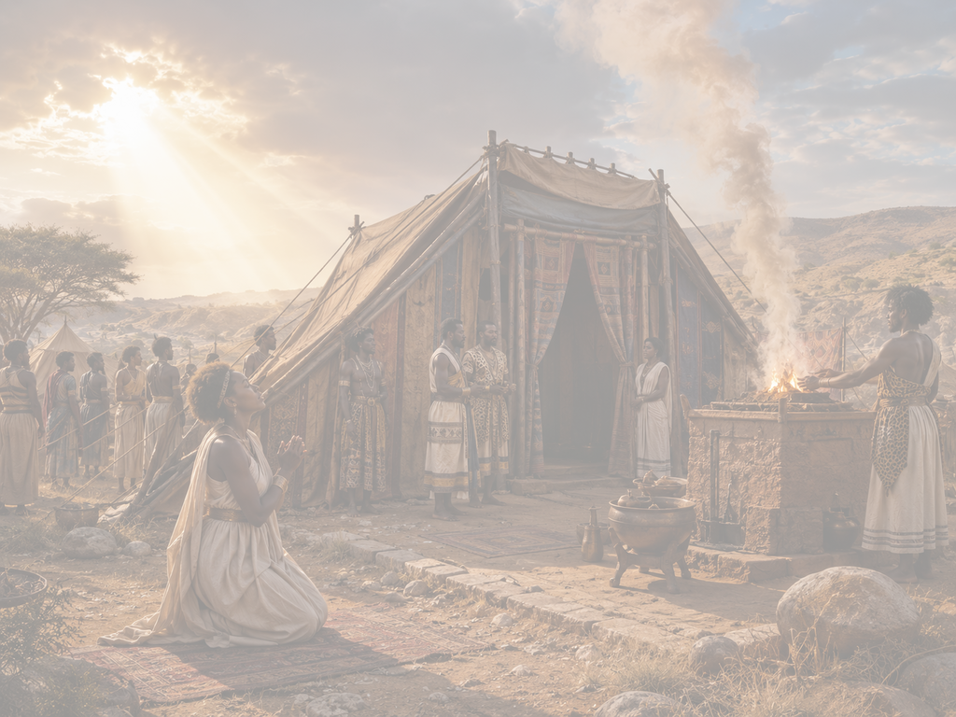
LESSON CONTEXT
Hannah, the Faithful Supplicant
House of the Lord
The permanent structure of the Lord’s temple was built many years after Hannah visited the “house” of the Lord in 1 Samuel 1. Until the temple’s construction, Israelites worshiped at the tabernacle, which was constructed according to God’s close instructions (Ex. 25–31; 35–40). This layered tent prepared the tribes of Israel for their period of wandering in the wilderness, with God’s sacred space at the center of their camp.
The tabernacle came through the wilderness wanderings and was eventually set up more permanently in Shiloh, the setting of today’s reading (see Josh. 18:1). Because it was still portable, the tabernacle was eventually moved to Nob, where David would eat consecrated bread while on the run (1 Sam. 21:1–9). Eventually, Solomon built the temple and the grandest “house” for God in the city of Jerusalem—the capital of David and place where the Lord had put His name (Deut. 12:5; Ps. 132:13).
God Remembers
  In 1 Samuel 1, Hannah cries out in anguish over her inability to have children. She asks God to “remember [her]” (1 Sam. 1:11). When she returns home, 1 Samuel 1:19-20 says that the Lord remembers her when she becomes pregnant. In Hebrew, the verb for remember is often signaling a redemptive action. For example, when the Israelites cry out to God for rescue from slavery, “God heard their groaning and he remembered his covenant with Abraham, with Isaac and with Jacob” (Ex. 1:24). God was not suddenly reminded of the promises He had made to Abraham—as if having forgotten them. It is a way of rehearsing God’s faithful action in continuity with His past promises. He steps up to rescue and to act because of His abundant faithfulness.
8
Notes:
House of the Lord
Main Idea
The “house of the Lord” in Hannah’s time was not Solomon’s later temple, but the tabernacle at Shiloh, where Israel gathered to worship God. This section gives important historical background. When 1 Samuel mentions the “house of the Lord,” it does not refer to the later temple but to the tabernacle at Shiloh. This matters because Hannah’s prayer takes place during a transitional time in Israel’s worship history. The tabernacle represented God’s holy presence, and Hannah’s visit shows that her suffering drove her toward worship, not away from it.
Three Key Points
1. Hannah worshiped before the temple existed. The permanent temple in Jerusalem had not yet been built during Hannah’s lifetime.
2. The tabernacle represented God’s presence. It was the sacred space at the center of Israel’s worship and community life.
3. Shiloh was an important worship location. The tabernacle was set up there, making it the setting for Hannah’s prayer.
Three Life Lessons Learned
1. God meets people in appointed places of worship. Hannah brought her pain to the place where God’s people gathered before Him.
2. Worship requires reverence. The tabernacle reminded Israel that God’s presence was holy and central.
3. God’s presence is not limited by buildings. Before the temple, God met His people through the tabernacle; His presence moved with them.
Summary
The passage explains that Hannah worshiped at the tabernacle, a portable sacred structure built according to God’s instructions. It served Israel during the wilderness period and was later set up at Shiloh. Over time, the tabernacle moved to other places, and eventually Solomon built the permanent temple in Jerusalem, the city associated with David and God’s chosen dwelling place.
===========================================
God Remembers
When Scripture says “God remembers,” it means God faithfully acts according to His promises, not that He had forgotten. This section clarifies a key biblical phrase. “God remembers” does not suggest that God has memory lapses. It means He steps into a situation with faithful action. In Hannah’s case, God’s remembrance turns grief into conception and hope. The phrase also connects Hannah’s story to Israel’s larger story, where God hears cries, remembers His covenant, and acts to rescue.
Three Key Points
1. Hannah prayed from anguish. Her request for God to remember her came from deep sorrow over childlessness.
2. God’s remembrance means action. God did not simply think about Hannah; He responded to her need.
3. God acts according to His faithfulness. His remembrance connects to His covenant character and reliable mercy.
Three Life Lessons Learned
1. God does not forget His people. Even when answers seem delayed, God remains aware and faithful.
2. Prayer invites us to trust God’s timing. Hannah prayed before she saw the answer.
3. God’s faithfulness is active. He does not merely observe suffering; He moves according to His will and mercy.
Summary
Hannah asks God to remember her in her anguish, and later the Lord remembers her by allowing her to conceive. In Hebrew thought, “remember” often points to redemptive action. Just as God remembered His covenant when Israel cried out in slavery, He remembered Hannah by acting in faithfulness and mercy.

Slide 9
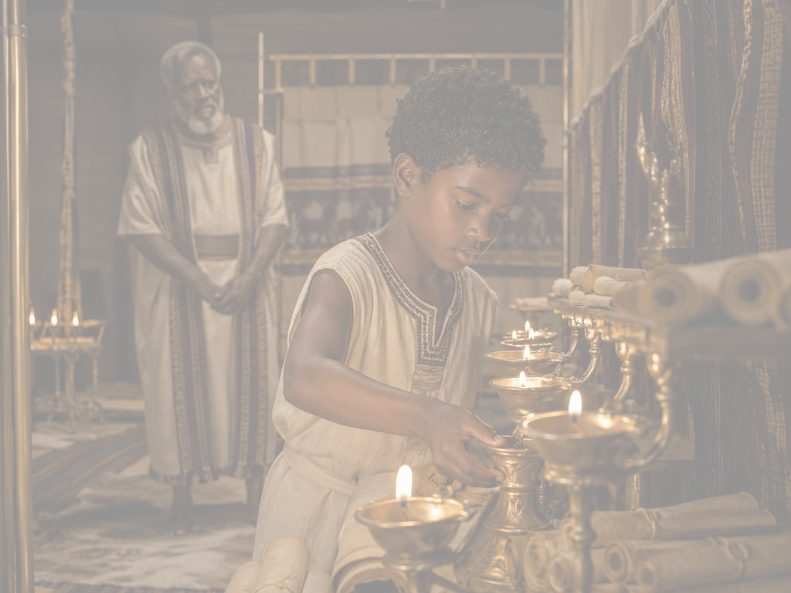
LESSON CONTEXT
Hannah, the Faithful Supplicant
Hannah’s Son, Samuel
Hannah’s son, Samuel, is raised by the priesthood and set apart for service to God. Samuel—rather than Eli—will be the one to hear from God, even at a young age and when “the word of the Lord was rare”(1 Sam. 3:1). He becomes very influential for the beginning of Israel’s monarchy. Samuel fulfills a variety of roles for Israel, acting as judge, priest, and prophet. He first anoints Saul and tries to guide him. When Saul is disobedient to God and rejected as king,
God sends Samuel to anoint a new king to rule after Saul. In Bethlehem, he finds the young shepherd boy, David, who will rule the nation. Samuel’s influence even persists after his death, when Saul asks a medium to conjure Samuel to speak from the place of the dead (1 Sam. 28). Samuel becomes a God-fearing prophet, perhaps Israel’s most exceptional leader since the time of Moses, generations earlier.
9
Notes:
Hannah’s Son, Samuel
Main Idea
Samuel was the answer to Hannah’s prayer and God’s chosen leader for Israel during a spiritually troubled time.
Summary
Samuel was raised in priestly service and set apart for God. Unlike Eli, Samuel heard from the Lord even when God’s word was rare. He became a judge, priest, and prophet who shaped Israel’s monarchy. Samuel anointed Saul and later David, making him one of Israel’s most significant leaders since Moses.
Three Key Points
1. Samuel was dedicated to God’s service. Hannah kept her vow by giving him back to the Lord.
2. Samuel heard God clearly. While Eli’s leadership was failing, Samuel became attentive to God’s voice.
3. Samuel shaped Israel’s future. He helped guide the nation through the beginning of its monarchy.
Three Life Lessons Learned
1. God can use one surrendered life greatly. Samuel’s life shows the power of dedication to God.
2. Spiritual sensitivity matters. Samuel’s ability to hear God contrasts with Eli’s dullness.
3. God’s answers can affect generations. Hannah prayed for a son, but God gave Israel a prophet and leader.
Analysis
Samuel’s life shows that Hannah’s answered prayer was larger than personal blessing. God gave Hannah a son, but He also gave Israel a leader. Samuel’s role as judge, priest, and prophet positioned him at a crucial point in Israel’s history. He guided Saul, anointed David, and helped move Israel from the period of the Judges into monarchy. This reveals that God’s response to prayer may have national, generational, and spiritual impact far beyond what the person praying can see.

Slide 10
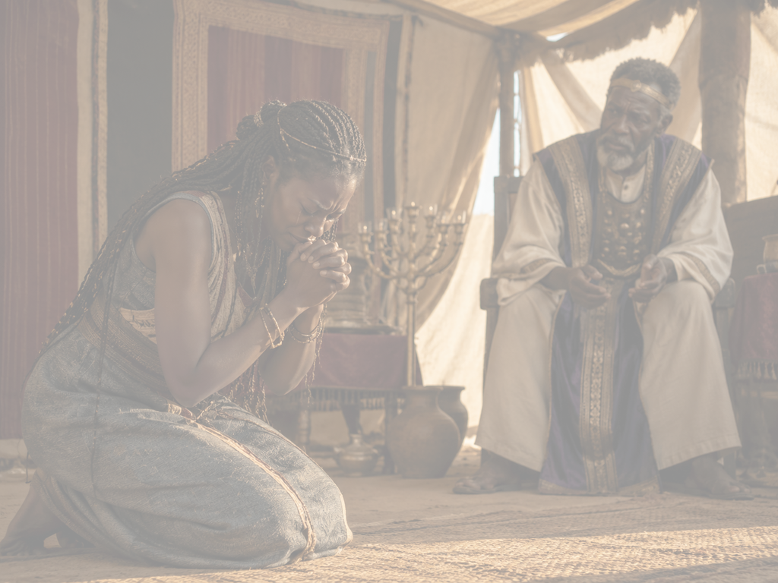
LESSON OVERVIEW
Hannah, the Faithful Supplicant
Misunderstood Grief - 1 Samuel 1:9–16 KJV
9 So Hannah rose up after they had eaten in Shiloh, and after they had drunk. Now Eli the priest sat upon a seat by a post of the temple of the Lord.
10 And she was in bitterness of soul, and prayed unto the Lord, and wept sore.
11 And she vowed a vow, and said, O Lord of hosts, if thou wilt indeed look on the affliction of thine handmaid, and remember me, and not forget thine handmaid, but wilt give unto thine handmaid a man child, then I will give him unto the Lord all the days of his life, and there shall no razor come upon his head.
12 And it came to pass, as she continued praying before the Lord, that Eli marked her mouth.
13 Now Hannah, she spake in her heart; only her lips moved, but her voice was not heard: therefore Eli thought she had been drunken.
14 And Eli said unto her, How long wilt thou be drunken? put away thy wine from thee.
15 And Hannah answered and said, No, my lord, I am a woman of a sorrowful spirit: I have drunk neither wine nor strong drink, but have poured out my soul before the Lord.
16 Count not thine handmaid for a daughter of Belial: for out of the abundance of my complaint and grief have I spoken hitherto.
• Hannah is one of two wives of her husband, Elkanah.
• Hannah is mistreated by the other wife, for Hannah has no children.
• During the family’s visit to God’s sanctuary, Hannah gets up after the meal to pray.
• She vows that if God gives her a son, he would be devoted to priestly service.
• Eli, the priest at the time, sees Hannah in wordless, emotional prayer. He assumes she is drunk.
• At Eli’s accusation, Hannah explains that she is pouring out her soul to God, expressing her grief.
10
Notes:
Misunderstood Grief
Hannah’s grief was misunderstood by others, but God understood her pain. Instead of responding with bitterness or despair, Hannah brought her sorrow to the Lord in honest, surrendered prayer. Hannah’s pain was deep. She was hurt by infertility, family conflict, shame, and loneliness. The yearly trip to Shiloh should have been a happy time of worship, but it reminded Hannah of what she did not have.
Still, Hannah showed strong faith. She did not let Peninnah’s teasing or Eli’s misunderstanding stop her from praying. She asked God for a son, but she also promised to give that son back to God’s service.
Eli judged Hannah too quickly. He saw her lips moving and thought she was drunk. But Hannah was actually praying sincerely. Her grief was misunderstood by people, but fully known by God.
Three Key Points
1. Hannah’s grief was intensified by comparison and mockery. Her infertility was painful by itself, but Peninnah’s ridicule made her suffering even heavier.
2. Hannah turned pain into prayer. Rather than retaliating or giving up, Hannah carried her anguish to God, believing He alone could give what she lacked.
3. Hannah’s prayer was misunderstood. Eli judged her outward appearance without understanding her heart, showing how easily sincere grief can be misread by others.
Three Life Lessons Learned
1. Take deep pain directly to God. Hannah teaches that grief should not be hidden from God. Honest prayer can become a holy place of surrender.
2. Do not judge people’s worship too quickly. Eli misunderstood Hannah because he looked only at her outward behavior. People may be carrying burdens we cannot see.
3. True surrender gives back to God. Hannah did not ask for a son merely to possess him. She promised to dedicate him to the Lord, showing faith beyond personal desire.
Summary
Hannah lived in a painful family situation as one of Elkanah’s two wives. Peninnah had children, but Hannah did not, and Peninnah mocked her because of it. During the family’s annual worship trip to Shiloh, Hannah withdrew to pray privately. In desperation, she asked God for a son and vowed to dedicate him to the Lord’s service. Eli misunderstood her silent prayer and assumed she was drunk, but Hannah explained that she was pouring out her soul before God in deep grief.
><><><><><><><><><><><><><><><
Misunderstood Grief
In Scripture, polygamy is not presented in a positive light—surely because of situations like Hannah’s at the start of 1 Samuel. Hannah is one of two wives of the same man, but Peninnah has children while Hannah does not. Hannah is grieved by her infertility, especially in the face of mockery from her rival (see 1 Sam. 1:6–7). The whole family makes an annual pilgrimage to worship at the sanctuary of Shiloh, which becomes a painful occasion for Hannah. The reading picks up during one of these trips, when the family is gathered to eat together. But Hannah removes herself to find a more private space for prayer. In her heart, she cries out to God in desperation (v. 10). Hannah knows that God alone can give what she lacks; God alone is powerful over the biological processes of conception (see Gen. 4:1).
Begging the Lord to remember her, she vows that her son would be dedicated to the Lord’s service. Her vow goes beyond the expectations of Exodus 13:2, promising that a potential son would never cut his hair—which is an indication of a priestly office or a Nazarite vow (see Num. 6:5). Her desire for a son is not so that she might cling to him but offer him back in service to the Creator.
Hannah is misunderstood while praying. Eli, the priest acting as leader at this time, observes her lips moving wordlessly. He leaps to the conclusion that Hannah has had too much feasting and has grown drunk on wine (vv. 12–14). Hannah’s response to Eli conveys her deep anguish. Her response draws a contrast between the drinks she has not consumed, beer and wine, and the offering of her soul that she has “poured out” to God (v. 15).

Slide 11
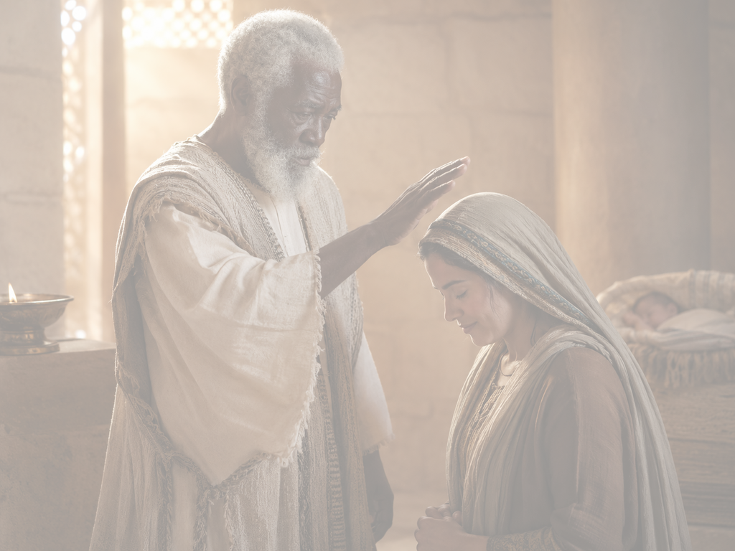
LESSON OVERVIEW
Rekindled Hope - 1 Samuel 1:17–20, 25 KJV
17 Then Eli answered and said, Go in peace: and the God of Israel grant thee thy petition that thou hast asked of him.
18 And she said, Let thine handmaid find grace in thy sight. So the woman went her way, and did eat, and her countenance was no more sad.
19 And they rose up in the morning early, and worshipped before the Lord, and returned, and came to their house to Ramah: and Elkanah knew Hannah his wife; and the Lord remembered her.
20 Wherefore it came to pass, when the time was come about after Hannah had conceived, that she bare a son, and called his name Samuel, saying, Because I have asked him of the Lord.
25 And they slew a bullock, and brought the child to Eli.
• When Eli realizes his mistake, he offers a blessing upon Hannah.
• His words ask for God to act and to fulfill her request.
• Hannah returns to the family feeling much better.
• Once home, she conceives a son and names him Samuel.
• As promised, she brings Samuel back to Eli to be trained as a priest.
Hannah, the Faithful Supplicant
11
Notes:
Rekindled Hope
God can renew hope in seasons of powerlessness. Hannah’s sorrow changed when she received a word of blessing, trusted God’s gracious character, and later saw her prayer answered through Samuel. Hannah moved from deep pain to renewed hope. At first, prayer was all she had. Eli’s blessing did not answer her prayer by itself, but it reminded Hannah that God is gracious and able.
God was doing more than Hannah could see. She prayed for a son, but God was preparing Samuel to become a leader for Israel.
Samuel’s birth shows that God can turn private sorrow into a public blessing. Hannah also kept her promise and gave Samuel back to the Lord. Her story teaches that God can renew hope, answer in His time, and use surrendered faith for a greater purpose.
Three Key Points
1. A word of blessing can restore hope. Eli’s blessing does not immediately change Hannah’s circumstances, but it changes her outlook. She moves from sorrow to renewed trust.
2. God remembers and acts faithfully. God’s remembrance of Hannah means He responds with mercy and purpose. Her conception is not random; it is part of God’s larger plan.
3. Hannah’s answered prayer blesses more than herself. Samuel is not only Hannah’s son. He becomes God’s servant and a leader who helps guide Israel back toward covenant faithfulness.
Three Life Lessons Learned
1. Hope can return before the answer arrives. Hannah’s face changed before she became pregnant. Faith allowed her to live with peace while waiting.
2. God can use imperfect people to speak encouragement. Eli had poor discernment, yet God still used his blessing to strengthen Hannah.
3. God’s answers often exceed our requests. Hannah asked for a son, but God gave Israel a prophet, priest, and judge whose life shaped the nation’s future.
Summary
Hannah’s heartfelt prayer and vow are met with Eli’s blessing: “May the God of Israel grant you what you have asked.” Though Eli had misunderstood her earlier, his blessing rekindles Hannah’s hope. She leaves with a changed attitude, eats again, and is no longer downcast. Later, God remembers Hannah, allows her to conceive, and she gives birth to Samuel. Hannah keeps her vow by returning Samuel to the Lord’s service. God not only gives Hannah a son but also raises Samuel to become a prophet, priest, judge, and leader for Israel.
><><><><><><><><><><><><><><><
Rekindled Hope
Many of us experience times of powerlessness, when heartfelt prayers are all we have. Hannah’s prayers and vow are met with a blessing. Hannah never actually explains the nature of her request before God, but words of blessing are important—particularly when spoken by Israel’s spiritual leader. Eli anticipates God’s action: “may the God of Israel grant you what you have asked” (v. 17).
The writer of the biblical text seems to enjoy the irony: Eli blesses the coming of a child whom God will choose to replace Eli. In the following chapters, the text describes his terrible leadership and inability to hear from God (see 1 Sam. 3:1, 11–14). But here he is just a priest who missed the point and was searching for the right words to say. Hannah knows that her situation has changed. Her posture is altered, and she feels able to eat and to carry on with her family once more (v. 18). Through Eli’s words, she recalls God’s gracious character.
To make the long journey home, the family rises early. Later when they are home, God allows Hannah to conceive (v. 19). This phrasing— God’s remembrance of a childless woman—is also used when Rachel first conceives (Gen. 30:22). Like other miraculous births in Scripture, the child is special, his role carefully prepared.
Hannah’s anguish will follow her no longer—she gives birth to a son! Names in Scripture often give clues about a person’s role. Hannah, the boy’s long-suffering mother, chooses a name to remind everyone of his origin: she asked for a son, and God granted her prayer. Thus the name “Samuel” sounds like the Hebrew verb for “ask” combined with a title for God. Samuel’s name is a reminder of answered prayers and petitions.
Many parents would not dream of giving up a precious child, but Hannah is faithful to the letter of her vow, returning him for the Lord’s service. Once he is no longer nursing, she brings him back to Eli (1 Sam. 2:25). Hannah’s desire for a son wasn’t just for her own sake, and God used her desires and prayers to bring leadership to His people—to bring them back to covenant faithfulness. This son of Hannah’s would go on to be a prophet, priest, and judge. He would go on to anoint two of Israel’s kings.
God’s blessing upon Hannah also went beyond her request for one child. Although she would visit Samuel each year, she would also have five more children (1 Sam. 2:19–21). God turned Hannah’s anguish into great joy.

Slide 12
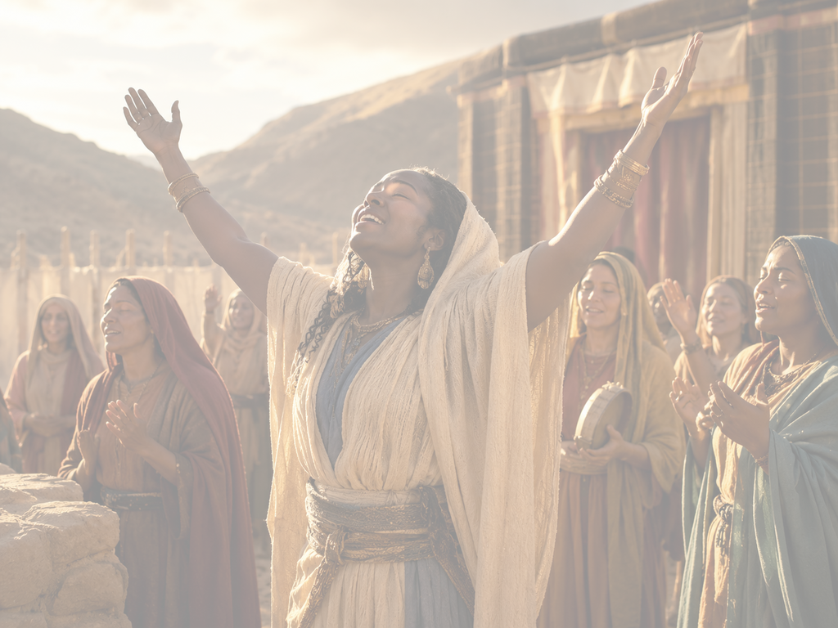
One Bible, One Story
Hannah, the Faithful Supplicant
SONGS OF JOY
Ever since humanity introduced sin into the biblical story in Genesis 3, people have suffered from pain and heartache and a world that no longer operates the way it was intended. Hannah’s anguish is a pain felt by many women throughout history. God hears her silent prayer and remembers her by giving her a son. In 1 Samuel 2, Hannah sings a magnificat—a song that celebrates the gift of joy. Her son will listen to God and bring Israel out of their dark time.
Hannah’s song comes full circle in the New Testament, when Mary sings her own magnificat, imitating Hannah’s (Luke 1:46–55). Like Hannah before her, Mary celebrates a God of justice, one who raises the humble and brings rescue to His people. Again through Mary, God sends a child to rescue His people and turn their anguish into joy. God’s salvation—in personal lives and on a global scale—should be celebrated! Praise the Lord who turns weeping into joyful songs!
12
Notes:
One Bible, One Story: Songs of Joy
God turns sorrow into joy by hearing the cries of His people and sending deliverance through His chosen servants, ultimately fulfilled in Christ. Hannah’s story fits within the whole Bible. Her pain is not isolated; it belongs to the larger story of human suffering after Genesis 3. Yet her joy also belongs to the larger story of God’s salvation. God hears her prayer, gives her Samuel, and uses Samuel to guide Israel during a dark spiritual time.
The connection between Hannah and Mary is especially important. Hannah sings after receiving Samuel; Mary sings before the birth of Jesus. Both songs celebrate a God who notices the lowly, reverses human expectations, and brings rescue. Samuel helped lead Israel, but Jesus brings ultimate salvation.
THE MAIN MESSAGE IS THAT GOD’S REDEMPTIVE WORK TURNS ANGUISH INTO PRAISE. WHETHER IN HANNAH’S HOME, ISRAEL’S HISTORY, OR THE COMING OF CHRIST, GOD BRINGS JOY WHERE SORROW ONCE RULED.
Three Key Points
1. Human sorrow began with sin’s entrance into the world. Pain, grief, and brokenness are part of a fallen world that no longer functions as God originally intended.
2. God hears and remembers His people. Hannah’s silent prayer was not ignored. God responded by giving her Samuel, who would help lead Israel out of spiritual darkness.
3. Hannah’s song points forward to Mary’s song. Both women praise God for lifting the humble, bringing justice, and sending a child connected to His saving work.
Three Life Lessons Learned
1. God can transform weeping into worship. Hannah’s sorrow became a song of praise because God met her in her pain.
2. Personal deliverance can point to a greater salvation story. Samuel’s birth blessed Hannah personally, but it also served God’s plan for Israel.
3. Joy should be celebrated when God acts. When God rescues, restores, or provides, His people should respond with praise and thanksgiving.
Summary
This section connects Hannah’s story to the larger biblical story of redemption. Since sin entered the world in Genesis 3, humanity has experienced pain, grief, and brokenness. Hannah’s anguish over infertility reflects this suffering. Yet God hears her silent prayer, remembers her, and gives her Samuel. Hannah responds with a song of joy in 1 Samuel 2. Her song later echoes in Mary’s song in Luke 1, where Mary also praises God for raising the humble and rescuing His people through the coming of Jesus.

Slide 13
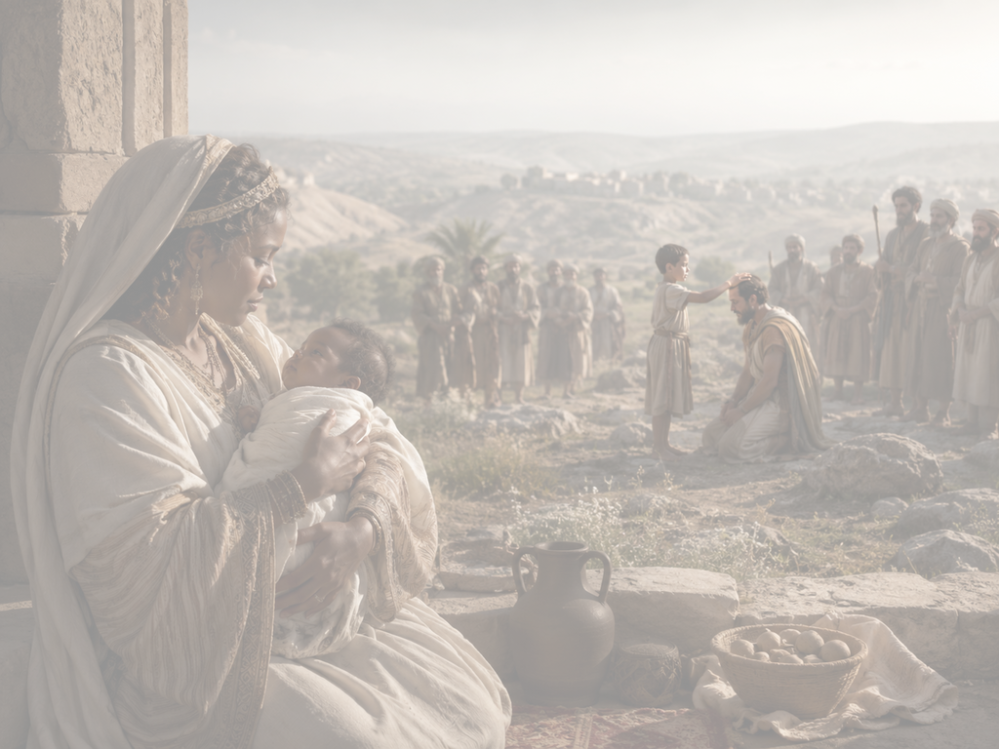
Apply the Message: God supplies more than we know to ask.
How Does “Even Better” Sound?
Hannah, the Faithful Supplicant
It would be easy to apply the wrong lessons from the story of Hannah. Who among us has not sat in the position of waiting for prayers to be answered? But perhaps we are transfixed by the story of Hannah because we think God responded with a simple, “Yes. ” We need to see that God’s answer was, “I’ll do even better. ” Hannah’s desire for a son became the context for God’s restoration of leadership to Israel. Eventually, Hannah seems to have understood this greater story as she exalts God for a coming king, one anointed by God (1 Sam. 2:10). Even Hannah could not have predicted the New Testament chapter to this story, the coming of an eternal king.
In church ministry, I meet with people in all circumstances. Jesus Himself invites His disciples to a posture of continual prayer, never losing hope as we remember God’s faithfulness (Luke 18:1). Still, I often reflect on the mysterious workings of God. I would love to reassure everyone, “God will give whatever you want if you pray faithfully. ” But I cannot say this. I see situations where God appears to be saying, “No,” or where the answer is not easy to see.
The Father in heaven enjoys giving good gifts (Luke 11:11–13). But it isn’t transactional! It’s not as if we can pray long and hard enough to get all the things we might want. Luke 11:13 even specifies that the good gift God most wants to give is the Holy Spirit. Meanwhile, I notice that all the prayers and waiting are often able to transform us, reshaping desires of our hearts to align more fully with God’s.
Sometimes we find joy when the Lord answers our prayers the way we first imagined. Other times, we find an entirely separate joy when God is present in our longing, offering more of His comfort, His peace, and His presence. It is in that way that God is always ready to transform our anguish into joy.
13
Notes:
:
How Does “Even Better” Sound?
Main Idea
God’s answers to prayer are not always simple “yes” answers; sometimes He does something greater than what we asked by using our longing to shape us and serve His larger purpose.
Summary
This section warns against misunderstanding Hannah’s story as a guarantee that faithful prayer always gets exactly what we want. Hannah asked God for a son, but God did more than answer her personal desire. He used Samuel to restore leadership to Israel and point forward to God’s greater redemptive plan. Prayer is not a transaction where we earn outcomes through effort. Instead, prayer keeps us near God, reshapes our desires, and allows us to receive His comfort, peace, presence, and gifts—even when His answer is “no,” “wait,” or “something better.”
Three Key Points
1. God’s answer to Hannah was greater than a simple “yes.” Hannah received a son, but Israel received Samuel, a leader who helped restore spiritual direction to the nation.
2. Prayer is not transactional. Faithful prayer does not mean God must give everything we request. God is generous, but He is not controlled by the length or intensity of our prayers.
3. Waiting can transform us. While we wait, God may reshape our desires, deepen our trust, and give us comfort, peace, and His presence.
Three Life Lessons Learned
1. Keep praying even when the answer is unclear. Jesus calls His followers to continual prayer and hope, even when God’s timing or response is difficult to understand.
2. Trust God’s character more than a specific outcome. God gives good gifts, but His wisdom may lead Him to answer differently than we expected.
3. God can turn longing into joy. Sometimes joy comes through receiving what we asked for; other times it comes through experiencing God’s presence in the waiting.
Analysis
This section gives a mature view of prayer. It avoids the false idea that prayer works like a formula: if we pray hard enough, long enough, or faithfully enough, God will give us exactly what we want. Hannah’s story is not meant to teach that every painful longing will be answered in the same way. Instead, it teaches that God is faithful, purposeful, and able to do more than we imagine.
Hannah prayed for a son, but God’s answer reached beyond her household. Samuel became part of God’s work to renew Israel’s leadership. This shows that God may use personal pain as the setting for a larger plan.
The passage also honors unanswered or confusing prayers. Sometimes God’s answer appears to be “no,” “not yet,” or hidden from view. Even then, prayer is not wasted. Through prayer, God forms our hearts, draws us closer, and gives the gift of His presence. The “even better” answer may not always be a changed circumstance; sometimes it is a changed heart, deeper trust, and joy that comes from knowing God is with us.
1 How was God’s answer to Hannah’s prayer even better than a simple yes?
If God had given a son of no special significance, Hannah would’ve had a child to love. But God goes beyond her request for a son, giving someone who will restore leadership to Israel.
2 What are some of the good gifts that God enjoys giving?
God seems to enjoy lavishing forgiveness, the Holy Spirit, and life itself. He makes the rain fall on all people, whether just or unjust (Matt. 5:45). Jesus says that part of the Father’s character is the enjoyment of giving (Matt. 7:9–11). For the same reason that we are given good things, we should be eager to be generous toward others.
3 Why might God say no to some of our prayers?
God’s understanding is greater than our own, and He has plans for us that go far beyond what we imagine. Until we meet God face to face, we might only glimpse bits and pieces of what He is doing and why some prayers are answered differently than others. Still, the Lord invites us to find our comfort and joy in Him. His Spirit can fill us with joy, no matter the circumstances.

Slide 14
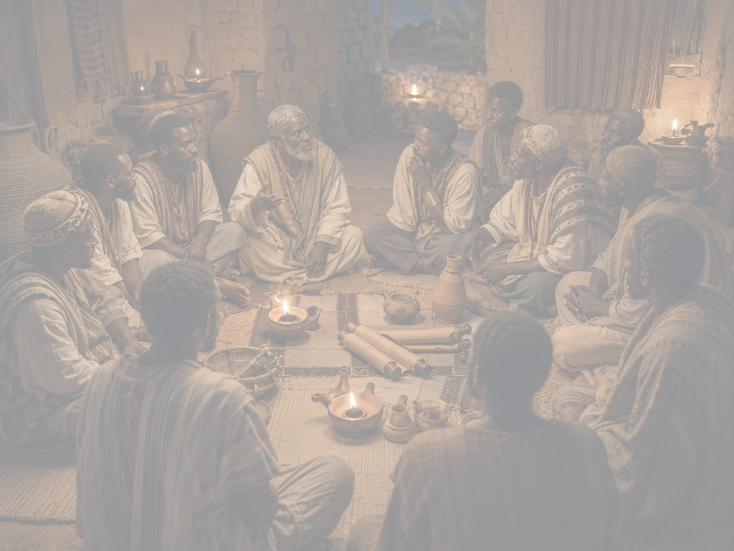
Apply the Message: God supplies more than we know to ask.
How Does “Even Better” Sound?
Hannah, the Faithful Supplicant
1 How was God’s answer to Hannah’s prayer even better than a simple yes?
2 What are some of the good gifts that God enjoys giving?
3 Why might God say no to some of our prayers?
14
Notes:
How Does “Even Better” Sound?
1 How was God’s answer to Hannah’s prayer even better than a simple yes?
If God had given a son of no special significance, Hannah would’ve had a child to love. But God goes beyond her request for a son, giving someone who will restore leadership to Israel.
2 What are some of the good gifts that God enjoys giving?
God seems to enjoy lavishing forgiveness, the Holy Spirit, and life itself. He makes the rain fall on all people, whether just or unjust (Matt. 5:45). Jesus says that part of the Father’s character is the enjoyment of giving (Matt. 7:9–11). For the same reason that we are given good things, we should be eager to be generous toward others.
3 Why might God say no to some of our prayers?
God’s understanding is greater than our own, and He has plans for us that go far beyond what we imagine. Until we meet God face to face, we might only glimpse bits and pieces of what He is doing and why some prayers are answered differently than others. Still, the Lord invites us to find our comfort and joy in Him. His Spirit can fill us with joy, no matter the circumstances.

Slide 15
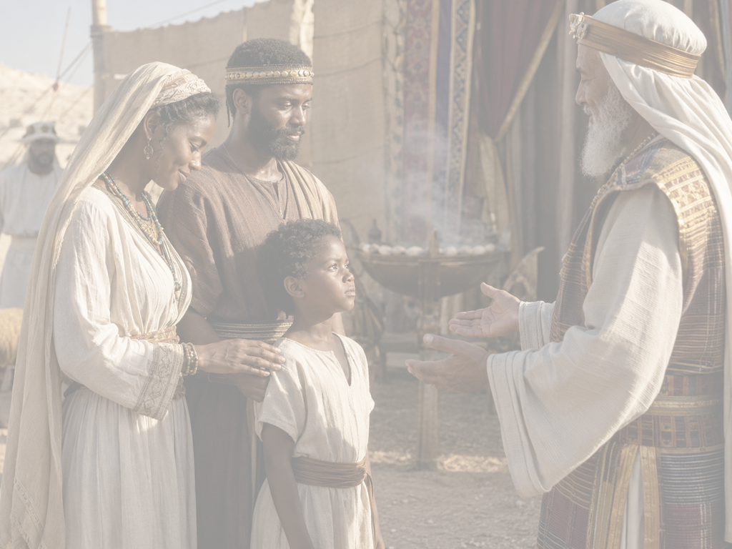
CONCLUSION
Hannah, the Faithful Supplicant
PLAYING OUR PARTS
Hannah faithfully approached God with her grief, desire, and need. Because she did, God allowed her to play a role in the grand narrative of God’s design. Hannah’s fidelity to her vow put her son in the right place at the right time to lead Israel as a priest, judge, and prophet.
Hannah models faithfulness in prayer, bravery in the face of false accusations, and dedication to her word. She asks God for her heart’s desire and then willingly returns that gift to God. Every mother knows the strength required to follow through with such a vow! May we all learn to have such faithfulness, submission, trust, and generosity in our relationships with God.
15
Notes:
Playing Our Parts
Main Idea
Hannah’s faithful prayer, obedience, and surrender allowed her to participate in God’s larger plan for Israel through the life and ministry of Samuel.
Summary
Hannah brought her grief, desire, and need honestly before God. When God answered her prayer with a son, she remained faithful to her vow and gave Samuel back to the Lord’s service. Because of her obedience, Samuel was placed where God wanted him to be, eventually serving Israel as priest, judge, and prophet. Hannah’s example teaches faithfulness in prayer, courage under misunderstanding, and generosity in surrendering God’s gifts back to Him.
Three Key Points
1. Hannah brought her whole heart to God.
She did not hide her grief or desire but approached God honestly and faithfully.
2. Hannah kept her vow.
After receiving the son she prayed for, she fulfilled her promise by dedicating Samuel to the Lord.
3. Hannah’s obedience served God’s bigger plan.
Her personal act of faith helped position Samuel to become a major spiritual leader in Israel.
Three Life Lessons Learned
1. Prayer invites us into God’s purpose.
When we bring our needs to God, He may use our lives in ways larger than we expect.
2. Faithfulness requires follow-through.
Hannah’s faith was not only seen in asking God for a son, but in keeping her promise afterward.
3. God’s gifts should be held with open hands.
Hannah received Samuel with joy, yet she trusted God enough to give him back for divine service.
Analysis
This section emphasizes Hannah’s role in God’s unfolding story. She was not a passive figure who simply received a blessing. She prayed, trusted, vowed, endured misunderstanding, and obeyed. Her faith became active participation in God’s plan.
The most powerful part of Hannah’s example is her surrender. She asked God for her heart’s desire, but when He answered, she did not cling selfishly to the gift. She returned Samuel to the Lord, trusting that God’s purpose for him was greater than her personal comfort.
Hannah’s story reminds believers that faithfulness often involves sacrifice. God may use our prayers, obedience, and surrendered gifts to bless others far beyond what we can see. Her life shows that when we play our part faithfully, God can weave our obedience into His greater work.

Slide 16

CONCLUSION
Hannah, the Faithful Supplicant
Live It Out: Reflect on past answers to prayer.
When we see the ways that God answers prayer, we often see that we received more that we originally asked. Jesus reminds us to persist in our prayers (Luke 18:1). Prayer shapes our patience.
Patient Faith
  During your prayer time this week, you are invited to try a gratitude exercise. Think back to the ways God has provided: a sought-after position, a victory over a health battle, the birth of a child. While you reflect on God’s answers to prayer, pay attention to the three answers God can give.
Notes:
:
Live It Out: Reflect on Past Answers to Prayer
Main Idea
Reflecting on God’s past answers to prayer strengthens patient faith and helps us recognize that God often gives more than we originally asked.
Summary
This section invites believers to look back on the ways God has provided in their lives. Whether through a job, healing, a child, or another answered prayer, remembering God’s faithfulness helps build patience and gratitude. Jesus teaches His followers to keep praying and not lose heart. Prayer does not only seek answers; it also shapes the heart, strengthens endurance, and teaches us to trust God’s timing and wisdom.
Three Key Points
1. Remembering answered prayers builds faith. Looking back helps us see that God has already been active, faithful, and generous.
2. Prayer develops patience. Waiting in prayer teaches us to trust God’s timing instead of demanding immediate results.
3. God may answer in different ways. God’s answers may be “yes,” “no,” or “wait,” but each response comes from His wisdom and love.
Three Life Lessons Learned
1. Gratitude helps us recognize God’s provision. When we pause to remember what God has done, we become more aware of His mercy.
2. Waiting is not wasted. Even before the answer comes, prayer can shape our character, deepen our patience, and strengthen our dependence on God.
3. God often gives more than we expected. Like Hannah, we may ask for one thing and later discover that God’s answer carried a larger purpose.
Analysis
This section moves the lesson from Bible study to personal application. Hannah’s story encourages believers not only to pray but also to reflect. Looking back at answered prayers helps us notice patterns of God’s faithfulness that we may have missed while we were waiting.
The gratitude exercise is important because prayer can easily become focused only on what we still lack. Reflection turns our attention toward what God has already done. This builds patient faith and reminds us that God’s answers are not always immediate or obvious.
The three possible answers—yes, no, and wait—help believers approach prayer with humility. A “yes” brings joy, a “no” may protect or redirect us, and “wait” forms patience and trust. In every case, God uses prayer not only to change circumstances but also to shape the heart.

Slide 17
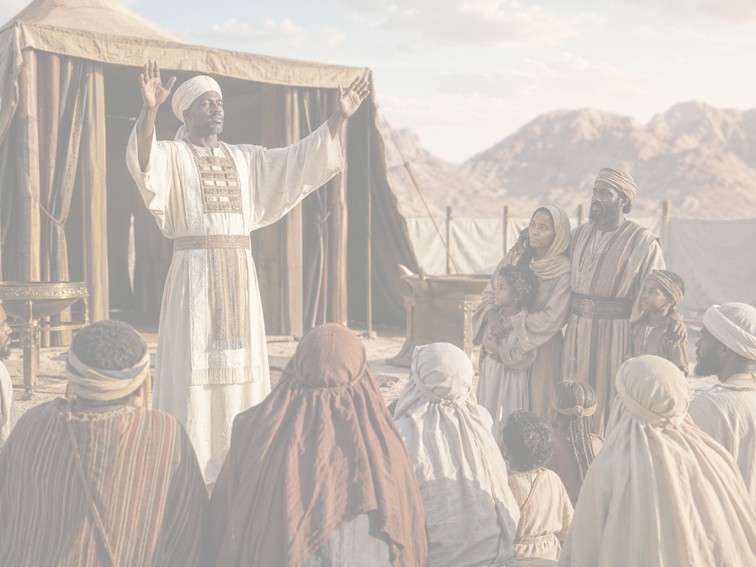


End
  The Lord bless thee, and keep thee:
  The Lord make his face shine upon thee, and be gracious unto thee:
  The Lord lift up his countenance upon thee and give thee peace.
  - Numbers 6:24-26,
Material adapted by Stanford W. Bowman Jr. from Echoes® Adult and Bible-in-Life® Adult SUMMER - 2026 quarter with permission, © David C Cook, https://davidccook.org. May not be further reproduced. All rights reserved.

Slide 18
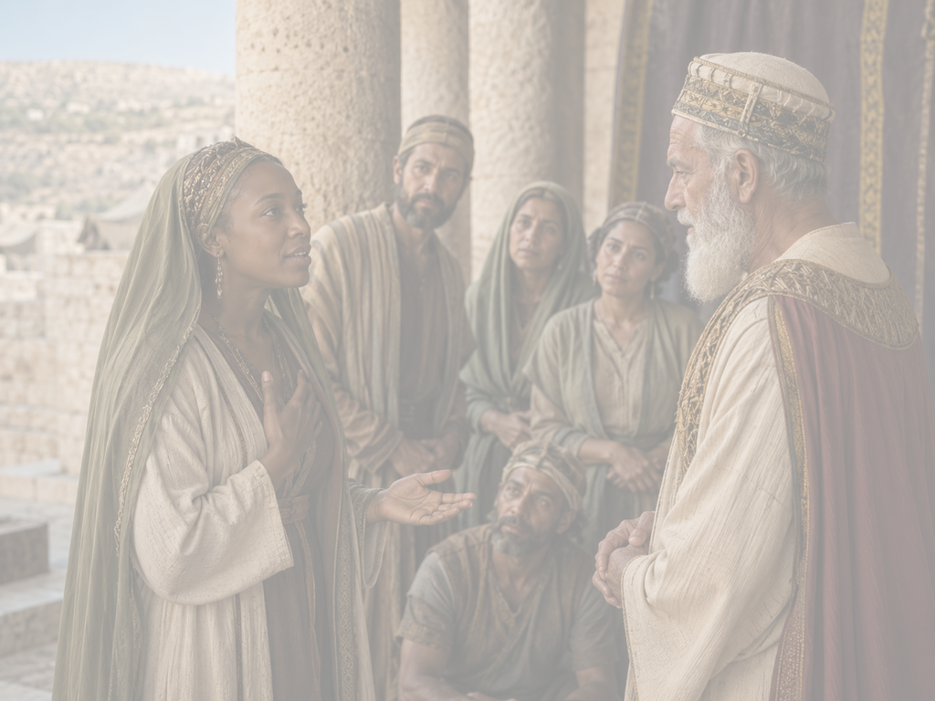
QUESTION & ANSWER
Hannah, the Faithful Supplicant
Misunderstood Grief
1 When have you been forced to endure the teasing or scorn of someone else?
2 Do you think that Hannah’s vow spurred God to act, or something else?
3 What might Eli’s misunderstanding expose about his sensitivity and powers of perception?
We might think of childhood bullies on school playgrounds. But teasing isn’t limited to childhood. Perhaps we have rivals as work, or perhaps our most difficult relationships are at home—like Hannah.
Throughout the Bible, we see evidence that God is near to the brokenhearted (see Ps. 34:18). He comforts in times of need (see 2 Cor. 1:3–4). From Hannah’s perspective, God’s action was her answer to prayer, but it will turn out to be so much more. God’s character is always gracious, always giving.
He is not very attuned to what Hannah is doing. Anyone can be guilty of a misunderstanding, but this is part of a pattern in 1 Samuel. Eli is not very good at seeing or hearing what is going on in front of him, one reason he is not a good priest. God is preparing another.
Notes:
Misunderstood Grief
1 When have you been forced to endure the teasing or scorn of someone else?
We might think of childhood bullies on school playgrounds. But teasing isn’t limited to childhood. Perhaps we have rivals as work, or perhaps our most difficult relationships are at home—like Hannah.
2 Do you think that Hannah’s vow spurred God to act, or something else?
Throughout the Bible, we see evidence that God is near to the brokenhearted (see Ps. 34:18). He comforts in times of need (see 2 Cor. 1:3–4). From Hannah’s perspective, God’s action was her answer to prayer, but it will turn out to be so much more. God’s character is always gracious, always giving.
3 What might Eli’s misunderstanding expose about his sensitivity and powers of perception?
He is not very attuned to what Hannah is doing. Anyone can be guilty of a misunderstanding, but this is part of a pattern in 1 Samuel. Eli is not very good at seeing or hearing what is going on in front of him, one reason he is not a good priest. God is preparing another.

Slide 19
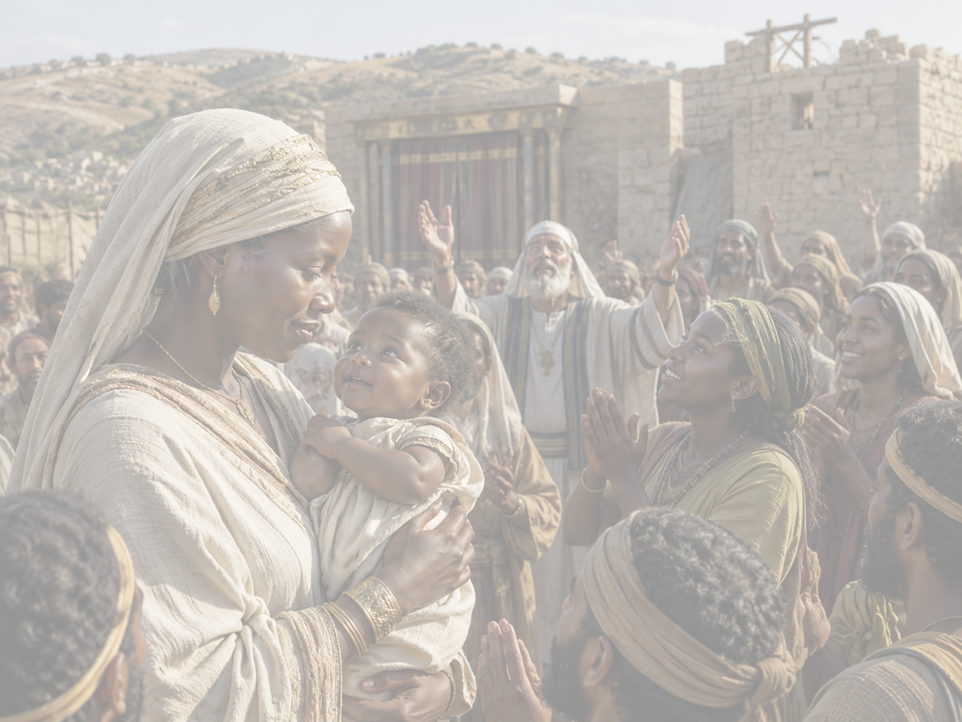
QUESTION & ANSWER
Hannah, the Faithful Supplicant
Rekindled Hope
1 What does the miraculous conception of Samuel demonstrate for readers?
2 What does Samuel’s name mean? Do you have a name with special meaning?
3
3 How does Hannah’s witness inspire you to greater faith?
Hannah’s praise of the Lord didn’t depend on her circumstances. She knows that the Lord gives and takes away and His name is still worthy of praise (see Job 1:21). God was honored through Hannah’s earnest prayer and her willingness to devote her child to God’s service.
Samuel’s name is a reminder of God’s faithfulness. It recalls Hannah’s supplication and God’s provision by sounding like the Hebrew words for ask and God. Many parents like to consider the meaning behind names that they give their children.
Hannah can remind us to bring our suffering before the Lord. We can be honest about our grief, persistent in prayer. Even when others do not understand or know our pain, God sees and understands.
Notes:
Rekindled Hope
1 What does the miraculous conception of Samuel demonstrate for readers?
Hannah’s praise of the Lord didn’t depend on her circumstances. She knows that the Lord gives and takes away and His name is still worthy of praise (see Job 1:21). God was honored through Hannah’s earnest prayer and her willingness to devote her child to God’s service.
2 What does Samuel’s name mean? Do you have a name with special meaning?
Samuel’s name is a reminder of God’s faithfulness. It recalls Hannah’s supplication and God’s provision by sounding like the Hebrew words for ask and God. Many parents like to consider the meaning behind names that they give their children.
3 How does Hannah’s witness inspire you to greater faith?
Hannah can remind us to bring our suffering before the Lord. We can be honest about our grief, persistent in prayer. Even when others do not understand or know our pain, God sees and understands.

Slide 20
End
  The Lord bless thee, and keep thee:
  The Lord make his face shine upon thee, and be gracious unto thee:
  The Lord lift up his countenance upon thee and give thee peace.
  - Numbers 6:24-26,
Material adapted by Stanford W. Bowman Jr. from Echoes® Adult and Bible-in-Life® Adult SUMMER - 2026 quarter with permission, © David C Cook, https://davidccook.org. May not be further reproduced. All rights reserved.

