Slide 1
God’s Word
Lesson 1
Copyright © 2025 Standard Publishing, part of the David C Cook family, Colorado Springs, Colorado 80918
All rights reserved. Photo © Getty Images

Slide 2
Treasured Possessions
When my mother went to be with the Lord, members of our family began going through her belongings. Among the items we found were various Bibles that mom had kept through the years.
The Bibles bore the signs of regular use. I was reminded of the saying, “A Bible that’s falling apart usually belongs to someone who isn’t.”
Mom didn’t just treasure the Bibles in her home; she memorized Scripture, which kept the wisdom of God on her lips and near her heart.
Notes:
Supplement with additional information from the Introduction as desired.

Slide 3
Into the Lesson
This game is like charades. Choose a team member to act out words or phrases without talking.
Each team has two minutes to guess the word or phrase written on the card. If the team guesses correctly, they get a point.
Alternate between teams until all cards are used. The team with the most points at the end of the game wins.
Notes:
Begin class time with an icebreaker game of charades. Divide participants into two teams. On index cards, write keywords or phrases from
today’s Scripture, such as “God’s Word,” “wisdom,” and “teaching.”
Lead into Bible study by saying, “Our game used keywords from today’s text. Today, we will study two passages that give us insight into the role of God’s Word, how it affects us each day, and its power in our lives.”

Slide 4
Lesson Context
This lesson pairs two texts—one from the Old Testament and one from the New—that praise God for revealing Himself (Psalm 19:7–13; 2 Timothy 3:14–15).
The superscription of Psalm 19 calls it a “Psalm of David,” meaning the words could have been written by David, the “sweet psalmist of Israel” (2 Samuel 23:1), or written for him, perhaps as a reminder that Israel’s kings should listen carefully to God.
When we shift to considering the New Testament text for this study, we will be moving forward in time more than 1,000 years from the writing of Psalm 19.
Notes:
Supplement with additional information from the Lesson Context as desired.

Slide 5
I. Gifts from God
Psalm 19:7–11
Life-Giving Instructions (v. 7)
Trustworthy Guidance (v. 8)
Enduring Value (vv. 9–11)
Notes:
Read Psalm 19:7–11 out loud.

Slide 6
What Do You Think?
How will you practice “fear of the Lord” this week?
Digging Deeper
In what ways is our “fear of the Lord” connected to our love for Him? How do Deuteronomy 10:12 and 1 John 4:18 inform your response?

Slide 7
What Do You Think?
What modern-day comparisons would you use to highlight the value of God’s Word?
Digging Deeper
How will you use these comparisons to teach others to study God’s Word?

Slide 8
II. Purpose for the Gifts
Psalm 19:12–13;
2 Timothy 3:14–15
Warning Against Wrongs (Psalm 19:12–13)
Granting Wisdom (2 Timothy 3:14–15)
Notes:
Read Psalm 19:12–13; 2 Timothy 3:14–15 out loud.

Slide 9
What Do You Think?
How does confession to another believer lead to revealing and cleansing “secret faults”?
Digging Deeper
Who is another believer to whom you may confess sin and be strengthened in your obedience to God?

Slide 10
What Do You Think?
How can believers overcome destructive sin habits that “dominate” our lives?
Digging Deeper
To what extent is this possible through personal willpower? through mutual accountability? through the Holy Spirit?

Slide 11
What Do You Think?
In what ways can you be a spiritual “parent” or “grandparent” to a younger believer?
Digging Deeper
What steps will you take to mentor a younger believer in studying Scripture?

Slide 12
Into Life
How have you successfully established the habit of Bible study and memorization?
How can you give advice to classmates looking to develop a better pattern of Bible study?
Notes:
In whole-class discussion, ask volunteers to share how they are equipped by God’s Word. If you have willing volunteers, ask them to share their answers to the questions on screen.
Divide participants into pairs. Invite partners to work together to make a plan to study God’s Word for guidance and wisdom. If participants need examples, consider asking them to commit to reading a chapter of the Bible each day and to spend time praying after they read.

Slide 13
Book of Immeasurable Value
In May 2023, a Hebrew Old Testament described as “one of the most important and singular texts in human history” became the most valuable manuscript ever sold at an auction.
That multimillion-dollar auction value may tempt us to connect it with Psalm 19:9–10, which values God’s Word above gold. But no matter how much an ancient or modern Bible sells for, it renders no eternal value to the one possessing it who does not read and heed its contents.
There is a value to the Bible that cannot be measured in monetary terms.
Notes:
Supplement with additional information from the Conclusion as desired.

Slide 14
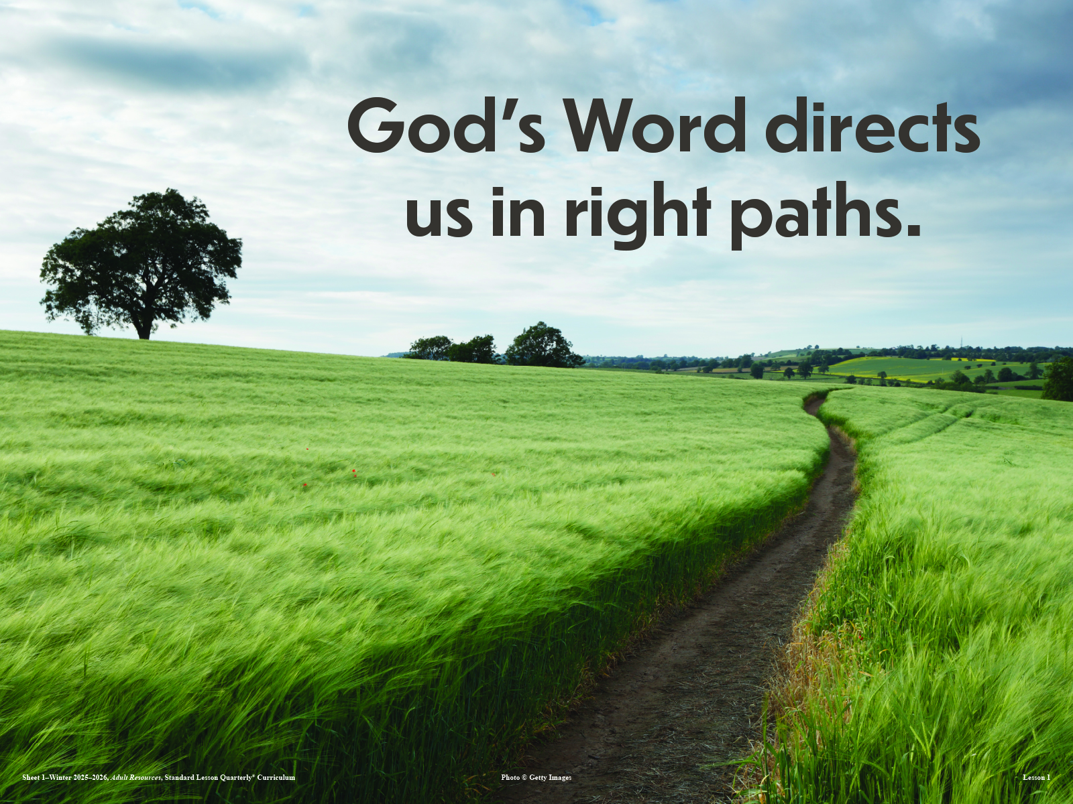
Notes:
Allow one minute for silent personal reflection on the statement shown, following the lesson’s conclusion.

Slide 15
Thought to Remember
Keep the words of Scripture—
and they will keep you.
Notes:
Suggested prayer: Thank You, heavenly Father, for providing us with the precious treasure of Your Word, the Bible. It is indeed a light for us in this dark world. Thank You for its timeless wisdom and, most of all, for its message of salvation through the living Word, Christ Jesus. In His name we pray. Amen.

Slide 16
Our Heavenly Father
Next Week’s Lesson

