Slide 1
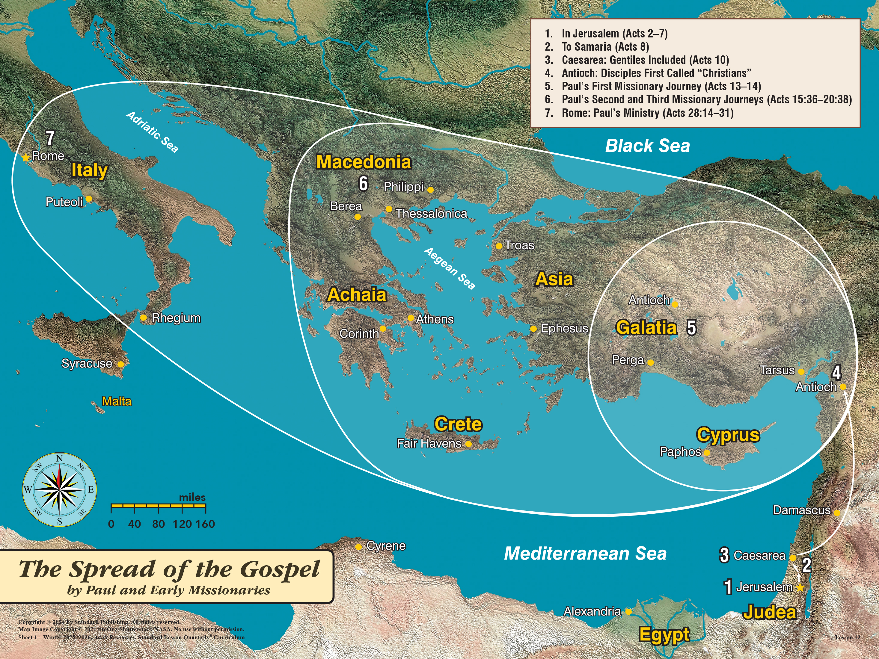

Slide 2
STEWARDSHIP AND MISSION
For you know the grace of our Lord Jesus Christ, that though he was rich, yet for your sake he became poor, so that you through his poverty might become rich.
—2 Corinthians 8:9 NIV
Notes:
STEWARDSHIP AND MISSION
February 22

Slide 3
Prayer
Heavenly Father, You showed us generosity when You gave us Your gift of grace through Your Son, Jesus. May our thankfulness for this gift be revealed in our heartfelt gifts in return. In Jesus’ name we pray.
Amen.
Thought to Remember
Generosity is our response to God’s grace.
Notes:
Prayer
Heavenly Father, You showed us generosity when You gave us Your gift of grace through Your Son, Jesus. May our thankfulness for this gift be revealed in our heartfelt gifts in return. In Jesus’ name we pray. Amen.
Thought to Remember
Generosity is our response to God’s grace.

Slide 4


Agenda
4
For you know the grace of our Lord Jesus Christ, that though he was rich, yet for your sake he became poor, so that you through his poverty might become rich.
  —2 Corinthians 8:9 NIV
    Review
    Introduction
    Lesson Context
    Overview
    A Kingdom of Power - Acts 1:6–8 NIV
    A Plea for Generosity - 2 Corinthians 8:3–9 NIV
    Conclusion
    Question & Answers
STEWARDSHIP AND MISSION
Notes:
A Kingdom of Power - Acts 1:6–8 NIV
A Plea for Generosity - 2 Corinthians 8:3–9 NIV
==============================================
I. The Kingdom Reframed (Acts 1:6–8)
The disciples expected political restoration. Their question reveals national hope, but Jesus redirects them toward spiritual mission. The kingdom would not advance through revolt, but through witness.
Jesus shifts their focus from curiosity about timing to commitment to testimony. The Father controls the calendar; the church carries the commission.
The promise of power is essential. In Baptist theology, we affirm that the Holy Spirit indwells every believer at salvation. This power is not emotional hype—it is divine enablement for gospel proclamation.
Application for McGee Chapel:
We are not called to speculate; we are called to serve.
Our Jerusalem is our local community.
Our Judea and Samaria include cross-cultural ministry.
Our uttermost part is global missions.
Mission is not optional—it is identity.
II. Grace That Gives (2 Corinthians 8:3–9)
Paul highlights Macedonian believers who gave beyond their ability. Notice the order:
They first gave themselves to the Lord.
Their generosity flowed from surrender.
Their giving proved the sincerity of their love.
This is stewardship theology:
Giving is grace.
Giving is worship.
Giving is Christlikeness.
Verse 9 anchors everything:
Christ, though rich, became poor. The Incarnation is the ultimate model of sacrificial generosity. He laid aside heavenly glory to redeem sinners.
At McGee Chapel, stewardship is more than tithing. It includes:
Time
Talent
Treasure
Testimony
We give because we have received.
III. The Unified Message
Acts 1 shows Spirit-empowered mission. 2 Corinthians 8 shows grace-motivated generosity.
Together they teach: The Spirit empowers the mission.
Grace funds the mission.
Witness without generosity lacks substance. Generosity without witness lacks purpose.
A HEALTHY CHURCH DOES BOTH.
Acts 1:6–8 (KJV)
Summary
The disciples expected a political restoration of Israel. Jesus redirected their focus from speculation about “times and seasons” to their present mission. Instead of overthrowing Rome, they would receive power through the Holy Ghost. Their task was not national revolution but global witness—beginning in Jerusalem and expanding outward to the ends of the earth. The kingdom would advance not by military force but by Spirit-empowered testimony.
Commentary
This passage corrects misplaced expectations. The kingdom of Christ is spiritual before it is visible. Jesus shifts them from curiosity to commission, from prediction to participation. The Holy Spirit supplies the power; believers supply obedience. The church today must avoid date-setting and remain faithful in witness. The mission field expands outward geographically and spiritually. Christ reigns now, and we proclaim that reign. The Spirit empowers boldness, unity, and perseverance. True stewardship begins with stewardship of the gospel.
2 Corinthians 8:3–9 (KJV)
Summary
Paul commends the Macedonian believers who gave beyond their ability, willingly and joyfully. Their generosity flowed from first giving themselves to the Lord. Paul challenges Corinth to abound in this grace also, proving the sincerity of their love. The supreme example is Christ, who though rich, became poor so that believers might become spiritually rich through His sacrifice.
Commentary
Christian generosity is rooted in grace, not pressure. Giving begins with surrender to Christ. The Macedonians gave out of poverty, proving that abundance is spiritual before it is financial. Paul grounds stewardship in Christology: Jesus’ incarnation and sacrifice define generosity. He exchanged heavenly riches for redemptive poverty. Therefore, believers give not to earn grace but because they have received it. Stewardship is mission in action—Spirit-empowered witness expressed through sacrificial love. True wealth is found in Christ, and true giving reflects Him.

Slide 5
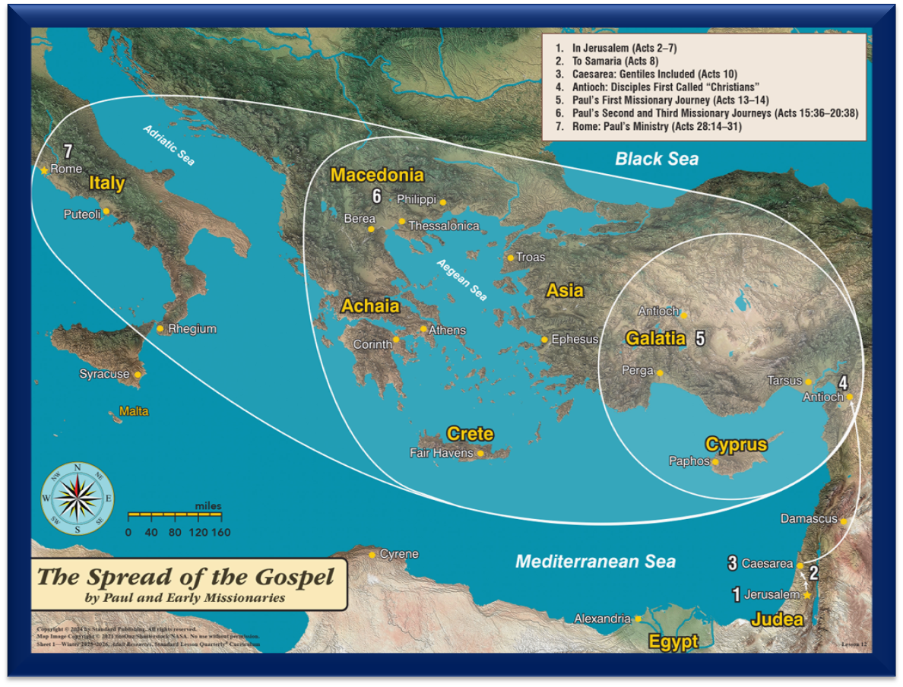
Epic Generosity
STEWARDSHIP AND MISSION
One of the world’s favorite stories is Victor Hugo’s Les Misérables. First as a novel and later as a musical stage play, it has fascinated audiences for generations.
Les Misérables is the story of Jean Valjean, a poor man imprisoned for stealing a loaf of bread. Finally released from prison, he is given refuge by a bishop of the church. Valjean repays the man’s generosity by stealing his silverware! But when the police capture Valjean, the bishop says that the silverware was a gift to the man. Stunned by the bishop’s gracious generosity, Valjean becomes a changed man—a person of humble, heroic generosity.
Perhaps what makes Les Misérables so beloved is that it illustrates the grace of God. Though we have rejected God’s generosity, He still offers us forgive ness by His grace. Having received that forgiveness, a person can never be the same. God’s gracious generosity begets the same generosity in His people
Notes:
---
**Three Key Points**
1. Grace Is Undeserved
Valjean deserved prison, yet received mercy. Likewise, sinners deserve judgment, yet God offers forgiveness through Christ (Romans 5:8). Grace cannot be earned; it is given.
2. Grace Transforms Character
The bishop’s act changed Valjean’s identity. God’s grace does not leave a person unchanged (2 Corinthians 5:17). Forgiveness produces humility and compassion.
3. Grace Reproduces Generosity
The forgiven man becomes generous himself. God’s gracious generosity creates generous people (2 Corinthians 9:8). What we receive vertically from God must flow horizontally to others.
---
**Three Life Lessons Learned**
1. **Mercy has power greater than punishment.**
Love can accomplish what condemnation cannot.
2. **You cannot truly receive grace and remain the same.**
Genuine forgiveness produces visible change.
3. **Generosity begins with gratitude.**
When we understand what Christ has done, giving becomes worship, not obligation.
---
**Summary**
*Les Misérables* portrays a profound spiritual truth: radical mercy transforms lives. The bishop’s gracious act mirrors God’s grace toward sinners. Though humanity has rejected God, He extends forgiveness through Christ. When grace is received, it reshapes the heart, producing humility, compassion, and generosity. God’s gracious generosity does not stop with us—it flows through us. Forgiven people become forgiving people; blessed people become blessing people.

Slide 6
Daily Bible Readings
Week of February 23 through February 28
Across these passages, Scripture teaches that genuine faith expresses itself through faithful action. In **Nehemiah**, God’s people unite to build and defend the wall, showing cooperation for the common good. In **Romans**, believers are urged to welcome and strengthen one another in Christ. **Proverbs** commands immediate kindness when it is within our power. **Ecclesiastes** warns that integrity requires fulfilling vows made to God. **Philemon** models reconciliation and bearing another’s debt. **James** declares that faith without works is dead. Together, these texts emphasize responsible love in action.
        Nehemiah 4:15–23—Work Together for the Common Good.
        Romans 15:1–17—Welcome One Another in Christ.
        Proverbs 3:27–32—Do Good whenever You Can.
        Ecclesiastes 5:4–8—Fulfill Your Vows.
        Philemon 10–21—Bear One Another’s Debts.
        James 2:14–26—Provide for Others and Demonstrate Faith.
Notes:
These Scriptures collectively teach that spiritual maturity is demonstrated through unity, integrity, generosity, and active compassion. True devotion to God results in responsibility toward others. Faith is not theoretical—it builds, welcomes, serves, keeps promises, forgives, and provides.
---
**Authentic faith in God produces visible obedience that seeks the good of others, honors commitments, practices reconciliation, and demonstrates Christlike love through practical action.**
The consistent lesson is this:
Belief must become behavior.
Grace must become generosity.
Commitment to God must become commitment to people.
WHERE FAITH IS REAL, LOVE WORKS.
===============================================
Nehemiah 4:15–23 — Work Together for the Common Good
Summary:
Nehemiah records how the people rebuilt Jerusalem’s wall despite opposition. They worked with tools in one hand and weapons in the other. Each family took responsibility for a section. Unity, vigilance, and shared commitment enabled progress under threat.
Commentary:
God’s work requires cooperation and courage. Spiritual leadership organizes people toward common purpose. The passage teaches balance—prayerful dependence and practical preparation. Kingdom building demands unity and readiness. The church thrives when every believer accepts responsibility for protecting and advancing God’s mission.
Romans 15:1–17 — Welcome One Another in Christ
Summary:
Paul urges strong believers to bear with the weak and pursue unity. Christ is the example, having served others for God’s glory. The gospel unites Jews and Gentiles in one body, producing shared worship and hope.
Commentary:
Christian maturity shows in selflessness. Unity is grounded in Scripture and centered in Christ. Welcoming others reflects God’s inclusive grace. The church glorifies God when cultural and spiritual differences are bridged by love. Strength is measured by how we serve.
Proverbs 3:27–32 — Do Good Whenever You Can
Summary:
The proverb commands believers to do good when it is within their power. It warns against withholding help, planning harm, or envying violent people. Integrity and generosity reflect godly character.
Commentary:
Opportunity creates responsibility. Delayed goodness can become disobedience. Righteous living includes active benevolence. The Lord blesses uprightness and opposes wickedness. Wisdom is not abstract—it is expressed through daily acts of fairness, kindness, and integrity.
Ecclesiastes 5:4–8 — Fulfill Your Vows
Summary:
The writer warns against making careless vows before God. It is better not to vow than to promise and fail to perform. Reverence, integrity, and fear of God guard speech and action.
Commentary:
God values sincerity over impulsive promises. Worship includes accountability. Empty words invite judgment. Faithfulness in commitments honors God. Spiritual maturity includes disciplined speech and responsible follow-through.
Philemon 10–21 — Bear One Another’s Debts
Summary:
Paul appeals to Philemon to receive Onesimus, once a runaway slave, now a brother in Christ. Paul offers to repay any debt. The gospel transforms relationships from hierarchy to fellowship.
Commentary:
Redemption reshapes social structures. Christian love goes beyond legality to reconciliation. Bearing another’s debt reflects Christ’s substitutionary work. Grace restores dignity and unity. The church must model forgiveness and restorative justice.
James 2:14–26 — Provide for Others and Demonstrate Faith
Summary:
James teaches that faith without works is dead. Genuine faith expresses itself through action, particularly in caring for those in need. Abraham and Rahab exemplify faith proven by obedience.
Commentary:
Faith is validated by visible fruit. Salvation is by grace, but saving faith produces works. Compassion is evidence of belief. Orthodoxy without charity is empty. True faith acts.

Slide 7

Context
The book of Acts gives a historical record of the good news about Jesus, moving out from Jerusalem and going to the ends of the earth. This is done through the power of the Holy Spirit at work in the lives of Jesus’ followers. The Spirit’s power draws people into relationship with Christ and begins changing how they think and live. This new way is clear in 2 Corinthians, where Paul writes to a fledgling church, asking them to donate generously for believers who have little. The Holy Spirit empowers us to become more like Christ.
The two texts for today’s lesson are dated almost three decades apart. Jesus was crucified during the Passover observance of AD 30, rose from the dead, and appeared physically to His followers for some 40 days thereafter (Acts 1:3) before His ascension. A few years later, Saul (also named “Paul”; see 13:9) met the resurrected Jesus on the road to Damascus (9:1–19). That interaction led to Paul’s mission trips across the Roman Empire as an apostle of Jesus Christ to the Gentiles (Romans 11:13; Galatians 2:8; 1 Timothy 2:7).
Paul was a native of the commercial hub of Tarsus of Cilicia. That city was the capital of a Roman province; therefore, Paul was a Roman citizen by birth (Acts 22:22–29). At some point in his younger days, he decided to move to Jerusalem to study under Gamaliel (22:3). After Paul’s experience on the road to Damascus, he founded churches in various Roman cities. As people responded to his gospel message, Paul found himself continually needing to bridge the cultural gap between Christ-followers of Gentile background and those of Jewish descent
STEWARDSHIP AND MISSION
Notes:
---
**Three Key Points**
1. The Gospel Expands by the Spirit’s Power
Acts shows the outward movement of salvation history. After Christ’s resurrection and ascension, the Holy Spirit empowers believers to testify boldly. The church grows because God moves.
2. The Gospel Transforms Cultural Barriers
Paul’s ministry bridges Jews and Gentiles. His background—Roman citizen, Jewish scholar under Gamaliel—uniquely positioned him to unite divided communities under Christ (Galatians 3:28).
3. The Gospel Produces Generous Living
In 2 Corinthians, Paul urges generosity for struggling believers. The Spirit who empowers preaching also produces compassion. True faith expresses itself in tangible care.
---
**Three Life Lessons Learned**
1. **The Spirit changes both direction and disposition.**
He sends us outward in mission and inward toward Christlike character.
2. **God uses our background for His purpose.**
Paul’s education, citizenship, and culture became tools for ministry.
3. **Spiritual maturity shows in generosity.**
When hearts are transformed, hands open.
---
**Summary**
Acts records the Spirit-driven spread of the gospel from Jerusalem to the nations. Nearly three decades later, Paul—converted on the Damascus road—calls believers to demonstrate that same Spirit’s work through generosity. The resurrection launched mission; the Spirit sustains it. The same power that created bold witnesses also forms compassionate givers. The church grows not merely through proclamation but through transformed lives that reflect Christ’s grace.

Slide 8
Key Points
The Power of the Holy Spirit—
STEWARDSHIP AND MISSION
From Genesis 1 to Revelation 22, the Holy Spirit is at work. In the Old Testament, the Spirit fills people for specific times and purposes. In the book of Luke, Jesus begins the work of showing what God’s arrival means: Jesus comes to Jerusalem to fulfill His mission. When the Spirit comes at Pentecost (Acts 2), people are given boldness and language to share the good news. Peter, the disciple who had denied he even knew Jesus, gets up and preaches a bold message of salvation when He is filled with the Spirit. The Spirit empowered believers to tell about Jesus in dangerous and fearful situations. After the arrival of the Spirit on believers in Jerusalem, they move outward from the city, declaring to the whole world what God has done.
Notes:
**1. The Power of the Holy Spirit**
****
**The Holy Spirit empowers God’s people to boldly proclaim Christ and carry the gospel to the world.**
**Analysis**
The Spirit is active throughout Scripture—from creation to the church age. In the Old Testament, the Spirit came upon individuals temporarily for specific tasks. After Pentecost (Acts 2), the Spirit indwells believers permanently, producing boldness, transformation, and mission. Peter’s change from fearful denier to fearless preacher demonstrates Spirit-enabled courage. The Spirit moves believers outward, expanding the gospel geographically and spiritually.
**Three Key Points**
1. The Spirit’s work spans all of redemptive history.
2. Pentecost marks a shift from selective empowerment to widespread indwelling.
3. The Spirit produces bold witness in difficult circumstances.
**Three Life Lessons**
1. God’s power overcomes human fear.
2. Spiritual boldness comes from dependence on the Spirit.
3. Mission is Spirit-driven, not personality-driven.
**Summary**
The Holy Spirit transforms believers and propels the gospel outward. His power turns fear into courage and hesitation into proclamation.
---

Slide 9
Offering for the Church in Jerusalem
Key Points
STEWARDSHIP AND MISSION
Paul spent several years, perhaps about AD 52–57, collecting money from churches he had planted so that he might bring a large monetary offering to the church in Jerusalem (Acts 24:17). We can only guess at the precise reasons for Paul’s strategy and what needs he saw in the church of Jerusalem. Jerusalem made up the first church—the gospel mission started there at Pentecost. Probably many Christians came to visit Jerusalem, which would have meant hospitality expenses. Also, because the church in Jerusalem was heavily Jewish, many of the people may have been ostracized by their families when they became followers of Jesus. They may not have had support of former friends and family. Additionally, there was a famine in AD 46; and taxes in Jerusalem were high, coming from both Romans and Jews. Paul hoped that Gentile churches giving support to Jewish Christians would promote unity among believers.
9
Notes:
Offering for the Church in Jerusalem**
****
**Christian generosity strengthens unity and meets real needs within the body of Christ.**
**Analysis**
Paul organized a collection from Gentile churches to support struggling believers in Jerusalem. Economic hardship, famine, taxation, and social rejection created genuine need. Beyond relief, Paul sought unity between Jewish and Gentile Christians. The offering symbolized shared faith and mutual responsibility within the church.
**Three Key Points**
1. Generosity addresses practical hardship.
2. Giving fosters unity across cultural lines.
3. Stewardship is a strategic expression of gospel partnership.
**Three Life Lessons**
1. Compassion requires action.
2. Unity grows through shared sacrifice.
3. Resources are entrusted to serve others.
**Summary**
Paul’s collection demonstrated that the gospel unites believers across backgrounds and calls them to tangible generosity.
---

Slide 10
Key Points
THE CHURCH AT CORINTH
Paul wrote three letters to the Corinthians. First Corinthians is a response to the arguments Paul received from the church after a first letter (not found in the Bible). Second Corinthians continues Paul’s work of mending relationships with the Corinthians and challenging them to live godly lives. Corinth was a city filled with great immorality, and the church of Corinth struggled with being influenced by their culture. They were also dealing with poor leadership and philosophical arguments, like the belief that being “spiritual” means setting aside the body. Paul writes to correct and encourage them. In 2 Corinthians, when he asks them to be generous, he points to the Macedonian churches (from Philippi, Thessalonica and Berea). They were facing trouble and persecution, but despite it all, they gave generously.
STEWARDSHIP AND MISSION
10
Notes:
**3. The Church at Corinth**
****
**Spiritual maturity is demonstrated through godly living and generous obedience despite cultural pressure.**
**Analysis**
Corinth was morally corrupt and philosophically confused. The church struggled with division, immorality, and distorted spirituality. Paul wrote to correct error and restore relationships. In urging generosity, he pointed to Macedonian believers who gave despite persecution. True spirituality expresses itself in disciplined living and sacrificial giving.
**Three Key Points**
1. Culture influences but must not control the church.
2. Correction is part of spiritual growth.
3. Generosity reflects genuine faith.
**Three Life Lessons**
1. Faith must resist cultural compromise.
2. Growth often comes through loving correction.
3. Giving proves spiritual sincerity.
**Summary**
Paul challenged Corinth to mature beyond cultural confusion and demonstrate authentic faith through obedience and generosity.

Slide 11
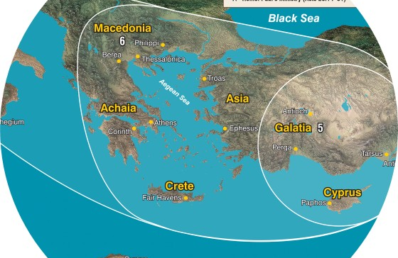
A Kingdom of Power - Acts 1:6–8 NIV
6 Then they gathered around him and asked him, “Lord, are you at this time going to restore the kingdom to Israel?”
7 He said to them: “It is not for you to know the times or dates the Father has set by his own authority.
8 But you will receive power when the Holy Spirit comes on you; and you will be my witnesses in Jerusalem, and in all Judea and Samaria, and to the ends of the earth. ”
• The apostle Paul, writing a few decades later, asks an early Gentile congregation to demonstrate generosity.
• Paul points out that other churches in Macedonia have given more, even though they were not wealthy.
• Paul asks the Corinthians to support the needy Christians in Jerusalem because of God’s generosity.
• Jesus was “rich,” but He set that characteristic aside to become human like us. Jesus models generosity for us.
STEWARDSHIP AND MISSION
11
Notes:
><><><><><><><><><><><><><><><><
A Kingdom of Power
Jesus accomplished His earthly mission. He came to earth as a man and became obedient to death on a cross (Phil. 2:8). Throughout His life, Jesus taught what it means to walk according to God’s design, to live as a human in the way God intends. By His death and resurrection, He has defeated sin and death—providing access for all to a restored relationship with God. But shortly after the resurrection, Jesus’ followers are still grappling to understand the full implications of what has happened. Jesus tells His disciples to remain in Jerusalem to await the gift of the Holy Spirit. In Acts 1:6, they gather around Him to ask if the time has come for Jesus to “restore the kingdom to Israel. ” The messianic hopes of Israel were based on expectations of a conquering king. They wanted someone like King David, who successfully defended the people and waged war against Israel’s enemies: solidifying borders, glorifying the name of God, and ensuring a strong and prosperous nation. God promised David a descendant, the Messiah, who would reign forever (see 2 Sam. 7:12). This is what Israel and the disciples expect when the Messiah arrives. They want to see a rerun of the glory days of Israel’s national might, under the leadership of a worthy king who would turn the Romans out and set God’s people free from foreign oppression.
And they knew that Jesus was Israel’s king. Everyone was waiting for Him to take the throne, to reign like a traditional king. The disciples’ question speaks to this hope. But Jesus responds in an indirect manner, acknowledging that He will reign as king and His throne will be established (v. 7). However, the Father has decided the appropriate time, and it’s not for them to know. We still eagerly await the return of Jesus and establishment of His kingdom in glory. In the meantime, the ministry of Jesus continues—through His followers. Jesus comforts the disciples with the promise that the Holy Spirit is coming to grant them power to be His witnesses (v. 8). In the Old Testament, the Holy Spirit is active in people’s lives, but usually only for specific people for specific times (for example, Joseph [Gen. 41:38]; the craftsmen of the tabernacle [Ex. 31:3], Joshua [Num. 27:18], King David [1 Sam. 16:13]). Figures of the past were filled with the Spirit to do the work of God. But after the death and resurrection of Jesus, the Spirit comes in abundance to all believers (Acts 2:4). Everyone can imitate Christ and be His witnesses. It is through the power of the Holy Spirit that believers bear witness for Christ, as the good news about Him goes from Jerusalem, into all of Judea and Samaria, and eventually to the whole world (Acts 1:8).
A Kingdom of Power — Analysis
Christ’s kingdom advances not by political force, but by Holy Spirit power through obedient witnesses.
Analysis
Jesus fulfilled His earthly mission through obedience, death, and resurrection (Phil. 2:8). Though the disciples expected a political restoration like David’s reign, Jesus redirected their focus from national power to spiritual mission. The timing of the kingdom’s visible rule belongs to the Father. Meanwhile, believers receive the Holy Spirit to carry the gospel outward. The shift from selective Old Testament empowerment to universal Spirit indwelling (Acts 2) marks a new covenant reality: every believer is called and empowered to witness.
Three Key Points
The Kingdom Is Spiritual Before It Is Political
Jesus corrects the disciples’ expectation of national dominance.
The Timing of God’s Plan Belongs to the Father
Speculation is replaced with obedience.
The Spirit Empowers Global Witness
Pentecost transforms fearful followers into bold proclaimers.
Three Life Lessons Learned
God’s purposes often differ from human expectations.
We must align our hopes with His design.
Our responsibility is obedience, not controlling outcomes.
Faithfulness matters more than timelines.
We cannot fulfill God’s mission without the Spirit’s power.
Witness flows from divine enablement, not human strength.
Summary
The disciples expected a political revolution; Jesus promised spiritual empowerment. His kingdom would expand through Spirit-filled witnesses, not military conquest. The Father controls the calendar, but believers carry the commission. From Jerusalem to the ends of the earth, the gospel spreads through the power of the Holy Spirit. Christ reigns now, and His kingdom advances through obedient, empowered followers.
Points to Emphasize

Slide 12
A Plea for Generosity - 2 Corinthians 8:3–9 NIV
3 For I testify that they gave as much as they were able, and even beyond their ability. Entirely on their own,
4 they ur gently pleaded with us for the privilege of sharing in this service to the Lord’s people.
5 And they exceeded our ex pectations: They gave themselves firs of all to the Lord, and then by the will of God also to us.
6 So we urged Titus, just as he had earlier made a beginning, to bring also to completion this act of grace on your part.
7 But since you ex cel in everything—in faith, in speech, in knowledge, in complete earnest ness and in the love we have kindled in you—see that you also excel in this grace of giving. 8 I am not com
manding you, but I want to test the sincerity of your love by comparing it with the earnestness of others.
9 For you know the grace of our Lord Jesus Christ, that though he was rich, yet for your sake he became poor, so that you through his poverty might become rich.
• The apostle Paul, writing a few decades later, asks an early Gentile congregation to demonstrate generosity.
• Paul points out that other churches in Macedonia have given more, even though they were not wealthy.
• Paul asks the Corinthians to support the needy Christians in Jerusalem because of God’s generosity.
• Jesus was “rich,” but He set that characteristic aside to become human like us. Jesus models generosity for us.
STEWARDSHIP AND MISSION
12
Notes:
><><><><><><><><><><><><><><><><
A Plea for Generosity
The empowering Spirit gives Jesus’ followers boldness to spread the good news about salvation. This means that many people—Jews and Gentiles—soon decide to follow Jesus and are being filled with the Spirit. They begin to live Spirit-led lives, in community with one another.
In his letter of 2 Corinthians, the apostle Paul, who planted many churches among the Gentiles, writes to the church in Corinth, asking for them to demonstrate generosity. Before Paul makes his dramatic and final trip back to Jerusalem, he spends about five years collecting money from Gentiles to support the Jewish Christians back where the gospel message first began to spread, in Jerusalem.
In 2 Corinthians 8, Paul asks the Corinthian church to donate generously. He uses the Macedonian churches as an example—citing their abundant giving. In verse 3, Paul tells the Corinthians that the Macedonian churches gave “as much as they were able, and even beyond their ability. ” He says they pleaded for the privilege of serving God’s people by giving in this way. The Macedonian churches had little, but gave much. The church at Corinth probably had more since Corinth was a wealthy city. The members could also give generously, if they choose to. Paul argues that giving to the urgent needs of brothers and sisters in the faith is a privilege. It isn’t to be done grudgingly, but with great joy, knowing that generous giving is one of the ways believers become more like Christ.
In verse 7, Paul points out the many gifts the Spirit has given the Corinthian believers. They excel in faith, speech, knowledge, earnestness, and love. But Paul wants them to excel at giving, which is another gift of the Spirit (Rom. 12:8).
Paul doesn’t command that the Corinthians donate generously, but he does say that this request is a test of their love (2 Cor. 8:8). Following Jesus is not only a mental agreement to a set of beliefs. It requires action, often sacrifice. He points out in verse 9 that Jesus, although He was deserving of everything (as God), became a poor human for the sake of our salvation. Jesus lived according to God’s will, and believers are meant to imitate Him (Eph. 5:1–2), to be formed into His likeness (2 Cor. 3:18).
A Plea for Generosity — Analysis
Spirit-filled believers demonstrate Christlike love through joyful, sacrificial generosity.
Analysis
The same Holy Spirit who empowers bold witness also produces compassionate giving. As the gospel spread among Jews and Gentiles, believers formed Spirit-led communities marked by unity and care. Paul’s collection for Jerusalem was both practical relief and theological testimony—showing that the gospel unites diverse believers. The Macedonians modeled extraordinary generosity despite poverty. Paul challenges Corinth to match spiritual maturity with financial grace. Giving is not commanded as law but invited as love. Christ’s incarnation and sacrifice provide the ultimate model of generosity.
Three Key Points
Generosity Is a Work of the Spirit
Giving is listed among spiritual gifts and flows from Spirit-led transformation.
Sacrificial Giving Reflects Christ’s Example
Jesus became poor so believers could become spiritually rich.
Generosity Proves the Sincerity of Love
Love is validated through action, not merely confession.
Three Life Lessons Learned
True spirituality includes practical compassion.
Faith must be visible through generosity.
Giving is a privilege, not a burden.
It shapes believers into Christ’s likeness.
Sacrifice deepens unity within the body of Christ.
Shared generosity strengthens shared faith.
Summary
Paul urges the Corinthians to excel in generosity as evidence of Spirit-filled maturity. Using the Macedonians as an example, he shows that giving flows from surrender and joy, not obligation. The request becomes a test of love. Ultimately, Christ’s self-giving sacrifice defines generosity. To follow Jesus is to imitate His grace, allowing the Spirit to transform belief into sacrificial action.

Slide 13
One Bible, One Story
A Generous God
From the beginning of the biblical story, God has shown that His character is generous. He created a world full of beauty and goodness and placed humanity in the garden of Eden, to care for His world and bear His image. After sin entered God’s good world, there were consequences; but in the midst of them, God promised to restore, redeem and rescue by sending one to crush the serpent (Gen. 3:15). God revealed His character to Abraham and his descendants, showing that He was rich in faithful, loyal love. He blessed them, giving them their own land, providing them with safety and resources, and forgiving them. In the ultimate act of generosity, God sent His own Son to die on a cross for the sins of the world, providing a way back to right relationship with God. Jesus abandoned the riches of heaven to become poor, for the sake of the world. Jesus gave of His riches, making us “rich” in the blessings of eternity
STEWARDSHIP AND MISSION
13
Notes:
A Generous God — Analysis
God’s nature is generous, and His redemptive plan culminates in the ultimate gift of His Son for our salvation.
Analysis
Scripture reveals generosity as central to God’s character. Creation itself displays divine abundance—beauty, provision, and purpose. Even after humanity’s fall, God responded not only with justice but with promise (Gen. 3:15). His covenant with Abraham demonstrated faithful, loyal love through blessing, protection, and forgiveness. The highest expression of God’s generosity is the sending of Jesus Christ. The Incarnation and crucifixion reveal sacrificial grace: Christ left heavenly glory to redeem sinners. Divine generosity restores what sin corrupted.
Three Key Points
Creation Reflects God’s Generous Nature God gave life, purpose, and provision freely.
Covenant Love Demonstrates Faithful Generosity God blesses, forgives, and preserves His people.
Christ Is the Ultimate Gift of Grace Jesus became poor so humanity could inherit eternal riches.
Three Life Lessons Learned
God’s generosity precedes human merit. Grace begins with Him, not us.
Redemption flows from covenant faithfulness. God keeps His promises despite human failure.
Receiving divine generosity calls for grateful response.
Those made spiritually rich should live generously.
Summary
From Eden to Calvary, the biblical narrative reveals a God who gives abundantly. Creation, covenant, and cross all testify to His generous character. Though sin brought separation, God promised restoration and fulfilled it through Christ. Jesus’ sacrifice represents the supreme act of generosity—exchanging heavenly riches for our redemption. God’s giving nature invites believers to reflect His grace in their own lives.

Slide 14
Apply the Message:
Our ability to give might change with our stage in life.
A Spirit of Generosity
When I was young, my family would take summer trips to Chicago. We would go to museums, shows, shops, and tour all of the historical parts of the city. These trips were filled with fun and excitement for us as we got to see a city that had so much to offer. But we couldn’t help but notice, as we walked around the city, there were many people on the streets—people who looked desperate and seemed to have no comfortable place to go. On one of these trips, my brother (only about eight), was moved with compassion for those experiencing homelessness. When we got home, he sent his piggy bank money to Pacific Garden Mission, a ministry dedicated to sharing Jesus and hope with those in need, there in Chicago. My brother received updates from the mission for years afterward.
As I was remembering my brother’s generosity at a young age, I couldn’t help but feel inadequate. At this stage in my life, I have never been more financially stable. And yet, I find myself thinking about the next stage of my financial planning, not for how I can share out of my abundance with others. My instinct is to be generous toward my current and future self, and it requires the work of the Holy Spirit to help me shift my thinking beyond what I want.
When Jesus sent the Holy Spirit to His people, they gained boldness to be generous toward the needs of one another. They were urgently sharing the blessings of the gospel! They allowed the Spirit to transform them.
As we continue in our own discipleship journeys, we need to continually be asking the Holy Spirit to grow this fruit in us. There might be areas where we’ve seen growth, and perhaps there are other areas (like generosity) where we need the Spirit to stretch us. The goal is to become more like Jesus, for He is generous in every way.
STEWARDSHIP AND MISSION
14
Notes:
Apply the Message — A Spirit of Generosity
Generosity is not determined by life stage but by Spirit-led transformation toward Christlikeness.
Analysis
This reflection highlights the tension between childhood compassion and adult calculation. The child’s giving flowed naturally from empathy, while adulthood often introduces financial planning and self-preservation. The issue is not wealth, but orientation of the heart. The Holy Spirit must continually reshape priorities from self-centered security to Christ-centered generosity. Just as the early church shared urgently after Pentecost, believers today must allow the Spirit to transform instinct into intentional generosity.
Three Key Points
Generosity Is Heart-Driven, Not Income-Driven
Even limited resources can reflect abundant compassion.
Life Stages Influence Capacity, Not Calling
The responsibility to give remains constant, though the form may change.
The Spirit Reorients Self-Focus Toward Service
True generosity requires spiritual renewal of motives.
Three Life Lessons Learned
Childlike compassion should not be lost in adulthood.
Growth should deepen generosity, not diminish it.
Financial stability can subtly encourage self-preservation.
Spiritual vigilance guards against hoarding.
Generosity is spiritual fruit cultivated over time.
It requires continual surrender to the Holy Spirit.
Summary
Generosity evolves across life stages, but the calling remains the same. Childhood giving may be simple and sincere, while adulthood introduces complexity and caution. Yet the Spirit’s work is to transform believers into the likeness of Christ—who gave freely and sacrificially. True discipleship involves asking the Holy Spirit to stretch us, reshape our priorities, and produce joyful generosity that reflects the heart of Jesus.

Slide 15
Apply the Message:
Our ability to give might change with our stage in life.
STEWARDSHIP AND MISSION
A Spirit of Generosity
1 Do you find generosity easy or difficult? Why?
2 What are some ways that people have shown you generosity throughout your life?
3 How can you continue to grow in generosity?
15
Notes:
1 Do you find generosity easy or difficult? Why?
If we think about this question from a financial standpoint, it might be that we think of giving as easy or hard, depending on our income. Jesus tells a parable in Matthew 25:14–30 with the message Be faithful, whether given much or given only a little. If we expand our definition of generosity to mean more than money, it is easier to see that this virtue is something we nurture in ourselves, at all stages of life.
2 What are some ways that people have shown you generosity throughout your life?
Perhaps you have been helped by the random generosity of a stranger, or perhaps by the targeted generosity of a Christian community. You might also consider the mentors and people of your past who welcomed you and included you. Or perhaps you might still rely on others to care for you in a particular way.
3 How can you continue to grow in generosity?
Our practice of generosity is never complete, and we never stop growing in our knowledge of Christ. Even in times of need, we can learn to be generous with our attention and our prayers before God. We should always be evaluating our own areas of abundance, looking for opportunities to meet the needs of others.

Slide 16

Conclusion
More than Money
STEWARDSHIP AND MISSION
The Bible reveals God’s expectations regard­ing how people are to treat each other. One such expectation concerns meeting the needs of the poverty-stricken. The Law of Moses had clear rules in this regard (examples: Leviticus 19:10; Deuteronomy 15:11). And the issue is no less pres­ent under the new covenant (examples: Matthew 25:34–46; Galatians 2:10).
Even so, money and its giving are touchy sub­jects at church, causing many to avoid discuss­ing the topic. The oft-heard complaint, “They’re always asking for money!” has soured many peo­ple away from church. Perhaps we should take a different approach to giving, one that acknowl­edges financial generosity as, first and foremost, a privileged response to God’s grace.
Our generosity results from first acknowledg­ing the generosity of God. Our God is a giving God, demonstrated through His gift of salvation. When we show generosity to others, we are fol­lowing God’s lead. Our acts of generosity are acts of worship, bearing witness to our testimony of Christ and His great love for us.
16
Notes:
More Than Money — Analysis
Main Idea (Highlighted)
Christian generosity is not primarily about money—it is worshipful response to God’s saving grace.
Analysis
Scripture consistently commands care for the poor under both the Old and New Covenants. Generosity is not optional; it reflects God’s heart. Yet financial discussions often produce discomfort because giving is misunderstood as institutional demand rather than spiritual privilege. Biblical generosity begins with recognizing God’s ultimate gift—salvation through Christ. When believers give, they mirror divine generosity. Thus, giving is not fundraising; it is faith-expression. It becomes testimony, worship, and gratitude in action.
Three Key Points
God Commands Care for the Needy
Compassion is a covenant expectation.
Giving Is a Privileged Response to Grace
Generosity flows from gratitude, not pressure.
Financial Stewardship Is Worship
Giving declares trust in God and love for others.
Three Life Lessons Learned
Avoiding the topic of money can obscure spiritual growth.
Stewardship is part of discipleship.
Grace must shape our perspective on generosity.
We give because we have received.
Generosity strengthens testimony.
Acts of giving reveal the character of Christ.
Summary
The Bible teaches that caring for the poor reflects God’s expectations for His people. Though discussions about money can feel uncomfortable, generosity must be reframed as worship rather than obligation. God’s saving grace is the foundation of all giving. When believers respond generously, they testify to the generosity of God Himself. Giving is more than financial exchange—it is spiritual obedience and grateful imitation of Christ.

Slide 17
Live It Out: Inventory the resources that God has provided, and plan to share them.
Money is one of the topics that Jesus discusses time and again, but it can be uncomfortable to bring up in a group that has people in all stages of life. Whether we are blessed with a lot or a little, we can find ways to grow our generosity toward others.
STEWARDSHIP AND MISSION
Imitating a Generous God
  God is generous to us, and He invites us to be generous to others, which is inseparable from the good news of Christ’s kingdom. Take the time now and in the week ahead to inventory your available resources. Are there ways you can give with freedom and joy, especially to those in your community? Maybe there are local groups for whom you can commit to prayer, which is extremely valuable. Ask God to show you where and how He wants you to show His generosity to others.
17
Notes:
Live It Out — Imitating a Generous God
Main Idea (Highlighted)
God calls believers to intentionally steward and share every resource as an act of joyful imitation of His generosity.
Analysis
Jesus frequently addressed money because it reveals the heart. Yet generosity extends beyond finances. Believers exist at different life stages—some with abundance, others with limitation—but all possess God-given resources. The issue is not quantity but willingness. Inventorying resources invites spiritual reflection: time, skills, influence, prayer, encouragement, material means. Generosity is inseparable from the gospel because it reflects the character of a giving God. Stewardship becomes discipleship when it is deliberate and Spirit-led.
Three Key Points
Generosity Begins with Honest Inventory
Recognizing what God has provided clarifies responsibility.
Resources Include More Than Money
Time, prayer, gifts, and compassion are valuable offerings.
Joyful Giving Reflects God’s Character
Freedom in giving reveals trust in God’s provision.
Three Life Lessons Learned
Every believer has something to give.
Capacity varies, but calling remains.
Intentional generosity requires planning.
Growth rarely happens accidentally.
Prayer aligns generosity with God’s purpose.
Seeking His direction ensures faithful stewardship.
Summary
Living out generosity requires thoughtful reflection on the resources God has entrusted to us. Whether great or small, every gift can be used for His kingdom. True generosity mirrors God’s own giving nature and is rooted in gratitude for the gospel. By prayerfully identifying opportunities to serve and share, believers grow into Christlikeness and demonstrate the reality of His kingdom through joyful, intentional action.

Slide 18



  The Lord bless thee, and keep thee:
  The Lord make his face shine upon thee, and be gracious unto thee:
  The Lord lift up his countenance upon thee and give thee peace.
  - Numbers 6:24-26,
18
Material adapted by Stanford W. Bowman Jr. from Echoes® Adult and Bible-in-Life® Adult Winter 2025 - 26 quarter with permission, © David C Cook, https://davidccook.org. May not be further reproduced. All rights reserved.

Slide 19
QUESTION & ANSWER
A Kingdom of Power
1 Why do you think the disciples are so curious about Jesus’ role as the king of Israel?
3 What are ways that the Spirit empowers us to be witnesses?
STEWARDSHIP AND MISSION
Jesus’ mission was radical and unexpected. It is reasonable for the disciples to expect Jesus to rule over them as king. They knew that he was the Messiah—undeniable after his resurrection from the grave. But they didn’t know that it would look different from their image of kings. They did not understand the delay.
2 How do we announce and welcome Jesus’ kingdom right now, even while we wait for His return?
Even though Christ might not have returned, He is still king, and we are still a part of His kingdom. We can share about our salvation and how we have been invited into God’s kingdom. We can fulfill Jesus’ last words before the ascension by being His witnesses.
The Spirit is a helper to us, who guides us in our pursuit of becoming more like Christ. He enables us to do the work that God has set out for us, as we share the good news of Christ with others. The Spirit gives us boldness of speech, insight into God’s perspective, and even helps us in our prayers (recalling Lesson 4).
19
Notes:
1 Why do you think the disciples are so curious about Jesus’ role as the king of Israel?
Jesus’ mission was radical and unexpected. It is reasonable for the disciples to expect Jesus to rule over them as king. They knew that he was the Messiah—undeniable after his resurrection from the grave. But they didn’t know that it would look different from their image of kings. They did not understand the delay.
2 How do we announce and welcome Jesus’ kingdom right now, even while we wait for His return?
Even though Christ might not have returned, He is still king, and we are still a part of His kingdom. We can share about our salvation and how we have been invited into God’s kingdom. We can fulfill Jesus’ last words before the ascension by being His witnesses.
3 What are ways that the Spirit empowers us to be witnesses?
The Spirit is a helper to us, who guides us in our pursuit of becoming more like Christ. He enables us to do the work that God has set out for us, as we share the good news of Christ with others. The Spirit gives us boldness of speech, insight into God’s perspective, and even helps us in our prayers (recalling Lesson 4).

Slide 20
QUESTION & ANSWER
A Plea for Generosity
20
1 Why do you think generous giving is one of the gifts of the Spirit? Is it a gift for all, or for only some?
2 Do you believe it’s easier or harder for wealthy people to show generosity?
3 Why do you think that Paul was so insistent that Gentile churches give back to the needs of Jewish Christians in Jerusalem?
STEWARDSHIP AND MISSION
For anyone who has been blessed with the riches of Christ’s love and forgiveness, generosity should be a way of life. But that is not to say that some people aren’t in a better position to demonstrate financial generosity by caring for the physical needs of the community.
Jesus said it is hard for a wealthy person to enter the kingdom! So perhaps it might be harder to be invested in the kingdom of God, if we are wrapped up in present possessions and wealth. Jesus commends the giving of the widow who gave out of her poverty (Mark 12:41–44). This remark suggests that generosity is apparent to God according to the heart of the giver, not the size of the offering.
Paul knows that Gentiles have been “grafted in” to God’s people, even though Jews had the blessings of covenant and Scripture beforehand (Rom. 11:11–24). He worries about pride and resentments. Thus he wants the Gentiles to show support for their Jewish brothers and sisters.
Notes:
1 Why do you think generous giving is one of the gifts of the Spirit? Is it a gift for all, or for only some?
For anyone who has been blessed with the riches of Christ’s love and forgiveness, generosity should be a way of life. But that is not to say that some people aren’t in a better position to demonstrate financial generosity by caring for the physical needs of the community.
2 Do you believe it’s easier or harder for wealthy people to show generosity?
Jesus said it is hard for a wealthy person to enter the kingdom! So perhaps it might be harder to be invested in the kingdom of God, if we are wrapped up in present possessions and wealth. Jesus commends the giving of the widow who gave out of her poverty (Mark 12:41–44). This remark suggests that generosity is apparent to God according to the heart of the giver, not the size of the offering.
3 Why do you think that Paul was so insistent that Gentile churches give back to the needs of Jewish Christians in Jerusalem?
Paul knows that Gentiles have been “grafted in” to God’s people, even though Jews had the blessings of covenant and Scripture beforehand (Rom. 11:11–24). He worries about pride and resentments. Thus he wants the Gentiles to show support for their Jewish brothers and sisters.

Slide 21
  The Lord bless thee, and keep thee:
  The Lord make his face shine upon thee, and be gracious unto thee:
  The Lord lift up his countenance upon thee and give thee peace.
  - Numbers 6:24-26,
21
Material adapted by Stanford W. Bowman Jr. from Echoes® Adult and Bible-in-Life® Adult Winter 2025 - 26 quarter with permission, © David C Cook, https://davidccook.org. May not be further reproduced. All rights reserved.

