Slide 1
Our Heavenly Father
Lesson 2
Copyright © 2025 Standard Publishing, part of the David C Cook family, Colorado Springs, Colorado 80918
All rights reserved. Photo © Getty Images

Slide 2
Pulling Back the Curtain
When thinking about the person and work of Jesus, people at first tend to think much less of Jesus than who He really is.
That seems as true now as it was in the first century. Jesus “pulled back the curtain” between heaven and earth to reveal the truth about God.
Today’s lesson reveals one of those truths.
Notes:
Supplement with additional information from the Introduction as desired.

Slide 3
Into the Lesson
Under the appropriate header, write down examples of “Minor,” “Serious,” and “Unusual” worries or concerns people may have.
Whole-class discussion:
How often do we think about our fears?
How often do we let our fears consume our thinking?
How do we handle our fears?
Notes:
Divide the class into small groups and distribute a sheet of paper and a pen to each group Direct groups to write the following words a headers of three columns on the sheet of paper: Minor, Serious, Unusual. After three minutes of group work, reconvene the class and ask volunteers to share examples.
Then, ask the questions for whole-class discussion.

Slide 4
Lesson Context
Today’s lesson text comes from a section of Jesus’ teaching called the “Sermon on the Mount” (Matthew 5–7).
Matthew 6 begins with Jesus’ warning about hypocrisy as one serves God in various ways. Then come instructions on prayer, fasting, and priorities.
Today’s lesson text continues Jesus’ teaching on living a life that depends on a loving heavenly Father’s gracious provision of all our needs. Luke 12:22–31 and 16:13 are parallel texts.
Notes:
Supplement with additional information from the Lesson Context as desired.

Slide 5
I. Serve or Despise the Father? Matthew 6:24
Notes:
Read Matthew 6:24 out loud.

Slide 6
What Do You Think?
How does our culture encourage people to give allegiance to financial wealth?
Digging Deeper
What steps can we take to ensure that wealth and its pursuit remain secondary to serving God?

Slide 7
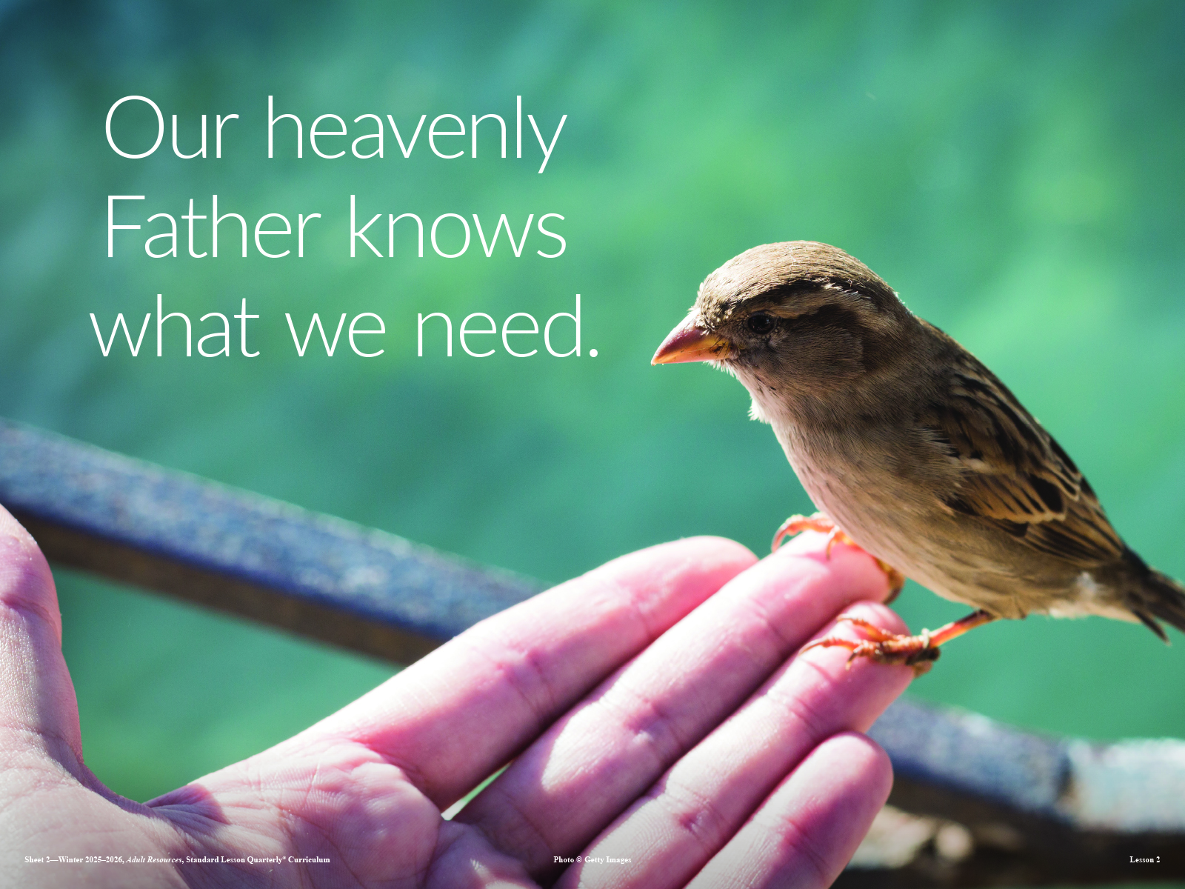
Notes:
Point to this visual and ask, “In what ways has our heavenly Father provided what we need?”

Slide 8
II. Worry or Trust the Father? Matthew 6:25–32
Anxious for Provision (v. 25)
Examples of Provision (vv. 26–29)
God of Provision (vv. 30–32)
Notes:
Read Matthew 6:25–32 out loud.

Slide 9
What Do You Think?
When do we cross the line between making prudent decisions about the future and engaging in undue worry about the future?
Digging Deeper
What questions do you ask to help you discern in this regard?

Slide 10
What Do You Think?
In what ways can we grow in faith to trust in God’s provision?
Digging Deeper
How do you balance faith in God and personal responsibility in this regard?

Slide 11
III. Kingdom Living Matthew 6:33–34
Righteousness First (v. 33)
Today, Not Tomorrow (v. 34)
Notes:
Read Matthew 6:33–34 out loud.

Slide 12
What Do You Think?
What concerns and actions are indicative of the kingdom of God and the righteousness of God?
Digging Deeper
What steps will you take to prioritize the kingdom of God in the upcoming week?

Slide 13
What Do You Think?
How can we balance focusing on “things above” with the need to pursue justice and righteousness in the world?
Digging Deeper
In what ways do Micah 6:8; Matthew 5:13–16; Acts 20:32–35; and James 1:27 inform your response?

Slide 14
Into Life
Let’s notice the needs of others in our community. Together, make a list of difficulties people are facing. Then, discuss:
What is already being done to help with these difficulties?
How can we partner with those already addressing these difficulties?
Notes:
Say, “One way we can deal with worry is to notice the needs of others in our community.” Ask participants to create a list on the board of difficulties that people in your community may face. Lead a brainstorming session on ways to address those difficulties. To help with brainstorming, ask the following questions:

Slide 15
Connecting People to the Father
All followers of Jesus can demonstrate the difference that living in the trust of a loving heavenly Father can make. Each of us has a sphere of influence that includes people to whom God seems far away.
A change in people’s understanding of God may not occur overnight through our efforts. Still, with patience and prayer perhaps we can use the illustration in the Lesson Introduction, “pulling back the curtain” and helping people see how much their Father really does love them.
Notes:
Supplement with additional information from the Conclusion as desired.

Slide 16
Thought to Remember
No one knows our earthly needs
better than our heavenly Father.
Notes:
Suggested prayer: What a sacred privilege it is to know You as our Father in heaven! May we never take this relationship for granted, and may we help others to see what a blessing it is to know You in that way and the difference it makes in our lives, both now and for eternity. In Jesus’ name we pray. Amen.

Slide 17
Christ the Savior
Next Week’s Lesson

