Slide 1
The Holy Spirit
Lesson 4
Copyright © 2025 Standard Publishing, part of the David C Cook family, Colorado Springs, Colorado 80918
All rights reserved. Photo © Getty Images
Notes:
##Replace background as appropriate per quarter.

Slide 2
Real Brother
When my friend Chris was 10, his family adopted a 5-year-old boy named Mark.
Mark began to cry when he broke one of Chris’s toys. Chris gave him a big hug and asked why he was trembling. Mark thought that their dad would be mad because Chris was the “real son.”
Chris pulled Mark closer and whispered, “You’re his real son now too. You’re my real brother.” The barrier was broken. Mark finally knew that he was part of the family.
Notes:
Supplement with additional information from the Introduction as desired.

Slide 3
Into the Lesson
Which organizations or foundations serve this purpose?
What are some things people do to help, serve, or bring awareness about this group?
Would any of the participants say they are an advocate for this cause? If so, how?
Why are advocates helpful to this group?
Notes:
Have participants identify a vulnerable population or an endangered animal species. Divide participants into small groups. Distribute index cards with the questions on the slide to find out what learners know about advocating for this population.
Bring the groups back together to present their findings in a whole-class discussion.
Lead into Bible study by saying, “An advocate is someone who speaks up for someone or something that cannot speak for themselves or struggles to be heard. As we study, consider in what ways the Holy Spirit is an advocate for us.”

Slide 4
Lesson Context
The apostle Paul wrote about 25 percent of the New Testament. But nearly half of the New Testament references to the (Holy) Spirit occur in his letters. Clearly, the person and work of the Holy Spirit is a vital doctrine for him—and should be so for us.
Notes:
Supplement with additional information from the Lesson Context as desired.

Slide 5
I. Flesh and Spirit Romans 8:12–14
Owe the Flesh (v. 12)
What Leads to Death (v. 13a)
What Leads to Life (v. 13b)
What Results (v. 14)
Notes:
Read Romans 8:12–14 out loud.

Slide 6
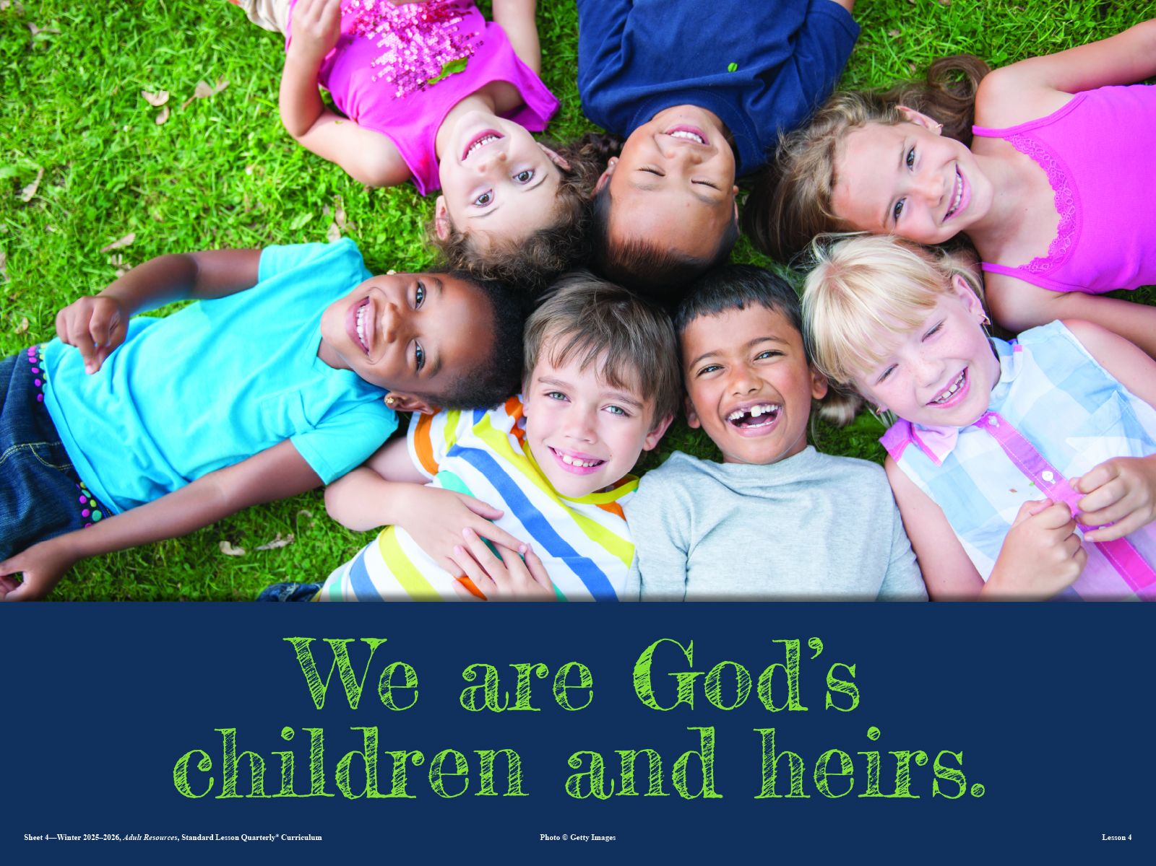
Notes:
Display this visual as you ask the discussion question associated with Romans 8:16.

Slide 7
What Do You Think?
What do you think it looks like to live by the Spirit and not according to the flesh?
Digging Deeper
How does Galatians 15:16–18 contribute to your previous response?

Slide 8
II. God’s Children Romans 8:15–17
Not Slaves (v. 15a)
Adopted (v. 15b)
Confirmed (v. 16)
Heirs with Jesus (v. 17)
Notes:
Read Romans 8:15–17 out loud.

Slide 9
What Do You Think?
What is it like to know that you are no longer bound to fear?
Digging Deeper
In what ways do you struggle to believe that you are freed from fear?

Slide 10
What Do You Think?
How should our lives look different, knowing we are children of God?
Digging Deeper
What does 1 John 3:1-2 contribute to your consideration of this?

Slide 11
What Do You Think?
What does it mean to share in Christ’s sufferings?
Digging Deeper
How do Philippians 3:1–7 and 1 Peter 4:12–19 inform your understanding of suffering with Christ?

Slide 12
III. Helped by the Spirit Romans 8:26–27
To Pray (v. 26)
Through Intercession (v. 27)
Notes:
Read Romans 8:26–27 out loud.

Slide 13
What Do You Think?
In what ways might your prayers change, recognizing that the Spirit intercedes for you?
Digging Deeper
What weaknesses or infirmities do you desire the Spirit’s help with?

Slide 14
Into Life
In what ways we can live confidently as believers?
Notes:
Lead a brief brainstorming session by challenging learners to list ways to live confidently as believers. Divide the group into pairs. Challenge pairs to make a plan to deal with their fears so they can live confidently as God’s children.

Slide 15
God’s Real Children
Unfortunately, some cultures view adopted children as having a kind of second-class status.
Believers are not second-class children. Rather, we are fully integrated into God’s family, given both His name and His Spirit.
God shows His love for His adopted children by sending us His Spirit as our advocate. He changes us so that we look more like Jesus, and one day He will resurrect our bodies just like He resurrected Jesus.
We are never alone, never inferior or illegitimate children in God’s eyes. We are God’s real sons and daughters.
Notes:
Supplement with additional information from the Conclusion as desired.

Slide 16
Thought to Remember
We are God’s real children!
Notes:
Suggested prayer: Heavenly Father, thank You for making us Your children and giving us your Spirit to intercede for us. In Jesus’ name. Amen.

Slide 17
Sin and Forgiveness
Next Week’s Lesson

