Slide 1
Sin and Forgiveness
Lesson 5
Copyright © 2025 Standard Publishing, part of the David C Cook family, Colorado Springs, Colorado 80918
All rights reserved. Photo © Getty Images

Slide 2
Talk vs Walk
Years ago, one of our sons, then a preteen, burst into the house to report a fire he had seen in a vacant lot nearby. The fire department awarded him a certificate in recognition of his alertness.
Days later, he admitted to accidentally starting the fire while playing with a lighter he’d found.
We visited the home of the fire chief, where our son “came clean” about the incident. The chief scolded him, then forgave him.
In today’s lesson, we examine the implications of when our talk (what we say we believe) conflicts with our walk (how we conduct ourselves).
Notes:
Supplement with additional information from the Introduction as desired.

Slide 3
Into the Lesson
Discuss the significance of light in the physical world, providing examples such as its role in plant growth, its ability to reveal hidden objects, and its part in vitamin D production and energy levels.
Contrast how darkness affects the world.
Next, consider light metaphorically. Examples might include guidance, purity, revelation, hope, unity, and comfort.
Finally, contrast metaphorical ideas of “light” with metaphorical ideas of “darkness.”
Notes:
Lead the discussion with the group.
Then, lead into Bible study by saying, “John often employs the metaphors of light and darkness in his writings to create a clearer mental image for his readers. In today’s lesson, we’ll explore a passage where John uses light to represent God and the daily life of Christians while portraying sin and unrighteousness as darkness.”

Slide 4
Lesson Context
In his Gospel, the apostle John avoided using his own name, instead identifying himself as the disciple whom Jesus loved (John 19:26; 20:2; 21:7).
This profound love significantly influenced John’s life and writing. The dozens of uses of the word love found in the Gospel that bears his name exceeds that of the other three Gospels combined!
Notes:
Supplement with additional information from the Lesson Context as desired.

Slide 5
I. True Fellowship
1 John 1:5–7
God is Light (v. 5)
Walking in the Light (vv. 6–7)
Notes:
Read 1 John 1:5–7 out loud.

Slide 6
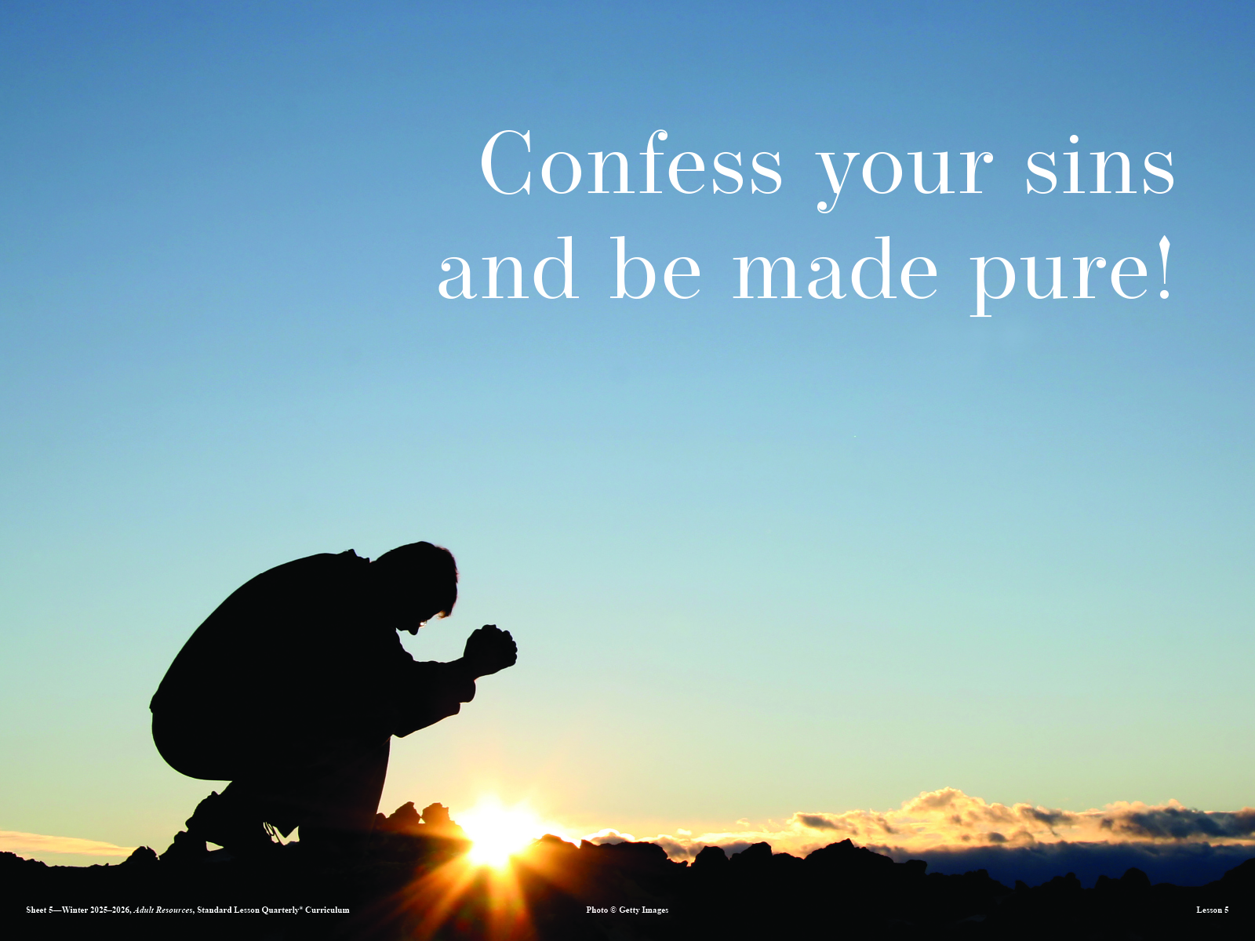
Notes:
Display this visual as you ask, “What is the connection between confessing sin and walking in the light of God?”

Slide 7
What Do You Think?
What evidence would point to someone walking “in darkness”?
Digging Deeper
How can you become aware of whether you are in danger of walking in darkness?

Slide 8
What Do You Think?
What does it look like to “walk in the light”?
Digging Deeper
How might you encourage fellow believers to walk in the light?

Slide 9
II. Necessary Confession
1 John 1:8–2:2
Our Sins and Us (1:8–10)
Our Sin and God (2:1–2)
Notes:
Read 1 John 1:8–2:2 out loud.

Slide 10
What Do You Think?
In what ways do we tend to say that we have not sinned?
Digging Deeper
How can relationships help us recognize our need for God’s forgiveness?

Slide 11
III. Obedient Walk
1 John 2:3–6
Proof of Knowledge (vv. 3–5)
Proof of Abiding (v. 6)
Notes:
Read 1 John 2:3–6 out loud.

Slide 12
What Do You Think?
What outward fruit should we expect to see in Christ-followers?
Digging Deeper
How does Galatians 5:13–26 align with these passages from 1 John?

Slide 13
Into Life
Brainstorm concrete ways to walk in the light and stay in fellowship.
Notes:
Say, “One way to walk in the light is to maintain fellowship with other believers.”
Give participants time to brainstorm. Distribute index cards to learners. After allowing time to reflect on the brainstormed ideas, ask, “What is one thing you can do this week to walk in the light and seek fellowship with another believer?” Invite learners to write their ideas on the card. Challenge them to follow through with the plan throughout the week.

Slide 14
Talk = Walk
In our spiritual walk, Jesus is our standard.
When we compare our lives to Christ’s example, we must ask ourselves whether we see a reflection of Him or a contradiction.
This self-assessment and willingness to correct our course when necessary is crucial to authentic faith.
Notes:
Supplement with additional information from the Conclusion as desired.

Slide 15
Thought to Remember
Praise God for the light of the gospel!
Notes:
Suggested prayer: Heavenly Father, we are grateful for Jesus’ light. Thank You for the reminder that when we abide in You, we walk in the light. May the world know that we are Christians by our “walk” being aligned with our “talk.” In Jesus’ name we pray. Amen.

Slide 16
Repentance and Faith
Next Week’s Lesson

